Slide 1
The African Monsoon Recent Evolution and Current Status Include Week-1 and Week-2 Outlooks
Update prepared
17 June 2024
For more information, visit:
http://www.cpc.ncep.noaa.gov/products/Global_Monsoons/African_Monsoons/precip_monitoring.shtml

Slide 2
Outline
Highlights
Recent Evolution and Current Conditions
NCEP GEFS Forecasts
Summary

Slide 3
Highlights: Last 7 Days
During the past 7 days, in West Africa, rainfall was below-average over parts of Senegal, Guinea-Bissau, pockets of Sierra Leone, Liberia, parts of Cote d’Ivoire, pockets of central Ghana, southern Togo, Benin, and much of Nigeria. In contrast, above-average rainfall was observed over much of Guinea, southern Mali, Burkina Faso, much of Ghana, and northern Togo northern Benin. In Central Africa, southern Cameroon, southern Chad, eastern Gabon, parts of CAR, and northern DRC received above-average rainfall. In contrast, rainfall was below-average over northern Cameroon and pockets of central CAR. In Eastern Africa, above-average rainfall was observed over pockets of southern Sudan, western and eastern South Sudan, and western and central Ethiopia. In contrast, parts of central and southeastern South Sudan and pockets of southern and eastern Ethiopia received below-average rainfall.
Week-1 outlooks call for a moderate to high tilt in the odds to favor above-normal rainfall over the far western West Africa, eastern Sudan and northwestern Ethiopia. In contrast, there is a moderate tilt in the odds to favor below-normal rainfall across the eastern portion of the Gulf of Guinea region, and much of Central Africa and the Lake Victoria region. For week-2, there is a moderate to high tilt in the odds to favor above-normal rainfall across the western portion of the Gulf of Guinea region, and parts of eastern Nigeria and western Ethiopia. In contrast, there is a moderate to high tilt in the odds to favor below-average rainfall over northern Congo, northern DRC, and parts of South Sudan and Uganda.

Slide 4
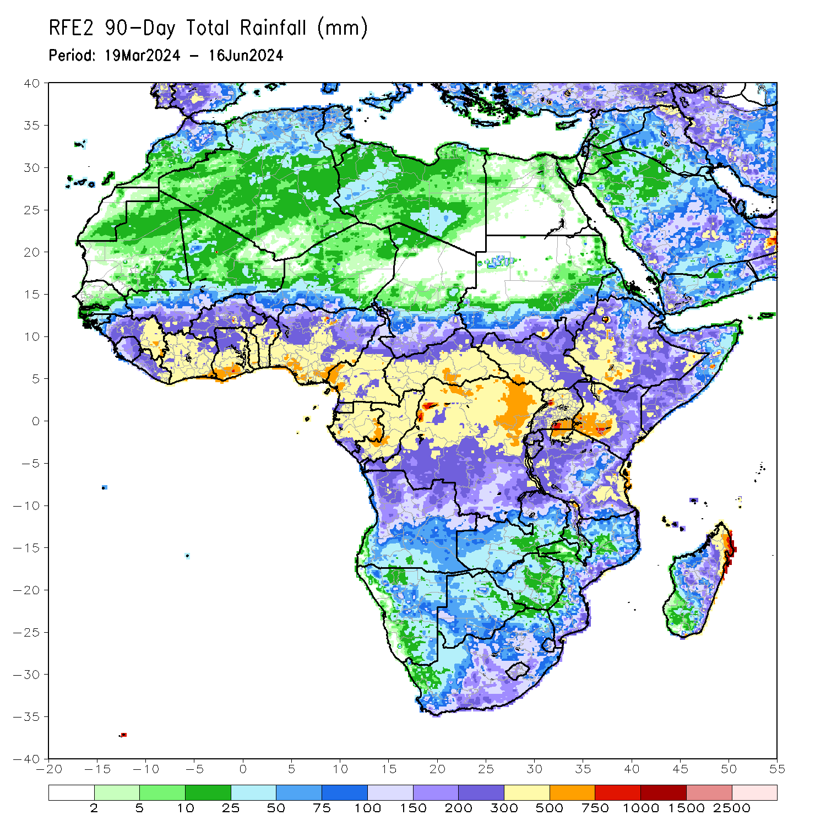
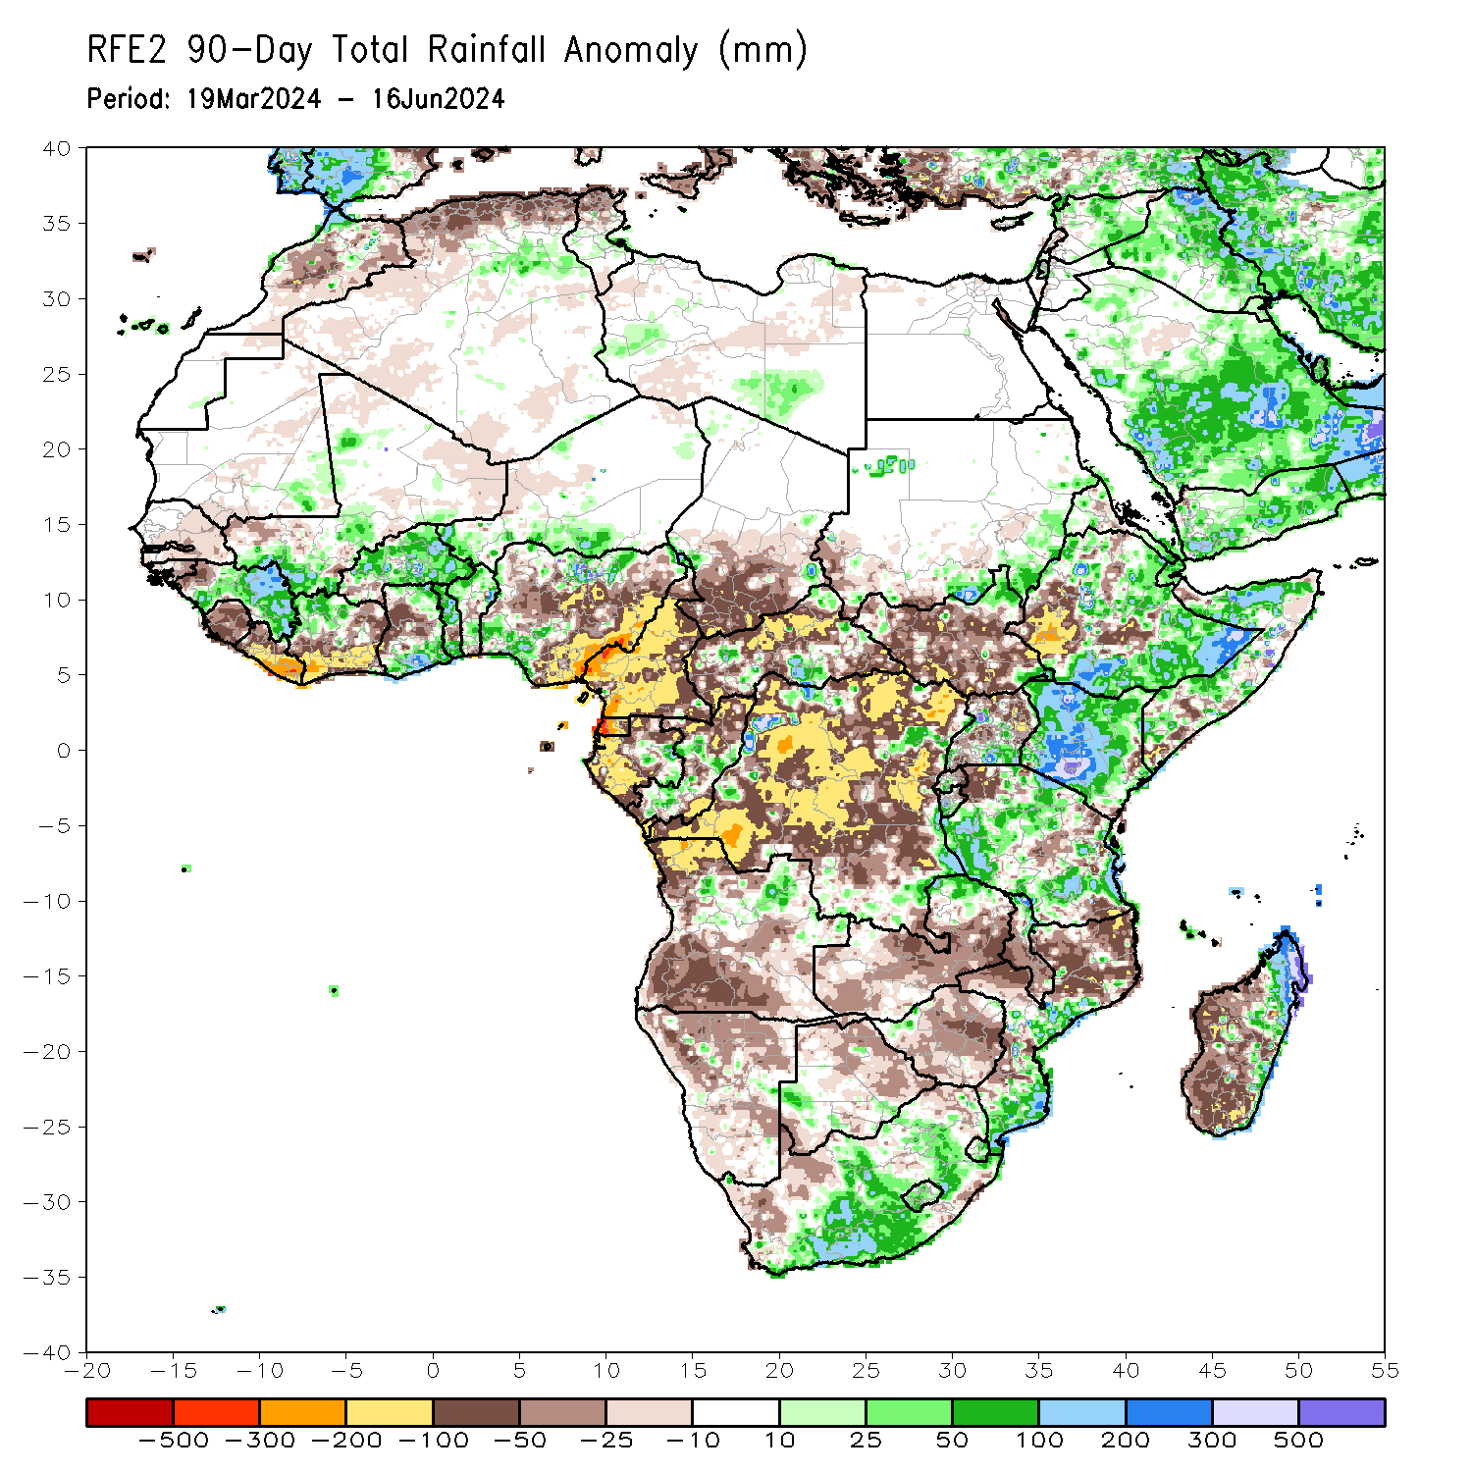
Rainfall Patterns: Last 90 Days
Over the past 90 days, in East Africa, rainfall was above-average over parts of northern, central, eastern and southern Ethiopia, much of Kenya, northern and central Somalia, pockets of southern Uganda, and many parts of Tanzania. Below-average rainfall was observed over much of South Sudan, parts of southern Sudan, western Ethiopia, much of Uganda, pockets of Tanzania and parts of western and southern Ethiopia. In Central Africa, above-average rainfall was observed over pockets of Gabon, Congo, DRC and CAR. In contrast, below-average rainfall was observed over much of Cameroon, southern Chad, much CAR, Equatorial Guinea, and much of Gabon and DRC. In Southern Africa, rainfall was below-average over much of northern Angola, much of Zambia, Zimbabwe, southern Malawi, northern Mozambique, Namibia, Botswana, pockets of South Africa, and northwestern and central Madagascar. In contrast, above-average rainfall was observed over pockets of northern Angola, many parts of South Africa, southern Mozambique and southern and northeastern Madagascar. In West Africa, above-average rainfall was observed over Guinea, northern Cote d’Ivoire, southwestern Mali, Burkina Faso, southern Ghana, Togo, Benin, and southwestern and northern Nigeria. In contrast, rainfall was below-average over Sierra Leone, Liberia, southern and eastern Cote d’Ivoire, northern Ghana and parts of Nigeria.
Notes:
4

Slide 5
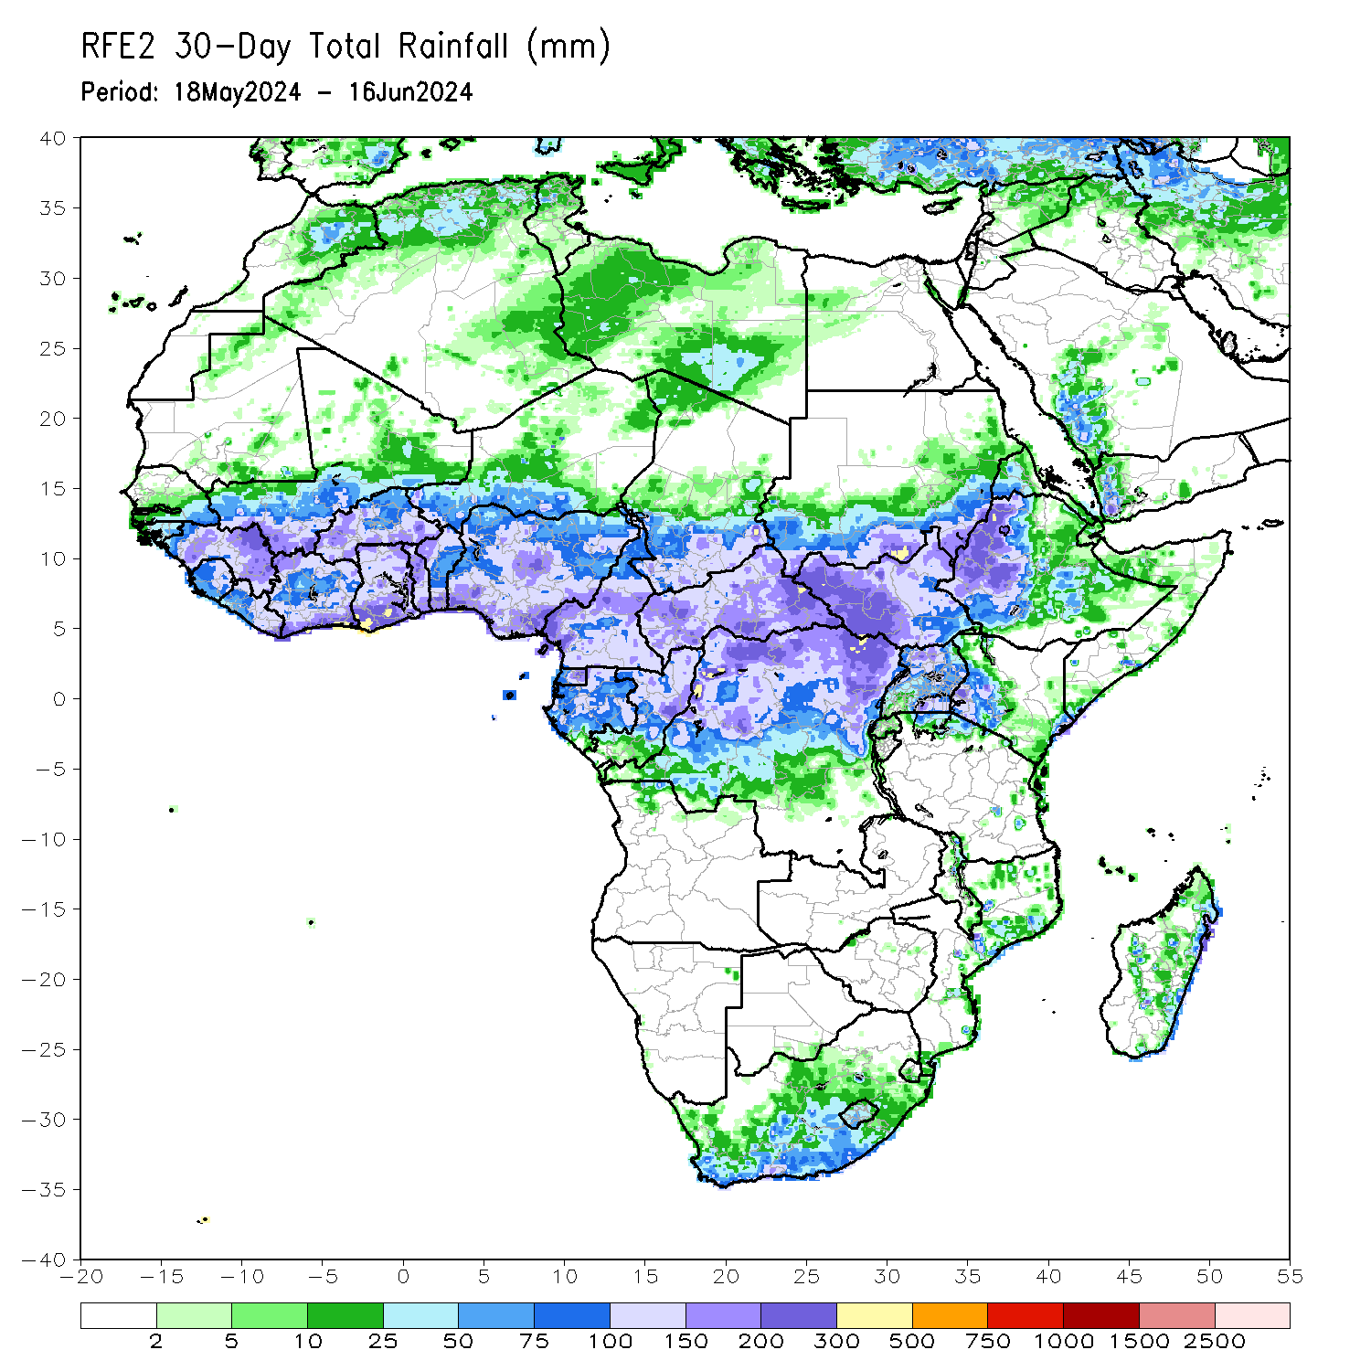
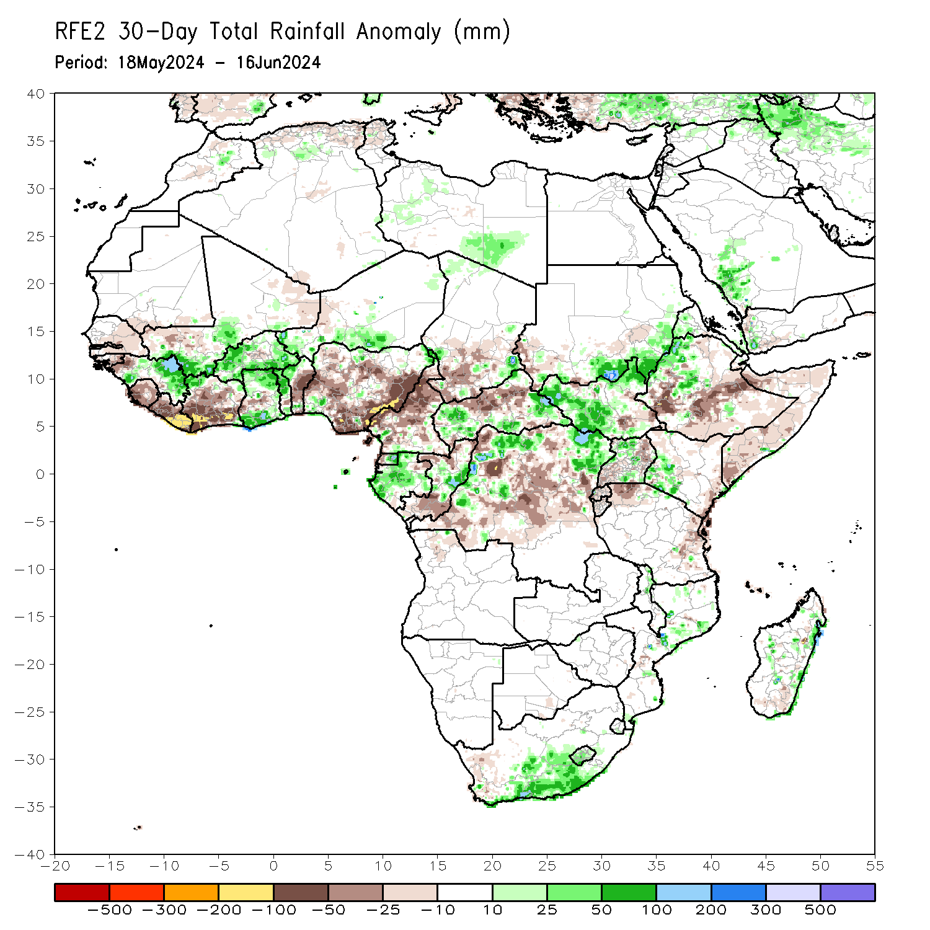
Rainfall Patterns: Last 30 Days
In the past 30 days, in West Africa, rainfall was above-average over central and eastern Guinea, central Mali, Burkina Faso, southern Ghana, parts of western southern Niger, and the far northern Nigeria. In contrast, below-average rainfall was observed over parts of Senegal, sierra Leone, Liberia, southwestern Mali, much of Cote d’Ivoire, northwestern Ghana, and northwestern and eastern Nigeria. In Central Africa, rainfall was below-average over much of Cameroon, southern Chad, northern CAR, parts of eastern Gabon, Congo, and many parts of DRC. In contrast, above-average rainfall was observed over Equatorial Guinea, pockets of CAR, Gabon, and central and northern DRC. In East Africa, below-average rainfall was observed over pockets of southwestern Sudan and southeastern South Sudan, southwestern and southern Ethiopia, Uganda, Rwanda, Burundi, parts of Tanzania and Somalia. In Southern Africa, the far southern South Africa, and pockets of central Mozambique and northern Madagascar received above-average rainfall.
Notes:
5

Slide 6
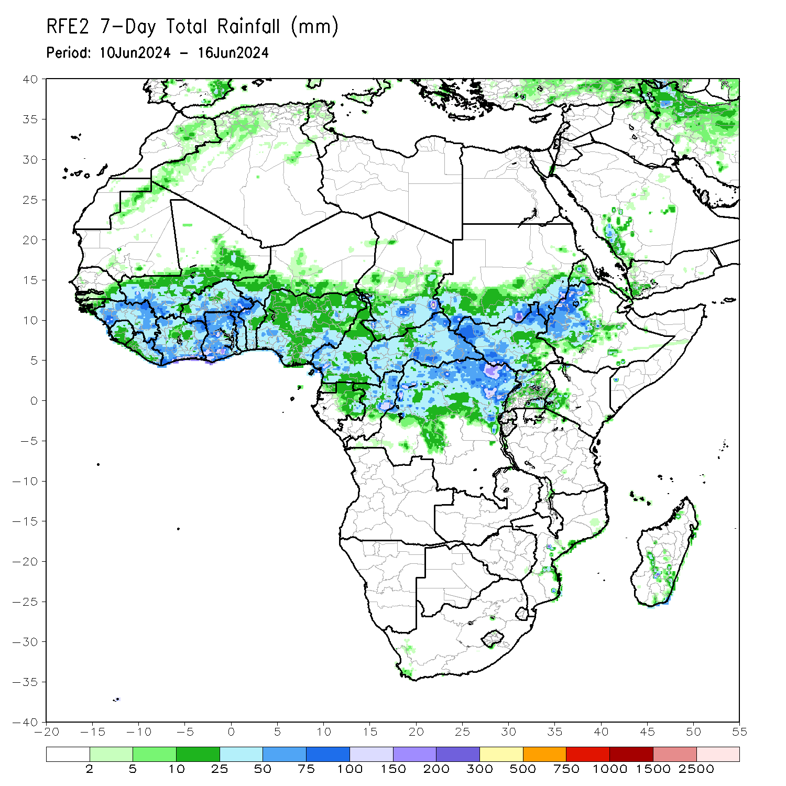
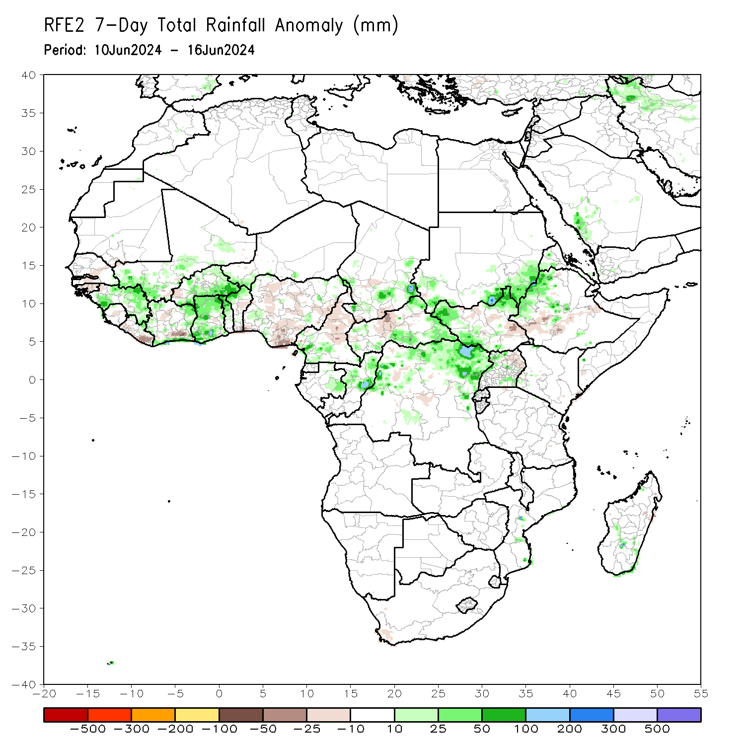
Rainfall Patterns: Last 7 Days
During the past 7 days, in West Africa, rainfall was below-average over parts of Senegal, Guinea-Bissau, pockets of Sierra Leone, Liberia, parts of Cote d’Ivoire, pockets of central Ghana, southern Togo, Benin, and much of Nigeria. In contrast, above-average rainfall was observed over much of Guinea, southern Mali, Burkina Faso, much of Ghana, and northern Togo northern Benin. In Central Africa, southern Cameroon, southern Chad, eastern Gabon, parts of CAR, and northern DRC received above-average rainfall. In contrast, rainfall was below-average over northern Cameroon and pockets of central CAR. In Eastern Africa, above-average rainfall was observed over pockets of southern Sudan, western and eastern South Sudan, and western and central Ethiopia. In contrast, parts of central and southeastern South Sudan and pockets of southern and eastern Ethiopia received below-average rainfall.

Slide 7
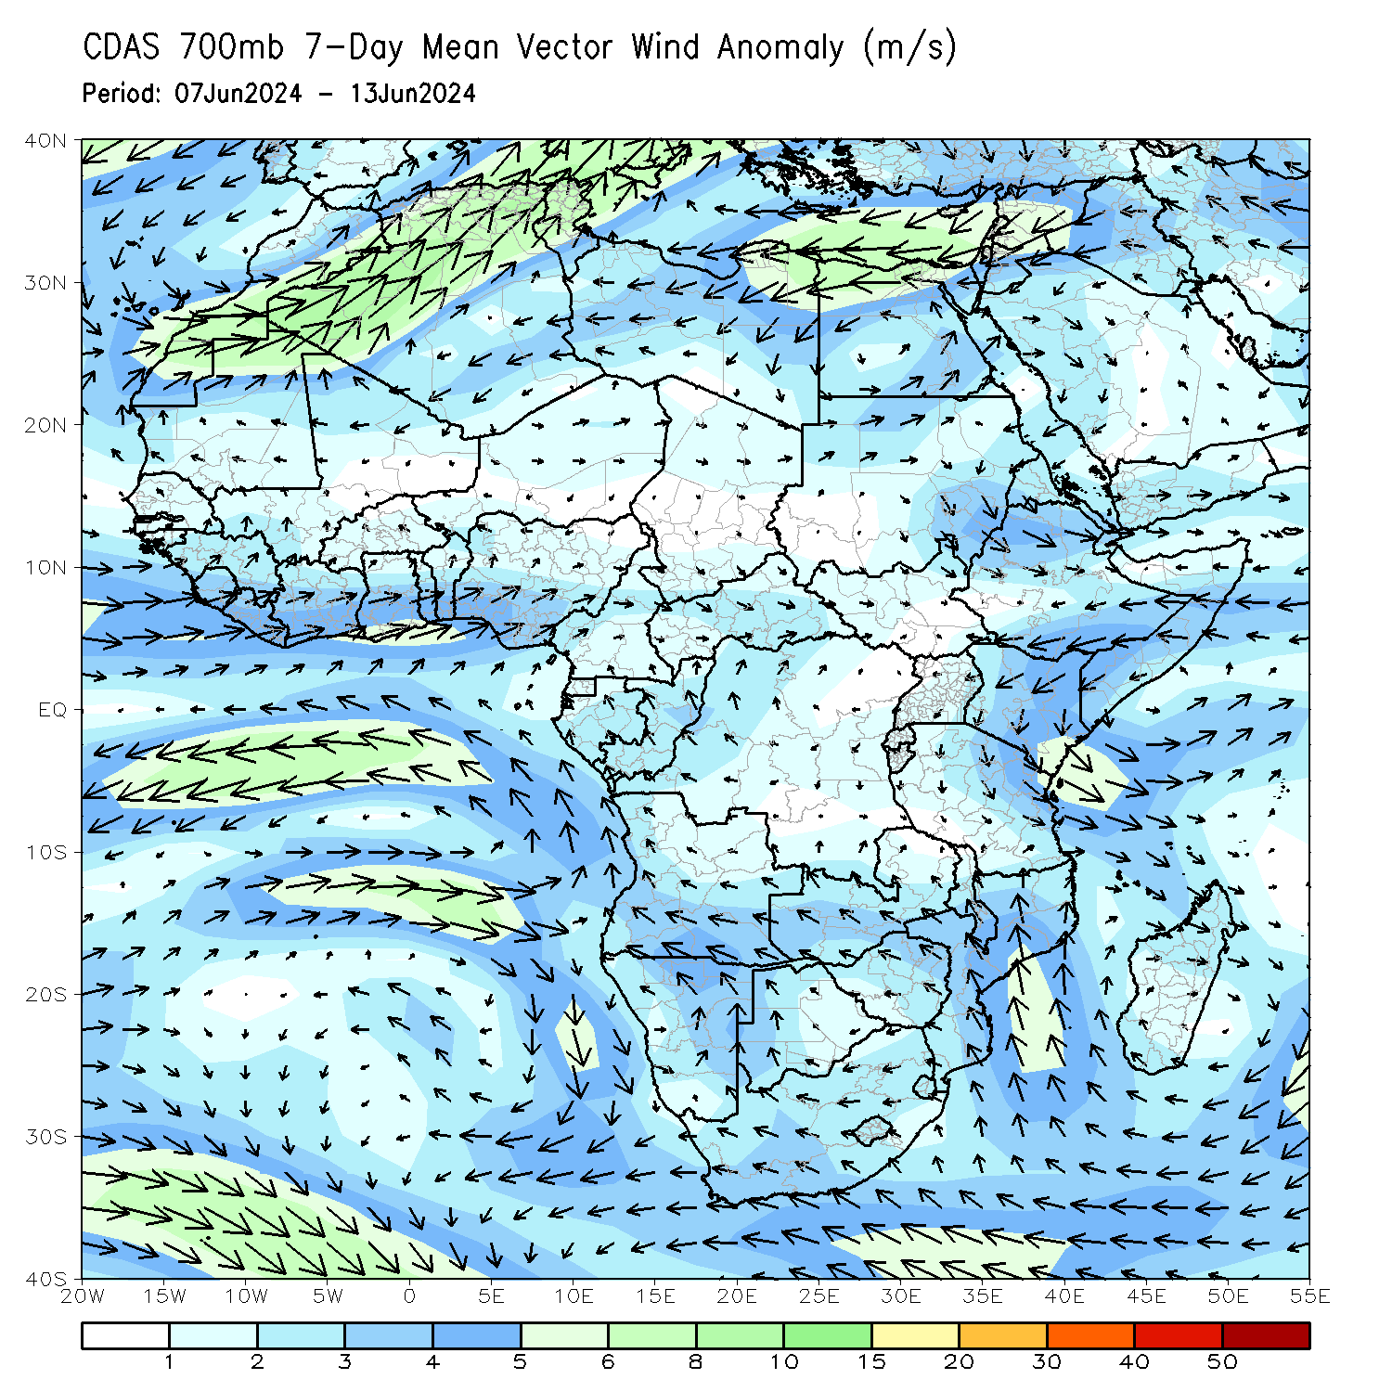
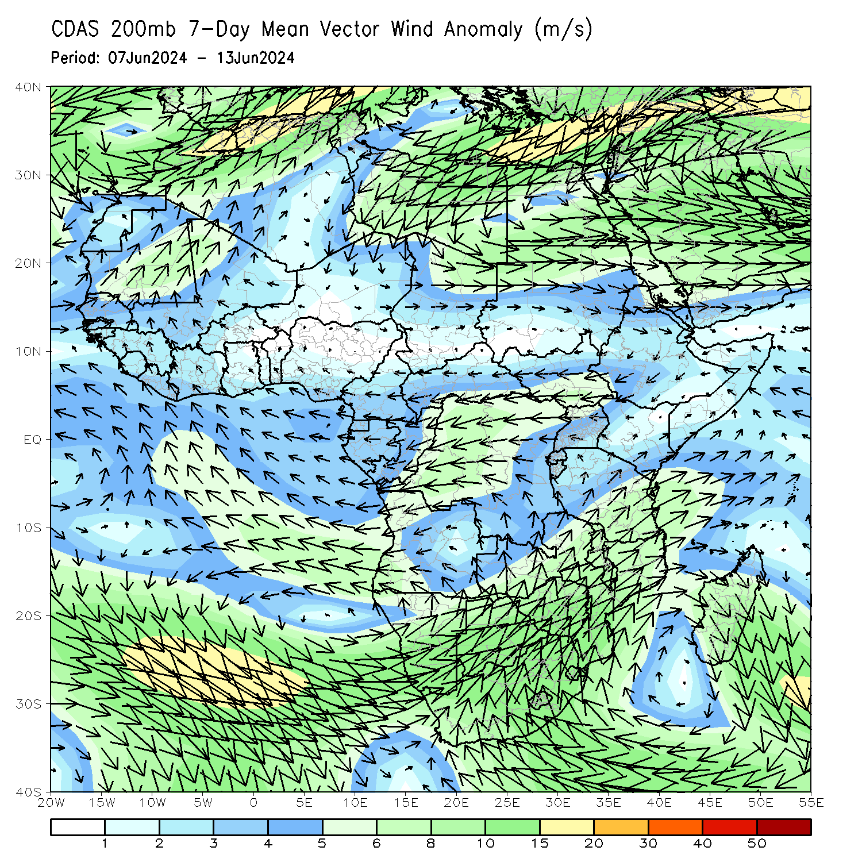
Atmospheric Circulation: Last 7 Days
At 700-hPa level (left panel), anomalous westerly flow along the Gulf of Guinea coast, with its associated cyclonic shear across West Africa may have contributed to observed above-average rainfall over parts of Sahel region.

Slide 8
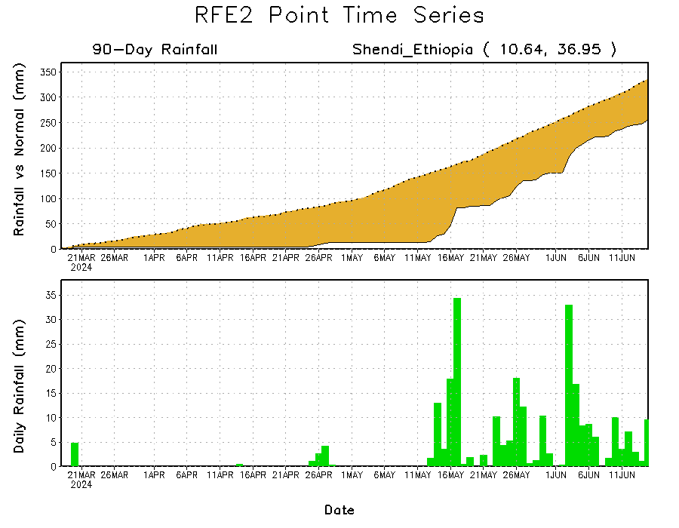
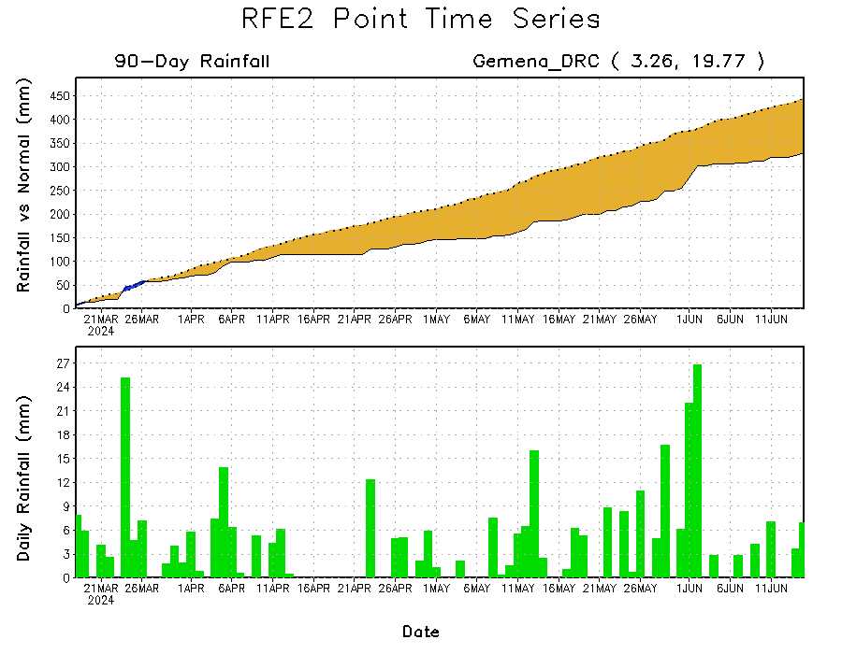
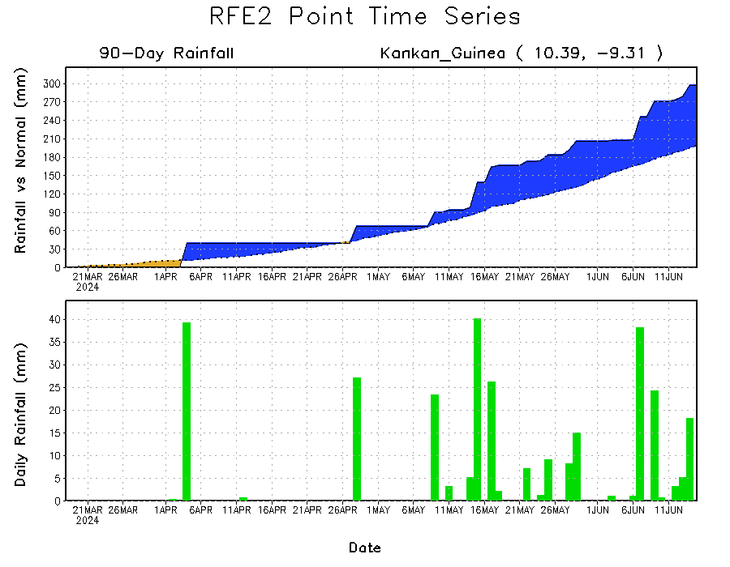
Rainfall Evolution
Daily evolution in rainfall at selected locations over the past 90 days shows that moderate to heavy rains resulted in moisture surpluses over parts of eastern Guinea (bottom left). Seasonal total rainfall remained below average over northern DRC (bottom right) and western Ethiopia (top right).

Slide 9
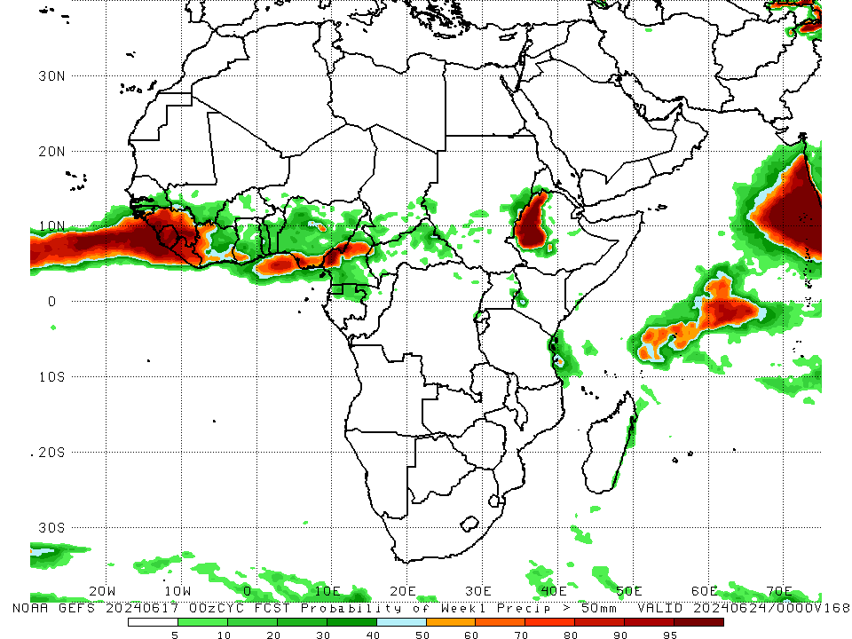
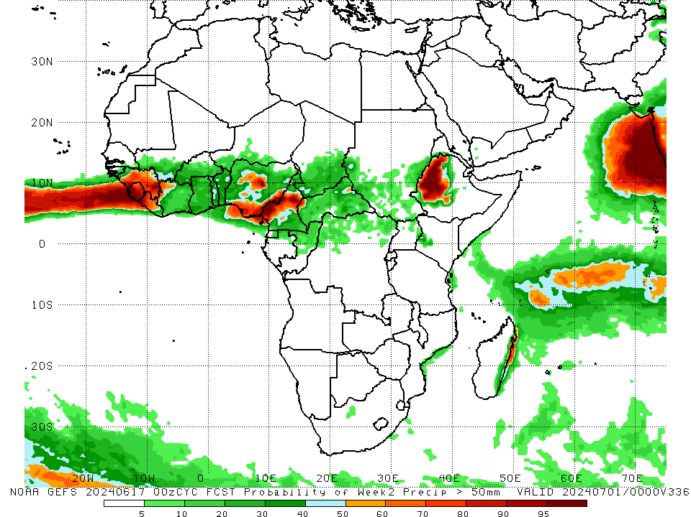
NCEP GEFS Model Forecasts Non-Bias Corrected Probability of precipitation exceedance
Week-1, Valid: 18 – 24 Jun, 2024
Week-2, Valid: 25 Jun – 01 Jul, 2024
For week-1 (left panel) and Week-2 (right panel), the NCEP GEFS indicates a moderate to high chance (over 70%) for rainfall to exceed 50 mm over guinea, Sierra Leone, Liberia, and parts of Cameroon, Nigeria and western Ethiopia.
Notes:
9

Slide 10
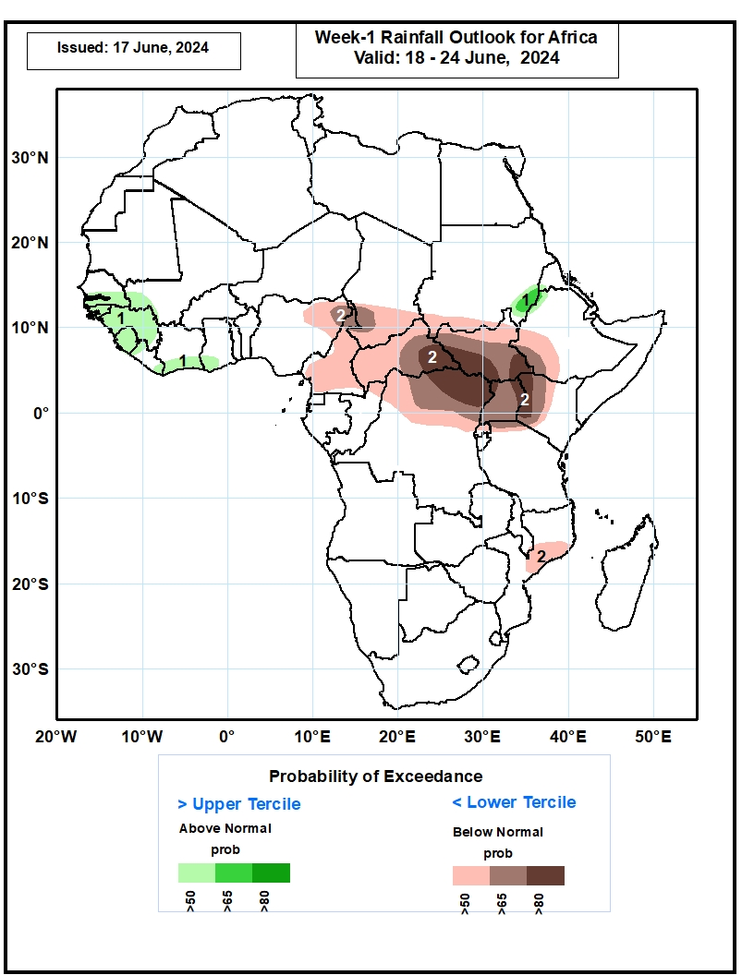
Week-1 Precipitation Outlooks
18 – 24 Jun, 2024
The probabilistic forecasts call for above 50% chance for weekly total rainfall to be above-normal (above the upper tercile) over southern Senegal, The Gambia, southwestern Mali, Guinea-Bissau, Guinea, Sierra Leone, southeastern Liberia, southern Cote d’Ivoire, southwestern Ghana, southeastern Sudan, and northwestern Ethiopia. There is above 65% chance for above-normal rainfall over southeastern Sudan.
The probabilistic forecasts call for above 50% chance for weekly rainfall to be below-normal (below the lower tercile) over northeastern Nigeria, Cameroon, southern Chad, southern Sudan, CAR, South Sudan, northern Congo, northern and central DR Congo, Uganda, Rwanda, northwestern Tanzania, western and central Kenya, southwestern Ethiopia, and central Mozambique. There is above 80% chance for below-normal rainfall over southeastern CAR, southern South Sudan, northeastern DR Congo, northwestern and eastern Uganda, and western Kenya.
Notes:
10

Slide 11
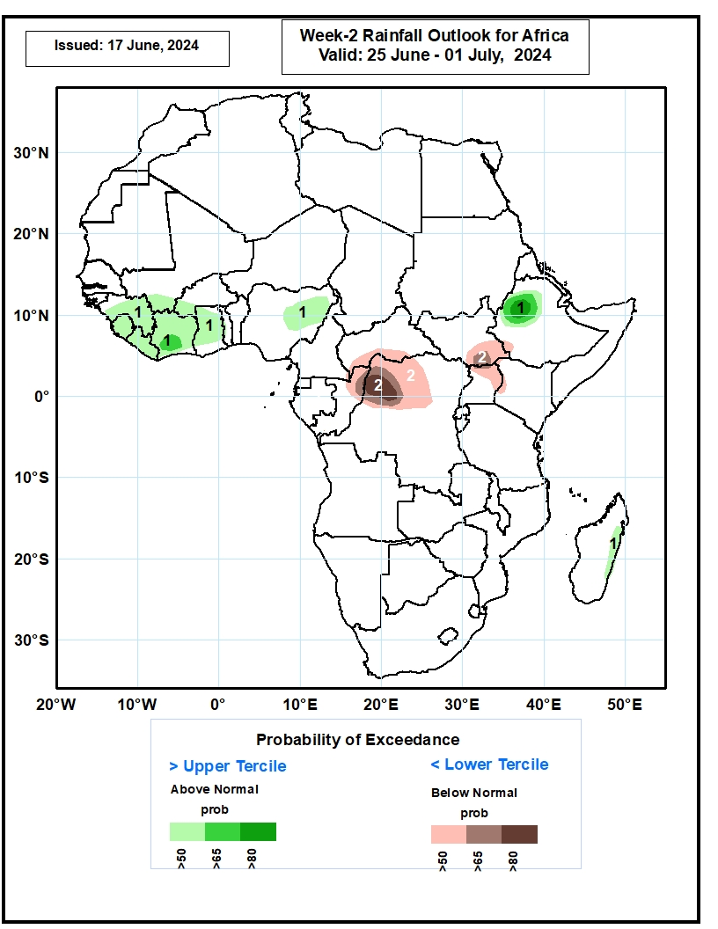
Week-2 Precipitation Outlooks
254 Jun – 01 Jul, 2024
The probabilistic forecasts call for above 50% chance for weekly rainfall to be above-normal (above the upper tercile) over much of Guinea, southern Mali, Sierra Leone, Liberia, much of Cote d’Ivoire, southwestern Burkina Faso, much of Ghana, northeastern Nigeria, western Ethiopia, and eastern Madagascar. There is above 80% chance for above-normal rainfall over western Ethiopia.
The probabilistic forecasts call for above 50% chance for weekly total rainfall to be below-normal (below the lower tercile) over southern CAR, northern Congo, northwestern and north-central DR Congo, southern South Sudan, southwestern Ethiopia, northern and eastern Uganda, and western Kenya. There is above 80% chance for below-normal rainfall over northwestern DR Congo.
Notes:
11

Slide 12
Summary
Over the past 90 days, in East Africa, rainfall was above-average over parts of northern, central, eastern and southern Ethiopia, much of Kenya, northern and central Somalia, pockets of southern Uganda, and many parts of Tanzania. Below-average rainfall was observed over much of South Sudan, parts of southern Sudan, western Ethiopia, much of Uganda, pockets of Tanzania and parts of western and southern Ethiopia. In Central Africa, above-average rainfall was observed over pockets of Gabon, Congo, DRC and CAR. In contrast, below-average rainfall was observed over much of Cameroon, southern Chad, much CAR, Equatorial Guinea, and much of Gabon and DRC. In Southern Africa, rainfall was below-average over much of northern Angola, much of Zambia, Zimbabwe, southern Malawi, northern Mozambique, Namibia, Botswana, pockets of South Africa, and northwestern and central Madagascar. In contrast, above-average rainfall was observed over pockets of northern Angola, many parts of South Africa, southern Mozambique and southern and northeastern Madagascar. In West Africa, above-average rainfall was observed over Guinea, northern Cote d’Ivoire, southwestern Mali, Burkina Faso, southern Ghana, Togo, Benin, and southwestern and northern Nigeria. In contrast, rainfall was below-average over Sierra Leone, Liberia, southern and eastern Cote d’Ivoire, northern Ghana and parts of Nigeria.
During the past 7 days, in West Africa, rainfall was below-average over parts of Senegal, Guinea-Bissau, pockets of Sierra Leone, Liberia, parts of Cote d’Ivoire, pockets of central Ghana, southern Togo, Benin, and much of Nigeria. In contrast, above-average rainfall was observed over much of Guinea, southern Mali, Burkina Faso, much of Ghana, and northern Togo northern Benin. In Central Africa, southern Cameroon, southern Chad, eastern Gabon, parts of CAR, and northern DRC received above-average rainfall. In contrast, rainfall was below-average over northern Cameroon and pockets of central CAR. In Eastern Africa, above-average rainfall was observed over pockets of southern Sudan, western and eastern South Sudan, and western and central Ethiopia. In contrast, parts of central and southeastern South Sudan and pockets of southern and eastern Ethiopia received below-average rainfall.
Week-1 outlooks call for a moderate to high tilt in the odds to favor above-normal rainfall over the far western West Africa, eastern Sudan and northwestern Ethiopia. In contrast, there is a moderate tilt in the odds to favor below-normal rainfall across the eastern portion of the Gulf of Guinea region, and much of Central Africa and the Lake Victoria region. For week-2, there is a moderate to high tilt in the odds to favor above-normal rainfall across the western portion of the Gulf of Guinea region, and parts of eastern Nigeria and western Ethiopia. In contrast, there is a moderate to high tilt in the odds to favor below-average rainfall over northern Congo, northern DRC, and parts of South Sudan and Uganda.

