Slide 1
The African Monsoon Recent Evolution and Current Status Include Week-1 and Week-2 Outlooks
Update prepared by
Climate Prediction Center / NCEP
3 December 2018
For more information, visit:
http://www.cpc.ncep.noaa.gov/products/Global_Monsoons/African_Monsoons/precip_monitoring.shtml

Slide 2
Outline
Highlights
Recent Evolution and Current Conditions
NCEP GEFS Forecasts
Summary

Slide 3
Highlights: Last 7 Days
Eastern Gabon, central Congo, western DRC, central and northwestern Angola, eastern Mozambique and local areas in northern Ethiopia, Kenya, central Tanzania and eastern Zambia experienced moisture surpluses of over 100 mm.
Moisture deficits of over 25 mm were observed in northern Morocco, Equatorial Guinea, Gabon, parts of Angola, northeastern DRC, southern Uganda, western and eastern Kenya, portions of Tanzania, Zambia and Madagascar.
Week-1 forecast calls for an increased chance for weekly rainfall totals to exceed 50 mm over southern Gabon, southern Congo-Brazzaville, northern Angola, DRC, Rwanda, Burundi, Uganda, southern Ethiopia, Kenya, western Tanzania and northern Zambia, as well as parts of eastern South Africa, Lesotho, Swaziland and local areas in Mozambique, Zimbabwe and Madagascar. Week-2 forecast indicates an increased chance for weekly rainfall totals to exceed 50 mm over local areas in southern Gabon, southwestern Congo, eastern DRC, southeastern Uganda, southern Kenya, Rwanda, Burundi, Tanzania, northern Zambia, eastern Zimbabwe, Mozambique, eastern Lesotho and Madagascar.

Slide 4
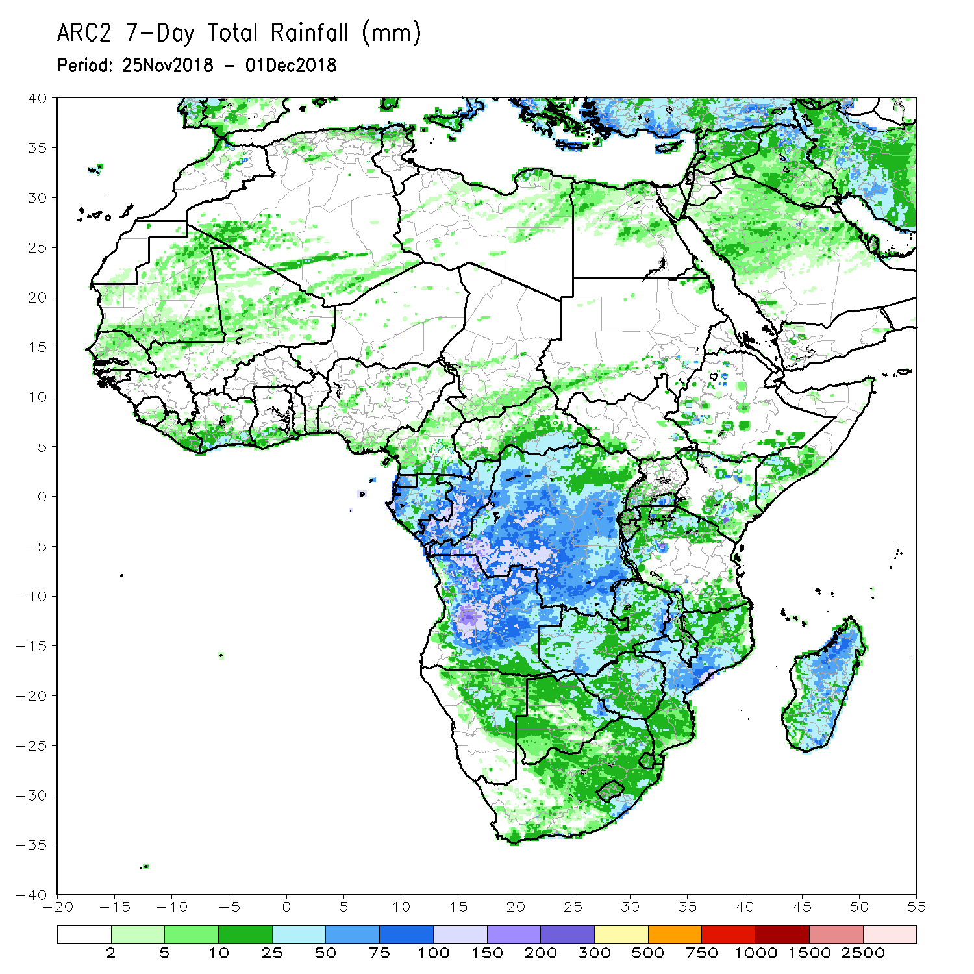
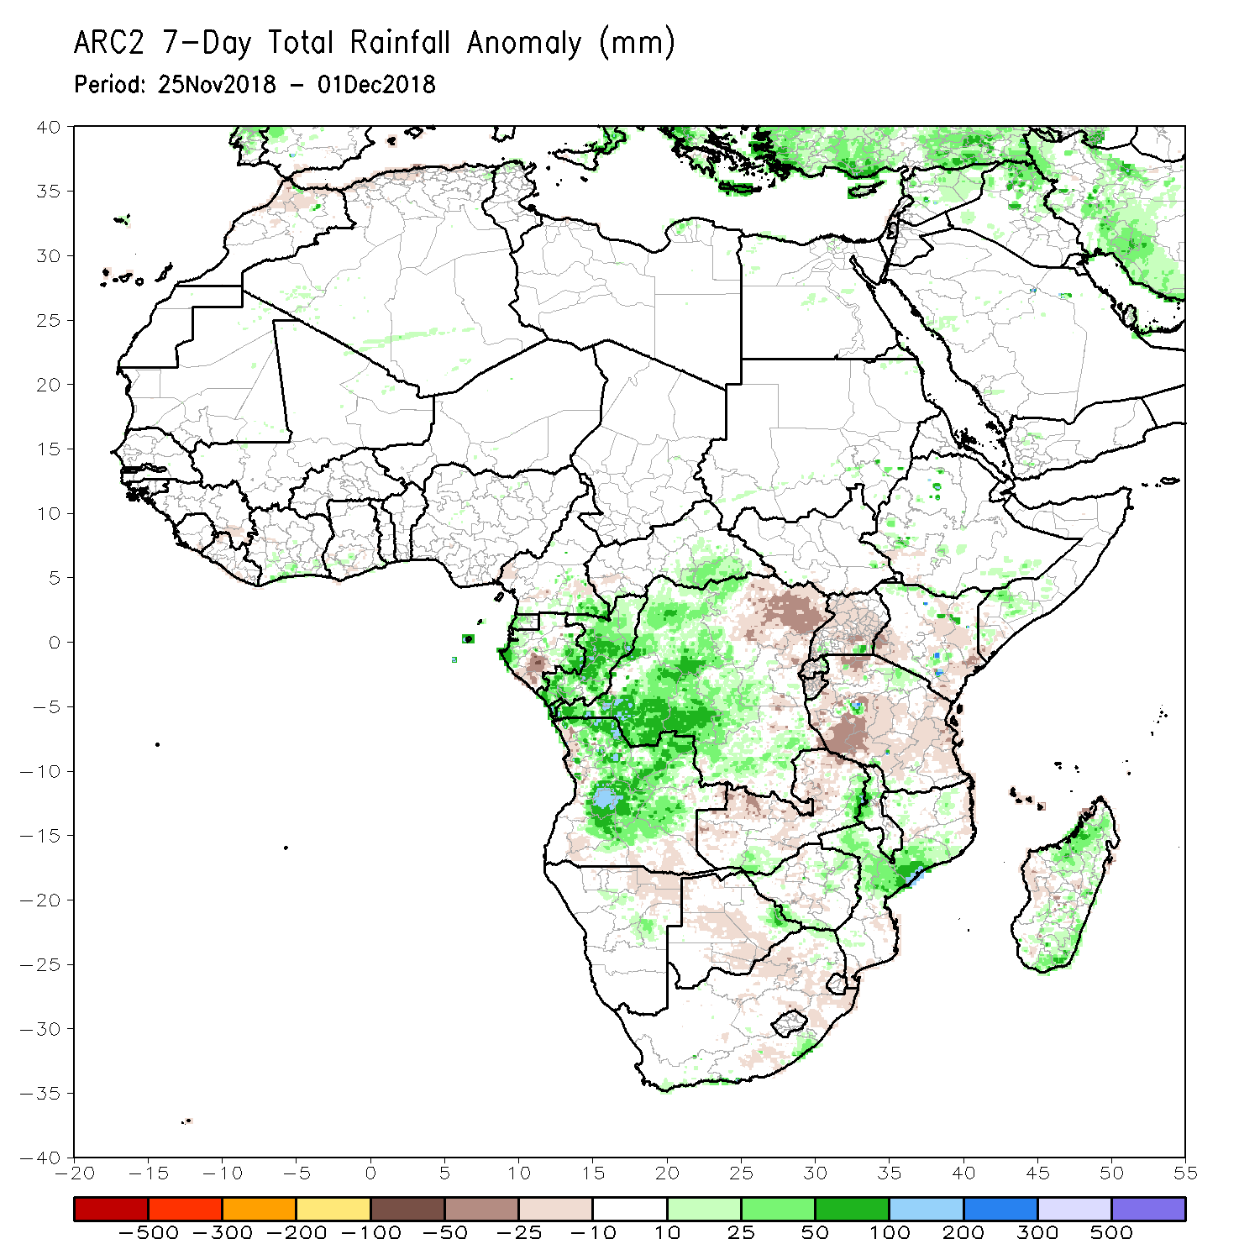
Rainfall Patterns: Last 7 Days
During the past 7 days, scattered above-average rainfall was observed over local areas in Northern Africa. Parts of Mauritania, Mali, southern part of Sudan and South Sudan, Ethiopia, southern Côte d’Ivoire, southern Ghana, Cameroon, CAR, southern Somalia, Kenya, Uganda, Tanzania, western Equatorial Guinea, Gabon, much of Congo-Brazzaville, western DRC, much of Angola, Namibia, Zambia, Malawi, Mozambique, Zimbabwe, eastern Botswana, southern part of South Africa and Madagascar experienced above-average rainfall.
In contrast, the northern part of Morocco and Algeria, the eastern part of Guinea, local areas in Liberia, southern Ghana, Cameroon, western CAR, western Ethiopia, southern Gabon, eastern DRC, Uganda, Kenya, much of Tanzania, Rwanda, Burundi, Zambia, Angola, northern Namibia, Mozambique, central Botswana, eastern South Africa and Madagascar received below-average rainfall.

Slide 5
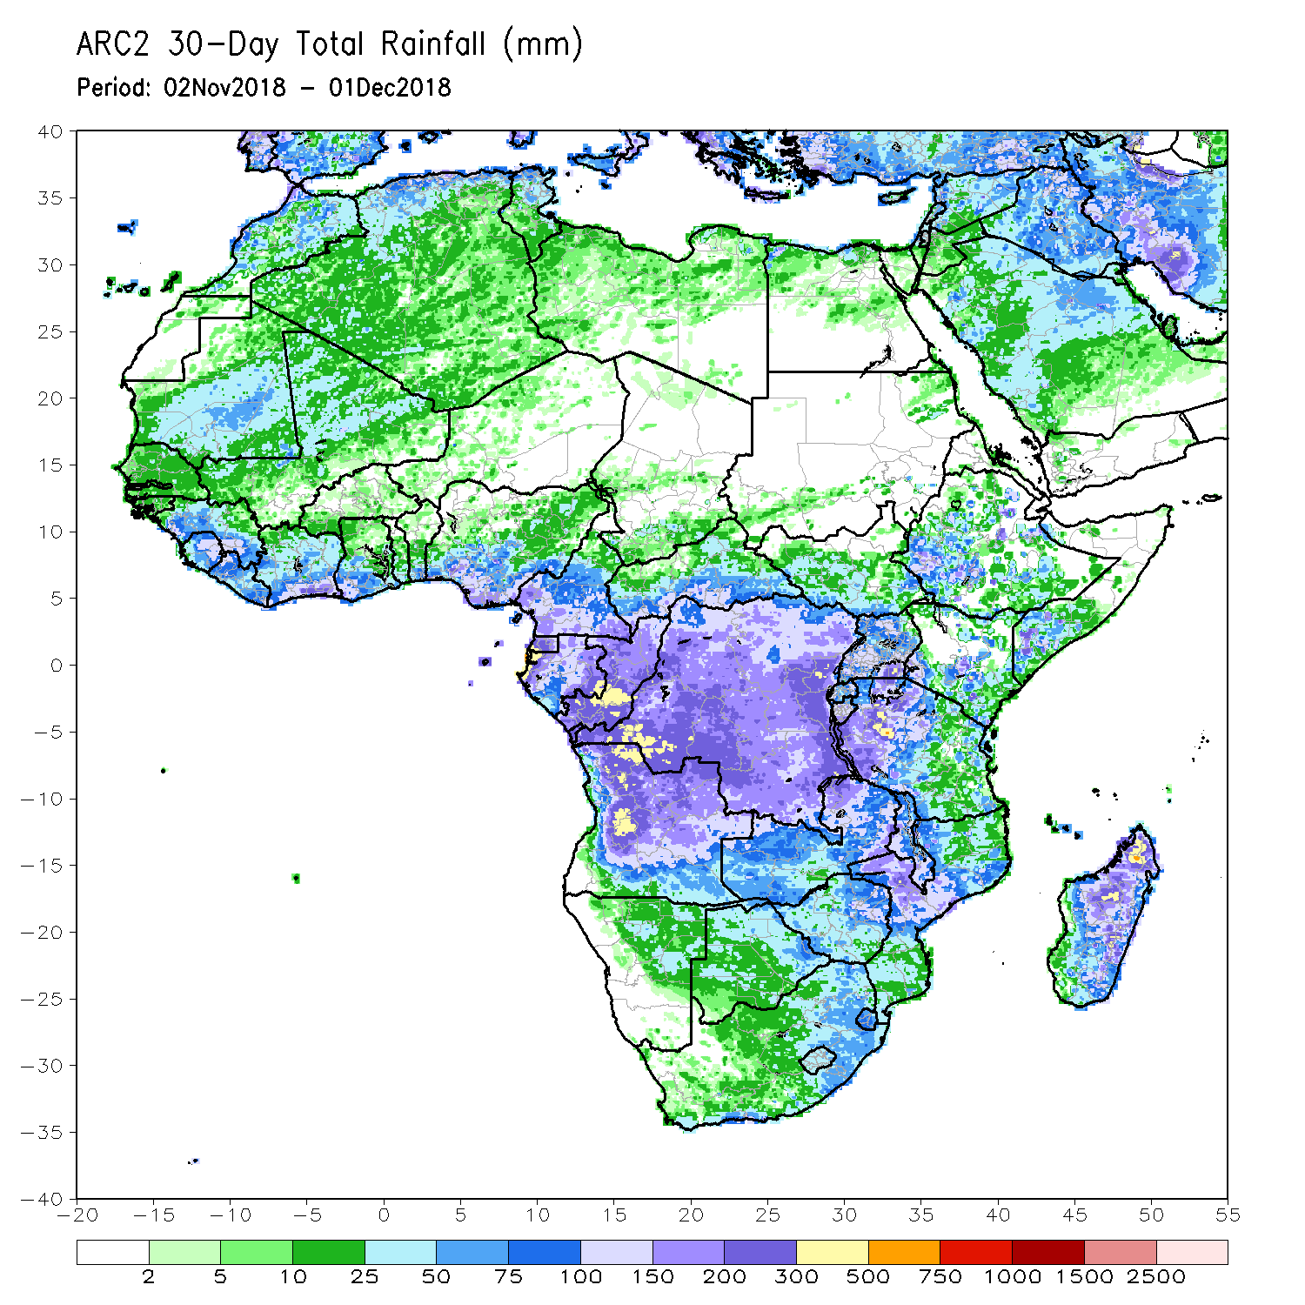
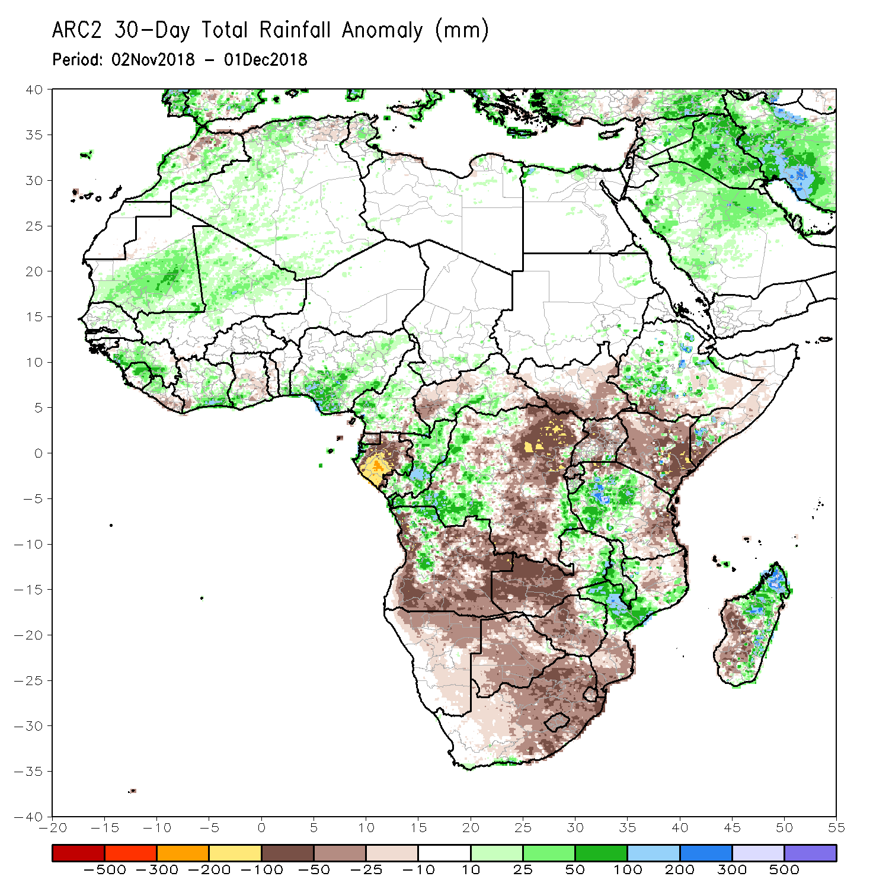
Rainfall Patterns: Last 30 Days
During the past 30 days, moisture surpluses of over 100 mm (more than 200% of normal rainfall) were observed in northern Tunisia, northwestern Libya, northwestern Egypt, central Mali, western Gambia, southern Côte d’Ivoire, southern Nigeria, parts of Cameroon, Ethiopia, southern Somalia, Kenya, portions of Congo, western and eastern DRC, northern Angola, eastern Zambia, northern Malawi, central Mozambique, extreme southern part of South Africa and northern and eastern Madagascar.
Conversely, moisture deficit of over 100 mm (less than 80% of normal rainfall) were observed in Gabon, western and eastern Angola, northeastern DRC, southern and northern Uganda, northern and eastern Tanzania, central Madagascar, eastern Kenya and southern Somalia.
Notes:
5

Slide 6
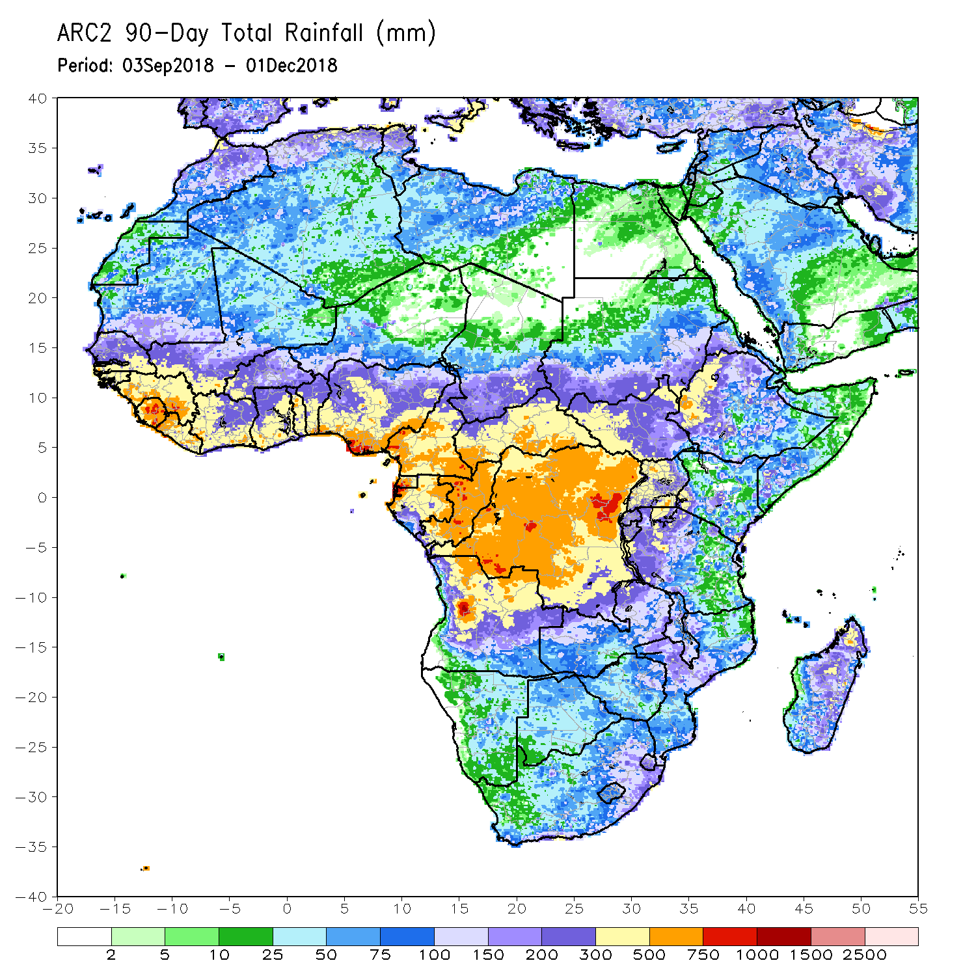
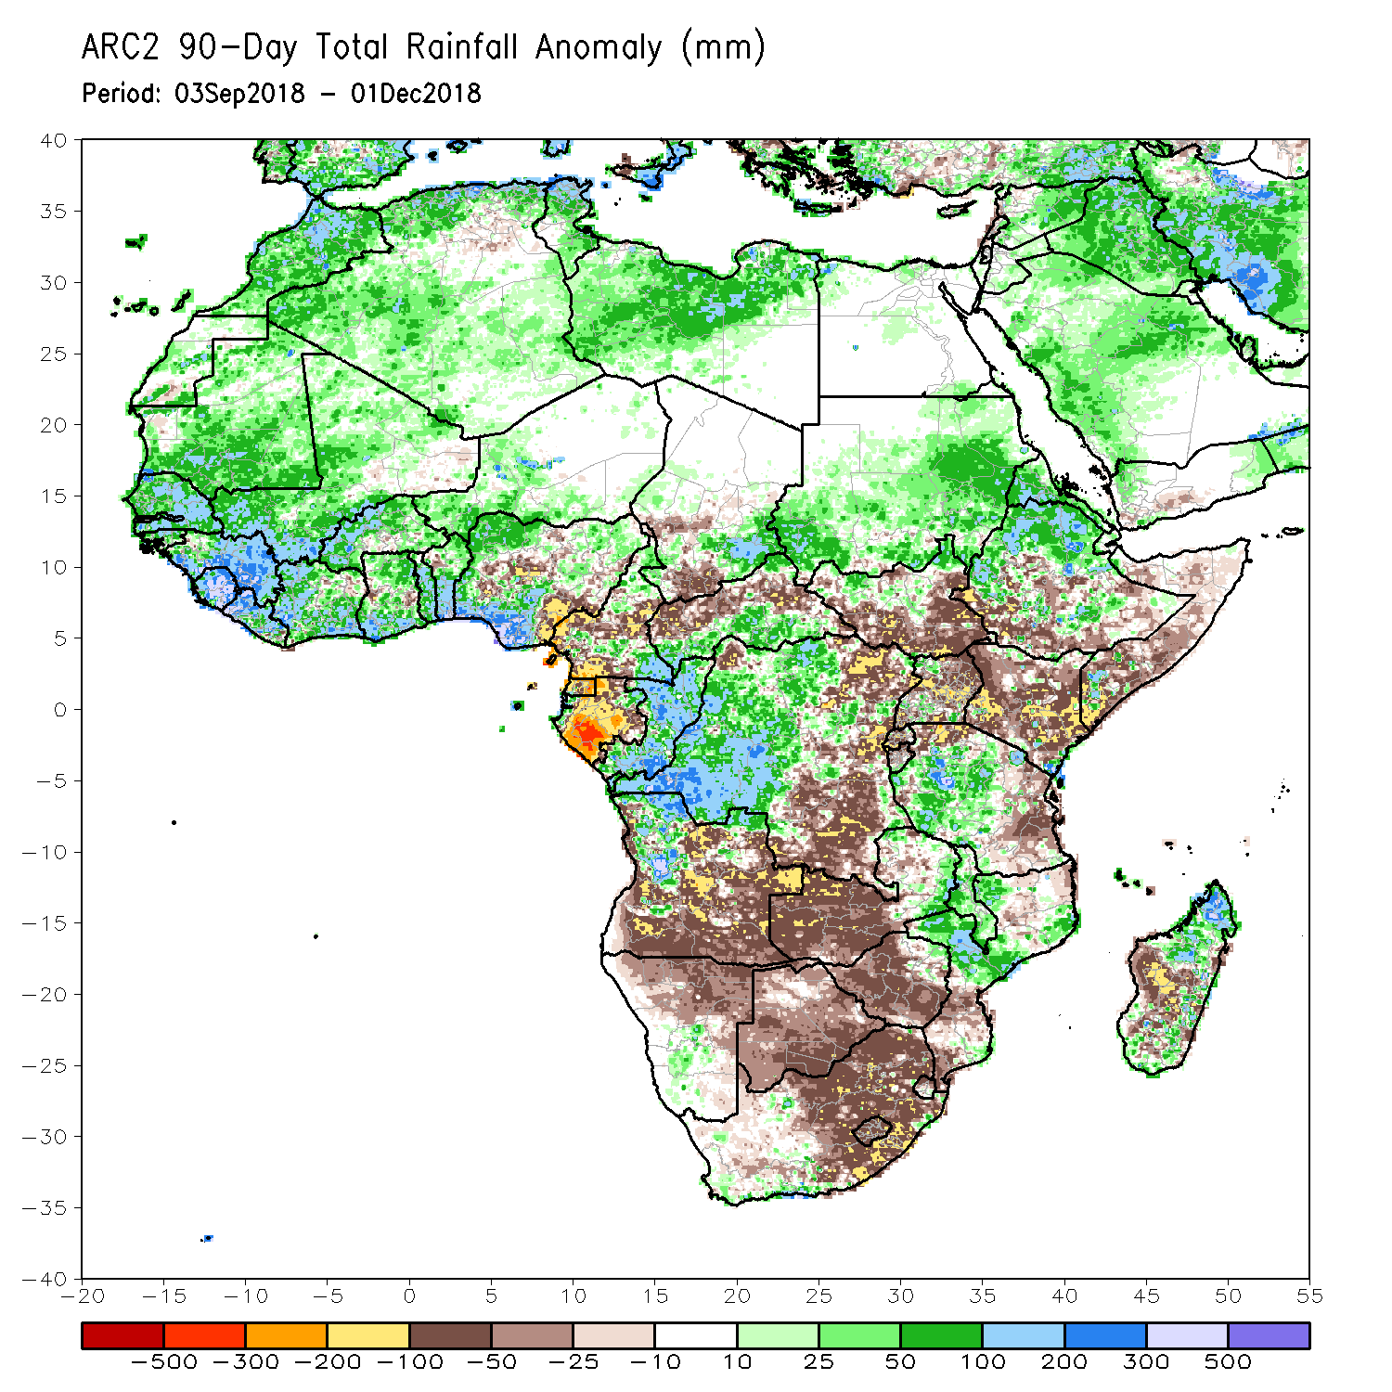
Rainfall Patterns: Last 90 Days
During the past 90 days, moisture surpluses of over 300 mm were observed in northern Morocco, northern Algeria, southern Guinea, Sierra Leone, Liberia, southern Côte d’Ivoire, southern Ghana, southern Benin, southern Nigeria, northern Ethiopia, southern Congo, southwestern DRC, northwestern Angola, southern Kenya, central Tanzania, southern part of South Africa and northern Madagascar.
Moisture deficits of over 200 mm were observed in southeastern border of Nigeria and Cameroon, Equatorial Guinea and Gabon.
Notes:
6

Slide 7
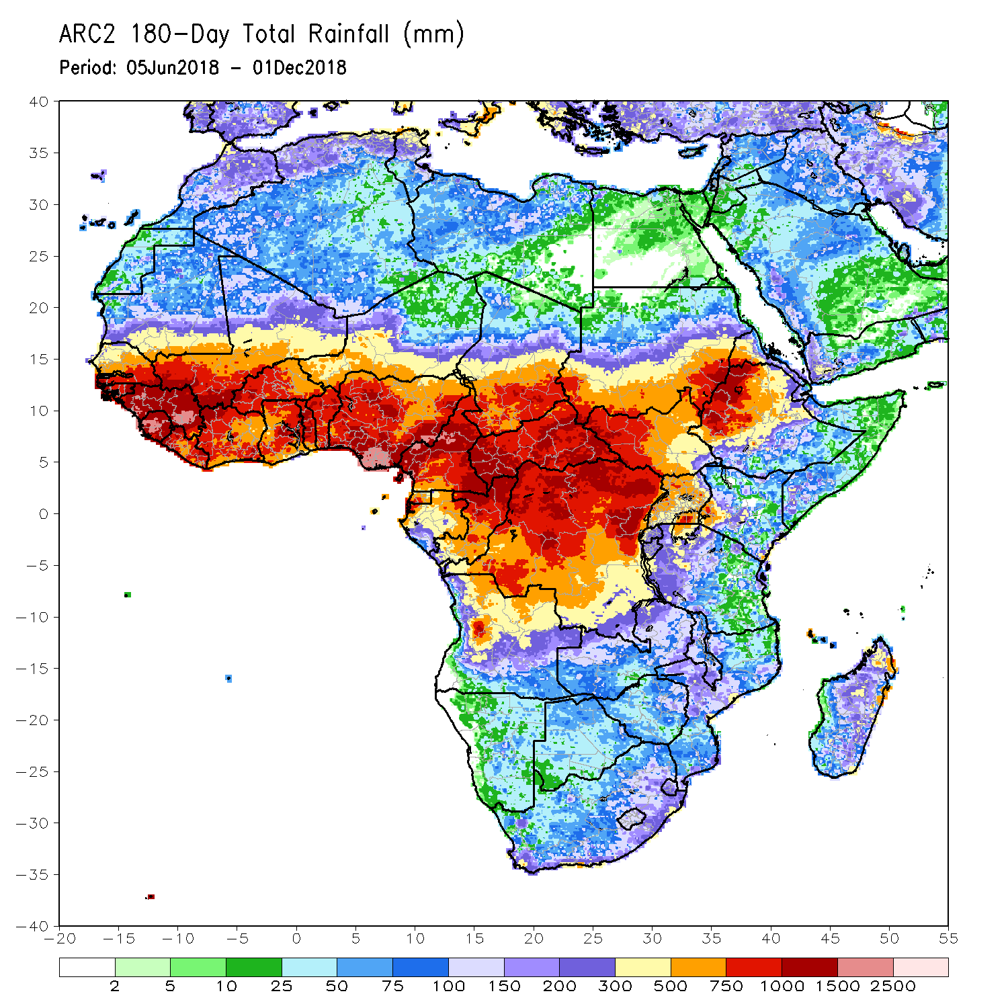
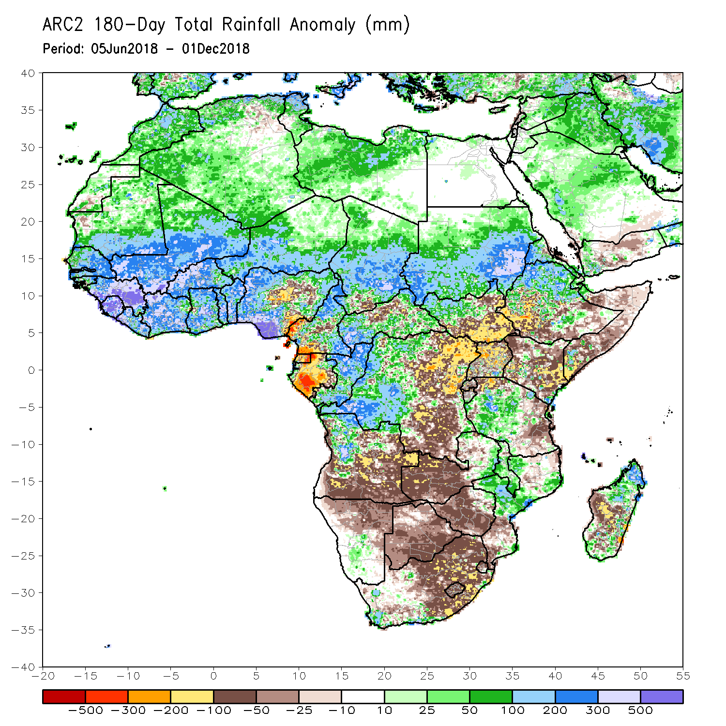
Rainfall Patterns: Last 180 Days
During the past 180 days, western and eastern Guinea, Sierra Leone, southern and eastern Nigeria and portions of Cameroon registered rainfall totals of over 2500 mm (moisture surpluses of over 500 mm).
Moisture deficits of over 300 mm were observed in the eastern border of Nigeria and Cameroon, southern Cameroon, Equatorial Guinea, portions of Gabon and local areas in the southern part of South Sudan and western Ethiopia.
Notes:
7

Slide 8
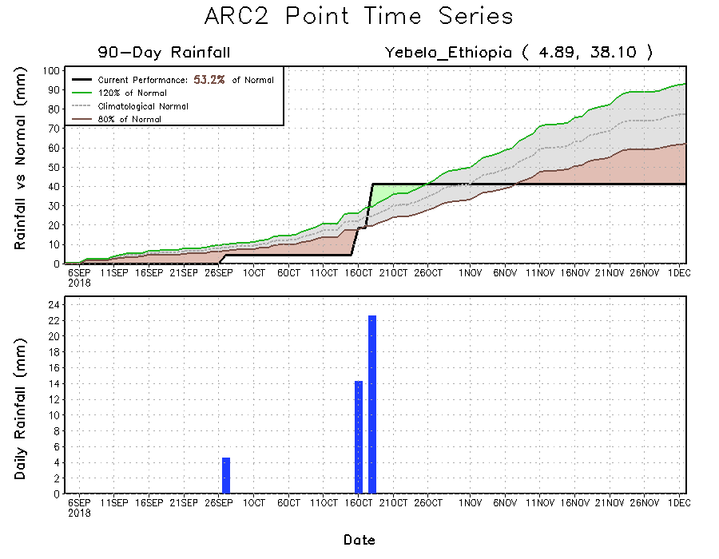
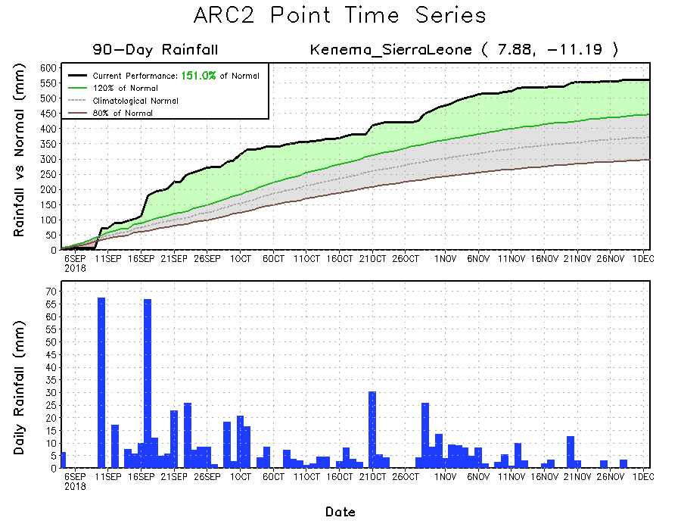
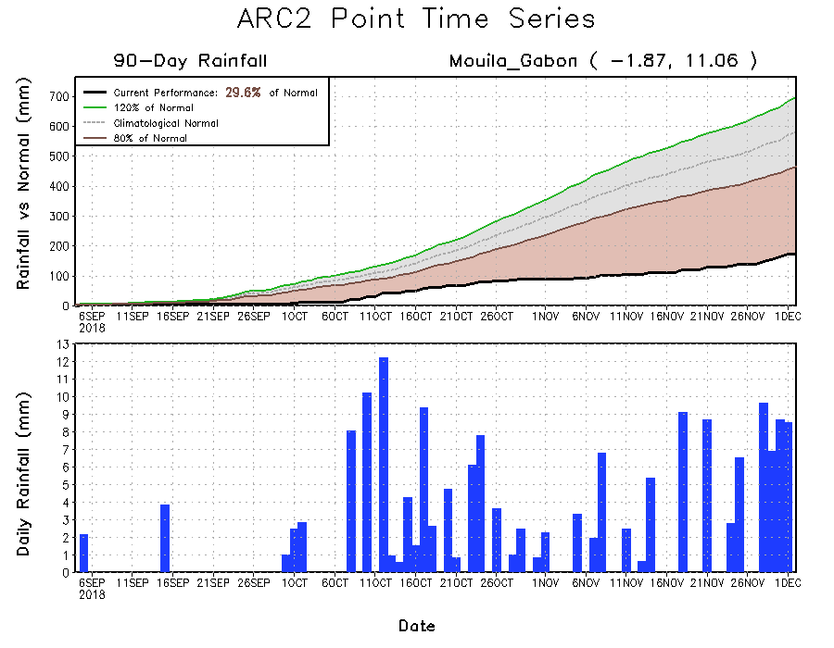
Recent Rainfall Evolution
Daily evolution of rainfall over the last 90 days at selected locations highlights moisture surpluses over Sierra Leone (bottom left), while moisture deficits are evident over southern Ethiopia Kenya that continues to experience suppressed rainfall (top right). Below-average rainfall prevailed over Gabon, despite the recent precipitation (bottom right).

Slide 9
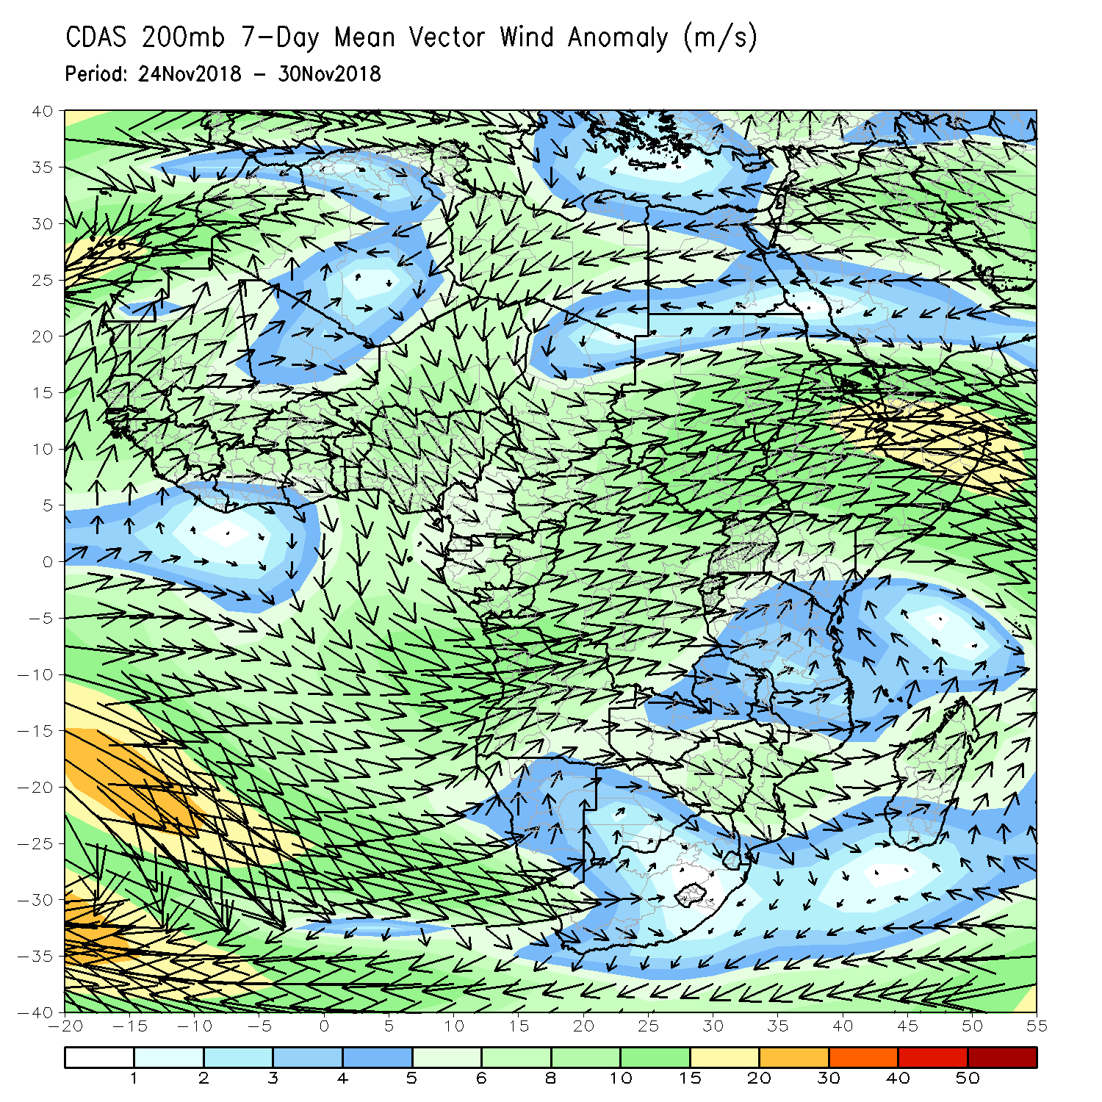
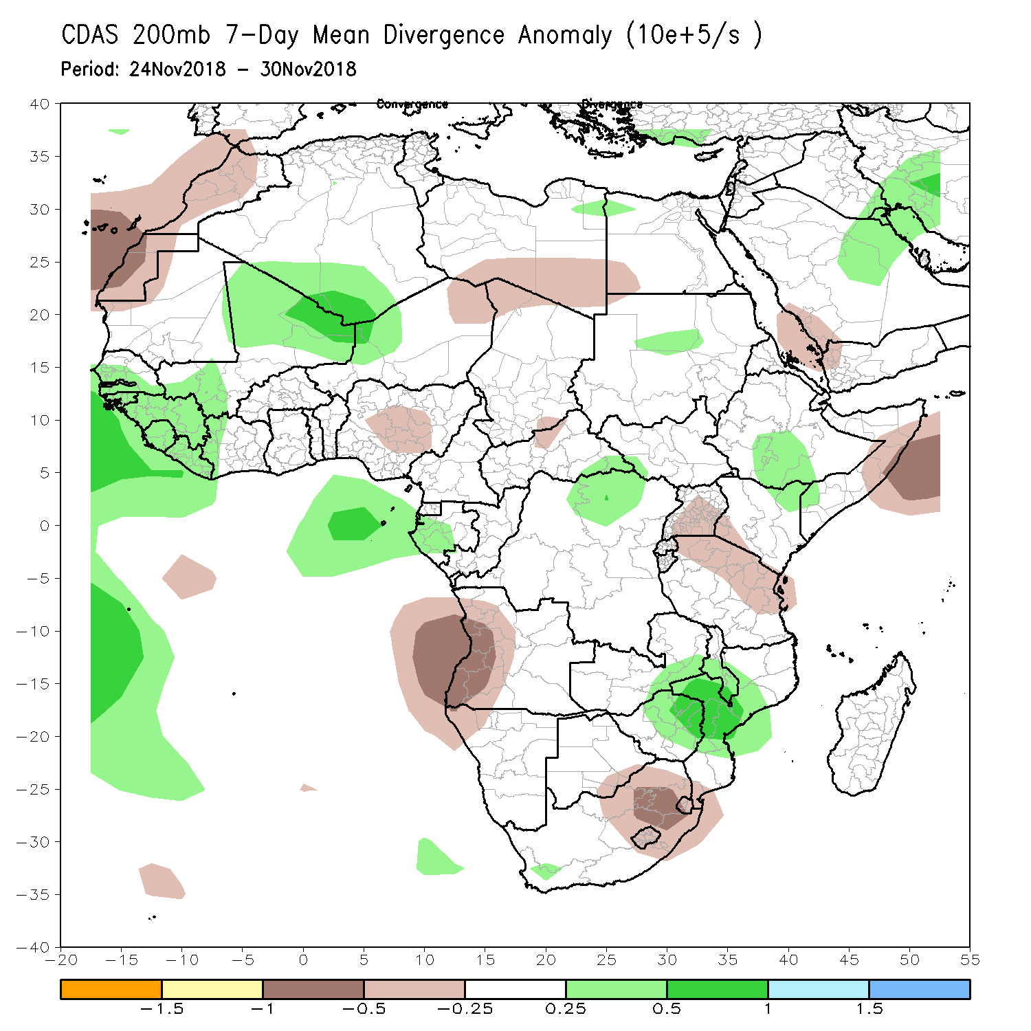
Atmospheric Circulation: Last 7 Days
The upper-level convergence zones over Uganda, southwestern Kenya and northern Tanzania may have led to dry conditions in the southern part of the Greater Horn of Africa.

Slide 10
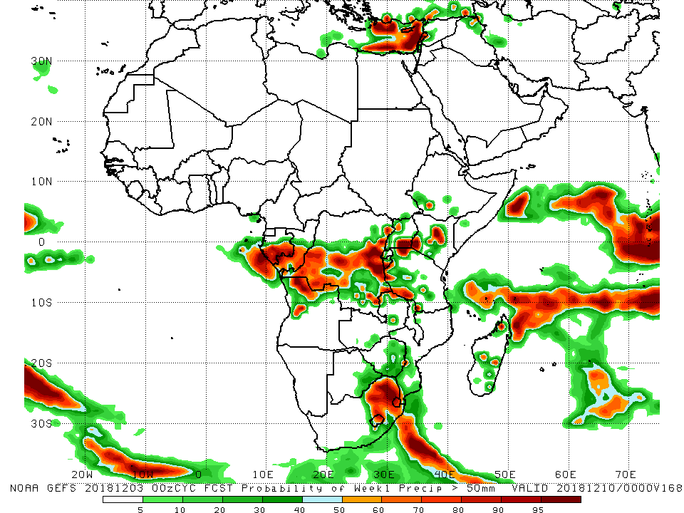
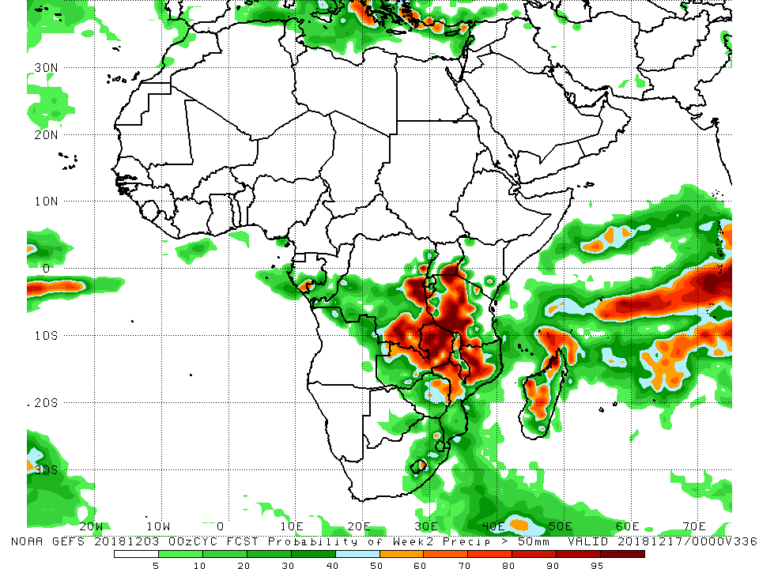
NCEP GEFS Model Forecasts Non-Bias Corrected Probability of precipitation exceedance
Week-1: Valid 4-10 December, 2018
Week-2: Valid 11-17 December, 2018
Week-1 forecast (left panel) calls for an increased chance for weekly rainfall totals to exceed 50 mm over southern Gabon, southern Congo-Brazzaville, northern Angola, DRC, Rwanda, Burundi, Uganda, southern Ethiopia, Kenya, western Tanzania and northern Zambia, as well as parts of eastern South Africa, Lesotho, Swaziland and local areas in Mozambique, Zimbabwe and Madagascar.
Week-2 forecast (right panel) indicates an increased chance for weekly rainfall totals to exceed 50 mm over local areas in southern Gabon, southwestern Congo, eastern DRC, southeastern Uganda, southern Kenya, Rwanda, Burundi, Tanzania, northern Zambia, eastern Zimbabwe, Mozambique, eastern Lesotho and Madagascar.
Notes:
10

Slide 11
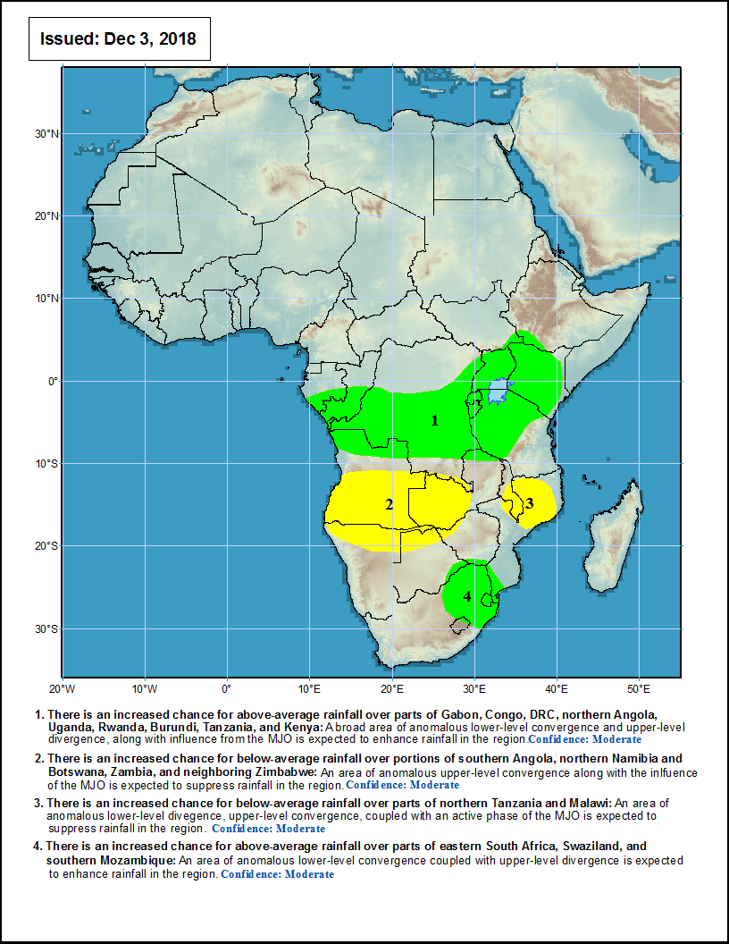
Week-1 Precipitation Outlooks
4-10 Dec, 2018
There is an increased chance for above-average rainfall over parts of Gabon, Congo, DRC, northern Angola, Uganda, Rwanda, Burundi, Tanzania, and Kenya: A broad area of anomalous lower-level convergence and upper-level divergence, along with influence from the MJO is expected to enhance rainfall in the region. Confidence: Moderate
There is an increased chance for below-average rainfall over portions of southern Angola, northern Namibia and Botswana, Zambia, and neighboring Zimbabwe: An area of anomalous upper-level convergence along with the influence of the MJO is expected to suppress rainfall in the region. Confidence: Moderate
There is an increased chance for below-average rainfall over parts of northern Tanzania and Malawi: An area of anomalous lower-level divergence, upper-level convergence, coupled with an active phase of the MJO is expected to suppress rainfall in the region. Confidence: Moderate
There is an increased chance for above-average rainfall over parts of eastern South Africa, Swaziland, and southern Mozambique: An area of anomalous lower-level convergence coupled with upper-level divergence is expected to enhance rainfall in the region. Confidence: Moderate
Notes:
11

Slide 12
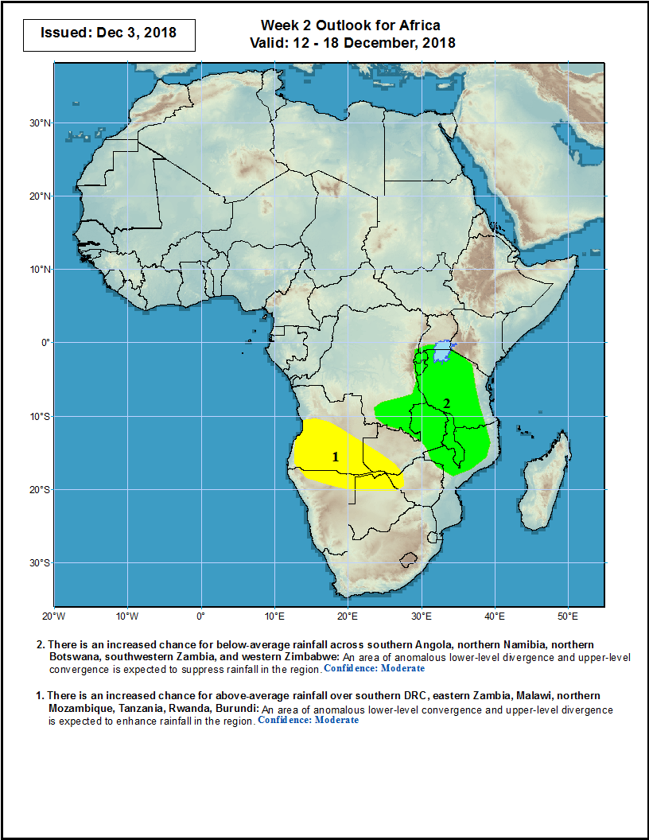
Week-2 Precipitation Outlooks
12-18 Dec, 2018
There is an increased chance for above-average rainfall over southern DRC, eastern Zambia, Malawi, northern Mozambique, Tanzania, Rwanda and Burundi: An area of anomalous lower-level convergence and upper-level divergence is expected to enhance rainfall in the region. Confidence: Moderate
There is an increased chance for below-average rainfall across southern Angola, northern Namibia, northern Botswana, southwestern Zambia, and western Zimbabwe: An area of anomalous lower-level divergence and upper-level convergence is expected to suppress rainfall in the region. Confidence: Moderate
Notes:
12

Slide 13
Summary
During the past 7 days, scattered above-average rainfall was observed over local areas in Northern Africa. Parts of Mauritania, Mali, southern part of Sudan and South Sudan, Ethiopia, southern Côte d’Ivoire, southern Ghana, Cameroon, CAR, southern Somalia, Kenya, Uganda, Tanzania, western Equatorial Guinea, Gabon, much of Congo-Brazzaville, western DRC, much of Angola, Namibia, Zambia, Malawi, Mozambique, Zimbabwe, eastern Botswana, southern part of South Africa and Madagascar experienced above-average rainfall. In contrast, the northern part of Morocco and Algeria, the eastern part of Guinea, local areas in Liberia, southern Ghana, Cameroon, western CAR, western Ethiopia, southern Gabon, eastern DRC, Uganda, Kenya, much of Tanzania, Rwanda, Burundi, Zambia, Angola, northern Namibia, Mozambique, central Botswana, eastern South Africa and Madagascar received below-average rainfall.
During the past 30 days, moisture surpluses of over 100 mm (more than 200% of normal rainfall) were observed in northern Tunisia, northwestern Libya, northwestern Egypt, central Mali, western Gambia, southern Côte d’Ivoire, southern Nigeria, parts of Cameroon, Ethiopia, southern Somalia, Kenya, portions of Congo, western and eastern DRC, northern Angola, eastern Zambia, northern Malawi, central Mozambique, extreme southern part of South Africa and northern and eastern Madagascar. Conversely, moisture deficit of over 100 mm (less than 80% of normal rainfall) were observed in Gabon, western and eastern Angola, northeastern DRC, southern and northern Uganda, northern and eastern Tanzania, central Madagascar, eastern Kenya and southern Somalia.
During the past 90 days, moisture surpluses of over 300 mm were observed in northern Morocco, northern Algeria, southern Guinea, Sierra Leone, Liberia, southern Côte d’Ivoire, southern Ghana, southern Benin, southern Nigeria, northern Ethiopia, southern Congo, southwestern DRC, northwestern Angola, southern Kenya, central Tanzania, southern part of South Africa and northern Madagascar. Moisture deficits of over 200 mm were observed in southeastern border of Nigeria and Cameroon, Equatorial Guinea and Gabon.
During the past 180 days, western and eastern Guinea, Sierra Leone, southern and eastern Nigeria and portions of Cameroon registered rainfall totals of over 2500 mm (moisture surpluses of over 500 mm). Moisture deficits of over 300 mm were observed in the eastern border of Nigeria and Cameroon, southern Cameroon, Equatorial Guinea, portions of Gabon and local areas in the southern part of South Sudan and western Ethiopia.
Week-1 forecast calls for an increased chance for weekly rainfall totals to exceed 50 mm over southern Gabon, southern Congo-Brazzaville, northern Angola, DRC, Rwanda, Burundi, Uganda, southern Ethiopia, Kenya, western Tanzania and northern Zambia, as well as parts of eastern South Africa, Lesotho, Swaziland and local areas in Mozambique, Zimbabwe and Madagascar. Week-2 forecast indicates an increased chance for weekly rainfall totals to exceed 50 mm over local areas in southern Gabon, southwestern Congo, eastern DRC, southeastern Uganda, southern Kenya, Rwanda, Burundi, Tanzania, northern Zambia, eastern Zimbabwe, Mozambique, eastern Lesotho and Madagascar.
Notes:
13

