Slide 1
The African Monsoon Recent Evolution and Current Status Include Week-1 and Week-2 Outlooks
Update prepared by
Climate Prediction Center / NCEP
15 April 2019
For more information, visit:
http://www.cpc.ncep.noaa.gov/products/Global_Monsoons/African_Monsoons/precip_monitoring.shtml

Slide 2
Outline
Highlights
Recent Evolution and Current Conditions
NCEP GEFS Forecasts
Summary

Slide 3
Highlights: Last 7 Days
Weekly rainfall surpluses ranged between 50-100mm over central Zambia, west-central and northeastern Ethiopia, and northern Madagascar.
Week-1 outlooks call for an increased chance for above-average rainfall over southern Zambia, northern Zimbabwe, central Ethiopia, and coastal Tanzania. In contrast, there is an increased chance for below-average rainfall over southern Nigeria, Uganda, parts of South Sudan, much of Kenya, northern Tanzania, and southern and central Somalia.

Slide 4
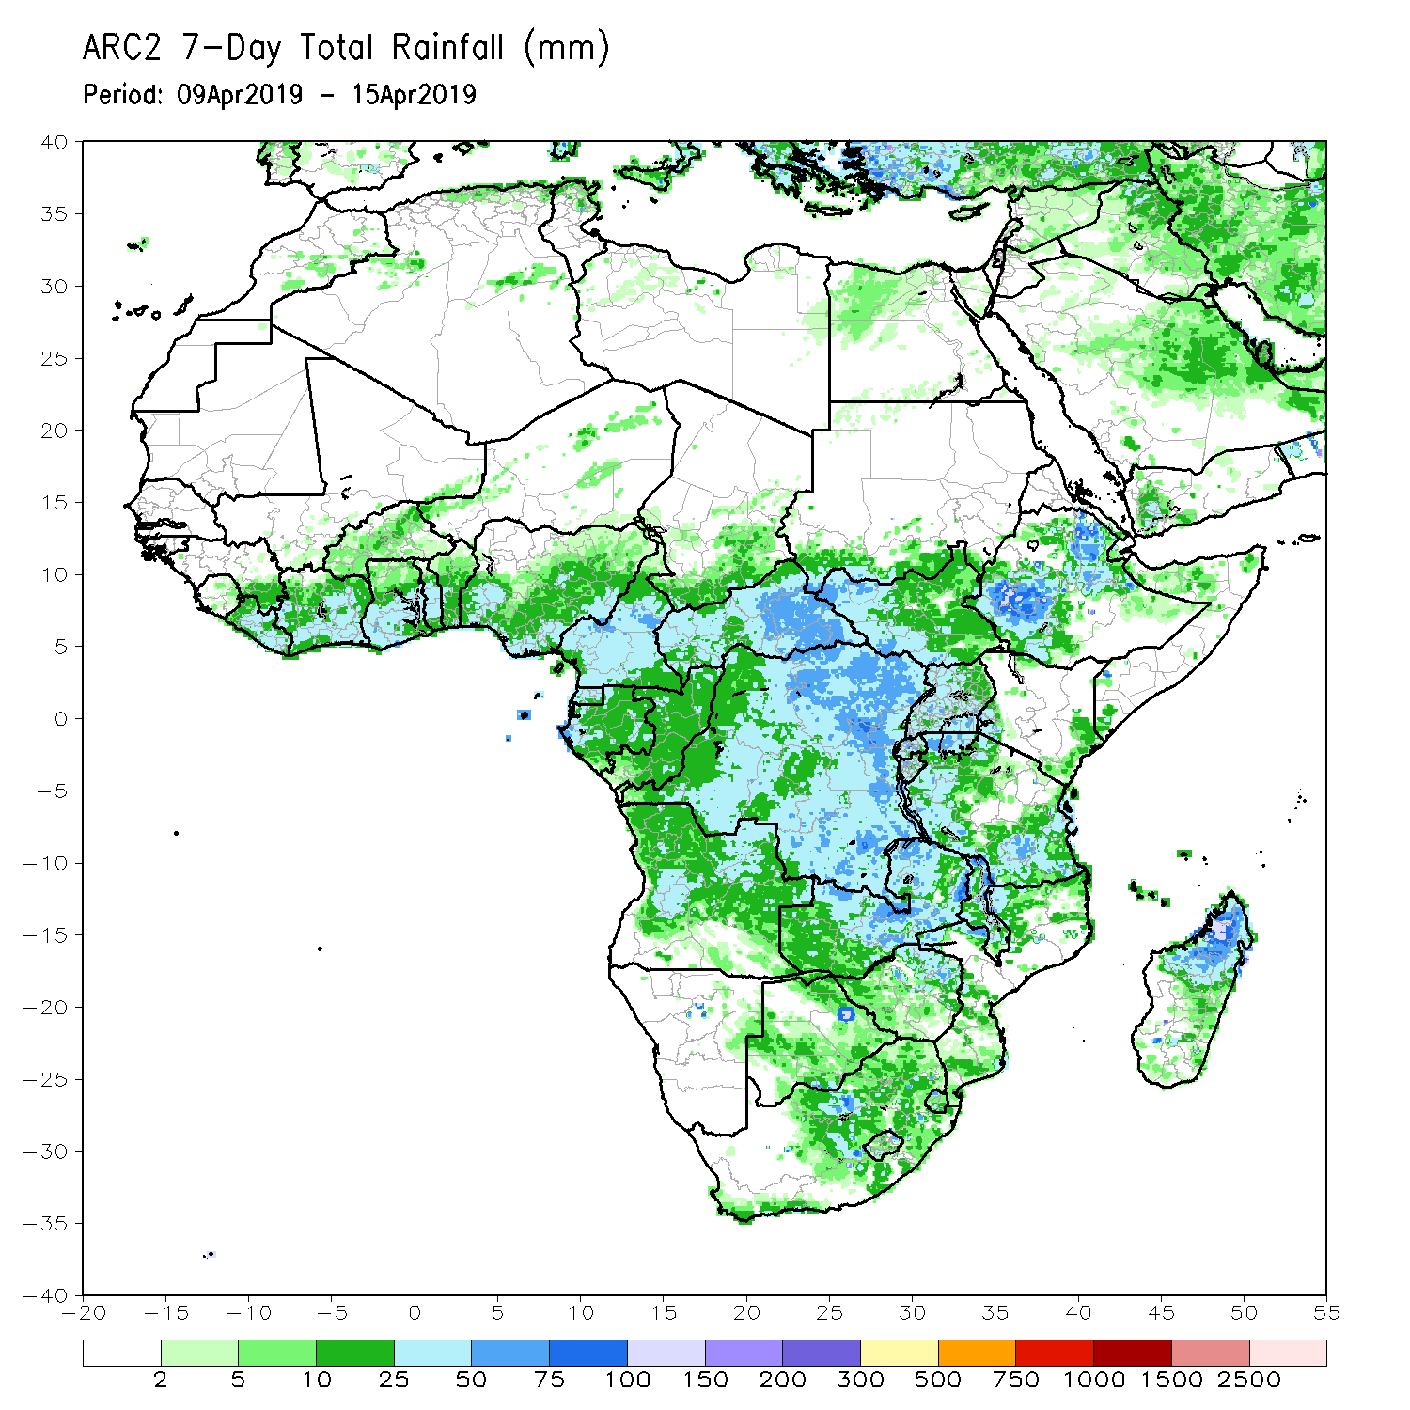
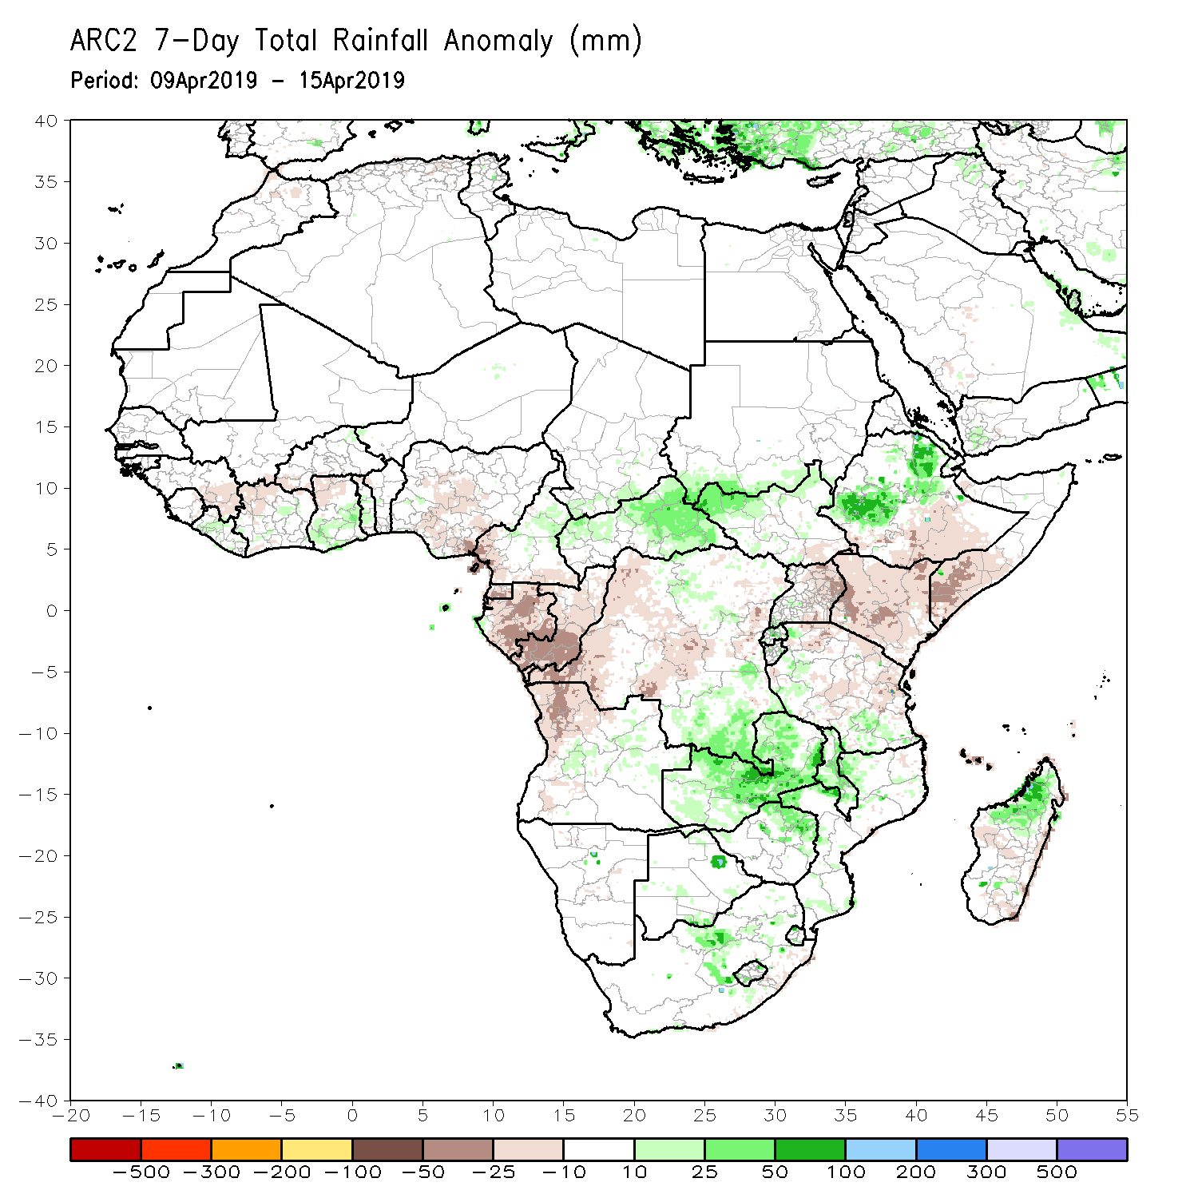
Rainfall Patterns: Last 7 Days
Weekly rainfall surpluses ranged between 50-100mm over parts of central Zambia, west-central and northeastern Ethiopia, and northern Madagascar.
Rainfall was above-average over southern Ghana and local areas of Cote d’Ivoire, eastern CAR, southern Sudan, and western South Sudan, southern DRC, central Zambia Malawi, central South Africa, portions of Ethiopia, and northern Madagascar.
Below-average rainfall was observed over parts of Guinea-Conakry, Cote d’Ivoire, northern Ghana, southern Nigeria, Equatorial Guinea, Gabon, Congo-Brazzaville, northwestern Angola, western DRC, Uganda, Kenya, northern Tanzania, southern Ethiopia, and southern Somalia.

Slide 5
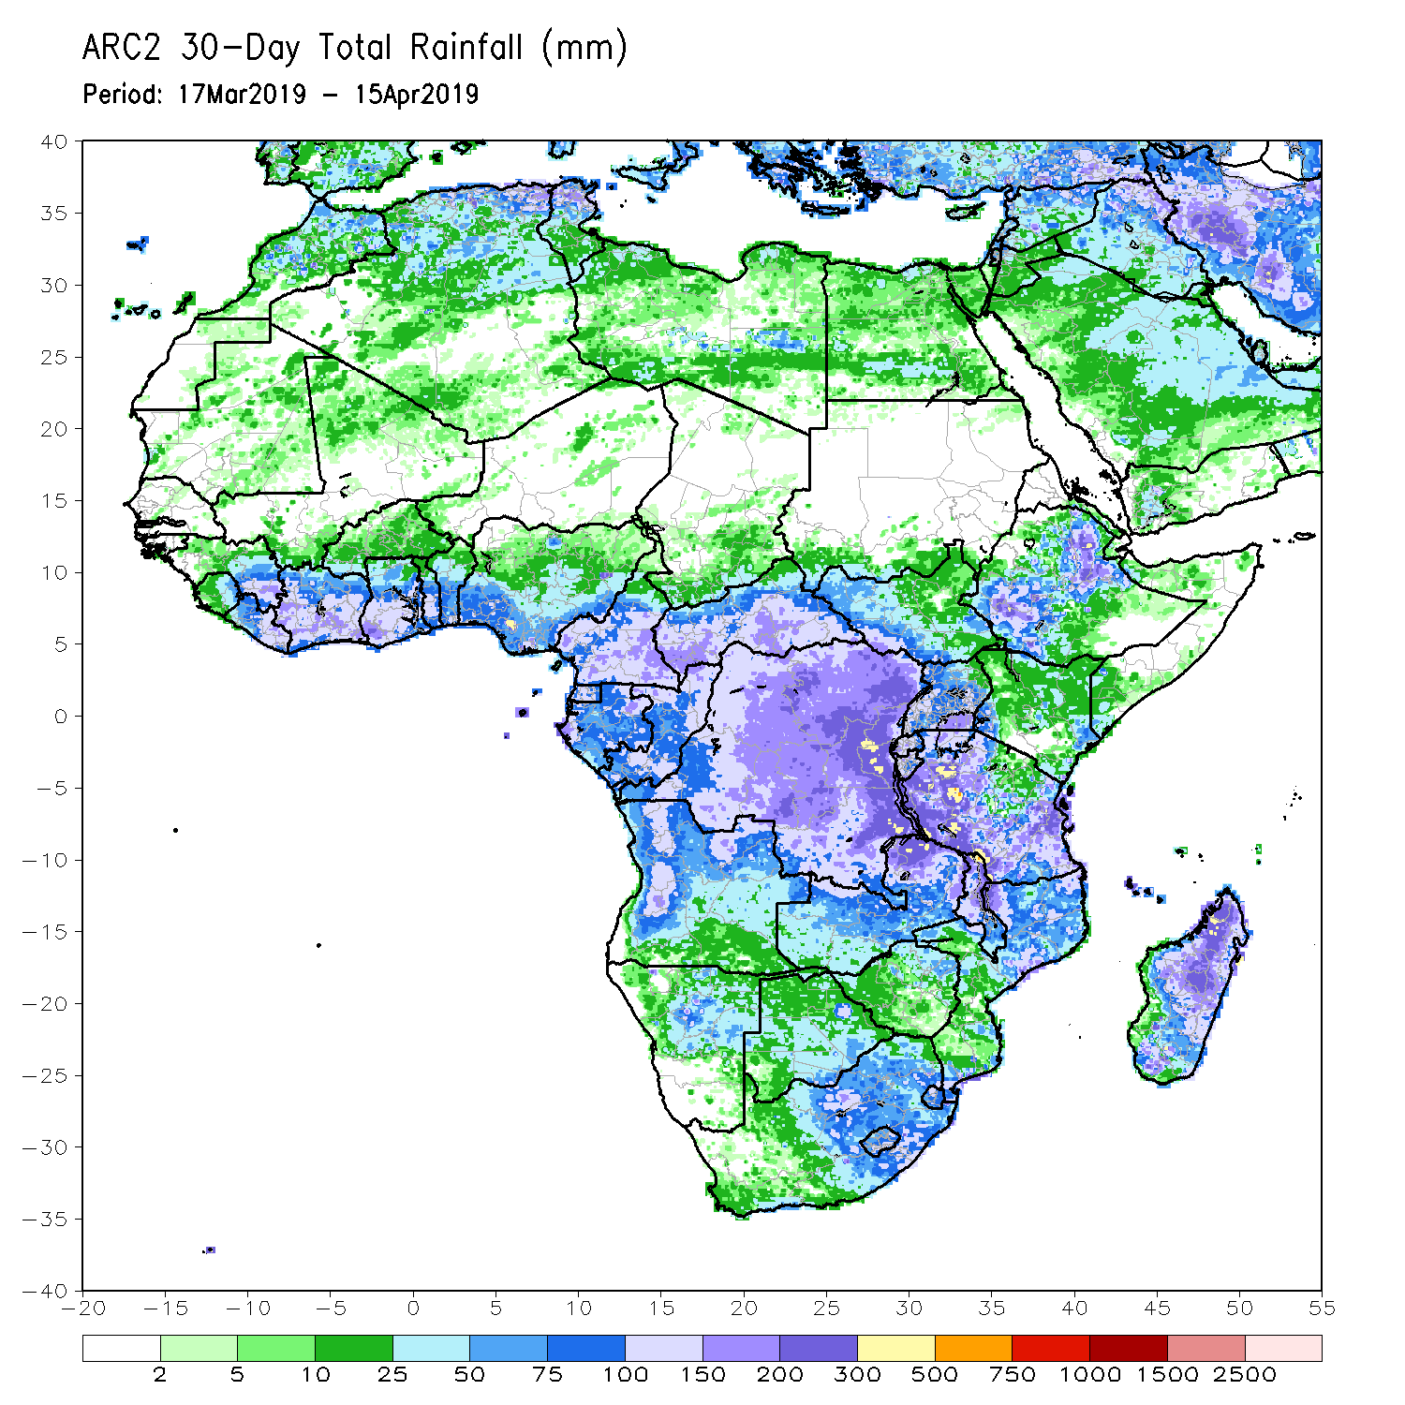
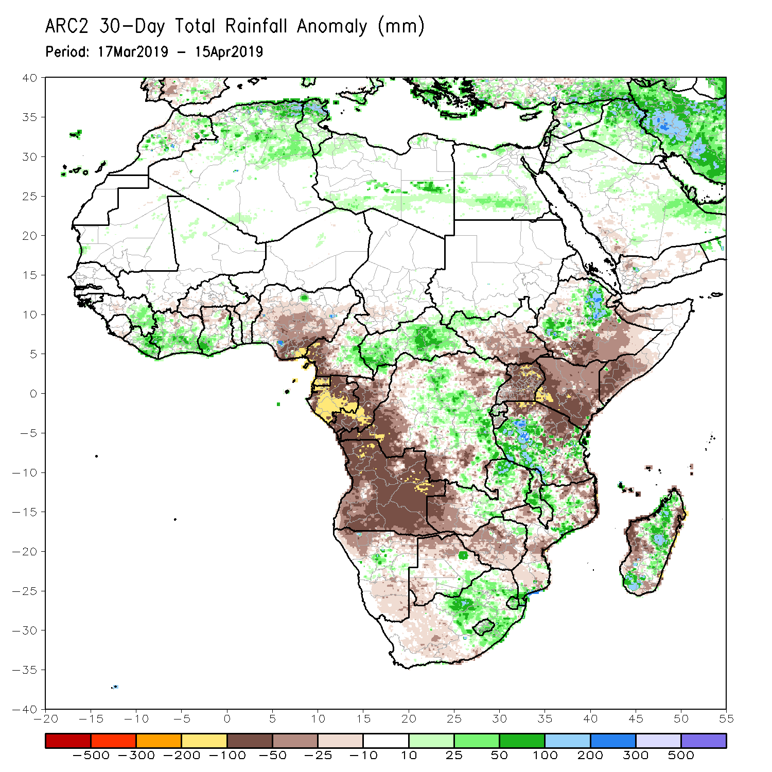
Rainfall Patterns: Last 30 Days
During the past 30 days, rainfall was above-average over parts of Guinea-Conakry, Liberia, Cote d’Ivoire, southern Ghana, CAR, central DRC, eastern South Africa, central Malawi, western and southern Tanzania, central and northeastern Ethiopia, many parts of northern Mozambique, and central Madagascar.
Below-average rainfall was observed over southern Nigeria, western Cameroon, Equatorial Guinea, Gabon, Congo-Brazzaville, Angola, western and eastern DRC, western Zambia, northern Namibia, northern Botswana, central Zimbabwe, southern South Sudan, Uganda, Kenya, northern Tanzania, southern Ethiopia, southern Somalia, and western Madagascar.
Notes:
5

Slide 6
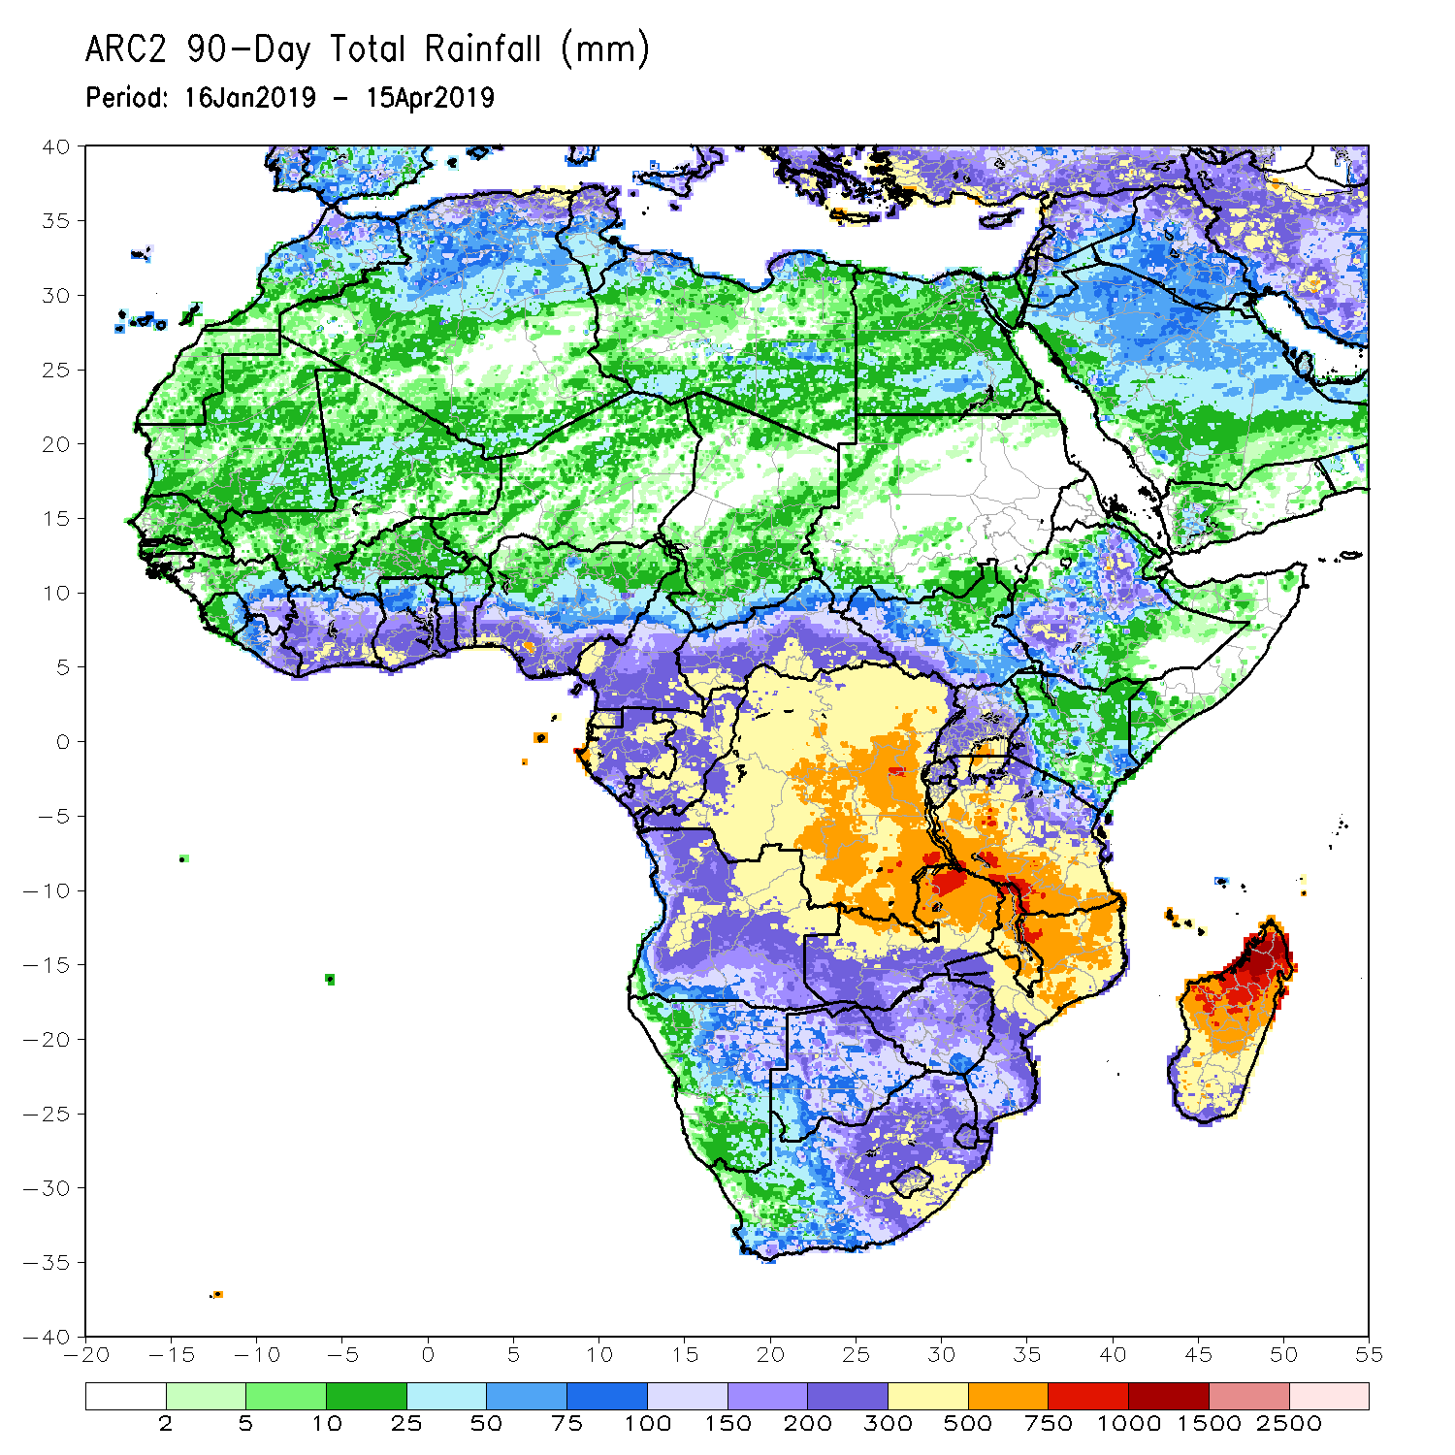
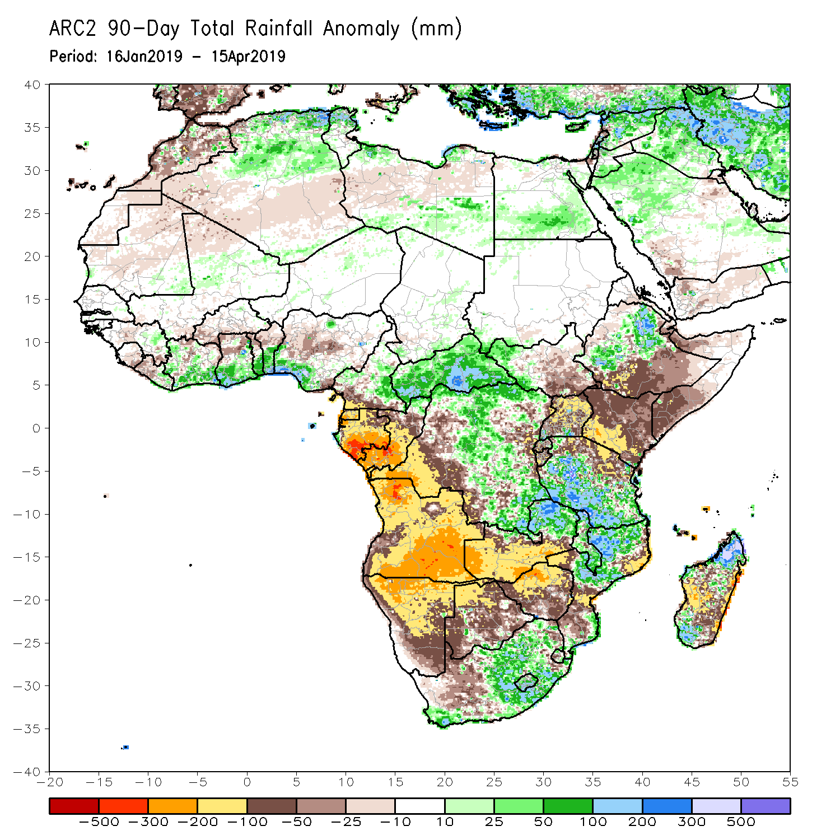
Rainfall Patterns: Last 90 Days
During the past 90 days, rainfall was above-average over eastern Guinea, many parts of Cote d’Ivoire, the southern portions of Ghana; Togo; Benin; and Nigeria, parts of western and eastern Cameroon, much of CAR, western South Sudan, many parts of DRC, northeastern and southwestern Ethiopia, many parts of Tanzania, eastern Zambia, Malawi, many parts of Mozambique, and portions of South Africa and Madagascar.
Parts of Sierra Leone, western Liberia, local areas in Cote d’Ivoire, northern Ghana, northern Togo, northern Benin, parts of Nigeria and Cameroon, Equatorial Guinea, Gabon, Congo, Angola, portions of DRC, Namibia, Botswana, Zimbabwe, western and central Zambia, portions of South Africa, southern South Sudan, portions of Ethiopia, Kenya, Somalia, northern Tanzania, local areas in Mozambique, and portions of Madagascar had below-average rainfall.
Notes:
6

Slide 7
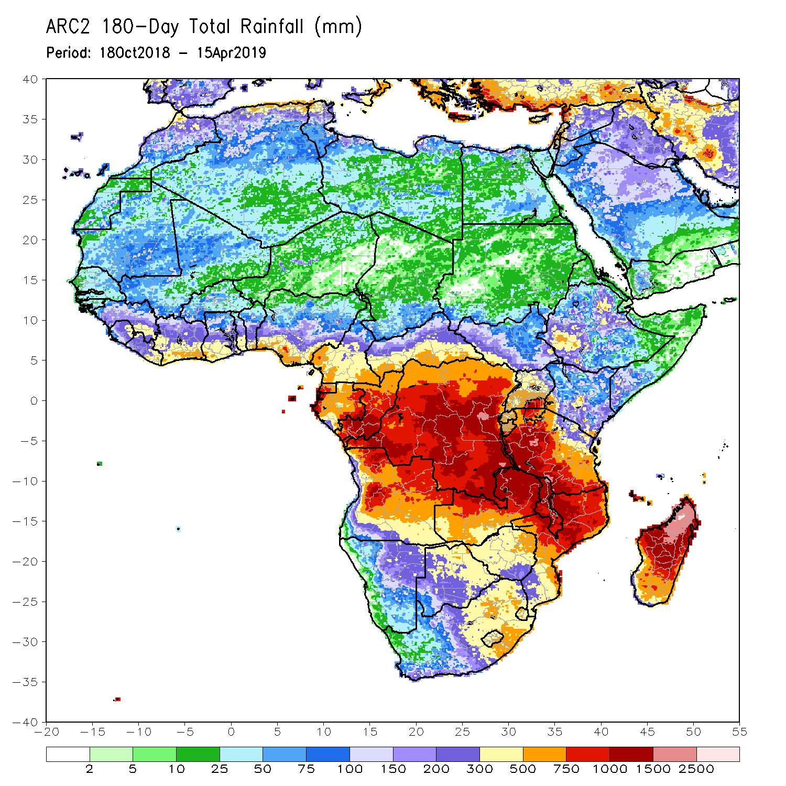
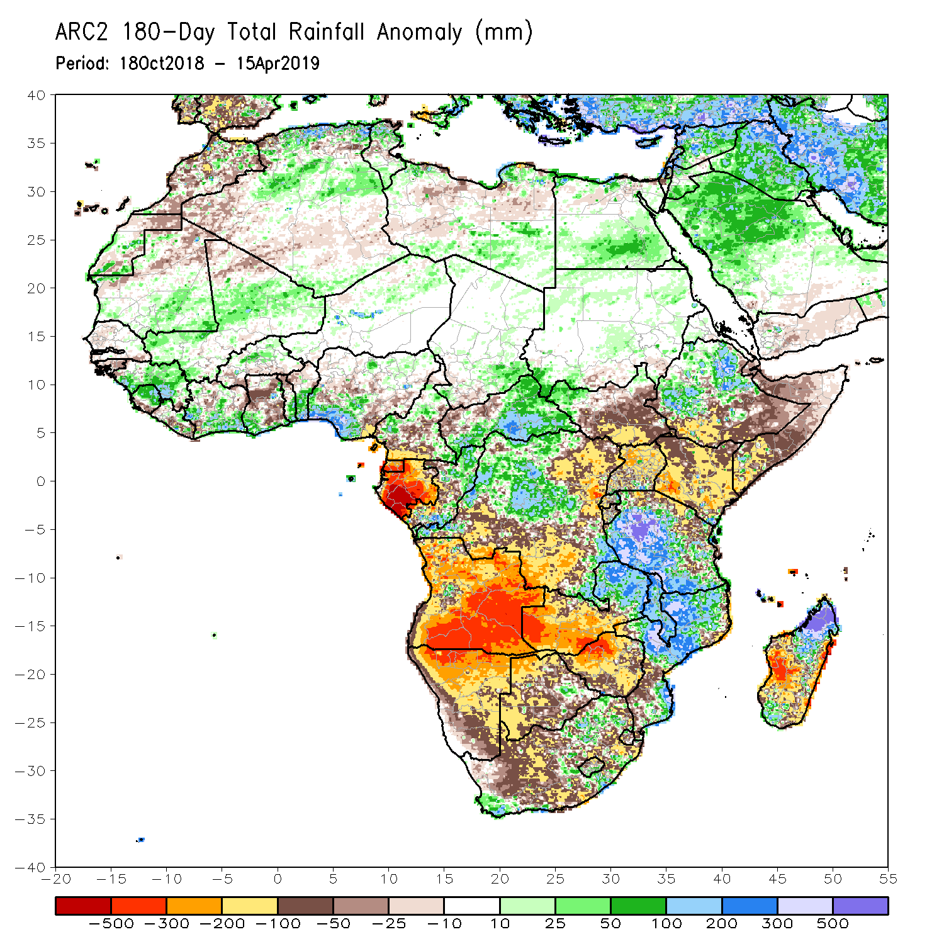
Rainfall Patterns: Last 180 Days
During the past 180 days, rainfall was above-average over parts of Mali, Guinea, Sierra Leone, parts of Cote d’Ivoire, southern Ghana, Burkina Faso, Togo, Benin, many parts of Nigeria and Cameroon, parts of eastern Chad, many parts of CAR, local areas in western South Sudan, portions of Ethiopia, many parts of Tanzania, much of Congo-Brazzaville, many parts of DRC, local areas in South Africa, eastern Zambia, Malawi, many parts of Mozambique, and portions of Madagascar.
Below-average rainfall was observed over local central Liberia, local areas in Cote d’Ivoire, portions of Ghana, parts of Nigeria and Cameroon, Equatorial Guinea, Gabon, parts of southern Chad, northwestern CAR, central DRC, many parts of South Sudan, portions of Ethiopia, Somalia, Uganda, Kenya, many parts of Angola and Namibia, western Zambia, many parts of Botswana, Zimbabwe, many parts of South Africa, local areas in Mozambique, and portions of Madagascar.
Notes:
7

Slide 8
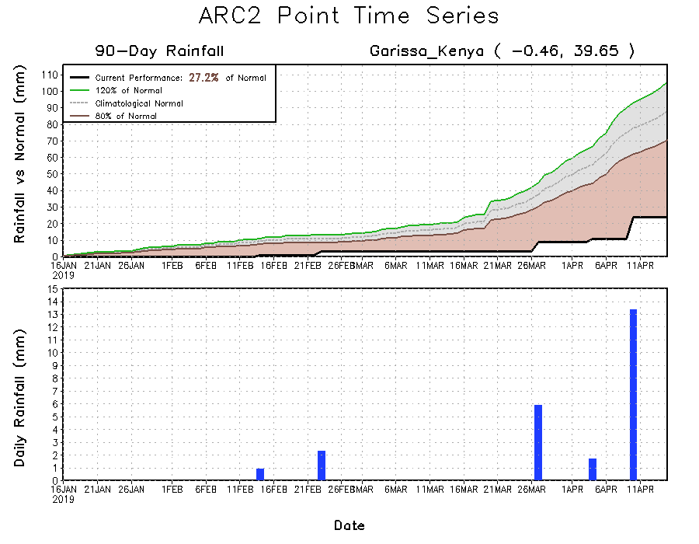
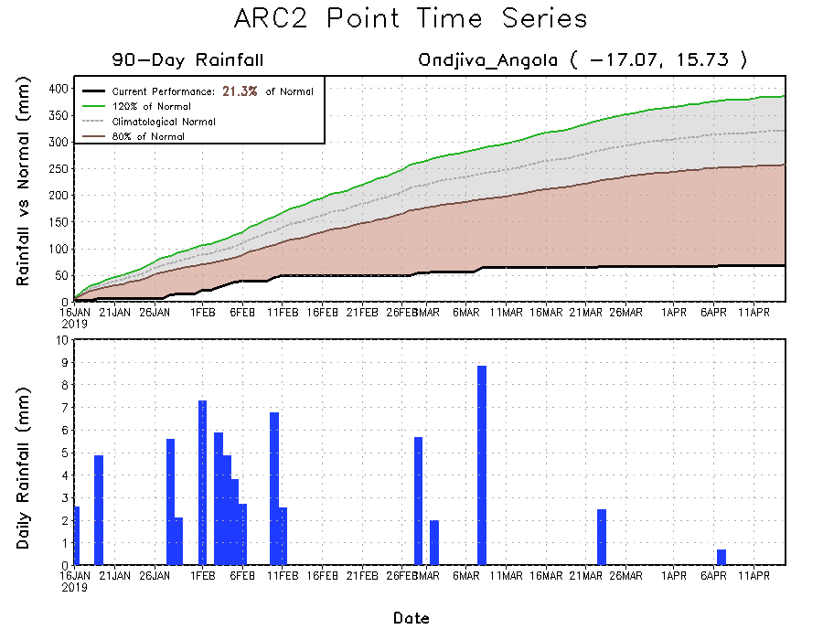
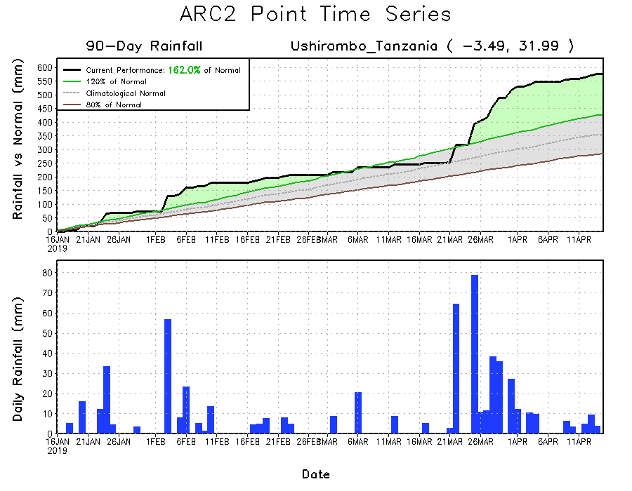
Recent Rainfall Evolution
Daily evolution of rainfall over the last 90 days at selected locations shows that seasonal total rainfall remained below-average over southern Angola (bottom left panel) and parts of Kenya (top right). In contrast, seasonal total rainfall remained above-average over parts of western Tanzania (bottom right).

Slide 9
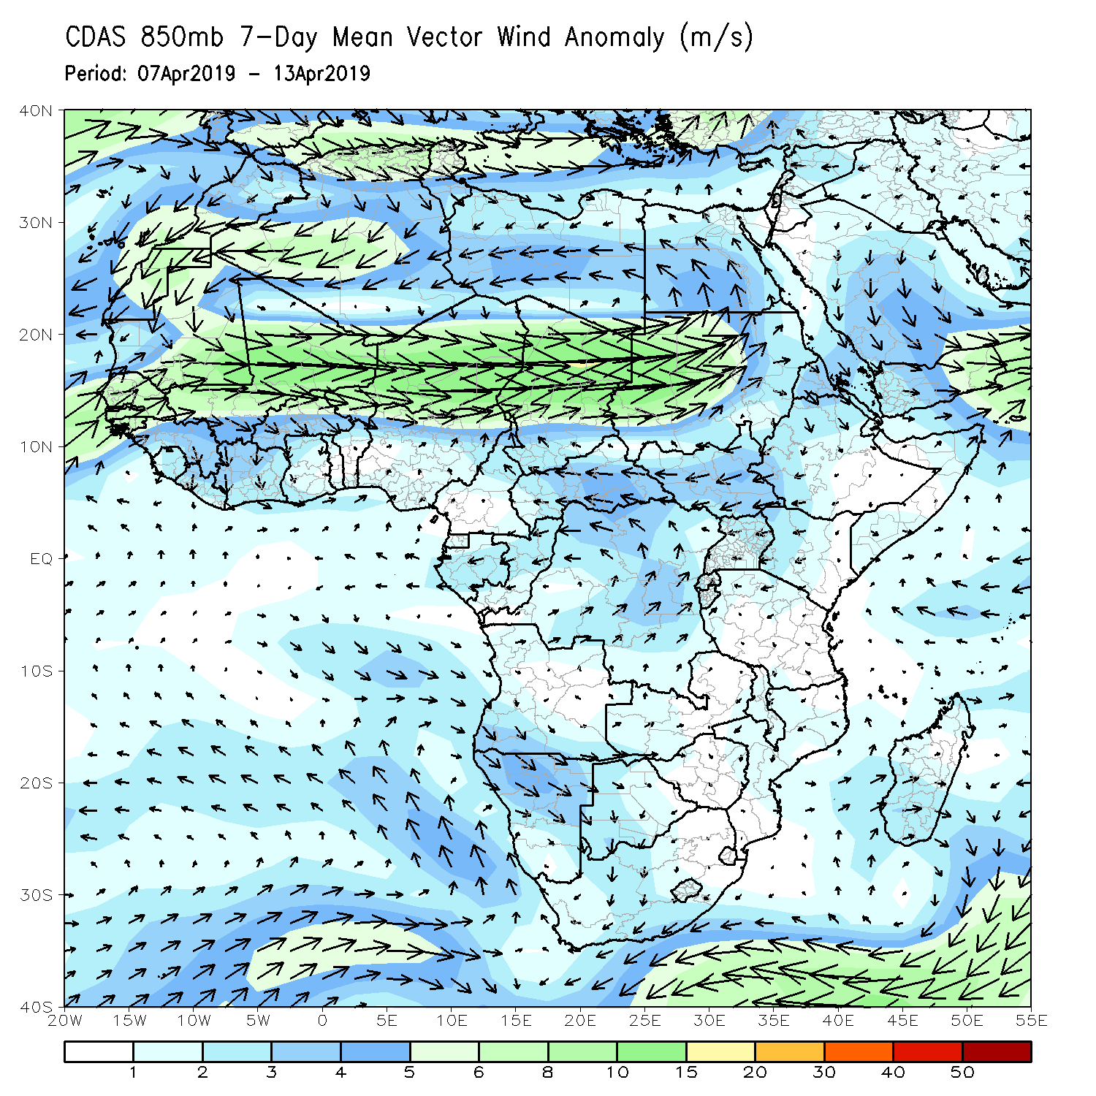
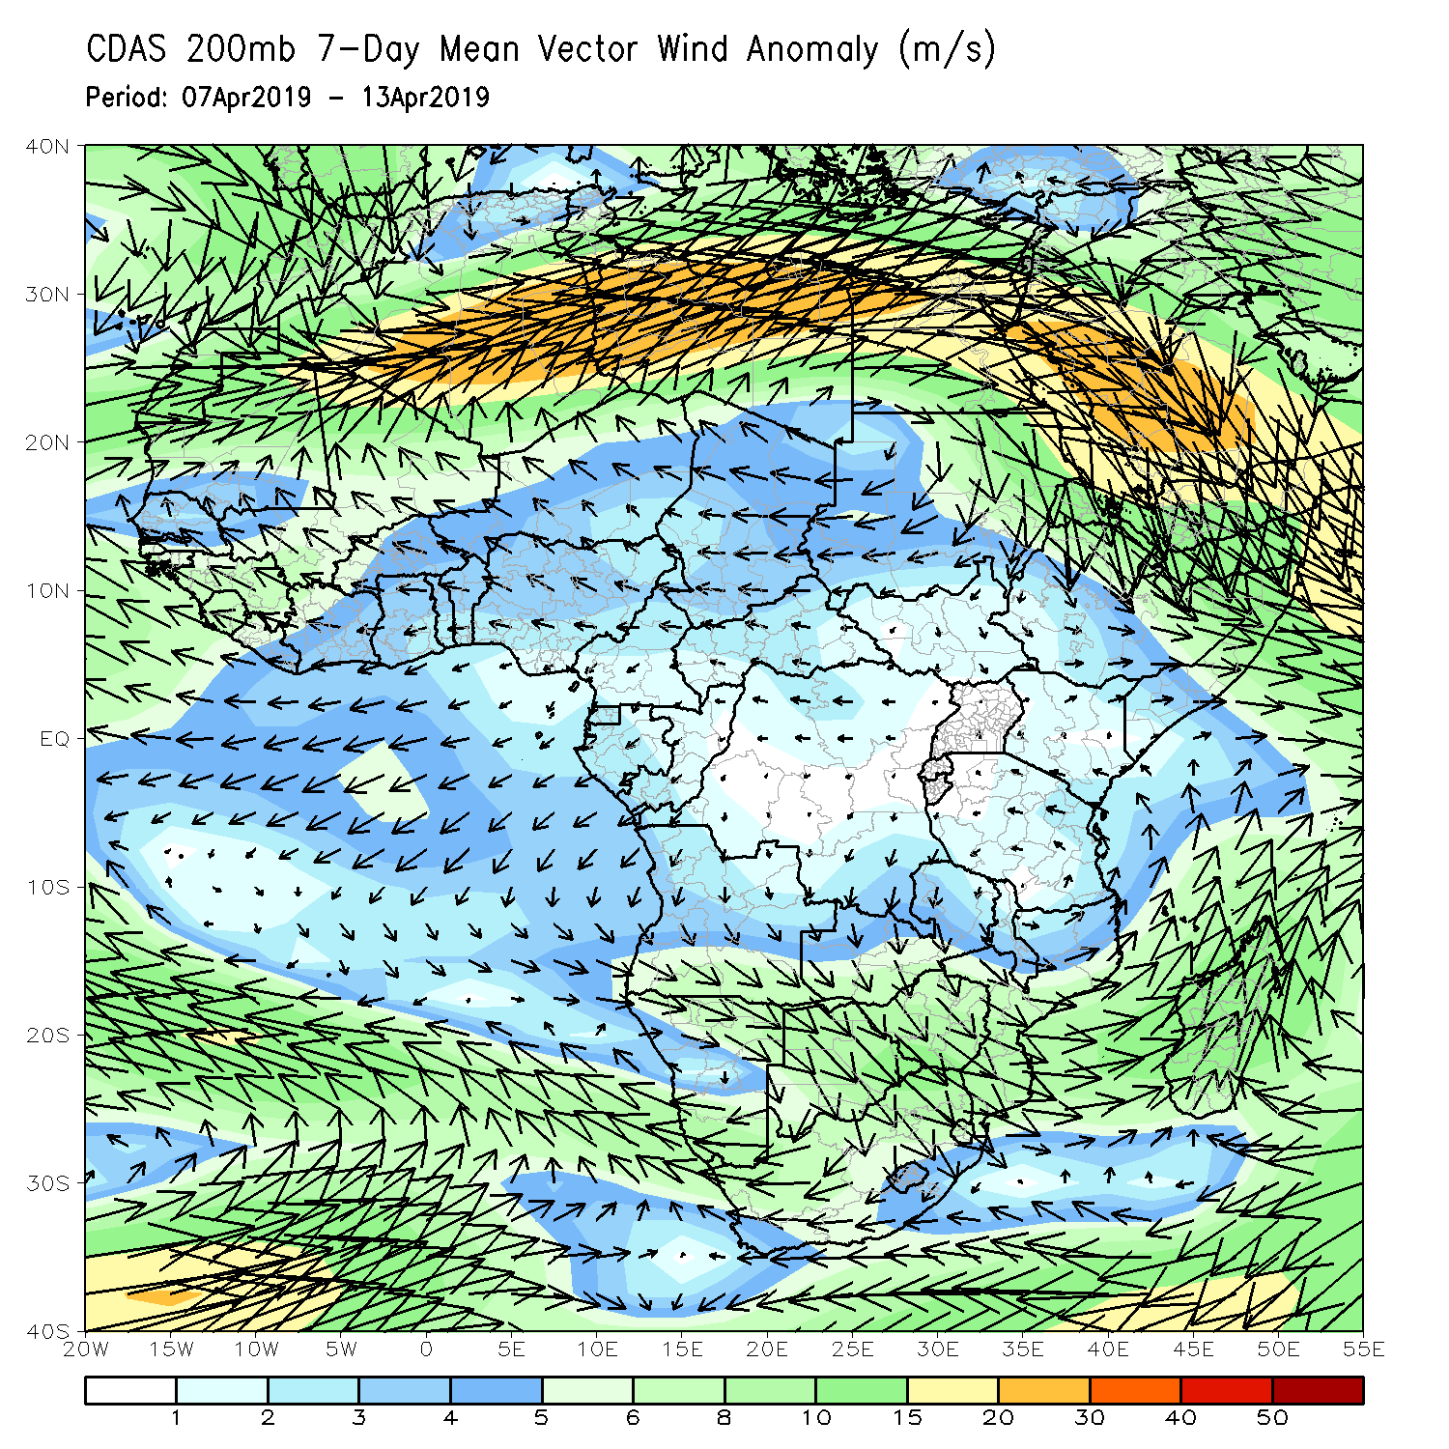
Atmospheric Circulation: Last 7 Days
Anomalous lower-level divergence (left panel), coupled with upper-level convergence was observed across equatorial eastern Africa, which may have contributed to the observed rainfall deficits in the region.

Slide 10
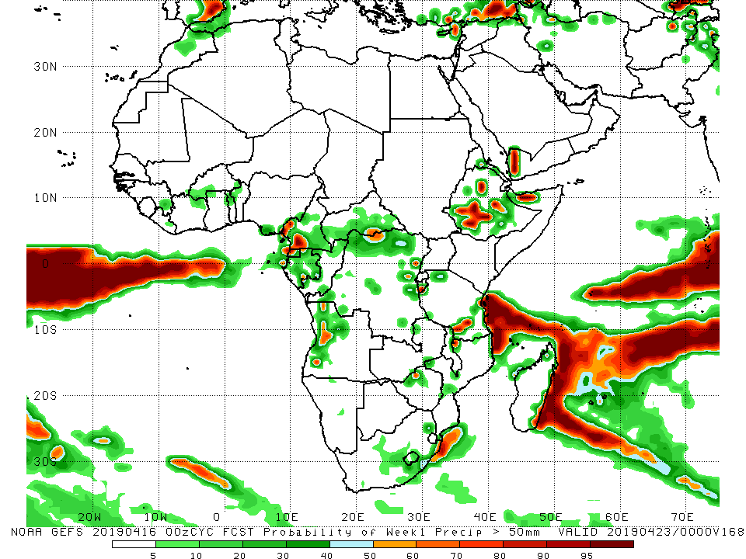
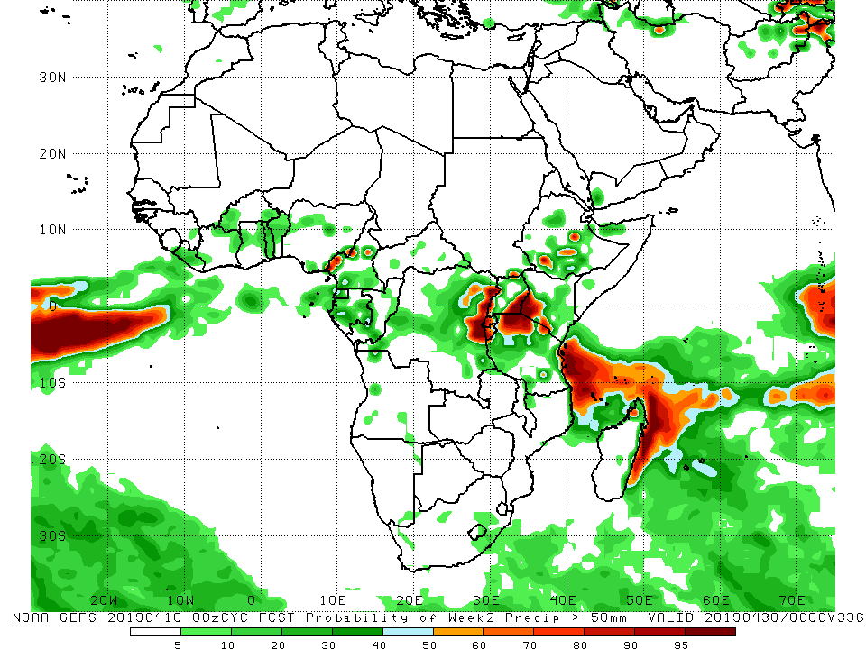
NCEP GEFS Model Forecasts Non-Bias Corrected Probability of precipitation exceedance
Week-1: Valid 17 – 23 April, 2019
Week-2: Valid 24 – 30 April, 2019
For week-1 (left panel), there is an increased chance for weekly rainfall totals to exceed 50 mm over western Cameroon, local areas in CAR, southern and eastern DRC, local areas of western Angola, coastal and southern Tanzania, and southwestern and central Ethiopia.
For week-2 (left panel), there is an increased chance for weekly rainfall totals to exceed 50 mm along the Nigeria-Cameroon border, eastern DRC, Rwanda, Burundi, the Lake Victoria region, local areas in Ethiopia, and coastal areas of Tanzania.
Notes:
10

Slide 11
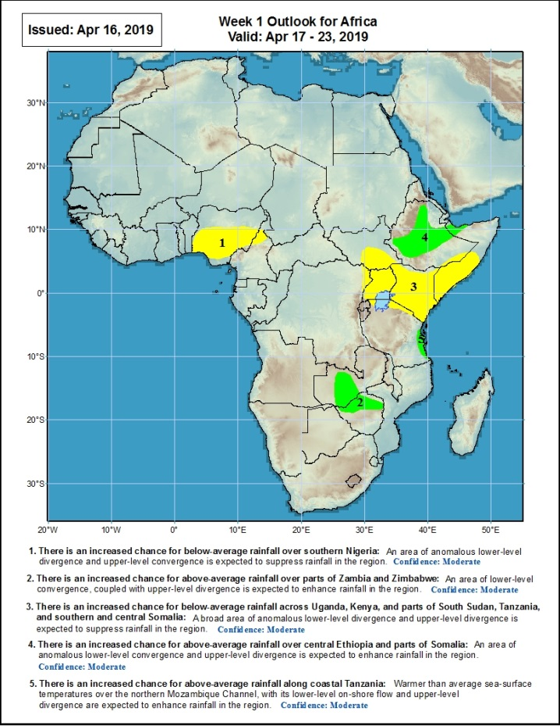
Week-1 Precipitation Outlooks
There is an increased chance for below-average rainfall over northern Angola, southern DRC, and parts of Zambia, and Tanzania: A broad area of anomalous lower-level divergence, combined with anomalous upper-level convergence is expected to suppress rainfall in the region. Confidence: Moderate
There is an increased chance for above-average rainfall over parts of southern Zambia and northern Zimbabwe: An area of anomalous lower-level convergence, coupled with anomalous upper-level divergence is expected to enhance rainfall in the region. Confidence: Moderate
There is an increased chance for below-average rainfall over northern Uganda, Kenya, northern Tanzania, and southern Somalia: A broad area of anomalous lower-level divergence and upper-level convergence is expected to suppress rainfall in the region. Confidence: Moderate
There is an increased chance for above-average rainfall over southwestern and northcentral Ethiopia: An area of anomalous lower-level convergence and anomalous upper-level divergence is expected to enhance rainfall in the region. Confidence: Moderate
There is an increased chance for above-average rainfall along coastal areas of Tanzania: Warmer than average sea-surface temperatures, with its associated lower-level on-shore flow, coupled with upper-level divergence is expected to enhance rainfall in the region. Confidence: Moderate:
17 – 23 April, 2019
Notes:
11

Slide 12
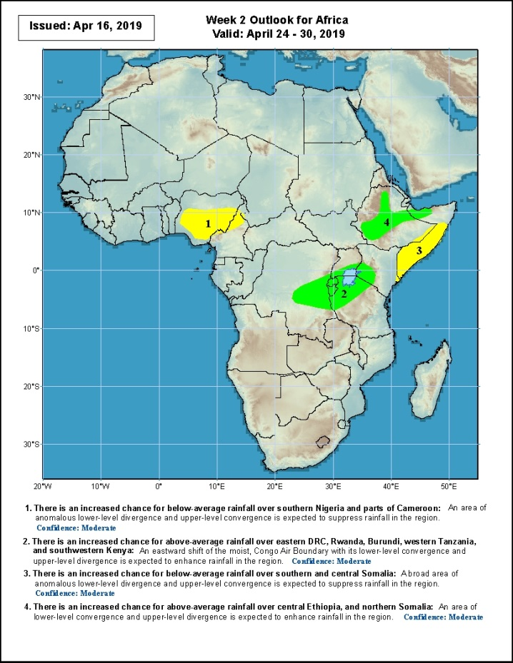
Week-2 Precipitation Outlooks
16 – 22 April, 2019
There is an increased chance for below-average rainfall over eastern Nigeria, Cameroon, and Equatorial Guinea: A broad area of anomalous lower-level divergence and upper-level convergence is expected to suppress rainfall in the region. Confidence: Moderate
There is an increased chance for above-average rainfall over eastern South Africa, Lesotho, and Swaziland: An eastward shift of the Congo Air Boundary, combined with anomalous upper-level divergence is expected to enhance rainfall in the region. Confidence: Moderate
There is an increased chance for below-average rainfall over southern and central Somalia: A broad area of anomalous low-level divergence and upper-level convergence is expected to suppress rainfall in the region. Confidence: Moderate
There is an increased chance for above-average rainfall over central and eastern Ethiopia: An area of anomalous lower-level convergence and anomalous upper-level divergence is expected to enhance rainfall in the region. Confidence: Moderate
Notes:
12

Slide 13
Summary
Weekly rainfall surpluses ranged between 50-100mm over central Zambia, west-central and northeastern Ethiopia, and northern Madagascar. Rainfall was above-average over southern Ghana and local areas of Cote d’Ivoire, eastern CAR, southern Sudan, and western South Sudan, southern DRC, central Zambia Malawi, central South Africa, portions of Ethiopia, and northern Madagascar. Below-average rainfall was observed over parts of Guinea-Conakry, Cote d’Ivoire, northern Ghana, southern Nigeria, Equatorial Guinea, Gabon, Congo-Brazzaville, northwestern Angola, western DRC, Uganda, Kenya, northern Tanzania, southern Ethiopia, and southern Somalia.
During the past 30 days, rainfall was above-average over parts of Guinea-Conakry, Liberia, Cote d’Ivoire, southern Ghana, CAR, central DRC, eastern South Africa, central Malawi, western and southern Tanzania, central and northeastern Ethiopia, many parts of northern Mozambique, and central Madagascar. Below-average rainfall was observed over southern Nigeria, western Cameroon, Equatorial Guinea, Gabon, Congo-Brazzaville, Angola, western and eastern DRC, western Zambia, northern Namibia, northern Botswana, central Zimbabwe, southern South Sudan, Uganda, Kenya, northern Tanzania, southern Ethiopia, southern Somalia, and western Madagascar.
During the past 90 days, rainfall was above-average over eastern Guinea, many parts of Cote d’Ivoire, the southern portions of Ghana; Togo; Benin; and Nigeria, parts of western and eastern Cameroon, much of CAR, western South Sudan, many parts of DRC, northeastern and southwestern Ethiopia, many parts of Tanzania, eastern Zambia, Malawi, many parts of Mozambique, and portions of South Africa and Madagascar. Parts of Sierra Leone, western Liberia, local areas in Cote d’Ivoire, northern Ghana, northern Togo, northern Benin, parts of Nigeria and Cameroon, Equatorial Guinea, Gabon, Congo, Angola, portions of DRC, Namibia, Botswana, Zimbabwe, western and central Zambia, portions of South Africa, southern South Sudan, portions of Ethiopia, Kenya, Somalia, northern Tanzania, local areas in Mozambique, and portions of Madagascar had below-average rainfall.
Week-1 outlooks call for an increased chance for above-average rainfall over southern Zambia, northern Zimbabwe, central Ethiopia, and coastal Tanzania. In contrast, there is an increased chance for below-average rainfall over southern Nigeria, Uganda, parts of South Sudan, much of Kenya, northern Tanzania, and southern and central Somalia.
Notes:
13

