Slide 1
The African Monsoon Recent Evolution and Current Status Include Week-1 and Week-2 Outlooks
Update prepared by
Climate Prediction Center / NCEP
22 April 2019
For more information, visit:
http://www.cpc.ncep.noaa.gov/products/Global_Monsoons/African_Monsoons/precip_monitoring.shtml

Slide 2
Outline
Highlights
Recent Evolution and Current Conditions
NCEP GEFS Forecasts
Summary

Slide 3
Highlights: Last 7 Days
Moderate to heavy rainfall resulted in moisture surpluses over many areas of DRC, eastern Angola, Zambia, central South Africa, parts of northern Zimbabwe, western Tanzania, and west-central Ethiopia.
Week-1 outlooks call for an increased chance for above-average rainfall over Rwanda, Burundi, Kenya, southern Ethiopia, much of Tanzania, and coastal areas of northern Mozambique. In contrast, there is an increased chance for below-average rainfall over Guinea-Conakry, Sierra Leone, Nigeria, Cameroon, CAR, southern Chad, northern DRC, and western South Sudan.

Slide 4
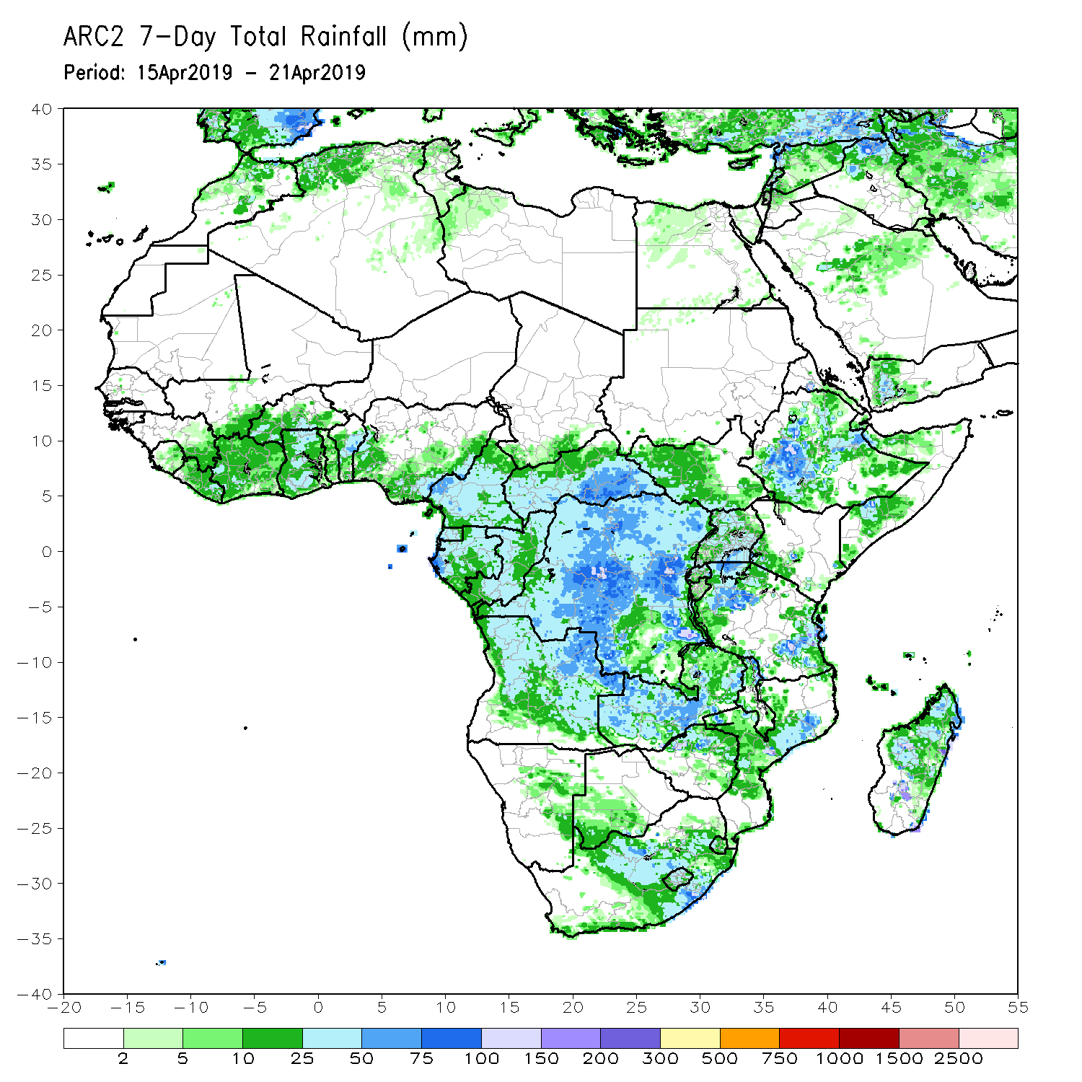
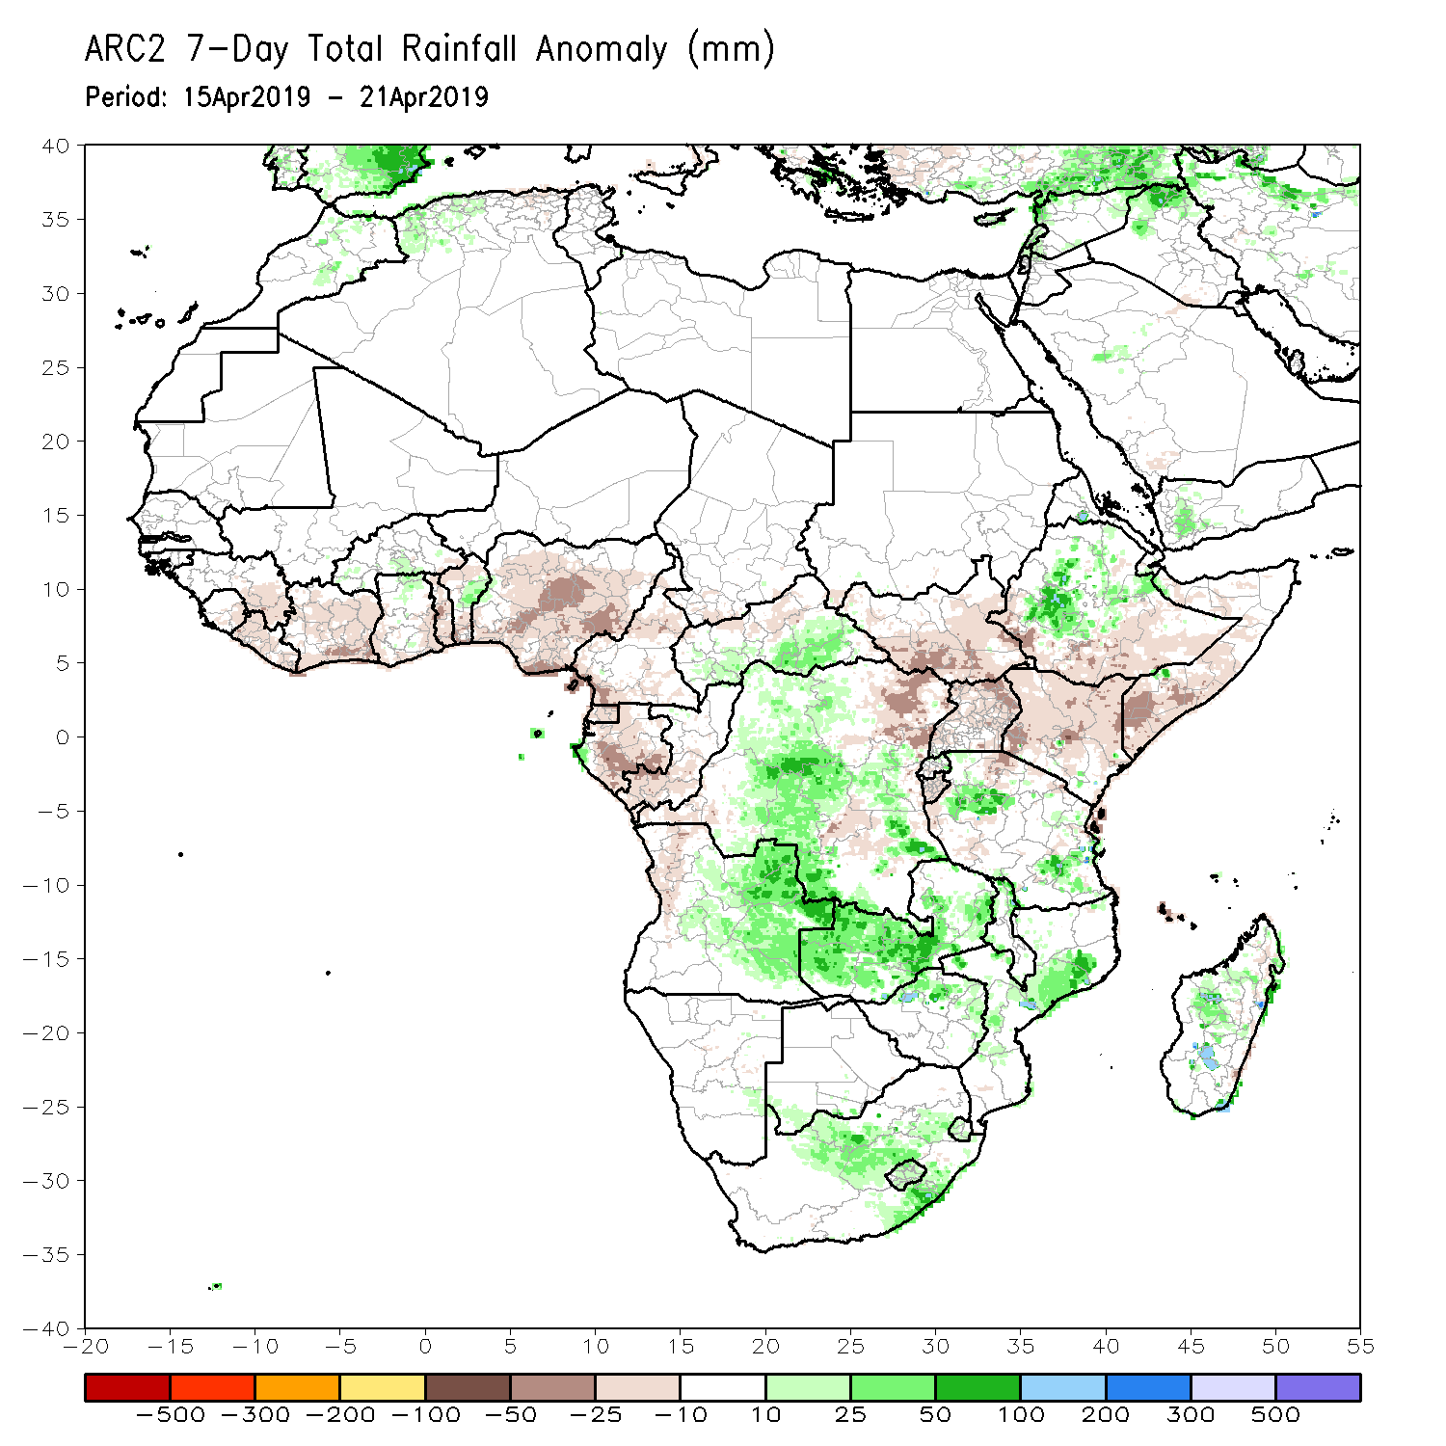
Rainfall Patterns: Last 7 Days
Heavy rainfall fell over areas of northeastern Angola, central DRC, eastern CAR, western and eastern Tanzania, western Ethiopia, and northern Mozambique, while suppressed rainfall continued over much of Kenya and southeastern Ethiopia.
Above-average rainfall was observed over parts of CAR, DRC, eastern Angola, Zambia, central South Africa, western Ethiopia, parts of Tanzania, and central Madagascar.
Below-average rainfall was observed over areas of Cote d’Ivoire, Togo, Nigeria, Cameroon, Equatorial Guinea, Gabon, eastern DRC, South Sudan, Uganda, Kenya, southern Ethiopia, and southern Somalia.

Slide 5
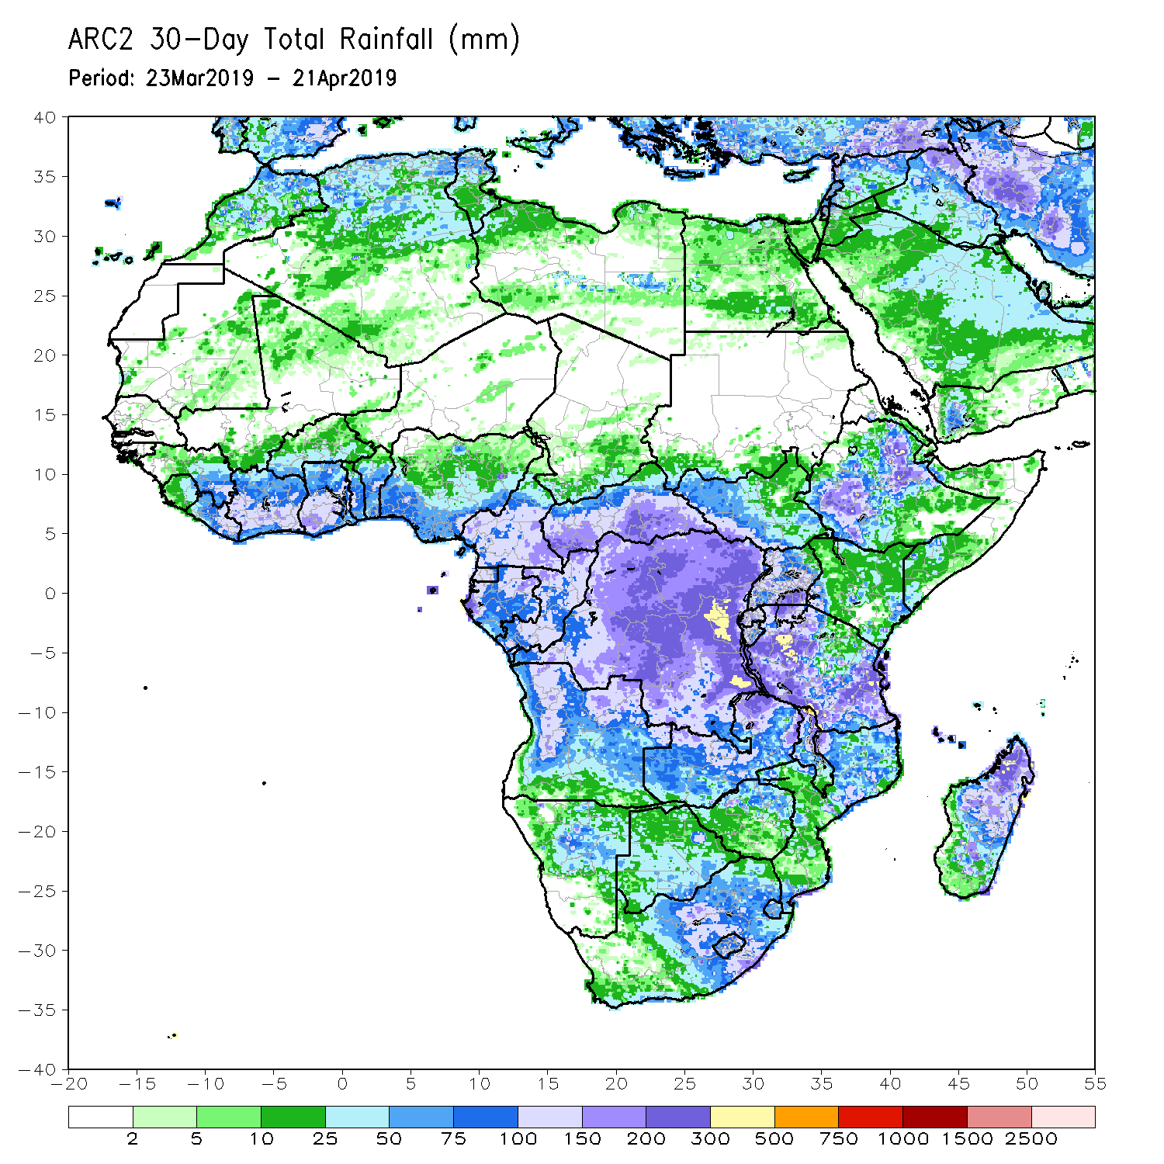
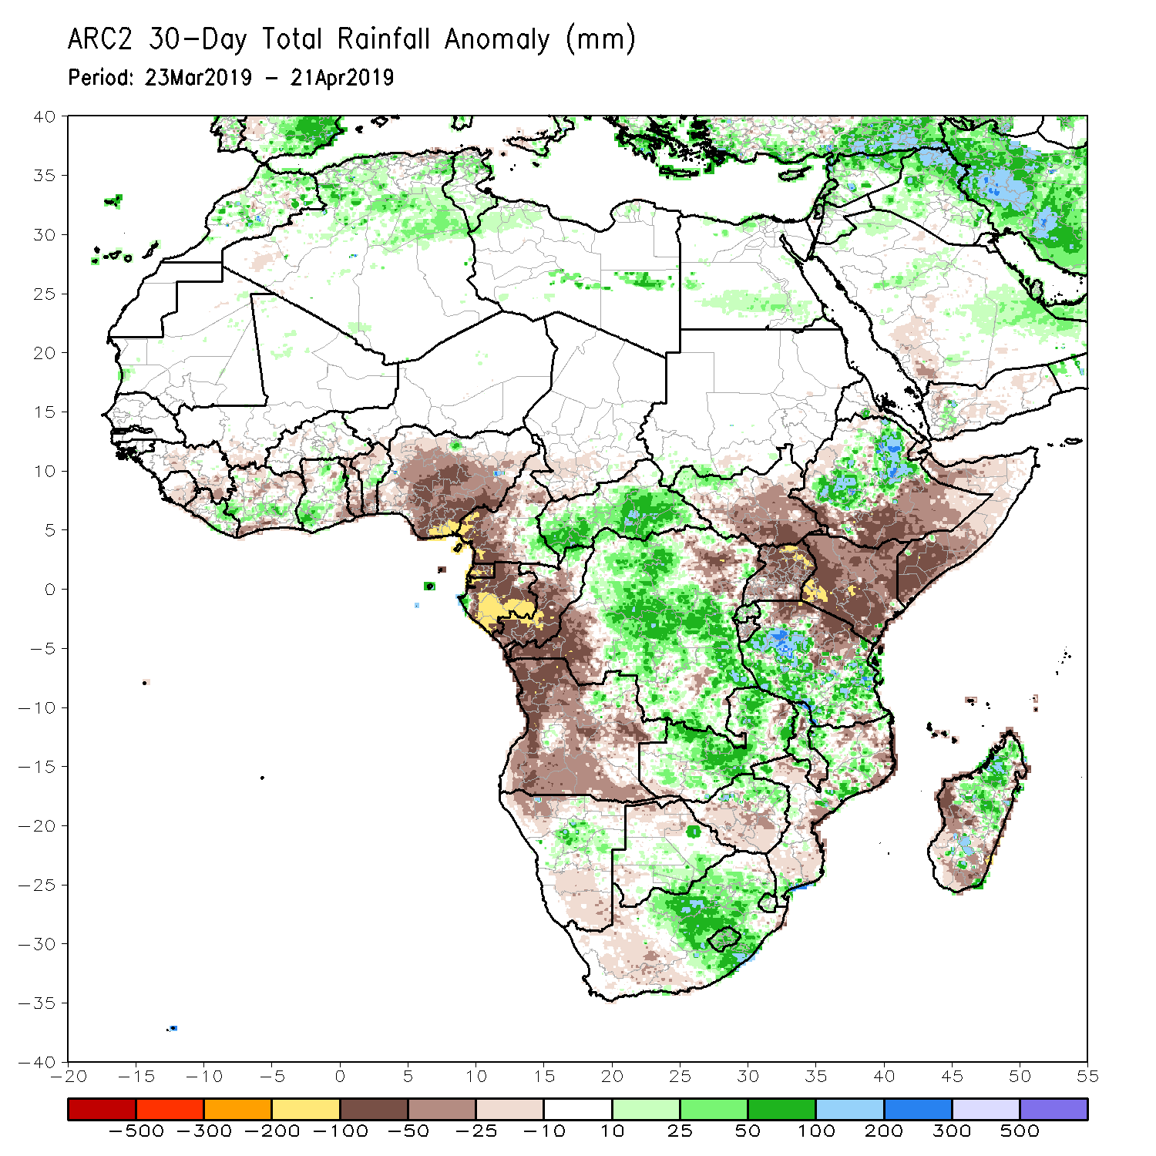
Rainfall Patterns: Last 30 Days
During the past 30 days, rainfall was above-average over parts of Liberia, Cote d’Ivoire, Ghana, Benin, CAR, DRC, Zambia, central Namibia, eastern South Africa, much of Tanzania, northern Ethiopia, and northern Madagascar.
Below-average rainfall was observed over the southern parts of Cote d’Ivoire, Ghana, Togo, Benin, much of Nigeria, western Cameroon, Equatorial Guinea, Gabon, Angola, western and eastern DRC, South Sudan, Uganda, Kenya, northern Tanzania, southern Ethiopia, southern Somalia, and parts of Madagascar.
Notes:
5

Slide 6
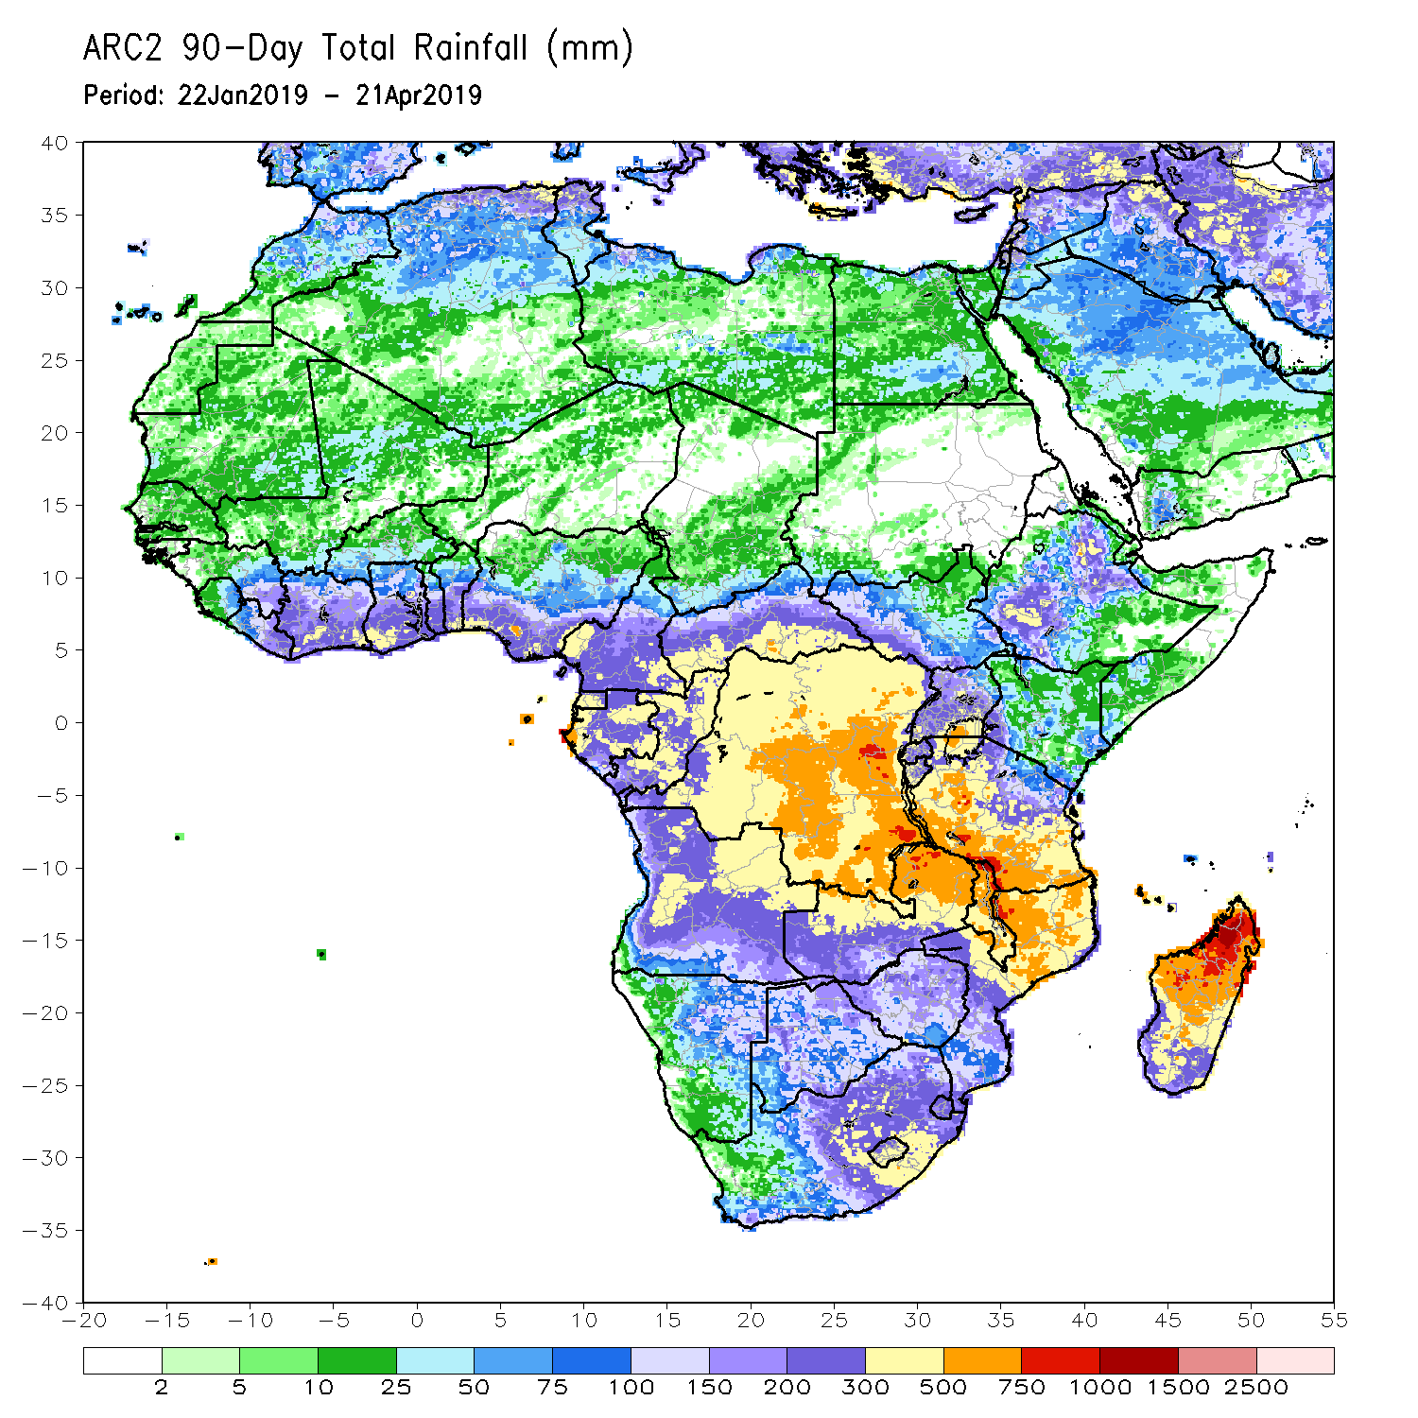
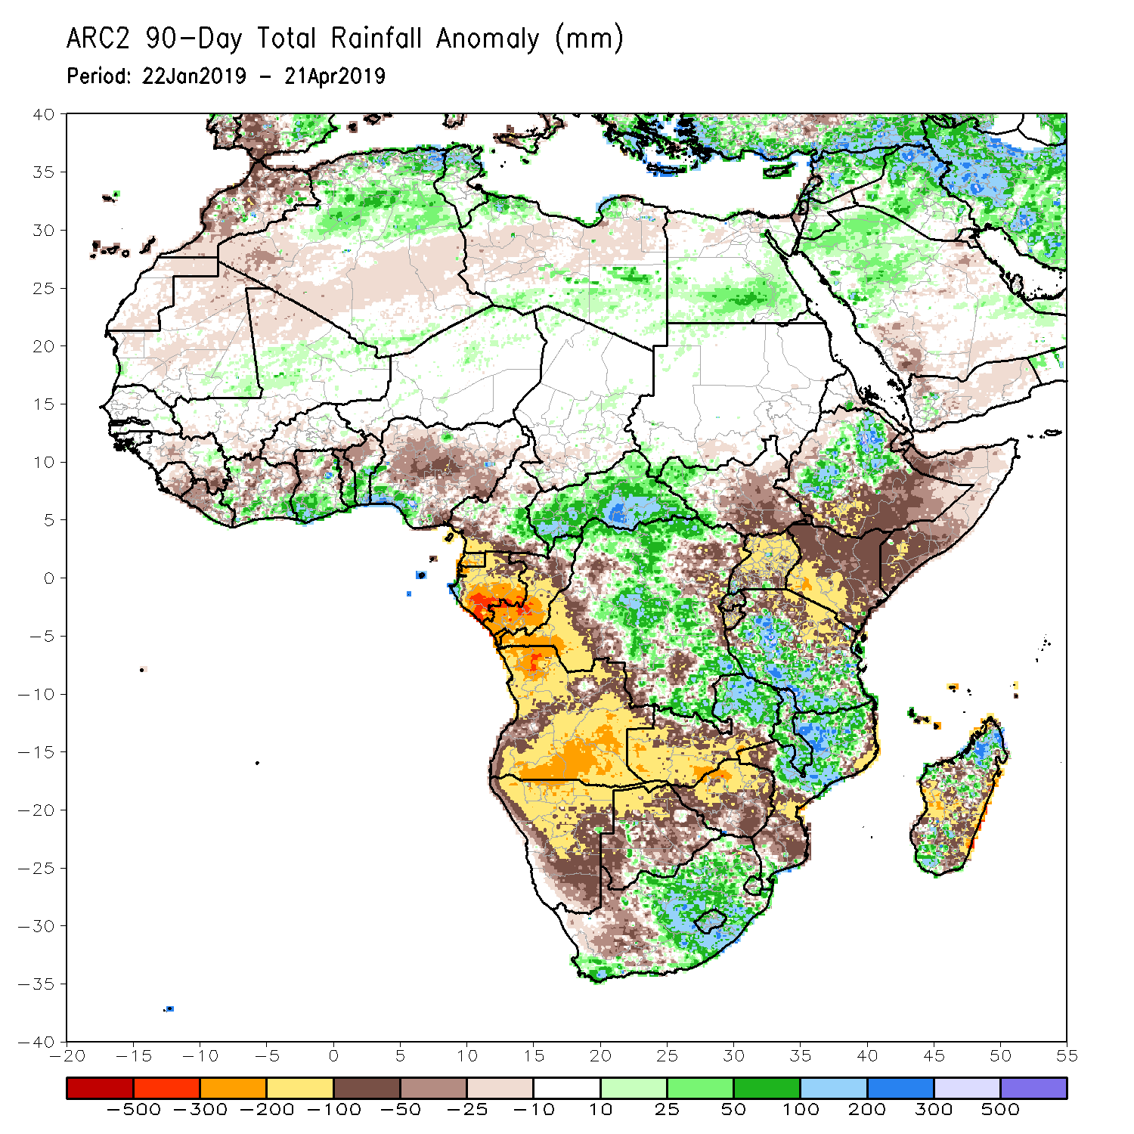
Rainfall Patterns: Last 90 Days
During the past 90 days, rainfall was above-average along the coastal areas of Cote d’Ivoire, Ghana, Togo, Benin, and southeastern Nigeria, CAR, many parts of DRC, eastern South Africa, western South Sudan, northern Zambia, Malawi, southern Tanzania, northern Mozambique, western and northeastern Ethiopia, and parts of Madagascar.
Below-average rainfall was registered over parts of Sierra Leone, western Liberia, parts of Cote d’Ivoire, areas of northern Ghana, northern Togo, northern Benin, much of Nigeria, parts of Cameroon, Equatorial Guinea, Gabon, Congo-Brazzaville, Angola, Namibia, western and eastern areas of DRC, southern Zambia, Botswana, Zimbabwe, Uganda, South Sudan, northern Tanzania, Kenya, southern Ethiopia, southern Somalia, and parts of Madagascar.
Notes:
6

Slide 7
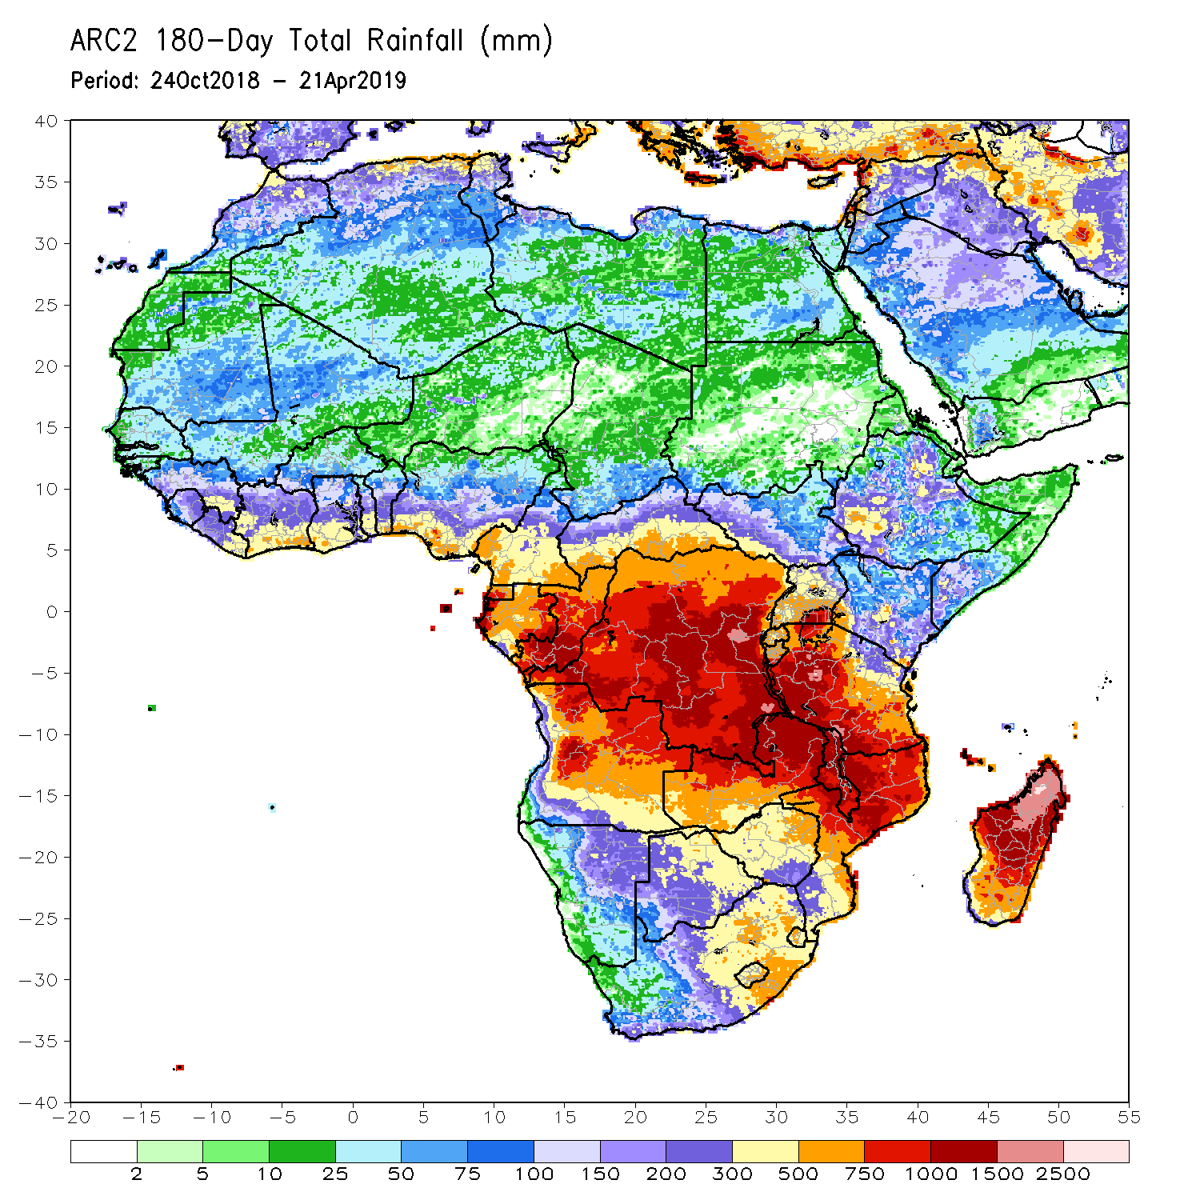
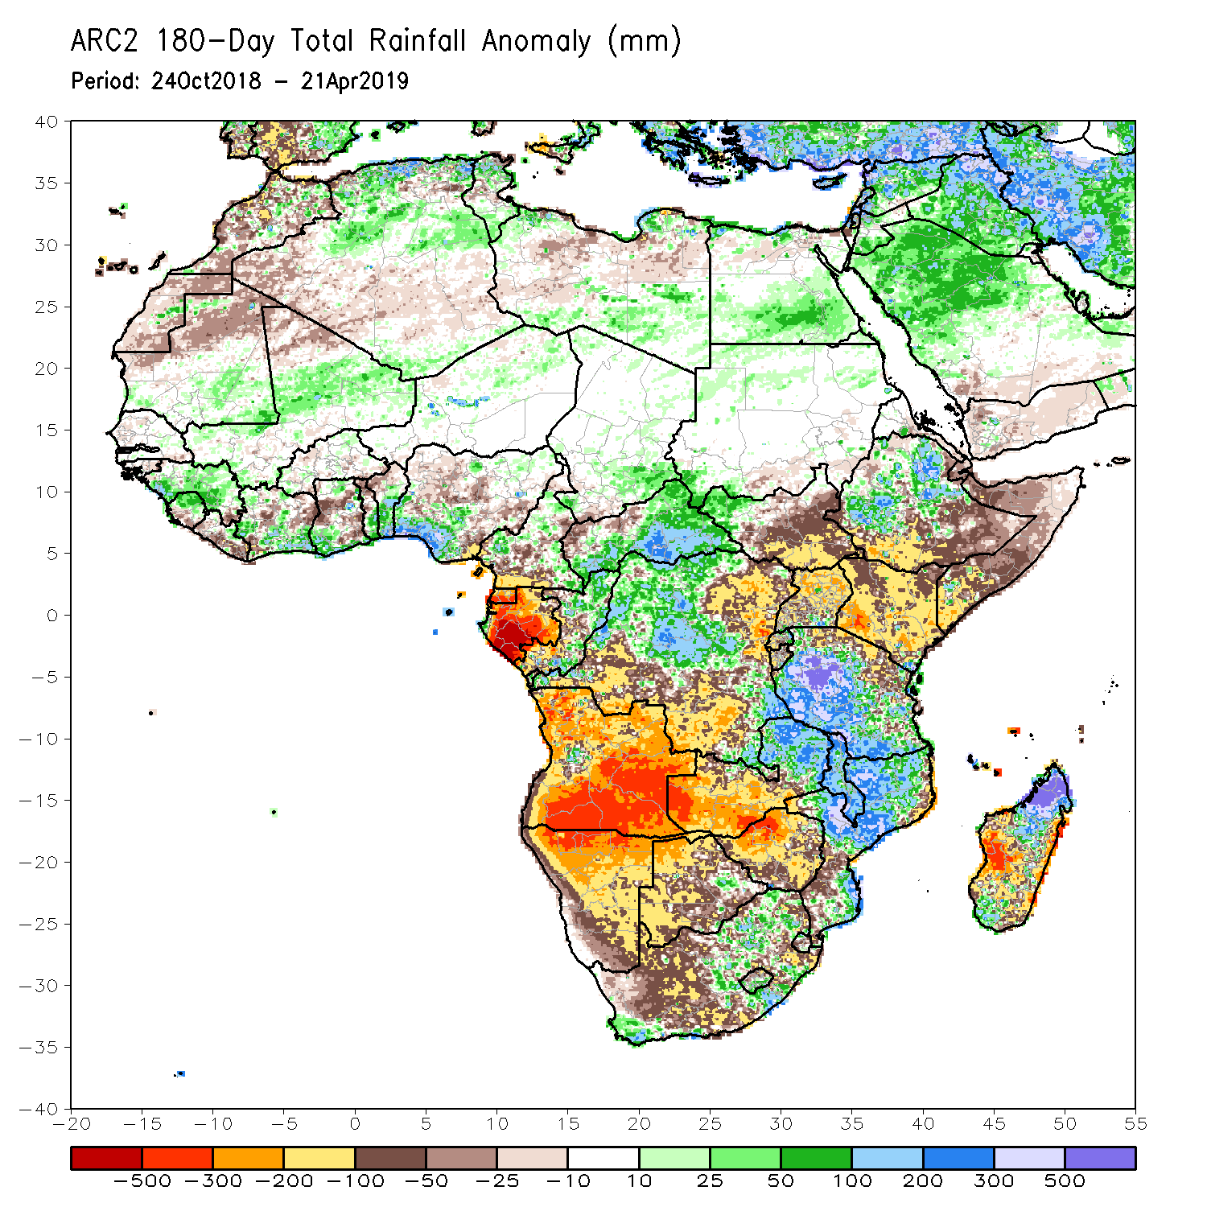
Rainfall Patterns: Last 180 Days
During the past 180 days, rainfall was above-average over parts of Mali, Guinea-Conakry, Sierra Leone, parts of Cote d’Ivoire, southern Ghana, Togo, Benin, southeastern Nigeria, parts of Cameroon, parts of eastern Chad, CAR, local areas in western South Sudan, portions of Ethiopia, much of Tanzania, many parts of Congo-Brazzaville, many parts of northern DRC, local areas in South Africa, eastern Zambia, Malawi, many parts of Mozambique, and portions of Madagascar.
Below-average rainfall was observed over central Liberia, local areas in Cote d’Ivoire, portions of Ghana, parts of Nigeria and Cameroon, Equatorial Guinea, Gabon, northwestern CAR, southern DRC, many parts of South Sudan, portions of Ethiopia, Somalia, Uganda, Kenya, many parts of Angola and Namibia, western Zambia, many parts of Botswana, Zimbabwe, many parts of South Africa, local areas in Mozambique, and portions of Madagascar.
Notes:
7

Slide 8
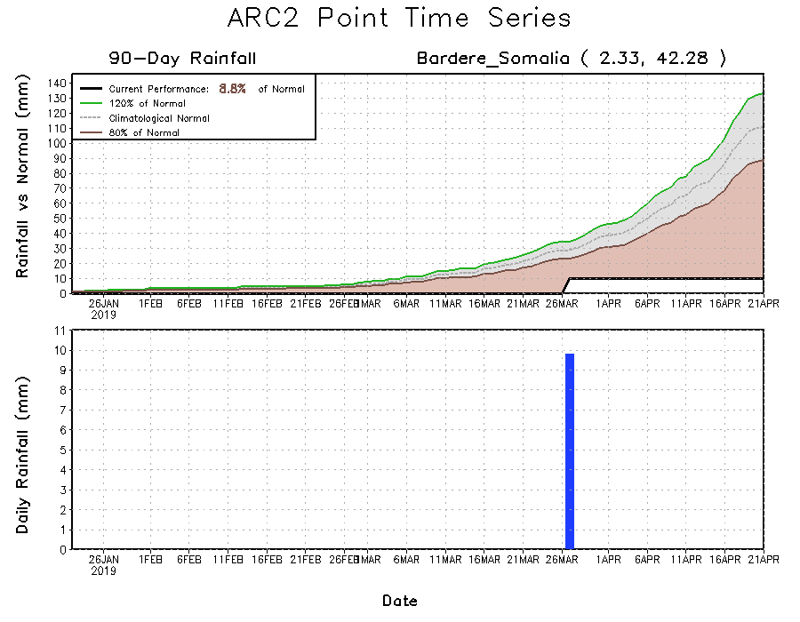
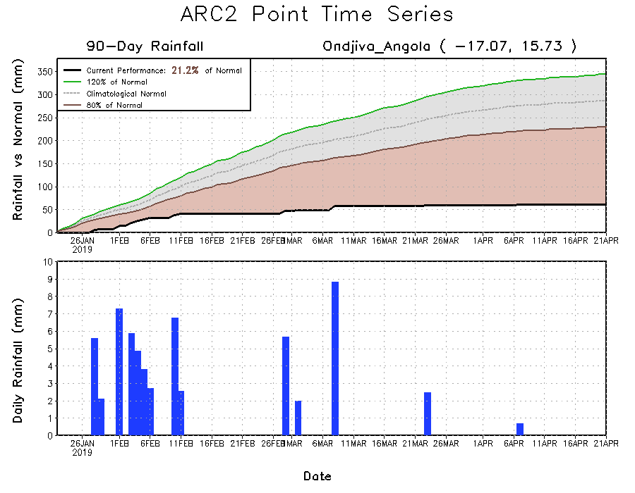
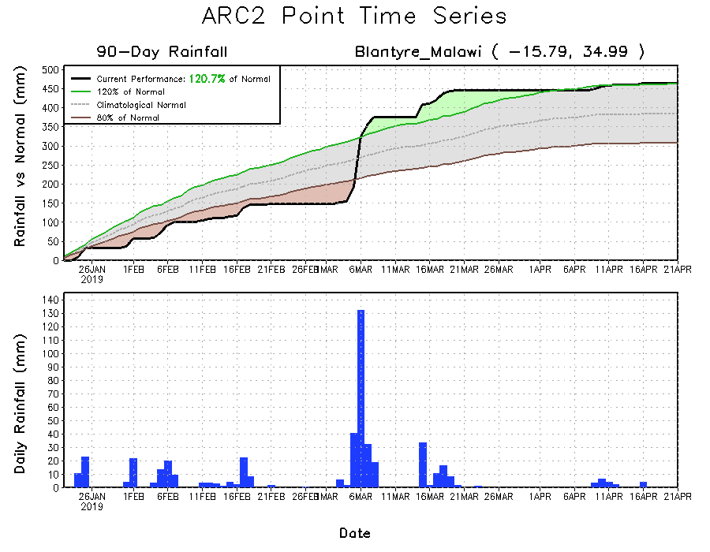
Recent Rainfall Evolution
Daily evolution of rainfall over the last 90 days at selected locations shows that seasonal total rainfall remained below-average over southern Angola (bottom left panel) and southern Somalia (top right). In contrast, seasonal total rainfall remained above-average over parts of southern Malawi (bottom right).

Slide 9
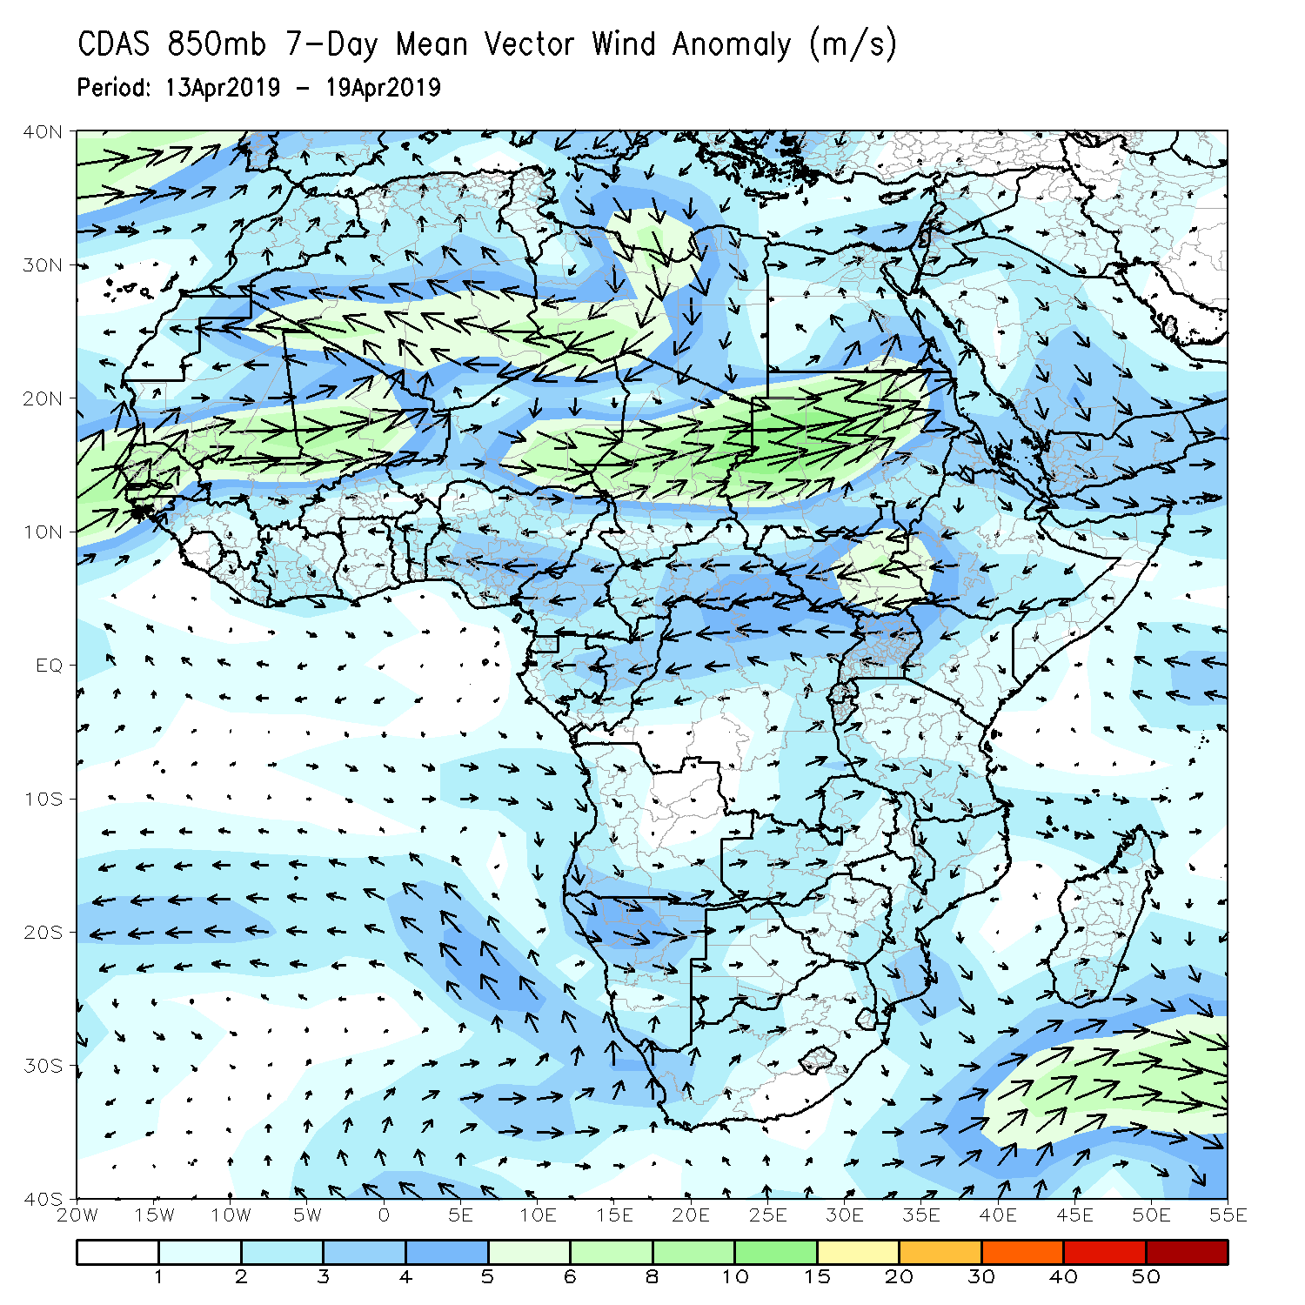
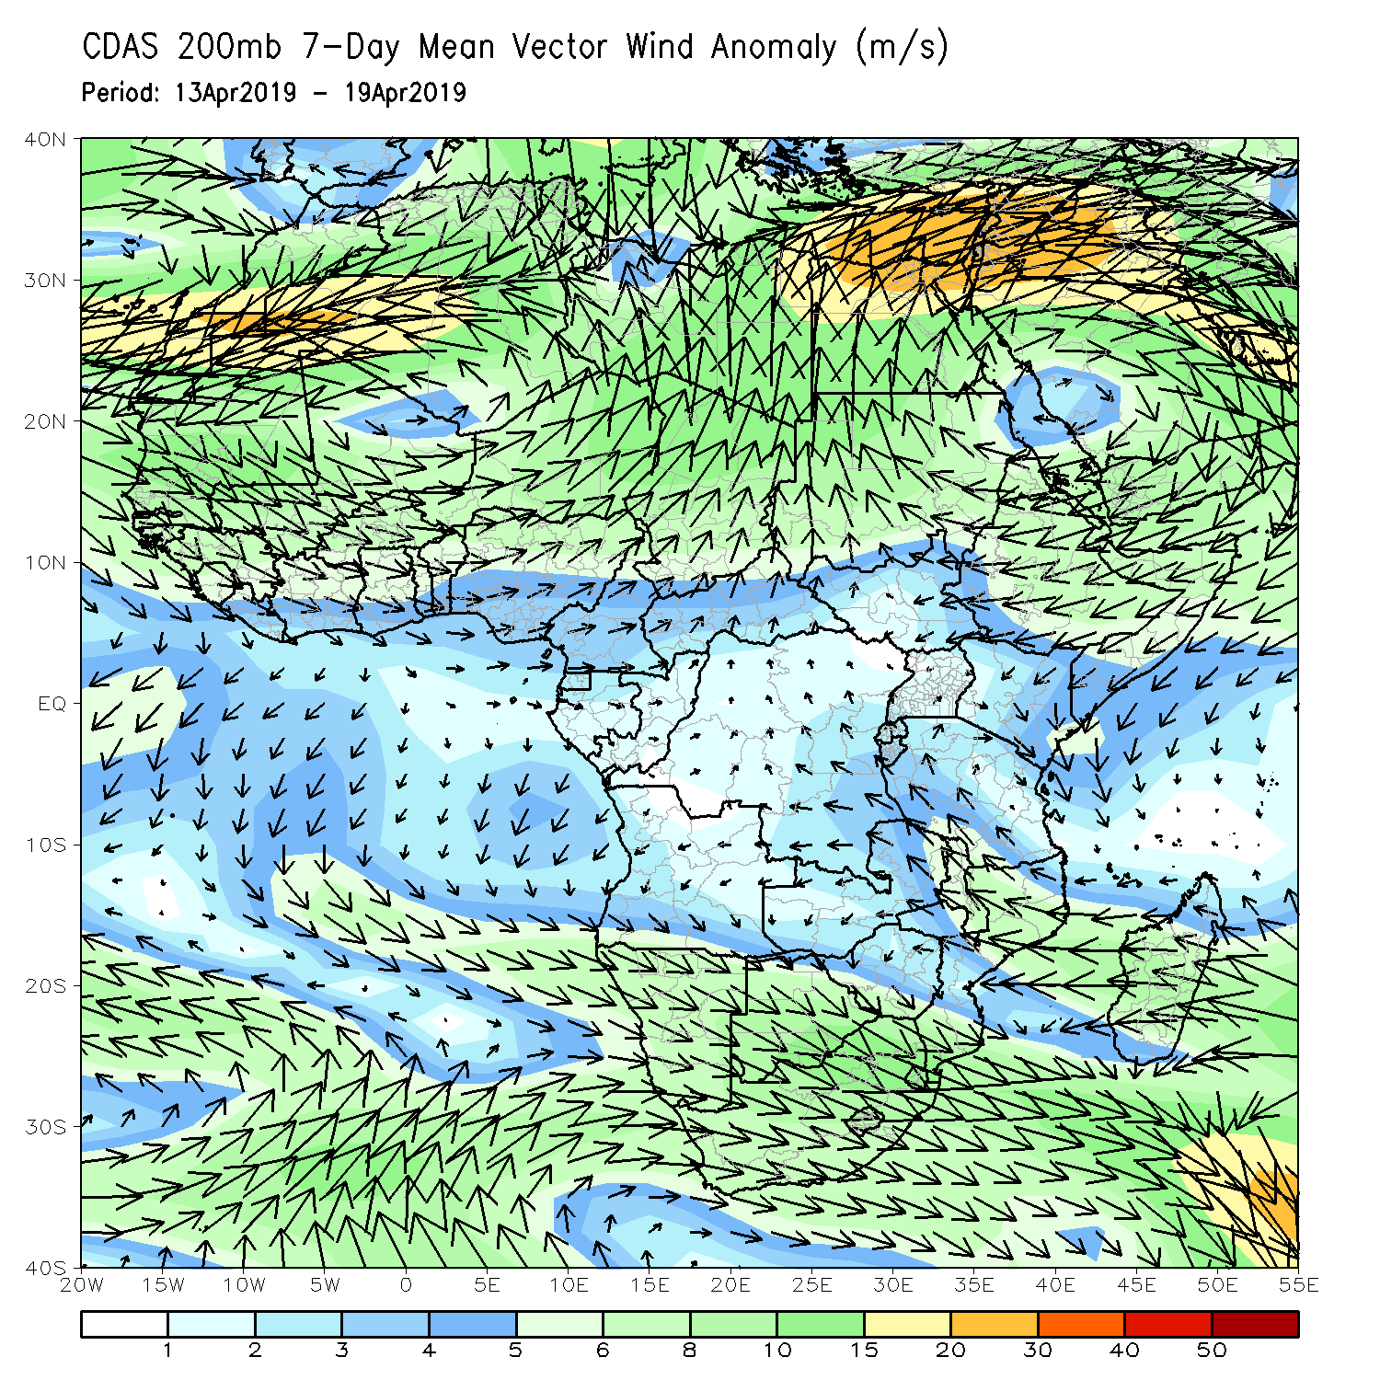
Atmospheric Circulation: Last 7 Days
Anomalous lower-level convergence (left panel), coupled with upper-level divergence was observed across central southern Africa, which may have contributed to the observed rainfall surpluses in the region.

Slide 10
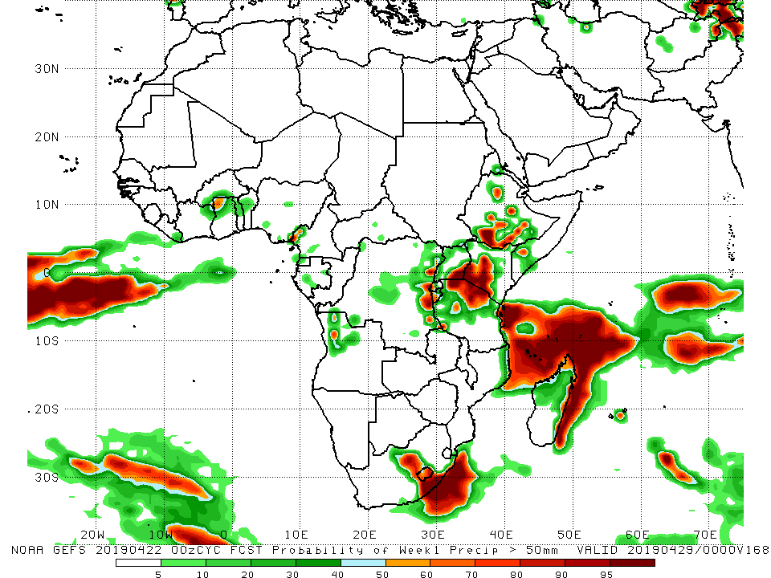
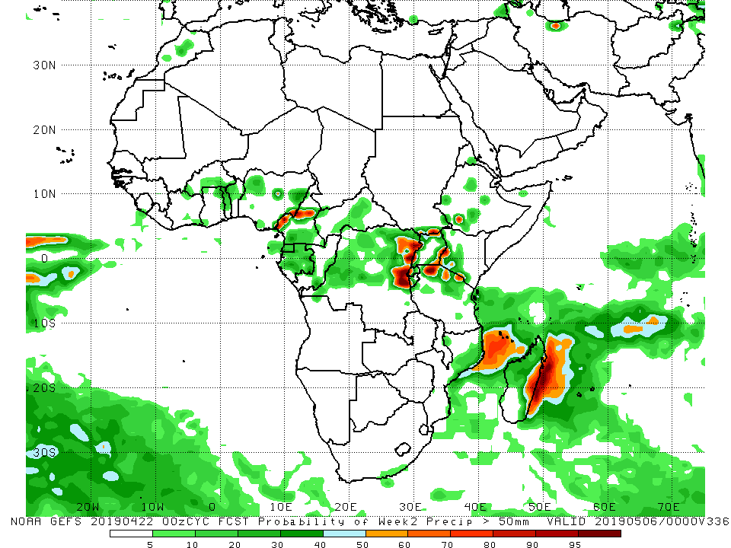
NCEP GEFS Model Forecasts Non-Bias Corrected Probability of precipitation exceedance
Week-1: Valid 23 – 29 April, 2019
Week-2: Valid 30 April – 6 May, 2019
For week-1 (left panel), there is an increased chance for weekly rainfall totals to exceed 50 mm over central South Africa and Lesotho, eastern DRC, northwestern Tanzania and southwestern Kenya, southern Ethiopia, and coastal areas of Tanzania, northern Mozambique, and eastern Madagascar.
For week-2 (left panel), there is an increased chance for weekly rainfall totals to exceed 50 mm over eastern DRC, northern Tanzania, and along coastal areas of eastern Madagascar.
Notes:
10

Slide 11
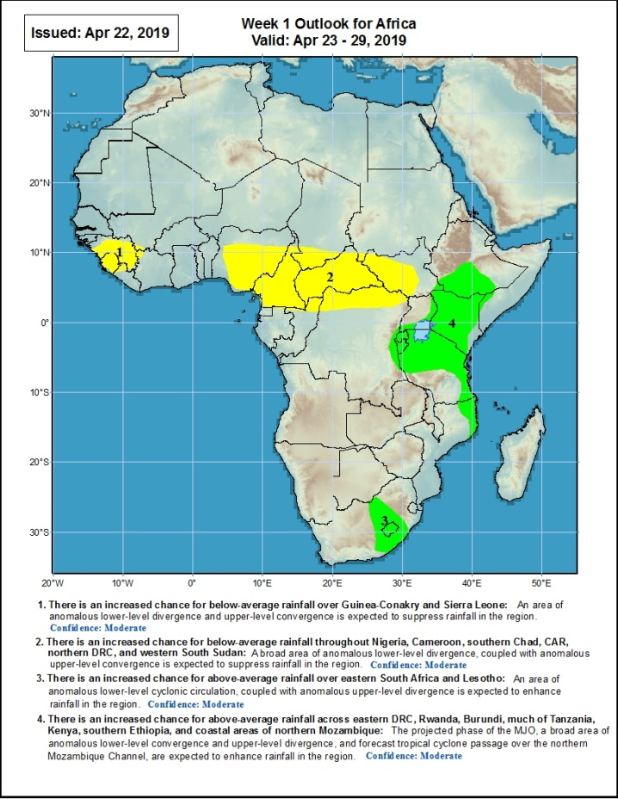
Week-1 Precipitation Outlooks
There is an increased chance for below-average rainfall over Guinea-Conakry and Sierra Leone: An area of anomalous lower-level divergence and anomalous upper-level convergence is expected to suppress rainfall in the region. Confidence: Moderate
There is an increased chance for below-average rainfall across Nigeria, Cameroon, southern Chad, CARD, northern DRC, and western South Sudan: A broad area of anomalous lower-level divergence, coupled with anomalous upper-level convergence is expected to suppress rainfall in the region. Confidence: Moderate
There is an increased chance for above-average rainfall over eastern South Africa and Lesotho: An area of anomalous lower-level cyclonic circulation, coupled with anomalous upper-level divergence is expected to enhance rainfall in the region. Confidence: Moderate
There is an increased chance for above-average rainfall across eastern DRC, Rwanda, Burundi, much of Tanzania, Kenya, southern Ethiopia, and coastal areas of northern Mozambique: The projected phase of the MJO, a broad area of anomalous lower-level convergence and anomalous upper-level divergence, and forecast tropical cyclone passage over the northern Mozambique Channel are expected to enhance rainfall in the region. Confidence: Moderate
23 – 29 April, 2019
Notes:
11

Slide 12
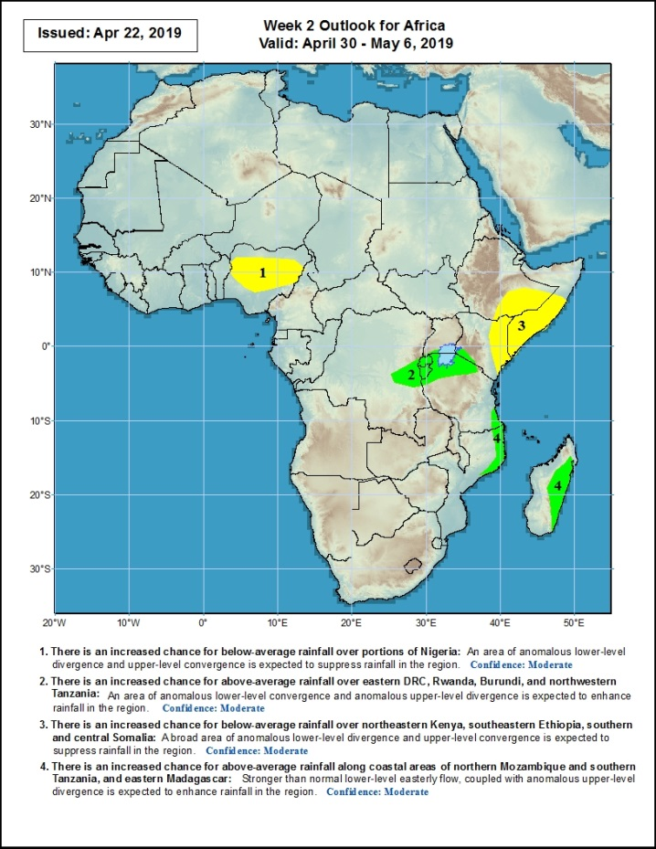
Week-2 Precipitation Outlooks
30 April – 6 May, 2019
There is an increased chance for below-average rainfall over portions of Nigeria: An area of anomalous lower-level divergence and anomalous upper-level convergence is expected to suppress rainfall in the region. Confidence: Moderate
There is an increased chance for above-average rainfall over eastern DRC, Rwanda, Burundi, and northwestern Tanzania: An area of anomalous lower-level convergence and anomalous upper-level divergence is expected to enhance rainfall in the region. Confidence: Moderate
There is an increased chance for below-average rainfall over northeastern Kenya and the southern and central parts of Somalia: A broad area of anomalous lower-level divergence and anomalous upper-level convergence is expected to suppress rainfall in the region. Confidence: Moderate
There is an increased chance for above-average rainfall over along coastal areas of northern Mozambique and southern Tanzania, and eastern Madagascar: Stronger than normal lower-level easterly flow, coupled with anomalous upper-level divergence is expected to enhance rainfall in the region. Confidence: Moderate
Notes:
12

Slide 13
Summary
Heavy rainfall fell over areas of northeastern Angola, central DRC, eastern CAR, western and eastern Tanzania, western Ethiopia, and northern Mozambique, while suppressed rainfall continued over much of Kenya and southeastern Ethiopia. Above-average rainfall was observed over parts of CAR, DRC, eastern Angola, Zambia, central South Africa, western Ethiopia, parts of Tanzania, and central Madagascar. Below-average rainfall was observed over areas of Cote d’Ivoire, Togo, Nigeria, Cameroon, Equatorial Guinea, Gabon, eastern DRC, South Sudan, Uganda, Kenya, southern Ethiopia, and southern Somalia.
During the past 30 days, rainfall was above-average over parts of Liberia, Cote d’Ivoire, Ghana, Benin, CAR, DRC, Zambia, central Namibia, eastern South Africa, much of Tanzania, northern Ethiopia, and northern Madagascar. Below-average rainfall was observed over the southern parts of Cote d’Ivoire, Ghana, Togo, Benin, much of Nigeria, western Cameroon, Equatorial Guinea, Gabon, Angola, western and eastern DRC, South Sudan, Uganda, Kenya, northern Tanzania, southern Ethiopia, southern Somalia, and parts of Madagascar.
During the past 90 days, rainfall was above-average along the coastal areas of Cote d’Ivoire, Ghana, Togo, Benin, and southeastern Nigeria, CAR, many parts of DRC, eastern South Africa, western South Sudan, northern Zambia, Malawi, southern Tanzania, northern Mozambique, western and northeastern Ethiopia, and parts of Madagascar. Below-average rainfall was registered over parts of Sierra Leone, western Liberia, parts of Cote d’Ivoire, areas of northern Ghana, northern Togo, northern Benin, much of Nigeria, parts of Cameroon, Equatorial Guinea, Gabon, Congo-Brazzaville, Angola, Namibia, western and eastern areas of DRC, southern Zambia, Botswana, Zimbabwe, Uganda, South Sudan, northern Tanzania, Kenya, southern Ethiopia, southern Somalia, and parts of Madagascar.
Week-1 outlooks call for an increased chance for above-average rainfall over Rwanda, Burundi, Kenya, southern Ethiopia, much of Tanzania, and coastal areas of northern Mozambique. In contrast, there is an increased chance for below-average rainfall over Guinea-Conakry, Sierra Leone, Nigeria, Cameroon, CAR, southern Chad, northern DRC, and western South Sudan.
Notes:
13

