Slide 1
The African Monsoon Recent Evolution and Current Status Include Week-1 and Week-2 Outlooks
Update prepared by
Climate Prediction Center / NCEP
8 July 2019
For more information, visit:
http://www.cpc.ncep.noaa.gov/products/Global_Monsoons/African_Monsoons/precip_monitoring.shtml

Slide 2
Outline
Highlights
Recent Evolution and Current Conditions
NCEP GEFS Forecasts
Summary

Slide 3
Highlights: Last 7 Days
Stronger than average lower-level, westerly flow brought heavy downpours over Guinea-Bissau, Guinea-Conakry, western Mali, Burkina Faso, Ghana, Togo, and Benin.
Week-1 outlooks call for an increased chance for above-average rainfall over Guinea-Conakry, Sierra Leone, southern Mali, parts of Cote d’Ivoire and Burkina Faso, much of Nigeria, northern Cameroon, northeastern CAR, parts of Chad, Sudan, and South Sudan, northeastern DRC, Uganda, and southwestern Kenya.

Slide 4
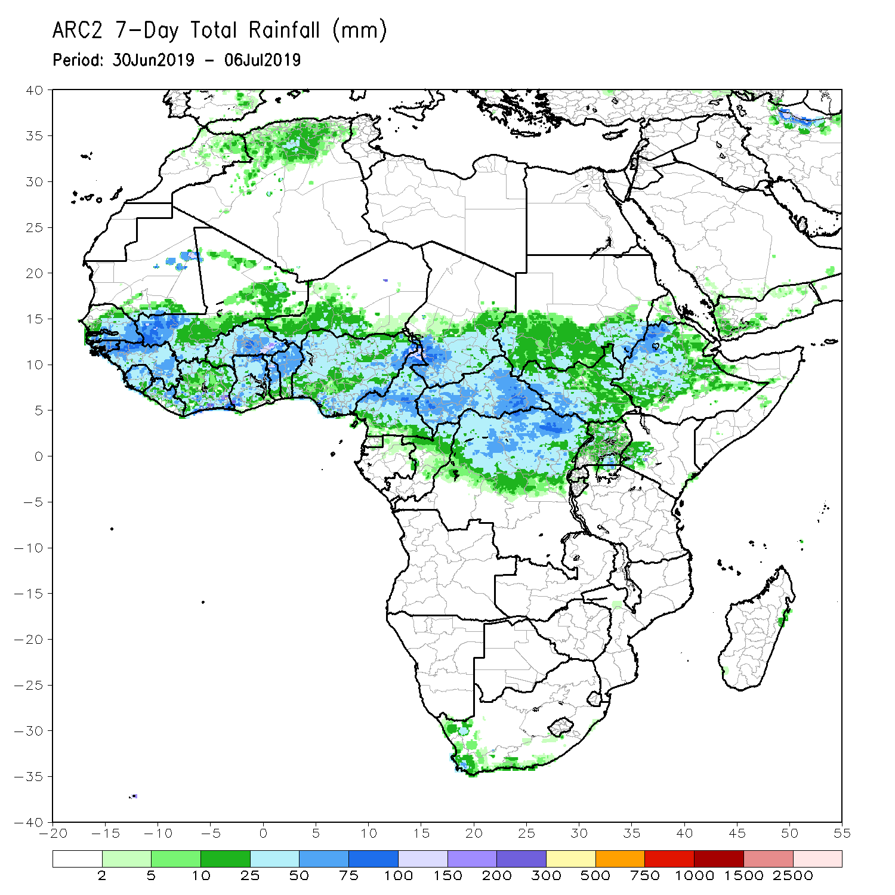
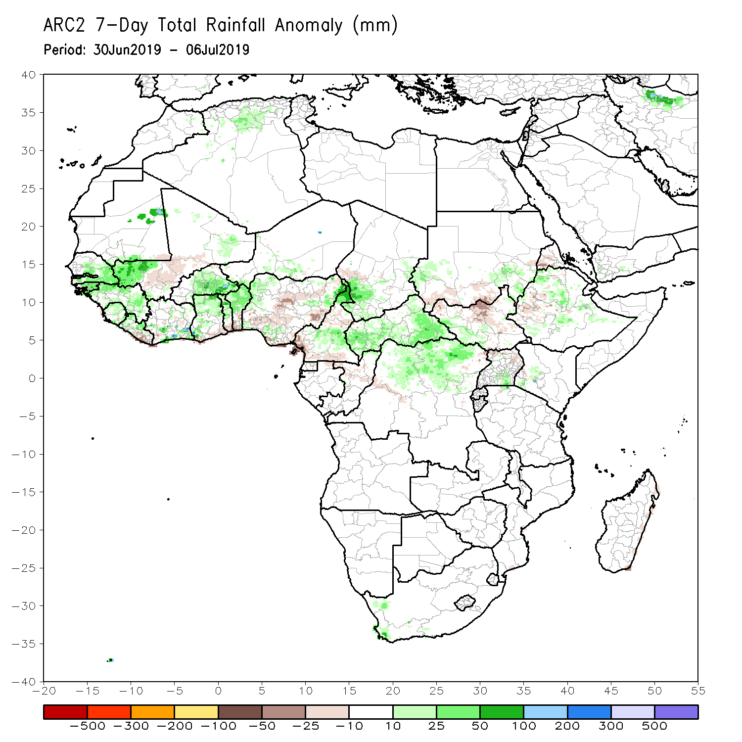
Rainfall Patterns: Last 7 Days
Heavy rainfall fell over Guinea-Bissau, northern Guinea-Conakry, eastern Senegal, western Mali, parts of Burkina Faso, Ghana, Togo, Benin, northern Cameroon, western Chad, CAR, northern DRC, and northwestern Ethiopia, while light to locally moderate rainfall was received over central Mali, the interior of Nigeria, South Sudan, and western Ethiopia.
Above-average rainfall was recorded over southern Senegal, Guinea-Bissau, northern Guinea-Conakry, western Mali, eastern Burkina Faso, parts of Ghana, Togo, Benin, central and northern Cameroon, western Chad, CAR, northern DRC, and parts of northwestern Ethiopia.
Below-average rainfall was observed over areas of central Mali, eastern Liberia, central Nigeria, South Sudan, and portions of western Ethiopia.

Slide 5
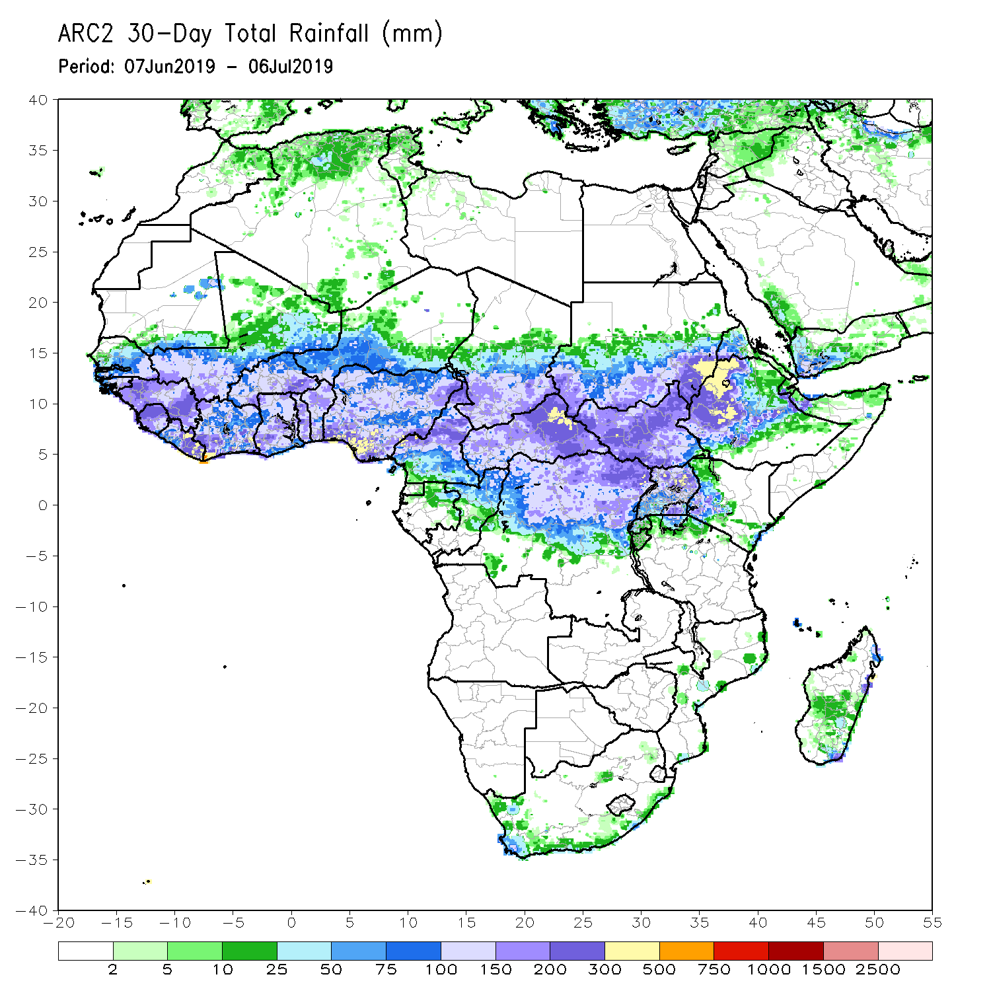
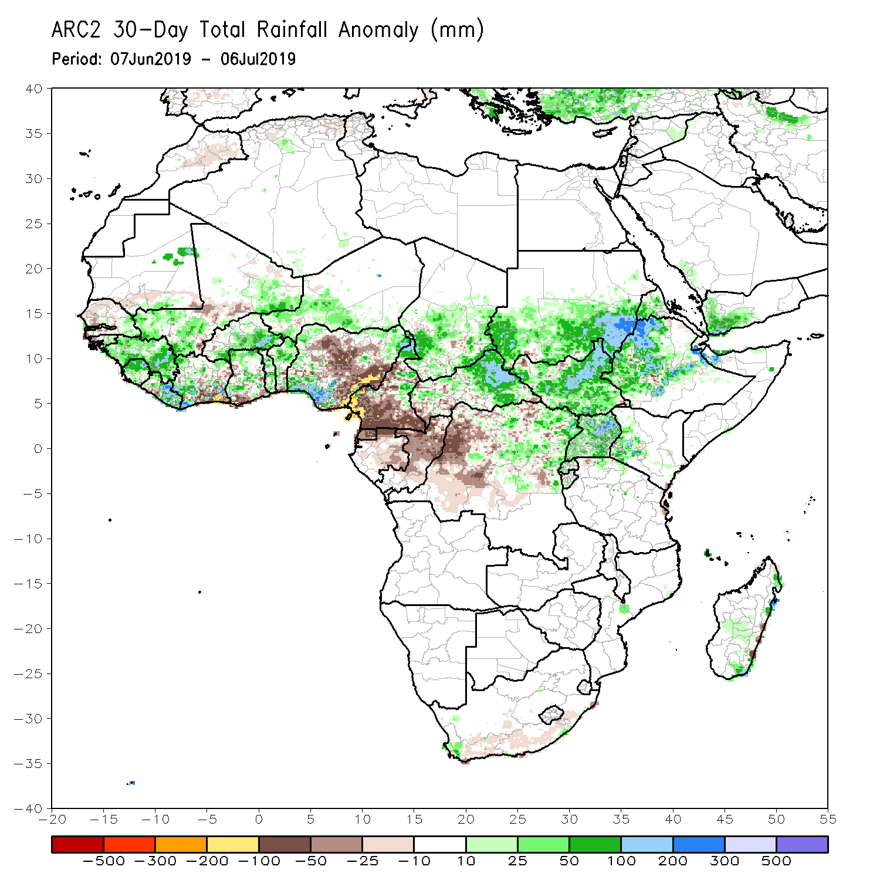
Rainfall Patterns: Last 30 Days
During the past 30 days, above-average rainfall was observed across Guinea-Bissau, Guinea-Conakry, Sierra Leone, Liberia, western Mali, southern Burkina Faso, much of Ghana, Togo, Benin, western Niger, western Nigeria, Chad, eastern CAR, Sudan, South Sudan, western Ethiopia, Eritrea, Uganda, and western Kenya.
In contrast, below-average rainfall was registered over parts of Senegal, central Mali, southern Cote-d’Ivoire, southern Ghana, central Nigeria, much of Cameroon, Congo-Brazzaville, and western DRC.
Notes:
5

Slide 6
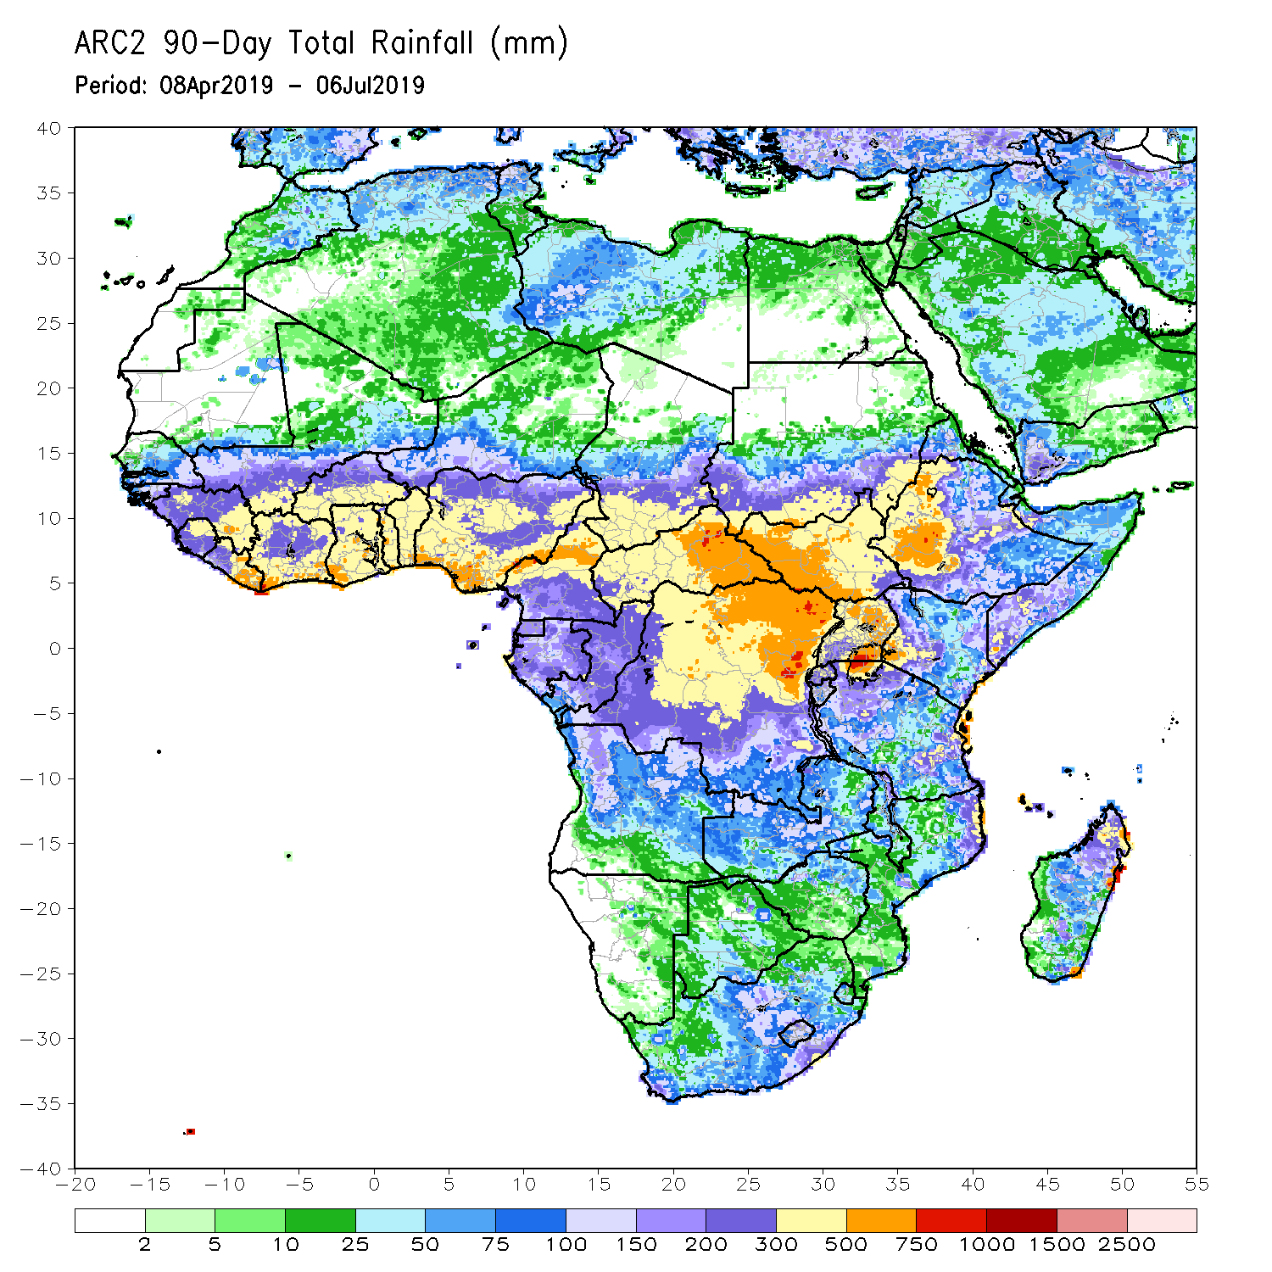
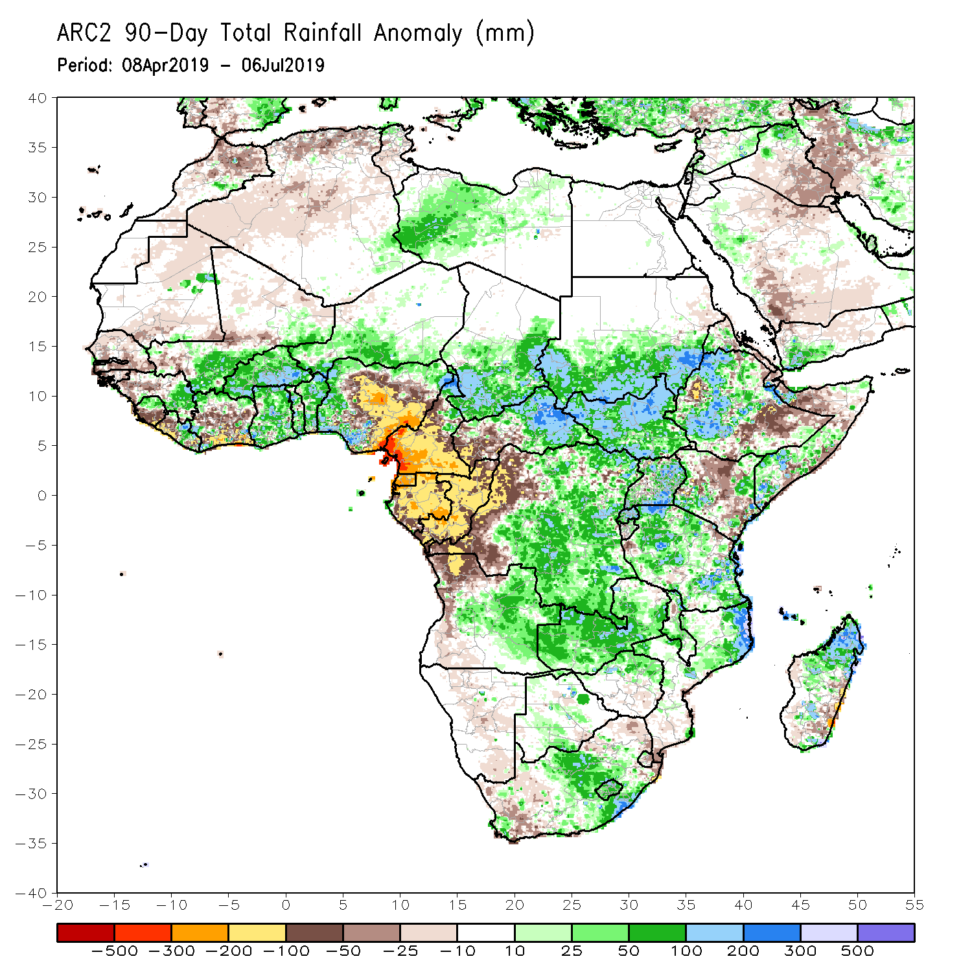
Rainfall Patterns: Last 90 Days
During the past 90 days, above-average rainfall spread over parts of Sierra Leone, eastern Guinea-Conakry, parts of Liberia, southern Mali, Burkina Faso, Ghana, Togo, Benin, western Nigeria, western and southern Niger, northern Cameroon, Chad, eastern CAR, southern Sudan, South Sudan, much of DRC, Uganda, western Ethiopia, southern Somalia, Tanzania, Zambia, eastern Angola, northern Mozambique, northern Madagascar, and central South Africa.
Below-average rainfall was registered over areas of Senegal, western Guinea Conakry, Sierra Leone, Liberia, Cote d’Ivoire, central Nigeria, Cameroon, Gabon, Equatorial Guinea, Congo-Brazzaville, western DRC, northwestern Angola, areas of Ethiopia, central Kenya, northern Somalia, areas of South Africa, and southeastern Madagascar.
Notes:
6

Slide 7
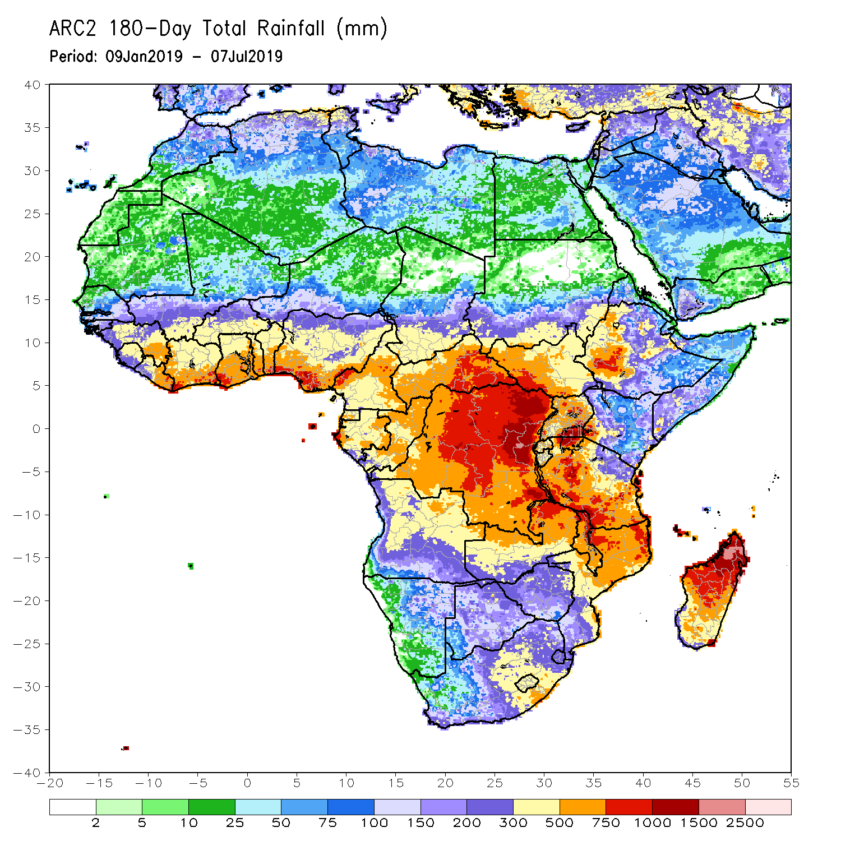
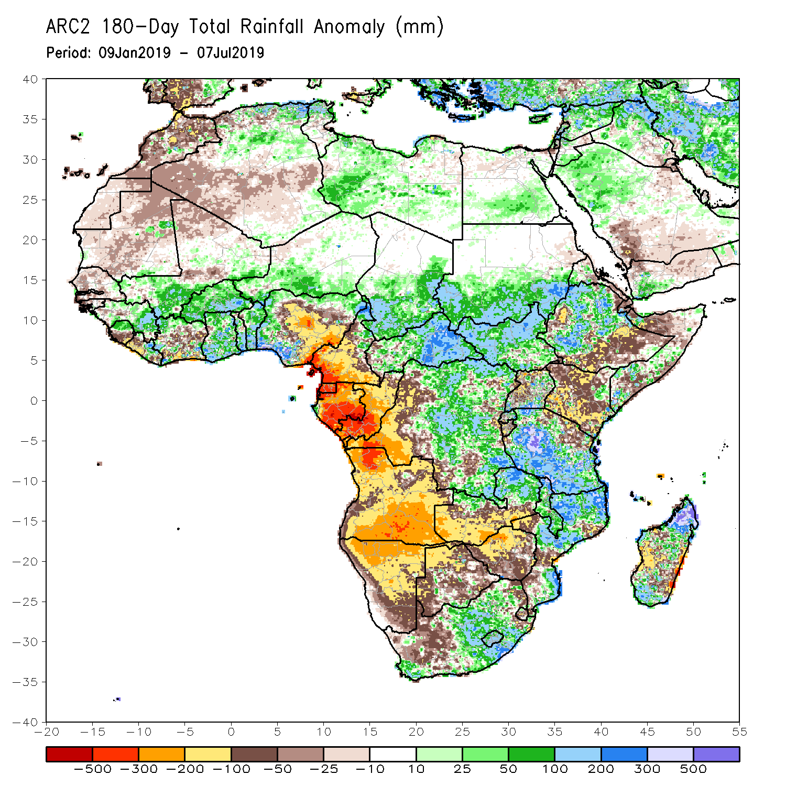
Rainfall Patterns: Last 180 Days
During the past 180 days, above-average rainfall was received over parts of Guinea-Conakry, Mali, much of Burkina Faso, Ghana, Togo, Benin, western and northern Nigeria, western and southern Niger, Chad, CAR, southern Sudan, South Sudan, eastern DRC, western Ethiopia, areas of Somalia, Tanzania, northern Zambia, Malawi, northern and southern Mozambique, central South Africa, and areas of Madagascar.
Below-average rainfall was observed over portions of Senegal, Sierra Leone, Liberia, Cote d’Ivoire, parts of Mali, central Nigeria, Cameroon, EQUATORIAL Guinea, Gabon, Congo-Brazzaville, western DRC, Angola, Namibia, southern Zambia, northern Botswana, Zimbabwe, central Mozambique, parts of South Africa, northern Tanzania, Kenya, areas of Somalia, and western Madagascar.
Notes:
7

Slide 8
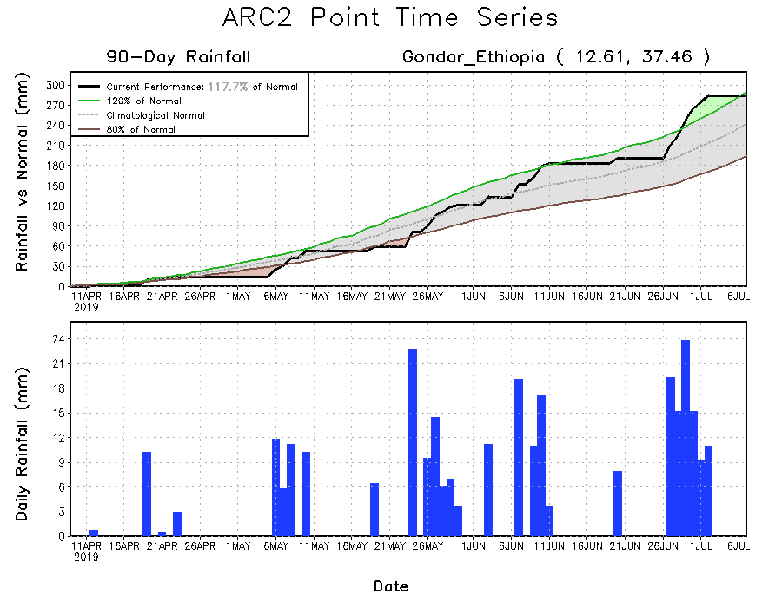
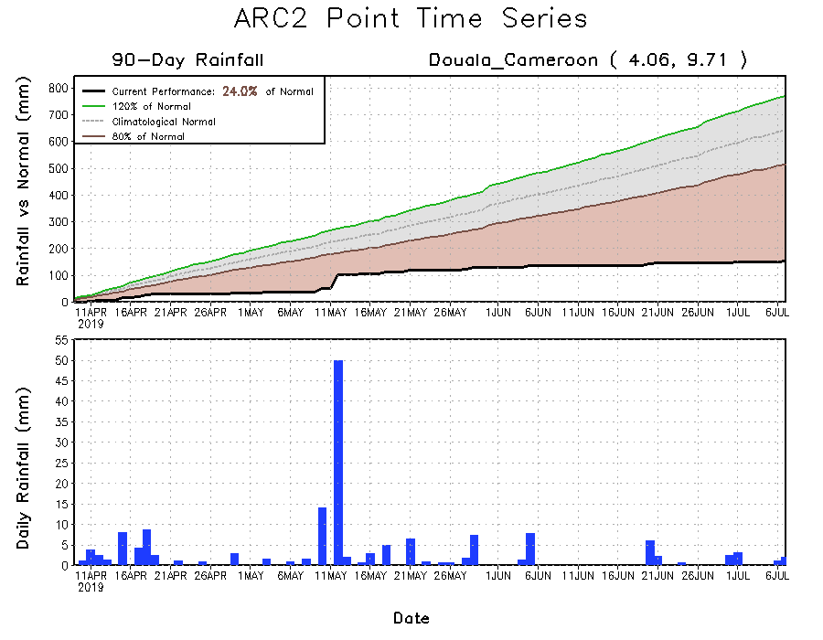
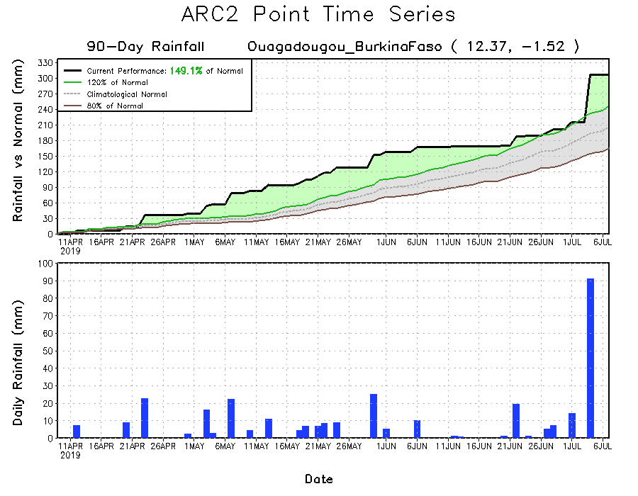
Recent Rainfall Evolution
Daily evolution of rainfall over the last 90 days at selected locations shows that seasonal rainfall totals remained above-average over central Burkina Faso (bottom right panel) and northwestern Ethiopia (top right). In contrast, seasonal rainfall totals remained well below-average over western Cameroon (bottom left).

Slide 9
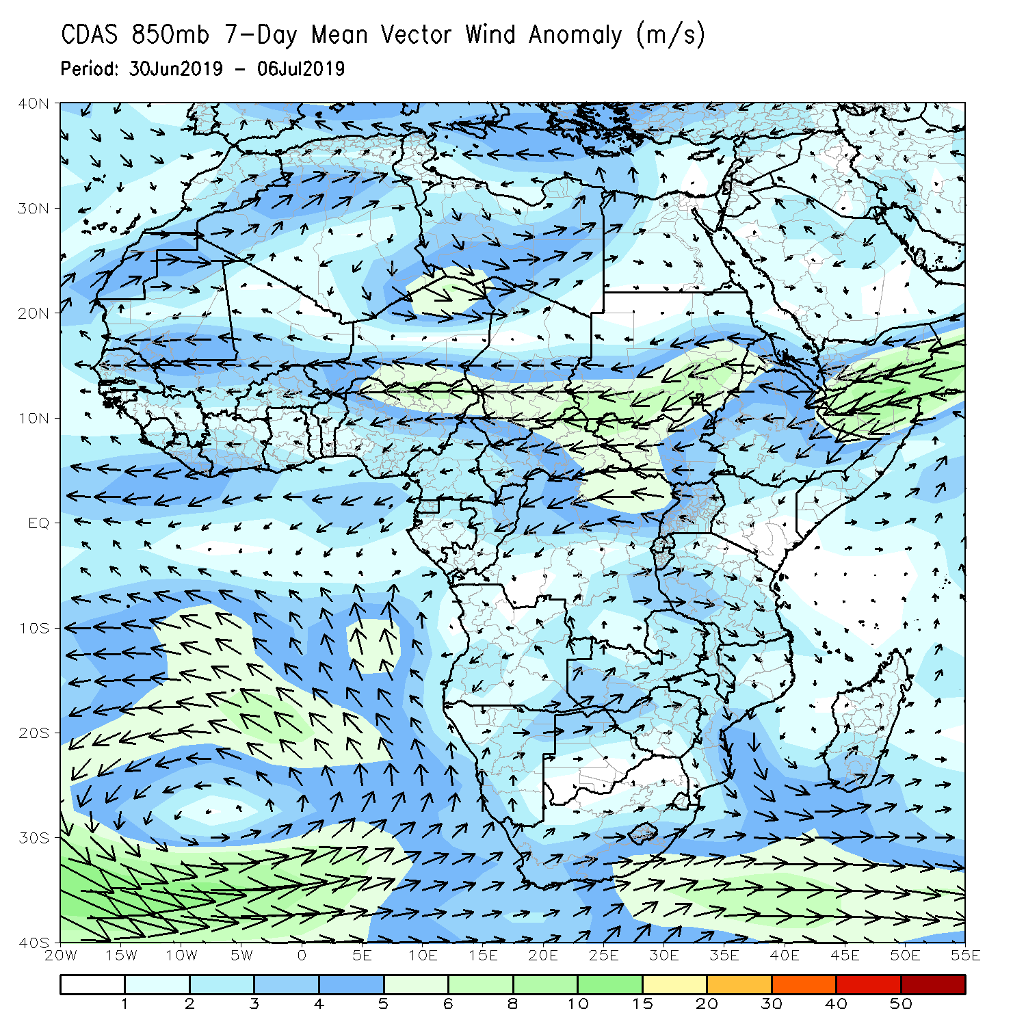
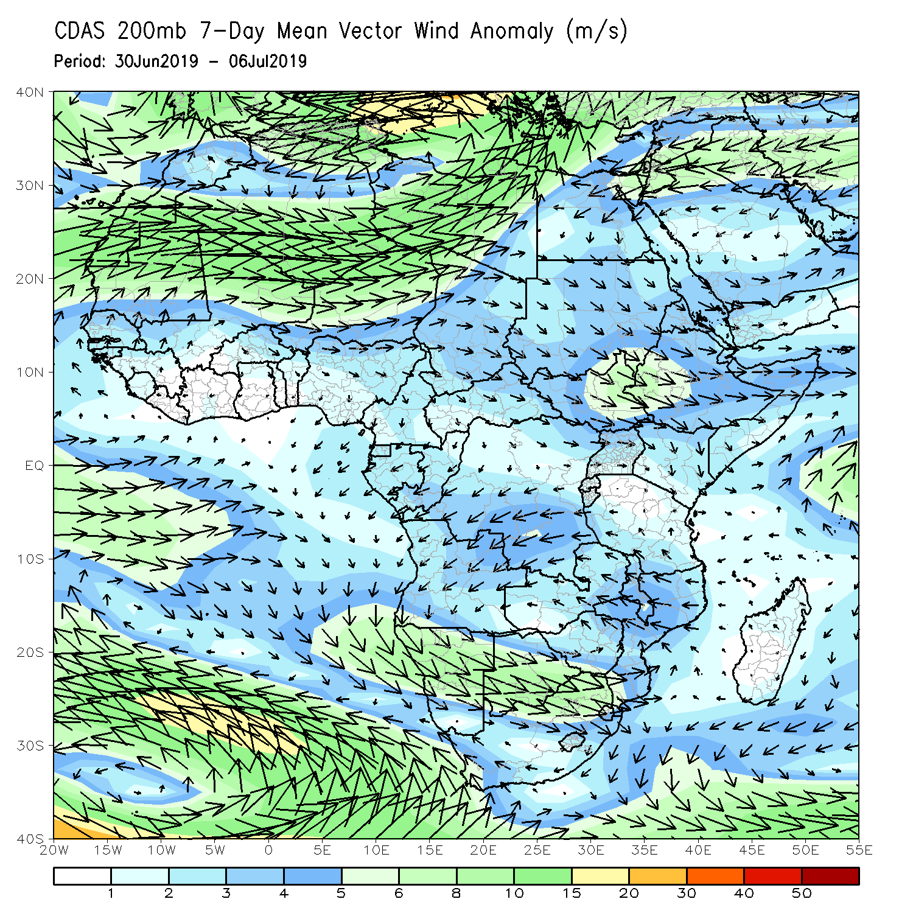
Atmospheric Circulation: Last 7 Days
Anomalous lower-level convergence (left panel), coupled with anomalous upper-level divergence was observed across West Africa and central Africa, which may have contributed to the observed rainfall surpluses in the region.

Slide 10
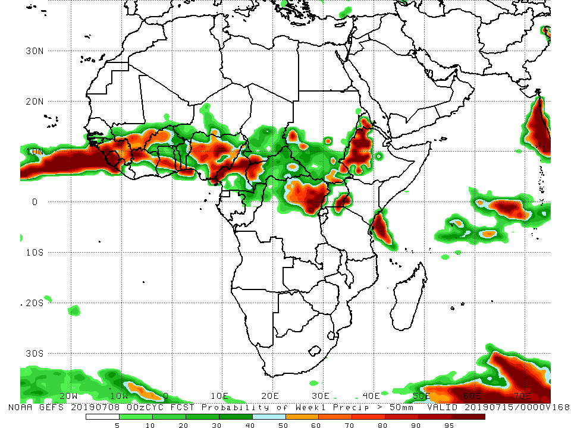
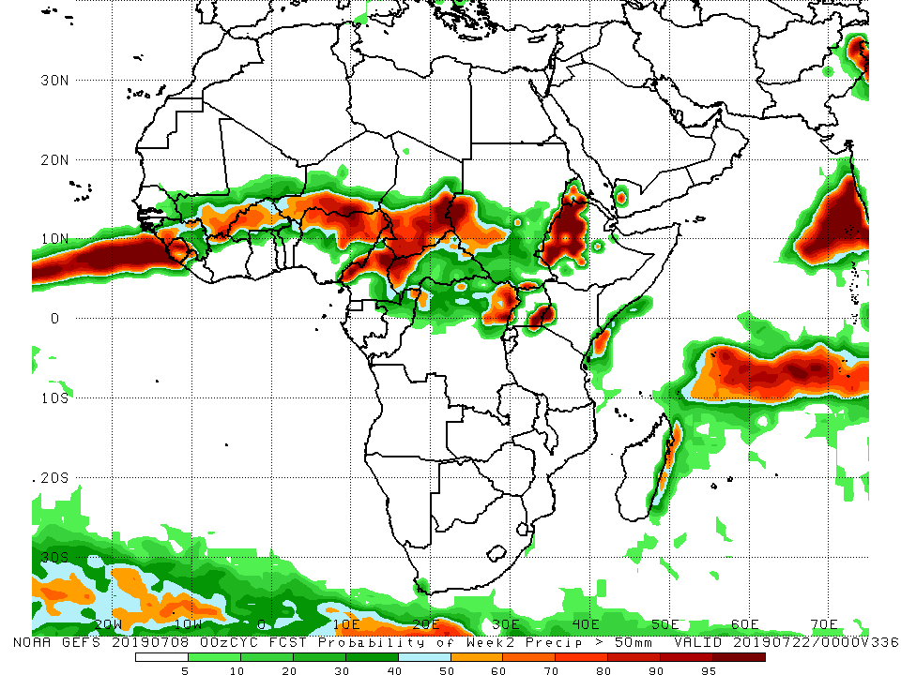
NCEP GEFS Model Forecasts Non-Bias Corrected Probability of precipitation exceedance
Week-1: Valid 9 – 15 July 2019
Week-2: Valid 16 – 22 July 2019
For week-1 (left panel), there is an increased chance for weekly rainfall totals to exceed 50 mm over Guinea-Conakry, Sierra Leone, parts of Cote d’Ivoire, areas of Ghana, Togo, Benin, parts of Nigeria, Cameroon, DRC, southeastern Uganda, southwestern Kenya, western Ethiopia, and coastal Kenya.
For week-2 (left panel), there is an increased chance for weekly rainfall totals to exceed 50 mm over parts of Guinea-Conakry, Sierra Leone, southern Niger and northern Nigeria, Chad, parts of Cameroon, western CAR, western Sudan, western Ethiopia, southeastern Uganda, and southwestern Kenya.
Notes:
10

Slide 11
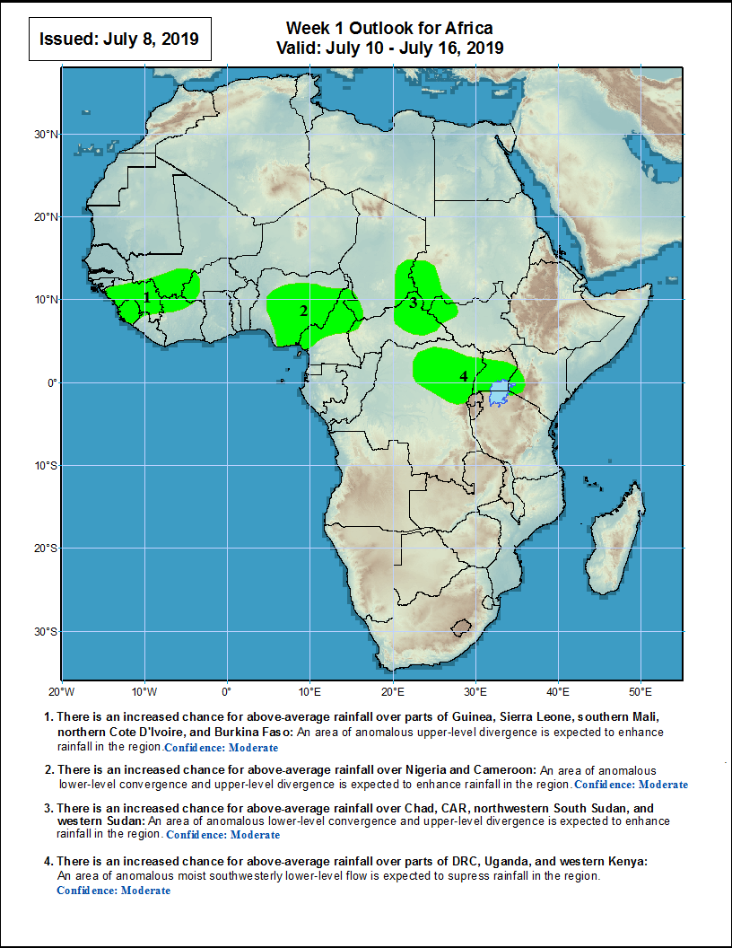
Week-1 Precipitation Outlooks
There is an increased chance for above-average rainfall over parts of Guinea-Conakry, Sierra Leone, southern Mali, northern Cote d’Ivoire, and Burkina Faso: An area of anomalous lower-level convergence and anomalous upper-level divergence is expected to enhance rainfall in the region. Confidence: Moderate
There is an increased chance for above-average rainfall across Nigeria and Cameroon: An area of anomalous lower-level convergence, coupled with anomalous upper-level divergence is expected to enhance rainfall in the region. Confidence: Moderate
There is an increased chance for above-average rainfall over parts of Chad, CAR, Sudan, and South Sudan: An area of anomalous lower-level convergence and anomalous upper-level divergence is expected to enhance rainfall in the region. Confidence: Moderate
There is an increased chance for above-average over parts of DRC, Uganda, and Kenya: An area of anomalous lower-level moist southwesterly flow is expected to enhance rainfall in the region. Confidence: Moderate
9 – 15 July, 2019
Notes:
11

Slide 12
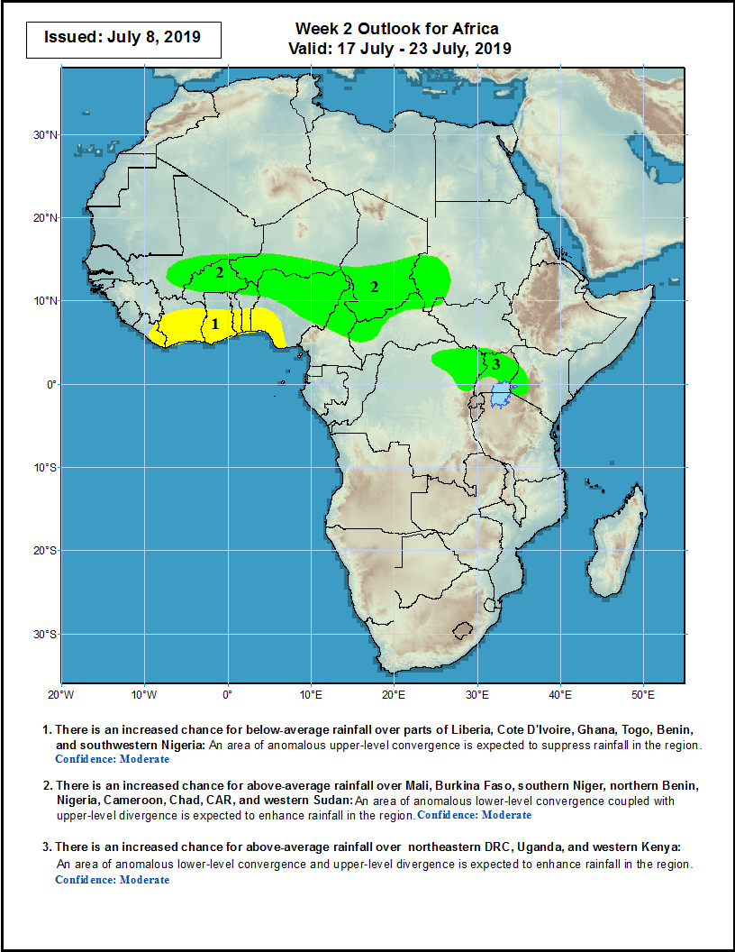
Week-2 Precipitation Outlooks
16 – 22 July 2019
There is an increased chance for below-average rainfall over portions of Liberia, Cote d’Ivoire, Ghana, Togo, Benin, and Nigeria: An area of anomalous upper-level convergence is expected to suppress rainfall in the region. Confidence: Moderate
There is an increased chance for above-average rainfall over Mali, Burkina Faso, southern Niger, northern Benin, Nigeria, Cameroon, Chad, CAR, and western Sudan: An area of anomalous lower-level convergence and anomalous upper-level divergence is expected to enhance rainfall in the region. Confidence: Moderate
There is an increased chance for above-average rainfall over northeastern DRC, Uganda, and western Kenya: An area of anomalous lower-level convergence and anomalous upper-level divergence is expected to enhance rainfall in the region. Confidence: Moderate
Notes:
12

Slide 13
Summary
Heavy rainfall fell over Guinea-Bissau, northern Guinea-Conakry, eastern Senegal, western Mali, parts of Burkina Faso, Ghana, Togo, Benin, northern Cameroon, western Chad, CAR, northern DRC, and northwestern Ethiopia, while light to locally moderate rainfall was received over central Mali, the interior of Nigeria, South Sudan, and western Ethiopia. Above-average rainfall was recorded over southern Senegal, Guinea-Bissau, northern Guinea-Conakry, western Mali, eastern Burkina Faso, parts of Ghana, Togo, Benin, central and northern Cameroon, western Chad, CAR, northern DRC, and parts of northwestern Ethiopia. Below-average rainfall was observed over areas of central Mali, eastern Liberia, central Nigeria, South Sudan, and portions of western Ethiopia.
During the past 30 days, above-average rainfall was observed across Guinea-Bissau, Guinea-Conakry, Sierra Leone, Liberia, western Mali, southern Burkina Faso, much of Ghana, Togo, Benin, western Niger, western Nigeria, Chad, eastern CAR, Sudan, South Sudan, western Ethiopia, Eritrea, Uganda, and western Kenya. In contrast, below-average rainfall was registered over parts of Senegal, central Mali, southern Cote-d’Ivoire, southern Ghana, central Nigeria, much of Cameroon, Congo-Brazzaville, and western DRC.
During the past 90 days, above-average rainfall spread over parts of Sierra Leone, eastern Guinea-Conakry, parts of Liberia, southern Mali, Burkina Faso, Ghana, Togo, Benin, western Nigeria, western and southern Niger, northern Cameroon, Chad, eastern CAR, southern Sudan, South Sudan, much of DRC, Uganda, western Ethiopia, southern Somalia, Tanzania, Zambia, eastern Angola, northern Mozambique, northern Madagascar, and central South Africa. Below-average rainfall was registered over areas of Senegal, western Guinea Conakry, Sierra Leone, Liberia, Cote d’Ivoire, central Nigeria, Cameroon, Gabon, Equatorial Guinea, Congo-Brazzaville, western DRC, northwestern Angola, areas of Ethiopia, central Kenya, northern Somalia, areas of South Africa, and southeastern Madagascar.
Week-1 outlooks call for an increased chance for above-average rainfall over Guinea-Conakry, Sierra Leone, southern Mali, parts of Cote d’Ivoire and Burkina Faso, much of Nigeria, northern Cameroon, northeastern CAR, parts of Chad, Sudan, and South Sudan, northeastern DRC, Uganda, and southwestern Kenya.
Notes:
13

