Slide 1
The African Monsoon Recent Evolution and Current Status Include Week-1 and Week-2 Outlooks
Update prepared by
Climate Prediction Center / NCEP
16 September 2019
For more information, visit:
http://www.cpc.ncep.noaa.gov/products/Global_Monsoons/African_Monsoons/precip_monitoring.shtml

Slide 2
Outline
Highlights
Recent Evolution and Current Conditions
NCEP GEFS Forecasts
Summary

Slide 3
Highlights: Last 7 Days
Weekly rainfall surpluses exceeded 100mm over southern Nigeria, and local areas in western CAR.
Week-1 outlooks call for an increased chance for above-average rainfall over parts of southern Senegal, Guinea-Bissau, Guinea-Conakry, Sierra Leone, western Liberia, northern Cote d’Ivoire, parts of southwestern Mali, southern Nigeria, and portions of Cameroon. In contrast, there is an increased chance for below-average rainfall across southeastern South Sudan and Uganda.

Slide 4
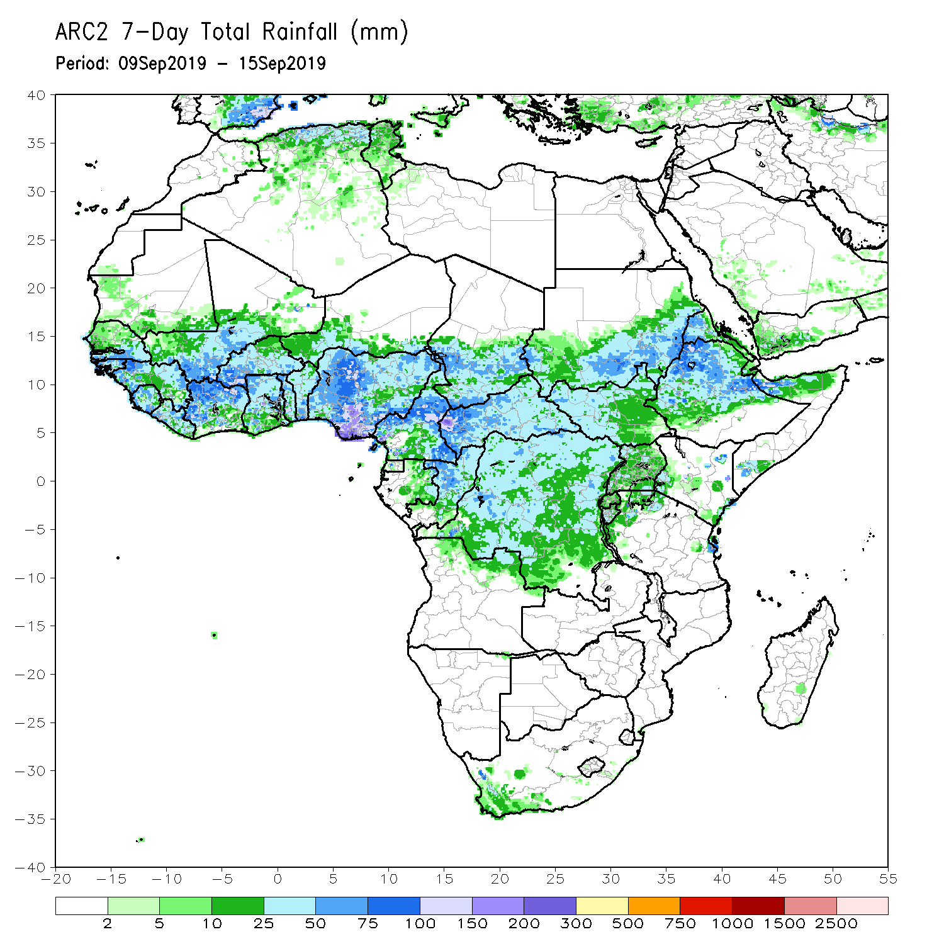
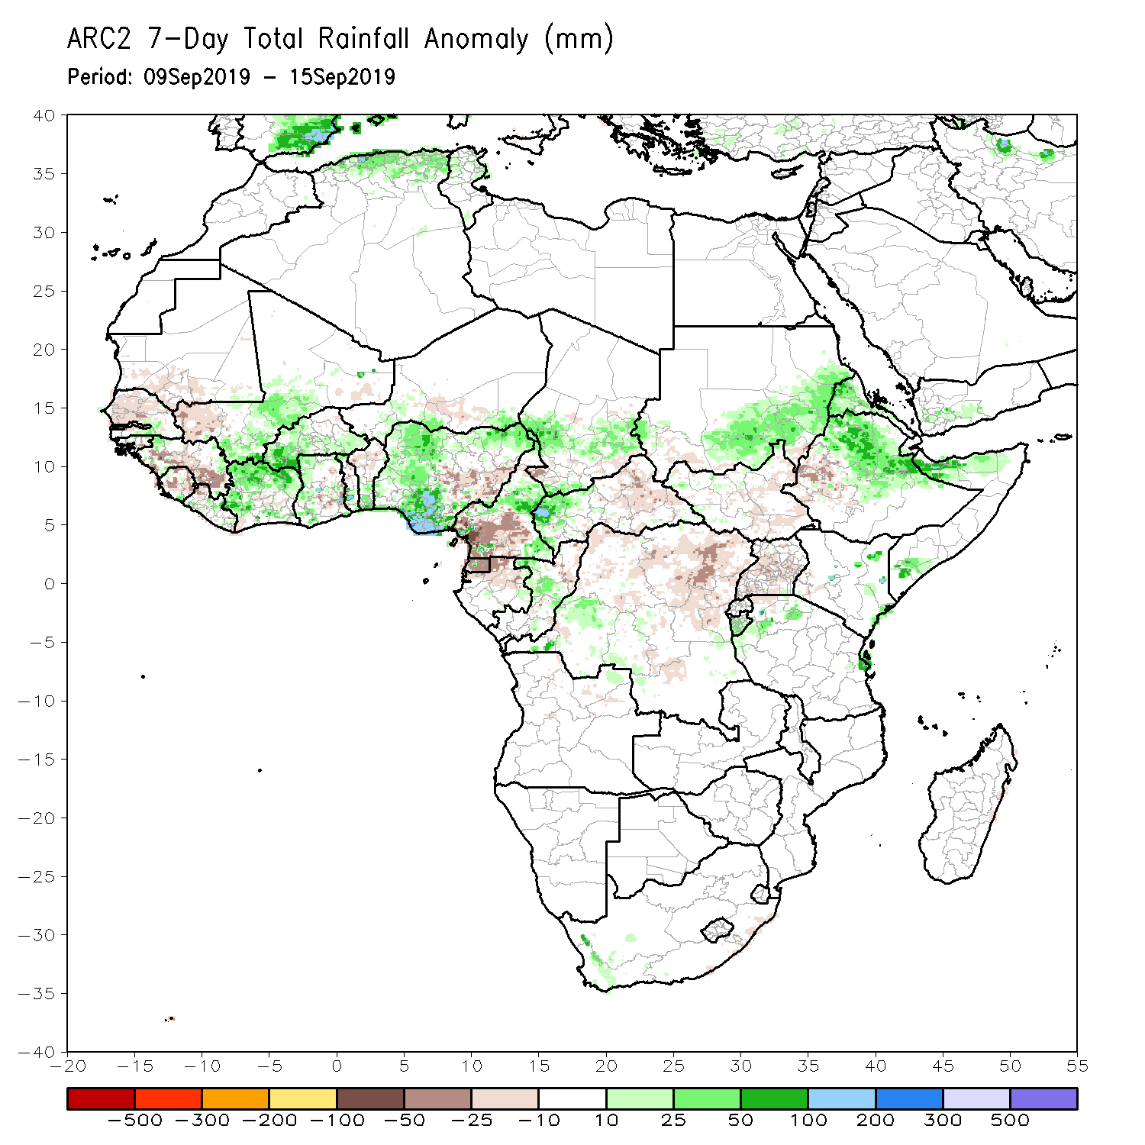
Rainfall Patterns: Last 7 Days
During the past 7 days, weekly rainfall totals exceeded 100mm over parts of northern Cote d’Ivoire and southwestern Burkina Faso, portions of Nigeria, , and local areas in Cameroon, and western CAR. Local areas in Senegal, Guinea and Liberia, parts of Mali, Cote D’Ivoire, portions of Burkina Faso and Ghana, southern Togo, southern Benin, portions of Nigeria and Cameroon, central and southern Chad, western CAR, local areas in DRC, southern Sudan, portions of Eritrea and Ethiopia, and local areas in Kenya, Somalia and Tanzania had above-average rainfall. Weekly rainfall surpluses exceeded 100mm over southern Nigeria, and local areas in western CAR.
Rainfall was below-average over southern Mauritania, western and northern Senegal, southwestern Mali, many parts of Guinea, Sierra Leone, southern Niger, parts of eastern Nigeria, southern Cameroon, eastern and southern CAR, Equatorial Guinea, northern Gabon, northern Congo, many parts of DRC, portions of South Sudan, and southwestern Ethiopia.

Slide 5
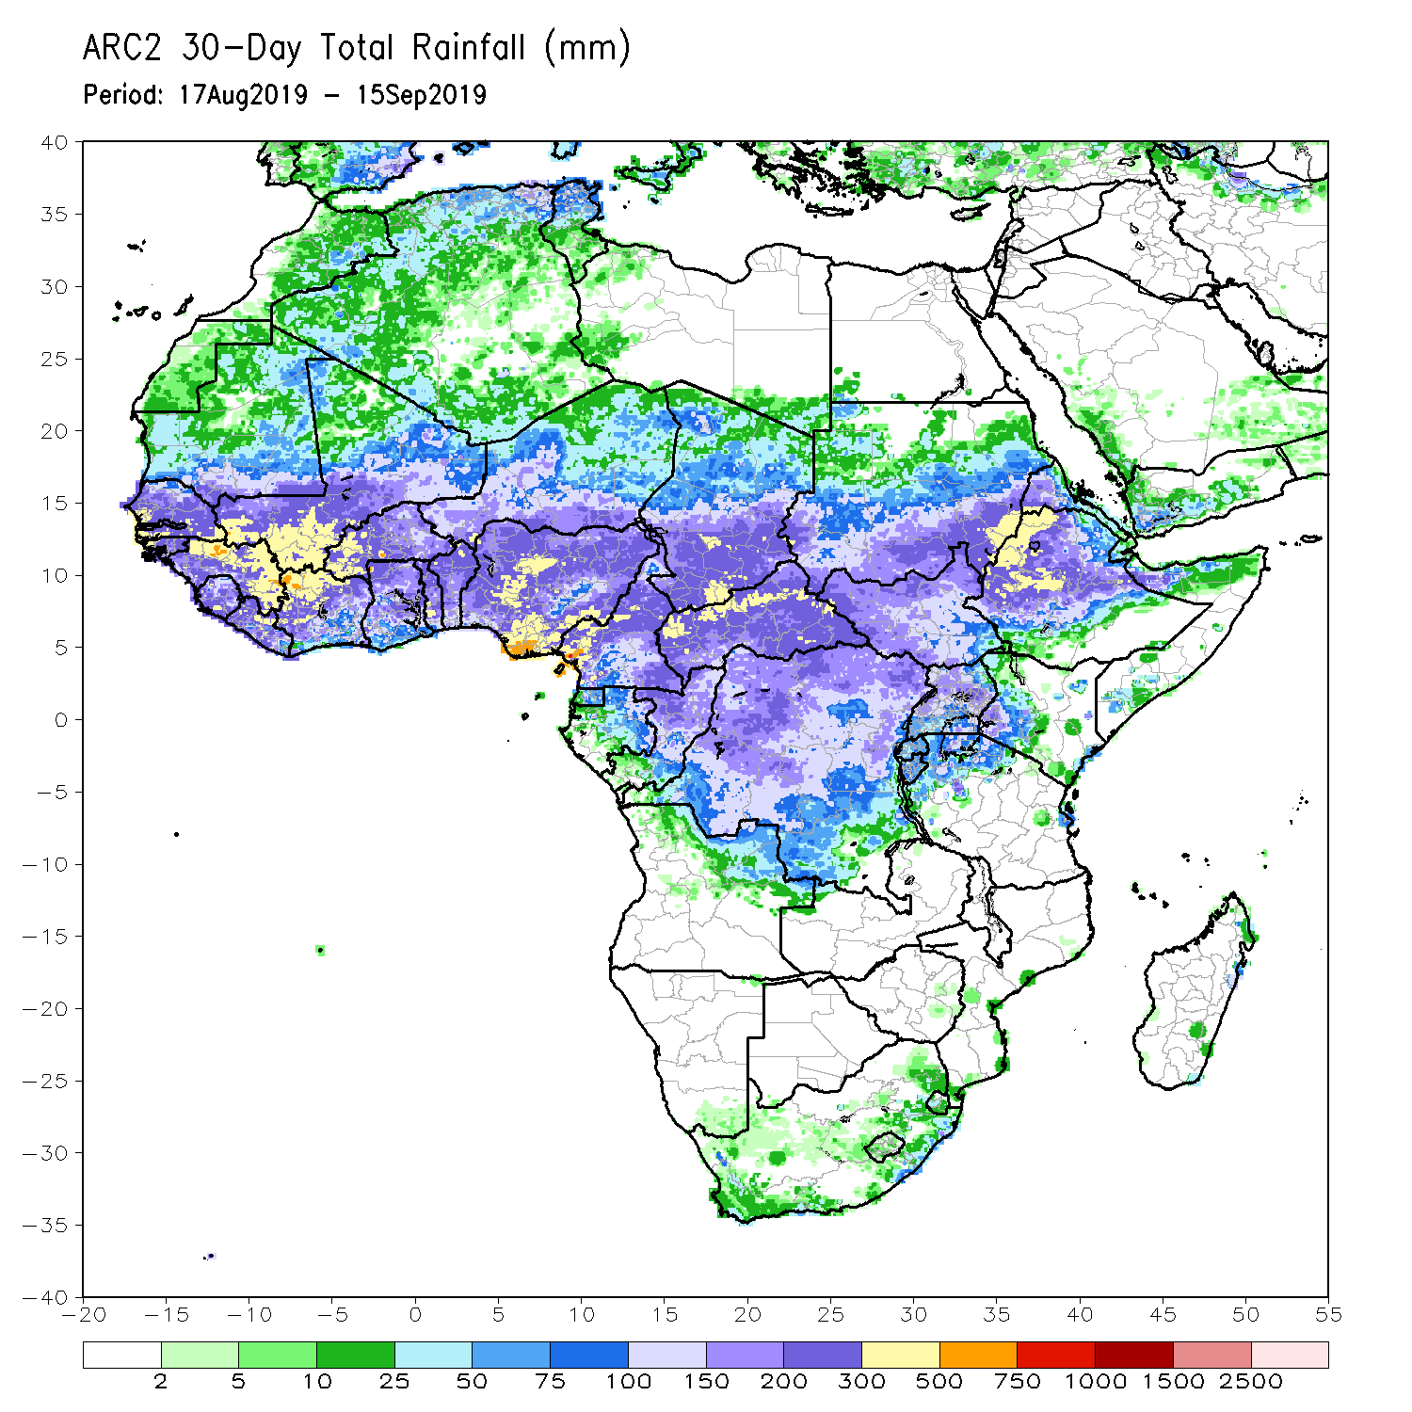
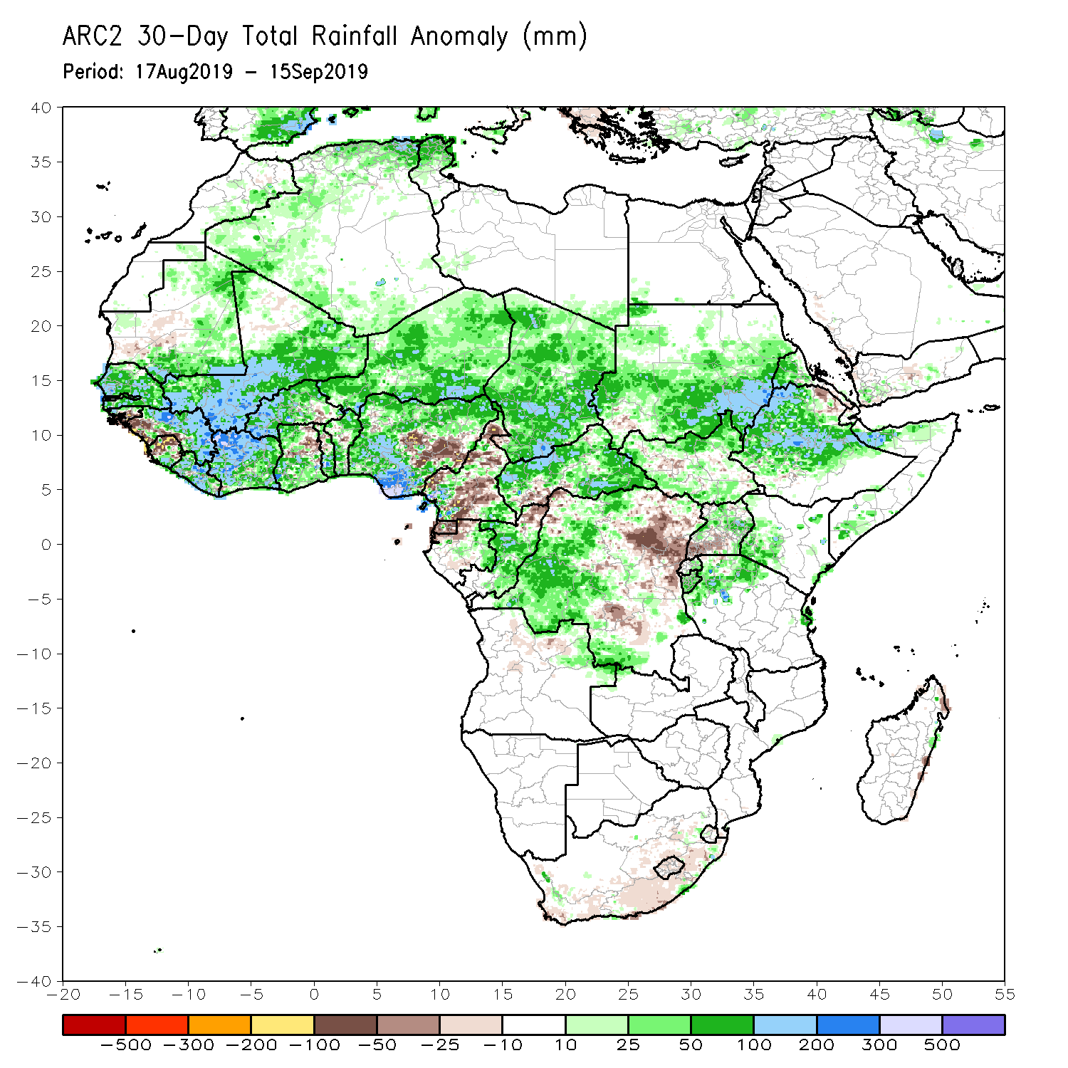
Rainfall Patterns: Last 30 Days
During the past 30 days, rainfall was above-average over southern and eastern Mauritania, much of Senegal, Guinea, parts of Sierra Leone, much of Liberia, Mali, many parts of Burkina Faso and Ghana, Cote d’Ivoire, much of Togo and Benin, Niger, many parts of Nigeria, portions of Cameroon, much of Chad and CAR, many parts of Congo, western DRC, portions of Uganda, South Sudan, Sudan, many parts of Ethiopia, Eritrea, northern Tanzania, northern Somalia and western Kenya.
Southwestern Mauritania, parts of western Guinea, western Sierra Leone, local areas in Ghana, Togo and Benin, portions of Nigeria and Cameroon, central and eastern DRC, southwestern CAR, local areas in South Sudan, southern Uganda had below-average rainfall.
Notes:
5

Slide 6
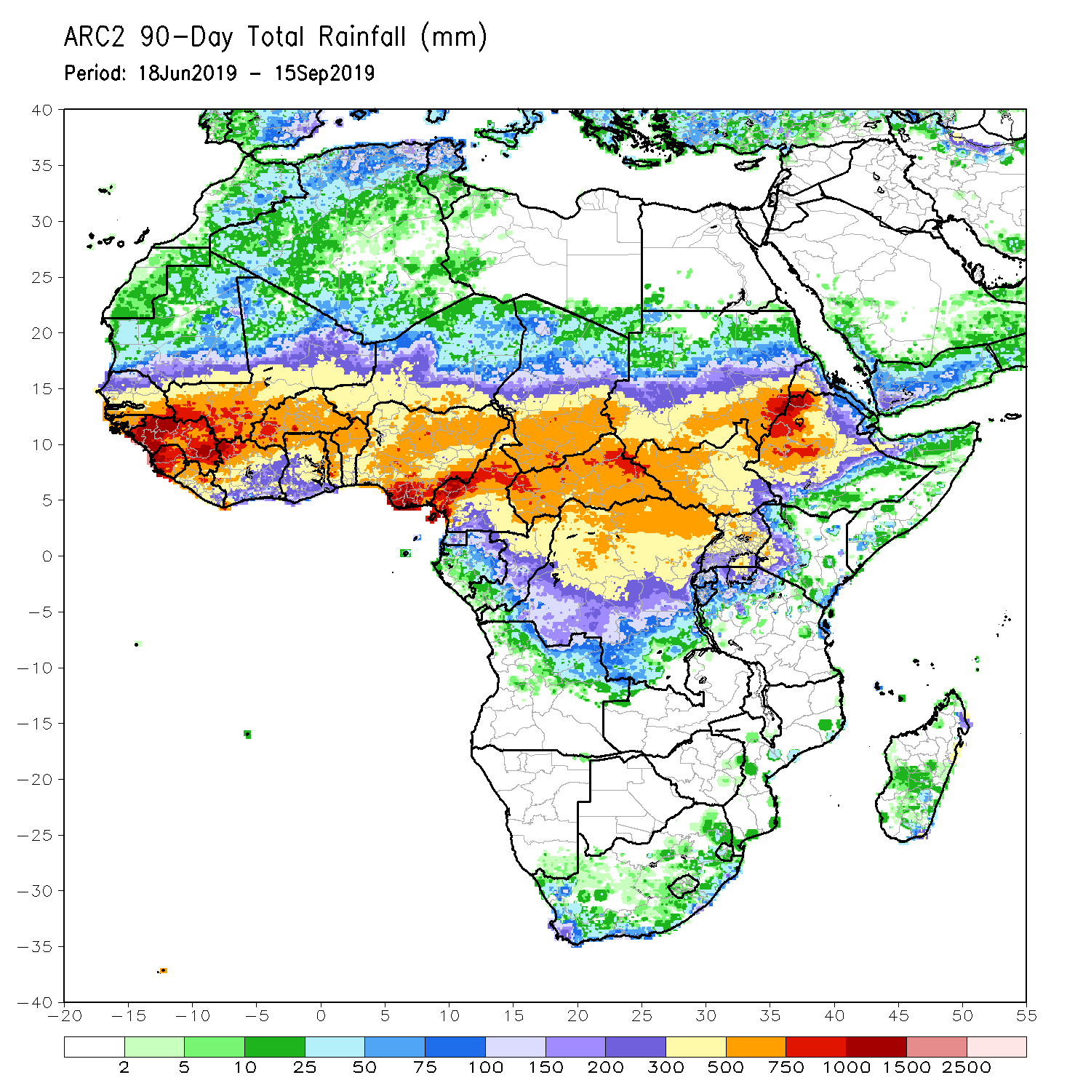
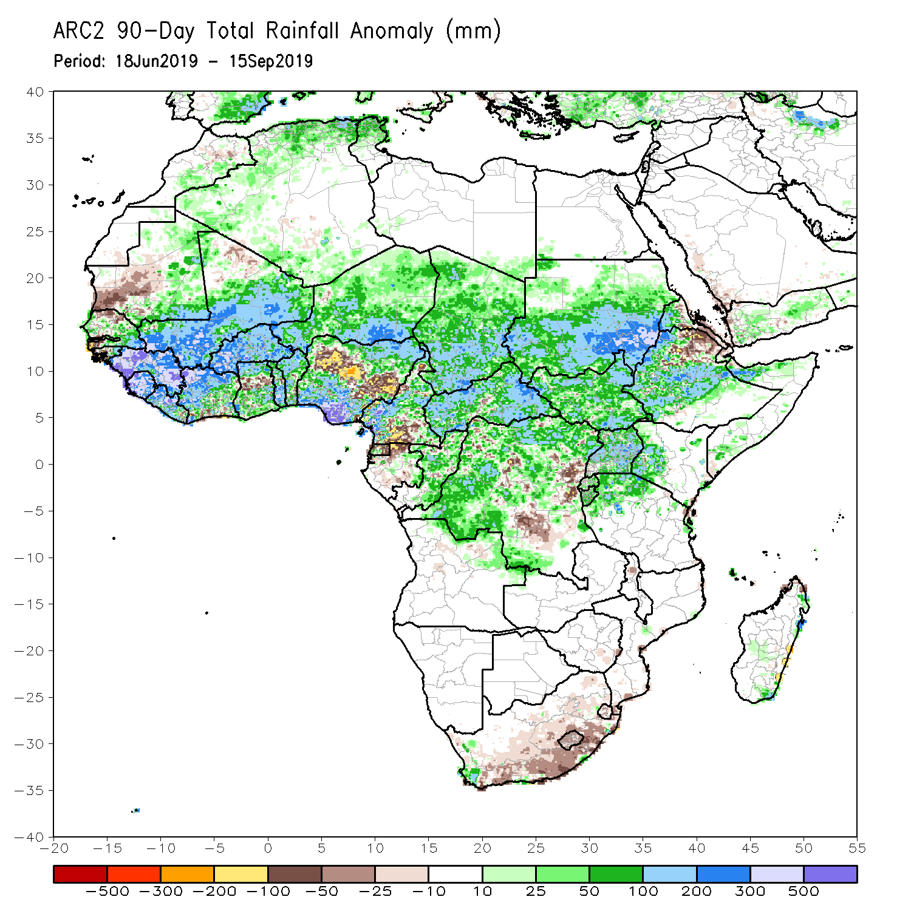
Rainfall Patterns: Last 90 Days
During the past 90 days, western and central Mauritania, parts of northern and southwestern Senegal, western Guinea-Bissau, local areas in Liberia, parts of Cote d’Ivoire and Ghana, local areas in Togo and Benin, portions of Nigeria and Cameroon, parts of Gabon, local areas in Congo, portions of DRC, and northeastern Ethiopia and southern South Africa had below-average rainfall.
Rainfall was above-average over many parts of Senegal, much Guinea, southern and eastern Mauritania, Sierra Leone, Liberia, Mali, many parts of Cote d’Ivoire, Burkina Faso, Ghana, Togo, Benin, Niger, parts of Nigeria, Chad, many parts of Cameroon, much of CAR, many parts of DRC, South Sudan, Uganda, Sudan, many parts of Ethiopia, and western Kenya, southern Somalia and northern Tanzania.
Notes:
6

Slide 7
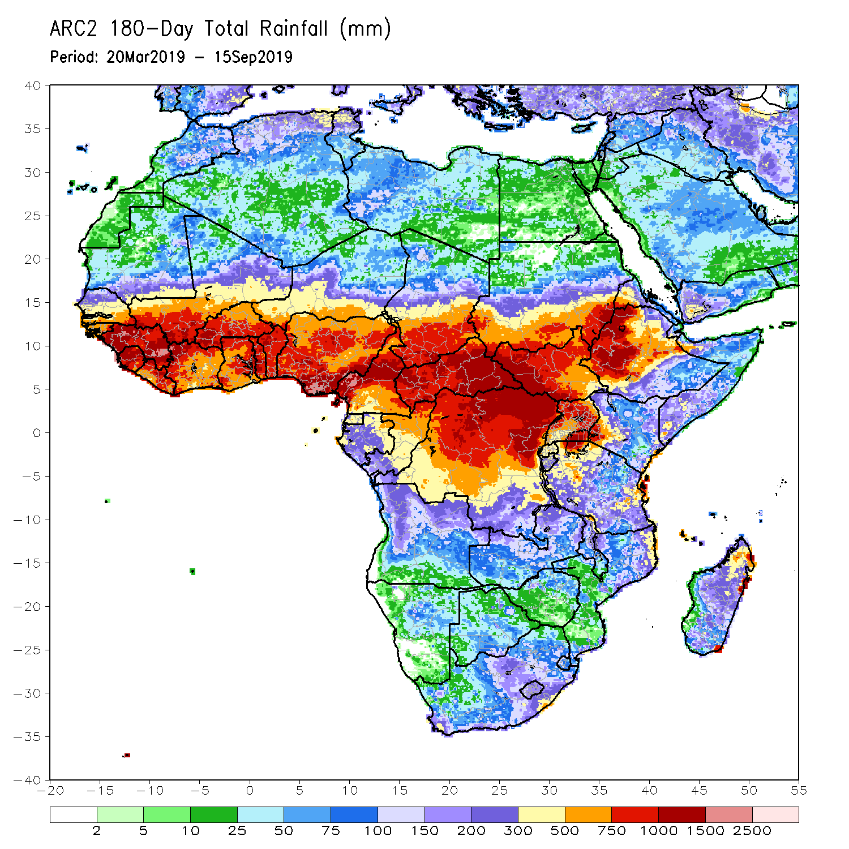
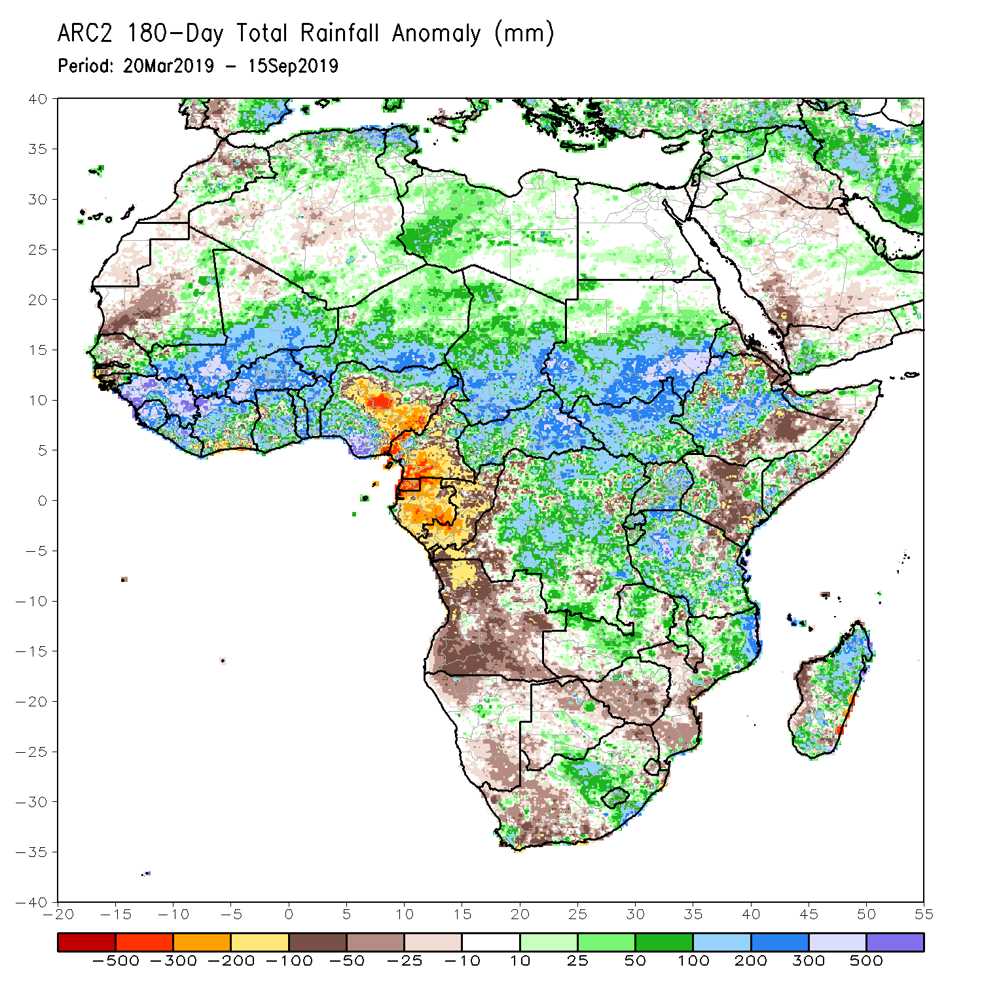
Rainfall Patterns: Last 180 Days
During the past 180 days, below-average rainfall was observed over western and central Mauritania, parts of northern and southwestern Senegal, western Guinea-Bissau, local areas in Liberia, parts of Cote d’Ivoire, local areas in Ghana, portions of Nigeria, many parts of Cameroon, Equatorial Guinea, Gabon, Congo, portions of DRC, Angola, Namibia, western and northeastern South Africa, portions of Zambia, Botswana, Zimbabwe, southern Mozambique, parts of Madagascar and Tanzania, many parts of Kenya, and portions of Ethiopia and Somalia.
Many parts of Senegal, eastern Guinea-Bissau, much of Guinea, Sierra Leone, Mali, much of Liberia and Cote d’Ivoire, Burkina Faso, Ghana, Togo, Benin, parts of Nigeria, Niger, Chad, CAR, many parts of DRC, South Sudan, Sudan, Uganda, many parts of Ethiopia, many parts of Tanzania and Zambia, local areas in Malawi, northern Mozambique, and portions of South Africa and Madagascar had above-average rainfall.
Notes:
7

Slide 8
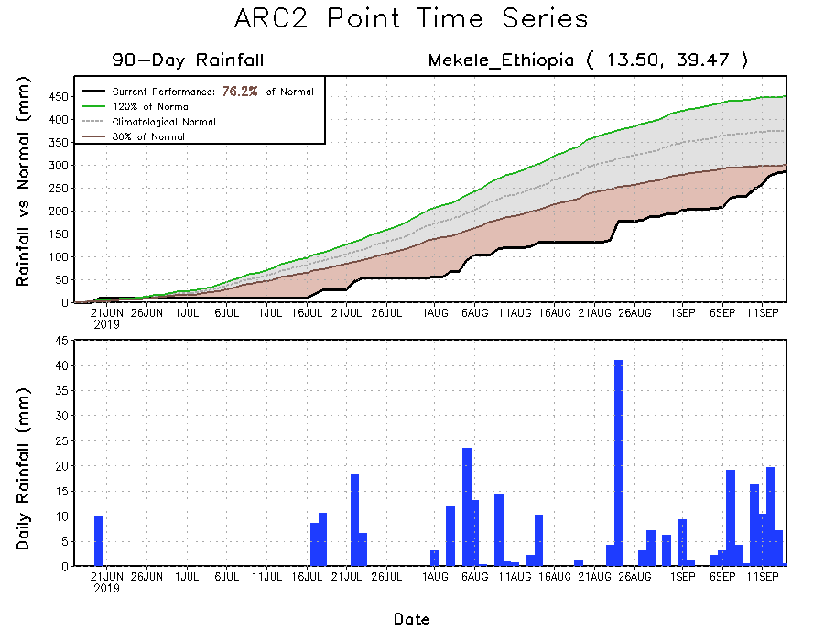
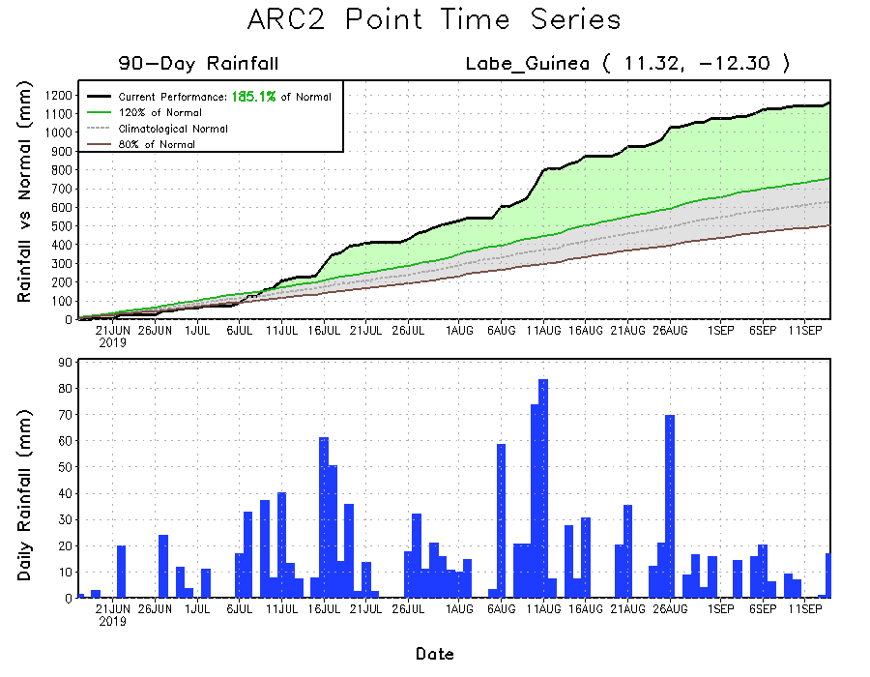
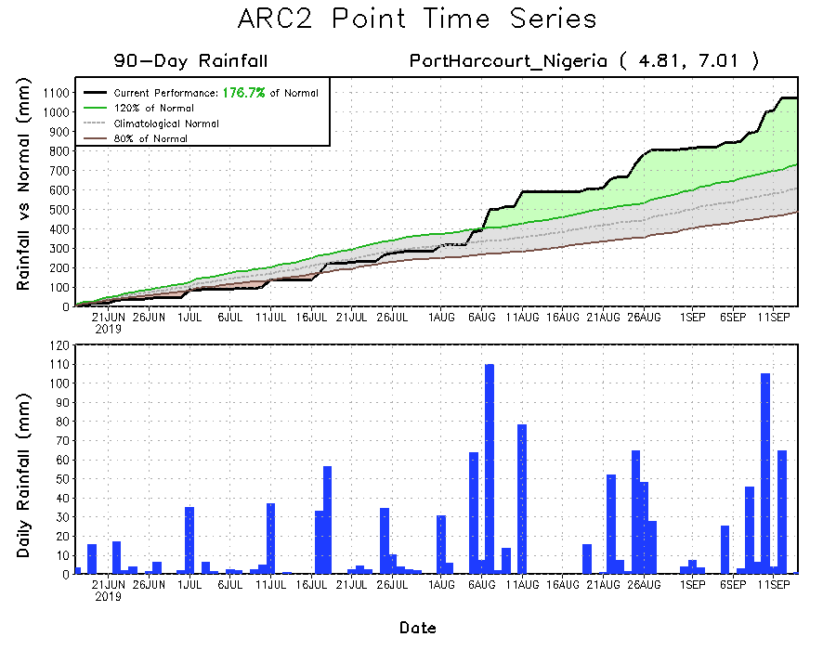
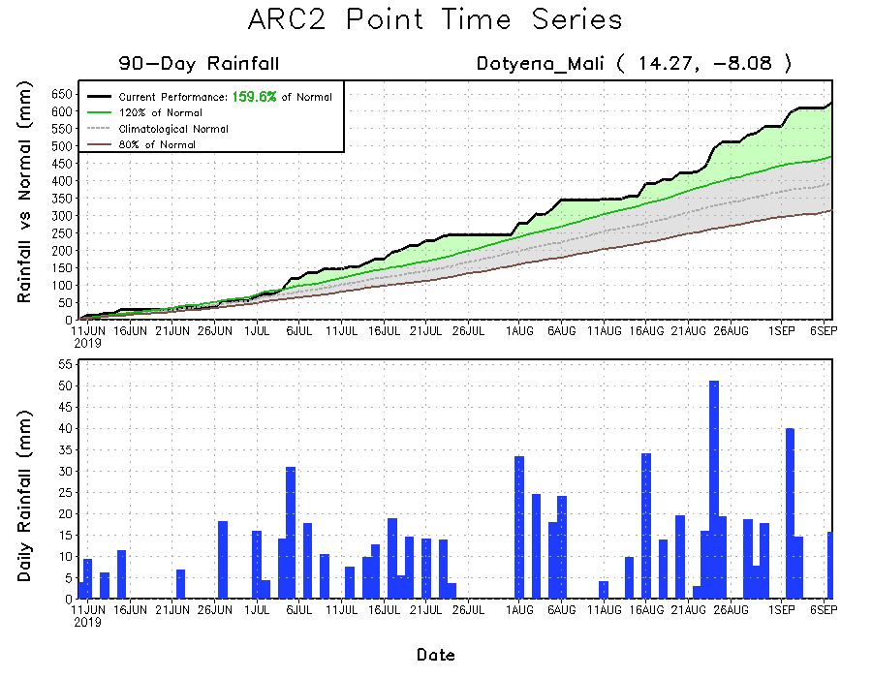
Recent Rainfall Evolution
Daily evolution of rainfall over the last 90 days at selected locations shows that seasonal total rainfall was above-average over parts of Guinea (bottom left) and southeastern Nigeria (bottom right). Light to moderate rainfall helped to reduce accumulated rainfall deficits over parts of Northeast Ethiopia (top right).

Slide 9
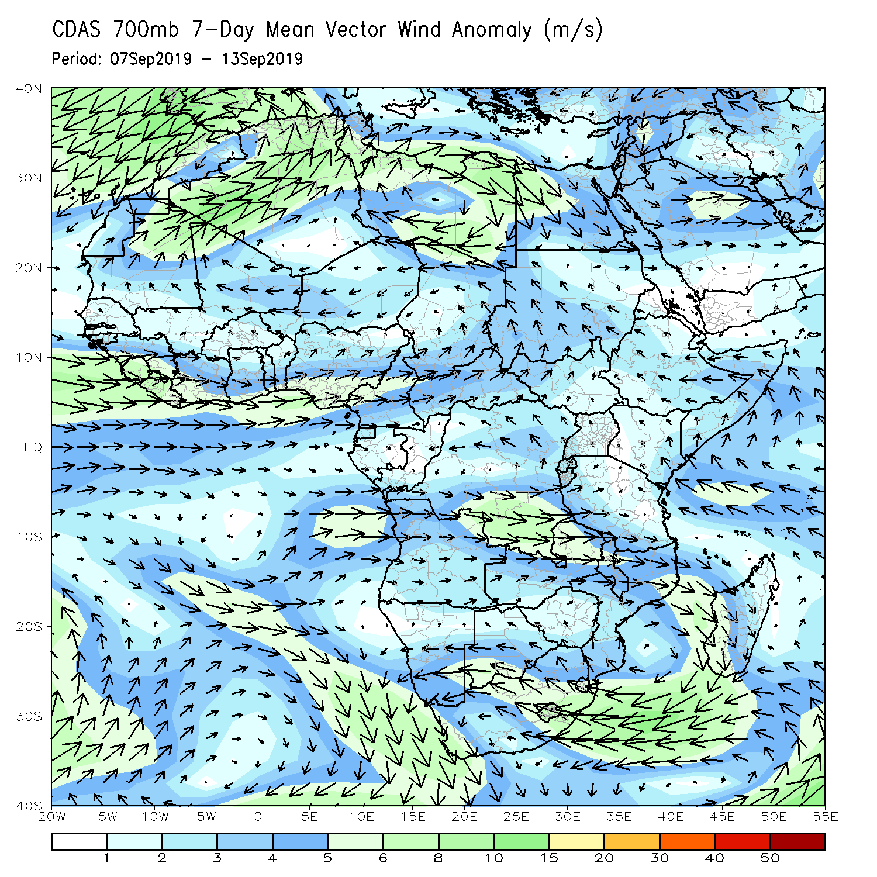
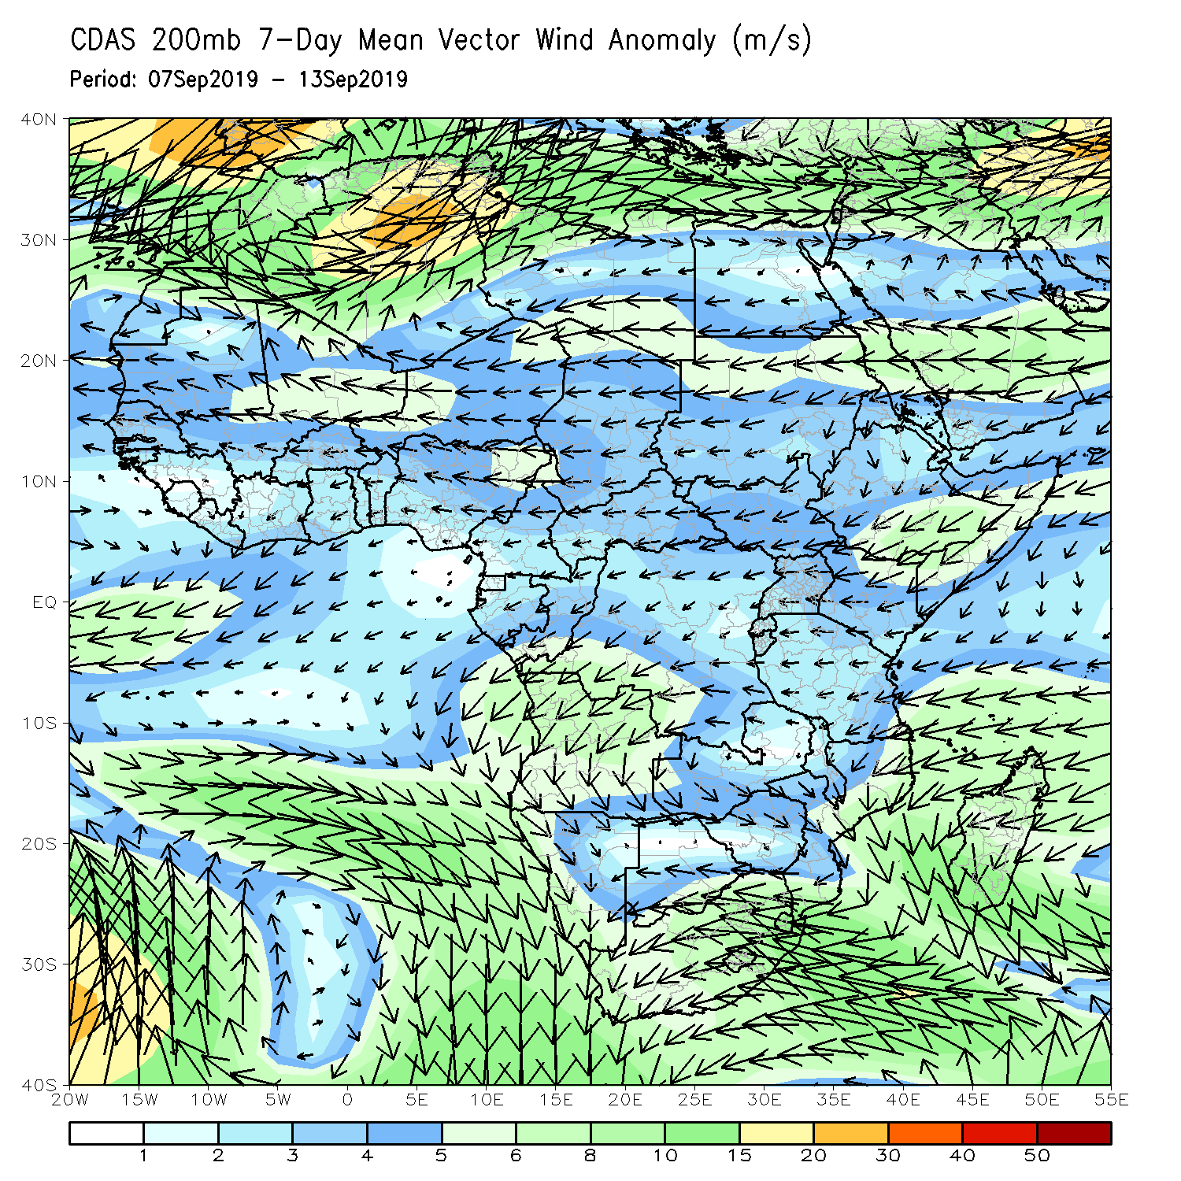
Atmospheric Circulation: Last 7 Days
Lowe-level wind anomalies were cyclonic across much of West Africa and the neighboring areas (left).

Slide 10
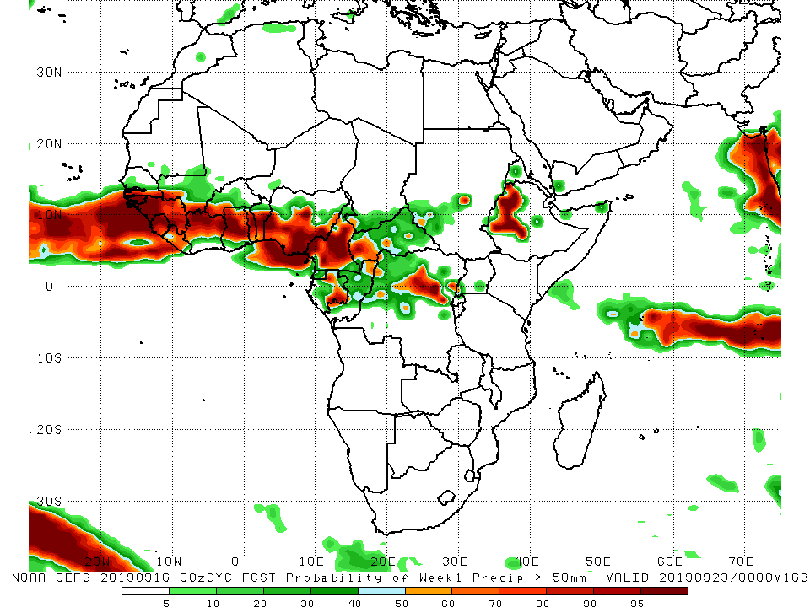
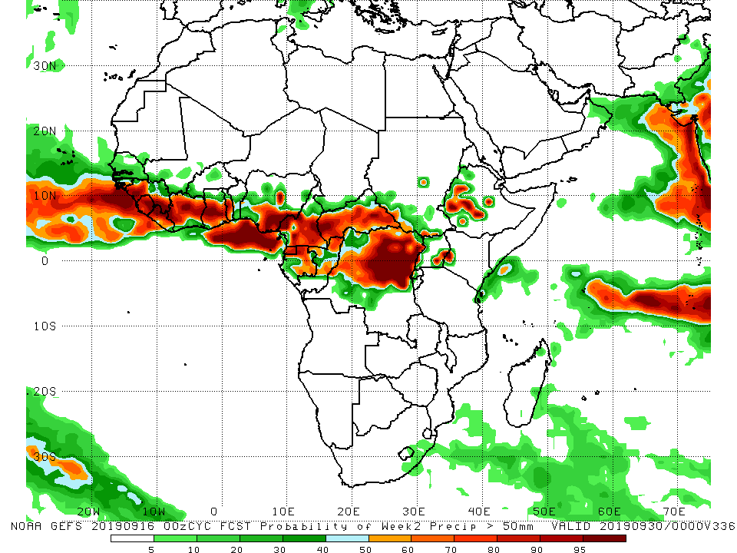
NCEP GEFS Model Forecasts Non-Bias Corrected Probability of precipitation exceedance
Week-1: Valid 17 – 23 September, 2019
Week-2: Valid 24 – 30 September, 2019
For week-1 (left panel), there is an increased chance for weekly rainfall totals to exceed 50mm over many places in the Gulf of Guinea, and portions of Central Africa countries, and western Ethiopia. Week-2 exceedance probabilities are higher over CAR and northern DRC (right panel).
Notes:
10

Slide 11
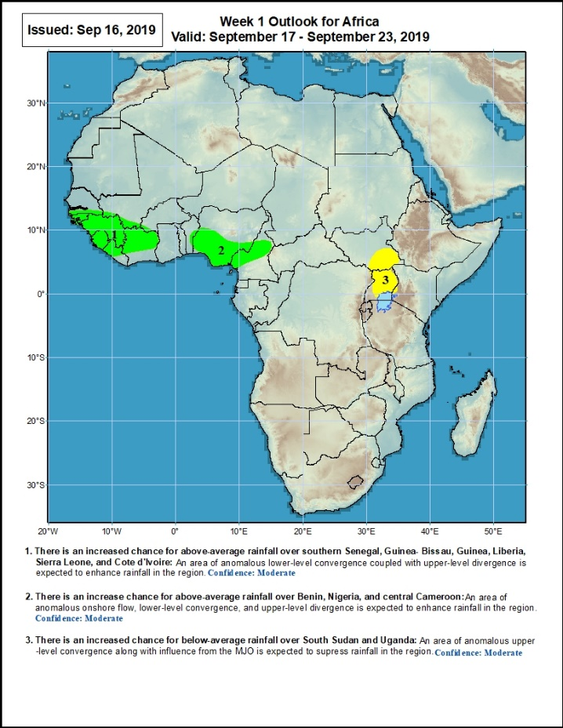
Week-1 Precipitation Outlooks
17 – 23 September, 2019
There is an increased chance for above-average rainfall over parts of southern Senegal, Guinea- Bissau, Guinea, Liberia, Sierra Leone, and Cote d'Ivoire: An area of anomalous lower-level convergence coupled with upper-level divergence is expected to enhance rainfall in the region. Confidence: Moderate
There is an increased chance for above-average rainfall over parts of eastern Benin, southern Nigeria, and central Cameroon: An area of anomalous onshore flow, lower-level convergence, and upper-level divergence is expected to enhance rainfall in the region.. Confidence: Moderate
There is an increased chance for below-average rainfall over southwestern South Sudan and Uganda: An area of upper-level convergence is expected to suppress rainfall in the region. Confidence: Moderate
Notes:
11

Slide 12
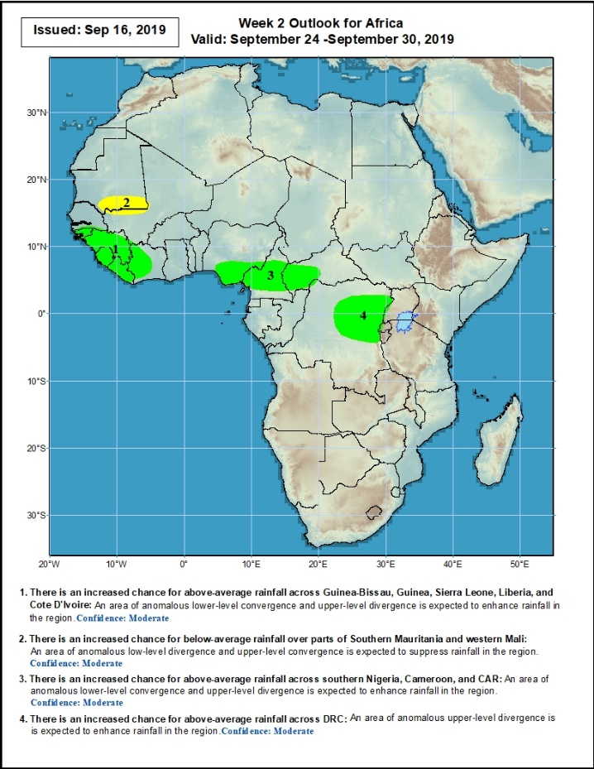
Week-2 Precipitation Outlooks
24 – 30 September, 2019
There is an increased chance for above-average rainfall across Guinea-Bissau, Guinea, Sierra Leone, Liberia, and Cote D'Ivoire: An area of anomalous lower-level convergence and upper-level divergence is expected to enhance rainfall in the region. Confidence: Moderate
There is an increased chance for below-average rainfall over parts of Southern Mauritania and western Mali: An area of anomalous lower-level divergence and upper-level convergence is expected to suppress rainfall in the region. Confidence: Moderate
There is an increased chance for above-average rainfall across southern Nigeria, Cameroon, and western CAR: An area of anomalous lower-level convergence and upper-level divergence is expected to enhance rainfall in the region. Confidence: Moderate
There is an increased chance for above-average rainfall across portions of DRC: An area of anomalous upper-level divergence is expected to enhance rainfall in the region. Confidence: Moderate
Notes:
12

Slide 13
Summary
During the past 7 days, weekly rainfall totals exceeded 100mm over parts of northern Cote d’Ivoire and southwestern Burkina Faso, portions of Nigeria, , and local areas in Cameroon, and western CAR. Local areas in Senegal, Guinea and Liberia, parts of Mali, Cote D’Ivoire, portions of Burkina Faso and Ghana, southern Togo, southern Benin, portions of Nigeria and Cameroon, central and southern Chad, western CAR, local areas in DRC, southern Sudan, portions of Eritrea and Ethiopia, and local areas in Kenya, Somalia and Tanzania had above-average rainfall. Weekly rainfall surpluses exceeded 100mm over southern Nigeria, and local areas in western CAR. Rainfall was below-average over southern Mauritania, western and northern Senegal, southwestern Mali, many parts of Guinea, Sierra Leone, southern Niger, parts of eastern Nigeria, southern Cameroon, eastern and southern CAR, Equatorial Guinea, northern Gabon, northern Congo, many parts of DRC, portions of South Sudan, and southwestern Ethiopia.
During the past 30 days, rainfall was above-average over southern and eastern Mauritania, much of Senegal, Guinea, parts of Sierra Leone, much of Liberia, Mali, many parts of Burkina Faso and Ghana, Cote d’Ivoire, much of Togo and Benin, Niger, many parts of Nigeria, portions of Cameroon, much of Chad and CAR, many parts of Congo, western DRC, portions of Uganda, South Sudan, Sudan, many parts of Ethiopia, Eritrea, northern Tanzania, northern Somalia and western Kenya. Southwestern Mauritania, parts of western Guinea, western Sierra Leone, local areas in Ghana, Togo and Benin, portions of Nigeria and Cameroon, central and eastern DRC, southwestern CAR, local areas in South Sudan, southern Uganda had below-average rainfall.
During the past 90 days, western and central Mauritania, parts of northern and southwestern Senegal, western Guinea-Bissau, local areas in Liberia, parts of Cote d’Ivoire and Ghana, local areas in Togo and Benin, portions of Nigeria and Cameroon, parts of Gabon, local areas in Congo, portions of DRC, and northeastern Ethiopia and southern South Africa had below-average rainfall. Rainfall was above-average over many parts of Senegal, much Guinea, southern and eastern Mauritania, Sierra Leone, Liberia, Mali, many parts of Cote d’Ivoire, Burkina Faso, Ghana, Togo, Benin, Niger, parts of Nigeria, Chad, many parts of Cameroon, much of CAR, many parts of DRC, South Sudan, Uganda, Sudan, many parts of Ethiopia, and western Kenya, southern Somalia and northern Tanzania.
Week-1 outlooks call for an increased chance for above-average rainfall over parts of southern Senegal, Guinea-Bissau, Guinea-Conakry, Sierra Leone, western Liberia, northern Cote d’Ivoire, parts of southwestern Mali, southern Nigeria, and portions of Cameroon. In contrast, there is an increased chance for below-average rainfall across southeastern South Sudan and Uganda.
Notes:
13

