Slide 1
The African Monsoon Recent Evolution and Current Status Include Week-1 and Week-2 Outlooks
Update prepared by
Climate Prediction Center / NCEP
21 October 2019
For more information, visit:
http://www.cpc.ncep.noaa.gov/products/Global_Monsoons/African_Monsoons/precip_monitoring.shtml

Slide 2
Outline
Highlights
Recent Evolution and Current Conditions
NCEP GEFS Forecasts
Summary

Slide 3
Highlights: Last 7 Days
Weekly rainfall surpluses exceeded 100mm over parts of central Kenya.
Week-1 outlooks call for an increased chance for above-average rainfall over southeastern Nigeria, central and southern Cameroon, Equatorial Guinea, Gabon, southern CAR, Congo, parts of northern Angola, and western and central DRC. Outlooks also call for above-average rainfall over eastern Kenya, northeastern Tanzania, parts of southeastern Ethiopia and southern Somalia. In contrast, there is an increased chance for below-average rainfall over portions of Madagascar.

Slide 4
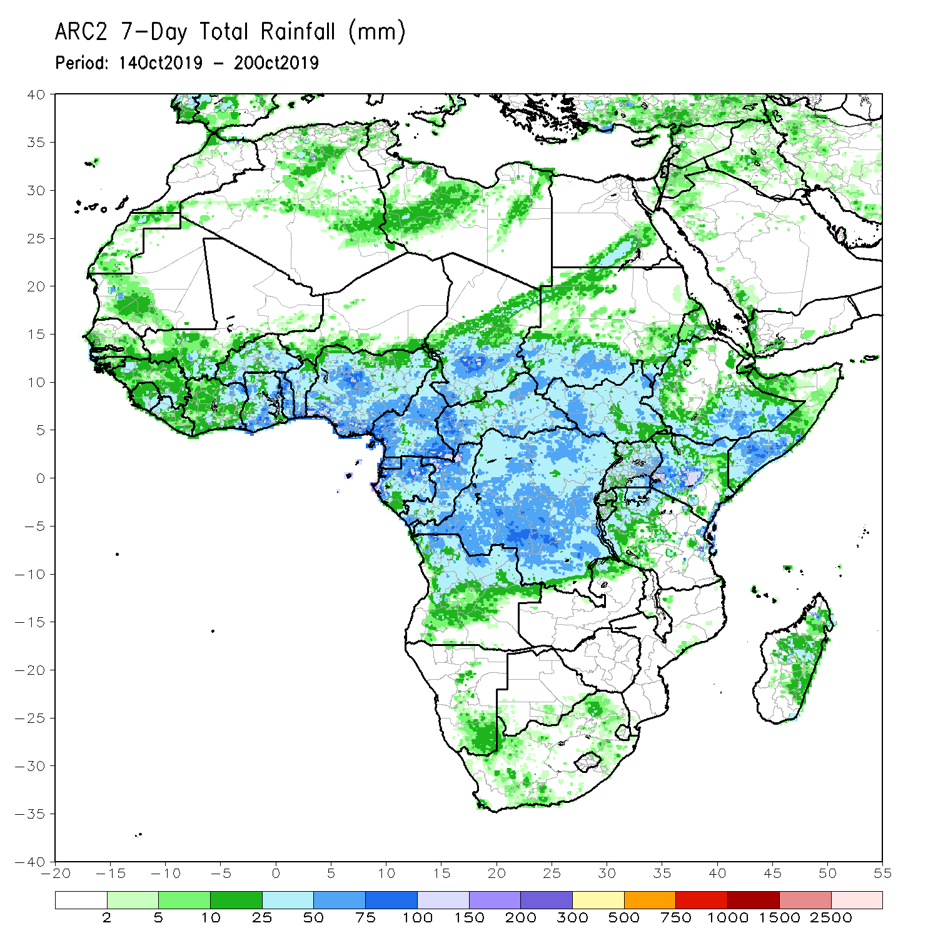
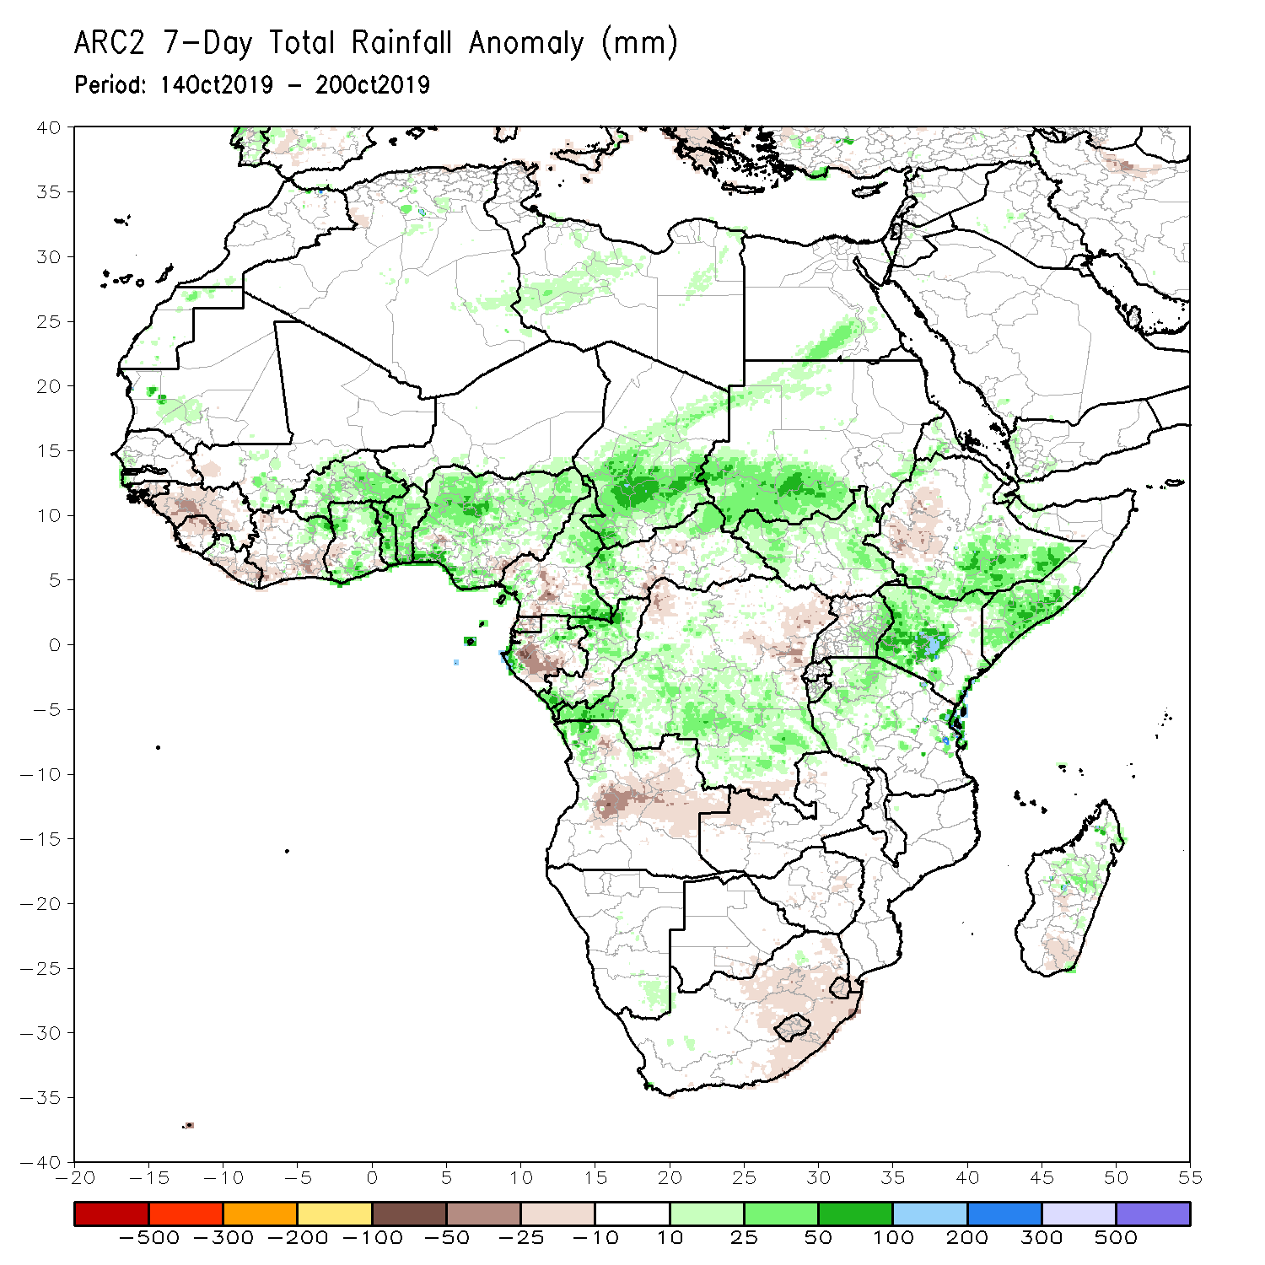
Rainfall Patterns: Last 7 Days
During the past 7 days, rainfall was above-average over local areas in Mauritania and Senegal, Cote d’Ivoire, Mali and Cote d’Ivoire, Ghana, Burkina Faso, Togo Benin, Nigeria, parts of Cameroon and Gabon, central and southern Chad, portions of Sudan and South Sudan, southern Ethiopia, southern Somalia, Kenya, eastern Uganda, parts of Congo, central and southern DRC, portions Tanzania, northern Angola and parts of northern Madagascar.
Many parts of Guinea, Liberia, portions of Cote d’Ivoire, Sierra Leone, Liberia, much of Cote d’Ivoire, parts of Ghana, parts of Nigeria, Equatorial Guinea, portions of Cameroon and Gabon, CAR, northern DRC, central and eastern Angola, western Ethiopia, portions of South Africa and southern Madagascar had below-average rainfall.

Slide 5
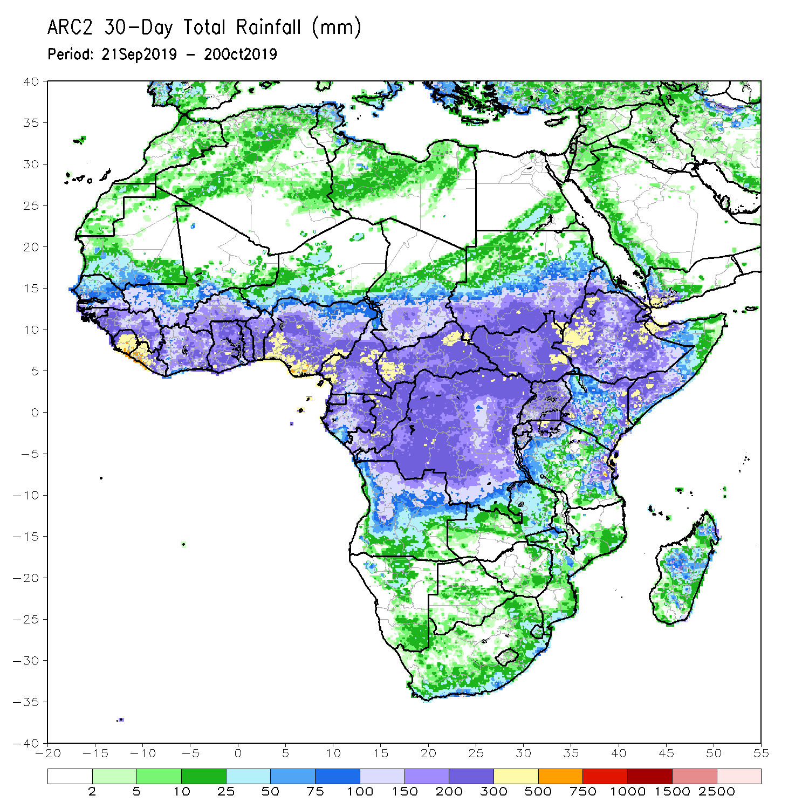
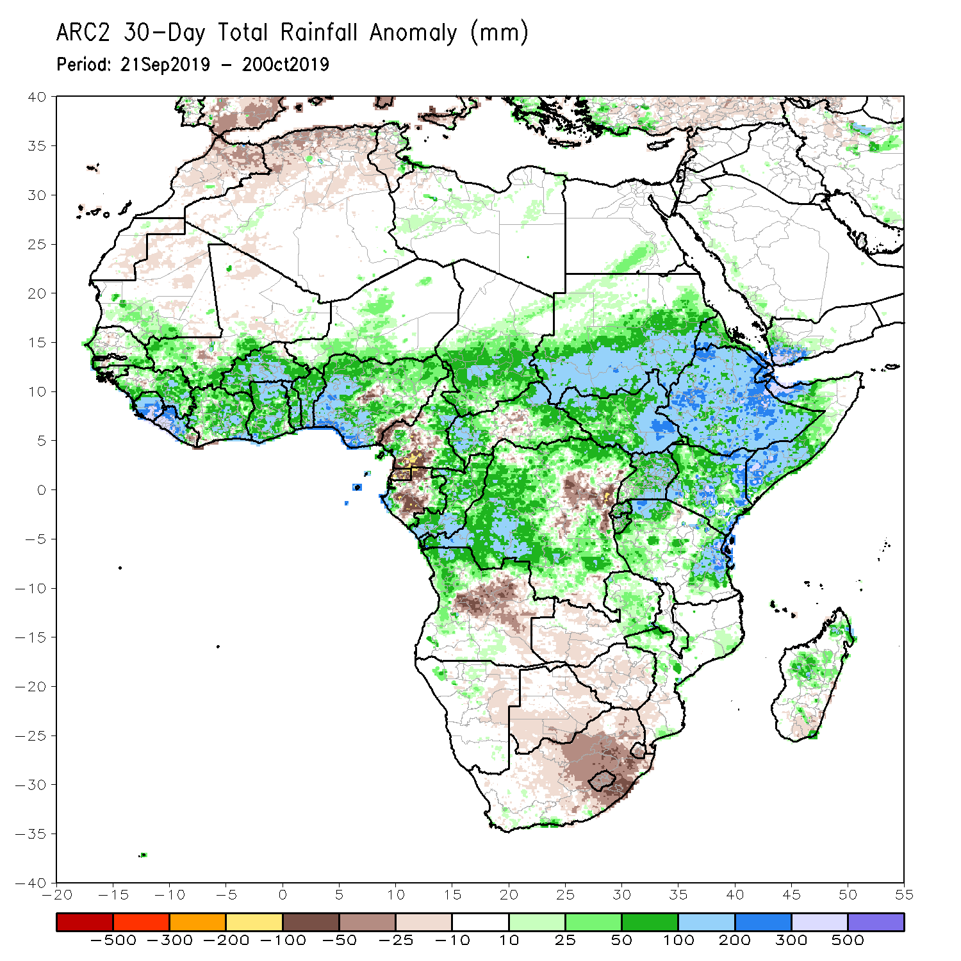
Rainfall Patterns: Last 30 Days
During the past 30 days, rainfall was above-average over southern Mauritania, many parts of Senegal, Guinea-Bissau and Guinea, Sierra Leone, Liberia, southern Mali, Burkina Faso, Ghana, Cote d’Ivoire, Togo, Benin, many parts of Nigeria, portions of Cameroon, central and southern Chad, much of CAR and Congo, portions of Gabon, many parts of DRC, much of South Sudan, Sudan, Ethiopia, Eritrea, Uganda, Tanzania, Somalia, Kenya, portions of Angola, eastern Zambia, and local areas in Namibia and Mozambique, and portions of Madagascar.
Local areas in Senegal, Guinea and Mali, parts of Nigeria Cameroon, many parts of Gabon, portions of Angola and DRC, western Zambia, Botswana, Zimbabwe, and many parts of South Africa had below-average rainfall.
Notes:
5

Slide 6
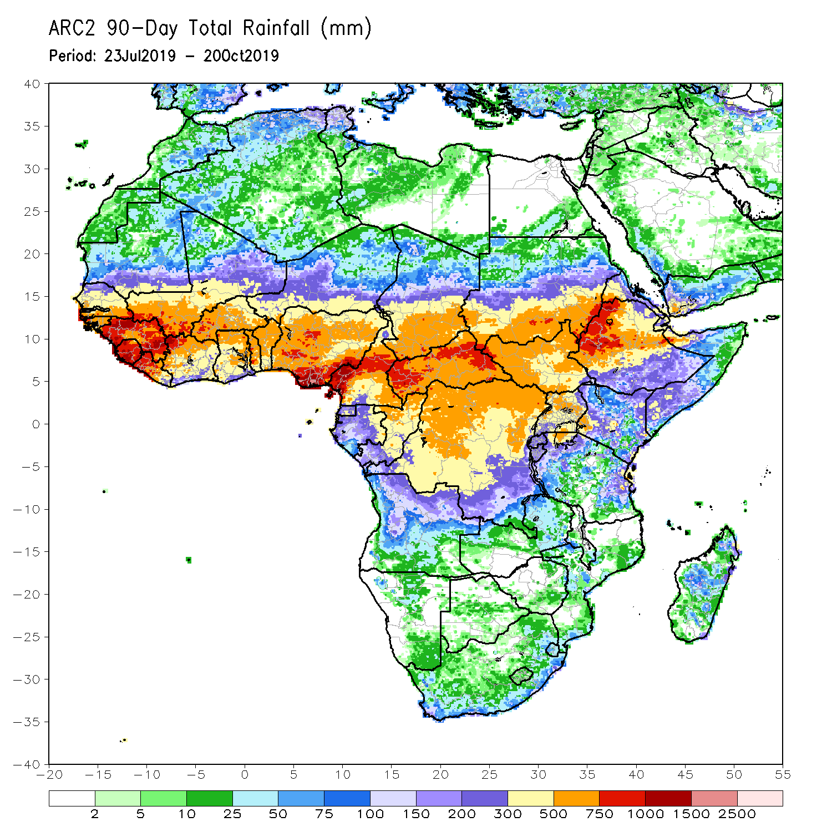
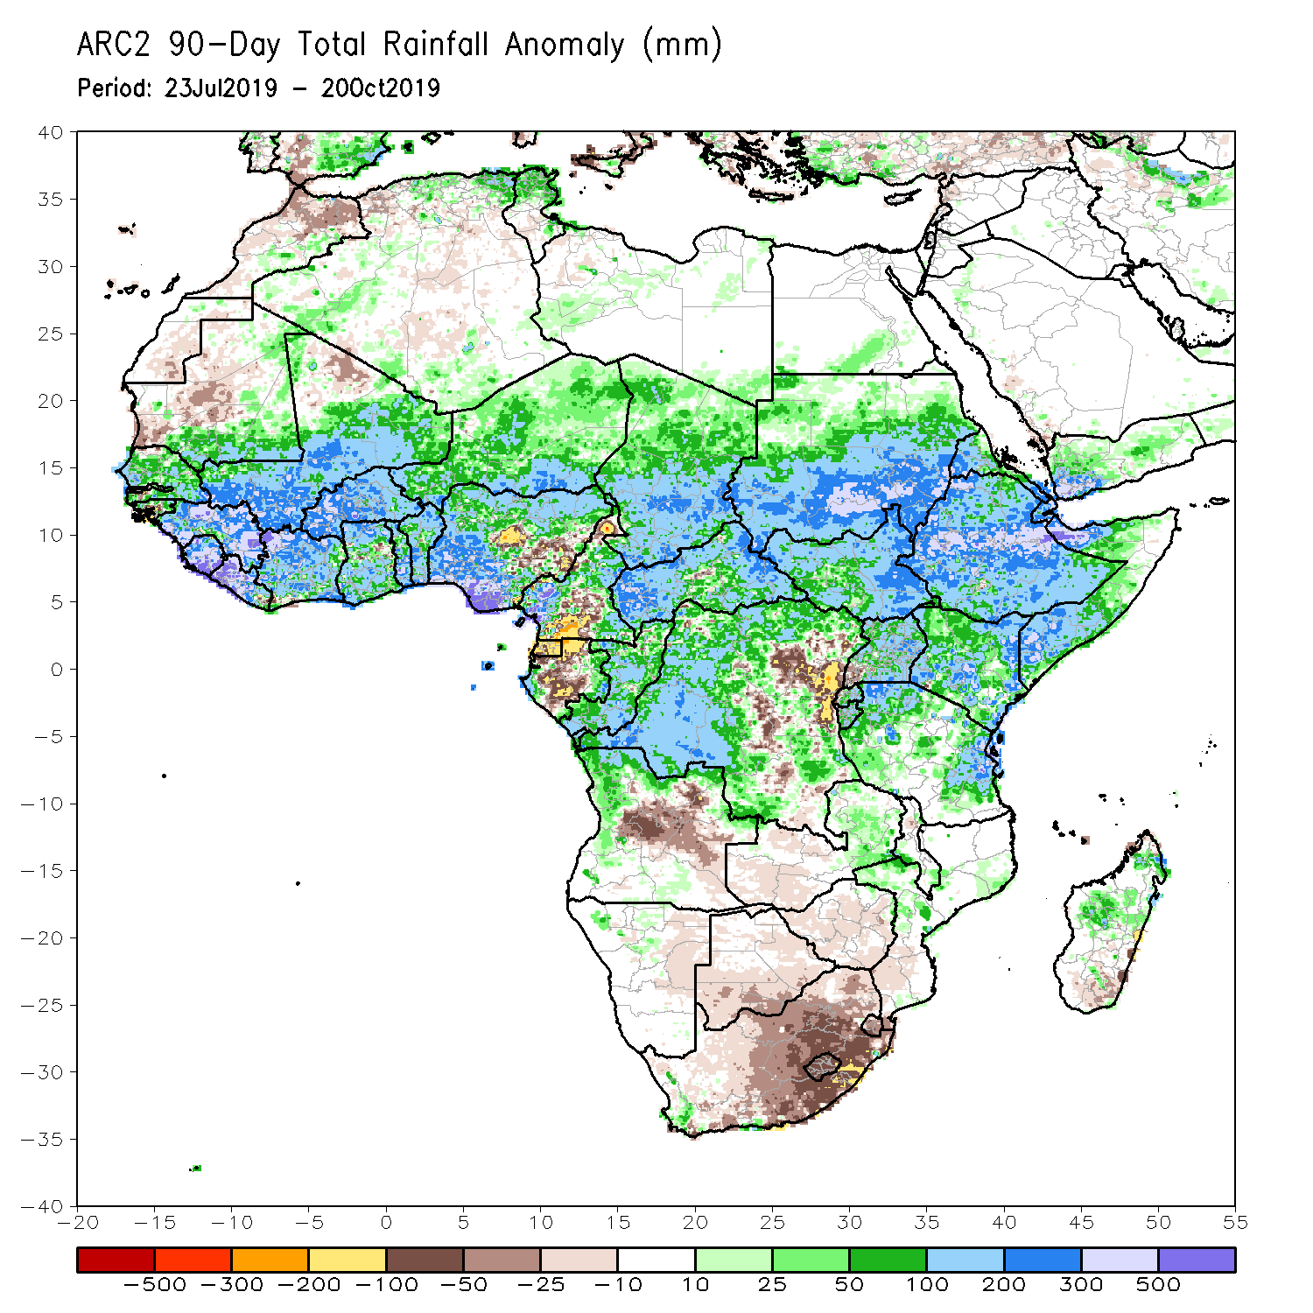
Rainfall Patterns: Last 90 Days
During the past 90 days, rainfall was above-average over southern and eastern Mauritania, much of Senegal, Guinea-Bissau, Guinea, Sierra Leone, Liberia, Mali, Cote d’Ivoire, Burkina Faso, Ghana, Togo, Benin, Niger, many parts of Nigeria, Chad, portions of Cameroon, CAR, many parts of DRC, South Sudan, Uganda, Sudan, Eritrea, Ethiopia, Kenya, Somalia, many parts of Tanzania, portions of Angola, eastern Zambia, and local areas in Mozambique and Madagascar.
Western and central Mauritania, parts of Nigeria and Cameroon, Gabon, portions of central and eastern DRC, portions of Angola, western Zambia, Zimbabwe, eastern Namibia, Botswana and many parts of South Africa had below-average rainfall.
Notes:
6

Slide 7
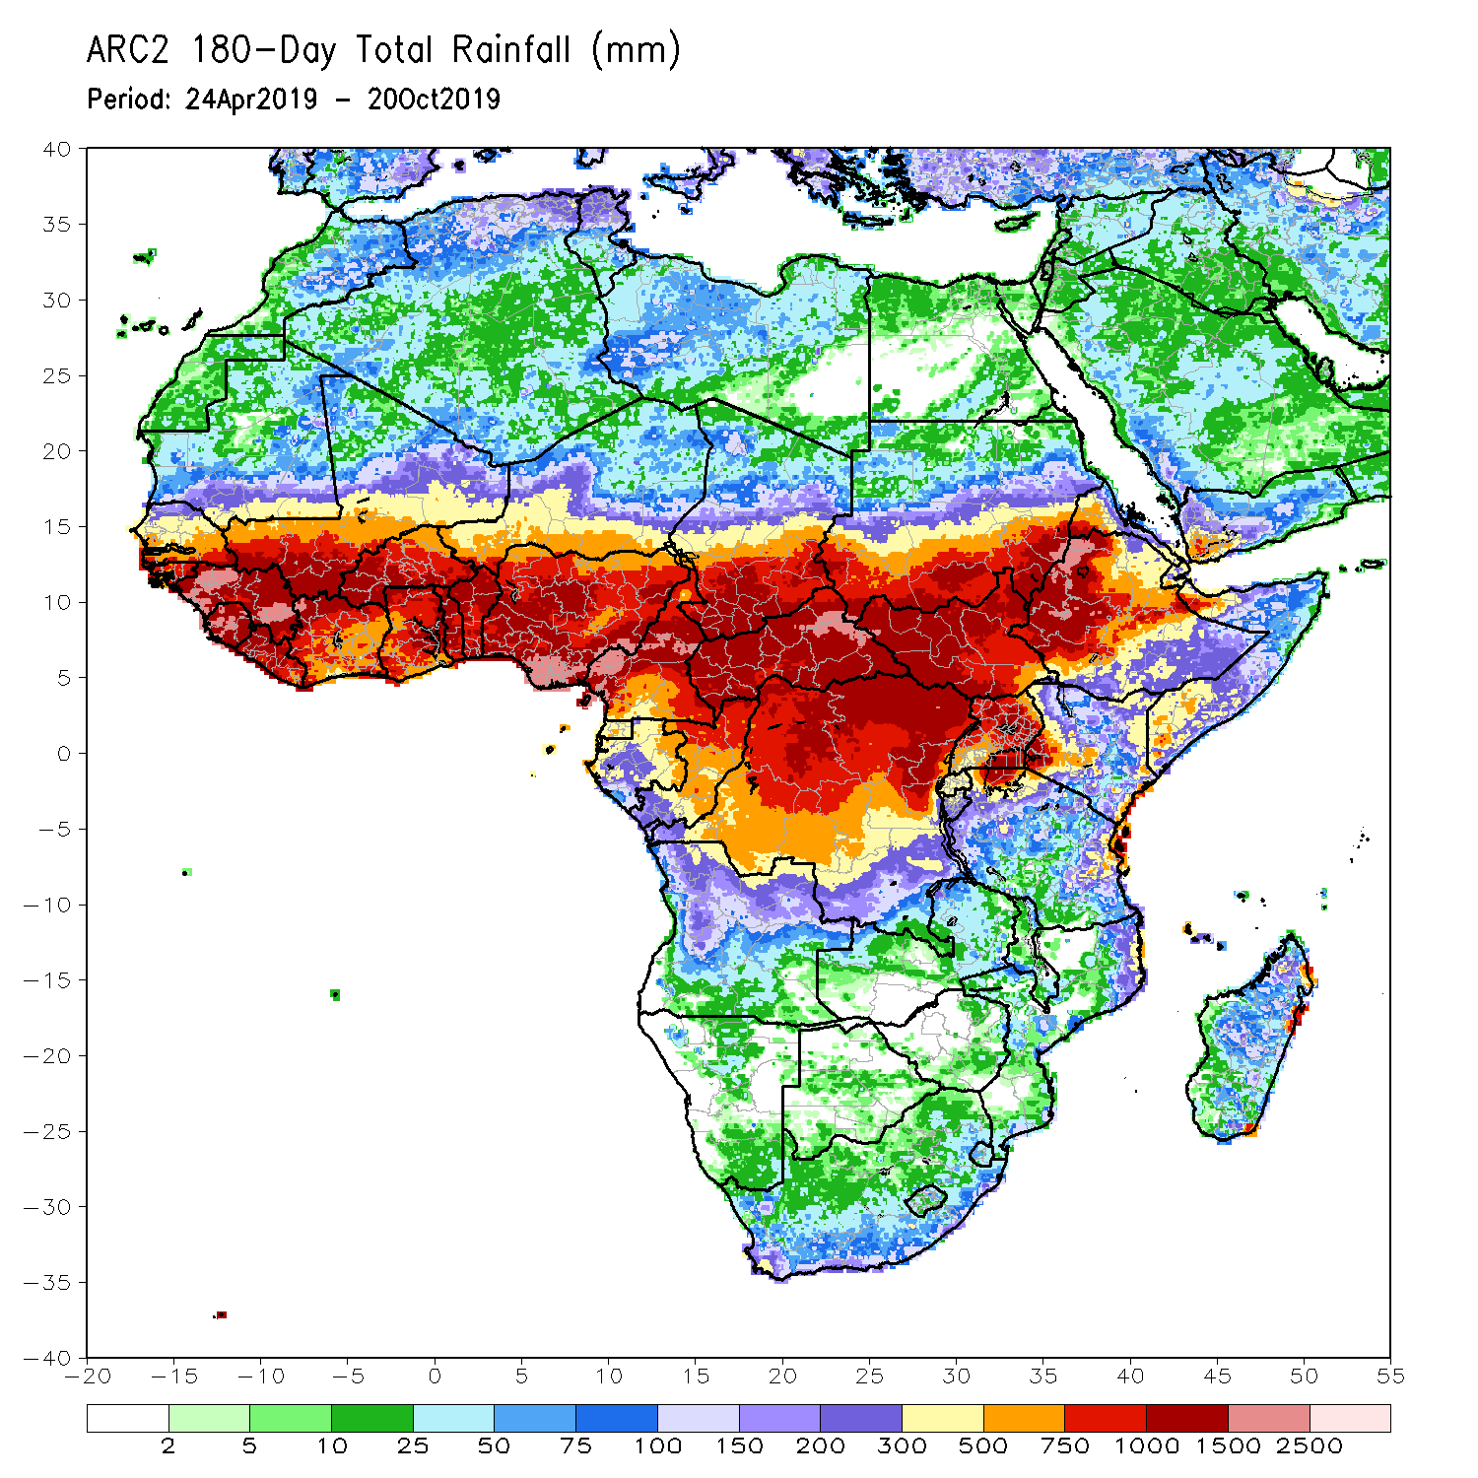
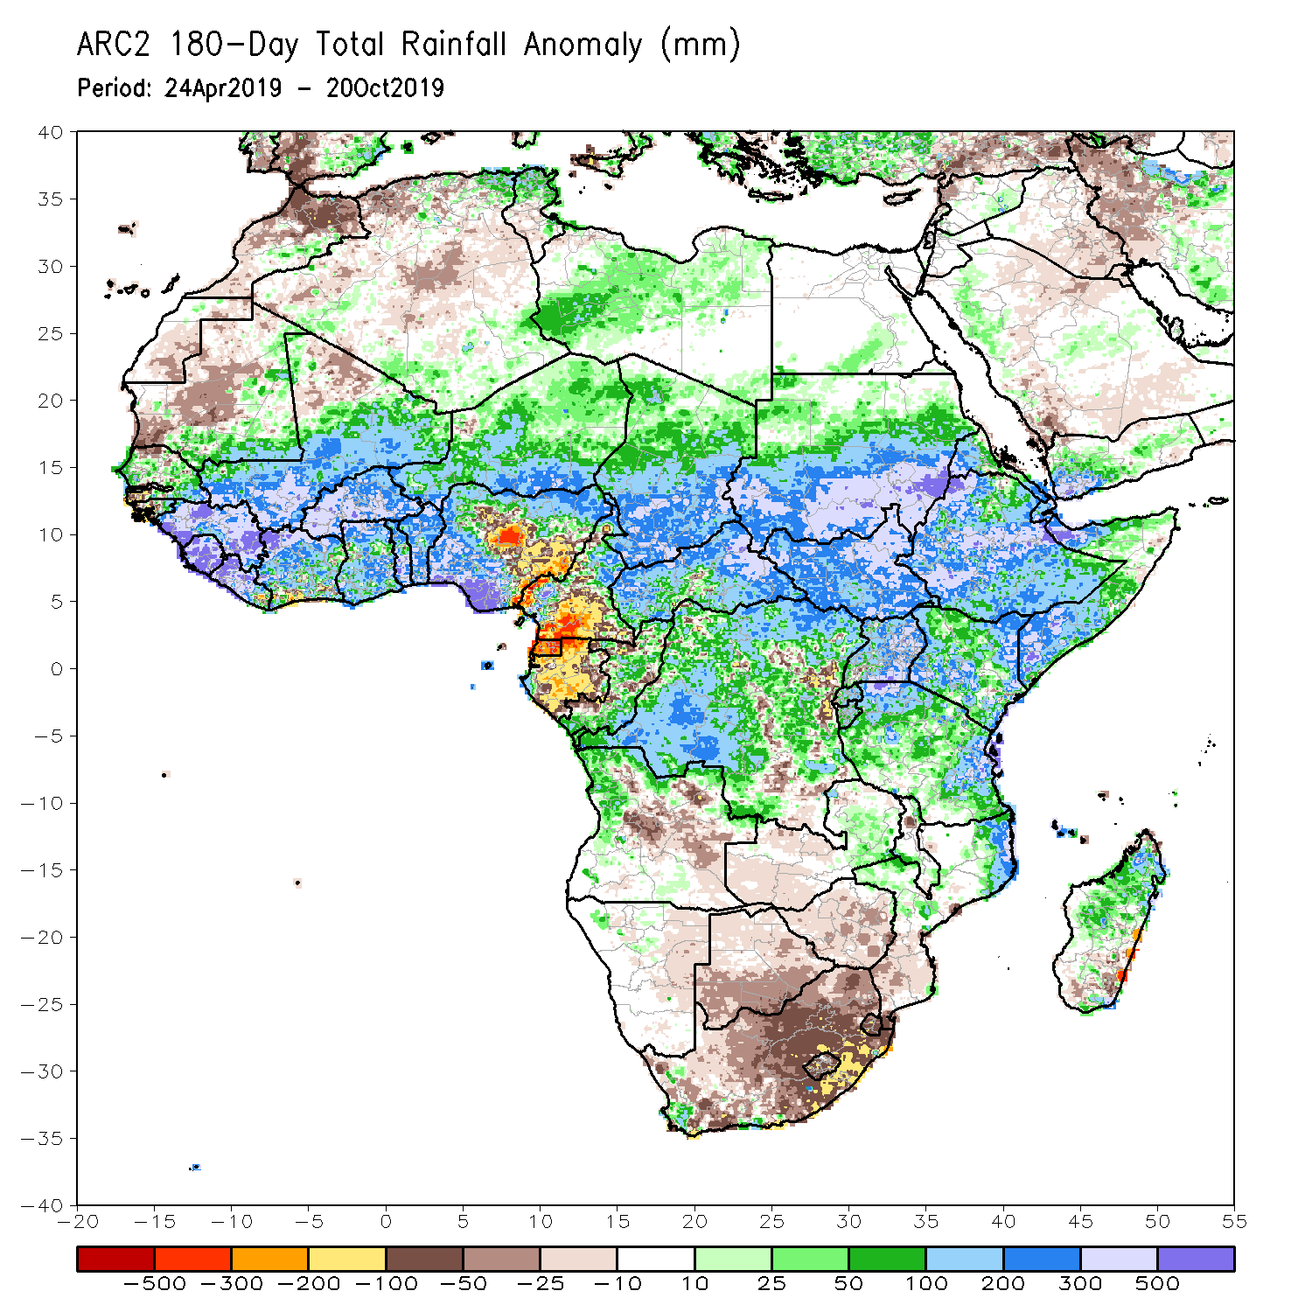
Rainfall Patterns: Last 180 Days
During the past 180 days, below-average rainfall was observed over western and central Mauritania, portions of Nigeria and Cameroon, Equatorial Guinea, Gabon, local areas in Congo, parts of central and eastern DRC, local areas in Angola, Namibia, western and northeastern South Africa, eastern Zambia, parts of Botswana, Zimbabwe, southern Mozambique and local areas in Madagascar.
Southern and eastern Mauritania, much of Senegal, Guinea-Bissau, Guinea, Sierra Leone, Mali, Liberia, Cote d’Ivoire, Burkina Faso, Ghana, Togo, Benin, portions of Nigeria and Cameroon, Niger, Chad, CAR, many parts of DRC, South Sudan, Sudan, Uganda, Eritrea, Ethiopia, Somalia, Kenya, Tanzania, portions of Angola and Zambia, local areas in Malawi, northern Mozambique, local areas in South Africa and portions of Madagascar had above-average rainfall.
Notes:
7

Slide 8
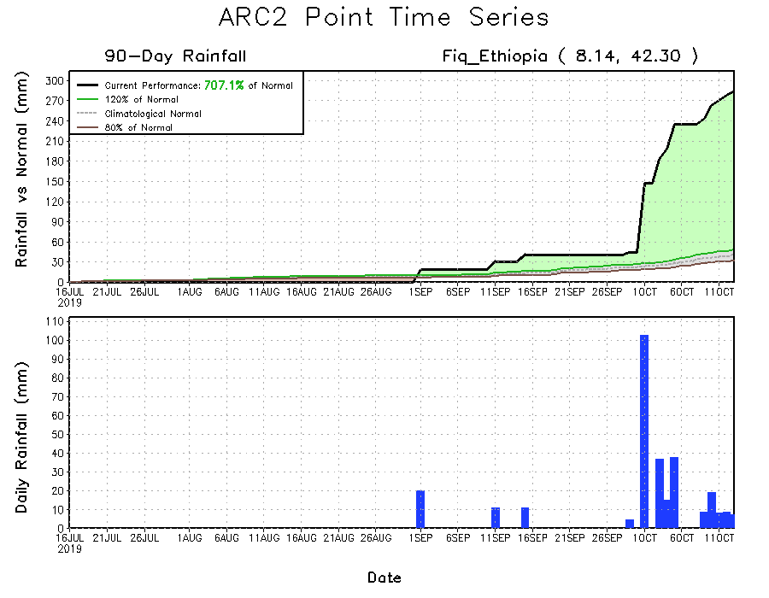
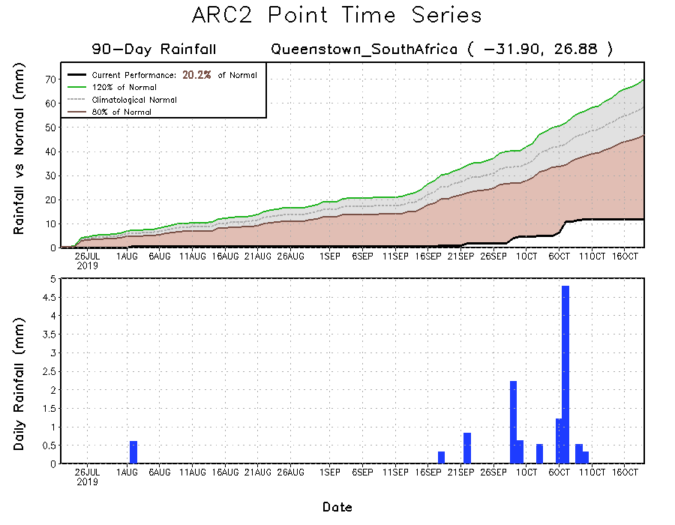
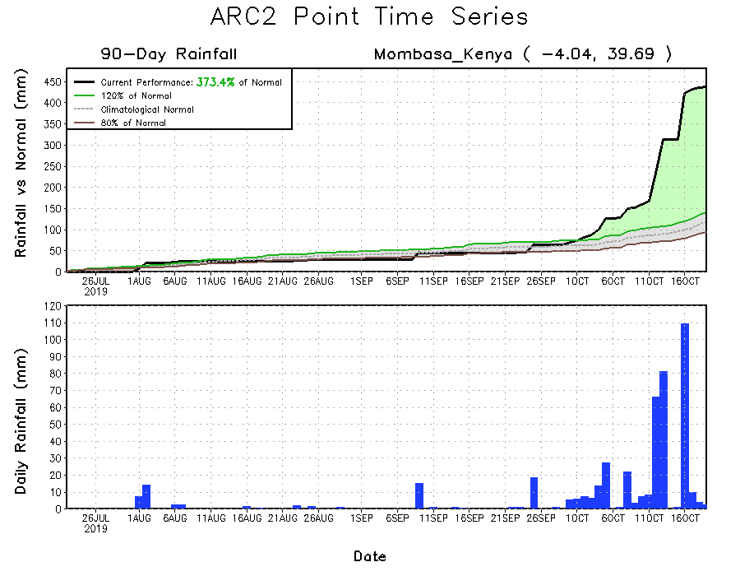
Recent Rainfall Evolution
Daily evolution of rainfall over the last 90 days at selected locations shows that moderate to locally heavy rainfall sustained moisture surpluses over parts of Kenya (bottom right) and many parts of Ethiopia (top right). Early season dryness was observed across southern South Africa (bottom left).

Slide 9
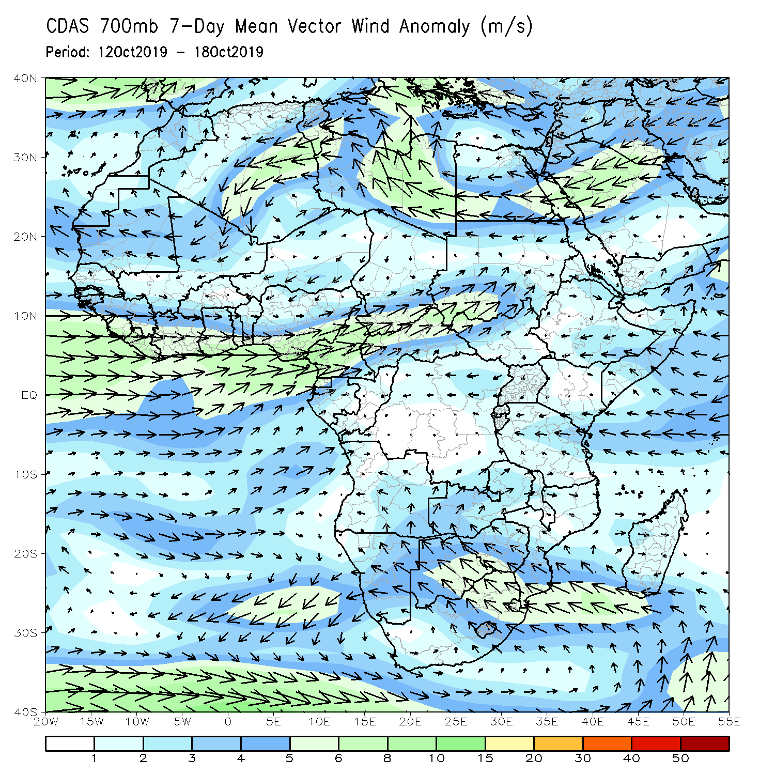
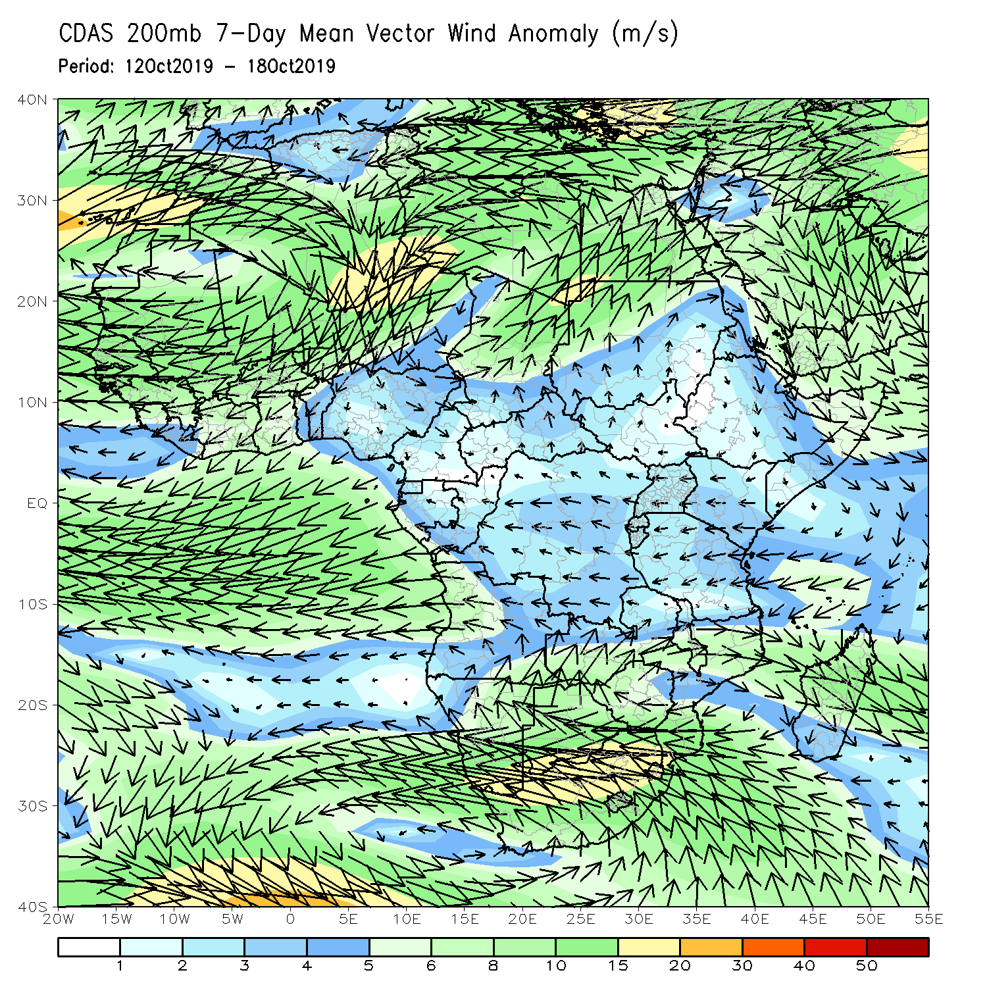
Atmospheric Circulation: Last 7 Days
Anomalous onshore westerly to southwesterly flow was observed along the Gulf of Guinea and the neighboring areas of Central Africa. Another week of onshore flow from the Indian Ocean may have contributed to the observed above-Average rainfall over portions of the Greater Horn of Africa (left panel).

Slide 10
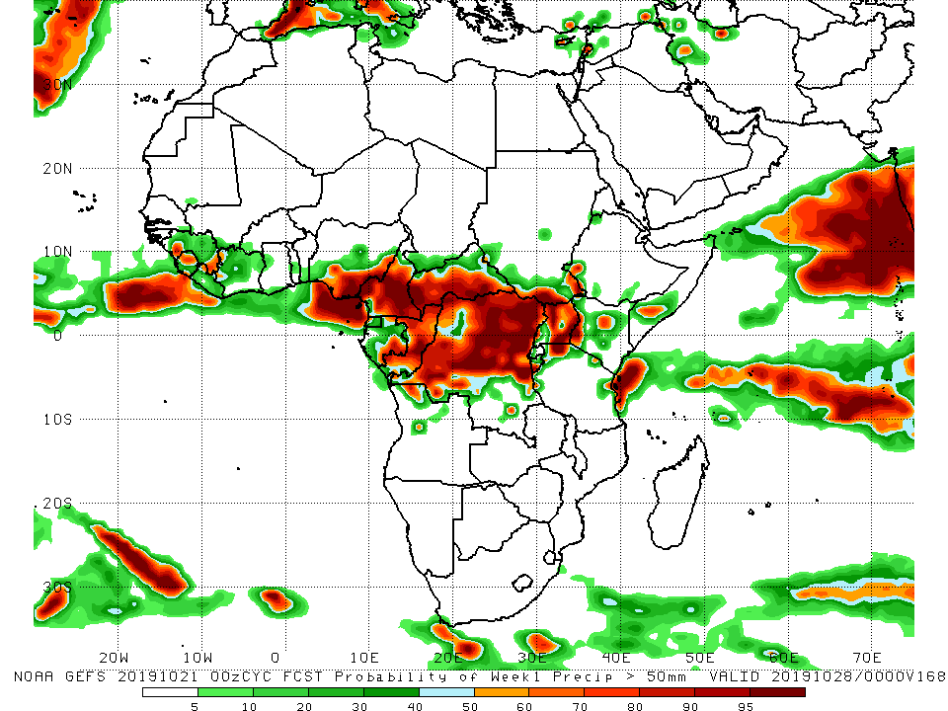
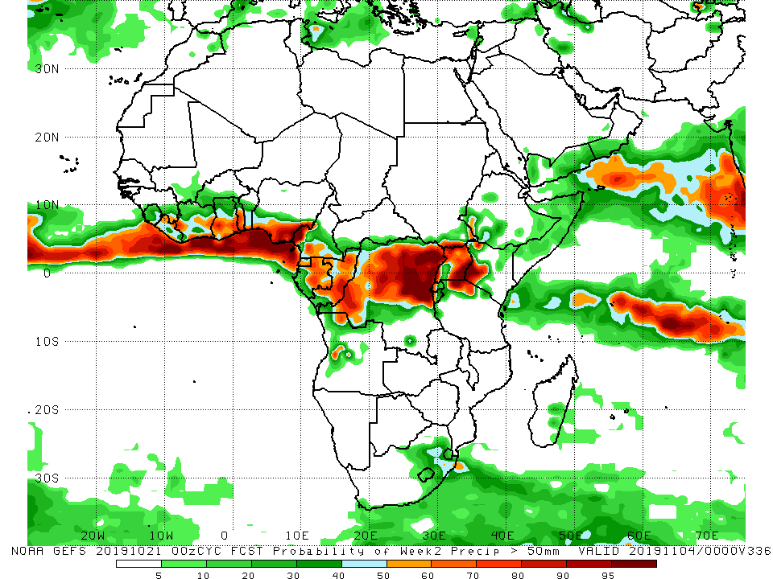
NCEP GEFS Model Forecasts Non-Bias Corrected Probability of precipitation exceedance
Week-1: Valid 22 – 28 October, 2019
Week-2: Valid 29 October – 5 November, 2019
For week-1 (left panel) and week-2 (right panel), there is an increased chance for weekly rainfall totals to exceed 50mm along the Gulf of Guinea coast and portions of Central Africa.
Notes:
10

Slide 11
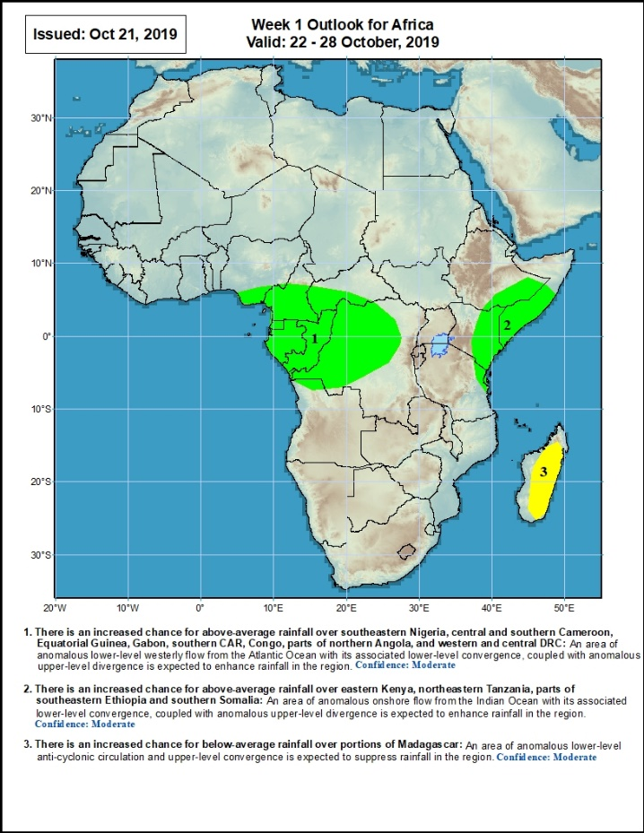
Week-1 Precipitation Outlooks
22 – 28 October, 2019
There is an increased chance for above-average rainfall over southeastern Nigeria, central and southern Cameroon, Equatorial Guinea, Gabon, southern CAR, Congo, parts of northern Angola, and western and central DRC: An area of anomalous lower-level westerly flow from the Atlantic Ocean with its associated lower-level convergence, coupled with anomalous upper-level divergence is expected to enhance rainfall in the region. Confidence: Moderate
There is an increased chance for above-average rainfall over eastern Kenya, northeastern Tanzania, parts of southeastern Ethiopia and southern Somalia: An area of anomalous onshore flow from the Indian Ocean with its associated lower-level convergence, coupled with anomalous upper-level divergence is expected to enhance rainfall in the region. Confidence: Moderate
There is an increased chance for below-average rainfall over portions of Madagascar: An area of anomalous lower-level anti-cyclonic circulation and upper-level convergence is expected to suppress rainfall in the region. Confidence: Moderate
Notes:
11

Slide 12
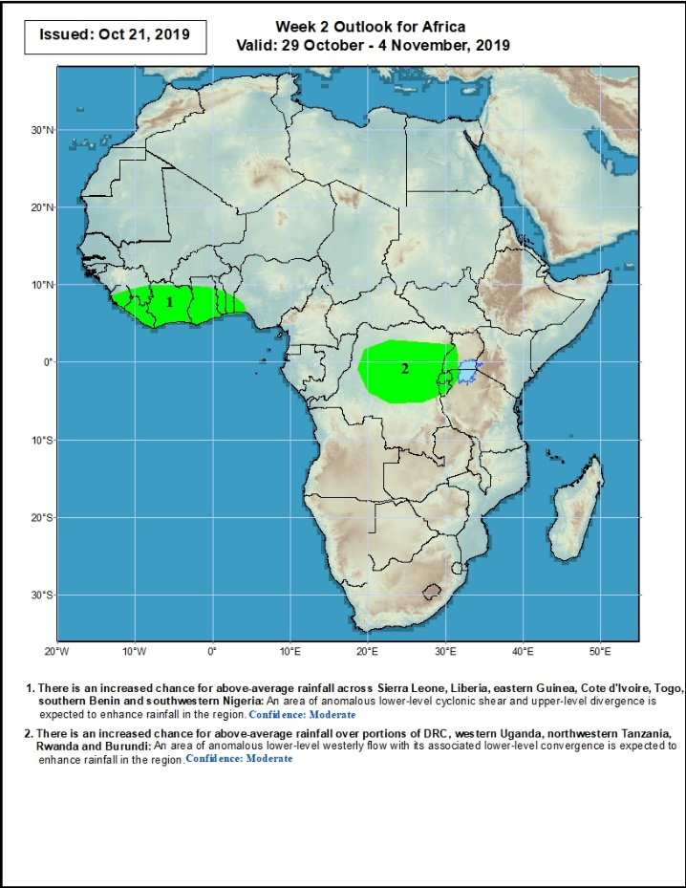
Week-2 Precipitation Outlooks
29 October – 5 November, 2019
There is an increased chance for above-average rainfall across Sierra Leone, Liberia, eastern Guinea, Cote d'Ivoire, Togo, southern Benin and southwestern Nigeria: An area of anomalous lower-level cyclonic shear and upper-level divergence is expected to enhance rainfall in the region. Confidence: Moderate
There is an increased chance for above-average rainfall over portions of DRC, western Uganda, northwestern Tanzania, Rwanda and Burundi: An area of anomalous lower-level westerly flow with its associated lower-level convergence is expected to enhance rainfall in the region. Confidence: Moderate
Notes:
12

Slide 13
Summary
During the past 7 days, rainfall was above-average over local areas in Mauritania and Senegal, Cote d’Ivoire, Mali and Cote d’Ivoire, Ghana, Burkina Faso, Togo Benin, Nigeria, parts of Cameroon and Gabon, central and southern Chad, portions of Sudan and South Sudan, southern Ethiopia, southern Somalia, Kenya, eastern Uganda, parts of Congo, central and southern DRC, portions Tanzania, northern Angola and parts of northern Madagascar. Many parts of Guinea, Liberia, portions of Cote d’Ivoire, Sierra Leone, Liberia, much of Cote d’Ivoire, parts of Ghana, parts of Nigeria, Equatorial Guinea, portions of Cameroon and Gabon, CAR, northern DRC, central and eastern Angola, western Ethiopia, portions of South Africa and southern Madagascar had below-average rainfall.
During the past 30 days, rainfall was above-average over southern Mauritania, many parts of Senegal, Guinea-Bissau and Guinea, Sierra Leone, Liberia, southern Mali, Burkina Faso, Ghana, Cote d’Ivoire, Togo, Benin, many parts of Nigeria, portions of Cameroon, central and southern Chad, much of CAR and Congo, portions of Gabon, many parts of DRC, much of South Sudan, Sudan, Ethiopia, Eritrea, Uganda, Tanzania, Somalia, Kenya, portions of Angola, eastern Zambia, and local areas in Namibia and Mozambique, and portions of Madagascar. Local areas in Senegal, Guinea and Mali, parts of Nigeria Cameroon, many parts of Gabon, portions of Angola and DRC, western Zambia, Botswana, Zimbabwe, and many parts of South Africa had below-average rainfall.
During the past 90 days, rainfall was above-average over southern and eastern Mauritania, much of Senegal, Guinea-Bissau, Guinea, Sierra Leone, Liberia, Mali, Cote d’Ivoire, Burkina Faso, Ghana, Togo, Benin, Niger, many parts of Nigeria, Chad, portions of Cameroon, CAR, many parts of DRC, South Sudan, Uganda, Sudan, Eritrea, Ethiopia, Kenya, Somalia, many parts of Tanzania, portions of Angola, eastern Zambia, and local areas in Mozambique and Madagascar. Western and central Mauritania, parts of Nigeria and Cameroon, Gabon, portions of central and eastern DRC, portions of Angola, western Zambia, Zimbabwe, eastern Namibia, Botswana and many parts of South Africa had below-average rainfall.
Week-1 outlooks call for an increased chance for above-average rainfall over southeastern Nigeria, central and southern Cameroon, Equatorial Guinea, Gabon, southern CAR, Congo, parts of northern Angola, and western and central DRC. Outlooks also call for above-average rainfall over eastern Kenya, northeastern Tanzania, parts of southeastern Ethiopia and southern Somalia. In contrast, there is an increased chance for below-average rainfall over portions of Madagascar.
Notes:
13

