Slide 1
The African Monsoon Recent Evolution and Current Status Include Week-1 and Week-2 Outlooks
Update prepared by
Climate Prediction Center / NCEP
04 November 2019
For more information, visit:
http://www.cpc.ncep.noaa.gov/products/Global_Monsoons/African_Monsoons/precip_monitoring.shtml

Slide 2
Outline
Highlights
Recent Evolution and Current Conditions
NCEP GEFS Forecasts
Summary

Slide 3
Highlights: Last 7 Days
Rainfall was above-average over much of the Gulf of Guinea region, while suppressed rainfall prevailed over many places in Central Africa.
Week-1 outlooks call for an increased chance for above-average rainfall over western Angola, southern Ethiopia, Somalia and parts of northern Kenya. Outlooks also call for above-average rainfall over eastern South Africa, Lesotho and Eswantini. In contrast, there is an increased chance for below-average rainfall over eastern and southern DRC, Rwanda, Burundi, Uganda, northern Tanzania and western Kenya, parts of eastern Angola, much of Zambia, northern Zimbabwe, western Mozambique, central Malawi and southern Madagascar.

Slide 4
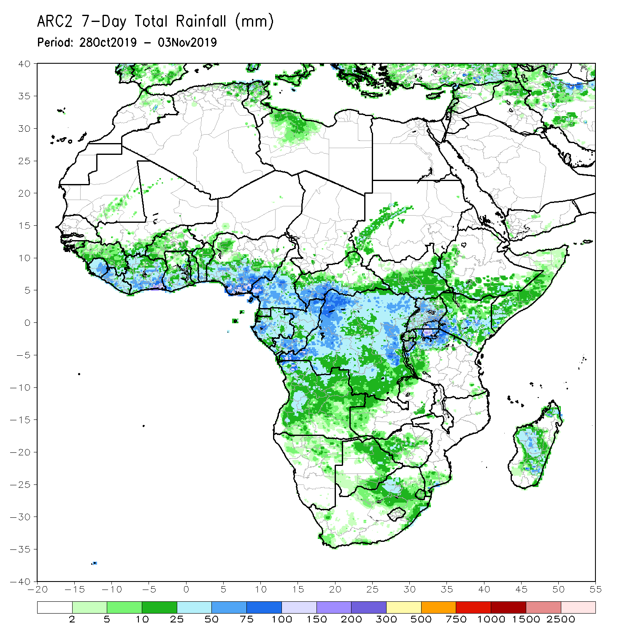
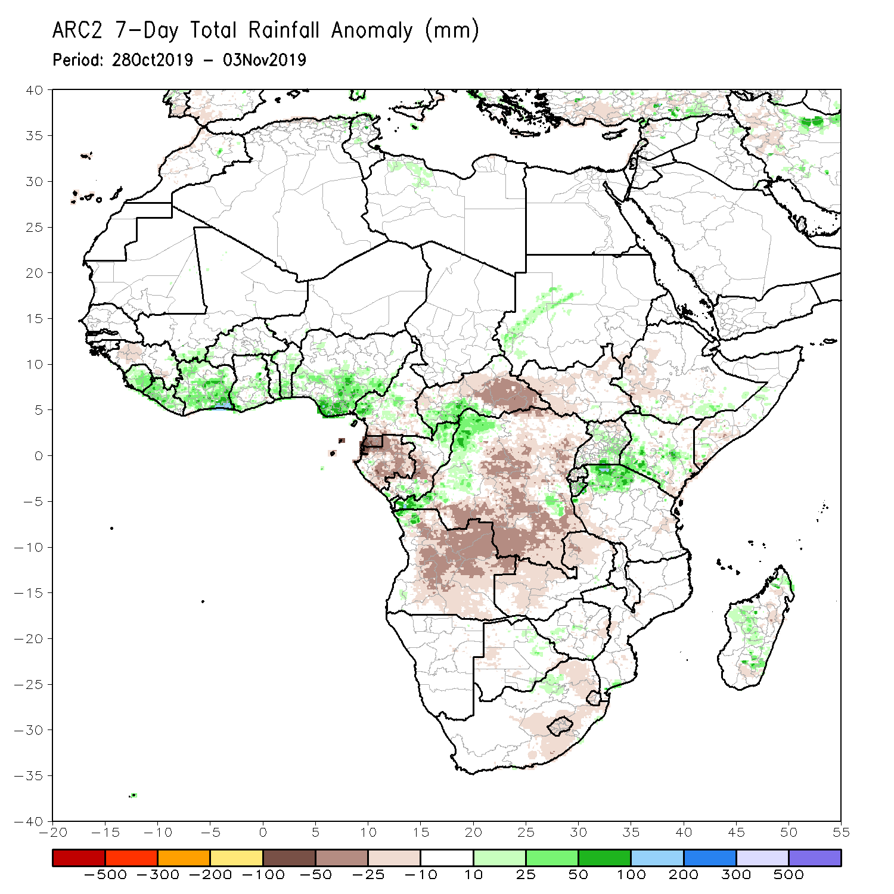
Rainfall Patterns: Last 7 Days
During the past 7 days, rainfall was above-average over Sierra Leone, Liberia, Cote d’Ivoire, local areas in Ghana, Togo, Benin and Cameroon, western CAR, northern Congo, western DRC, northwestern Angola, parts of Uganda, northern Tanzania, parts of southern Somalia and Kenya, and portions of Madagascar.
Portions of Guinea, Equatorial Guinea, southern Cameroon, Gabon, central Congo, portions of CAR, many parts of DRC and Angola, parts of South Sudan and Ethiopia, portions of Zambia, and eastern South Africa had below-average rainfall.

Slide 5
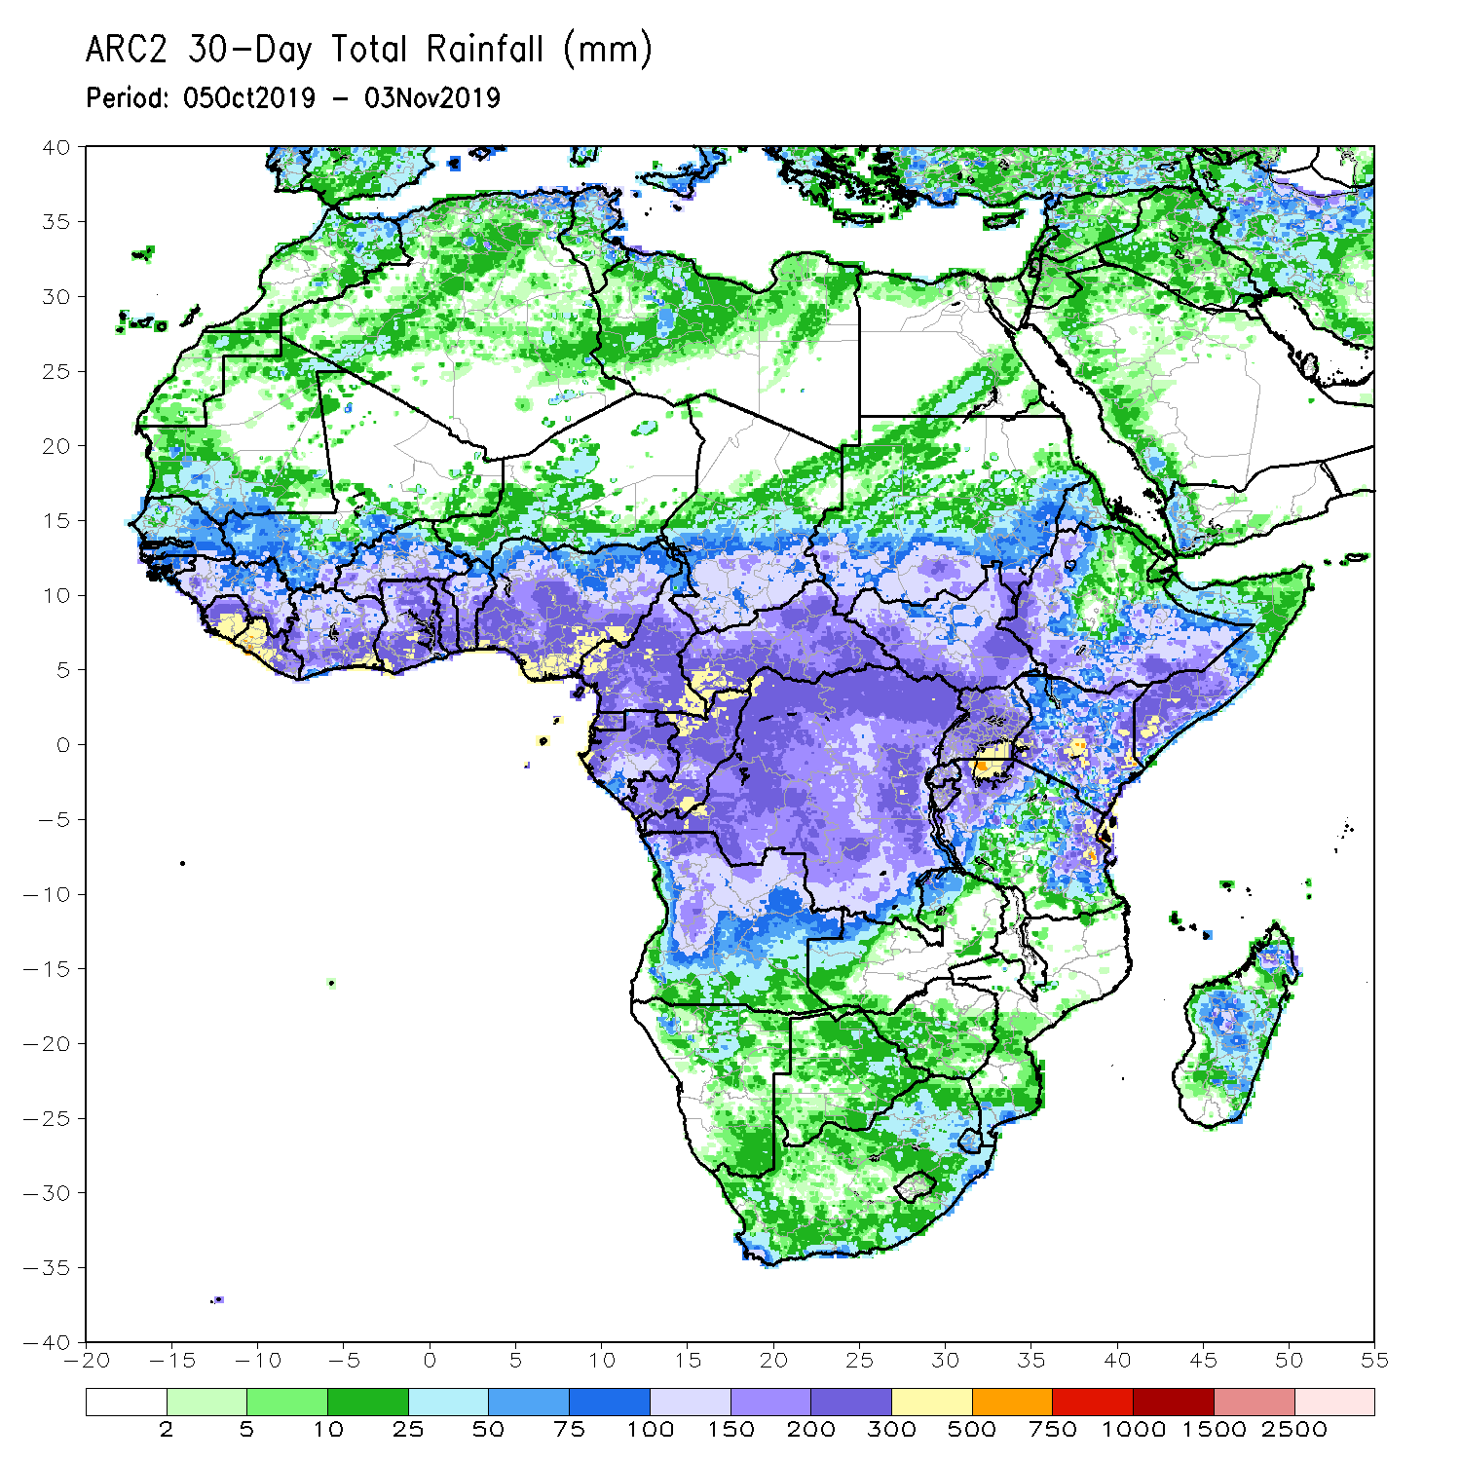
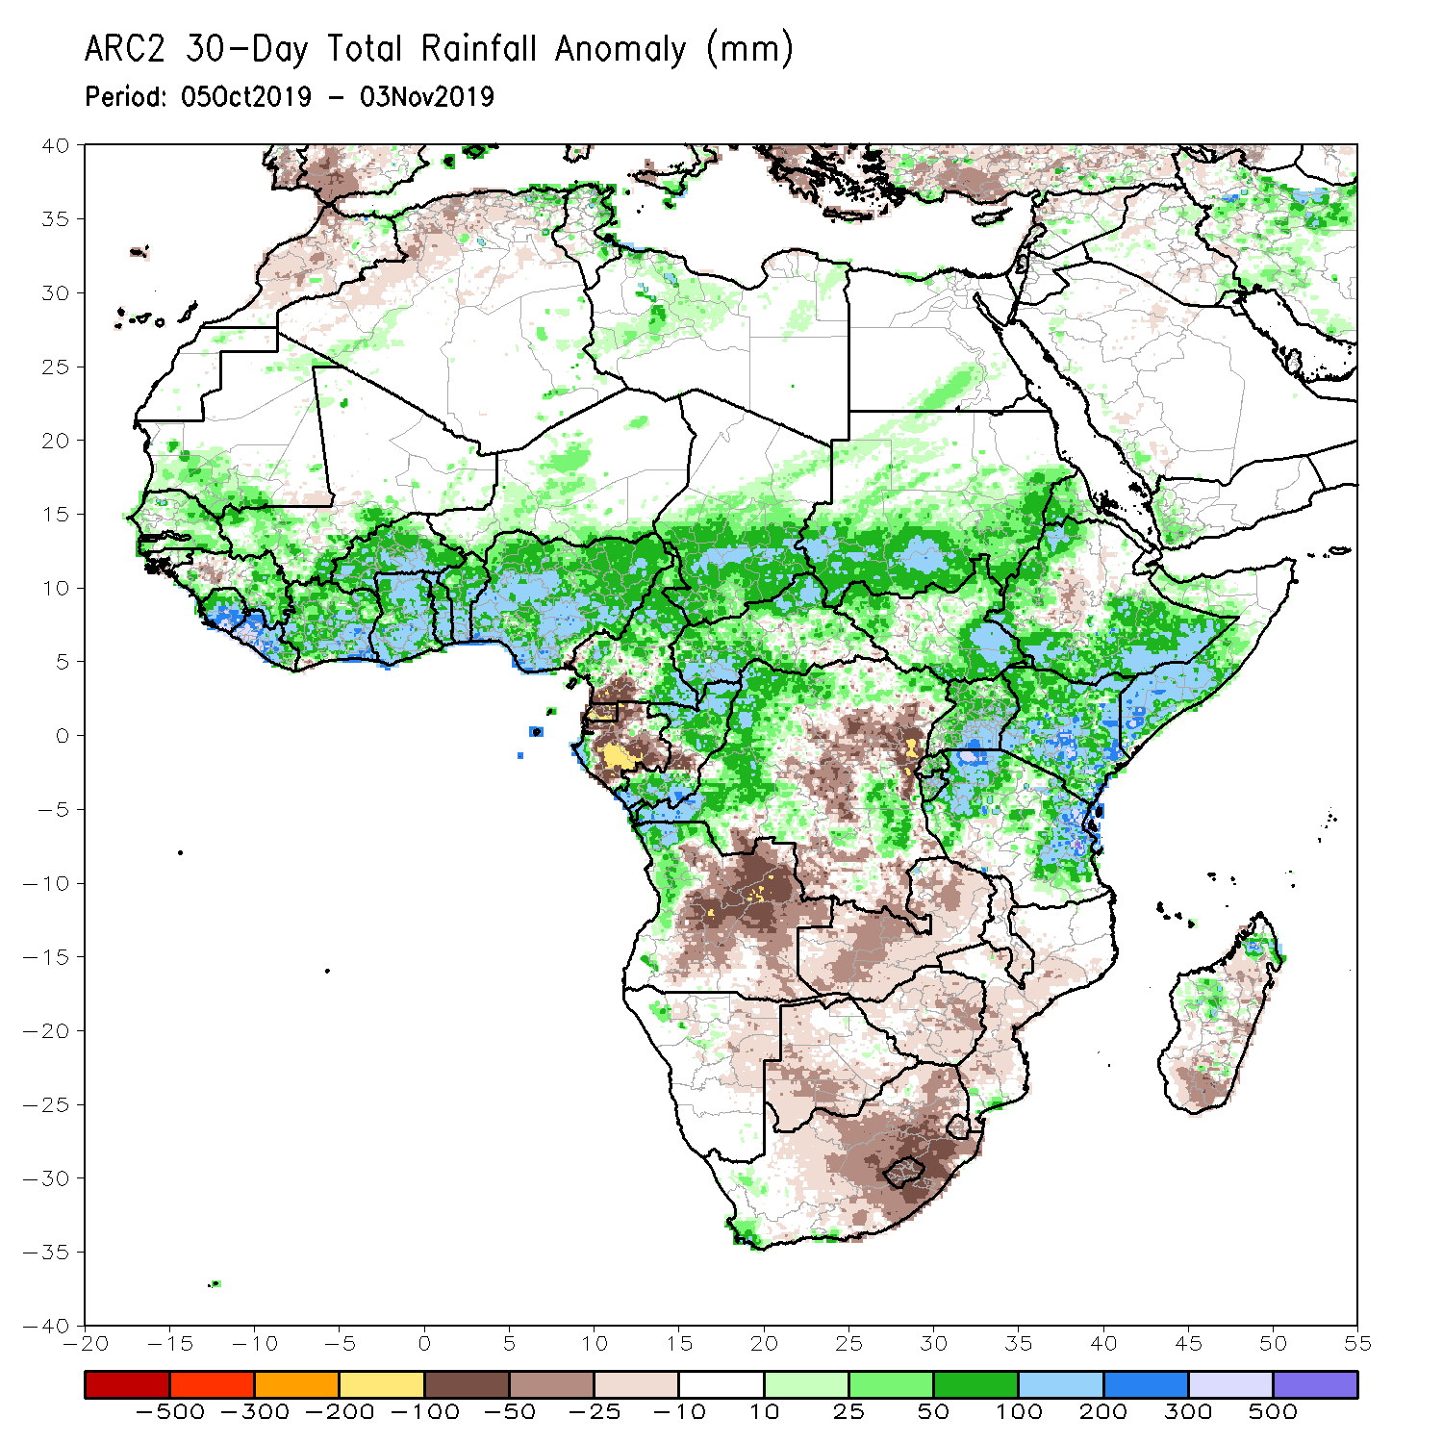
Rainfall Patterns: Last 30 Days
During the past 30 days, rainfall was above-average over southern Mauritania, many parts of Senegal, Guinea-Bissau, portions of Guinea, Sierra Leone, Liberia, southern Mali, Burkina Faso, Ghana, Cote d’Ivoire, Togo, Benin, much of Nigeria, portions of Cameroon, central and southern Chad, portions of CAR and Congo, western Gabon, portions of DRC, South Sudan, Sudan, many parts of Ethiopia, Eritrea, Uganda, Tanzania, Somalia, Kenya, western Angola, local areas in Namibia and Mozambique, and portions of Madagascar.
Local areas in Guinea and Mali, parts of Cameroon, many parts of Gabon, portions of Angola and DRC, eastern Namibia, Zambia, Malawi, Botswana, Zimbabwe, portions of Madagascar and many parts of South Africa had below-average rainfall.
Notes:
5

Slide 6
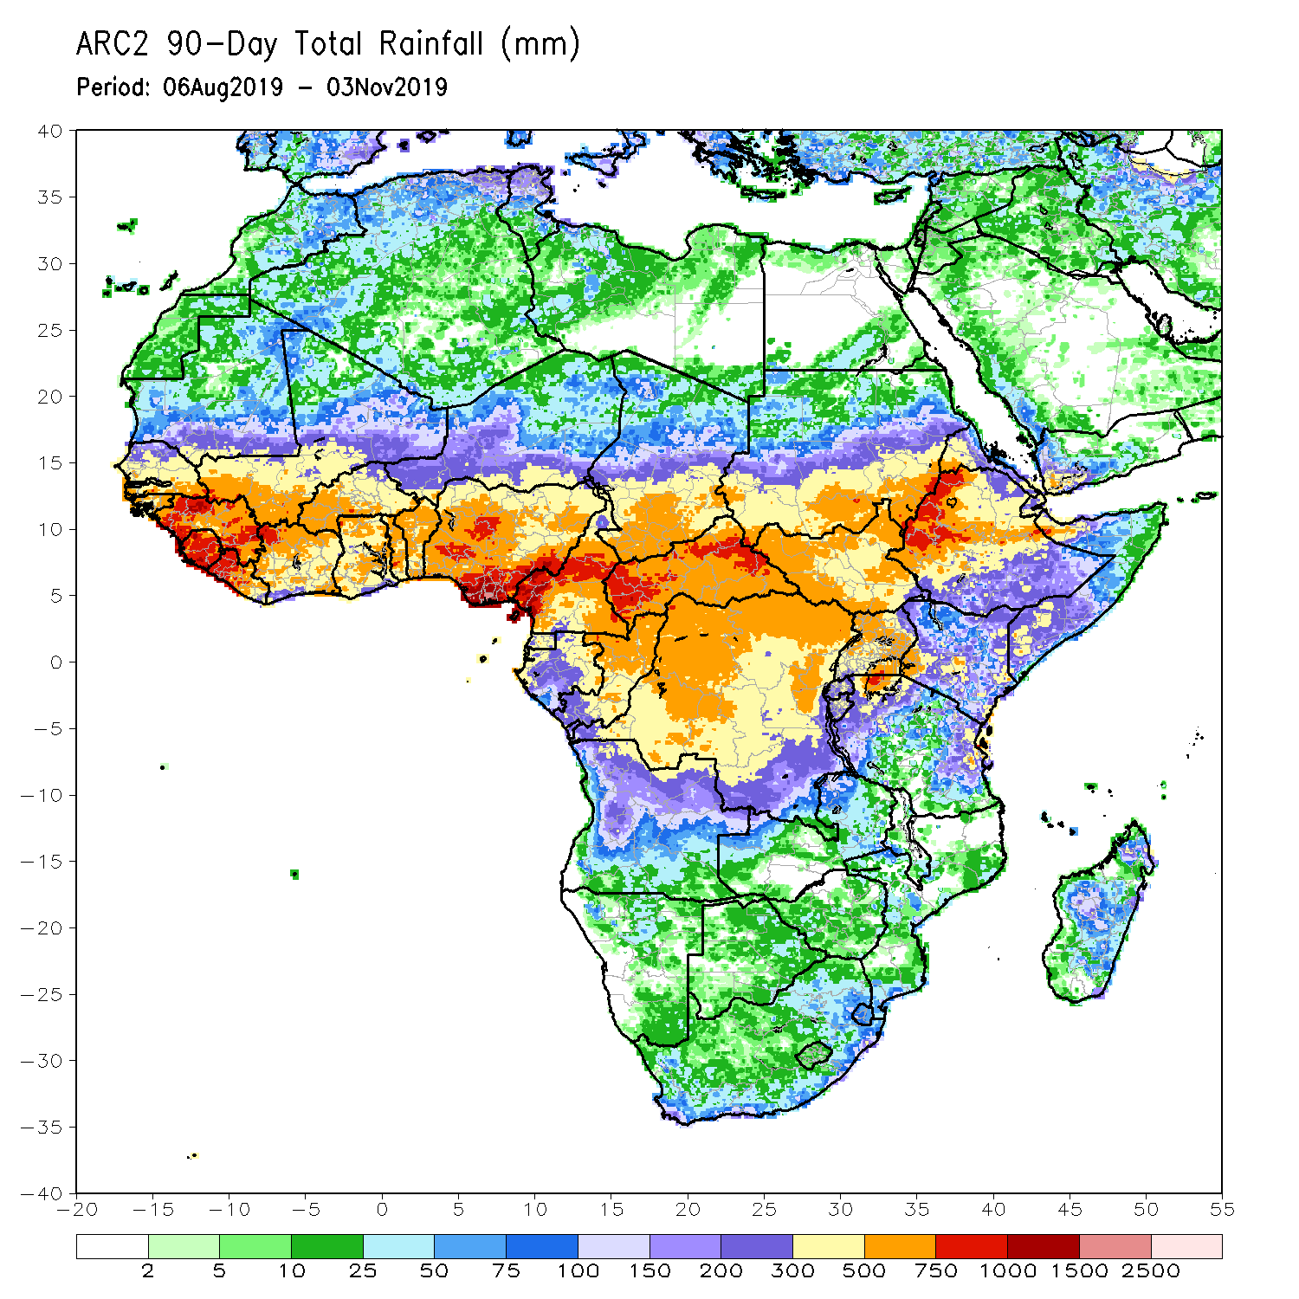
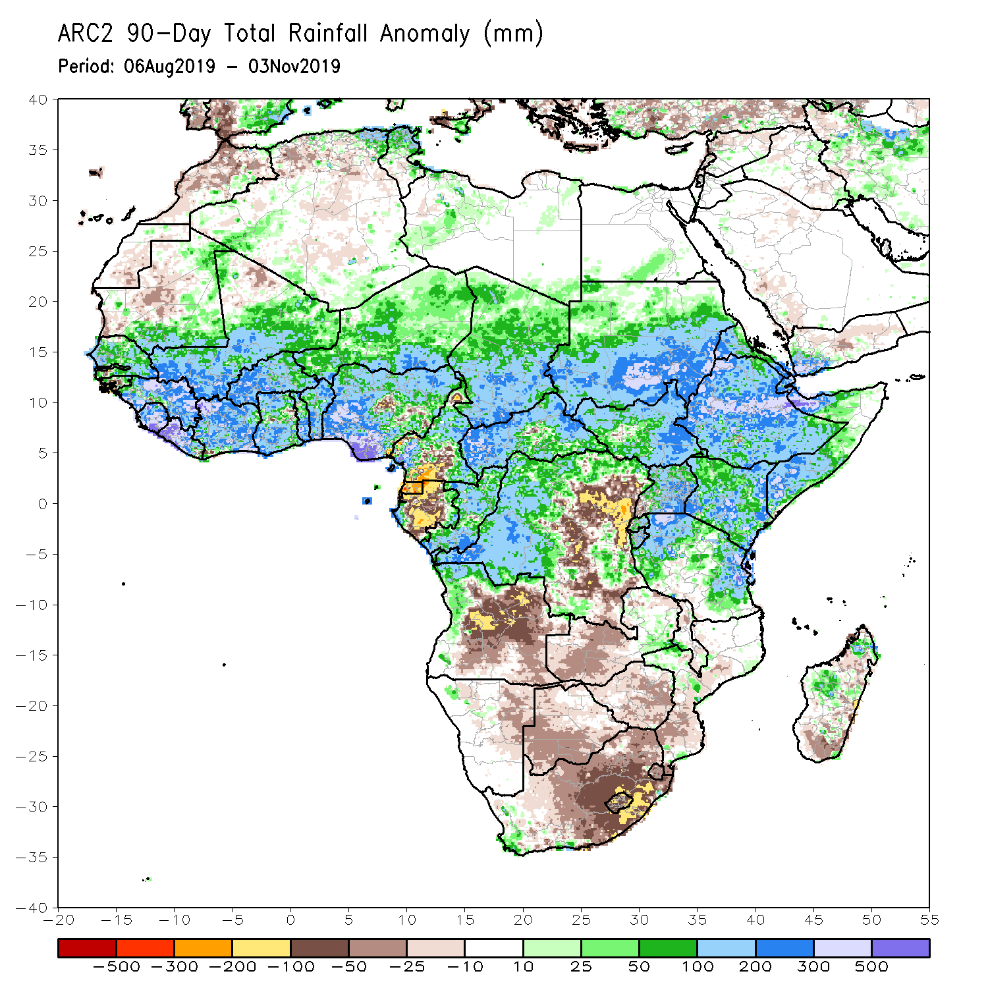
Rainfall Patterns: Last 90 Days
During the past 90 days, rainfall was above-average over southern and eastern Mauritania, much of Senegal, Guinea-Bissau, Guinea, Sierra Leone, Liberia, Mali, Cote d’Ivoire, Burkina Faso, Ghana, Togo, Benin, Niger, many parts of Nigeria, Chad, portions of Cameroon, CAR, many parts of DRC, South Sudan, Uganda, Sudan, Eritrea, Ethiopia, Kenya, Somalia, many parts of Tanzania, portions of Angola, eastern Zambia, and local areas in Mozambique and Madagascar.
Western and central Mauritania, parts of Nigeria and Cameroon, Gabon, portions of central and eastern DRC, many parts of Angola, Zambia, Zimbabwe, eastern Namibia, Botswana, southern Madagascar and many parts of South Africa had below-average rainfall.
Notes:
6

Slide 7
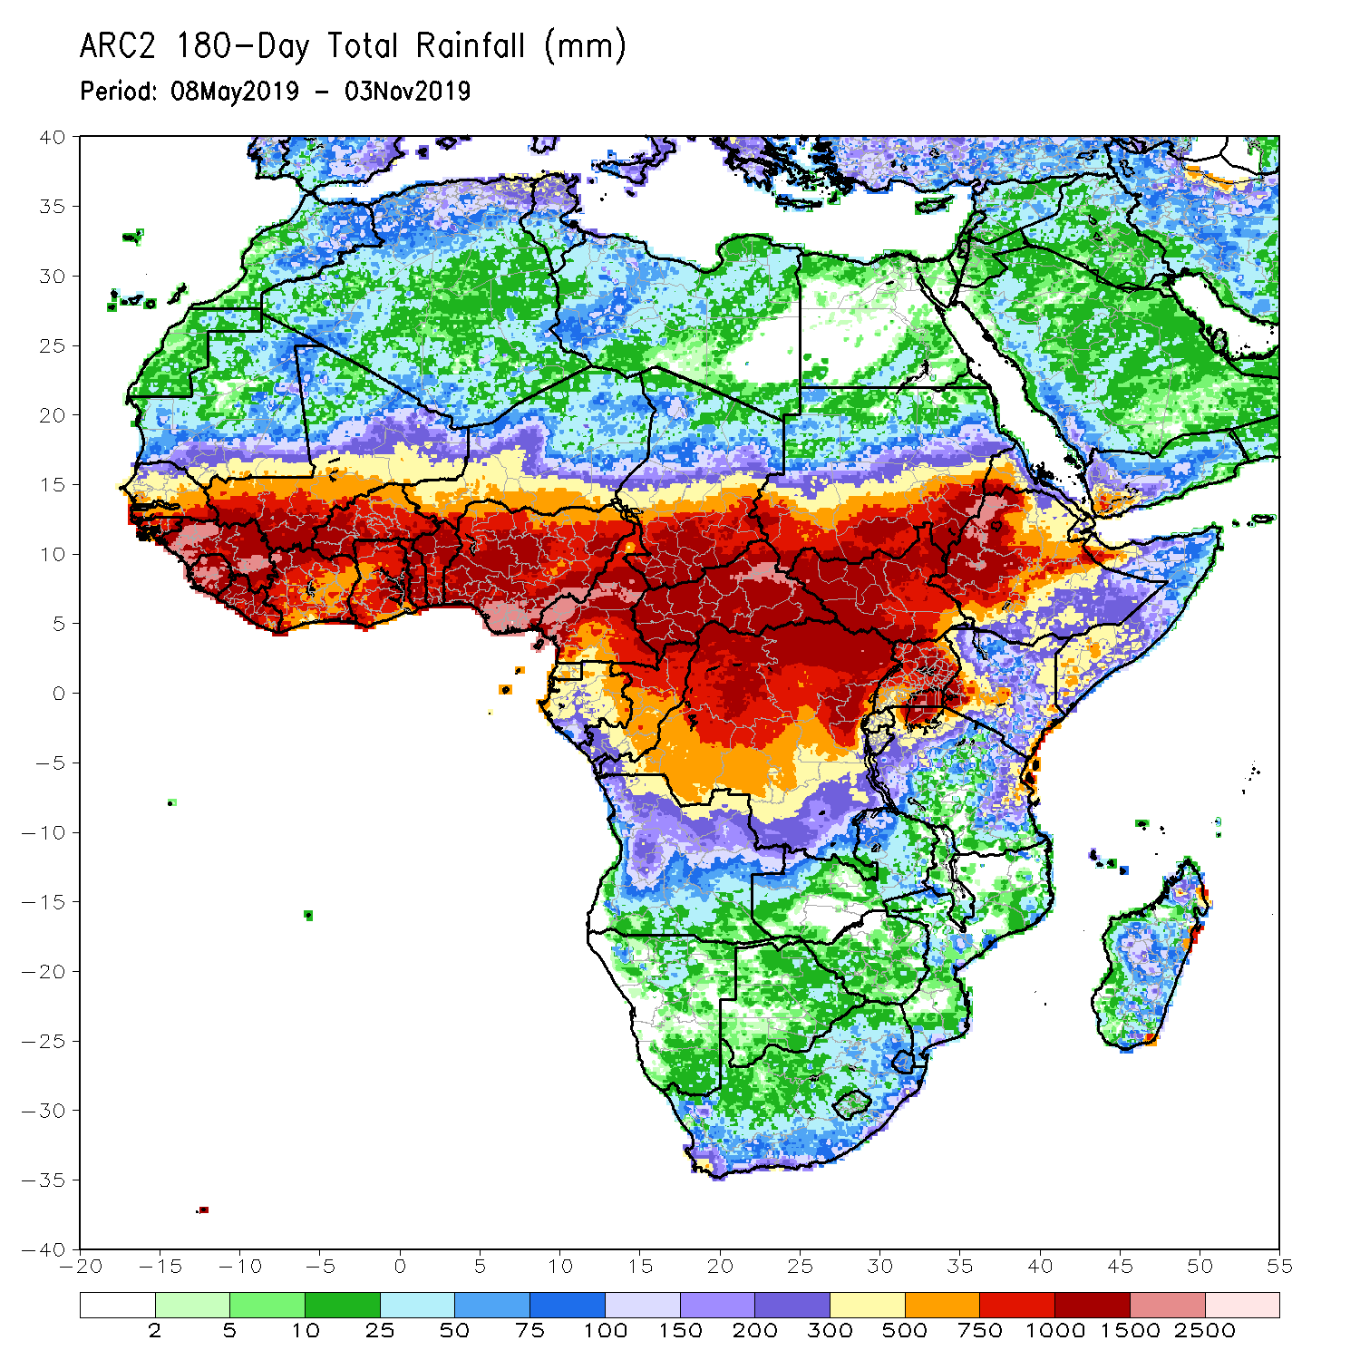
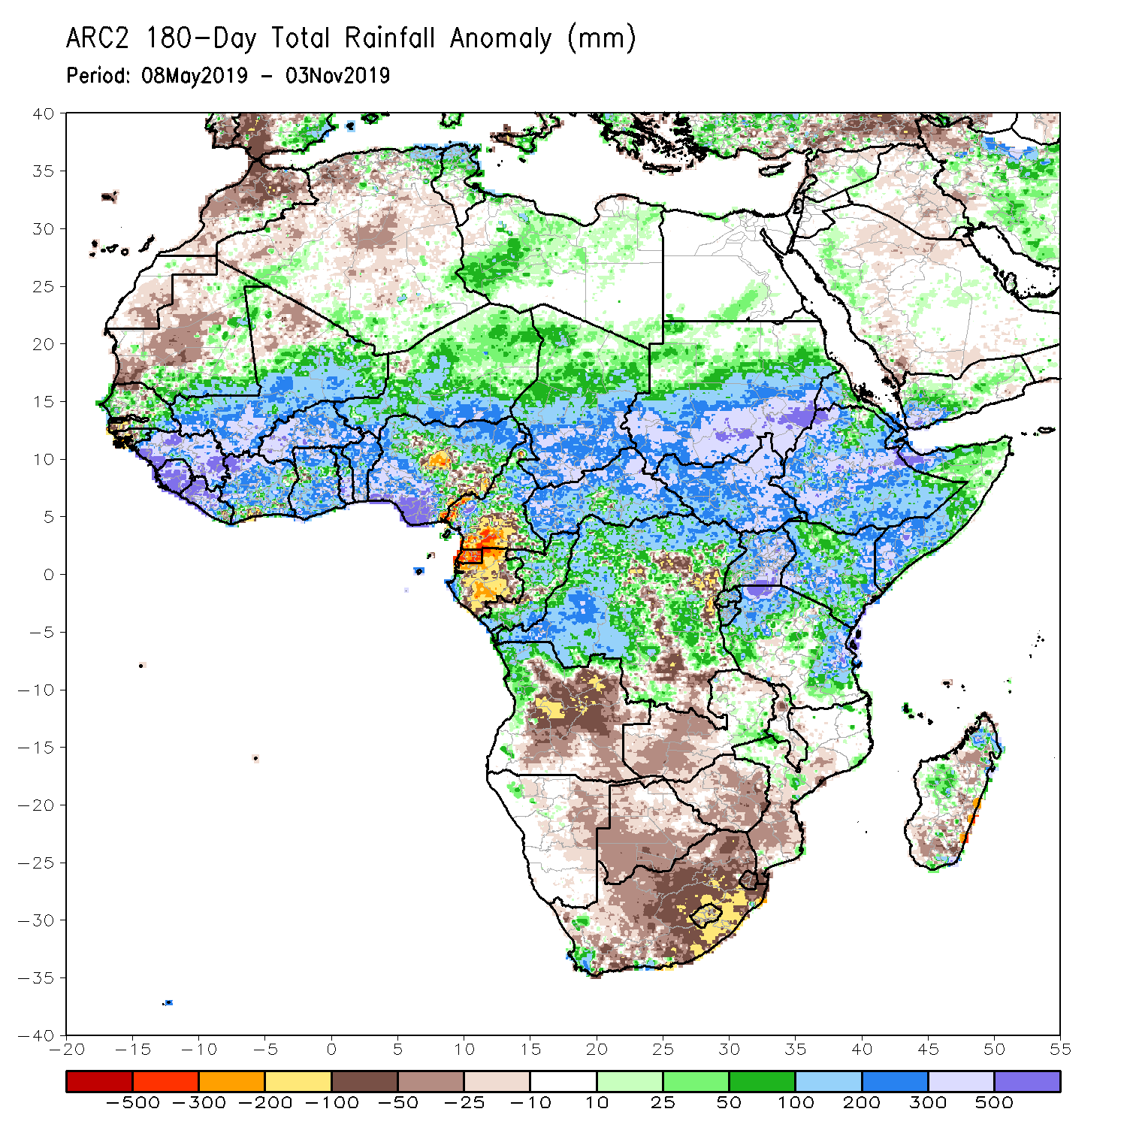
Rainfall Patterns: Last 180 Days
During the past 180 days, below-average rainfall was observed over western and central Mauritania, portions of Nigeria and Cameroon, Equatorial Guinea, Gabon, local areas in Congo, parts of central and eastern DRC, many parts of Angola, Namibia, western and northeastern South Africa, Zambia, parts of Botswana, Zimbabwe, southern Mozambique and southern Madagascar.
Southern and eastern Mauritania, much of Senegal, Guinea-Bissau, Guinea, Sierra Leone, Mali, Liberia, Cote d’Ivoire, Burkina Faso, Ghana, Togo, Benin, portions of Nigeria and Cameroon, Niger, Chad, CAR, many parts of DRC, South Sudan, Sudan, Uganda, Eritrea, Ethiopia, Somalia, Kenya, Tanzania, western Angola and parts of eastern Zambia, local areas in Mozambique and South Africa and portions of Madagascar had above-average rainfall.
Notes:
7

Slide 8
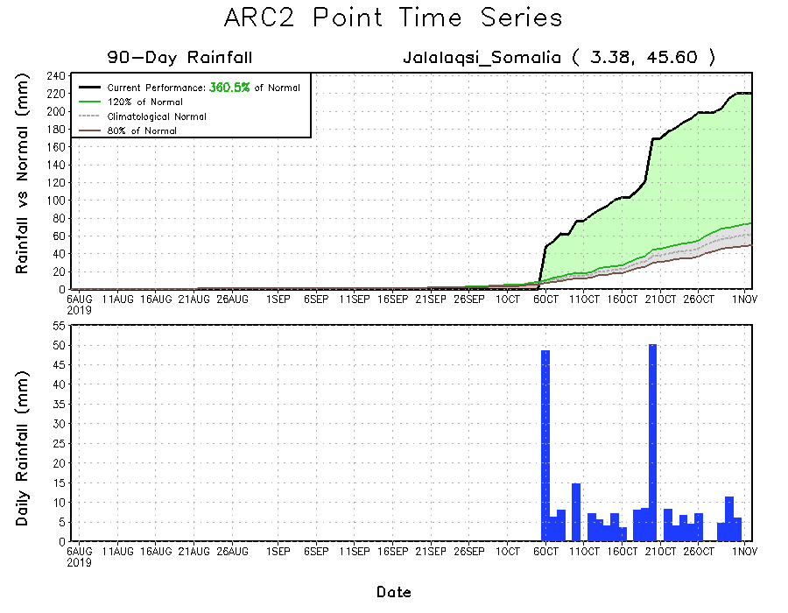
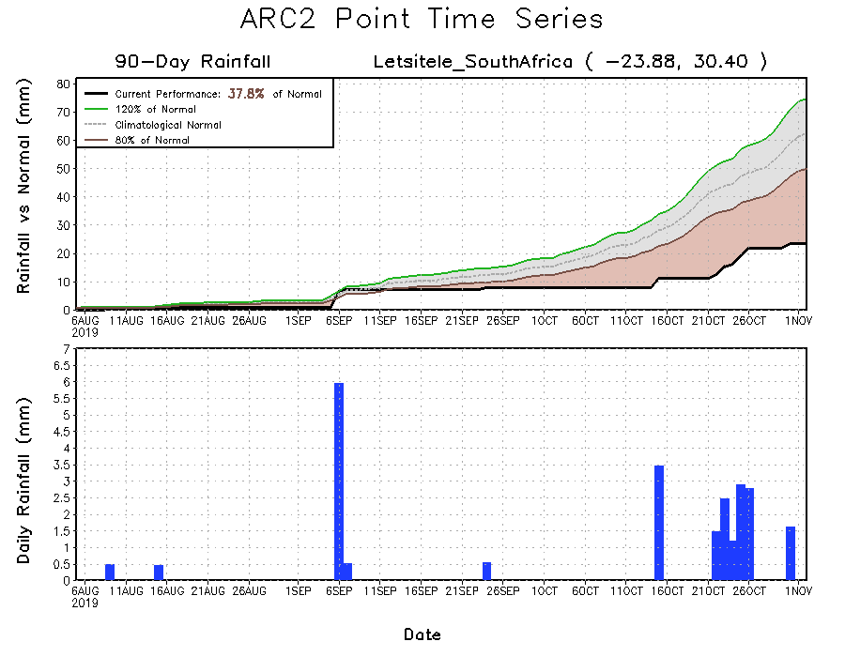
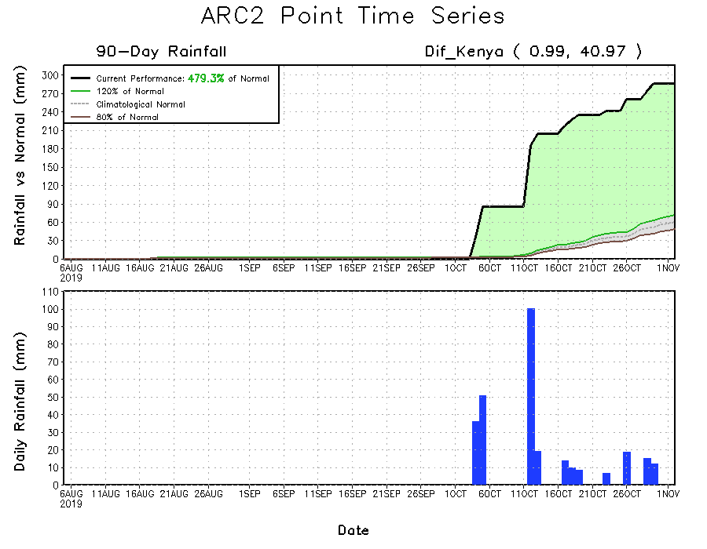
Recent Rainfall Evolution
Daily evolution of rainfall over the last 90 days at selected locations shows that moderate to locally heavy rainfall sustained moisture surpluses over parts of Kenya (bottom right) and southern Somalia (top right). Seasonal total rainfall remained below-average over many parts of South Africa (bottom left).

Slide 9
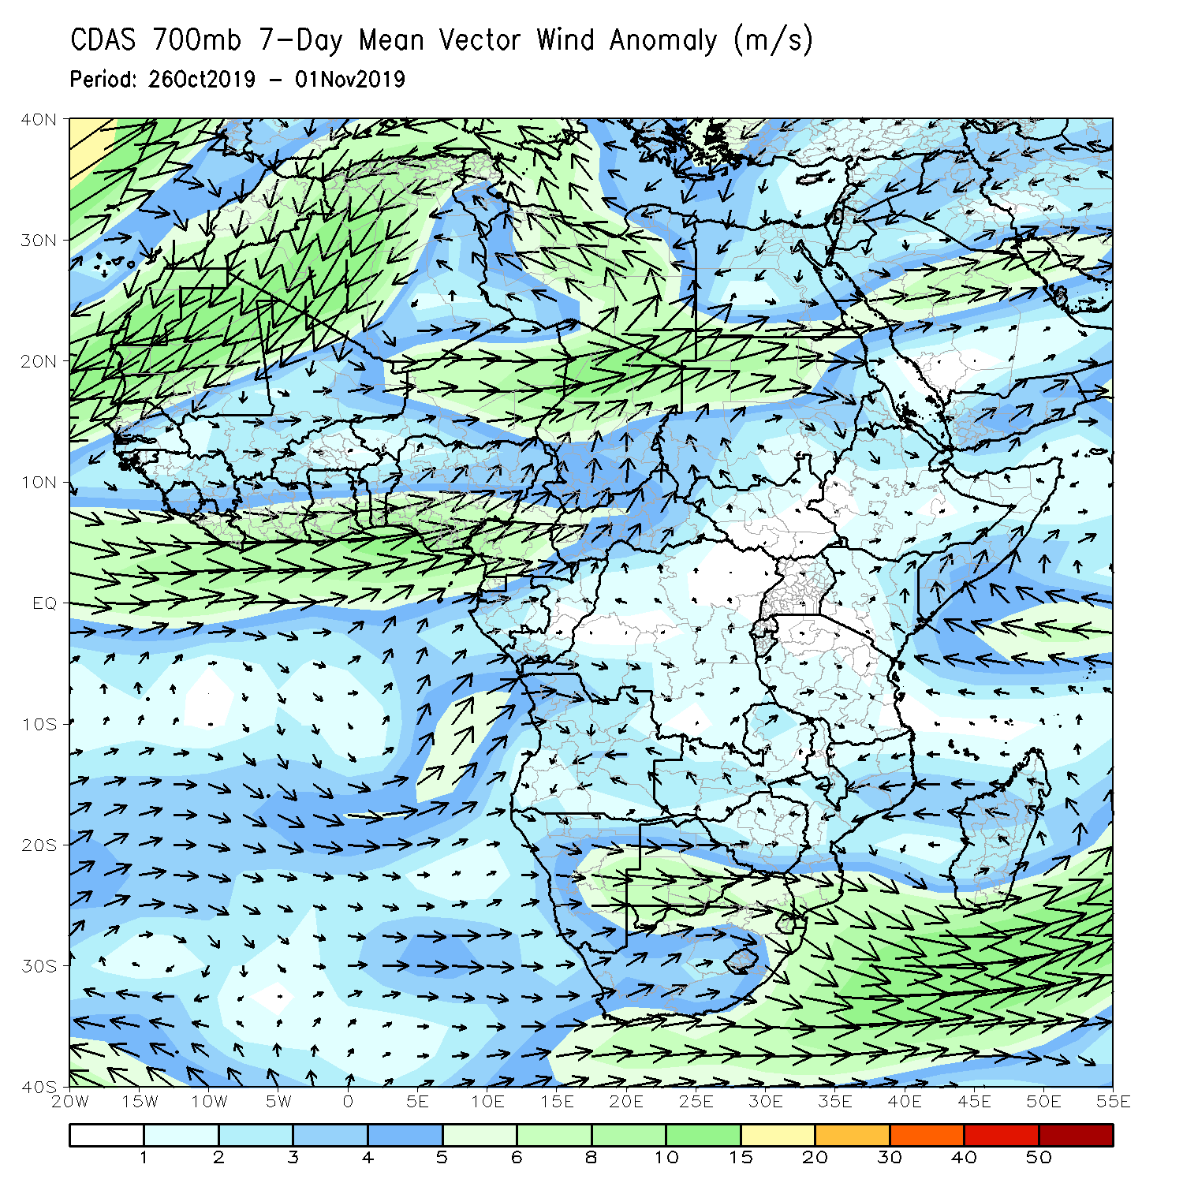
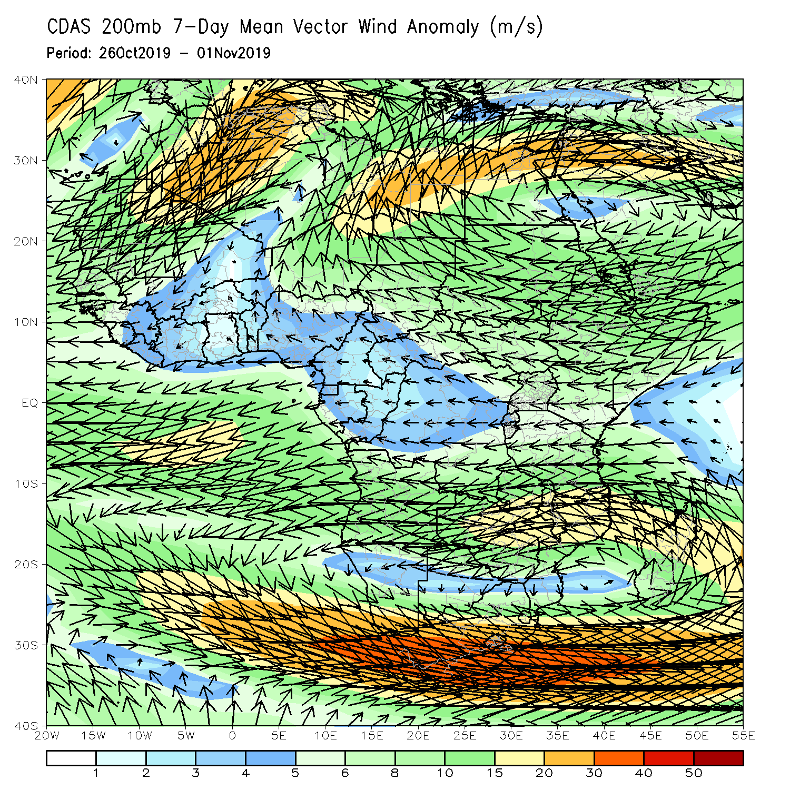
Atmospheric Circulation: Last 7 Days
Anomalous westerly flow with its associated cyclonic shear was observed across the Gulf of Guinea countries (left panel).

Slide 10
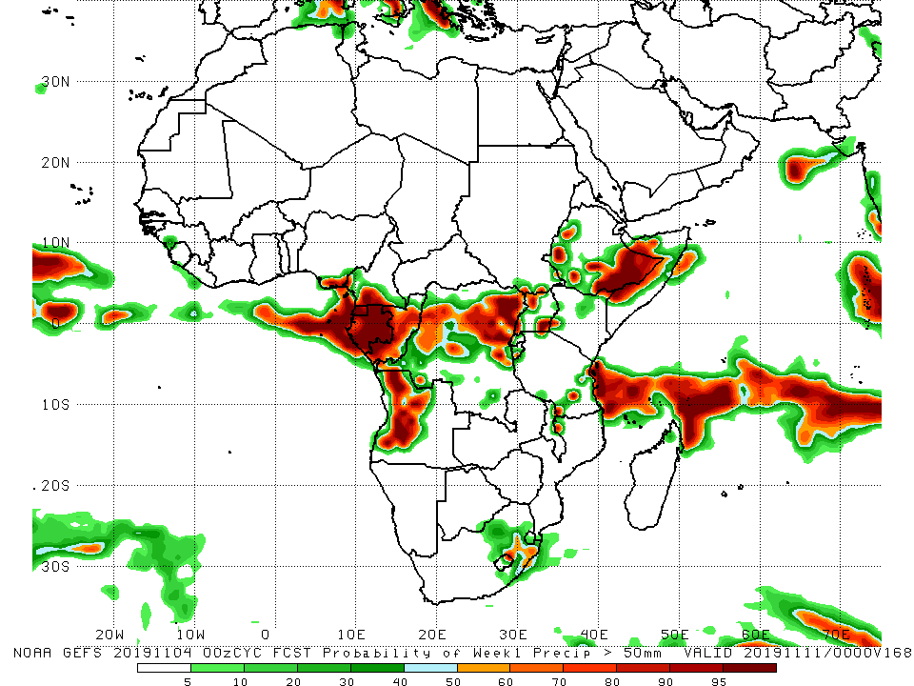
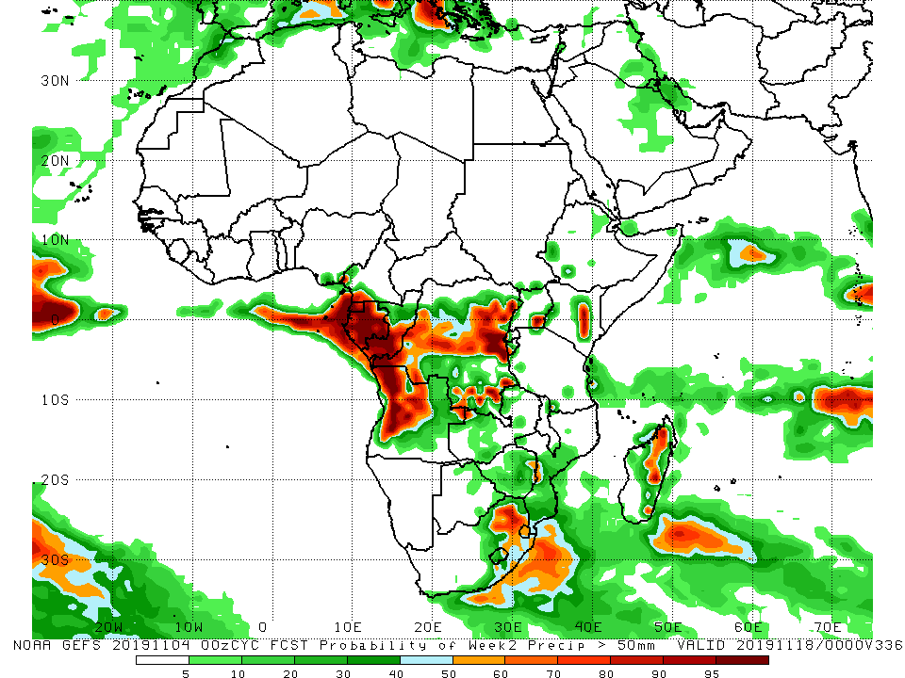
NCEP GEFS Model Forecasts Non-Bias Corrected Probability of precipitation exceedance
Week-1: Valid 5 – 11 November, 2019
Week-2: Valid 12 – 18 November, 2019
For week-1 (left panel), there is an increased chance for weekly rainfall totals to exceed 50mm over southern Cameroon, Equatorial guinea, western Angola, Congo, northern DRC, western and southern Ethiopia, Somalia, costal Tanzania, and eastern South Africa. The model forecast suggests lower exceedance probabilities for heavy rainfall over much of East Africa during week-2 (right panel).
Notes:
10

Slide 11
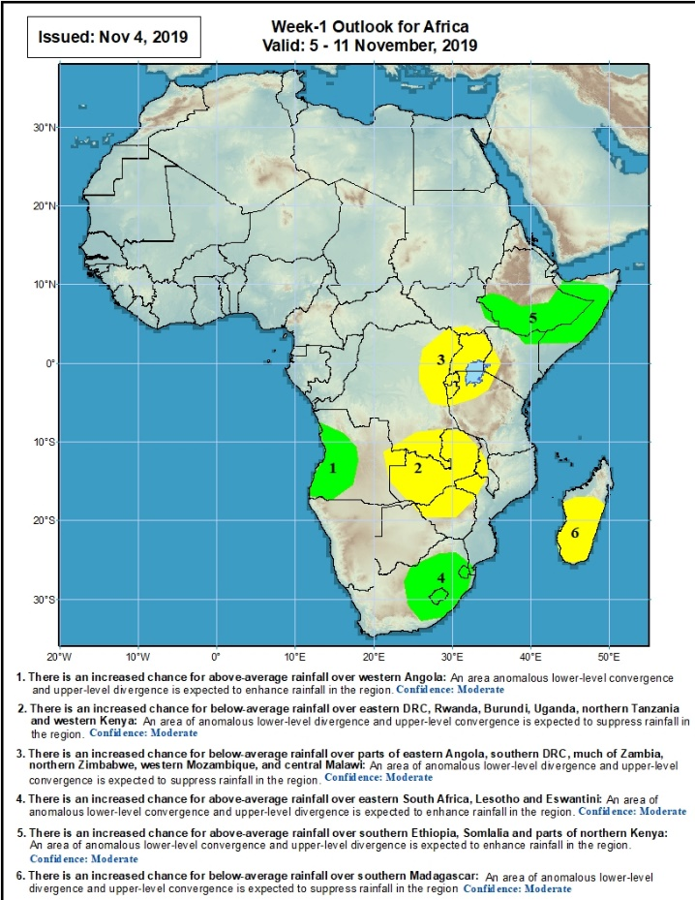
Week-1 Precipitation Outlooks
There is an increased chance for above-average rainfall over western Angola: An area anomalous lower-level convergence and upper-level divergence is expected to enhance rainfall in the region. Confidence: Moderate
There is an increased chance for below-average rainfall over parts of eastern Angola, southern DRC, much of Zambia, northern Zimbabwe, western Mozambique, and central Malawi: An area of anomalous lower-level divergence and upper-level convergence is expected to suppress rainfall in the region. Confidence: Moderate
There is an increased chance for below-average rainfall over eastern DRC, Rwanda, Burundi, Uganda, northern Tanzania and western Kenya: An area of anomalous lower-level divergence and upper-level convergence is expected to suppress rainfall in the region. Confidence: Moderate
There is an increased chance for above-average rainfall over eastern South Africa, Lesotho and Eswantini: An area anomalous lower-level convergence and upper-level divergence is expected to enhance rainfall in the region. Confidence: Moderate
There is an increased chance for above-average rainfall over southern Ethiopia, Somalia and parts of northern Kenya: An area of anomalous lower-level convergence and upper-level divergence is expected to enhance rainfall in the region. Confidence: Moderate
There is an increased chance for below-average rainfall over southern Madagascar: An area anomalous lower-level divergence and upper-level convergence is expected to suppress rainfall in the region. Confidence: Moderate
5 – 11 November, 2019
Notes:
11

Slide 12
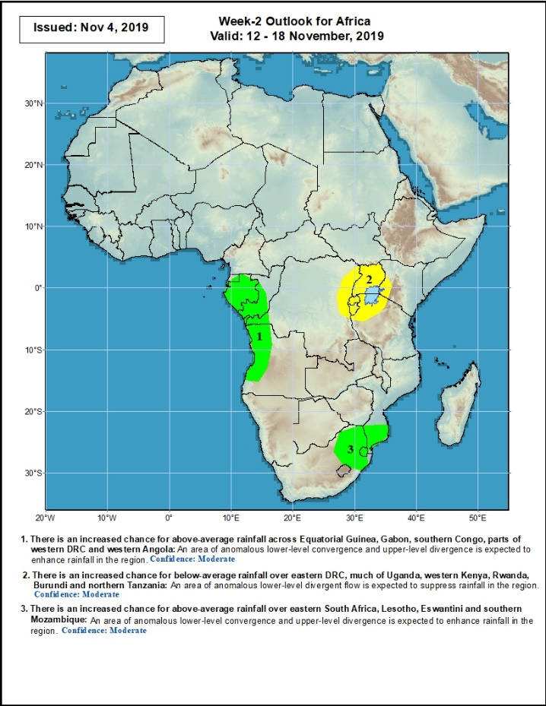
Week-2 Precipitation Outlooks
12 – 18 November, 2019
There is an increased chance for above-average rainfall across Equatorial Guinea, Gabon, southern Congo, parts of western DRC and western Angola: An area of anomalous lower-level convergence and upper-level divergence is expected to enhance rainfall in the region. Confidence: Moderate
There is an increased chance for below-average rainfall over eastern DRC, much of Uganda, western Kenya, Rwanda, Burundi and northern Tanzania: An area of anomalous lower-level divergent flow is expected to suppress rainfall in the region. Confidence: Moderate
There is an increased chance for above-average rainfall over eastern South Africa, Lesotho, Eswantini and southern Mozambique: An area of anomalous lower-level convergence and upper-level divergence is expected to enhance rainfall in the region. Confidence: Moderate
Notes:
12

Slide 13
Summary
During the past 7 days, rainfall was above-average over Sierra Leone, Liberia, Cote d’Ivoire, local areas in Ghana, Togo, Benin and Cameroon, western CAR, northern Congo, western DRC, northwestern Angola, parts of Uganda, northern Tanzania, parts of southern Somalia and Kenya, and portions of Madagascar. Portions of Guinea, Equatorial Guinea, southern Cameroon, Gabon, central Congo, portions of CAR, many parts of DRC and Angola, parts of South Sudan and Ethiopia, portions of Zambia, and eastern South Africa had below-average rainfall.
During the past 30 days, rainfall was above-average over southern Mauritania, many parts of Senegal, Guinea-Bissau, portions of Guinea, Sierra Leone, Liberia, southern Mali, Burkina Faso, Ghana, Cote d’Ivoire, Togo, Benin, much of Nigeria, portions of Cameroon, central and southern Chad, portions of CAR and Congo, western Gabon, portions of DRC, South Sudan, Sudan, many parts of Ethiopia, Eritrea, Uganda, Tanzania, Somalia, Kenya, western Angola, local areas in Namibia and Mozambique, and portions of Madagascar. Local areas in Guinea and Mali, parts of Cameroon, many parts of Gabon, portions of Angola and DRC, eastern Namibia, Zambia, Malawi, Botswana, Zimbabwe, portions of Madagascar and many parts of South Africa had below-average rainfall.
During the past 90 days, rainfall was above-average over southern and eastern Mauritania, much of Senegal, Guinea-Bissau, Guinea, Sierra Leone, Liberia, Mali, Cote d’Ivoire, Burkina Faso, Ghana, Togo, Benin, Niger, many parts of Nigeria, Chad, portions of Cameroon, CAR, many parts of DRC, South Sudan, Uganda, Sudan, Eritrea, Ethiopia, Kenya, Somalia, many parts of Tanzania, portions of Angola, eastern Zambia, and local areas in Mozambique and Madagascar. Western and central Mauritania, parts of Nigeria and Cameroon, Gabon, portions of central and eastern DRC, many parts of Angola, Zambia, Zimbabwe, eastern Namibia, Botswana, southern Madagascar and many parts of South Africa had below-average rainfall.
Week-1 outlooks call for an increased chance for above-average rainfall over western Angola, southern Ethiopia, Somalia and parts of northern Kenya. Outlooks also call for above-average rainfall over eastern South Africa, Lesotho and Eswantini. In contrast, there is an increased chance for below-average rainfall over eastern and southern DRC, Rwanda, Burundi, Uganda, northern Tanzania and western Kenya, parts of eastern Angola, much of Zambia, northern Zimbabwe, western Mozambique, central Malawi and southern Madagascar.
Notes:
13

