Slide 1
The African Monsoon Recent Evolution and Current Status Include Week-1 and Week-2 Outlooks
Update prepared by
Climate Prediction Center / NCEP
25 November 2019
For more information, visit:
http://www.cpc.ncep.noaa.gov/products/Global_Monsoons/African_Monsoons/precip_monitoring.shtml

Slide 2
Outline
Highlights
Recent Evolution and Current Conditions
NCEP GEFS Forecasts
Summary

Slide 3
Highlights: Last 7 Days
Rainfall was above-average over many places in the Greater Horn of Africa and Southeast Africa.
Week-1 outlooks call for an increased chance for above-average rainfall over portions of western Angola, western Namibia, eastern DRC, southern Uganda, Rwanda, Burundi, southwestern Kenya, Tanzania and eastern Zambia. In contrast, there is an increased chance for below-average rainfall over much of Botswana, southern Mozambique, Botswana, South Africa, Lesotho, Eswantini, central and southern Madagascar.

Slide 4
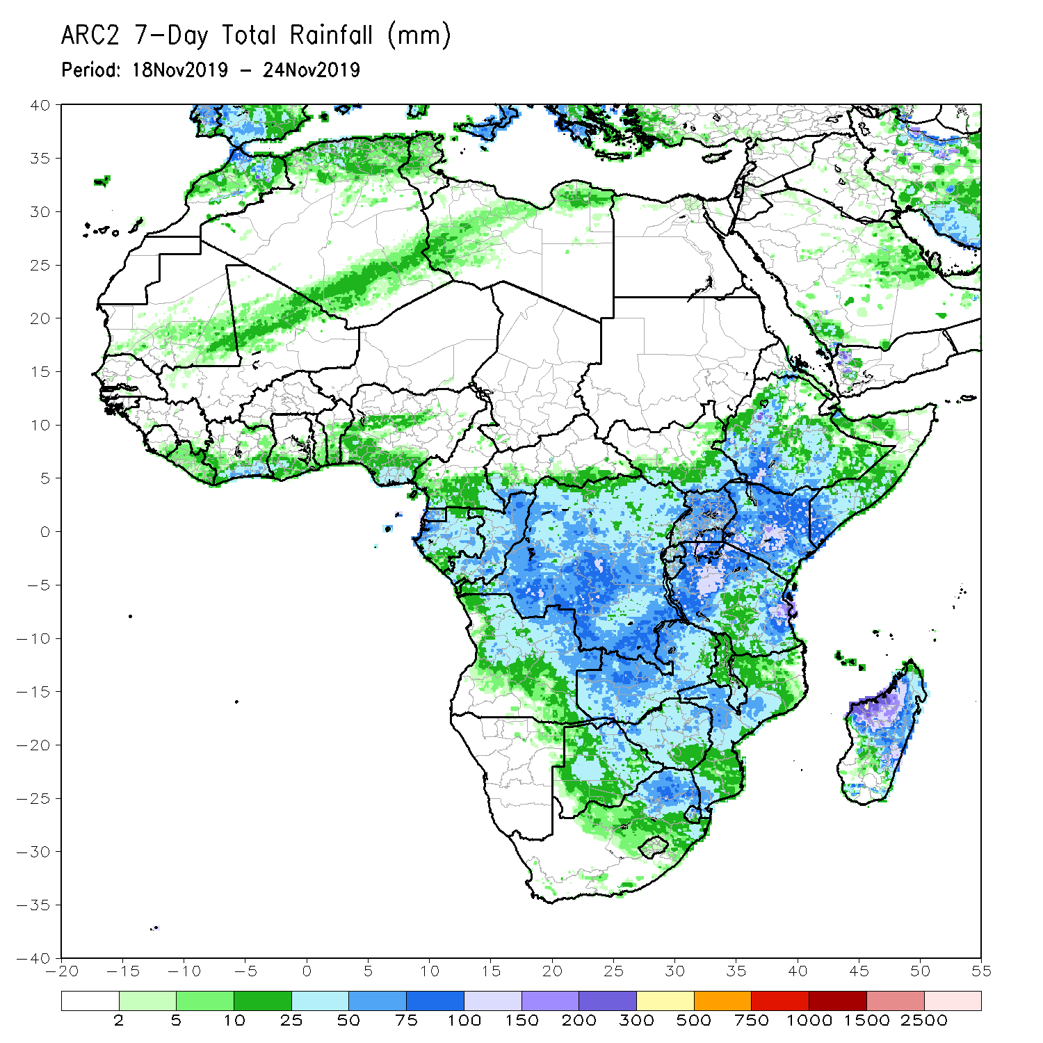
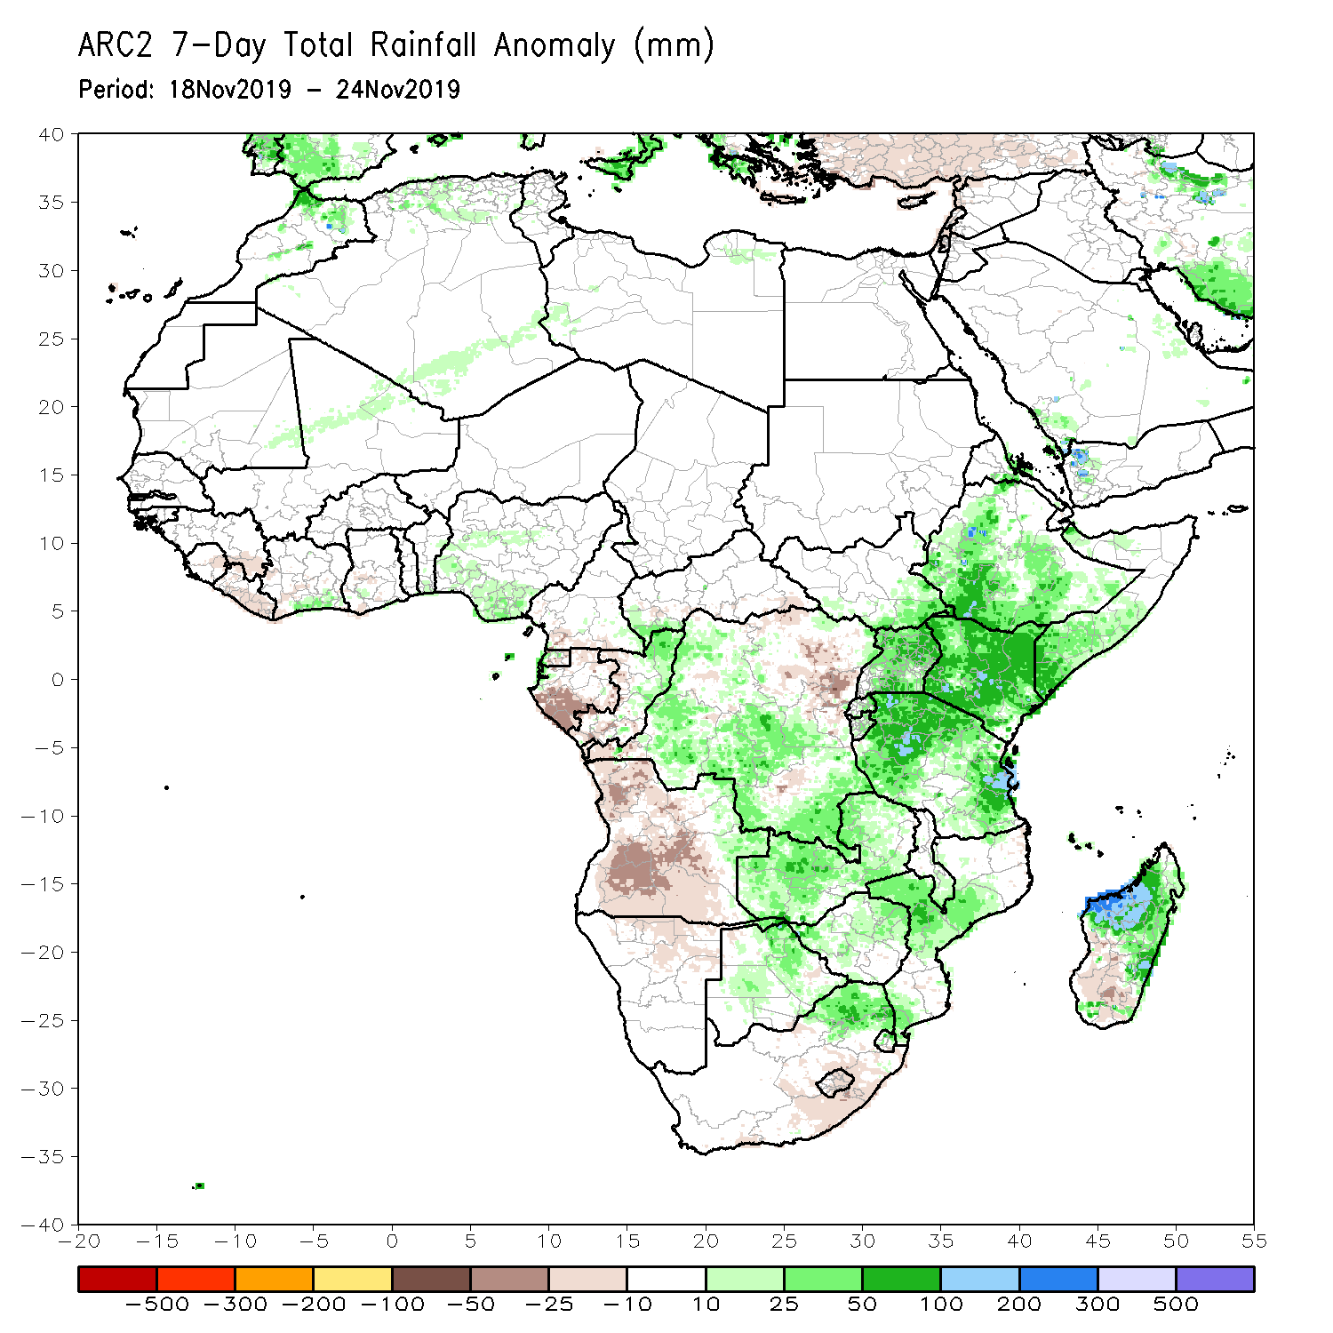
Rainfall Patterns: Last 7 Days
During the past 7 days, local areas in the Gulf of guinea countries, northern Congo, many parts of DRC, parts of eastern Angola, Zambia, Botswana, northeastern South Africa, Mozambique, Malawi, Tanzania, Rwanda, Burundi, Uganda, Kenya, Ethiopia and many parts of Madagascar had above-average rainfall.
Below-average rainfall was observed over Equatorial Guinea, Gabon, southern Congo, northeastern DRC, much of Angola and parts of South Africa.

Slide 5
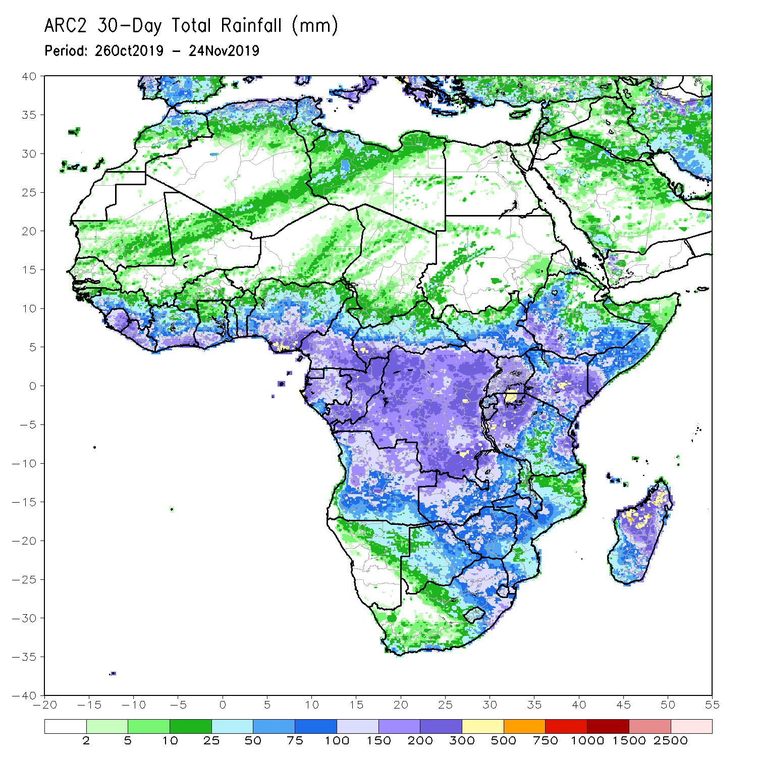
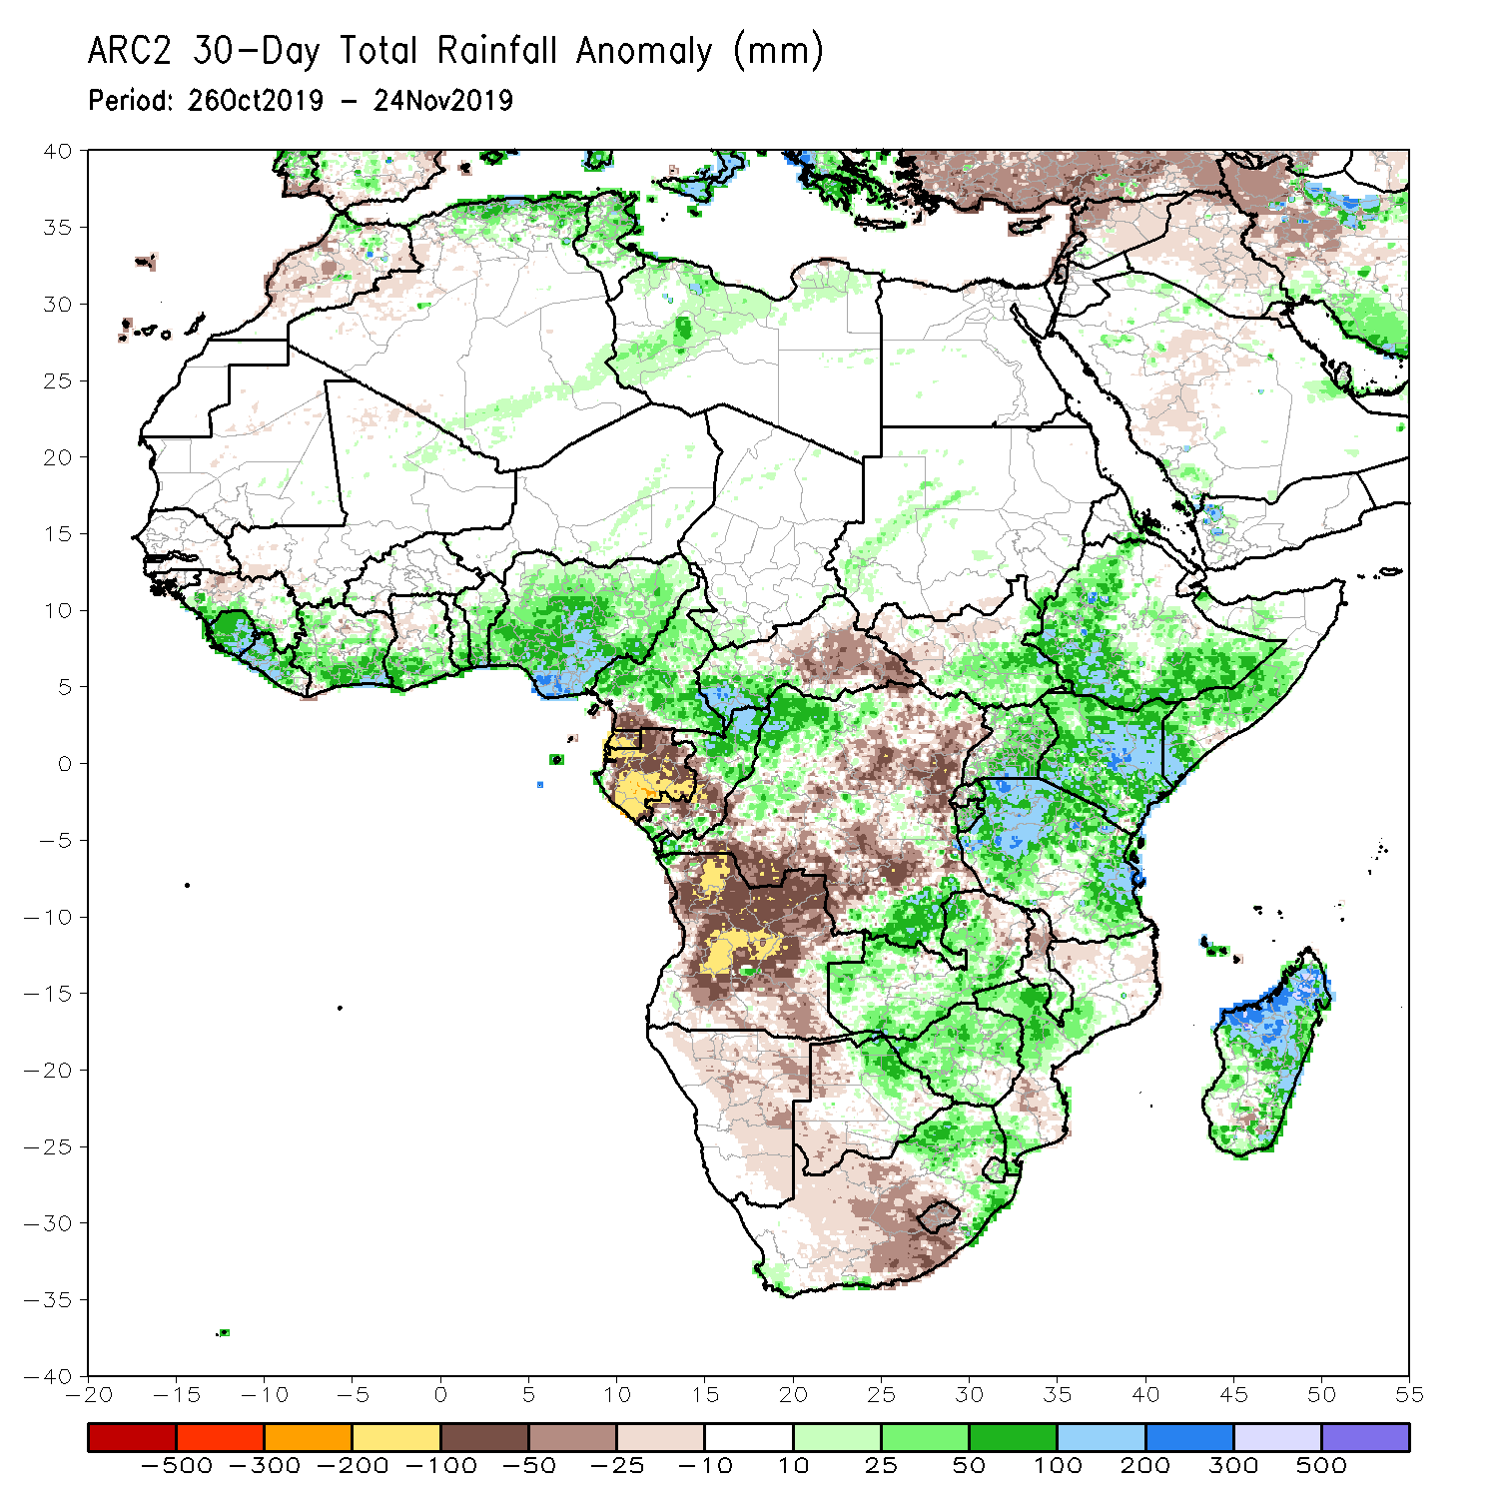
Rainfall Patterns: Last 30 Days
During the past 30 days, rainfall was above-average over parts of Guinea, Sierra Leone, Liberia, Ghana, Cote d’Ivoire, Togo, Benin, much of Nigeria, Cameroon, western CAR, northern Congo, portions of DRC and South Sudan, western and southern Ethiopia, southern Uganda, Tanzania, Somalia, Kenya, local areas in eastern Botswana, Zambia, Zimbabwe, eastern South Africa, and many parts of Madagascar.
Equatorial Guinea, many parts of Gabon, central Congo, much of Angola, many parts of DRC, Namibia, parts of Botswana, parts of Mozambique, and western South Africa had below-average rainfall.
Notes:
5

Slide 6
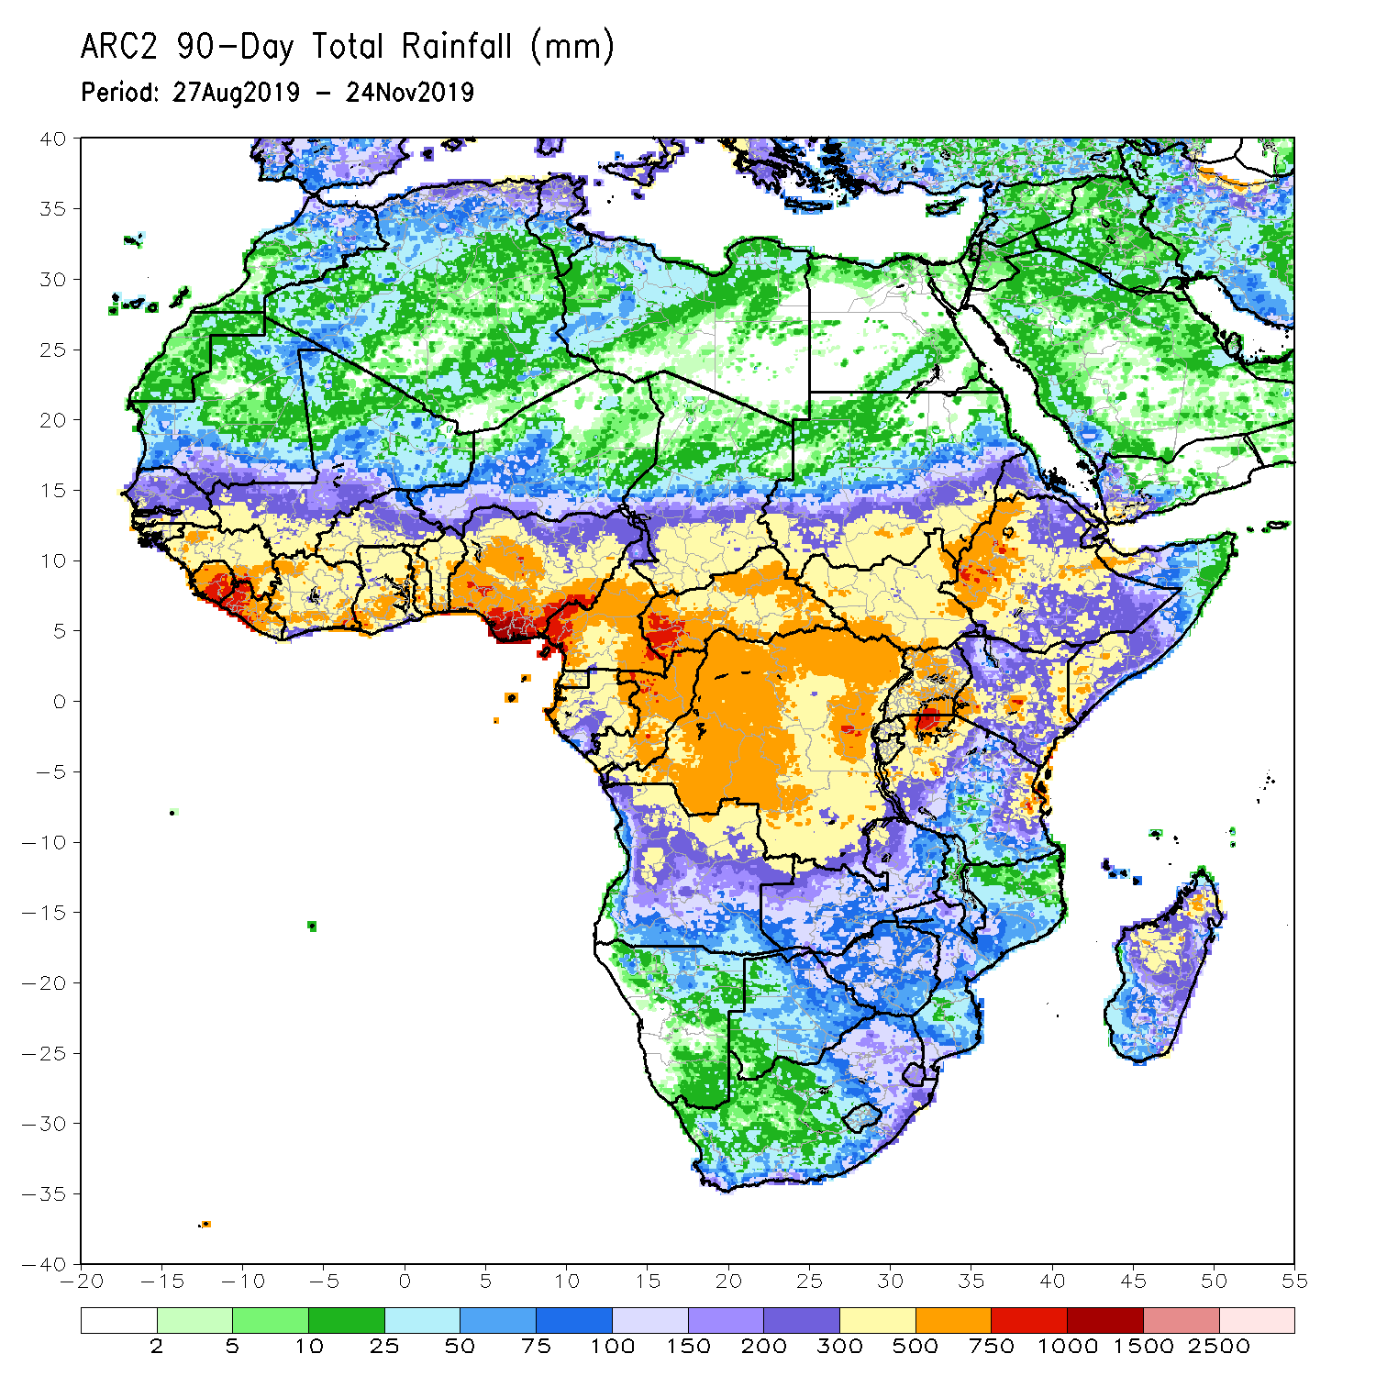
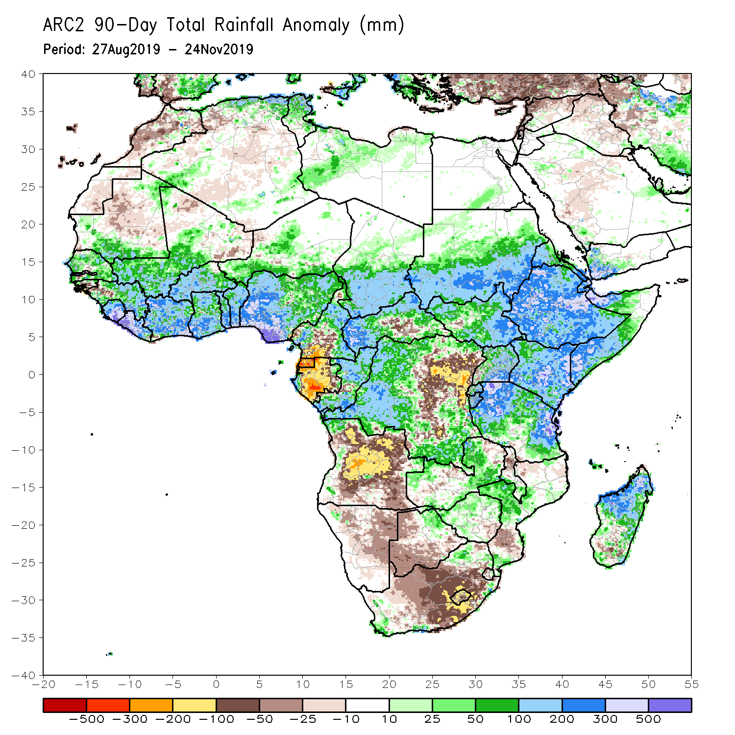
Rainfall Patterns: Last 90 Days
During the past 90 days, rainfall was above-average over parts of southern Mauritania, much of Senegal, Guinea-Bissau, Guinea, Sierra Leone, Liberia, Mali, Cote d’Ivoire, Burkina Faso, Ghana, Togo, Benin, Niger, many parts of Nigeria, Chad, portions of Cameroon, CAR, many parts of DRC, South Sudan, Uganda, Sudan, Eritrea, Ethiopia, Kenya, Somalia, many parts of Tanzania, portions of Angola, Zambia, Zimbabwe, and local areas in Mozambique, and much of Madagascar.
Parts of Cameroon, Gabon, portions of central and eastern DRC, many parts of Angola, local areas in Zambia, Zimbabwe, Namibia, Botswana, southern Madagascar and many parts of South Africa had below-average rainfall.
Notes:
6

Slide 7
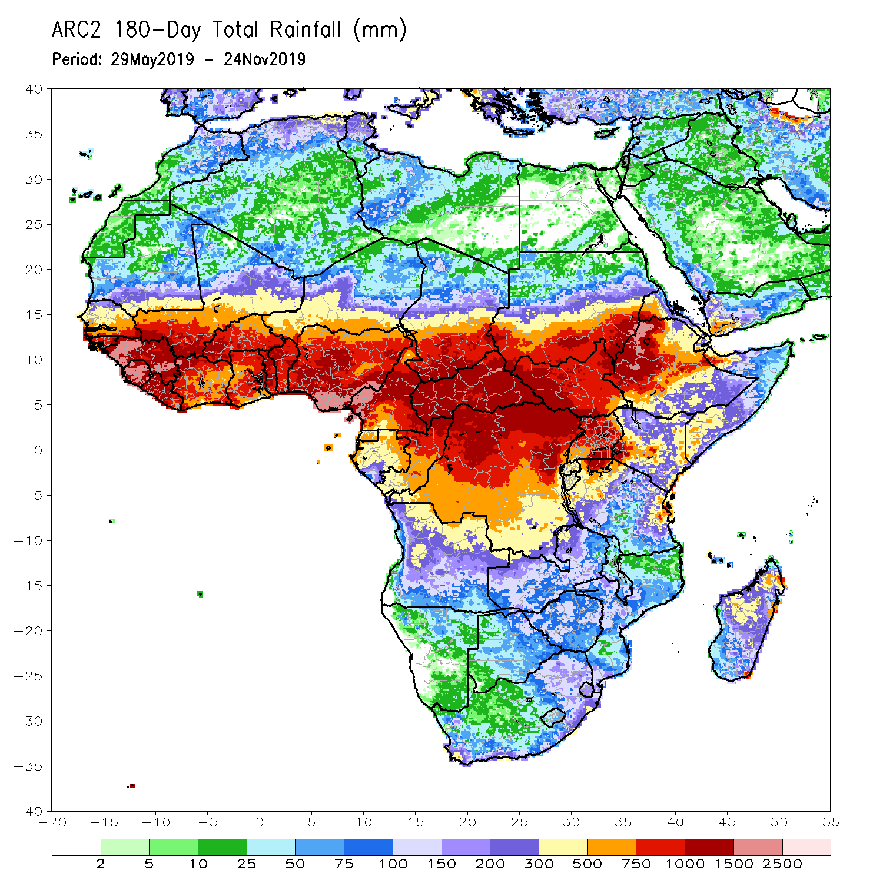
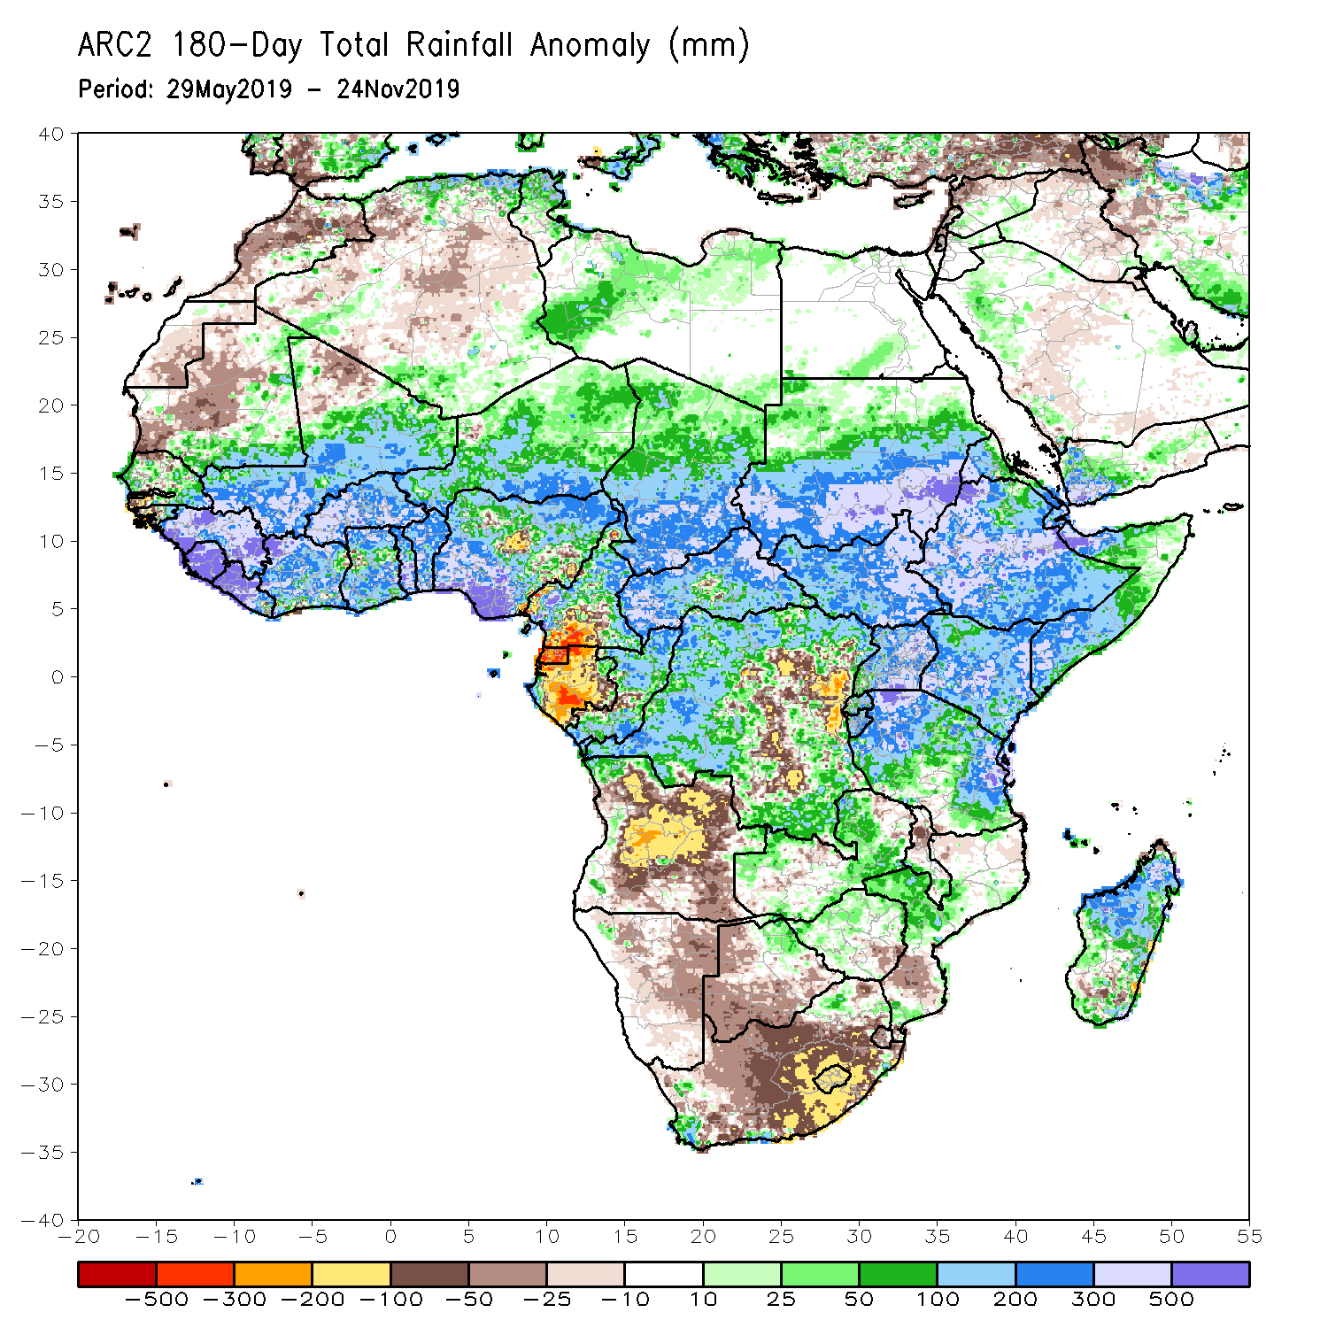
Rainfall Patterns: Last 180 Days
During the past 180 days, below-average rainfall was observed over portions of Cameroon, Equatorial Guinea, Gabon, local areas in Congo, parts of central and eastern DRC, many parts of Angola, Namibia, much of South Africa, western Zambia, Botswana, Zimbabwe, and portions of Mozambique.
Southern and eastern Mauritania, much of Senegal, Guinea-Bissau, Guinea, Sierra Leone, Mali, Liberia, Cote d’Ivoire, Burkina Faso, Ghana, Togo, Benin, many parts of Nigeria and Cameroon, Niger, Chad, CAR, many parts of DRC, South Sudan, Sudan, Uganda, Eritrea, Ethiopia, Somalia, Kenya, Tanzania, western Angola and parts of eastern Zambia, local areas in Mozambique and South Africa and many parts of Madagascar had above-average rainfall.
Notes:
7

Slide 8
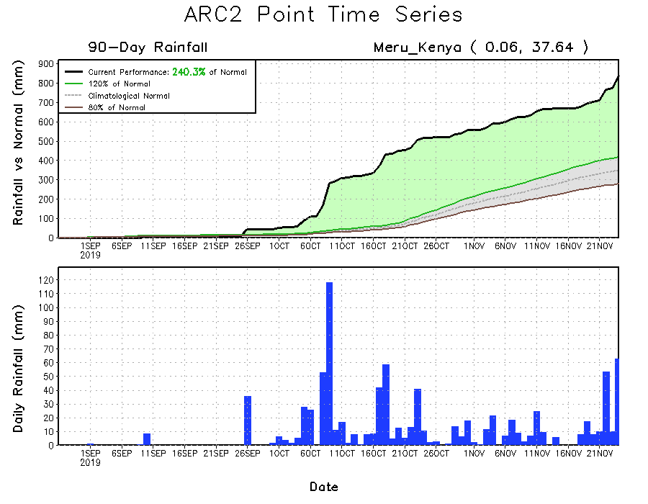
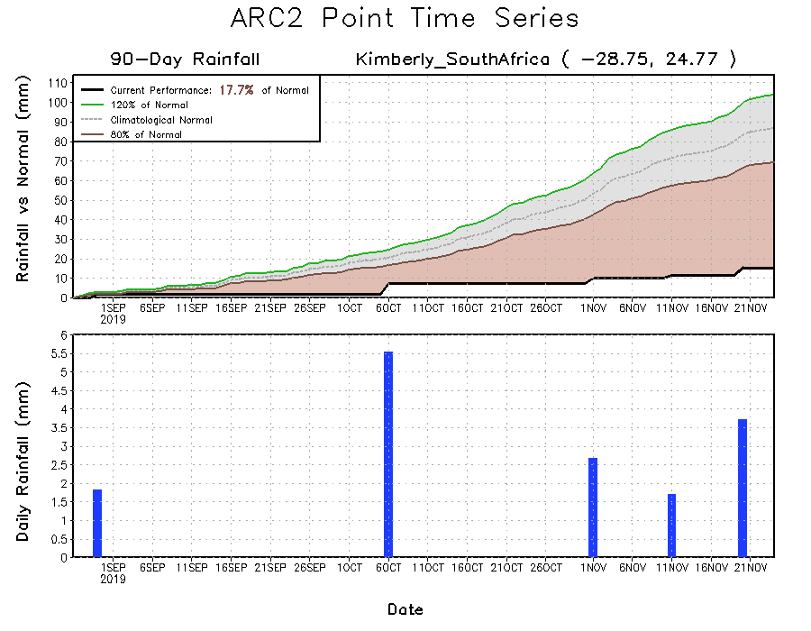
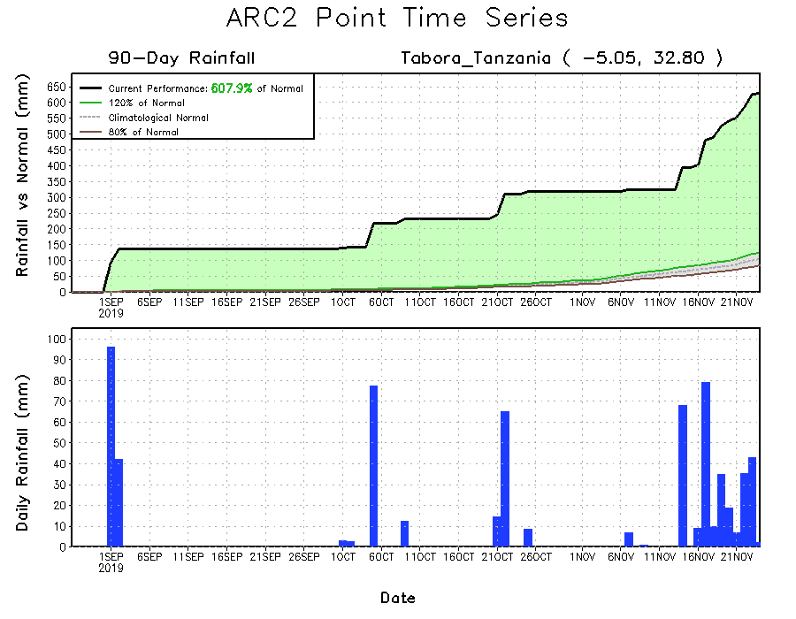
Recent Rainfall Evolution
Daily evolution of rainfall over the last 90 days at selected locations shows that moderate to locally heavy rainfall sustained moisture surpluses over parts of Tanzania (bottom right) and Kenya (top right). Seasonal total rainfall remained below-average over many parts of South Africa (bottom left).

Slide 9
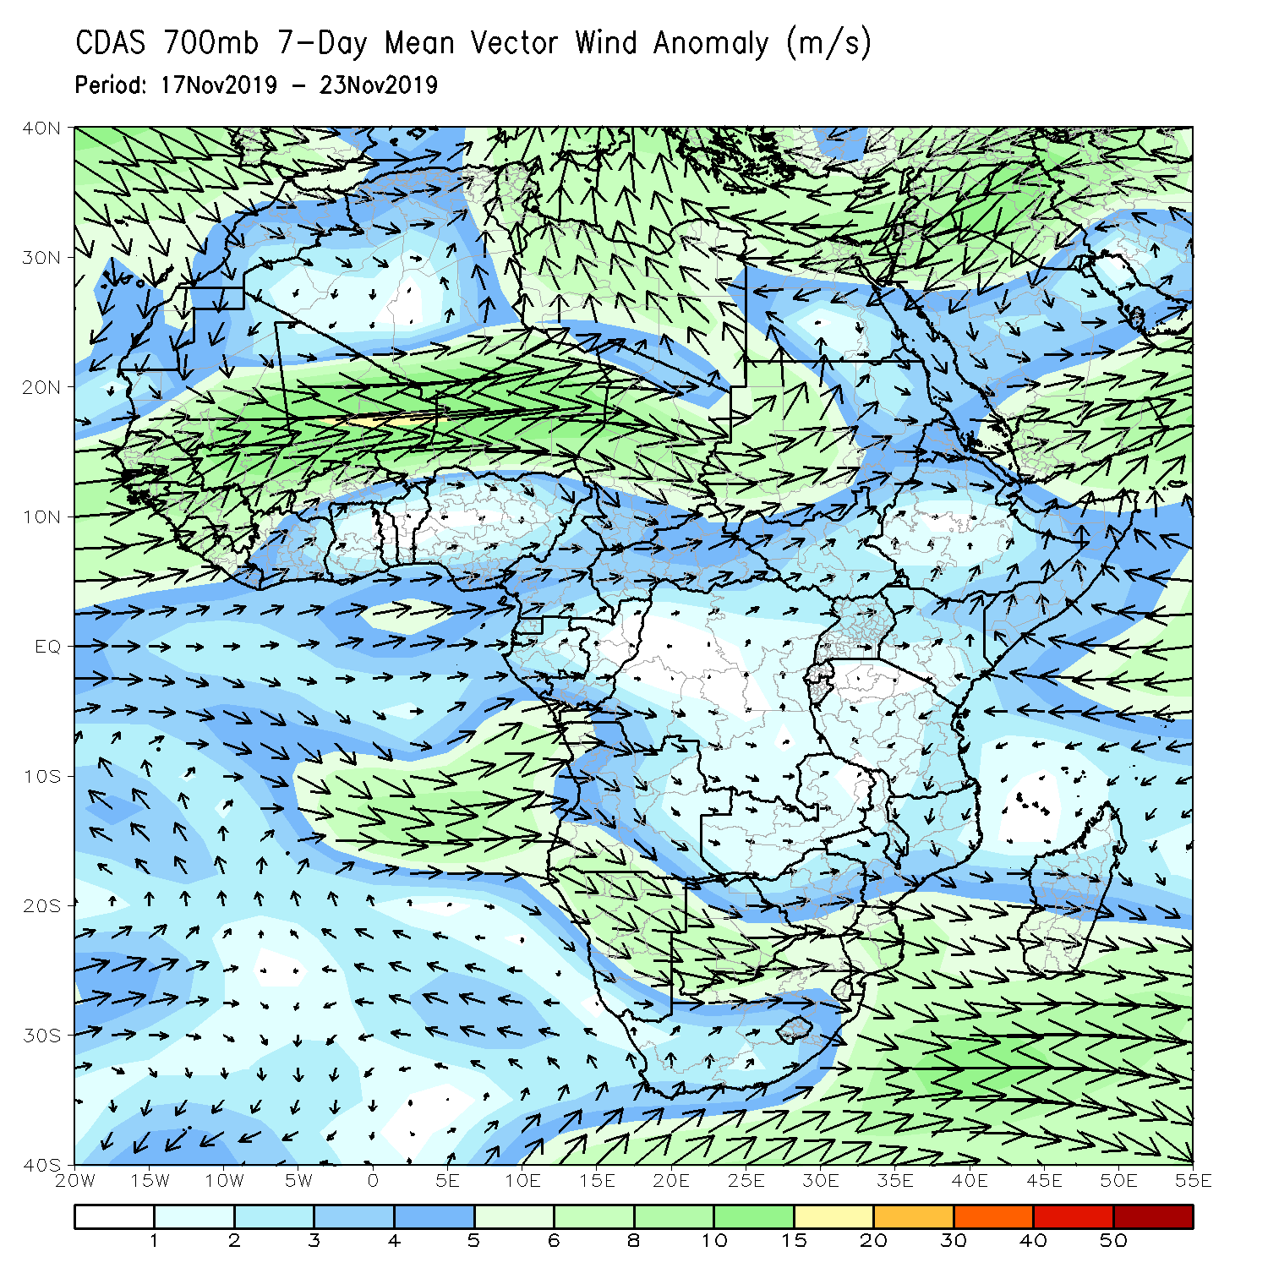
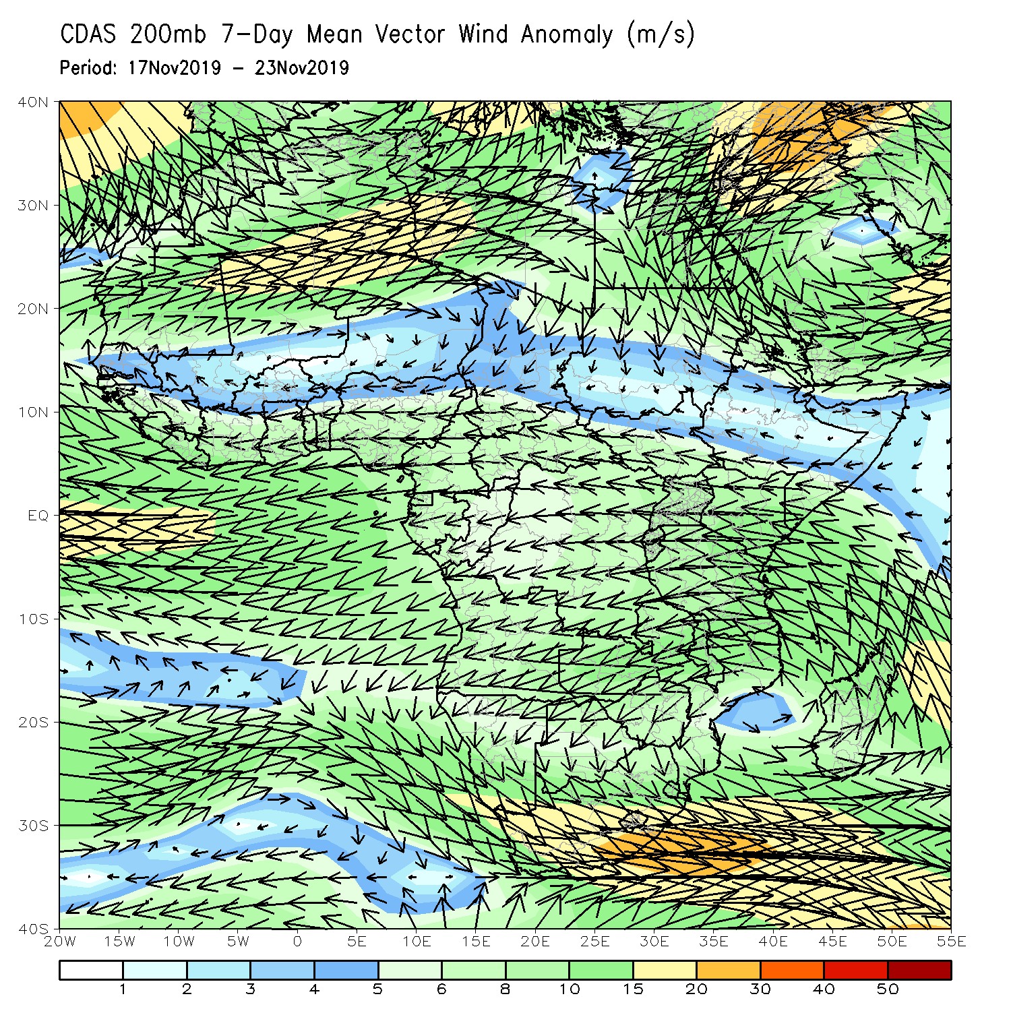
Atmospheric Circulation: Last 7 Days
Lower-level anomalies were westerly across much of West and Central Africa (left panel).

Slide 10
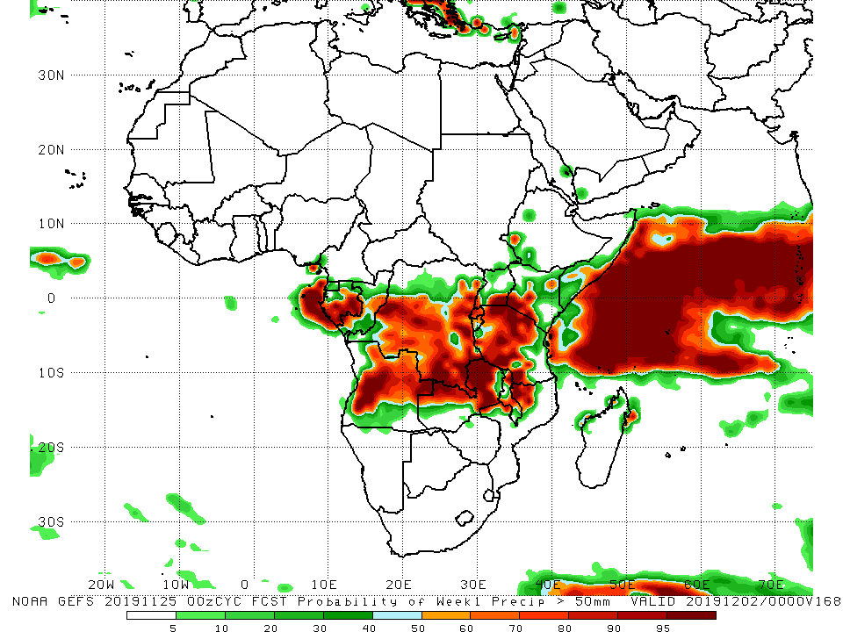
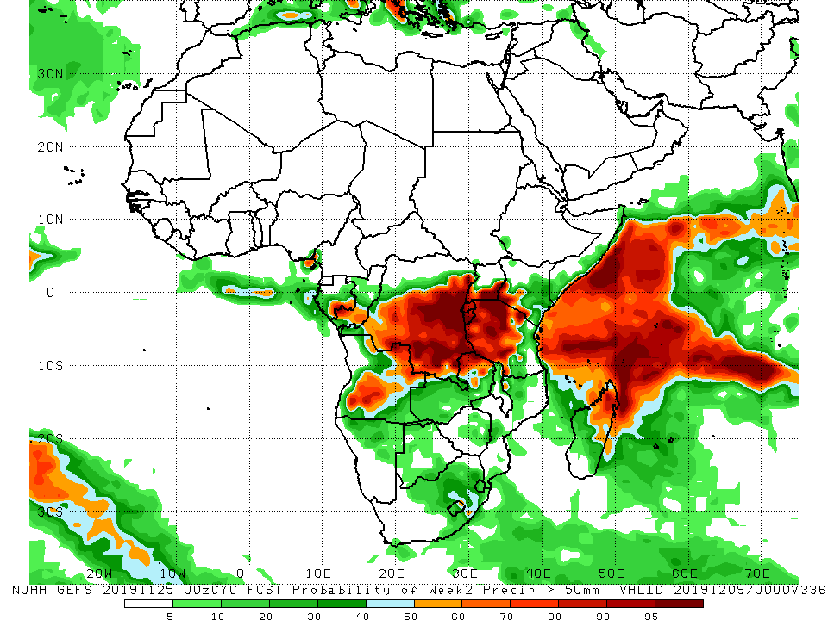
NCEP GEFS Model Forecasts Non-Bias Corrected Probability of precipitation exceedance
Week-1: Valid 26 November – 2 December, 2019
Week-2: Valid 3 – 9 December, 2019
For week-1 (left panel) and week-2 (right panel) there is an increased chance for weekly rainfall totals to exceed 50mm over many places in Central and East Africa.
Notes:
10

Slide 11
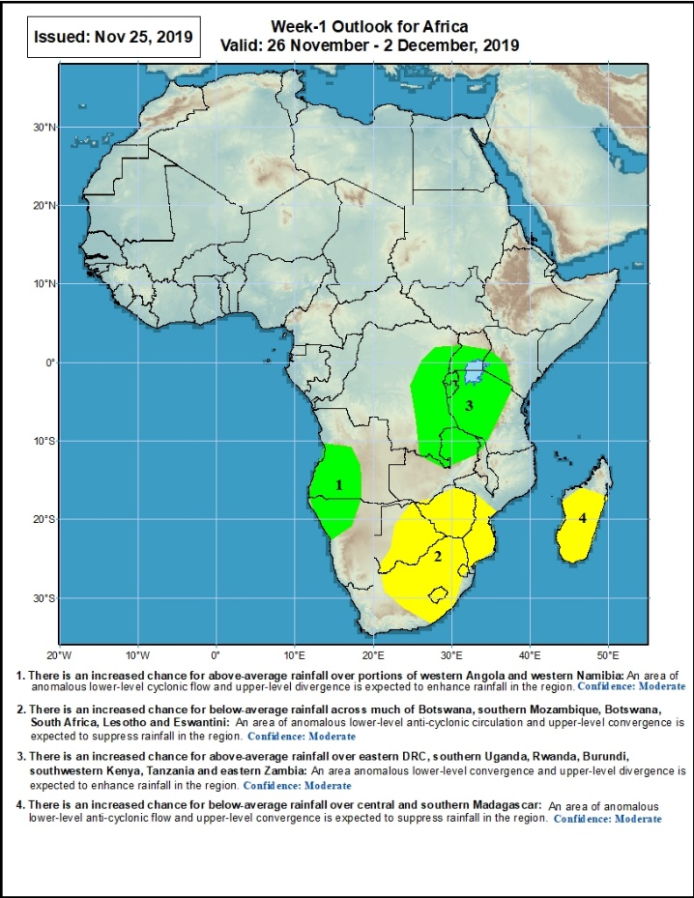
Week-1 Precipitation Outlooks
26 November – 2 December, 2019
There is an increased chance for above-average rainfall over portions of western Angola and western Namibia: An area of anomalous lower-level cyclonic flow and upper-level divergence is expected to enhance rainfall in the region. Confidence: Moderate
There is an increased chance for below-average rainfall across much of Botswana, southern Mozambique, Botswana, South Africa, Lesotho and Eswantini: An area of anomalous lower-level anti-cyclonic circulation and upper-level convergence is expected to suppress rainfall in the region. Confidence: Moderate
There is an increased chance for above-average rainfall over eastern DRC, southern Uganda, Rwanda, Burundi, southwestern Kenya, Tanzania and eastern Zambia: An area anomalous lower-level convergence and upper-level divergence is expected to enhance rainfall in the region. Confidence: Moderate
There is an increased chance for below-average rainfall over central and southern Madagascar: An area of anomalous lower-level anti-cyclonic flow and upper-level convergence is expected to suppress rainfall in the region. Confidence: Moderate
Notes:
11

Slide 12
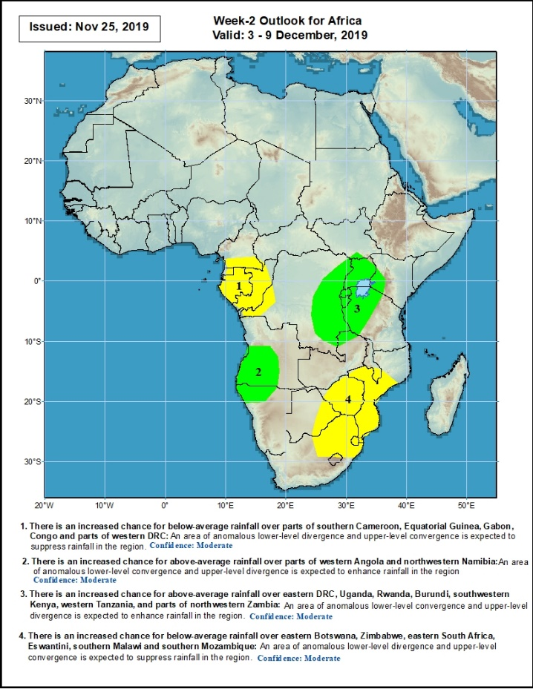
Week-2 Precipitation Outlooks
3 – 9 December, 2019
There is an increased chance for below-average rainfall over parts of southern Cameroon, Equatorial Guinea, Gabon, Congo and parts of western DRC: An area of anomalous lower-level divergence and upper-level convergence is expected to suppress rainfall in the region. Confidence: Moderate
There is an increased chance for above-average rainfall over parts of western Angola and northwestern Namibia: An area of anomalous lower-level convergence and upper-level divergence is expected to enhance rainfall in the region. Confidence: Moderate
There is an increased chance for above-average rainfall over eastern DRC, Uganda, Rwanda, Burundi, southwestern Kenya, western Tanzania, and parts of northwestern Zambia: An area of anomalous lower-level convergence and upper-level divergence is expected to enhance rainfall in the region. Confidence: Moderate
There is an increased chance for below-average rainfall over eastern Botswana, Zimbabwe, eastern South Africa, Eswantini, southern Malawi and southern Mozambique: An area of anomalous lower-level divergence and upper-level convergence is expected to suppress rainfall in the region. Confidence: Moderate
Notes:
12

Slide 13
Summary
During the past 7 days, local areas in the Gulf of guinea countries, northern Congo, many parts of DRC, parts of eastern Angola, Zambia, Botswana, northeastern South Africa, Mozambique, Malawi, Tanzania, Rwanda, Burundi, Uganda, Kenya, Ethiopia and many parts of Madagascar had above-average rainfall. Below-average rainfall was observed over Equatorial Guinea, Gabon, southern Congo, northeastern DRC, much of Angola and parts of South Africa.
During the past 30 days, rainfall was above-average over parts of Guinea, Sierra Leone, Liberia, Ghana, Cote d’Ivoire, Togo, Benin, much of Nigeria, Cameroon, western CAR, northern Congo, portions of DRC and South Sudan, western and southern Ethiopia, southern Uganda, Tanzania, Somalia, Kenya, local areas in eastern Botswana, Zambia, Zimbabwe, eastern South Africa, and many parts of Madagascar. Equatorial Guinea, many parts of Gabon, central Congo, much of Angola, many parts of DRC, Namibia, parts of Botswana, parts of Mozambique, and western South Africa had below-average rainfall
During the past 90 days, rainfall was above-average over parts of southern Mauritania, much of Senegal, Guinea-Bissau, Guinea, Sierra Leone, Liberia, Mali, Cote d’Ivoire, Burkina Faso, Ghana, Togo, Benin, Niger, many parts of Nigeria, Chad, portions of Cameroon, CAR, many parts of DRC, South Sudan, Uganda, Sudan, Eritrea, Ethiopia, Kenya, Somalia, many parts of Tanzania, portions of Angola, Zambia, Zimbabwe, and local areas in Mozambique, and much of Madagascar. Parts of Cameroon, Gabon, portions of central and eastern DRC, many parts of Angola, local areas in Zambia, Zimbabwe, Namibia, Botswana, southern Madagascar and many parts of South Africa had below-average rainfall.
Week-1 outlooks call for an increased chance for above-average rainfall over portions of western Angola, western Namibia, eastern DRC, southern Uganda, Rwanda, Burundi, southwestern Kenya, Tanzania and eastern Zambia. In contrast, there is an increased chance for below-average rainfall over much of Botswana, southern Mozambique, Botswana, South Africa, Lesotho, Eswantini, central and southern Madagascar.
Notes:
13

