Slide 1
The African Monsoon Recent Evolution and Current Status Include Week-1 and Week-2 Outlooks
Update prepared by
Climate Prediction Center / NCEP
02 December 2019
For more information, visit:
http://www.cpc.ncep.noaa.gov/products/Global_Monsoons/African_Monsoons/precip_monitoring.shtml

Slide 2
Outline
Highlights
Recent Evolution and Current Conditions
NCEP GEFS Forecasts
Summary

Slide 3
Highlights: Last 7 Days
Another week of moderate to heavy rainfall sustained moisture surpluses over portions of East Africa.
Suppressed rainfall prevailed over many places in Southern Africa.
Week-1 outlooks call for an increased chance for above-average rainfall over portions of Angola, northern and eastern Namibia, eastern DRC, Rwanda, Burundi, southern Uganda, southwestern Kenya, western Tanzania, eastern Zambia, southern Botswana, and central South Africa. In contrast, there is an increased chance for below-average rainfall over southern Malawi, central Mozambique and southern Madagascar.

Slide 4
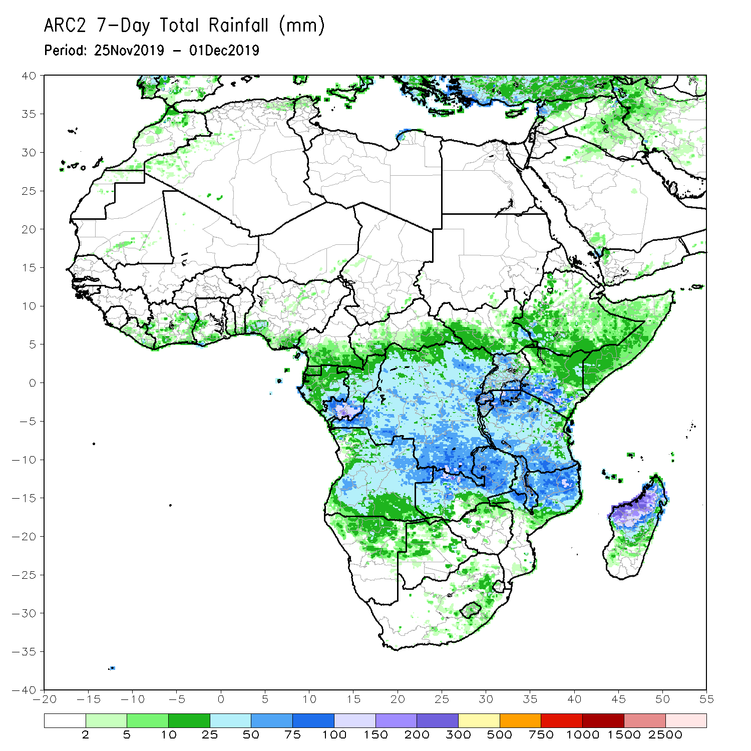
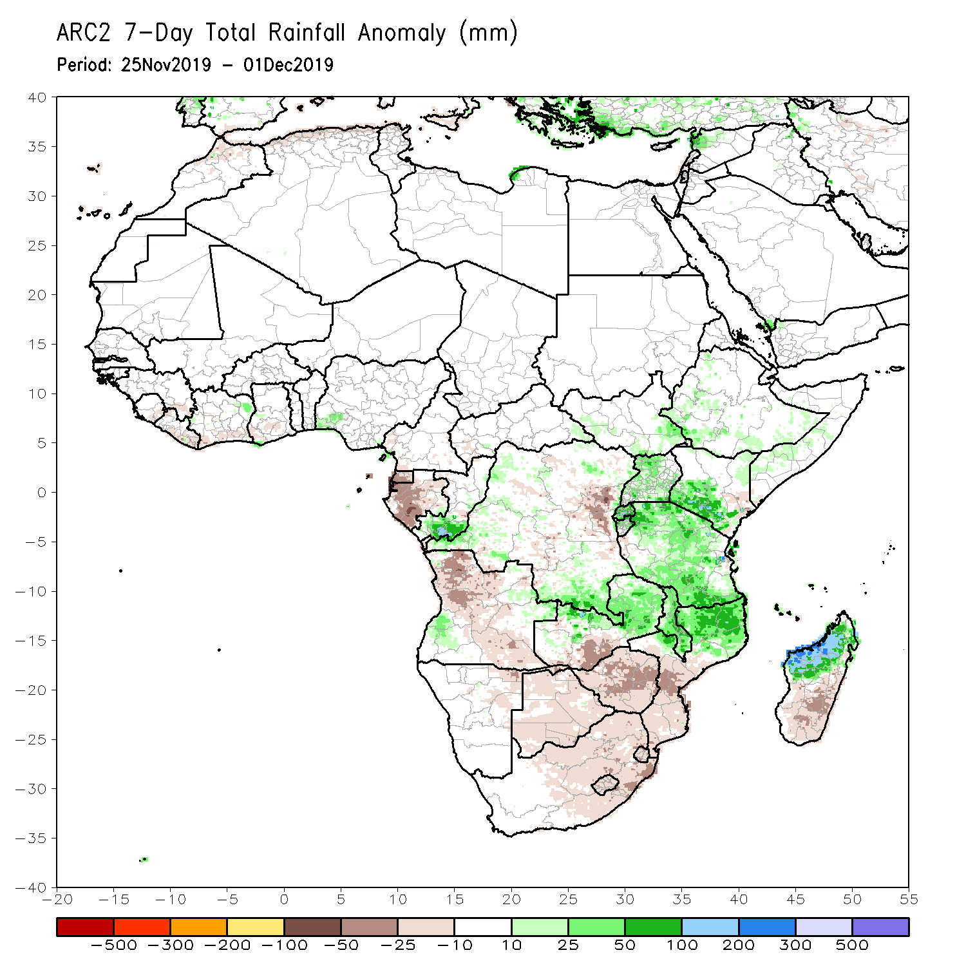
Rainfall Patterns: Last 7 Days
During the past 7 days, rainfall was below-average over Equatorial Guinea, Gabon, many parts of Angola, portions of DRC, southwestern Zambia, Namibia, Botswana, South Africa, Lesotho, Easwantini, Zimbabwe, southern Mozambique and southern Madagascar.
Parts of southern Congo, local areas in western Angola and DRC, parts of southern Ethiopia, southwestern Kenya, Rwanda, Burundi, Tanzania, Malawi, northern Mozambique and northern Madagascar had above-average rainfall.

Slide 5
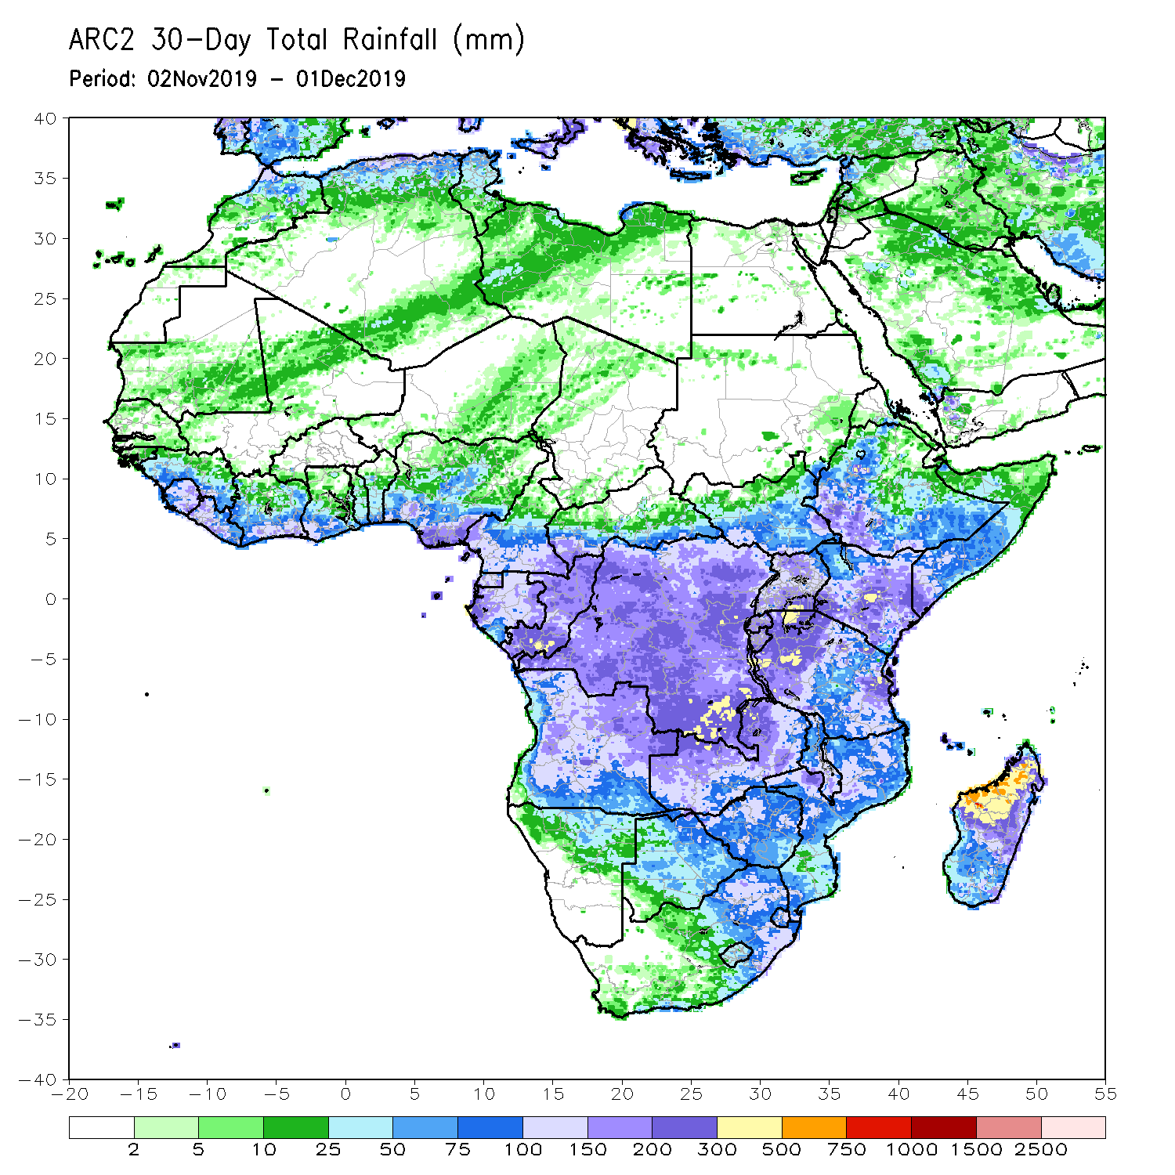
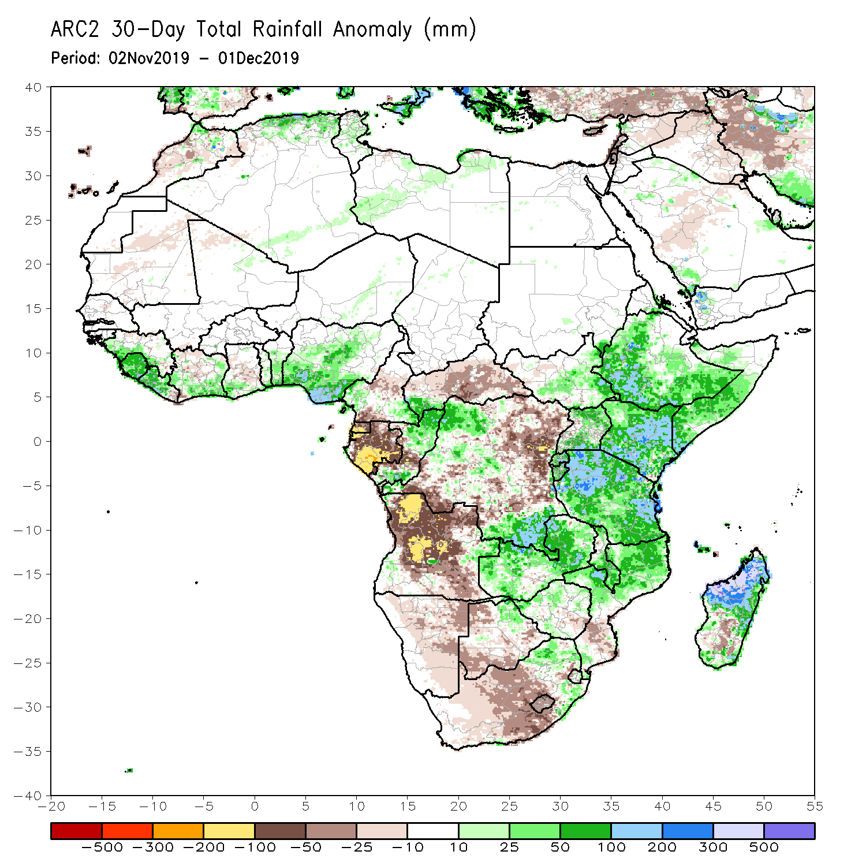
Rainfall Patterns: Last 30 Days
During the past 30 days, rainfall was above-average over local areas in Guinea, Sierra Leone, Liberia, southern Cote d’Ivoire, local areas in Ghana, southern Benin, portions of Nigeria, local areas in Cameroon and CAR, northern and southern Congo, northwestern and southeastern DRC, local areas in South Sudan, western and southern Ethiopia, Uganda, Kenya, Tanzania, southern Somalia, local areas in northeastern Botswana, much of Zambia, Zimbabwe, eastern South Africa, Malawi, northern Mozambique, and many parts of Madagascar.
Parts of Cameroon, Equatorial Guinea, Gabon, central Congo, much of Angola, many parts of DRC, Namibia, much of Botswana, parts of southern Mozambique, and western and southern South Africa had below-average rainfall.
Notes:
5

Slide 6
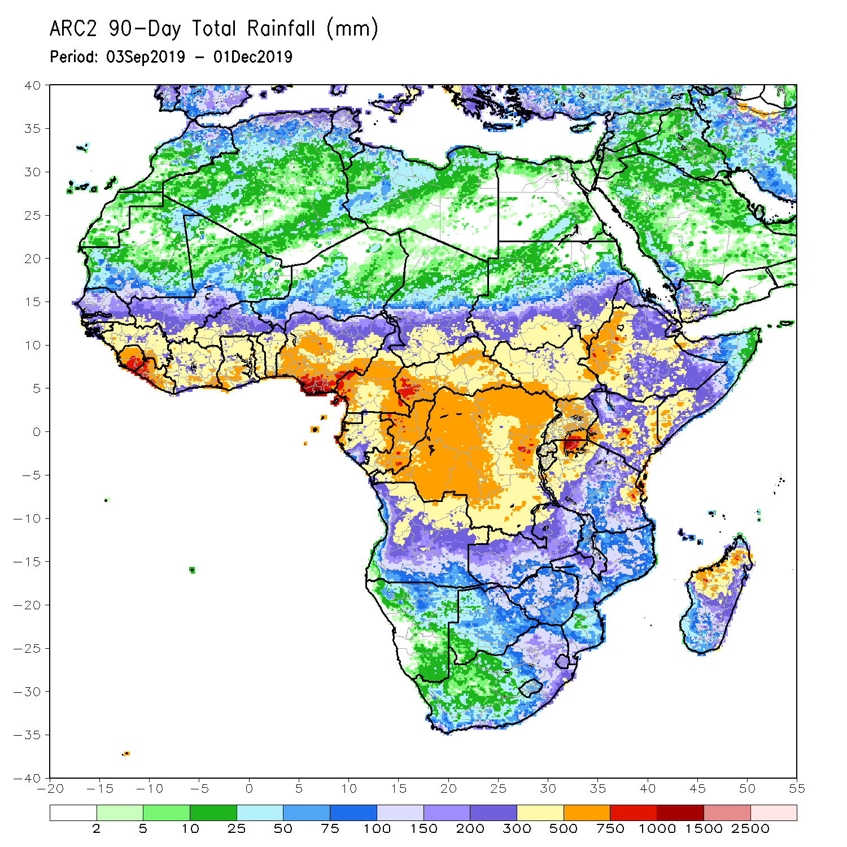
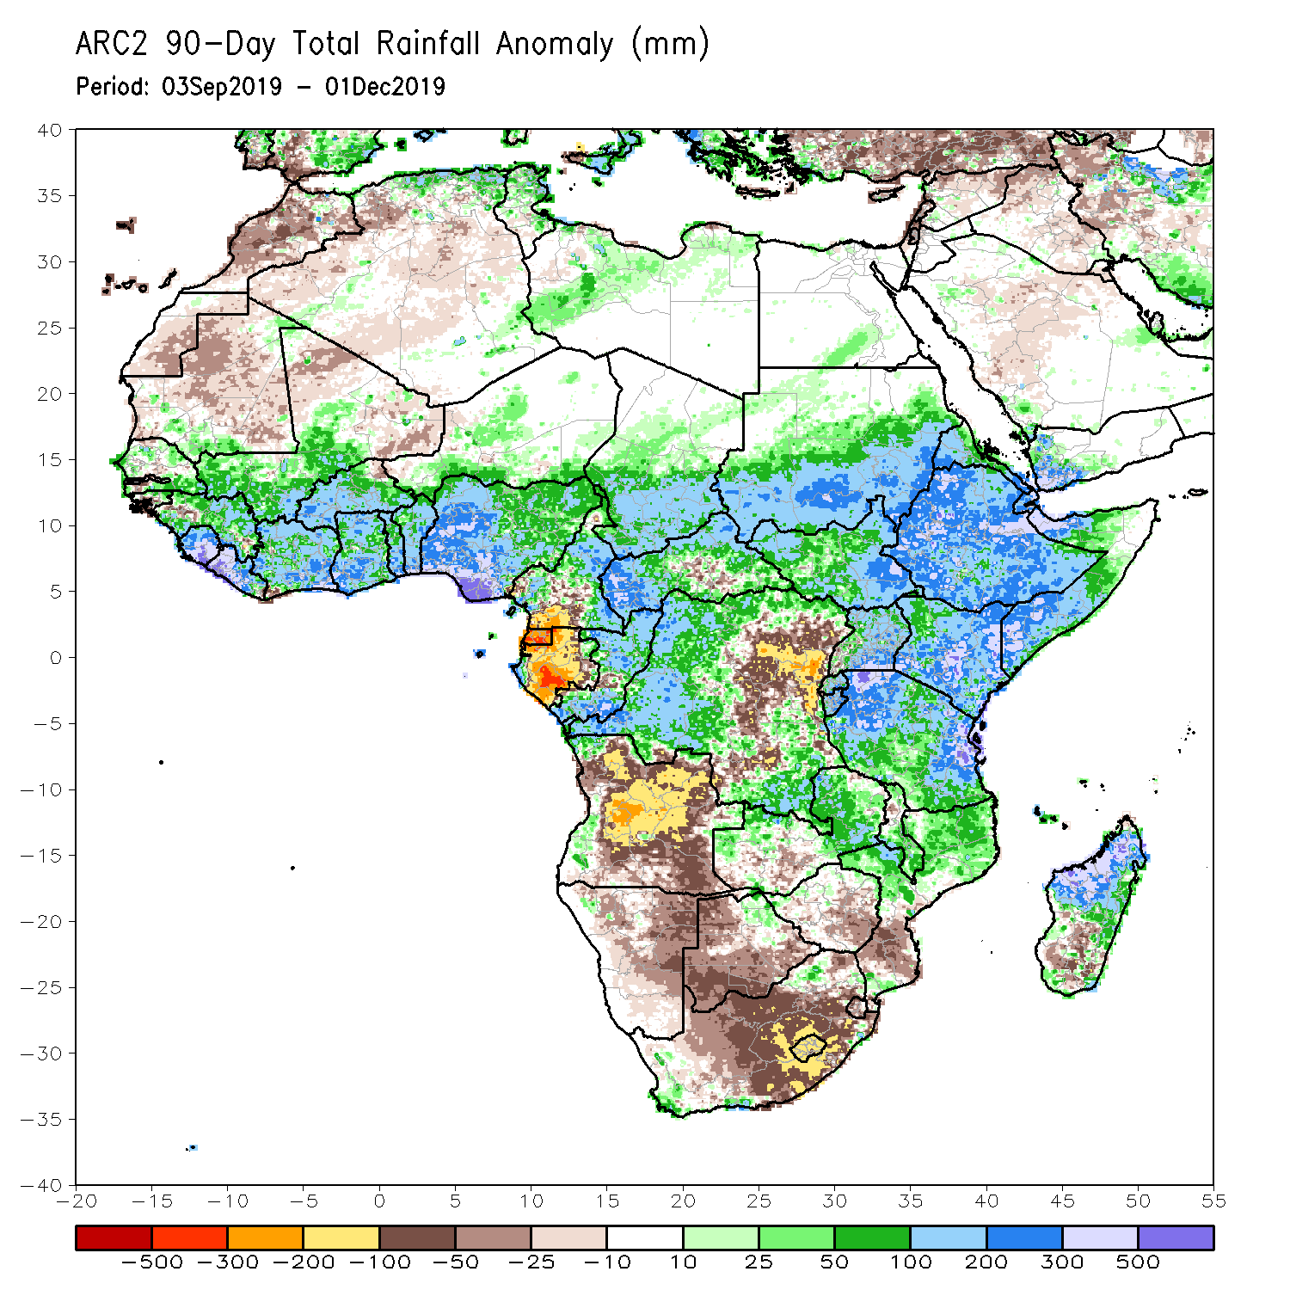
Rainfall Patterns: Last 90 Days
During the past 90 days, rainfall was above-average over parts of southern Mauritania, Senegal, Guinea-Bissau, Guinea, Sierra Leone, eastern Liberia, central and southern Mali, Cote d’Ivoire, Burkina Faso, Ghana, Togo, Benin, Niger, many parts of Nigeria, Chad, portions of Cameroon, CAR, portions of DRC, South Sudan, Uganda, southern and eastern Sudan, Eritrea, Ethiopia, Kenya, Somalia, many parts of Tanzania, local areas in northern Angola, parts of Zambia, Malawi, northern Mozambique, and much of Madagascar.
Parts of southern Cameroon, Gabon, portions of central and eastern DRC, many parts of Angola, local areas in Zambia, Zimbabwe, Namibia, Botswana, southern Madagascar and many parts of South Africa had below-average rainfall.
Notes:
6

Slide 7
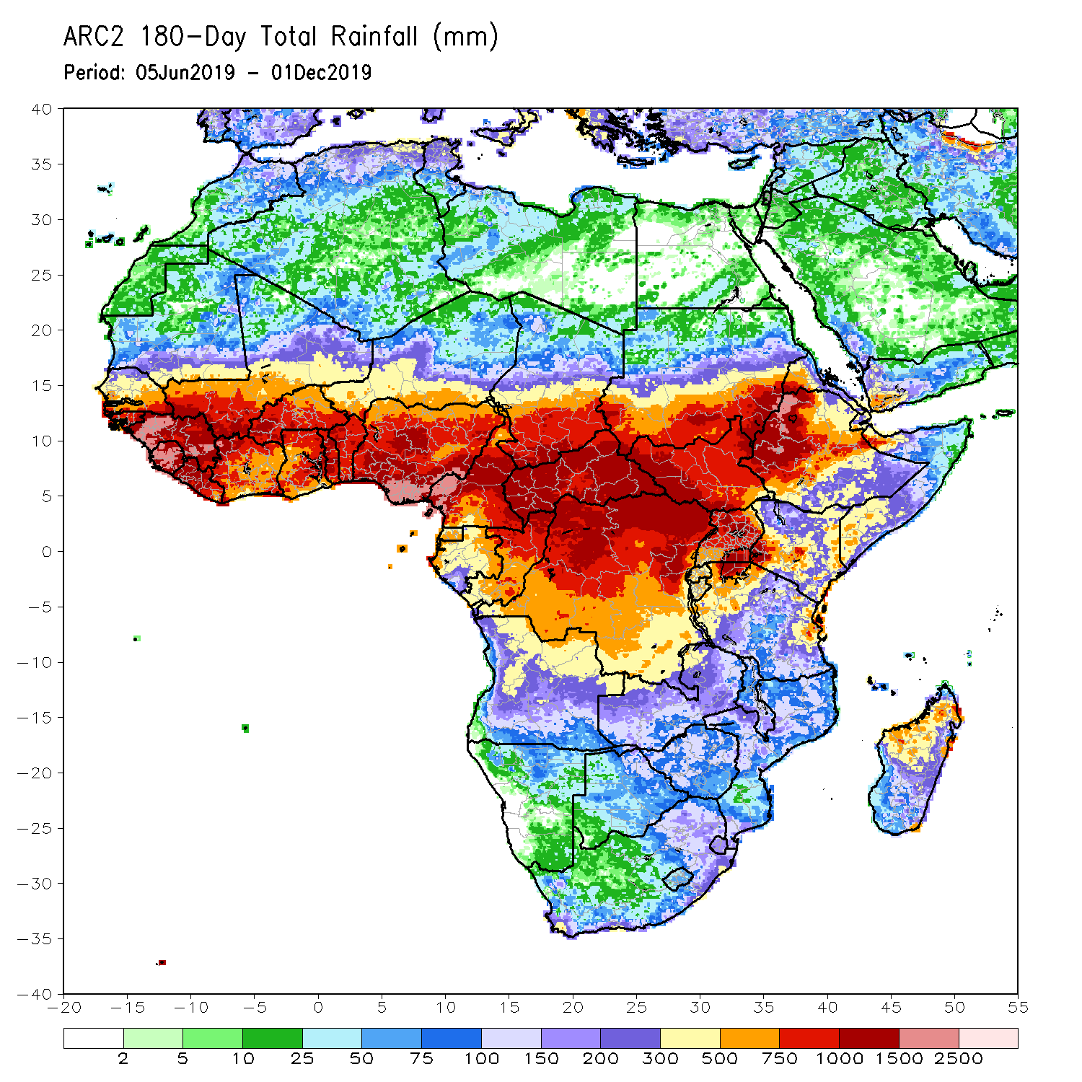
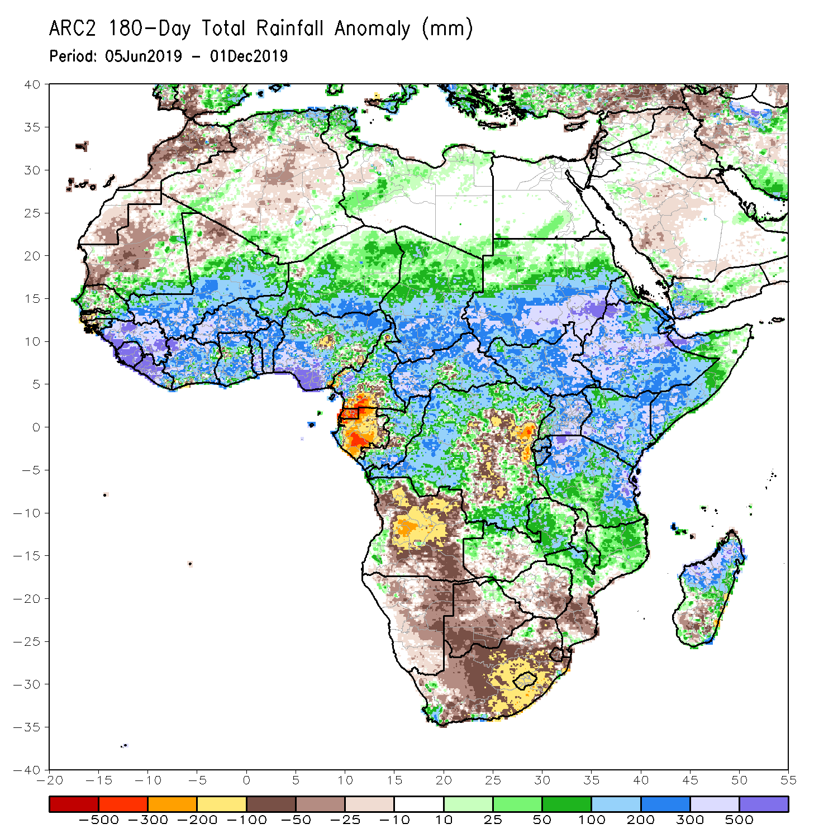
Rainfall Patterns: Last 180 Days
During the past 180 days, below-average rainfall was observed over portions of southern Cameroon, Equatorial Guinea, Gabon, local areas in Congo, parts of central and eastern DRC, many parts of Angola, Namibia, much of South Africa, western Zambia, Botswana, Zimbabwe, and portions of Mozambique and southern Madagascar.
Parts of Southern and eastern Mauritania, much of Senegal, Guinea-Bissau, Guinea, Sierra Leone, Mali, Liberia, Cote d’Ivoire, Burkina Faso, Ghana, Togo, Benin, Nigeria, much of Cameroon, Niger, Chad, CAR, many parts of DRC, South Sudan, Sudan, Uganda, Eritrea, Ethiopia, Somalia, Kenya, Tanzania, parts of western Angola, portions of Zambia, Malawi, northern Mozambique and many parts of Madagascar had above-average rainfall.
Notes:
7

Slide 8
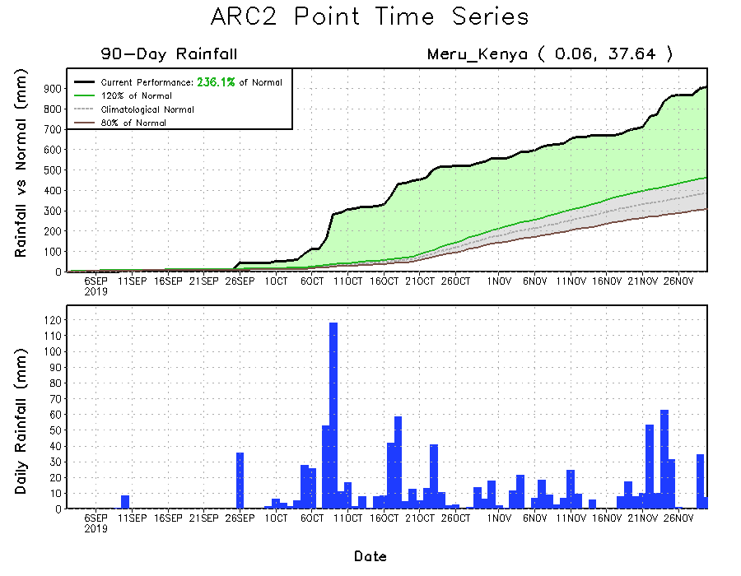
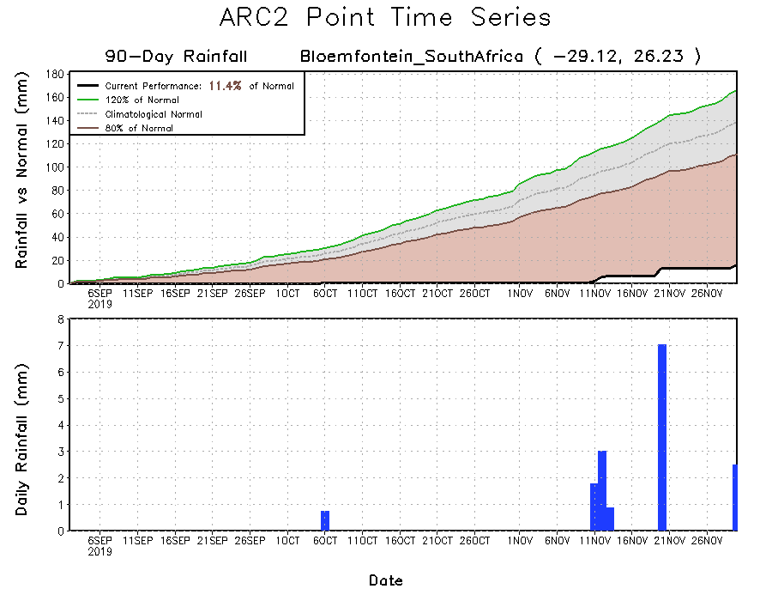
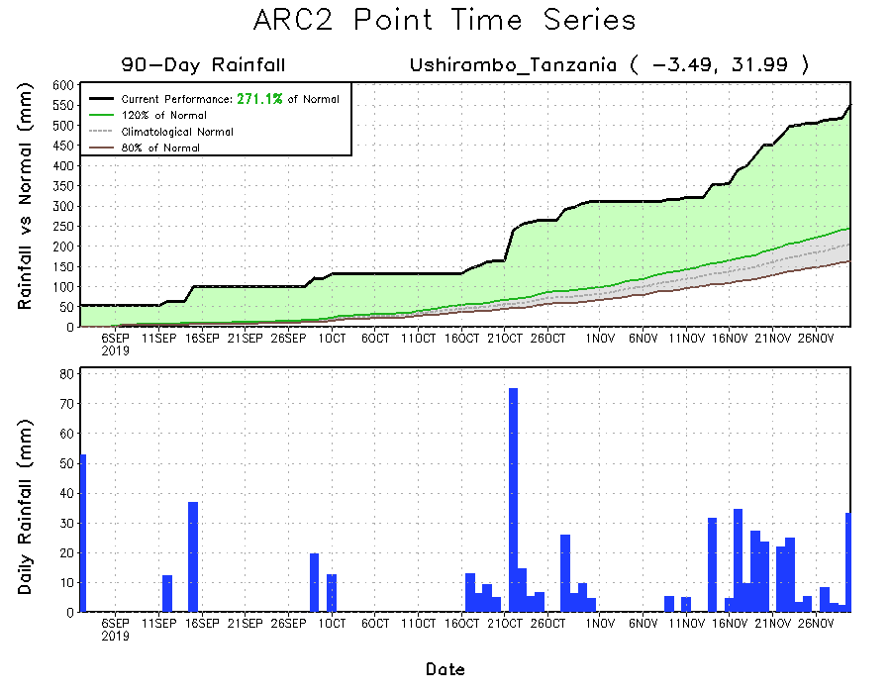
Recent Rainfall Evolution
Daily evolution of rainfall over the last 90 days at selected locations shows that moderate to locally heavy rainfall sustained moisture surpluses over parts of Tanzania (bottom right) and Kenya (top right). Seasonal total rainfall remained below-average over many parts of South Africa (bottom left).

Slide 9
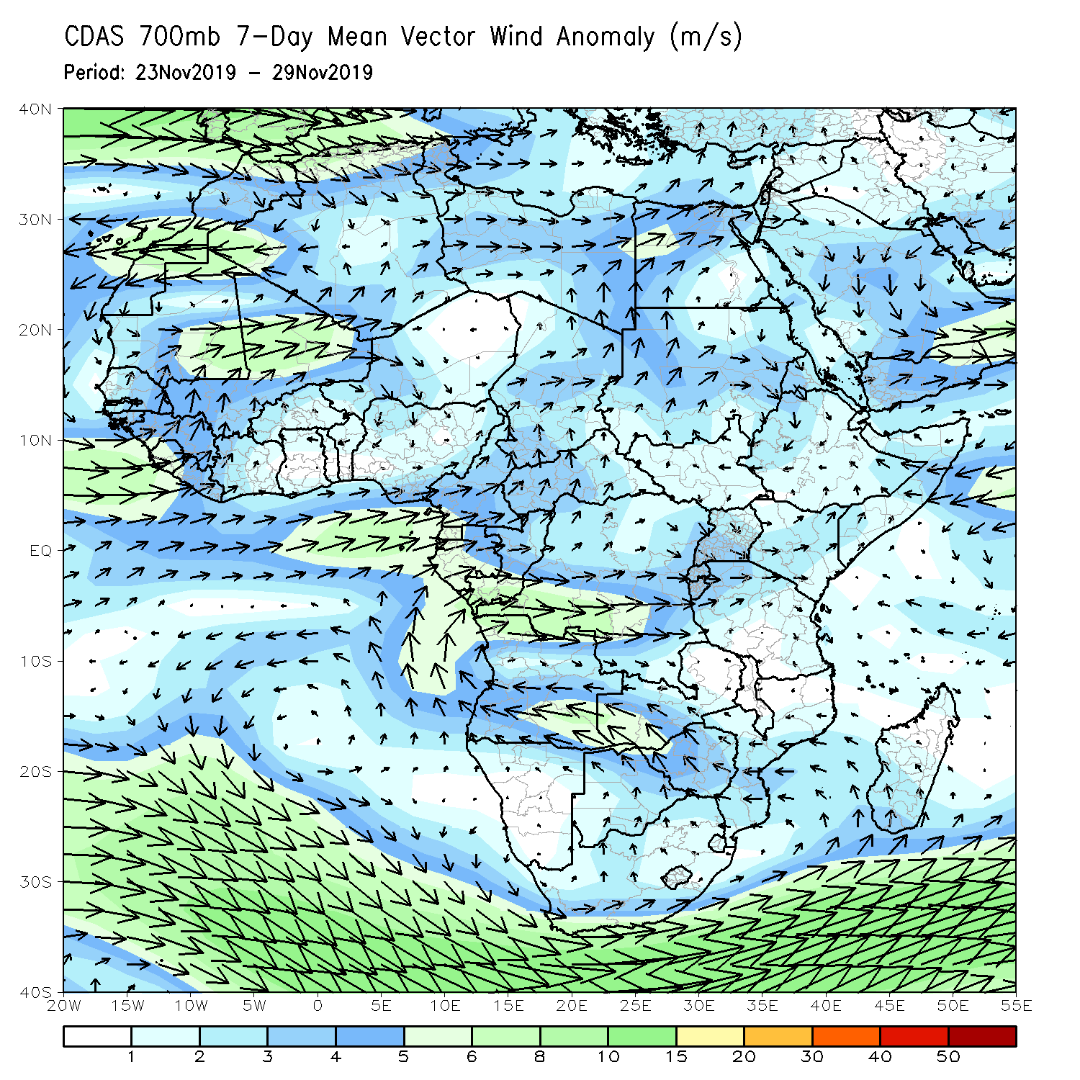
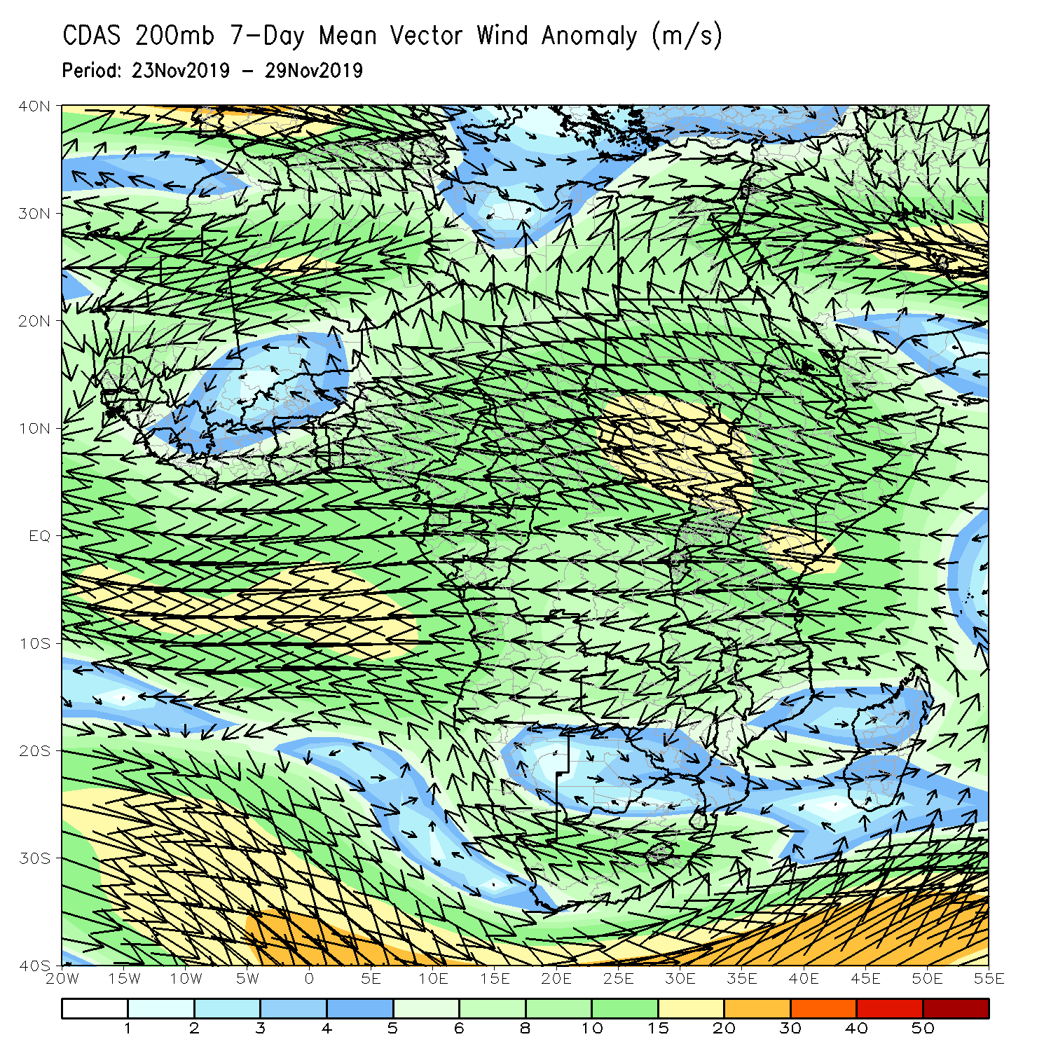
Atmospheric Circulation: Last 7 Days
Anomalous lower-level convergence over equatorial East Africa may have contributed to the observed rainfall surpluses in the region (left panel).

Slide 10
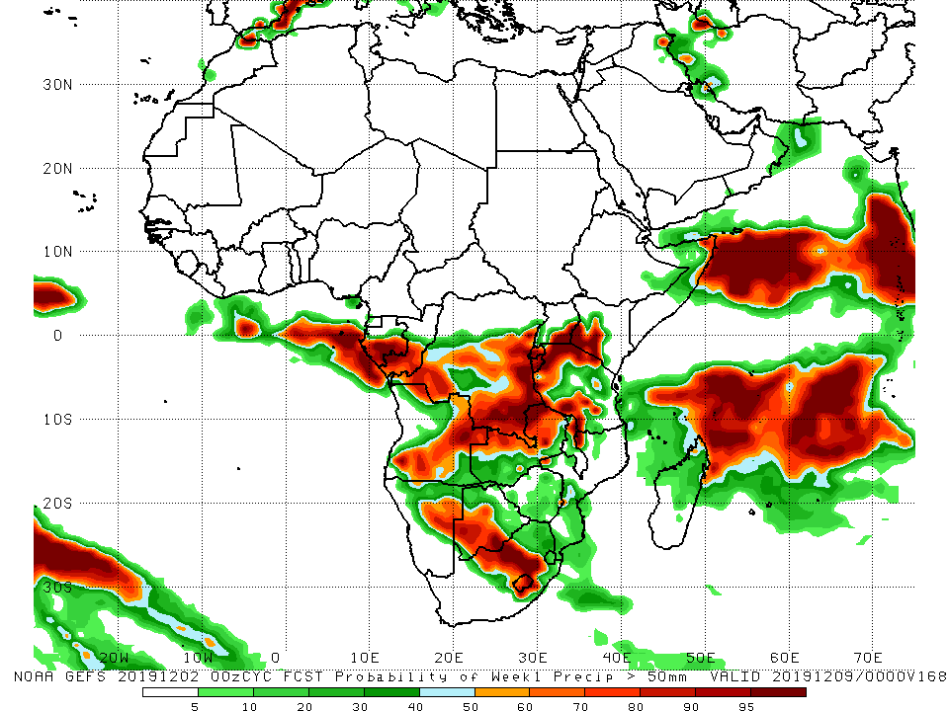
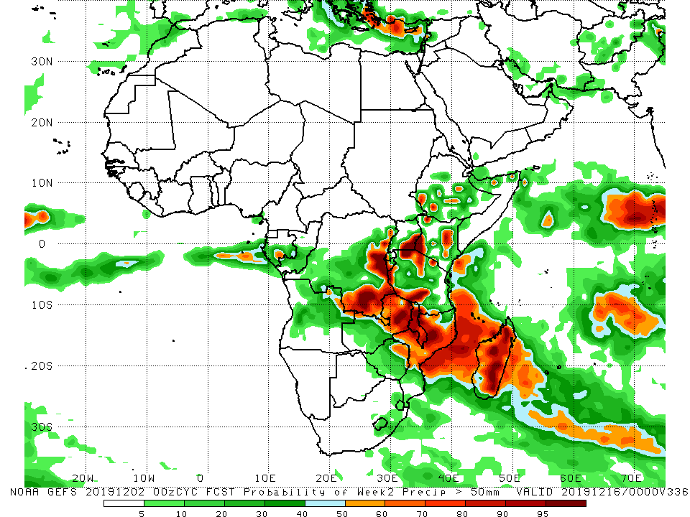
NCEP GEFS Model Forecasts Non-Bias Corrected Probability of precipitation exceedance
Week-1: Valid 3 – 9 December, 2019
Week-2: Valid 10 – 16 December, 2019
For week-1 (left panel) there is an increased chance for weekly rainfall totals to exceed 50mm over southern Gabon, southern Congo, portions of Angola and DRC, Rwanda, Burundi, southeastern Uganda, southwestern Kenya, northern and western Tanzania, northern Zambia, eastern Namibia, southern Botswana, and central South Africa. For week-2 (right panel), there is an increased chance for weekly rainfall totals to exceed 50mm over eastern and southern DRC, southeastern Uganda, local areas in Ethiopia and Kenya, parts of Tanzania, Malawi, eastern Zambia, northern Mozambique and much of Madagascar.
Notes:
10

Slide 11
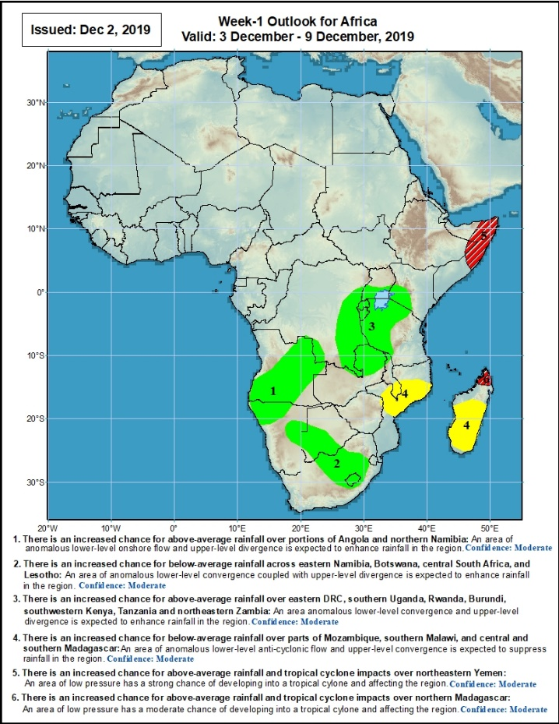
Week-1 Precipitation Outlooks
There is an increased chance for above-average rainfall over portions of Angola and northern Namibia: An area of anomalous lower-level onshore flow and upper-level divergence is expected to enhance rainfall in the region. Confidence: Moderate
There is an increased chance for above-average rainfall across eastern Namibia, Botswana, central South Africa, and Lesotho: An area of anomalous lower-level cyclonic circulation and upper-level divergence is expected to suppress rainfall in the region. Confidence: Moderate
There is an increased chance for above-average rainfall over eastern DRC, southern Uganda, Rwanda, Burundi, southwestern Kenya, Tanzania and northeastern Zambia: An area anomalous lower-level convergence and upper-level divergence is expected to enhance rainfall in the region. Confidence: Moderate
There is an increased chance for below-average rainfall over parts of Mozambique, southern Malawi, and central and southern Madagascar: An area of anomalous lower-level anti-cyclonic flow and upper-level convergence is expected to suppress rainfall in the region. Confidence: Moderate
There is an increased chance for above-average rainfall over parts of southeastern Ethiopia and Somalia: An area of anomalous low pressure has a strong chance of developing into a tropical cyclone and affecting the region. Confidence: Moderate
There is an increased chance for above-average rainfall the far northern Madagascar: An area of anomalous low pressure has a moderate chance of developing into a tropical cyclone and affecting the region. Confidence: Moderate
3 – 9 December, 2019
Notes:
11

Slide 12
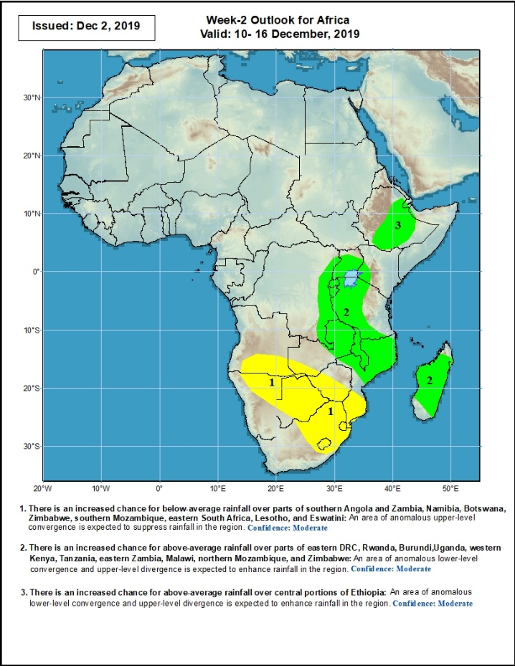
Week-2 Precipitation Outlooks
10 – 16 December, 2019
There is an increased chance for below-average rainfall over parts of southern Angola and Zambia, Namibia, Botswana, Zimbabwe, southern Mozambique, eastern South Africa, Lesotho, and Eswatini: An area of anomalous lower-level divergence and upper-level convergence is expected to suppress rainfall in the region. Confidence: Moderate
There is an increased chance for above-average rainfall over eastern DRC, Uganda, Rwanda, Burundi, southwestern Kenya, western Tanzania, and parts of northwestern Zambia Kenya, Tanzania, eastern Zambia, Malawi, northern Mozambique, and Zimbabwe: An area of anomalous lower-level convergence and upper-level divergence is expected to enhance rainfall in the region. Confidence: Moderate
There is an increased chance for above-average rainfall over portions of Ethiopia: An area of anomalous lower-level convergence and upper-level divergence is expected to enhance rainfall in the region. Confidence: Moderate
Notes:
12

Slide 13
Summary
During the past 7 days, rainfall was below-average over Equatorial Guinea, Gabon, many parts of Angola, portions of DRC, southwestern Zambia, Namibia, Botswana, South Africa, Lesotho, Easwantini, Zimbabwe, southern Mozambique and southern Madagascar. Parts of southern Congo, local areas in western Angola and DRC, parts of southern Ethiopia, southwestern Kenya, Rwanda, Burundi, Tanzania, Malawi, northern Mozambique and northern Madagascar had above-average rainfall.
During the past 30 days, rainfall was above-average over local areas in Guinea, Sierra Leone, Liberia, southern Cote d’Ivoire, local areas in Ghana, southern Benin, portions of Nigeria, local areas in Cameroon and CAR, northern and southern Congo, northwestern and southeastern DRC, local areas in South Sudan, western and southern Ethiopia, Uganda, Kenya, Tanzania, southern Somalia, local areas in northeastern Botswana, much of Zambia, Zimbabwe, eastern South Africa, Malawi, northern Mozambique, and many parts of Madagascar. Parts of Cameroon, Equatorial Guinea, Gabon, central Congo, much of Angola, many parts of DRC, Namibia, much of Botswana, parts of southern Mozambique, and western and southern South Africa had below-average rainfall.
During the past 90 days, rainfall was above-average over parts of southern Mauritania, Senegal, Guinea-Bissau, Guinea, Sierra Leone, eastern Liberia, central and southern Mali, Cote d’Ivoire, Burkina Faso, Ghana, Togo, Benin, Niger, many parts of Nigeria, Chad, portions of Cameroon, CAR, portions of DRC, South Sudan, Uganda, southern and eastern Sudan, Eritrea, Ethiopia, Kenya, Somalia, many parts of Tanzania, local areas in northern Angola, parts of Zambia, Malawi, northern Mozambique, and much of Madagascar. Parts of southern Cameroon, Gabon, portions of central and eastern DRC, many parts of Angola, local areas in Zambia, Zimbabwe, Namibia, Botswana, southern Madagascar and many parts of South Africa had below-average rainfall.
Week-1 outlooks call for an increased chance for above-average rainfall over portions of Angola, northern and eastern Namibia, eastern DRC, Rwanda, Burundi, southern Uganda, southwestern Kenya, western Tanzania, eastern Zambia, southern Botswana, and central South Africa. In contrast, there is an increased chance for below-average rainfall over southern Malawi, central Mozambique and southern Madagascar.
Notes:
13

