Slide 1
The African Monsoon Recent Evolution and Current Status Include Week-1 and Week-2 Outlooks
Update prepared by
Climate Prediction Center / NCEP
16 December 2019
For more information, visit:
http://www.cpc.ncep.noaa.gov/products/Global_Monsoons/African_Monsoons/precip_monitoring.shtml

Slide 2
Outline
Highlights
Recent Evolution and Current Conditions
NCEP GEFS Forecasts
Summary

Slide 3
Highlights: Last 7 Days
Weekly rainfall surpluses exceeded 100mm over parts of Central Congo and southern Madagascar, and local areas in Kenya.
Week-1 outlooks call for an increased chance for above-average rainfall over parts of northern and western Angola, southeastern DRC, Burundi, Tanzania, eastern Zambia, northern Malawi and northern Mozambique. In contrast, there is an increased chance for below-average rainfall over parts of southeastern Angola, northern Mauritania, western Zambia, Zimbabwe, and southern Mozambique.

Slide 4
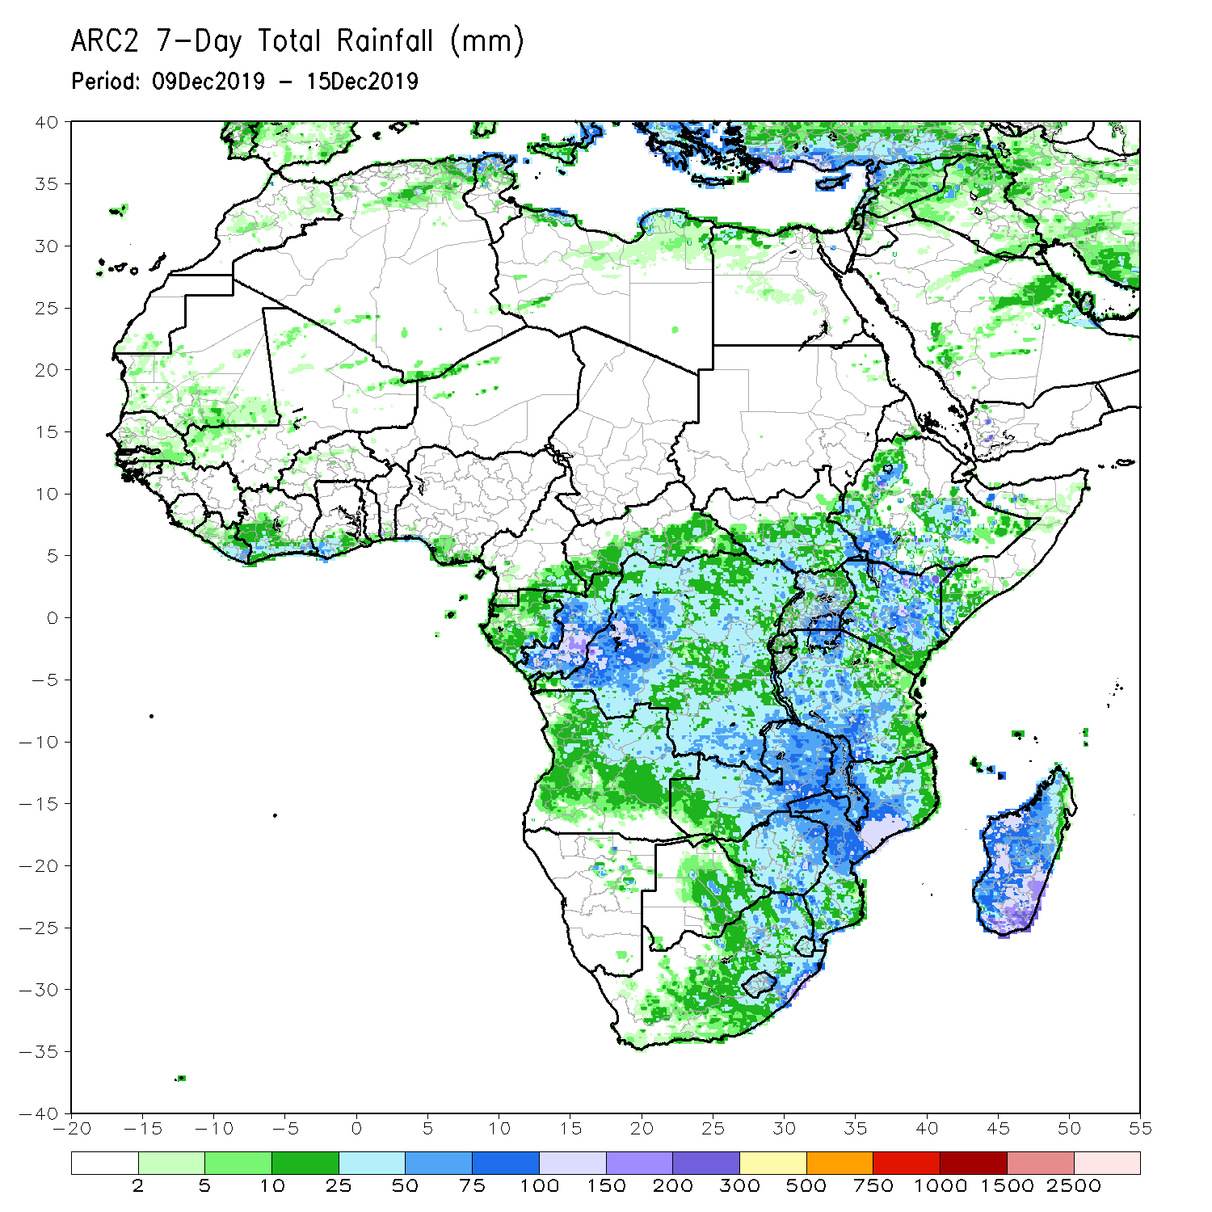
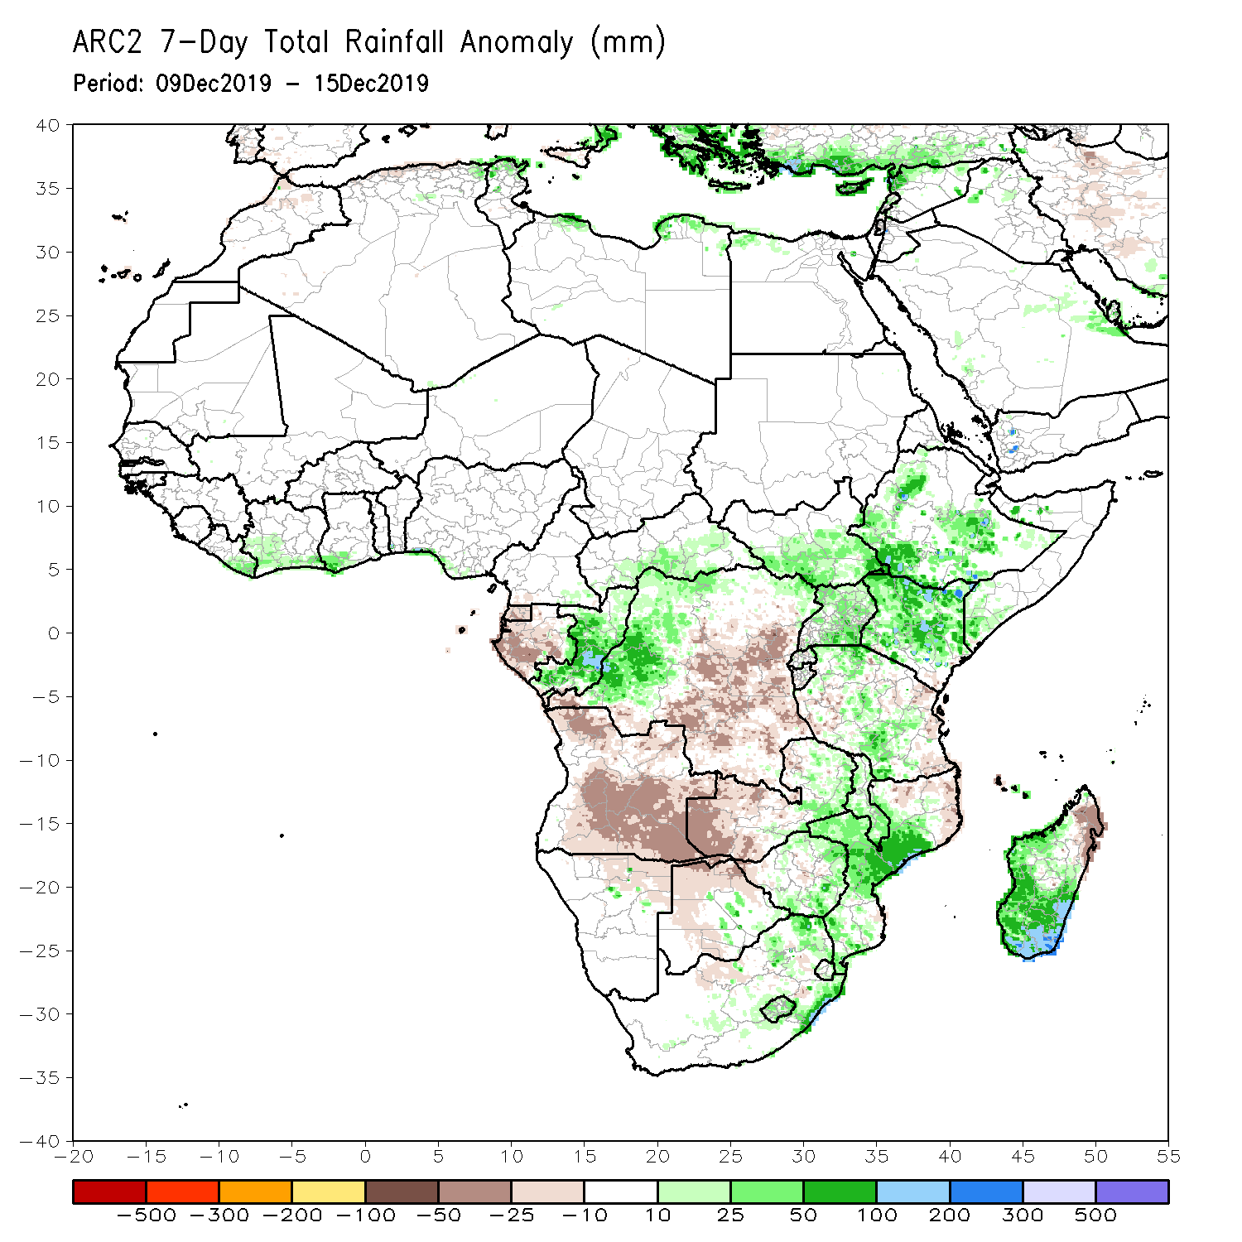
Rainfall Patterns: Last 7 Days
During the past 7 days, rainfall was below-average over Equatorial Africa, Gabon, much of Angola, central and eastern DRC, western and northern Zambia, and local areas in northern Mozambique and northern Madagascar.
Eastern Liberia, southern Cote d’Ivoire, southwestern Ghana, much of Congo, parts of CAR, western DRC, South Sudan, many parts of Ethiopia, southwestern Somalia, much of Uganda and Kenya, Tanzania, parts of eastern and southern Zambia, Malawi, local areas in Botswana, Zimbabwe, central and southern Mozambique, eastern South Africa, Lesotho, Swaziland, and many parts of Madagascar had above-average rainfall.

Slide 5
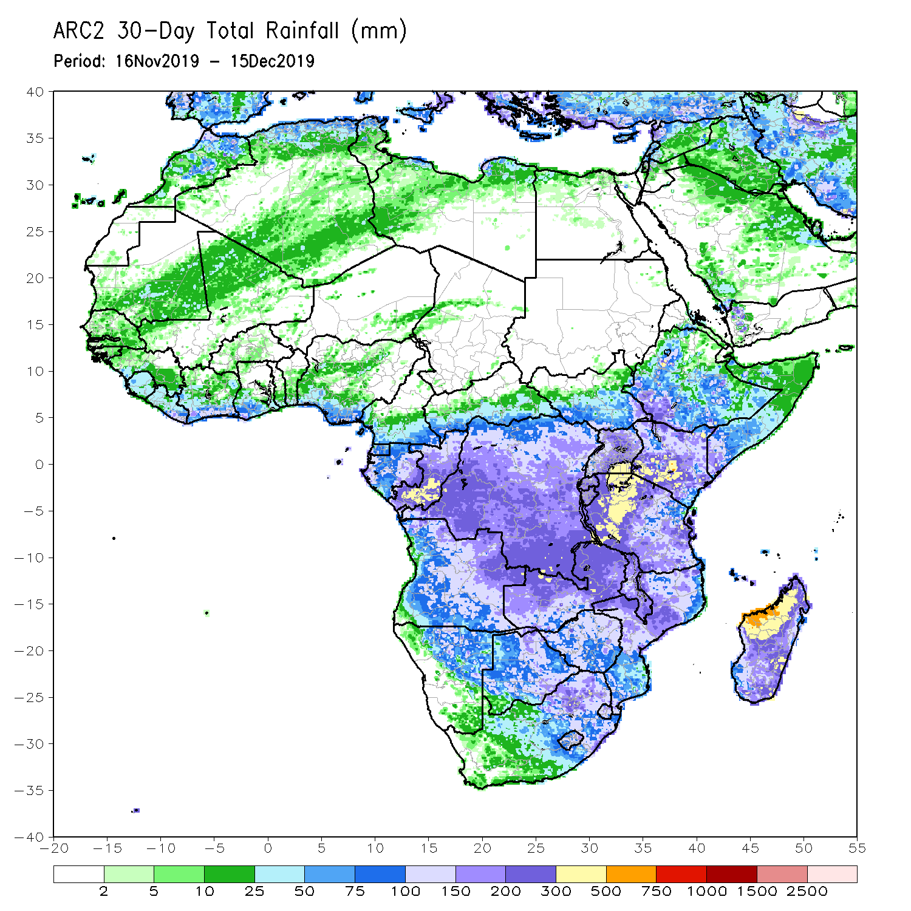
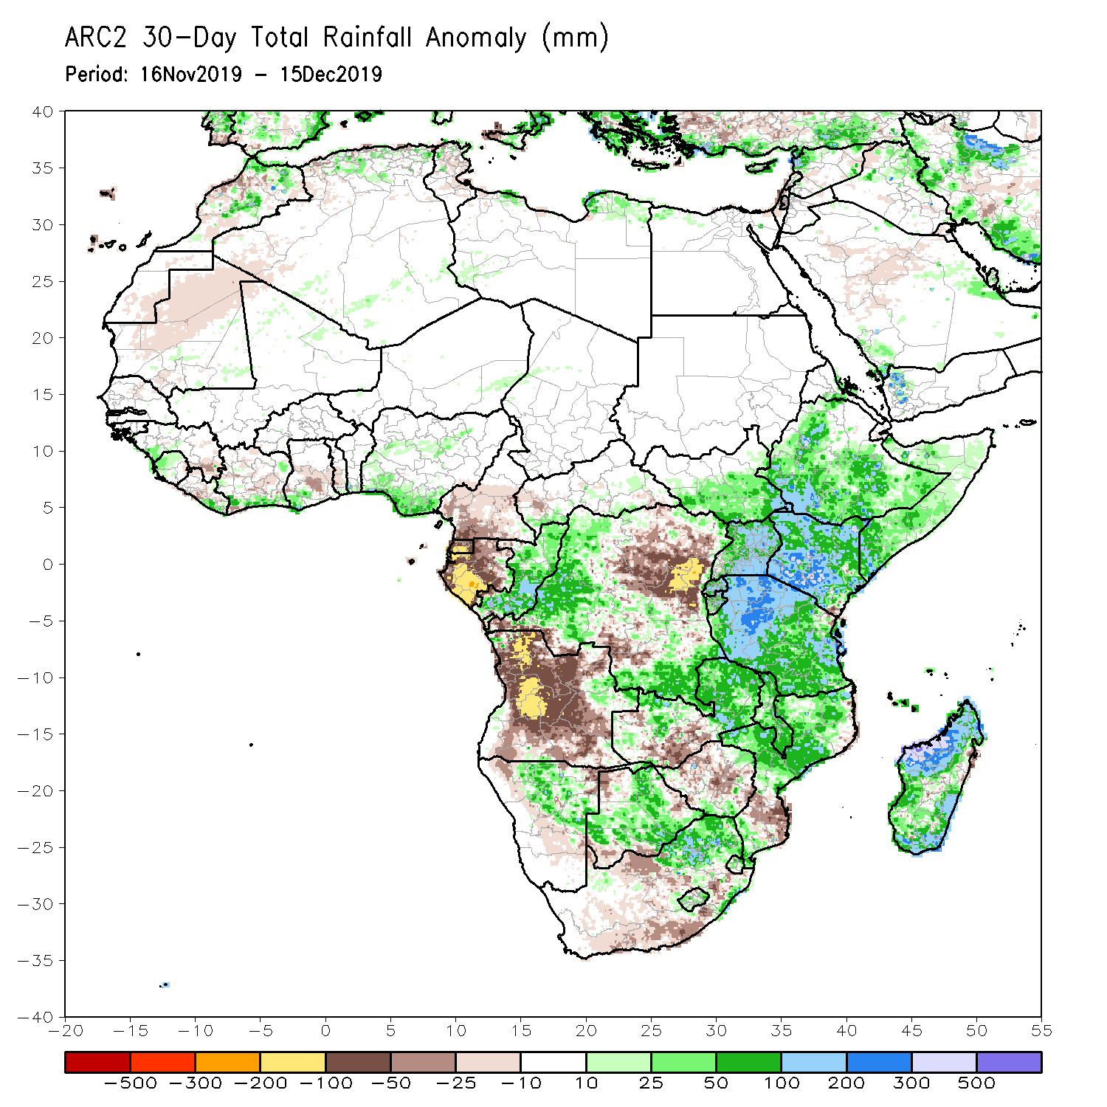
Rainfall Patterns: Last 30 Days
During the past 30 days, rainfall was above-average over local areas in Guinea, Sierra Leone, Liberia, parts of southern Cote d’Ivoire, local areas in Ghana, portions of Nigeria, much of Congo, western and southern DRC, South Sudan, Ethiopia, Rwanda, Burundi, Uganda, Kenya, Tanzania, Somalia, local areas in Angola, Namibia, Botswana, northern and eastern Zambia, eastern South Africa, Malawi, northern Mozambique, and many parts of Madagascar.
Local areas in Guinea and Liberia, parts of Cote d’Ivoire and Ghana, southern Cameroon, Equatorial Guinea, Gabon, much of Angola, many parts of DRC, parts of western Zambia, Zimbabwe, parts of southern Mozambique, and western and southern South Africa had below-average rainfall.
Notes:
5

Slide 6
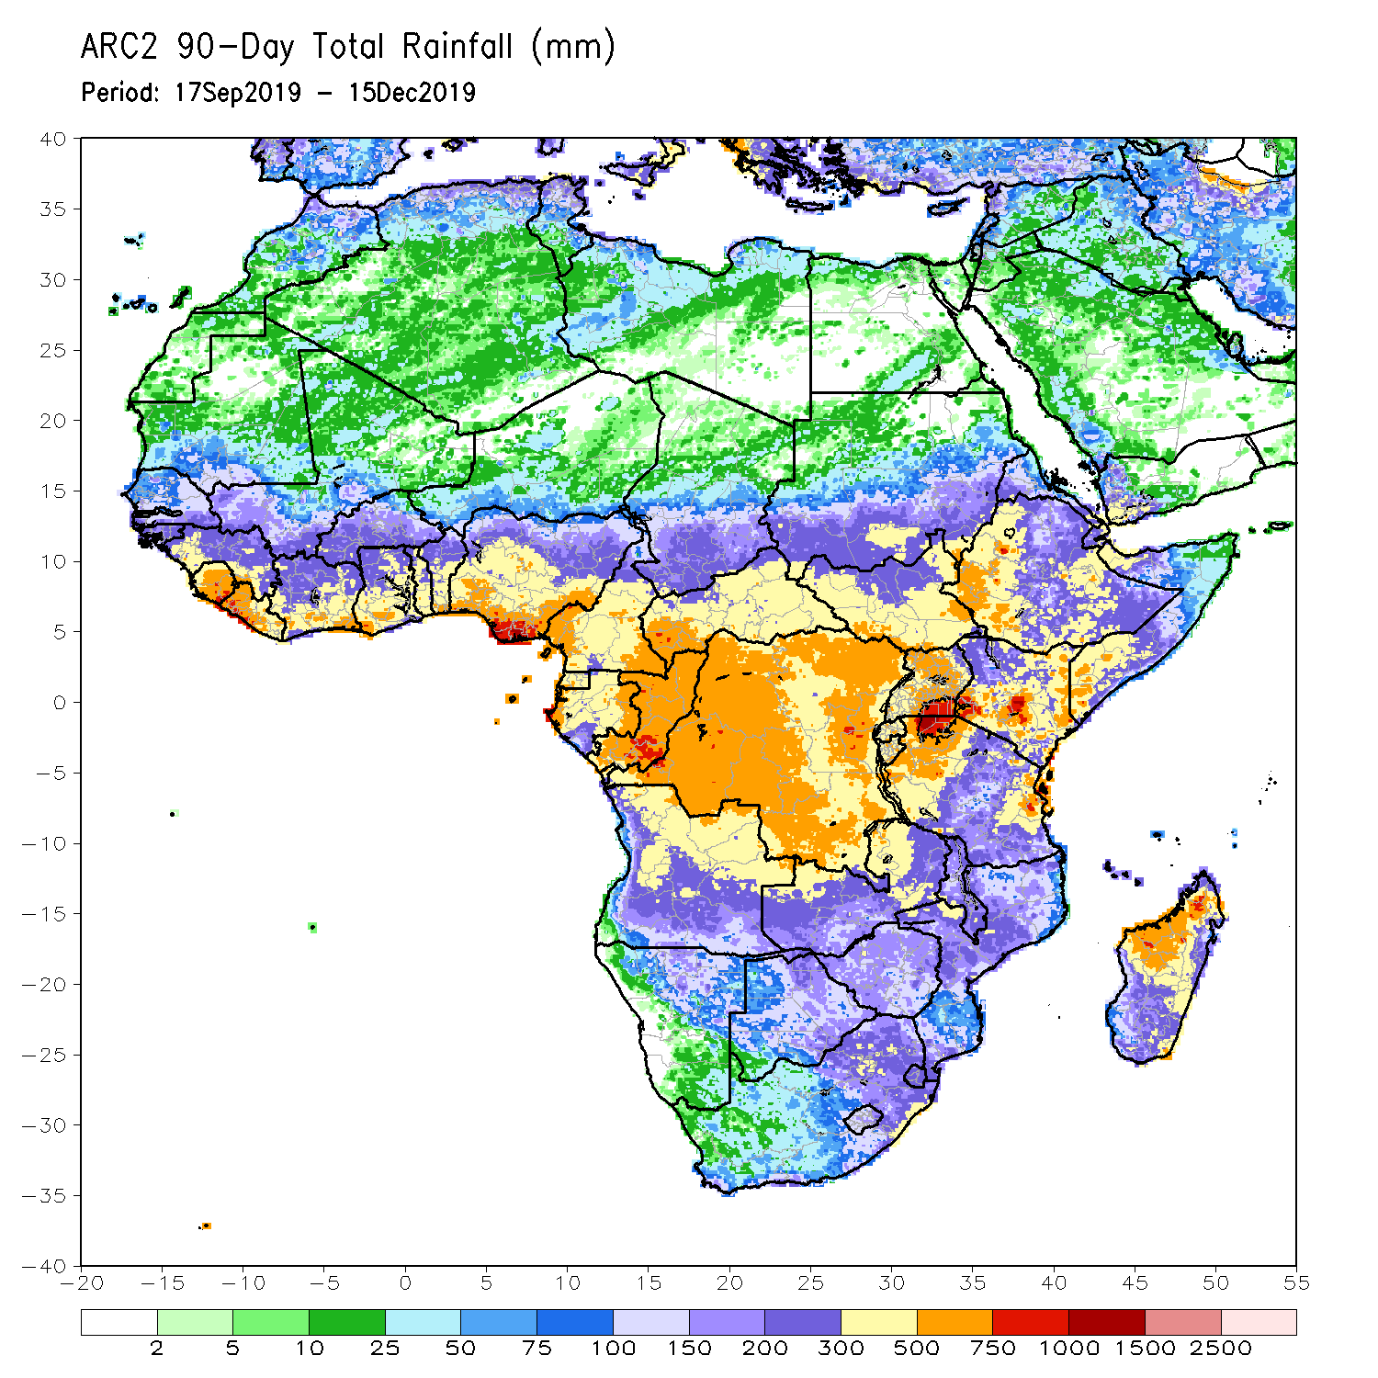
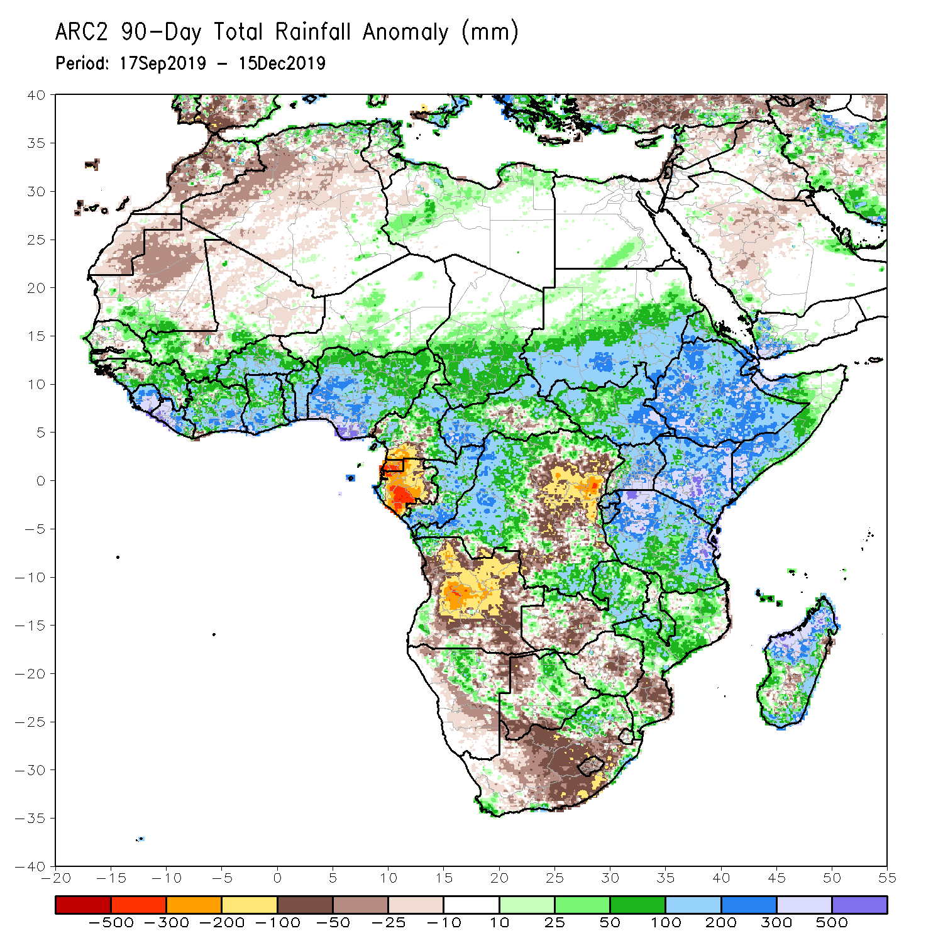
Rainfall Patterns: Last 90 Days
During the past 90 days, rainfall was above-average over parts of southern Mauritania, Senegal, Guinea-Bissau, much of Guinea, Sierra Leone, Liberia, southwestern Mali, Cote d’Ivoire, Burkina Faso, Ghana, Togo, Benin, parts of Niger, many parts of Nigeria, Chad, portions of Cameroon and CAR, portions of DRC, South Sudan, Uganda, southern and eastern Sudan, Eritrea, Ethiopia, Kenya, Somalia, many parts of Tanzania, local areas in Angola, many parts of Zambia, parts of Namibia and Botswana, Malawi, northeastern South Africa, northern Mozambique, and many parts of Madagascar.
Local areas in Guinea, parts of southern Cameroon, Gabon, parts of CAR, portions of central and eastern DRC, many parts of Angola, parts of western Zambia, Zimbabwe, parts of Namibia and Botswana, southern Mozambique, southern Madagascar and many parts of South Africa had below-average rainfall.
Notes:
6

Slide 7
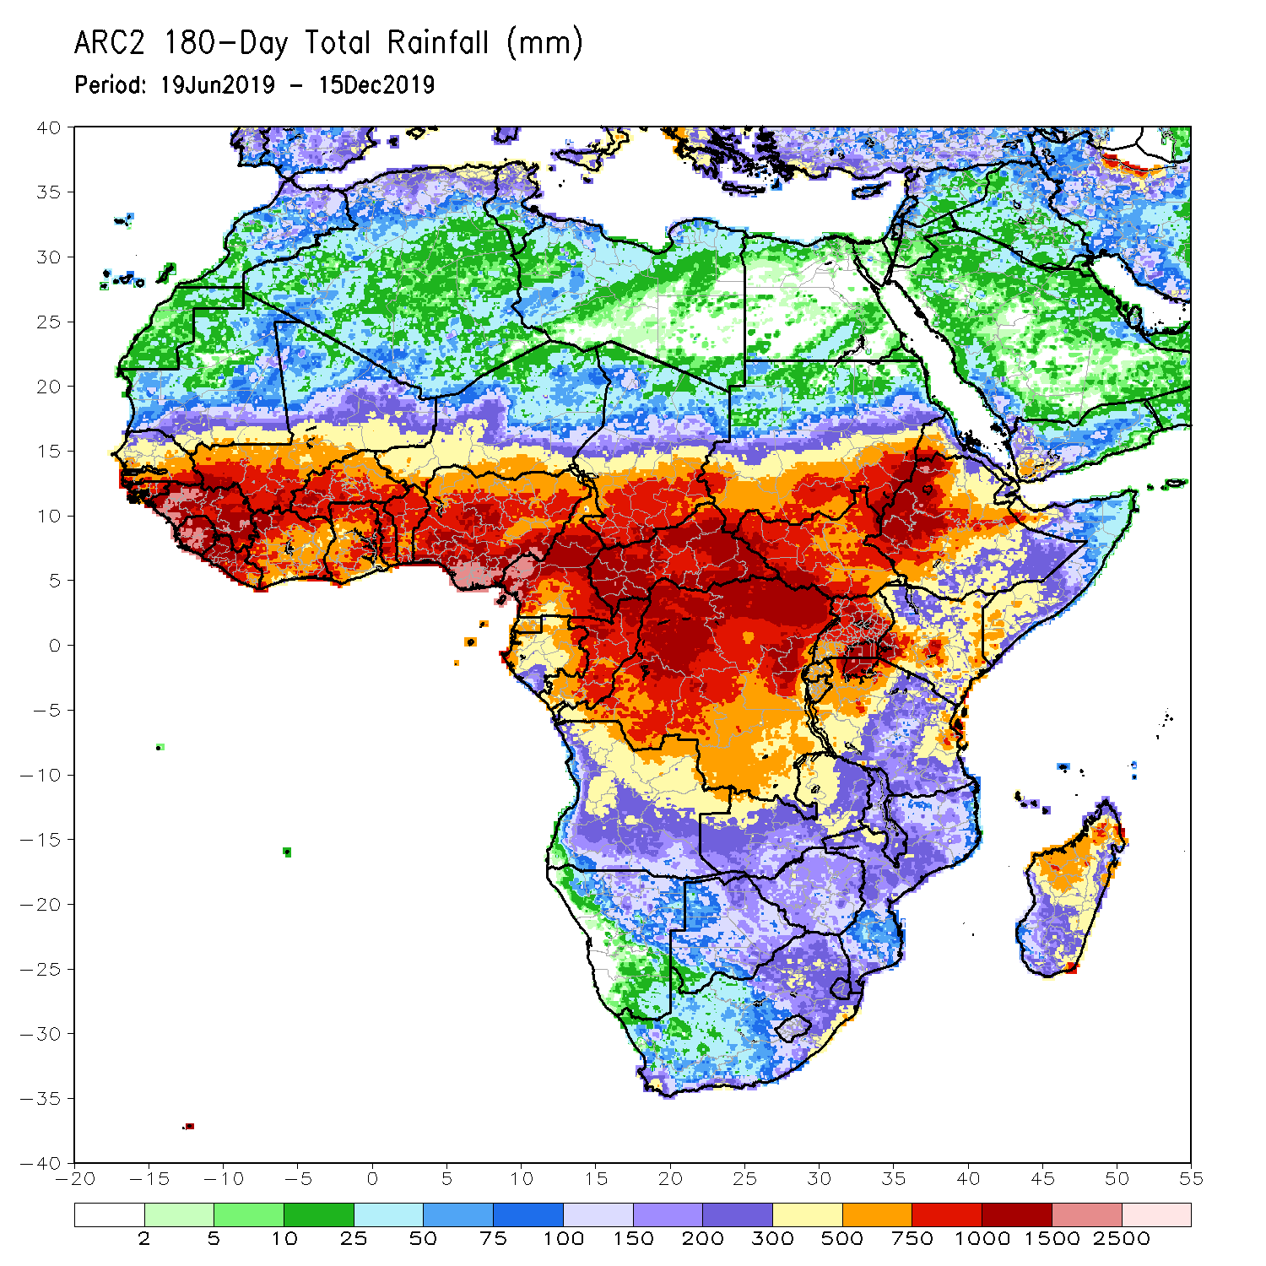
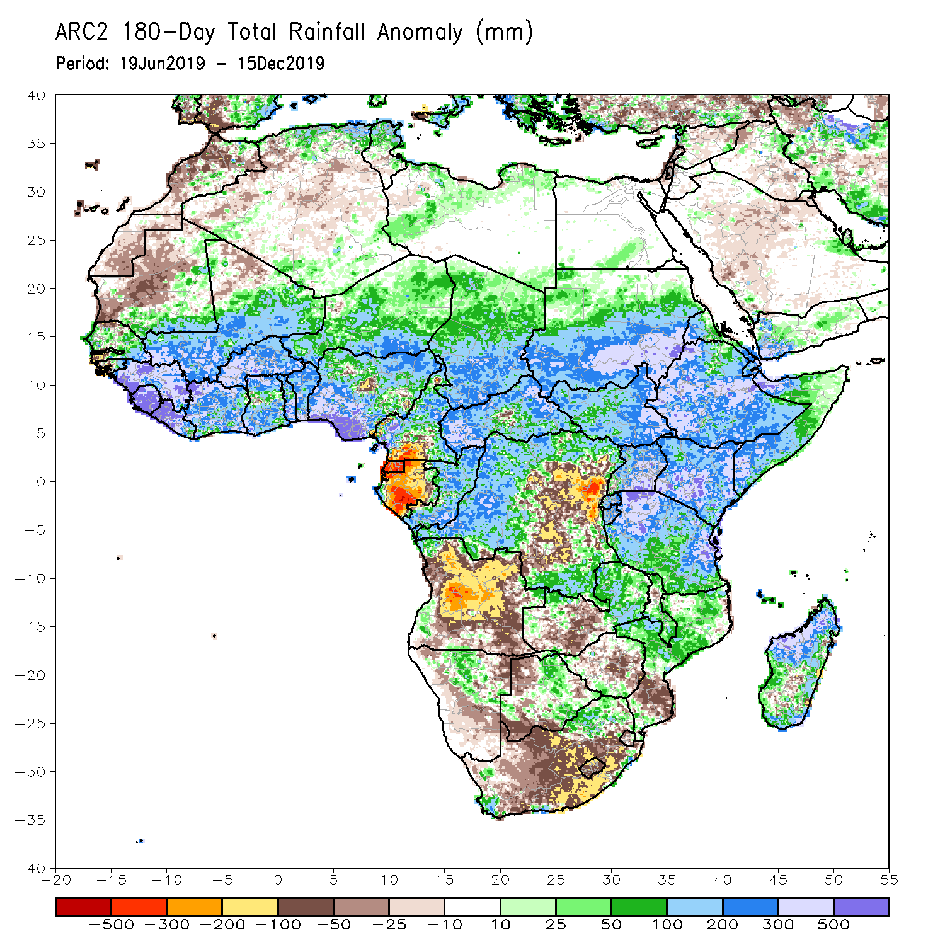
Rainfall Patterns: Last 180 Days
During the past 180 days, below-average rainfall was observed over portions of southern Cameroon, Equatorial Guinea, Gabon, parts of central and eastern DRC, many parts of Angola, parts of Namibia and Botswana, much of South Africa, western Zambia, Zimbabwe, and southern Mozambique and southern Madagascar.
Parts of Southern and eastern Mauritania, much of Senegal, Guinea-Bissau, Guinea, Sierra Leone, Mali, Liberia, Cote d’Ivoire, Burkina Faso, Ghana, Togo, Benin, Nigeria, much of Cameroon, Niger, Chad, CAR, many parts of DRC, South Sudan, Sudan, Uganda, Eritrea, Ethiopia, Somalia, Kenya, Tanzania, local areas in Angola, portions of Zambia, Namibia and Botswana, much of Malawi, northern Mozambique and many parts of Madagascar had above-average rainfall.
Notes:
7

Slide 8
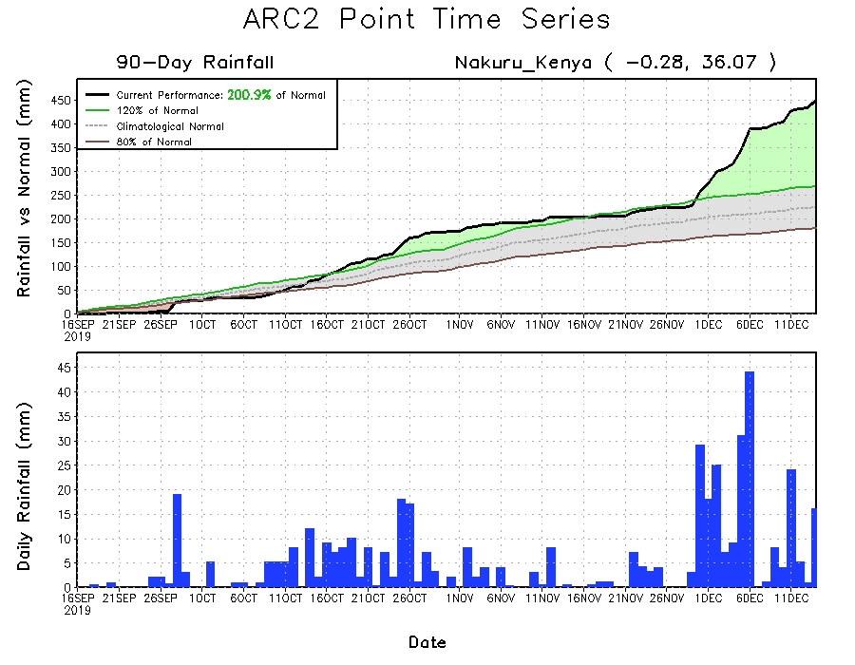
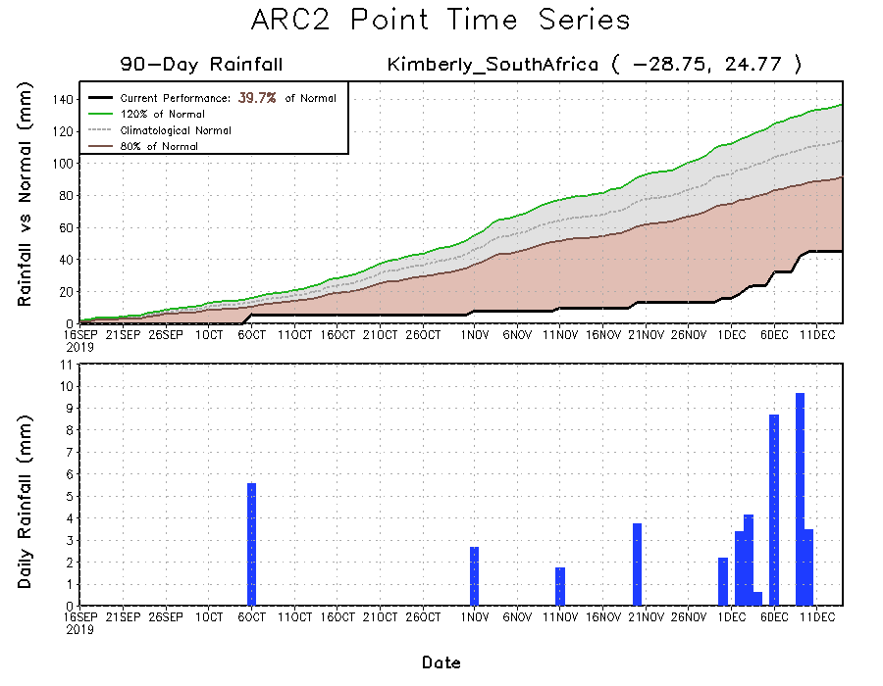
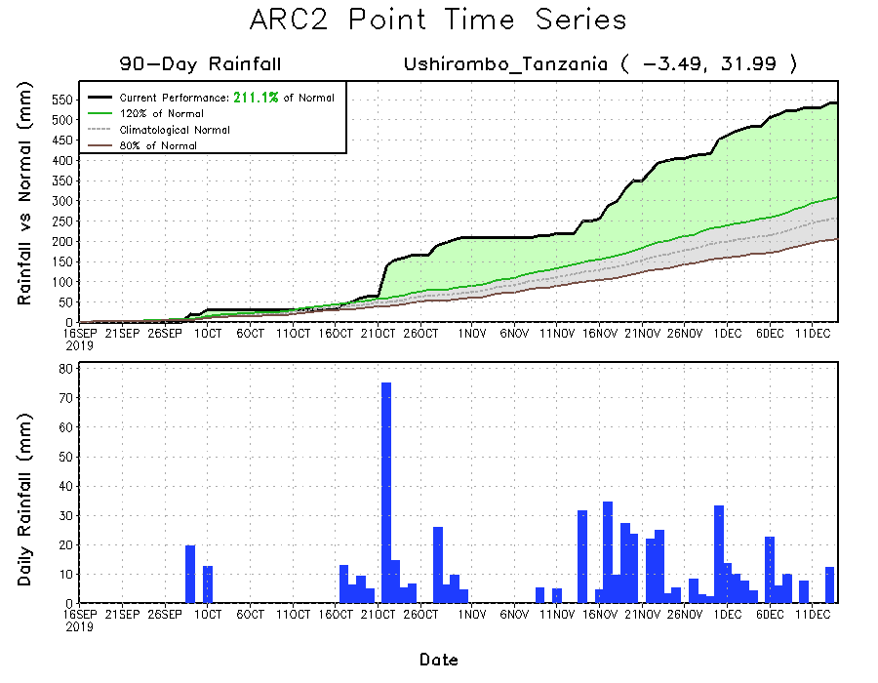
Recent Rainfall Evolution
Daily evolution of rainfall over the last 90 days at selected locations shows that moderate to locally heavy rainfall sustained moisture surpluses over parts of Tanzania (bottom right) and Kenya (top right). Seasonal total rainfall remained below-average over many parts of South Africa (bottom left).

Slide 9
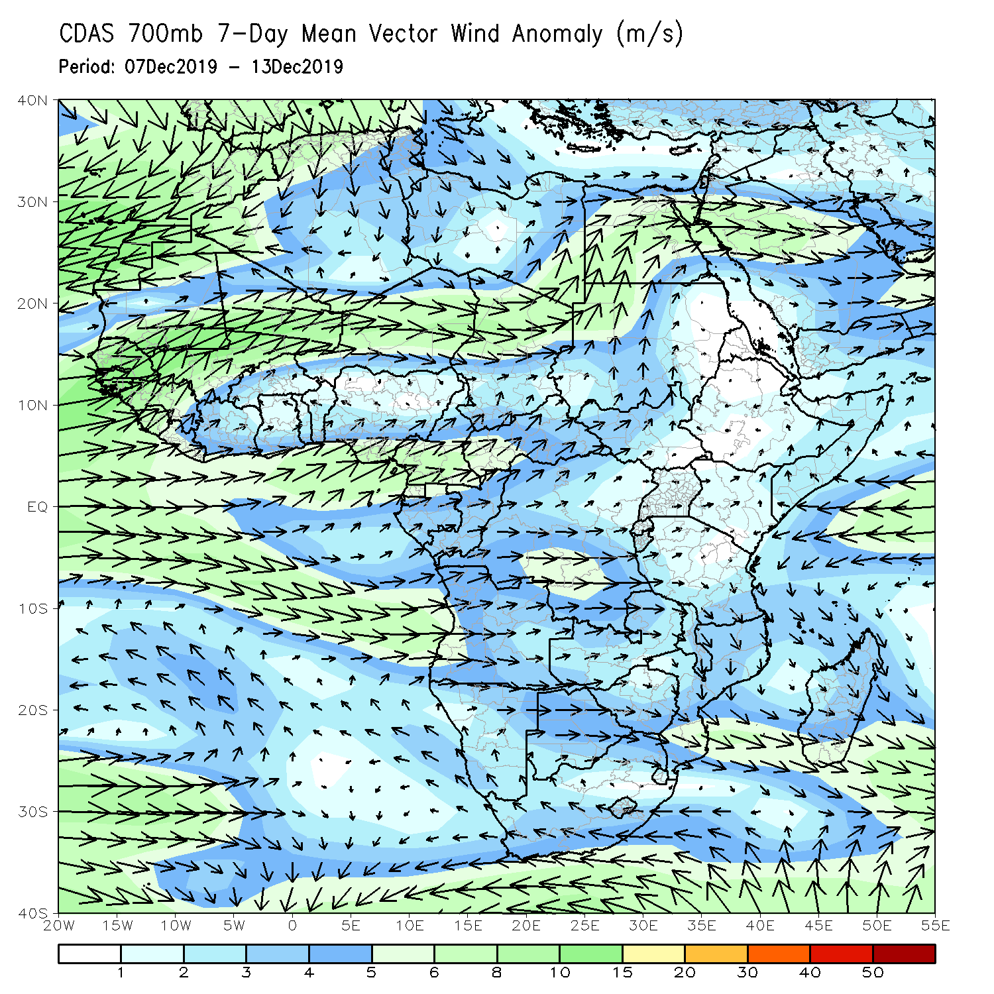
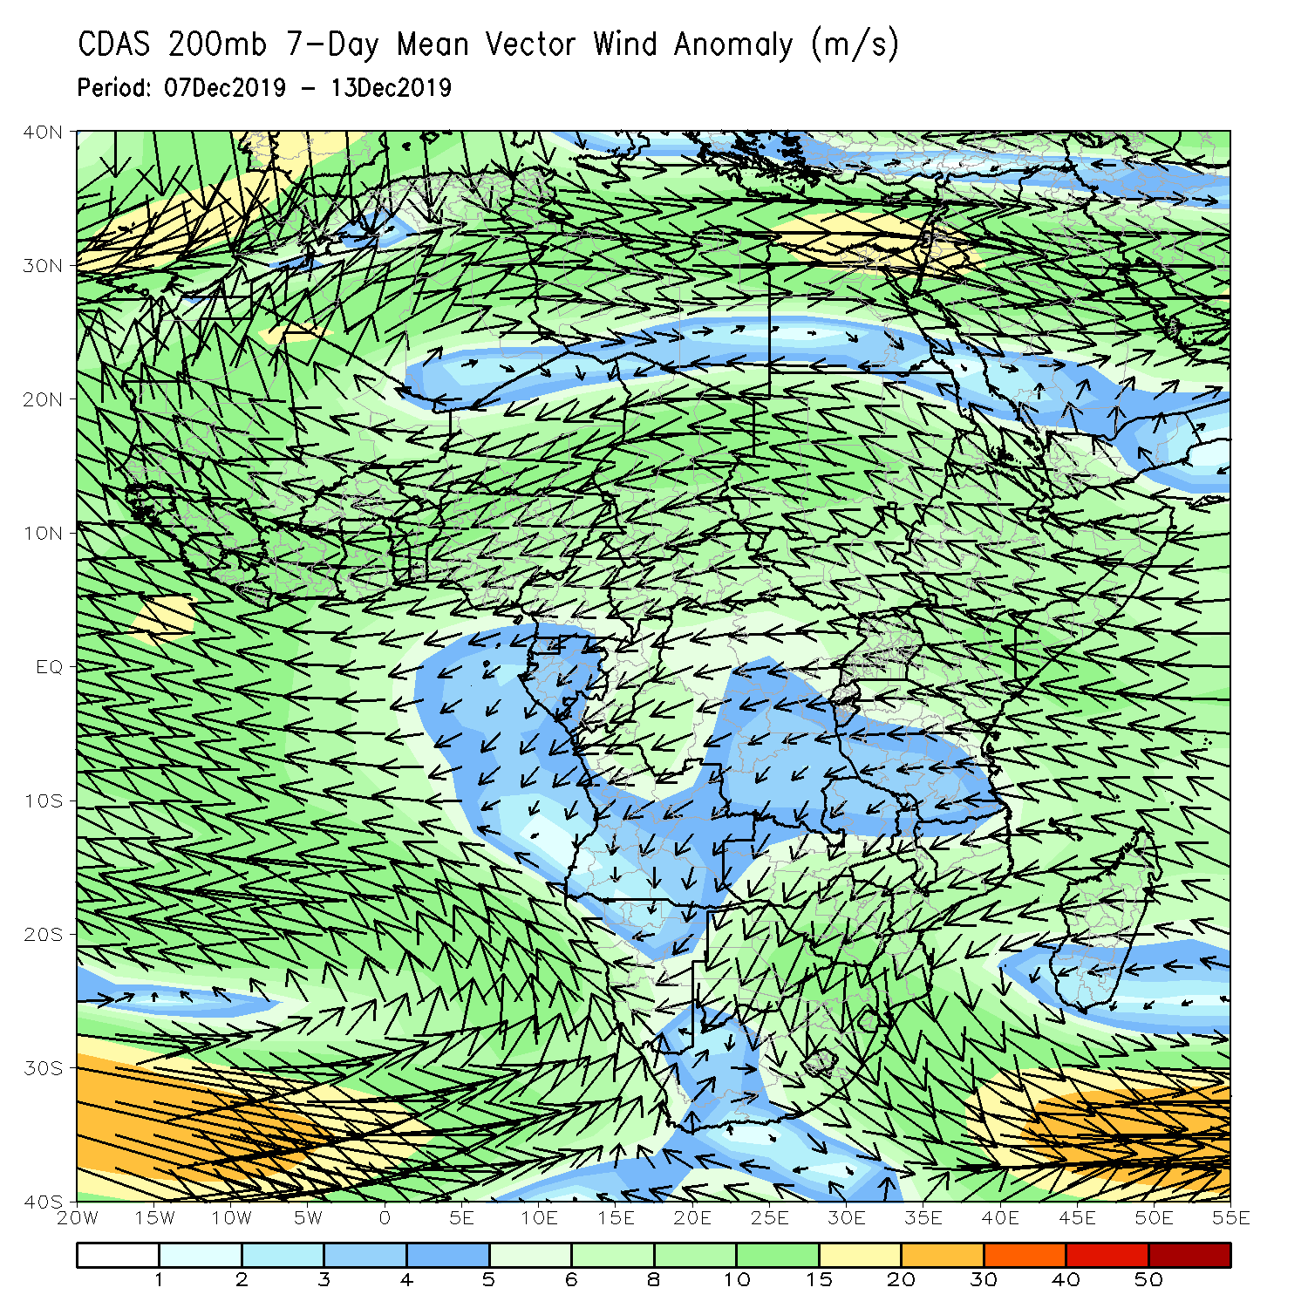
Atmospheric Circulation: Last 7 Days
Lower-level wind anomalies were westerly over many places of equatorial Africa (left panel).

Slide 10
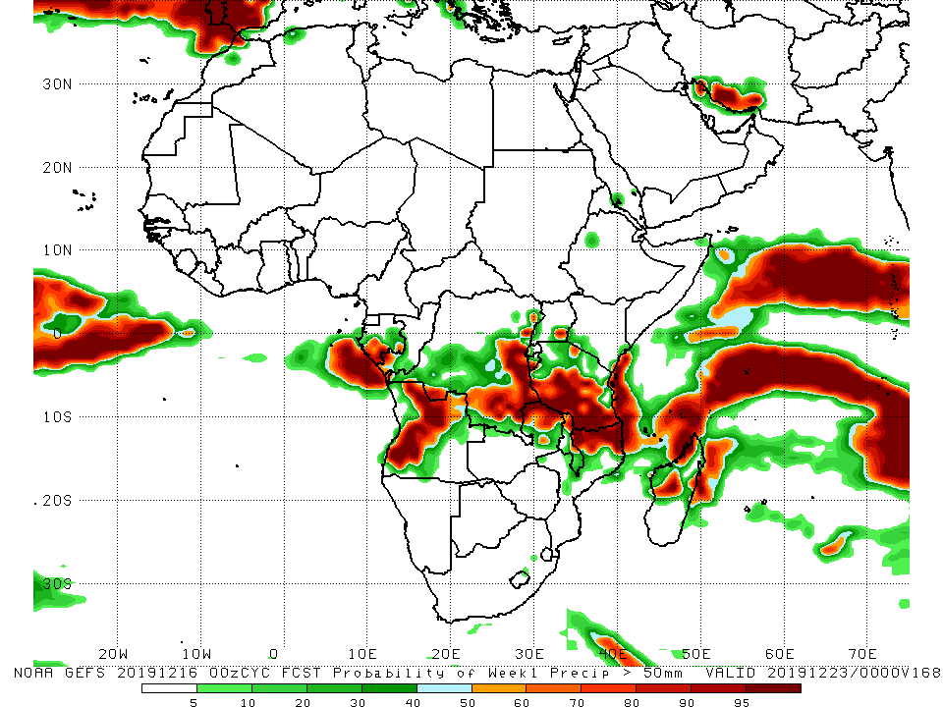
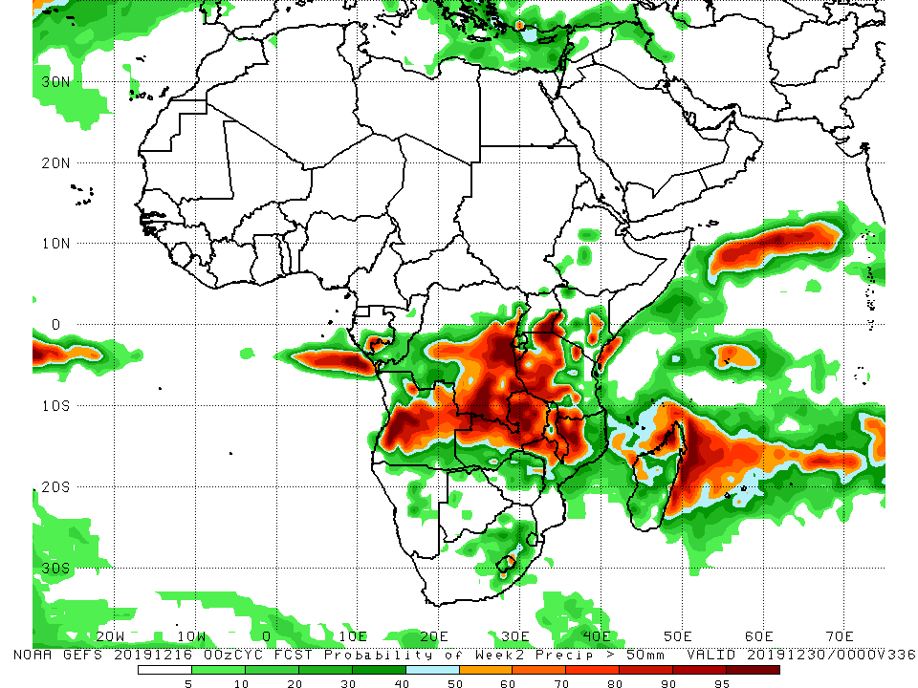
NCEP GEFS Model Forecasts Non-Bias Corrected Probability of precipitation exceedance
Week-1: Valid 17 – 23 December, 2019
Week-2: Valid 24 – 30 December, 2019
For week-1 (left panel) and week-2 (right panel), there is an increased chance for weekly rainfall totals to exceed 50mm over parts of southern Gabon, Angola, portions of DRC and Zambia, Tanzania, Malawi northern Mozambique and northern Madagascar.
Notes:
10

Slide 11
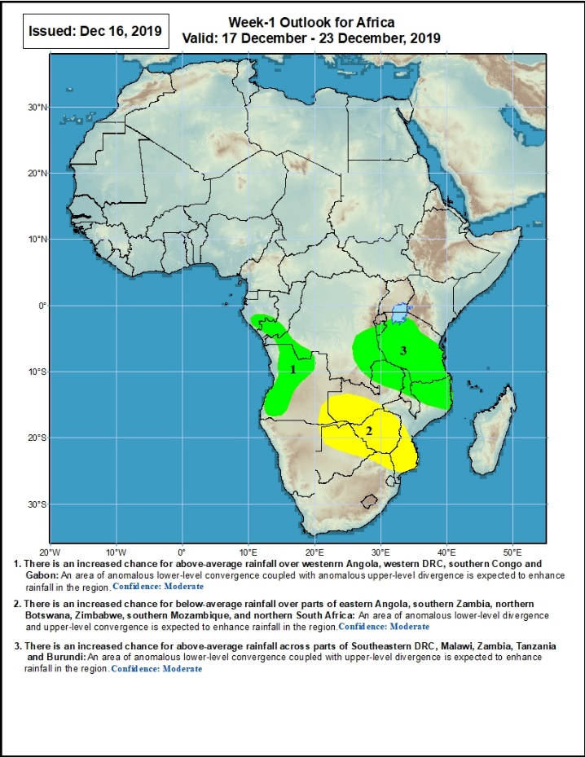
Week-1 Precipitation Outlooks
17 – 23 December, 2019
There is an increased chance for above-average rainfall over parts of southern Gabon, southern Congo, western DRC, and western Angola: An area of anomalous lower-level convergence and upper-level divergence is expected to enhance rainfall in the region. Confidence: Moderate
There is an increased chance for below-average rainfall over parts of southeastern Angola, southern Zambia, northern Botswana, Zimbabwe, southern Mozambique, and parts of northern South Africa: An area of anomalous lower-level divergence and upper-level convergence is expected to suppress rainfall in the region. Confidence: Moderate
There is an increased chance for above-average rainfall across parts of Southeastern DRC, Burundi, Malawi, eastern Zambia and Tanzania: An area anomalous lower-level convergence and upper-level divergence is expected to enhance rainfall in the region. Confidence: Moderate
Notes:
11

Slide 12
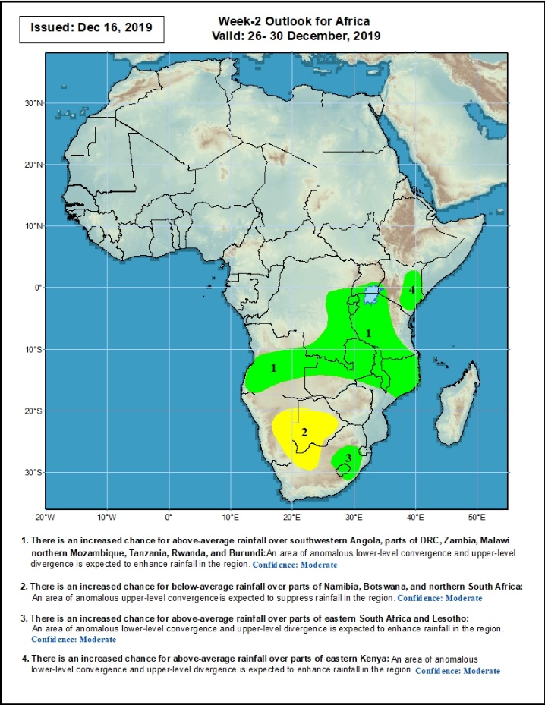
Week-2 Precipitation Outlooks
24 – 30 December, 2019
There is an increased chance for above-average rainfall over southwestern Angola, southern and eastern DRC, Zambia, Malawi, northern Mozambique, Tanzania, Rwanda and Burundi: An area of anomalous lower-level convergence and upper-level divergence is expected to enhance rainfall in the region. Confidence: Moderate
There is an increased chance for below-average rainfall over parts of eastern Namibia, Botswana, and northern South Africa: An area of anomalous lower-level divergence and upper-level convergence is expected to suppress rainfall in the region. Confidence: Moderate
There is an increased chance for above-average rainfall over parts of eastern South Africa and Lesotho: An area of anomalous lower-level convergence and upper-level divergence is expected to enhance rainfall in the region. Confidence: Moderate
There is an increased chance for above-average rainfall over parts of eastern Kenya: An area of anomalous lower-level convergence and upper-level divergence is expected to enhance rainfall in the region. Confidence: Moderate
Notes:
12

Slide 13
Summary
During the past 7 days, rainfall was below-average over Equatorial Guinea, western Gabon, many parts of DRC, western and central Angola, central Zambia, much of Zimbabwe, Malawi, Mozambique, and many parts of Madagascar. Local areas in Congo, northwestern, southern and eastern Angola, parts of southern DRC, Namibia, Botswana, parts of South Africa, parts of western and eastern Zambia, Rwanda, Burundi, Uganda, portions of Kenya, Tanzania, and the far northern Madagascar had above-average rainfall.
During the past 30 days, rainfall was above-average over local areas in Guinea, Sierra Leone, Liberia, parts of southern Cote d’Ivoire, local areas in Ghana, portions of Nigeria, much of Congo, western and southern DRC, South Sudan, Ethiopia, Rwanda, Burundi, Uganda, Kenya, Tanzania, Somalia, local areas in Angola, Namibia, Botswana, northern and eastern Zambia, eastern South Africa, Malawi, northern Mozambique, and many parts of Madagascar. Local areas in Guinea and Liberia, parts of Cote d’Ivoire and Ghana, southern Cameroon, Equatorial Guinea, Gabon, much of Angola, many parts of DRC, parts of western Zambia, Zimbabwe, parts of southern Mozambique, and western and southern South Africa had below-average rainfall.
During the past 90 days, rainfall was above-average over parts of southern Mauritania, Senegal, Guinea-Bissau, much of Guinea, Sierra Leone, Liberia, southwestern Mali, Cote d’Ivoire, Burkina Faso, Ghana, Togo, Benin, parts of Niger, many parts of Nigeria, Chad, portions of Cameroon and CAR, portions of DRC, South Sudan, Uganda, southern and eastern Sudan, Eritrea, Ethiopia, Kenya, Somalia, many parts of Tanzania, local areas in Angola, many parts of Zambia, parts of Namibia and Botswana, Malawi, northeastern South Africa, northern Mozambique, and many parts of Madagascar. Local areas in Guinea, parts of southern Cameroon, Gabon, parts of CAR, portions of central and eastern DRC, many parts of Angola, parts of western Zambia, Zimbabwe, parts of Namibia and Botswana, southern Mozambique, southern Madagascar and many parts of South Africa had below-average rainfall.
Week-1 outlooks call for an increased chance for above-average rainfall over parts of northern and western Angola, southeastern DRC, Burundi, Tanzania, eastern Zambia, northern Malawi and northern Mozambique. In contrast, there is an increased chance for below-average rainfall over parts of southeastern Angola, northern Mauritania, western Zambia, Zimbabwe, and southern Mozambique.
Notes:
13

