Slide 1
The African Monsoon Recent Evolution and Current Status Include Week-1 and Week-2 Outlooks
Update prepared by
Climate Prediction Center / NCEP
23 December 2019
For more information, visit:
http://www.cpc.ncep.noaa.gov/products/Global_Monsoons/African_Monsoons/precip_monitoring.shtml

Slide 2
Outline
Highlights
Recent Evolution and Current Conditions
NCEP GEFS Forecasts
Summary

Slide 3
Highlights: Last 7 Days
Below-average rainfall was observed over many places in Southern Africa, while moderate to locally heavy rainfall sustained moisture surpluses over many parts of Tanzania.
Week-1 outlooks call for an increased chance for above-average rainfall over parts of Angola, southern DRC, northern and eastern Zambia, Malawi, Tanzania, northern Mozambique, and parts of South Africa and Lesotho. In contrast, there is an increased chance for below-average rainfall over parts of southern Zambia, southeastern Angola, northern and eastern Botswana, Zimbabwe, northeastern South Africa, and central and southern Mozambique.

Slide 4
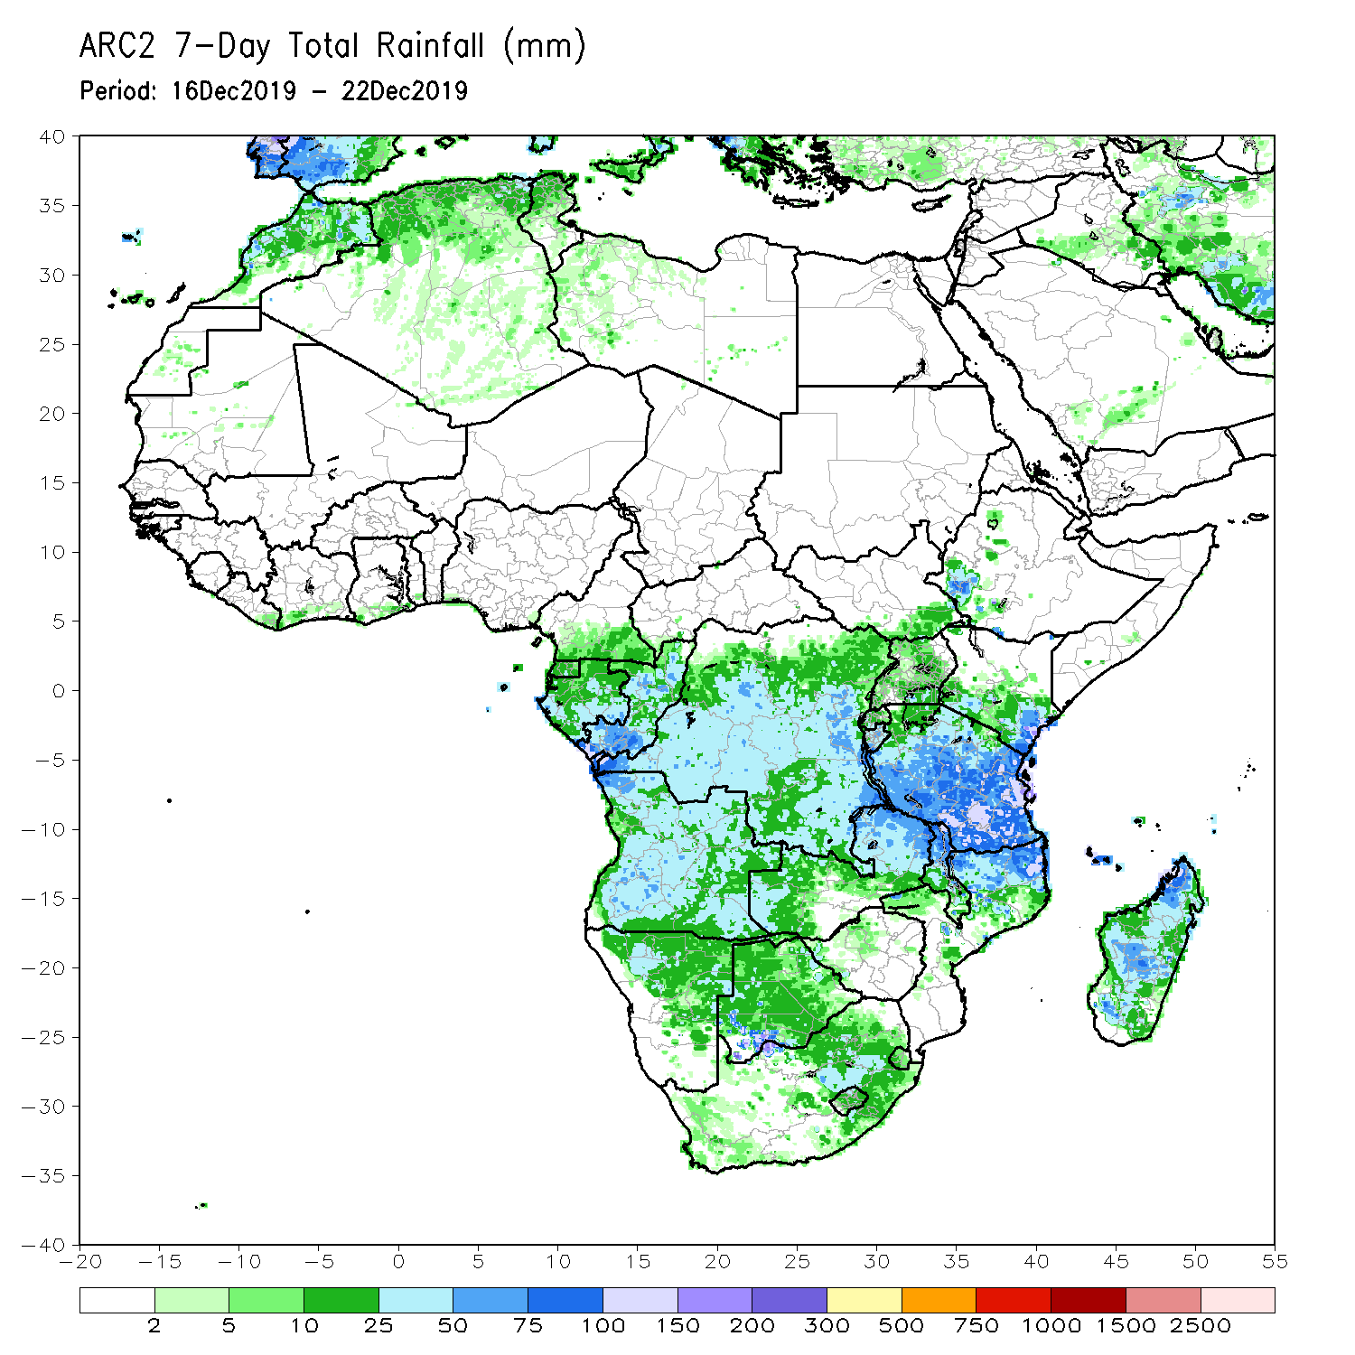
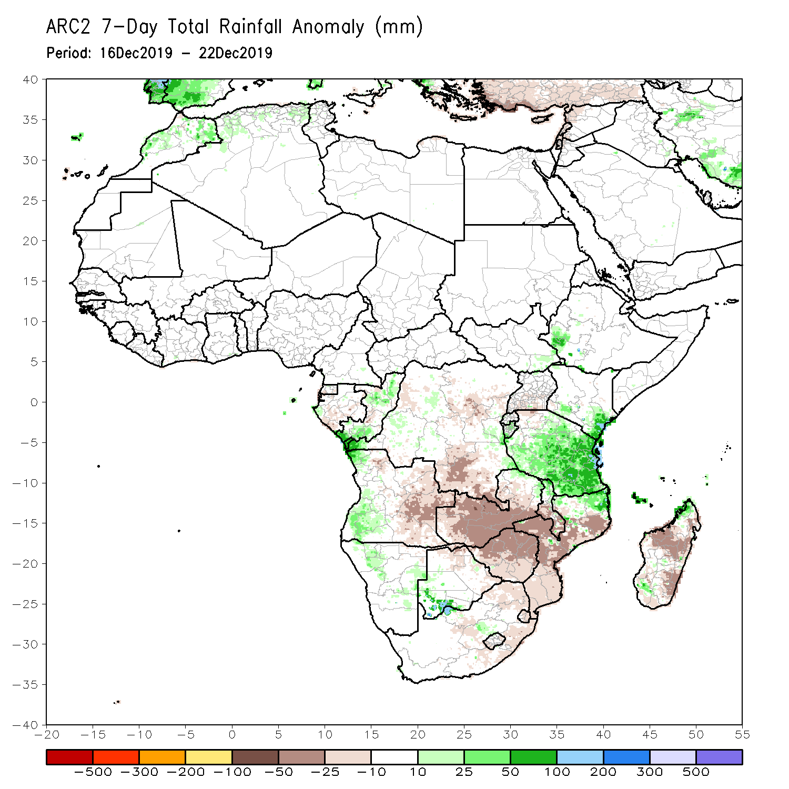
Rainfall Patterns: Last 7 Days
During the past 7 days, rainfall was below-average over local areas in Gabon and central Congo, portions of Angola and DRC, many parts of Zambia, Zimbabwe, Malawi, Mozambique, Madagascar and portions of South Africa.
Eastern Liberia, parts of Congo, western Angola, local areas in DRC, southwestern Ethiopia, parts of Kenya, many parts of Tanzania, local areas in northern Mozambique, and southwestern Botswana had above-average rainfall.

Slide 5
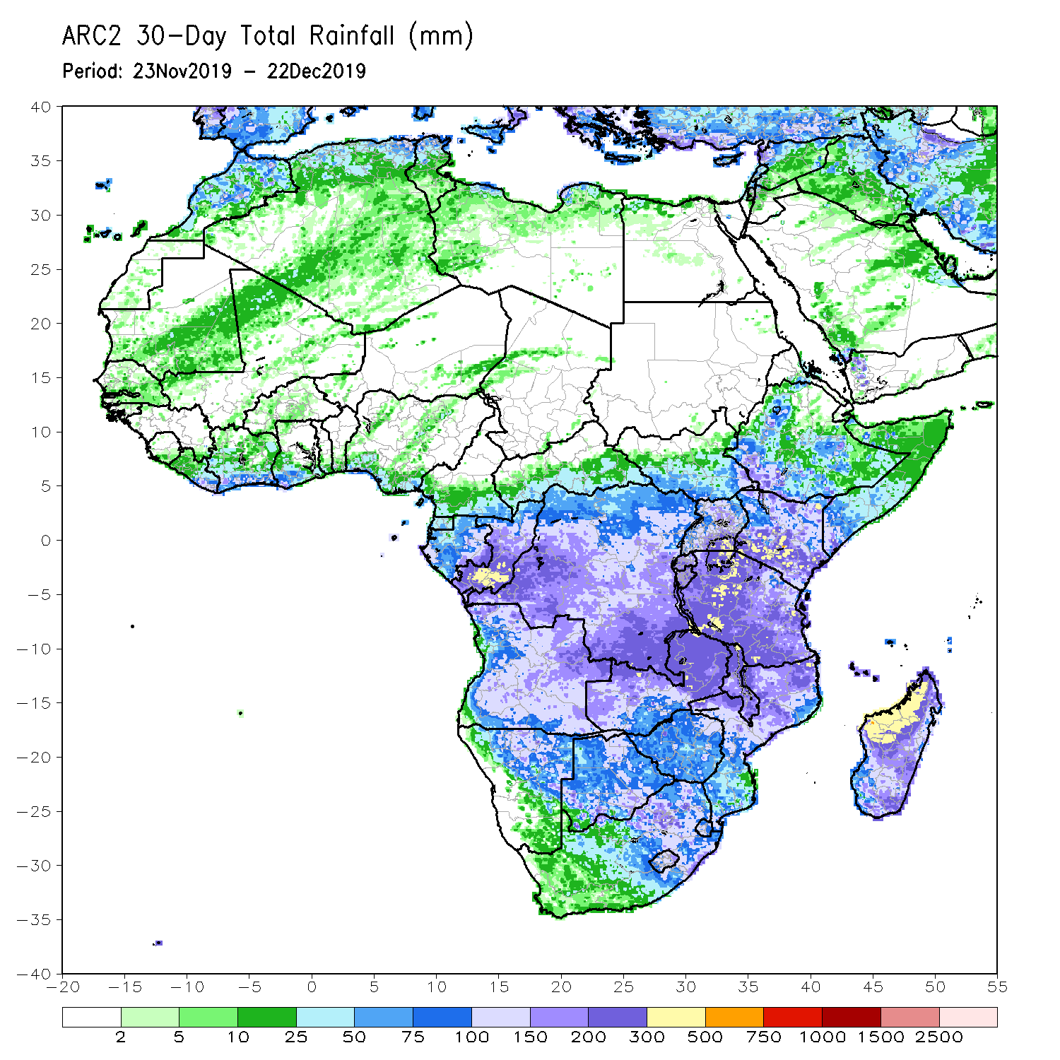
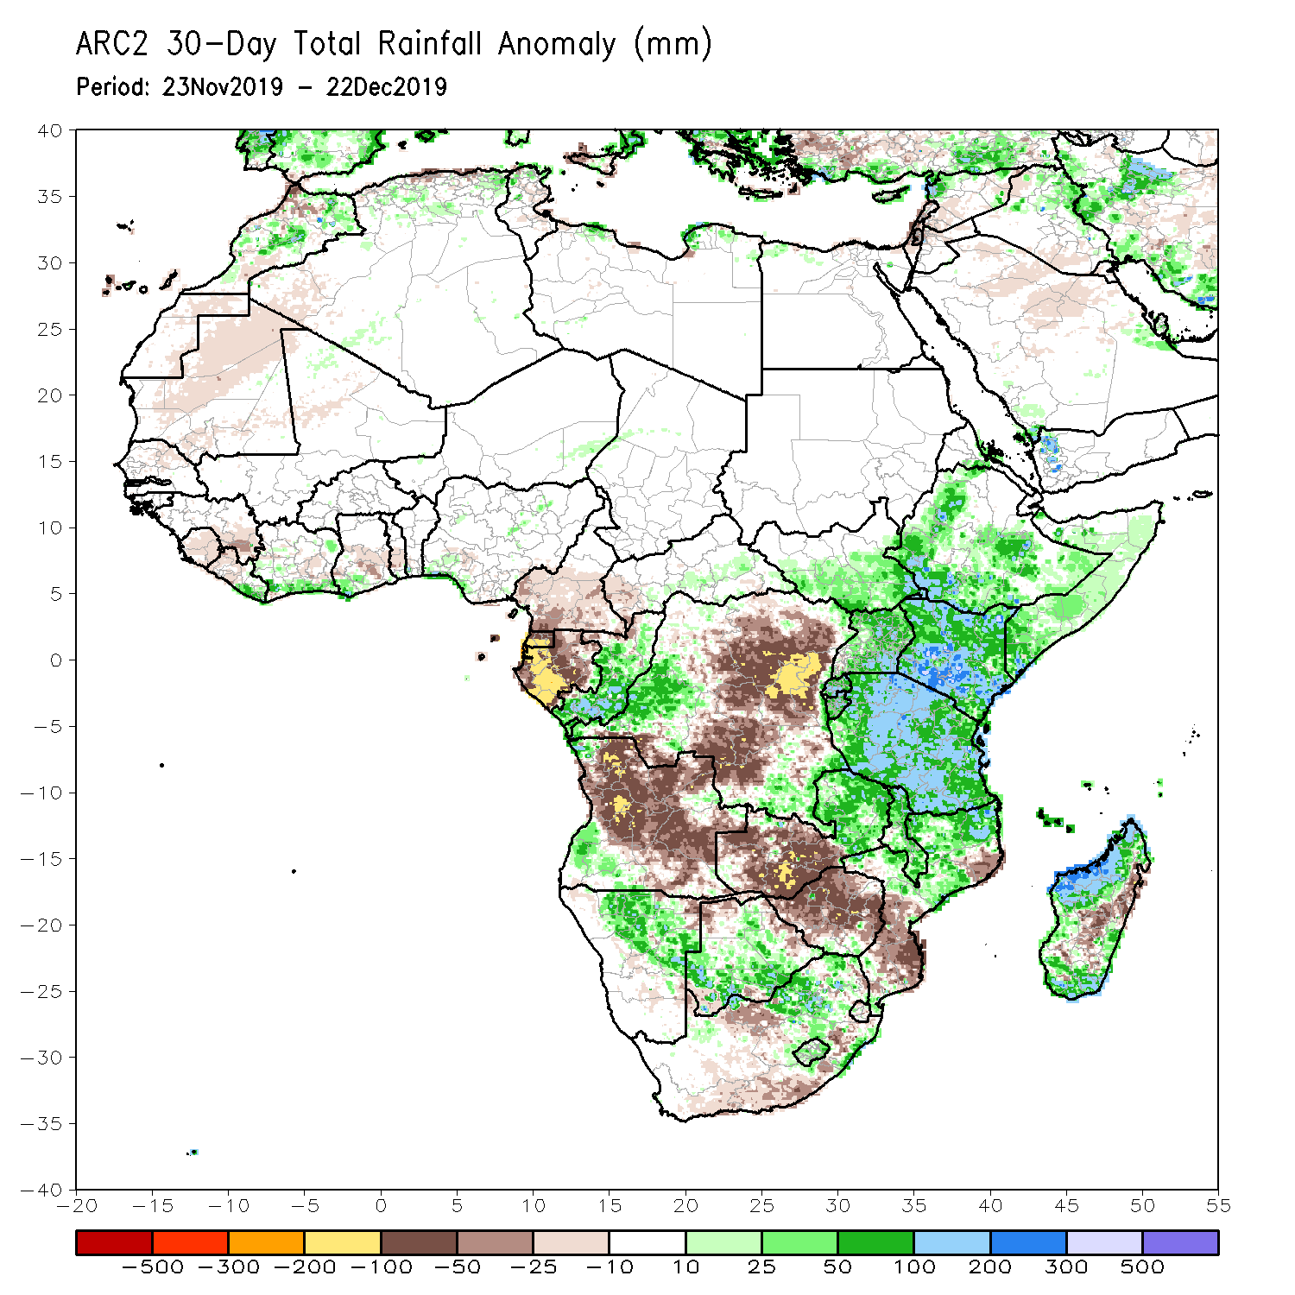
Rainfall Patterns: Last 30 Days
During the past 30 days, rainfall was above-average over local areas in Liberia, parts of southern Cote d’Ivoire, local areas in Ghana and Nigeria, much of Congo, western and southern DRC, South Sudan, Ethiopia, Rwanda, Burundi, Uganda, Kenya, Tanzania, Somalia, local areas in Angola, Namibia, Botswana, eastern Zambia, eastern South Africa, Malawi, northern Mozambique, and many parts of Madagascar.
Local areas in Guinea and Liberia, parts of Cote d’Ivoire and Ghana, southern Cameroon, Equatorial Guinea, Gabon, many parts of Angola and DRC, western Zambia, Zimbabwe, southern Mozambique, western and southern South Africa and parts of Madagascar had below-average rainfall.
Notes:
5

Slide 6
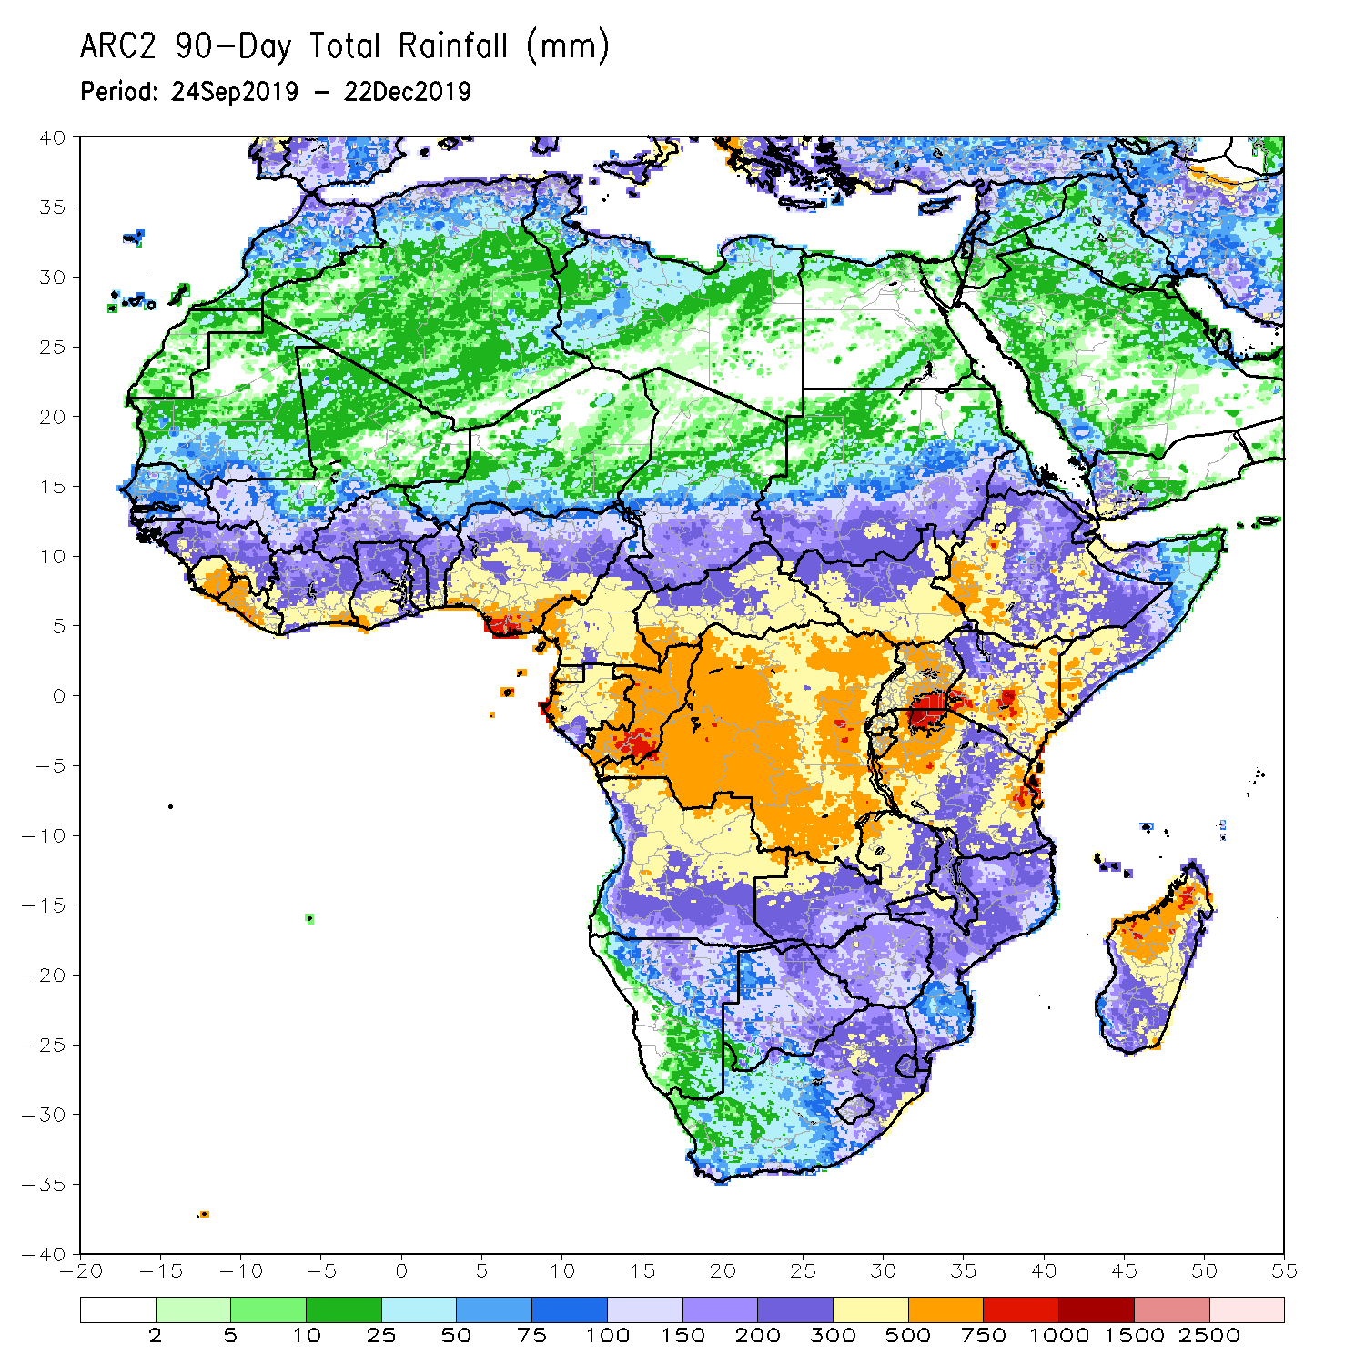
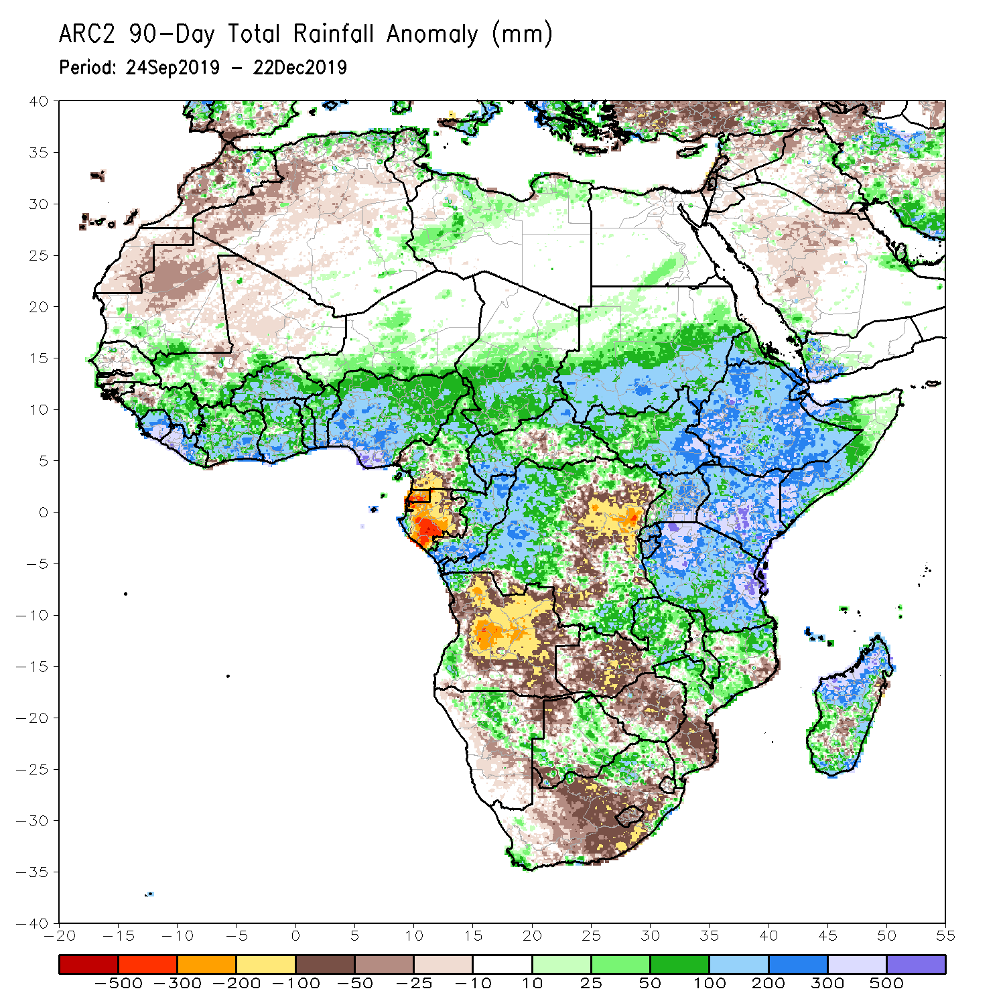
Rainfall Patterns: Last 90 Days
During the past 90 days, rainfall was above-average over parts of southern Mauritania, Senegal, Guinea-Bissau, portions of Guinea, Sierra Leone, Liberia, southwestern Mali, Cote d’Ivoire, Burkina Faso, Ghana, Togo, Benin, parts of Niger, many parts of Nigeria, Chad, portions of Cameroon and CAR, portions of DRC, South Sudan, Uganda, southern and eastern Sudan, Eritrea, Ethiopia, Kenya, Somalia, many parts of Tanzania, local areas in Angola, many parts of Zambia, parts of Namibia and Botswana, Malawi, northeastern South Africa, northern Mozambique, and many parts of Madagascar.
Local areas in Guinea, parts of southern Cameroon, Equatorial Guinea, Gabon, parts of CAR, portions of central and eastern DRC, many parts of Angola, western Zambia, Zimbabwe, parts of Namibia and Botswana, southern Mozambique, parts of southern Madagascar and many parts of South Africa had below-average rainfall.
Notes:
6

Slide 7
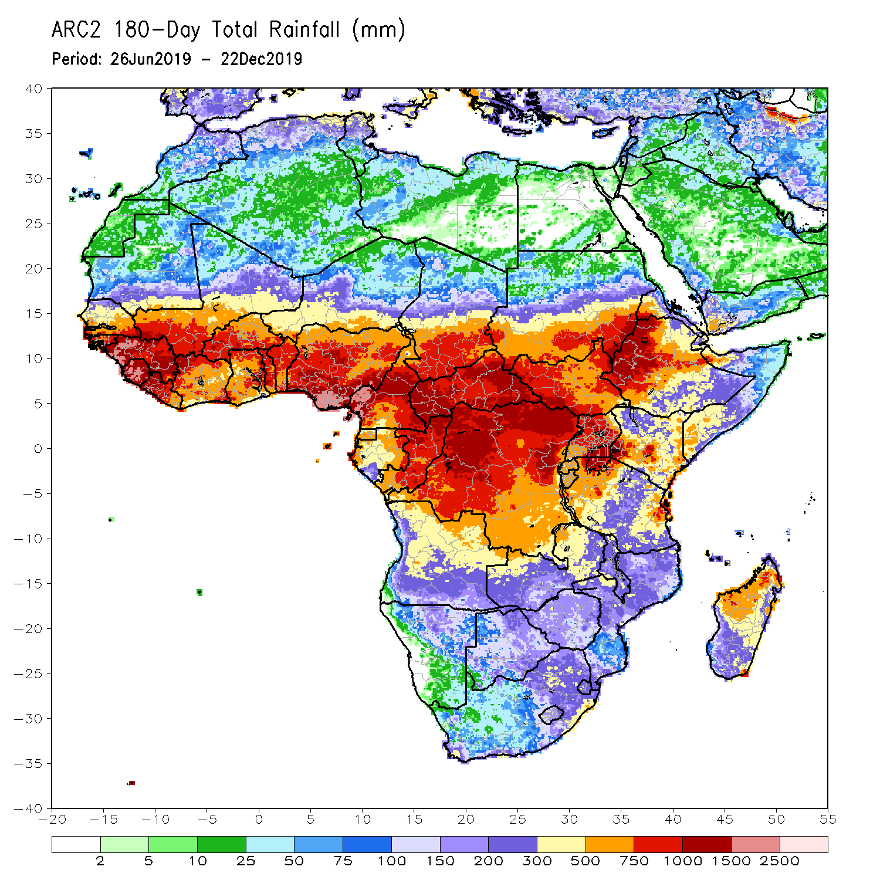
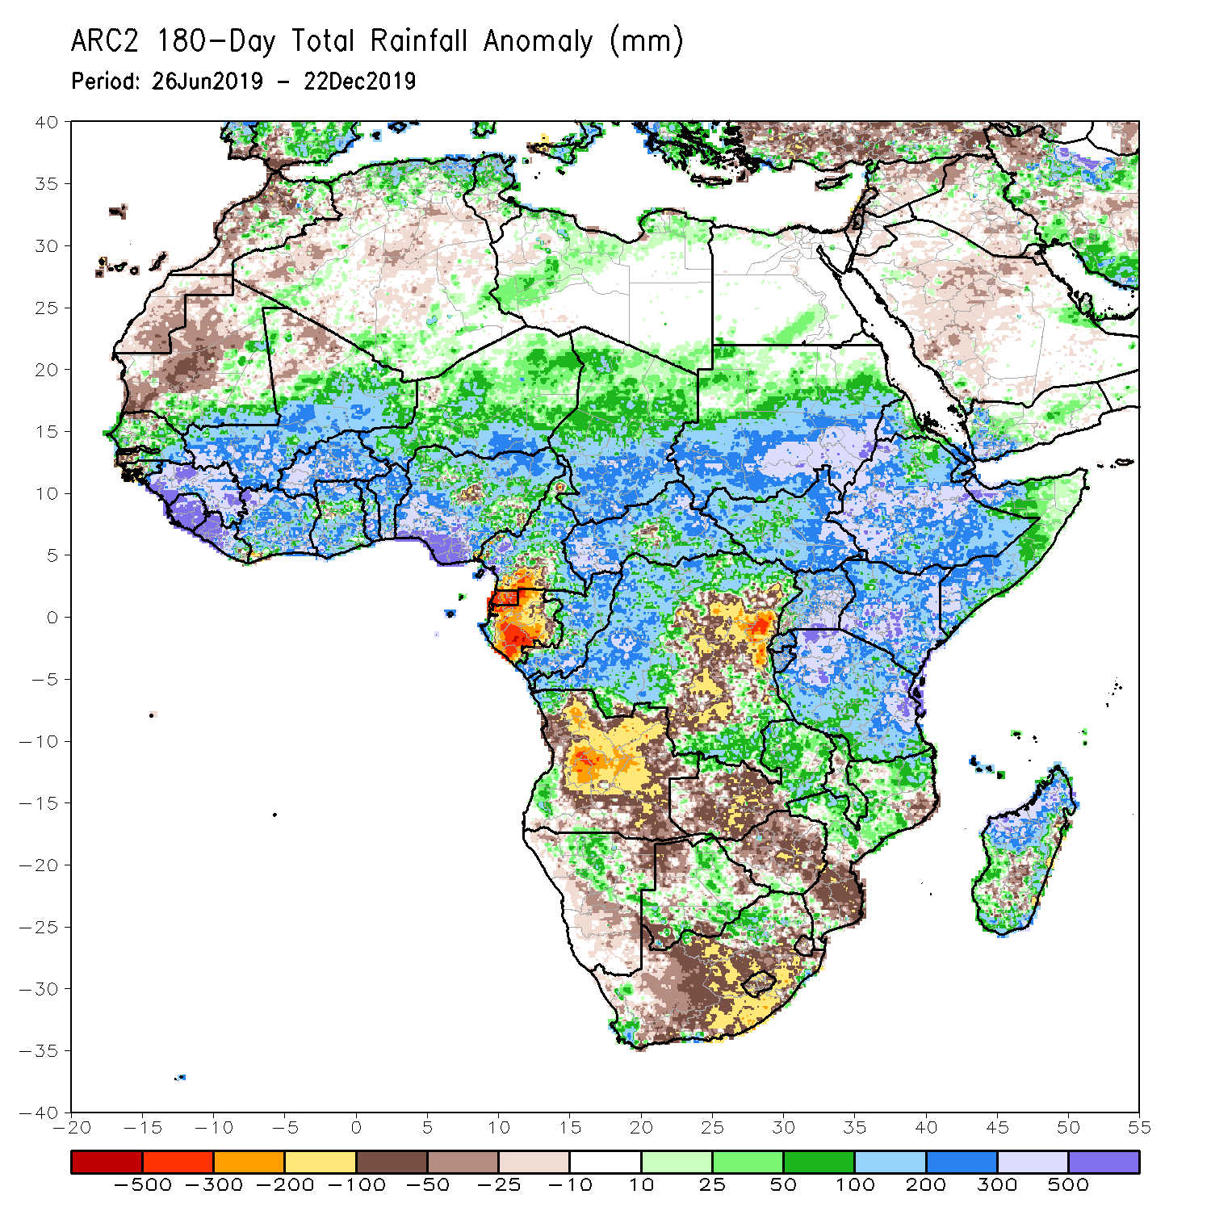
Rainfall Patterns: Last 180 Days
During the past 180 days, below-average rainfall was observed over portions of southern Cameroon, Equatorial Guinea, Gabon, parts of central and eastern DRC, many parts of Angola, parts of Namibia and Botswana, much of South Africa, western Zambia, Zimbabwe, and southern Mozambique and southern Madagascar.
Parts of Southern and eastern Mauritania, much of Senegal, Guinea-Bissau, Guinea, Sierra Leone, Mali, Liberia, Cote d’Ivoire, Burkina Faso, Ghana, Togo, Benin, Nigeria, much of Cameroon, Niger, Chad, CAR, many parts of DRC, South Sudan, Sudan, Uganda, Eritrea, Ethiopia, Somalia, Kenya, Tanzania, local areas in Angola, portions of Zambia, Namibia and Botswana, much of Malawi, northern Mozambique and many parts of Madagascar had above-average rainfall.
Notes:
7

Slide 8
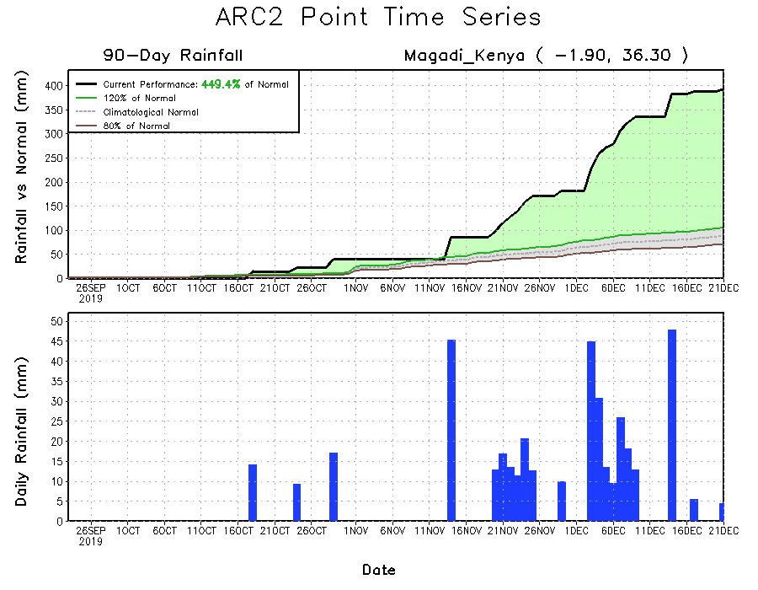
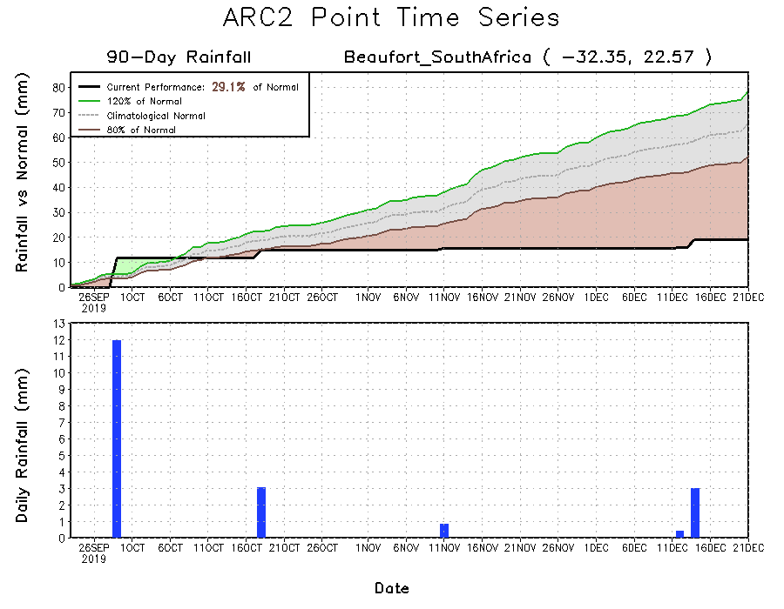
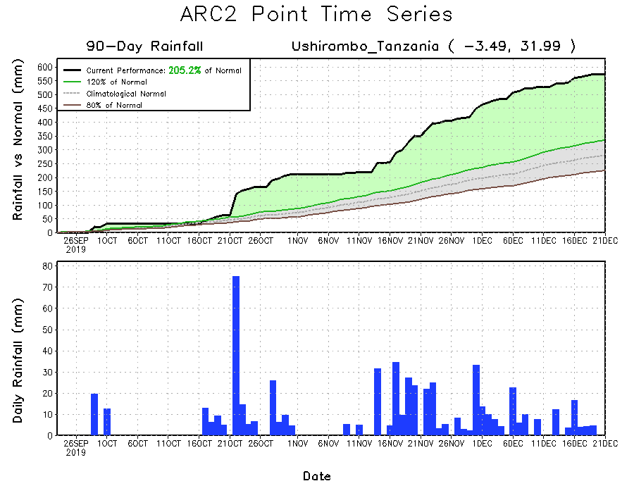
Recent Rainfall Evolution
Daily evolution of rainfall over the last 90 days at selected locations shows that moderate to locally heavy rainfall sustained moisture surpluses over parts of Tanzania (bottom right) and Kenya (top right). Seasonal total rainfall remained below-average over many parts of South Africa (bottom left).

Slide 9
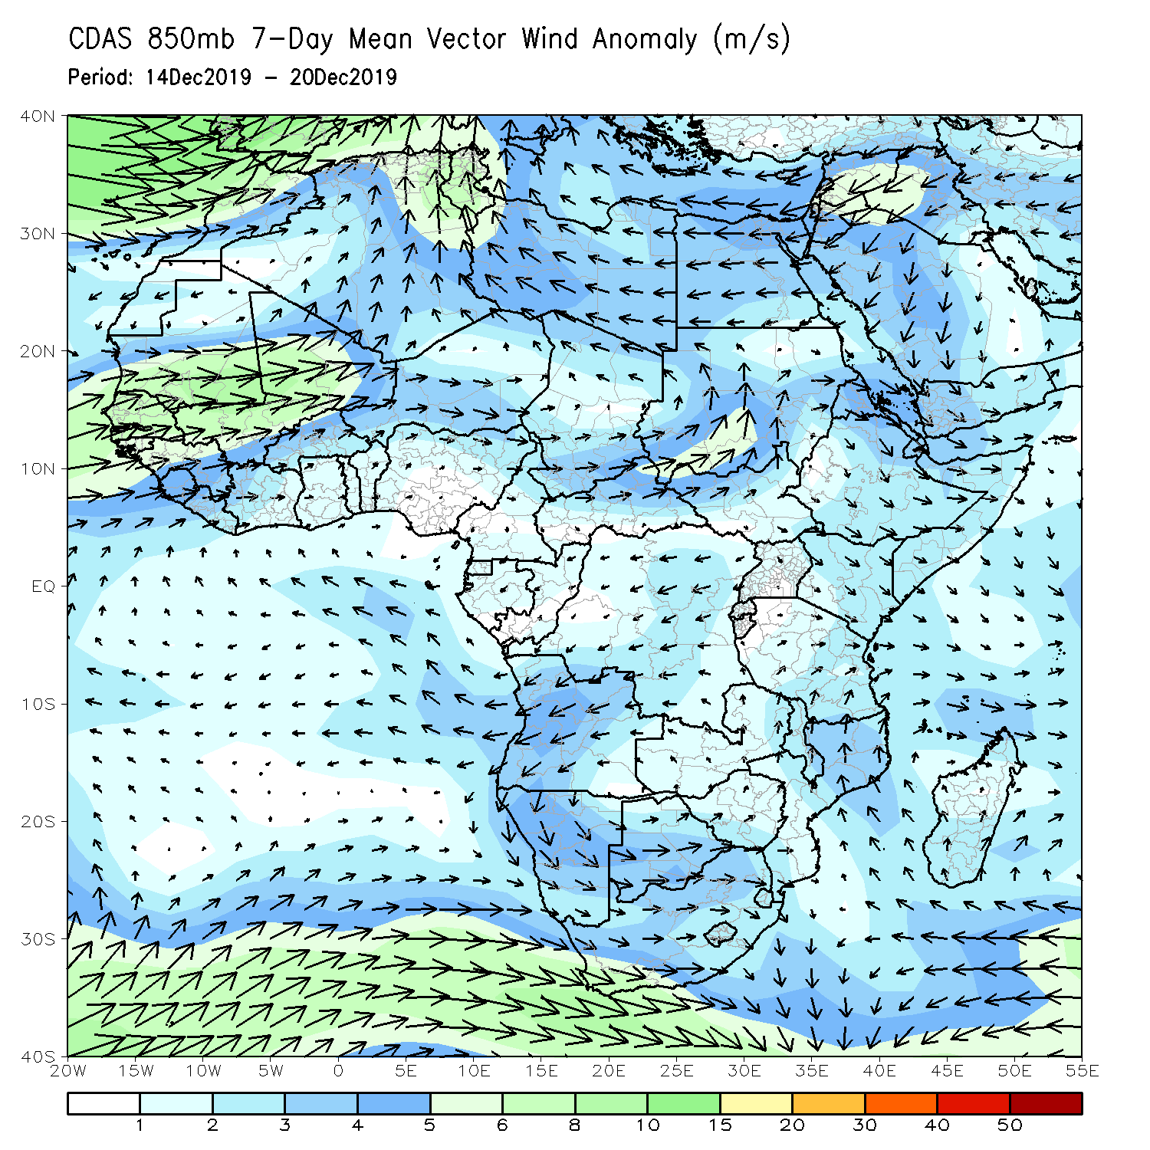
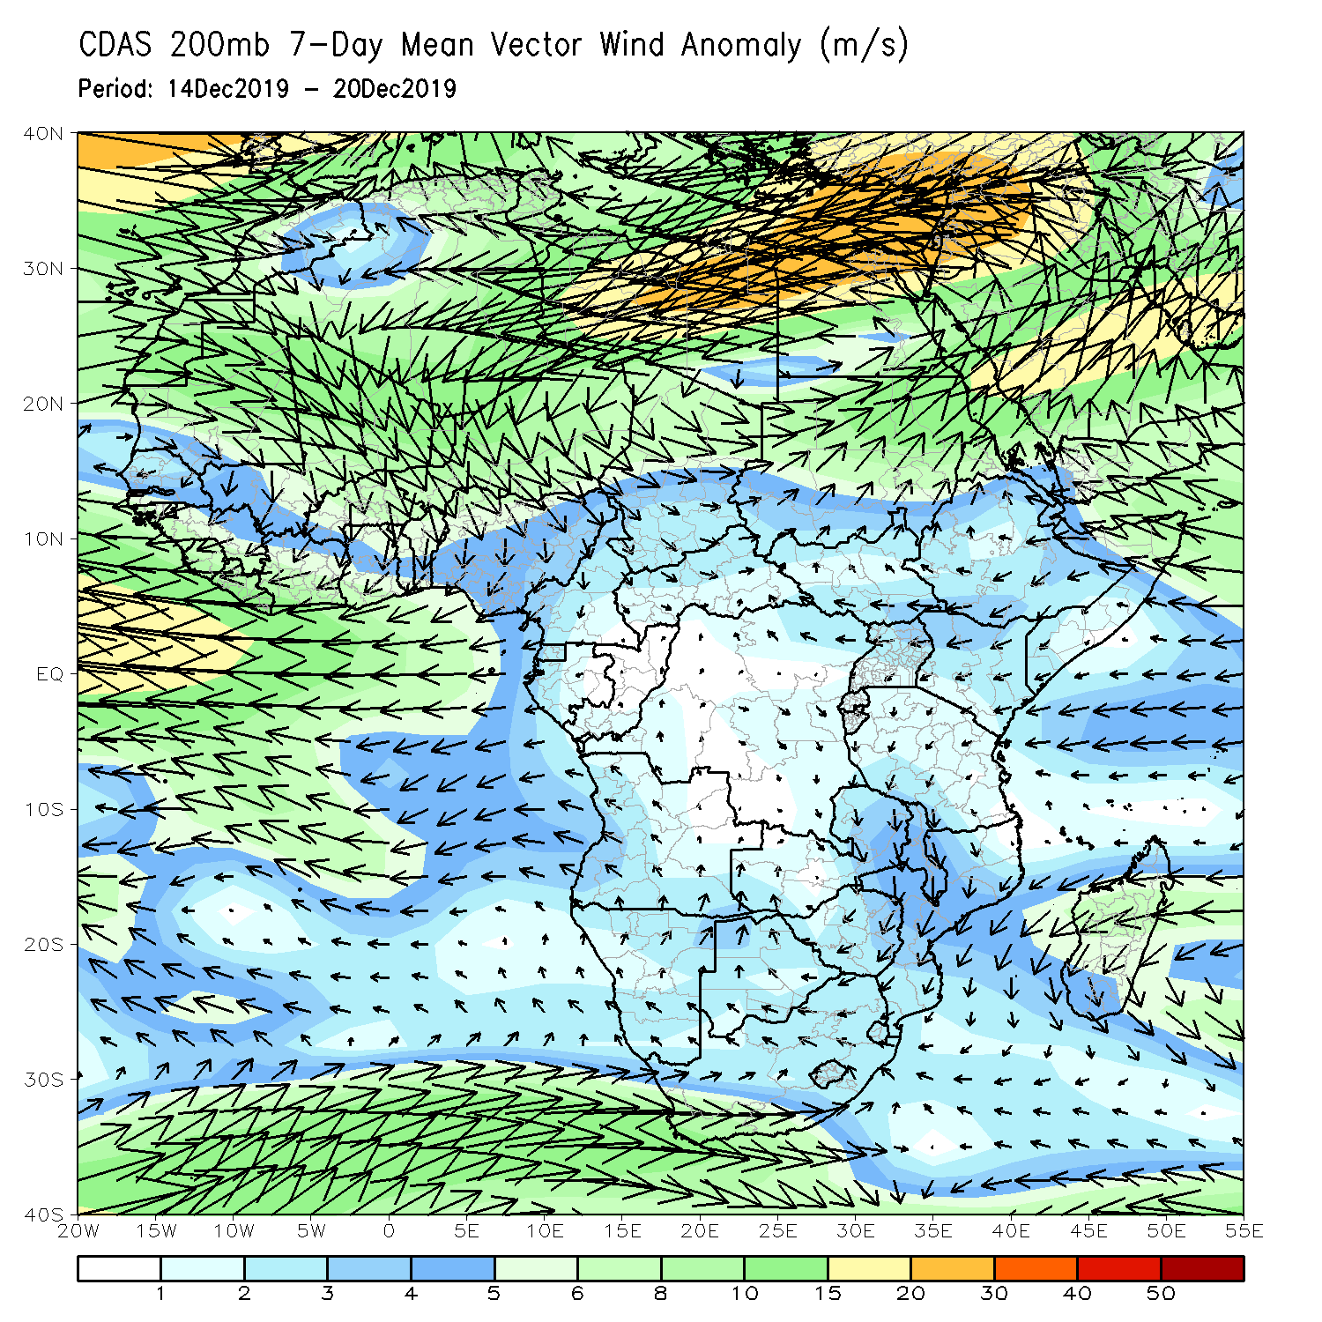
Atmospheric Circulation: Last 7 Days
An area of anomalous lower-level anti-cyclonic circulation (left) and upper level-cyclonic circulation (right) may have contributed the observed rainfall deficits across southern Africa.

Slide 10
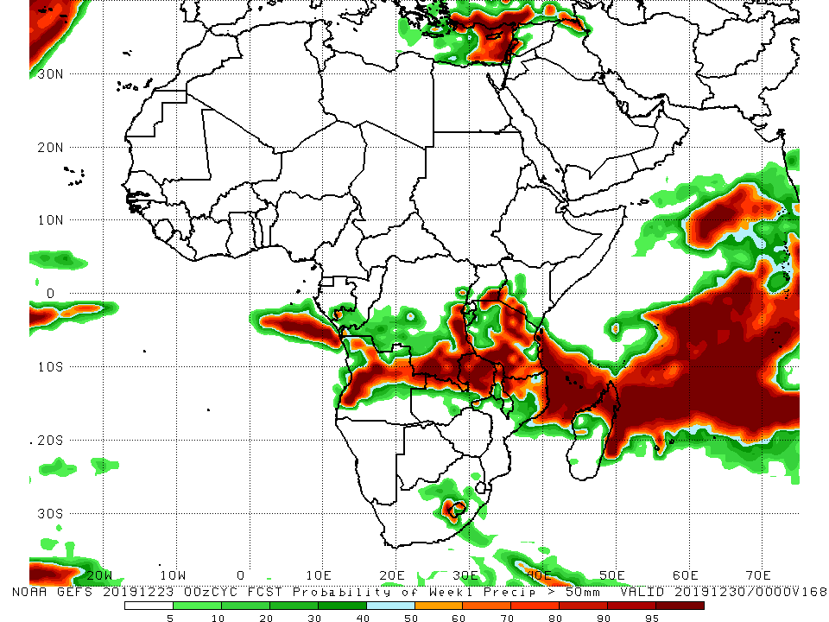
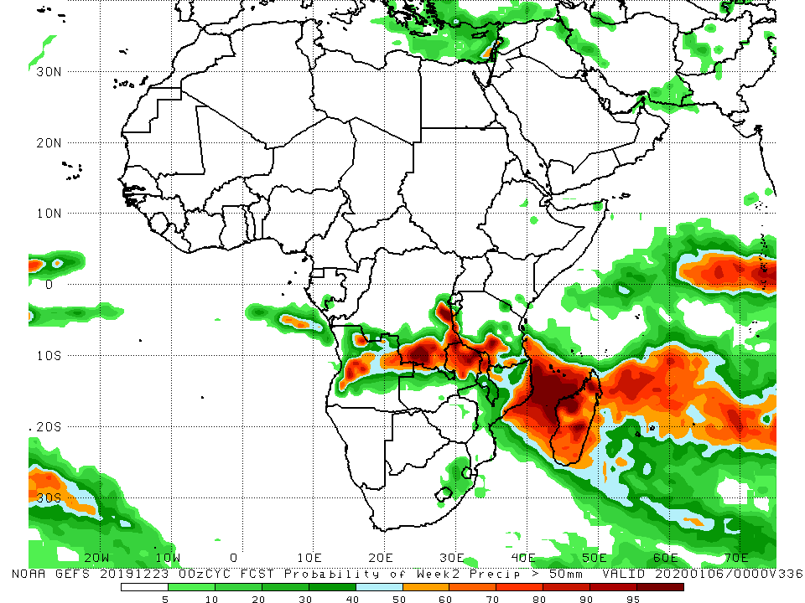
NCEP GEFS Model Forecasts Non-Bias Corrected Probability of precipitation exceedance
Week-1: Valid 24 – 30 December, 2019
Week-2: Valid 31 December – 6 January, 2020
For week-1 (left panel) and week-2 (right panel), there is an increased chance for weekly rainfall totals to exceed 50mm over parts of Angola, southern and eastern DRC, northern and eastern Zambia, southeastern Uganda and southwestern Kenya, Tanzania, northern Malawi, northern Mozambique, and Madagascar.
Notes:
10

Slide 11
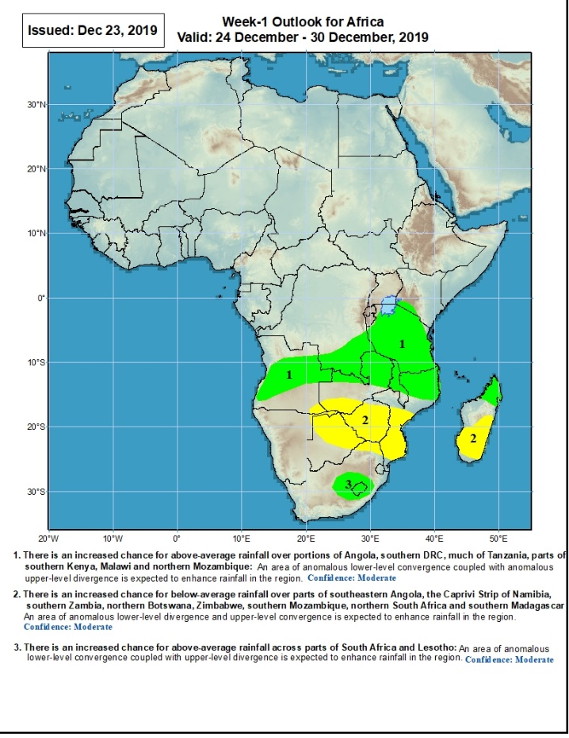
Week-1 Precipitation Outlooks
24 – 30 December, 2019
There is an increased chance for above-average rainfall over portions of Angola, southern DRC, much of Tanzania, parts of southern Kenya, Malawi, northern Mozambique and northern Madagascar: An area of anomalous lower-level convergence and upper-level divergence is expected to enhance rainfall in the region. Confidence: Moderate
There is an increased chance for below-average rainfall over parts of southeastern Angola, the Caprivi Strip of Namibia, southern Zambia, northern Botswana, Zimbabwe, southern Mozambique, northern South Africa and southern Madagascar: An area of anomalous lower-level divergence and upper-level convergence is expected to suppress rainfall in the region. Confidence: Moderate
There is an increased chance for above-average rainfall across parts of South Africa and Lesotho: An area anomalous lower-level convergence and upper-level divergence is expected to enhance rainfall in the region. Confidence: Moderate
Notes:
11

Slide 12
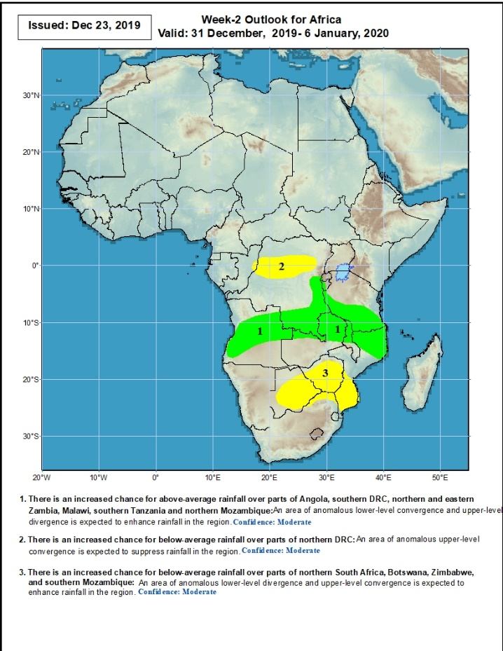
Week-2 Precipitation Outlooks
31 December - 6 January, 2020
There is an increased chance for above-average rainfall over parts of Angola, southern DRC, northern and eastern Zambia, Malawi, southern Tanzania and northern Mozambique: An area of anomalous lower-level convergence and upper-level divergence is expected to enhance rainfall in the region. Confidence: Moderate
There is an increased chance for below-average rainfall over parts of northern DRC: An area of anomalous lower-level divergence and upper-level convergence is expected to suppress rainfall in the region. Confidence: Moderate
There is an increased chance for below-average rainfall over parts of northern South Africa, Botswana, Zimbabwe, and southern Mozambique: An area of anomalous lower-level divergence and upper-level convergence is expected to suppress rainfall in the region. Confidence: Moderate
Notes:
12

Slide 13
Summary
During the past 7 days, rainfall was below-average over local areas in Gabon and central Congo, portions of Angola and DRC, many parts of Zambia, Zimbabwe, Malawi, Mozambique, Madagascar and portions of South Africa. Eastern Liberia, parts of Congo, western Angola, local areas in DRC, southwestern Ethiopia, parts of Kenya, many parts of Tanzania, local areas in northern Mozambique, and southwestern Botswana had above-average rainfall.
During the past 30 days, rainfall was above-average over local areas in Liberia, parts of southern Cote d’Ivoire, local areas in Ghana and Nigeria, much of Congo, western and southern DRC, South Sudan, Ethiopia, Rwanda, Burundi, Uganda, Kenya, Tanzania, Somalia, local areas in Angola, Namibia, Botswana, eastern Zambia, eastern South Africa, Malawi, northern Mozambique, and many parts of Madagascar. Local areas in Guinea and Liberia, parts of Cote d’Ivoire and Ghana, southern Cameroon, Equatorial Guinea, Gabon, many parts of Angola and DRC, western Zambia, Zimbabwe, southern Mozambique, western and southern South Africa and parts of Madagascar had below-average rainfall.
During the past 30 days, rainfall was above-average over local areas in Liberia, parts of southern Cote d’Ivoire, local areas in Ghana and Nigeria, much of Congo, western and southern DRC, South Sudan, Ethiopia, Rwanda, Burundi, Uganda, Kenya, Tanzania, Somalia, local areas in Angola, Namibia, Botswana, eastern Zambia, eastern South Africa, Malawi, northern Mozambique, and many parts of Madagascar. Local areas in Guinea and Liberia, parts of Cote d’Ivoire and Ghana, southern Cameroon, Equatorial Guinea, Gabon, many parts of Angola and DRC, western Zambia, Zimbabwe, southern Mozambique, western and southern South Africa and parts of Madagascar had below-average rainfall.
Week-1 outlooks call for an increased chance for above-average rainfall over parts of Angola, southern DRC, northern and eastern Zambia, Malawi, Tanzania, northern Mozambique, and parts of South Africa and Lesotho. In contrast, there is an increased chance for below-average rainfall over parts of southern Zambia, southeastern Angola, northern and eastern Botswana, Zimbabwe, northeastern South Africa, and central and southern Mozambique.
Notes:
13

