Slide 1
The African Monsoon Recent Evolution and Current Status Include Week-1 and Week-2 Outlooks
Update prepared by
Climate Prediction Center / NCEP
18 February 2020
For more information, visit:
http://www.cpc.ncep.noaa.gov/products/Global_Monsoons/African_Monsoons/precip_monitoring.shtml

Slide 2
Outline
Highlights
Recent Evolution and Current Conditions
NCEP GEFS Forecasts
Summary

Slide 3
Highlights: Last 7 Days
Weekly rainfall totals exceeded 100mm over local areas in Angola and DRC, parts of Zambia, southern Tanzania, northern Malawi, western Mozambique, and parts of Zimbabwe and Madagascar.
Week-1 outlooks call for an increased chance for above-average rainfall over parts of Angola, northeastern Namibia, parts of southern DRC, central and eastern Zambia, Malawi, parts of southern Tanzania, northern Mozambique, eastern South Africa, Lesotho, Eswatini and Madagascar. In contrast, there is an increased chance for below-average rainfall over central Mozambique.

Slide 4
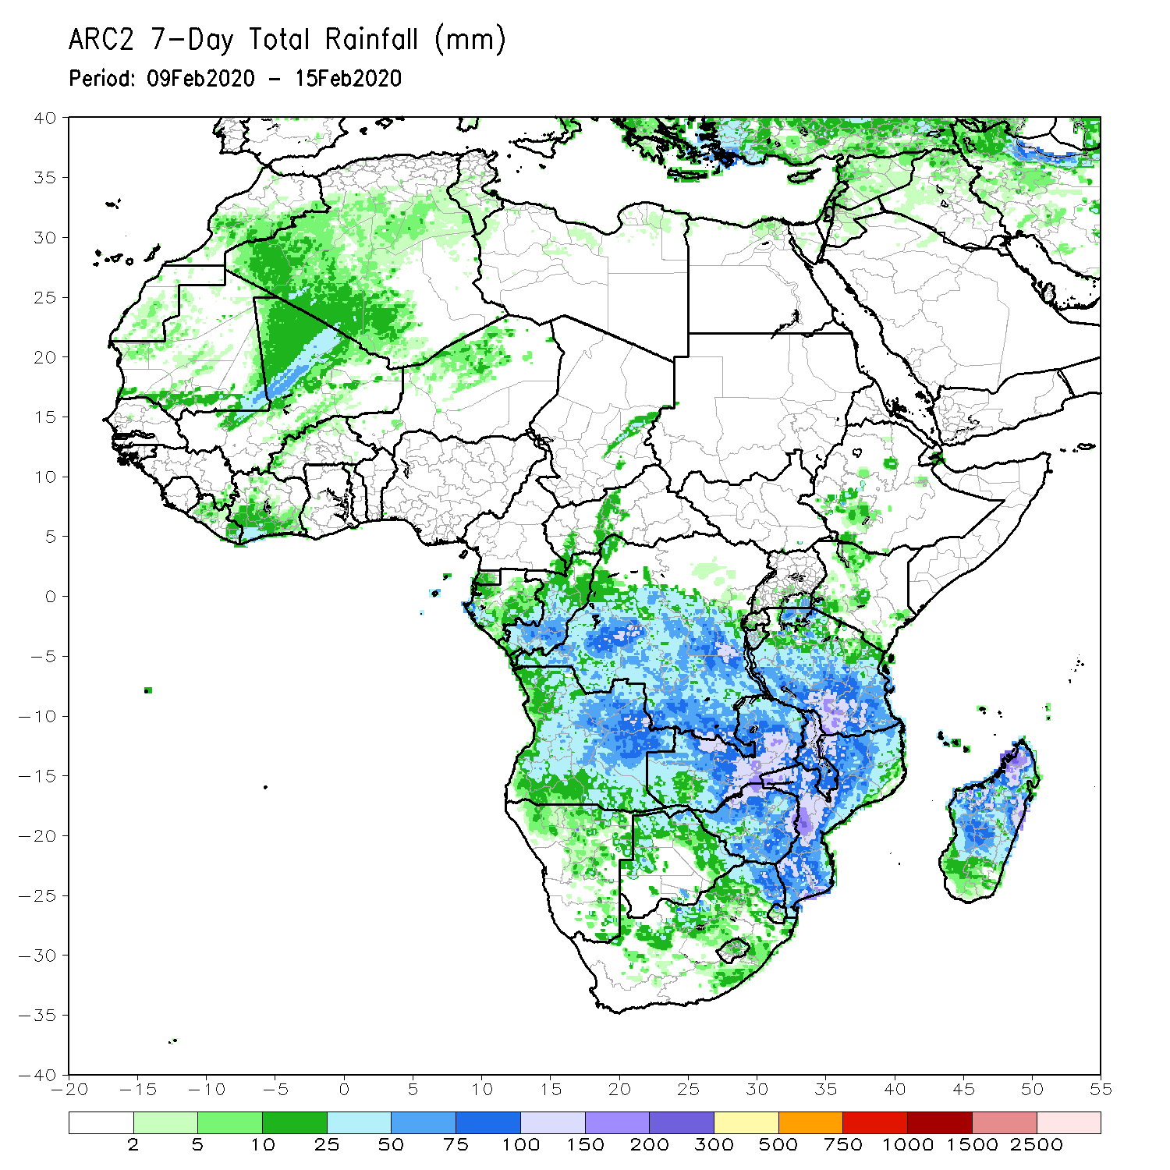
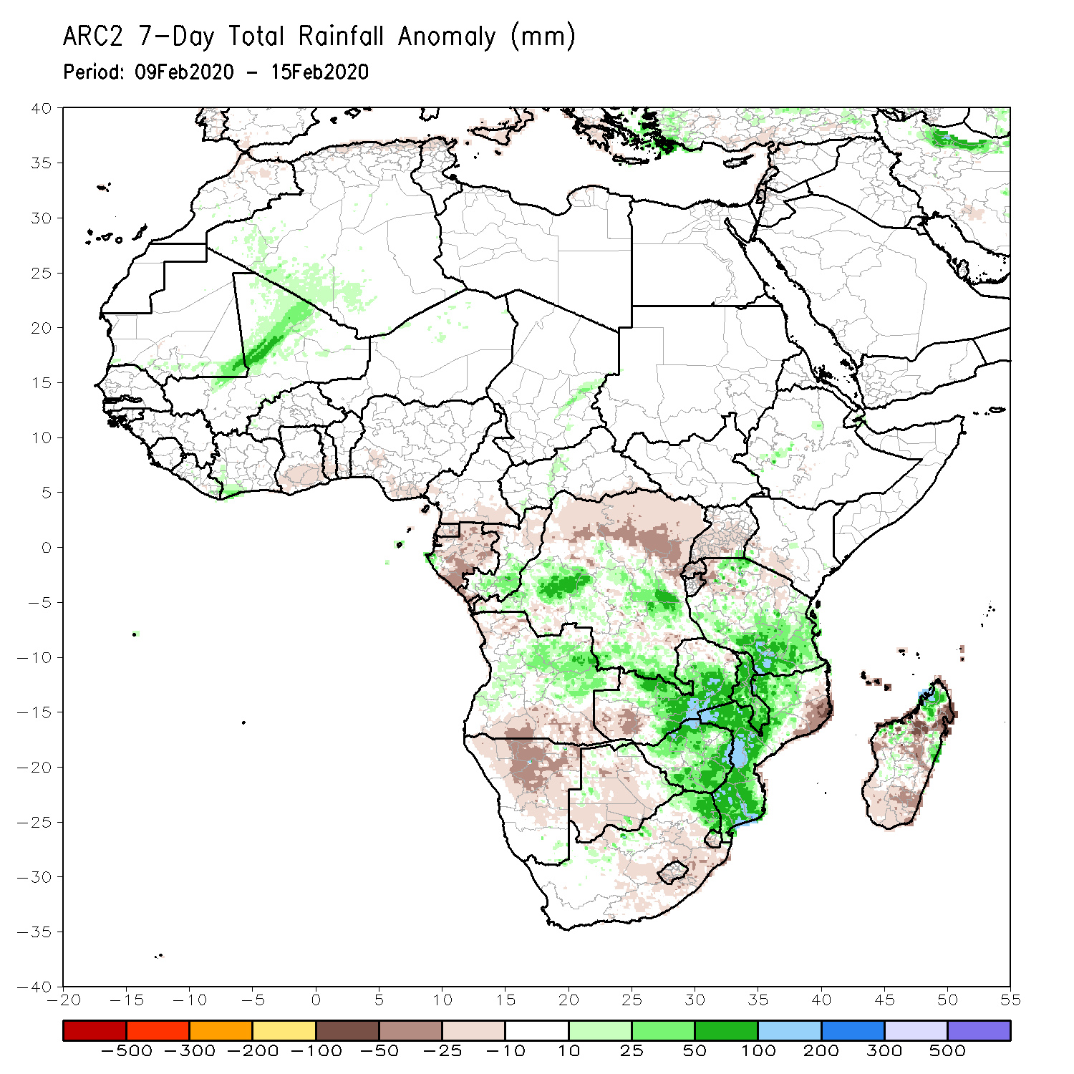
Rainfall Patterns: Last 7 Days
During the past 7 days, weekly rainfall totals exceeded 100mm over local areas in Angola and DRC, parts of Zambia, southern Tanzania, northern Malawi, western Mozambique, and parts of Zimbabwe and Madagascar. Rainfall was above-average over southern Congo, central and southern DRC, parts of Angola, Tanzania, central and eastern Zambia, Malawi, Zimbabwe, northeastern South Africa, Mozambique, and local areas in Madagascar. Weekly rainfall surpluses exceeded 100mm over local areas in Zambia and Mozambique.
Equatorial Guinea, much of Gabon, northern DRC, southern Angola, Namibia, western Zambia, local areas in Botswana, northeastern Mozambique and parts of Madagascar had below-average rainfall.

Slide 5
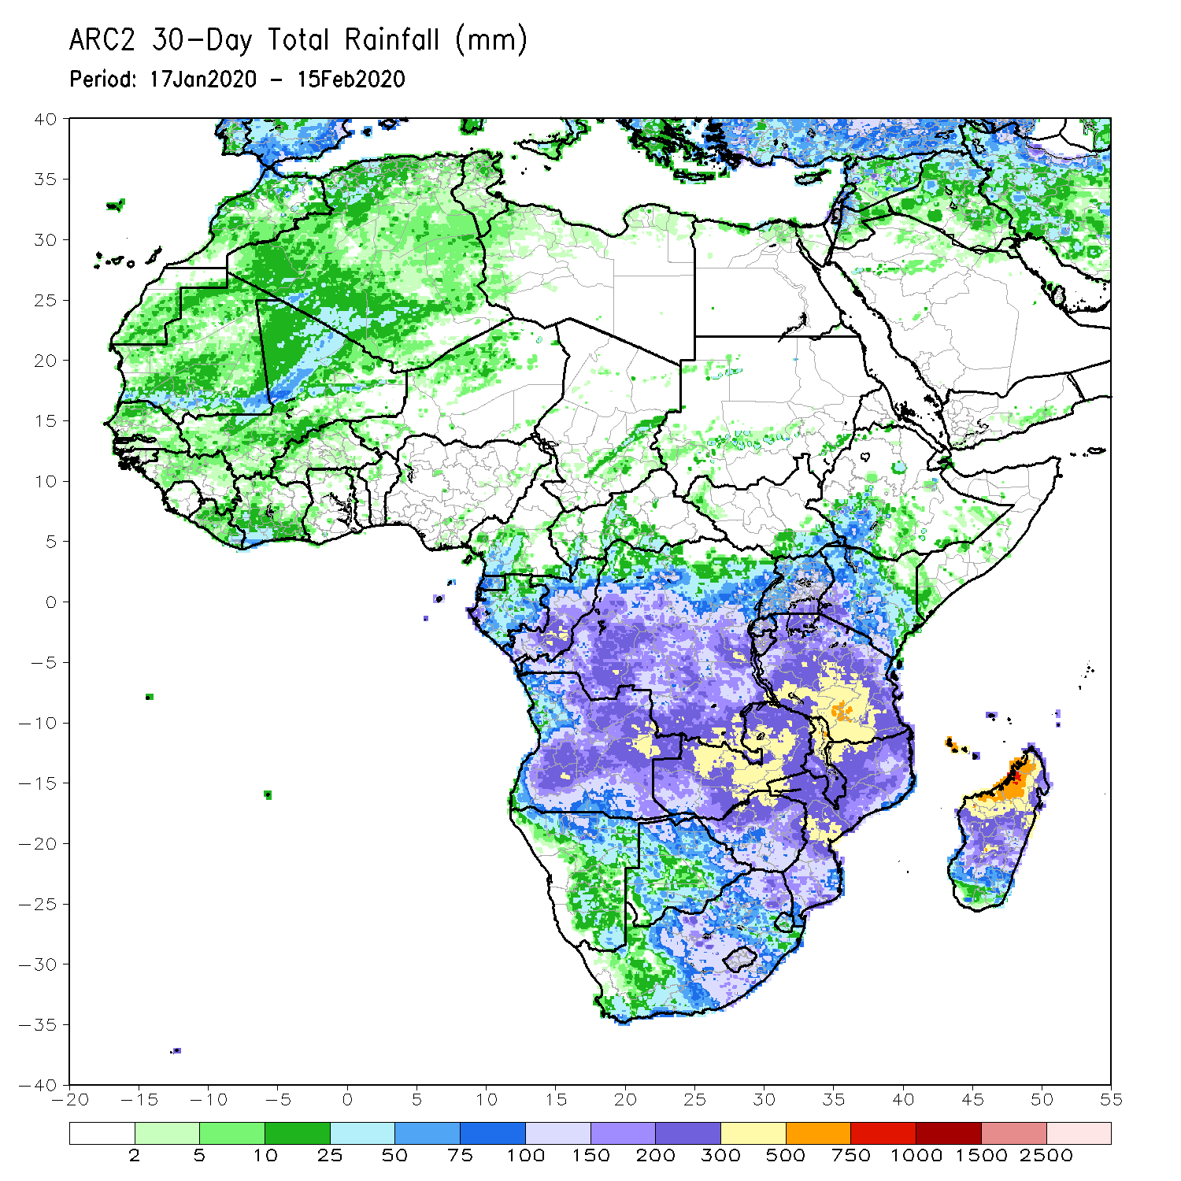
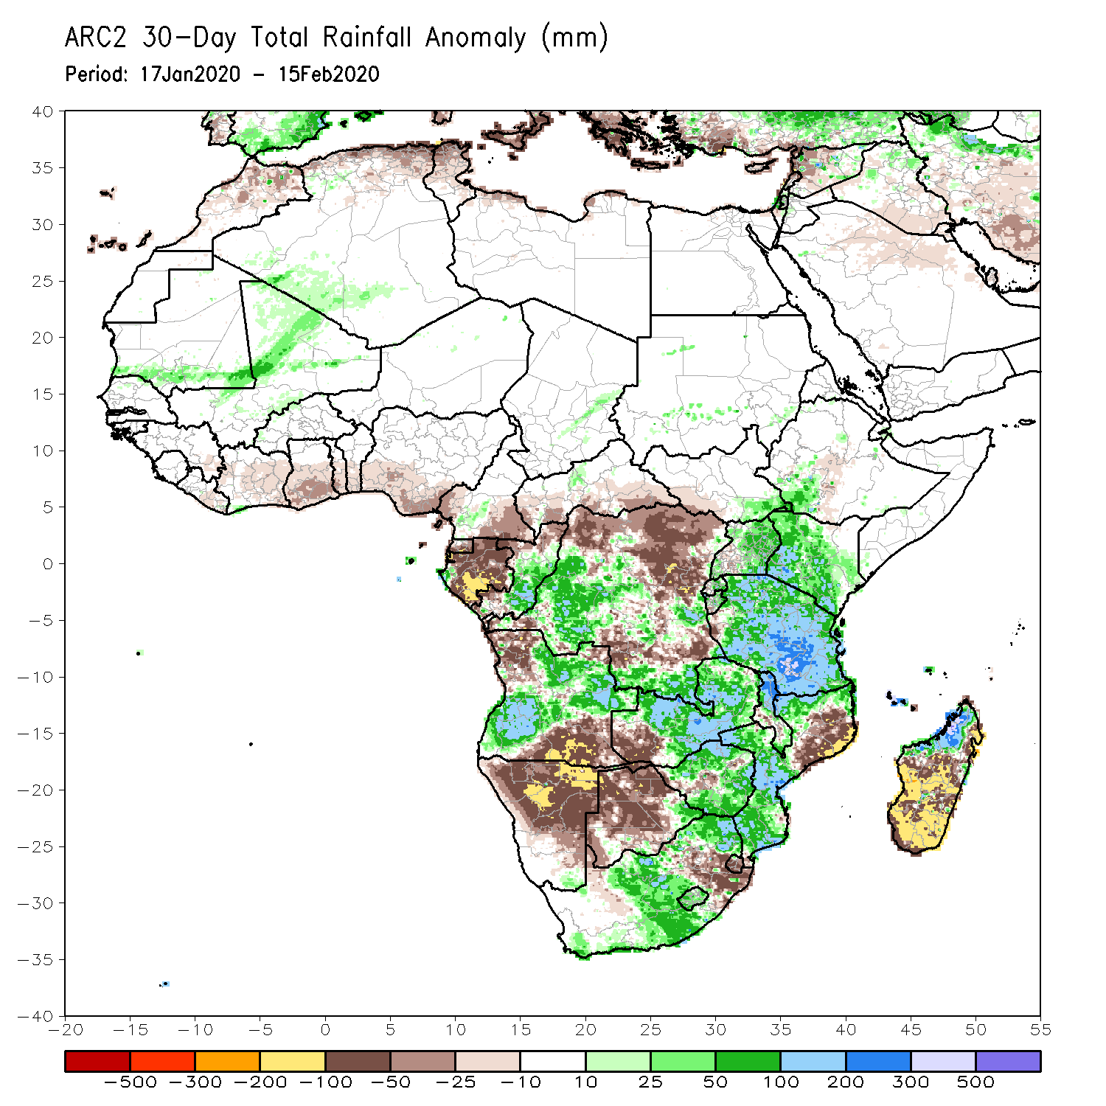
Rainfall Patterns: Last 30 Days
During the past 30 days, rainfall totals exceeded 300mm over local areas in Angola and DRC, central and eastern Zambia, northern Malawi, central and southern Tanzania, central Mozambique and northern Madagascar, with rainfall totals in excess of 750mm observed over local areas in northwestern Madagascar. Rainfall was above-average over many parts of Congo, portions of DRC, southwestern Ethiopia, Uganda, Kenya, Tanzania, parts of Angola, central and eastern Zambia, Malawi, portions of Mozambique and South Africa, Lesotho, and northern Madagascar. Rainfall surpluses exceeded 300mm over local areas in Tanzania and northwestern Madagascar.
Many places along the Gulf of Guinea coast, Southern Cameroon, Equatorial Guinea, Gabon, local areas in Congo, many portions of DRC, parts of northwestern and southeastern Angola, local areas in Zimbabwe, much of Namibia and Botswana, parts of Eastern South Africa, Eswatini, northeastern Mozambique, and central and southern Madagascar had below-average rainfall.
Notes:
5

Slide 6
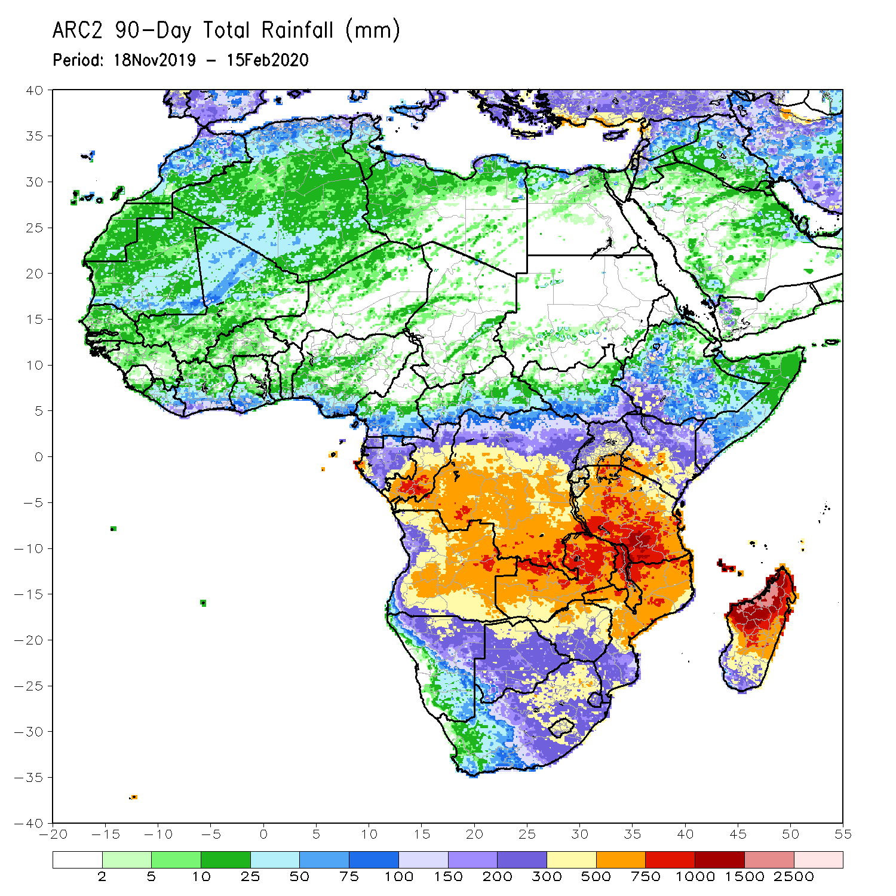
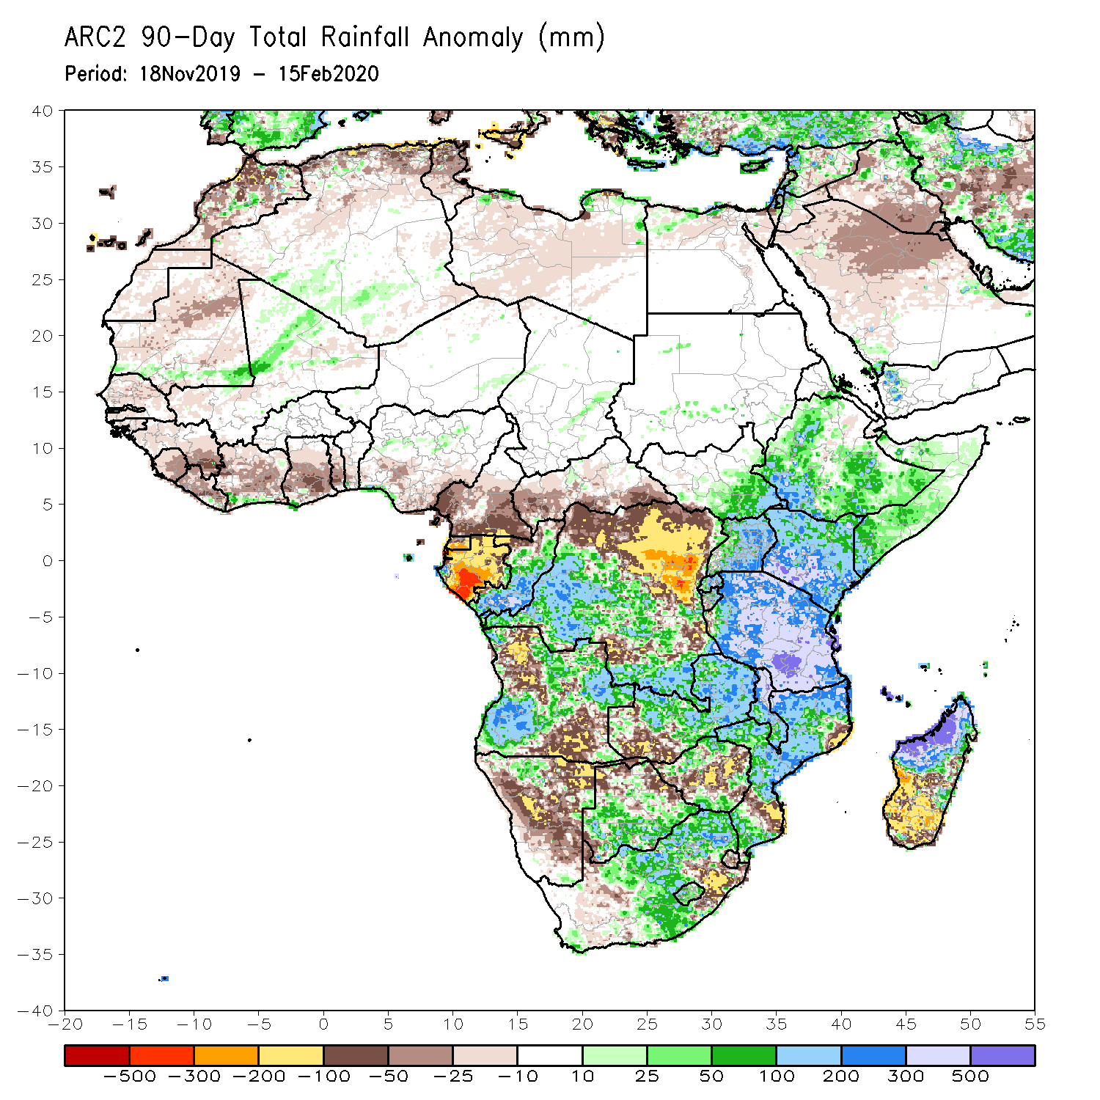
Rainfall Patterns: Last 90 Days
During the past 90 days, rainfall totals exceeded 750mm over parts of southern Congo and southern DRC, local areas in Angola, portions of Tanzania, central and eastern Zambia, Malawi, northern Mozambique, and central and northern Madagascar. Rainfall was above-average over local areas in Cote d’Ivoire, much of Congo, many parts of DRC, eastern South Sudan, Rwanda, Burundi, Uganda, Ethiopia, Kenya, Somalia, Tanzania, parts of Angola, many parts of Zambia and Botswana, Malawi, South Africa, Mozambique, and northern Madagascar. Rainfall surpluses exceeded 500mm over local areas in Tanzania and northern Madagascar.
Many parts of Guinea, Sierra Leone, Liberia, Cote d’Ivoire, Ghana, Togo, Benin, parts of Nigeria, Cameroon, Equatorial Guinea, Gabon, CAR, portions of DRC and Angola, parts of southwestern Zambia, Zimbabwe, Namibia, parts of northern Botswana, local areas in Mozambique, eastern South Africa, and southern Madagascar had below-average rainfall. Rainfall deficits exceeded 300mm over parts of Gabon.
Notes:
6

Slide 7
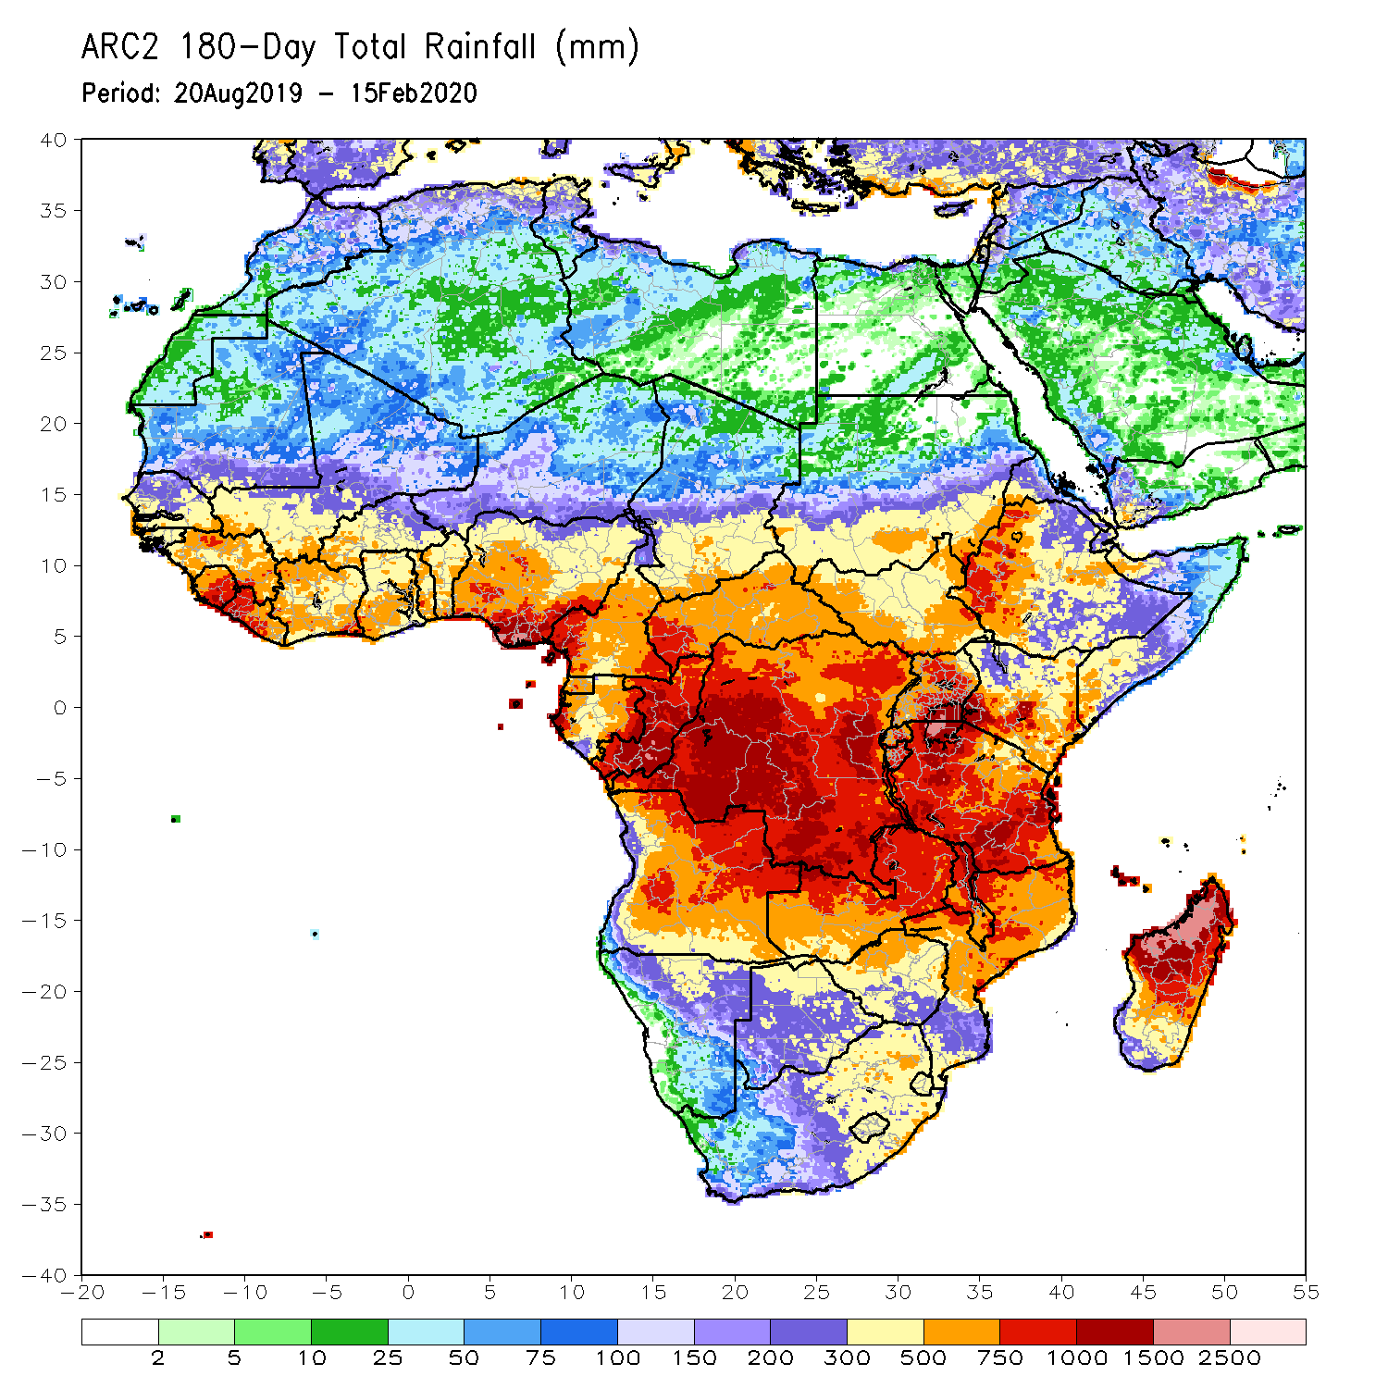
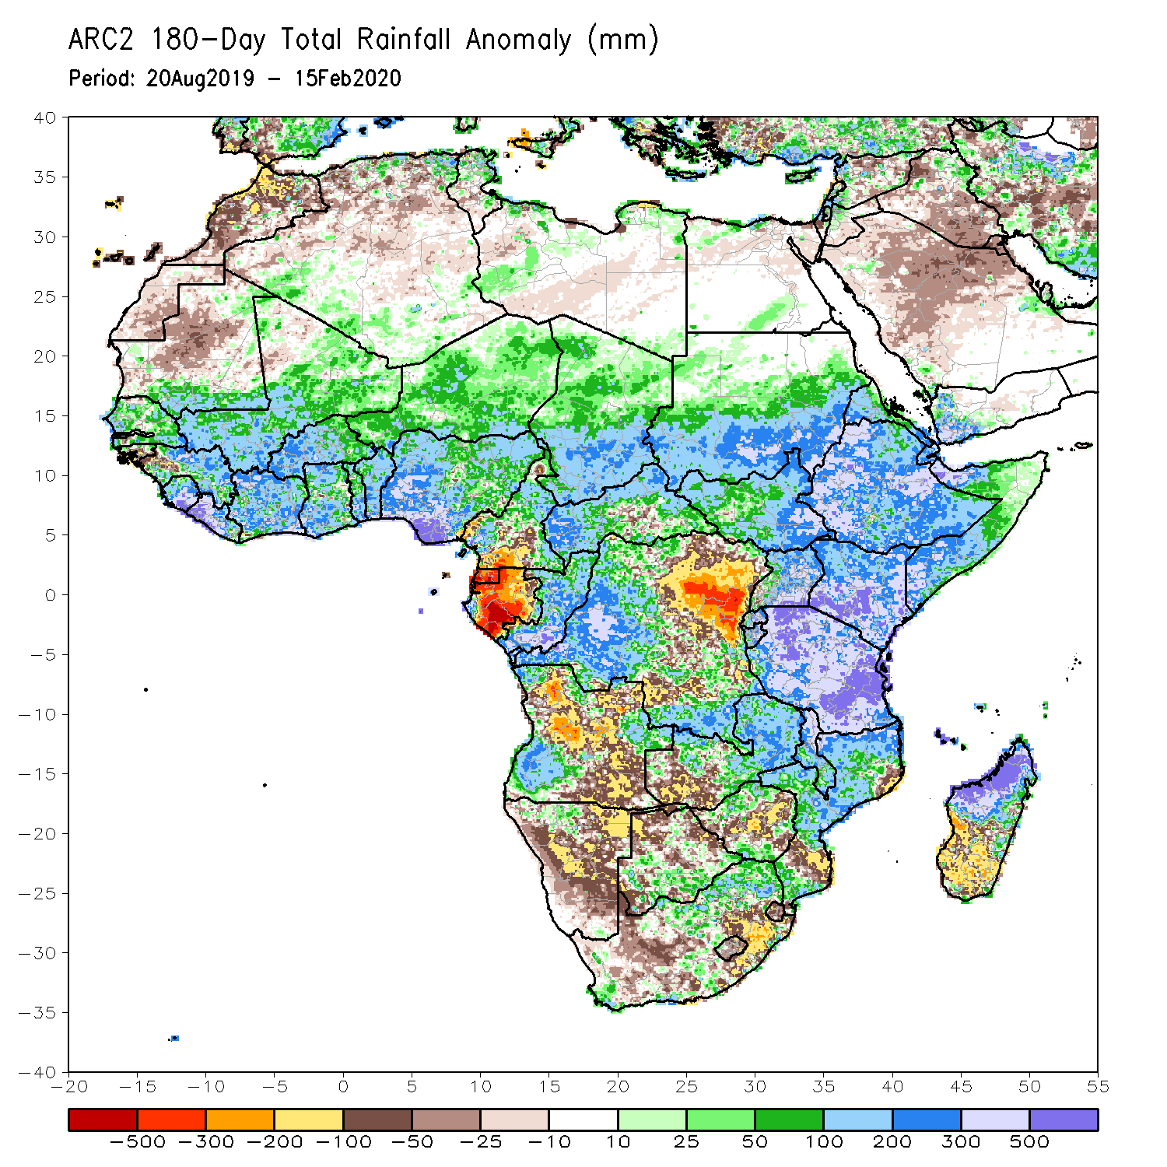
Rainfall Patterns: Last 180 Days
During the past 180 days, rainfall totals in excess of 1500mm were observed over parts of northern Madagascar. Southern Mauritania, much of Senegal, Guinea-Bissau, Guinea, Sierra Leone, Mali, Liberia, Cote d’Ivoire, Burkina Faso, Ghana, Togo, Benin, Nigeria, portions of Cameroon, Niger, Chad, CAR, portions of DRC, South Sudan, Sudan, Uganda, Eritrea, Ethiopia, Somalia, Kenya, Tanzania, parts of Angola, northern Namibia, many parts of Zambia, parts of Botswana, Malawi, northern South Africa, many parts of Mozambique and northern Madagascar had above-average rainfall. Rainfall surpluses exceeded 500mm over parts of Sierra Leone and Liberia, southern Nigeria, Kenya, Tanzania, and northern Madagascar.
Below-average rainfall was observed over portions of Cameroon, Equatorial Guinea, Gabon, parts of central and eastern DRC, many parts of Angola and Namibia, parts of South Africa, western Zambia, Zimbabwe, and southern Mozambique and southern Madagascar. Rainfall deficits exceeded 500mm over parts of Gabon.
Notes:
7

Slide 8
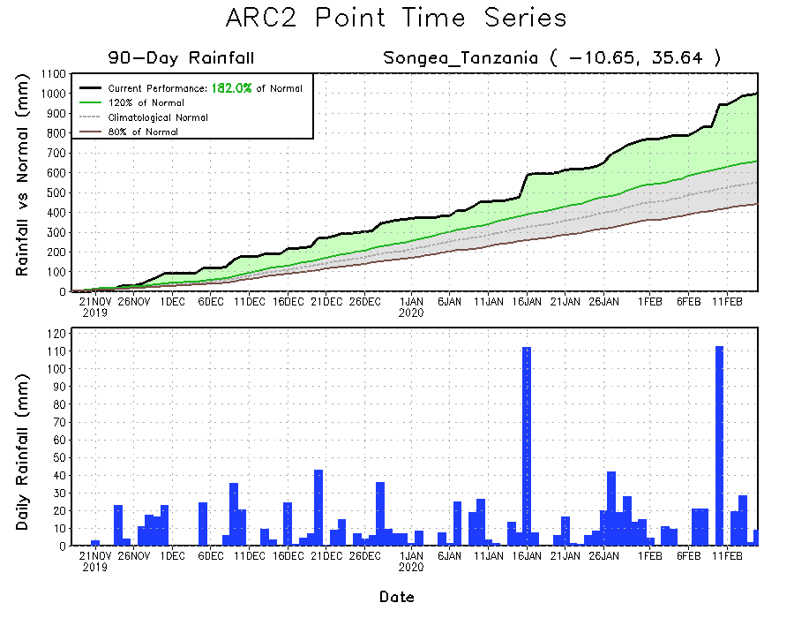
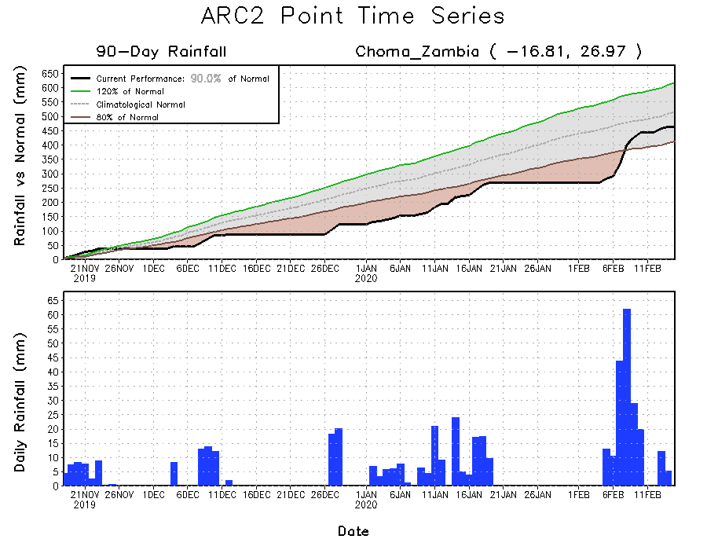
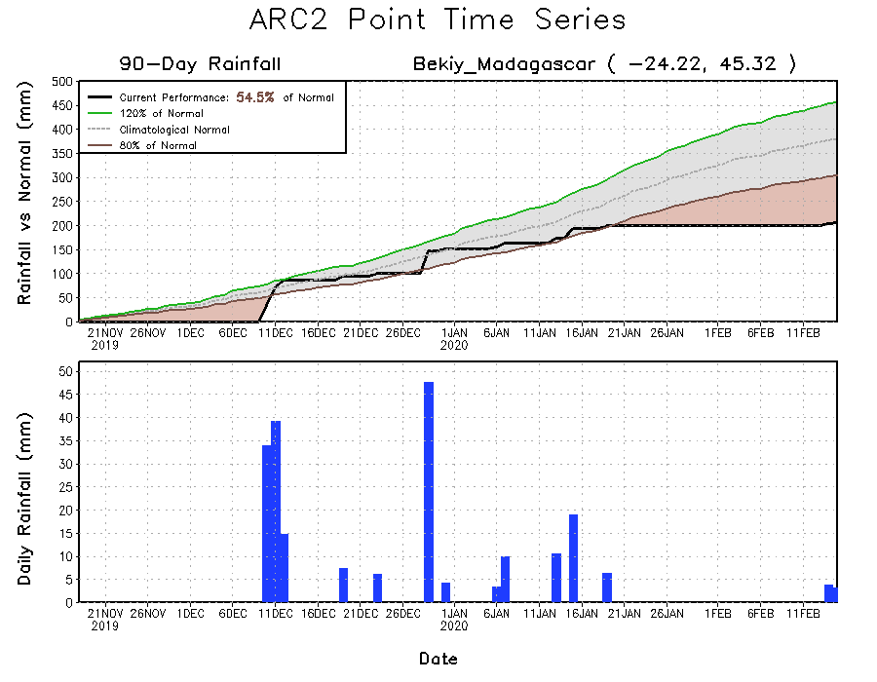
Recent Rainfall Evolution
Daily evolution of rainfall over the last 90 days at selected locations shows that moderate to locally heavy rainfall sustained moisture surpluses over portions of Tanzania (top right). Moderate to locally heavy rainfall also helped to reduce accumulated rainfall deficits over parts of western Zambia (bottom left). Seasonal total rainfall remained below-average over southern Madagascar (bottom right).

Slide 9
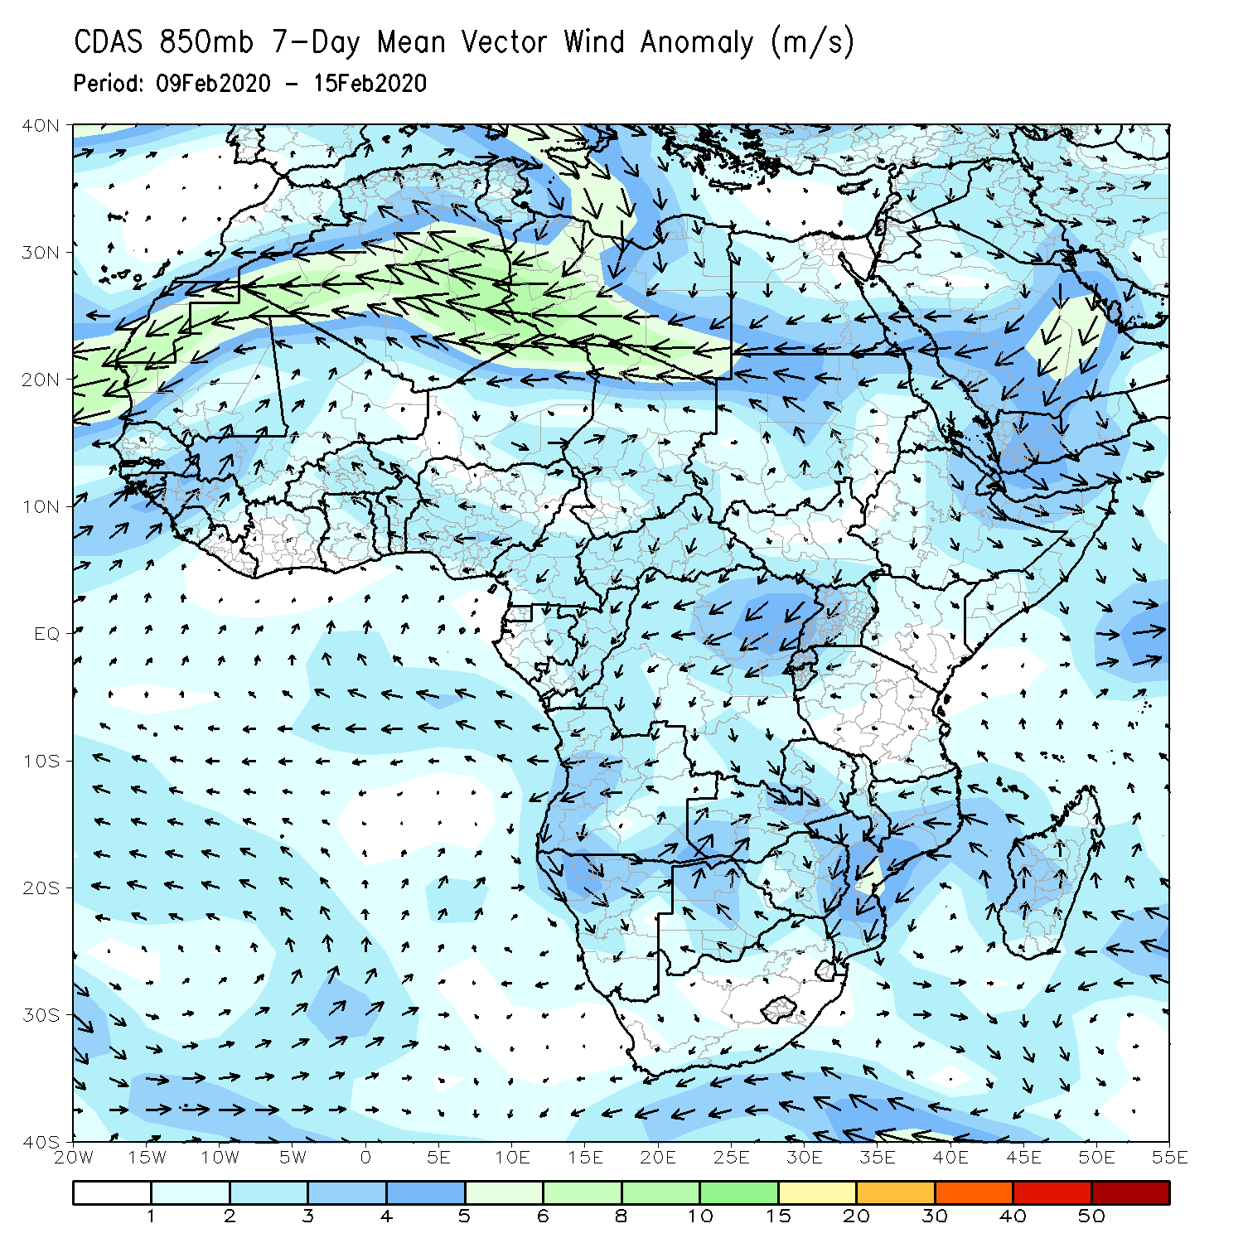
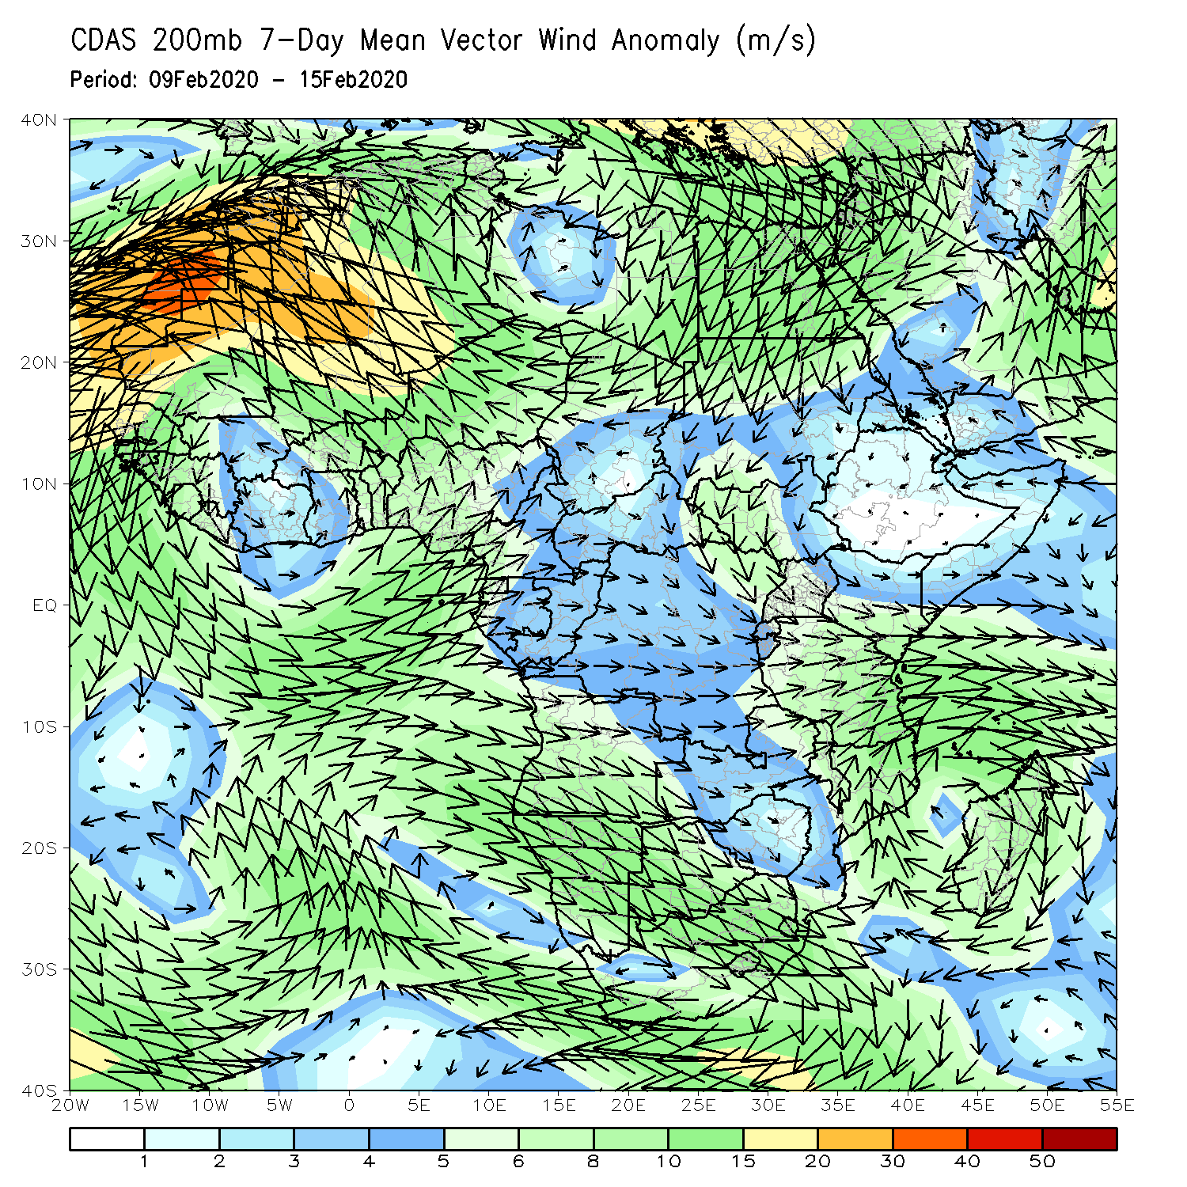
Atmospheric Circulation: Last 7 Days
An area of anomalous lower-level cyclonic circulation with its associated lower-level convergence may have contributed to the observed above-average rainfall over portions southern Africa.

Slide 10
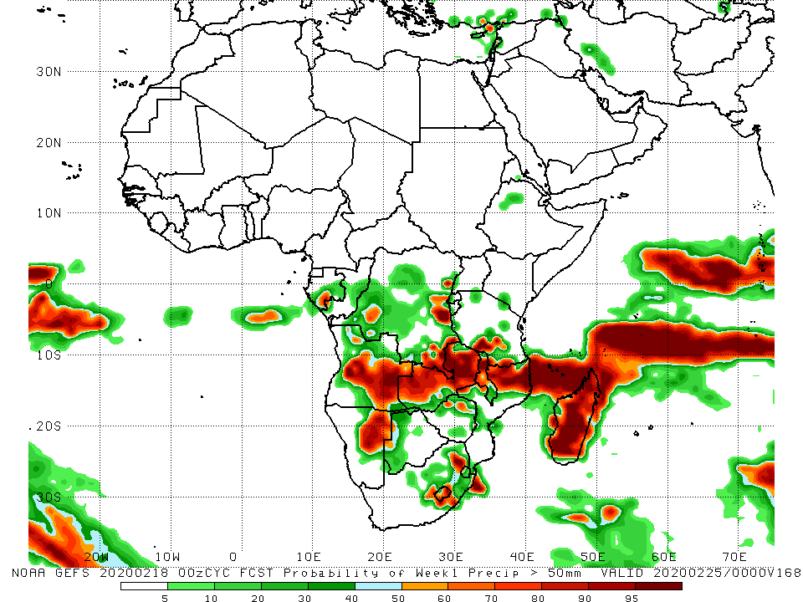
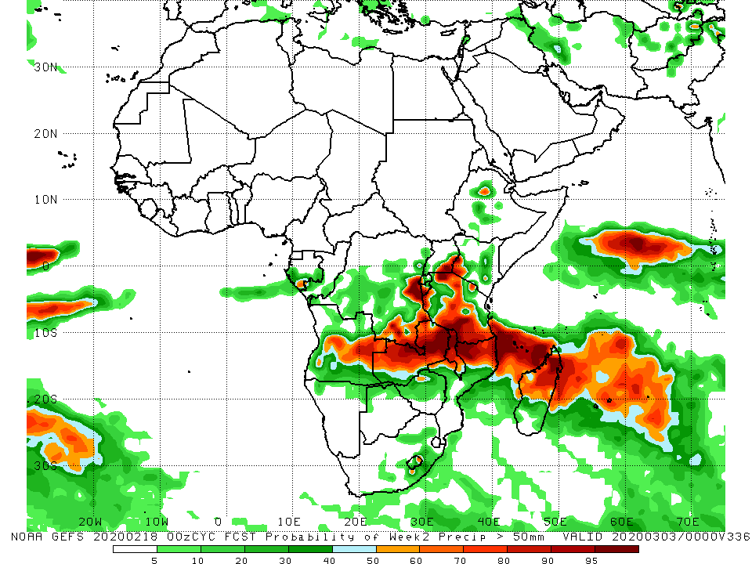
NCEP GEFS Model Forecasts Non-Bias Corrected Probability of precipitation exceedance
Week-1: Valid 19 – 25 February, 2020
Week-2: Valid 26 February – 3 March, 2020
For week-1 (left panel) and week-2 (right panel), there is an increased chance for weekly rainfall totals to exceed 50mm over many places in the northern portions of Southern Africa, including Madagascar.
Notes:
10

Slide 11
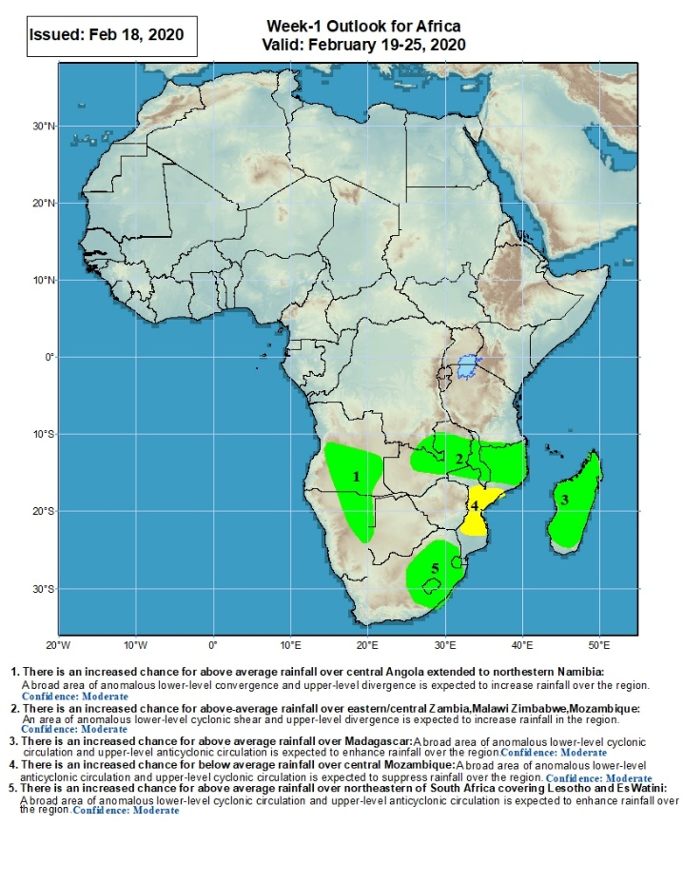
Week-1 Precipitation Outlooks
There is an increased chance for above average rainfall across southern Angola and northeastern Namibia: An area of anomalous lower-level convergence and upper-level divergence is expected to enhance rainfall in the region. Confidence: Moderate
There is an increased chance for above-average rainfall across central and eastern Zambia, parts of southern DRC, Malawi, and northern Mozambique: An area of anomalous lower-level cyclonic shear and upper-level divergence is expected to enhance rainfall in the region. Confidence: Moderate
There is an increased chance for above-average rainfall over much of Madagascar: An area of anomalous lower-level cyclonic circulation and upper-level divergence is expected to enhance rainfall in the region. Confidence: Moderate
There is an increased chance for below-average rainfall over central Mozambique: An area of anomalous lower-level anti-cyclonic circulation and upper-level cyclonic circulation is expected to suppress rainfall in the region. Confidence: Moderate
There is an increased chance for above-average rainfall over eastern South Africa, Lesotho and Eswatini: An area of anomalous lower-level cyclonic circulation and upper-level divergence is expected to enhance rainfall in the region. Confidence: Moderate
19 - 25 February, 2020
Notes:
11

Slide 12
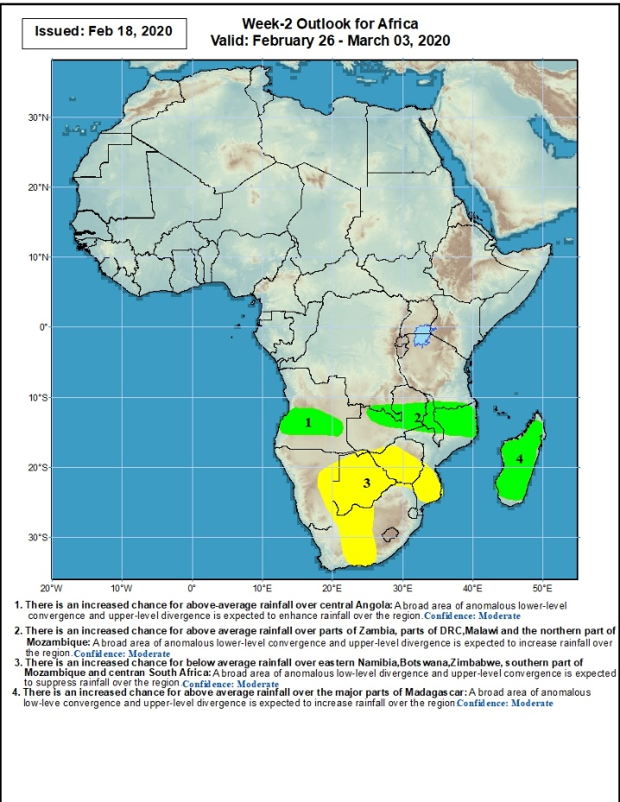
Week-2 Precipitation Outlooks
26 February – 3 March, 2020
There is an increased chance for above-average rainfall over central Angola: An area of anomalous lower-level convergence and upper-level divergence is expected to enhance rainfall in the region. Confidence: Moderate
There is an increased chance for above-average rainfall over parts of southern DRC, central and eastern Zambia, Malawi and northern Mozambique: A broad area of anomalous lower-level convergence and upper-level divergence is expected to enhance rainfall in the region. Confidence: Moderate
There is an increased chance for below-average rainfall over eastern Namibia, much of Botswana, portions of South Africa and Zimbabwe, and southern Mozambique: A broad area of anomalous lower-level divergence and upper-level convergence is expected to suppress rainfall in the region. Confidence: Moderate
There is an increased chance for above-average rainfall over much of Madagascar: An area of anomalous lower-level convergence and upper-level divergence is expected to enhance rainfall in the region. Confidence: Moderate
Notes:
12

Slide 13
Summary
During the past 7 days, weekly rainfall totals exceeded 100mm over local areas in Angola and DRC, parts of Zambia, southern Tanzania, northern Malawi, western Mozambique, and parts of Zimbabwe and Madagascar. Rainfall was above-average over southern Congo, central and southern DRC, parts of Angola, Tanzania, central and eastern Zambia, Malawi, Zimbabwe, northeastern South Africa, Mozambique, and local areas in Madagascar. Weekly rainfall surpluses exceeded 100mm over local areas in Zambia and Mozambique. Equatorial Guinea, much of Gabon, northern DRC, southern Angola, Namibia, western Zambia, local areas in Botswana, northeastern Mozambique and parts of Madagascar had below-average rainfall.
During the past 30 days, rainfall totals exceeded 300mm over local areas in Angola and DRC, central and eastern Zambia, northern Malawi, central and southern Tanzania, central Mozambique and northern Madagascar, with rainfall totals in excess of 750mm observed over local areas in northwestern Madagascar. Rainfall was above-average over many parts of Congo, portions of DRC, southwestern Ethiopia, Uganda, Kenya, Tanzania, parts of Angola, central and eastern Zambia, Malawi, portions of Mozambique and South Africa, Lesotho, and northern Madagascar. Rainfall surpluses exceeded 300mm over local areas in Tanzania and northwestern Madagascar. Many places along the Gulf of Guinea coast, Southern Cameroon, Equatorial Guinea, Gabon, local areas in Congo, many portions of DRC, parts of northwestern and southeastern Angola, local areas in Zimbabwe, much of Namibia and Botswana, parts of Eastern South Africa, Eswatini, northeastern Mozambique, and central and southern Madagascar had below-average rainfall.
During the past 90 days, rainfall totals exceeded 750mm over parts of southern Congo and southern DRC, local areas in Angola, portions of Tanzania, central and eastern Zambia, Malawi, northern Mozambique, and central and northern Madagascar. Rainfall was above-average over local areas in Cote d’Ivoire, much of Congo, many parts of DRC, eastern South Sudan, Rwanda, Burundi, Uganda, Ethiopia, Kenya, Somalia, Tanzania, parts of Angola, many parts of Zambia and Botswana, Malawi, South Africa, Mozambique, and northern Madagascar. Rainfall surpluses exceeded 500mm over local areas in Tanzania and northern Madagascar. Many parts of Guinea, Sierra Leone, Liberia, Cote d’Ivoire, Ghana, Togo, Benin, parts of Nigeria, Cameroon, Equatorial Guinea, Gabon, CAR, portions of DRC and Angola, parts of southwestern Zambia, Zimbabwe, Namibia, parts of northern Botswana, local areas in Mozambique, eastern South Africa, and southern Madagascar had below-average rainfall. Rainfall deficits exceeded 300mm over parts of Gabon.
Week-1 outlooks call for an increased chance for above-average rainfall over parts of Angola, northeastern Namibia, parts of southern DRC, central and eastern Zambia, Malawi, parts of southern Tanzania, northern Mozambique, eastern South Africa, Lesotho, Eswatini and Madagascar. In contrast, there is an increased chance for below-average rainfall over central Mozambique.
Notes:
13

