Slide 1
The African Monsoon Recent Evolution and Current Status Include Week-1 and Week-2 Outlooks
Update prepared by
Climate Prediction Center / NCEP
24 February 2020
For more information, visit:
http://www.cpc.ncep.noaa.gov/products/Global_Monsoons/African_Monsoons/precip_monitoring.shtml

Slide 2
Outline
Highlights
Recent Evolution and Current Conditions
NCEP GEFS Forecasts
Summary

Slide 3
Highlights: Last 7 Days
Weekly rainfall surpluses exceeded 100mm over central Madagascar.
Week-1 outlooks call for an increased chance for above-average rainfall over parts of eastern Angola, northeastern Namibia, Zambia, southeastern DRC, Malawi, portions of Tanzania, northern Mozambique and northern Madagascar. In contrast, there is an increased chance for below-average rainfall over parts of southwestern Angola and northwestern Namibia, and southern Zimbabwe, northeastern South Africa and southern Mozambique.

Slide 4
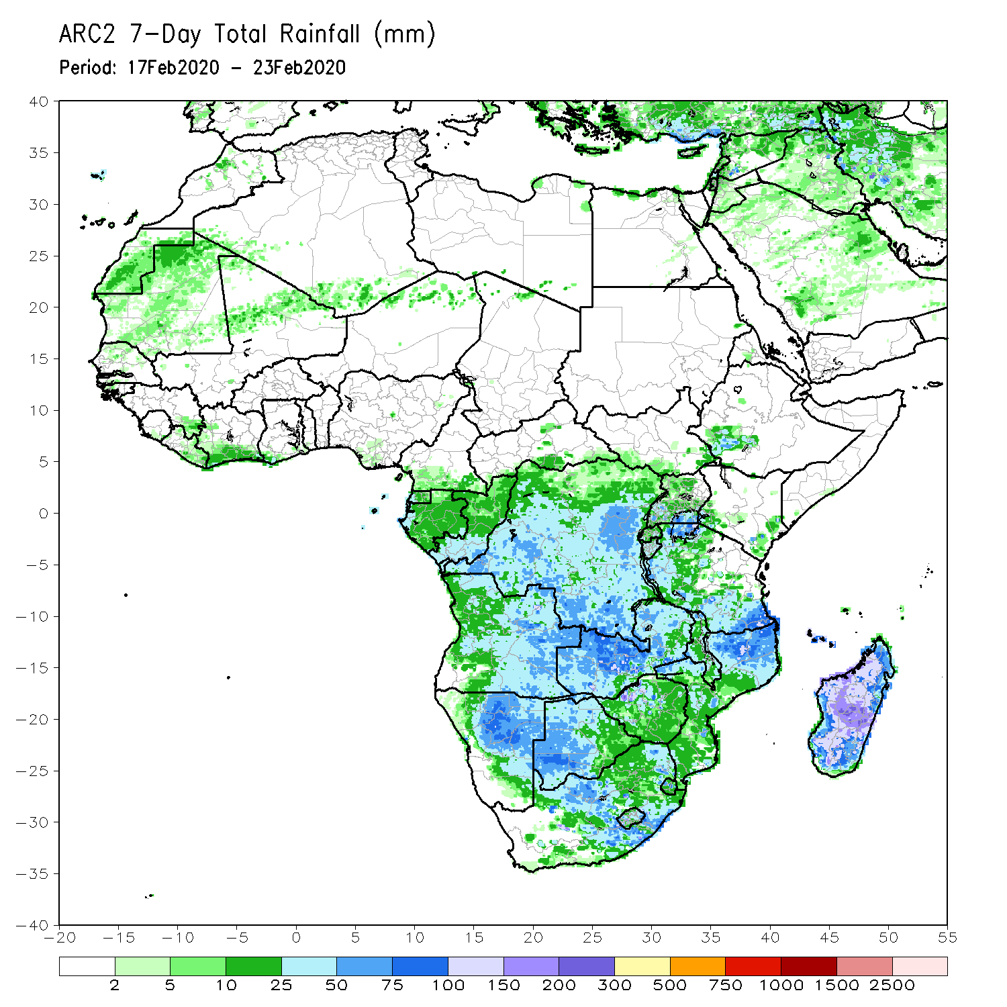
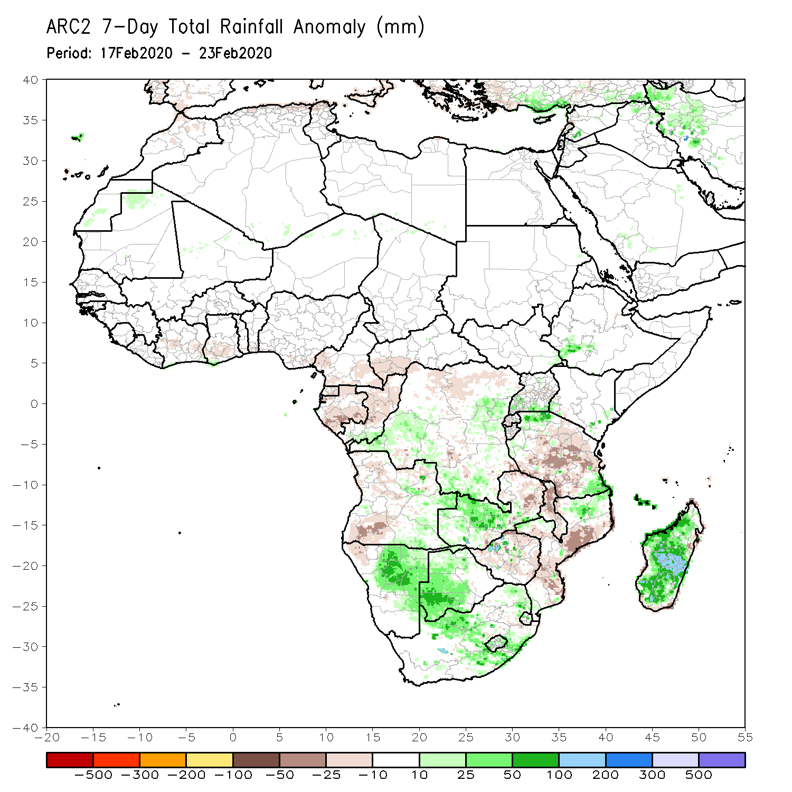
Rainfall Patterns: Last 7 Days
During the past 7 days, weekly rainfall totals exceeded 100mm over local areas in northern Mozambique and many parts of Madagascar. Rainfall was above-average over parts of DRC, local areas in southwestern Ethiopia and Tanzania, western Zambia, Namibia, Botswana, South Africa, local areas in Zimbabwe, northern Mozambique, and much of Madagascar. Rainfall surpluses exceeded 100mm over central Madagascar.
Rainfall was slightly below average over portions of the Gulf of Guinea countries including Cameroon northern Congo and CAR. Below-average rainfall was also observed over parts of Angola and DRC, Tanzania, eastern Zambia, Malawi, eastern Zimbabwe, northeastern South Africa, and central and southern Mozambique.

Slide 5
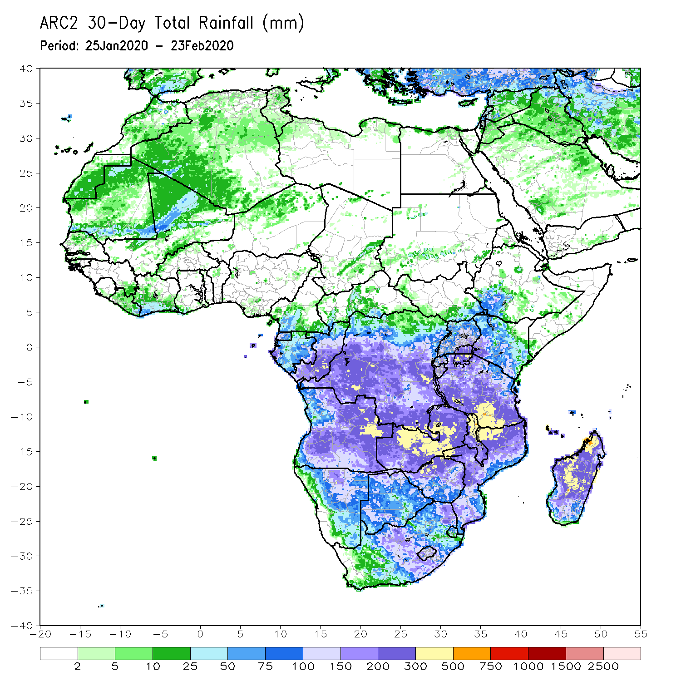
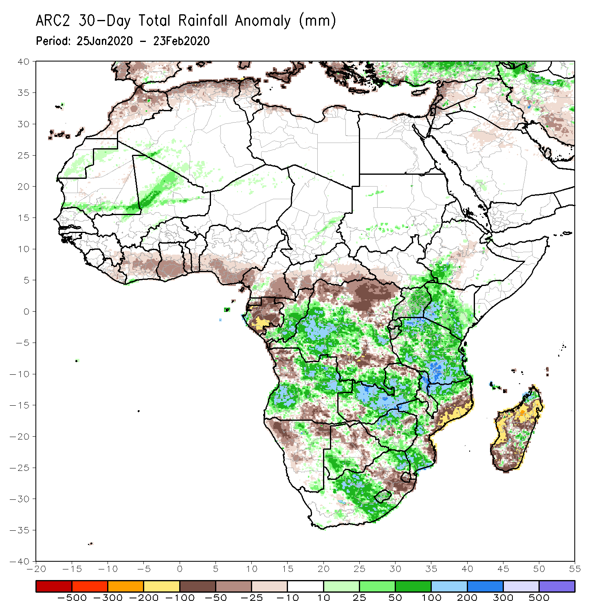
Rainfall Patterns: Last 30 Days
During the past 30 days, rainfall totals exceeded 300mm over local areas in eastern Angola and DRC, central Zambia, northern Malawi, southern Tanzania, northern Mozambique and northern Madagascar, with rainfall totals in excess of 500mm observed over local areas in northwestern Madagascar. Rainfall was above-average over many parts of Congo, portions of DRC, southwestern Ethiopia, Uganda, Kenya, Tanzania, many parts of Angola and Zambia, Malawi, portions of Mozambique and South Africa, Lesotho, and local areas in Madagascar. Rainfall surpluses exceeded 200mm over parts of southern Tanzania.
Many places along the Gulf of Guinea coast, Southern Cameroon, Equatorial Guinea, Gabon, local areas in Congo, portions of DRC, parts of northwestern and southeastern Angola, local areas in Zimbabwe, much of Namibia and Botswana, parts of eastern South Africa, Eswatini, eastern Mozambique, and much of Madagascar had below-average rainfall.
Notes:
5

Slide 6
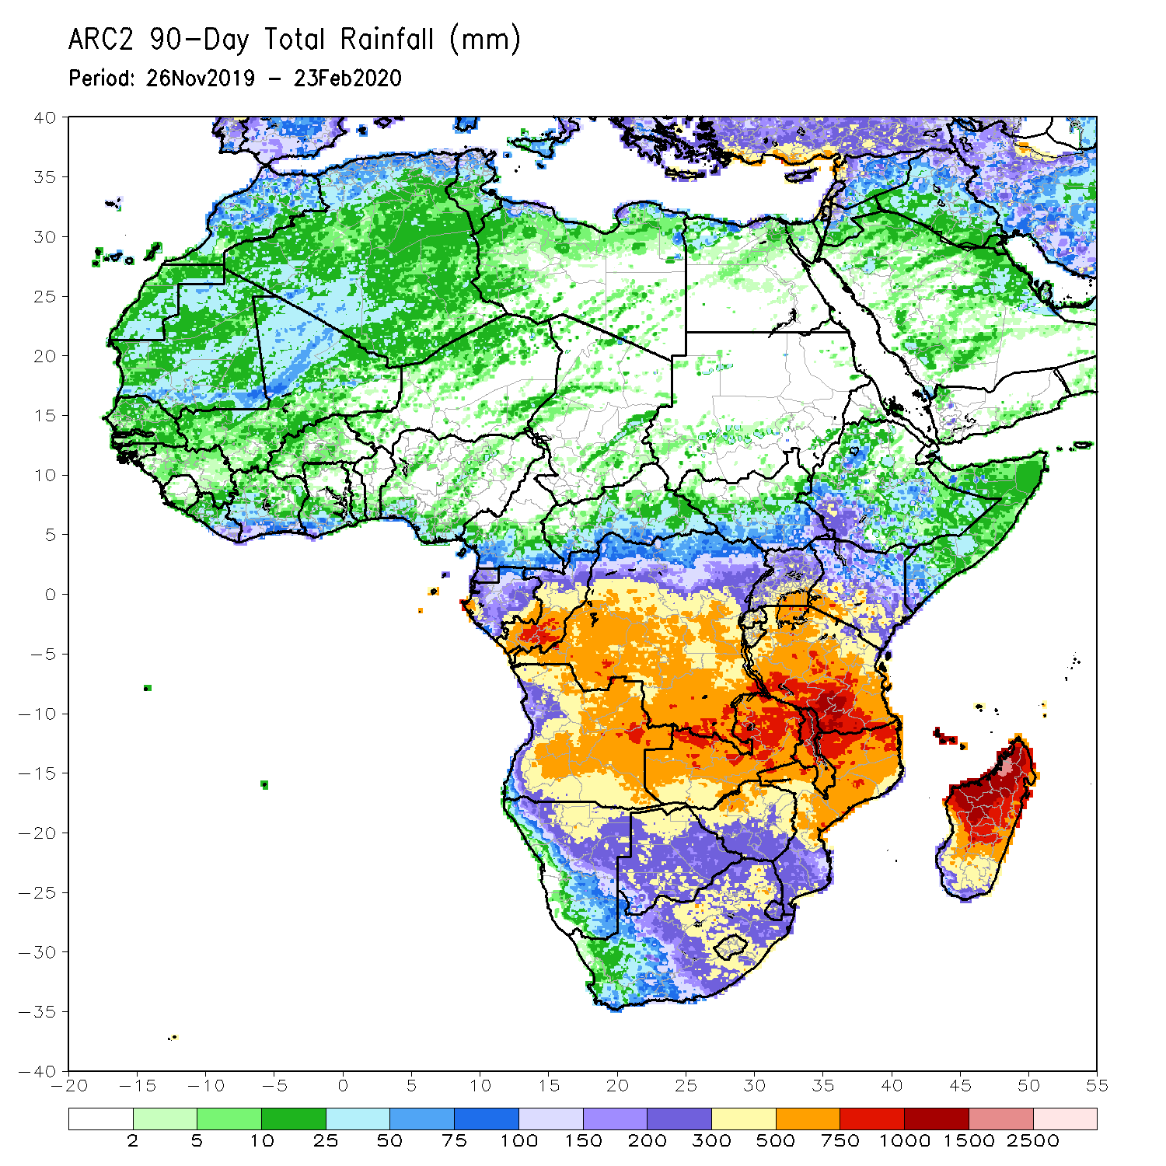
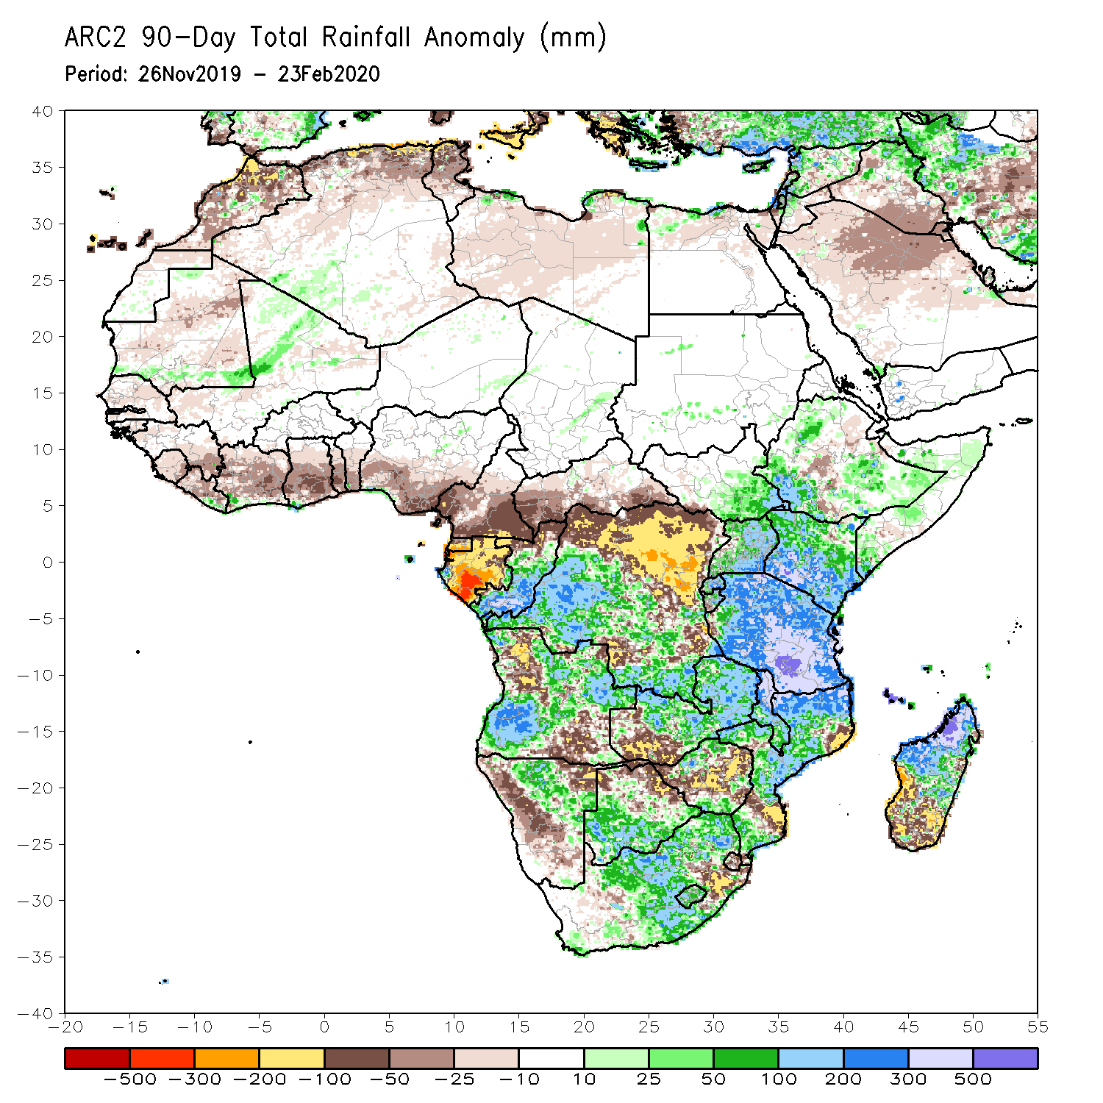
Rainfall Patterns: Last 90 Days
During the past 90 days, rainfall totals exceeded 750mm over parts of southern Congo and southern DRC, local areas in eastern Angola, portions of Tanzania, central and eastern Zambia, northern Malawi, northern Mozambique, and central and northern Madagascar. Rainfall was above-average over local areas in Cote d’Ivoire, much of Congo, many parts of DRC, eastern South Sudan, Rwanda, Burundi, Uganda, Ethiopia, Kenya, Somalia, Tanzania, parts of Angola, many parts of Zambia and Botswana, Malawi, South Africa, Mozambique, and northern Madagascar. Rainfall surpluses exceeded 500mm over local areas in Tanzania and northern Madagascar.
Many places in the Gulf of Guinea countries including Cameroon and CAR, portions of DRC and Angola, parts of western Zambia, Zimbabwe, Namibia, parts of northern Botswana, local areas in Mozambique, eastern South Africa, and southern Madagascar had below-average rainfall. Rainfall deficits exceeded 300mm over parts of Gabon.
Notes:
6

Slide 7
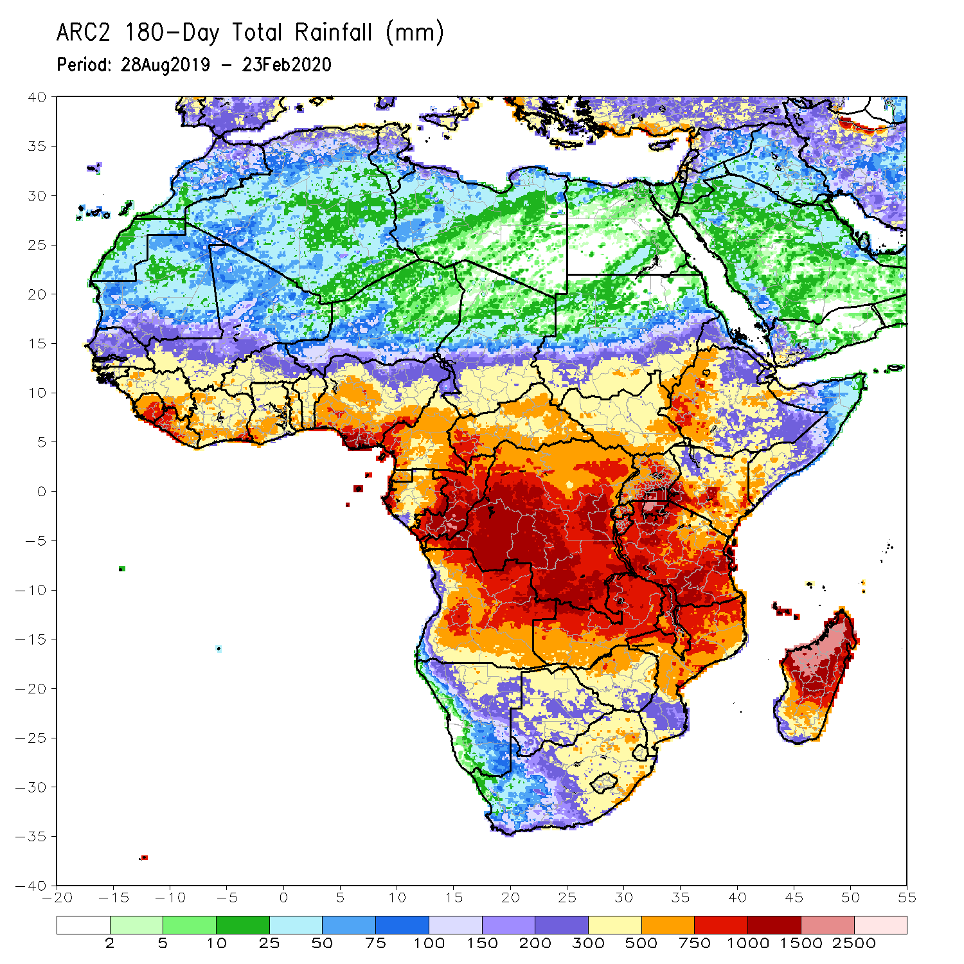
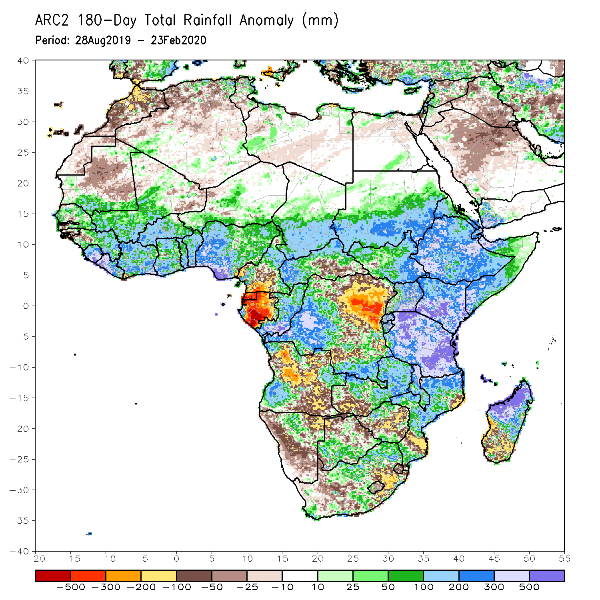
Rainfall Patterns: Last 180 Days
During the past 180 days, rainfall totals in excess of 1500mm were observed over parts of northern Madagascar. Southern Mauritania, much of Senegal, Guinea-Bissau, Guinea, Sierra Leone, Mali, Liberia, Cote d’Ivoire, Burkina Faso, Ghana, Togo, Benin, Nigeria, portions of Cameroon, Niger, Chad, portions of CAR and DRC, South Sudan, Sudan, Uganda, Eritrea, Ethiopia, Somalia, Kenya, Tanzania, parts of Angola, parts of northern Namibia, many parts of Zambia, parts of Botswana, Malawi and South Africa, many parts of Mozambique and northern Madagascar had above-average rainfall. Rainfall surpluses exceeded 500mm over parts of southern Nigeria, Kenya, Tanzania, and northern Madagascar.
Below-average rainfall was observed over portions of Cameroon, Equatorial Guinea, Gabon, parts of central and eastern DRC, many parts of Angola and Namibia, parts of South Africa, western Zambia, Zimbabwe, and southern Mozambique and southern Madagascar. Rainfall deficits exceeded 500mm over parts of Gabon.
Notes:
7

Slide 8
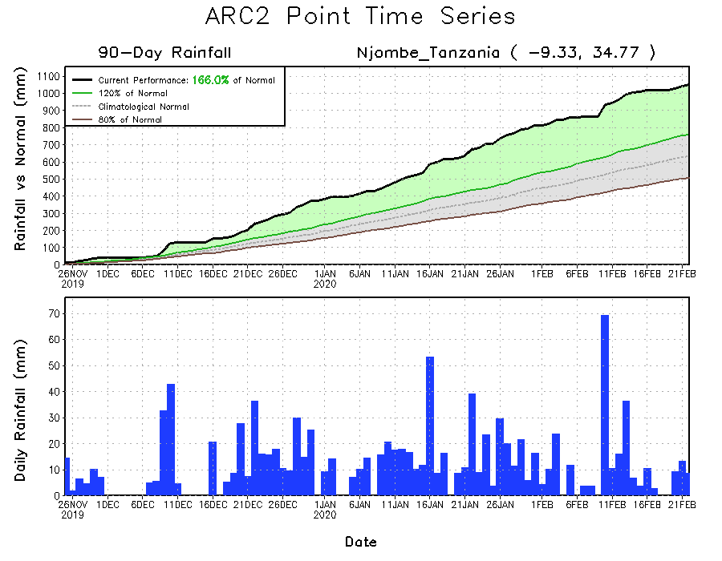
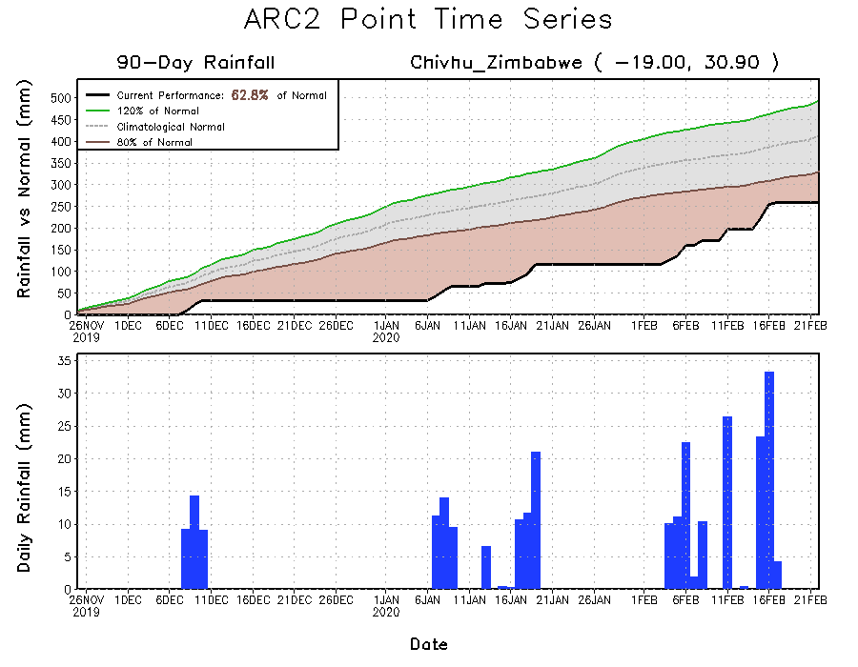
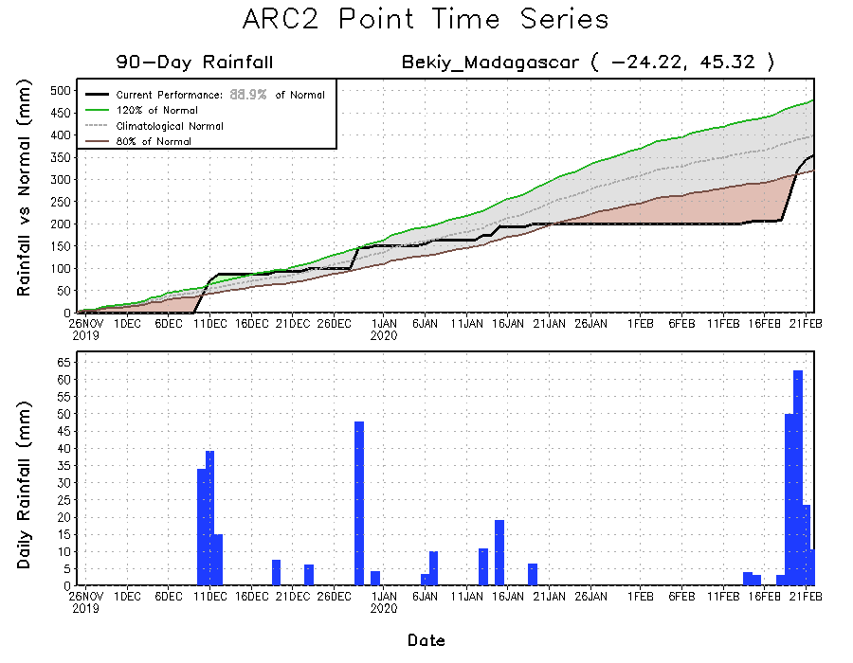
Recent Rainfall Evolution
Daily evolution of rainfall over the last 90 days at selected locations shows that moderate to locally heavy rainfall sustained moisture surpluses over portions of Tanzania (top right). Moderate to locally heavy rainfall also helped to reduce accumulated rainfall deficits over parts of southern Madagascar (bottom right). Seasonal total rainfall remained below-average over parts of western Zambia (bottom left).

Slide 9
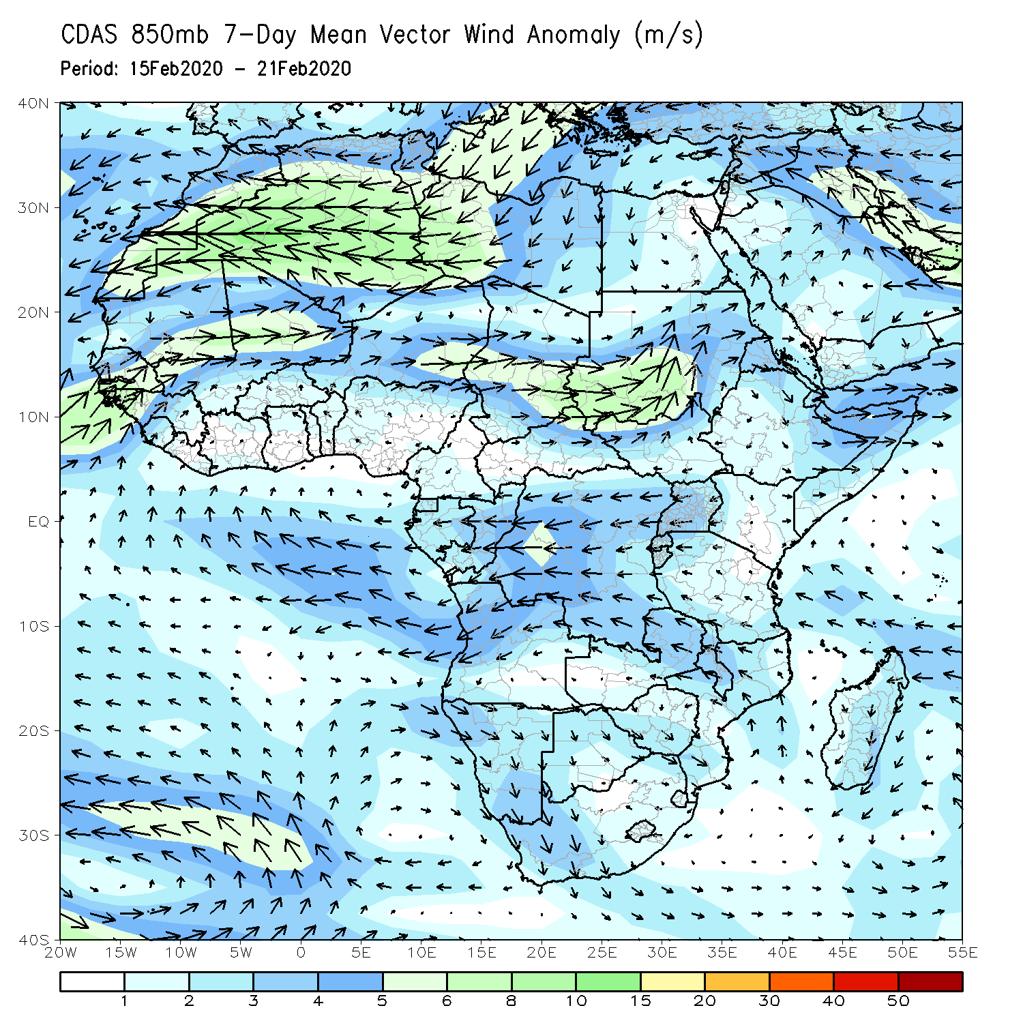
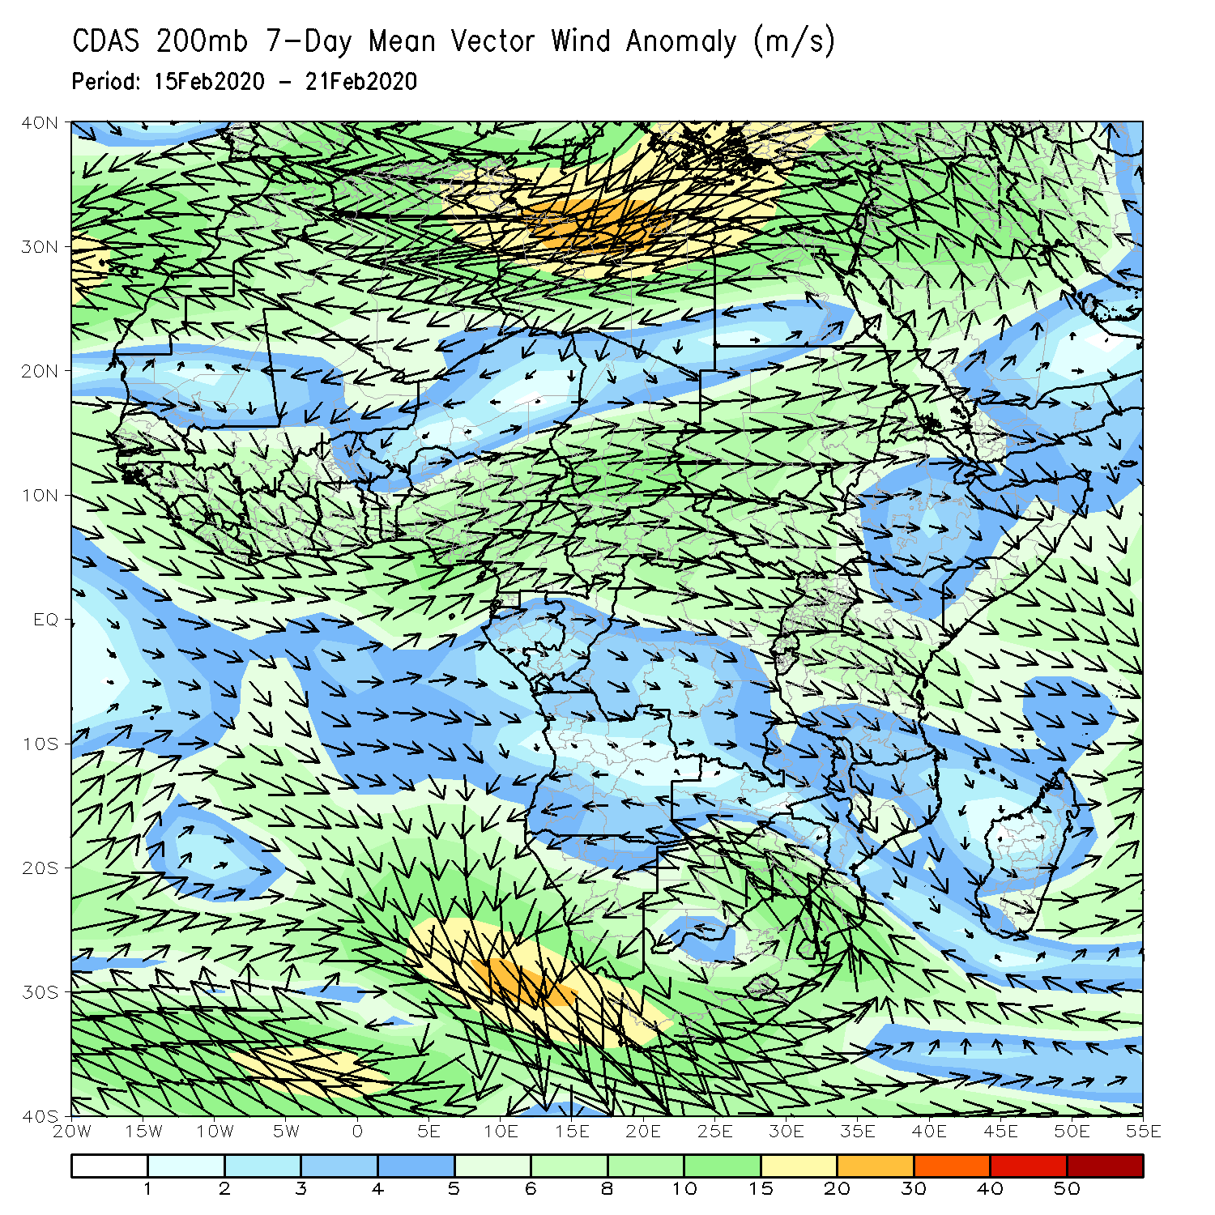
Atmospheric Circulation: Last 7 Days
Lower-level wind anomalies were easterly across much of DRC and the neighboring areas (left panel).

Slide 10
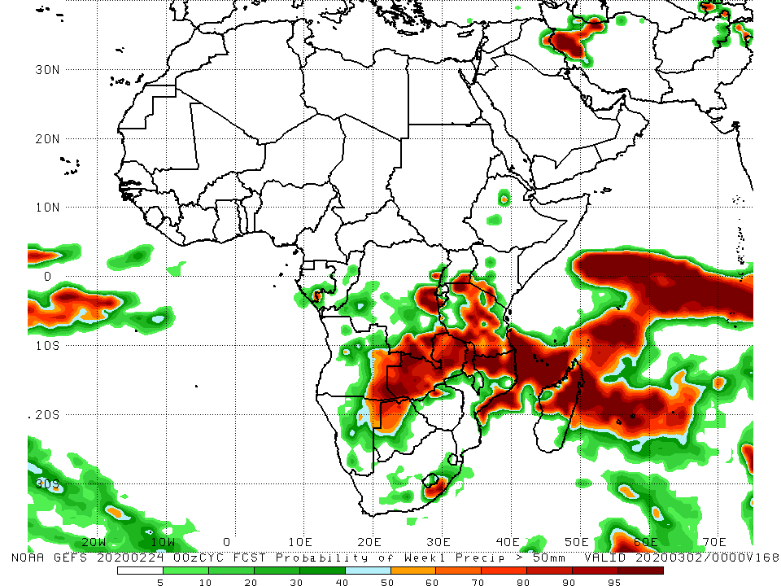
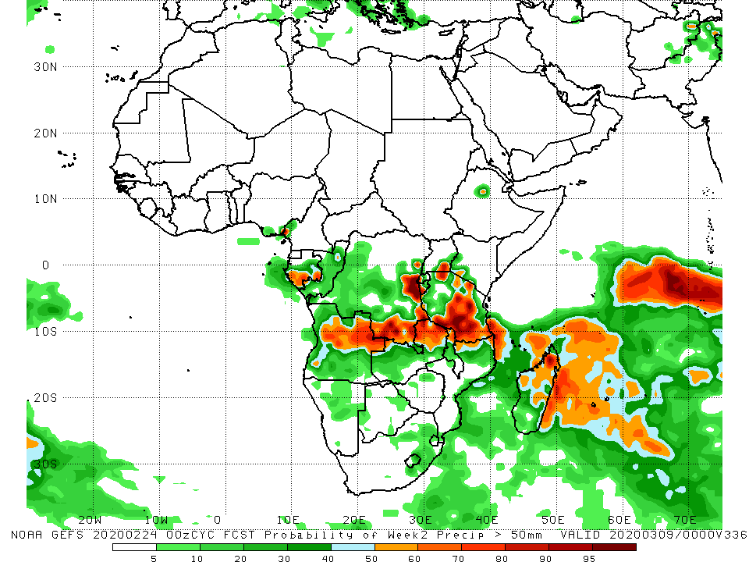
NCEP GEFS Model Forecasts Non-Bias Corrected Probability of precipitation exceedance
Week-1: Valid 24 February – 2 March, 2020
Week-2: Valid 3 - 9 March, 2020
For week-1 (left panel), there is an increased chance for weekly rainfall totals to exceed 50mm over eastern Angola, northeastern Namibia, northern Botswana, much of Zambia, parts of southern and eastern DRC, Tanzania, Malawi, northern Mozambique, local areas in in South Africa, and northern Madagascar. For week-2 (right panel), there is an increased chance for weekly rainfall totals to exceed 50mm over southern Gabon, northern Angola, parts of southern and eastern DRC, eastern Zambia, portions of Tanzania, and northern Madagascar.
Notes:
10

Slide 11
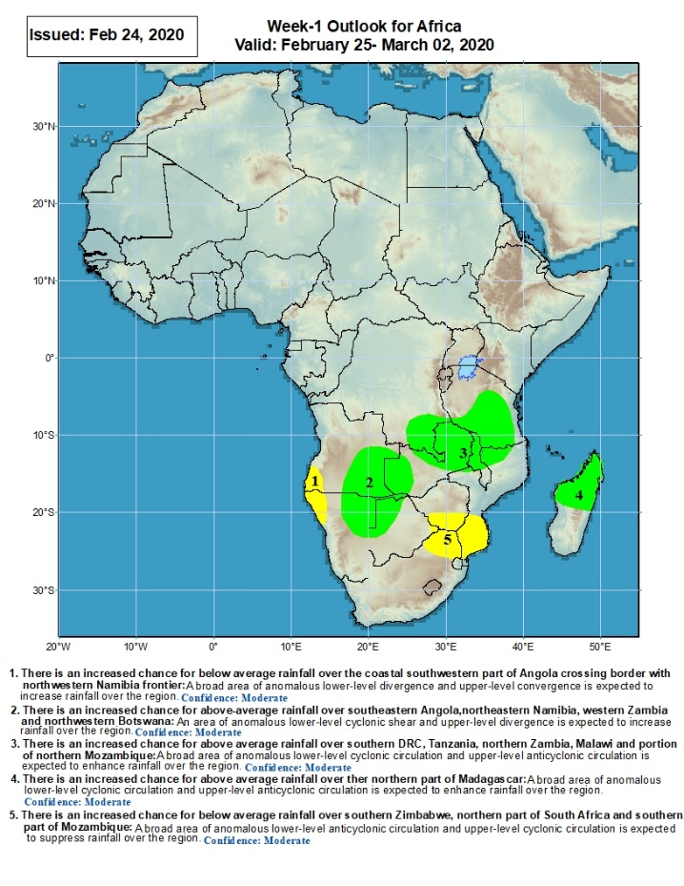
Week-1 Precipitation Outlooks
There is an increased chance for below average rainfall over southwestern Angola and northwestern Namibia: An area of anomalous lower-level divergence and upper-level convergence is expected to suppress rainfall in the region. Confidence: Moderate
There is an increased chance for above-average rainfall across southeastern Angola, northeastern Namibia, western Zambia and northwestern Botswana: An area of anomalous lower-level cyclonic shear and upper-level divergence is expected to enhance rainfall in the region. Confidence: Moderate
There is an increased chance for above-average rainfall over southwestern DRC, eastern Zambia, southern Tanzania, northern Malawi and northern Mozambique: An area of anomalous lower-level cyclonic circulation and upper-level divergence is expected to enhance rainfall in the region. Confidence: Moderate
There is an increased chance for below-average rainfall over northern Madagascar: An area of anomalous lower-level cyclonic circulation and upper-level anti-cyclonic circulation is expected to enhance rainfall in the region. Confidence: Moderate
There is an increased chance for below-average rainfall over southern Zimbabwe, northern South Africa and southern Mozambique: An area of anomalous lower-level anti-cyclonic circulation and upper-level cyclonic circulation is expected to suppress rainfall in the region. Confidence: Moderate
25 February – 2 March, 2020
Notes:
11

Slide 12
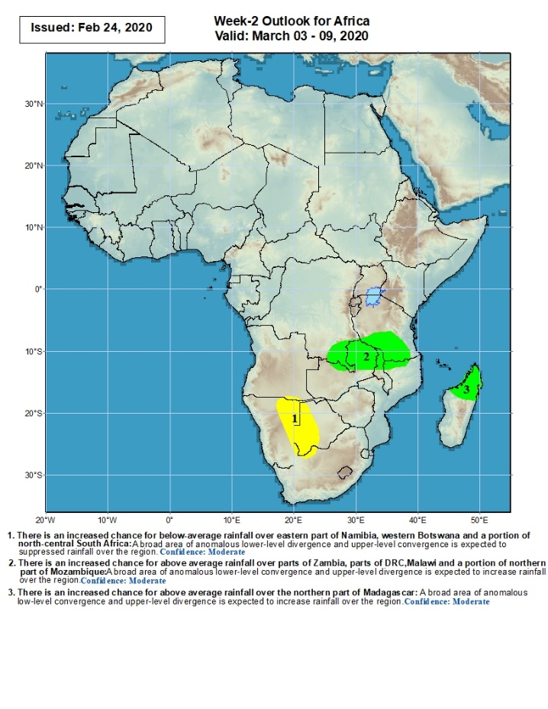
Week-2 Precipitation Outlooks
3 – 9 March, 2020
There is an increased chance for below-average rainfall over eastern Namibia, western Botswana and a portion of northcentral South Africa: An area of anomalous lower-level divergence and upper-level convergence is expected to suppress rainfall in the region. Confidence: Moderate
There is an increased chance for above-average rainfall over parts of Zambia, southern DRC, Malawi and a portion of northern Mozambique: A broad area of anomalous lower-level convergence and upper-level divergence is expected to enhance rainfall in the region. Confidence: Moderate
There is an increased chance for above-average rainfall over northern Madagascar: An area of anomalous lower-level convergence and upper-level divergence is expected to enhance rainfall in the region. Confidence: Moderate
Notes:
12

Slide 13
Summary
During the past 7 days, weekly rainfall totals exceeded 100mm over local areas in northern Mozambique and many parts of Madagascar. Rainfall was above-average over parts of DRC, local areas in southwestern Ethiopia and Tanzania, western Zambia, Namibia, Botswana, South Africa, local areas in Zimbabwe, northern Mozambique, and much of Madagascar. Rainfall surpluses exceeded 100mm over central Madagascar. Rainfall was slightly below average over portions of the Gulf of Guinea countries including Cameroon northern Congo and CAR. Below-average rainfall was also observed over parts of Angola and DRC, Tanzania, eastern Zambia, Malawi, eastern Zimbabwe, northeastern South Africa, and central and southern Mozambique.
During the past 30 days, rainfall totals exceeded 300mm over local areas in Angola and DRC, central and eastern Zambia, northern Malawi, central and southern Tanzania, central Mozambique and northern Madagascar, with rainfall totals in excess of 750mm observed over local areas in northwestern Madagascar. Rainfall was above-average over many parts of Congo, portions of DRC, southwestern Ethiopia, Uganda, Kenya, Tanzania, parts of Angola, central and eastern Zambia, Malawi, portions of Mozambique and South Africa, Lesotho, and northern Madagascar. Rainfall surpluses exceeded 300mm over local areas in Tanzania and northwestern Madagascar. Many places along the Gulf of Guinea coast, Southern Cameroon, Equatorial Guinea, Gabon, local areas in Congo, many portions of DRC, parts of northwestern and southeastern Angola, local areas in Zimbabwe, much of Namibia and Botswana, parts of Eastern South Africa, Eswatini, northeastern Mozambique, and central and southern Madagascar had below-average rainfall.
During the past 90 days, rainfall totals exceeded 750mm over parts of southern Congo and southern DRC, local areas in Angola, portions of Tanzania, central and eastern Zambia, Malawi, northern Mozambique, and central and northern Madagascar. Rainfall was above-average over local areas in Cote d’Ivoire, much of Congo, many parts of DRC, eastern South Sudan, Rwanda, Burundi, Uganda, Ethiopia, Kenya, Somalia, Tanzania, parts of Angola, many parts of Zambia and Botswana, Malawi, South Africa, Mozambique, and northern Madagascar. Rainfall surpluses exceeded 500mm over local areas in Tanzania and northern Madagascar. Many parts of Guinea, Sierra Leone, Liberia, Cote d’Ivoire, Ghana, Togo, Benin, parts of Nigeria, Cameroon, Equatorial Guinea, Gabon, CAR, portions of DRC and Angola, parts of southwestern Zambia, Zimbabwe, Namibia, parts of northern Botswana, local areas in Mozambique, eastern South Africa, and southern Madagascar had below-average rainfall. Rainfall deficits exceeded 300mm over parts of Gabon.
Week-1 outlooks call for an increased chance for above-average rainfall over parts of eastern Angola, northeastern Namibia, Zambia, southeastern DRC, Malawi, portions of Tanzania, northern Mozambique and northern Madagascar. In contrast, there is an increased chance for below-average rainfall over parts of southwestern Angola and northwestern Namibia, and southern Zimbabwe, northeastern South Africa and southern Mozambique.
Notes:
13

