Slide 1
The African Monsoon Recent Evolution and Current Status Include Week-1 and Week-2 Outlooks
Update prepared by
Climate Prediction Center / NCEP
16 March 2020
For more information, visit:
http://www.cpc.ncep.noaa.gov/products/Global_Monsoons/African_Monsoons/precip_monitoring.shtml

Slide 2
Outline
Highlights
Recent Evolution and Current Conditions
NCEP GEFS Forecasts
Summary

Slide 3
Highlights: Last 7 Days
Weekly rainfall surpluses exceeded 200mm over parts of northern Madagascar.
Week-1 outlooks call for an increased chance for above-average rainfall over parts of Angola and southern DRC, northern Zambia, northern Malawi, Tanzania, parts of Ethiopia, eastern South Africa, and Lesotho. In contrast, there is an increased chance for below-average rainfall over parts of eastern Namibia, Botswana, Zimbabwe, and central and southern Mozambique.

Slide 4
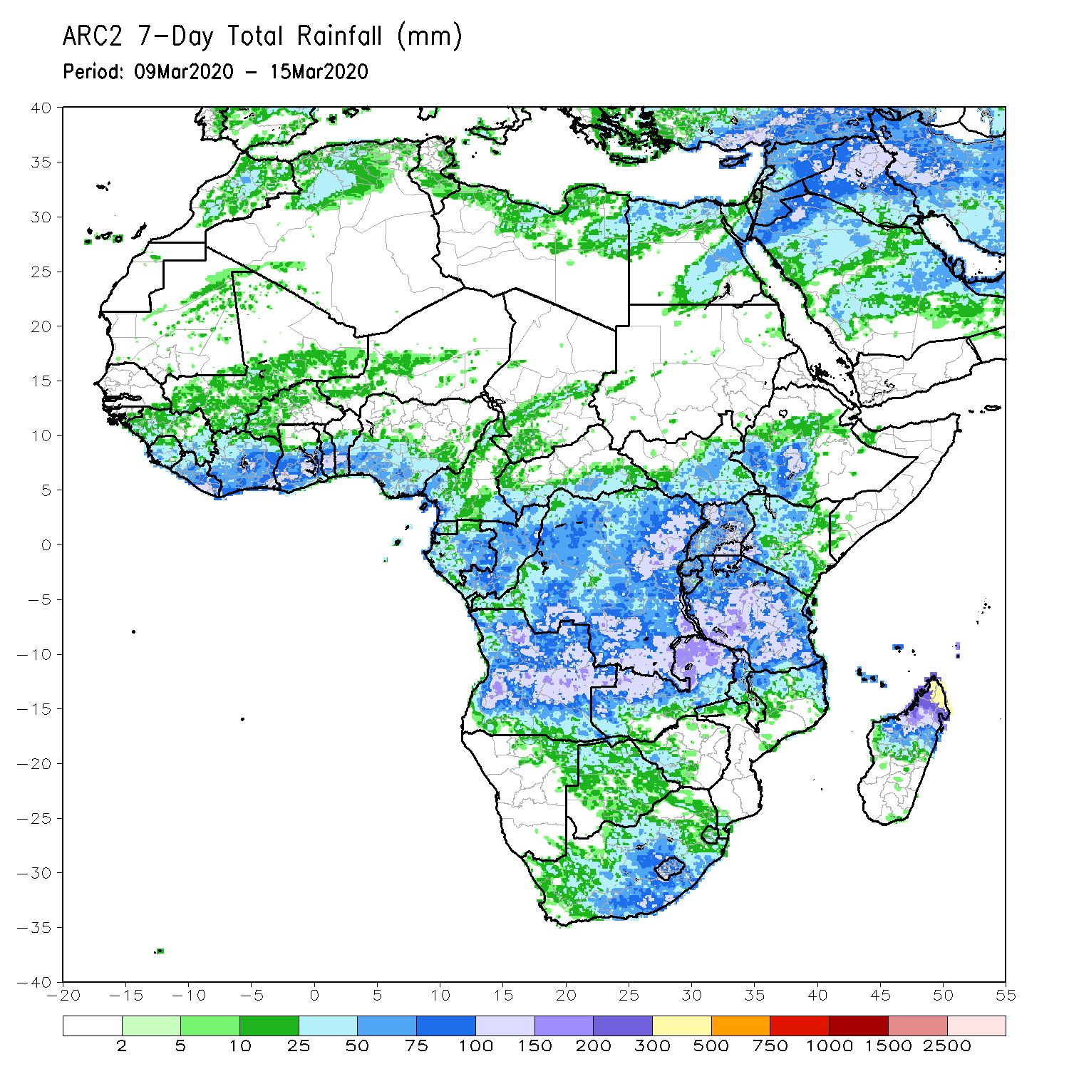
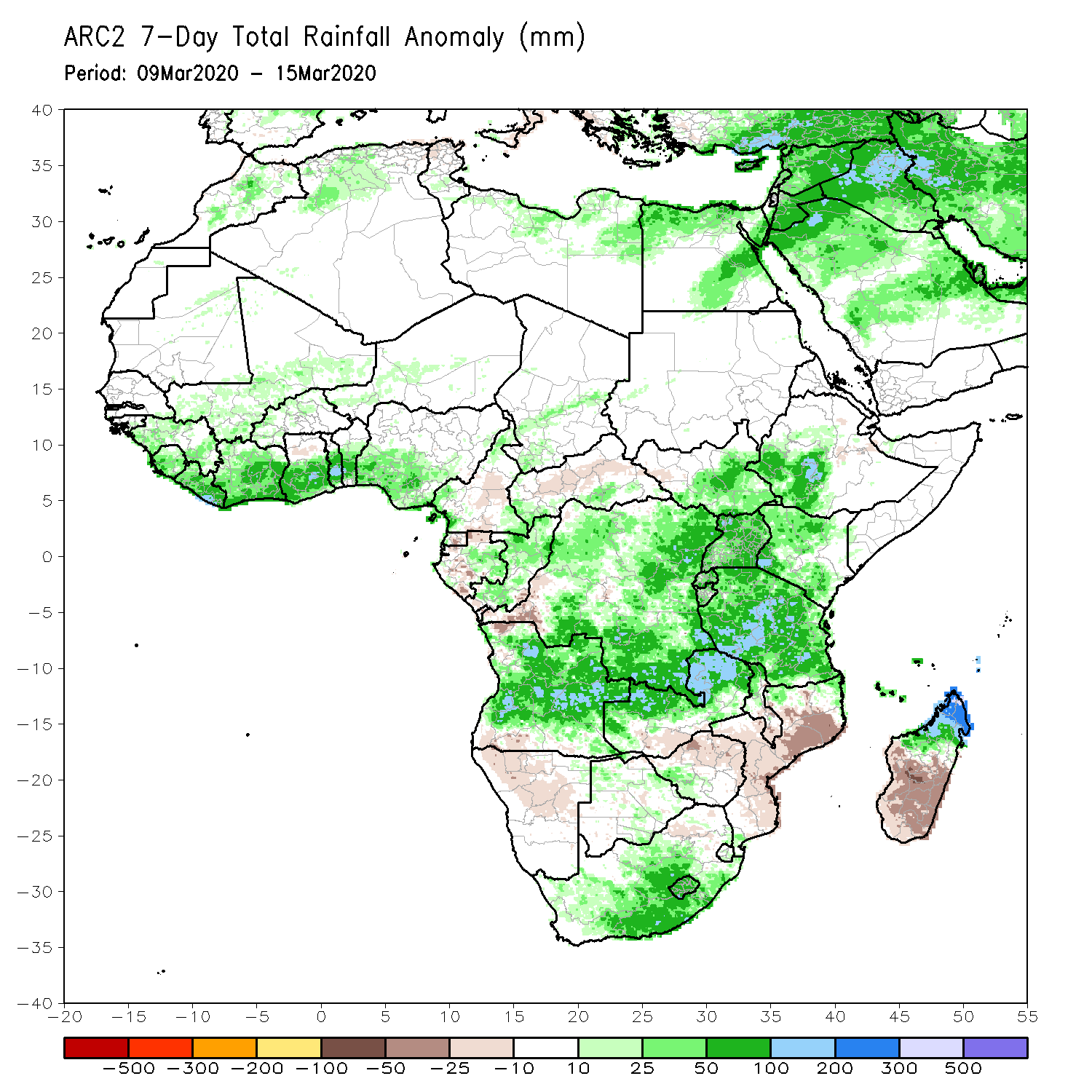
Rainfall Patterns: Last 7 Days
During the past 7 days, weekly rainfall totals exceeded 100mm over local areas in the Gulf of Guinea region, many parts of Angola, southern and eastern DRC, northern and eastern Zambia, portions of Uganda and Tanzania, local areas in South Africa, and northern Madagascar, with rainfall amount in excess of 150mm recorded over parts of northern Madagascar. Rainfall was above-average along the Gulf of Guinea coast, Congo, southern CAR, Angola, much of DRC, South Sudan, southwestern Ethiopia, parts of Kenya, Tanzania, northern Zambia, South Africa and northern Madagascar. Rainfall surpluses exceeded 100mm over local areas in Angola, DRC, Uganda, Tanzania, and northern Madagascar.
Rainfall was slightly below average over parts of Cameroon, Gabon, Namibia, Zimbabwe, southern Zambia, southern Malawi, Mozambique and southern Madagascar.
Notes:
Week-1 outlooks call for an increased chance for above-average rainfall over parts of Central Angola and southwestern DRC, southwestern Kenya, most of Tanzania, northern Zambia, northern Malawi and southern South Africa. In contrast, there is an increased chance for below-average rainfall over parts of northern Namibia, parts of western Botswana, part of northern Mozambique and a broad area form central to southern Madagascar.

Slide 5
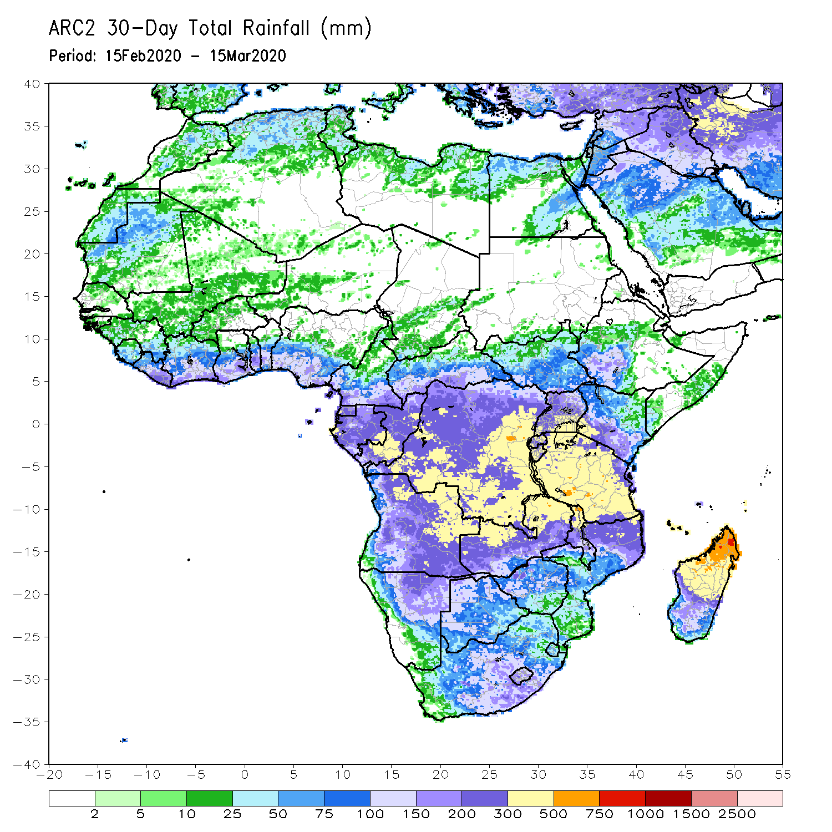
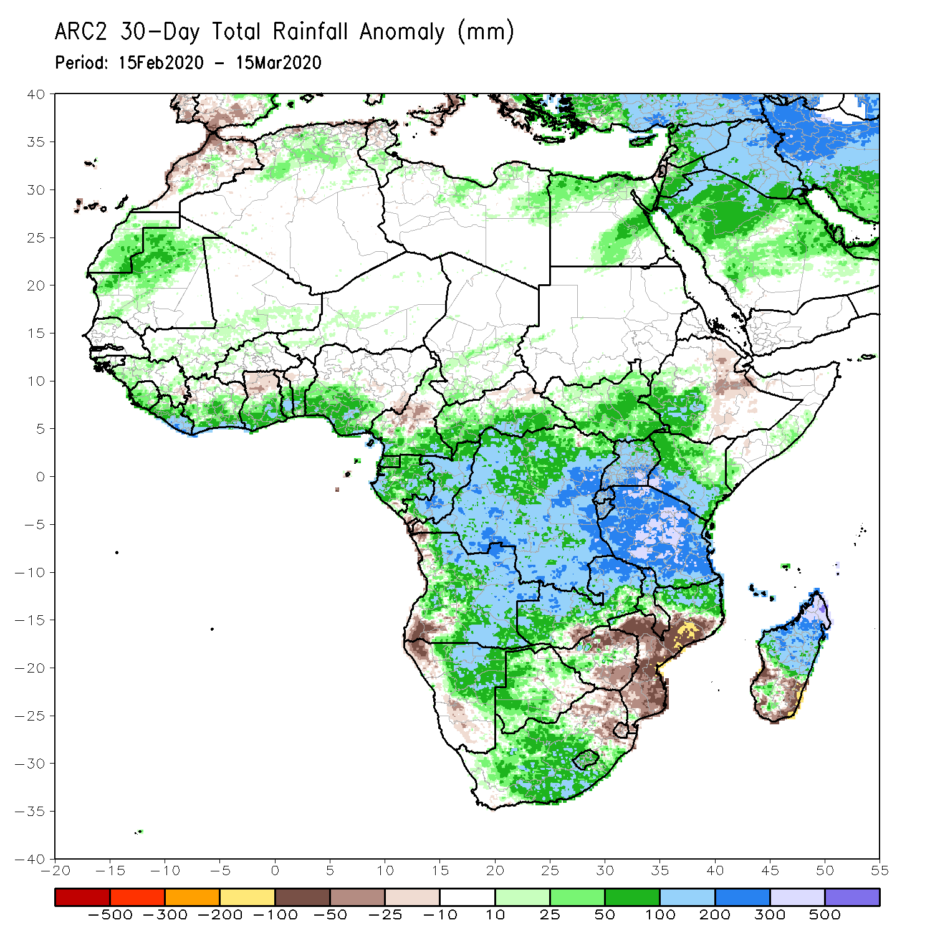
Rainfall Patterns: Last 30 Days
During the past 30 days, rainfall totals exceeded 300mm over local areas in Congo, parts of DRC, parts of eastern Angola, many parts of Tanzania, northern Zambia, northern Malawi, and northern Madagascar, with rainfall totals in excess of 500mm observed over local areas in central Tanzania and northern Madagascar. Rainfall was above-average along the Gulf of Guinea coast, Gabon, Congo, southern CAR, much of DRC, South Sudan, Uganda, southwestern Ethiopia, much of Kenya, Tanzania, Zambia, many parts of Angola, Namibia, Malawi, northern Mozambique, western and central South Africa, Lesotho, and many parts of Madagascar. Rainfall surpluses exceeded 300mm over parts of Tanzania and northern Madagascar
Rainfall was below-average over western Angola, central and southern Mozambique, local areas in Namibia and eastern South Africa, much of Eswatini, and local areas in southern Madagascar.
Notes:
5

Slide 6
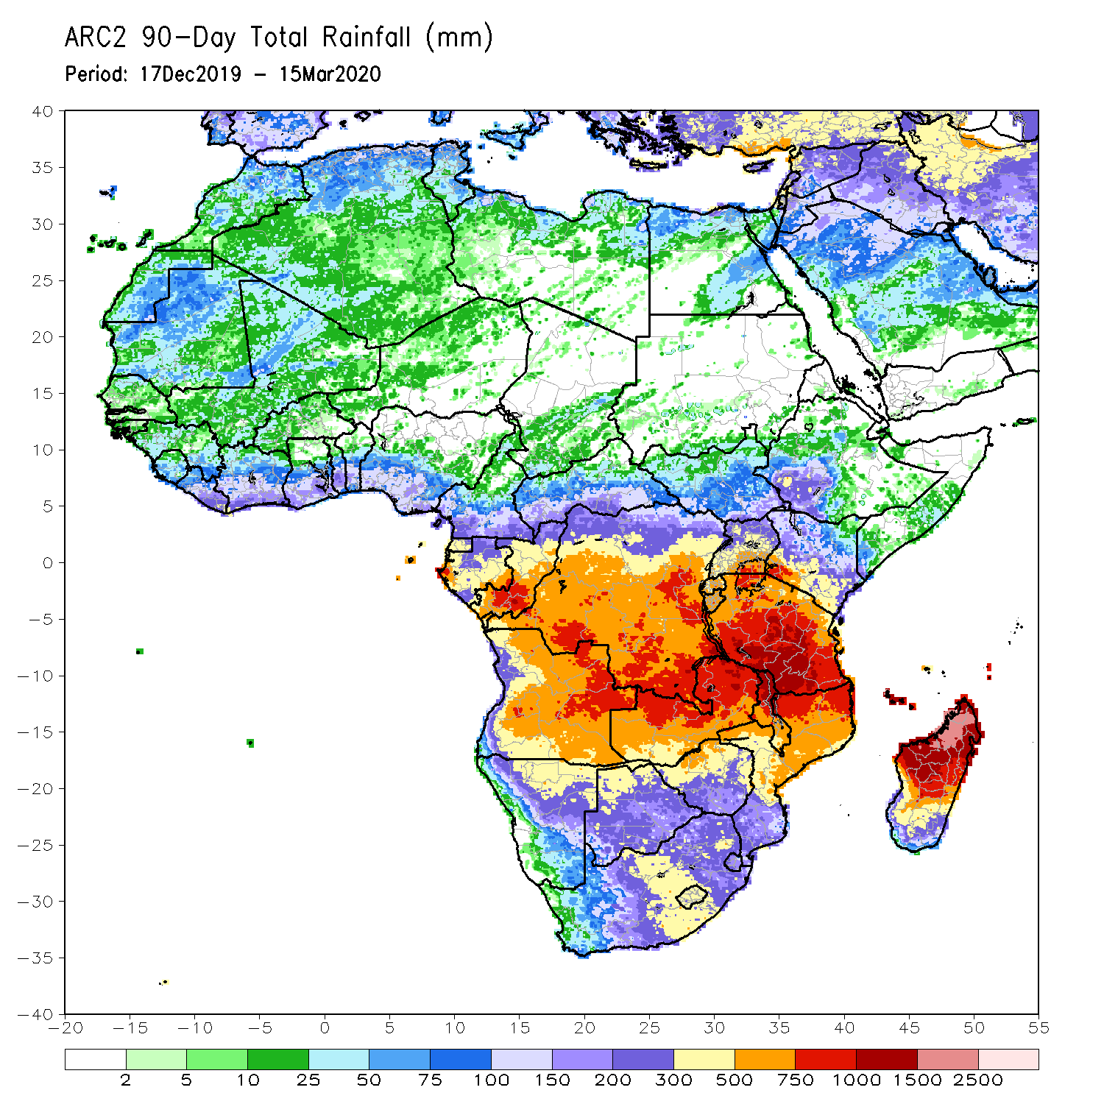
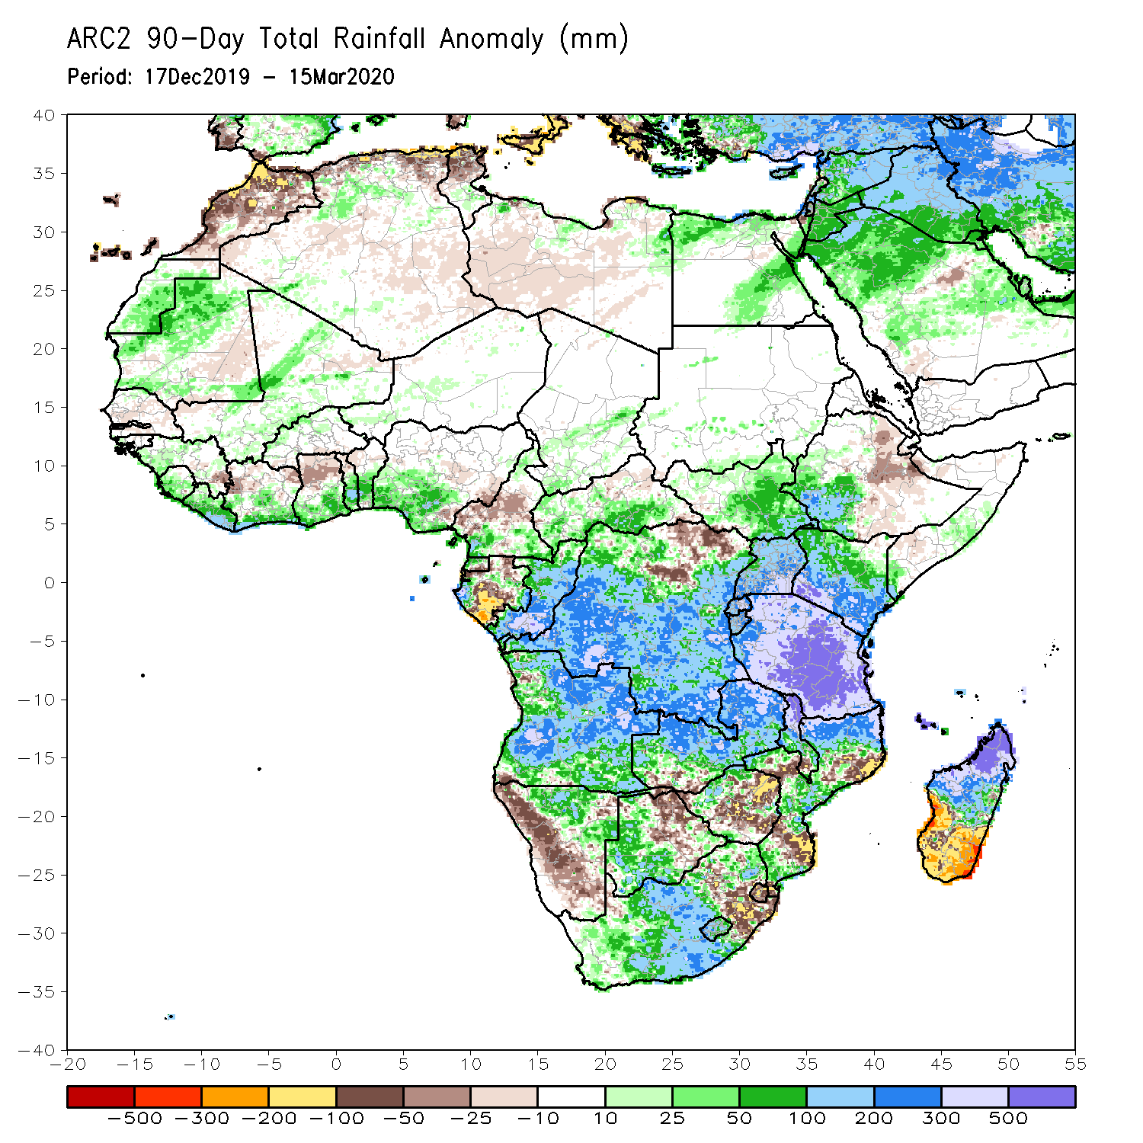
Rainfall Patterns: Last 90 Days
During the past 90 days, rainfall totals exceeded 750mm over parts of southern Congo and local areas in DRC, local areas in eastern Angola, Tanzania, northern Zambia, northern Malawi, northern Mozambique, and central and northern Madagascar. Rainfall was above-average along the Gulf of Guinea coast, parts of CAR, South Sudan, much of Congo and DRC, Rwanda, Burundi, Uganda, Kenya, southwestern Ethiopia, much of Tanzania, many parts of Angola, many parts of Zambia, eastern Malawi, parts of Namibia, western Botswana, central South Africa, many parts of Mozambique, and northern Madagascar. Rainfall surpluses exceeded 500mm over local areas in central Tanzania and northern Madagascar.
Local areas in the Gulf of Guinea countries including Gabon and western Cameroon, parts of northeastern of DRC, western Namibia, parts of Zimbabwe and northeastern Botswana, local areas in Mozambique, Eswatini and local areas in eastern South Africa, and southern Madagascar had below-average rainfall.
Notes:
6

Slide 7
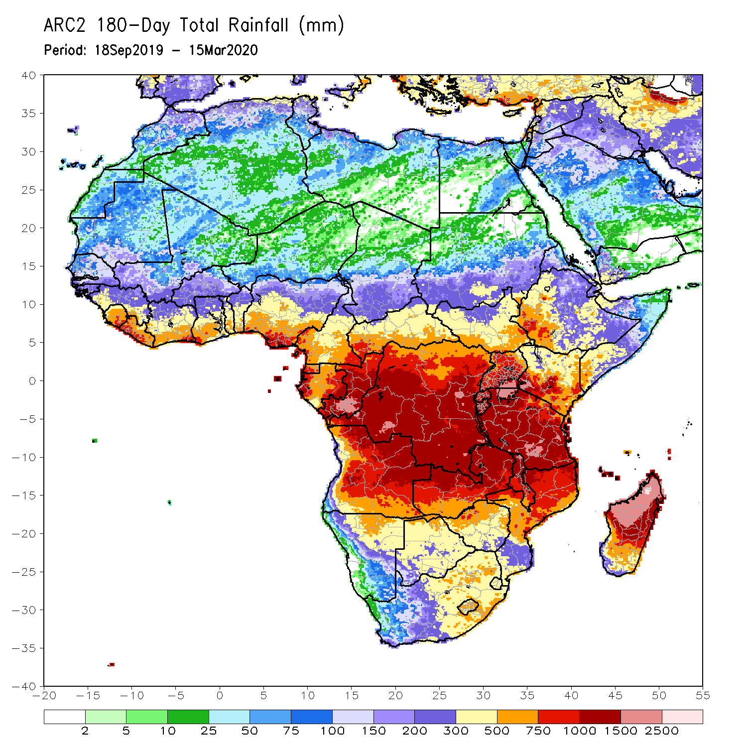
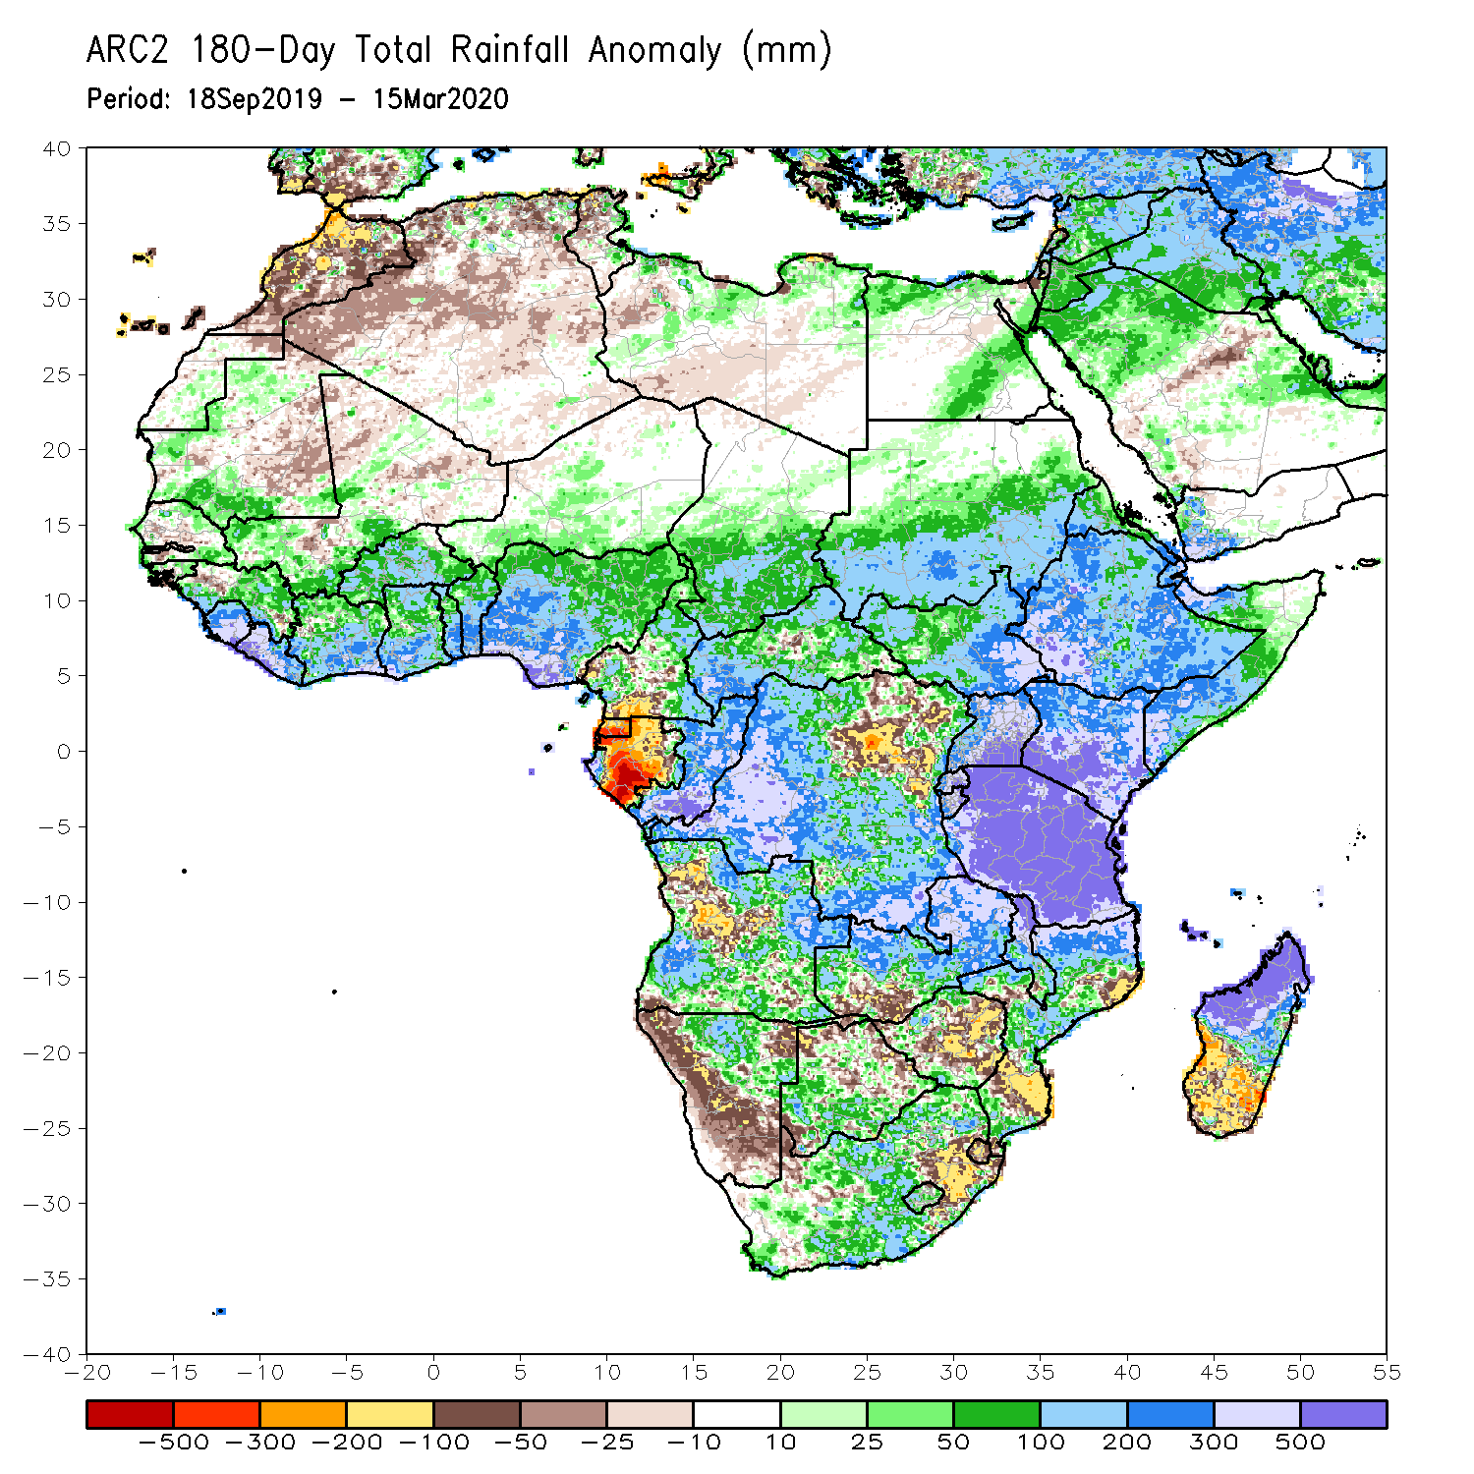
Rainfall Patterns: Last 180 Days
During the past 180 days, rainfall totals in excess of 1500mm were observed over parts of northern Madagascar. Southern Mauritania, portions of Senegal, Guinea-Bissau, Guinea, Sierra Leone, much of southern Mali, Liberia, Cote d’Ivoire, Burkina Faso, Ghana, Togo, Benin, Nigeria, portions of Cameroon, Niger, Chad, portions of CAR and DRC, South Sudan, Sudan, Uganda, Eritrea, Ethiopia, Somalia, Kenya, Tanzania, parts of Angola, parts of northern Namibia, many parts of Zambia, parts of Namibia, Malawi and South Africa, many parts of Mozambique and northern Madagascar had above-average rainfall. Rainfall surpluses exceeded 500mm over parts of southern Nigeria, local areas in Congo, Kenya, Tanzania, and northern Madagascar.
Below-average rainfall was observed over portions of southern Cameroon, Equatorial Guinea, Gabon, parts of northeastern DRC, parts of Angola, western Namibia, southeastern South Africa, local areas in western Zambia, parts of Botswana and Zimbabwe, parts of southern Mozambique and southern Madagascar. Rainfall deficits exceeded 500mm over parts of Gabon and Equatorial Guinea.
Notes:
7

Slide 8
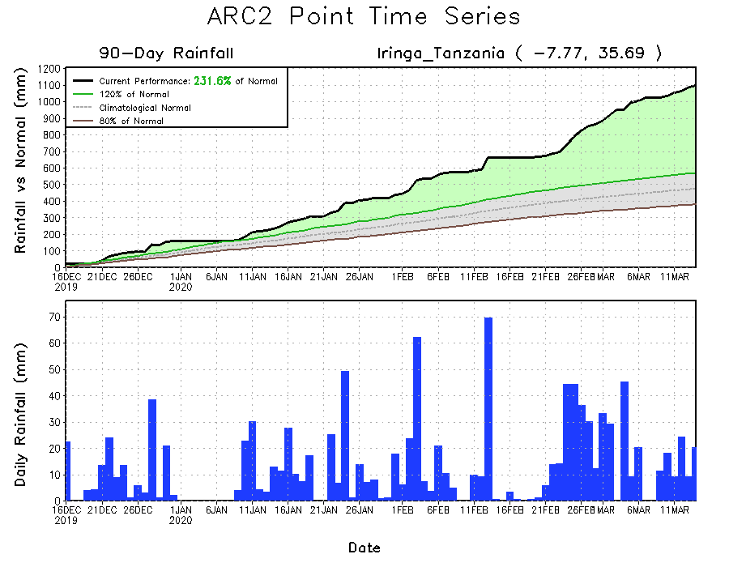
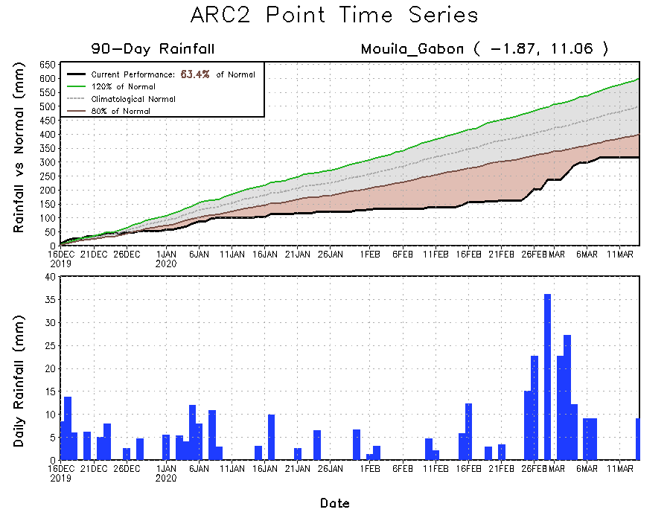
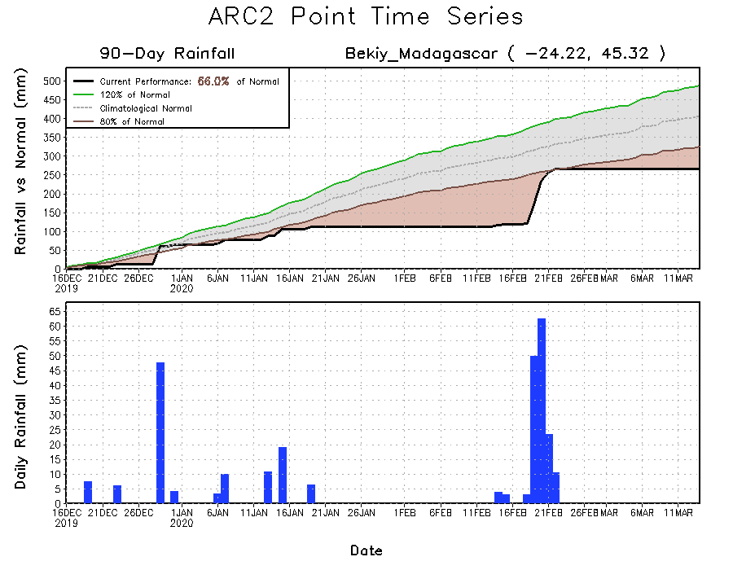
Recent Rainfall Evolution
Daily evolution of rainfall over the last 90 days at selected locations shows that moderate to locally heavy rainfall sustained moisture surpluses over portions of Tanzania (top right). Seasonal total rainfall remained below-average over parts of Gabon(bottom left) and southern Madagascar(bottom right).

Slide 9
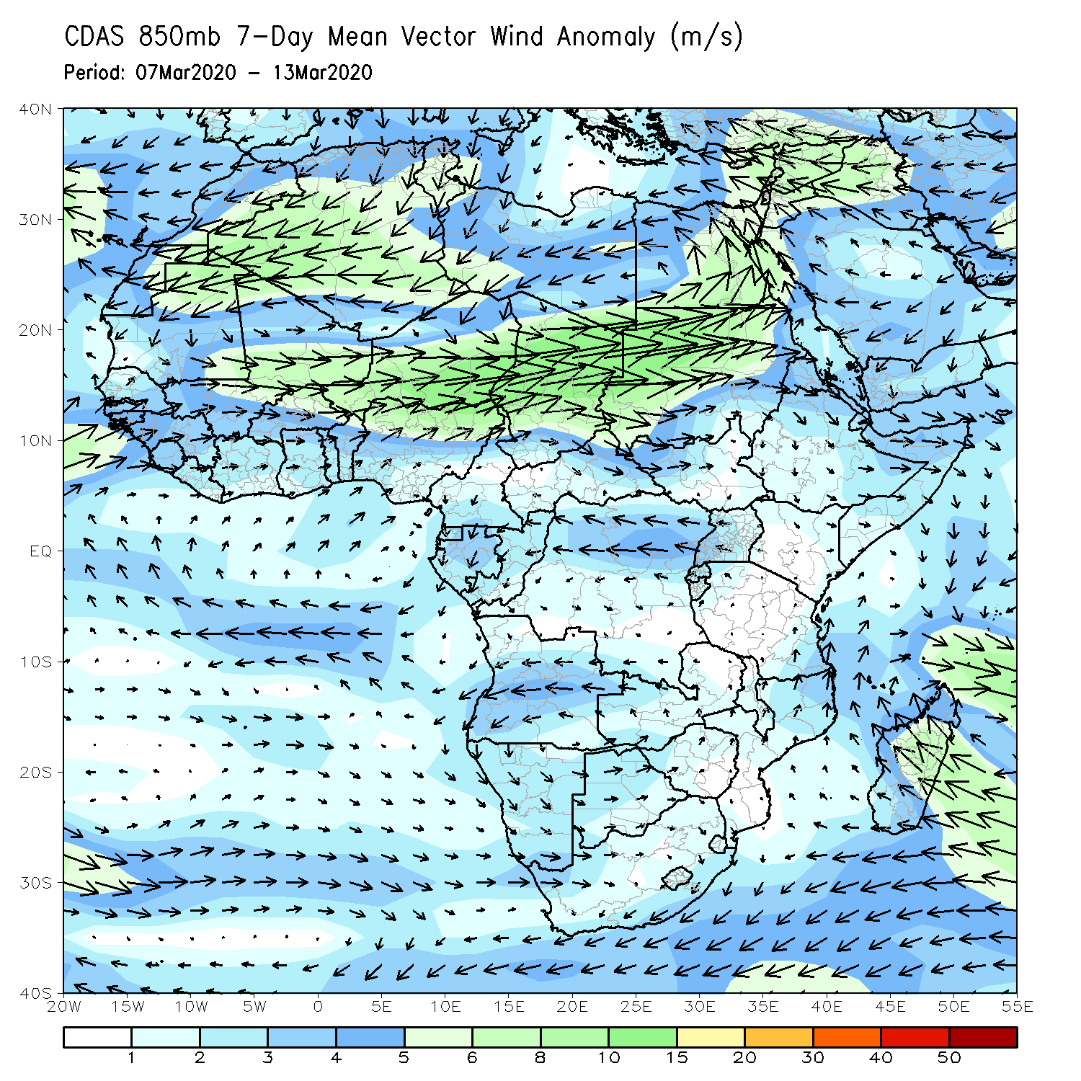
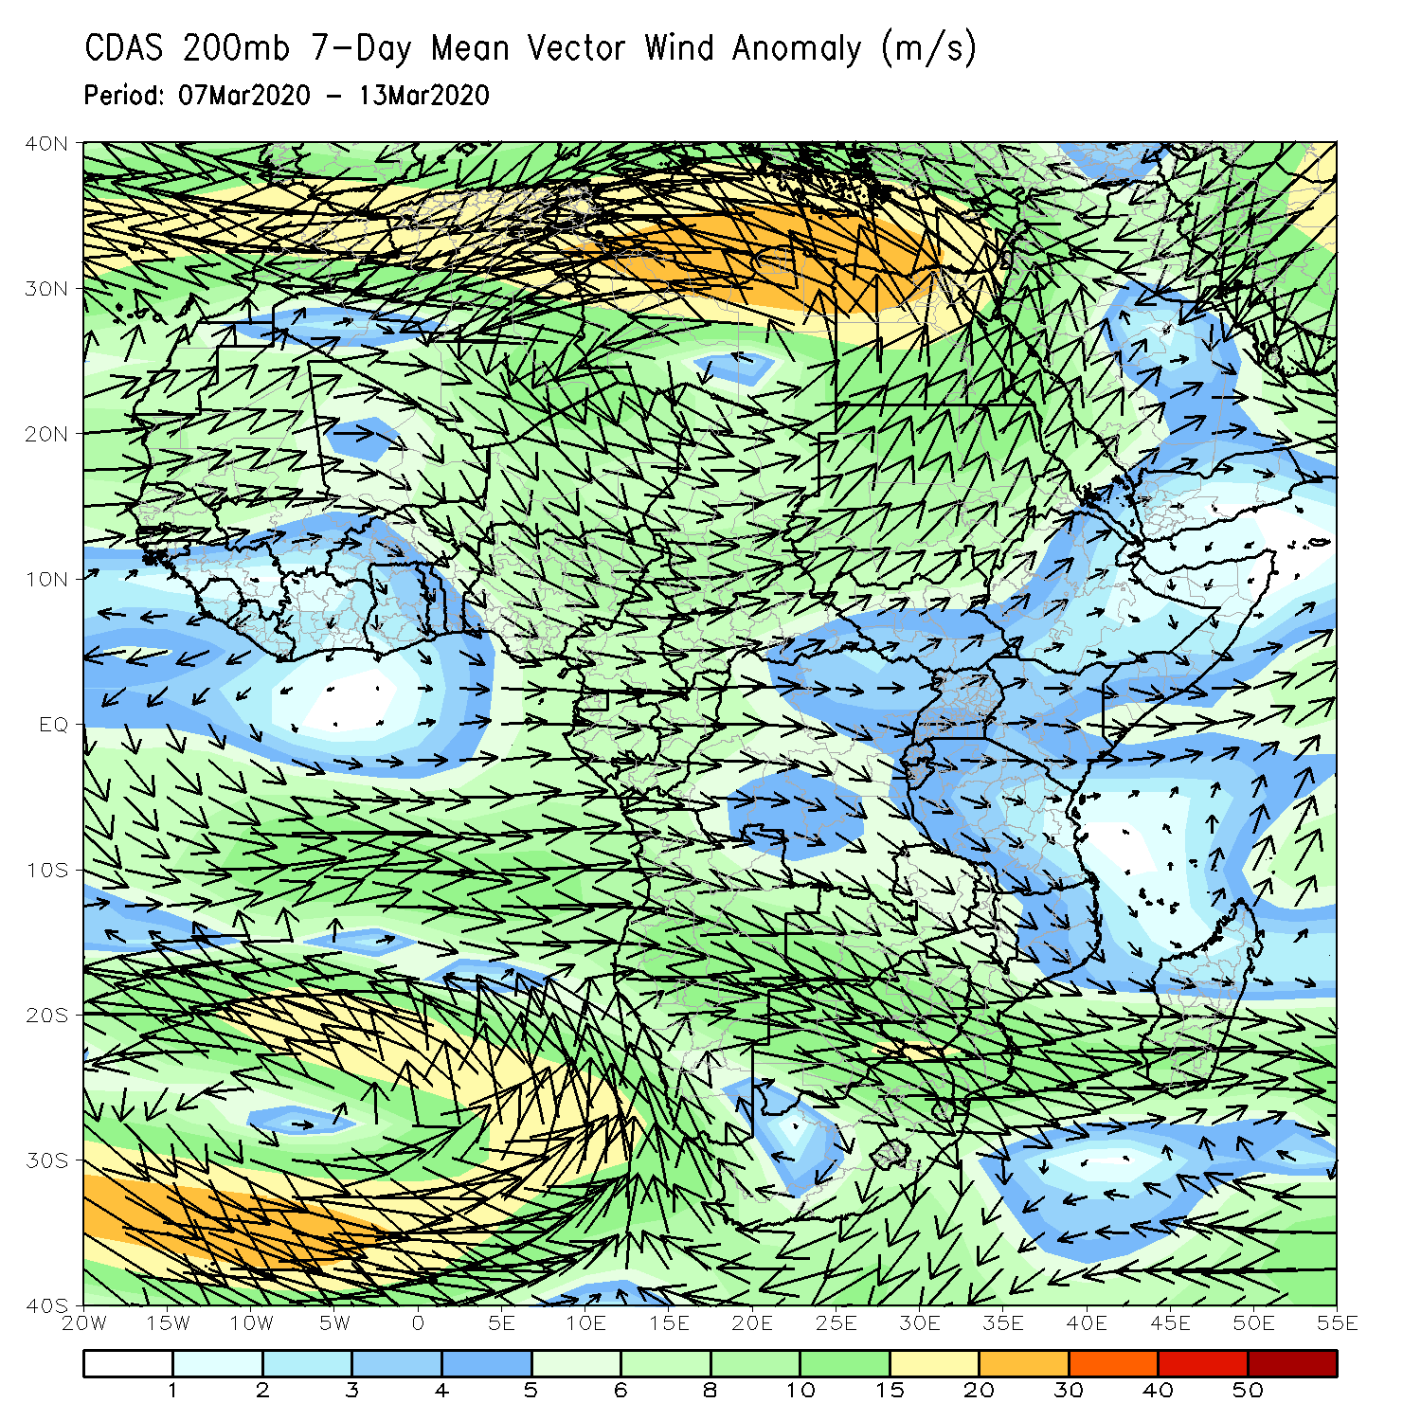
Atmospheric Circulation: Last 7 Days
Lower-level wind anomalies were anti-cyclonic across the western portions of Southern Africa (left panel).

Slide 10
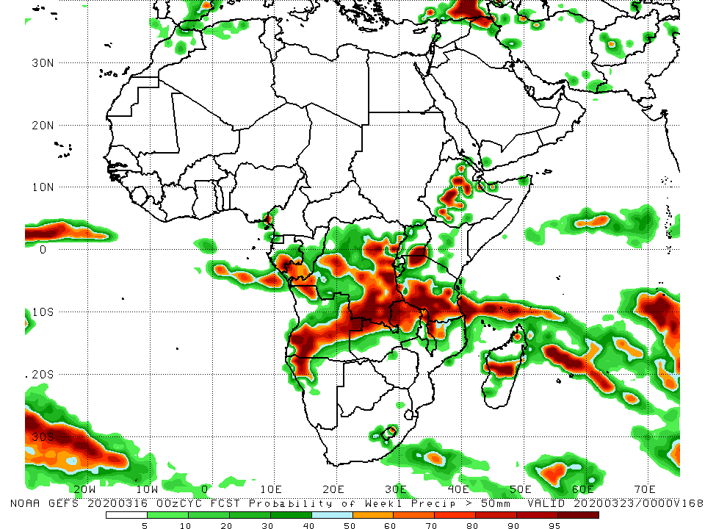
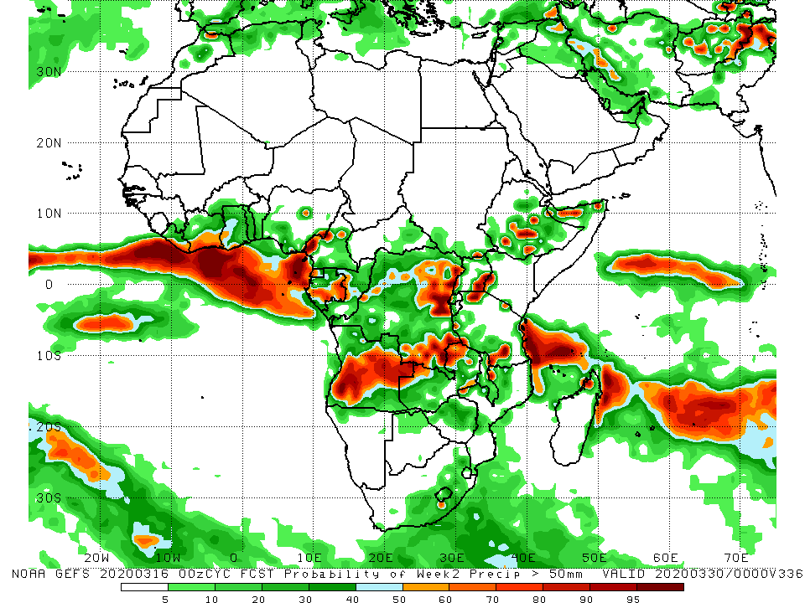
NCEP GEFS Model Forecasts Non-Bias Corrected Probability of precipitation exceedance
Week-1: Valid 17 - 23 March, 2020
Week-2: Valid 24 - 30 March, 2020
For week-1 (left panel), there is an increased chance for weekly rainfall totals to exceed 50mm over Gabon, parts of Angola and DRC, Tanzania, northern Malawi, parts of Ethiopia and Madagascar. For week-2 (right panel), there is an increased chance for weekly rainfall totals to exceed 50mm over parts of eastern Nigeria, Gabon, parts of Angola and DRC, northern Zambia, and local areas in Tanzania and Ethiopia.
Notes:
10

Slide 11
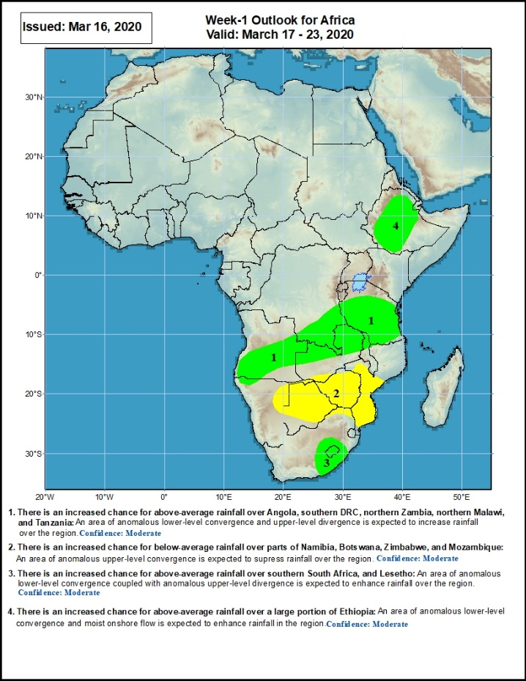
Week-1 Precipitation Outlooks
17 – 23 March, 2020
There is an increased chance for above-average rainfall over Angola, southern DRC, northern Zambia, northern Malawi, and Tanzania: An area of anomalous lower-level convergence and upper-level divergence is expected to enhance rainfall in the region. Confidence: Moderate
There is an increased chance for below-average rainfall over parts of Namibia, Botswana, Zimbabwe, and Mozambique: An area of anomalous upper-level convergence is expected to suppress rainfall over the region. Confidence: Moderate
There is an increased chance for above-average rainfall over southern South Africa, and Lesotho: An area of anomalous lower-level convergence coupled with upper-level divergence is expected to enhance rainfall over the region. Confidence: Moderate
There is an increased chance for above-average rainfall over a large portion of Ethiopia: An area of anomalous lower-level convergence and moist onshore flow is expected to enhance rainfall over the region. Confidence: Moderate
Notes:
11

Slide 12
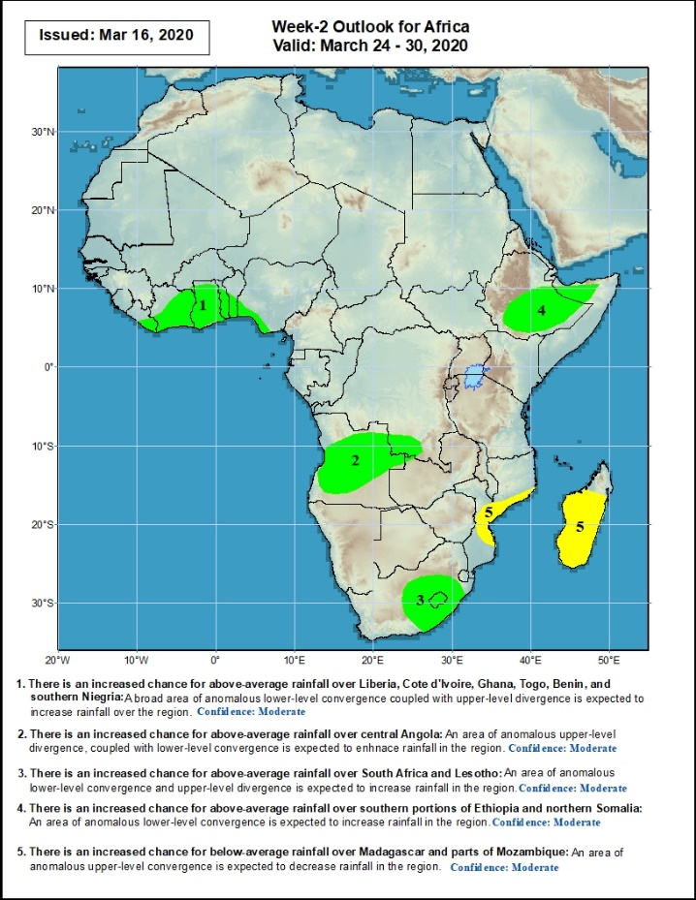
Week-2 Precipitation Outlooks
24 – 30 March, 2020
There is an increased chance for above-average rainfall over Liberia, Cote d'Ivoire, Ghana, Togo, Benin, and southern Nigeria: An area of anomalous lower level convergence and upper-level divergence is expected to enhance rainfall in the region. Confidence: Moderate
There is an increased chance for above-average rainfall over central Angola: An area of anomalous lower-level convergence and upper-level divergence is expected to enhance rainfall in the region. Confidence: Moderate
There is an increased chance for above-average rainfall over South Africa and Lesotho: An area of anomalous lower-level convergence and upper-level divergence is expected to enhance rainfall in the region.. Confidence: Moderate
There is an increased chance for above-average rainfall over southern portions of Ethiopia and northern Somalia: An area of anomalous lower-level convergence is expected to enhance rainfall in the region. Confidence: Moderate
There is an increased chance for below-average rainfall over parts of Mozambique and Madagascar: An area anomalous upper-level convergence is expected to suppress rainfall in the region. Confidence: Moderate
Notes:
12

Slide 13
Summary
During the past 7 days, weekly rainfall totals exceeded 100mm over local areas in the Gulf of Guinea region, many parts of Angola, southern and eastern DRC, northern and eastern Zambia, portions of Uganda and Tanzania, local areas in South Africa, and northern Madagascar, with rainfall amount in excess of 150mm recorded over parts of northern Madagascar. Rainfall was above-average along the Gulf of Guinea coast, Congo, southern CAR, Angola, much of DRC, South Sudan, southwestern Ethiopia, parts of Kenya, Tanzania, northern Zambia, South Africa and northern Madagascar. Rainfall surpluses exceeded 100mm over local areas in Angola, DRC, Uganda, Tanzania, and northern Madagascar. Rainfall was slightly below average over parts of Cameroon, Gabon, Namibia, Zimbabwe, southern Zambia, southern Malawi, Mozambique and southern Madagascar.
During the past 30 days, rainfall totals exceeded 300mm over local areas in Congo, parts of DRC, parts of eastern Angola, many parts of Tanzania, northern Zambia, northern Malawi, and northern Madagascar, with rainfall totals in excess of 500mm observed over local areas in central Tanzania and northern Madagascar. Rainfall was above-average along the Gulf of Guinea coast, Gabon, Congo, southern CAR, much of DRC, South Sudan, Uganda, southwestern Ethiopia, much of Kenya, Tanzania, Zambia, many parts of Angola, Namibia, Malawi, northern Mozambique, western and central South Africa, Lesotho, and many parts of Madagascar. Rainfall surpluses exceeded 300mm over parts of Tanzania and northern Madagascar. Rainfall was below-average over western Angola,, central and southern Mozambique, local areas in Namibia and eastern South Africa, much of Eswatini, and local areas in southern Madagascar.
During the past 90 days, rainfall totals exceeded 750mm over parts of southern Congo and local areas in DRC, local areas in eastern Angola, Tanzania, northern Zambia, northern Malawi, northern Mozambique, and central and northern Madagascar. Rainfall was above-average along the Gulf of Guinea coast, parts of CAR, South Sudan, much of Congo and DRC, Rwanda, Burundi, Uganda, Kenya, southwestern Ethiopia, much of Tanzania, many parts of Angola, many parts of Zambia, eastern Malawi, parts of Namibia, western Botswana, central South Africa, many parts of Mozambique, and northern Madagascar. Rainfall surpluses exceeded 500mm over local areas in central Tanzania and northern Madagascar. Local areas in the Gulf of Guinea countries including Gabon and western Cameroon, parts of northeastern of DRC, western Namibia, parts of Zimbabwe and northeastern Botswana, local areas in Mozambique, Eswatini and local areas in eastern South Africa, and southern Madagascar had below-average rainfall.
Week-1 outlooks call for an increased chance for above-average rainfall over parts of Angola and southern DRC, northern Zambia, northern Malawi, Tanzania, parts of Ethiopia, eastern South Africa, and Lesotho. In contrast, there is an increased chance for below-average rainfall over parts of eastern Namibia, Botswana, Zimbabwe, and central and southern Mozambique.
Notes:
13

