Slide 1
The African Monsoon Recent Evolution and Current Status Include Week-1 and Week-2 Outlooks
Update prepared by
Climate Prediction Center / NCEP
27 April 2020
For more information, visit:
http://www.cpc.ncep.noaa.gov/products/Global_Monsoons/African_Monsoons/precip_monitoring.shtml

Slide 2
Outline
Highlights
Recent Evolution and Current Conditions
NCEP GEFS Forecasts
Summary

Slide 3
Highlights: Last 7 Days
Many places in Central Africa and the Greater Horn of Africa received above-average rainfall.
Week-1 outlooks call for an increased chance for above-average rainfall over eastern Guinea, Sierra Leone, Liberia, Cote d’Ivoire, northern Ghana, northern Togo, northern Benin, northwestern Nigeria, northern Angola, southern DRC, Rwanda, Burundi, portions of Tanzania, Kenya, eastern and southern Ethiopia and Somalia. In contrast, there is an increased chance for below-average rainfall over eastern CAR, South Sudan and parts of southwestern Ethiopia.

Slide 4
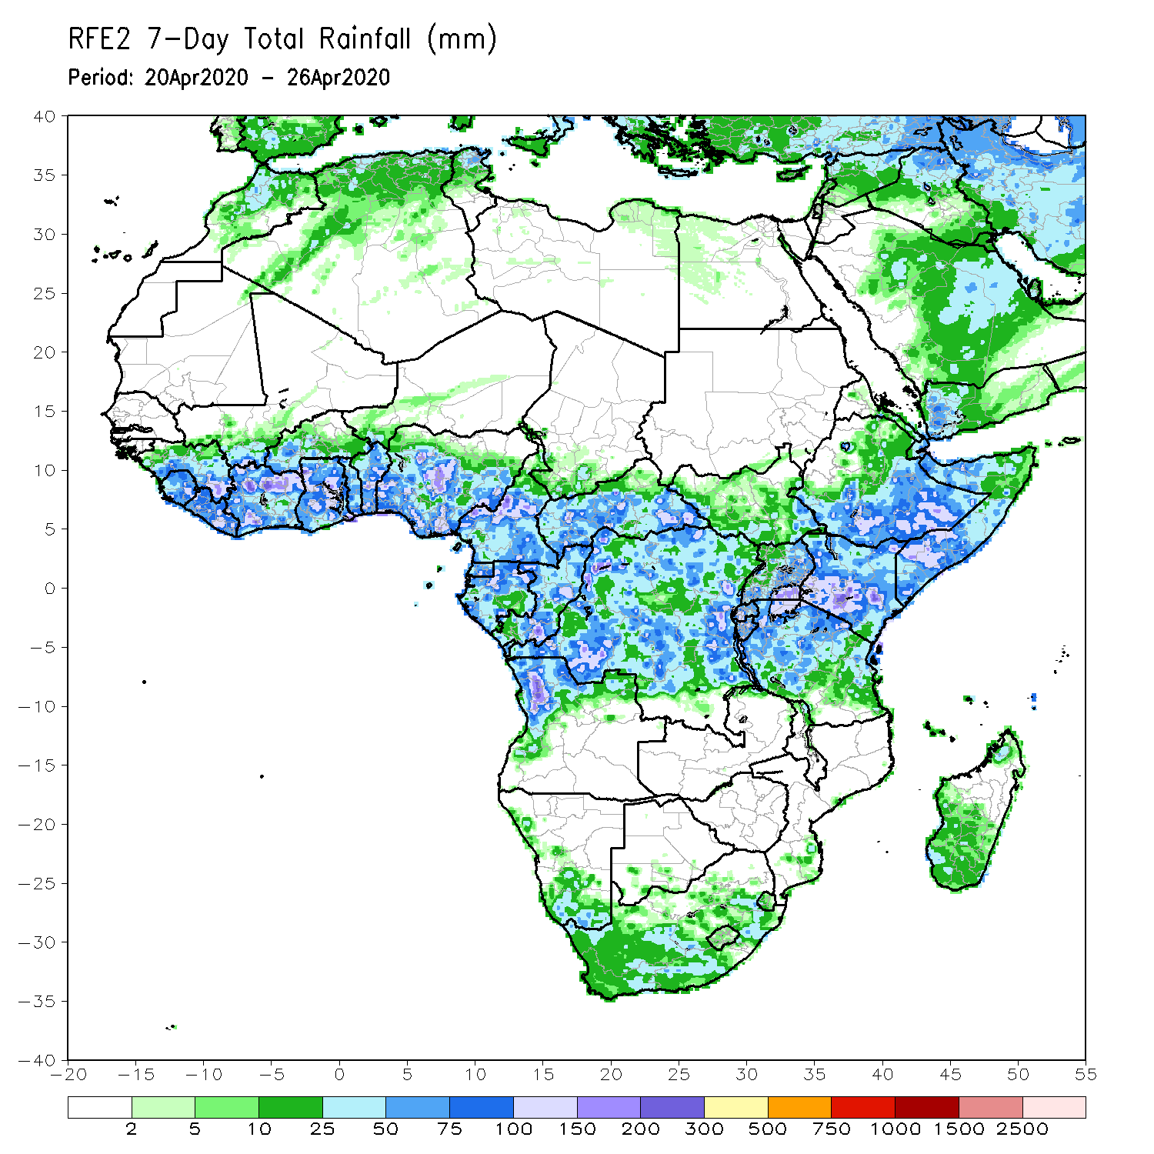
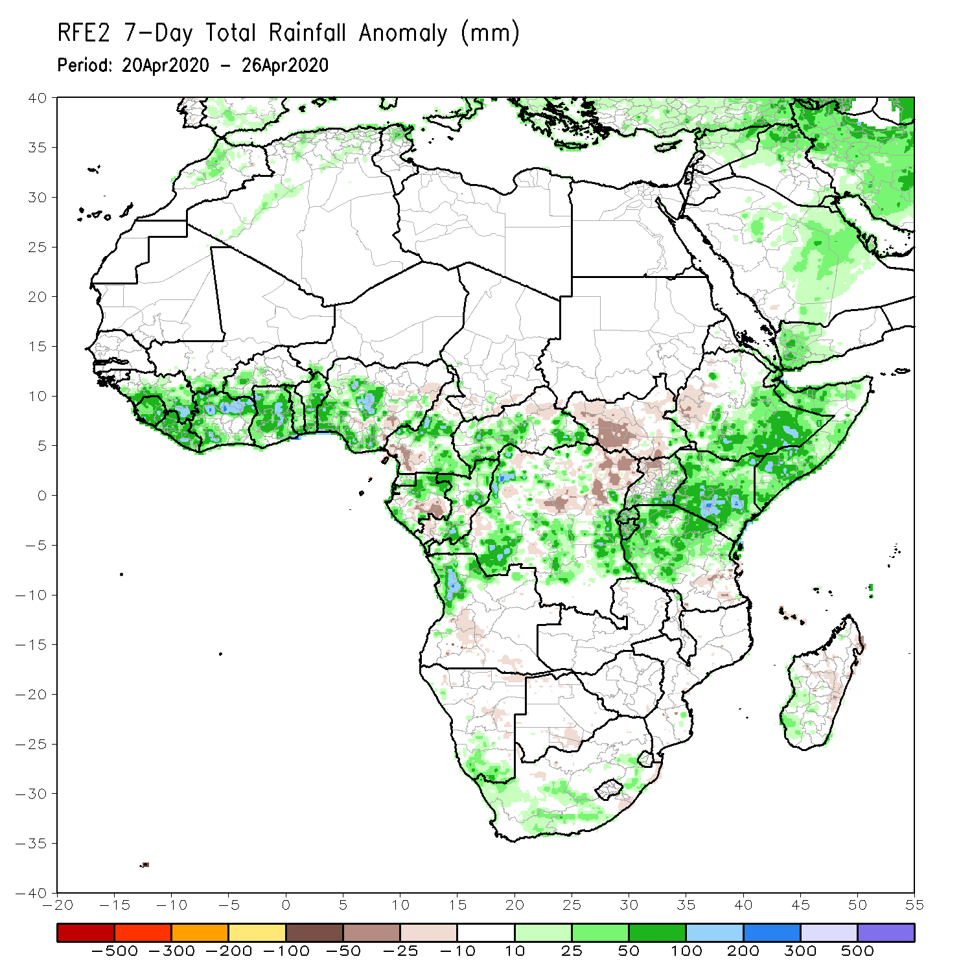
Rainfall Patterns: Last 7 Days
During the past 7 days, rainfall was above-average over parts of Guinea, Sierra Leone, Liberia, Cote d’Ivoire, Ghana, Togo, Benin, Nigeria, portions of Cameroon and Gabon, CAR, parts of DRC, northern Angola, portions of Ethiopia, Somalia, Kenya, Rwanda, Burundi, Tanzania, southern Namibia and parts of South Africa and western Madagascar.
Below-average rainfall was observed over local areas in Nigeria, southwestern Cameroon, parts of Gabon, much of South Sudan, western Ethiopia, portions of DRC and northwestern Uganda.

Slide 5
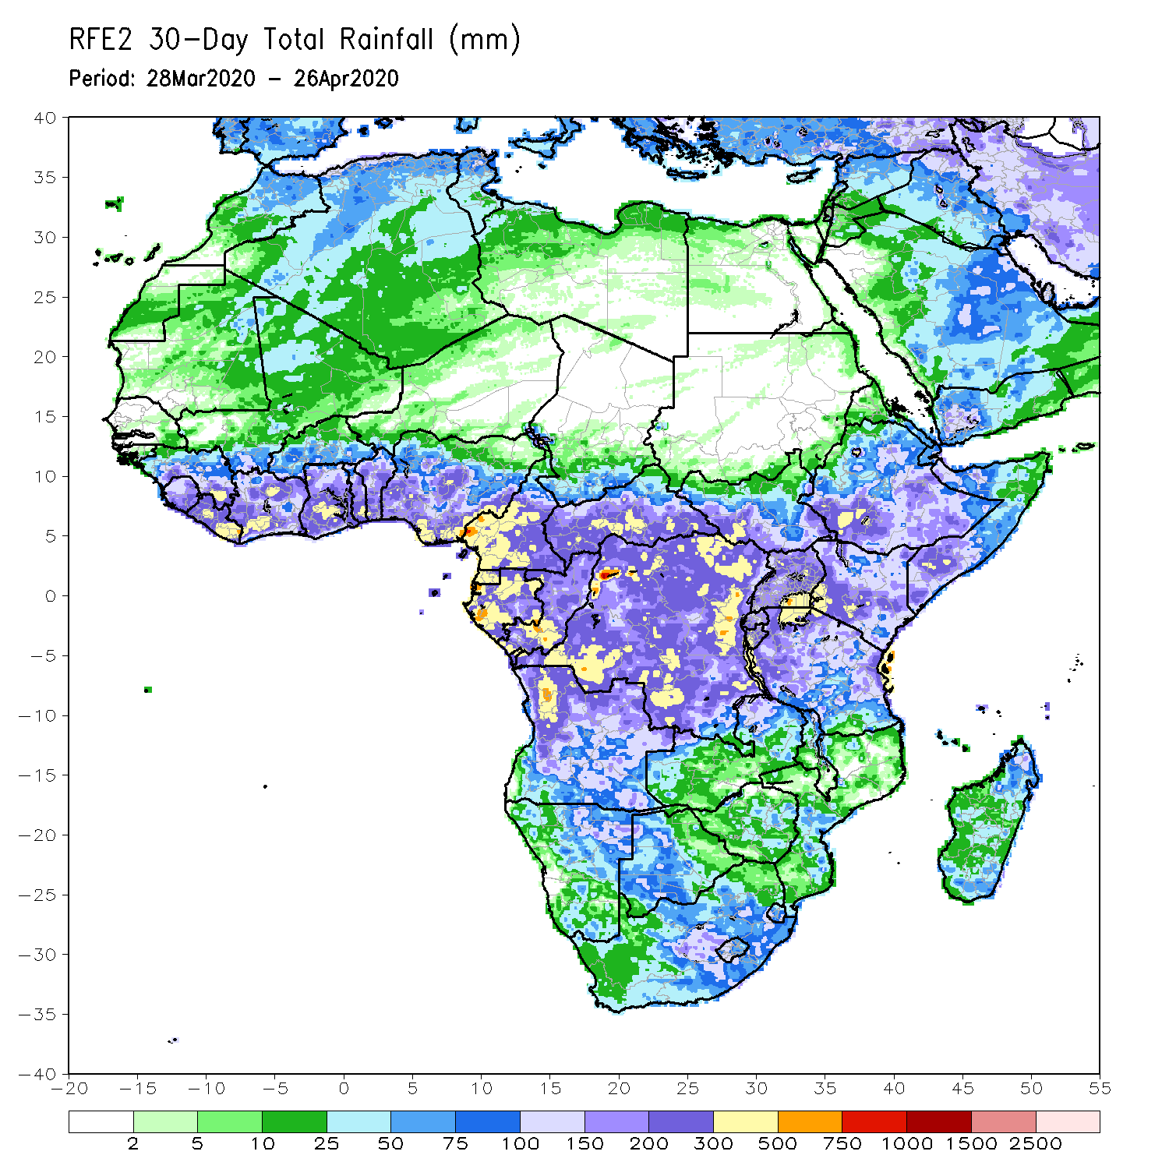
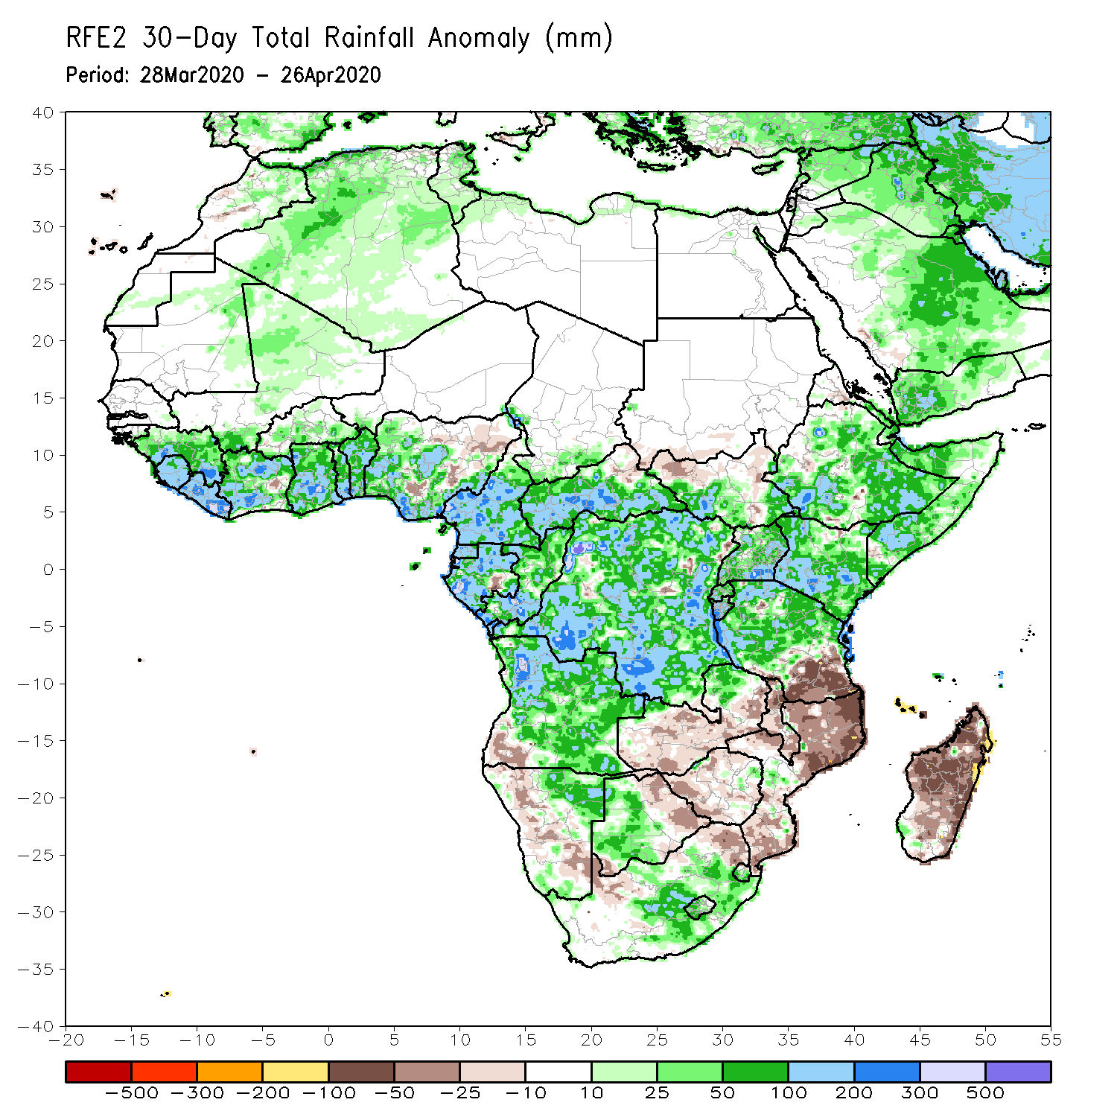
Rainfall Patterns: Last 30 Days
During the past 30 days, rainfall was above-average over many places in the Gulf of Guinea region, including much of Cameroon, Gabon and Congo, CAR, much of DRC, parts of South Sudan, Uganda, many parts of Ethiopia, much of Kenya, Somalia, Rwanda, Burundi, Tanzania, Angola, northeastern Namibia, Botswana, northern Zambia, central South Africa, Lesotho, and Eswatini.
Rainfall was below-average over parts of southwestern Angola, western Namibia, eastern Botswana, southern Zambia, Zimbabwe, Malawi, Mozambique, parts of South Africa, and much of Madagascar.
Notes:
5

Slide 6
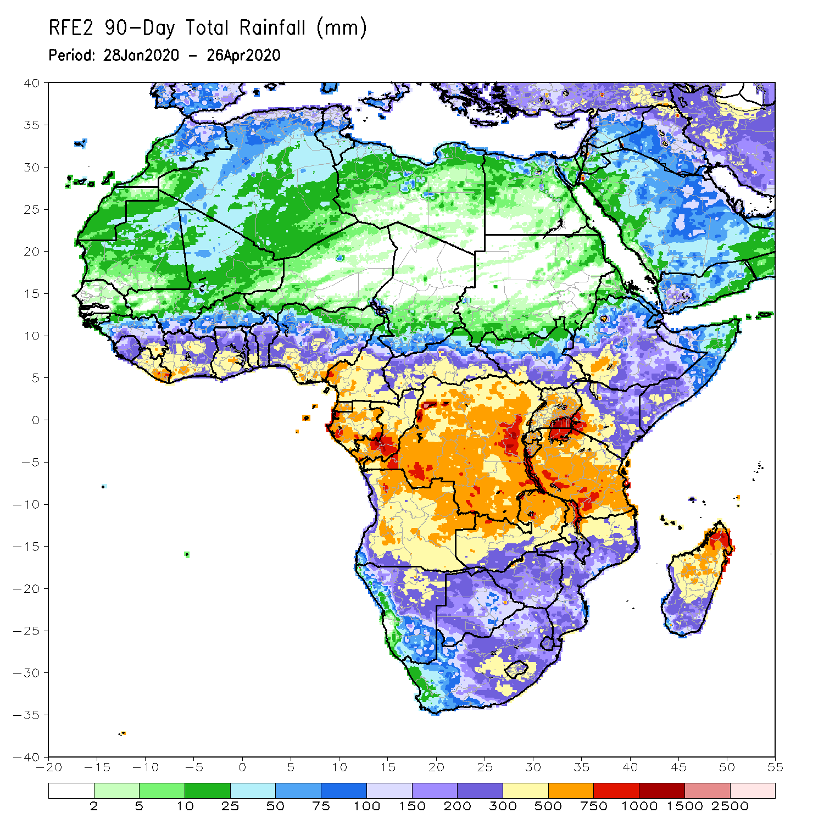
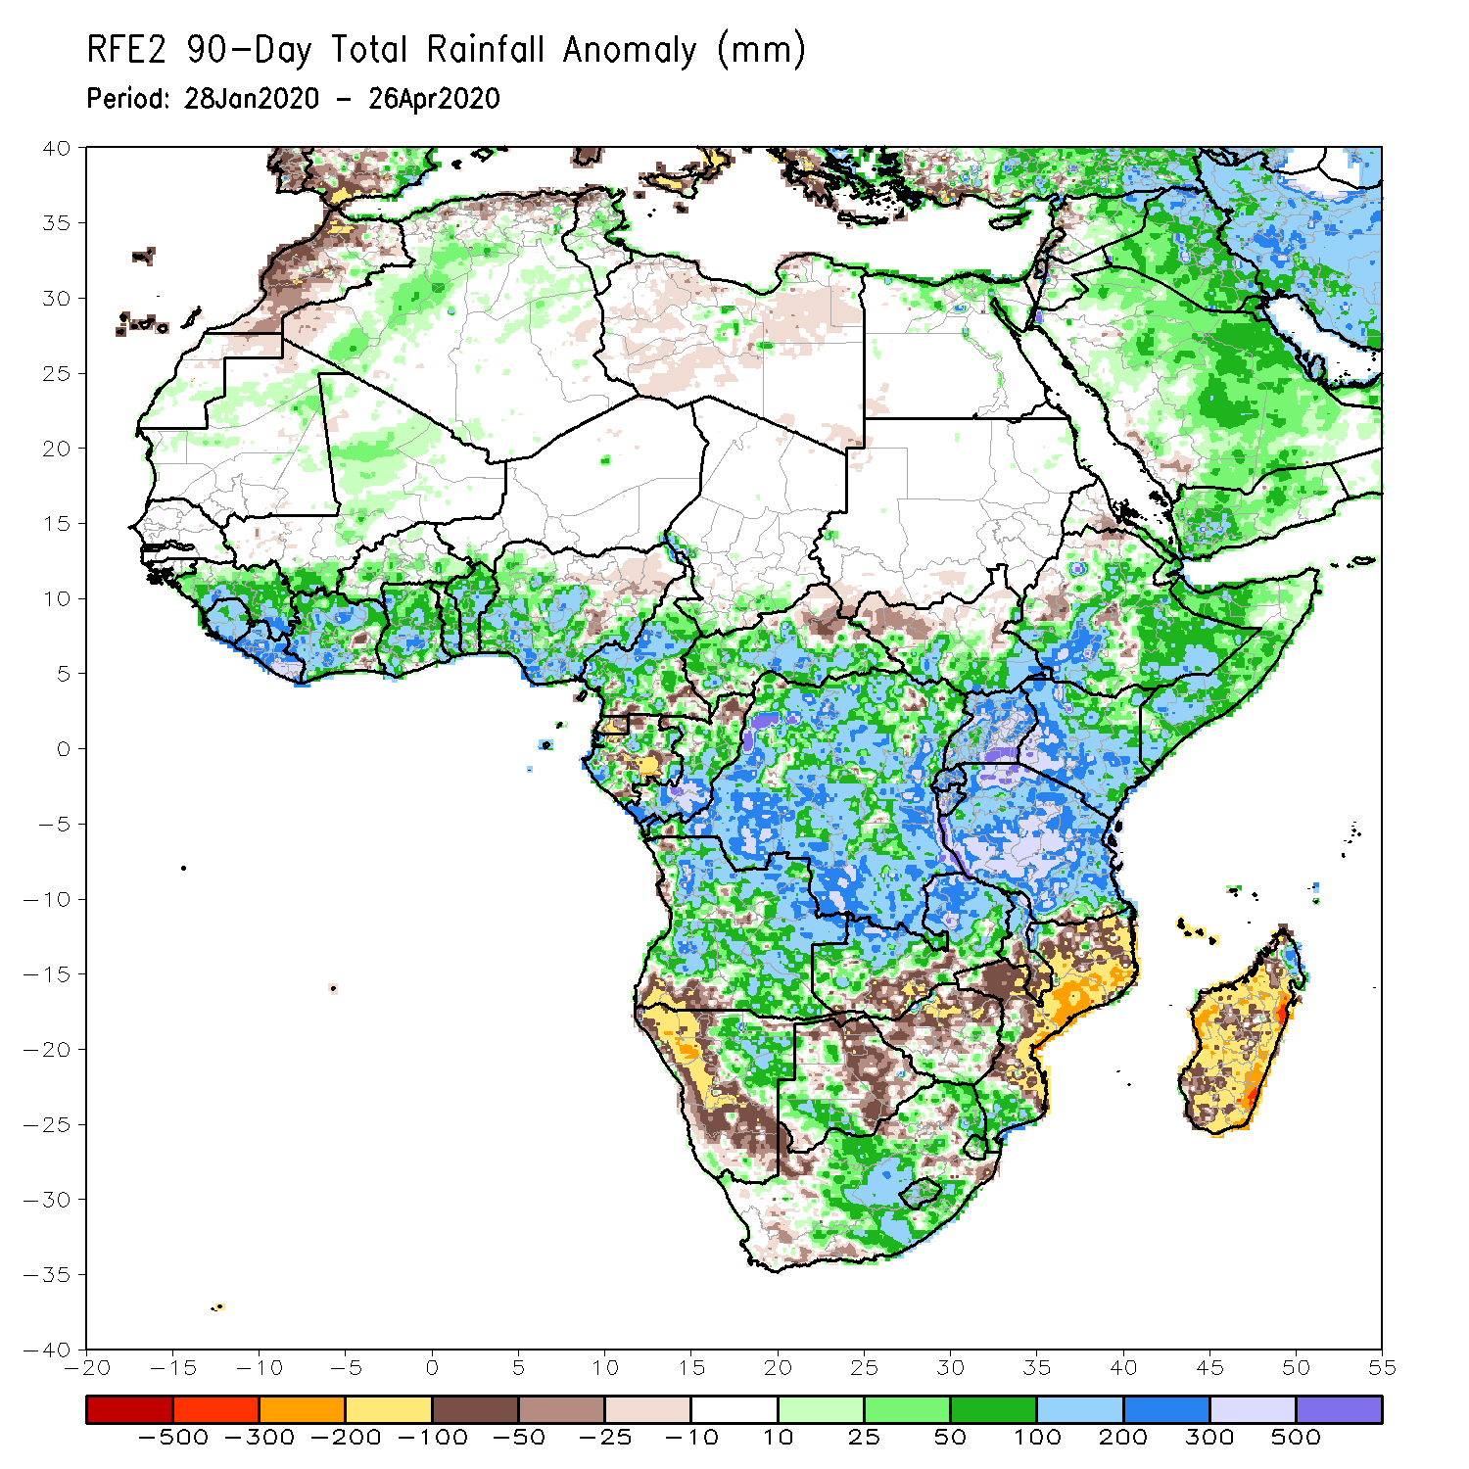
Rainfall Patterns: Last 90 Days
During the past 90 days, rainfall was above-average over many places in the Gulf of Guinea region, including Cameroon, and CAR, parts of South Sudan, southern Congo, many parts of DRC, Rwanda, Burundi, Uganda, Kenya, many parts of Ethiopia, Somalia, much of Tanzania, many parts of Angola and northern Zambia, northern Malawi, northeastern Namibia, western Botswana, portions of South Africa, local areas in southern Mozambique, and northern Madagascar.
Local areas in Cameroon, Equatorial Guinea, Gabon, local areas in CAR, Angola and DRC, local areas in Ethiopia, western and southern Namibia, parts of Botswana, much of Zimbabwe, southern Zambia, portions of South Arica, many parts of Mozambique, and much of Madagascar.
Notes:
6

Slide 7
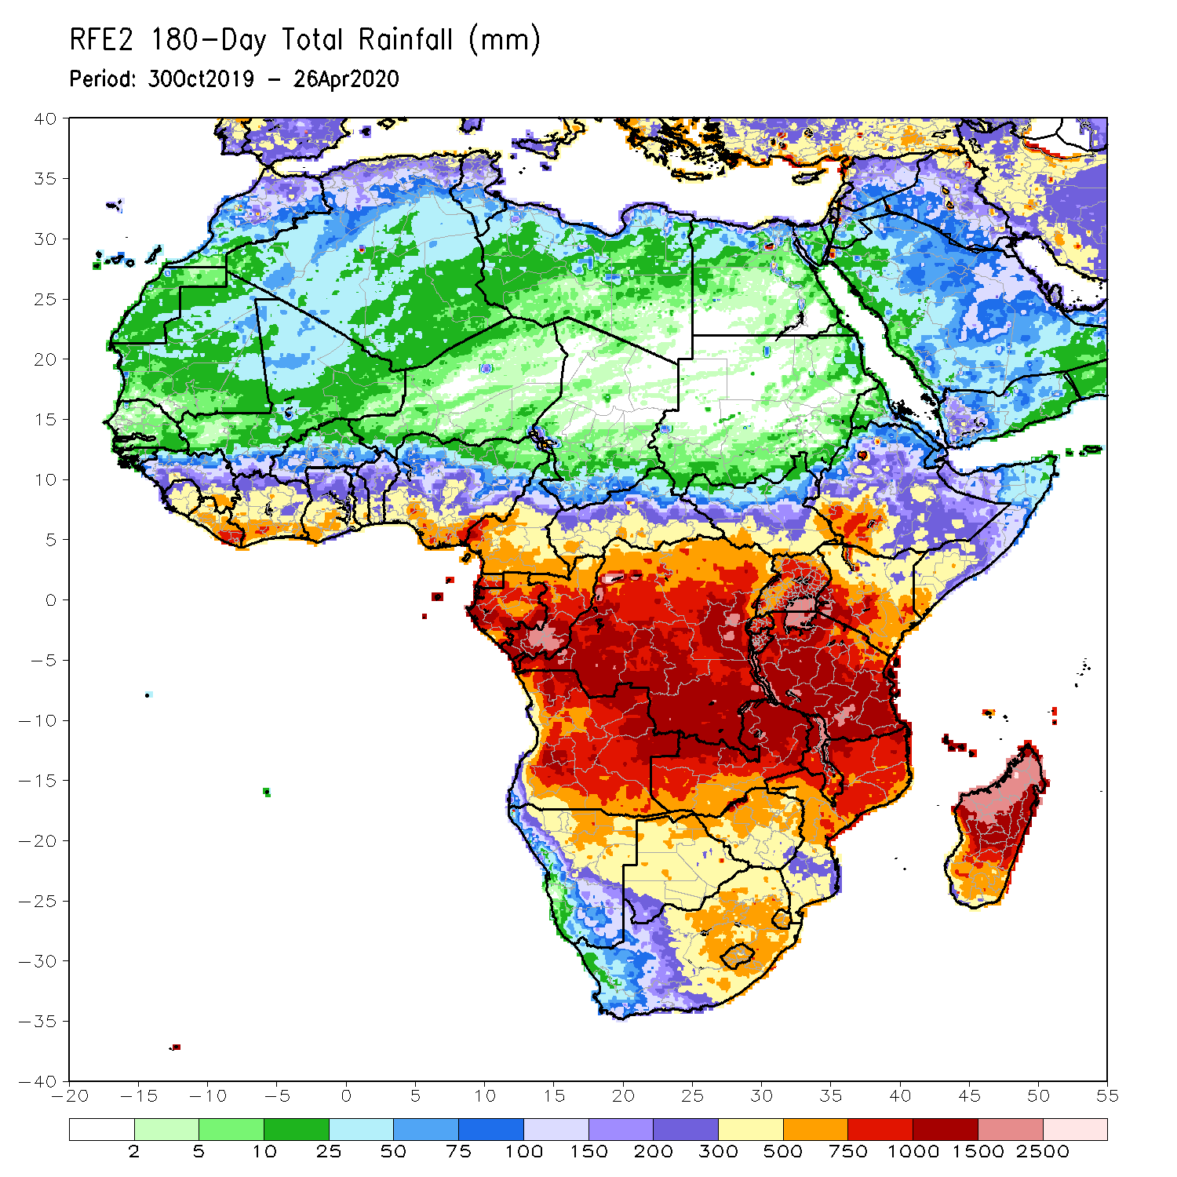
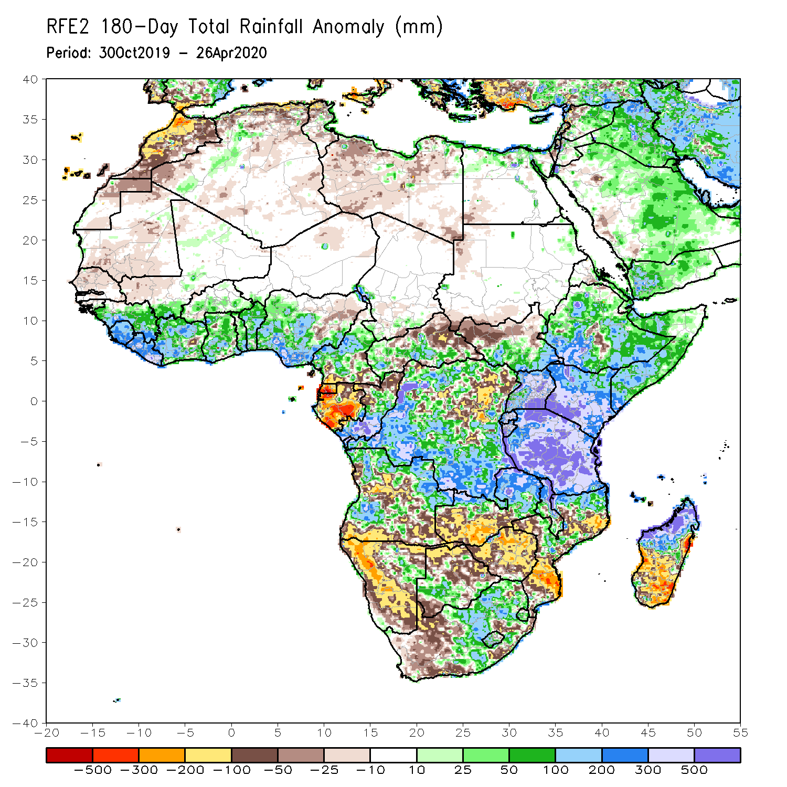
Rainfall Patterns: Last 180 Days
During the past 180 days, eastern Guinea, Sierra Leone, Liberia, many parts of Cote d’Ivoire and Ghana, Togo, Benin, Nigeria, Cameroon, southern Chad, portions of CAR, DRC and South Sudan, Uganda, many parts of Ethiopia, southern Somalia, Kenya, Tanzania, parts of Angola, local areas in Namibia, parts of Zambia, Malawi, parts of South Africa, portions of Mozambique and northern Madagascar had above-average rainfall.
Below-average rainfall was observed over portions of Senegal, Guinea-Bissau, western Mali, Equatorial Guinea, Gabon, parts of northeastern DRC, parts of Angola, Namibia, South Africa, western Zambia, many parts of Botswana and Zimbabwe, parts of Mozambique and southern Madagascar.
Notes:
7

Slide 8
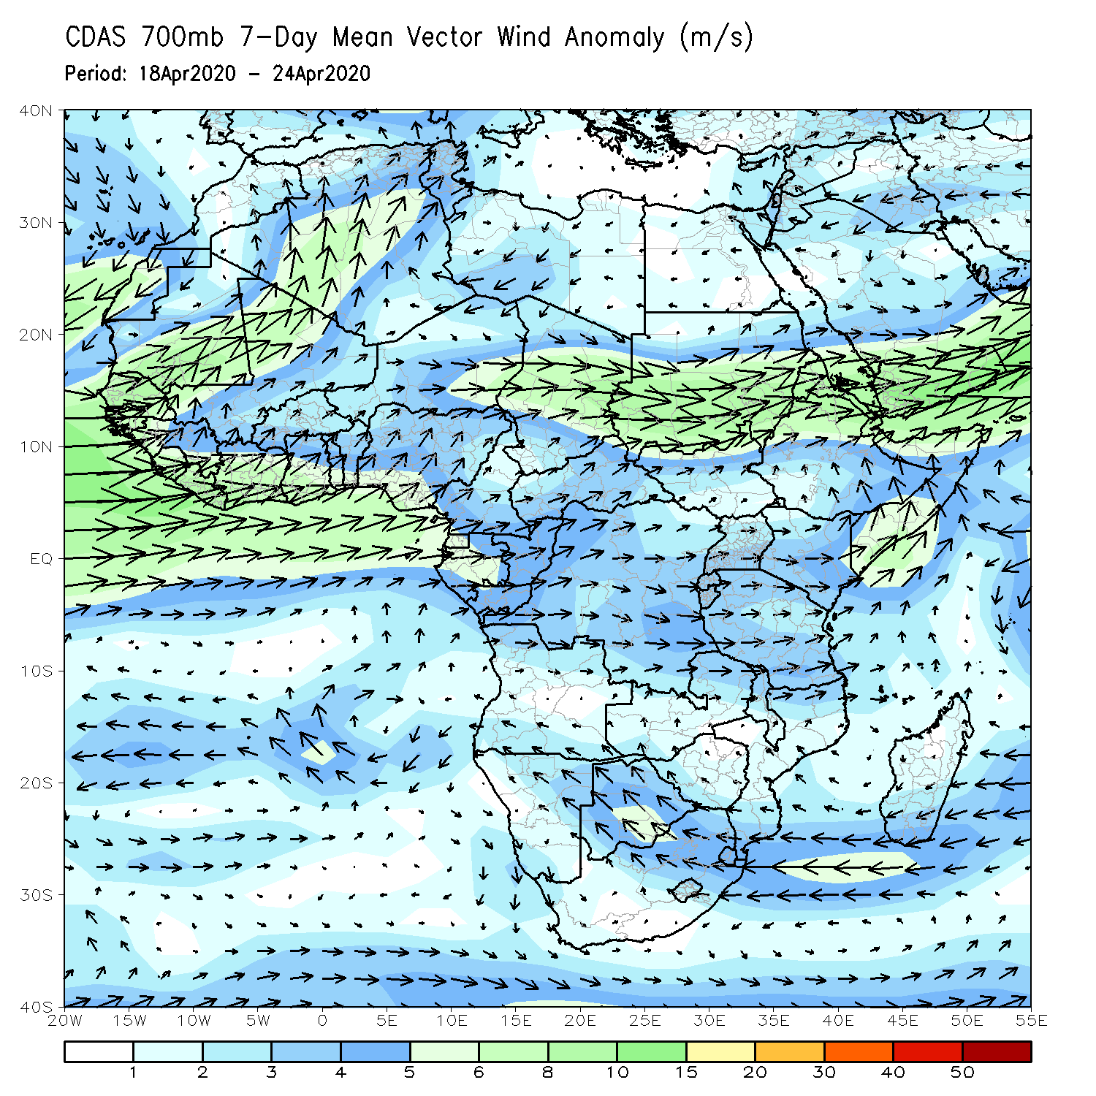
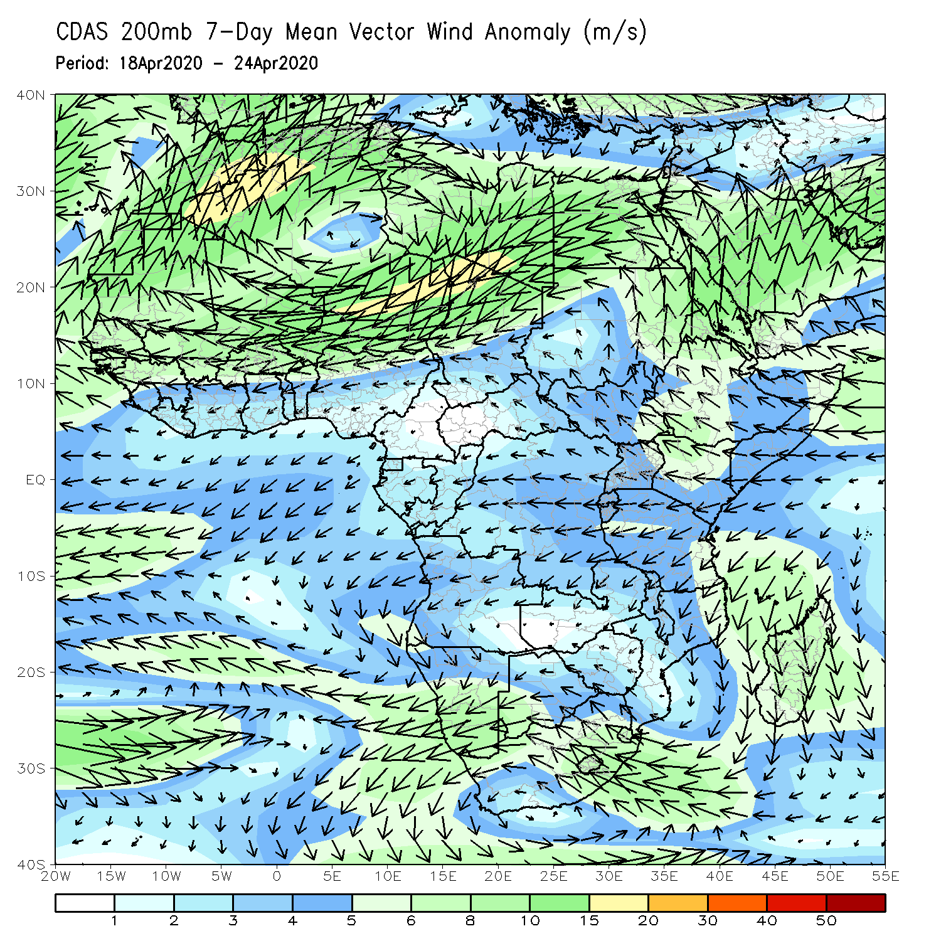
Atmospheric Circulation: Last 7 Days
A broad area anomalous lower-level westerly flow prevailed across Central and East Africa (left panel).

Slide 9
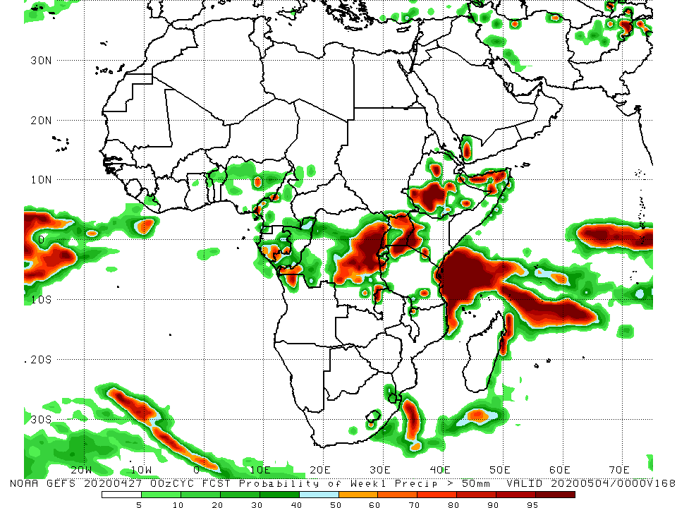
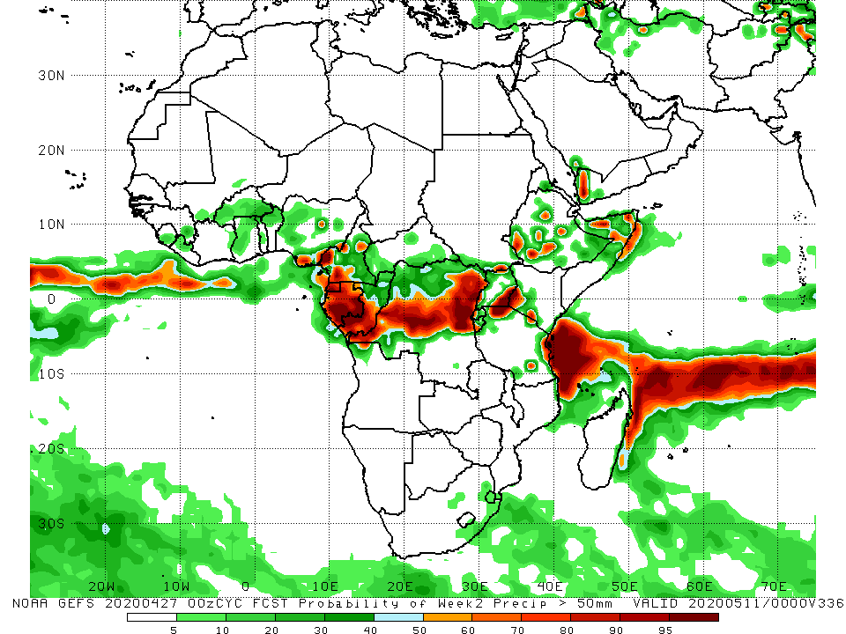
NCEP GEFS Model Forecasts Non-Bias Corrected Probability of precipitation exceedance
Week-2: Valid 28 April - 4 May, 2020
Week-2: Valid 5 - 11 May, 2020
For week-1 (left panel), there is an increased chance for weekly rainfall totals to exceed 50mm over local areas in Nigeria, Gabon, northern Angola, eastern DRC, Uganda, western Kenya, Ethiopia and northern Somalia. For week-2 (right panel), there is an increased chance for weekly rainfall totals to exceed 50mm over parts of Cameroon, Gabon, southern Congo, portions of DRC, parts of Uganda, and Kenya, and local areas in Ethiopia and northern Somalia.
Notes:
9

Slide 10
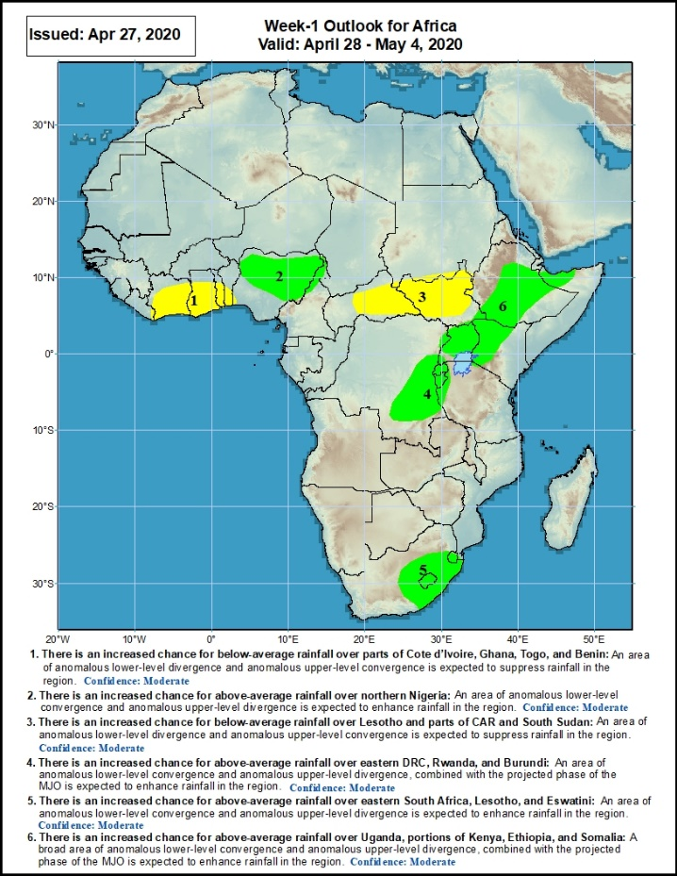
Week-1 Precipitation Outlooks
There is an increased chance for below-average rainfall over parts of Cote d’Ivoire, Ghana, Togo, and Benin: An area of anomalous lower-level divergence and upper-level convergence is expected to suppress rainfall in the region. Confidence: Moderate
There is an increased chance for above-average rainfall over northern Nigeria: An area of anomalous lower-level convergence and upper-level divergence is expected to enhance rainfall in the region. Confidence: Moderate
There is an increased chance for below-average rainfall over parts of CAR and South Sudan: An area of anomalous lower-level divergence and upper-level convergence is expected to suppress rainfall in the region. Confidence: Moderate
There is an increased chance for above-average rainfall over eastern DRC, Rwanda, and Burundi: An area of anomalous lower-level convergence and upper-level divergence, combined with the projected phase of the MJO is expected to enhance rainfall in the region. Confidence: Moderate
There is an increased chance for above-average rainfall over eastern South Africa, Lesotho, and Eswatini: An area of anomalous lower-level convergence and upper-level divergence. Confidence: Moderate
There is an increased chance for above-average rainfall over Uganda, portions of Kenya, Ethiopia, and Somalia: An area of anomalous lower-level convergence and upper-level divergence, combined with the projected phase of the MJO is expected to enhance rainfall in the region. Confidence: Moderate
28 April – 04 May, 2020
Notes:
10

Slide 11
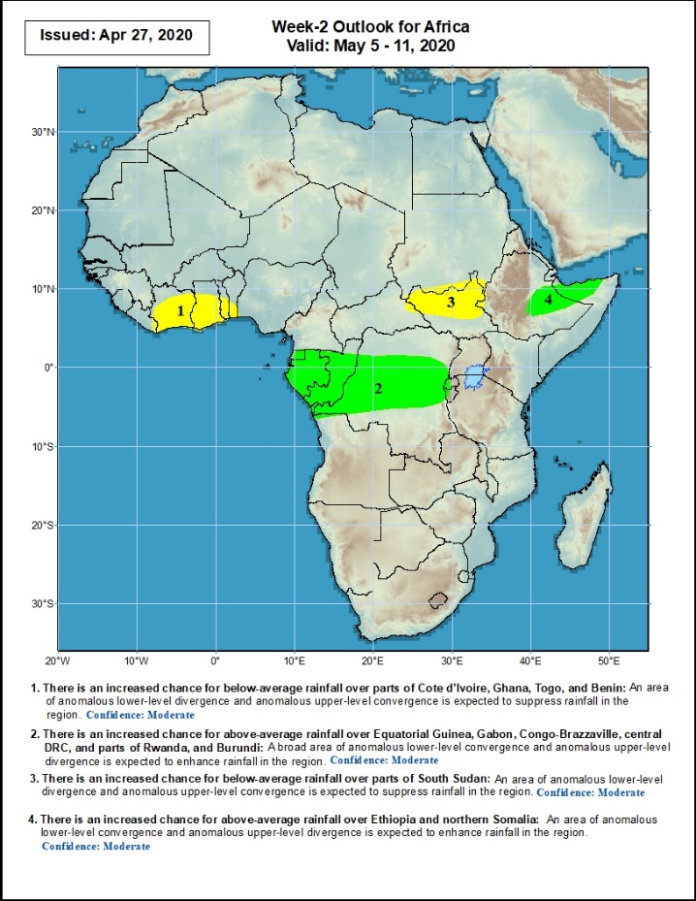
Week-2 Precipitation Outlooks
05 – 11 May, 2020
There is an increased chance for below-average rainfall over parts of Cote d’Ivoire, Ghana, Togo, and Benin: An area of anomalous lower-level divergence and upper-level convergence is expected to suppress rainfall in the region. Confidence: Moderate
There is an increased chance for above-average rainfall over Equatorial Guinea, Gabon, Congo-Brazzaville, central DRC, and parts of Rwanda, and Burundi: An area of anomalous lower-level convergence and upper-level divergence is expected to enhance rainfall in the region. Confidence: Moderate
There is an increased chance for below-average rainfall over parts of South Sudan: An area of anomalous lower-level divergence and upper-level convergence is expected to suppress rainfall in the region. Confidence: Moderate
There is an increased chance for above-average rainfall over Ethiopia and northern Somalia: An area of anomalous lower-level convergence and upper-level divergence is expected to enhance rainfall in the region. Confidence: Moderate
Notes:
11

Slide 12
Summary
During the past 7 days, rainfall was above-average over parts of Guinea, Sierra Leone, Liberia, Cote d’Ivoire, Ghana, Togo, Benin, Nigeria, portions of Cameroon and Gabon, CAR, parts of DRC, northern Angola, portions of Ethiopia, Somalia, Kenya, Rwanda, Burundi, Tanzania, southern Namibia and parts of South Africa and western Madagascar. Below-average rainfall was observed over local areas in Nigeria, southwestern Cameroon, parts of Gabon, much of South Sudan, western Ethiopia, portions of DRC and northwestern Uganda.
During the past 30 days, rainfall was above-average over many places in the Gulf of Guinea region, including much of Cameroon, Gabon and Congo, CAR, much of DRC, parts of South Sudan, Uganda, many parts of Ethiopia, much of Kenya, Somalia, Rwanda, Burundi, Tanzania, Angola, northeastern Namibia, Botswana, northern Zambia, central South Africa, Lesotho, and Eswatini. Rainfall was below-average over parts of southwestern Angola, western Namibia, eastern Botswana, southern Zambia, Zimbabwe, Malawi, Mozambique, parts of South Africa, and much of Madagascar.
During the past 90 days, rainfall was above-average over many places in the Gulf of Guinea region, including Cameroon, and CAR, parts of South Sudan, southern Congo, many parts of DRC, Rwanda, Burundi, Uganda, Kenya, many parts of Ethiopia, Somalia, much of Tanzania, many parts of Angola and northern Zambia, northern Malawi, northeastern Namibia, western Botswana, portions of South Africa, local areas in southern Mozambique, and northern Madagascar. Local areas in Cameroon, Equatorial Guinea, Gabon, local areas in CAR, Angola and DRC, local areas in Ethiopia, western and southern Namibia, parts of Botswana, much of Zimbabwe, southern Zambia, portions of South Arica, many parts of Mozambique, and much of Madagascar.
Week-1 outlooks call for an increased chance for above-average rainfall over eastern Guinea, Sierra Leone, Liberia, Cote d’Ivoire, northern Ghana, northern Togo, northern Benin, northwestern Nigeria, northern Angola, southern DRC, Rwanda, Burundi, portions of Tanzania, Kenya, eastern and southern Ethiopia and Somalia. In contrast, there is an increased chance for below-average rainfall over eastern CAR, South Sudan and parts of southwestern Ethiopia.
Notes:
12

