Slide 1
The African Monsoon Recent Evolution and Current Status Include Week-1 and Week-2 Outlooks
Update prepared by
Climate Prediction Center / NCEP
4 May 2020
For more information, visit:
http://www.cpc.ncep.noaa.gov/products/Global_Monsoons/African_Monsoons/precip_monitoring.shtml

Slide 2
Outline
Highlights
Recent Evolution and Current Conditions
NCEP GEFS Forecasts
Summary

Slide 3
Highlights: Last 7 Days
Another week of moderate to locally heavy rainfall sustained moisture surpluses over portions of Central and the Greater Horn of Africa.
Week-1 outlooks call for an increased chance for above-average rainfall over much of Gabon, Equatorial Africa, northern DRC, northern Uganda, southeastern Ethiopia and northern Somalia. In contrast, there is an increased chance for below-average rainfall over much of the Gulf of Guinea region.

Slide 4
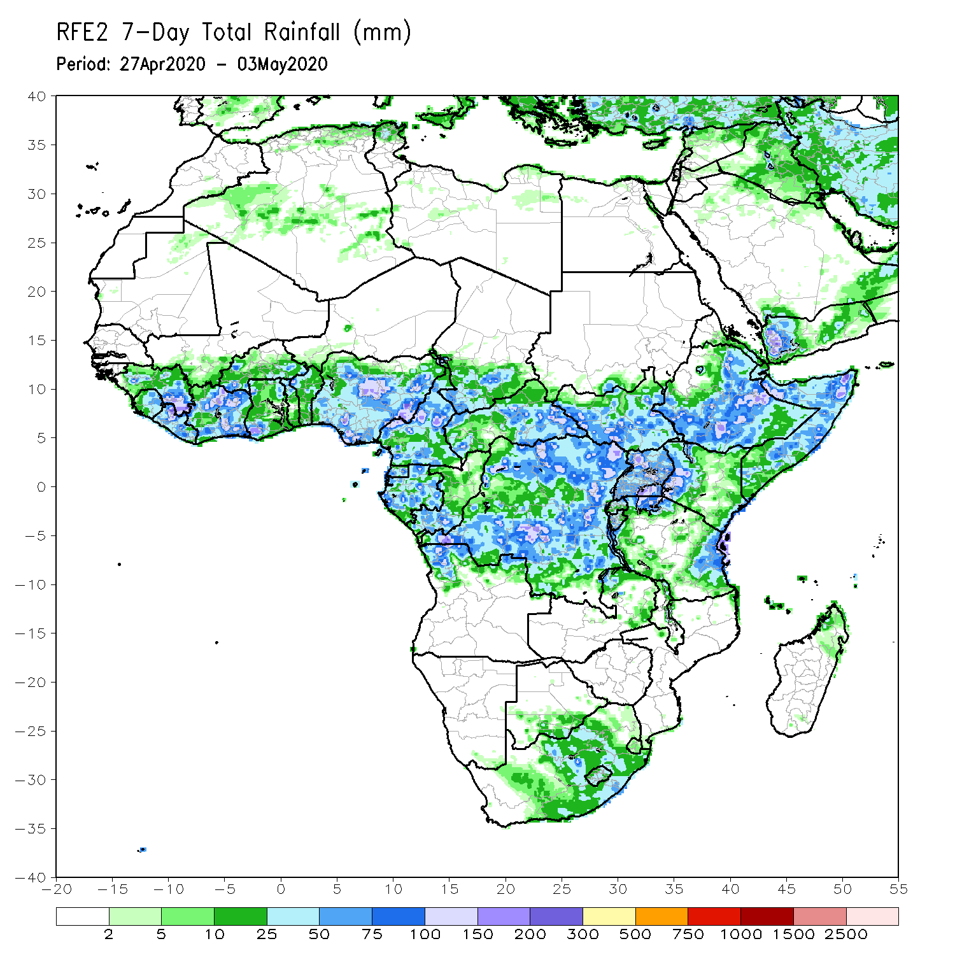
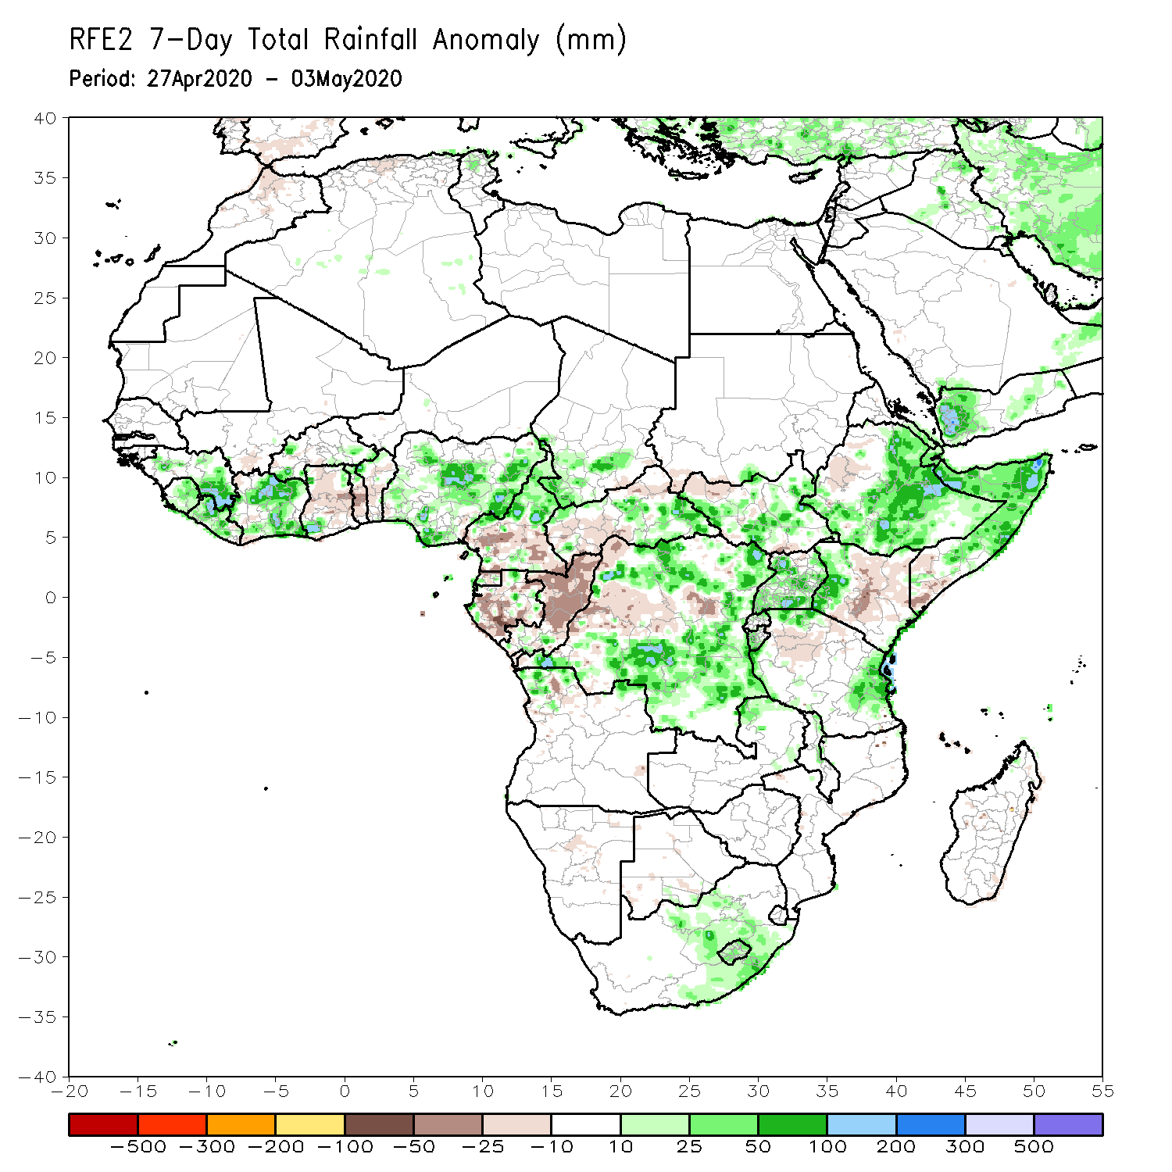
Rainfall Patterns: Last 7 Days
During the past 7 days, rainfall was above-average over parts of Guinea, Sierra Leone, Liberia, Cote d’Ivoire, Nigeria, northern Cameroon, local areas in Chad, eastern CAR, portions of DRC, South Sudan, Uganda, portions of Ethiopia, Somalia, western Kenya, eastern Tanzania, and portions of South Africa.
Below-average rainfall was observed over parts of Ghana, Togo, Benin, southern Cameroon, Gabon, Congo, western CAR, portions of DRC, western Ethiopia, central and eastern Kenya, parts of southern Somalia, and portions of Tanzania.

Slide 5
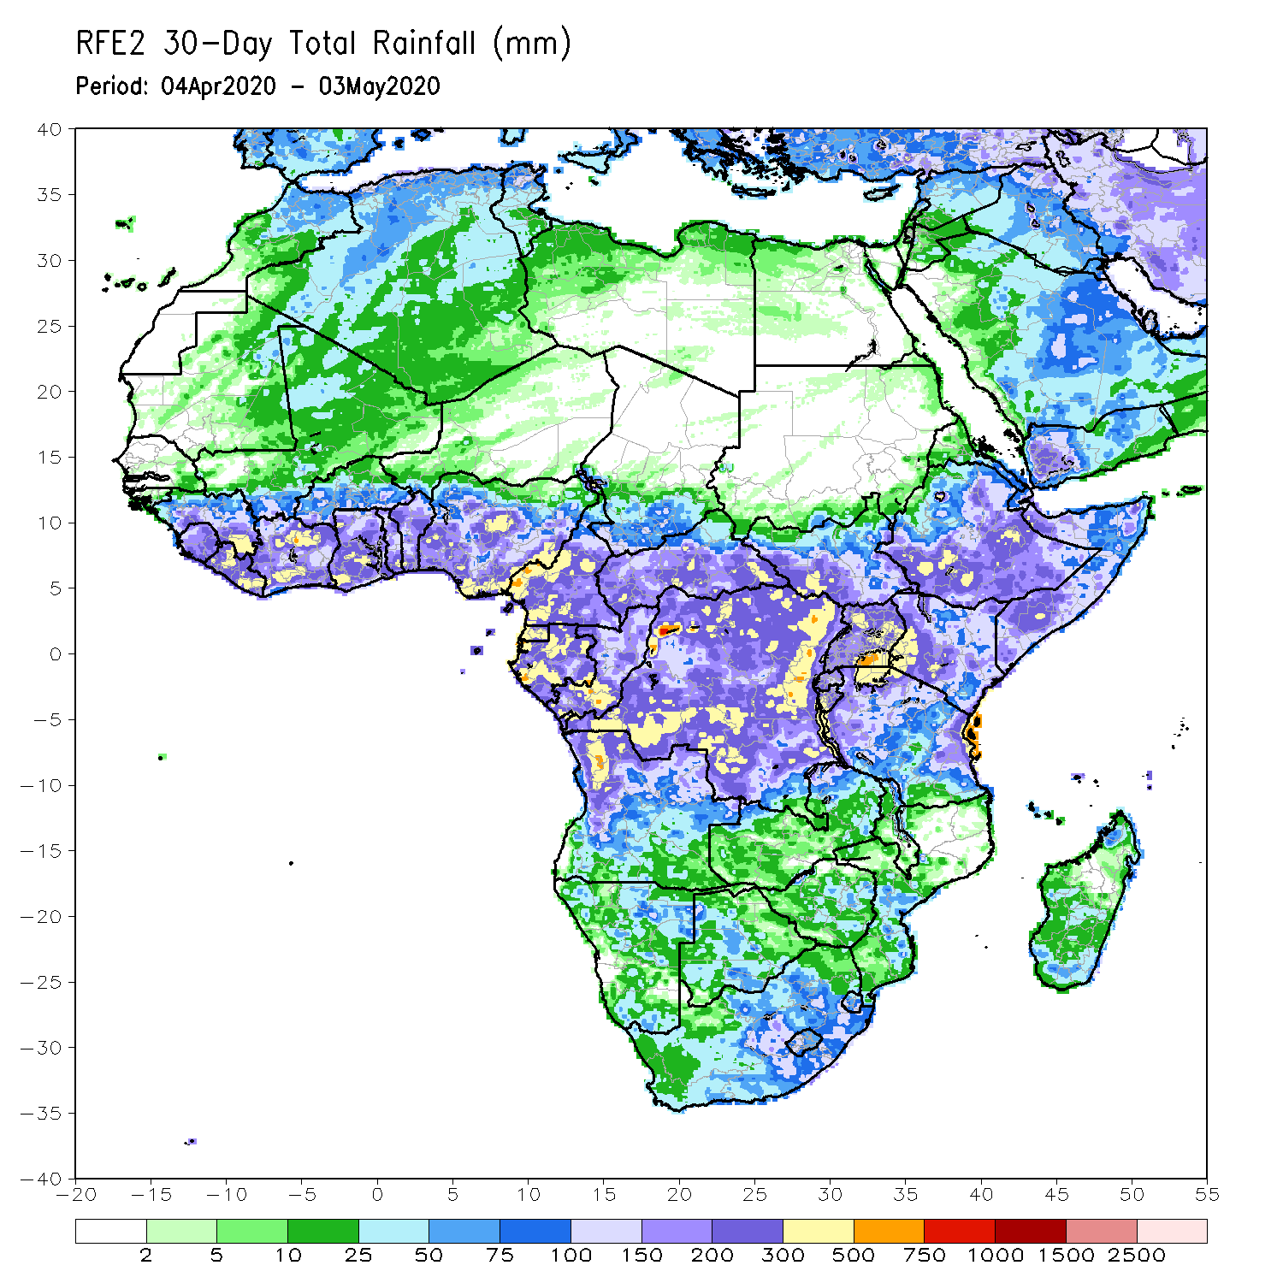
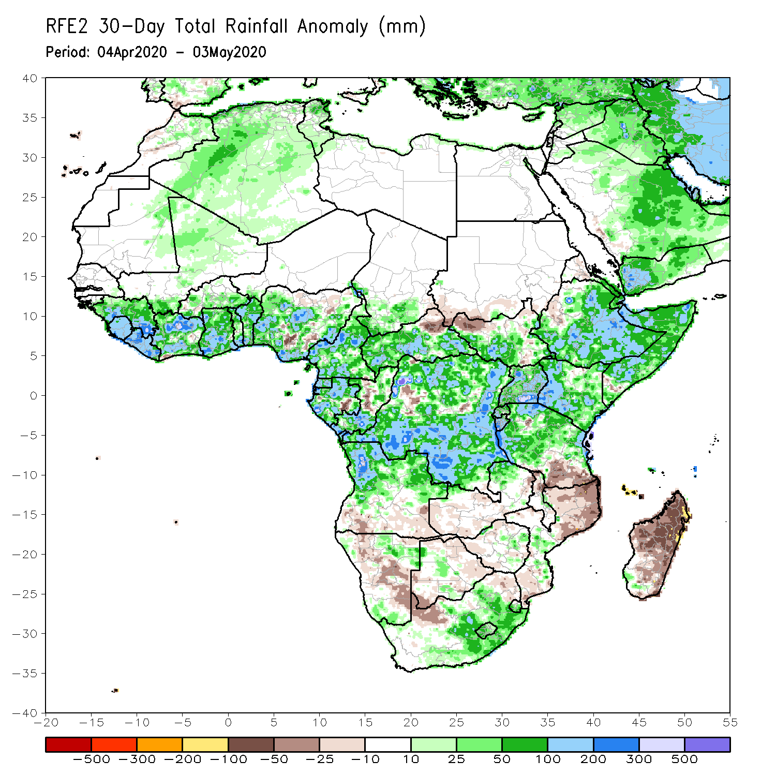
Rainfall Patterns: Last 30 Days
During the past 30 days, rainfall was above-average over many places in the Gulf of Guinea region, including much of Cameroon, Gabon and Congo, CAR, much of DRC, many parts of South Sudan, Uganda, many parts of Ethiopia, much of Kenya, Somalia, Rwanda, Burundi, Tanzania, northern Angola, northeastern Namibia, Botswana, parts of northern Zambia, central South Africa, Lesotho, and Eswatini.
Rainfall was below-average over parts of southern Angola, portions of Namibia and Botswana, southern Zambia, Zimbabwe, Malawi, Mozambique, parts of South Africa, and much of Madagascar.
Notes:
5

Slide 6
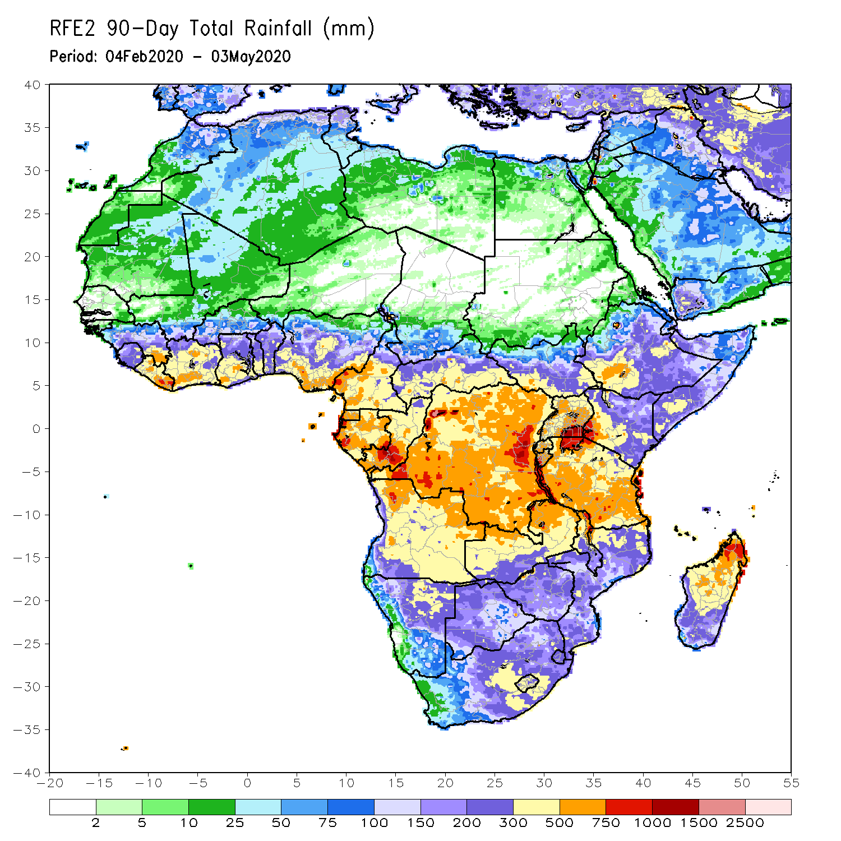
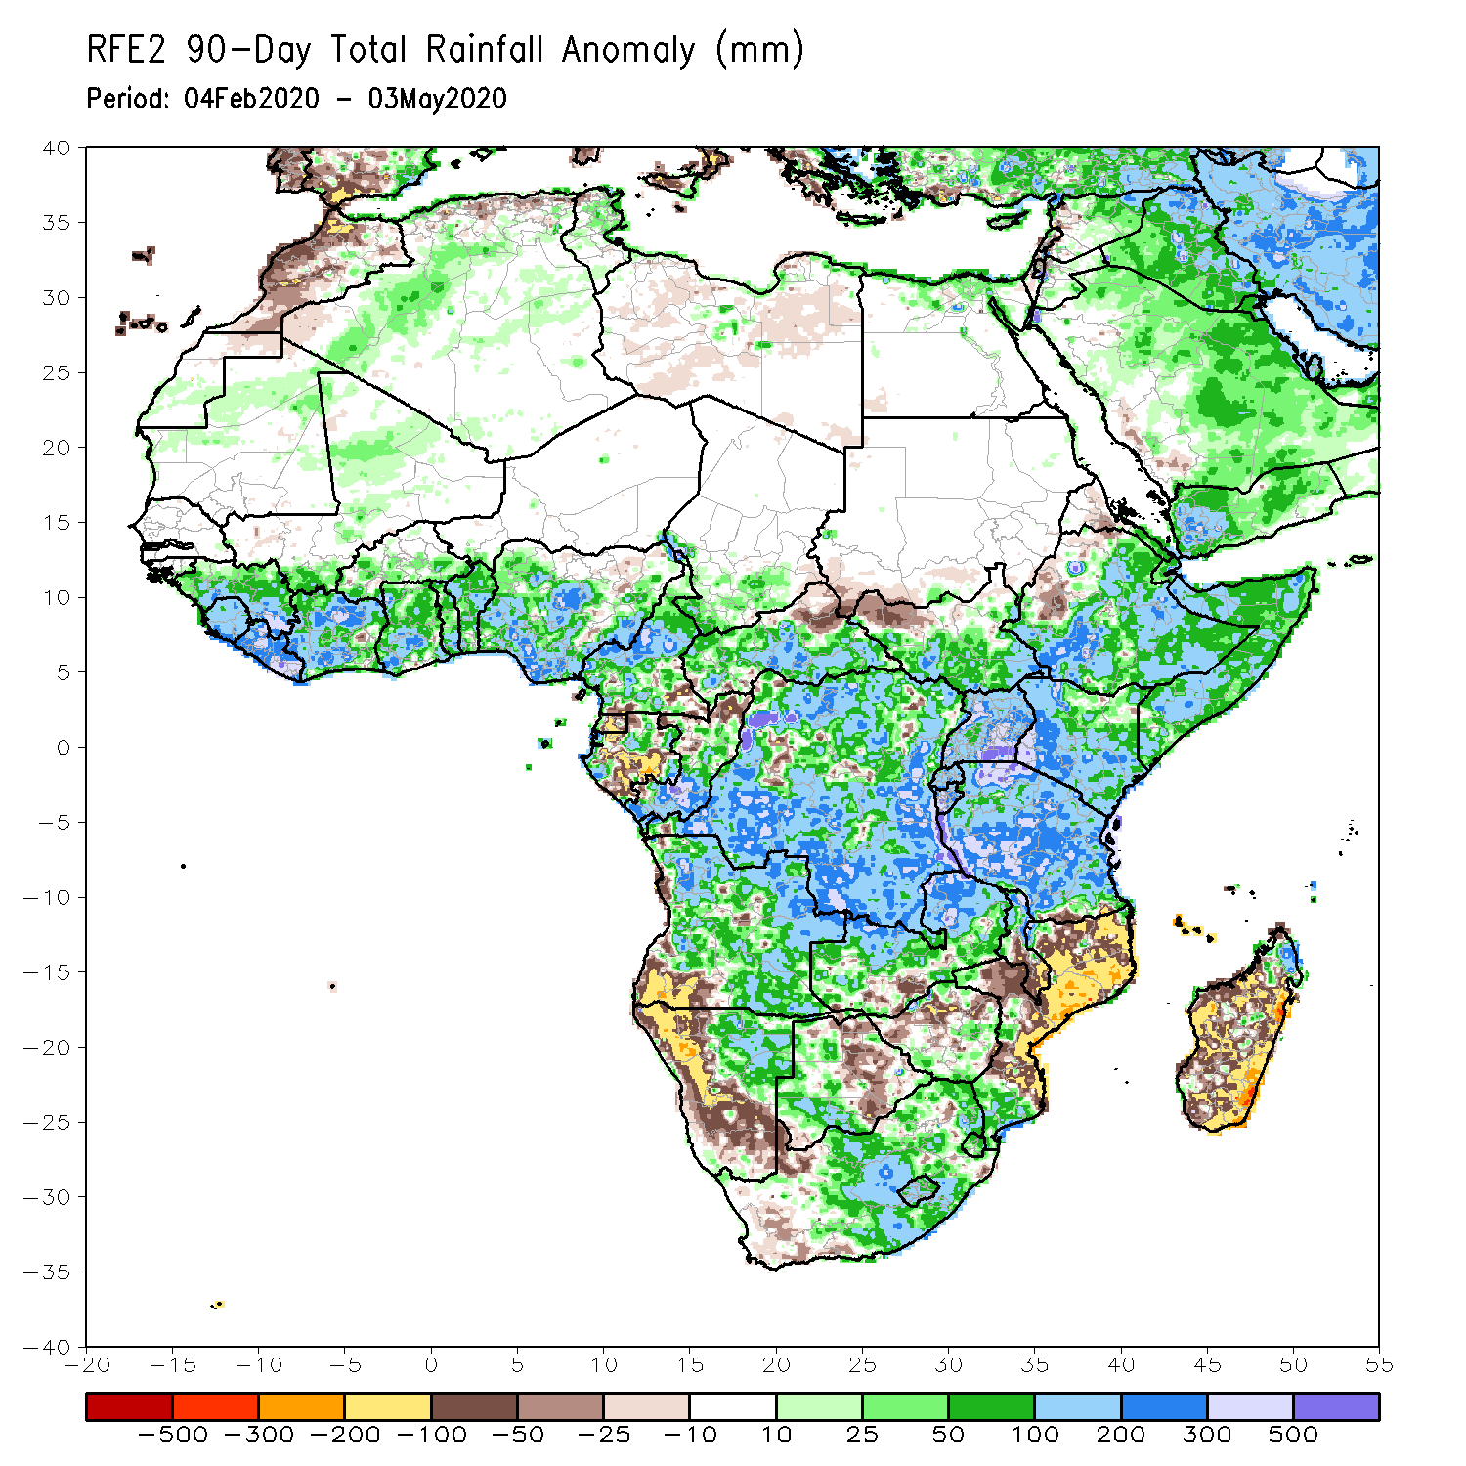
Rainfall Patterns: Last 90 Days
During the past 90 days, rainfall was above-average over many places in the Gulf of Guinea region, including Cameroon, and much of CAR, parts of South Sudan, parts of Gabon, Congo, many parts of DRC, Rwanda, Burundi, Uganda, Kenya, many parts of Ethiopia, Somalia, much of Tanzania, many parts of Angola and northern Zambia, northern Malawi, northeastern Namibia, western Botswana, portions of South Africa, local areas in southern Mozambique, and northern Madagascar.
Local areas in Cameroon, Equatorial Guinea, parts of Gabon, local areas in CAR and Angola, western Ethiopia, western and southern Namibia, parts of Botswana, much of Zimbabwe, parts of southern Zambia, western South Arica, central and northern Mozambique, and much of Madagascar.
Notes:
6

Slide 7
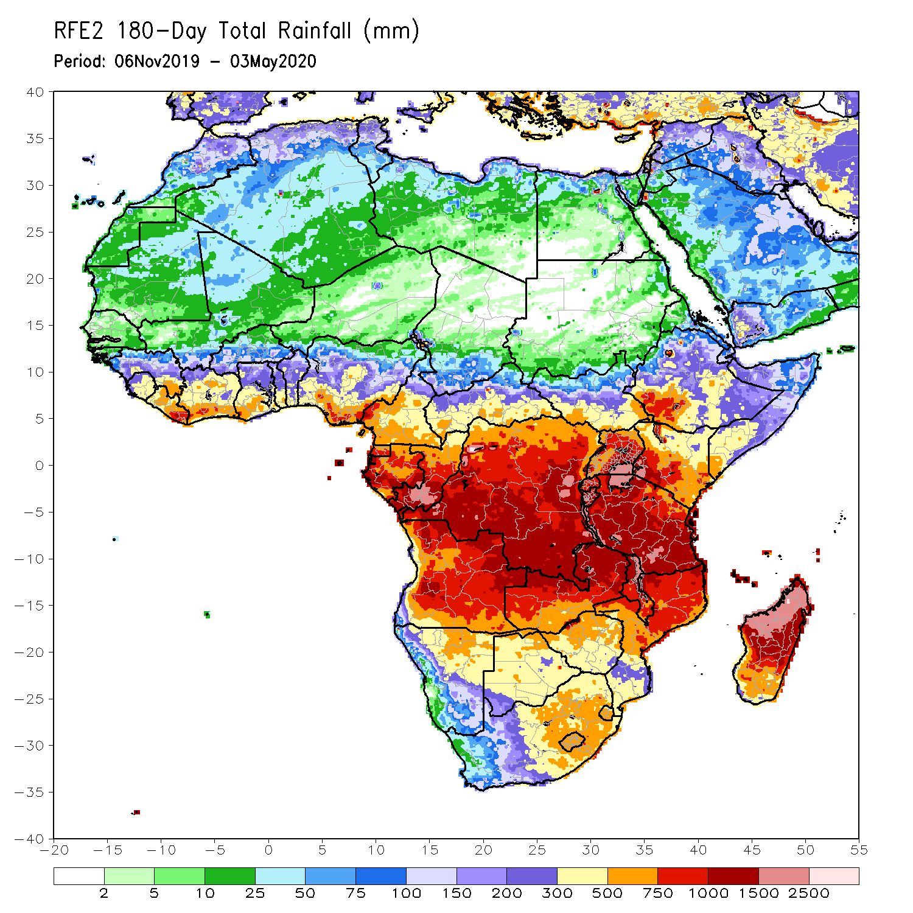
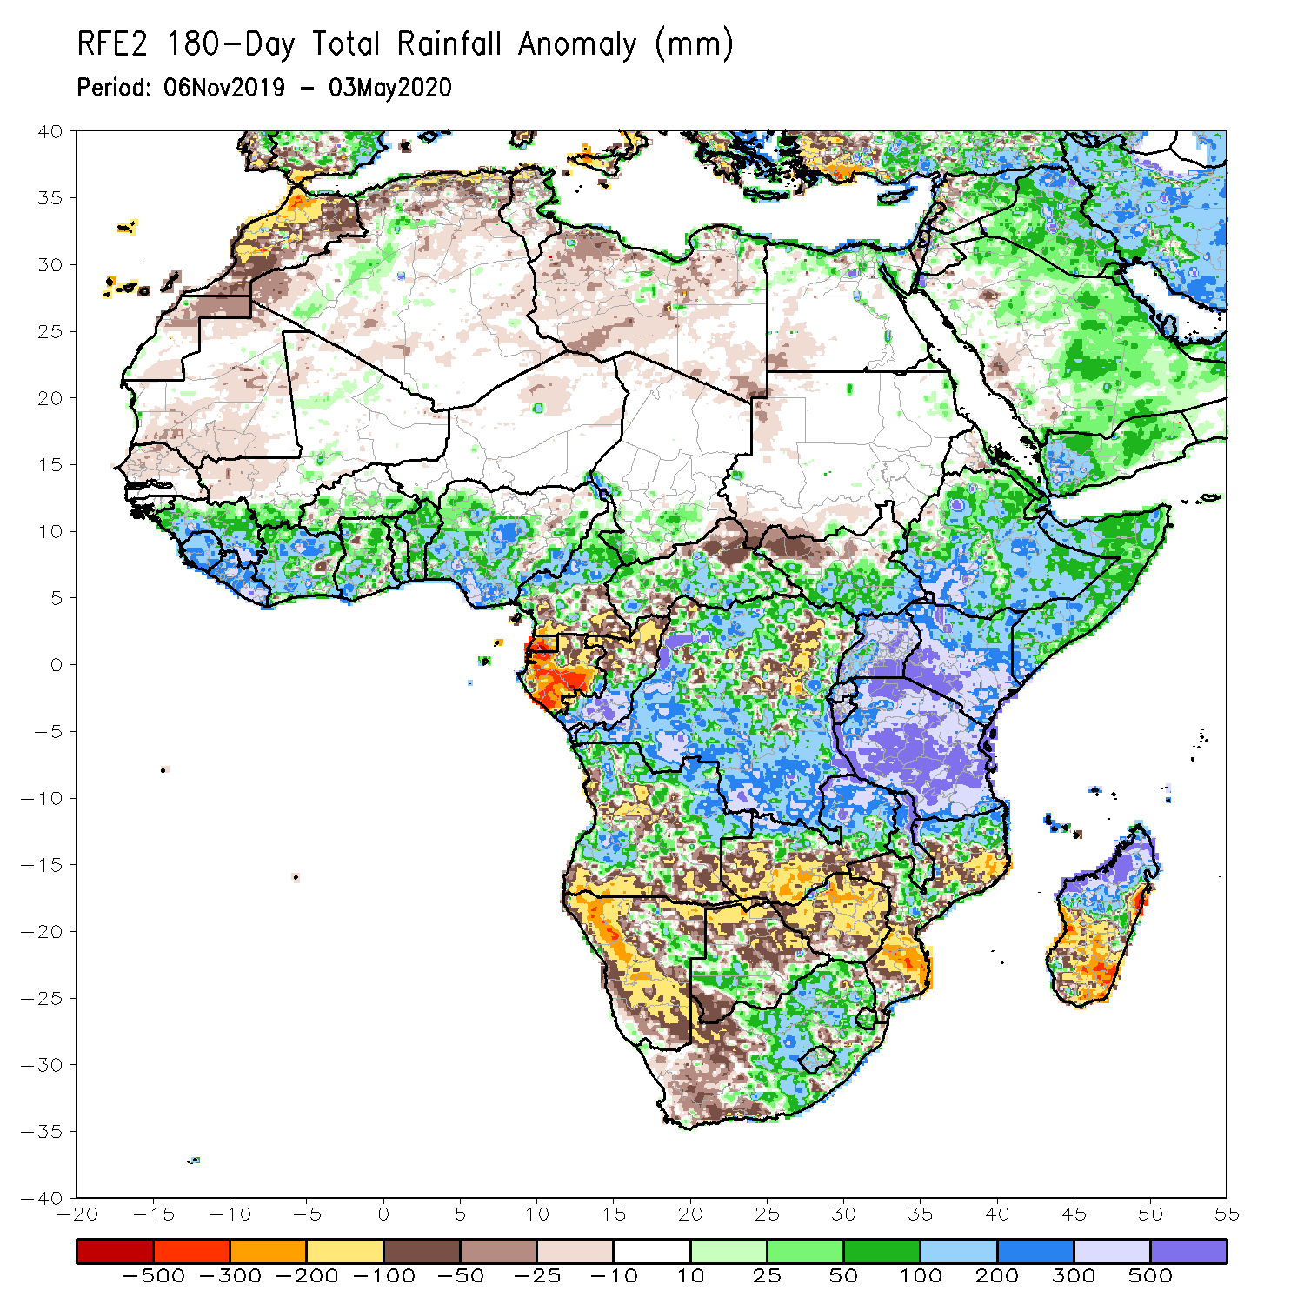
Rainfall Patterns: Last 180 Days
During the past 180 days, many places in the Gulf of Guinea region including northern Cameroon, local areas in southern Chad, portions of CAR, DRC and South Sudan, Uganda, many parts of Ethiopia, much Somalia, Kenya, Tanzania, parts of Angola, local areas in Namibia, parts of Zambia, Malawi, parts of South Africa, portions of Mozambique and northern Madagascar had above-average rainfall.
Below-average rainfall was observed over Equatorial Guinea, Gabon, northern Congo, parts of DRC, parts of Angola, Namibia, western South Africa, western Zambia, many parts of Botswana and Zimbabwe, parts of Mozambique and southern Madagascar.
Notes:
7

Slide 8
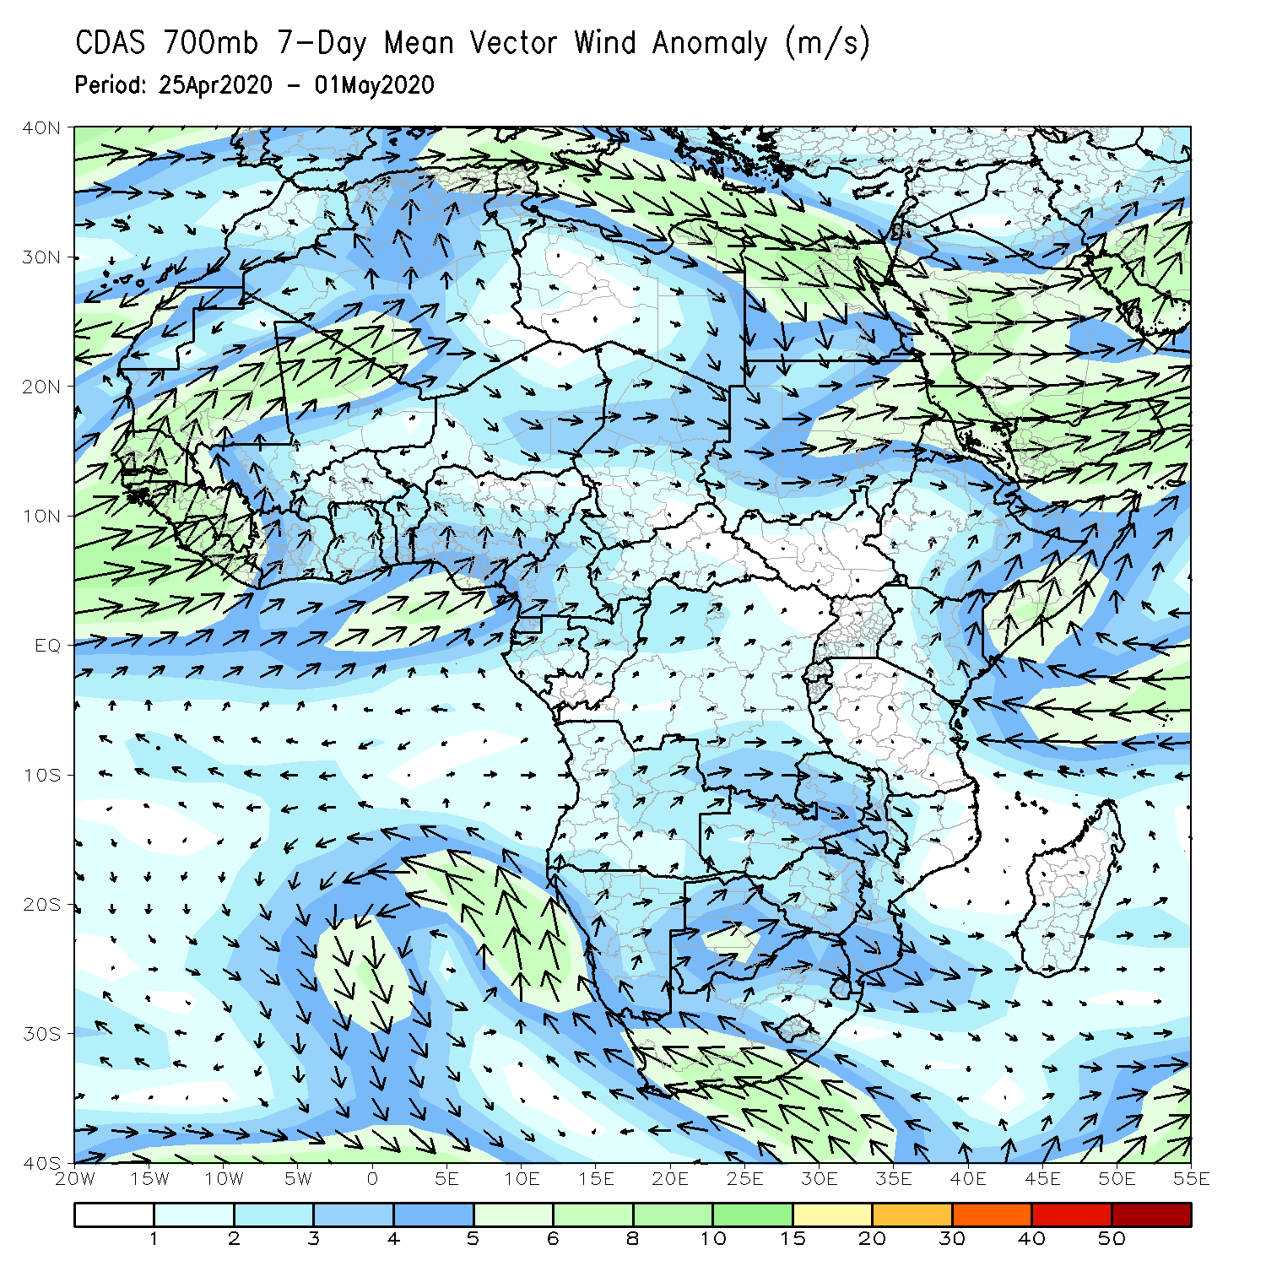
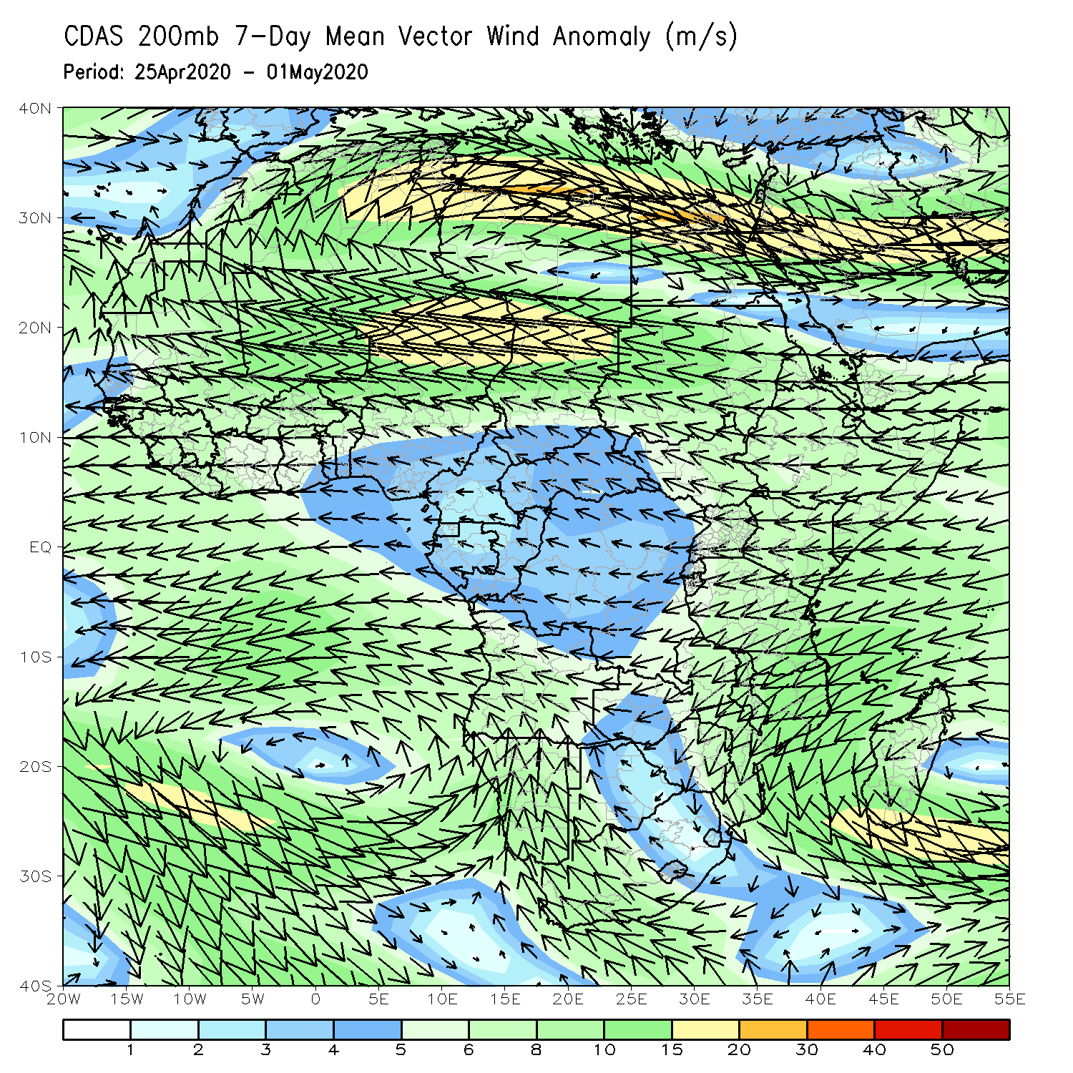
Atmospheric Circulation: Last 7 Days
Anomalous lower-level cross-equatorial flow may have contributed to the observed above-average rainfall over portions of the Greater Horn of Africa (left panel).

Slide 9
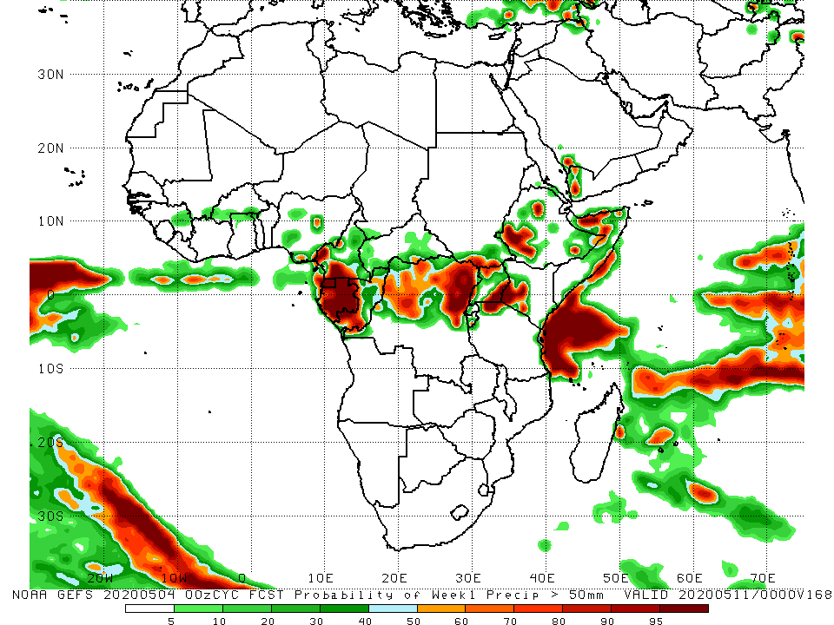
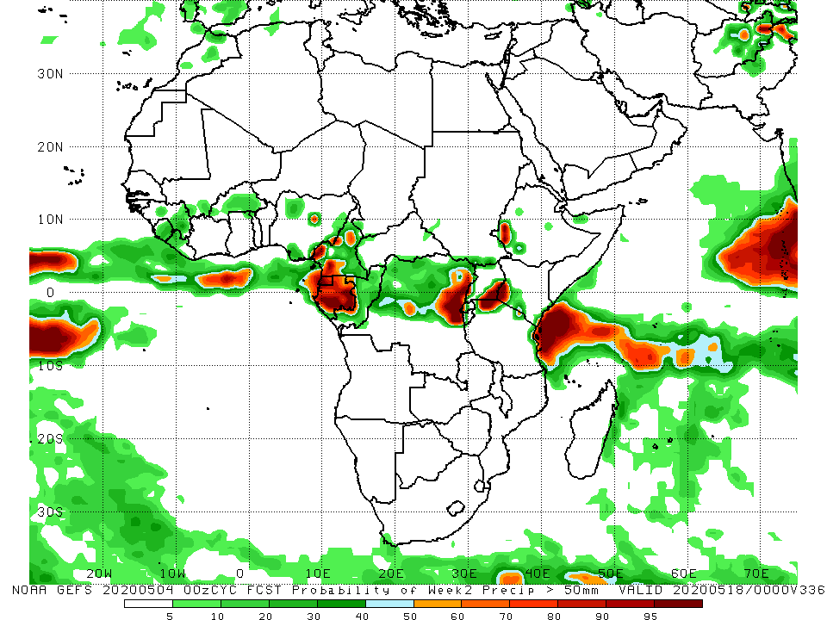
NCEP GEFS Model Forecasts Non-Bias Corrected Probability of precipitation exceedance
Week-2: 5 - 11 May, 2020
Week-2: Valid 12 - 18 May, 2020
For week-1 (left panel), there is an increased chance for weekly rainfall totals to exceed 50mm over many places in equatorial Africa and portions of the Greater Horn of Africa. For week-2 (right panel), there is an increased chance for rainfall totals to exceed 50mm over local areas in Cameroon, much of Gabon, northeastern DRC, southeastern Uganda, southwestern Ethiopia, and coastal Tanzania.
Notes:
9

Slide 10
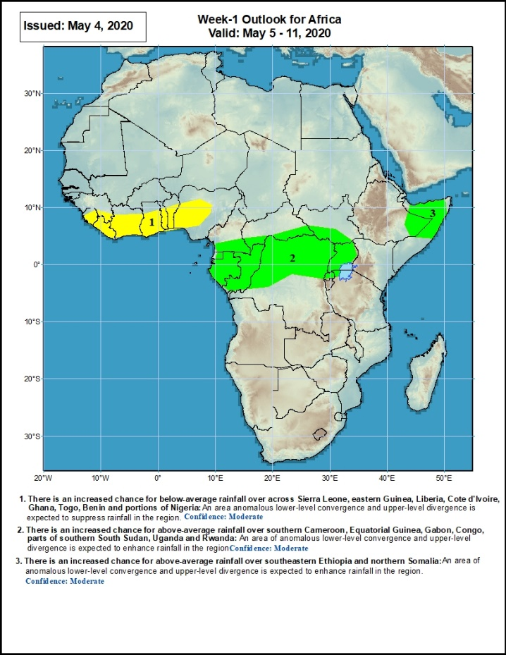
Week-1 Precipitation Outlooks
05 – 11 May, 2020
There is an increased chance for below-average rainfall over Sierra Leone, eastern Guinea, Liberia, Cote d'Ivoire, Ghana, Togo, Benin and portions of Nigeria: An area anomalous lower-level divergence and upper-level convergence is expected to suppress rainfall in the region. Confidence: Moderate
There is an increased chance for above-average rainfall over southern Cameroon, Equatorial Guinea, Gabon, Congo, parts of southern CAR, portions of DRC, parts of southern South Sudan, Uganda and Rwanda: An area of anomalous lower-level convergence and upper-level divergence is expected to enhance rainfall in the region. Confidence: Moderate
There is an increased chance for above-average rainfall over southeastern Ethiopia and northern Somalia: An area of anomalous lower-level convergence and upper-level divergence is expected to enhance rainfall in the region. Confidence: Moderate
Notes:
10

Slide 11
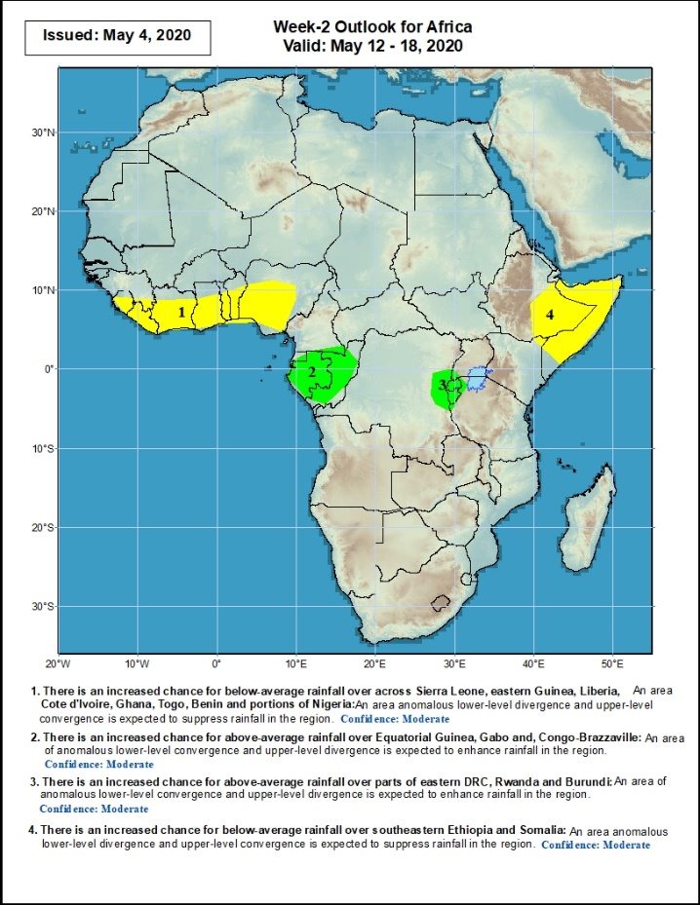
Week-2 Precipitation Outlooks
12 – 18 May, 2020
There is an increased chance for below-average rainfall over across Sierra Leone, eastern Guinea, Liberia, Cote d'Ivoire, Ghana, Togo, Benin and portions of Nigeria: An area anomalous lower-level divergence and upper-level convergence is expected to suppress rainfall in the region. Confidence: Moderate
There is an increased chance for above-average rainfall over Equatorial Guinea, Gabon and, Congo-Brazzaville: An area of anomalous lower-level convergence and upper-level divergence is expected to enhance rainfall in the region. Confidence: Moderate
There is an increased chance for above-average rainfall over parts of eastern DRC, Rwanda and Burundi: An area of anomalous lower-level convergence and upper-level divergence is expected to enhance rainfall in the region. Confidence: Moderate
There is an increased chance for below-average rainfall over southeastern Ethiopia and Somalia: An area of anomalous lower-level divergence and upper-level convergence is expected to suppress rainfall in the region. Confidence: Moderate
Notes:
11

Slide 12
Summary
During the past 7 days, rainfall was above-average over parts of Guinea, Sierra Leone, Liberia, Cote d’Ivoire, Nigeria, northern Cameroon, local areas in Chad, eastern CAR, portions of DRC, South Sudan, Uganda, portions of Ethiopia, Somalia, western Kenya, eastern Tanzania, and portions of South Africa. Below-average rainfall was observed over parts of Ghana, Togo, Benin, southern Cameroon, Gabon, Congo, western CAR, portions of DRC, western Ethiopia, central and eastern Kenya, parts of southern Somalia, and portions of Tanzania.
During the past 30 days, rainfall was above-average over many places in the Gulf of Guinea region, including much of Cameroon, Gabon and Congo, CAR, much of DRC, many parts of South Sudan, Uganda, many parts of Ethiopia, much of Kenya, Somalia, Rwanda, Burundi, Tanzania, northern Angola, northeastern Namibia, Botswana, parts of northern Zambia, central South Africa, Lesotho, and Eswatini. Rainfall was below-average over parts of southern Angola, portions of Namibia and Botswana, southern Zambia, Zimbabwe, Malawi, Mozambique, parts of South Africa, and much of Madagascar.
During the past 90 days, rainfall was above-average over many places in the Gulf of Guinea region, including Cameroon, and much of CAR, parts of South Sudan, parts of Gabon, Congo, many parts of DRC, Rwanda, Burundi, Uganda, Kenya, many parts of Ethiopia, Somalia, much of Tanzania, many parts of Angola and northern Zambia, northern Malawi, northeastern Namibia, western Botswana, portions of South Africa, local areas in southern Mozambique, and northern Madagascar. Local areas in Cameroon, Equatorial Guinea, parts of Gabon, local areas in CAR and Angola, western Ethiopia, western and southern Namibia, parts of Botswana, much of Zimbabwe, parts of southern Zambia, western South Arica, central and northern Mozambique, and much of Madagascar.
Week-1 outlooks call for an increased chance for above-average rainfall over much of Gabon, Equatorial Africa, northern DRC, northern Uganda, southeastern Ethiopia and northern Somalia. In contrast, there is an increased chance for below-average rainfall over much of the Gulf of Guinea region.
Notes:
12

