Slide 1
The African Monsoon Recent Evolution and Current Status Include Week-1 and Week-2 Outlooks
Update prepared by
Climate Prediction Center / NCEP
26 May 2020
For more information, visit:
http://www.cpc.ncep.noaa.gov/products/Global_Monsoons/African_Monsoons/precip_monitoring.shtml

Slide 2
Outline
Highlights
Recent Evolution and Current Conditions
NCEP GEFS Forecasts
Summary

Slide 3
Highlights: Last 7 Days
Weekly rainfall surpluses exceeded 100mm over local areas in Ghana, Nigeria, Central African Republic and DRC.
Week-1 outlooks call for an increased chance for above-average rainfall over Guinea, Sierra Leone, Liberia, Cote d'Ivoire, parts of southern Mali and southern Burkina Faso Ghana, Togo, Benin and northern Somalia. In contrast, there is an increased chance for below-average rainfall over Central African Republic, South Sudan, and parts of northern DRC.

Slide 4
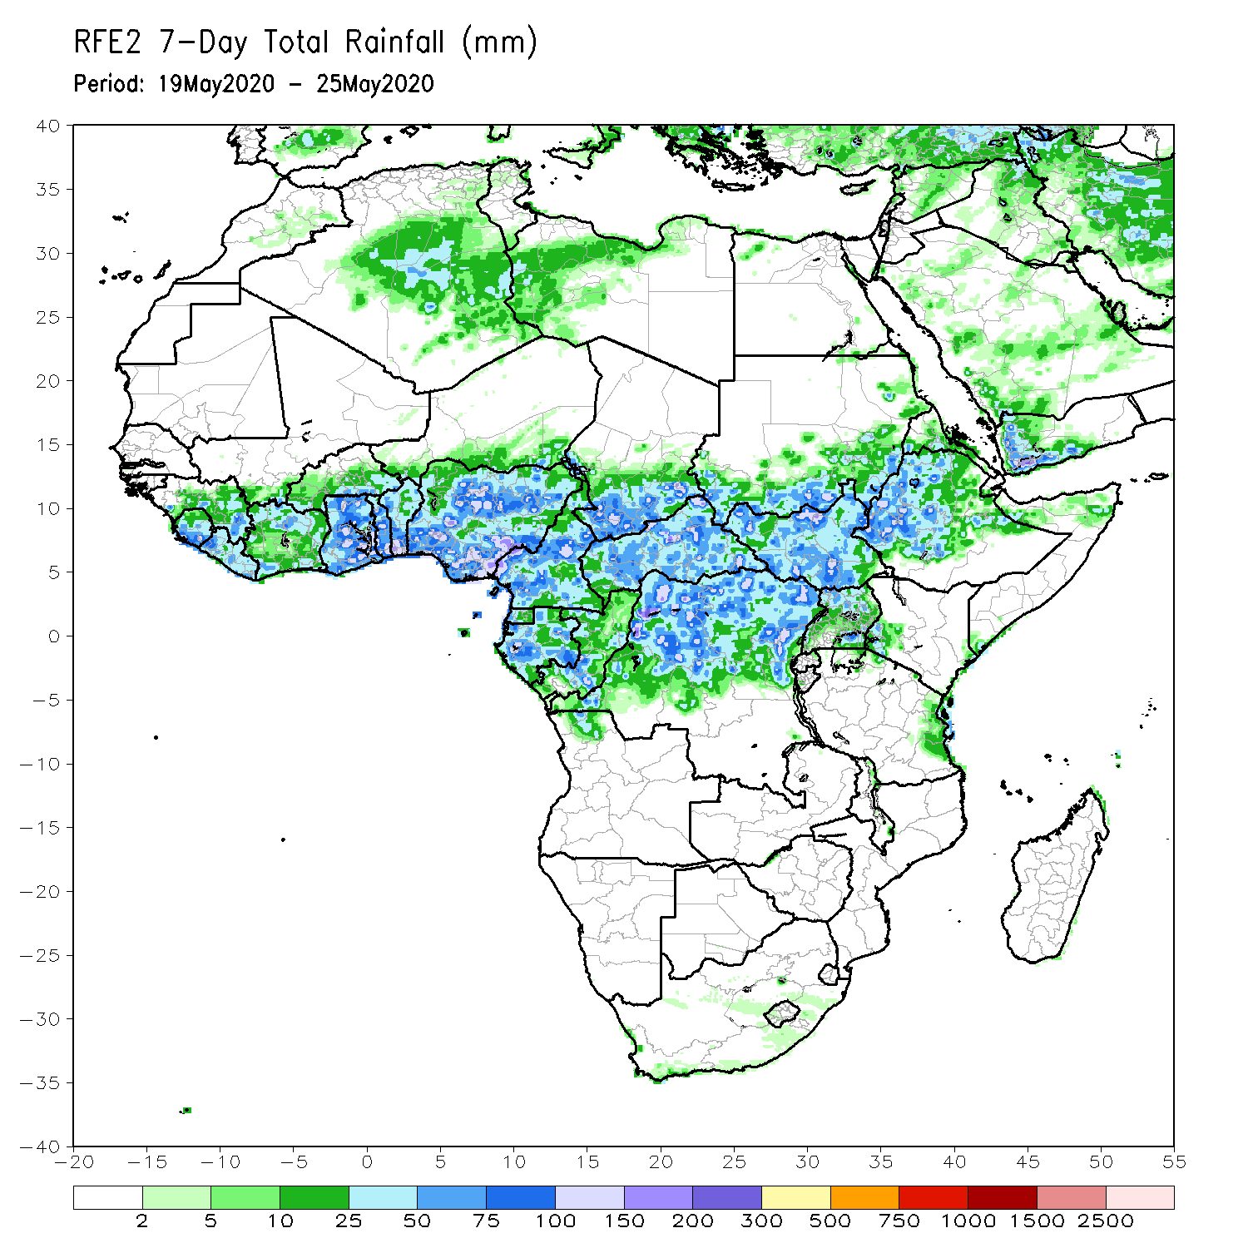
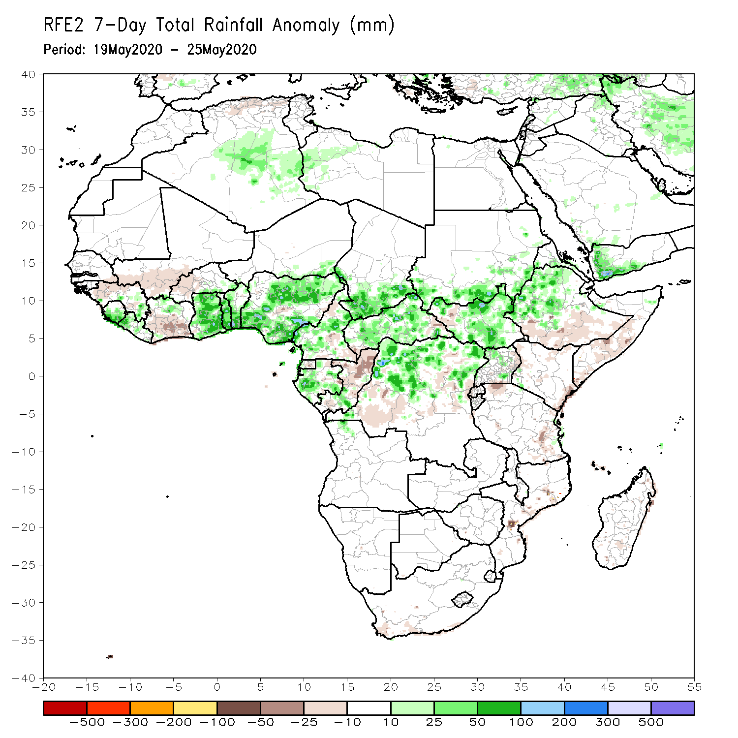
Rainfall Patterns: Last 7 Days
During the past 7 days, rainfall was above-average over parts of Guinea, Sierra Leone, Liberia, northern Cote d’Ivoire, Ghana, Togo, Benin, Nigeria, Cameroon, southern Chad, Gabon, southern Congo, CAR, northern DRC, South Sudan, Ethiopia and local areas in Uganda.
Below-average rainfall was observed prts of western Guinea and southern Mali, central and southern Cote d’Ivoire, local areas in Nigeria and Cameroon, northern Congo, parts of DRC and western South Sudan, southern Ethiopia and southern Somalia.

Slide 5
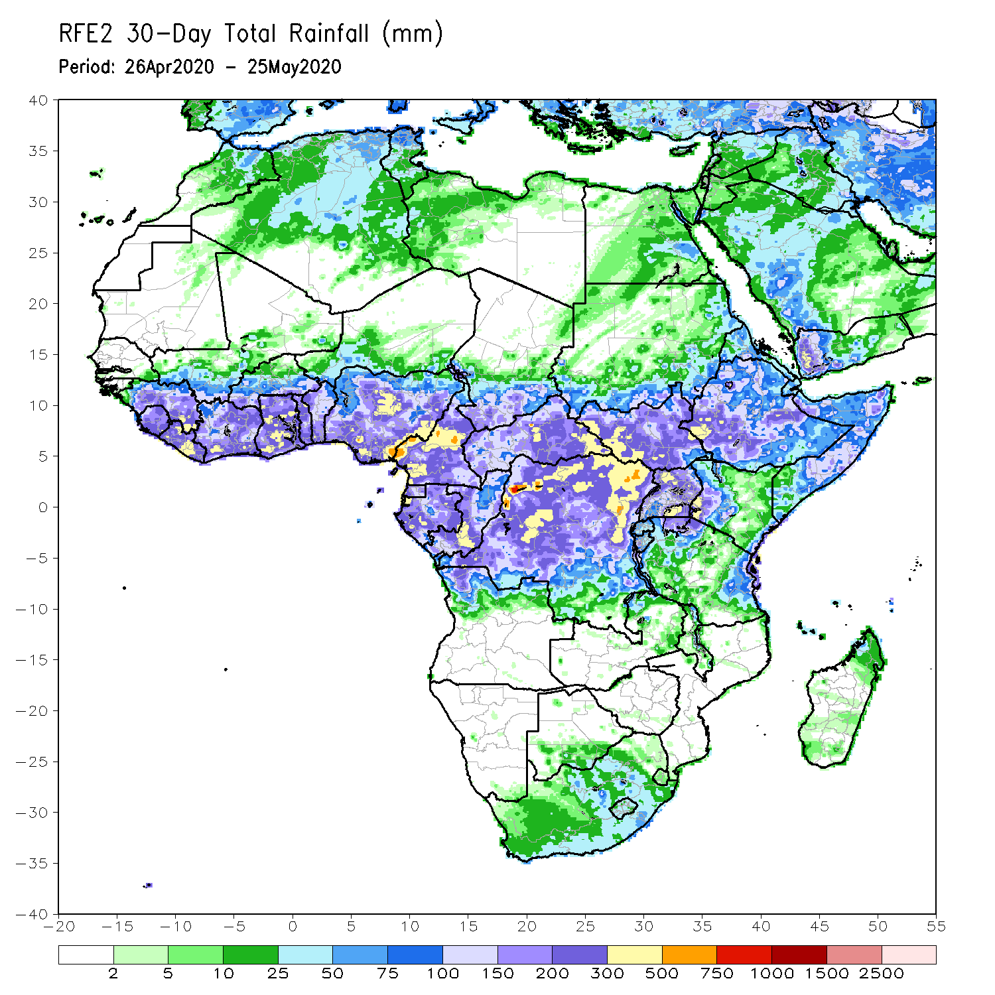
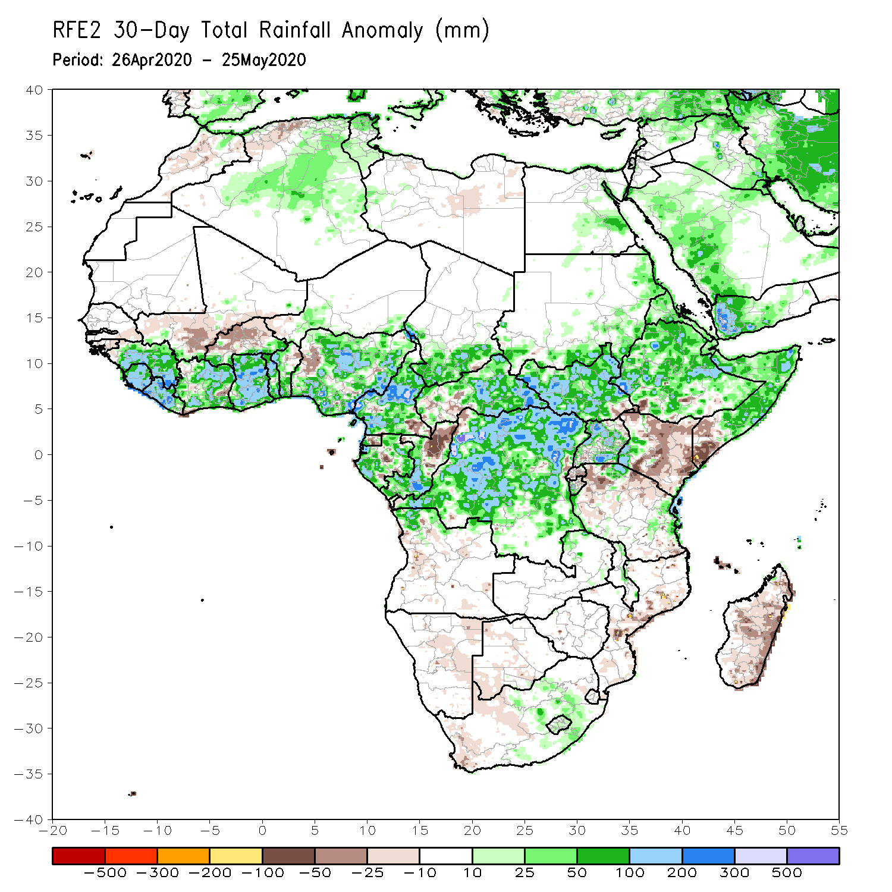
Rainfall Patterns: Last 30 Days
During the past 30 days, rainfall was above-average over many places in the Gulf of Guinea region, including much of Cameroon, Gabon and Congo, CAR, much of DRC, South Sudan, Uganda, Eritrea, Ethiopia, western Kenya, Somalia, Burundi, local areas in Tanzania, northern Angola, and local areas in South Africa.
Rainfall was below-average over parts of southern Mali, Burkina Faso, local areas in Cote d’Ivoire and Nigeria, western CAR, northern Congo, central and eastern Kenya, parts of southern Somalia, local area sin Mozambique, and much of Madagascar.
Notes:
5

Slide 6
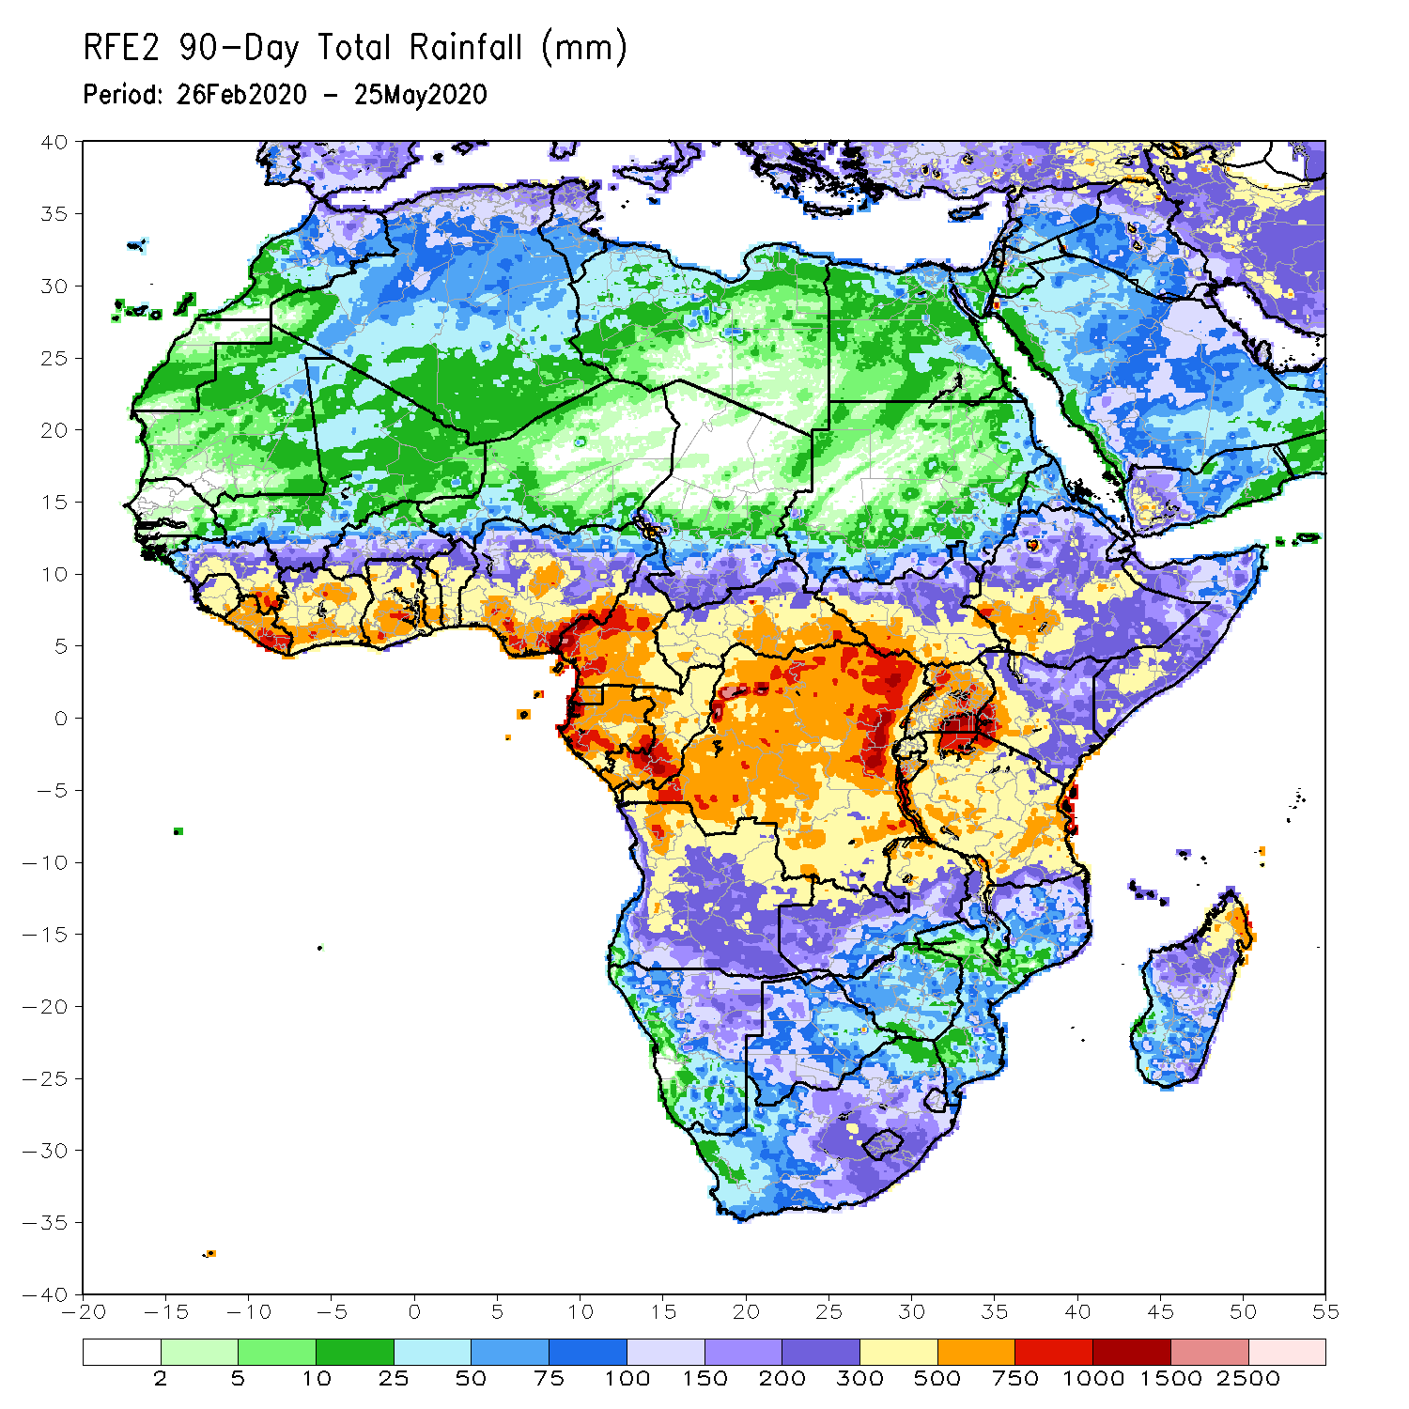
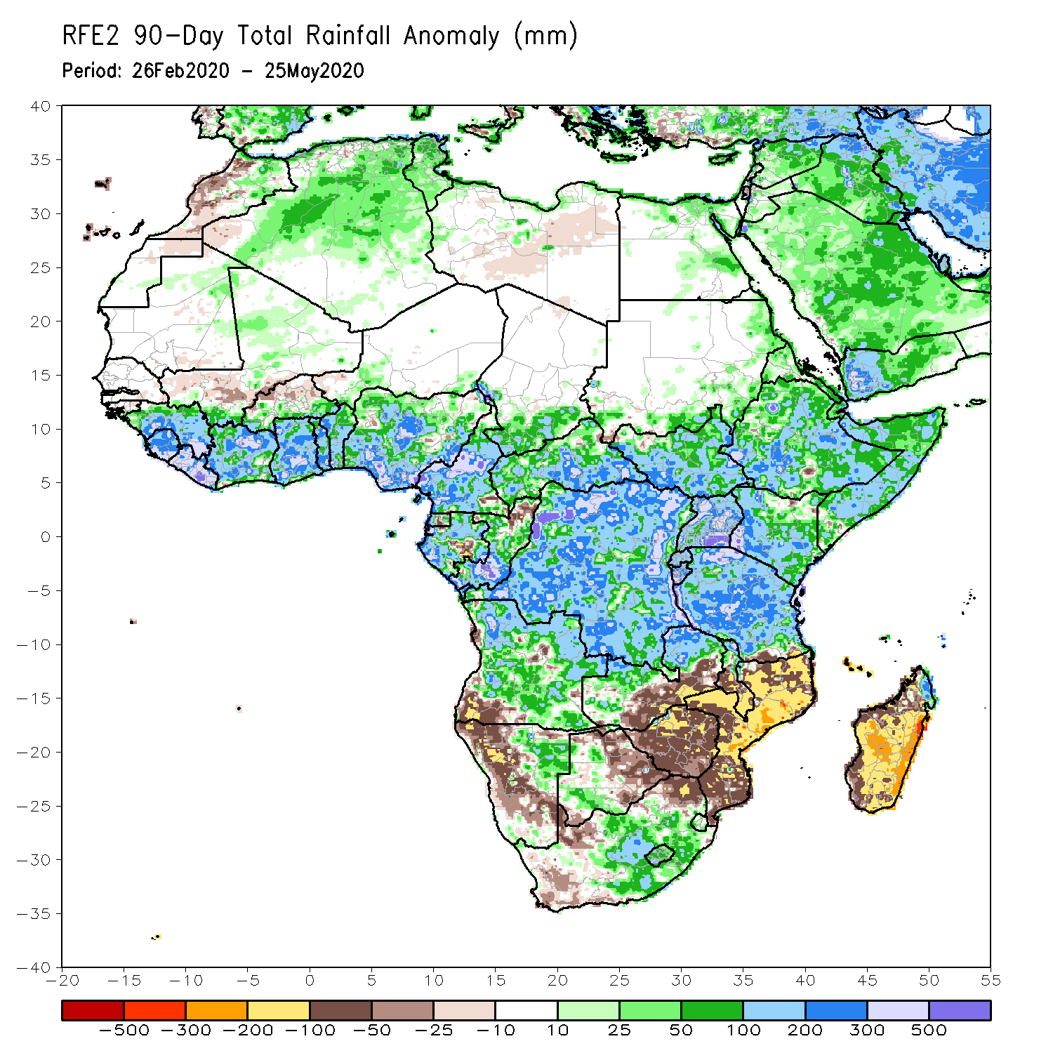
Rainfall Patterns: Last 90 Days
During the past 90 days, rainfall was above-average over many places in the Gulf of Guinea region, including Cameroon, and southern Chad, much of CAR, South Sudan, Gabon, Congo, DRC, Rwanda, Burundi, Uganda, Kenya, Eritrea, Ethiopia, Somalia, much of Tanzania, many parts of Angola and northern Zambia, northern Malawi, northeastern Namibia, western Botswana, portions of South Africa, and northern Madagascar.
Parts of southern Mali and Burkina Faso, southwestern Angola, western and southern Namibia, eastern Botswana, much of Zimbabwe, parts of southern Zambia, western South Arica, much of Mozambique, and central and southern Madagascar.
Notes:
6

Slide 7
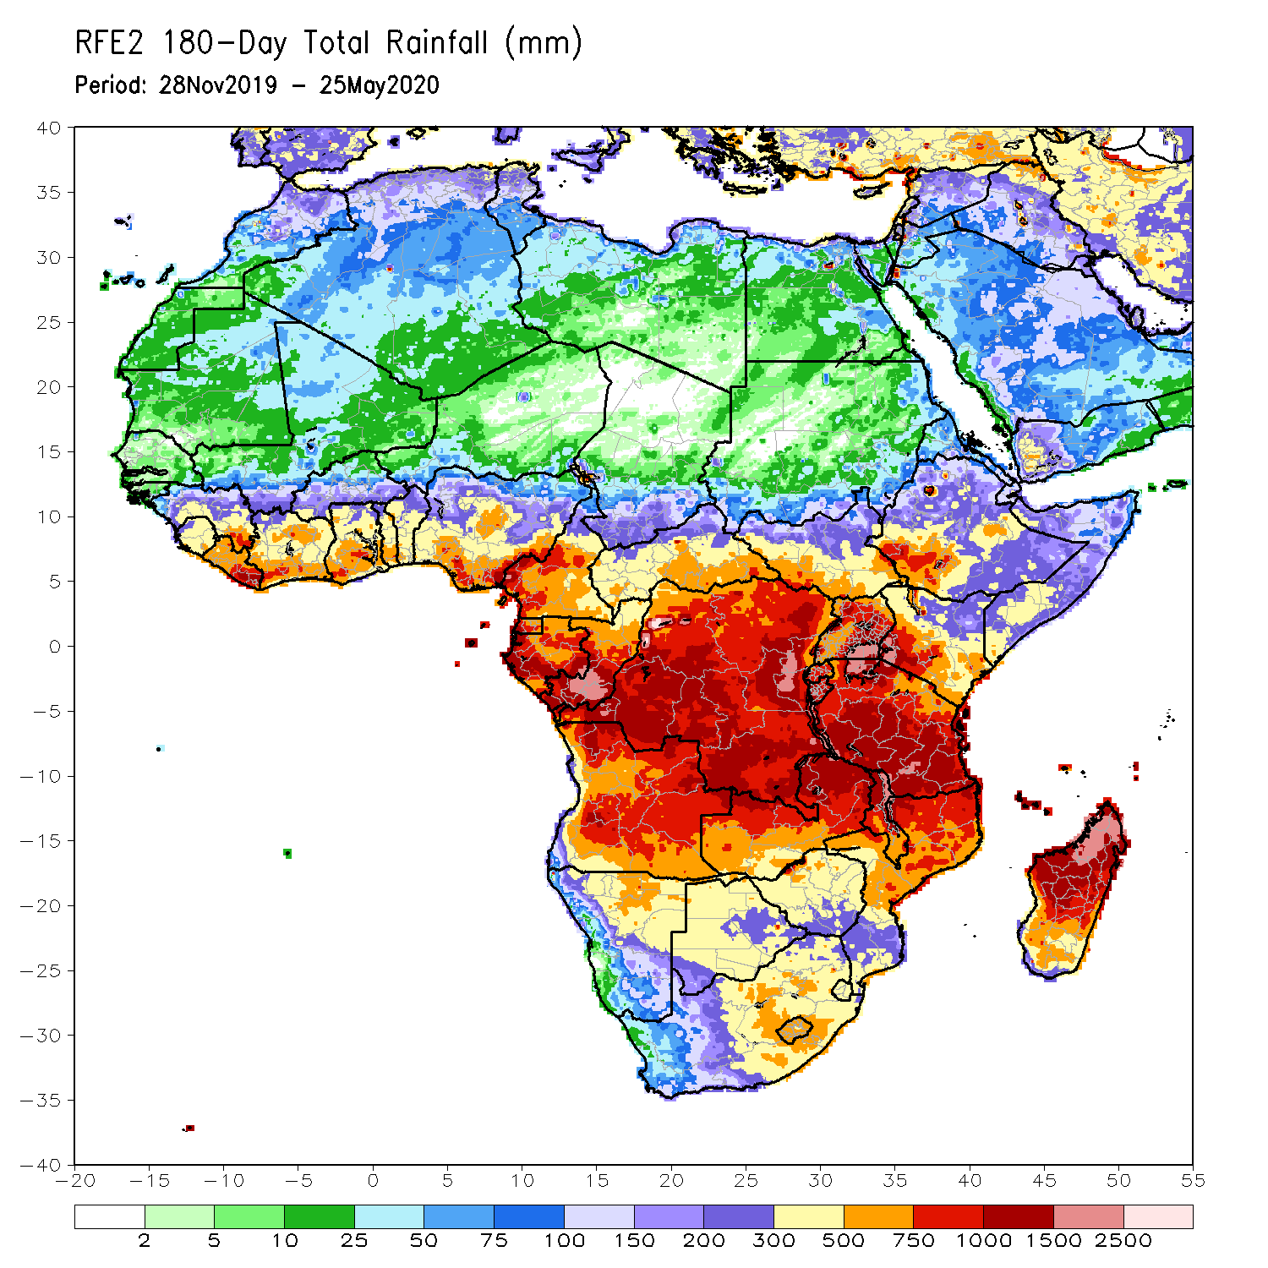
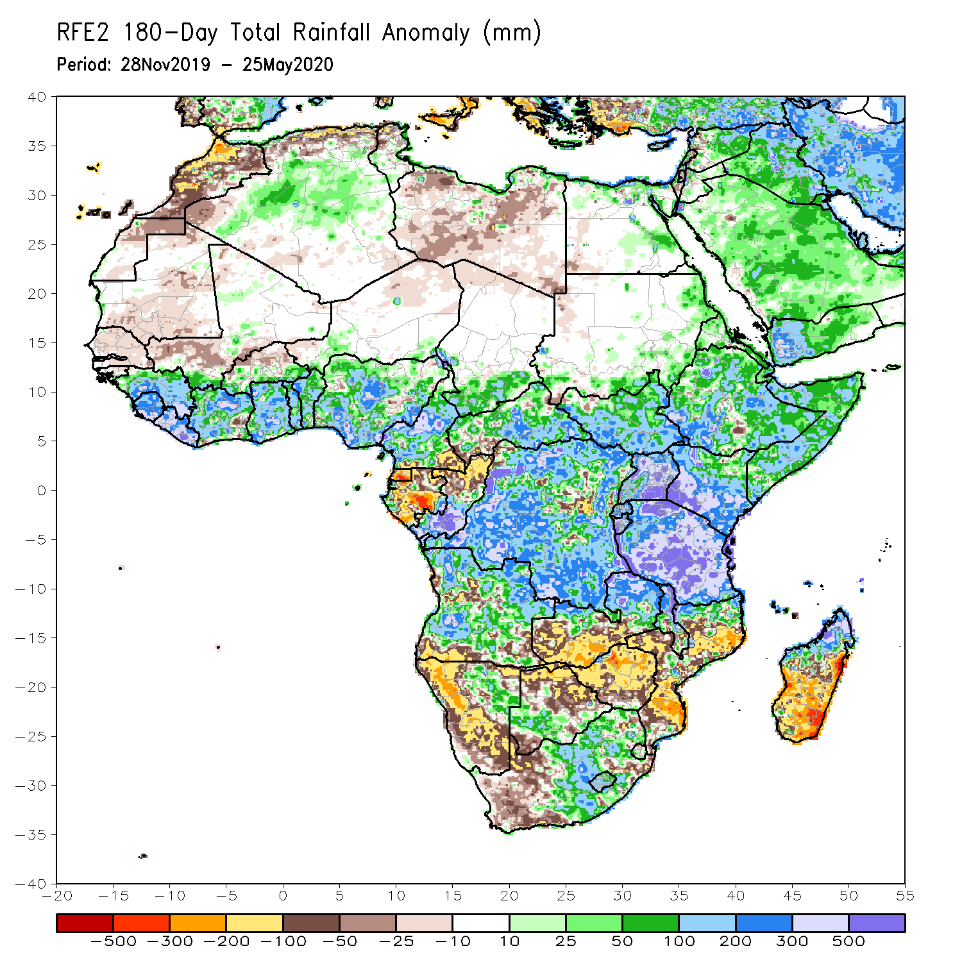
Rainfall Patterns: Last 180 Days
During the past 180 days, many places in the Gulf of Guinea region including Cameroon, southern Chad, much of CAR, DRC and South Sudan, Uganda, Eritrea, Ethiopia, much Somalia, Kenya, Tanzania, many parts of Angola, northeastern Namibia, northern Zambia, Malawi, parts of South Africa, portions of Mozambique and northern Madagascar had above-average rainfall.
Below-average rainfall was observed over Equatorial Guinea, Gabon, northern Congo, local areas in CAR and DRC, parts of Angola, western and southern Namibia, western South Africa, southern Zambia, northern and eastern Botswana, much of Zimbabwe, parts of Mozambique and southern Madagascar.
Notes:
7

Slide 8
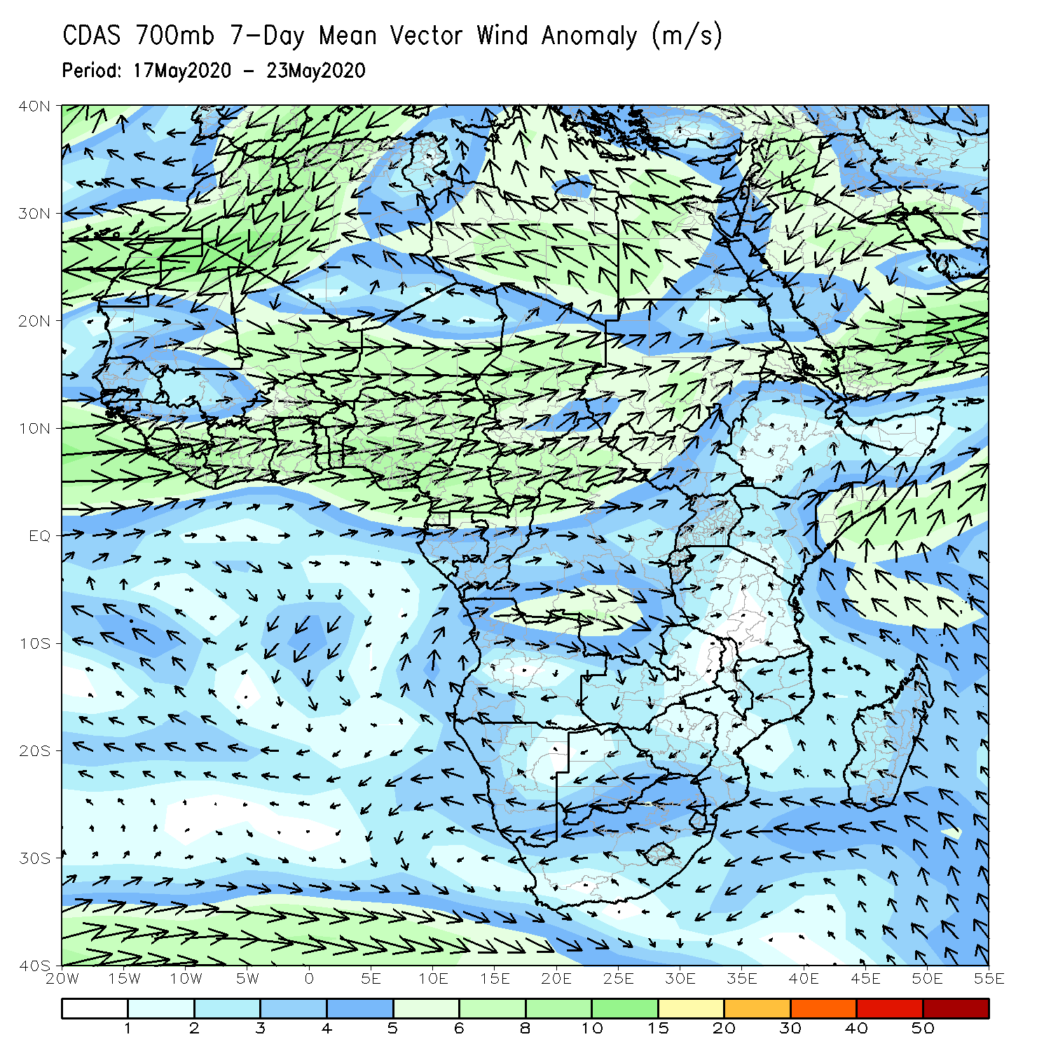
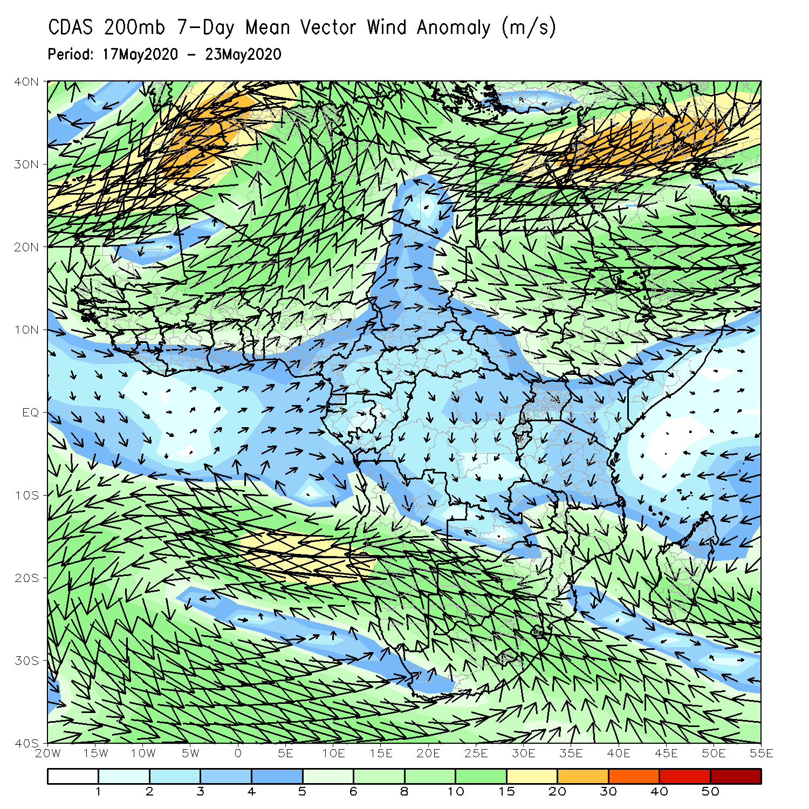
Atmospheric Circulation: Last 7 Days
A broad area of anomalous lower-level westerly flow prevailed across the Gulf of Guinea region (left panel).

Slide 9
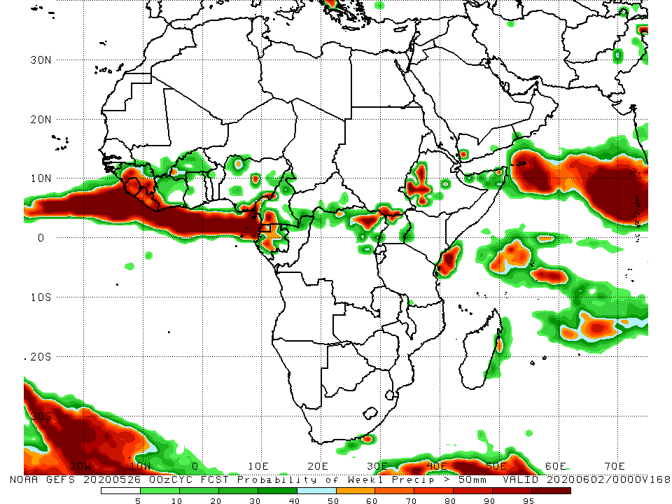
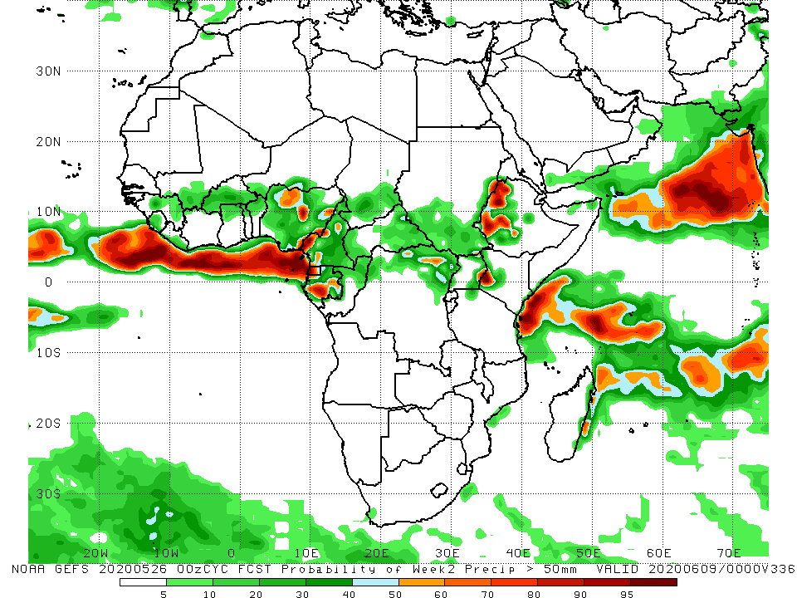
NCEP GEFS Model Forecasts Non-Bias Corrected Probability of precipitation exceedance
Week-1: 27 May – 2 June, 2020
Week-2: Valid 3 – 9 June, 2020
For week-1 (left panel) and week-2 (right panel), there is an increased chance for weekly rainfall totals to exceed 50mm over local areas in Nigeria, Cameroon, DRC and Ethiopia.
Notes:
9

Slide 10
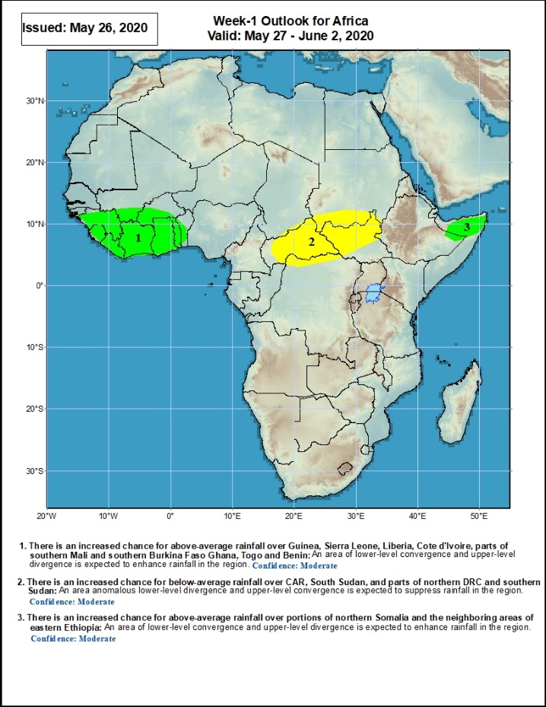
Week-1 Precipitation Outlooks
27 May – 2 June, 2020
There is an increased chance for above-average rainfall over Guinea, Sierra Leone, Liberia, Cote d'Ivoire, parts of southern Mali and southern Burkina Faso Ghana, Togo and Benin: An area of lower-level convergence and upper-level divergence is expected to enhance rainfall in the region. Confidence: Moderate
There is an increased chance for below-average rainfall over CAR, South Sudan, and parts of northern DRC and southern Sudan: An area anomalous lower-level divergence and upper-level convergence is expected to suppress rainfall in the region. Confidence: Moderate
There is an increased chance for above-average rainfall over portions of northern Somalia and the neighboring areas of eastern Ethiopia: An area of lower-level convergence and upper-level divergence is expected to enhance rainfall in the region Confidence: Moderate
Notes:
10

Slide 11
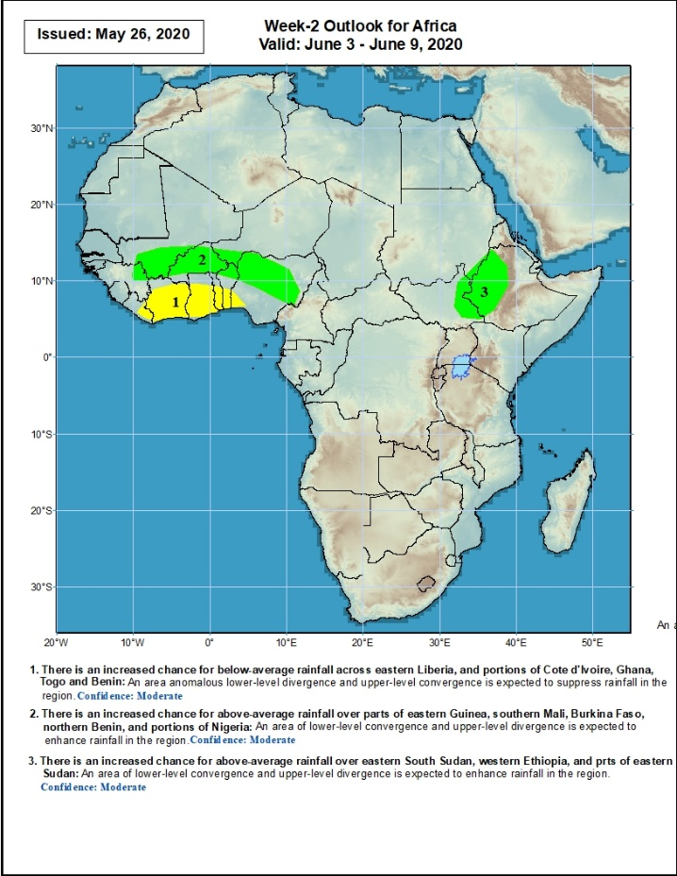
Week-2 Precipitation Outlooks
3 – 9 June, 2020
There is an increased chance for below-average rainfall across eastern Liberia, and portions of Cote d'Ivoire, Ghana, Togo and Benin: An area of anomalous lower-level divergence and upper-level convergence is expected to suppress rainfall in the region. Confidence: Moderate
There is an increased chance for above-average rainfall over parts of eastern Guinea, southern Mali, Burkina Faso, northern Benin, and portions of Nigeria: An area of lower-level convergence and upper-level divergence is expected to enhance rainfall in the region. Confidence: Moderate
There is an increased chance for above-average rainfall over eastern South Sudan, western Ethiopia, and parts of eastern Sudan: An area of lower-level convergence and upper-level divergence is expected to enhance rainfall in the region. Confidence: Moderate
Notes:
11

Slide 12
Summary
During the past 7 days, rainfall was above-average over parts of Guinea, Sierra Leone, Liberia, northern Cote d’Ivoire, Ghana, Togo, Benin, Nigeria, Cameroon, southern Chad, Gabon, southern Congo, CAR, northern DRC, South Sudan, Ethiopia and local areas in Uganda. Below-average rainfall was observed prts of western Guinea and southern Mali, central and southern Cote d’Ivoire, local areas in Nigeria and Cameroon, northern Congo, parts of DRC and western South Sudan, southern Ethiopia and southern Somalia.
During the past 30 days, rainfall was above-average over many places in the Gulf of Guinea region, including much of Cameroon, Gabon and Congo, CAR, much of DRC, South Sudan, Uganda, Eritrea, Ethiopia, western Kenya, Somalia, Burundi, local areas in Tanzania, northern Angola, and local areas in South Africa. Rainfall was below-average over parts of southern Mali, Burkina Faso, local areas in Cote d’Ivoire and Nigeria, western CAR, northern Congo, central and eastern Kenya, parts of southern Somalia, local area sin Mozambique, and much of Madagascar.
During the past 90 days, rainfall was above-average over many places in the Gulf of Guinea region, including Cameroon, and southern Chad, much of CAR, South Sudan, Gabon, Congo, DRC, Rwanda, Burundi, Uganda, Kenya, Eritrea, Ethiopia, Somalia, much of Tanzania, many parts of Angola and northern Zambia, northern Malawi, northeastern Namibia, western Botswana, portions of South Africa, and northern Madagascar. Parts of southern Mali and Burkina Faso, southwestern Angola, western and southern Namibia, eastern Botswana, much of Zimbabwe, parts of southern Zambia, western South Arica, much of Mozambique, and central and southern Madagascar.
Week-1 outlooks call for an increased chance for above-average rainfall over Guinea, Sierra Leone, Liberia, Cote d'Ivoire, parts of southern Mali and southern Burkina Faso Ghana, Togo, Benin and northern Somalia. In contrast, there is an increased chance for below-average rainfall over Central African Republic, South Sudan, and parts of northern DRC.
Notes:
12

