Slide 1
The African Monsoon Recent Evolution and Current Status Include Week-1 and Week-2 Outlooks
Update prepared by
Climate Prediction Center / NCEP
15 June 2020
For more information, visit:
http://www.cpc.ncep.noaa.gov/products/Global_Monsoons/African_Monsoons/precip_monitoring.shtml

Slide 2
Outline
Highlights
Recent Evolution and Current Conditions
NCEP GEFS Forecasts
Summary

Slide 3
Highlights: Last 7 Days
Above-average rainfall was observed over many places in West and Central Africa, and much of South Sudan and western Ethiopia.
Rainfall surpluses exceeded 100mm over local areas in Guinea, Mali, Burkina Faso, Nigeria, Congo, DRC, South Sudan and Ethiopia.
Week-1 outlooks call for an increased chance for above-average rainfall over western Guinea, Sierra Leone, Liberia, eastern Nigeria, Cameroon, Equatorial Guinea, Gabon and western Congo. In contrast, there is an increased chance for below-average rainfall over portions of northern DRC.

Slide 4
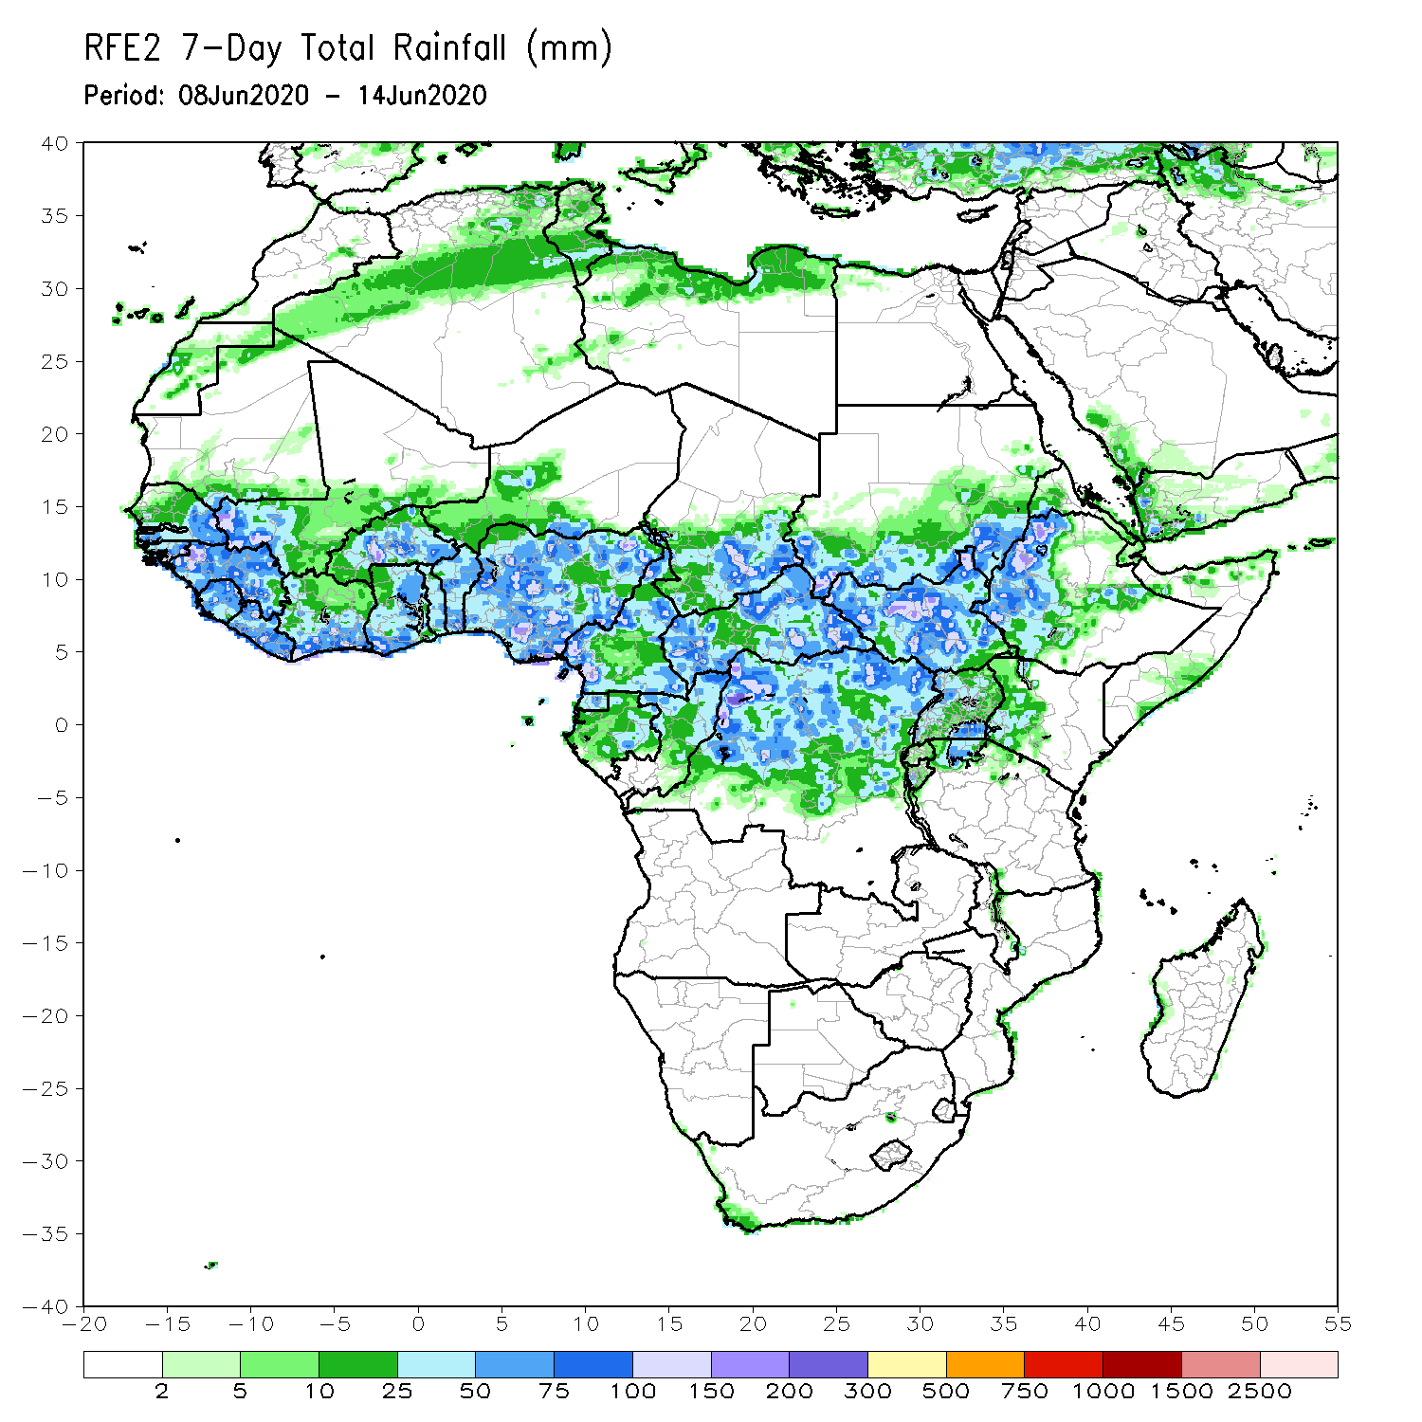
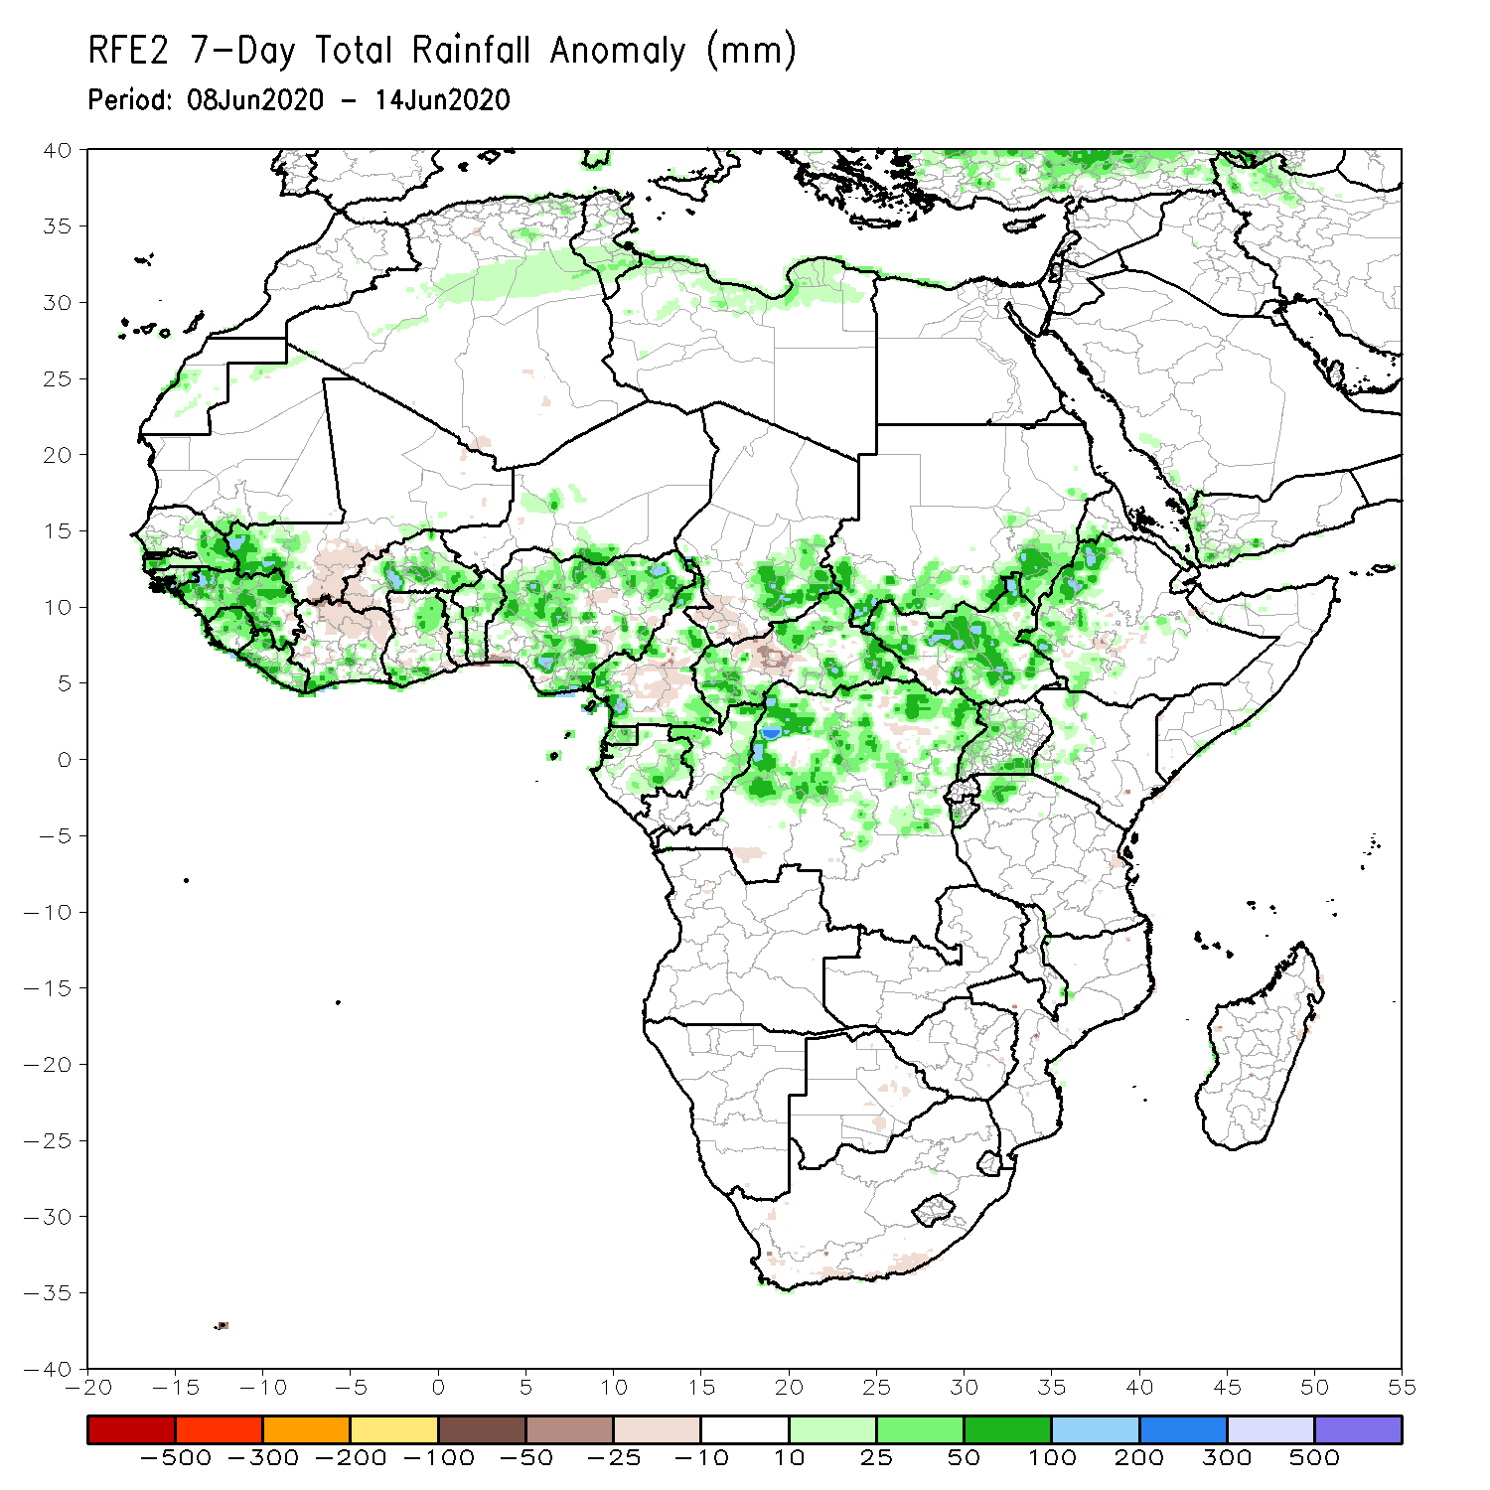
Rainfall Patterns: Last 7 Days
During the past 7 days, rainfall was above-average over eastern Senegal, much of Guinea, southwestern Mali, Liberia, local areas in Cote d’Ivoire and Ghana, Burkina Faso, Togo, Benin, Nigeria, parts of Cameroon and Chad, Gabon, northern Congo, much of CAR, northern DRC, southern Sudan, much of South Sudan, parts of Uganda and western Ethiopia.
Below-average rainfall was observed over southern Mali, northern Cote d’Ivoire, local areas in Ghana and Nigeria, portions of Cameroon, southwestern Chad, and local areas in CAR and South Sudan.

Slide 5
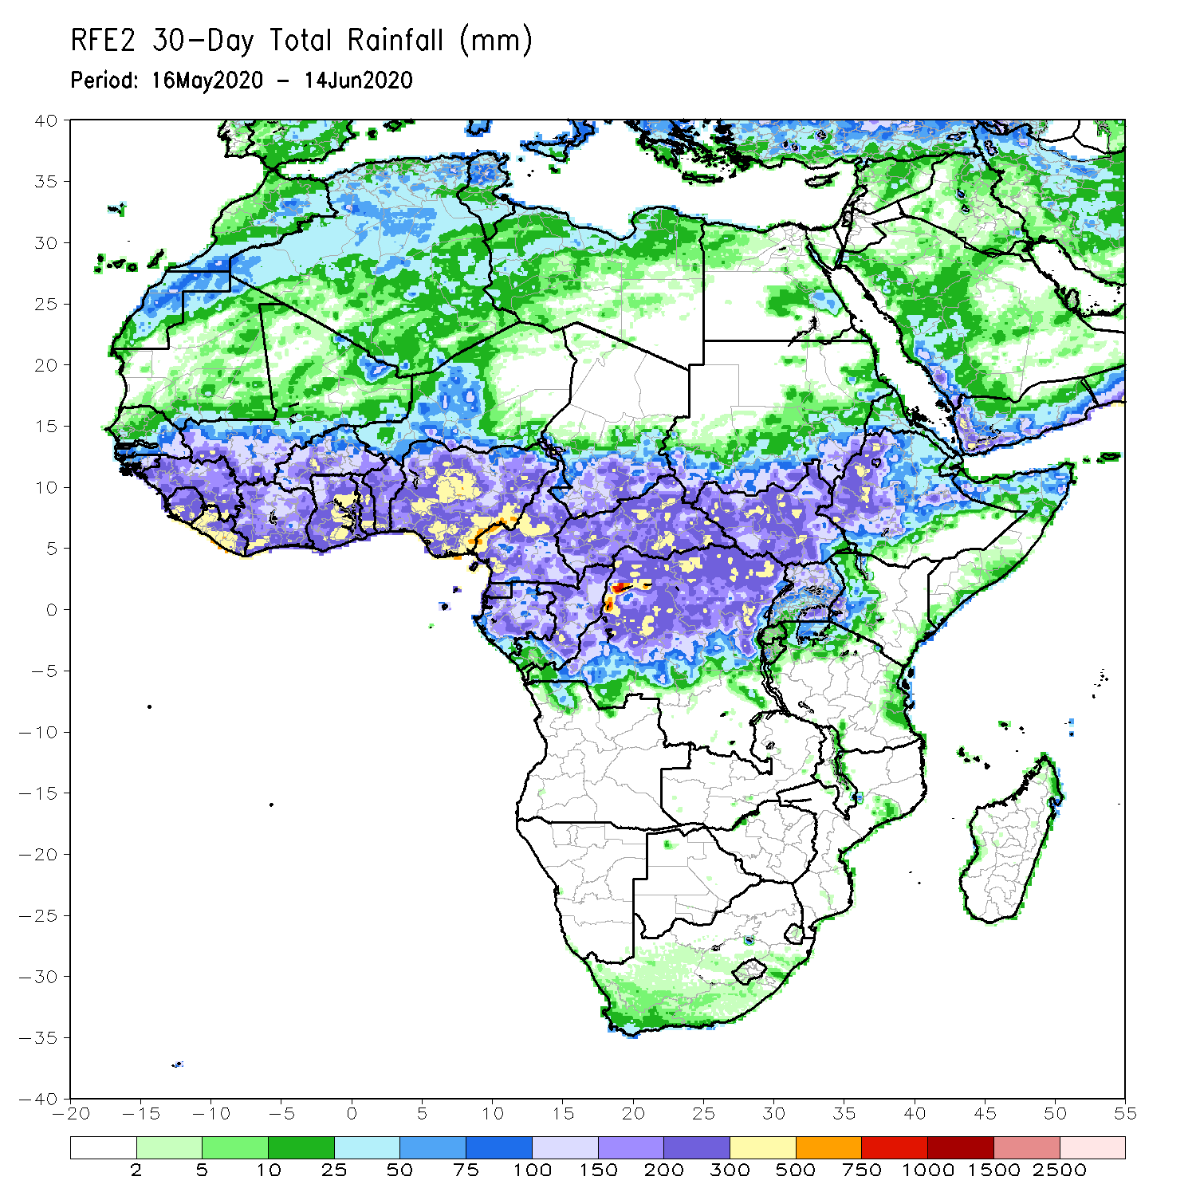
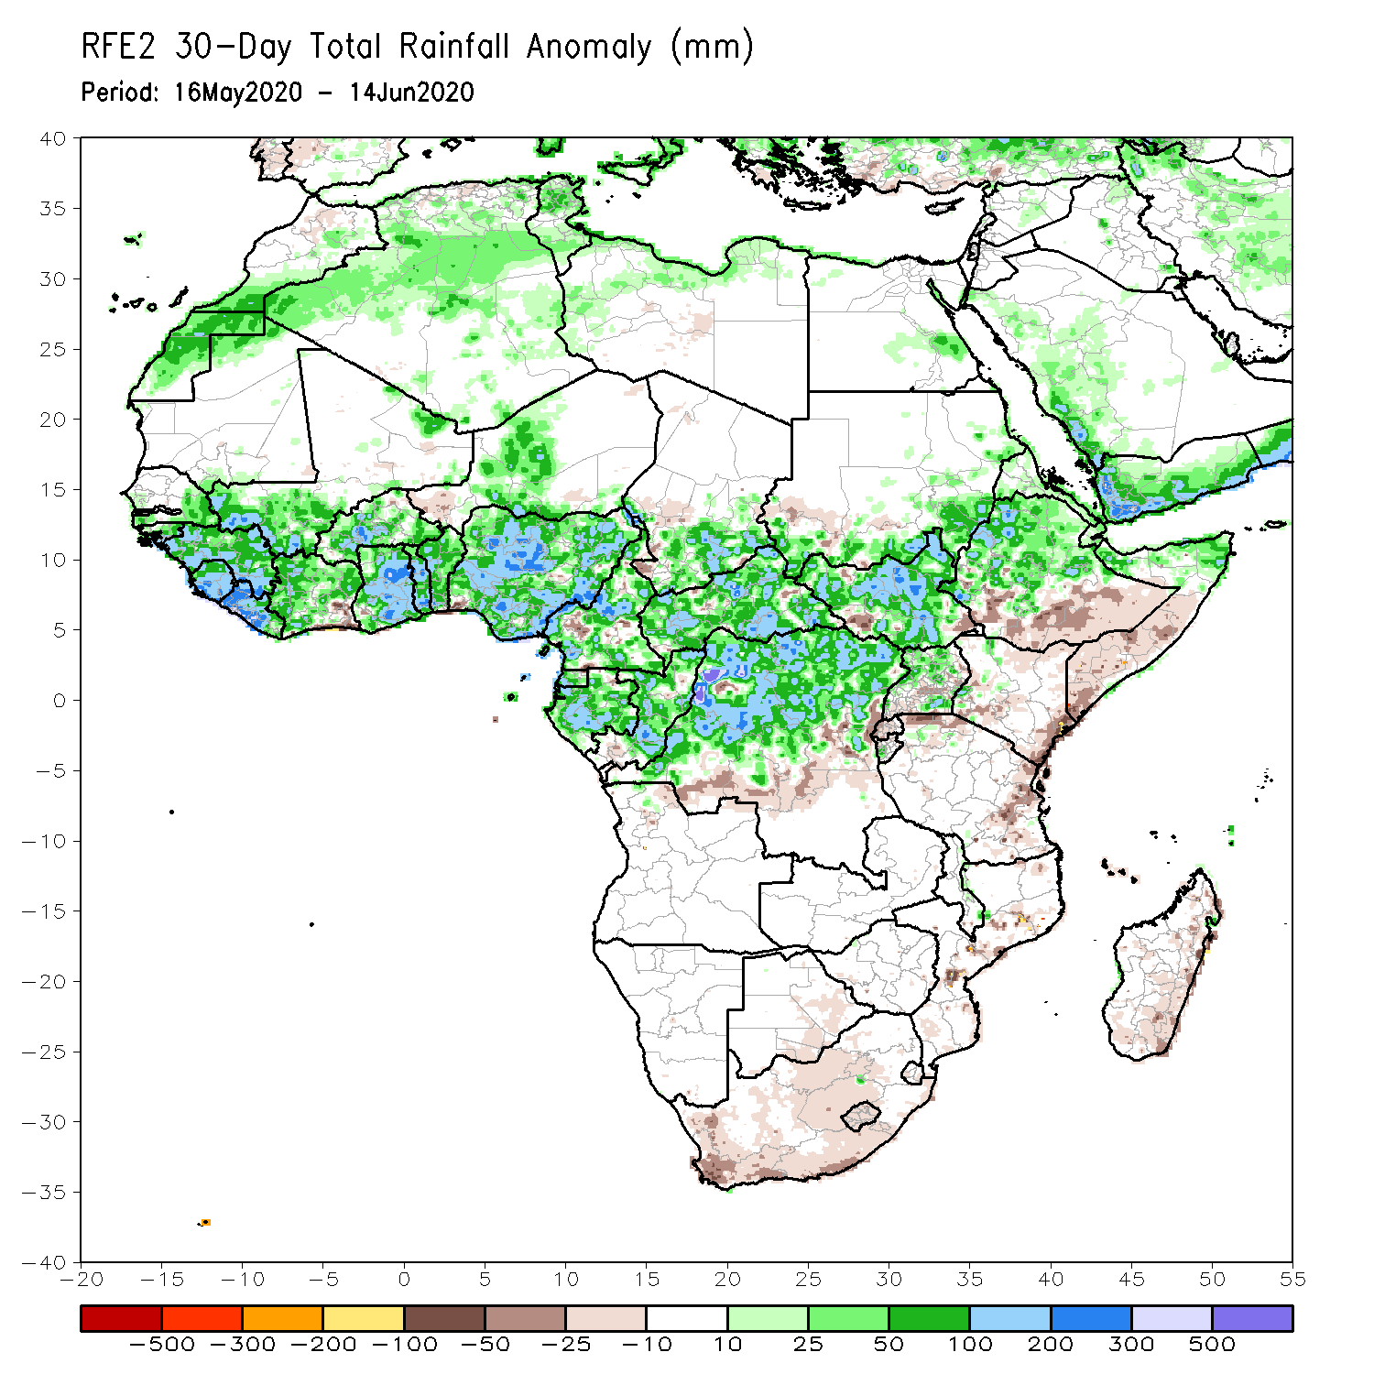
Rainfall Patterns: Last 30 Days
During the past 30 days, rainfall was above-average over many places in the Gulf of Guinea and Central Africa countries. Above-average rainfall was also observed over South Sudan, parts of eastern Sudan, Uganda, Eritrea, central and northern Ethiopia, local areas in western Kenya, and northern Somalia.
Rainfall was below-average over local areas in southeastern Cote d’Ivoire, western Niger, local areas in Cameroon, Congo and DRC, Rwanda, Burundi, local areas in Uganda and southern Sudan, southeastern Kenya, parts of eastern Tanzania, central and southern Somalia, southern Ethiopia, and local area in Mozambique, South Africa and Madagascar.
Notes:
5

Slide 6
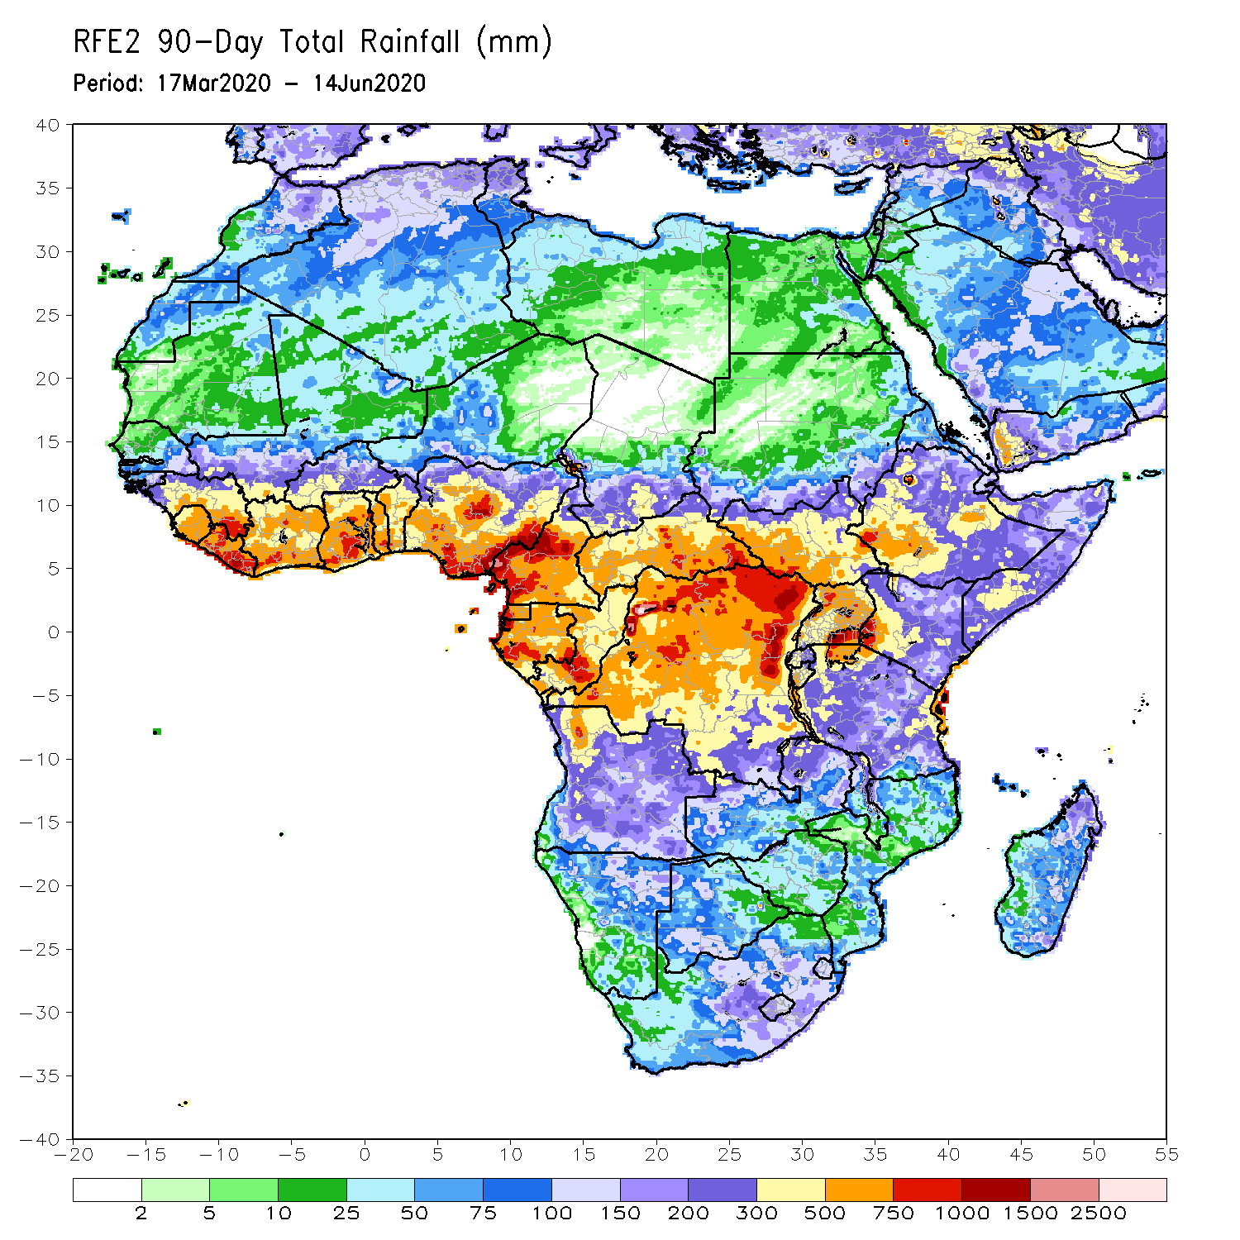
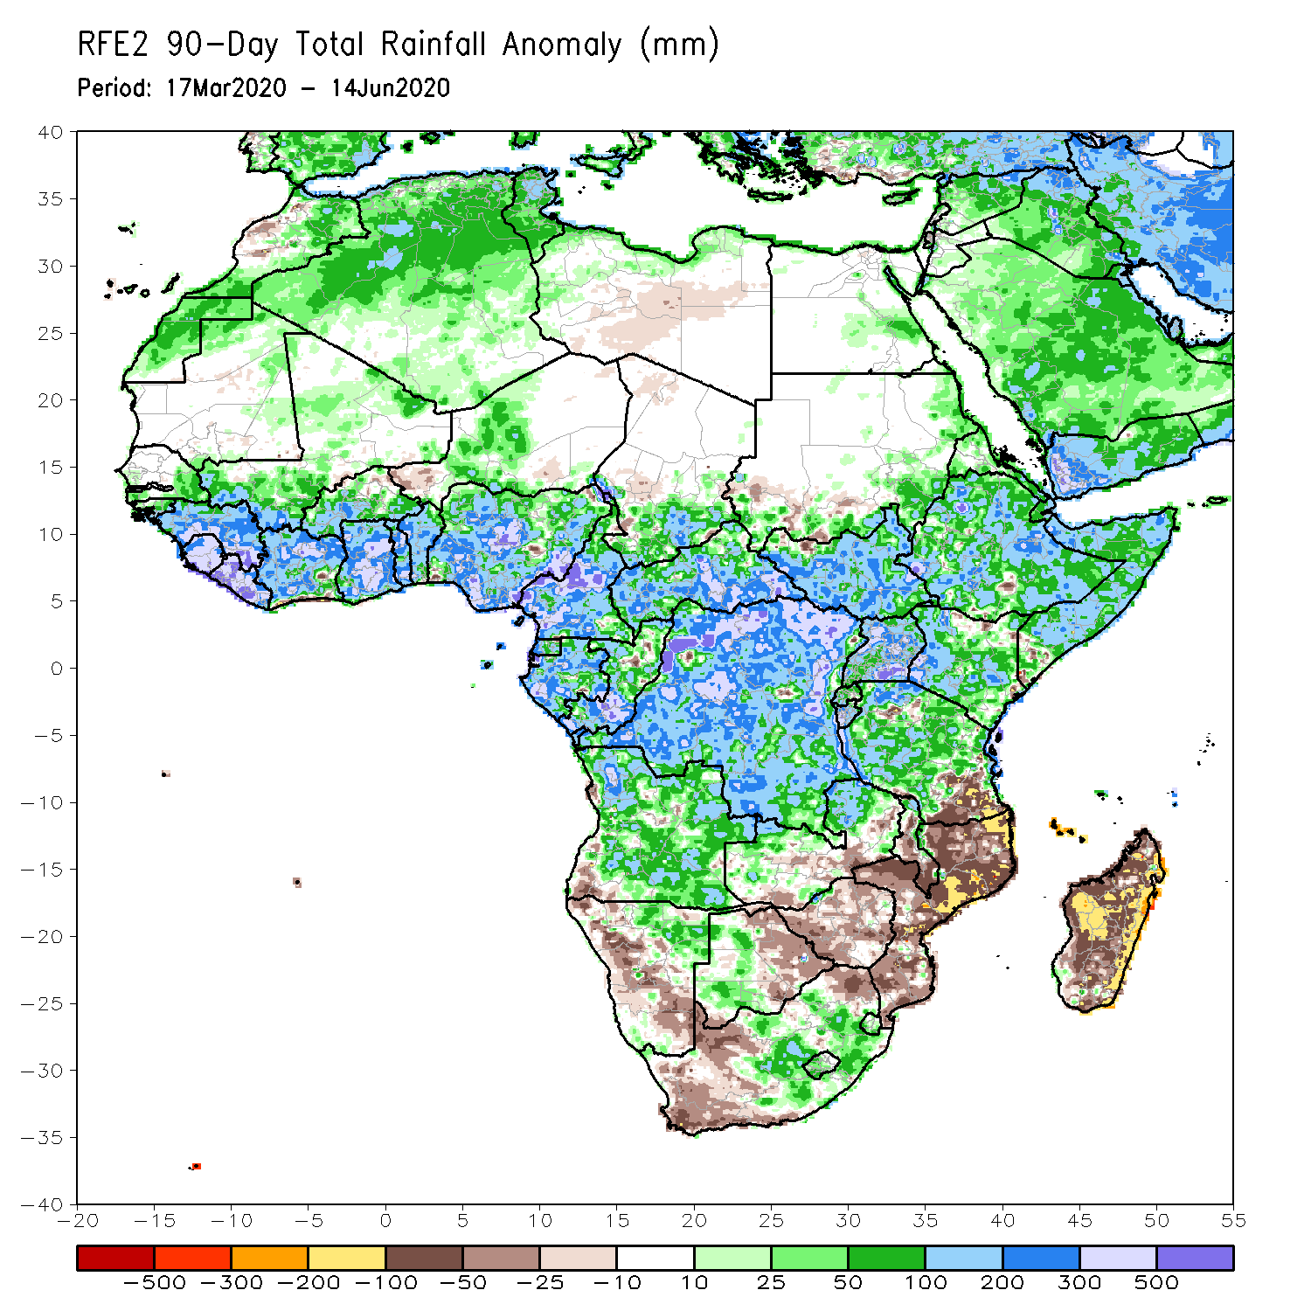
Rainfall Patterns: Last 90 Days
During the past 90 days, rainfall was above-average over much of West, Central and the Greater Horn of Africa, including the northern portions of Southern Africa. Rainfall was also above-average over northeastern Namibia, western Botswana, and portions of South Africa.
Local areas in Burkina Faso, western Niger, southern Sudan, southwestern Angola, western and southern Namibia, eastern Botswana, much of Zimbabwe, parts of southern Zambia, western South Arica, much of Mozambique, and much of Madagascar had below-average rainfall.
Notes:
6

Slide 7
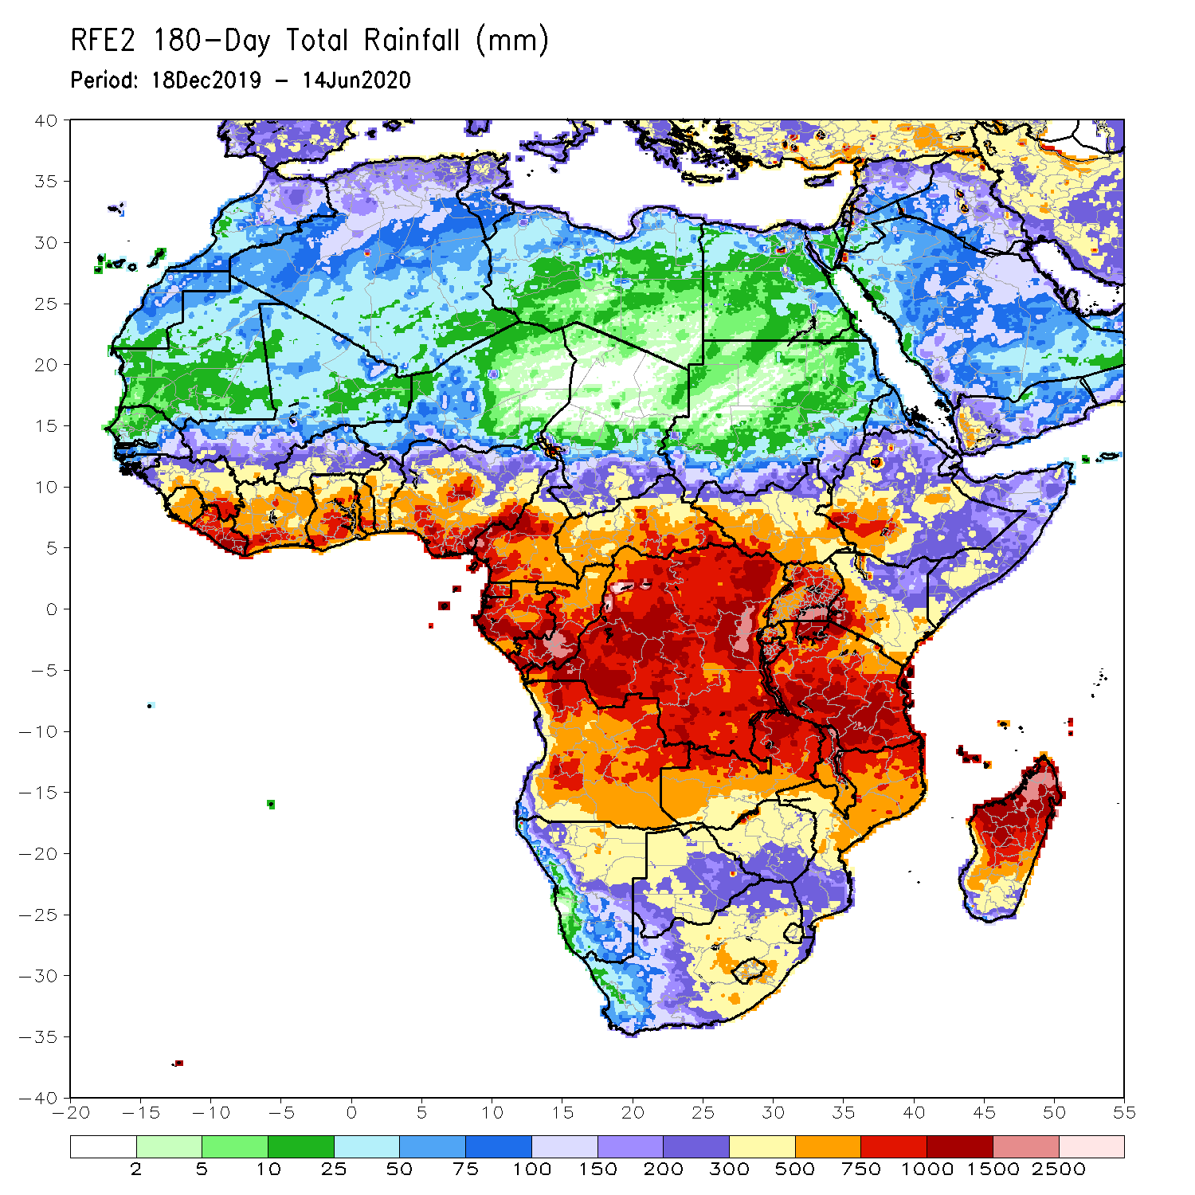
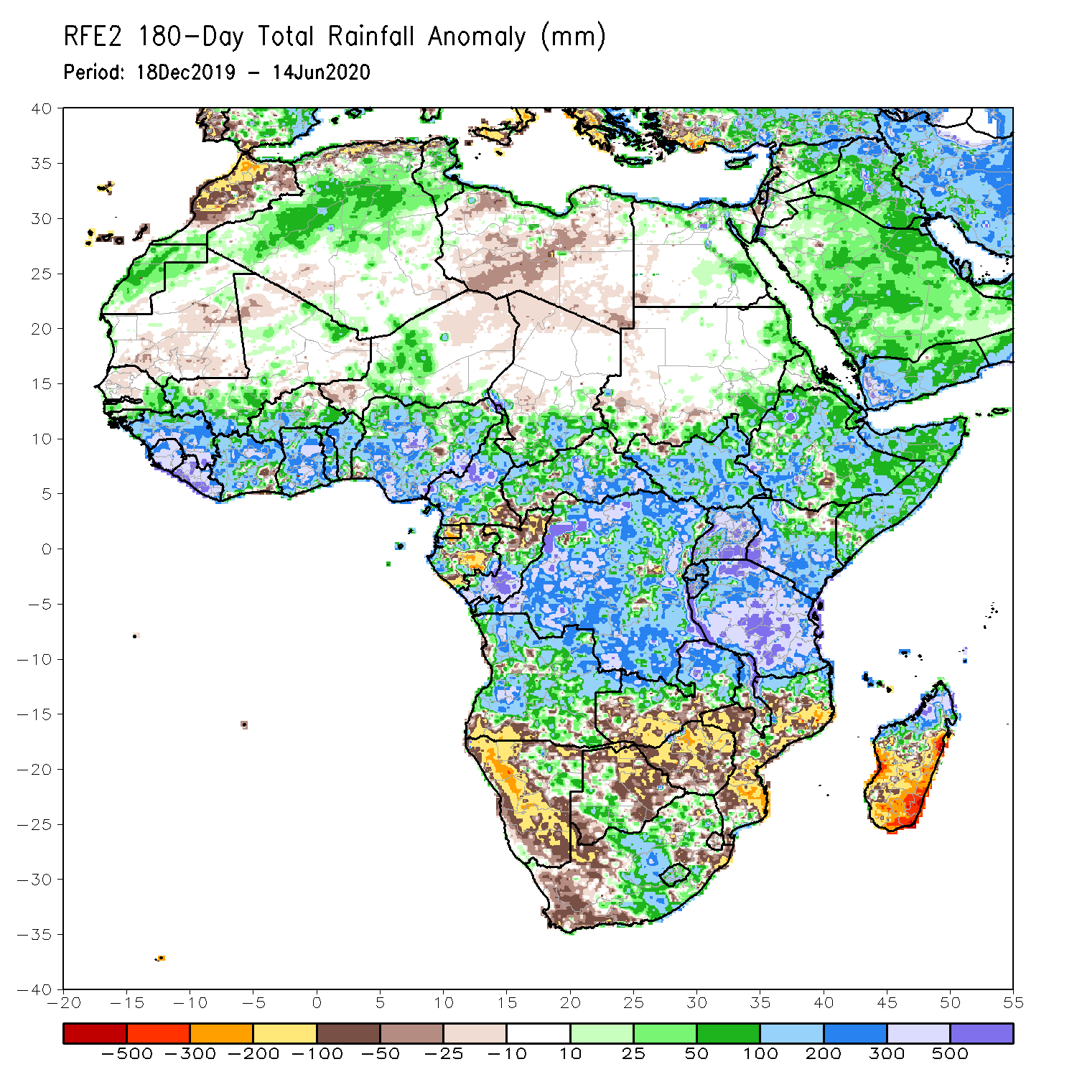
Rainfall Patterns: Last 180 Days
During the past 180 days, rainfall was above-average over much of West, Central and the Greater Horn of Africa, including the northern portions of Southern Africa. Rainfall was also above-average over northeastern Namibia, western Botswana, portions of South Africa, and northern Madagascar.
Below-average rainfall was observed over local areas in Cote d’Ivoire and Nigeria, parts of western Niger, local areas in Cameroon, Equatorial Guinea, parts of Gabon, northern Congo, local areas in DRC and Angola, western and southern Namibia, western South Africa, southern Zambia, northern and eastern Botswana, much of Zimbabwe, many parts of Mozambique and southern Madagascar.
Notes:
7

Slide 8
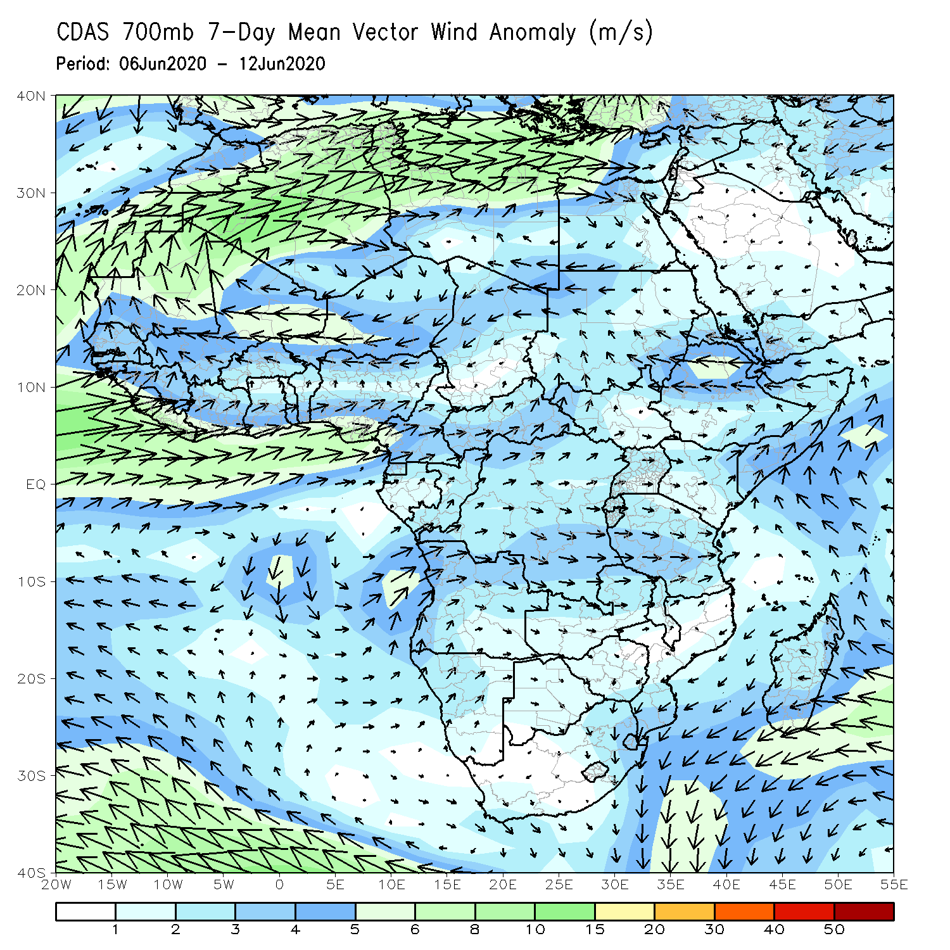
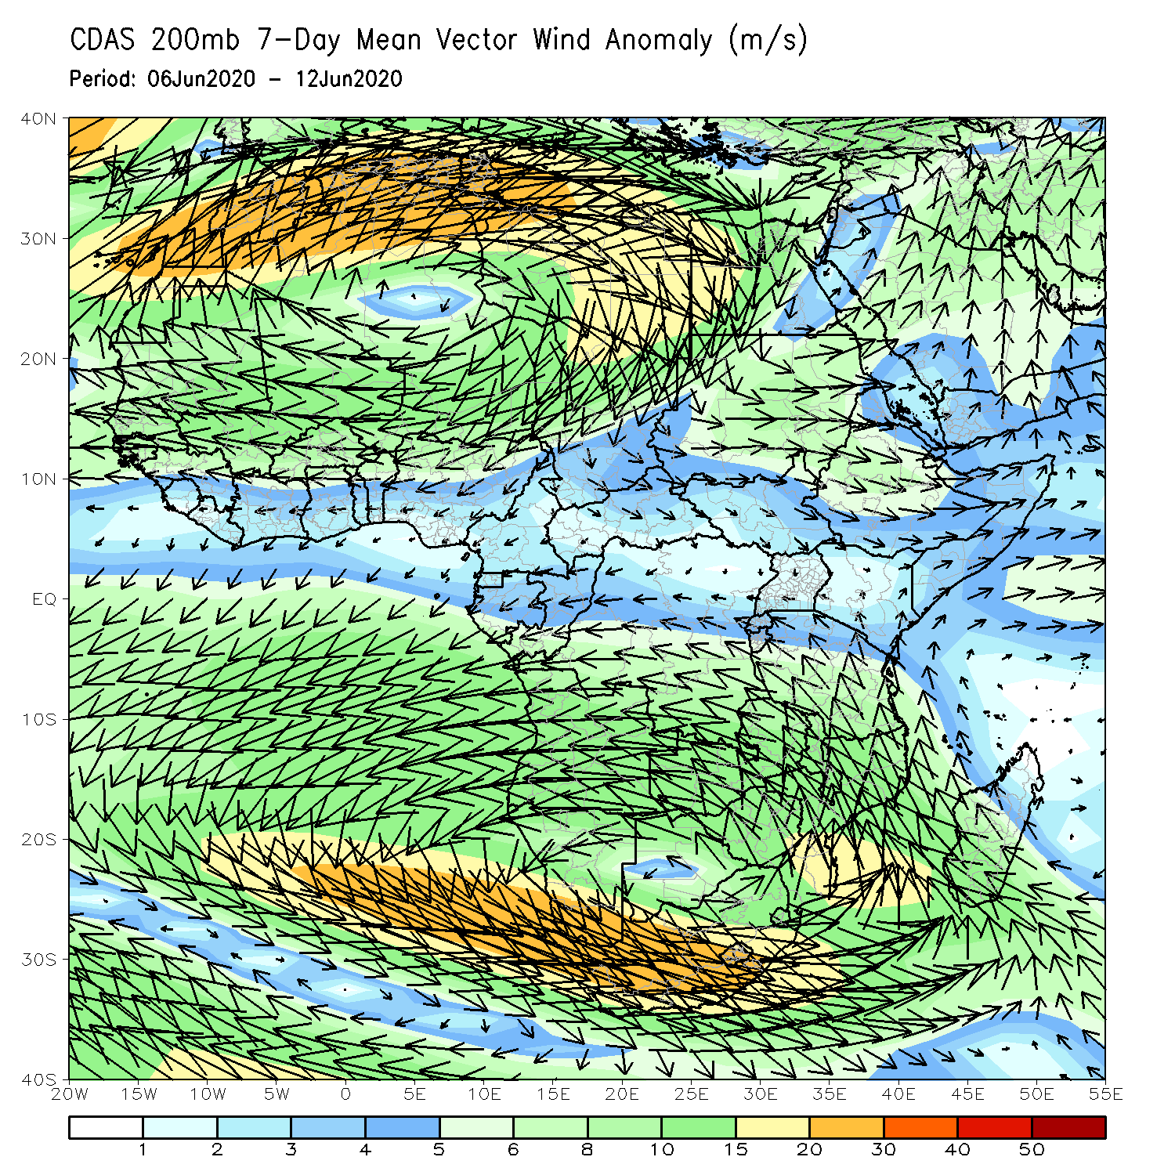
Atmospheric Circulation: Last 7 Days
Anomalous lower-level cyclonic shear (left panel) may have contributed to the observed above-average rainfall over much of West Africa.

Slide 9
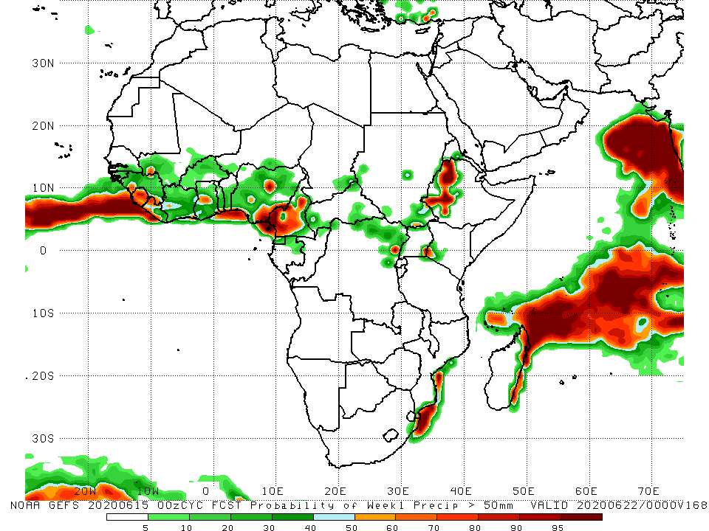
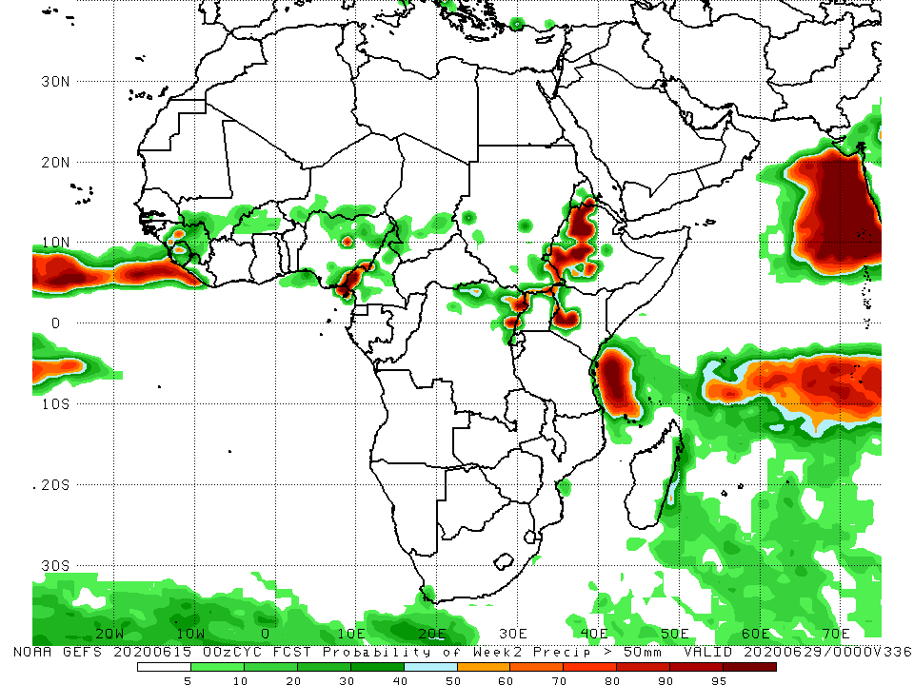
NCEP GEFS Model Forecasts Non-Bias Corrected Probability of precipitation exceedance
Week-1 Valid 16 – 22 June, 2020
Week-2: Valid 23 – 29 June, 2020
For week-1 (left panel) and week-2 (right panel), there is an increased chance for weekly rainfall totals to exceed 50mm over local areas in Guinea, Mai, Sierra Leone, Liberia, Ghana, Nigeria, Cameroon, DRC, western Kenya and western Ethiopia.
Notes:
9

Slide 10
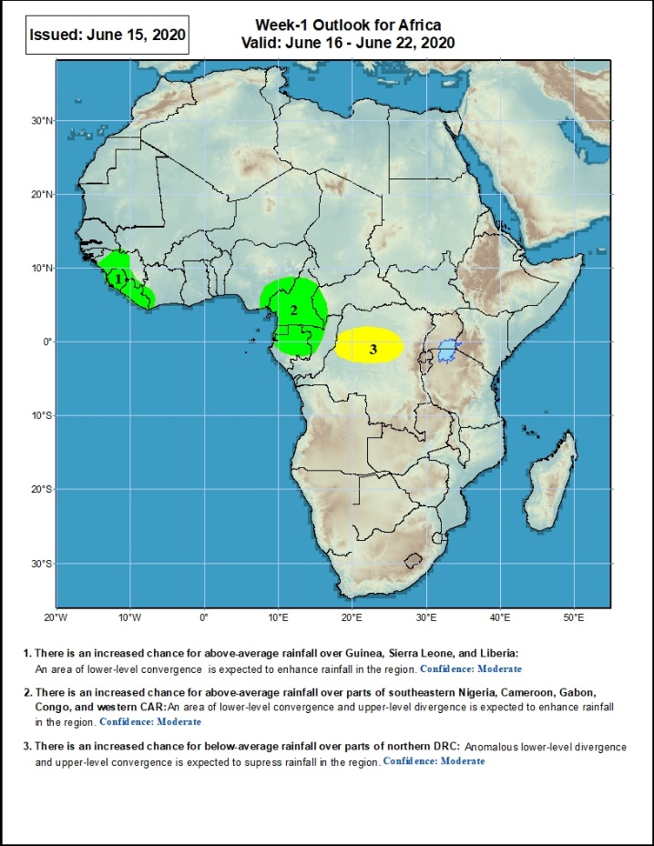
Week-1 Precipitation Outlooks
16 – 22 June, 2020
There is an increased chance for above-average rainfall over western Guinea, Sierra Leone and Liberia: An area of anomalous lower-level convergence and upper-level divergence is expected to enhance rainfall in the region. Confidence: Moderate
There is an increased chance for above-average rainfall over eastern Nigeria, Cameroon, Equatorial Guinea, Gabon and western Congo: An area of anomalous lower-level convergence and upper-level divergence is expected to enhance rainfall in the region. Confidence: Moderate
There is an increased chance for below-average rainfall over parts of northern DRC: An area of anomalous lower-level divergence and upper-level Convergence is expected to suppress rainfall in the region. Confidence: Moderate
Notes:
10

Slide 11
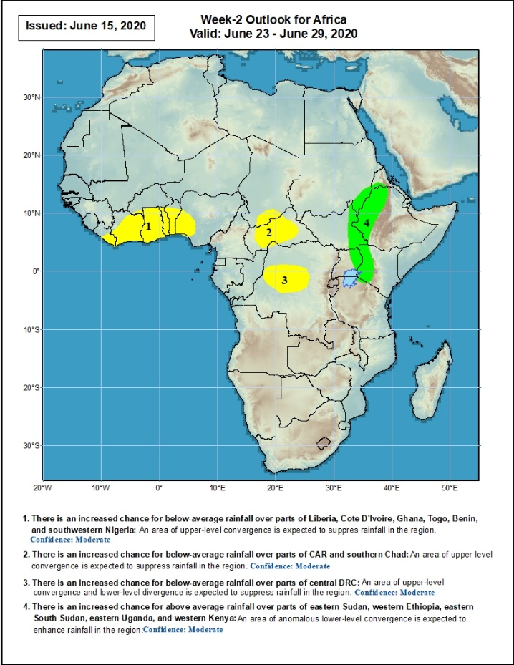
Week-2 Precipitation Outlooks
23 – 29 June, 2020
There is an increased chance for below-average rainfall over eastern Liberia, Cote d’Ivoire, Ghana, Togo, Benin, and western Nigeria: An area of lower-level divergence and upper-level convergence is expected to suppress rainfall in the region. Confidence: Moderate
There is an increased chance for below-average rainfall over parts of southern Chad, and CAR: An area of lower-level divergence and upper-level convergence is expected to suppress rainfall in the region. Confidence: Moderate
There is an increased chance for below-average rainfall over parts of northern DRC: An area of lower-level divergence and upper-level convergence is expected to suppress rainfall in the region. Confidence: Moderate
There is an increased chance for above-average rainfall over parts of eastern Sudan, eastern South Sudan, eastern Uganda, western Ethiopia, and western Kenya: An area of lower-level convergence and upper-level divergence is expected to enhance rainfall in the region. Confidence: Moderate
Notes:
11

Slide 12
Summary
During the past 7 days, rainfall was above-average over eastern Senegal, much of Guinea, southwestern Mali, Liberia, local areas in Cote d’Ivoire and Ghana, Burkina Faso, Togo, Benin, Nigeria, parts of Cameroon and Chad, Gabon, northern Congo, much of CAR, northern DRC, southern Sudan, much of South Sudan, parts of Uganda and western Ethiopia. Below-average rainfall was observed over southern Mali, northern Cote d’Ivoire, local areas in Ghana and Nigeria, portions of Cameroon, southwestern Chad, and local areas in CAR and South Sudan.
During the past 30 days, rainfall was above-average over many places in the Gulf of Guinea and Central Africa countries. Above-average rainfall was also observed over South Sudan, parts of eastern Sudan, Uganda, Eritrea, central and northern Ethiopia, local areas in western Kenya, and northern Somalia. Rainfall was below-average over local areas in southeastern Cote d’Ivoire, western Niger, local areas in Cameroon, Congo and DRC, Rwanda, Burundi, local areas in Uganda and southern Sudan, southeastern Kenya, parts of eastern Tanzania, central and southern Somalia, southern Ethiopia, and local area in Mozambique, South Africa and Madagascar.
During the past 90 days, rainfall was above-average over much of West, Central and the Greater Horn of Africa, including the northern portions of Southern Africa. Rainfall was also above-average over northeastern Namibia, western Botswana, and portions of South Africa. Local areas in Burkina Faso, western Niger, southern Sudan, southwestern Angola, western and southern Namibia, eastern Botswana, much of Zimbabwe, parts of southern Zambia, western South Arica, much of Mozambique, and much of Madagascar had below-average rainfall.
Week-1 outlooks call for an increased chance for above-average rainfall over western Guinea, Sierra Leone, Liberia, eastern Nigeria, Cameroon, Equatorial Guinea, Gabon and western Congo. In contrast, there is an increased chance for below-average rainfall over portions of northern DRC.
Notes:
12

