Slide 1
The African Monsoon Recent Evolution and Current Status Include Week-1 and Week-2 Outlooks
Update prepared by
Climate Prediction Center / NCEP
22 June 2020
For more information, visit:
http://www.cpc.ncep.noaa.gov/products/Global_Monsoons/African_Monsoons/precip_monitoring.shtml

Slide 2
Outline
Highlights
Recent Evolution and Current Conditions
NCEP GEFS Forecasts
Summary

Slide 3
Highlights: Last 7 Days
Rainfall surpluses exceeded 100mm over local areas in Benin, Nigeria, Cameroon, DRC, South Sudan and Ethiopia.
Week-1 outlooks call for an increased chance for below-average rainfall over eastern Liberia, Cote d’Ivoire, Ghana, southwestern Burkina Faso, Togo, Benin, western Nigeria, and parts of northern DRC. In contrast, there is an increased chance for above-average rainfall over northeastern DRC, Uganda, Rwanda, western Kenya, southeastern South Sudan, and southwestern Ethiopia.

Slide 4
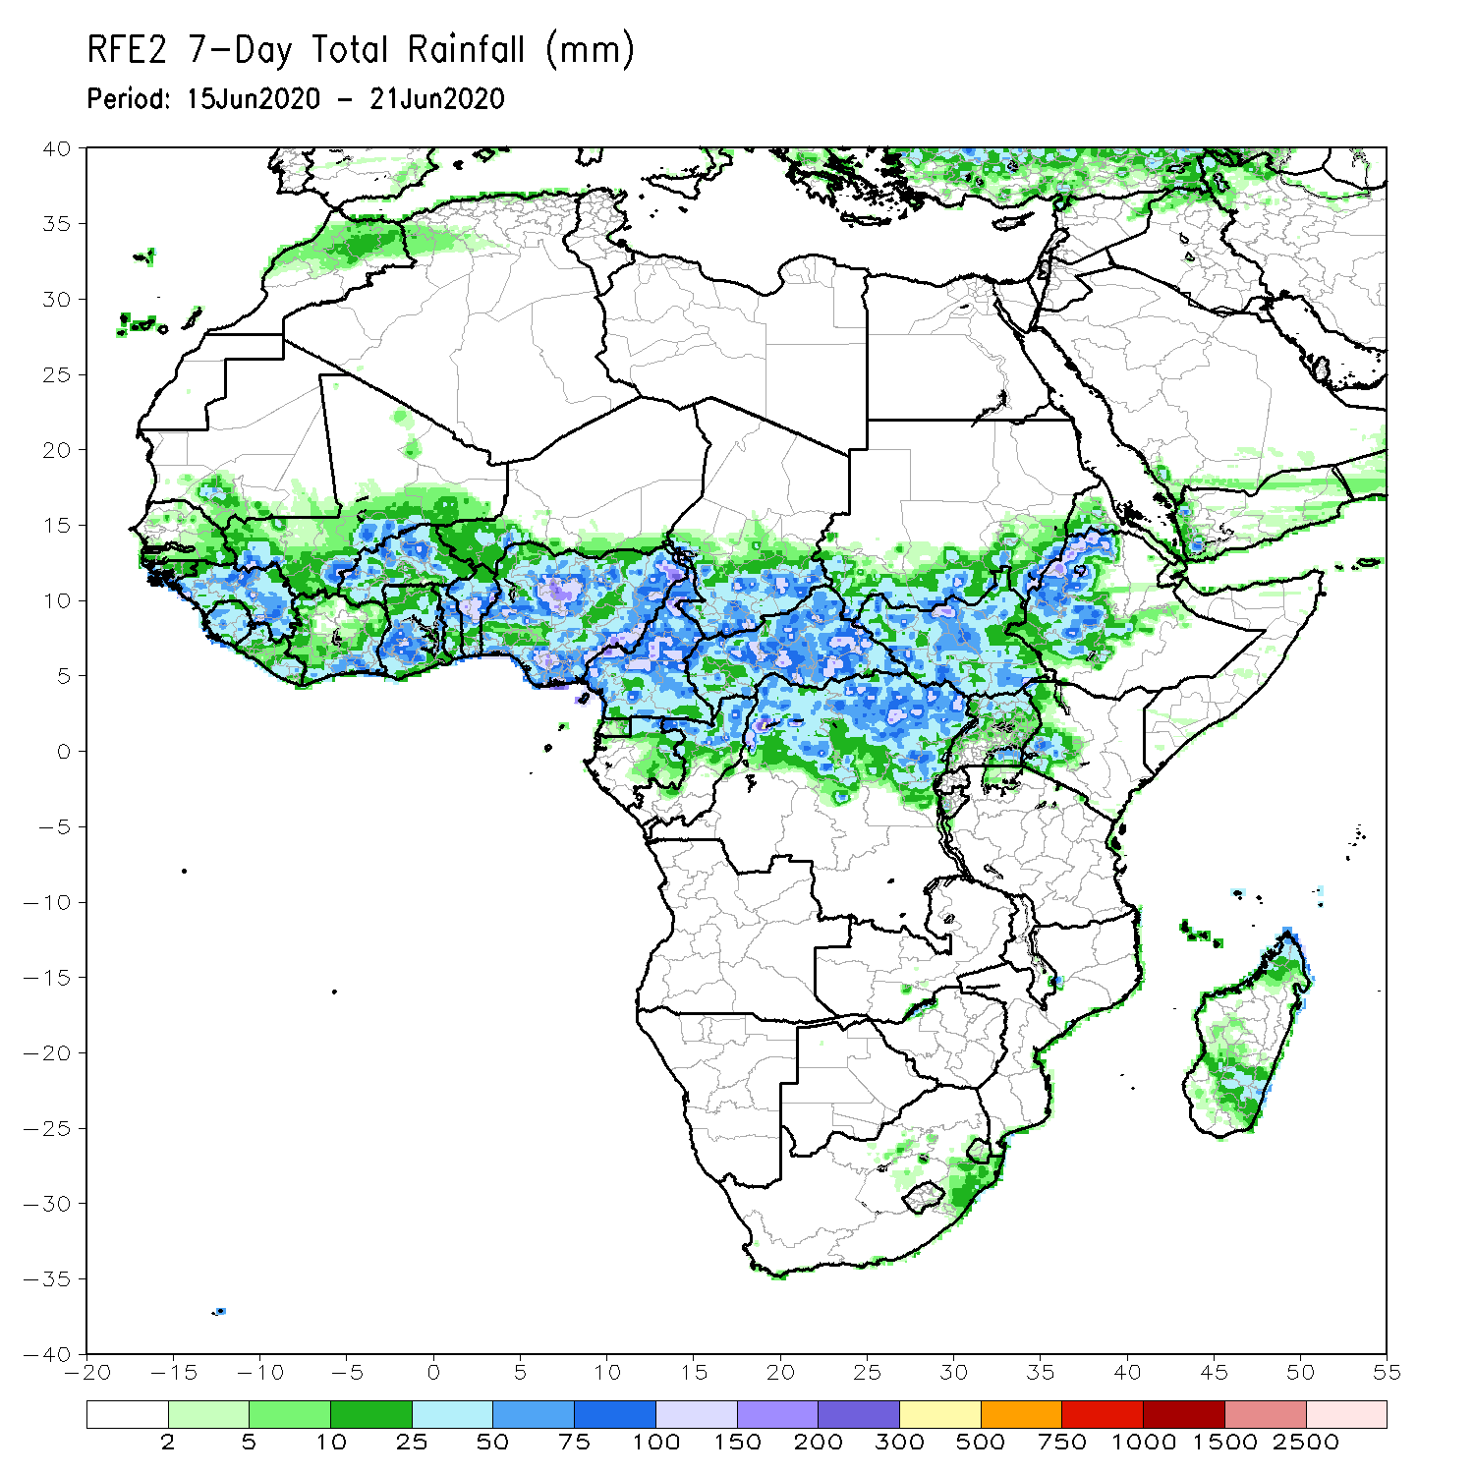
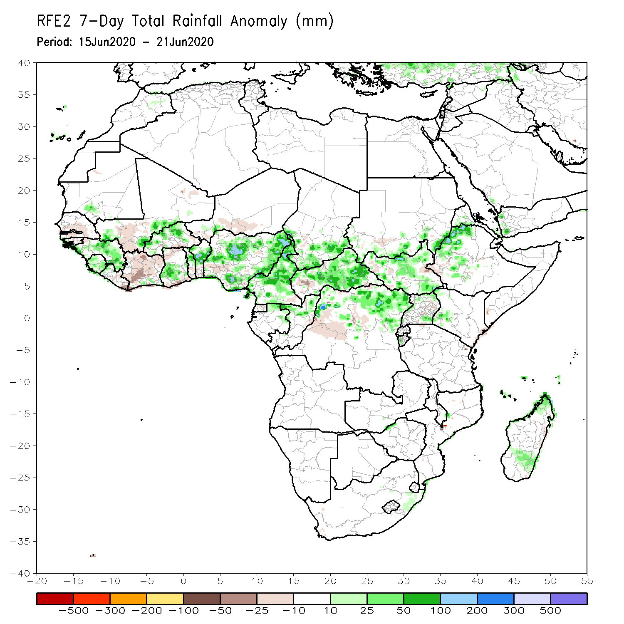
Rainfall Patterns: Last 7 Days
During the past 7 days, rainfall was above-average over much of Guinea, Sierra Leone, local areas in Mali, parts of Burkina Faso and Ghana, northern Togo, Benin, many parts of Nigeria and Cameroon, southern Chad, CAR, northern Gabon, northern Congo, northern DRC, South Sudan, western Ethiopia, and parts of Madagascar.
Below-average rainfall was observed over parts of Senegal and Mali, Liberia, Cote d’Ivoire, local areas in Burkina Faso and Ghana, parts of Niger and Nigeria, western CAR, portions of DRC, and local area in southwestern Ethiopia.

Slide 5
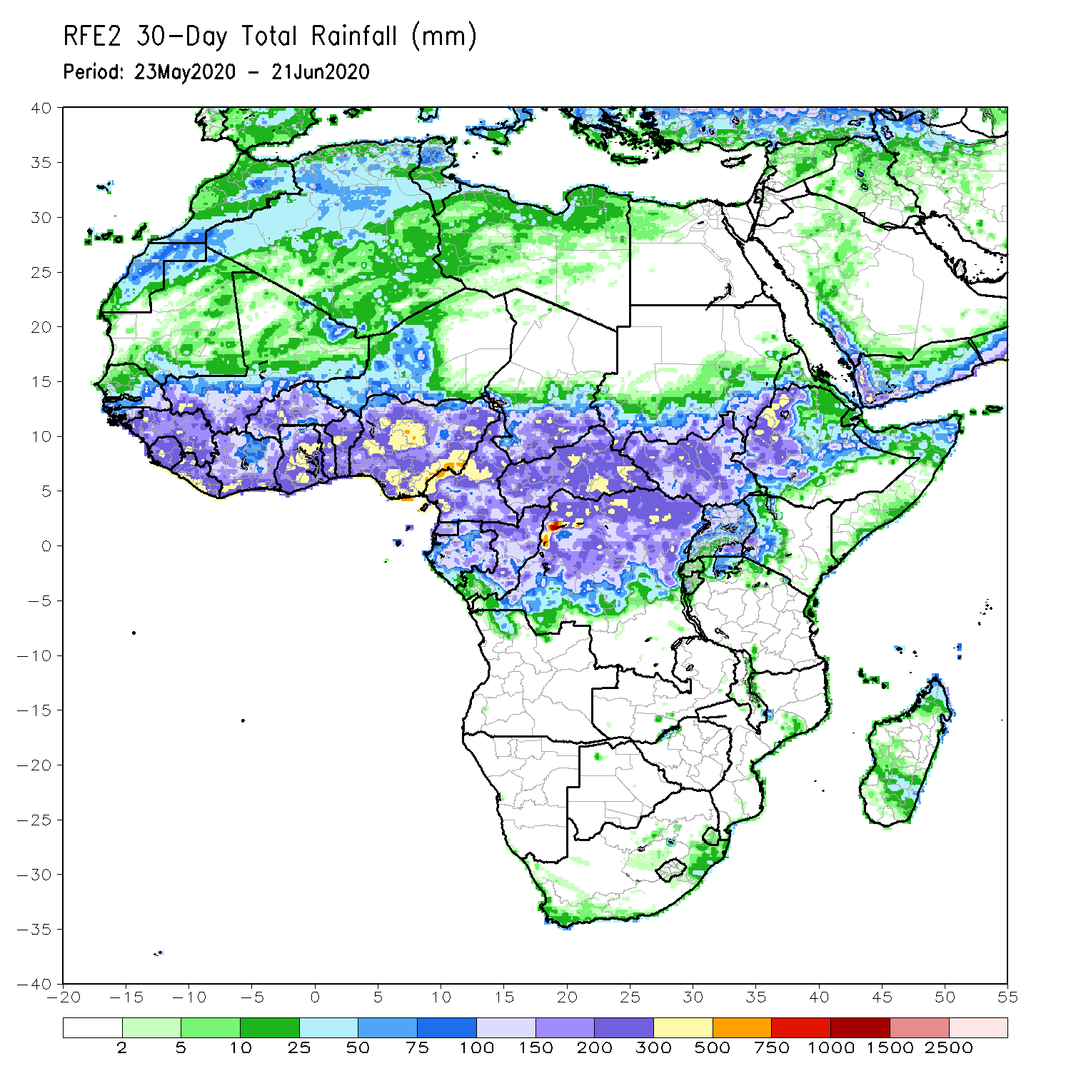
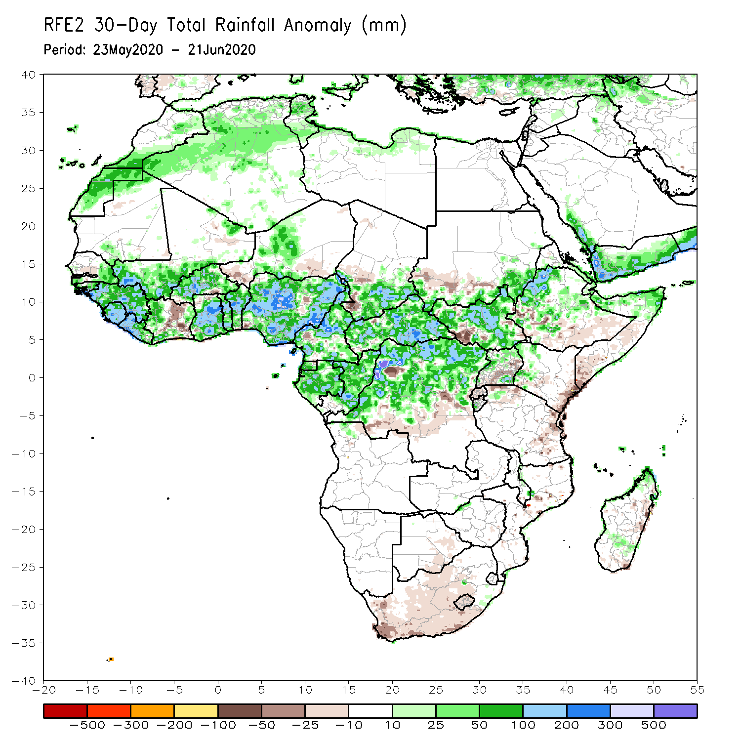
Rainfall Patterns: Last 30 Days
During the past 30 days, rainfall was above-average over many places in the Gulf of Guinea and Central Africa countries. Above-average rainfall was also observed over South Sudan, parts of eastern Sudan, Uganda, Ethiopia, local areas in western Kenya, and northern Somalia.
Rainfall was below-average over local areas in Senegal, parts of Cote d’Ivoire, western Niger, local areas in Nigeria, Chad, Cameroon, Congo and DRC, Rwanda, Burundi, local areas in Uganda and southern Sudan, southeastern Kenya, parts of eastern Tanzania, and parts of southern Somalia.
Notes:
5

Slide 6
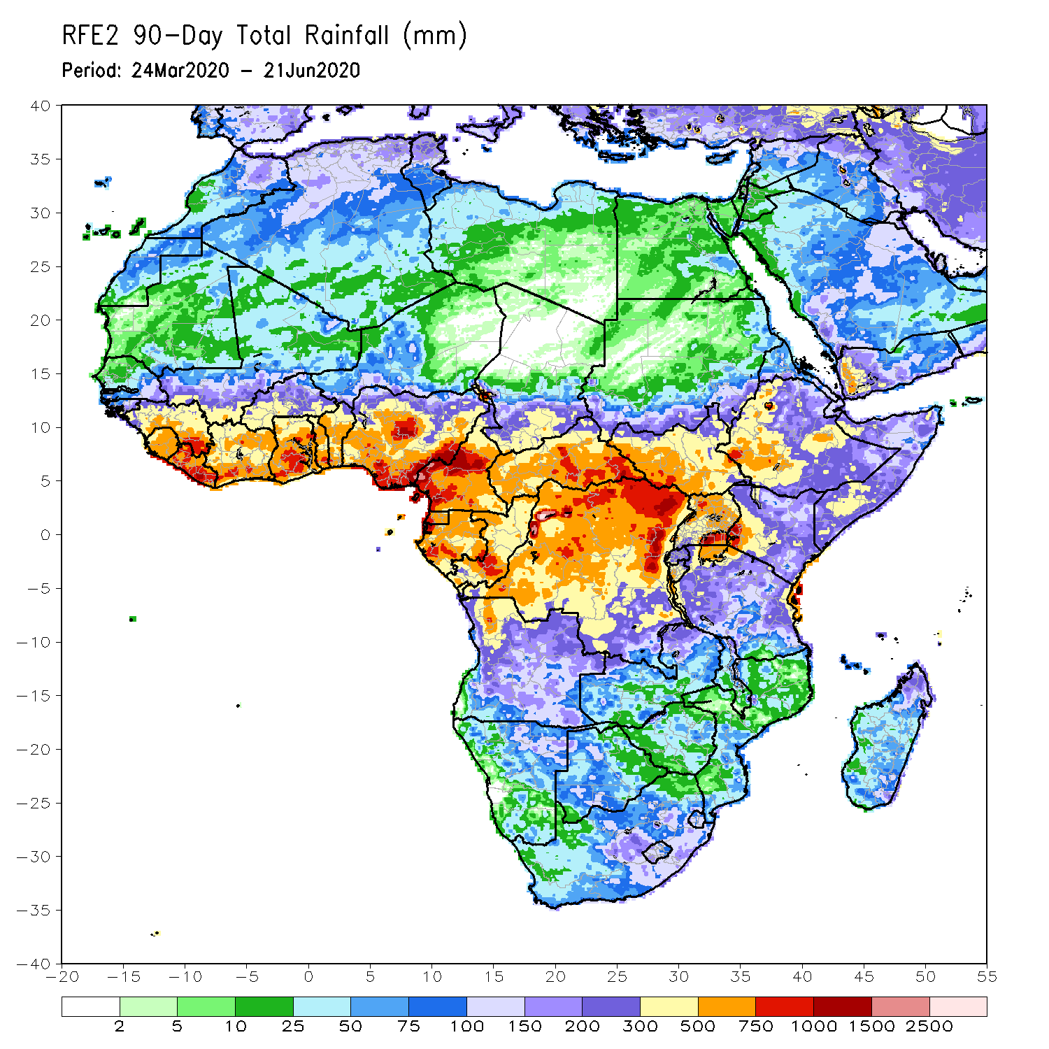
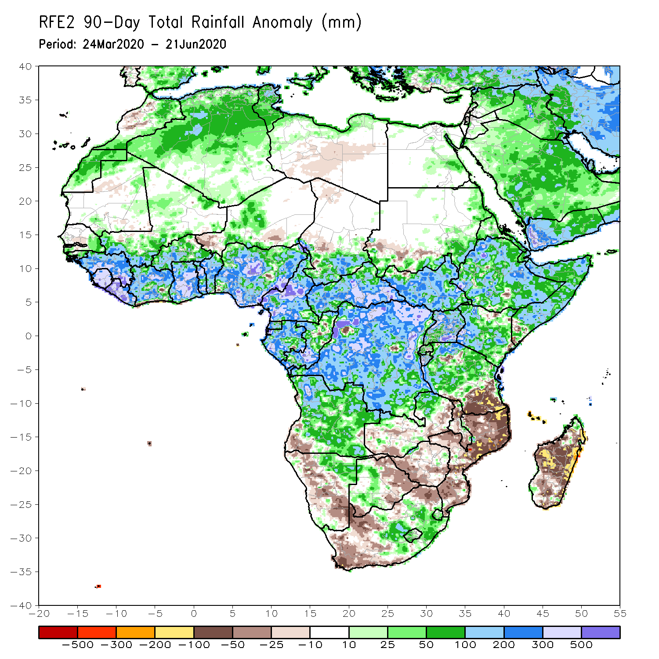
Rainfall Patterns: Last 90 Days
During the past 90 days, rainfall was above-average over much of West, Central and the Greater Horn of Africa, including the northern portions of Southern Africa. Rainfall was also above-average over northeastern Namibia, western Botswana, and portions of South Africa.
Western Niger, southern Sudan, southwestern Angola, western and southern Namibia, eastern Botswana, much of Zimbabwe, parts of southern Zambia, western South Arica, southern Tanzania, much of Mozambique, and much of Madagascar had below-average rainfall.
Notes:
6

Slide 7
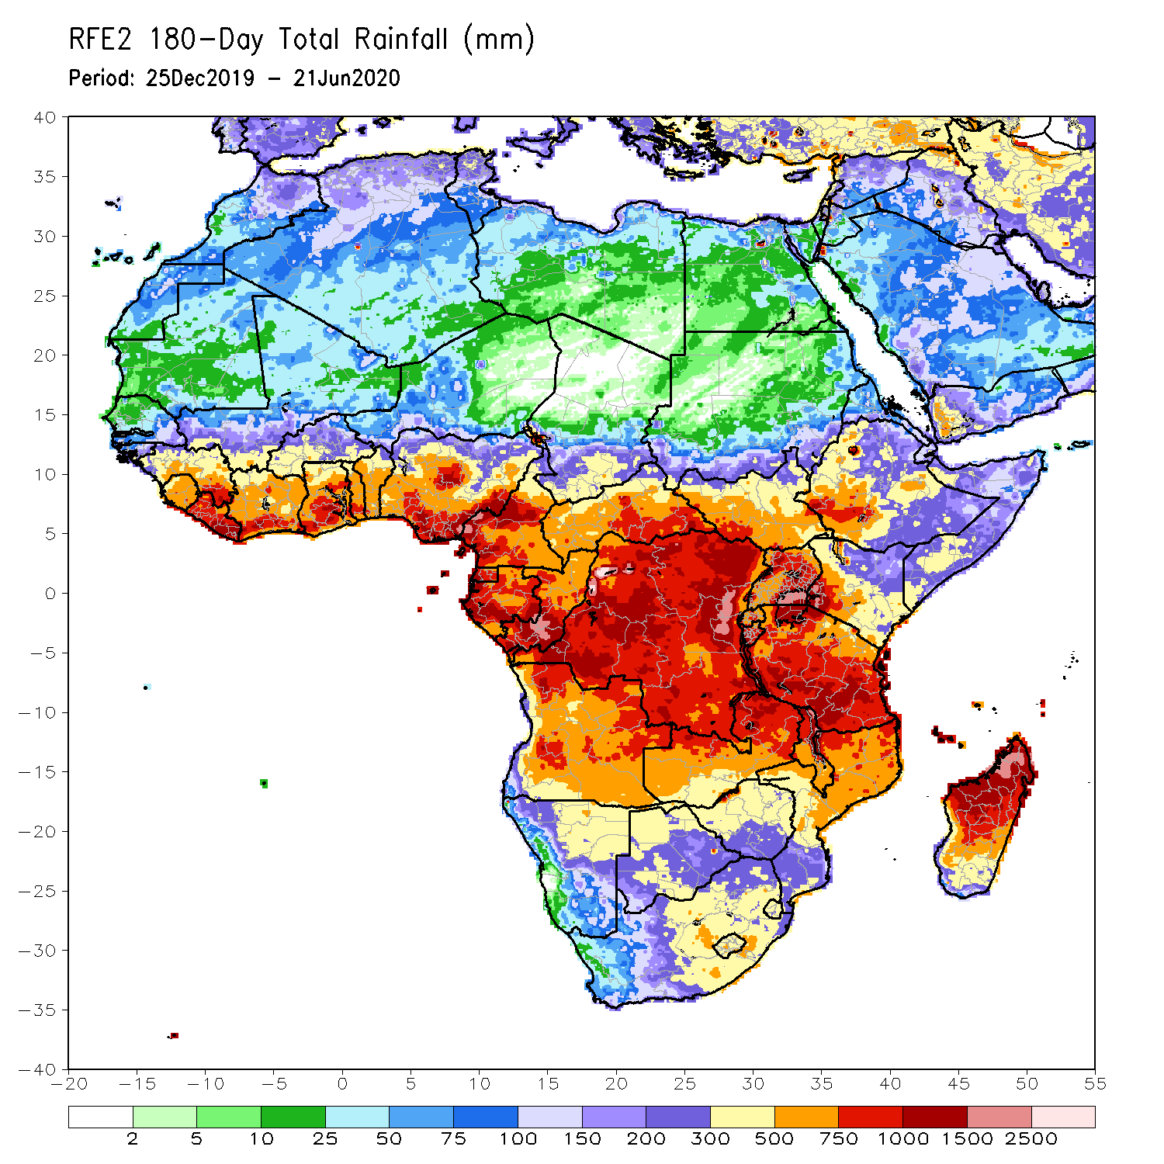
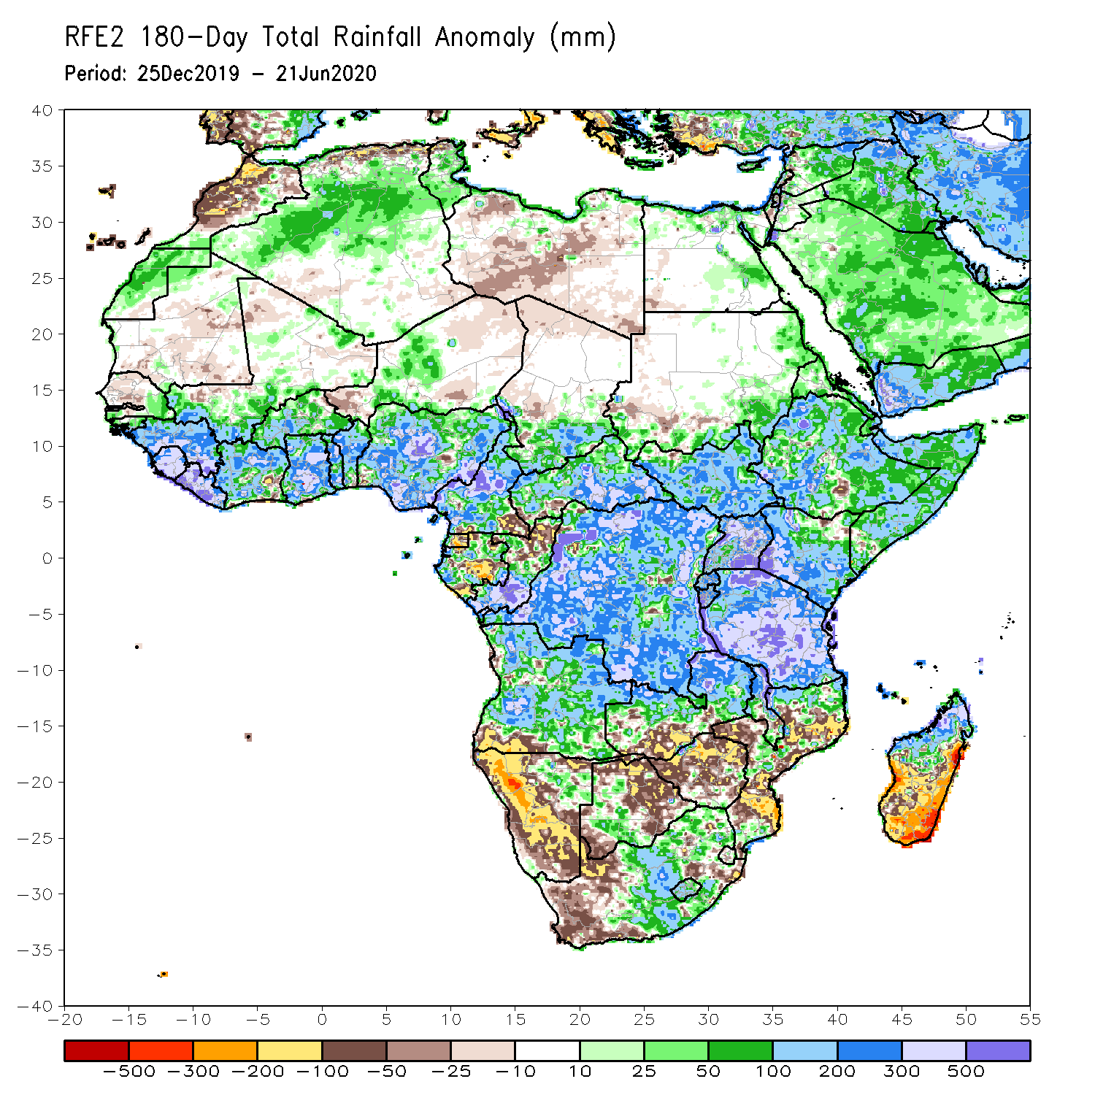
Rainfall Patterns: Last 180 Days
During the past 180 days, rainfall was above-average over much of West, Central and the Greater Horn of Africa, including the northern portions of Southern Africa. Rainfall was also above-average over northeastern Namibia, western Botswana, portions of South Africa, and northern Madagascar.
Below-average rainfall was observed over local areas in Cote d’Ivoire and Nigeria, parts of western Niger, local areas in Cameroon, Equatorial Guinea, parts of Gabon, northern Congo, local areas in Angola, western and southern Namibia, western South Africa, southern Zambia, northern and eastern Botswana, much of Zimbabwe, many parts of Mozambique and southern Madagascar.
Notes:
7

Slide 8
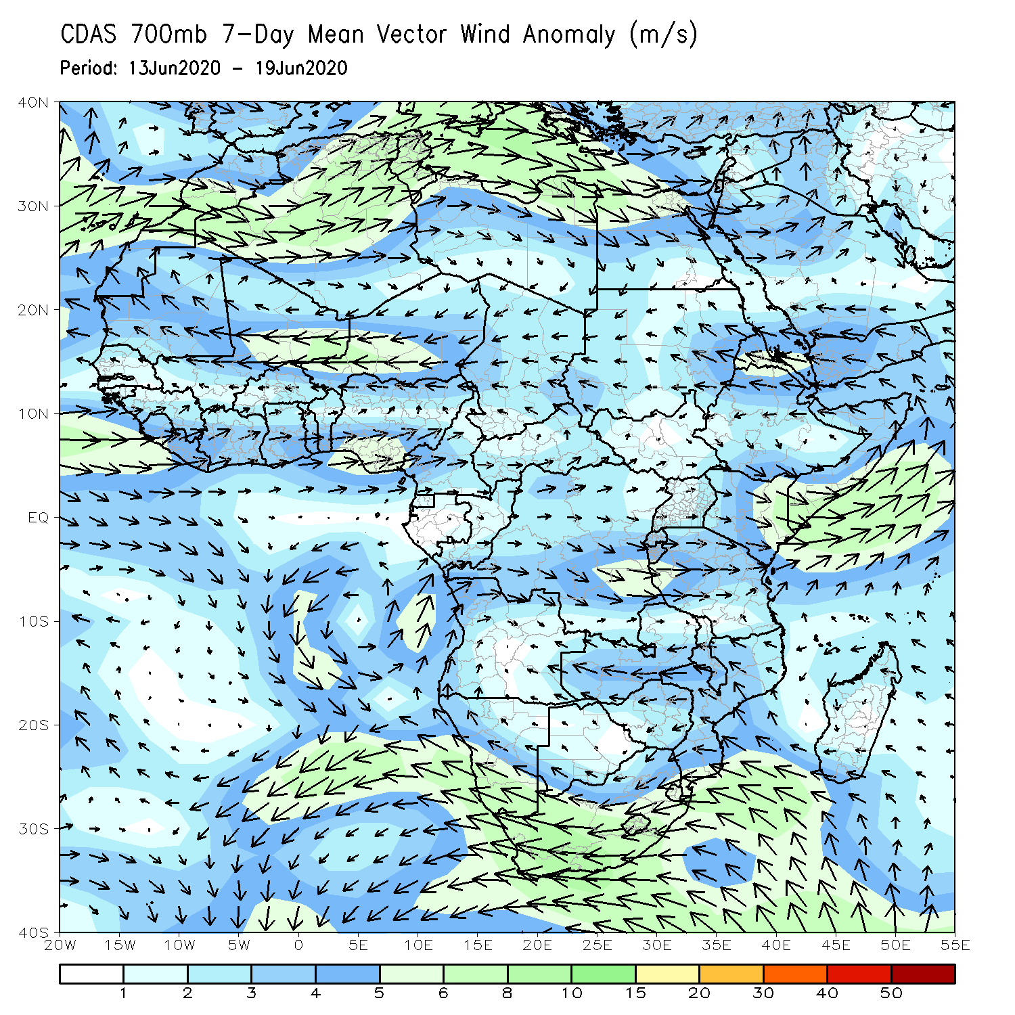
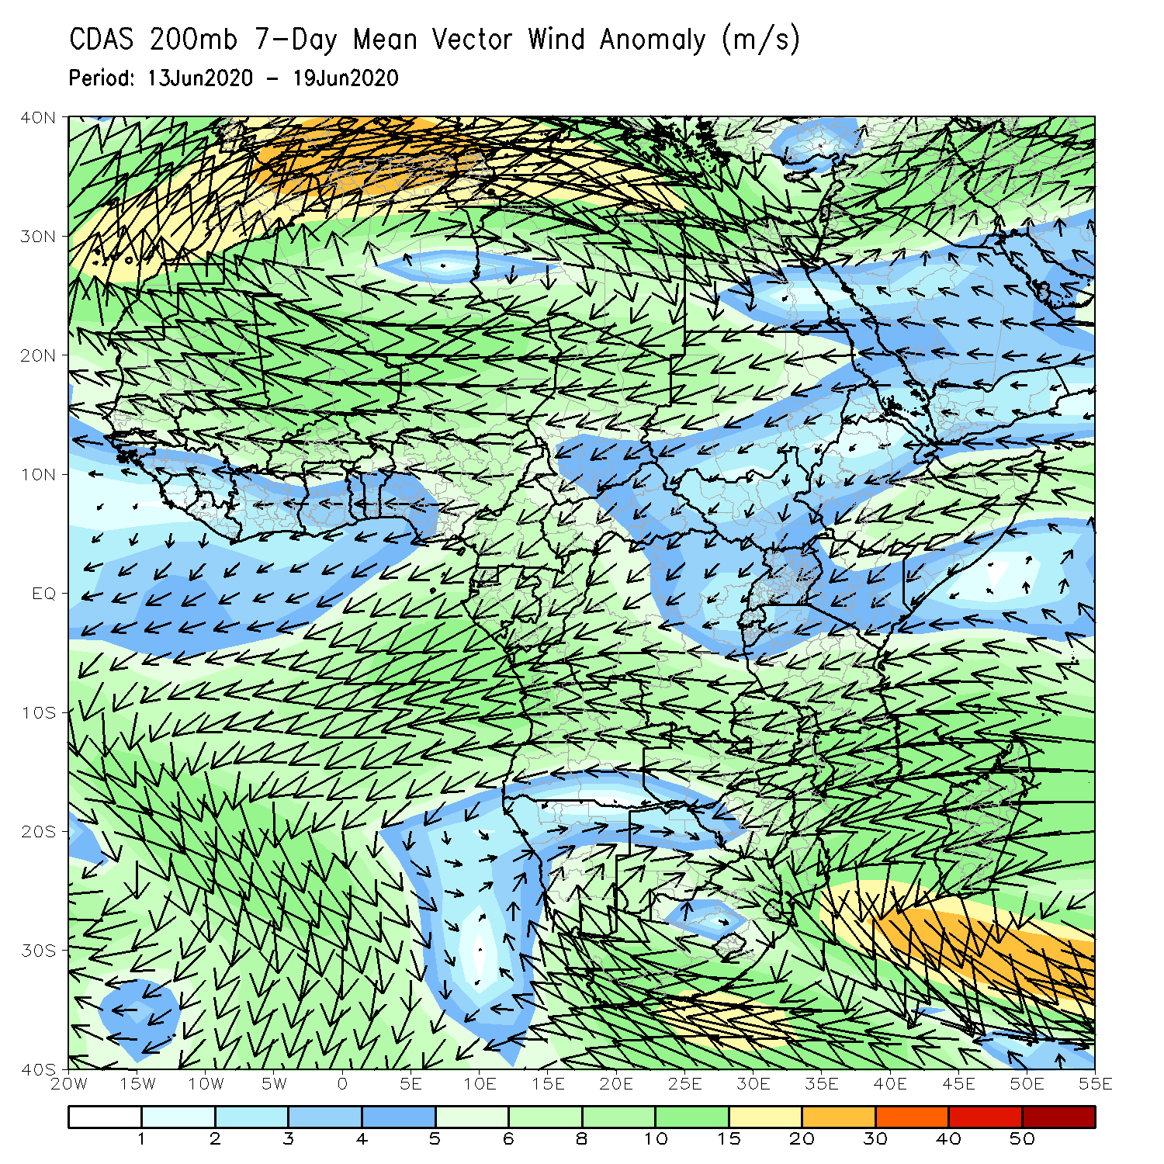
Atmospheric Circulation: Last 7 Days
Anomalous lower-level cyclonic turning (left panel) may have contributed to the observed above-average rainfall over portions of West Africa.

Slide 9
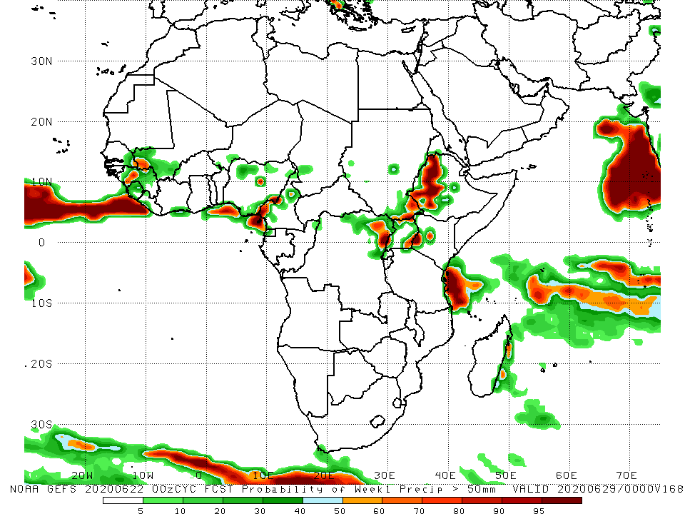
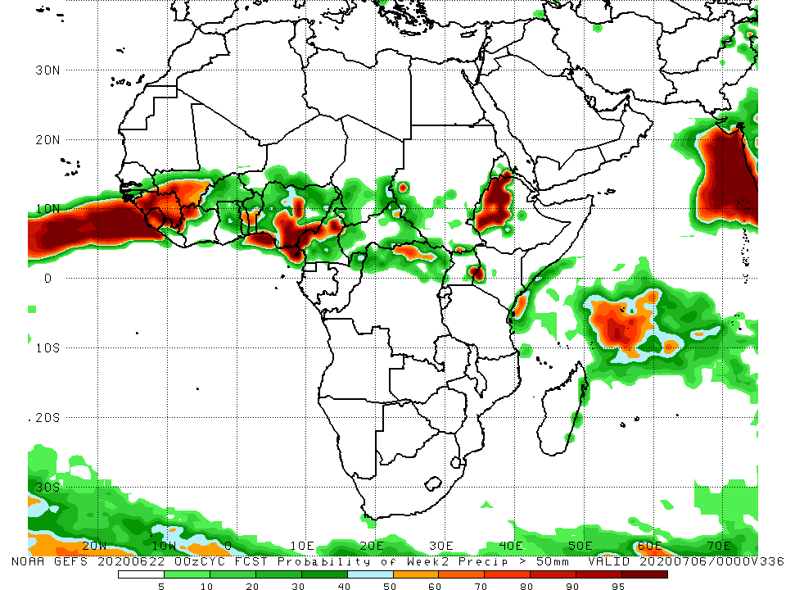
NCEP GEFS Model Forecasts Non-Bias Corrected Probability of precipitation exceedance
Week-1 Valid 23 – 29 June, 2020
Week-2: Valid 30 June – 6 July, 2020
For week-1 (left panel) and week-2 (right panel), there is an increased chance for weekly rainfall totals to exceed 50mm over Guinea, southern Mali, Benin, Nigeria, Cameroon, northern DRC, parts of eastern Uganda and western Kenya, and western Ethiopia.
Notes:
9

Slide 10
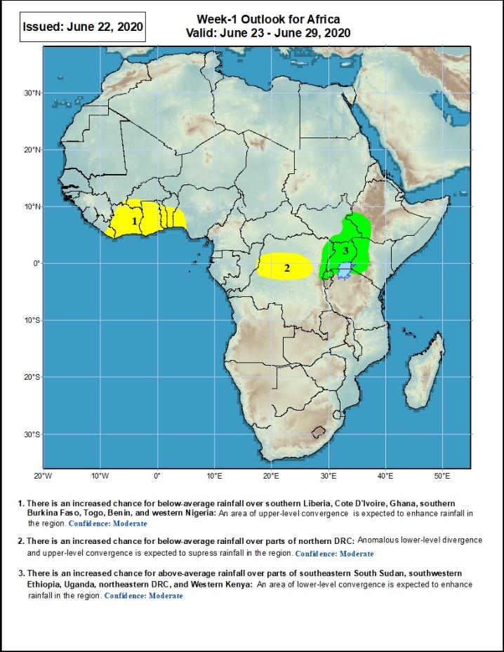
Week-1 Precipitation Outlooks
23 – 29 June, 2020
There is an increased chance for below-average rainfall over eastern Liberia, Cote d’Ivoire, Ghana, southwestern Burkina Faso, Togo, Benin, western Nigeria: An area of anomalous lower-level divergence and upper-level convergence is expected to suppress rainfall in the region. Confidence: Moderate
There is an increased chance for below-average rainfall over parts of northern DRC: An area of anomalous lower-level divergence and upper-level convergence is expected to suppress rainfall in the region. Confidence: Moderate
There is an increased chance for above-average rainfall over parts of northeastern DRC, Uganda, Rwanda, western Kenya, southeastern South Sudan and southwestern Ethiopia: An area of anomalous lower-level convergence and upper-level divergence is expected to enhance rainfall in the region. Confidence: Moderate
Notes:
10

Slide 11
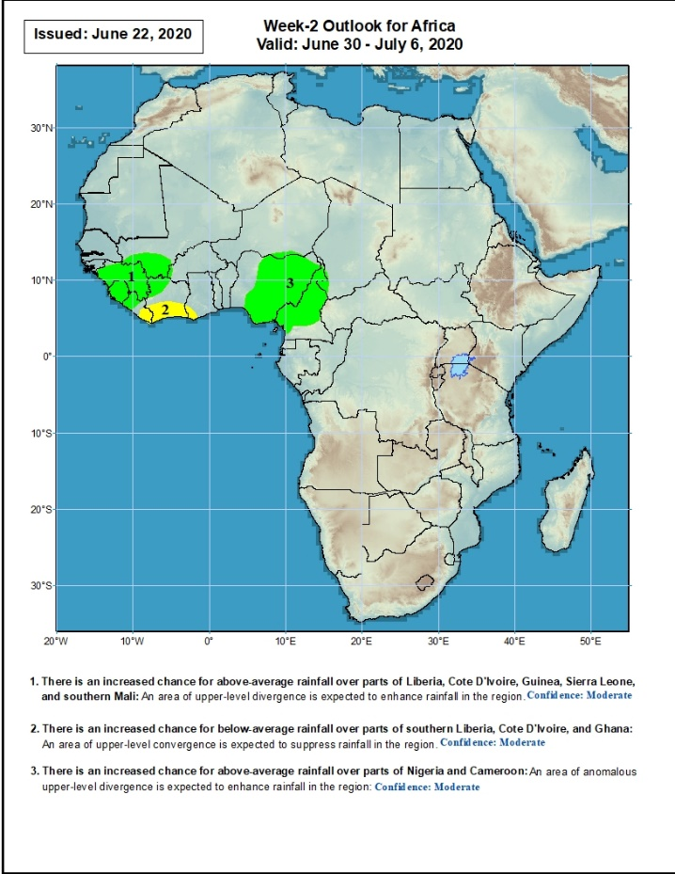
Week-2 Precipitation Outlooks
30 June – 6 July, 2020
There is an increased chance for above-average rainfall over much of Guinea, Sierra Leone, southwestern Mali, western Liberia, and northwestern Cote d’Ivoire: An area of anomalous lower-level convergence and upper-level divergence is expected to enhance rainfall in the region. Confidence: Moderate
There is an increased chance for below-average rainfall over parts of eastern Liberia and southern Cote d’Ivoire: An area of anomalous lower-level divergence and upper-level convergence is expected to suppress rainfall in the region. Confidence: Moderate
There is an increased chance for above-average rainfall over parts of Nigeria and Cameroon: An area of anomalous lower-level convergence and upper-level divergence is expected to enhance rainfall in the region. Confidence: Moderate
Notes:
11

Slide 12
Summary
During the past 7 days, rainfall was above-average over much of Guinea, Sierra Leone, local areas in Mali, parts of Burkina Faso and Ghana, northern Togo, Benin, many parts of Nigeria and Cameroon, southern Chad, CAR, northern Gabon, northern Congo, northern DRC, South Sudan, western Ethiopia, and parts of Madagascar. Below-average rainfall was observed over parts of Senegal and Mali, Liberia, Cote d’Ivoire, local areas in Burkina Faso and Ghana, parts of Niger and Nigeria, western CAR, portions of DRC, and local area in southwestern Ethiopia.
During the past 30 days, rainfall was above-average over many places in the Gulf of Guinea and Central Africa countries. Above-average rainfall was also observed over South Sudan, parts of eastern Sudan, Uganda, Ethiopia, local areas in western Kenya, and northern Somalia. Rainfall was below-average over local areas in Senegal, parts of Cote d’Ivoire, western Niger, local areas in Nigeria, Chad, Cameroon, Congo and DRC, Rwanda, Burundi, local areas in Uganda and southern Sudan, southeastern Kenya, parts of eastern Tanzania, and parts of southern Somalia.
During the past 90 days, rainfall was above-average over much of West, Central and the Greater Horn of Africa, including the northern portions of Southern Africa. Rainfall was also above-average over northeastern Namibia, western Botswana, and portions of South Africa. Western Niger, southern Sudan, southwestern Angola, western and southern Namibia, eastern Botswana, much of Zimbabwe, parts of southern Zambia, western South Arica, southern Tanzania, much of Mozambique, and much of Madagascar had below-average rainfall.
Week-1 outlooks call for an increased chance for below-average rainfall over eastern Liberia, Cote d’Ivoire, Ghana, southwestern Burkina Faso, Togo, Benin, western Nigeria, and parts of northern DRC. In contrast, there is an increased chance for above-average rainfall over northeastern DRC, Uganda, Rwanda, western Kenya, southeastern South Sudan, and southwestern Ethiopia.
Notes:
12

