Slide 1
The African Monsoon Recent Evolution and Current Status Include Week-1 and Week-2 Outlooks
Update prepared by
Climate Prediction Center / NCEP
29 June 2020
For more information, visit:
http://www.cpc.ncep.noaa.gov/products/Global_Monsoons/African_Monsoons/precip_monitoring.shtml

Slide 2
Outline
Highlights
Recent Evolution and Current Conditions
NCEP GEFS Forecasts
Summary

Slide 3
Highlights: Last 7 Days
Rainfall surpluses exceeded 100mm over local areas in Guinea, Mali, Nigeria, Central African Republic, DRC, South Sudan and Sudan.
Week-1 outlooks call for an increased chance for above-average rainfall over Guinea-Bissau, Guinea-Conakry, southeastern Senegal, Sierra Leone, southwestern Mali, southern Benin, southern Nigeria, western CAR, northern Congo and northern DRC. In contrast, there is an increased chance for below-average rainfall over eastern Liberia, southern Cote d’Ivoire and southwestern Ghana.
Week-2 outlooks call for an increased chance for above-average rainfall over Guinea-Bissau, Guinea-Conakry, Sierra Leone, southwestern Mali, western Liberia, parts of eastern Burkina Faso, western Niger, northern Benin, much of Nigeria, Cameroon, southern Chad and parts of western Sudan. In contrast, there is an increased chance for below-average rainfall over southern Cote d’Ivoire and the neighboring areas of eastern Liberia and southwestern Ghana.

Slide 4
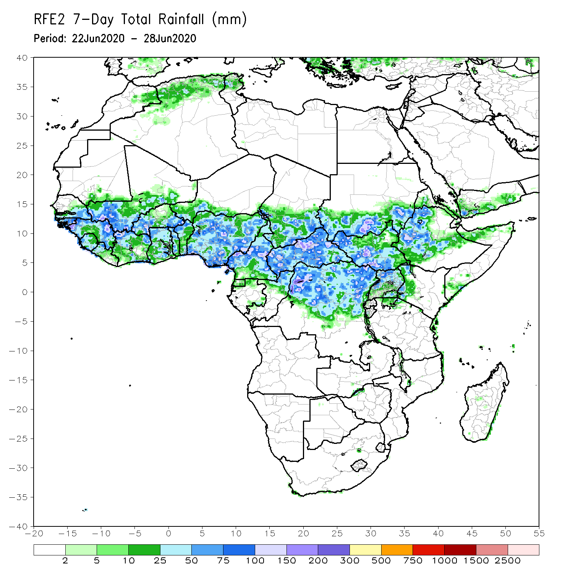
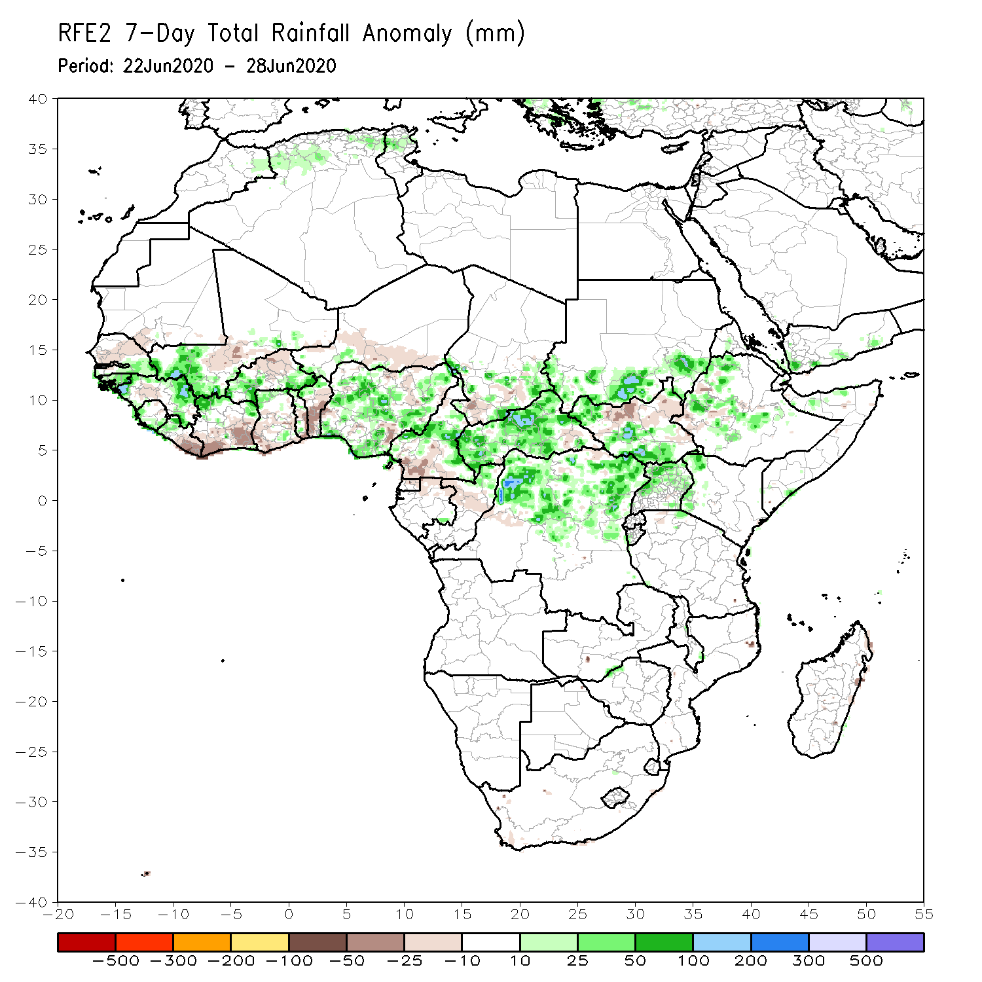
Rainfall Patterns: Last 7 Days
During the past 7 days, rainfall was above-average over southeastern Senegal, western and eastern Guinea, southwestern Mali, western Liberia, northern Cote d’Ivoire, western and eastern Burkina Faso, many parts of Nigeria, central and northern Cameroon, local areas in Chad, CAR, northern DRC, southern Sudan, parts of South Sudan and Uganda, local areas in Kenya and many parts of Ethiopia.
Below-average rainfall was observed over parts of Senegal and Mali, eastern Liberia, southern Cote d’Ivoire, central Burkina Faso, parts of Ghana and Niger, central and southern Benin, Nigeria, southern Cameroon, and parts of eastern CAR and South Sudan.

Slide 5
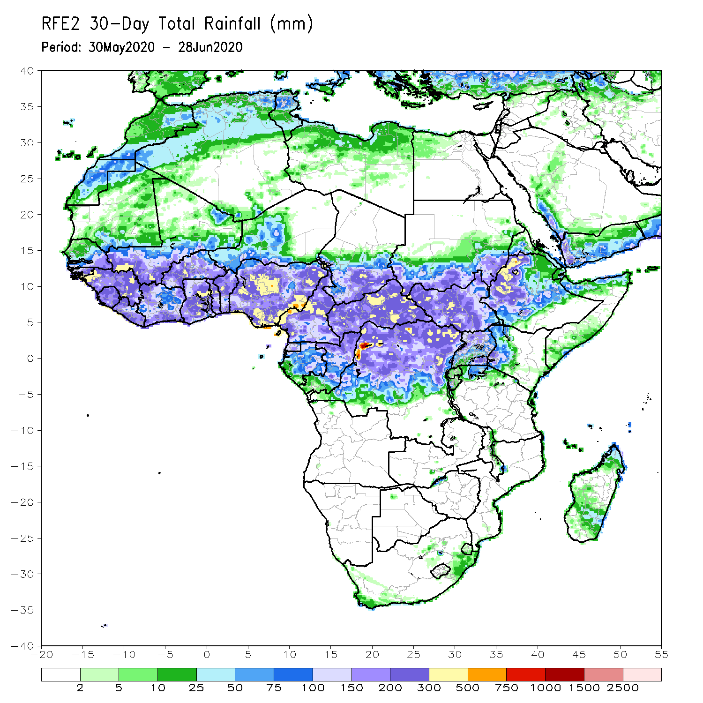
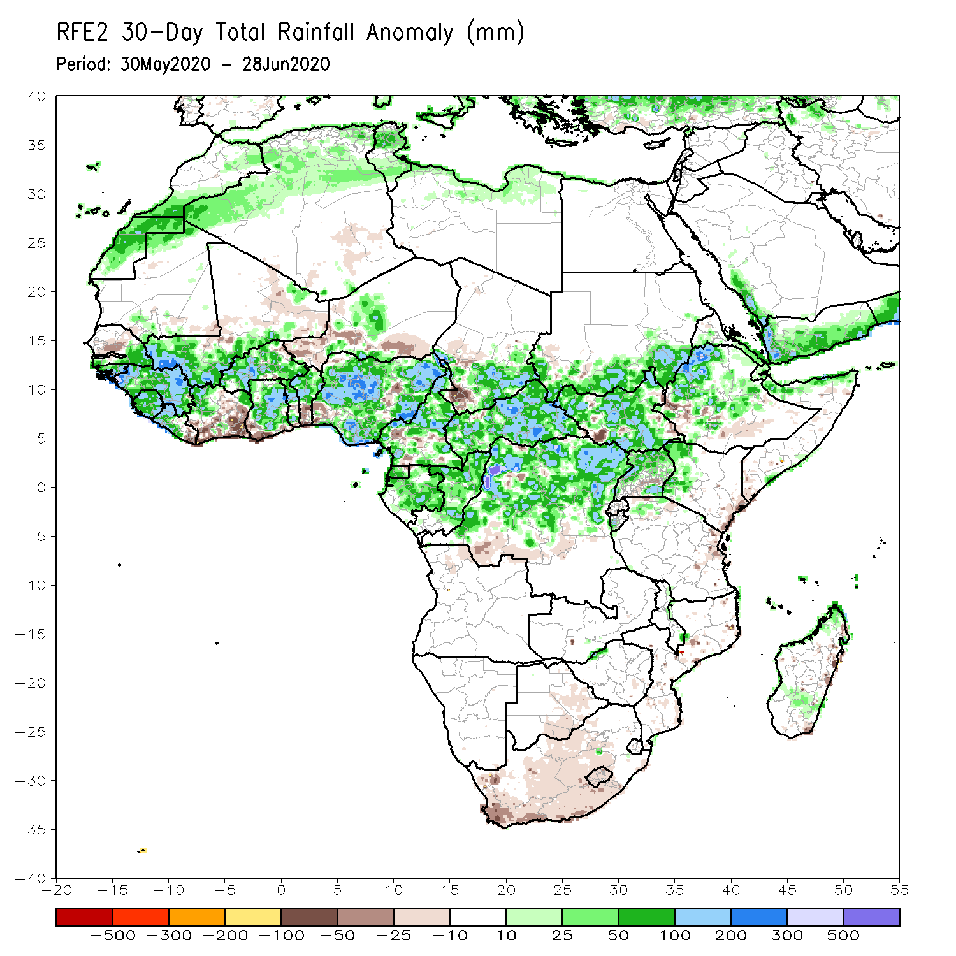
Rainfall Patterns: Last 30 Days
During the past 30 days, rainfall was above-average over many places in West and Central Africa countries. Above-average rainfall was also observed over South Sudan, parts of eastern and southern Sudan, Uganda, Ethiopia, local areas in western Kenya, and northern Somalia.
Rainfall was below-average over local areas in Senegal, parts of Cote d’Ivoire, western and southern Niger, local areas in Nigeria, Chad, Cameroon, DRC and Ethiopia. Below-average rainfall was also observed over portions of South Africa.
Notes:
5

Slide 6
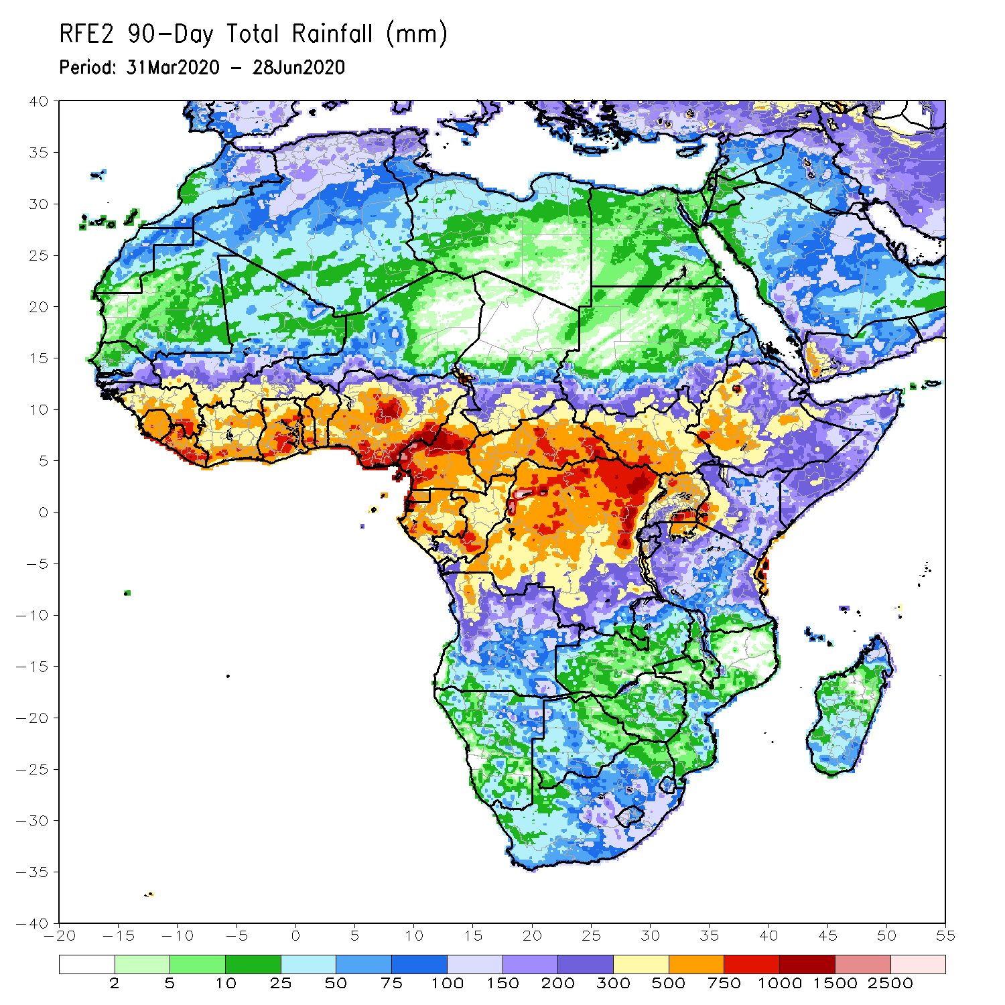
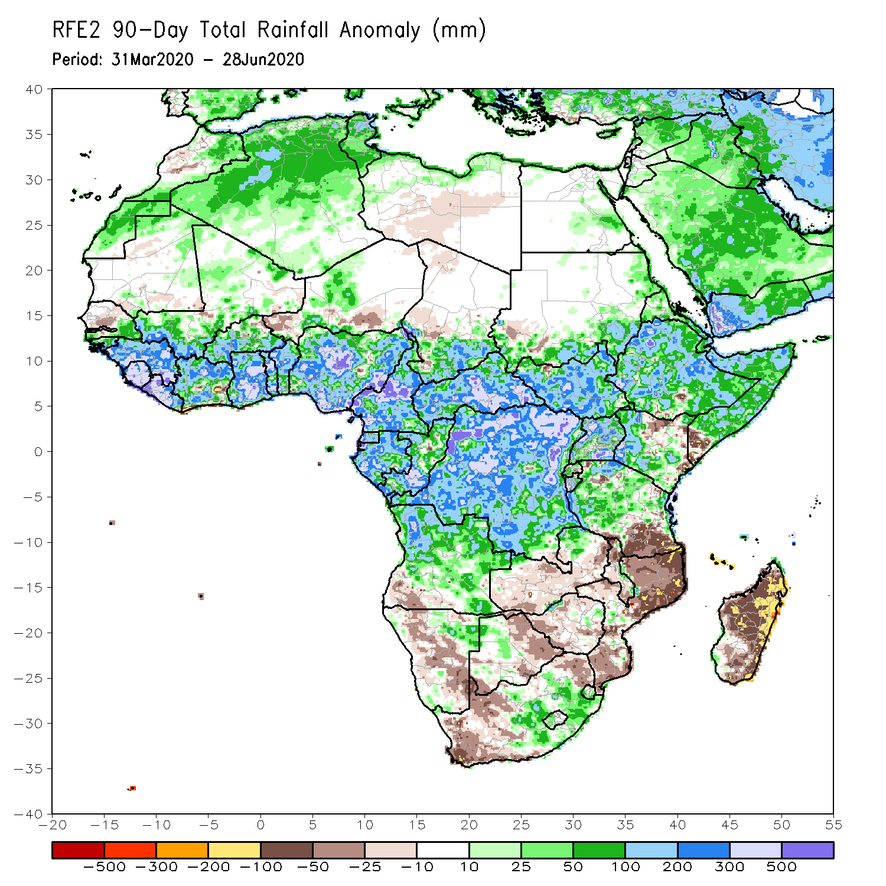
Rainfall Patterns: Last 90 Days
During the past 90 days, rainfall was above-average over much of West, Central and the Greater Horn of Africa, including the northern portions of Southern Africa. Rainfall was also above-average over northeastern Namibia, western Botswana, and portions of South Africa.
Local areas in Senegal, parts of western, southern Niger and southern Sudan, southwestern Angola, western and southern Namibia, eastern Botswana, much of Zimbabwe, many parts of Zambia, western and northeastern South Arica, southern Tanzania, and much of Mozambique Madagascar had below-average rainfall.
Notes:
6

Slide 7
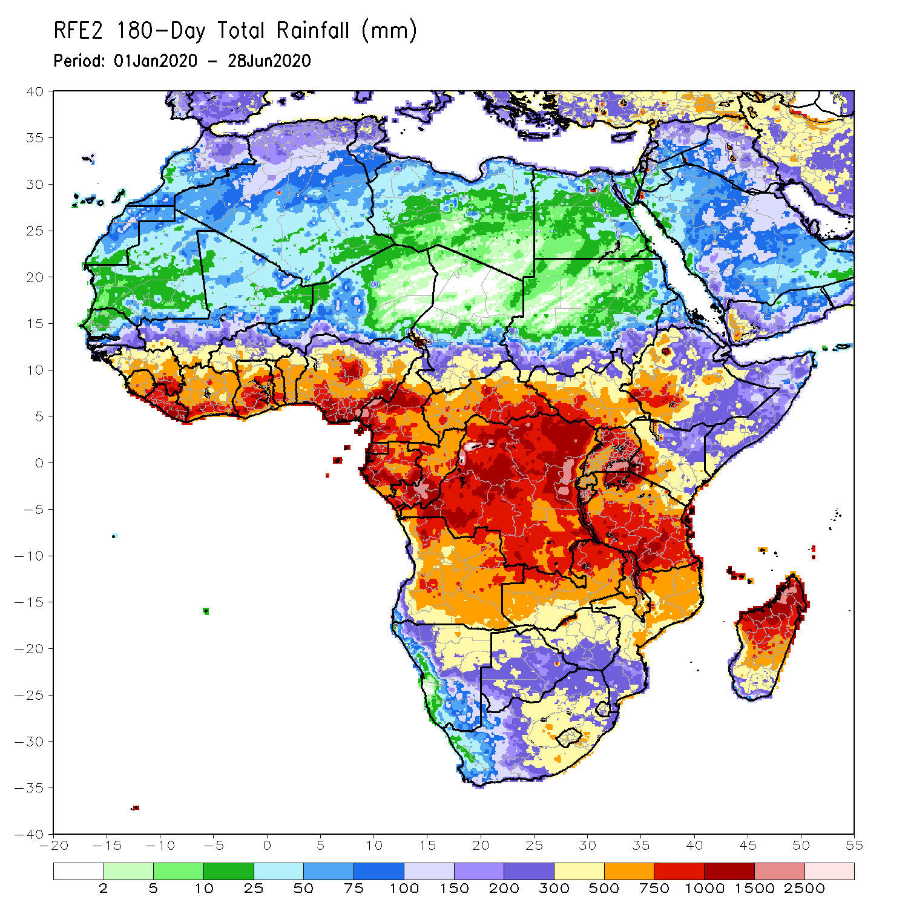
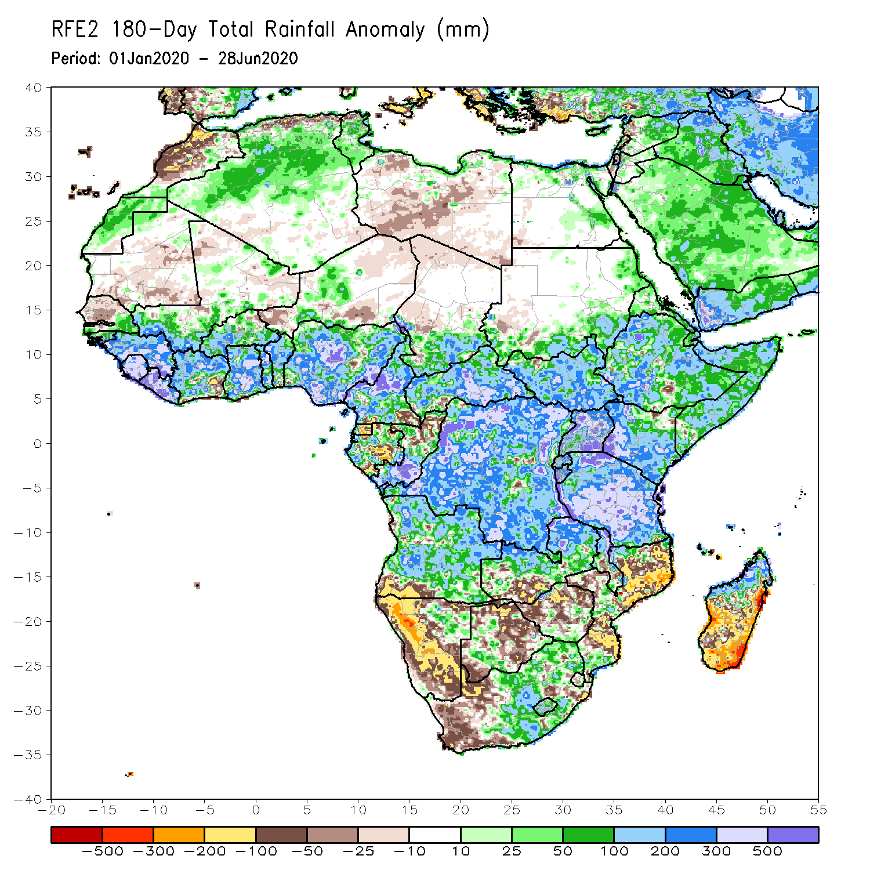
Rainfall Patterns: Last 180 Days
During the past 180 days, rainfall was above-average over much of West, Central and the Greater Horn of Africa, including the northern portions of Southern Africa. Rainfall was also above-average over northeastern Namibia, western Botswana, portions of South Africa, and northern Madagascar.
Below-average rainfall was observed over portions of Mauritania and Senegal, local areas in Cote d’Ivoire, parts of western and southern Niger, local areas in Cameroon, Equatorial Guinea, parts of Gabon, northern Congo, local areas in Angola, western and southern Namibia, western South Africa, southern Zambia, northern and eastern Botswana, much of Zimbabwe, many parts of Mozambique and southern Madagascar.
Notes:
7

Slide 8
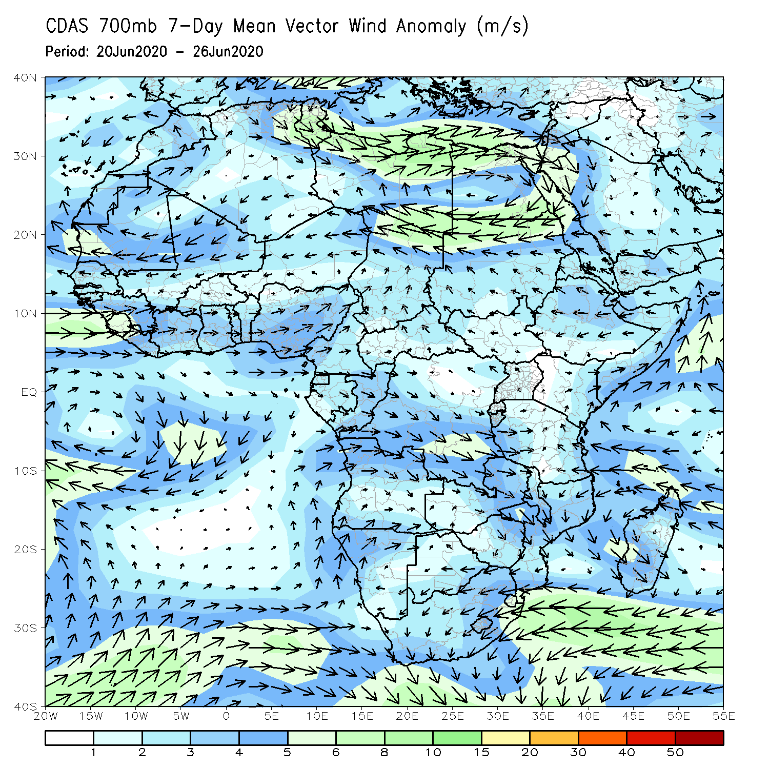
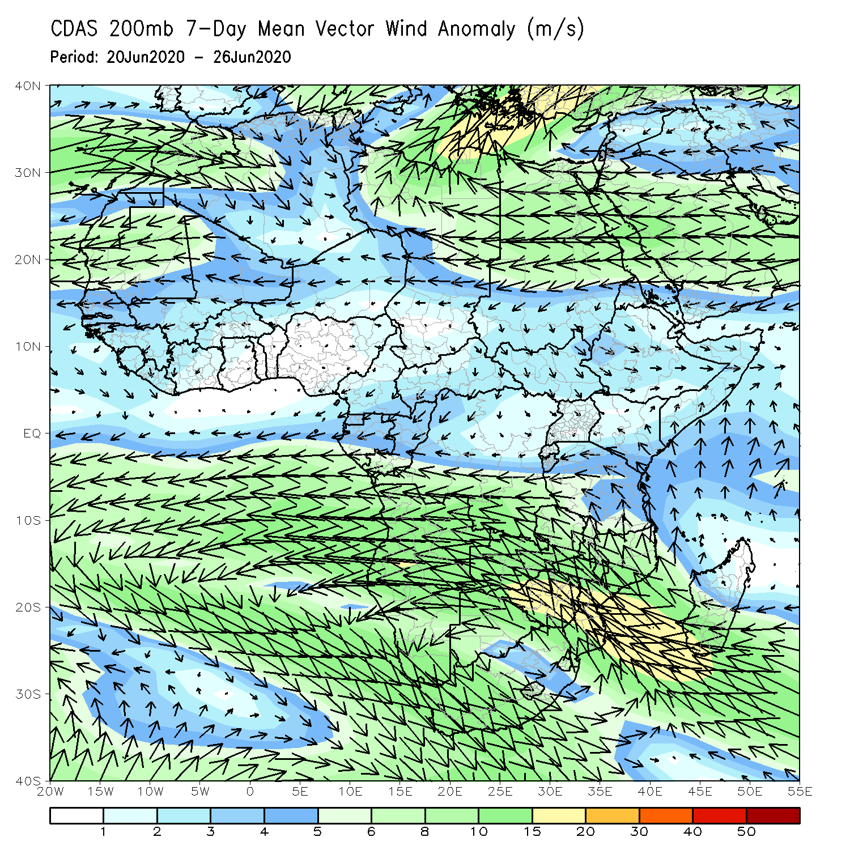
Atmospheric Circulation: Last 7 Days
Anomalous lower-level cyclonic turning (left panel) may have contributed to the observed above-average rainfall over portions of West Africa.

Slide 9
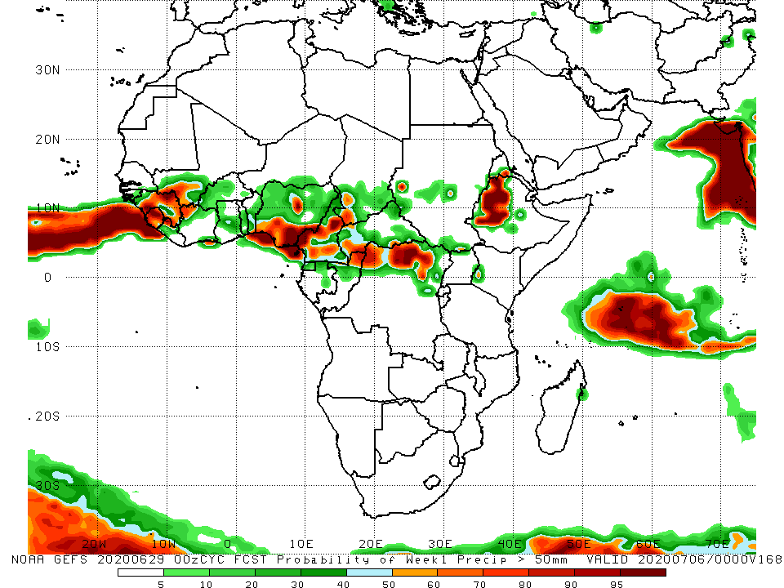
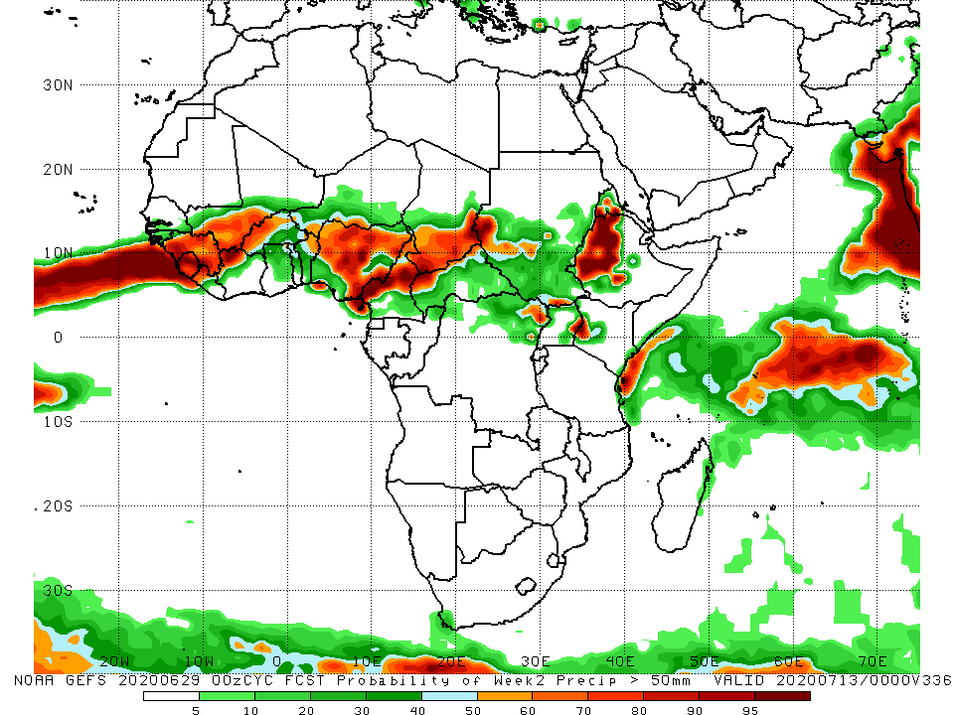
NCEP GEFS Model Forecasts Non-Bias Corrected Probability of precipitation exceedance
Week-1 Valid 30 June – 6 July, 2020
Week-2: Valid 7 – 13 July, 2020
For week-1 (left panel) and week-2 (right panel), there is an increased chance for weekly rainfall totals to exceed 50mm over Guinea, southern Mali, parts of Burkina Faso, Benin, Nigeria, Cameroon, southern Chad, parts of CAR, northern DRC, parts of South Sudan and western Kenya, and western Ethiopia.
Notes:
9

Slide 10
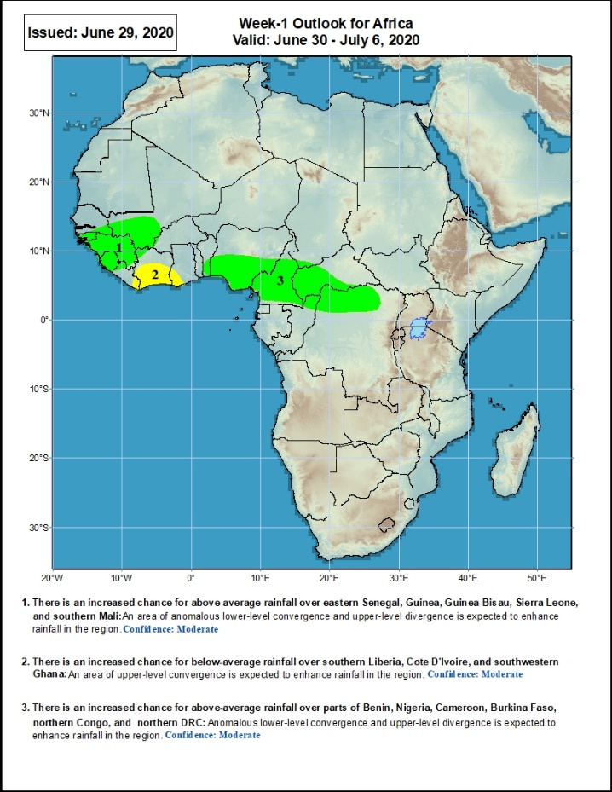
Week-1 Precipitation Outlooks
30 June – 6 July, 2020
There is an increased chance for above-average rainfall over Guinea-Bissau, southeastern Senegal, Guinea, Sierra Leone and southwestern Mali: An area of anomalous lower-level convergence and upper-level divergence is expected to enhance rainfall in the region. Confidence: Moderate
There is an increased chance for below-average rainfall over southern Cote d’Ivoire, and the neighboring areas of eastern Liberia and southwestern Ghana: An area of anomalous upper-level convergence is expected to suppress rainfall in the region. Confidence: Moderate
There is an increased chance for above-average rainfall over southern Benin, southern Nigeria, Cameroon, western CAR, northern Congo, and northern DRC: An area of anomalous lower-level convergence and upper-level divergence is expected to enhance rainfall in the region. Confidence: Moderate
Notes:
10

Slide 11
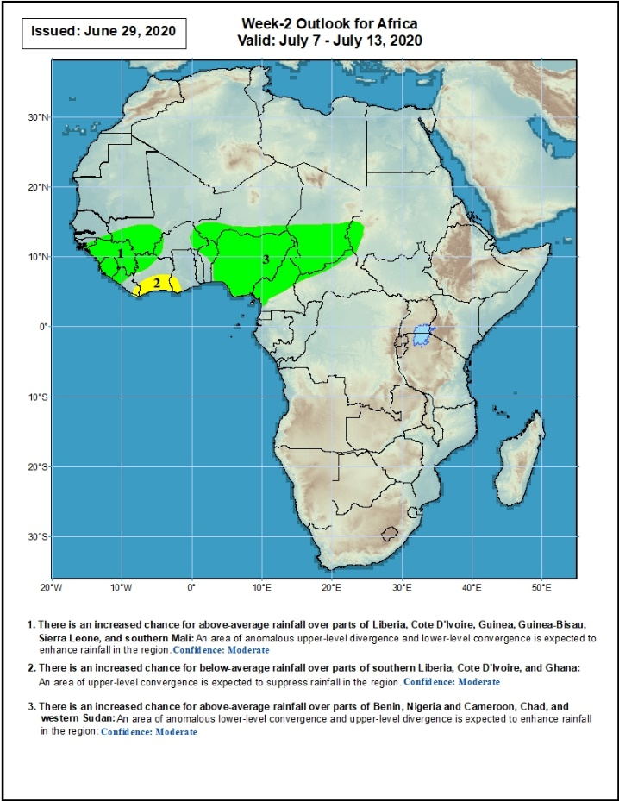
Week-2 Precipitation Outlooks
7 – 13 July, 2020
There is an increased chance for above-average rainfall over Guinea-Bissau, Guinea, southwestern Mali, Sierra Leone, and western Liberia: An area of anomalous lower-level convergence and upper-level divergence is expected to enhance rainfall in the region. Confidence: Moderate
There is an increased chance for below-average rainfall over southern Cote d’Ivoire, and the neighboring areas of eastern Liberia and southwestern Ghana: An area of anomalous upper-level convergence is expected to suppress rainfall in the region. Confidence: Moderate
There is an increased chance for above-average rainfall over parts of eastern Burkina Faso, western Niger, northern Benin, much of Nigeria, southern Chad, Cameroon, and parts of western Sudan: An area of anomalous lower-level convergence and upper-level divergence is expected to enhance rainfall in the region. Confidence: Moderate
Notes:
11

Slide 12
Summary
During the past 7 days, rainfall was above-average over southeastern Senegal, western and eastern Guinea, southwestern Mali, western Liberia, northern Cote d’Ivoire, western and eastern Burkina Faso, many parts of Nigeria, central and northern Cameroon, local areas in Chad, CAR, northern DRC, southern Sudan, parts of South Sudan and Uganda, local areas in Kenya and many parts of Ethiopia. Below-average rainfall was observed over parts of Senegal and Mali, eastern Liberia, southern Cote d’Ivoire, central Burkina Faso, parts of Ghana and Niger, central and southern Benin, Nigeria, southern Cameroon, and parts of eastern CAR and South Sudan.
During the past 30 days, rainfall was above-average over many places in West and Central Africa countries. Above-average rainfall was also observed over South Sudan, parts of eastern and southern Sudan, Uganda, Ethiopia, local areas in western Kenya, and northern Somalia. Rainfall was below-average over local areas in Senegal, parts of Cote d’Ivoire, western and southern Niger, local areas in Nigeria, Chad, Cameroon, DRC and Ethiopia. Below-average rainfall was also observed over portions of South Africa.
During the past 90 days, rainfall was above-average over much of West, Central and the Greater Horn of Africa, including the northern portions of Southern Africa. Rainfall was also above-average over northeastern Namibia, western Botswana, and portions of South Africa. Local areas in Senegal, parts of western, southern Niger and southern Sudan, southwestern Angola, western and southern Namibia, eastern Botswana, much of Zimbabwe, many parts of Zambia, western and northeastern South Arica, southern Tanzania, and much of Mozambique Madagascar had below-average rainfall.
Week-1 outlooks call for an increased chance for above-average rainfall over Guinea-Bissau, Guinea-Conakry, southeastern Senegal, Sierra Leone, southwestern Mali, southern Benin, southern Nigeria, western CAR, northern Congo and northern DRC. In contrast, there is an increased chance for below-average rainfall over eastern Liberia, southern Cote d’Ivoire and southwestern Ghana.
Week-2 outlooks call for an increased chance for above-average rainfall over Guinea-Bissau, Guinea-Conakry, Sierra Leone, southwestern Mali, western Liberia, parts of eastern Burkina Faso, western Niger, northern Benin, much of Nigeria, Cameroon, southern Chad and parts of western Sudan. In contrast, there is an increased chance for below-average rainfall over southern Cote d’Ivoire and the neighboring areas of eastern Liberia and southwestern Ghana.
Notes:
12

