Slide 1
The African Monsoon Recent Evolution and Current Status Include Week-1 and Week-2 Outlooks
Update prepared by
Climate Prediction Center / NCEP
06 July 2020
For more information, visit:
http://www.cpc.ncep.noaa.gov/products/Global_Monsoons/African_Monsoons/precip_monitoring.shtml

Slide 2
Outline
Highlights
Recent Evolution and Current Conditions
NCEP GEFS Forecasts
Summary

Slide 3
Highlights: Last 7 Days
Rainfall surpluses exceeded 100mm over local areas in Mali, Burkina Faso, Ghana, Nigeria, Congo DRC, South Sudan and Ethiopia.
Week-1 outlooks call for an increased chance for above-average rainfall over Guinea-Bissau, Guinea, Sierra Leone, northwestern Liberia, southern Niger, portions of Nigeria, much of Cameroon, portions of western CAR, northern DRC, South Sudan, Uganda and Rwanda. In contrast, there is an increased chance for below-average rainfall over eastern Liberia, portions of Cote d'Ivoire, much of Ghana, Togo, Benin and western Nigeria.
Week-2 outlooks call for an increased chance for above-average rainfall over much of Guinea, southern Mali, Burkina Faso, northern Ghana, southern Niger, northern Togo, northern Benin, much of Nigeria, western Cameroon, parts of southern Chad, southern Sudan, CAR, northern DRC, South Sudan and southwestern Ethiopia. In contrast, there is an increased chance for below-average rainfall over eastern Liberia, southern Cote d'Ivoire and southern Ghana.

Slide 4
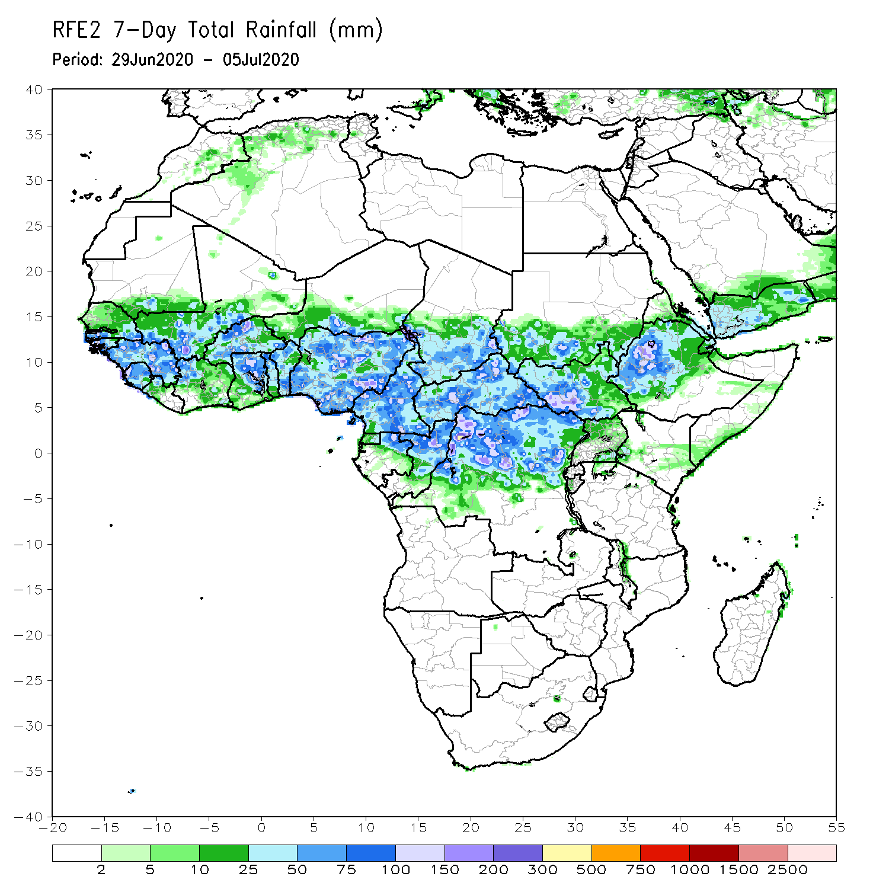
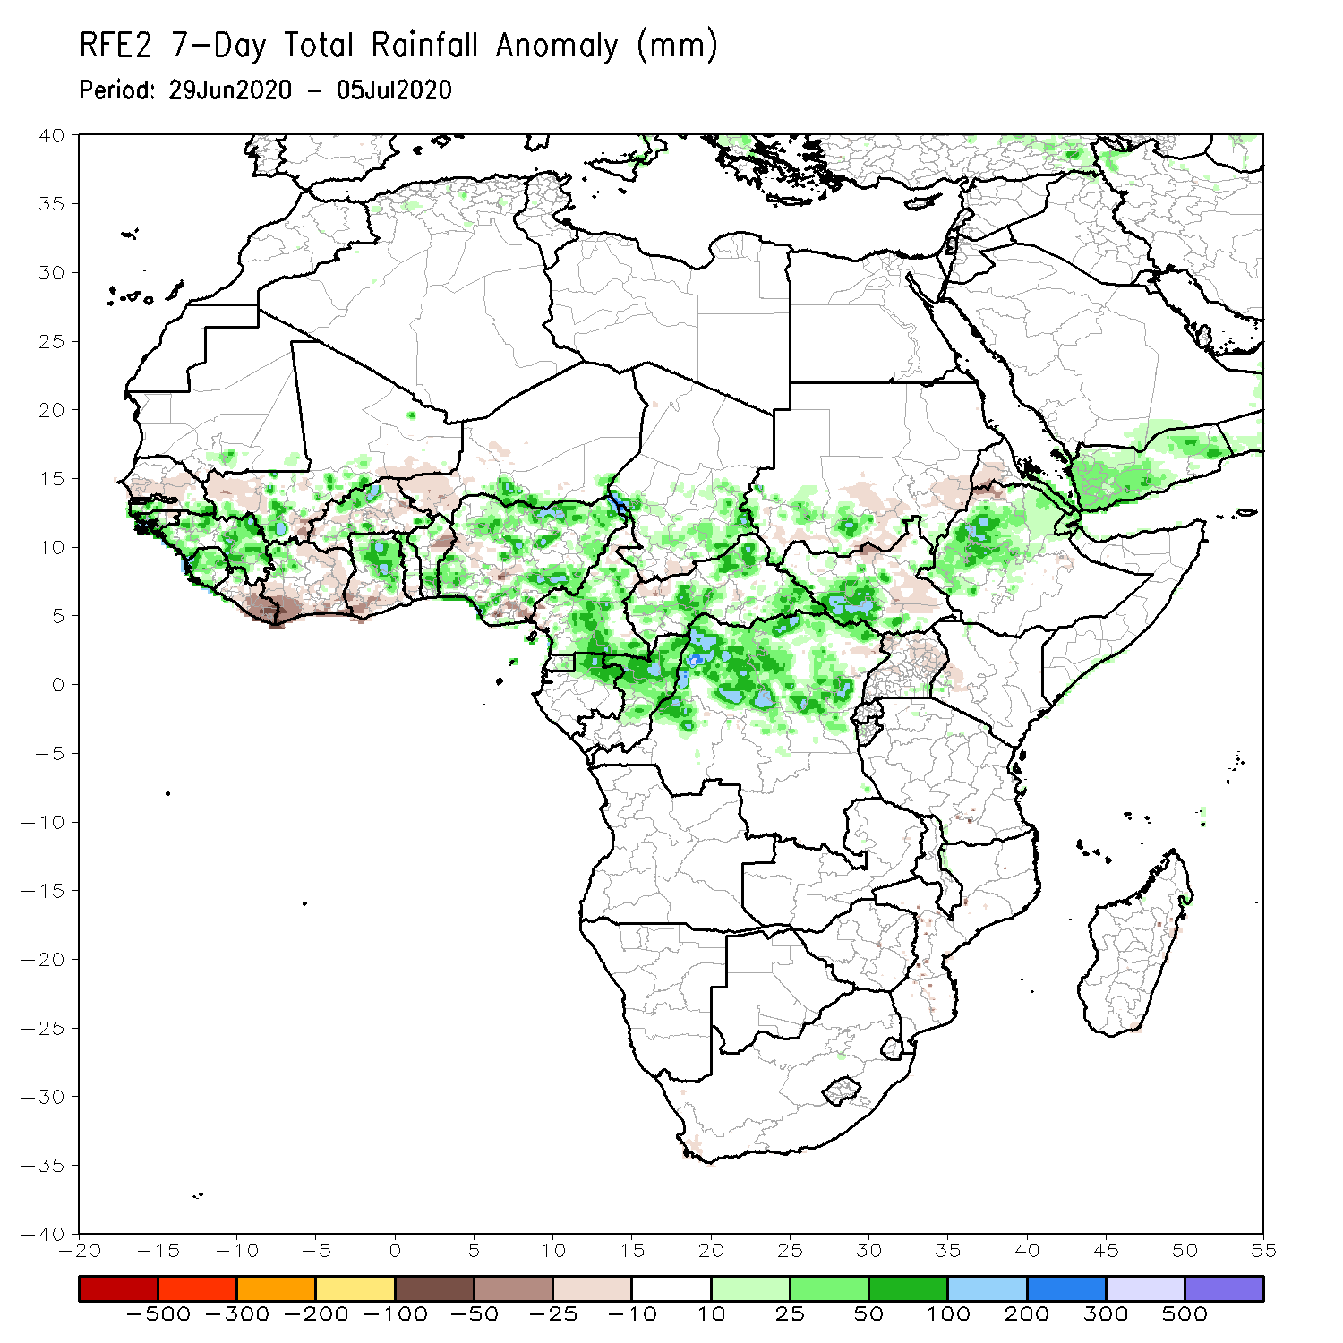
Rainfall Patterns: Last 7 Days
During the past 7 days, rainfall was above-average over much of Guinea, local areas in Mali, Sierra Leone, parts of Burkina Faso and Ghana, local areas in Benin, much of Nigeria, Cameroon, northern Gabon, Congo, northern DRC, southern Chad, CAR, parts of Sudan and South Sudan, and portions of Ethiopia.
Below-average rainfall was observed over parts of Senegal and Mali, Liberia, much of Cote d’Ivoire, parts of Burkina Faso and Ghana, western Niger, parts of Togo and Benin, local areas in Nigeria, Chad and CAR, parts of Sudan and South Sudan, and Eritrea.

Slide 5
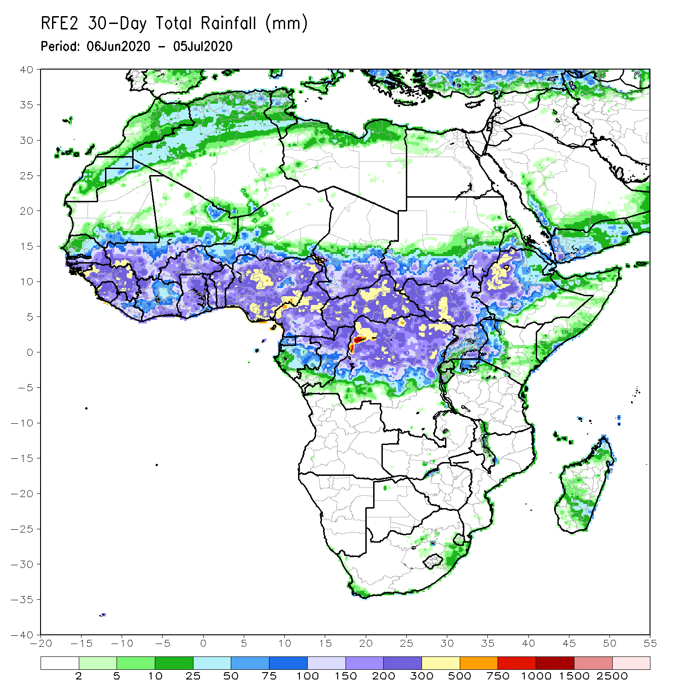
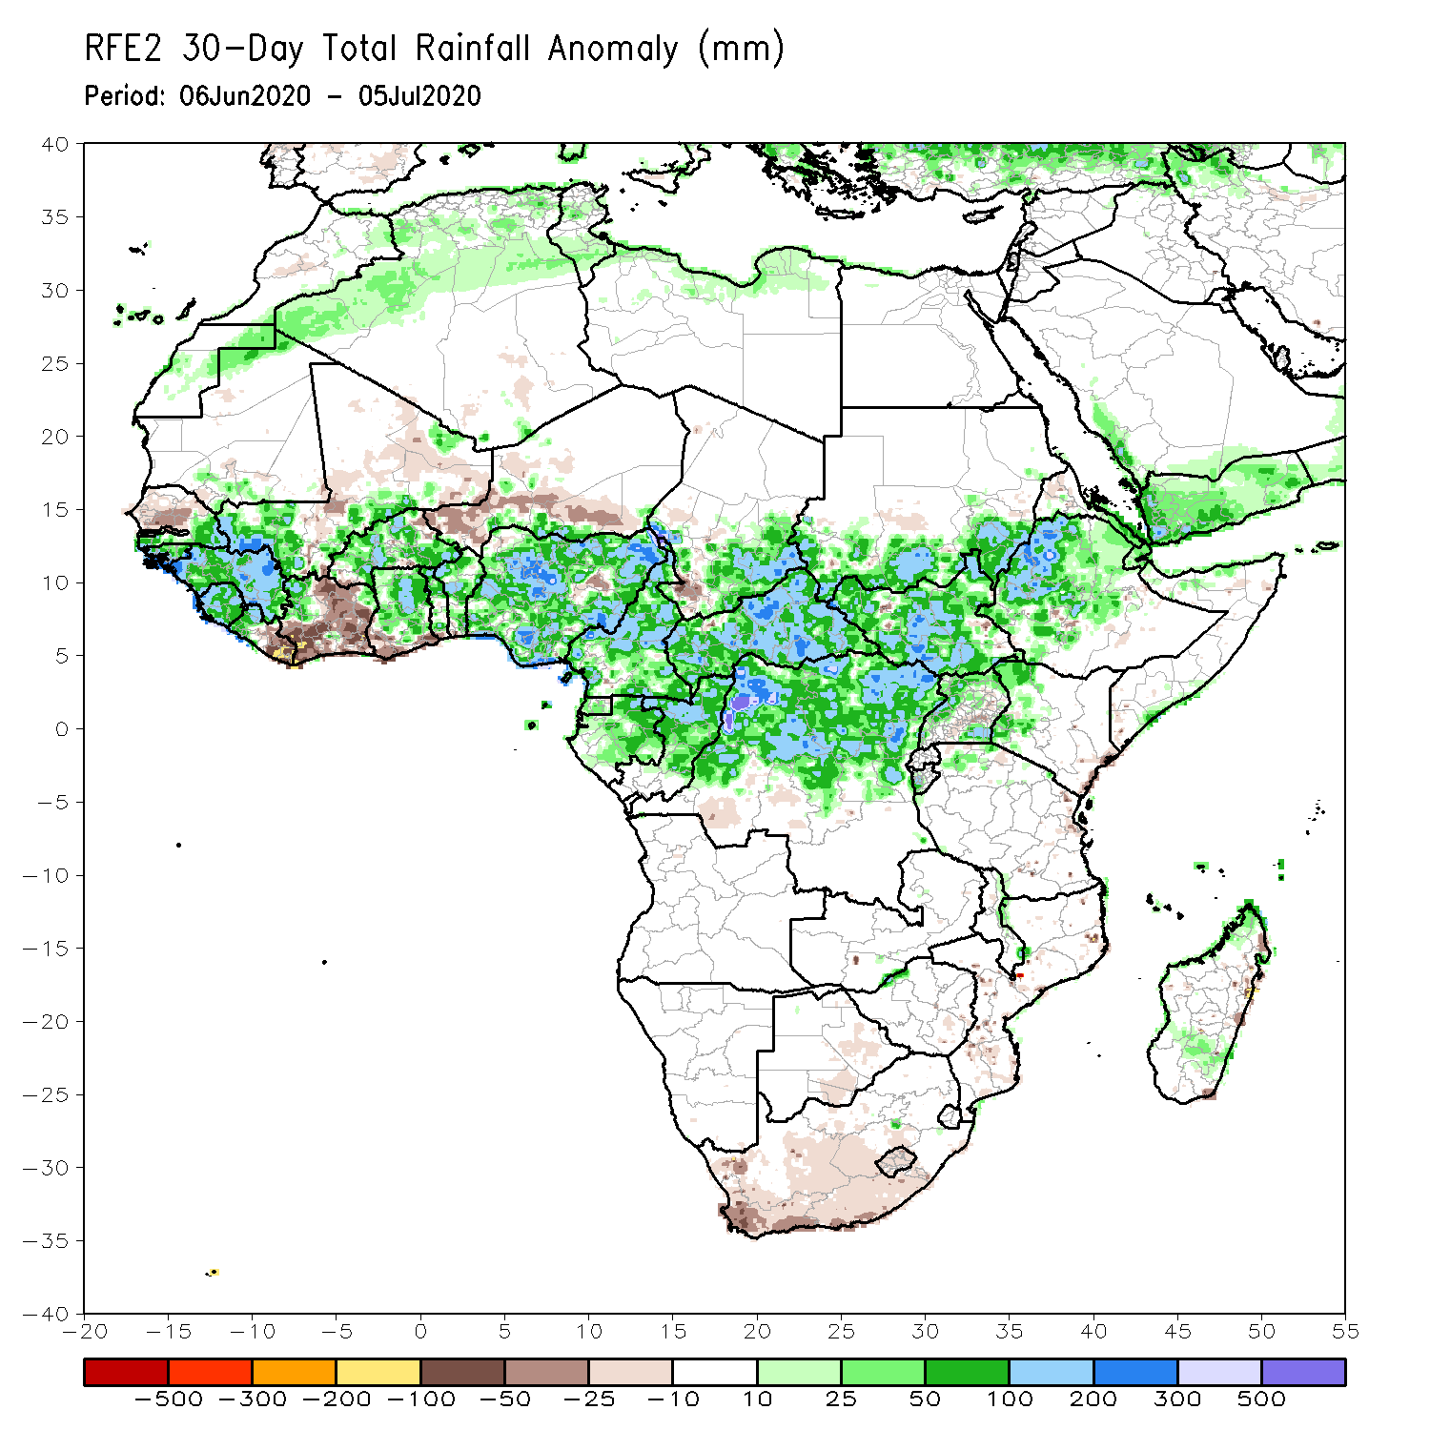
Rainfall Patterns: Last 30 Days
During the past 30 days, rainfall was above-average over many places in West and Central Africa countries. Above-average rainfall was also observed over South Sudan, parts of eastern and southern Sudan, Uganda, Ethiopia, and local areas in western Kenya.
Rainfall was below-average over local areas in Senegal, parts of Cote d’Ivoire, western and southern Niger, and local areas in Nigeria and Chad. Below-average rainfall was also observed over portions of South Africa.
Notes:
5

Slide 6
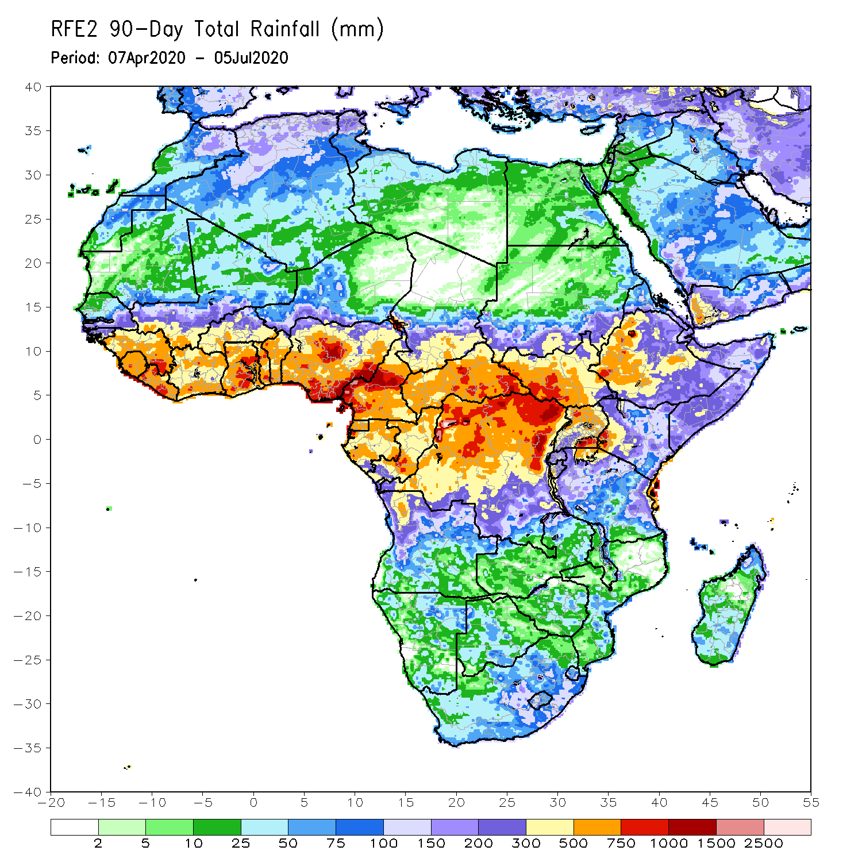
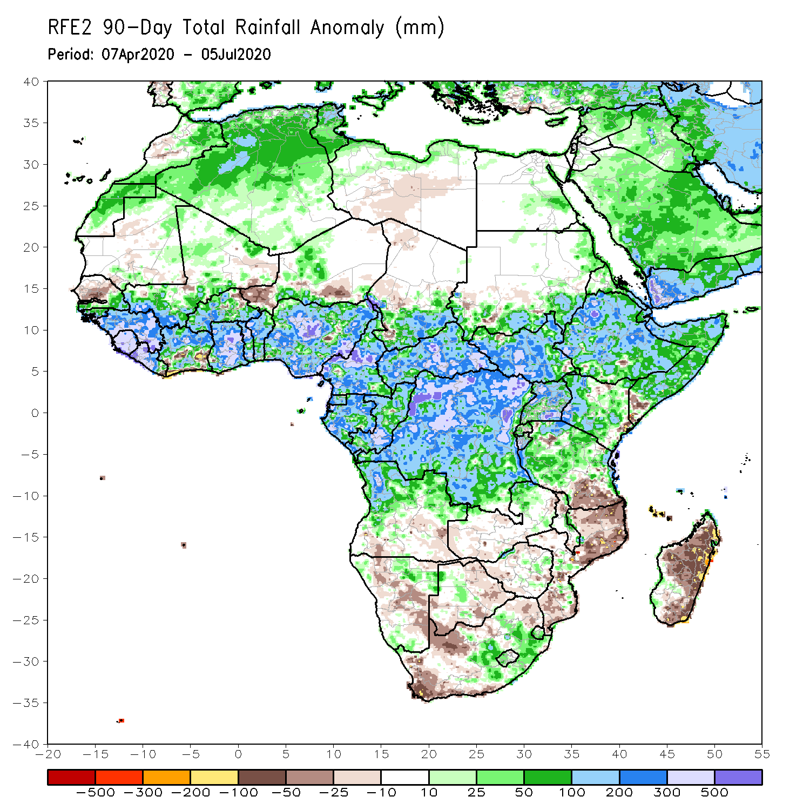
Rainfall Patterns: Last 90 Days
During the past 90 days, rainfall was above-average over much of West, Central and the Greater Horn of Africa, including the northern portions of Southern Africa. Rainfall was also above-average over local areas in northeastern Namibia, western Botswana, and portions of South Africa.
Local areas in Senegal, parts of western, southern Niger, parts of southwestern Angola, western and southern Namibia, eastern Botswana, parts of Zimbabwe and Zambia, western and northeastern South Arica, southern Tanzania, and much of Mozambique and Madagascar had below-average rainfall.
Notes:
6

Slide 7
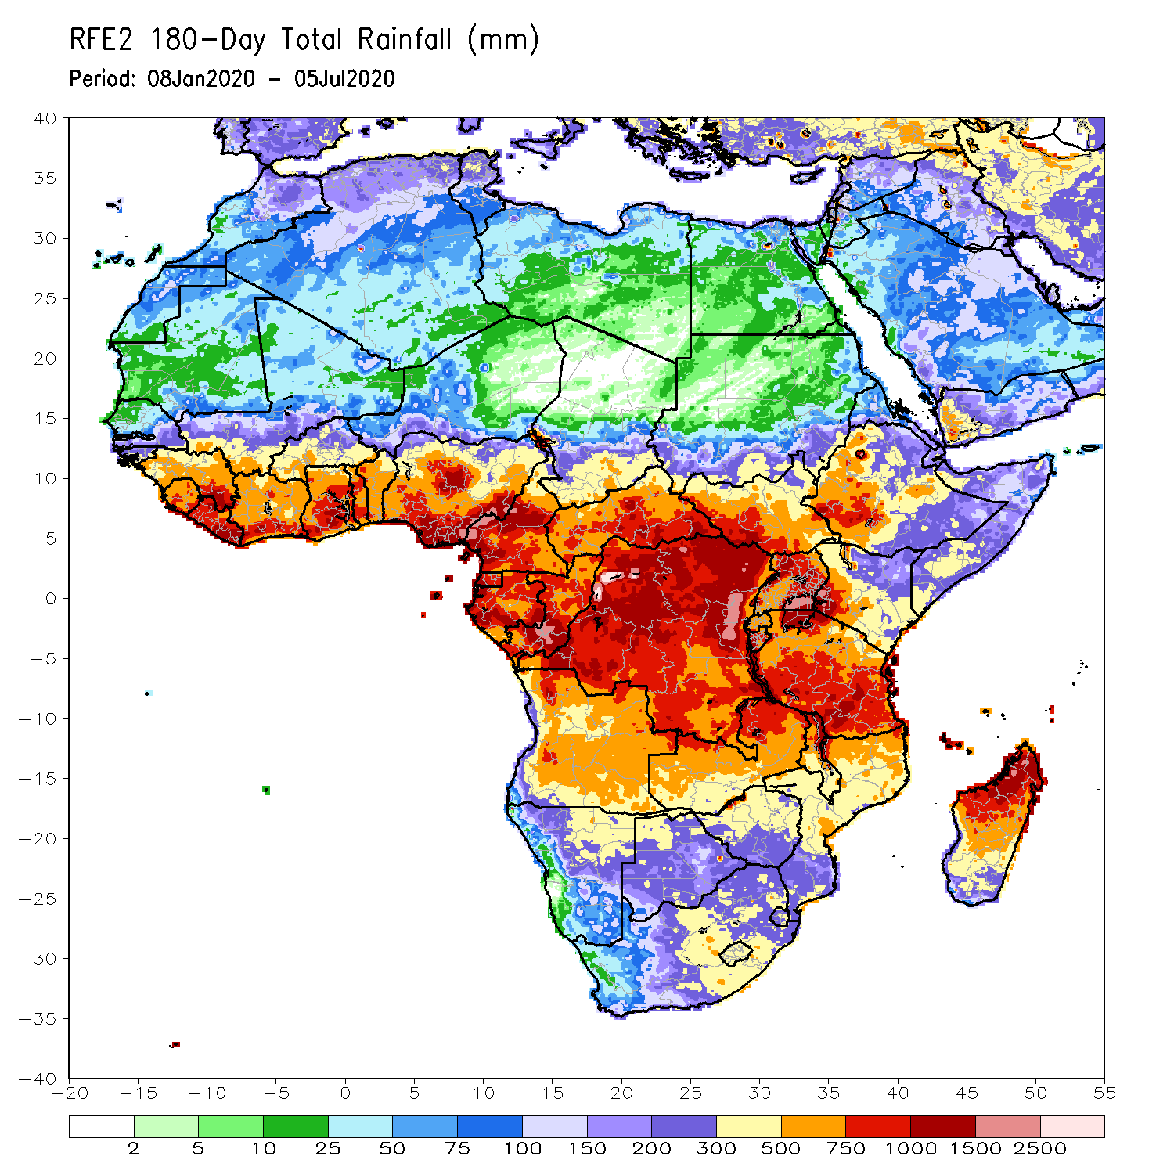
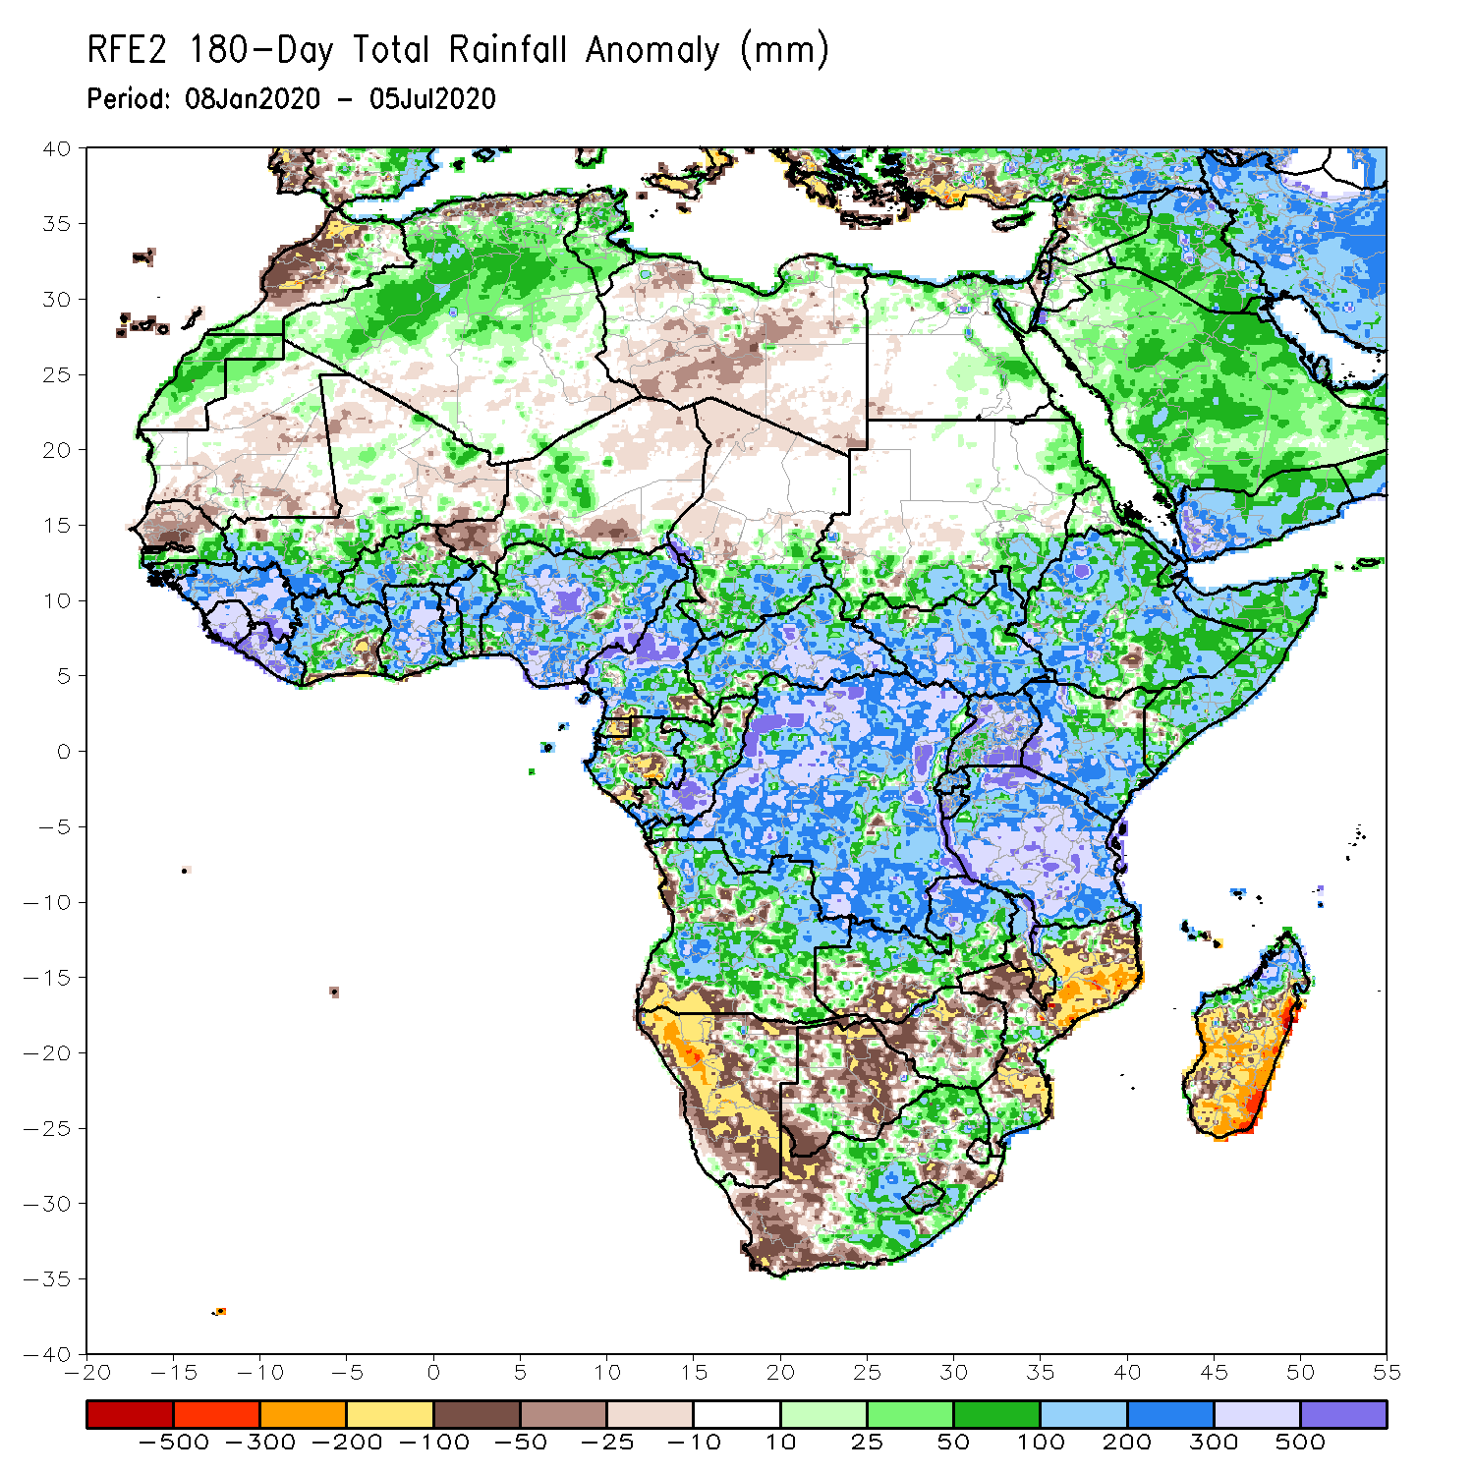
Rainfall Patterns: Last 180 Days
During the past 180 days, rainfall was above-average over much of West, Central and the Greater Horn of Africa, including the northern portions of Southern Africa. Rainfall was also above-average over northeastern Namibia, parts of western Botswana, portions of South Africa, and northern Madagascar.
Below-average rainfall was observed over portions of Mauritania and Senegal, local areas in Cote d’Ivoire, parts of western and southern Niger, local areas in Cameroon, Equatorial Guinea, parts of Gabon, northern Congo, local areas in Angola, western and southern Namibia, western South Africa, southern Zambia, northern and eastern Botswana, much of Zimbabwe, many parts of Mozambique and southern Madagascar.
Notes:
7

Slide 8
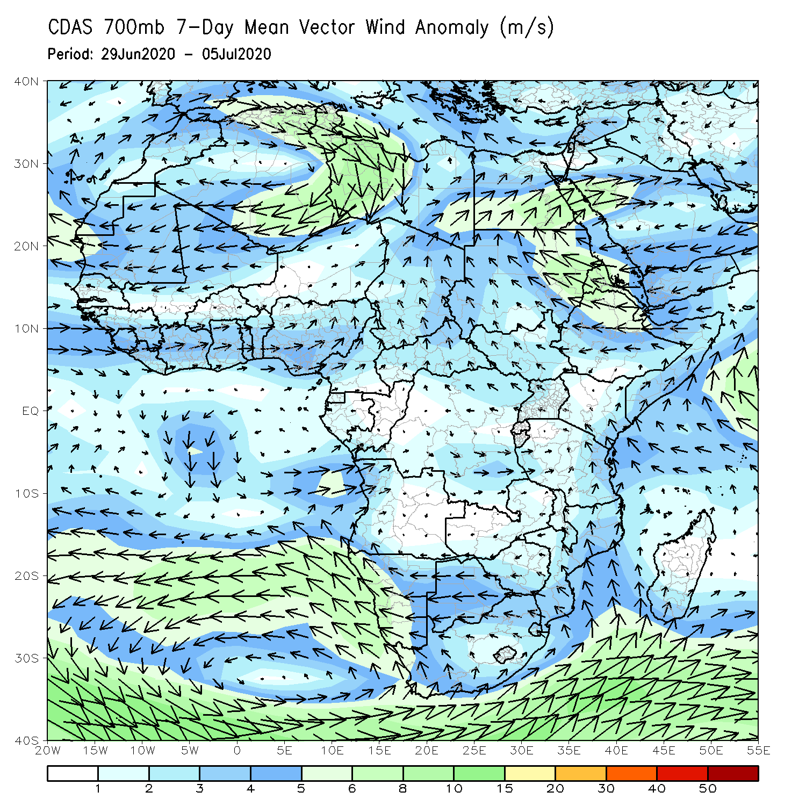
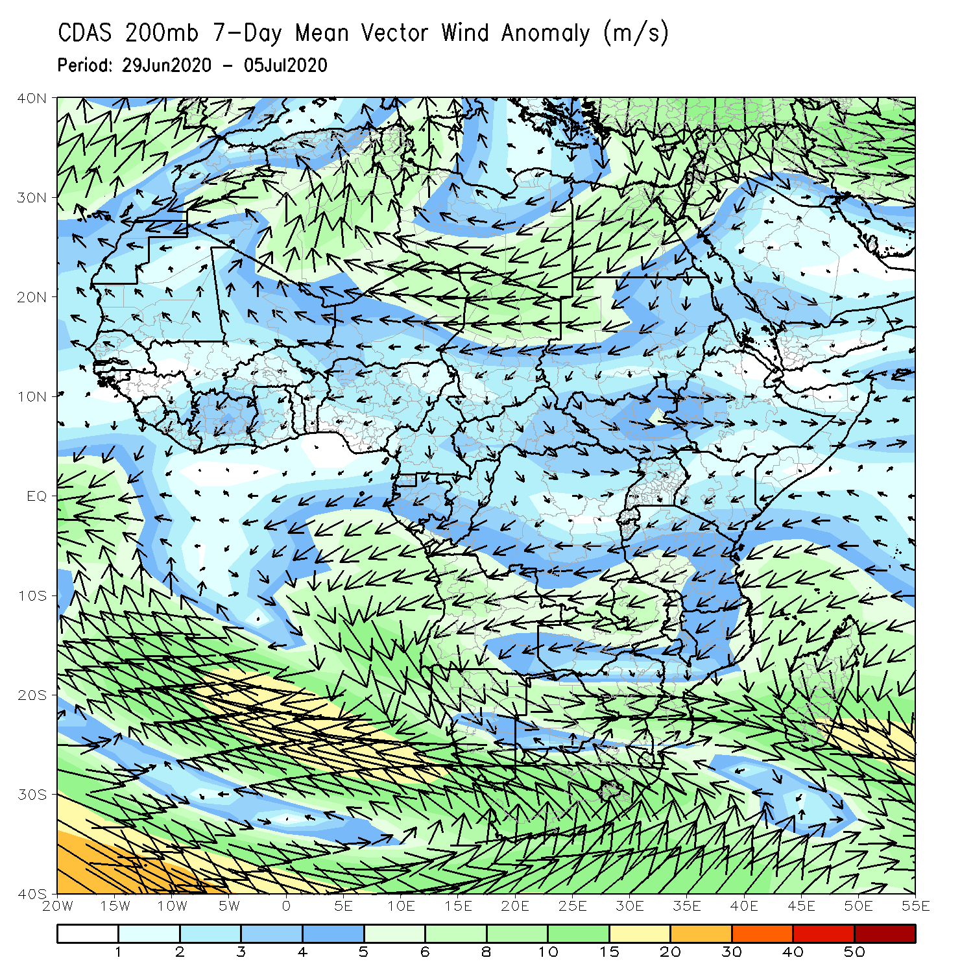
Atmospheric Circulation: Last 7 Days
Anomalous lower-level cyclonic shear (left panel) may have contributed to the observed above-average rainfall over portions of West Africa.

Slide 9
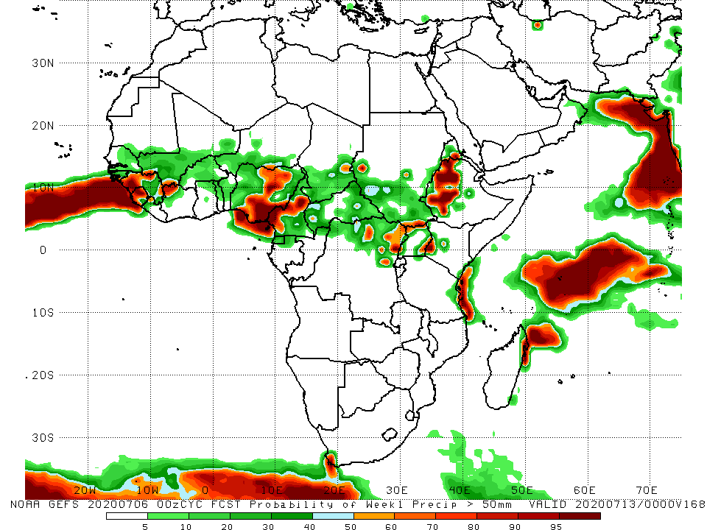
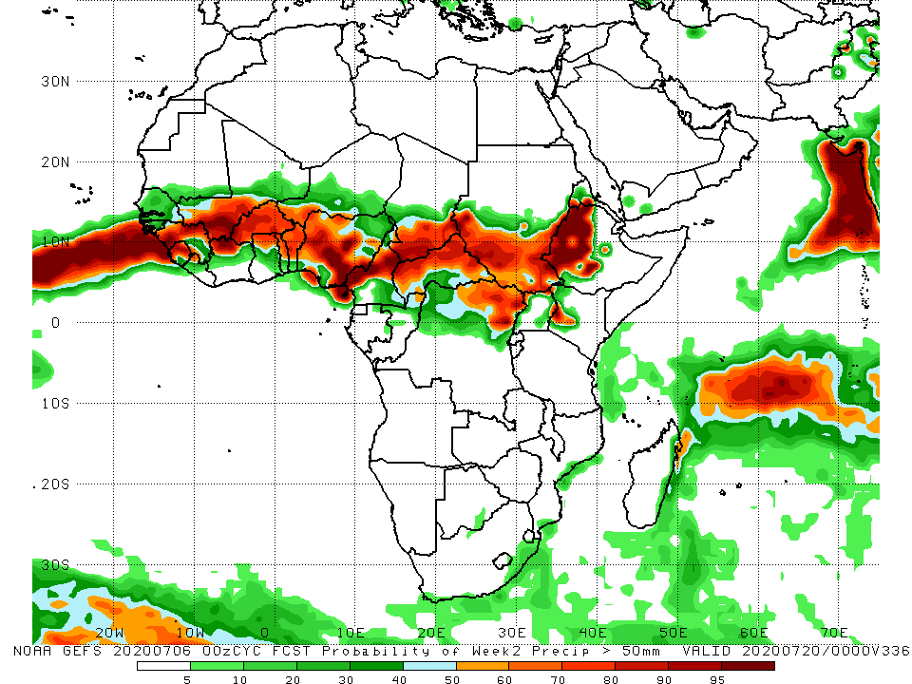
NCEP GEFS Model Forecasts Non-Bias Corrected Probability of precipitation exceedance
Week-1 Valid 7 – 13 July, 2020
Week-2: Valid 14 – 20 July, 2020
For week-1 (left panel), there is an increased chance for weekly rainfall totals to exceed 50mm over Guinea, Sierra Leone, southwestern Mali, Nigeria, northern Cameroon, local areas in Chad and DRC, western Kenya and western Ethiopia.
For week-2 (right panel), there is an increased chance for weekly rainfall totals to exceed 50mm over many places in West and Central Africa, and much of South Sudan, western Ethiopia and local areas in Kenya.
Notes:
9

Slide 10
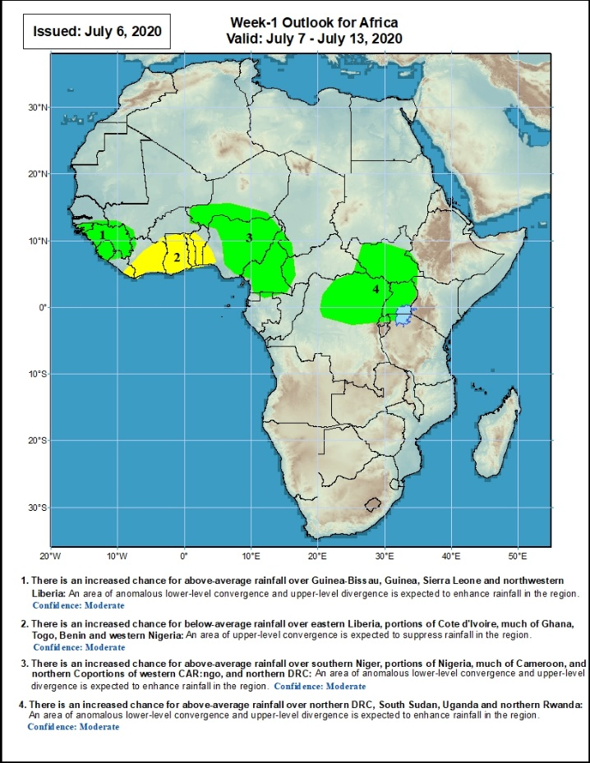
Week-1 Precipitation Outlooks
7 – 13 July, 2020
There is an increased chance for above-average rainfall over Guinea-Bissau, Guinea, Sierra Leone and northwestern Liberia: An area of anomalous lower-level convergence and upper-level divergence is expected to enhance rainfall in the region. Confidence: Moderate
There is an increased chance for below-average rainfall over eastern Liberia, portions of Cote d'Ivoire, much of Ghana, Togo, Benin and western Nigeria: An area of anomalous upper-level convergence is expected to suppress rainfall in the region. Confidence: Moderate
There is an increased chance for above-average rainfall over southern Niger, portions of Nigeria, much of Cameroon, and portions of western CAR: An area of anomalous lower-level convergence and upper-level divergence is expected to enhance rainfall in the region. Confidence: Moderate
There is an increased chance for above-average rainfall over northern DRC, South Sudan, Uganda and Rwanda: An area of anomalous lower-level convergence and upper-level divergence is expected to enhance rainfall in the region. Confidence: Moderate
Notes:
10

Slide 11
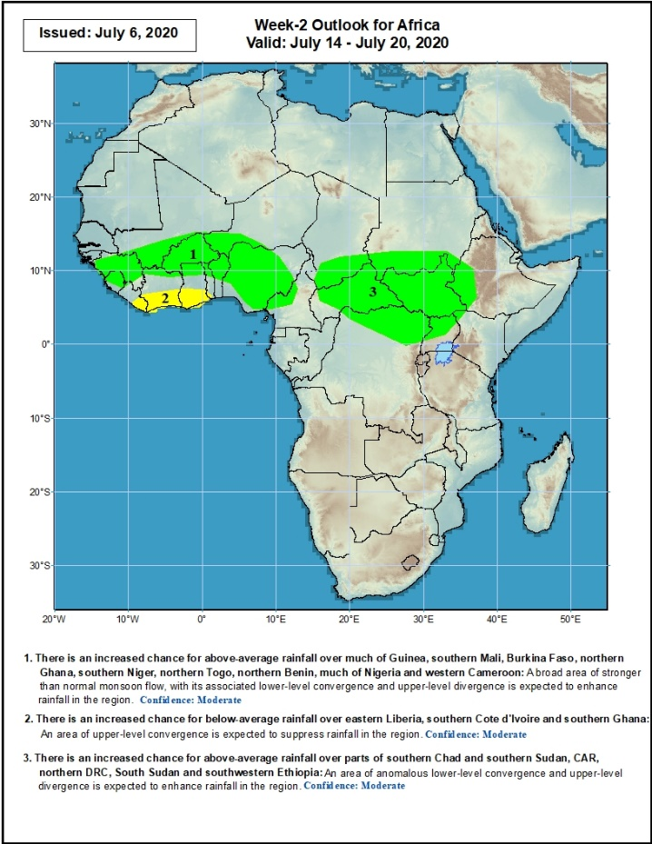
Week-2 Precipitation Outlooks
14 – 20 July, 2020
There is an increased chance for above-average rainfall over much of Guinea, southern Mali, Burkina Faso, northern Ghana, southern Niger, northern Togo, northern Benin, much of Nigeria and western Cameroon: An area of anomalous lower-level convergence and upper-level divergence is expected to enhance rainfall in the region. Confidence: Moderate
There is an increased chance for below-average rainfall over eastern Liberia, southern Cote d'Ivoire and southern Ghana: An area of anomalous upper-level convergence is expected to suppress rainfall in the region. Confidence: Moderate
There is an increased chance for above-average rainfall over parts of southern Chad and southern Sudan, CAR, northern DRC, South Sudan and southwestern Ethiopia: An area of anomalous lower-level convergence and upper-level divergence is expected to enhance rainfall in the region. Confidence: Moderate
Notes:
11

Slide 12
Summary
During the past 7 days, rainfall was above-average over much of Guinea, local areas in Mali, Sierra Leone, parts of Burkina Faso and Ghana, local areas in Benin, much of Nigeria, Cameroon, northern Gabon, Congo, northern DRC, southern Chad, CAR, parts of Sudan and South Sudan, and portions of Ethiopia. Below-average rainfall was observed over parts of Senegal and Mali, Liberia, much of Cote d’Ivoire, parts of Burkina Faso and Ghana, western Niger, parts of Togo and Benin, local areas in Nigeria, Chad and CAR, parts of Sudan and South Sudan, and Eritrea.
During the past 30 days, rainfall was above-average over many places in West and Central Africa countries. Above-average rainfall was also observed over South Sudan, parts of eastern and southern Sudan, Uganda, Ethiopia, and local areas in western Kenya. Rainfall was below-average over local areas in Senegal, parts of Cote d’Ivoire, western and southern Niger, and local areas in Nigeria and Chad. Below-average rainfall was also observed over portions of South Africa.
During the past 90 days, rainfall was above-average over much of West, Central and the Greater Horn of Africa, including the northern portions of Southern Africa. Rainfall was also above-average over local areas in northeastern Namibia, western Botswana, and portions of South Africa. Local areas in Senegal, parts of western, southern Niger, parts of southwestern Angola, western and southern Namibia, eastern Botswana, parts of Zimbabwe and Zambia, western and northeastern South Arica, southern Tanzania, and much of Mozambique and Madagascar had below-average rainfall.
Week-1 outlooks call for an increased chance for above-average rainfall over Guinea-Bissau, Guinea-Conakry, southeastern Senegal, Sierra Leone, southwestern Mali, southern Benin, southern Nigeria, western CAR, northern Congo and northern DRC. In contrast, there is an increased chance for below-average rainfall over eastern Liberia, southern Cote d’Ivoire and southwestern Ghana.
Week-2 outlooks call for an increased chance for above-average rainfall over Guinea-Bissau, Guinea-Conakry, Sierra Leone, southwestern Mali, western Liberia, parts of eastern Burkina Faso, western Niger, northern Benin, much of Nigeria, Cameroon, southern Chad and parts of western Sudan. In contrast, there is an increased chance for below-average rainfall over southern Cote d’Ivoire and the neighboring areas of eastern Liberia and southwestern Ghana.
Notes:
12

