Slide 1
The African Monsoon Recent Evolution and Current Status Include Week-1 and Week-2 Outlooks
Update prepared by
Climate Prediction Center / NCEP
3 Augus 2020
For more information, visit:
http://www.cpc.ncep.noaa.gov/products/Global_Monsoons/African_Monsoons/precip_monitoring.shtml

Slide 2
Outline
Highlights
Recent Evolution and Current Conditions
NCEP GEFS Forecasts
Summary

Slide 3
Highlights: Last 7 Days
Weekly rainfall surpluses exceeded 100mm over local areas in Mali, Cameroon, Chad, Sudan, and South Sudan.
Rainfall was below average along the Gulf of Guinea coast.
Week-1 outlooks call for an increased chance for above-average rainfall over much of Senegal, parts of southern Mauritania, Gambia, Guinea-Bissau, northern Guinea, southern Mali, Burkina Faso, northern Benin, southern Niger, northern Nigeria, Chad, Sudan, eastern South Sudan, Eritrea and western Ethiopia. In contrast, there is an increased chance for below-average rainfall along the Gulf of Guinea coast.
Week-2 outlooks call for an increased chance for above-average rainfall over eastern Senegal, parts of southern Mauritania, southern Mali, Gambia, Guinea-Bissau, Guinea, Sierra Leone, parts of northern Cote d'Ivoire, Burkina Faso, southwestern Niger, northern Ghana, northern Benin, northwestern and northeastern Nigeria, southern Chad, portions of Sudan, eastern South Sudan, Eritrea and western Ethiopia. In contrast, there is an increased chance for below-average rainfall along the Gulf of Guinea coast.

Slide 4
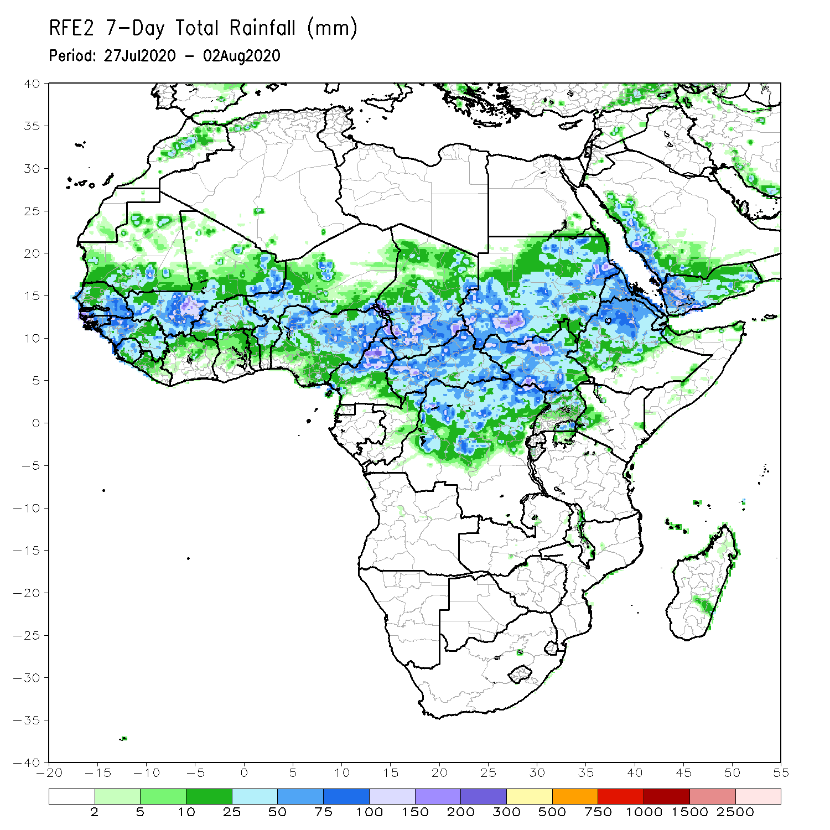
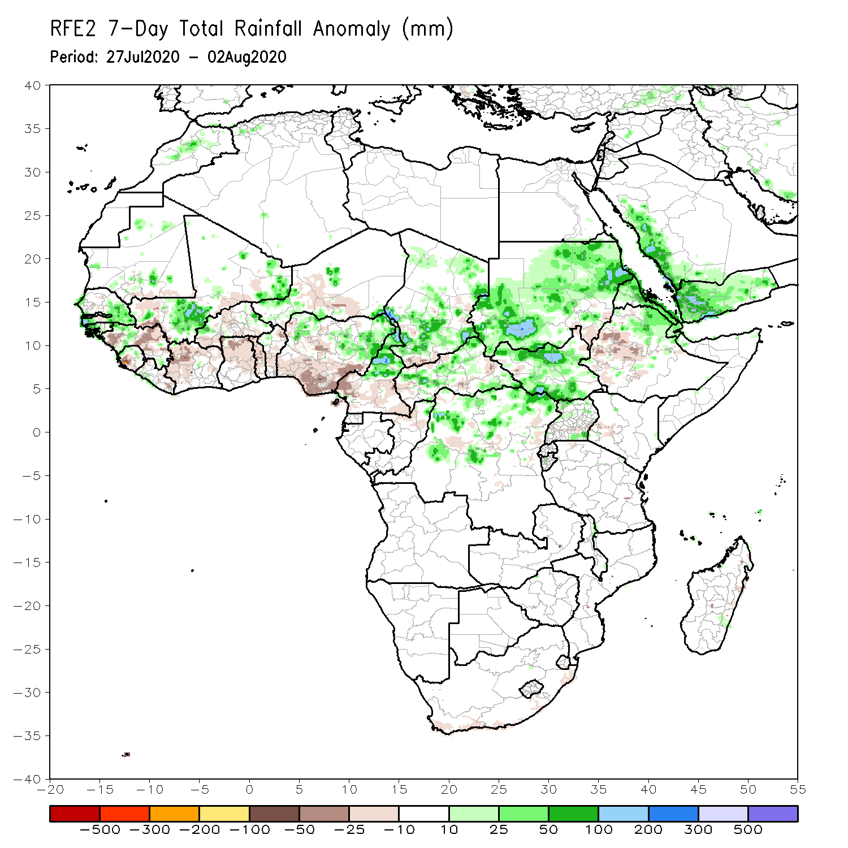
Rainfall Patterns: Last 7 Days
During the past 7 days, rainfall was above-average over eastern Senegal, parts of Mali, local areas in Niger, northern Nigeria, northern Cameroon, Chad, much of CAR, northern DRC, Sudan, South Sudan, Eritrea and northeastern Ethiopia.
Below-average rainfall was observed over much of the Gulf of Guinea region, local areas in Senegal, Mali Burkina Faso and Niger, local areas in CAR, local area sin eastern Sudan, and western Ethiopia.

Slide 5
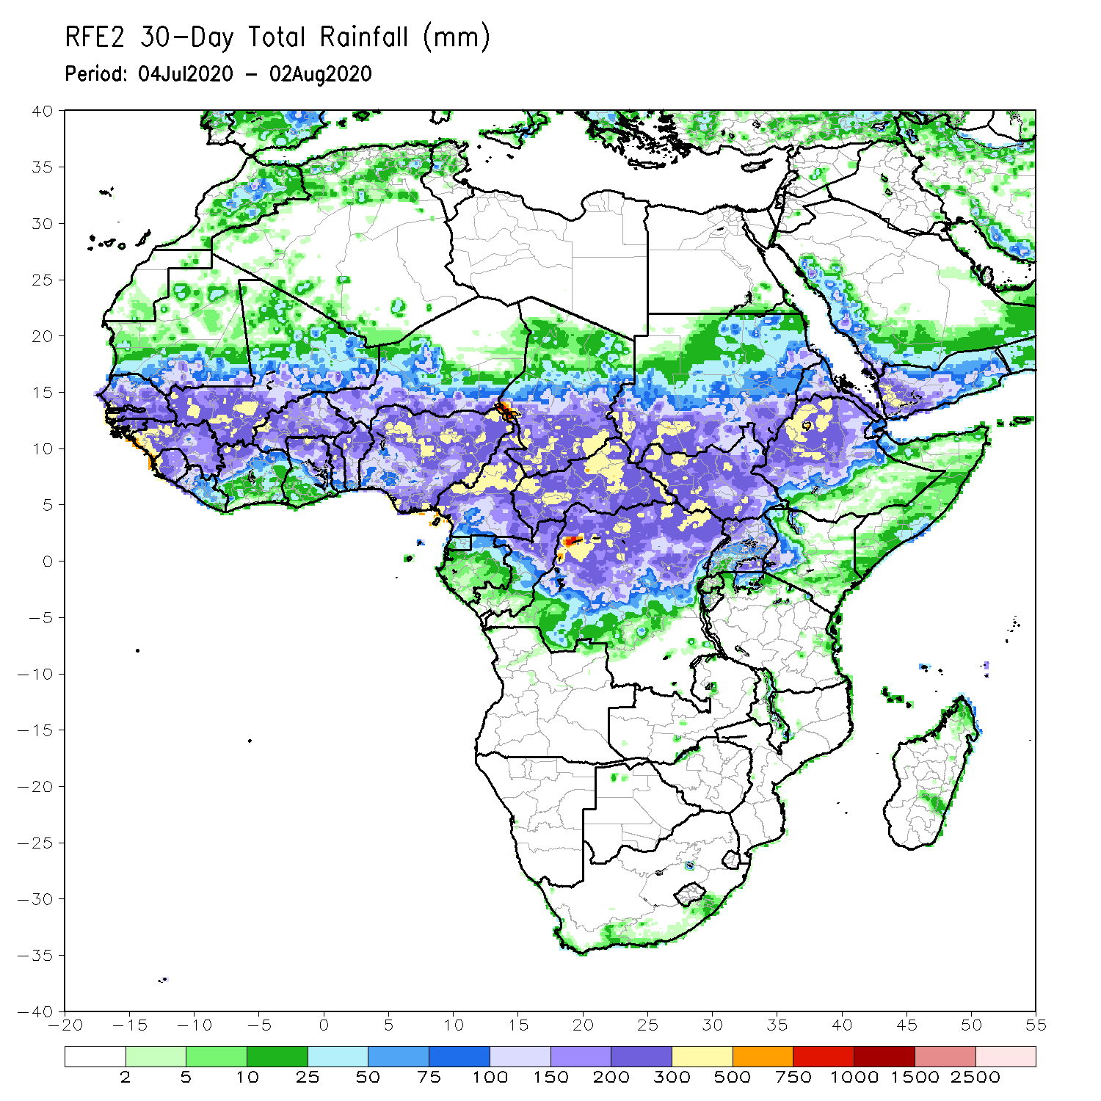
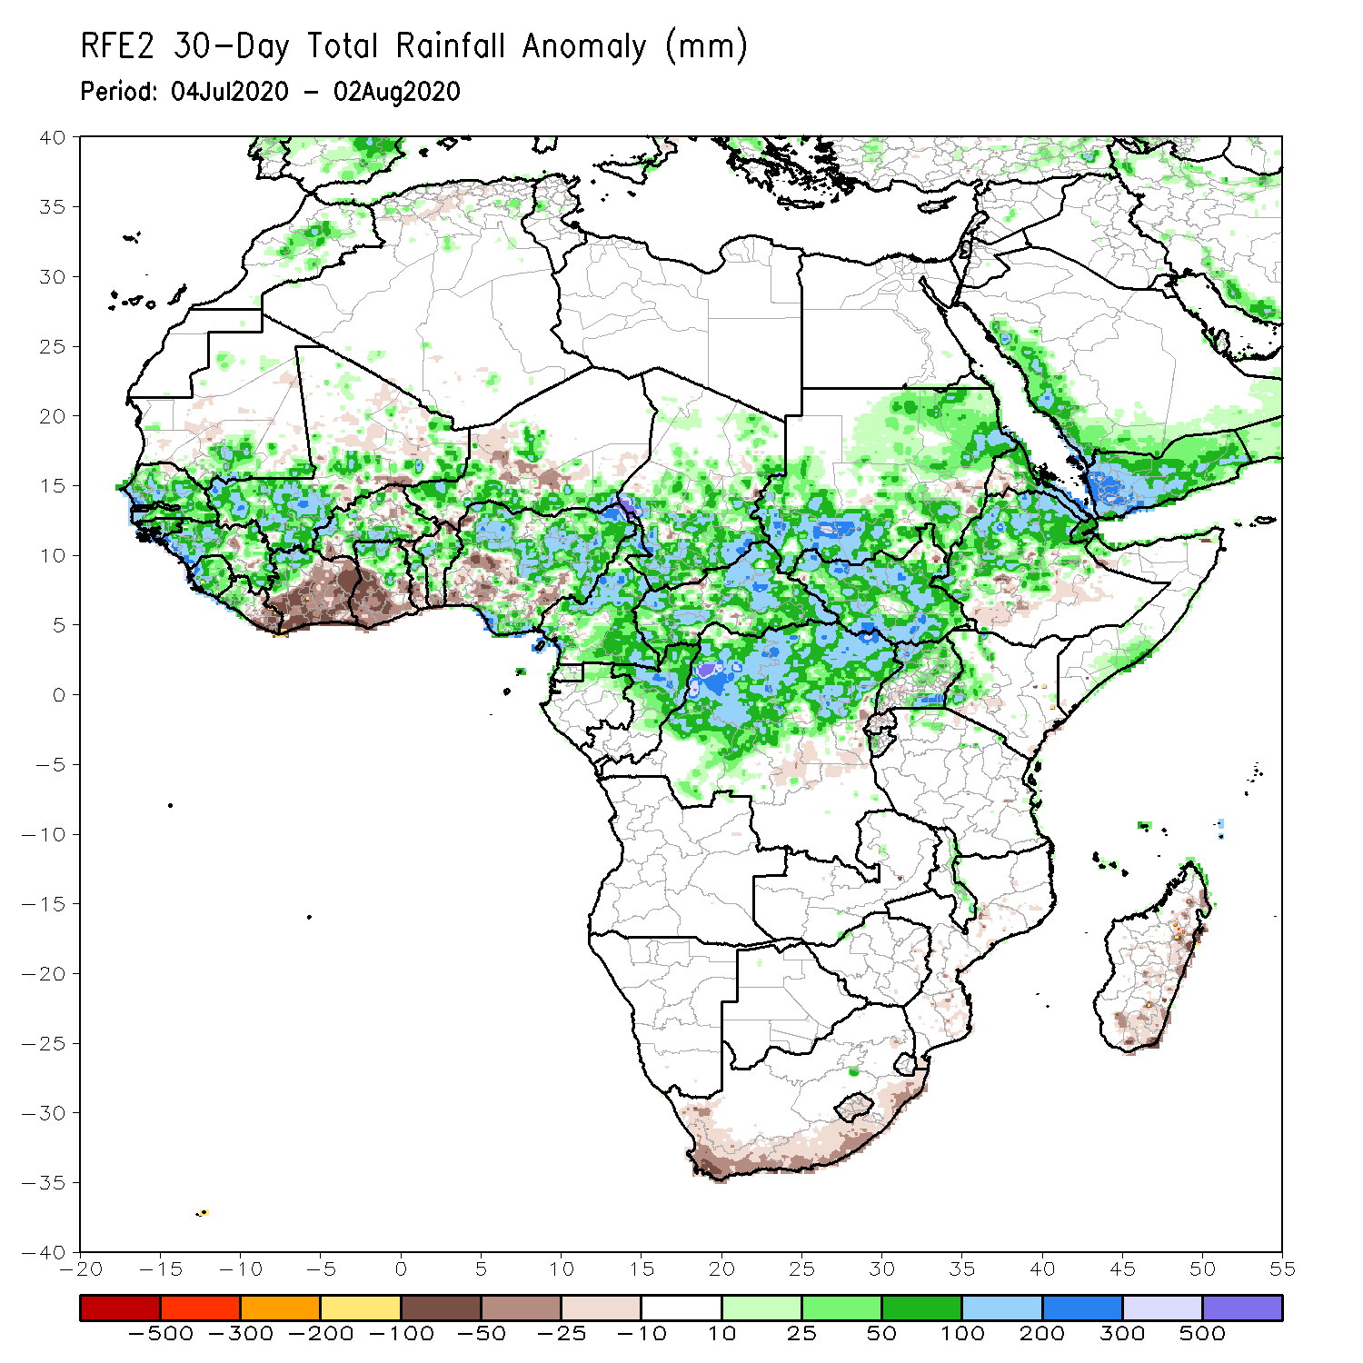
Rainfall Patterns: Last 30 Days
During the past 30 days, rainfall was above-average over many places in the Sahel region, the far western and eastern Gulf of Guinea, and Central Africa countries. Above-average rainfall was also observed over South Sudan, much of Sudan, Uganda, Ethiopia, and local areas in western Kenya and southern Somalia.
Rainfall was below-average over eastern Liberia, portions of Cote d’Ivoire, southwestern Ghana, local areas in Burkina Faso, Nigeria and Niger, local areas in Ethiopia and Eritrea, and coastal South Africa and Madagascar.
Notes:
5

Slide 6
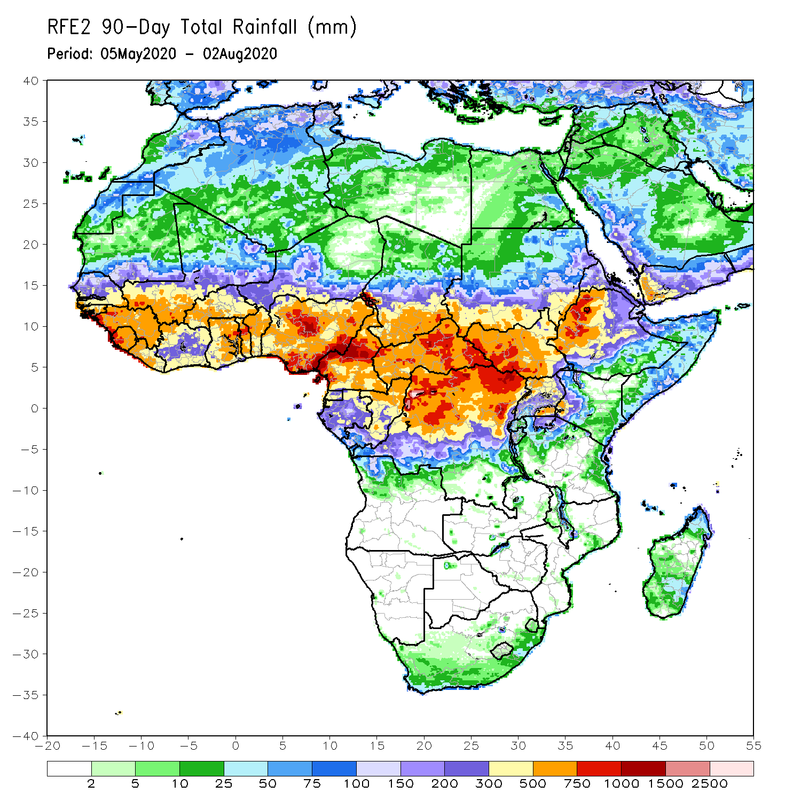
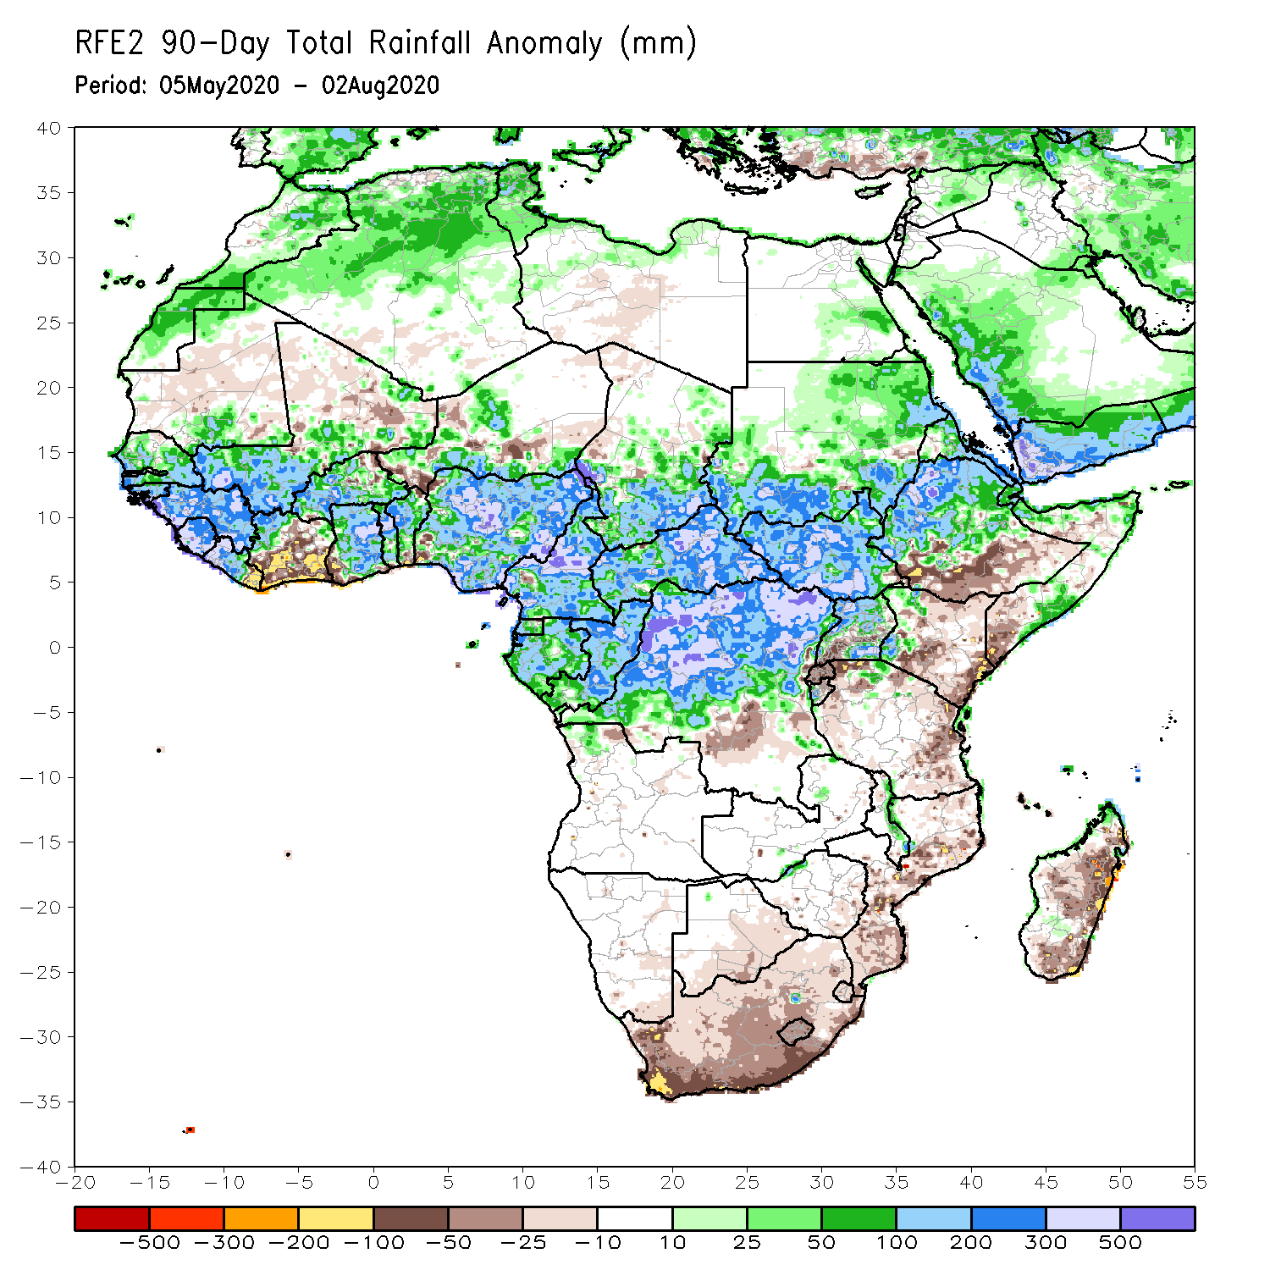
Rainfall Patterns: Last 90 Days
During the past 90 days, rainfall was above-average over much of West, Central and the Greater Horn of Africa.
Below-average rainfall was observed over parts of Cote d’Ivoire, local areas in Niger, southern Ethiopia, Kenya, southern Somalia, parts of southern DRC, Tanzania, South Africa, Mozambique and Madagascar.
Notes:
6

Slide 7
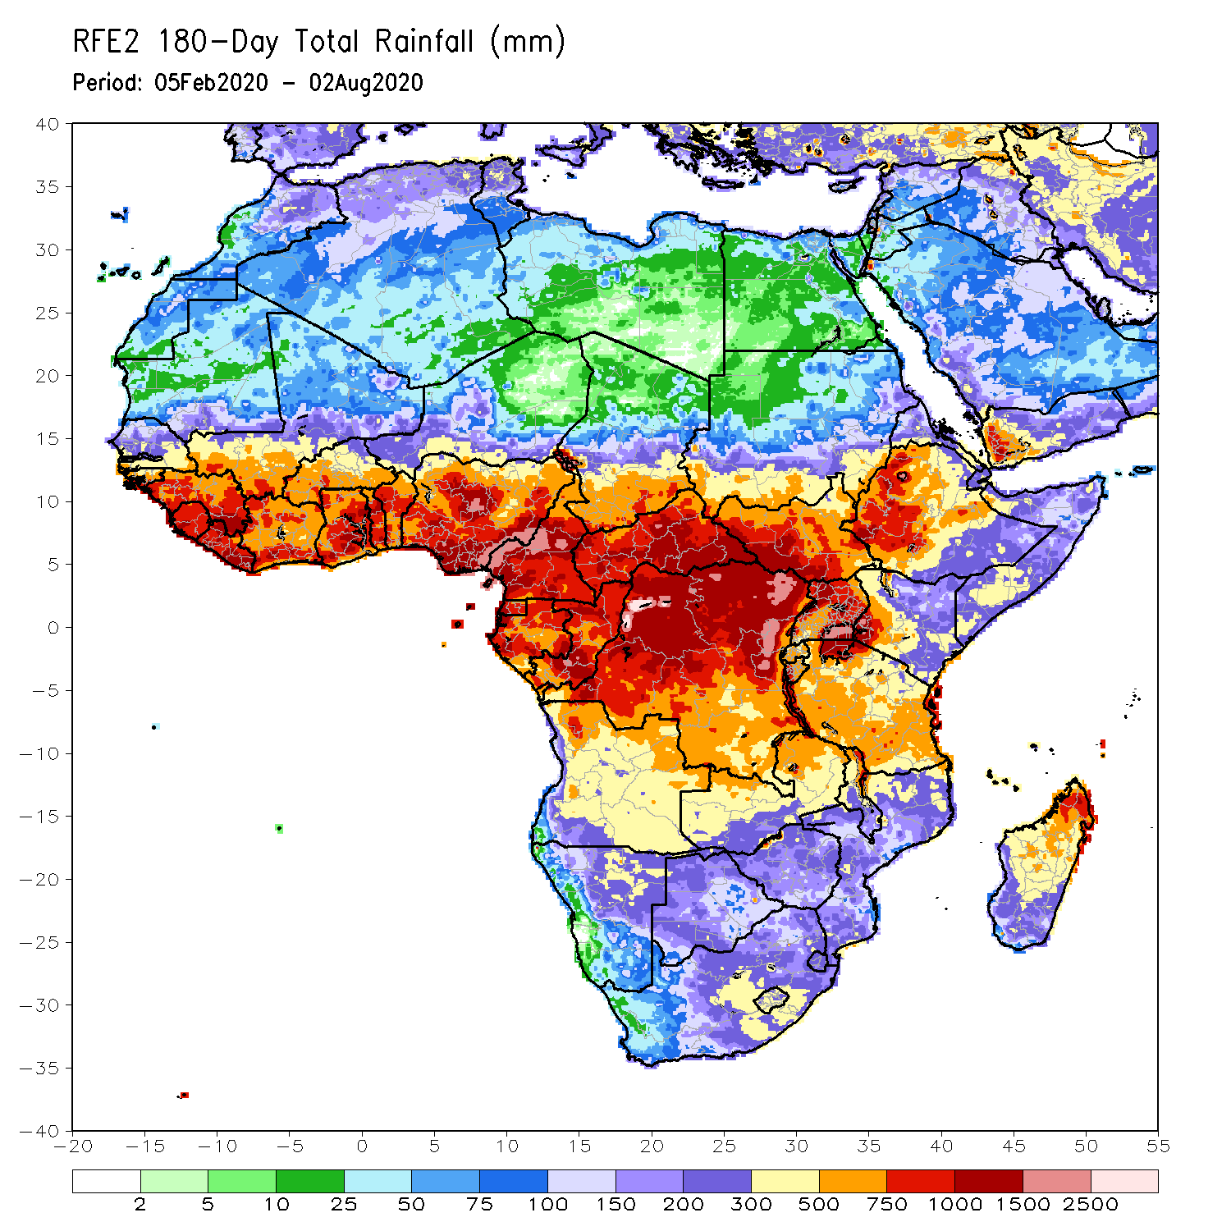
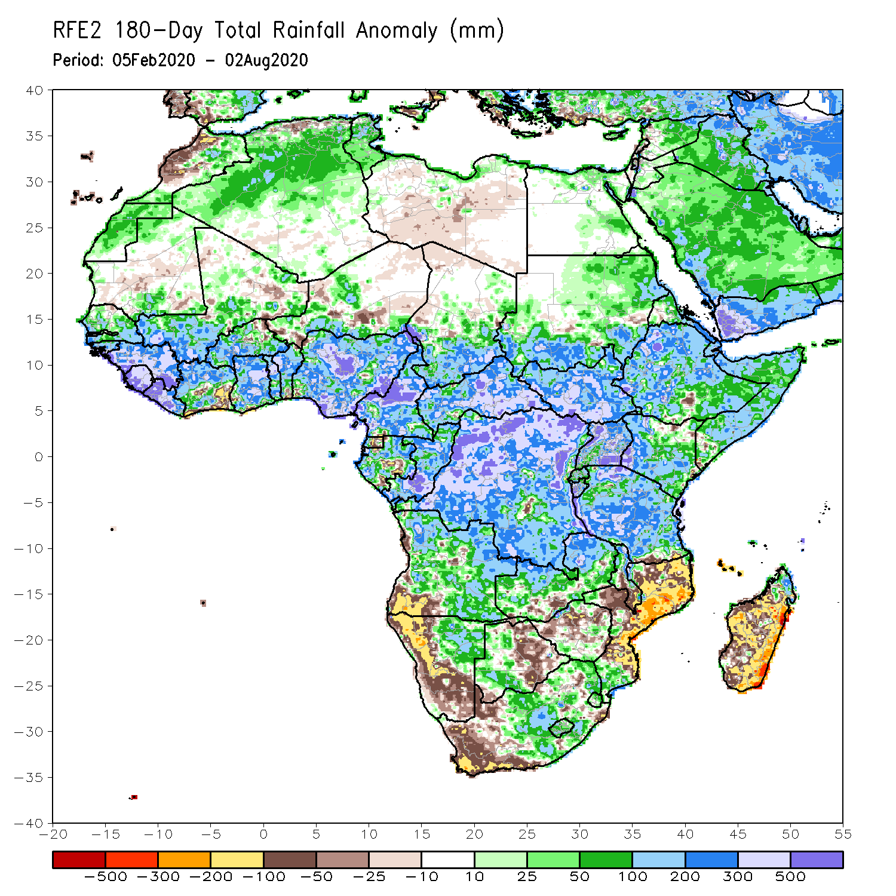
Rainfall Patterns: Last 180 Days
During the past 180 days, rainfall was above-average over much of West, Central and the Greater Horn of Africa, including the northern portions of Southern Africa. Rainfall was also above-average over northeastern Namibia, western Botswana, portions of South Africa, and northern Madagascar.
Below-average rainfall was observed over portions of southwestern Angola, western and southern Namibia, western South Africa, local areas in southern Zambia, eastern Botswana, Zimbabwe, many parts of Mozambique, and central and southern Madagascar.
Notes:
7

Slide 8
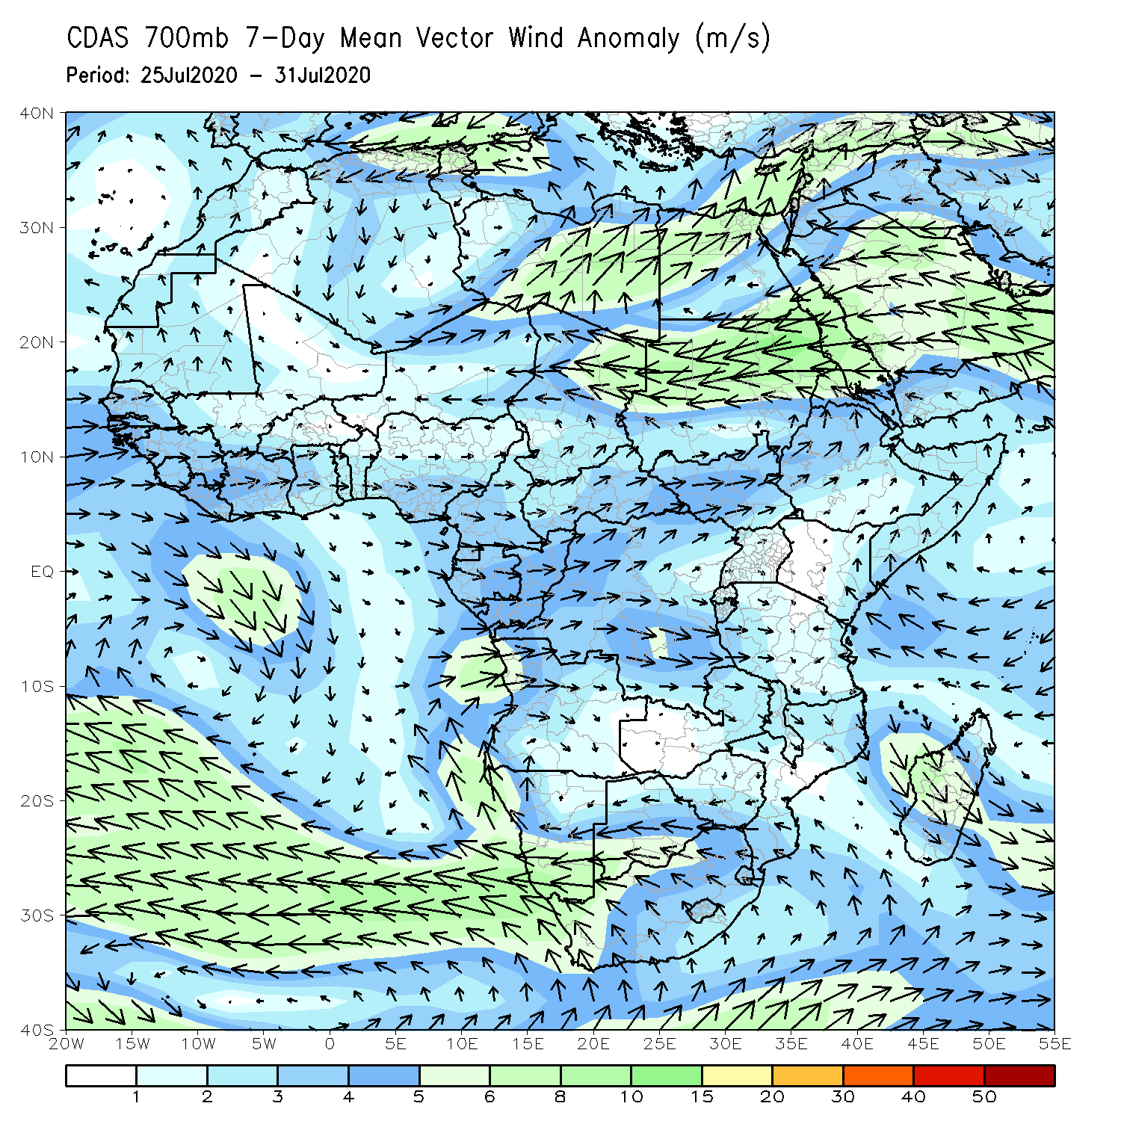
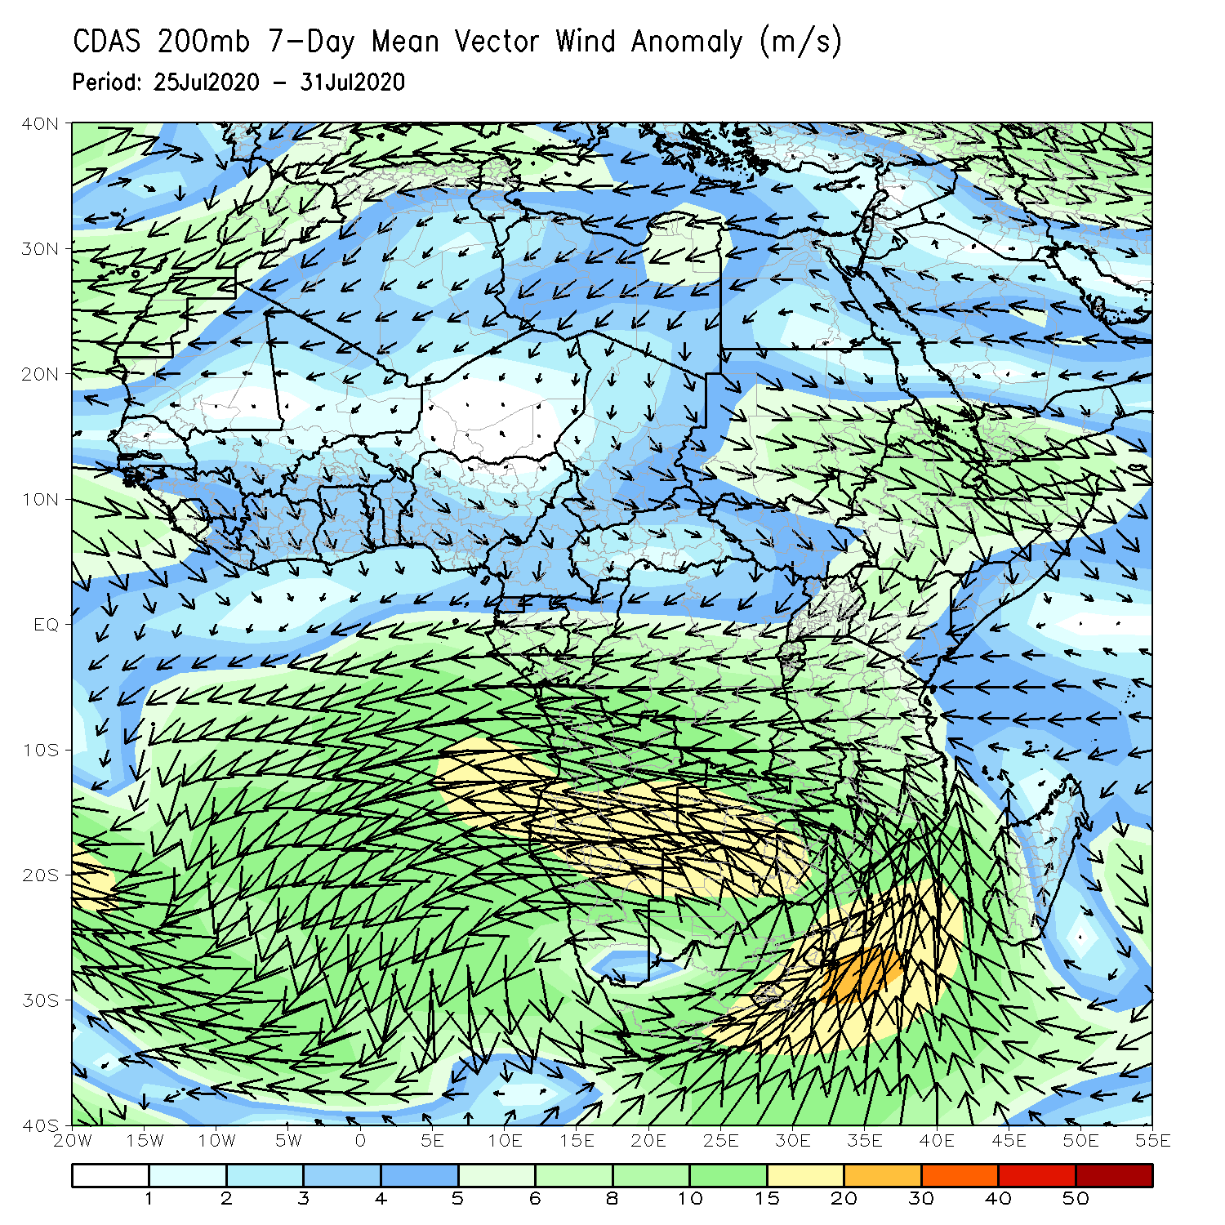
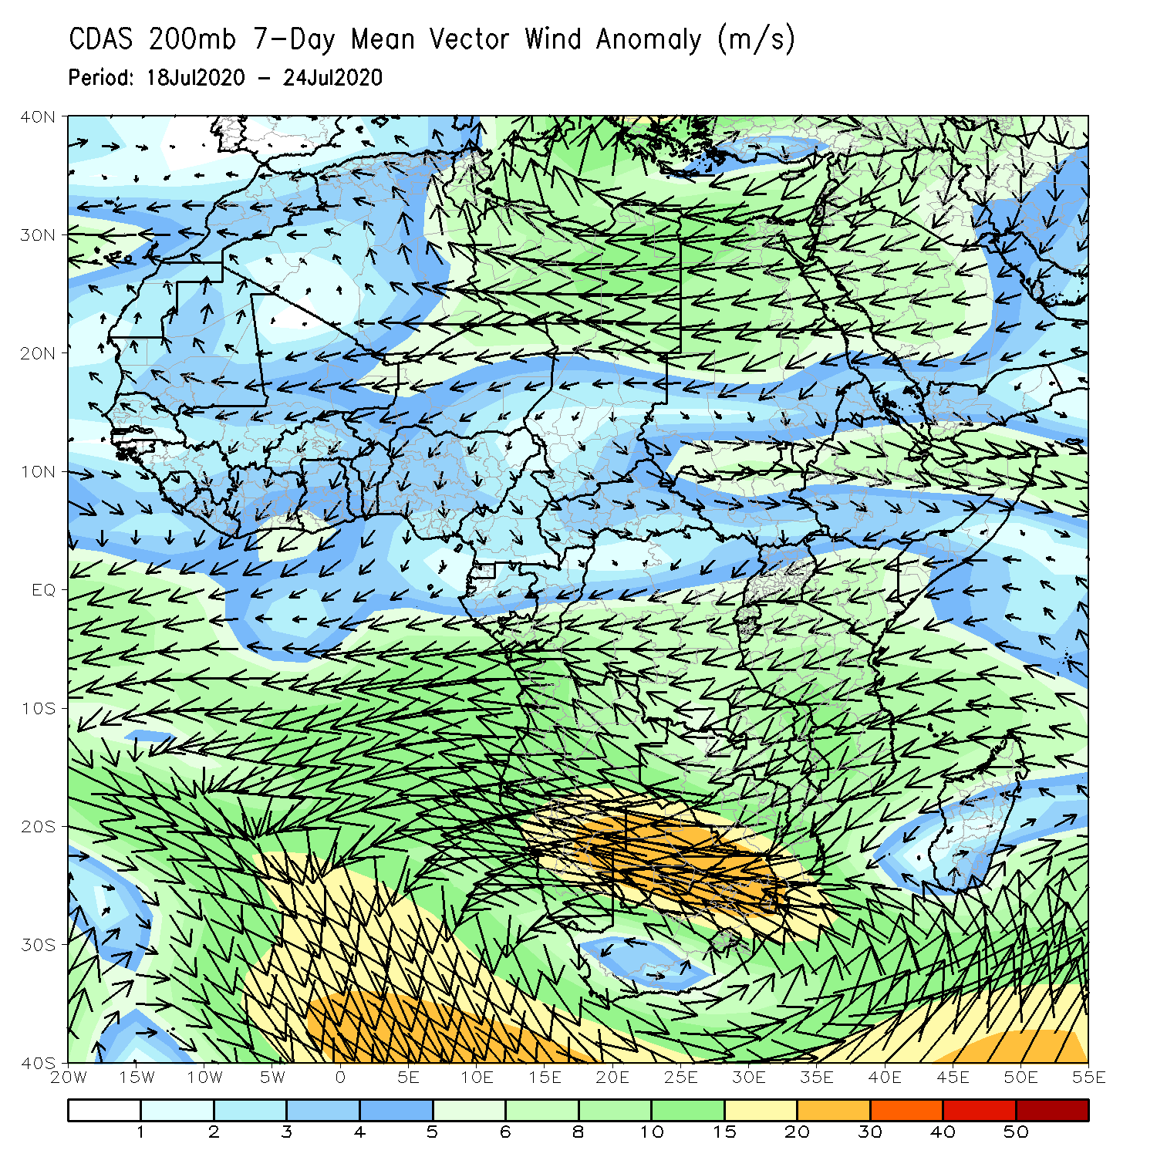
Atmospheric Circulation: Last 7 Days
An area of anomalous lower-level cyclonic flow was observed across Central athe Greater Hon of Africa (left panel).

Slide 9
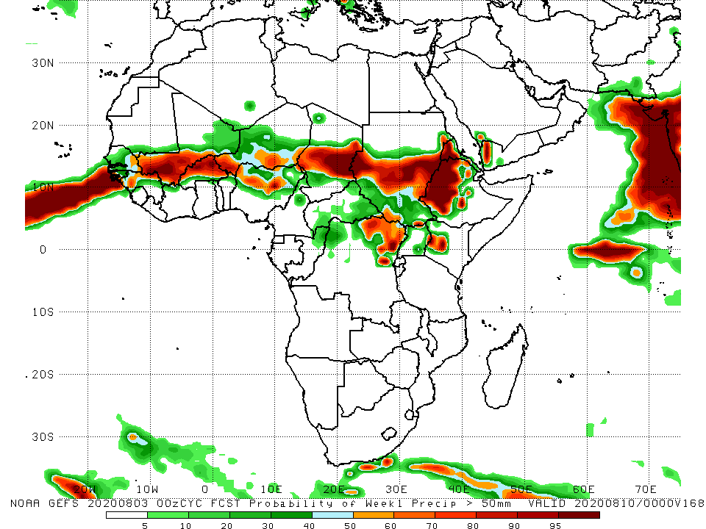
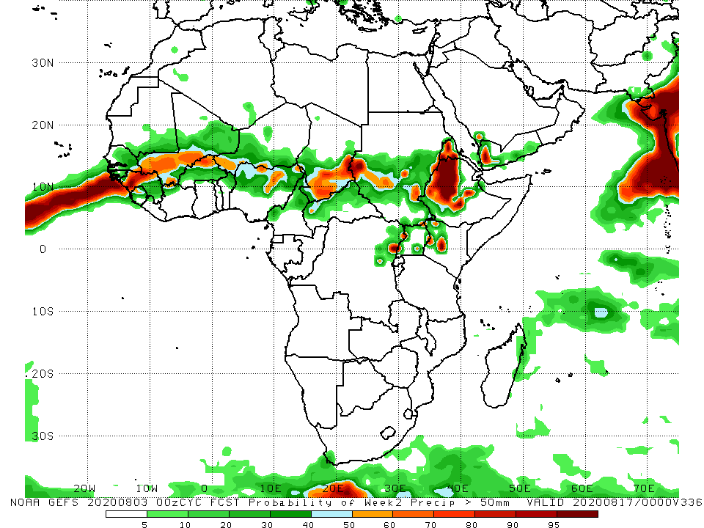
NCEP GEFS Model Forecasts Non-Bias Corrected Probability of precipitation exceedance
Week-1 Valid 4 – 10 August, 2020
Week-2: Valid 11 – 17 August, 2020
For week-1 (left panel) and Week-2 (right panel), there is an increased chance for weekly rainfall totals to exceed 50mm over many places in the Sahel region, and portions of the Greater Horn of Africa.
Notes:
9

Slide 10
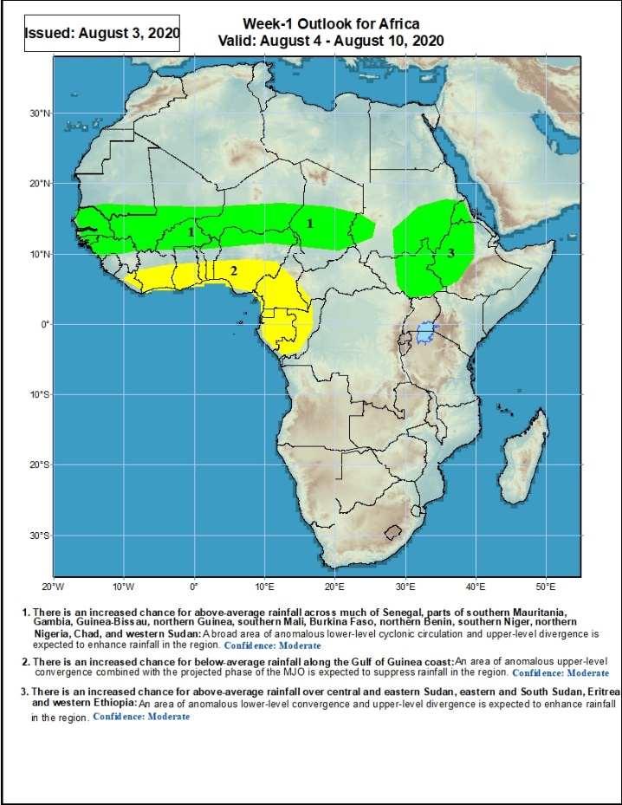
Week-1 Precipitation Outlooks
4 – 10 August, 2020
There is an increased chance for above-average rainfall across much of Senegal, parts of southern Mauritania, Gambia, Guinea-Bissau, northern Guinea, southern Mali, Burkina Faso, northern Benin, southern Niger, northern Nigeria, Chad, and western Sudan: A broad area of anomalous lower-level cyclonic circulation and upper-level divergence is expected to enhance rainfall in the region. Confidence: Moderate
There is an increased chance for below-average rainfall along the Gulf of Guinea coast: An area of anomalous upper-level convergence combined with the projected phase of the MJO is expected to suppress rainfall in the region. Confidence: Moderate
There is an increased chance for above-average rainfall over central and eastern Sudan, eastern South Sudan, Eritrea and western Ethiopia: An area of anomalous lower-level convergence and upper-level divergence is expected to enhance rainfall in the region. Confidence: Moderate
Notes:
10

Slide 11
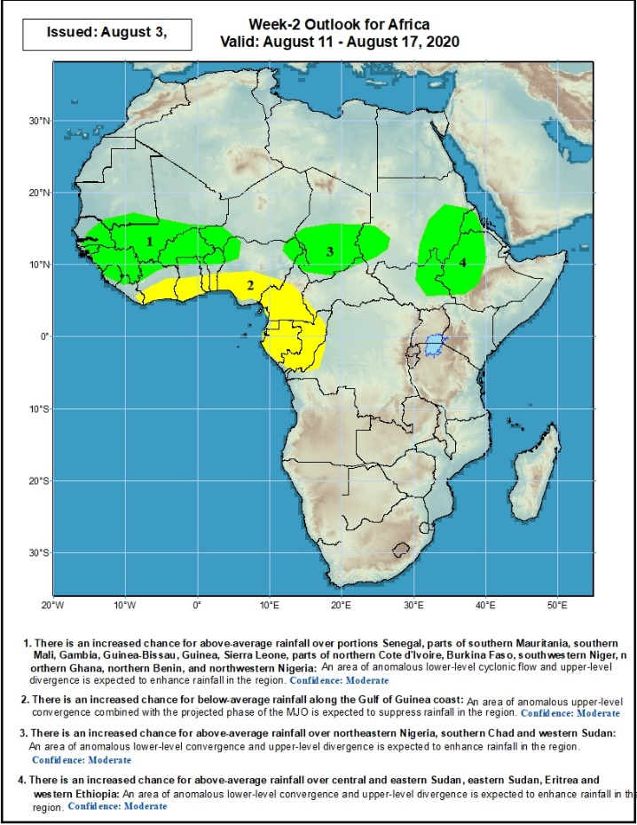
Week-2 Precipitation Outlooks
11 – 17 August, 2020
There is an increased chance for above-average rainfall over eastern Senegal, parts of southern Mauritania, southern Mali, Gambia, Guinea-Bissau, Guinea, Sierra Leone, parts of northern Cote d'Ivoire, Burkina Faso, southwestern Niger, northern Ghana, northern Benin, and northwestern Nigeria: An area of anomalous lower-level cyclonic flow and upper-level divergence is expected to enhance rainfall in the region. Confidence: Moderate
There is an increased chance for below-average rainfall along the Gulf of Guinea coast: An area of anomalous upper-level convergence combined with the projected phase of the MJO is expected to suppress rainfall in the region. Confidence: Moderate
There is an increased chance for above-average rainfall over northeastern Nigeria, southern Chad and western Sudan: An area of anomalous lower-level convergence and upper-level divergence is expected to enhance rainfall in the region. Confidence: Moderate
There is an increased chance for above-average rainfall over central and eastern Sudan, eastern South Sudan, Eritrea and western Ethiopia: An area of anomalous lower-level convergence and upper-level divergence is expected to enhance rainfall in the region. Confidence: Moderate
Notes:
11

Slide 12
Summary
During the past 7 days, rainfall was above-average over eastern Senegal, parts of Mali, local areas in Niger, northern Nigeria, northern Cameroon, Chad, much of CAR, northern DRC, Sudan, South Sudan, Eritrea and northeastern Ethiopia. Below-average rainfall was observed over much of the Gulf of Guinea region, local areas in Senegal, Mali Burkina Faso and Niger, local areas in CAR, local area sin eastern Sudan, and western Ethiopia.
During the past 30 days, rainfall was above-average over many places in the Sahel region, the far western and eastern Gulf of Guinea, and Central Africa countries. Above-average rainfall was also observed over South Sudan, much of Sudan, Uganda, Ethiopia, and local areas in western Kenya and southern Somalia. Rainfall was below-average over eastern Liberia, portions of Cote d’Ivoire, southwestern Ghana, local areas in Burkina Faso, Nigeria and Niger, local areas in Ethiopia and Eritrea, and coastal South Africa and Madagascar.
During the past 90 days, rainfall was above-average over much of West, Central and the Greater Horn of Africa. Below-average rainfall was observed over parts of Cote d’Ivoire, local areas in Niger, southern Ethiopia, Kenya, southern Somalia, parts of southern DRC, Tanzania, South Africa, Mozambique and Madagascar.
Week-1 outlooks call for an increased chance for above-average rainfall over southern Mauritania, much of Senegal, southwestern Mali, Guinea-Bissau, Guinea, Sierra Leone, Sierra Leone, western Liberia, northern Cote d'Ivoire, western Burkina Faso, southern Niger, northern Nigeria, central Chad, western and eastern Sudan, western Ethiopia, and eastern South Sudan. In contrast, there is an increased chance for below-average rainfall over eastern Liberia, southern Cote d'Ivoire, southern Ghana, southern Togo, southern Benin, and southwestern Nigeria.
Week-2 outlooks call for an increased chance for above-average rainfall over much of Senegal, Guinea-Bissau, Guinea, Sierra Leone, southern Mali, Burkina Faso, southern Niger, northern Nigeria, southern Chad, western and eastern Sudan, eastern South Sudan, and western Ethiopia. In contrast, there is an increased chance for below-average rainfall along the Gulf of Guinea coast.
Notes:
12

