Slide 1
The African Monsoon Recent Evolution and Current Status Include Week-1 and Week-2 Outlooks
Update prepared by
Climate Prediction Center / NCEP
24 August 2020
For more information, visit:
http://www.cpc.ncep.noaa.gov/products/Global_Monsoons/African_Monsoons/precip_monitoring.shtml

Slide 2
Outline
Highlights
Recent Evolution and Current Conditions
NCEP GEFS Forecasts
Summary

Slide 3
Highlights: Last 7 Days
Another week of moderate to heave rainfall sustained moisture surpluses over many places in Central Africa and the Greater Horn of Africa.
Week-1 outlooks call for an increased chance for above-average rainfall over Senegal, Gambia, Guinea-Bissau, Guinea, Sierra Leone, southern Mauritania, southern Mali, Burkina Faso, southern Niger, northern Benin, northern Nigeria, central and southern Chad, western Sudan, central Congo, and central and northern DRC. In contrast, there is an increased chance for below-average rainfall along the Gulf of Guinea coast.
Week-2 outlooks call for an increased chance for above-average rainfall over southern Senegal, Gambia, Guinea-Bissau, Guinea, Sierra Leone, southern Mali, Burkina Faso, southern Niger, northern Benin, northern Nigeria, central and southern Chad, northern and eastern Cameroon, northern Congo, CAR, northern DRC, western Sudan and western South Sudan. In contrast, there is an increased chance for below-average rainfall over eastern Liberia, Cote d'Ivoire, southern Ghana, southern Togo and southern Benin.

Slide 4
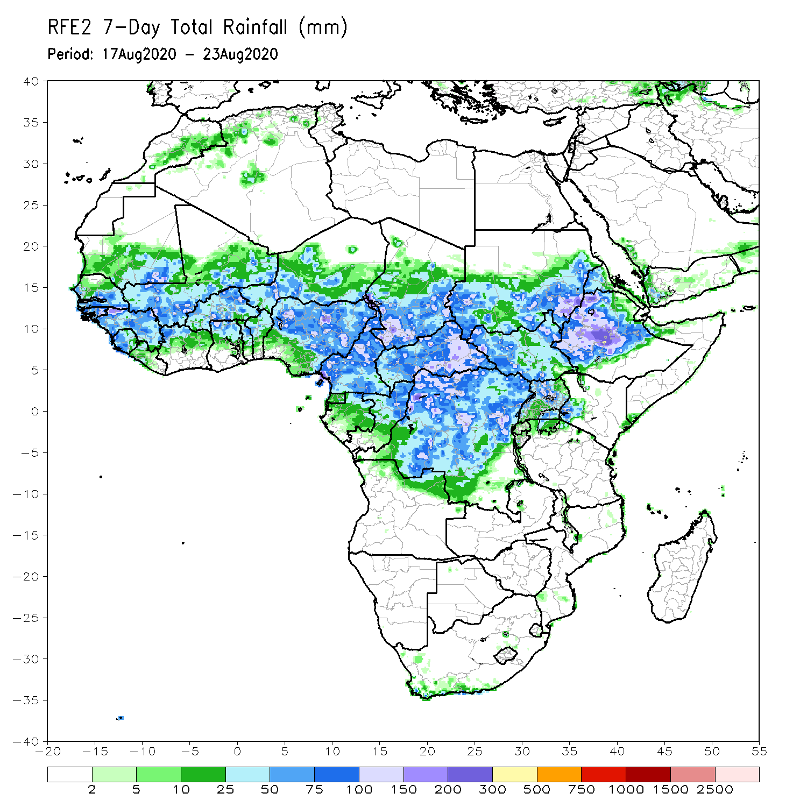
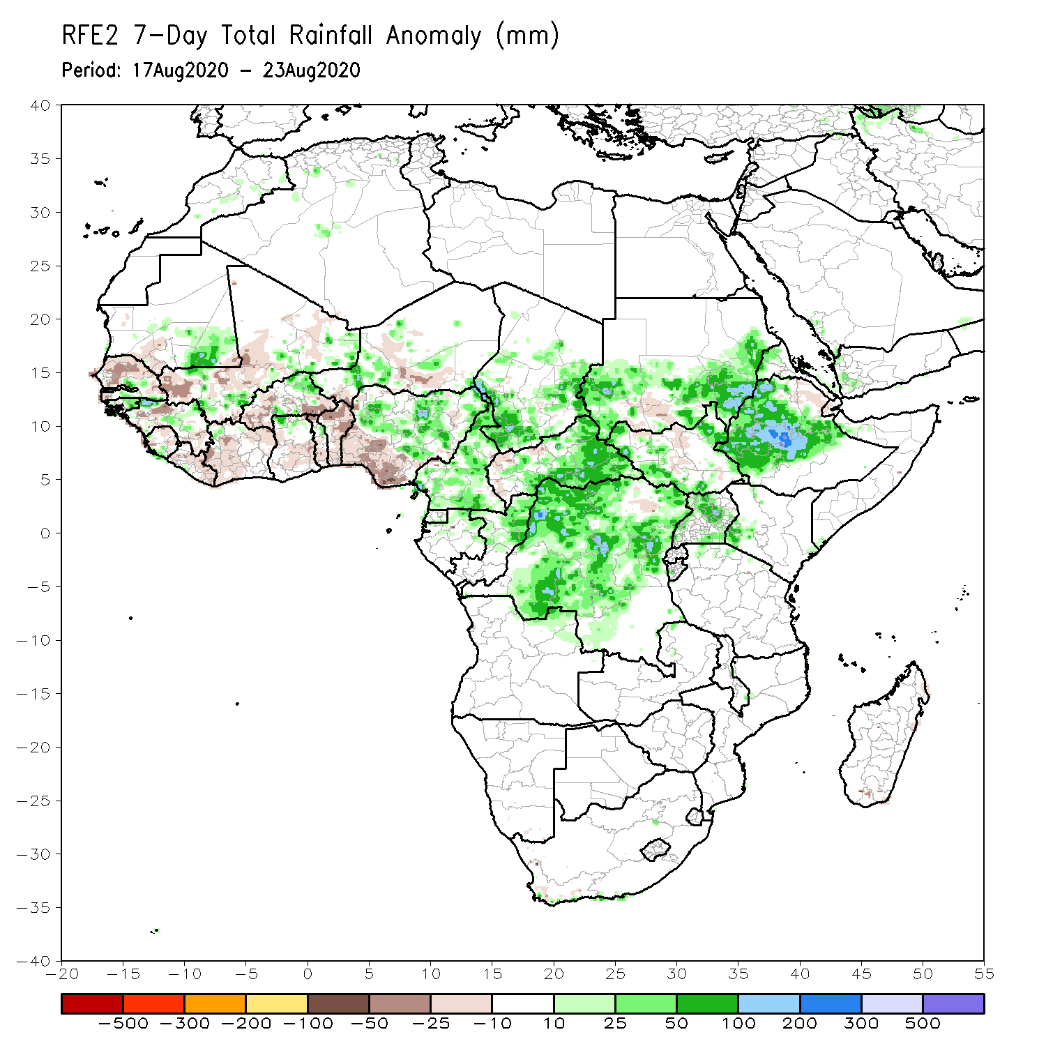
Rainfall Patterns: Last 7 Days
During the past 7 days, rainfall was above-average over local areas in Mauritania, Senegal and western Mali, parts of northern Guinea, local areas in Burkina Faso and Niger, northern Nigeria, Cameroon, parts of Chad, central and eastern CAR, southern and eastern Sudan, DRC, local areas in South Sudan, parts of Uganda, southwestern Kenya, and many parts of Ethiopia.
Below-average rainfall was observed over southern Mauritania, much of Senegal, local areas in Guinea, Sierra Leone, Liberia, central Mali, Cote d’Ivoire, Burkina Faso, Ghana, local areas in Niger, southern Nigeria, and local areas in Sudan and South Sudan.

Slide 5
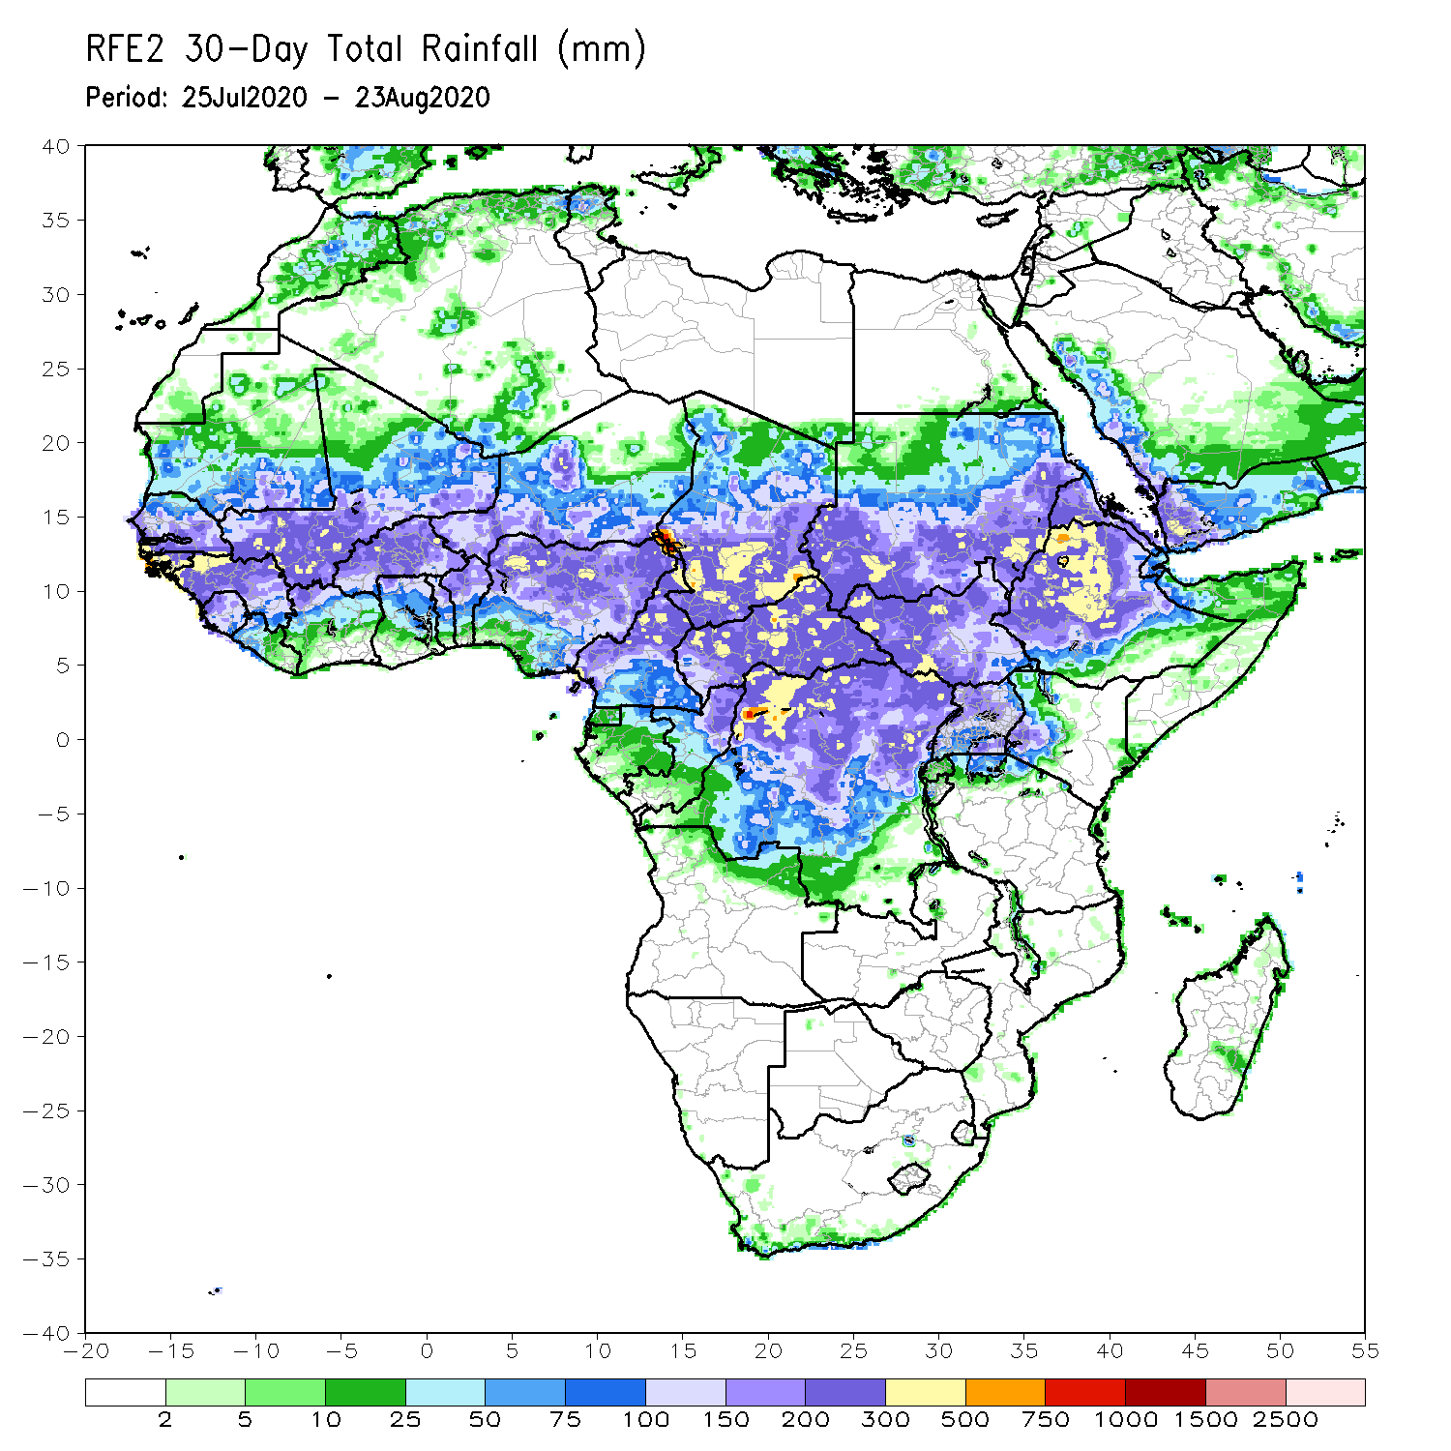
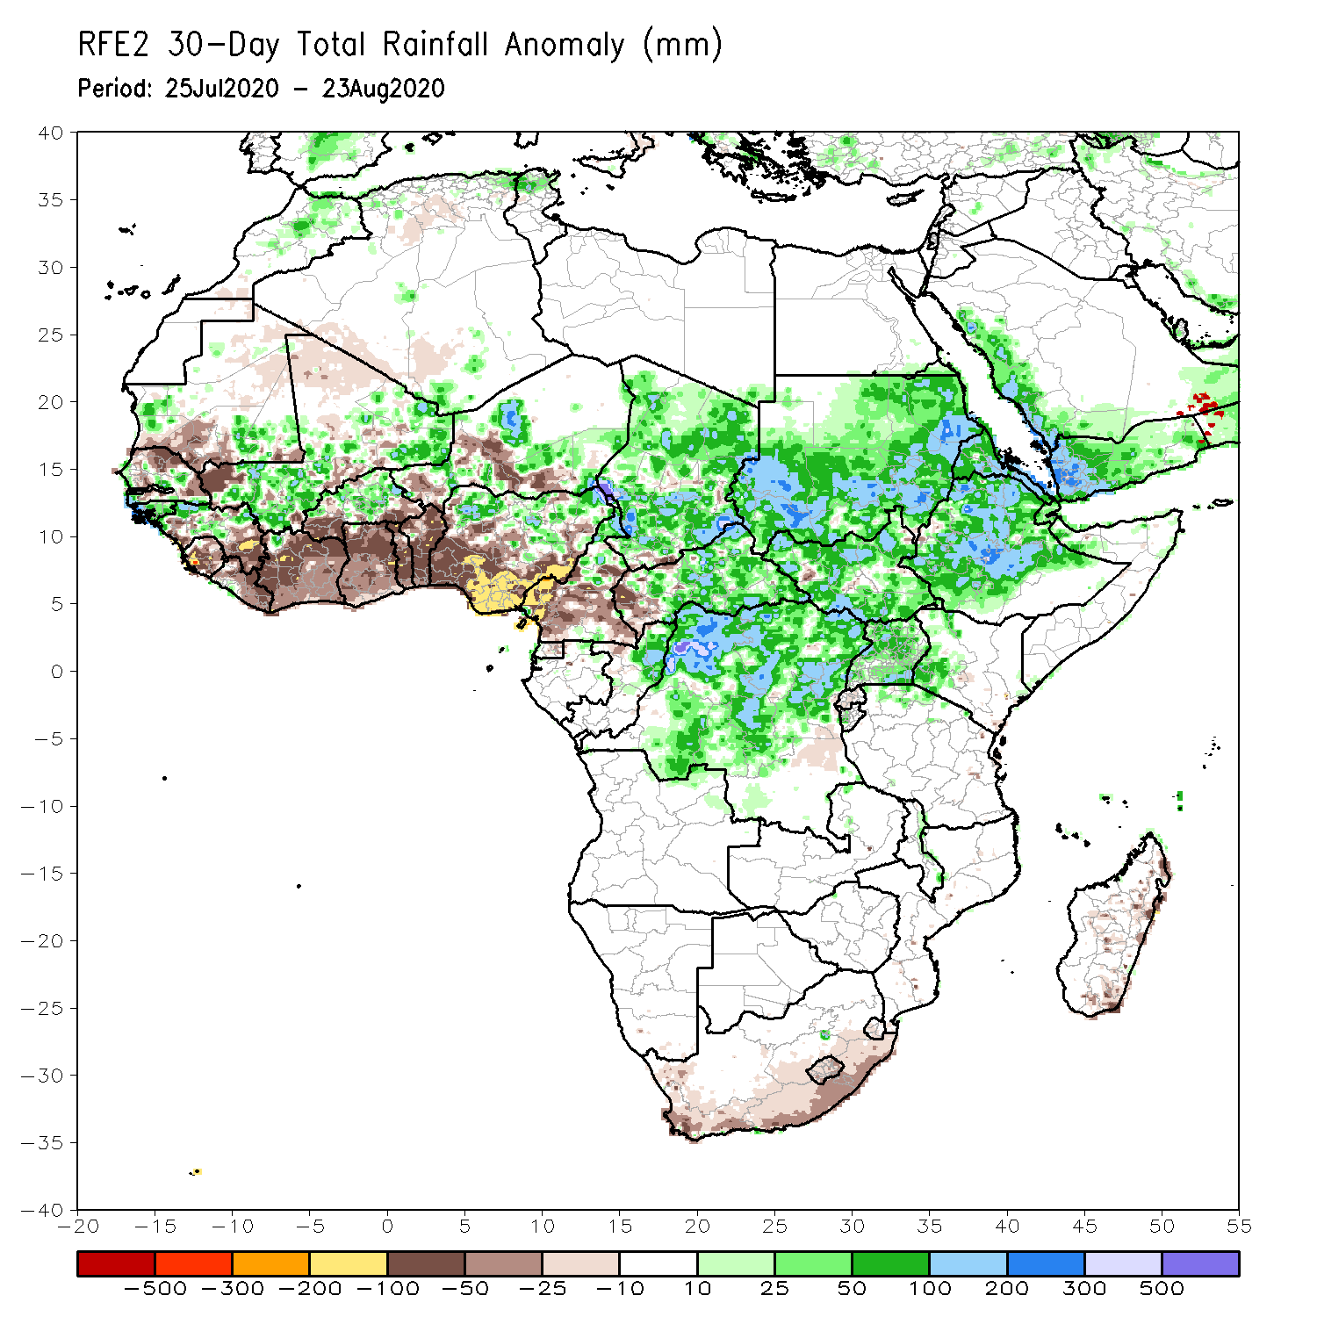
Rainfall Patterns: Last 30 Days
During the past 30 days, rainfall was above-average over local areas in Mauritania and Senegal, portions of Guinea and Mali, parts of Burkina Faso, local areas in Niger, northern Nigeria, much of Chad, local areas in northern Cameroon, much of CAR, Sudan, South Sudan, DRC, Eritrea, and many parts of Ethiopia.
Rainfall was below-average over local areas in Mauritania, portions of Senegal, local areas in Guinea and Mali, Sierra Leone, Liberia, Togo, Benin, parts of Niger, southern Nigeria, parts of Cameroon, and local areas in western CAR.
Notes:
5

Slide 6
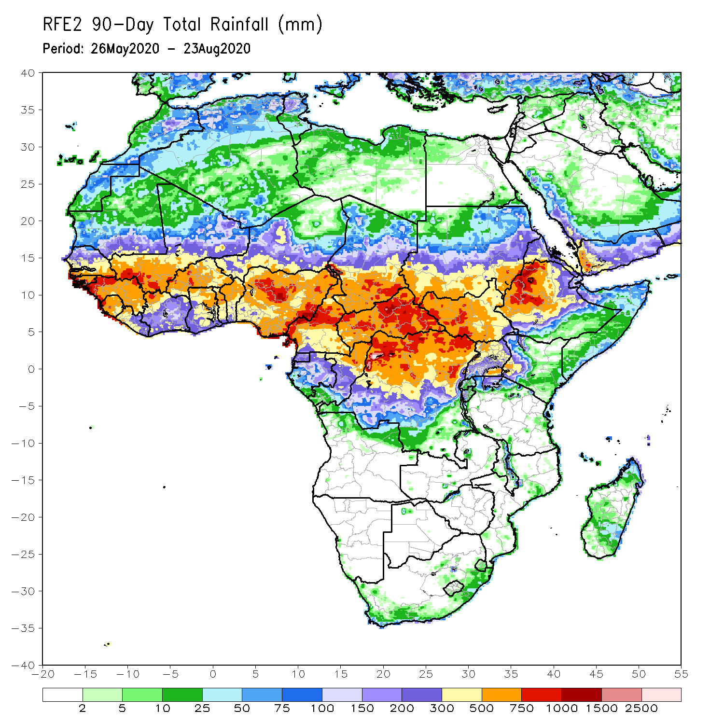
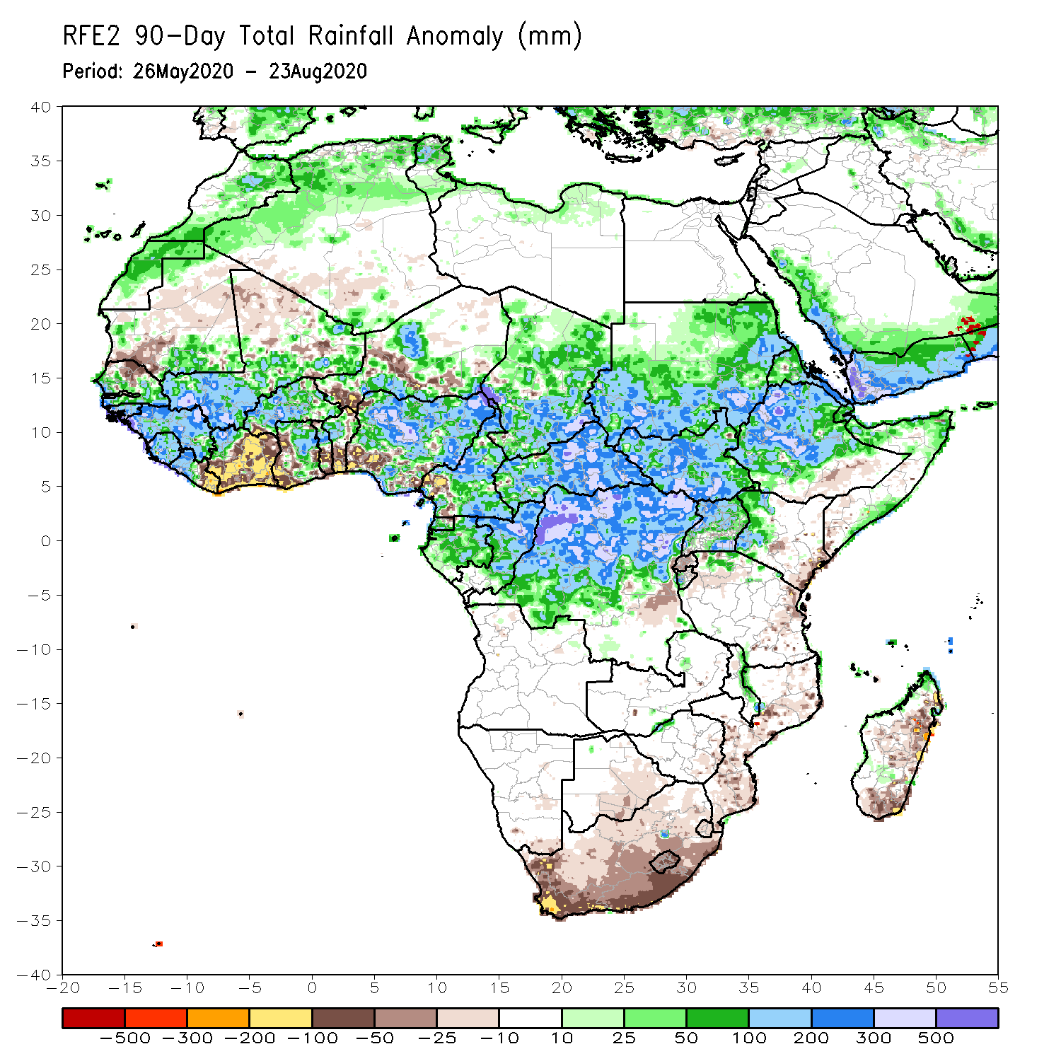
Rainfall Patterns: Last 90 Days
During the past 90 days, rainfall was above-average over many places in West, Central and the Greater Horn of Africa.
Below-average rainfall was observed over local areas in Mauritania, northern Senegal and Mali, Cote d’Ivoire, local areas in Niger and Cameroon, coastal Tanzania, portions of South Africa, Mozambique and Madagascar.
Notes:
6

Slide 7
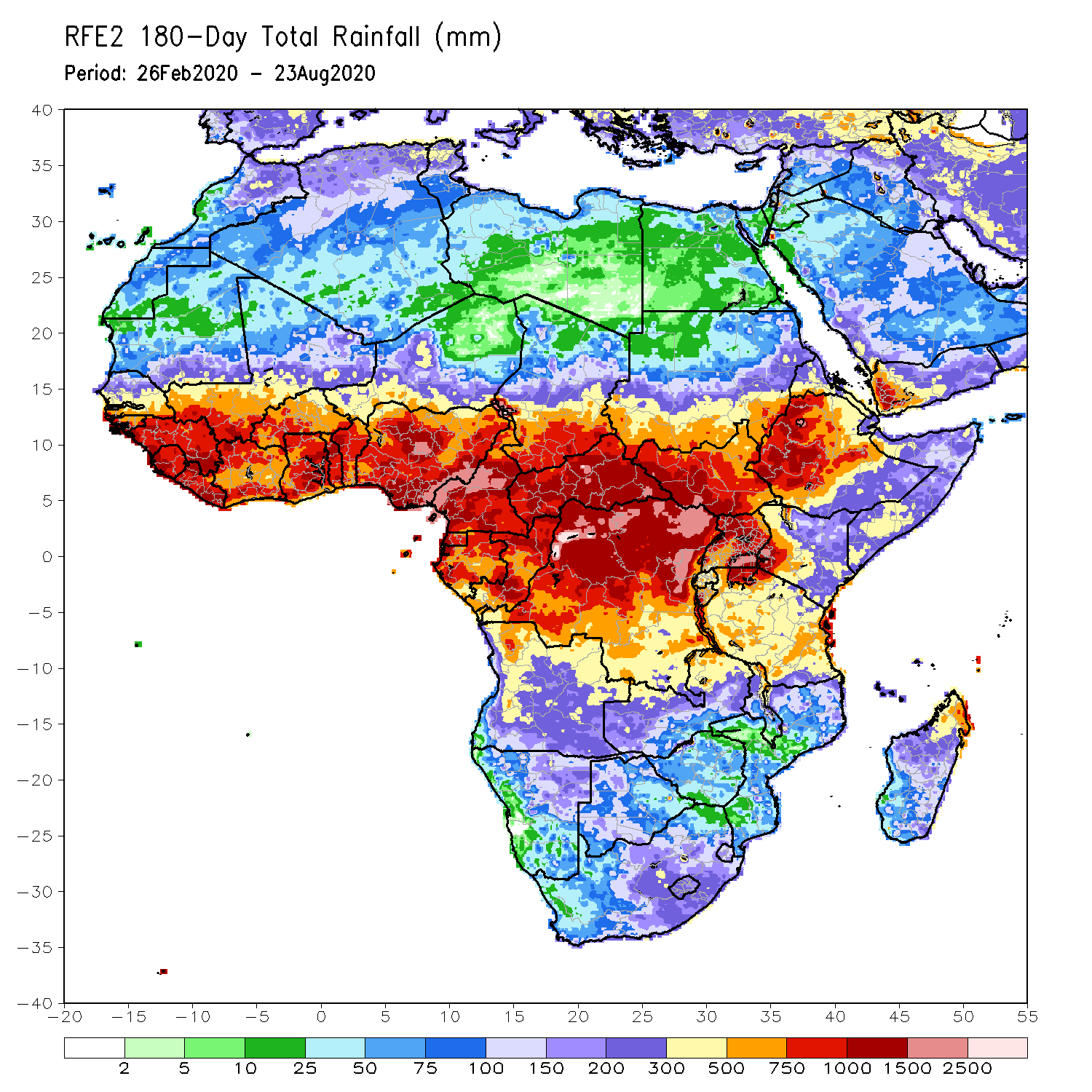
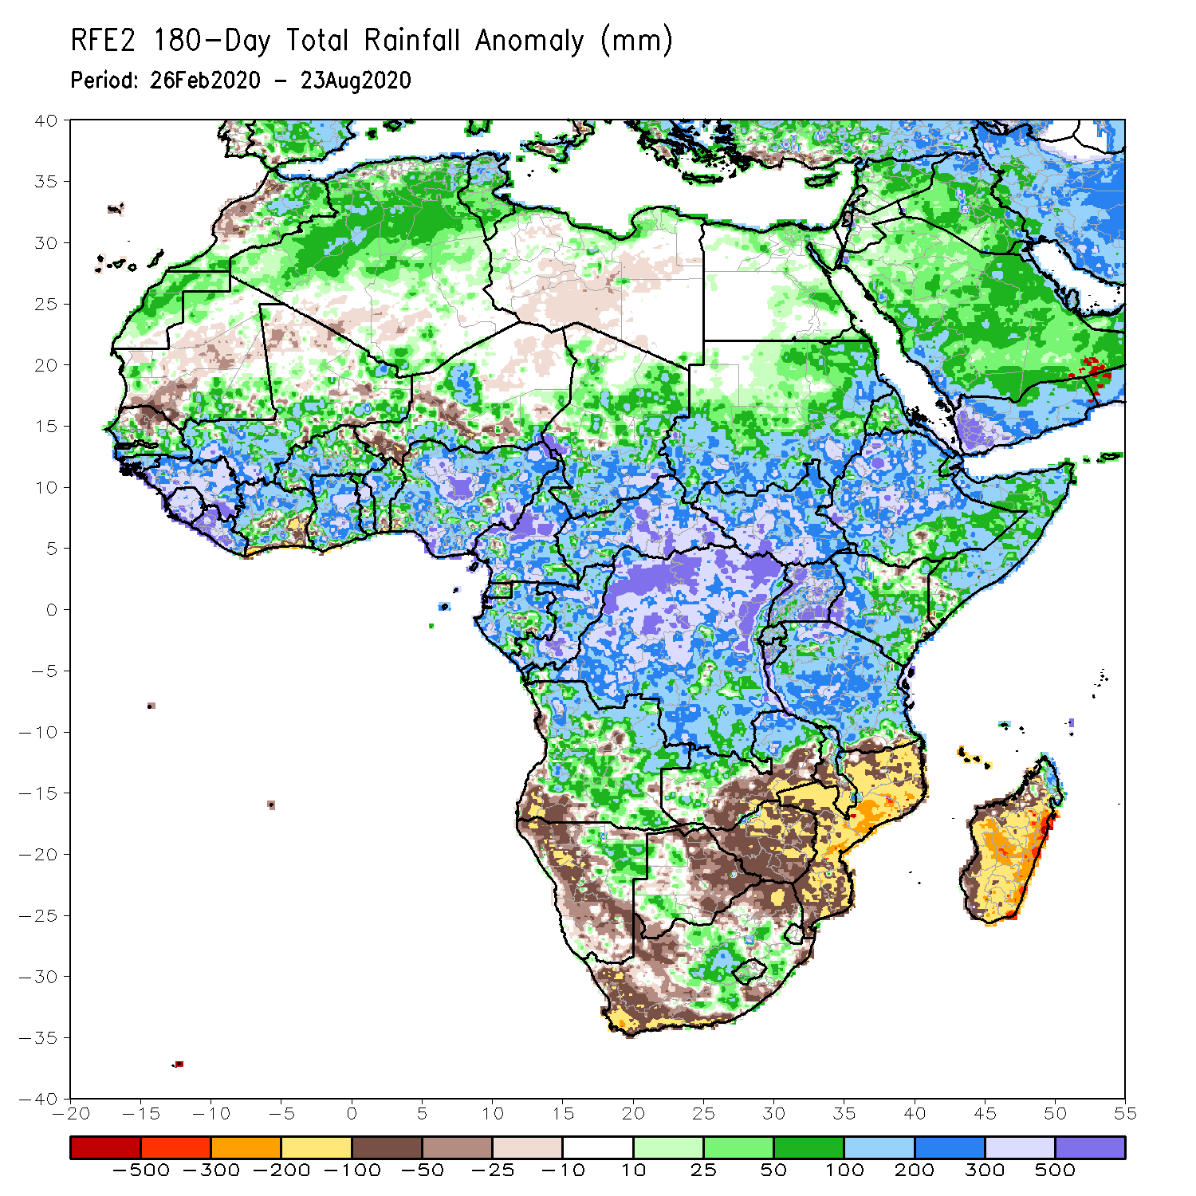
Rainfall Patterns: Last 180 Days
During the past 180 days, rainfall was above-average over much of West, Central and the Greater Horn of Africa, including the northern portions of Southern Africa. Rainfall was also above-average over northeastern Namibia, western Botswana, portions of South Africa, and northern Madagascar.
Below-average rainfall was observed over portions of southwestern Angola, western and southern Namibia, western South Africa, local areas in southern Zambia, eastern Botswana, Zimbabwe, many parts of Mozambique, and central and southern Madagascar.
Notes:
7

Slide 8
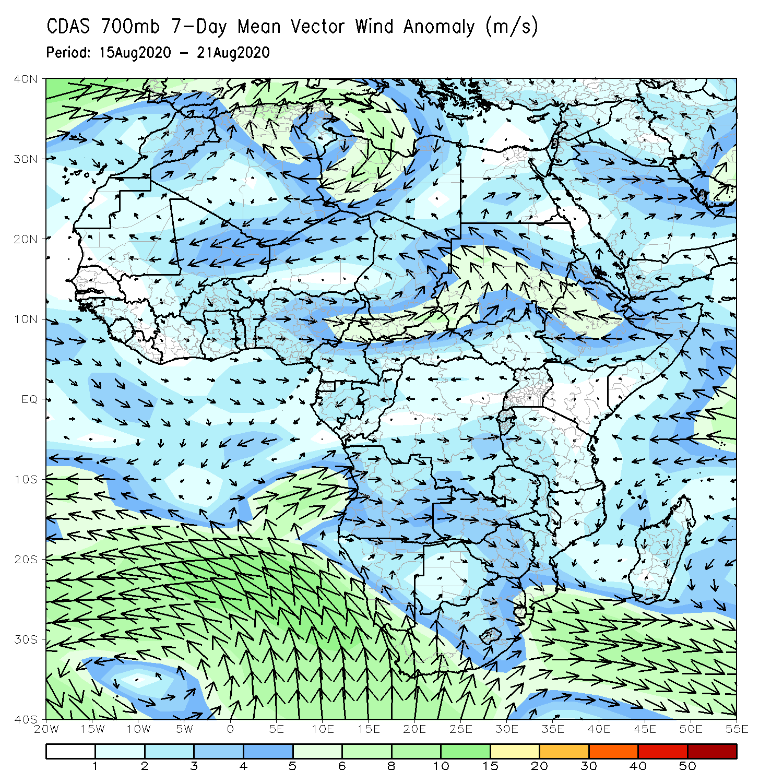
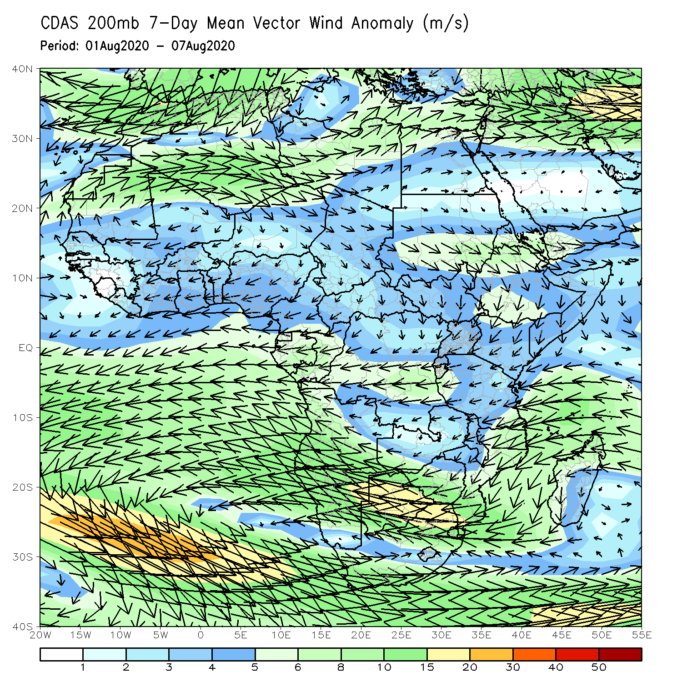
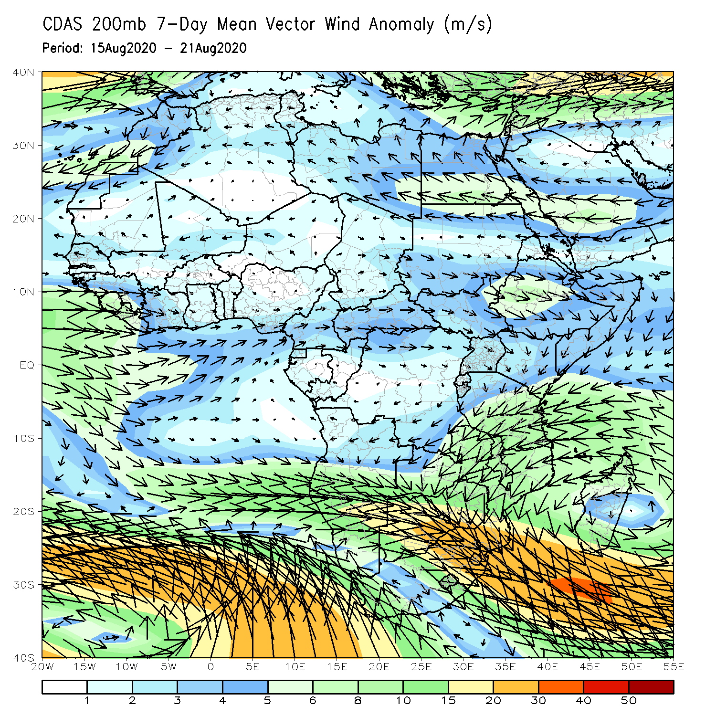
Atmospheric Circulation: Last 7 Days
An area of anomalous lower-level cyclonic flow was observed the Sahel region (left panel).

Slide 9
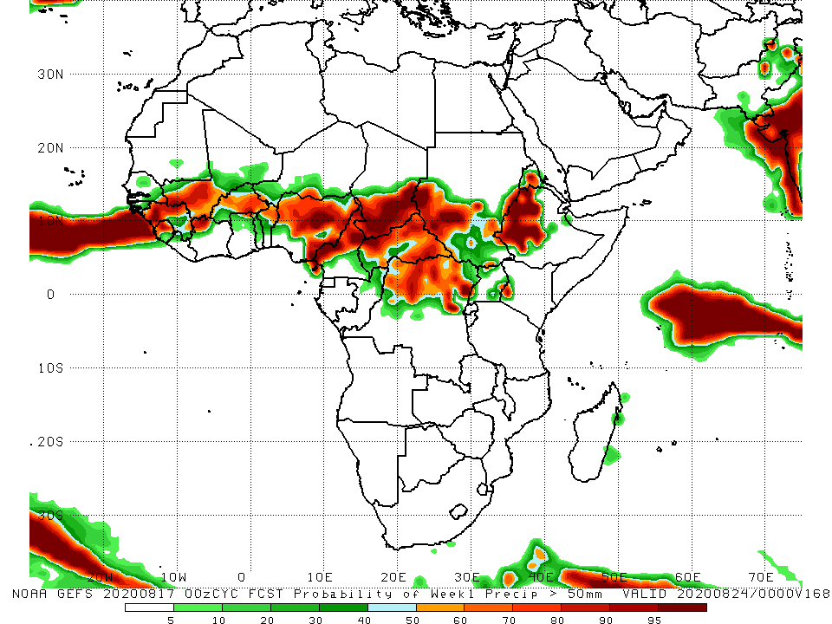
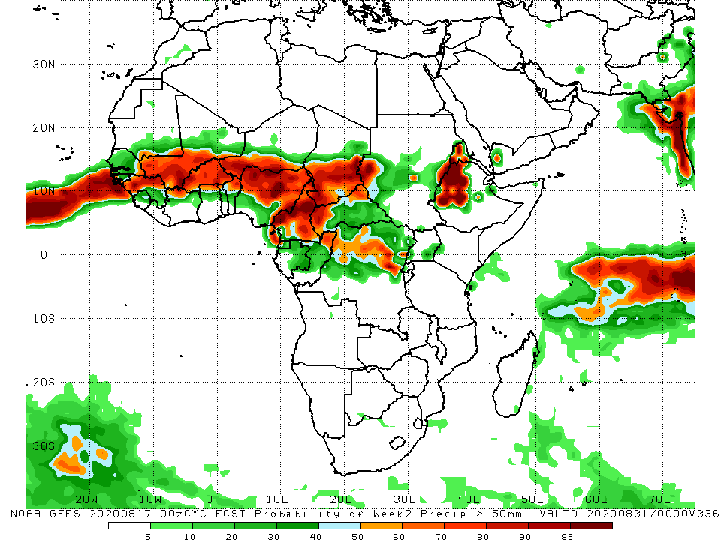
NCEP GEFS Model Forecasts Non-Bias Corrected Probability of precipitation exceedance
Week-1 Valid 25 – 31 August, 2020
Week-2: Valid 1 – 7 September, 2020
For week-1 (left panel) and Week-2 (right panel), there is an increased chance for weekly rainfall totals to exceed 50mm over many places in the Sahel region, and northern DRC, Eritrea and western Ethiopia.
Notes:
9

Slide 10
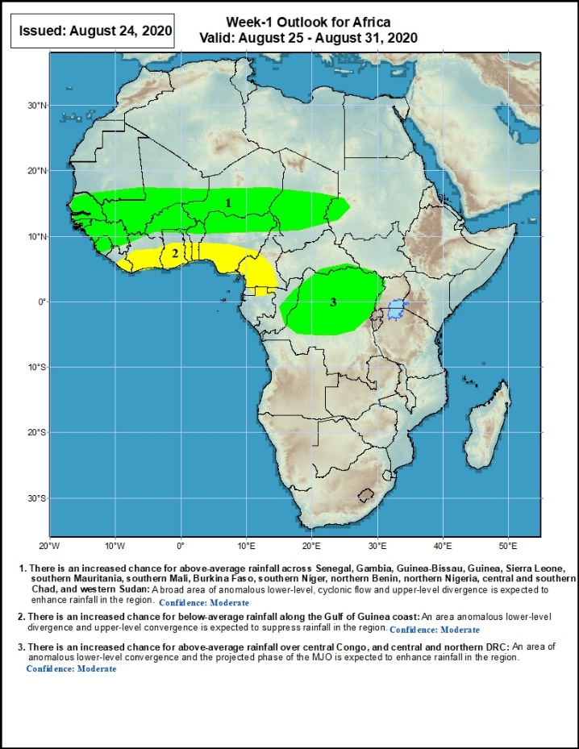
Week-1 Precipitation Outlooks
25 – 31 August, 2020
There is an increased chance for above-average rainfall across Senegal, Gambia, Guinea-Bissau, Guinea, Sierra Leone, southern Mauritania, southern Mali, Burkina Faso, southern Niger, northern Benin, northern Nigeria, central and southern Chad, and western Sudan: A broad area of anomalous lower-level, cyclonic flow and upper-level divergence is expected to enhance rainfall in the region. Confidence: Moderate
There is an increased chance for below-average rainfall along the Gulf of Guinea coast: An area anomalous lower-level divergence and upper-level convergence is expected to suppress rainfall in the region. Confidence: Moderate
There is an increased chance for above-average rainfall over central Congo, and central and northern DRC: An area of anomalous lower-level convergence and the projected phase of the MJO is expected to enhance rainfall in the region. Confidence: Moderate
Notes:
10

Slide 11
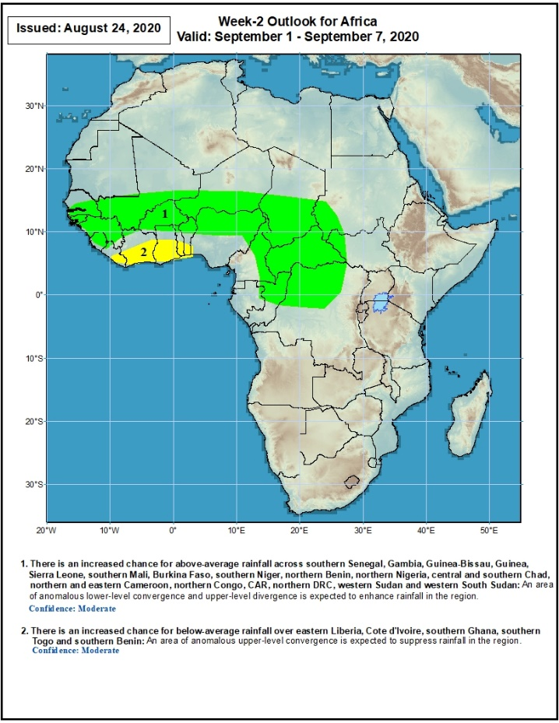
Week-2 Precipitation Outlooks
1 - 7 September, 2020
There is an increased chance for above-average rainfall across southern Senegal, Gambia, Guinea-Bissau, Guinea, Sierra Leone, southern Mali, Burkina Faso, southern Niger, northern Benin, northern Nigeria, central and southern Chad, northern and eastern Cameroon, northern Congo, CAR, northern DRC, western Sudan and western South Sudan: An area of anomalous lower-level convergence and upper-level divergence is expected to enhance rainfall in the region. Confidence: Moderate
There is an increased chance for below-average rainfall over eastern Liberia, Cote d'Ivoire, southern Ghana, southern Togo and southern Benin: An area of anomalous upper-level convergence is expected to suppress rainfall in the region. Confidence: Moderate
Notes:
11

Slide 12
Summary
During the past 7 days, rainfall was above-average over local areas in Mauritania, Senegal and western Mali, parts of northern Guinea, local areas in Burkina Faso and Niger, northern Nigeria, Cameroon, parts of Chad, central and eastern CAR, southern and eastern Sudan, DRC, local areas in South Sudan, parts of Uganda, southwestern Kenya, and many parts of Ethiopia. Below-average rainfall was observed over southern Mauritania, much of Senegal, local areas in Guinea, Sierra Leone, Liberia, central Mali, Cote d’Ivoire, Burkina Faso, Ghana, local areas in Niger, southern Nigeria, and local areas in Sudan and South Sudan.
During the past 30 days, rainfall was above-average over local areas in Mauritania and Senegal, portions of Guinea and Mali, parts of Burkina Faso, local areas in Niger, northern Nigeria, much of Chad, local areas in northern Cameroon, much of CAR, Sudan, South Sudan, DRC, Eritrea, and many parts of Ethiopia. Rainfall was below-average over local areas in Mauritania, portions of Senegal, local areas in Guinea and Mali, Sierra Leone, Liberia, Togo, Benin, parts of Niger, southern Nigeria, parts of Cameroon, and local areas in western CAR.
During the past 90 days, rainfall was above-average over many places in West, Central and the Greater Horn of Africa. Below-average rainfall was observed over local areas in Mauritania, northern Senegal and Mali, Cote d’Ivoire, local areas in Niger and Cameroon, coastal Tanzania, portions of South Africa, Mozambique and Madagascar.
Week-1 outlooks call for an increased chance for above-average rainfall over Senegal, Gambia, Guinea-Bissau, Guinea, Sierra Leone, southern Mauritania, southern Mali, Burkina Faso, southern Niger, northern Benin, northern Nigeria, central and southern Chad, western Sudan, central Congo, and central and northern DRC. In contrast, there is an increased chance for below-average rainfall along the Gulf of Guinea coast.
Week-2 outlooks call for an increased chance for above-average rainfall over southern Senegal, Gambia, Guinea-Bissau, Guinea, Sierra Leone, southern Mali, Burkina Faso, southern Niger, northern Benin, northern Nigeria, central and southern Chad, northern and eastern Cameroon, northern Congo, CAR, northern DRC, western Sudan and western South Sudan. In contrast, there is an increased chance for below-average rainfall over eastern Liberia, Cote d'Ivoire, southern Ghana, southern Togo and southern Benin.
Notes:
12

