Slide 1
The African Monsoon Recent Evolution and Current Status Include Week-1 and Week-2 Outlooks
Update prepared by
Climate Prediction Center / NCEP
31 August 2020
For more information, visit:
http://www.cpc.ncep.noaa.gov/products/Global_Monsoons/African_Monsoons/precip_monitoring.shtml

Slide 2
Outline
Highlights
Recent Evolution and Current Conditions
NCEP GEFS Forecasts
Summary

Slide 3
Highlights: Last 7 Days
Weekly rainfall surpluses exceeded 100mm over eastern Sudan and many parts of Ethiopia.
Week-1 outlooks call for an increased chance for above-average rainfall over Senegal, Gambia, Guinea-Bissau, Guinea, Sierra Leone, southern Mauritania, southern Mali, Burkina Faso, southern Niger, northern Benin, Nigeria, central and southern Chad, Cameroon, and western Sudan. In contrast, there is an increased chance for below-average rainfall along the Gulf of Guinea coast.
Week-2 outlooks call for an increased chance for above-average rainfall over southern Senegal, Gambia, Guinea-Bissau, Guinea, southern Mauritania, southern Mali, Burkina Faso, southwestern Niger, northern Cote d'Ivoire, northern Ghana, northern Togo, northern Benin, Nigeria, southwestern Chad, as well as northern and eastern Cameroon.

Slide 4
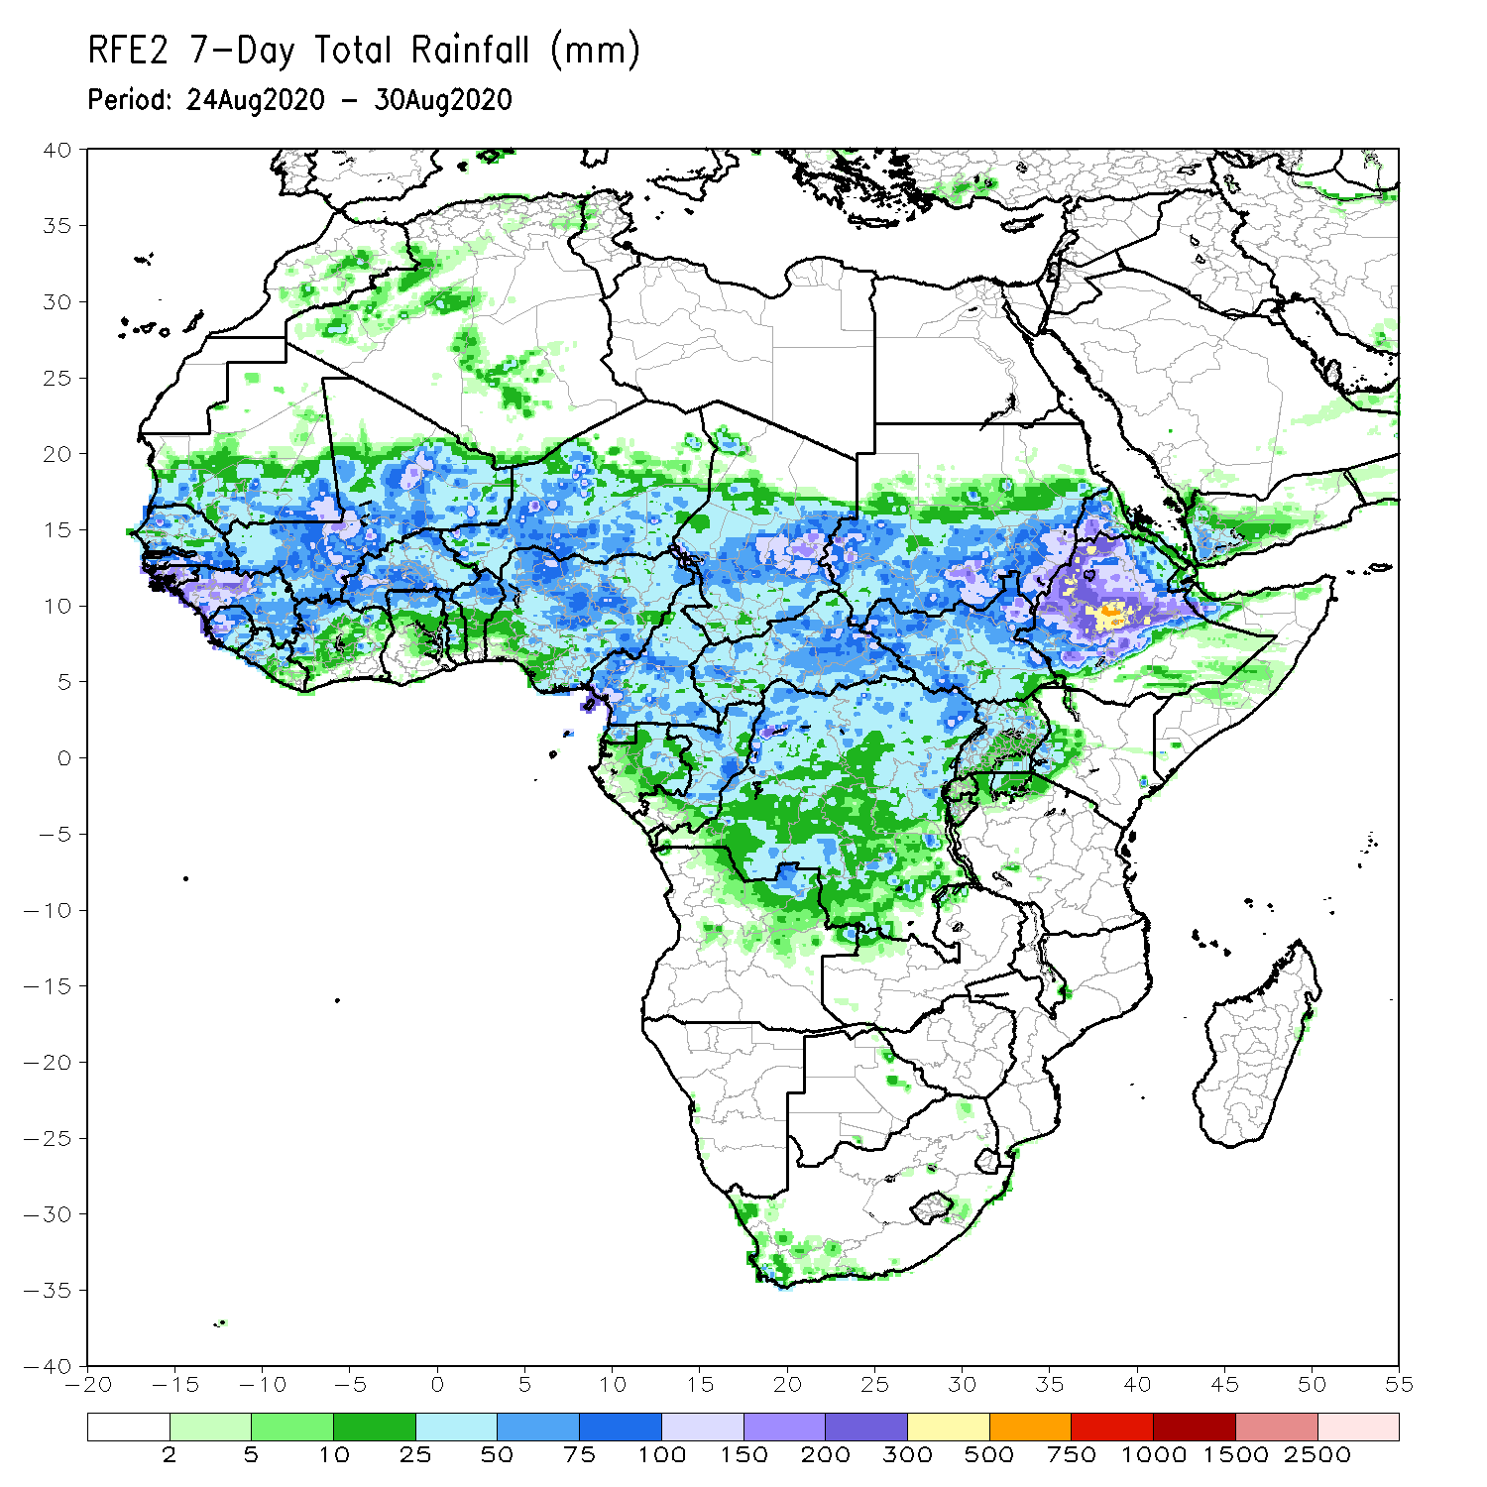
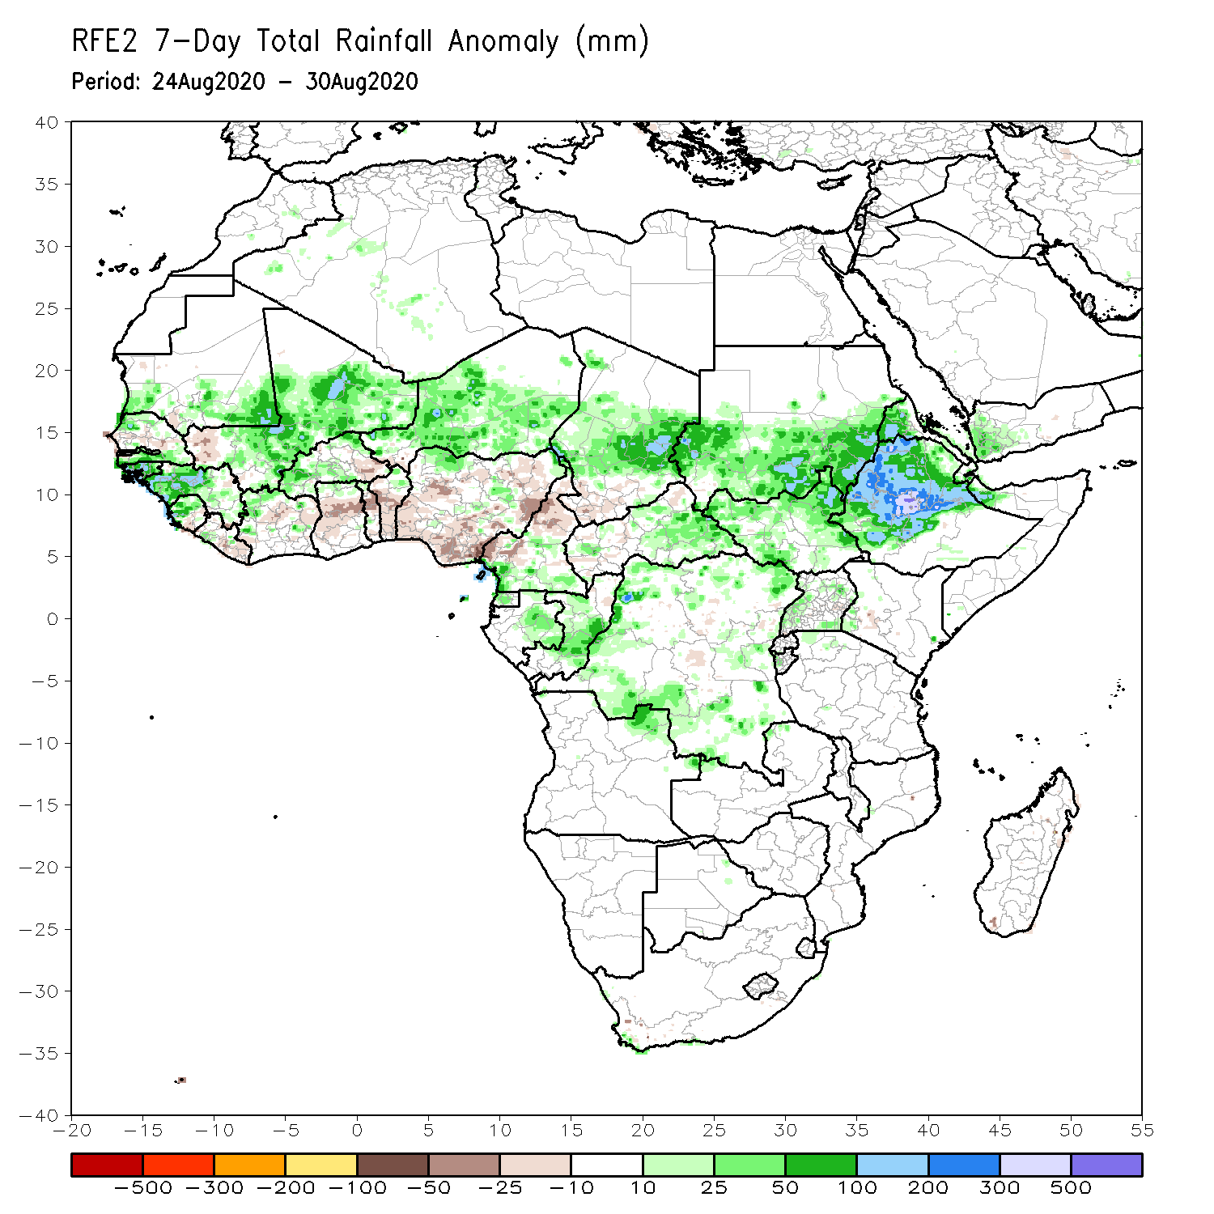
Rainfall Patterns: Last 7 Days
During the past 7 days, rainfall was above-average over southern Mauritania, northern Senegal, Guinea-Bissau, Guinea, Sierra Leone, many parts of Mali, northwestern Cote d’Ivoire, parts of Burkina Faso, Niger, local areas in Cameroon, Gabon, Congo, central Chad, Sudan, parts of CAR, portions of DRC, South Sudan, Eritrea and Ethiopia.
Below-average rainfall was observed over local areas in Senegal and Mali, Liberia, Cote d’Ivoire, parts of Burkina Faso, Ghana, Togo, Benin, many parts of Nigeria, southern Chad, northern Cameroon, and local areas in CAR.

Slide 5
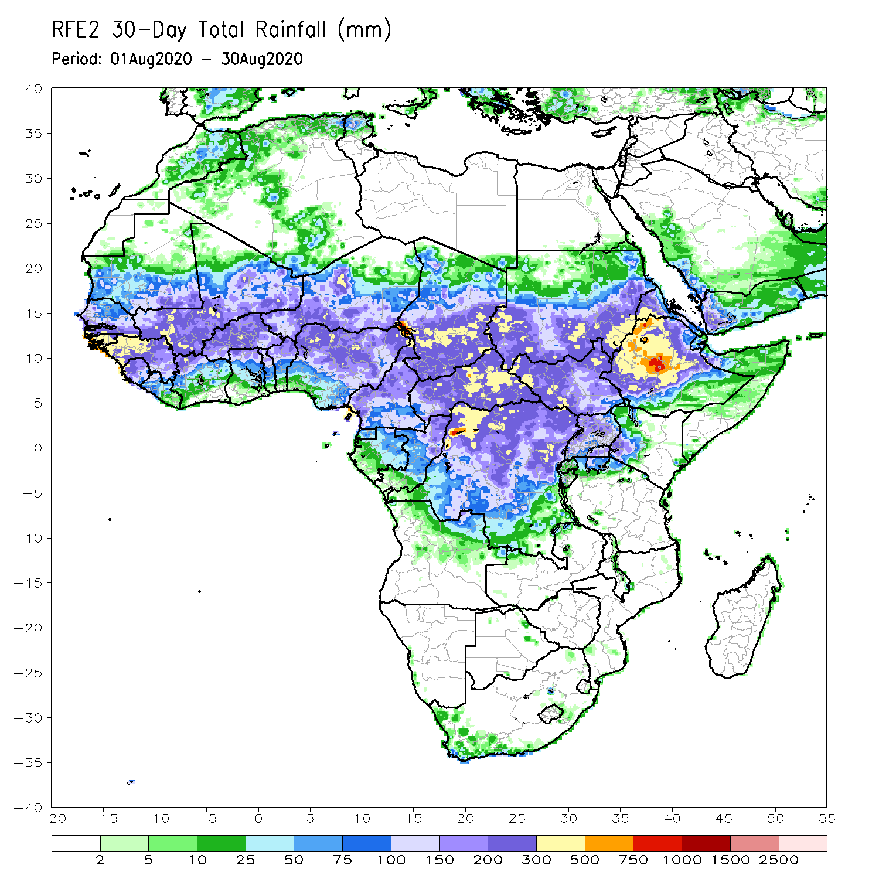
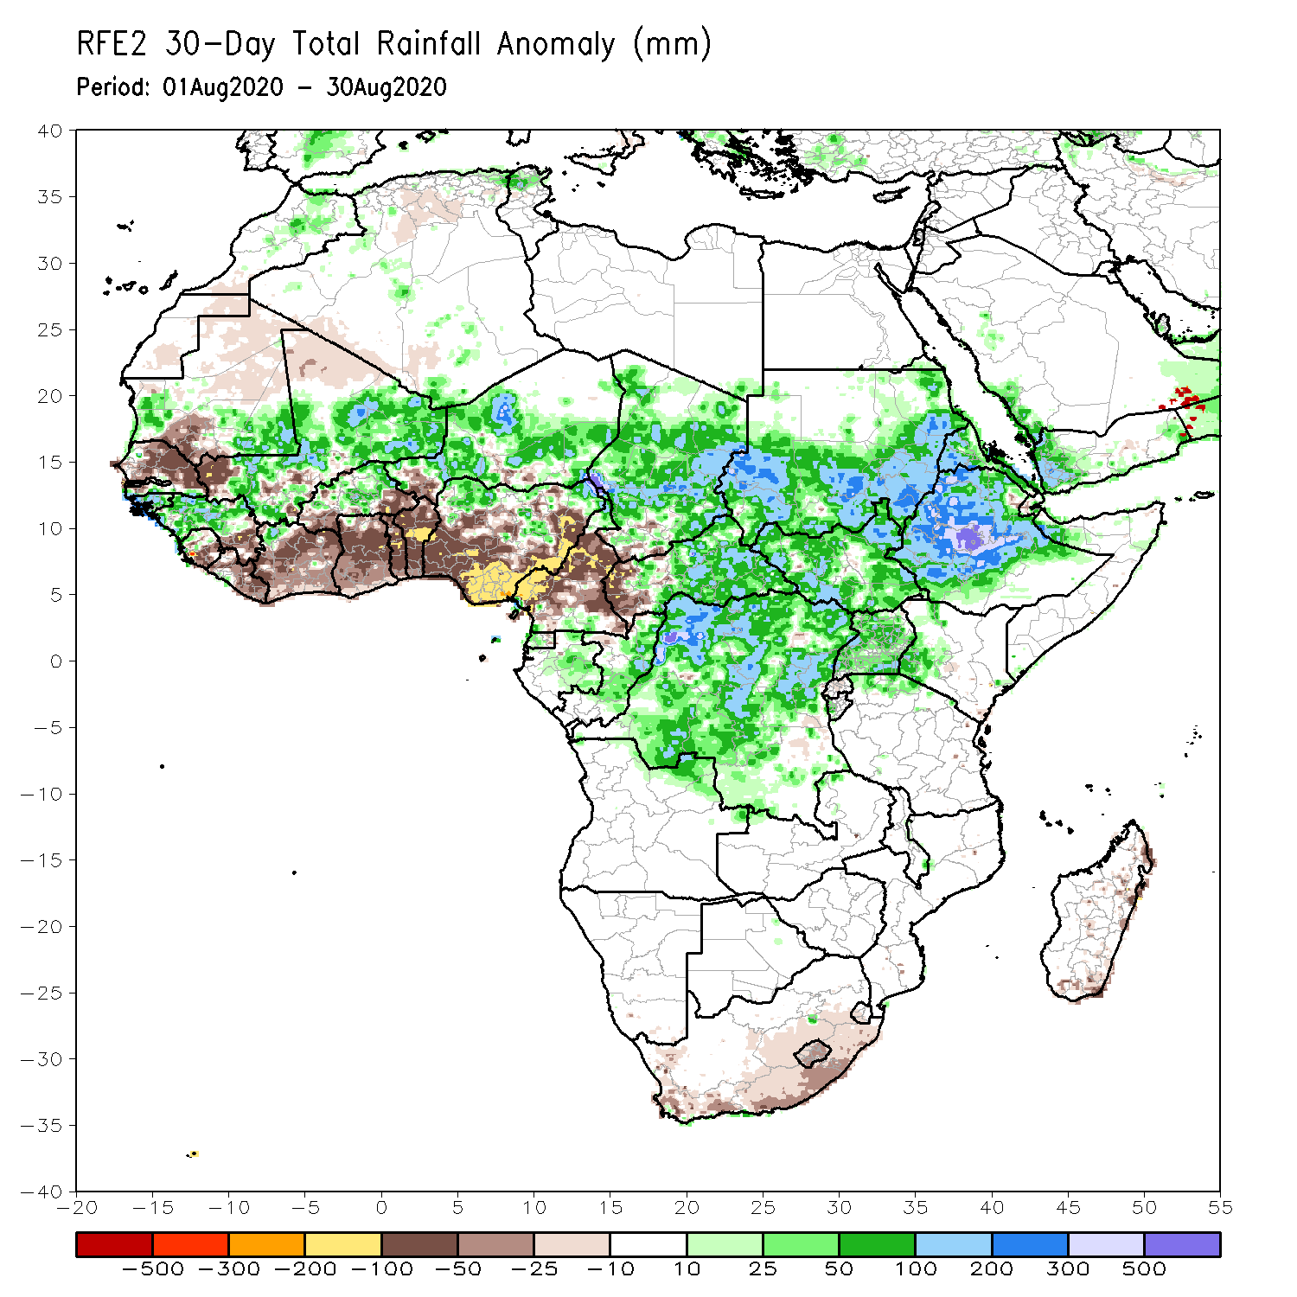
Rainfall Patterns: Last 30 Days
During the past 30 days, rainfall was above-average over local areas in Mauritania, portions of Guinea and Mali, parts of Burkina Faso, Niger, northern Nigeria, much of Chad, local areas in northern Cameroon, much of CAR, Sudan, South Sudan, DRC, Eritrea, and many parts of Ethiopia.
Rainfall was below-average over local areas in Mauritania, much of Senegal, local areas in Guinea and Mali, Sierra Leone, Liberia, Ghana, Togo, Benin, local areas in Niger, central and southern Nigeria, much of Cameroon, and local areas in western CAR.
Notes:
5

Slide 6
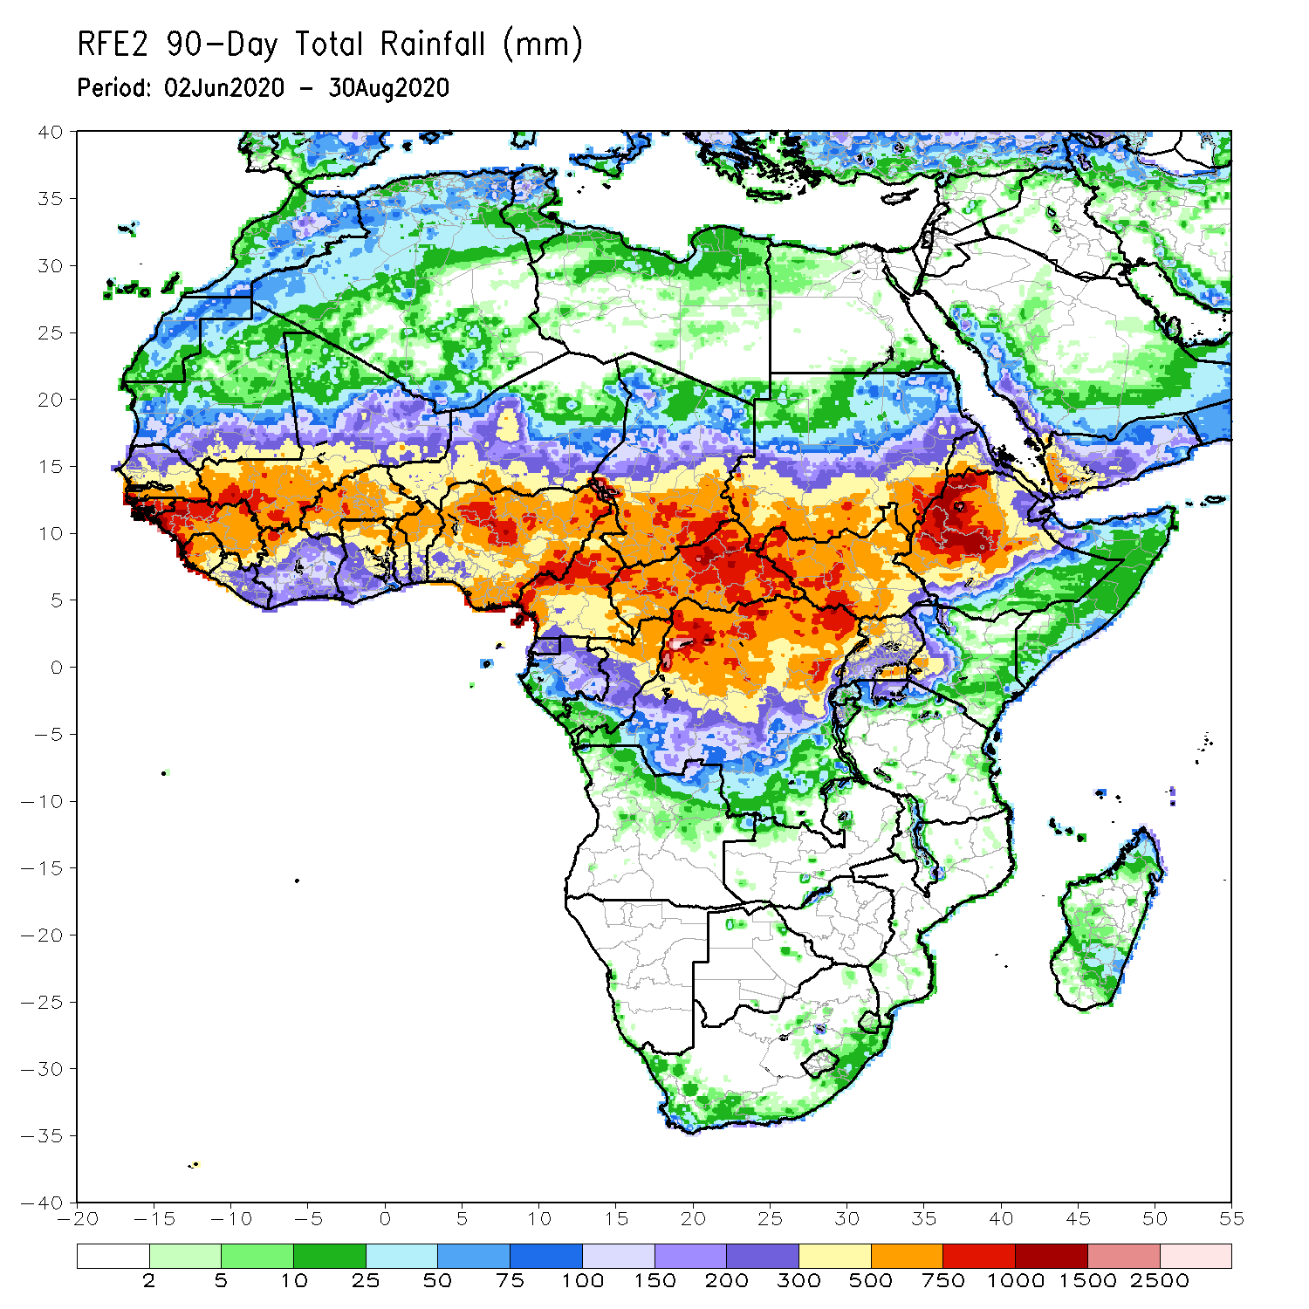
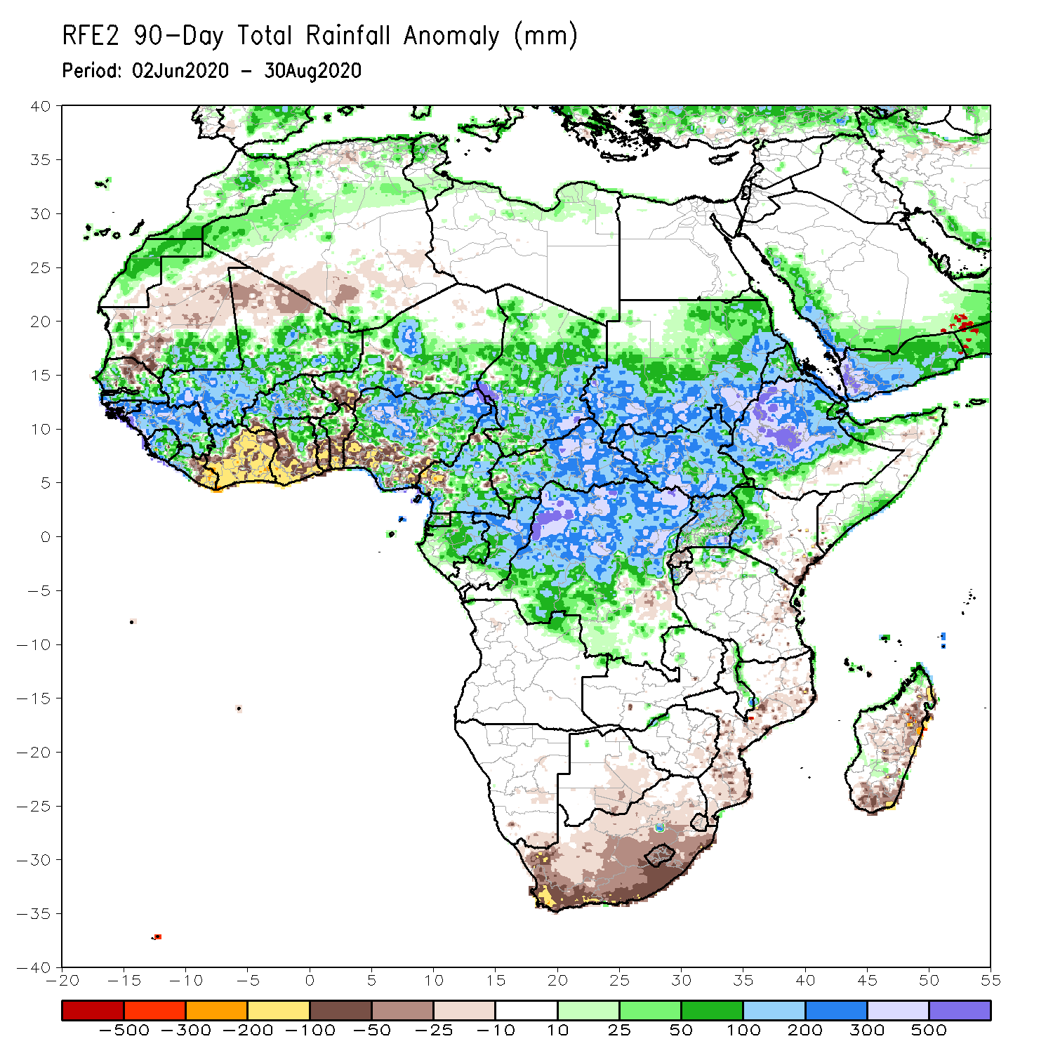
Rainfall Patterns: Last 90 Days
During the past 90 days, rainfall was above-average over many places in West, Central and the Greater Horn of Africa.
Below-average rainfall was observed over local areas in Mauritania, northern Senegal, eastern Liberia, Cote d’Ivoire, local areas in Niger, Togo, Benin, Nigeria and Cameroon, and portions of South Africa, Mozambique and Madagascar.
Notes:
6

Slide 7
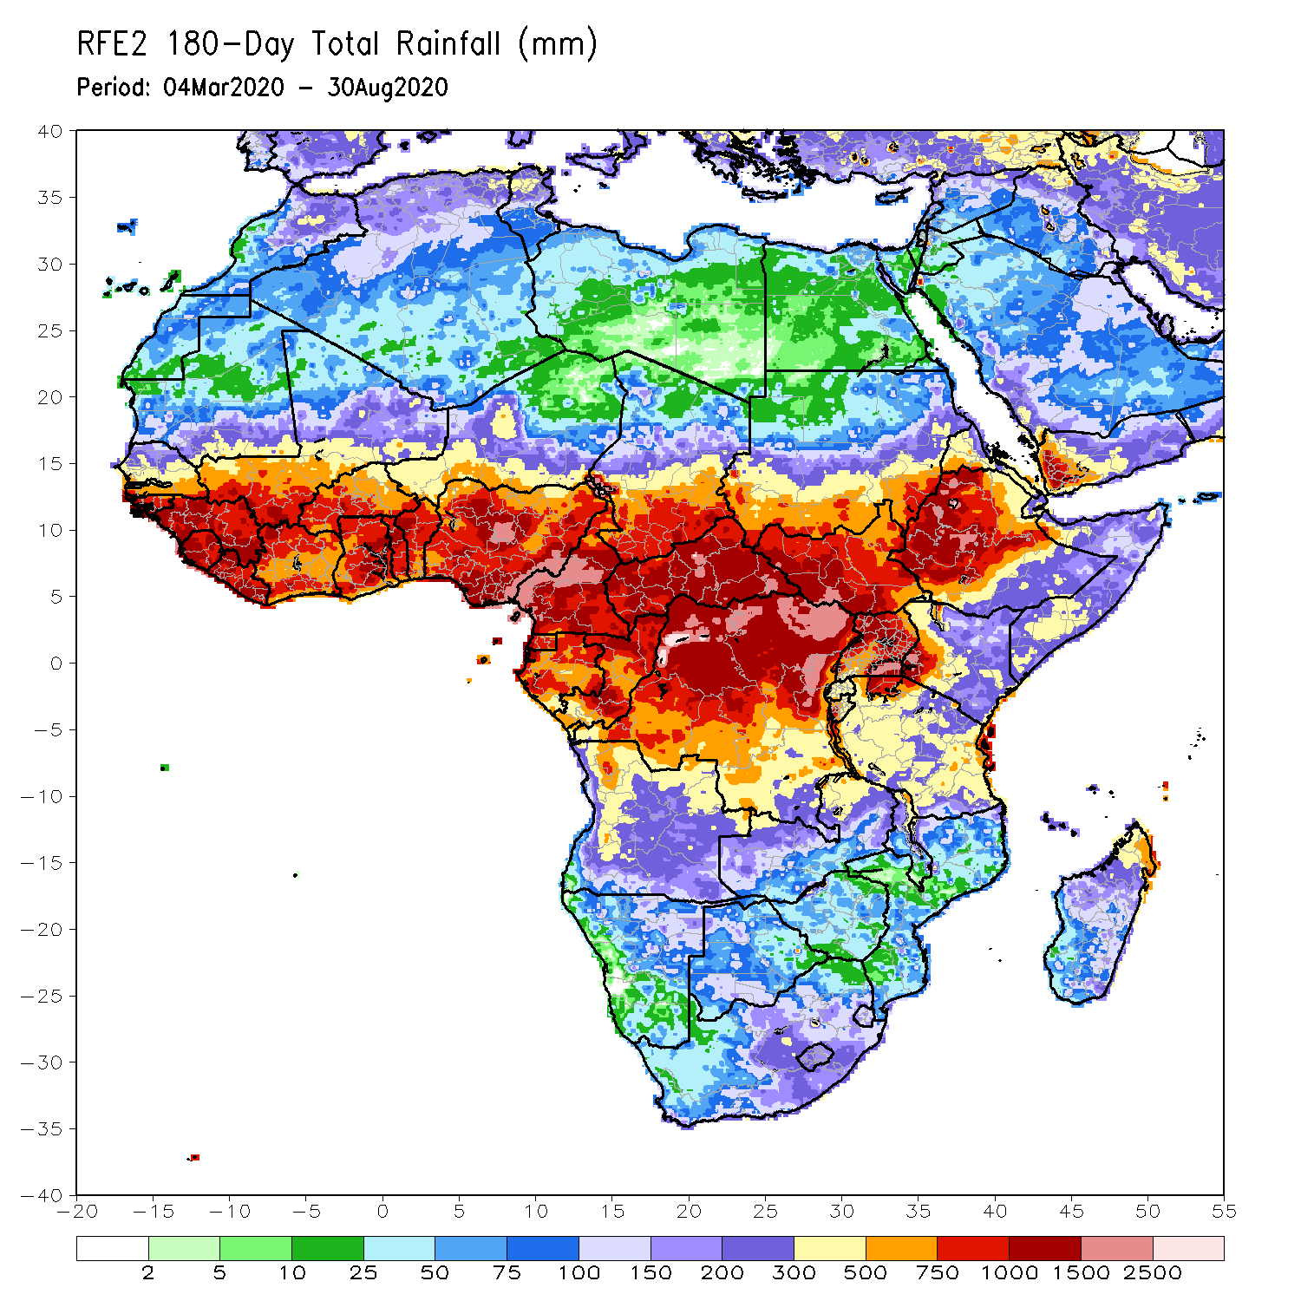
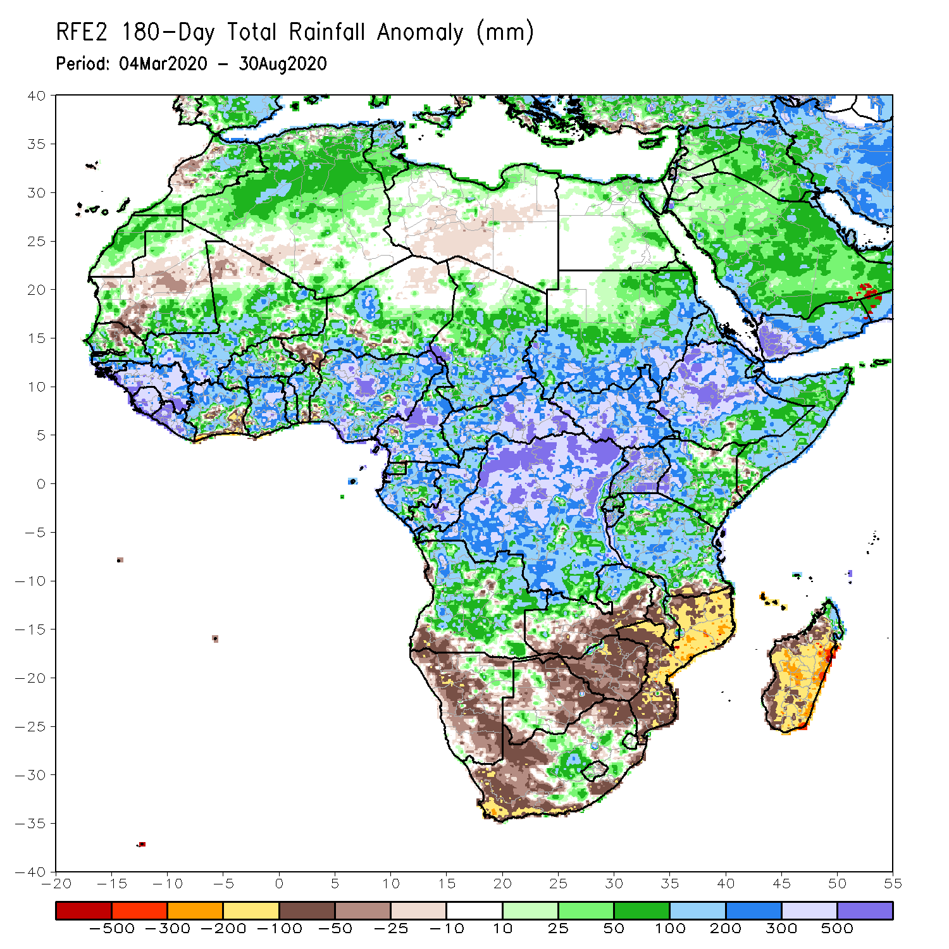
Rainfall Patterns: Last 180 Days
During the past 180 days, rainfall was above-average over much of West, Central and the Greater Horn of Africa, including the northern portions of Southern Africa. Rainfall was also above-average over northeastern Namibia, western Botswana, portions of South Africa, and northern Madagascar.
Below-average rainfall was observed over portions of southwestern Angola, western and southern Namibia, western South Africa, southern Zambia, eastern Botswana, Zimbabwe, much of Mozambique, and central and southern Madagascar.
Notes:
7

Slide 8
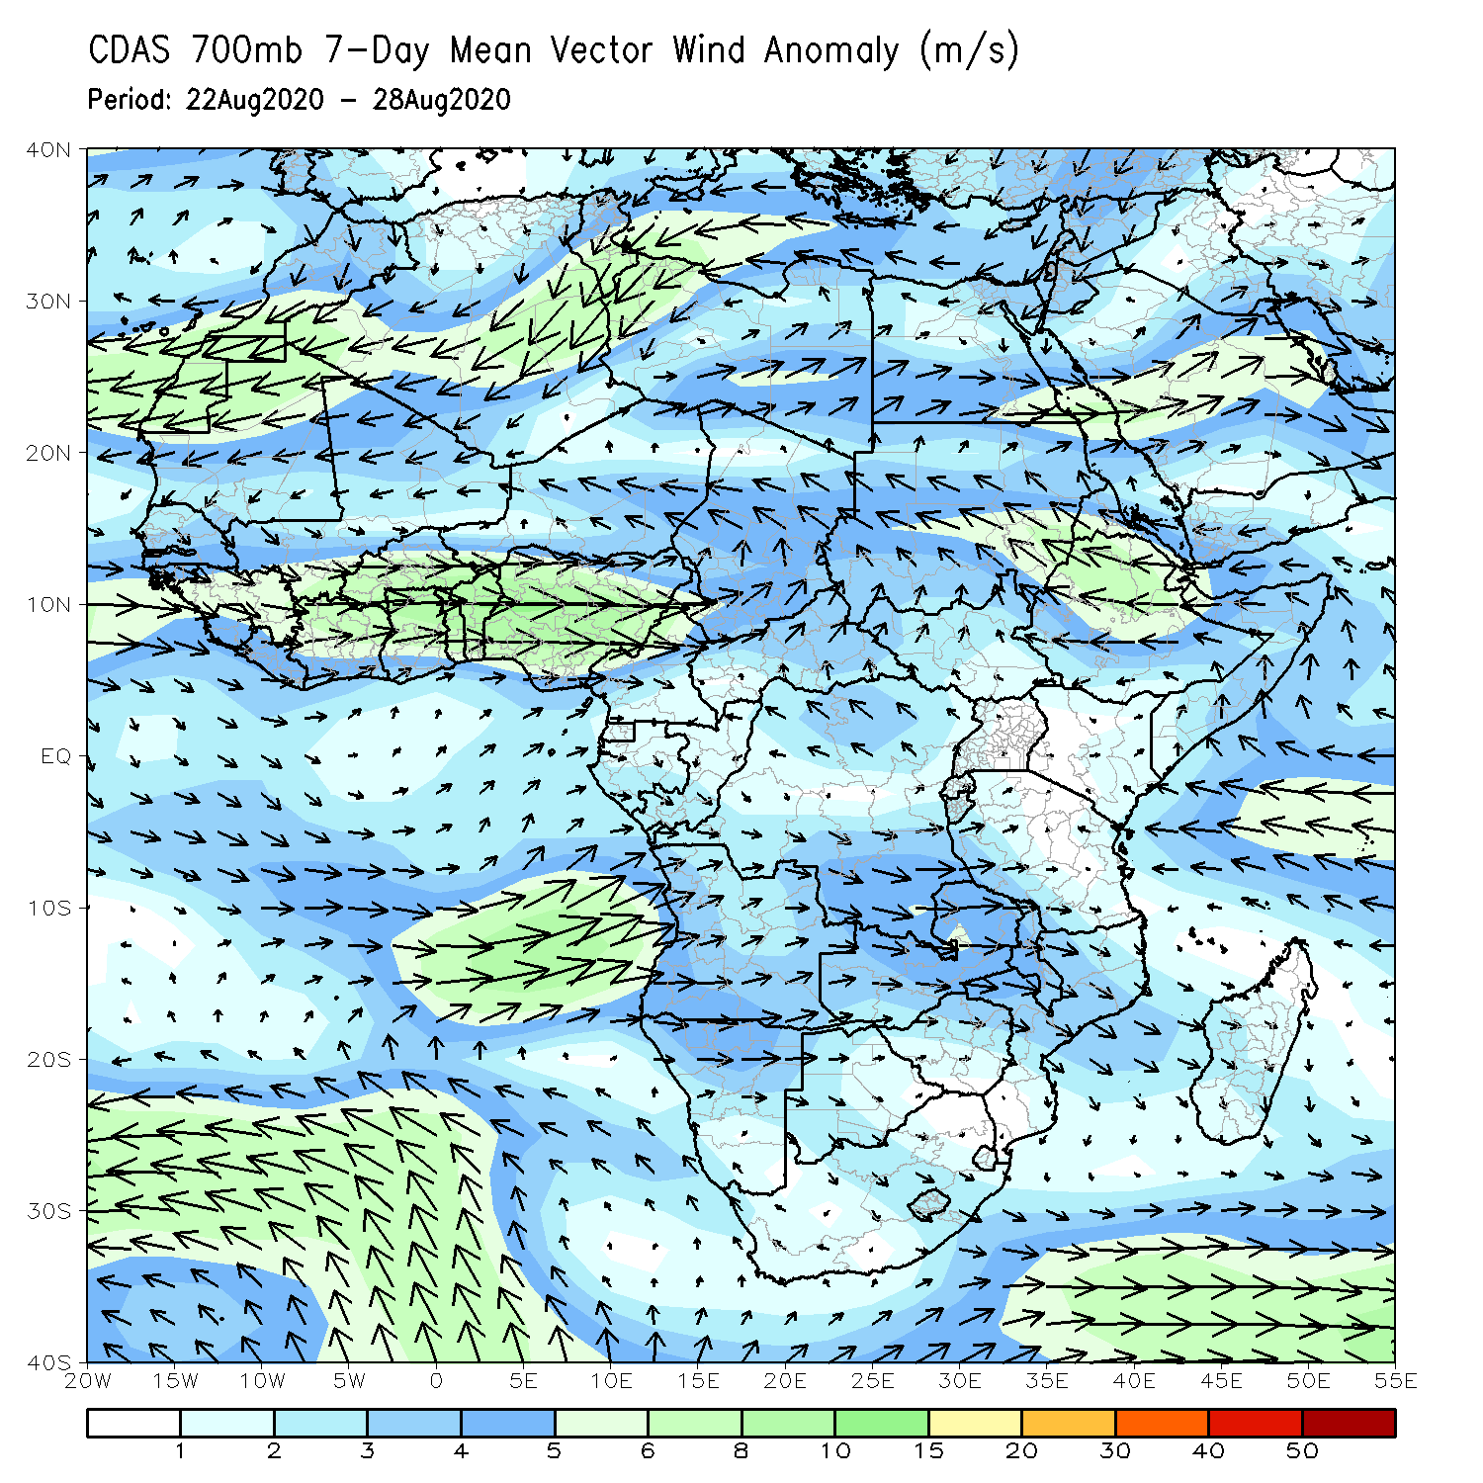
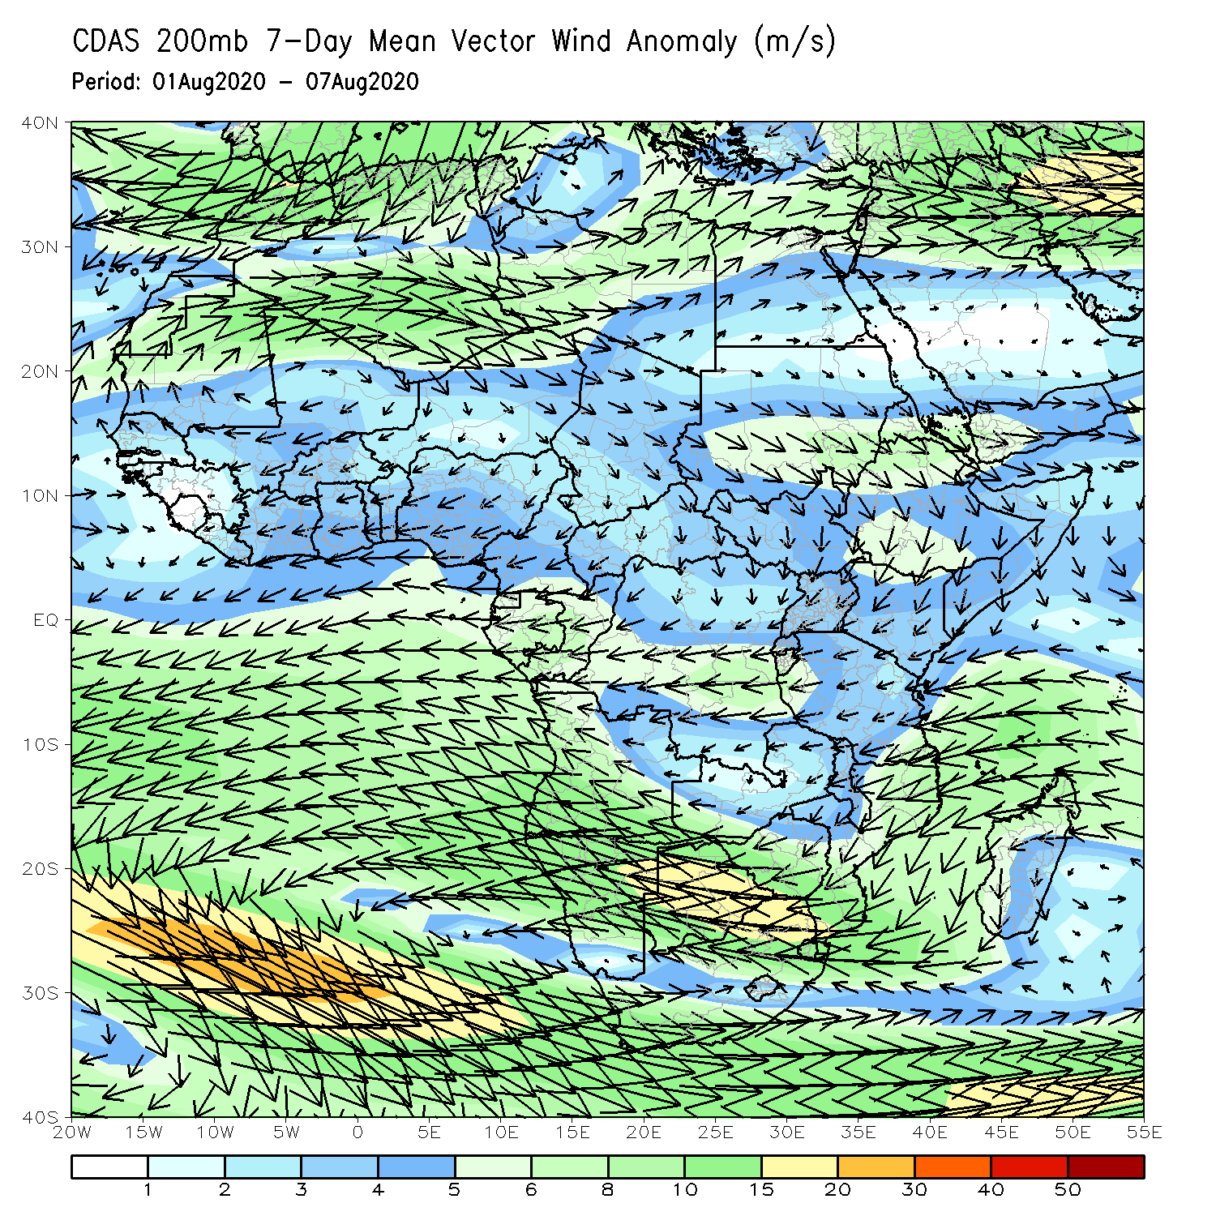
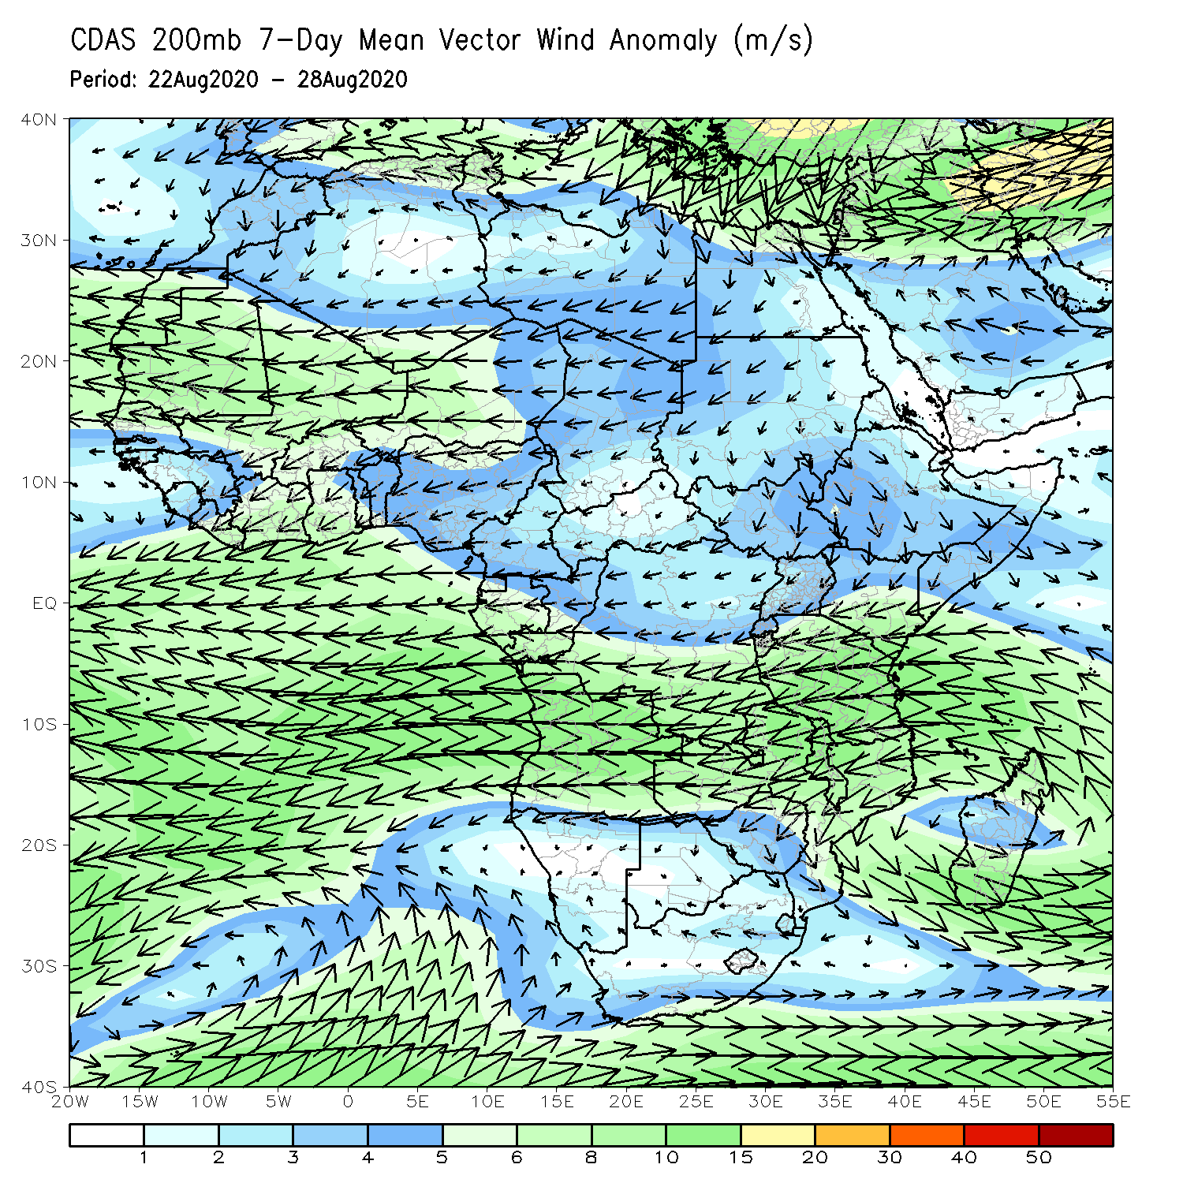
Atmospheric Circulation: Last 7 Days
An area of anomalous lower-level cyclonic flow was observed across the Sahel region (left panel).

Slide 9
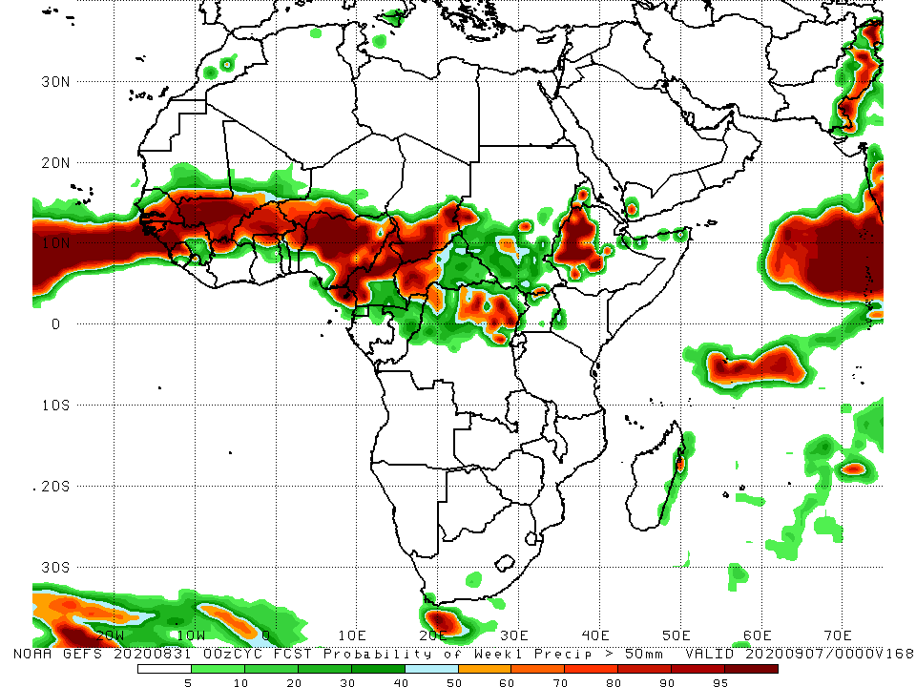
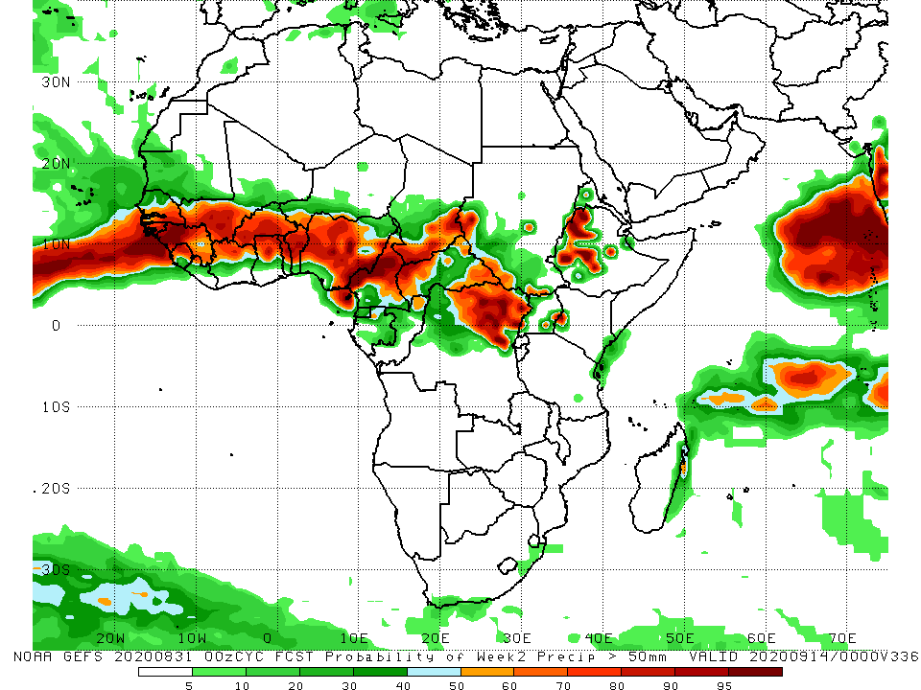
NCEP GEFS Model Forecasts Non-Bias Corrected Probability of precipitation exceedance
Week-1 Valid 1 – 7 September, 2020
Week-2: Valid 8 – 14 September, 2020
For week-1 (left panel) and Week-2 (right panel), there is an increased chance for weekly rainfall totals to exceed 50mm over many places in the Sahel region, and northern DRC, Eritrea and western Ethiopia.
Notes:
9

Slide 10
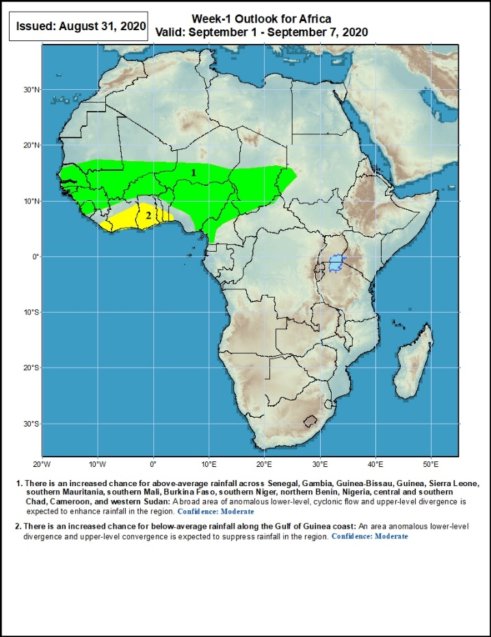
Week-1 Precipitation Outlooks
1 - 7 September, 2020
There is an increased chance for above-average rainfall across Senegal, Gambia, Guinea-Bissau, Guinea, Sierra Leone, southern Mauritania, southern Mali, Burkina Faso, southern Niger, northern Benin, Nigeria, central and southern Chad, Cameroon, and western Sudan: A broad area of anomalous lower-level cyclonic flow and upper-level divergence is expected to enhance rainfall in the region. Confidence: Moderate
There is an increased chance for below-average rainfall along the Gulf of Guinea coast: An area anomalous lower-level divergence and upper-level convergence is expected to suppress rainfall in the region. Confidence: Moderate
Notes:
10

Slide 11
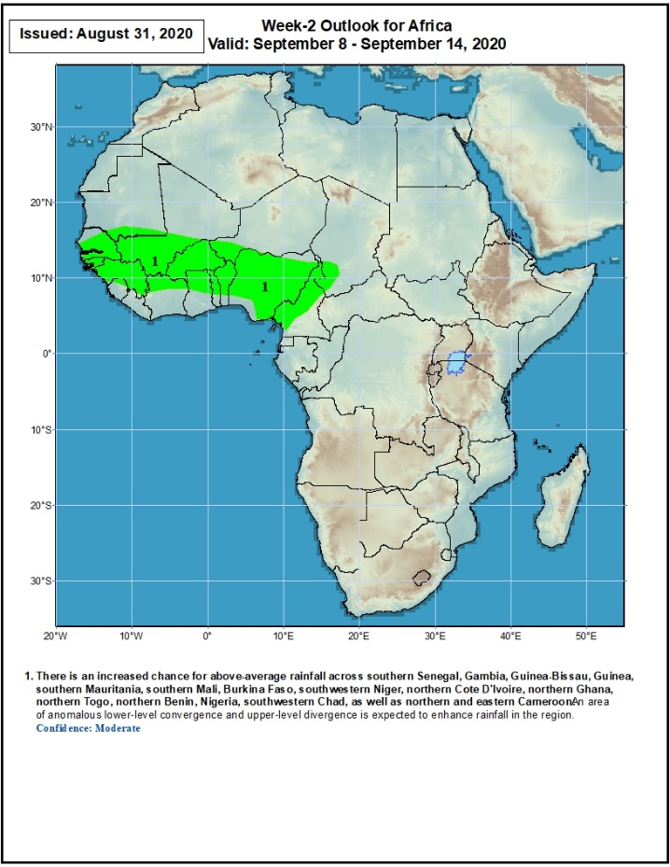
Week-2 Precipitation Outlooks
8 - 14 September, 2020
There is an increased chance for above-average rainfall across southern Senegal, Gambia, Guinea-Bissau, Guinea, southern Mauritania, southern Mali, Burkina Faso, southwestern Niger, northern Cote d'Ivoire, northern Ghana, northern Togo, northern Benin, Nigeria, southwestern Chad, as well as northern and eastern Cameroon: An area of anomalous lower-level convergence and upper-level divergence is expected to enhance rainfall in the region. Confidence: Moderate
Notes:
11

Slide 12
Summary
During the past 7 days, rainfall was above-average over southern Mauritania, northern Senegal, Guinea-Bissau, Guinea, Sierra Leone, many parts of Mali, northwestern Cote d’Ivoire, parts of Burkina Faso, Niger, local areas in Cameroon, Gabon, Congo, central Chad, Sudan, parts of CAR, portions of DRC, South Sudan, Eritrea and Ethiopia. Below-average rainfall was observed over local areas in Senegal and Mali, Liberia, Cote d’Ivoire, parts of Burkina Faso, Ghana, Togo, Benin, many parts of Nigeria, southern Chad, northern Cameroon, and local areas in CAR.
During the past 30 days, rainfall was above-average over local areas in Mauritania, portions of Guinea and Mali, parts of Burkina Faso, Niger, northern Nigeria, much of Chad, local areas in northern Cameroon, much of CAR, Sudan, South Sudan, DRC, Eritrea, and many parts of Ethiopia. Rainfall was below-average over local areas in Mauritania, much of Senegal, local areas in Guinea and Mali, Sierra Leone, Liberia, Ghana, Togo, Benin, local areas in Niger, central and southern Nigeria, much of Cameroon, and local areas in western CAR.
During the past 90 days, rainfall was above-average over many places in West, Central and the Greater Horn of Africa. Below-average rainfall was observed over local areas in Mauritania, northern Senegal, eastern Liberia, Cote d’Ivoire, local areas in Niger, Togo, Benin, Nigeria and Cameroon, and portions of South Africa, Mozambique and Madagascar.
Week-1 outlooks call for an increased chance for above-average rainfall over Senegal, Gambia, Guinea-Bissau, Guinea, Sierra Leone, southern Mauritania, southern Mali, Burkina Faso, southern Niger, northern Benin, Nigeria, central and southern Chad, Cameroon, and western Sudan. In contrast, there is an increased chance for below-average rainfall along the Gulf of Guinea coast.
Week-2 outlooks call for an increased chance for above-average rainfall over southern Senegal, Gambia, Guinea-Bissau, Guinea, southern Mauritania, southern Mali, Burkina Faso, southwestern Niger, northern Cote d'Ivoire, northern Ghana, northern Togo, northern Benin, Nigeria, southwestern Chad, as well as northern and eastern Cameroon.
Notes:
12

