Slide 1
The African Monsoon Recent Evolution and Current Status Include Week-1 and Week-2 Outlooks
Update prepared by
Climate Prediction Center / NCEP
8 September 2020
For more information, visit:
http://www.cpc.ncep.noaa.gov/products/Global_Monsoons/African_Monsoons/precip_monitoring.shtml

Slide 2
Outline
Highlights
Recent Evolution and Current Conditions
NCEP GEFS Forecasts
Summary

Slide 3
Highlights: Last 7 Days
Moisture surpluses of over 100 mm were observed over southern Mauritania, portions of Senegal, Mali, Guinea-Bissau, Guinea, southern Sierra Leone, northwestern Liberia, northwestern Côte d’Ivoire, eastern Burkina Faso, northern and southern Nigeria, coastal areas of Cameroon, portions of Chad, northern DRC, parts of Ethiopia, northwestern Somalia, northern Tanzania, Zimbabwe, Mozambique and Madagascar.
Week-1 outlook calls for an increased chance for below-average rainfall over much of Senegal, southern Mauritania, and southwestern Mali. It also indicates an increased chance for above-average rainfall across Guinea, Sierra Leone, western Liberia, southeastern Mali, northern Cote d'Ivoire, southern Burkina Faso, central and northern Ghana, Togo, Benin, portions of Nigeria, much of CAR, western South Sudan, northern Congo, and northern DRC.
Week-2 outlook calls for an increased chance for below-average rainfall over much of Senegal, southern Mauritania, and southwestern Mali. In contrast, there is an increased chance for above-average rainfall across Guinea, Sierra Leone, western Liberia, southeastern Mali, northern Cote d'Ivoire, Burkina Faso, central and northern Ghana, Togo, Benin, much of Nigeria, and southwestern Cameroon.

Slide 4
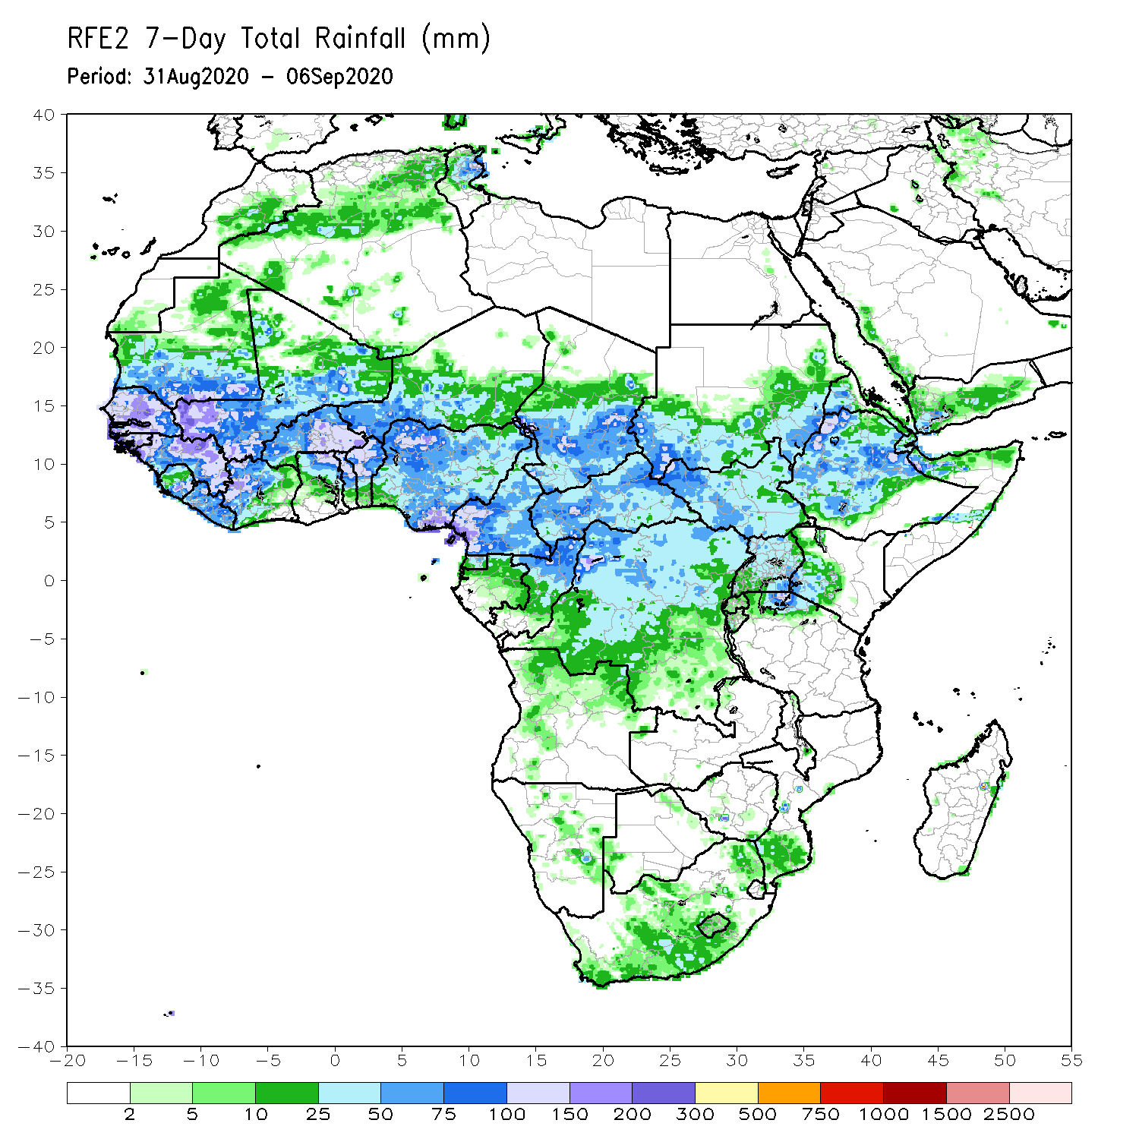
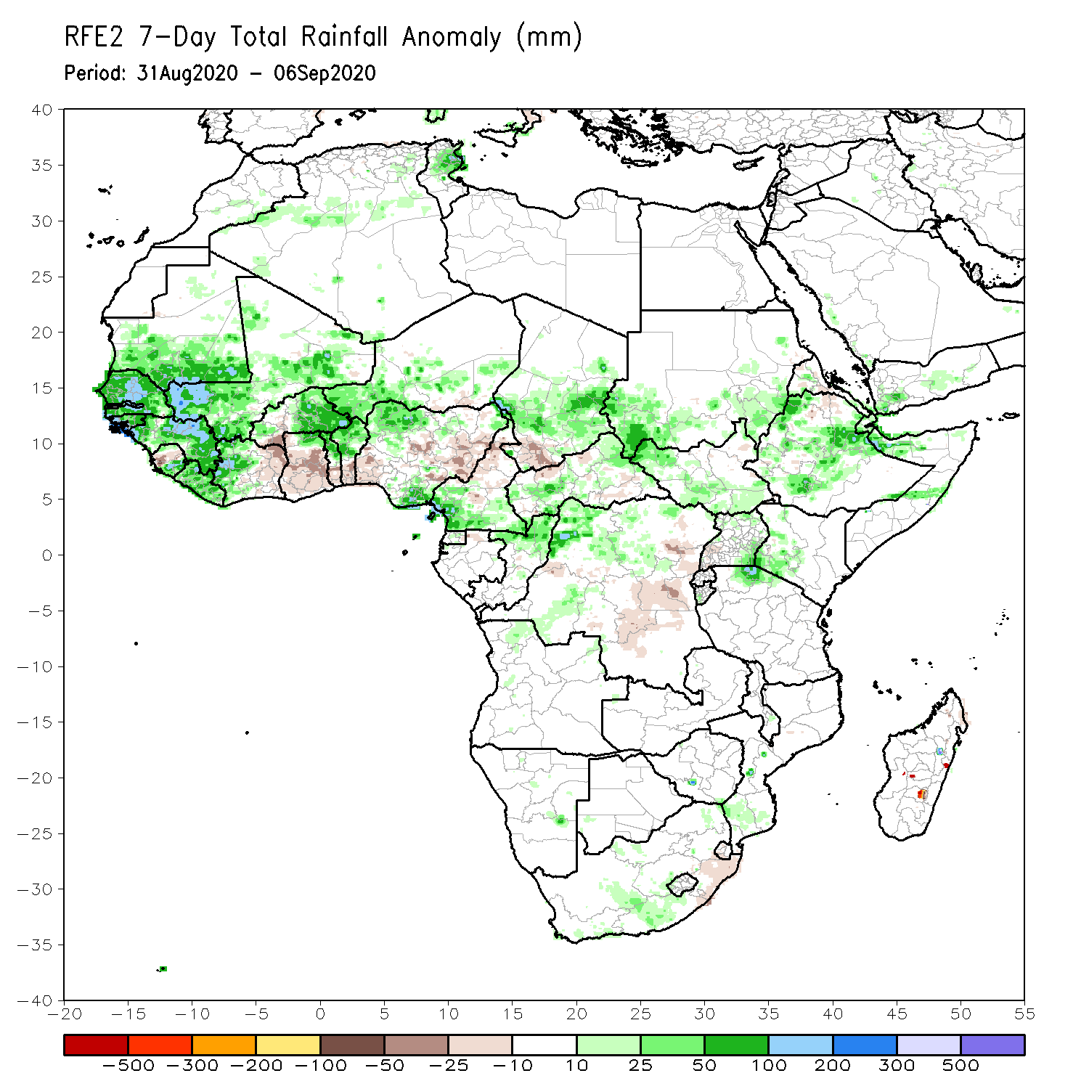
Rainfall Patterns: Last 7 Days
During the past 7 days, moisture surpluses of over 100 mm were observed over southern Mauritania, portions of Senegal, Mali, Guinea-Bissau, Guinea, southern Sierra Leone, northwestern Liberia, northwestern Côte d’Ivoire, eastern Burkina Faso, northern and southern Nigeria, coastal areas of Cameroon, portions of Chad, northern DRC, parts of Ethiopia, northwestern Somalia, northern Tanzania, Zimbabwe, Mozambique and Madagascar.
Conversely, parts of Sierra Leone, northeastern Côte d’Ivoire, southwestern Burkina Faso, Ghana, Togo, Benin, portions of Nigeria, northern Cameroon, southern Chad, northwestern CAR, DRC and Madagascar experienced moisture surpluses of over 25 mm.

Slide 5
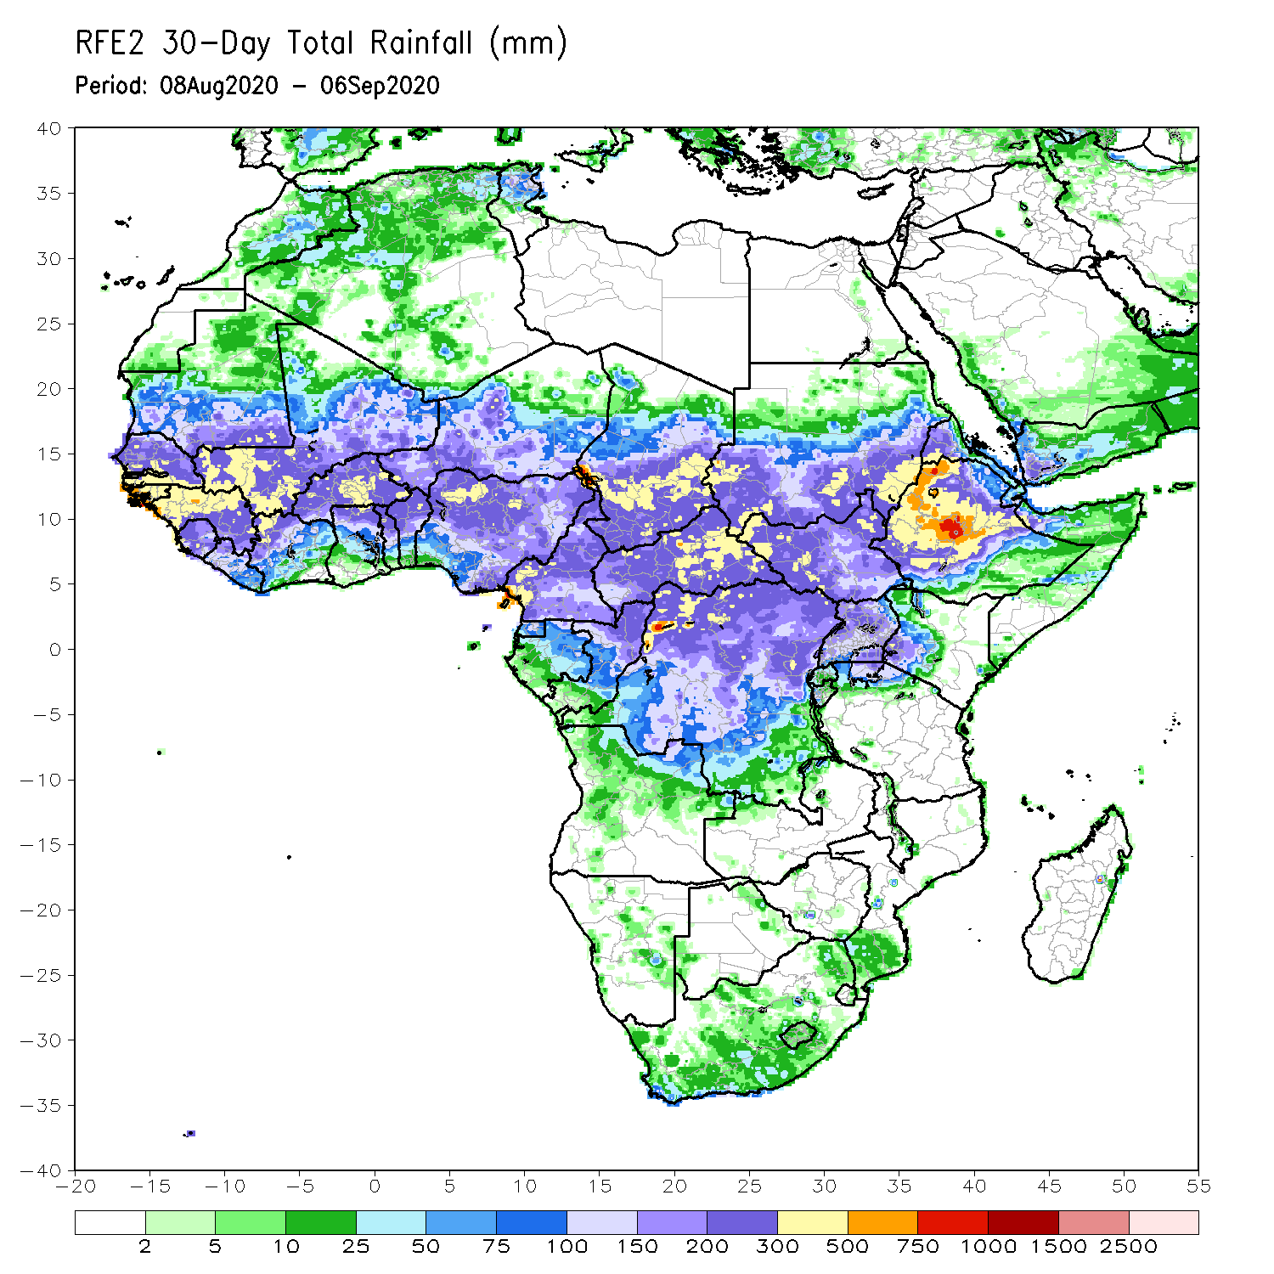
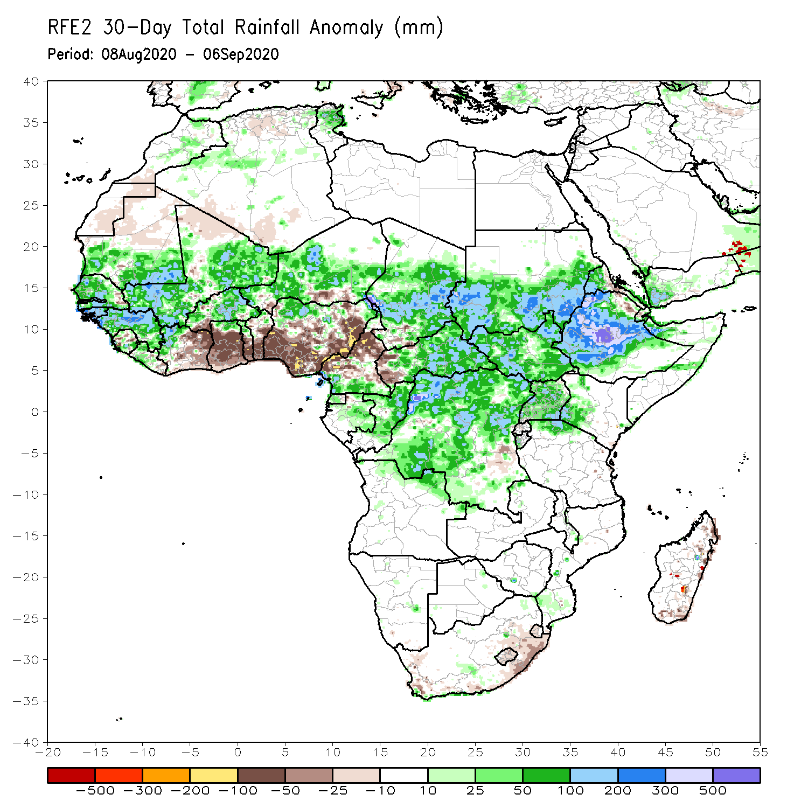
Rainfall Patterns: Last 30 Days
During the past 30 days, rainfall was above-average, with moisture surpluses of over 200 mm over local areas in Senegal, Guinea-Bissau, Guinea, southeastern Mauritania, Mali, northern Niger, the northern border of Nigeria, Cameroon and Chad, coastal areas in Cameroon, eastern Chad, Sudan, South Sudan, CAR, Ethiopia, northwestern Somalia, northern DRC.
Moisture deficits of over 100 mm were observed over local areas in countries of the Gulf of Guinea (Côte d’Ivoire, Ghana, Togo, Benin, Nigeria and Cameroon) and in Madagascar.
Notes:
5

Slide 6
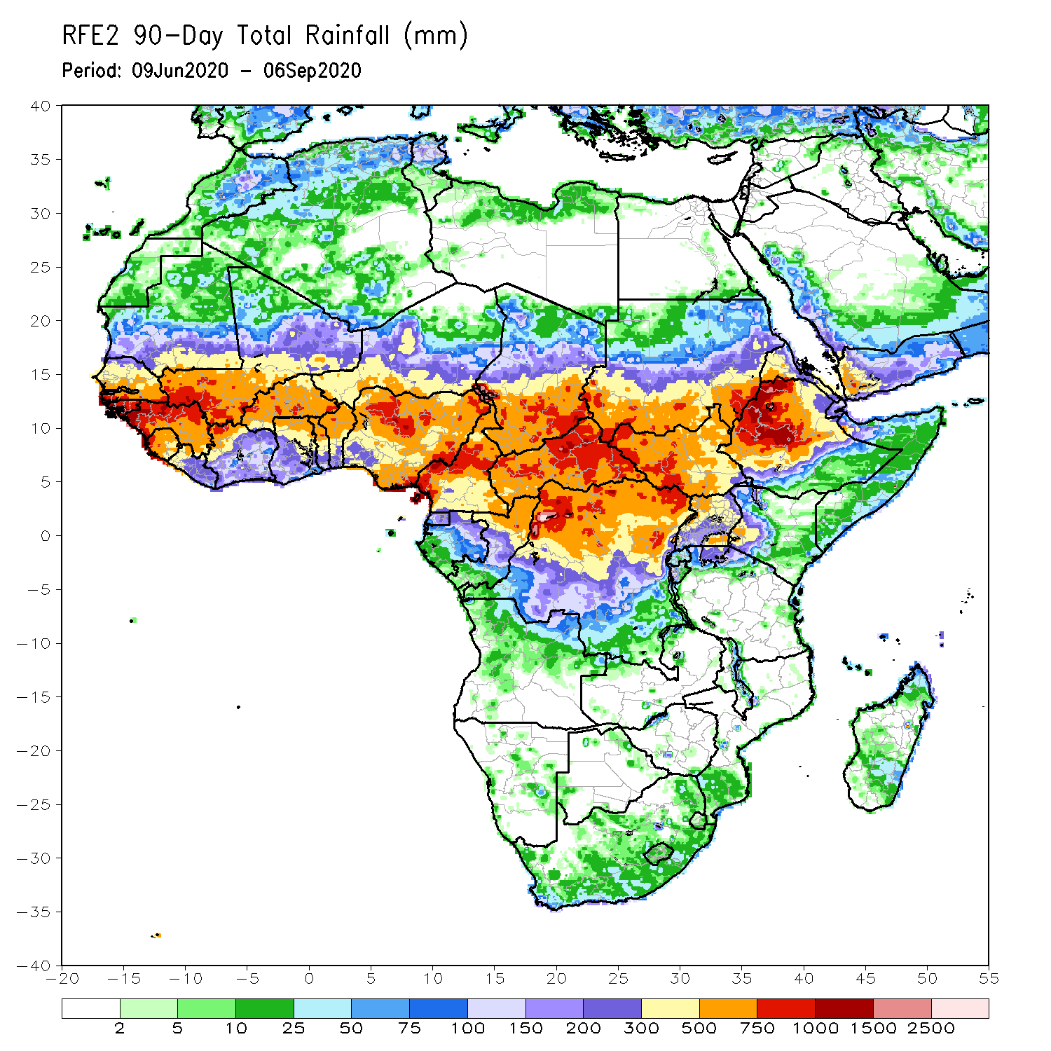
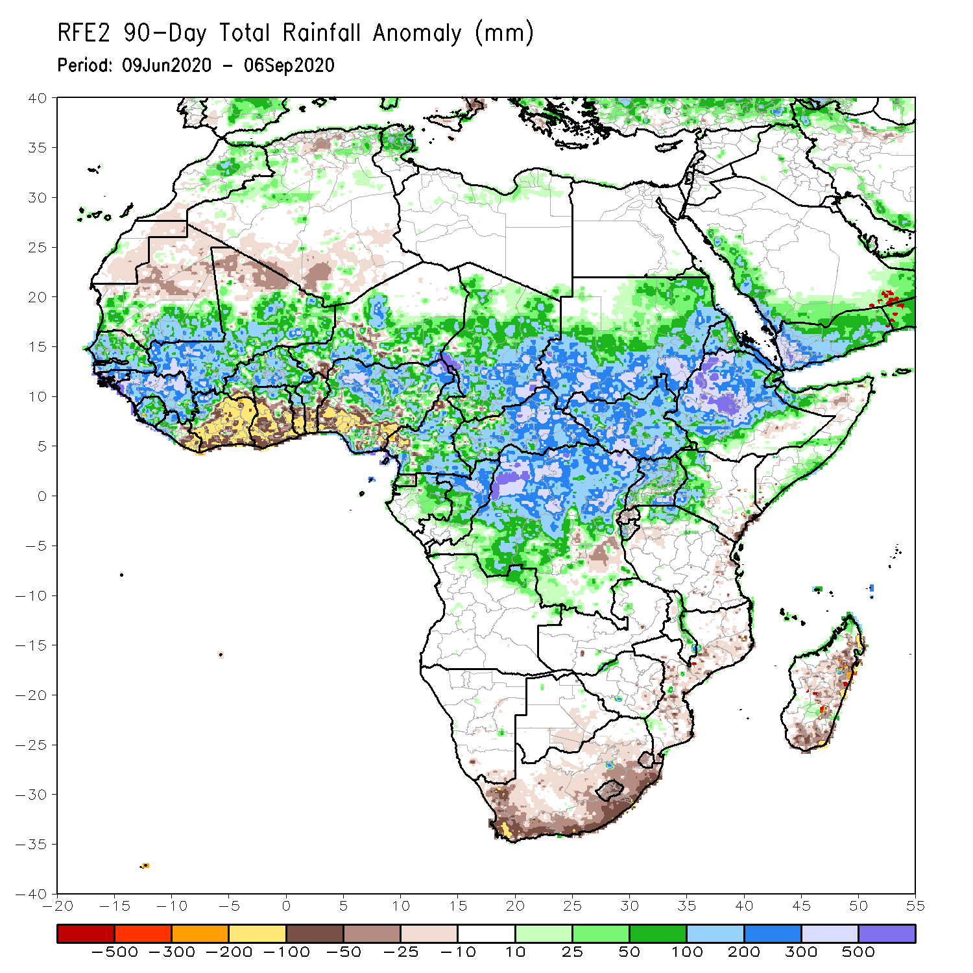
Rainfall Patterns: Last 90 Days
During the past 90 days, local areas in Guinea-Bissau, Guinea, the northern border of Nigeria, Niger, Chad and Cameroon, southeastern Chad, western and eastern Sudan, western Ethiopia, parts of CAR, northern DRC and southeastern Uganda experienced moisture surpluses of over 500 mm.
Conversely, moisture deficits exceed 100 mm over the countries of the Gulf of Guinea, southwestern Niger, southwestern Burkina Faso, northwestern CAR, southern South Africa and Madagascar.
Notes:
6

Slide 7
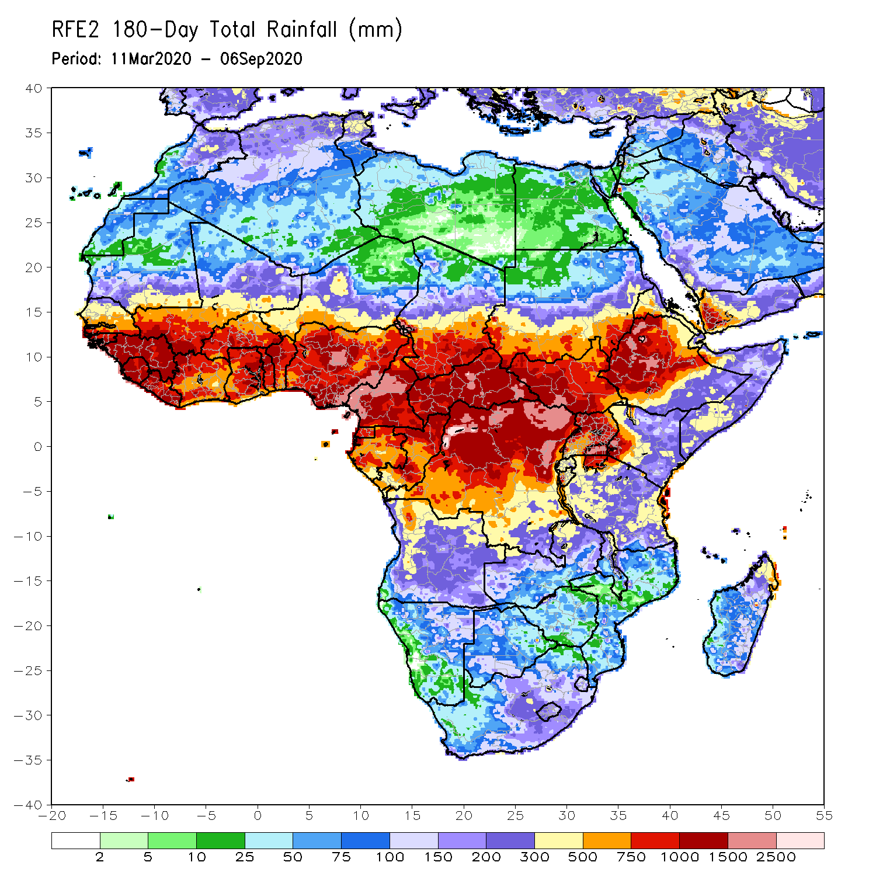
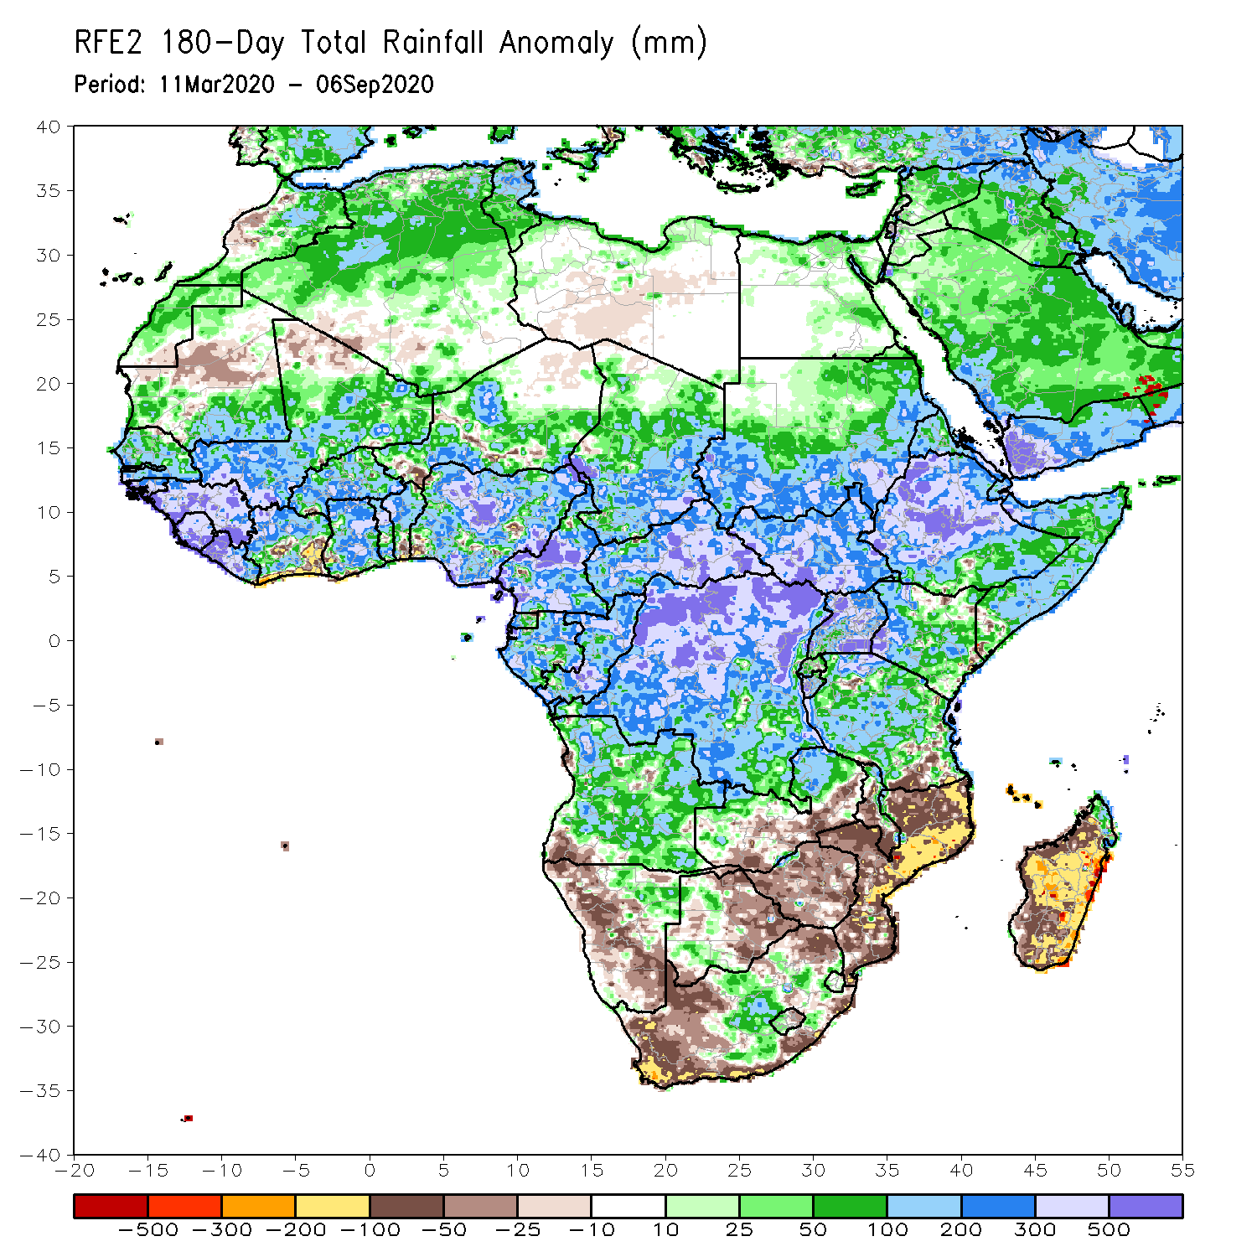
Rainfall Patterns: Last 180 Days
During the past 180 days, rainfall was well above-average, with moisture surpluses of over 500 mm, over southeastern Mali, Guinea-Bissau, Guinea, Sierra Leone, Liberia, northwestern Côte d’Ivoire, southeastern Niger, Nigeria, Chad, Cameroon, CAR, Sudan, South Sudan, Ethiopia, northwestern Somalia, Uganda, Kenya, Burundi, northern Tanzania, DRC, Gabon and Congo.
By contrast, moisture deficits of over 100 mm were observed over Côte d’Ivoire, southern Ghana, southern Benin, Nigeria and southwestern Niger. In addition, the southern part of Africa, eastern Mozambique and Madagascar experienced less than 50% of normal rainfall (moisture deficits of over 100 mm).
Notes:
7

Slide 8
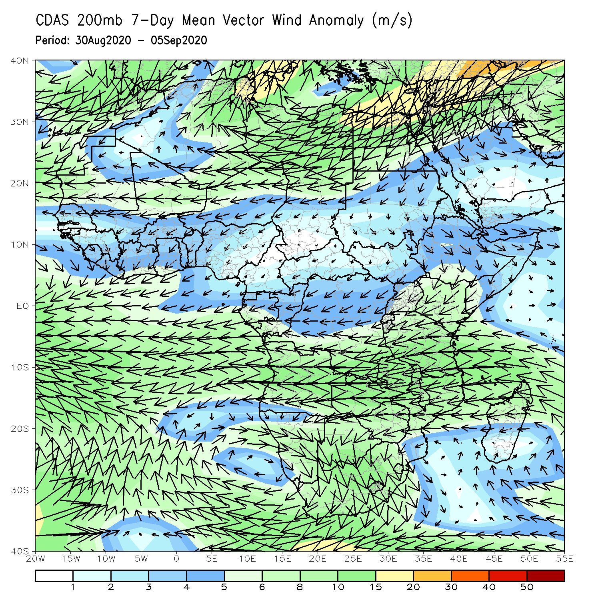
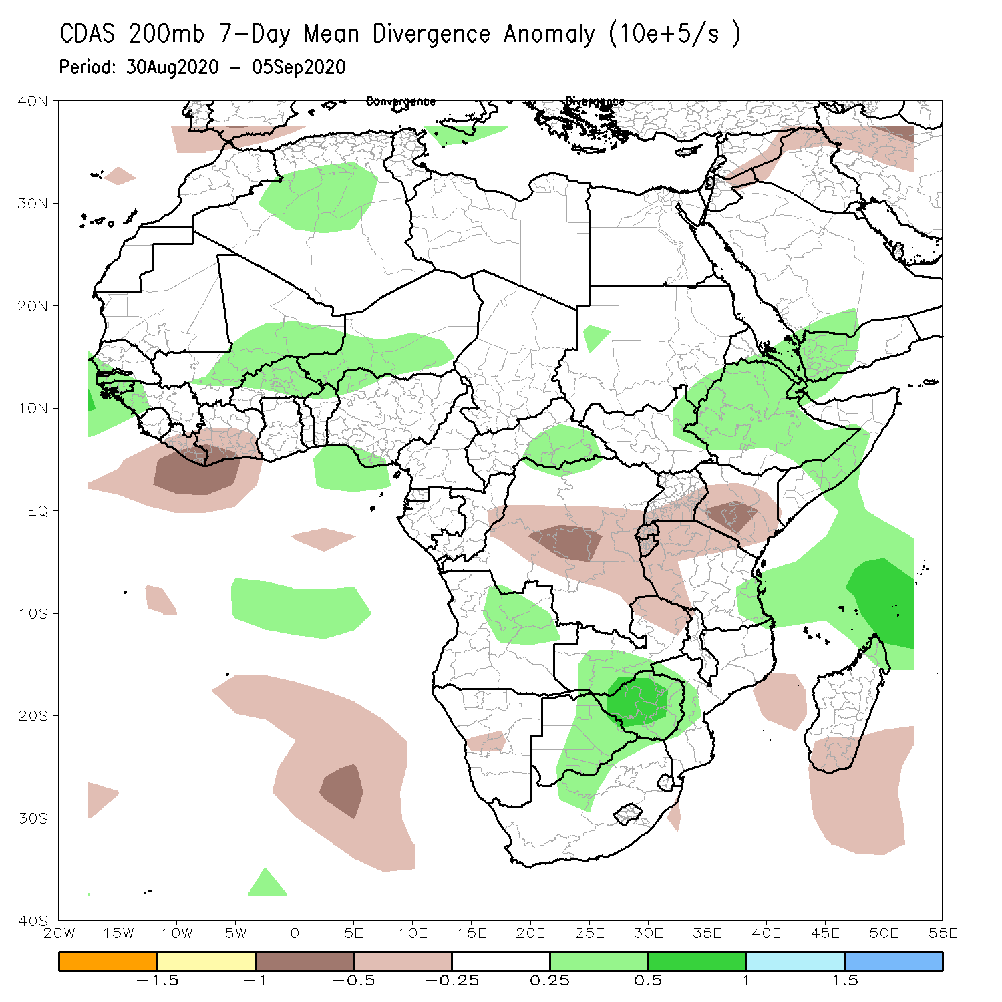
Atmospheric Circulation: Last 7 Days
At 200 hPa, the divergence areas over western Africa may have contributed to enhanced rainfall over Senegal, Guinea-Bissau, Guinea, Mali, Burkina Faso and Niger. In addition, the divergence area over the Greater Horn of Africa may have led to enhanced rainfall over Sudan, South Sudan, Eritrea, Ethiopia and Somalia.

Slide 9
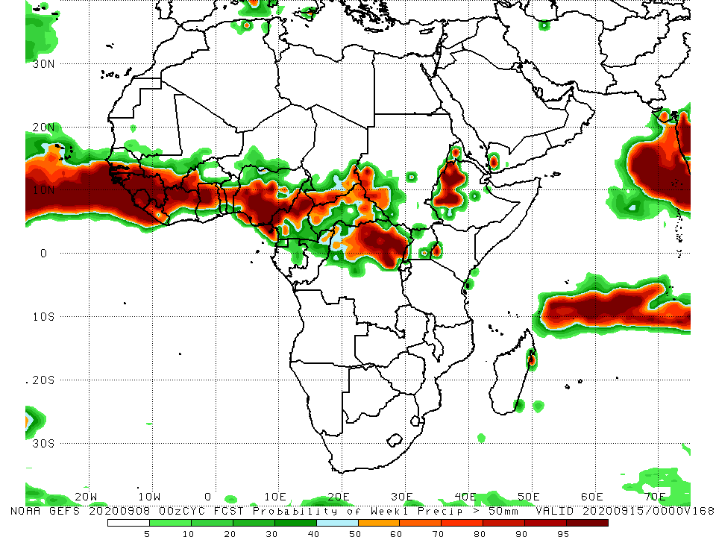
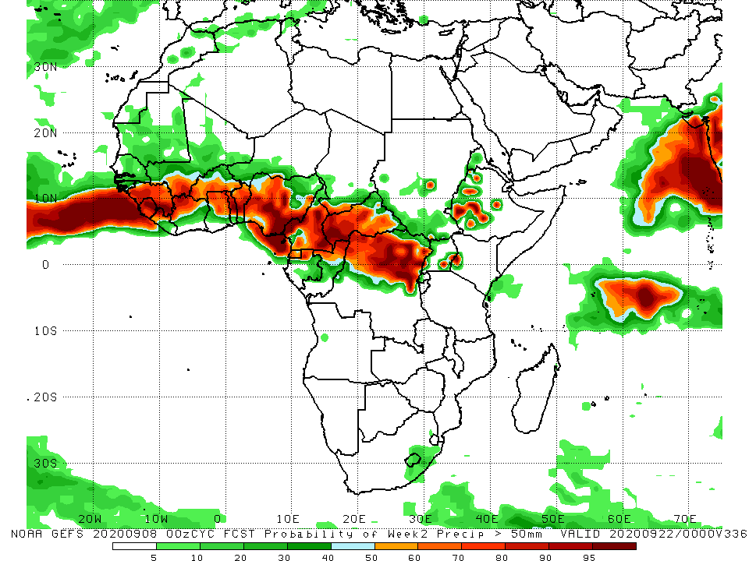
NCEP GEFS Model Forecasts Non-Bias Corrected Probability of precipitation exceedance
Week-1 Valid 9 – 15 September, 2020
Week-2: Valid 16 – 22 September, 2020
For week-1 (left panel) and week-2 (right panel), there is an increased chance for weekly rainfall totals to exceed 50 mm over many places in the Sahel region, Cameroon, southern Chad, CAR, northern DRC, northern Congo, portions of Sudan and South Sudan, Uganda, Kenya, western Ethiopia.
In addition, week-2 forecast calls for an increased chance for weekly rainfall to exceed 50 mm over equatorial Guinea and the northern part of Gabon.
Notes:
9

Slide 10
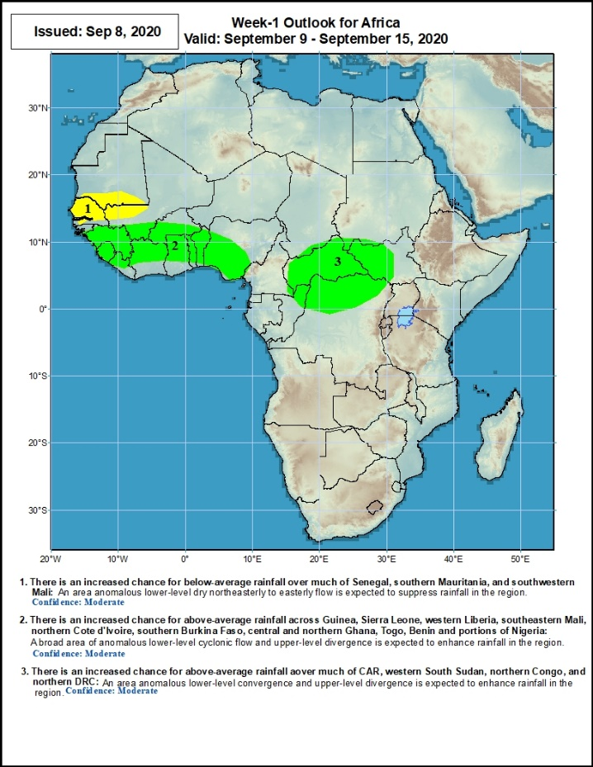
Week-1 Precipitation Outlooks
9 – 15 September, 2020
There is an increased chance for below-average rainfall over much of Senegal, southern Mauritania, and southwestern Mali: An area anomalous lower-level dry northeasterly to easterly flow is expected to suppress rainfall in the region. Confidence: moderate
There is an increased chance for above-average rainfall across Guinea, Sierra Leone, western Liberia, southeastern Mali, northern Cote d'Ivoire, southern Burkina Faso, central and northern Ghana, Togo, Benin and portions of Nigeria: A broad area of anomalous lower-level cyclonic flow and upper-level divergence is expected to enhance rainfall in the region. Confidence: moderate
There is an increased chance for above-average rainfall over much of CAR, western South Sudan, northern Congo, and northern DRC: An area anomalous lower-level convergence and upper-level divergence is expected to enhance rainfall in the region. Confidence: moderate
Notes:
10

Slide 11
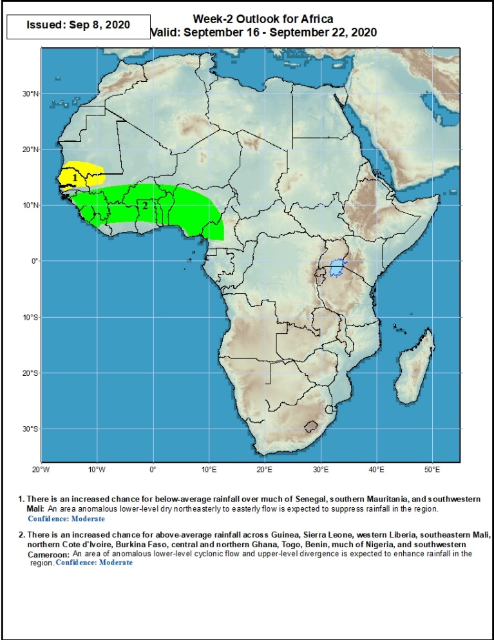
Week-2 Precipitation Outlooks
16 – 22 September, 2020
1. There is an increased chance for below-average rainfall over much of Senegal, southern Mauritania, and southwestern Mali: An area anomalous lower-level dry northeasterly to easterly flow is expected to suppress rainfall in the region. Confidence: moderate
2. There is an increased chance for above-average rainfall across Guinea, Sierra Leone, western Liberia, southeastern Mali, northern Cote d'Ivoire, Burkina Faso, central and northern Ghana, Togo, Benin, much of Nigeria, and southwestern Cameroon: An area of anomalous lower-level cyclonic flow and upper-level divergence is expected to enhance rainfall in the region. Confidence: moderate
Notes:
11

Slide 12
Summary
During the past 7-day, rainfall was above-average, with moisture surpluses of over 50 mm, over much of the Sahel region, portions of Central Africa and the Greater Horn of Africa. However, parts of Sierra Leone, eastern Côte d’Ivoire, southern Togo, southern Benin, parts of Nigeria, northern Cameroon, southern Chad, DRC and Madagascar experienced moisture deficits of over 25 mm (less than 25% of normal rainfall).
During the past 30-day and 90-day, many places in the Sahel, Central Africa and the Greater Horn of Africa experienced above-average rainfall (moisture surpluses of over 100 mm). Conversely, below-average rainfall (moisture deficits of over 50 mm) were observed over the countries of the Gulf of Guinea, the southern part of Africa and Madagascar.
During the past 180-day, moisture surpluses exceed 100 mm over Western Africa, Central Africa and the Greater Horn of Africa, while moisture deficits of over 50 mm were observed over local areas in Côte d’Ivoire, southwestern Burkina Faso, southern Ghana, southwestern Niger, local areas in Benin, Nigeria, Cameroon and much of the southern part of Africa and Madagascar.
Week-1 outlook calls for an increased chance for below-average rainfall over much of Senegal, southern Mauritania, and southwestern Mali. It also indicates an increased chance for above-average rainfall across Guinea, Sierra Leone, western Liberia, southeastern Mali, northern Cote d'Ivoire, southern Burkina Faso, central and northern Ghana, Togo, Benin, portions of Nigeria, much of CAR, western South Sudan, northern Congo, and northern DRC.
Week-2 outlook calls for an increased chance for below-average rainfall over much of Senegal, southern Mauritania, and southwestern Mali. In contrast, there is an increased chance for above-average rainfall across Guinea, Sierra Leone, western Liberia, southeastern Mali, northern Cote d'Ivoire, Burkina Faso, central and northern Ghana, Togo, Benin, much of Nigeria, and southwestern Cameroon.
Notes:
12

