Slide 1
The African Monsoon Recent Evolution and Current Status Include Week-1 and Week-2 Outlooks
Update prepared by
Climate Prediction Center / NCEP
05 October 2020
For more information, visit:
http://www.cpc.ncep.noaa.gov/products/Global_Monsoons/African_Monsoons/precip_monitoring.shtml

Slide 2
Outline
Highlights
Recent Evolution and Current Conditions
NCEP GEFS Forecasts
Summary

Slide 3
Highlights: Last 7 Days
Heavy downpours continue to sustain flooding in western Ethiopia. Sizable rainfall amounts exacerbated floods in western Mali as moisture supply continues to be abundant. Liberia registered extremely heavy rains that could result in local flooding.
The NCEP GEFS suggests that heavy rains will sustain the floods in western Ethiopia this week. Heavy rains might also increase flood risks in Liberia continuing into week-2.

Slide 4
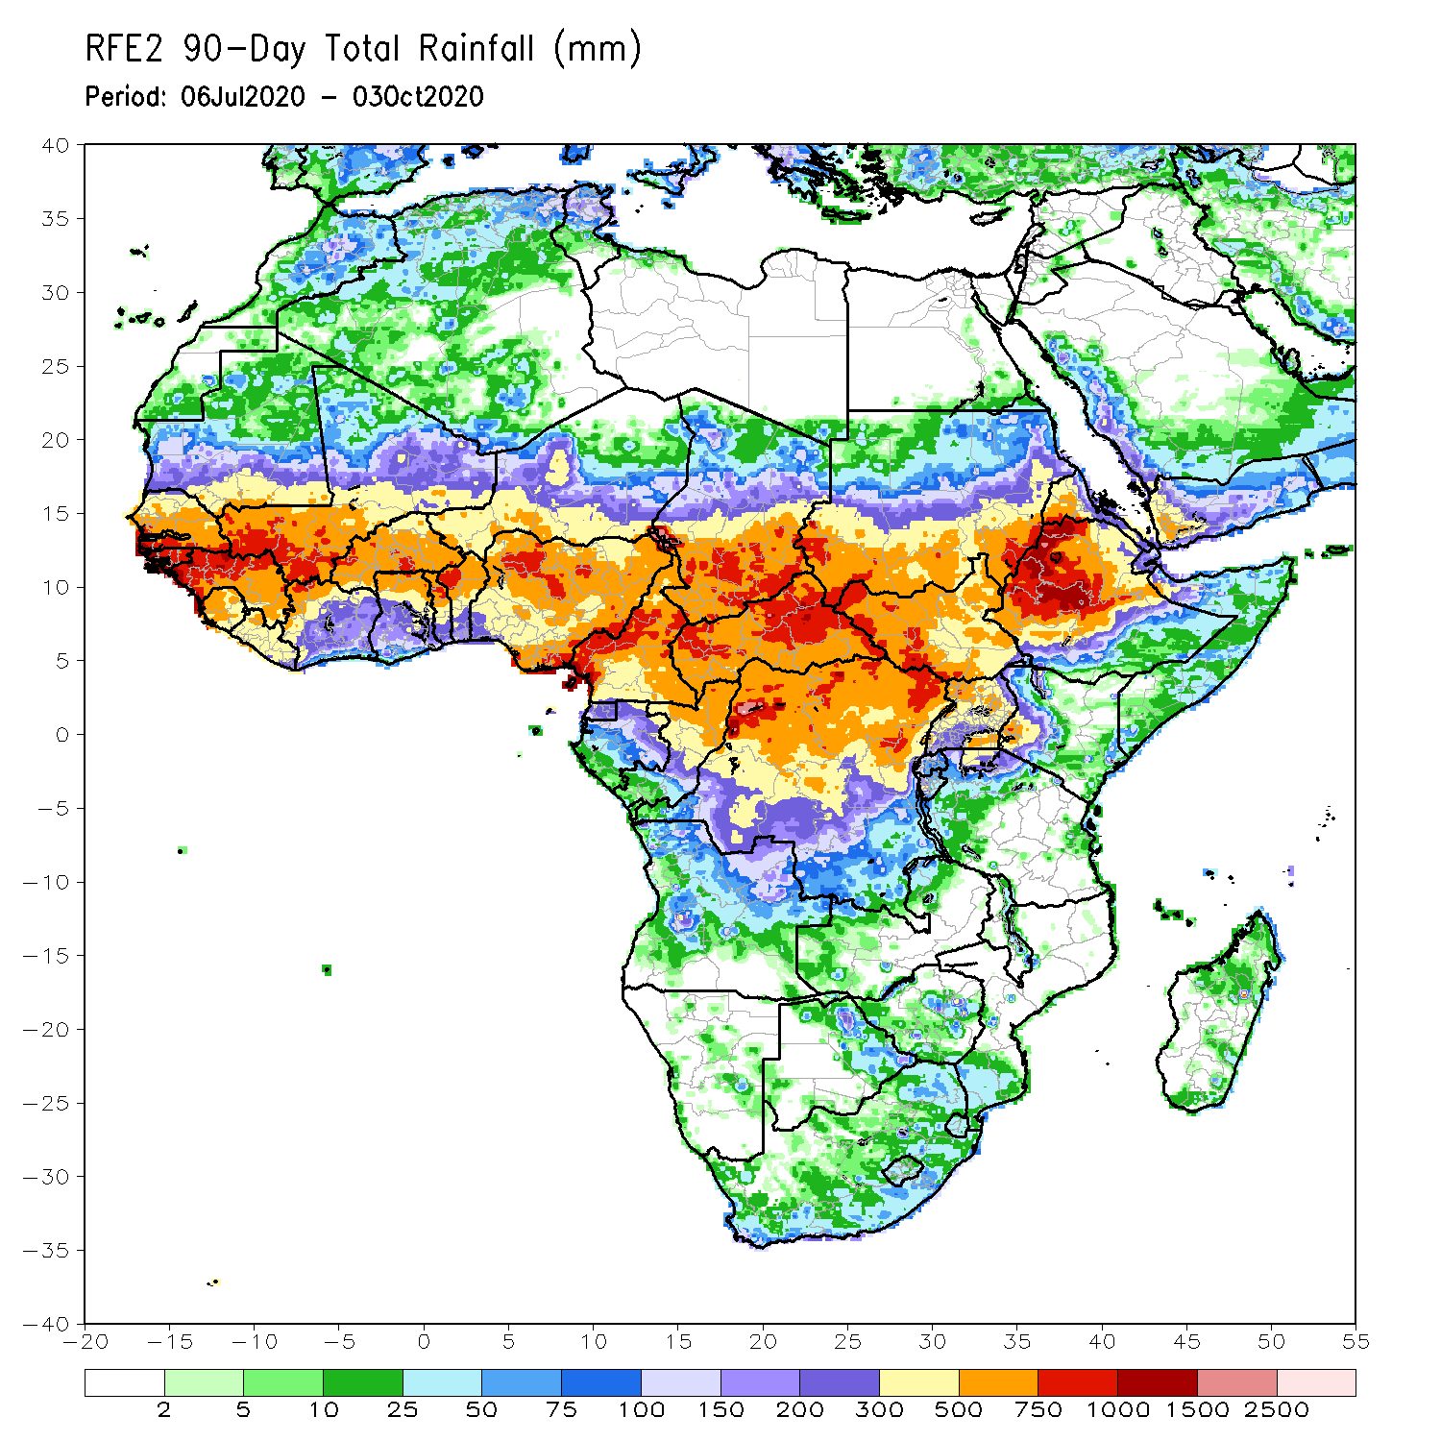
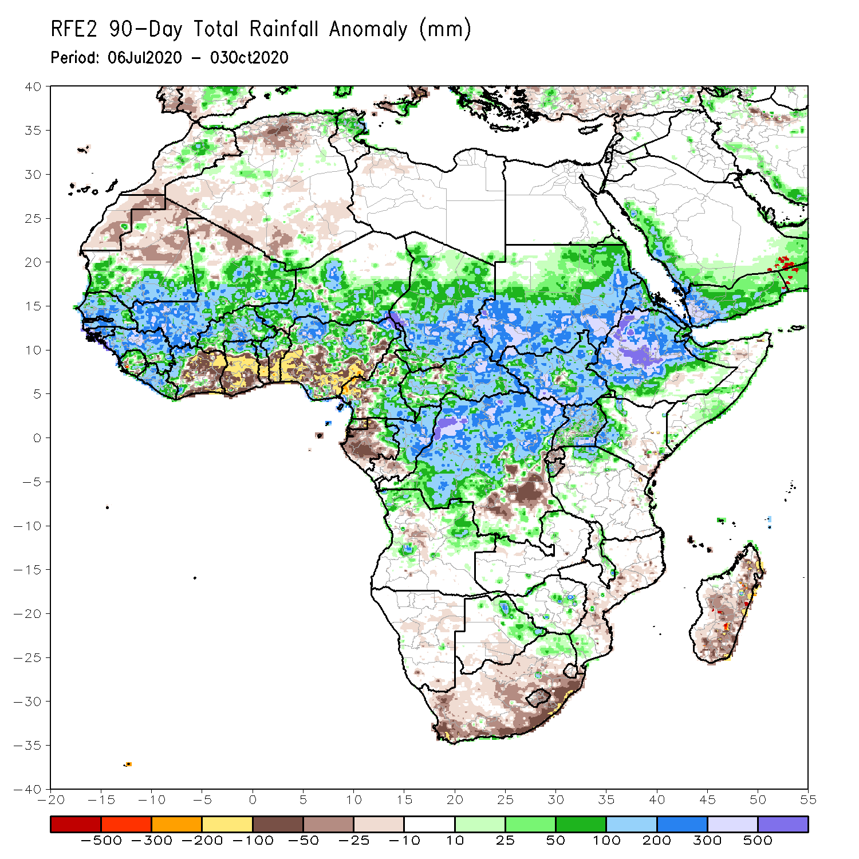
Rainfall Patterns: Last 90 Days
During the past 90 days, in West Africa, above-average rains prevailed across much of the Sahel from Senegal eastward to Chad. The border between Mali and Guinea registered rainfall amounts in the range between 700 and 1000 mm (300 mm above the mean). In contrast, rainfall was below-average over the southern areas of the Gulf of Guinea region with totals ranging between 100 and 300 mm (50 to 200 mm below the mean). In East Africa, the heaviest amounts 1000 to 1500 mm (over 500 mm above the mean) occurred over the Ethiopian Highlands. Well above-average rainfall (over 300 mm above the mean) was also observed in portions of southern Sudan. In Central Africa, rainfall was much above-average from southern Chad southward to the northern two-third of DRC. Rainfall was locally below-average over southeastern DRC. Persistent below average rainfall increased moisture deficits over Gabon.
Notes:
4

Slide 5
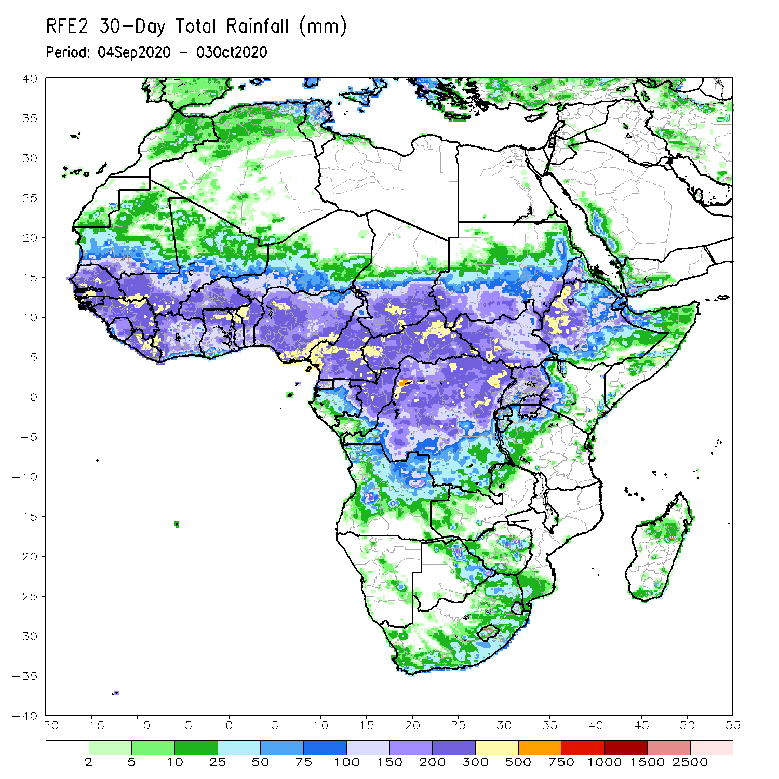
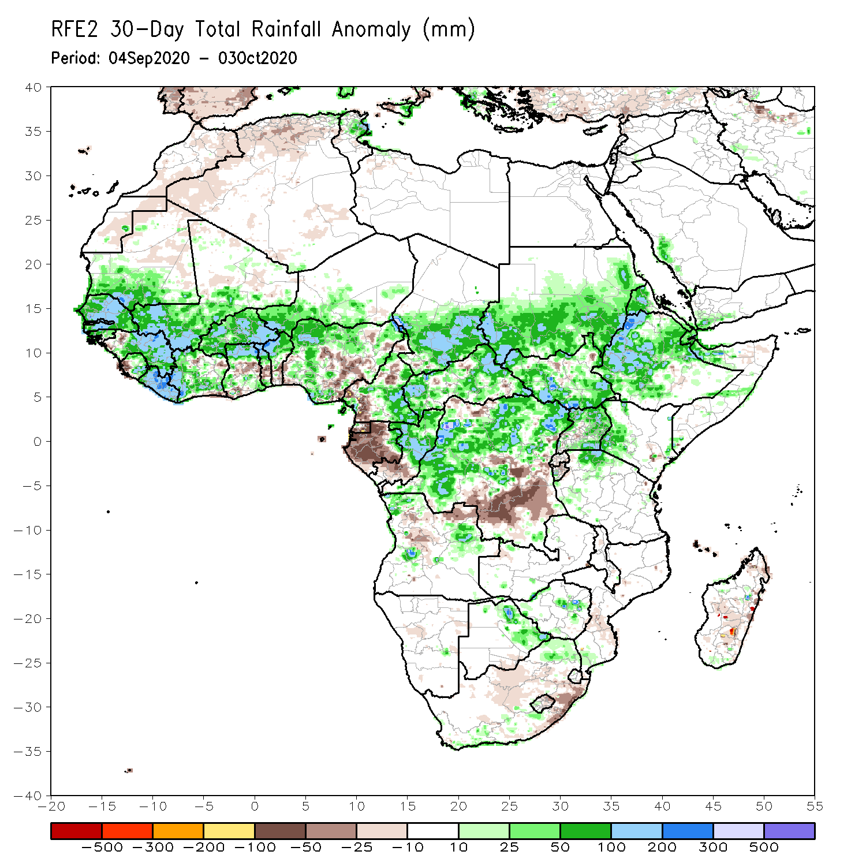
Rainfall Patterns: Last 30 Days
During the past 30 days, despite an overall reduction in rains, surpluses still prevailed over much of West Africa in the areas including the Sahel and the western Gulf of Guinea region, where totals exceeded 500 mm in the northern areas of Guinea. Rainfall improved in local areas in Ghana, Togo, Benin, and eastern Nigeria. In East Africa, moisture surpluses prevailed over the Ethiopian Highlands and southern Sudan. In Central Africa, above-average rainfall was observed in most areas. However, northern Cameroon continued to register below-average rains, while moisture deficits worsened in Gabon and eastern DRC.
Notes:
5

Slide 6
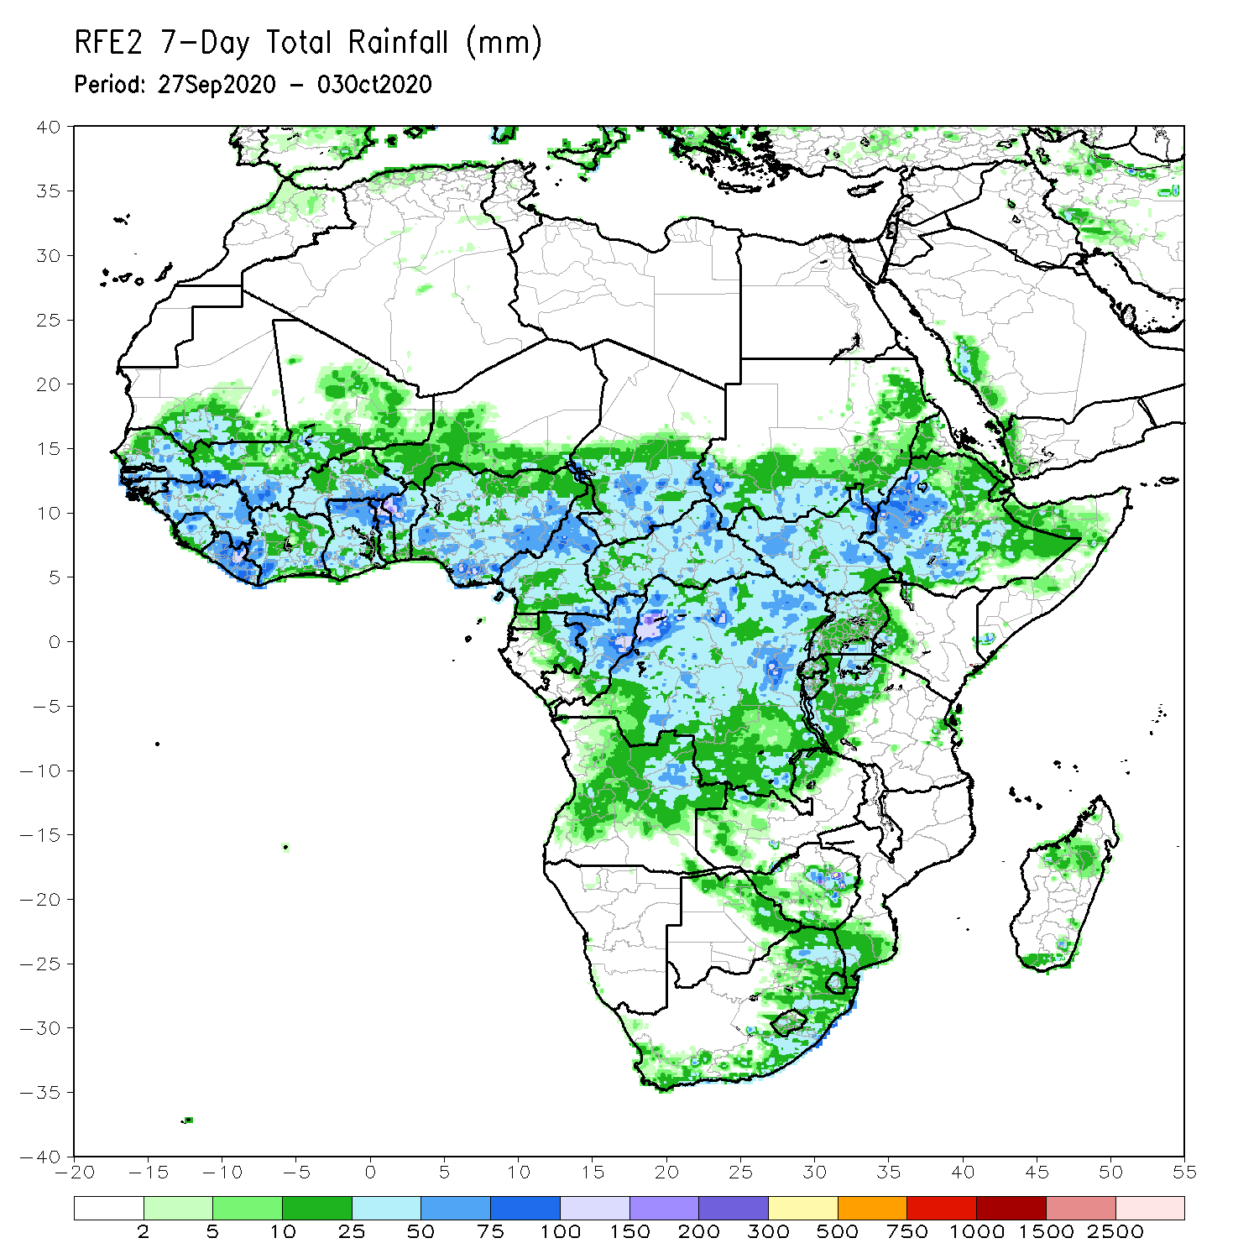
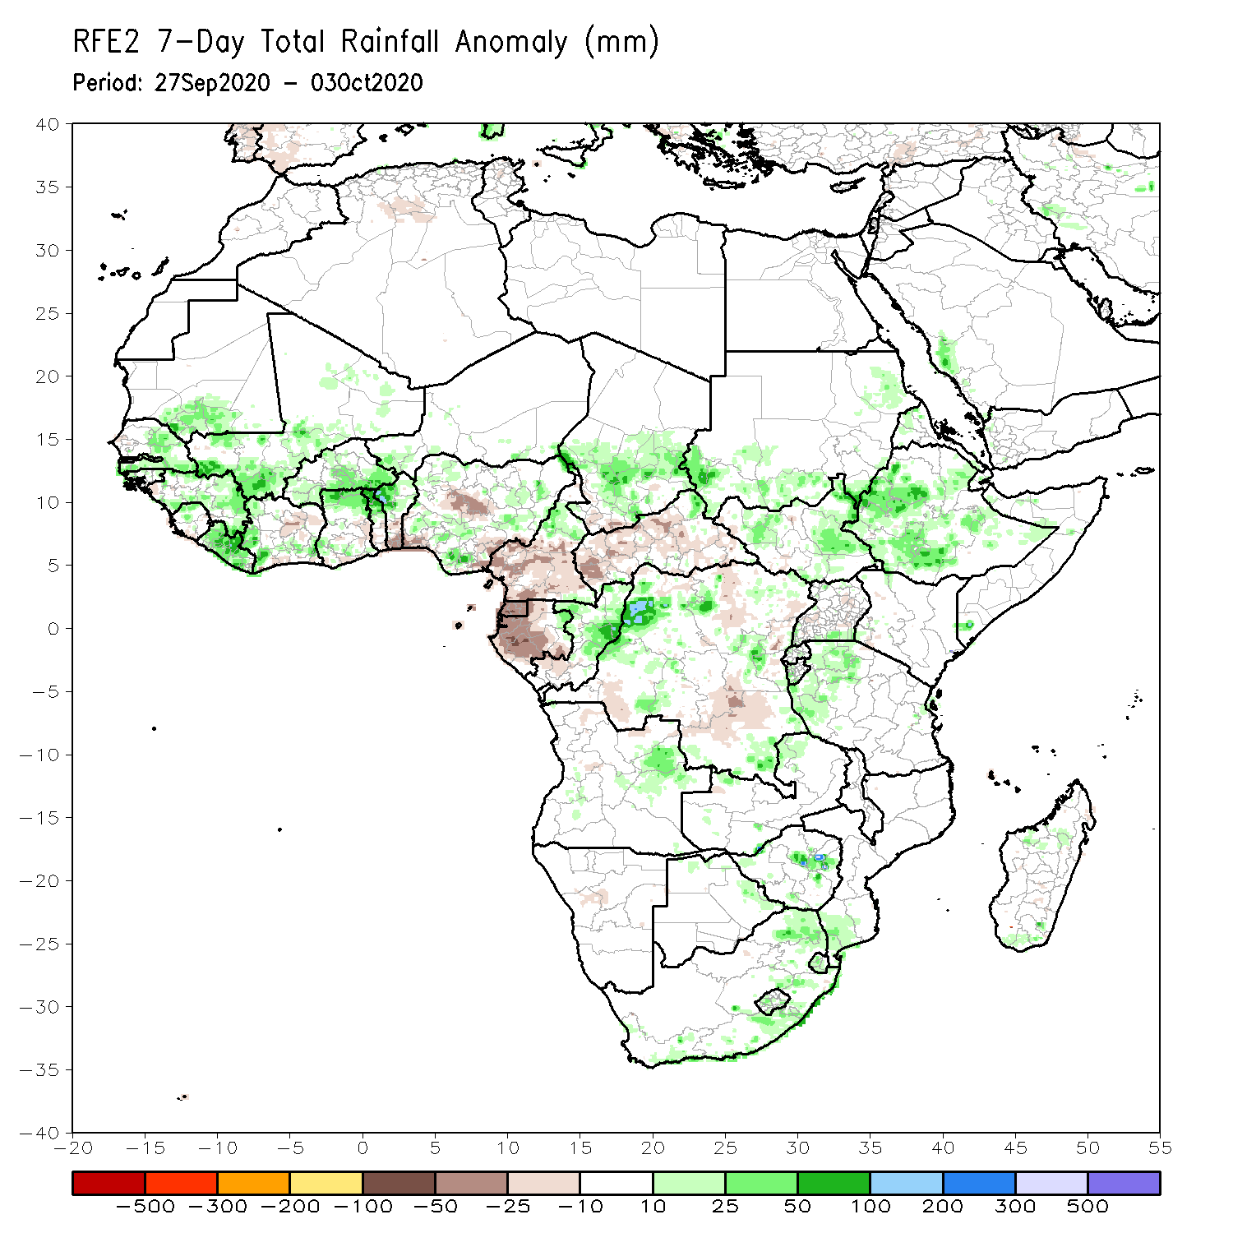
Rainfall Patterns: Last 7 Days
During the past 7 days, in West Africa, weekly rainfall totals approached 100 mm (about 50 mm above the mean) over parts of the western Sahel from southeastern Senegal to Burkina Faso. Rainfall was heavier (75-100 mm) over Liberia, and the northern areas of Ghana, Togo, and Benin. In Central Africa, rainfall was generally near average with totals averaging between 50 and 100 mm, exceeding 150 mm locally over eastern DRC. The exception was western Gabon and the southern half of Cameroon where lighter rains or dry conditions prevailed. In East Africa, the western Ethiopian Highlands continue to receive sizable rainfall amounts, exceeding 150 mm in local areas. Average conditions prevailed over southern Sudan, South Sudan and Uganda. Rainfall was slightly above average over western Tanzania.

Slide 7
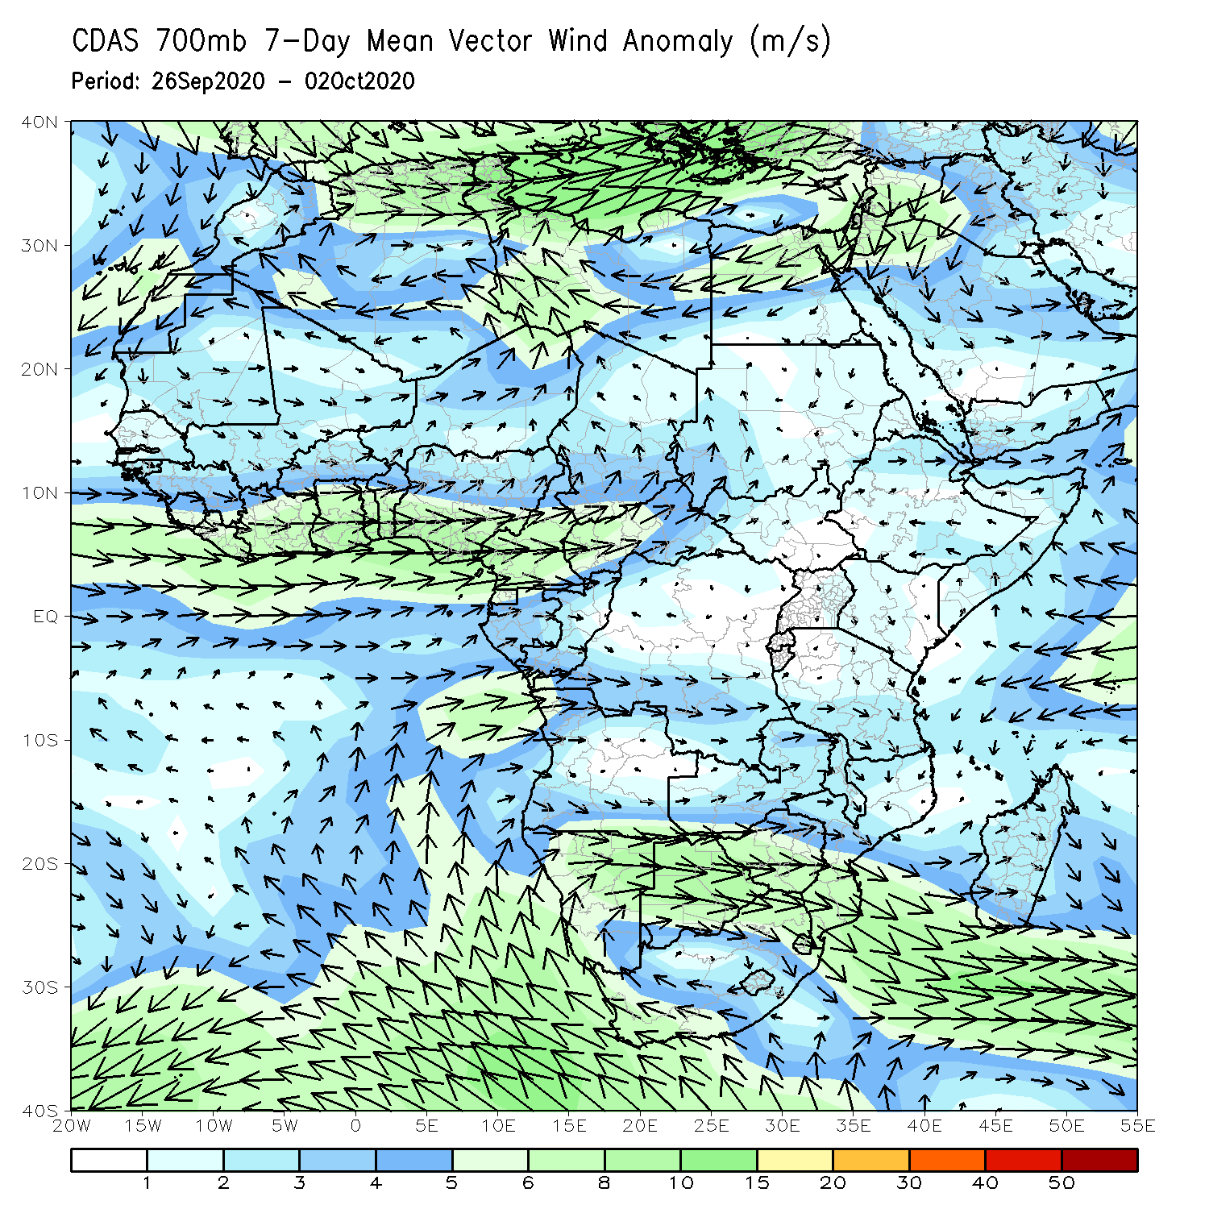
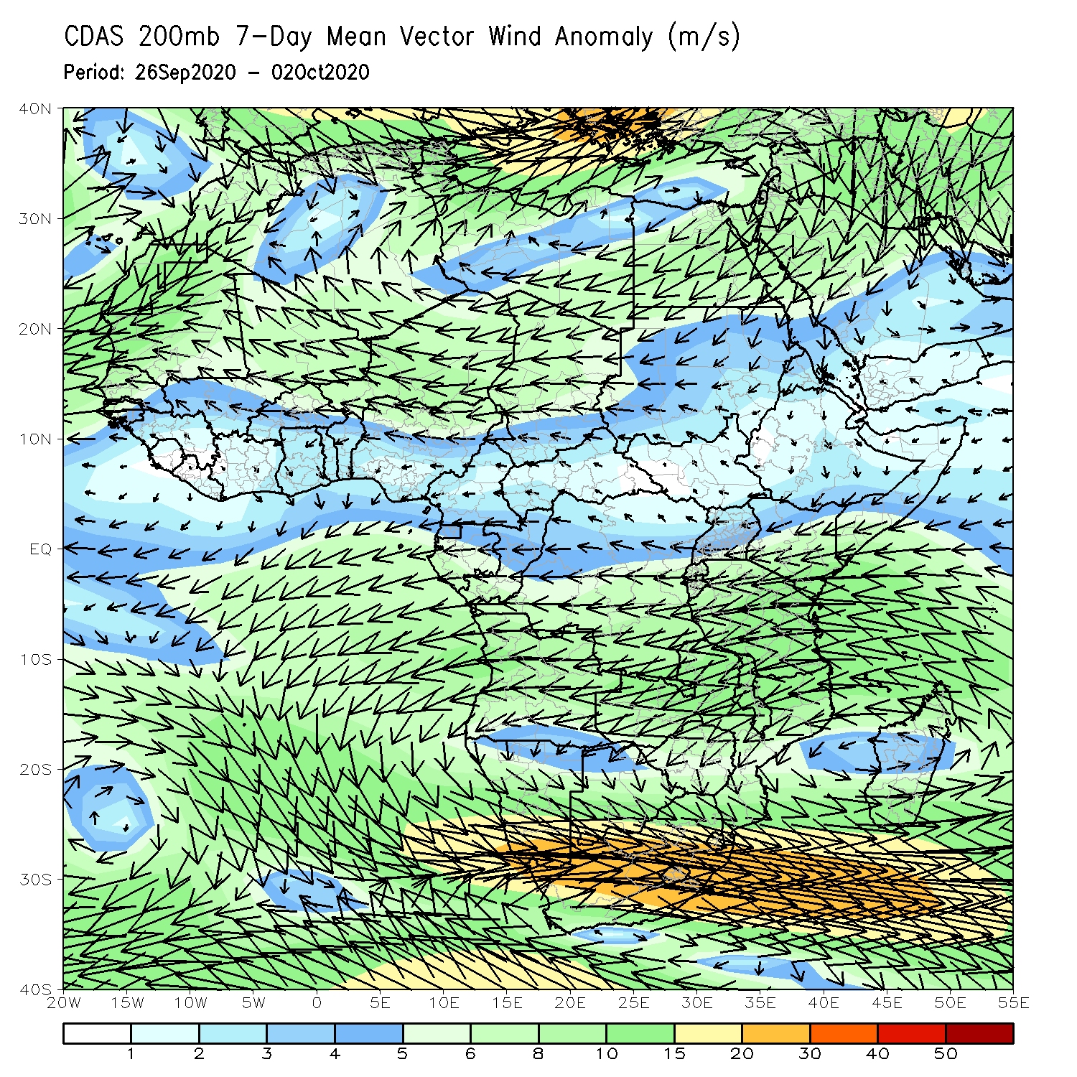
Atmospheric Circulation: Last 7 Days
Westerly wind anomalies prevailed along the Guinean Coast at lower-level (left panel). At upper level (right panel) the dominant feature is an amplification of the Mascarene High Pressure system in southeastern Africa and upper level easterlies over West Africa.

Slide 8
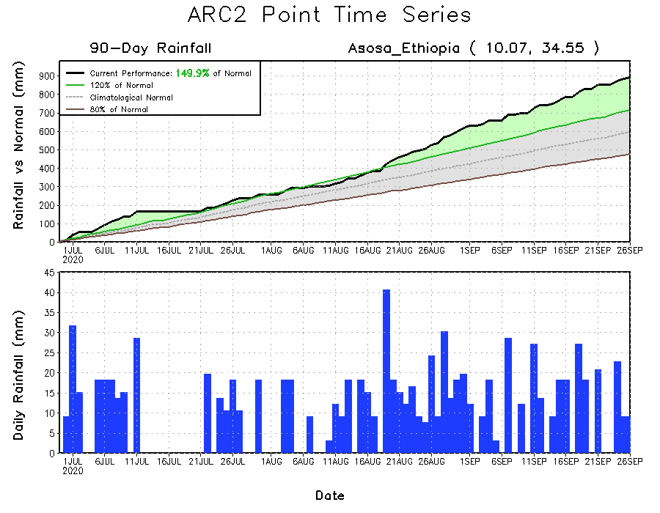
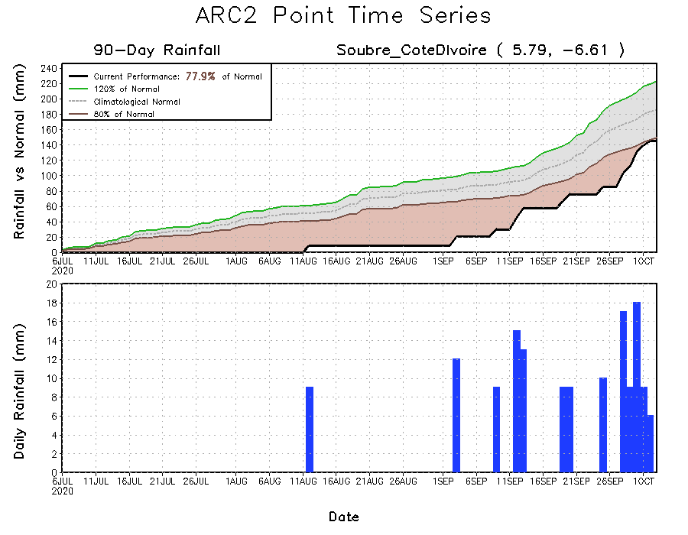
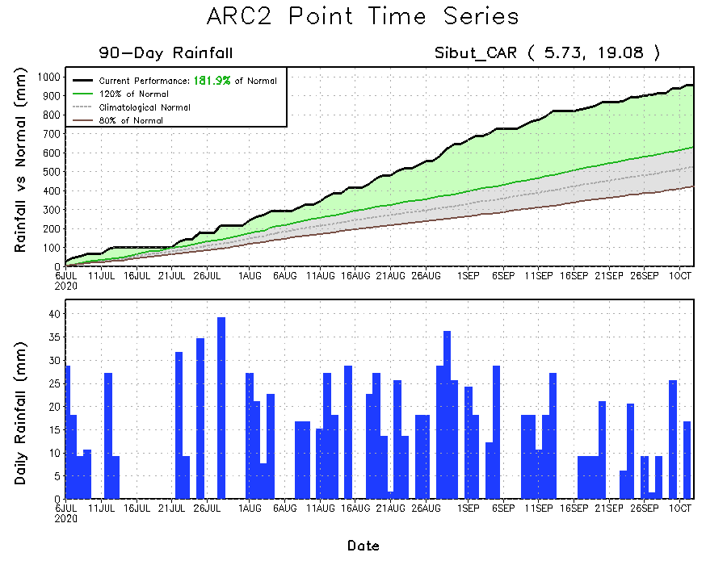
Rainfall Evolution
Daily evolution of rainfall over the last 90 days at selected locations indicated that moderate but steady rains in recent weeks helped to reduce rainfall deficits over Cote d’Ivoire (bottom left). Moderate to heavy rainfall sustained moisture surpluses over western CAR (bottom right) and Ethiopia (top right).

Slide 9
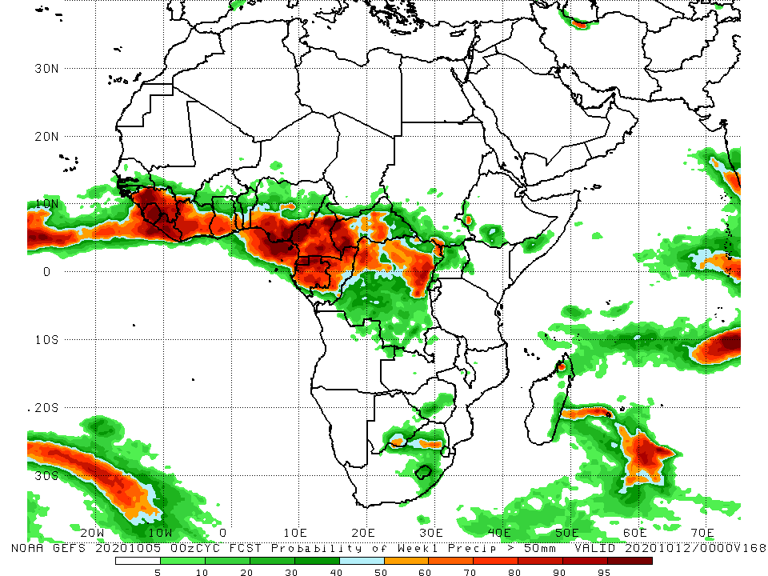
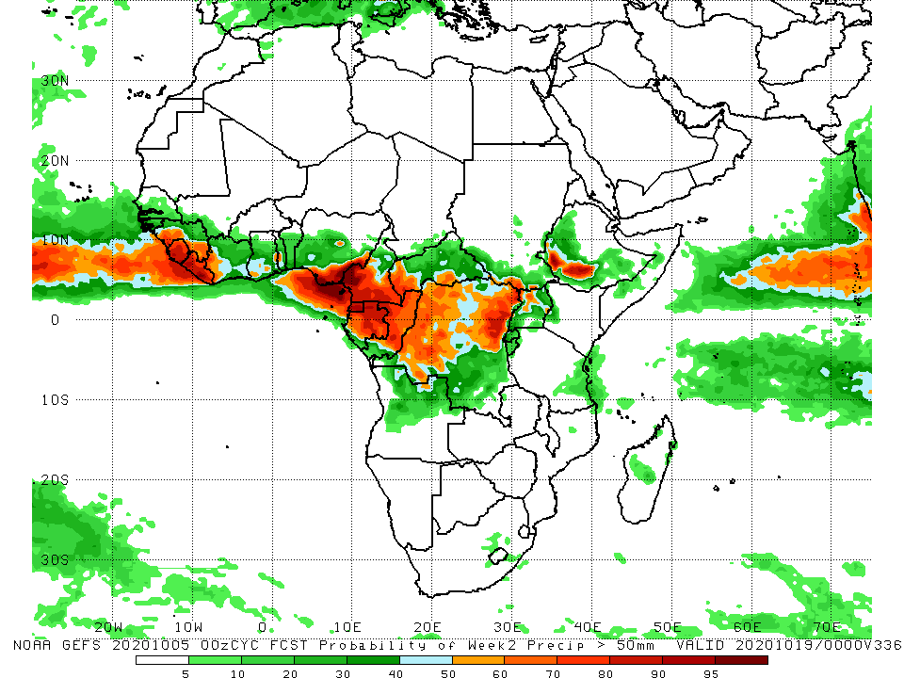
NCEP GEFS Model Forecasts Non-Bias Corrected Probability of precipitation exceedance
Week-1 Valid 06 – 12 October, 2020
Week-2: Valid 13 – 19 October, 2020
For week-1 (left panel), the NCEP GEFS call for a high chance for rainfall to exceed 50 mm along the Gulf of Guinea coastline from Guinea to Cameroon and Gabon, extending into portions of northern DRC. For week-2 (right panel), there is an increased chance for rainfall to exceed 50 mm in the Gulf of Guinea region over Sierra Leone and Liberia, and in Central Africa, over southern Cameroon, Gabon and portions of the Congo and DRC.
Notes:
9

Slide 10
Summary
During the past 30 to 90 days, moisture surpluses prevailed across much of West Africa, in the areas encompassing the Sahel and the western areas of the Gulf of Guinea Region. Below average rains resulted in moisture deficits in the eastern areas of the Gulf of Guinea region, with noticeable improvements in recent weeks. In East Africa, extremely heavy rains continued to fall over the Western Ethiopian Highlands and southern Sudan. In Central Africa above average rainfall persisted in most areas, except for northern Cameroon and Gabon where light rains or dry conditions in recent weeks sustained moisture deficits.
Over the past 7 days, in West Africa, above average rains persisted over western Sahel and portions of the Gulf of Guinea region. In Central Africa, rainfall was overall near-average except for western Gabon and the southern half of Cameroon where lighter rains or dry conditions prevailed. In East Africa, the western Ethiopian Highlands continued to register heavy rains, while average conditions prevailed over southern Sudan, South Sudan and Uganda. Rainfall was slightly above-average over western Tanzania.
The NCEP GEFS calls for a high chance for rainfall to exceed 50 mm along the Gulf of Guinea coastline from Guinea to Cameroon and Gabon, extending into portions of northern DRC during week-1. There is an increased chance for rainfall to exceed 50 mm in the western Gulf of Guinea Region and in parts of Central Africa during week-2.

