Slide 1
The African Monsoon Recent Evolution and Current Status Include Week-1 and Week-2 Outlooks
Update prepared by
Climate Prediction Center / NCEP
13 October 2020
For more information, visit:
http://www.cpc.ncep.noaa.gov/products/Global_Monsoons/African_Monsoons/precip_monitoring.shtml

Slide 2
Outline
Highlights
Recent Evolution and Current Conditions
NCEP GEFS Forecasts
Summary

Slide 3
Highlights: Last 7 Days
The West African Monsoon retreated significantly. However, sizable rainfall amounts fell over Liberia and Cote d'Ivoire. Below average rainfall siustained moisture deficits in southwestern Cameroon, while Ethiopia was relieved from the heavy downpours and flood events of the past several weeks. Heavy rains fell in southern DRC and Zambia, marking the onset of the rainfall season in southern Africa.
The NCEP GEFS calls for a moderate to high chance for rainfall to exceed 50 mm in Central Africa both week-1 and week-2..

Slide 4
During the past 90 days, in West Africa, above-average rainfall was observed across much of the Sahel from Senegal eastward to Chad. The border between Mali and Guinea registered rainfall amounts in the range between 700 and 1000 mm (300 mm above the mean). In contrast, rainfall was below-average over the southern areas of the Gulf of Guinea region with totals ranging between 100 and 300 mm (50 to 200 mm below the mean). In East Africa, the heaviest amounts 1000 to 1500 mm (over 500 mm above the mean) occurred over the Ethiopian Highlands. Well above-average rainfall (over 300 mm above the mean) was also observed in portions of southern Sudan. Rainfall was much above-average over Central Africa from southern Chad southward to the northern two-third of DRC. Rainfall was locally below-average over southeastern DRC.

Slide 5
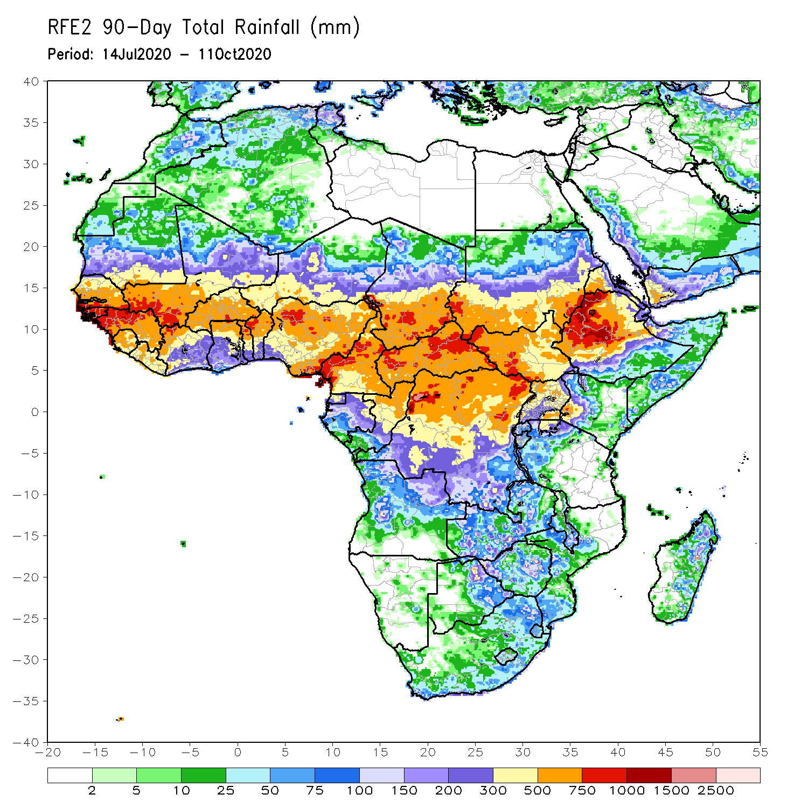
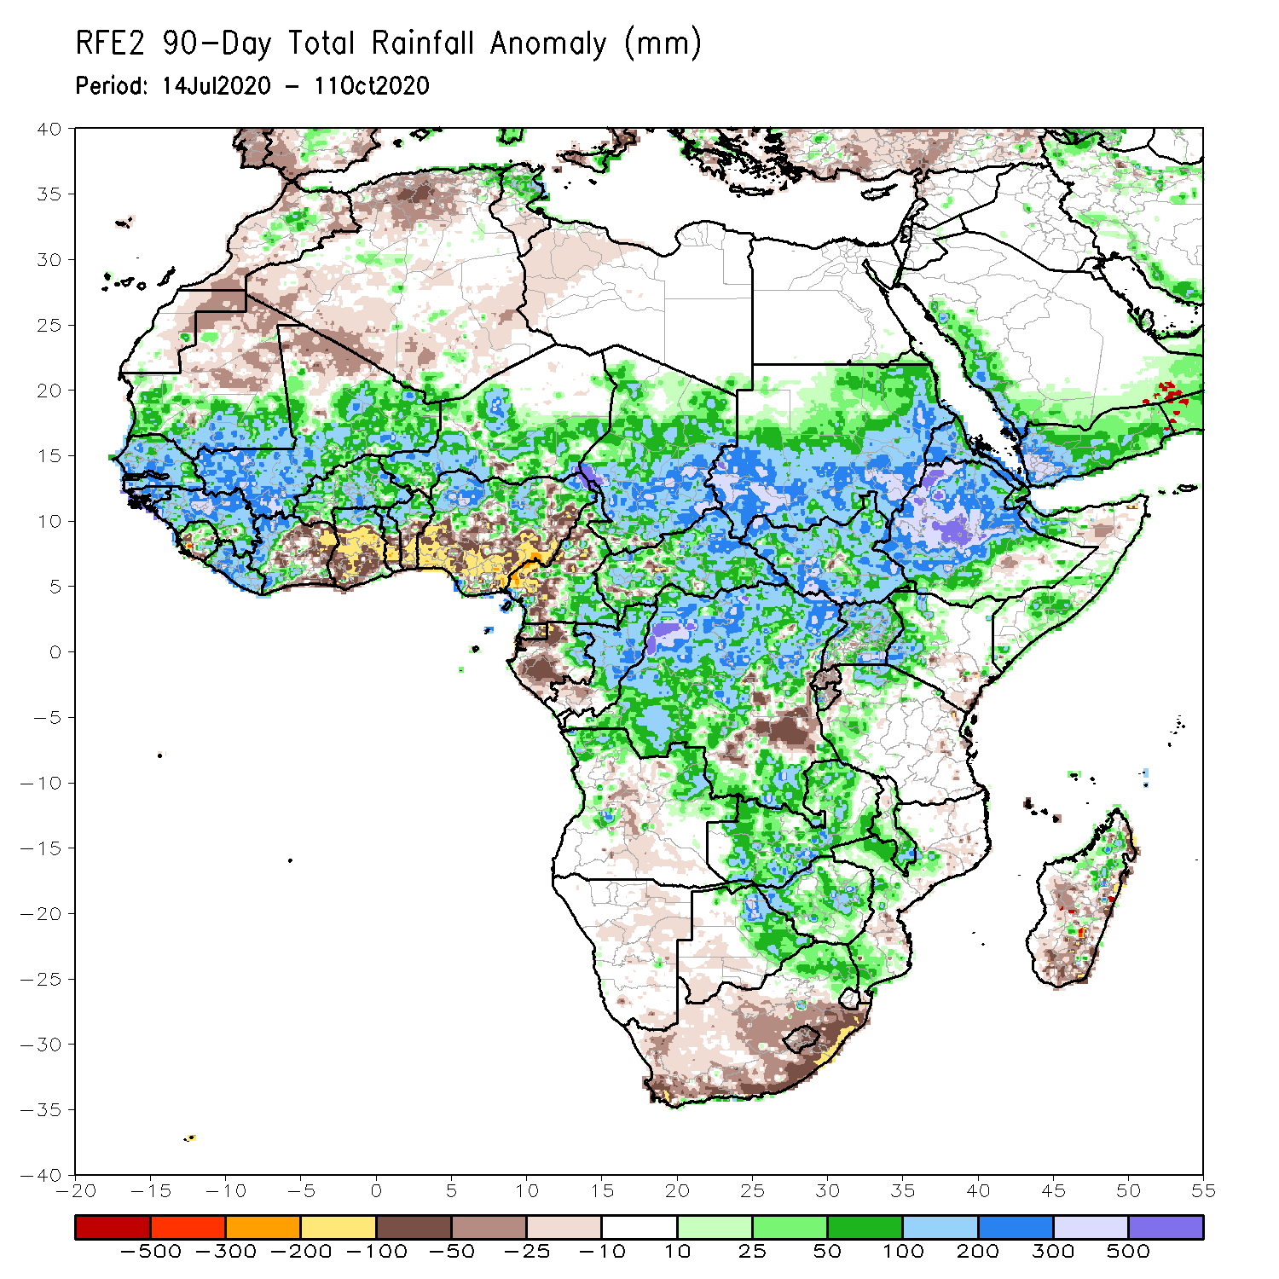
Rainfall Patterns: Last 90 Days
During the past 90 days, in West Africa, above-average rainfall was observed across much of the Sahel from Senegal eastward to Chad. The border between Mali and Guinea registered rainfall amounts in the range between 700 and 1000 mm (300 mm above the mean). In contrast, rainfall was below-average over the southern areas of the Gulf of Guinea region with totals ranging between 100 and 300 mm (50 to 200 mm below the mean). In East Africa, the heaviest amounts 1000 to 1500 mm (over 500 mm above the mean) occurred over the Ethiopian Highlands. Well above-average rainfall (over 300 mm above the mean) was also observed in portions of southern Sudan. Rainfall was much above-average over Central Africa from southern Chad southward to the northern two-third of DRC. Rainfall was locally below-average over southeastern DRC.
Notes:
5

Slide 6
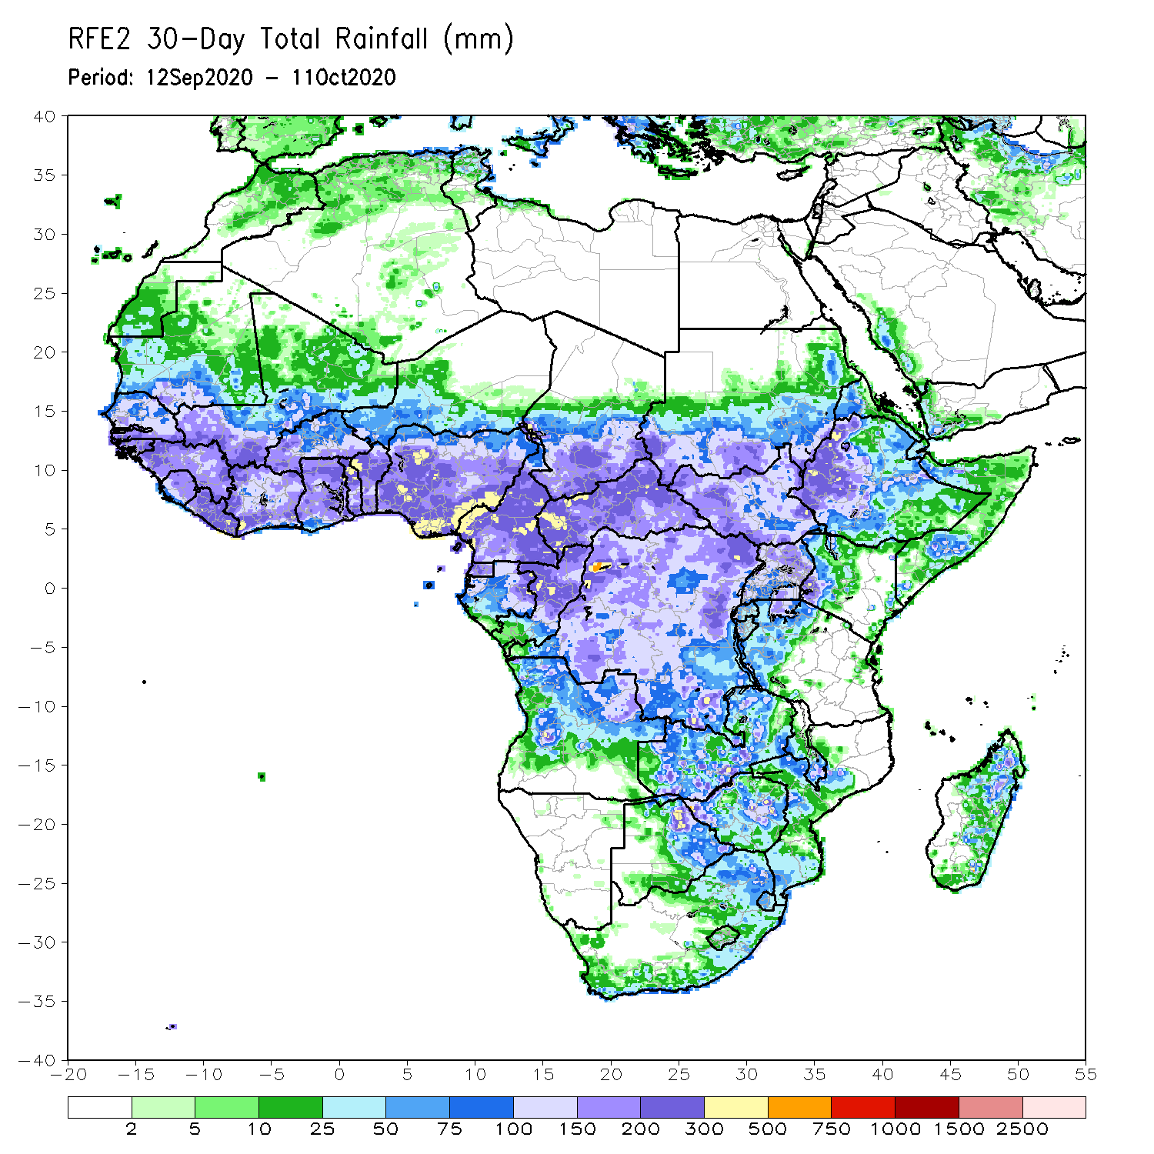
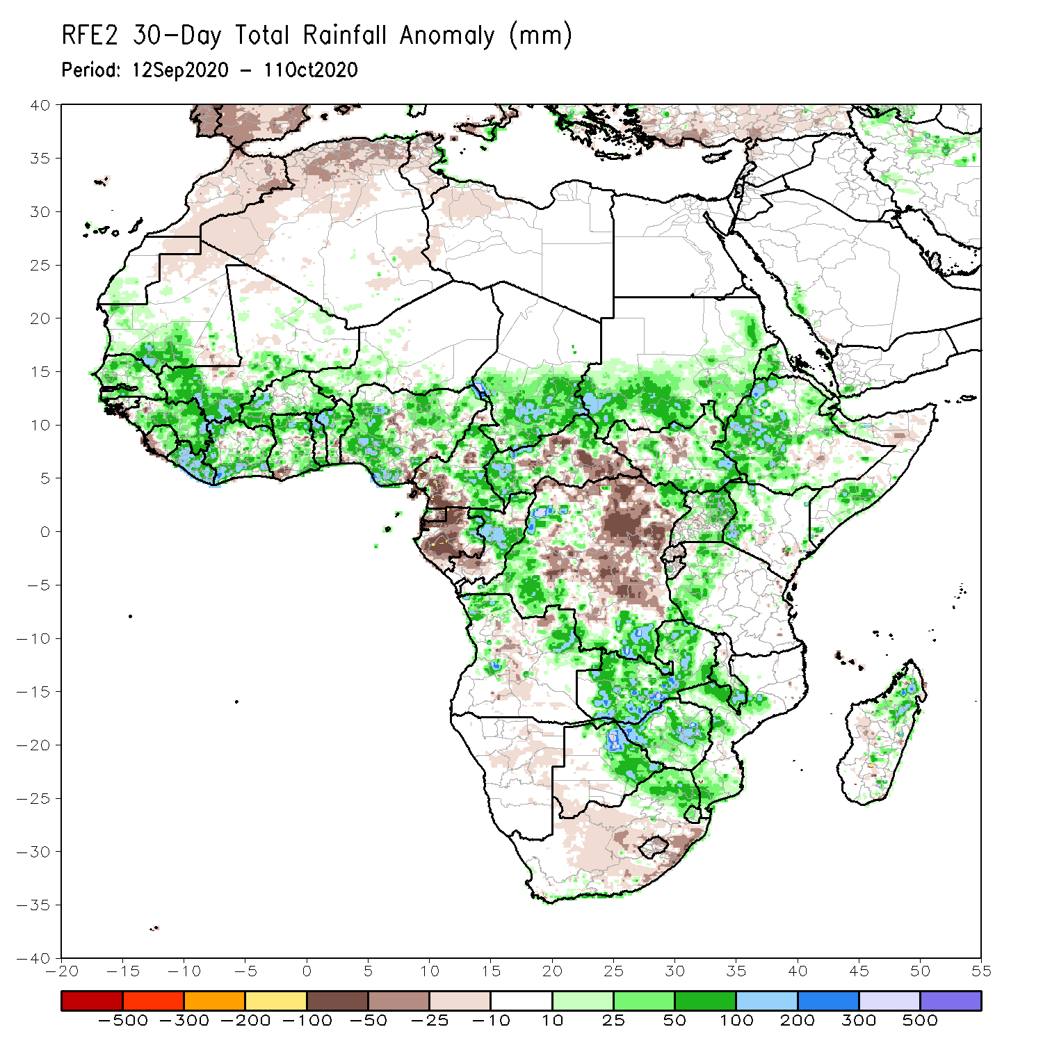
Rainfall Patterns: Last 30 Days
During the past 30 days, above-average rainfall prevailed over much of West Africa in the areas including the Sahel and the Gulf of Guinea region, where totals exceeded 300 mm. Local areas in western Sahel registered rainfall 50 to 100 mm above the mean. In East Africa, moisture surpluses prevailed over the Ethiopian Highlands and southern Sudan. In contrast, rainfall was below average over many areas in Central Africa, including eastern DRC and Gabon, where amounts were less than 300 mm (about 50 to 100 mm below the mean).
Notes:
6

Slide 7
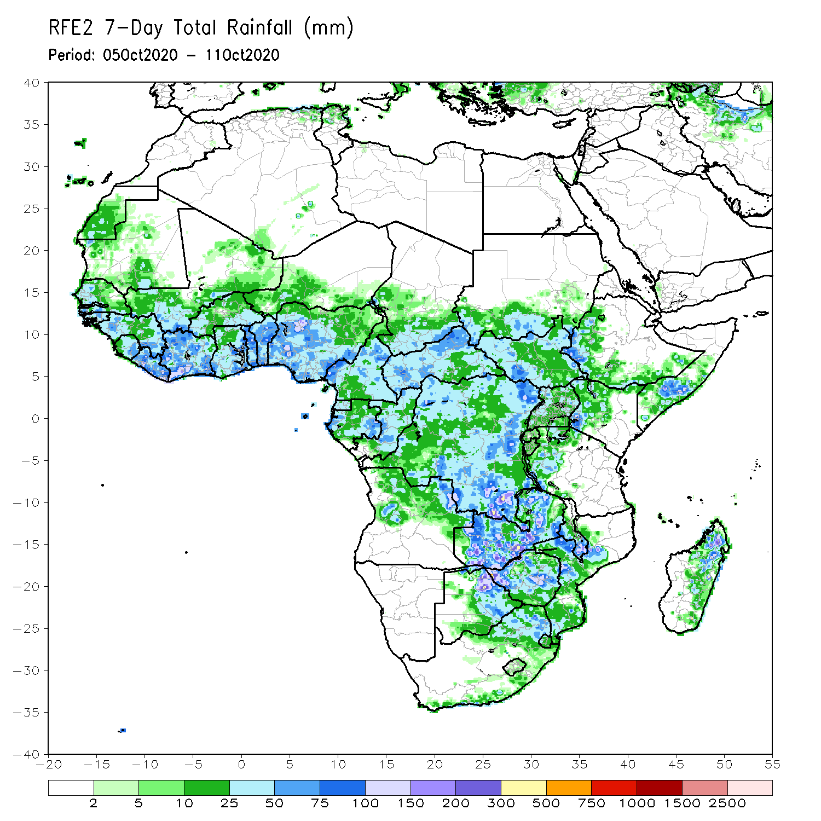
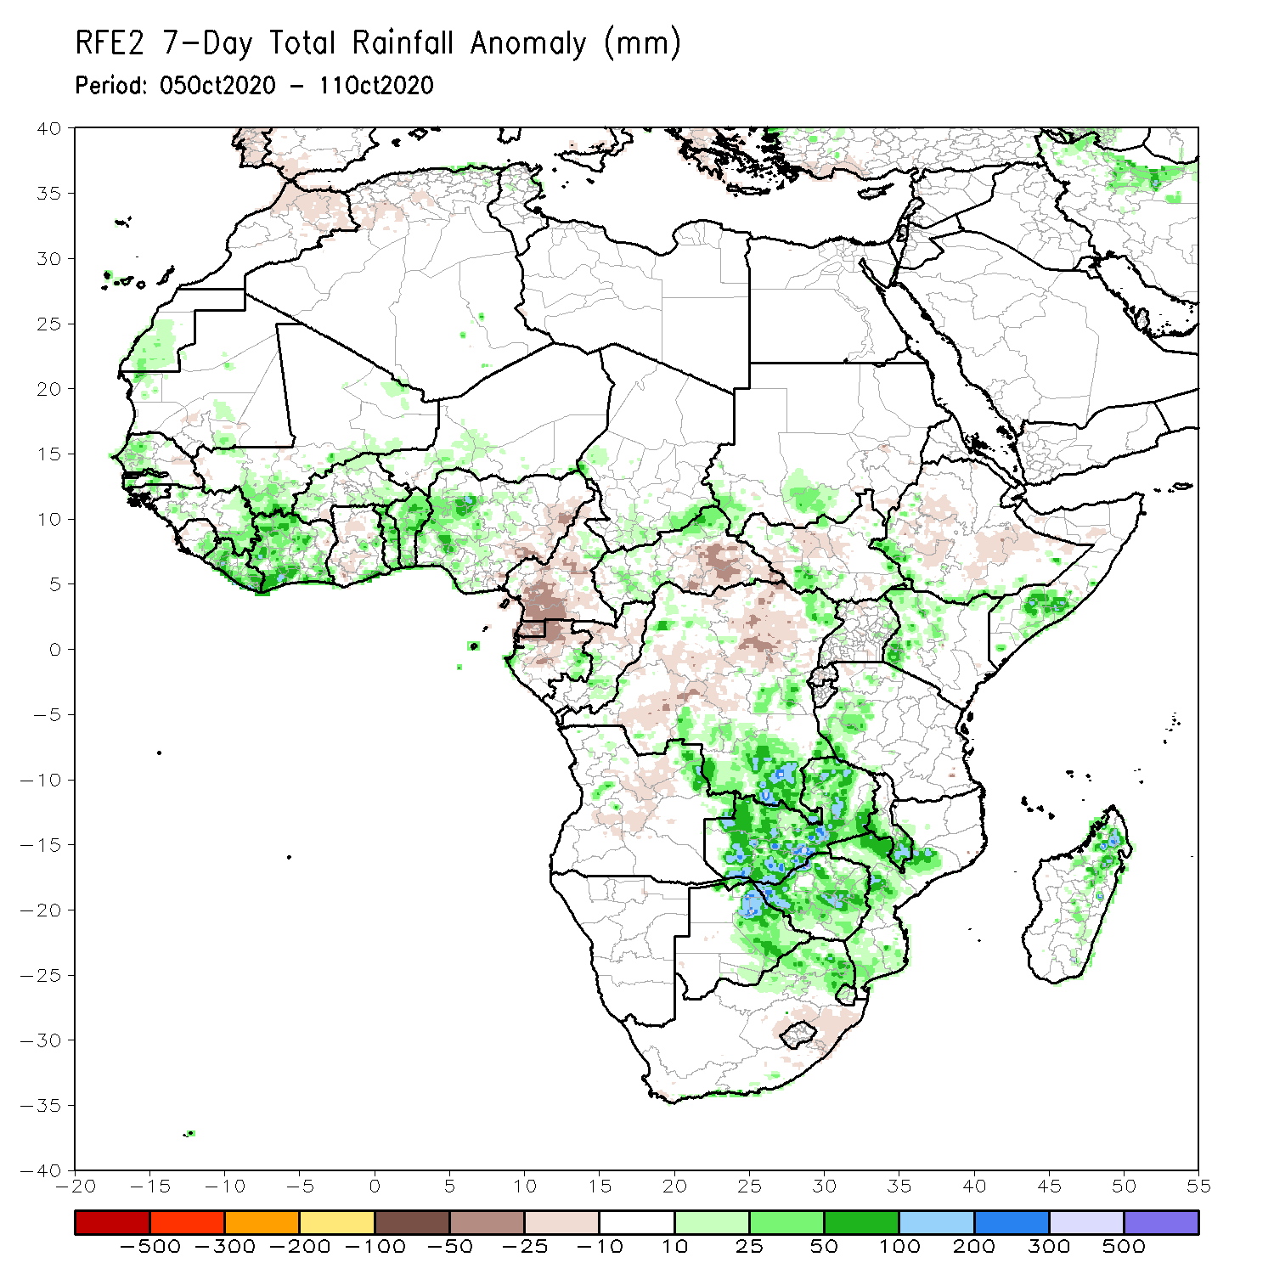
Rainfall Patterns: Last 7 Days
During the past 7 days, much of the West African Monsoon activity was confined to areas in the Gulf of Guinea region, including Liberia, Cote d’Ivoire, and Benin, where totals ranged between 50 mm and 150 mm (25-100 mm above the mean) Light to moderate rains fell in the Sahel. In East Africa, light or no rain alleviated flooding in western Ethiopia and southern Sudan. In central Africa, light rains sustained moisture deficits in southwestern Cameroon. In contrast, heavy downpours marked the onset of the seasonal rains in southern Africa as Zambia and Mozambique registered 75mm to 200 mm (25mm-100 mm above the mean).

Slide 8
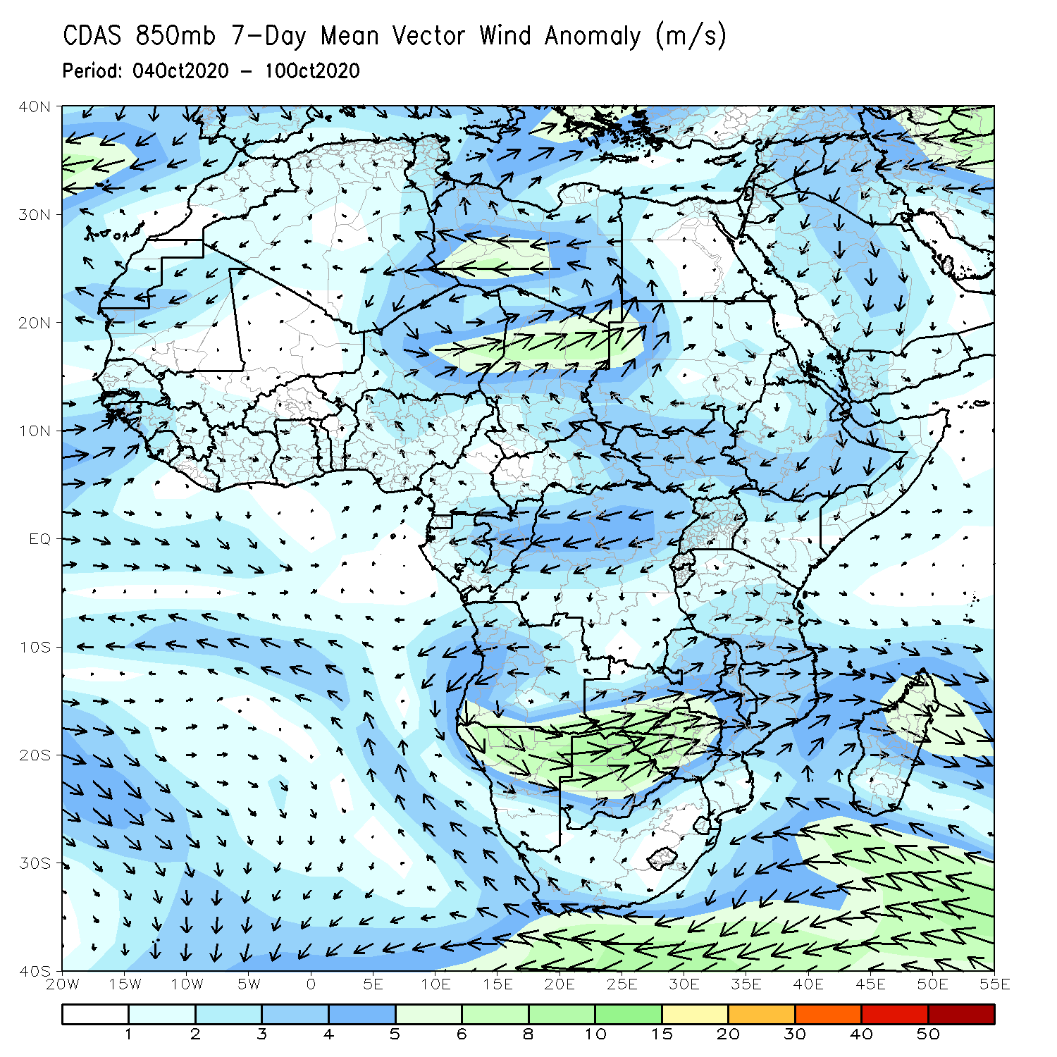
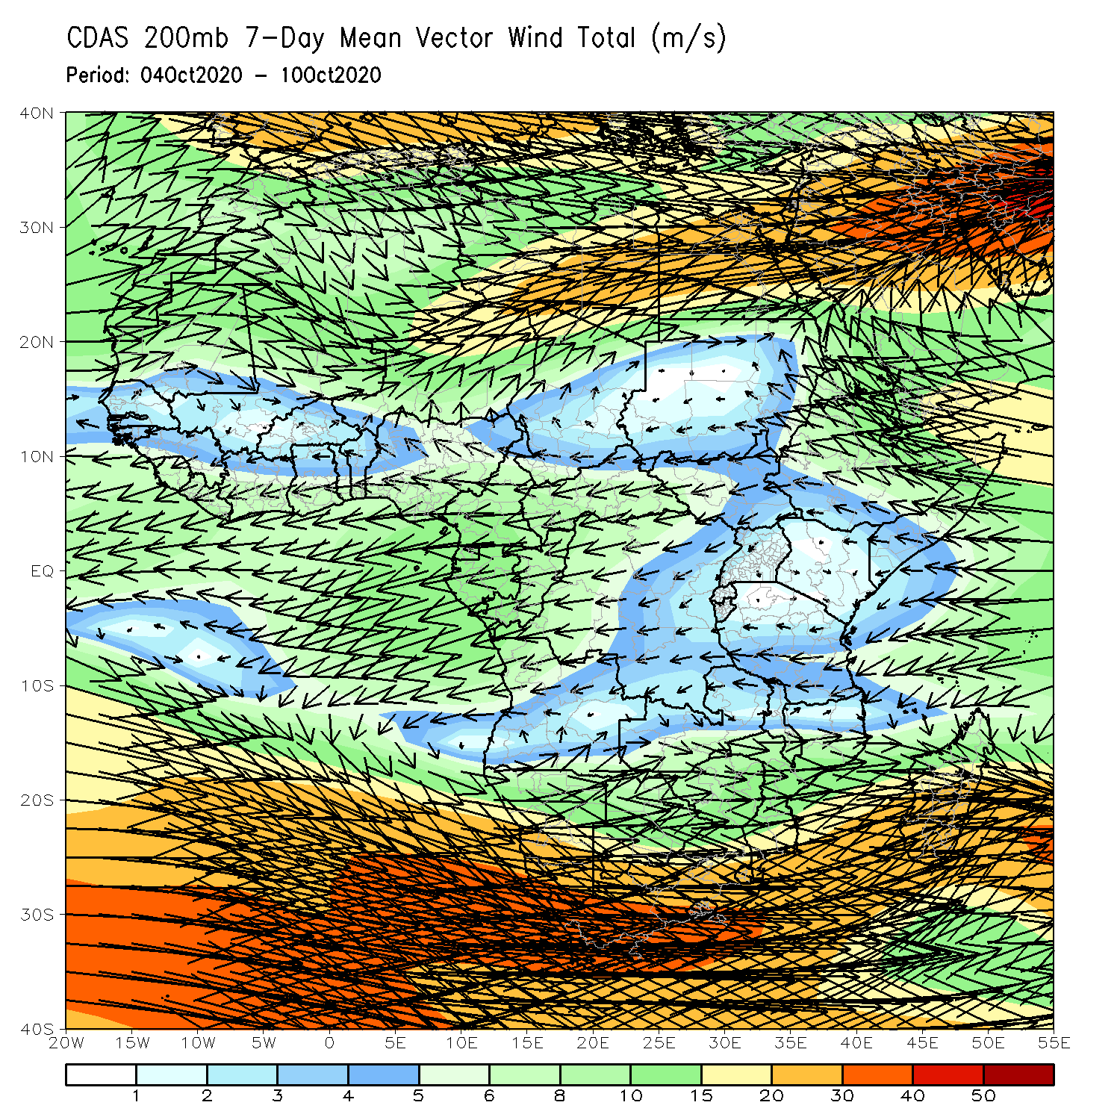
Atmospheric Circulation: Last 7 Days
The low-level wind anomalies (left panel) did not present any significant feature, while the upper-level wind anomalies (right panel) featured an anomalous trough over northwestern Africa and a ridge extending from the Sahara desert to the central areas of the Sahel.

Slide 9
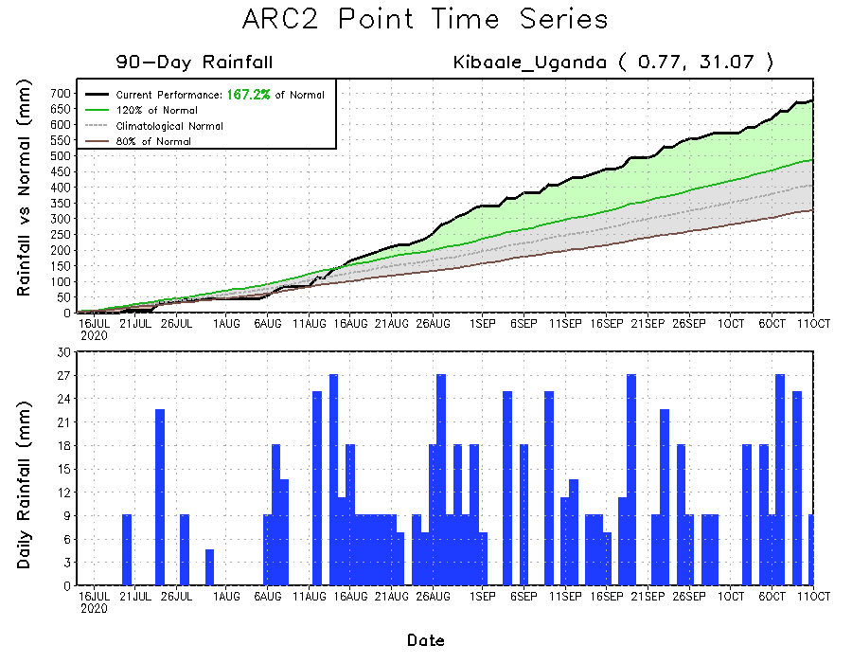
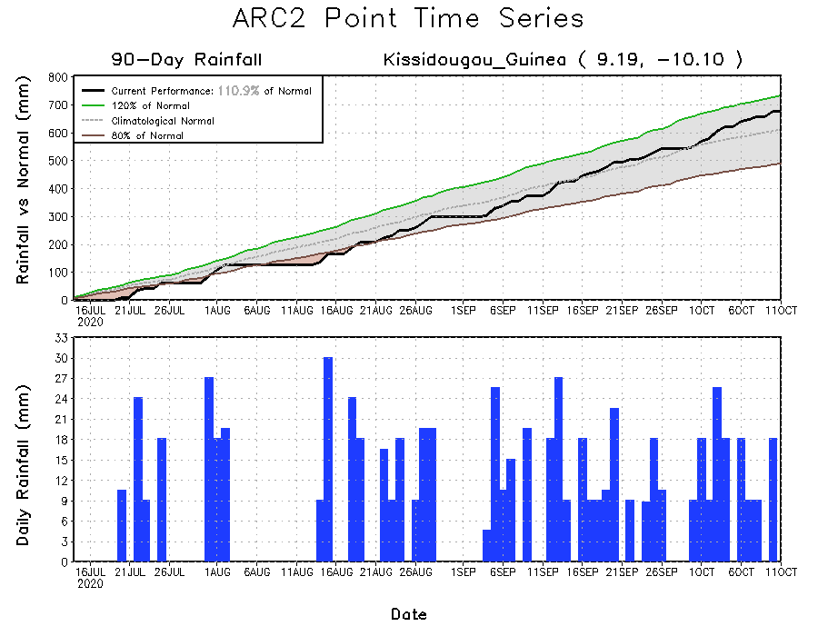
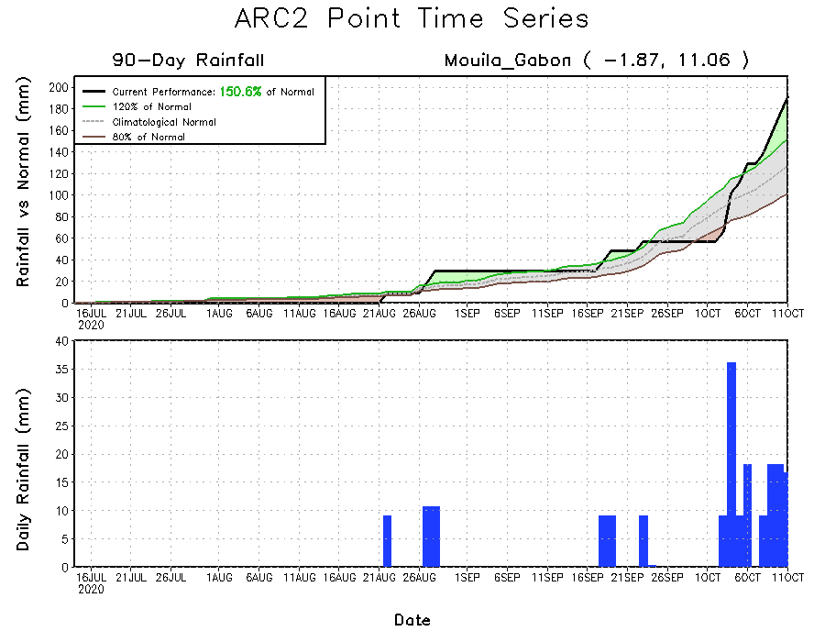
Rainfall Evolution
Daily evolution of rainfall over the last 90 days at selected locations shows that moderate to locally heavy rainfall sustained moisture surpluses over Guinea Conakry (bottom left) and many parts of DRC (top right). The rainfall time series also revealed a break in the dry spell observed during the past several weeks with a return of the rains in recent days across Gabon (bottom right).

Slide 10
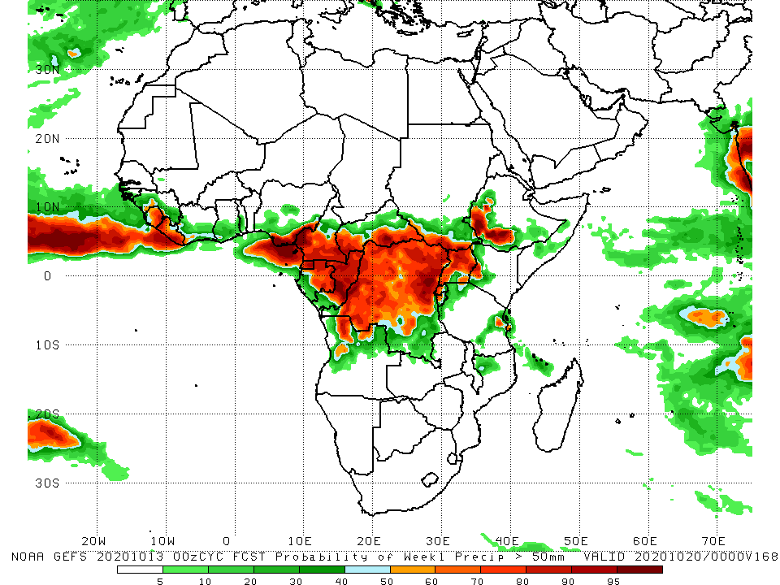
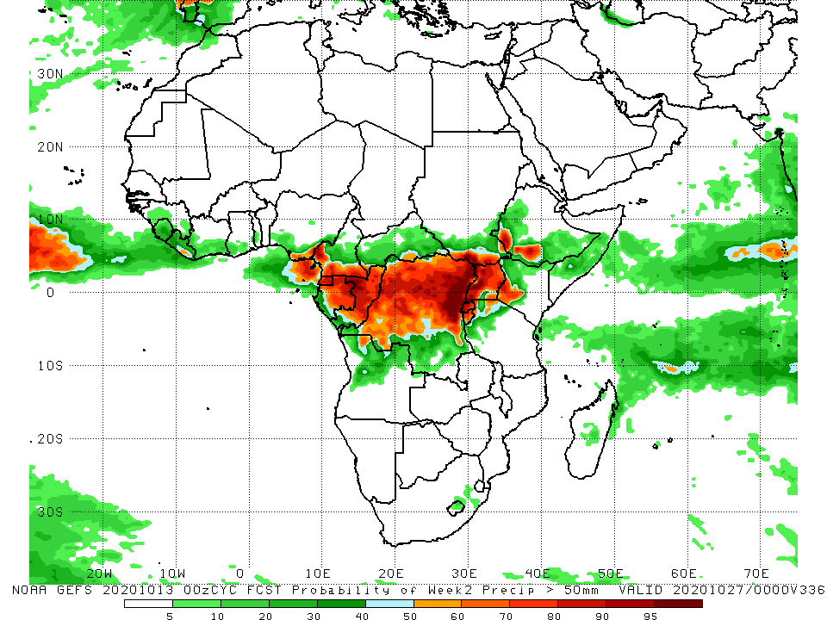
NCEP GEFS Model Forecasts Non-Bias Corrected Probability of precipitation exceedance
Week-1 Valid 14 – 20 October, 2020
Week-2: Valid 21 – 27 October, 2020
For week-1 (left panel), the NCEP GEFS call for a high chance for rainfall to exceed 50 mm across Sierra Leone, Liberia, and most parts of Central Africa extending into portions of Uganda and western Ethiopia. For week-2 (right panel), there is an increased chance for rainfall to exceed 50 mm over parts of Central Africa and parts of Eastern Africa countries.
Notes:
10

Slide 11
Summary
During the past 30 to 90 days, in West Africa, above-average rainfall was observed across much of the Sahel from Senegal eastward to Chad. In contrast, rainfall was below-average over the southern areas of the Gulf of Guinea region. However, there has been an improvement over the past 30 days. In East Africa, moisture surpluses prevailed over the Ethiopian Highlands and southern Sudan. In contrast, rainfall was below average over many areas in Central Africa, including eastern DRC and Gabon.
During the past 7 days, the West African Monsoon retreated and much of the rains were confined to areas in the Gulf of Guinea region. In East Africa, light or no rain alleviated flooding in western Ethiopia and southern Sudan. In central Africa, light rains sustained moisture deficits in southwestern Cameroon. Heavy downpours marked the onset of the seasonal rains in southern Africa as Zambia and Mozambique registered above average rains.
The NCEP GEFS calls for a high chance for rainfall to exceed 50 mm over parts of Central Africa during week-1 and week-2.

