Slide 1
The African Monsoon Recent Evolution and Current Status Include Week-1 and Week-2 Outlooks
Update prepared by
Climate Prediction Center / NCEP
19 October 2020
For more information, visit:
http://www.cpc.ncep.noaa.gov/products/Global_Monsoons/African_Monsoons/precip_monitoring.shtml

Slide 2
Outline
Highlights
Recent Evolution and Current Conditions
NCEP GEFS Forecasts
Summary

Slide 3
Highlights: Last 7 Days
The West Africa monsoon continued to retreat. However, the western end of the Sahel registered significant rainfall amounts. Heavy rains returned to western Ethiopia, while the short rainfall season is equatorial East Africa is off to a slow start. Moderate to heavy rains resulted in moisture surpluses in portions of southern Africa.
The week-1 and week-2 forecasts call for an increased chance for rainfall to exceed 50 mm over parts of the northern areas in Central Africa.

Slide 4
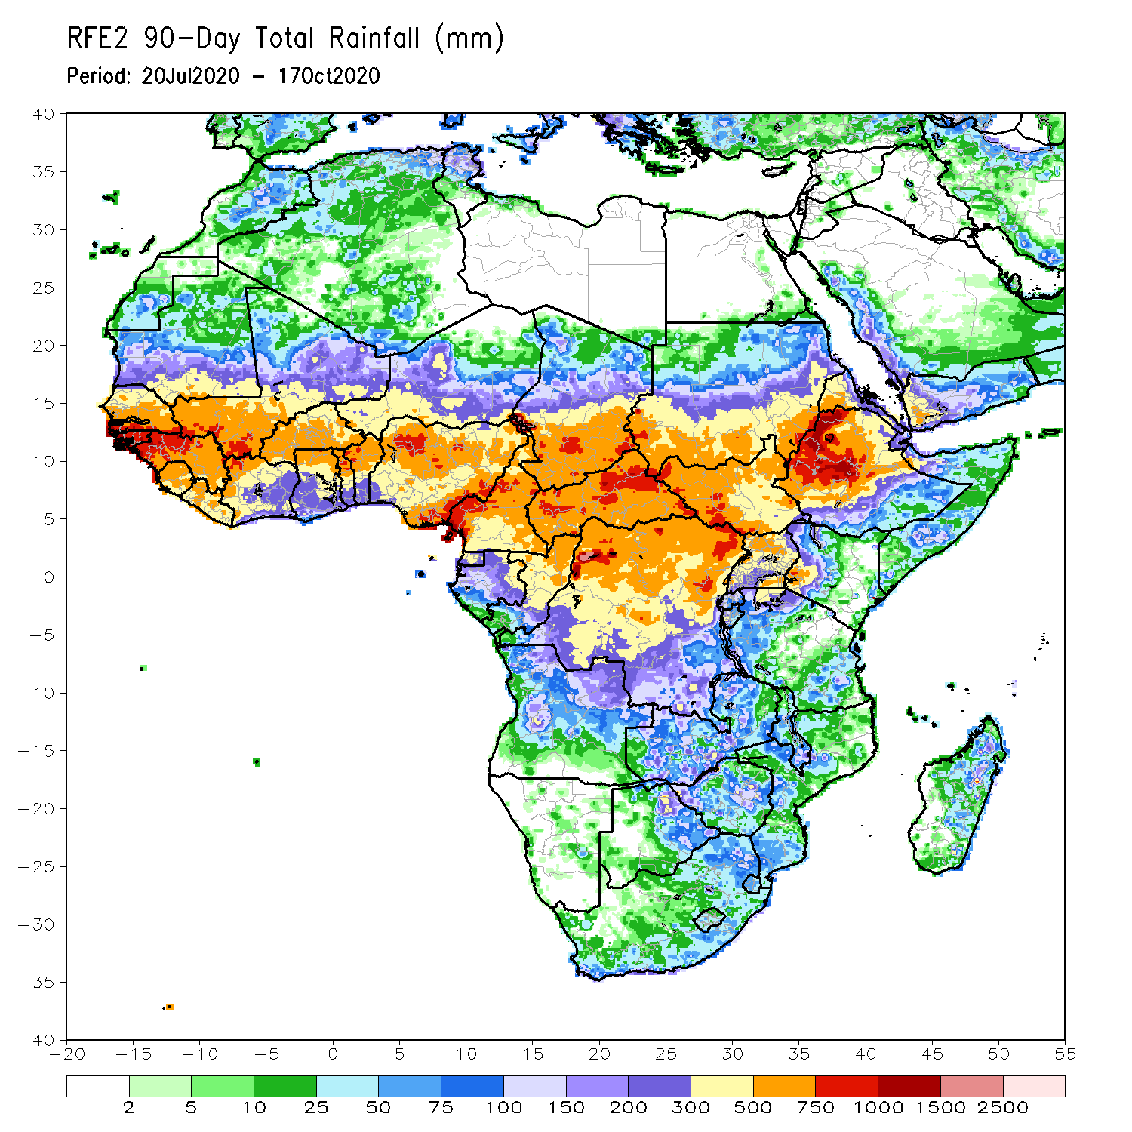
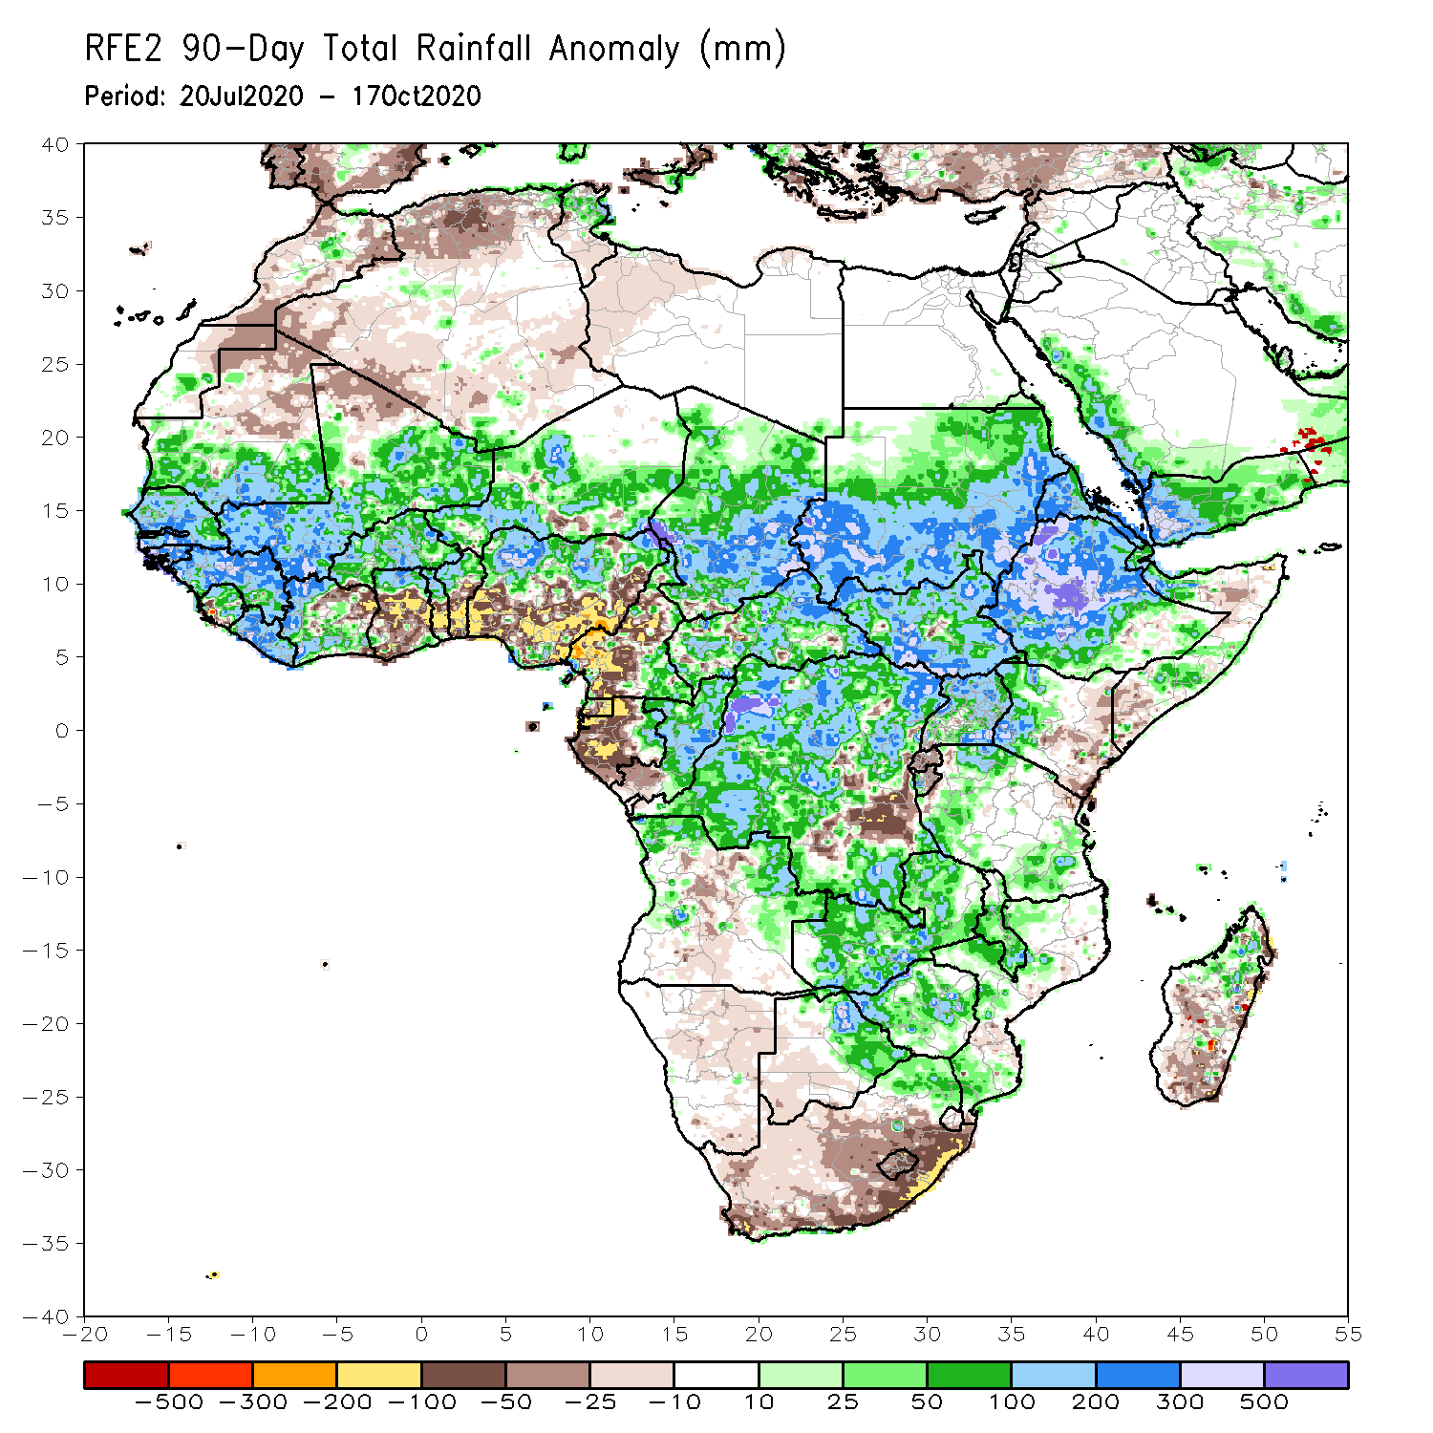
Rainfall Patterns: Last 90 Days
During the past 90 days, in West Africa, above-average rainfall was observed across much of the Sahel from Senegal eastward to Chad. In contrast, rainfall was below-average over the southern areas of the Gulf of Guinea region with totals ranging between 100 and 300 mm (50 to 200 mm below the mean). The moisture deficits extended to western Central Africa in the area encompassing Cameroon, Gabon and southeastern Congo. Rainfall was much above-average in the remainder of Central Africa from southern Chad to the northern two third of DRC. Rainfall was locally below average in southeastern DRC. In East Africa, the heaviest amounts 1000 to 1500 mm (over 500 mm above the mean) occurred over the Ethiopian Highlands and locally over southern Sudan. Well above-average rainfall (over 300 mm above the mean) was also observed over south Sudan and Uganda. Rainfall was below-average over eastern Kenya and southern Somalia. In southern Africa, moisture surpluses prevailed over Zambia, Zimbabwe, and the northern tip of Madagascar. Rainfall was below-average on eastern South Africa.
Notes:
4

Slide 5
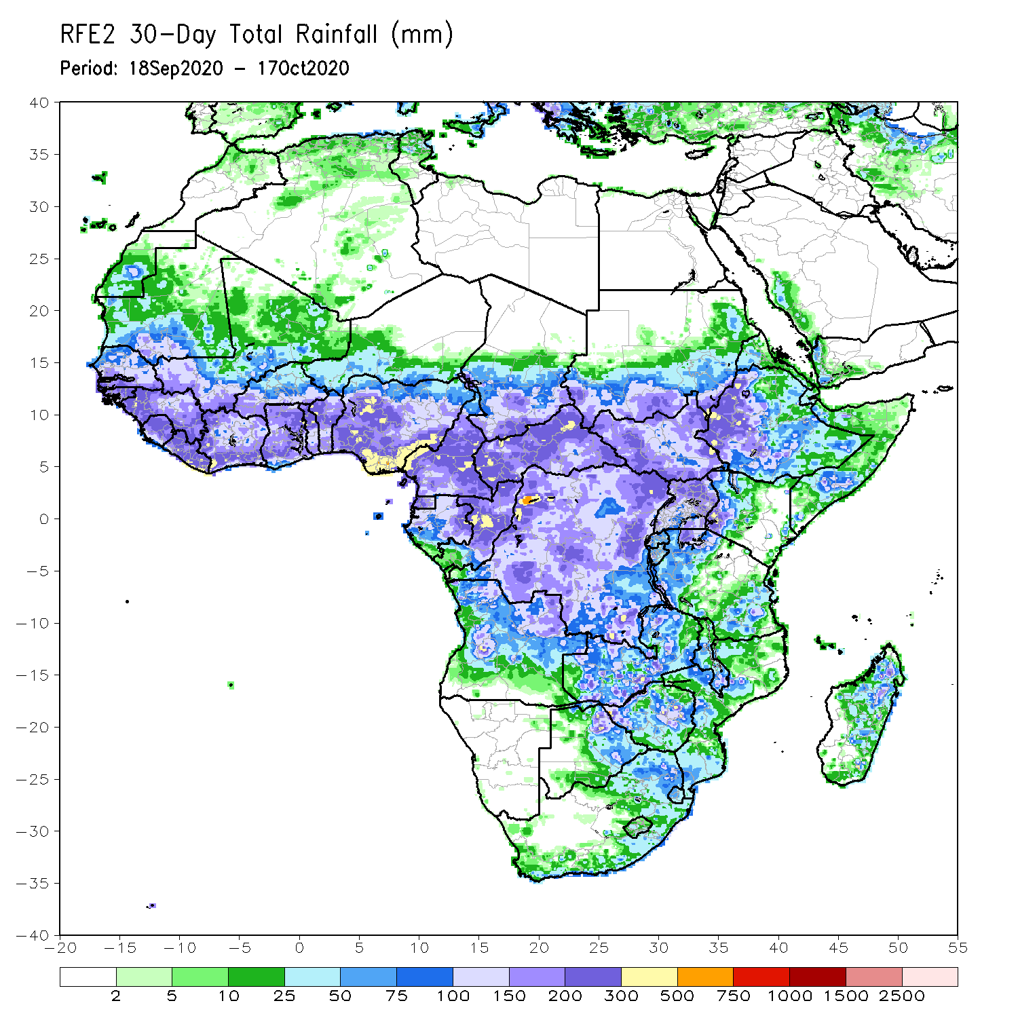
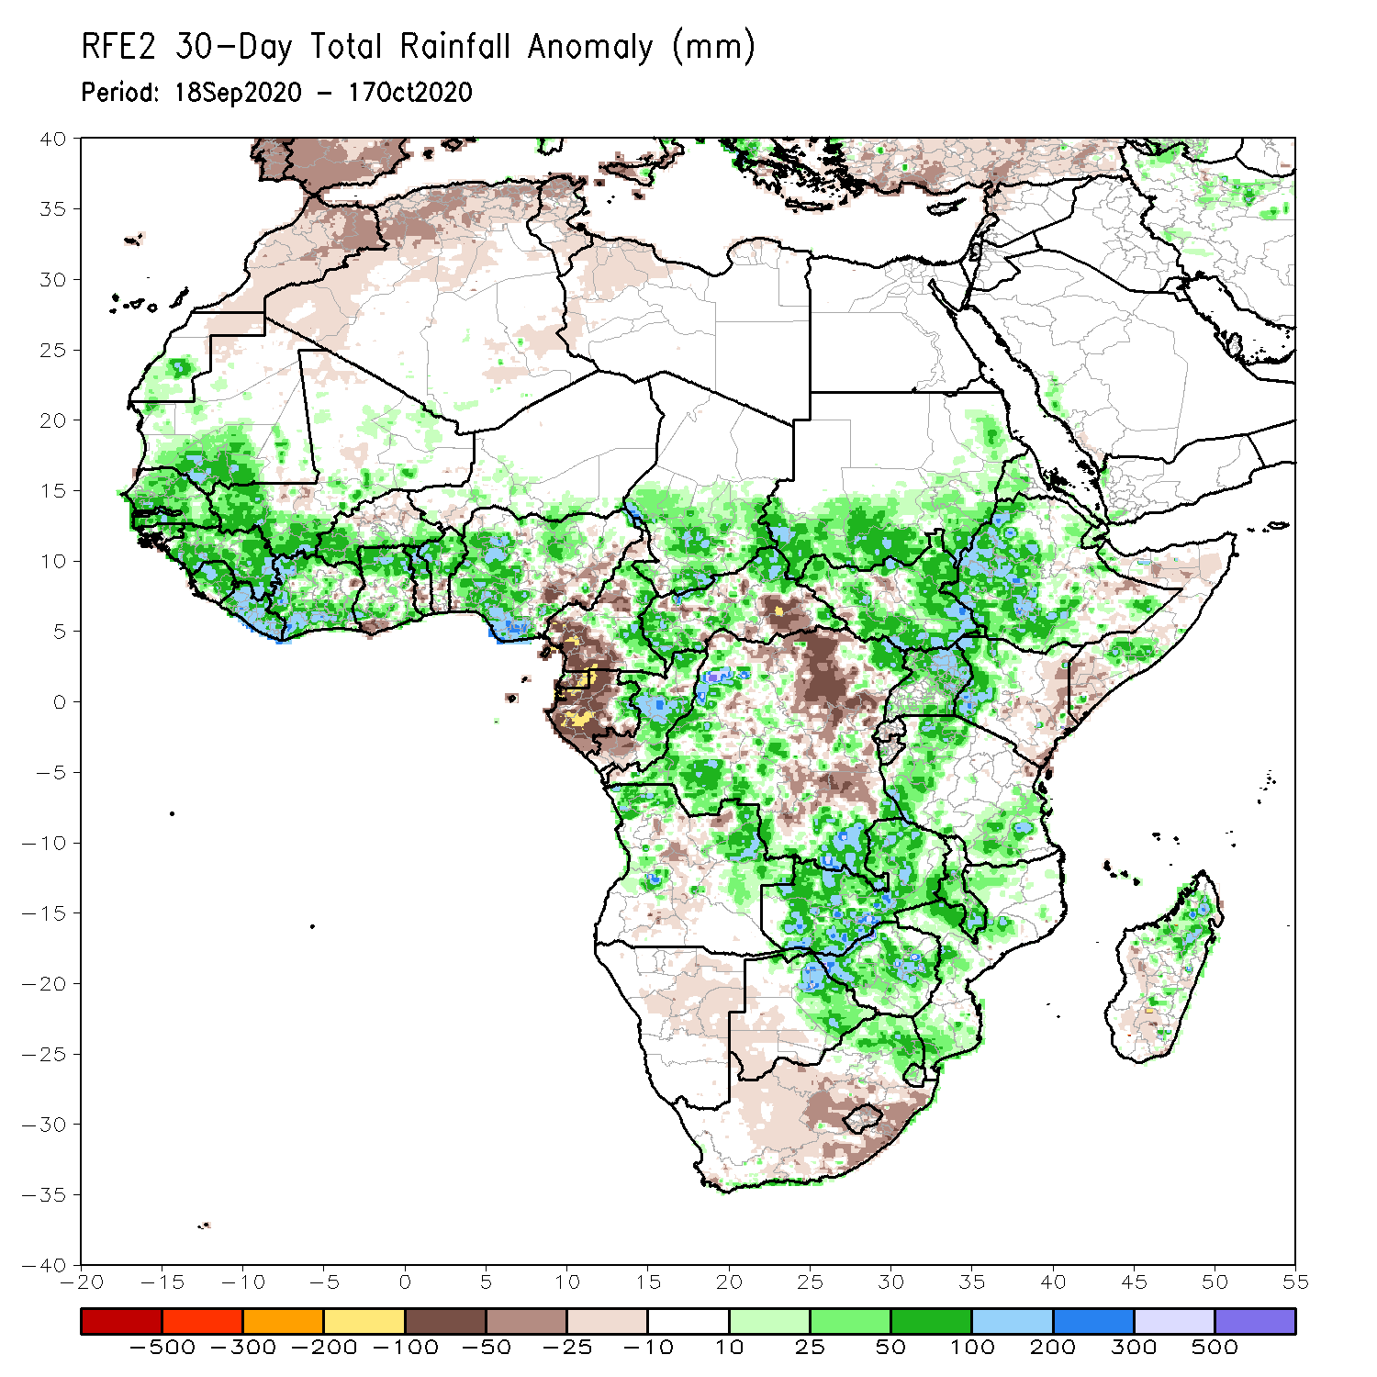
Rainfall Patterns: Last 30 Days
During the past 30 days, above-average rainfall prevailed over much of West Africa in the areas including the western end of the Sahel and the Gulf of Guinea region, where totals exceeded 300 mm. In Central Africa, rainfall was below average along the coastal areas and the eastern half of DRC. Rainfall was above average in western DRC extending into Congo. Rainfall was also above average over southern Chad. In East Africa, moisture surpluses prevailed over the Ethiopian Highlands and southern Sudan. Above average rainfall was also observed over much of South Sudan and Uganda. In contrast, rainfall was below average over eastern Kenya and southern Somalia. In Southern Africa, rainfall was above average over Zambia, Zimbabwe, and Malawi. Rainfall was below average over eastern South Africa.
Notes:
5

Slide 6
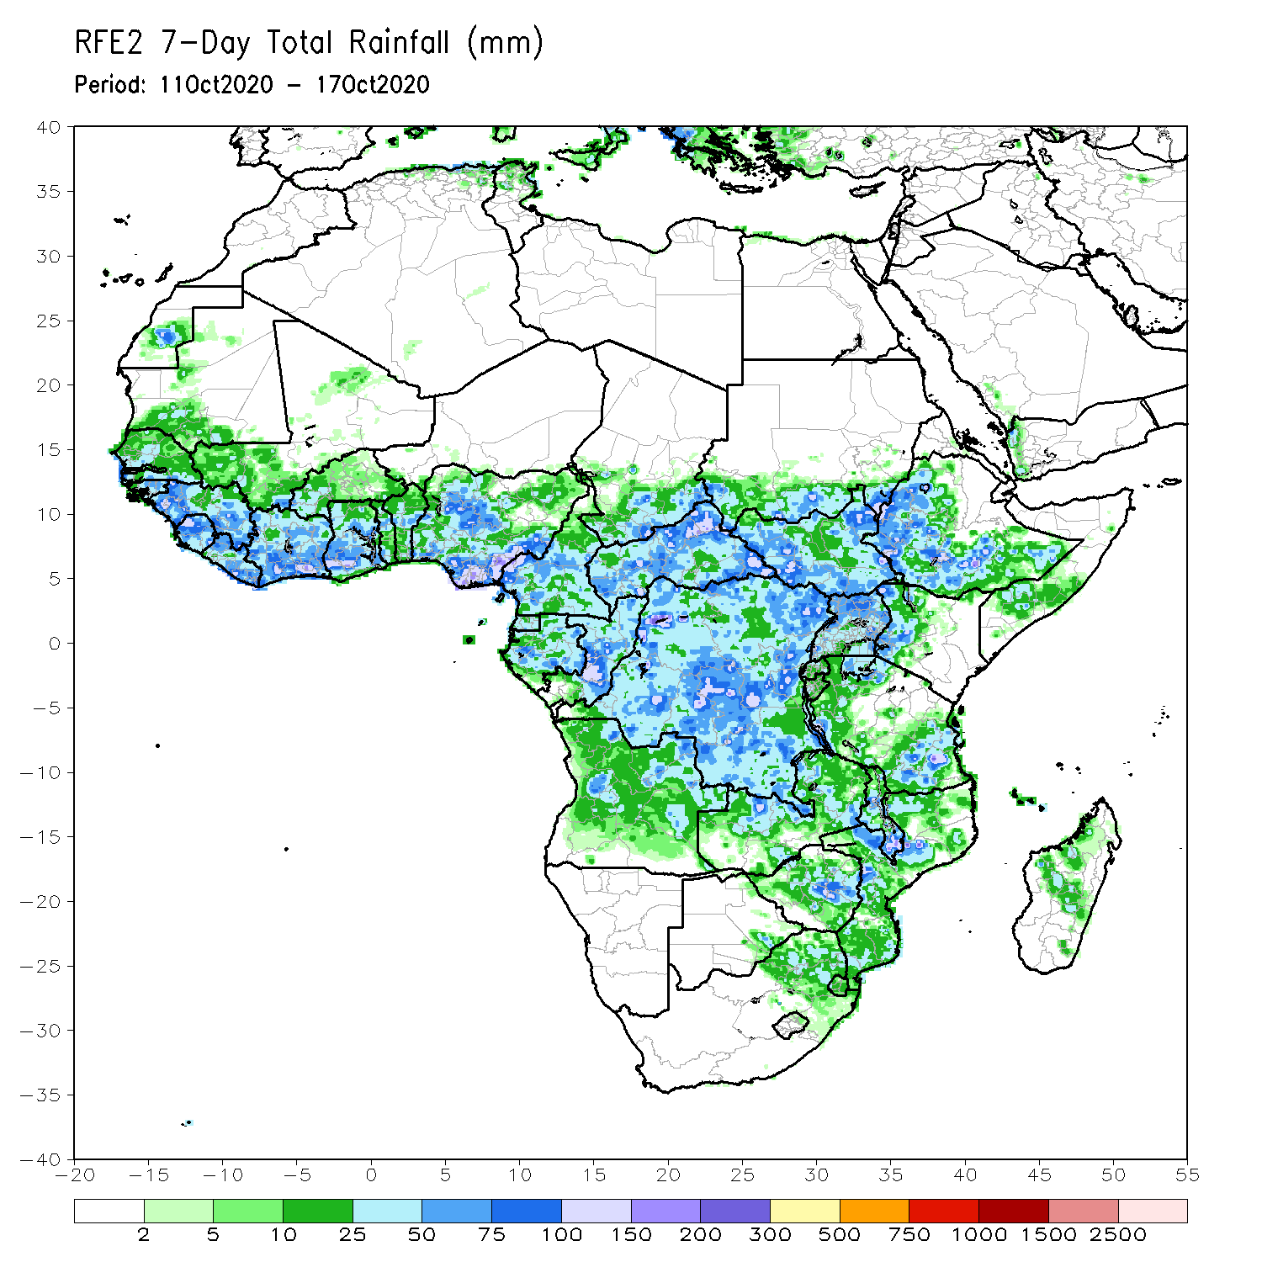
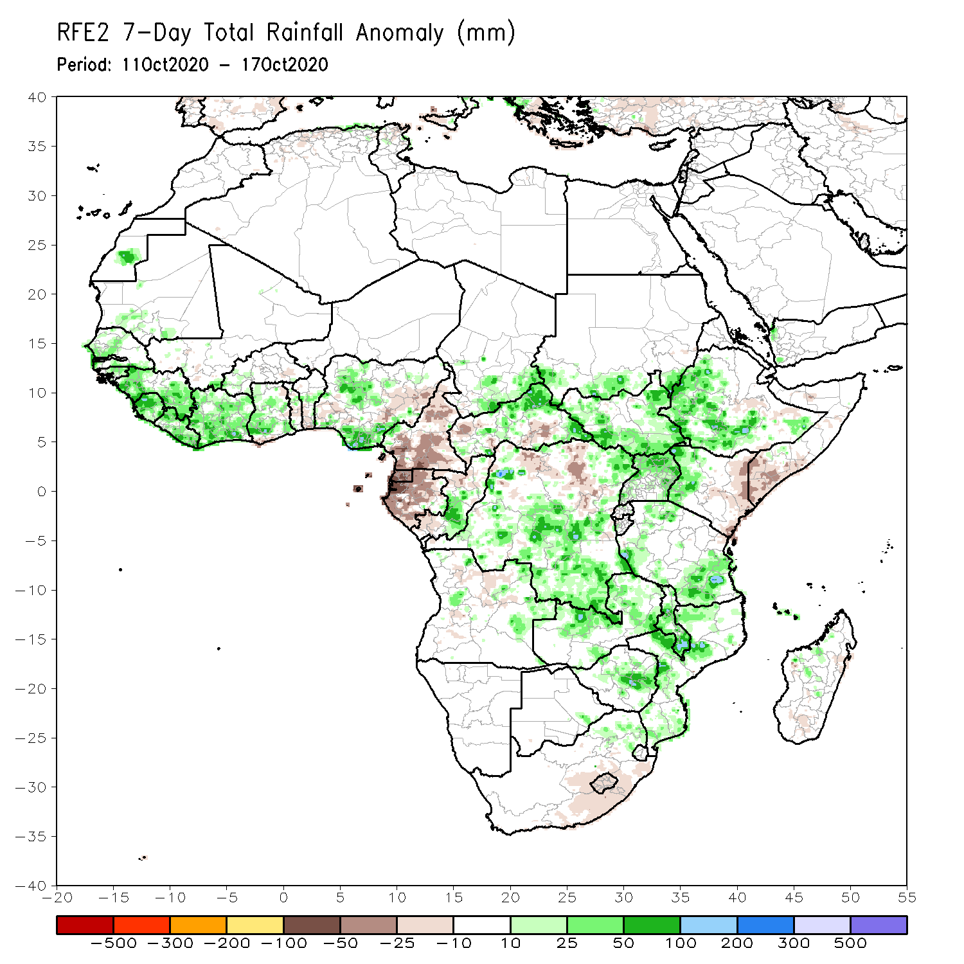
Rainfall Patterns: Last 7 Days
During the past 7 days, the West Africa monsoon continued its withdrawal. However, the western end of the Sahel registered moderate rains approaching 100 to 150 mm (25-50 mm above the mean) locally over central Senegal. Moderate to heavy rains (50 to 150 mm; 25-100 mm above the mean) fell over the Gulf of Guinea region from Guinea to western Ghana. Rainfall was heavy in pockets over Nigeria. In Central Africa, light rains sustained moisture deficits in Cameroon and Gabon, while moderate rains (50 – 150 mm) resulted in moisture surpluses over portions of CAR, Congo, and DRC. In East Africa, heavy rains returned to western Ethiopia, while light rains or dry conditions prevailed over eastern Kenya and southern Somalia. In Southern Africa, moderate to heavy rains (50-150 mm; 10-100mm above the mean) resulted in moisture surpluses in the area encompassing Zambia, southern Tanzania, and Malawi.

Slide 7
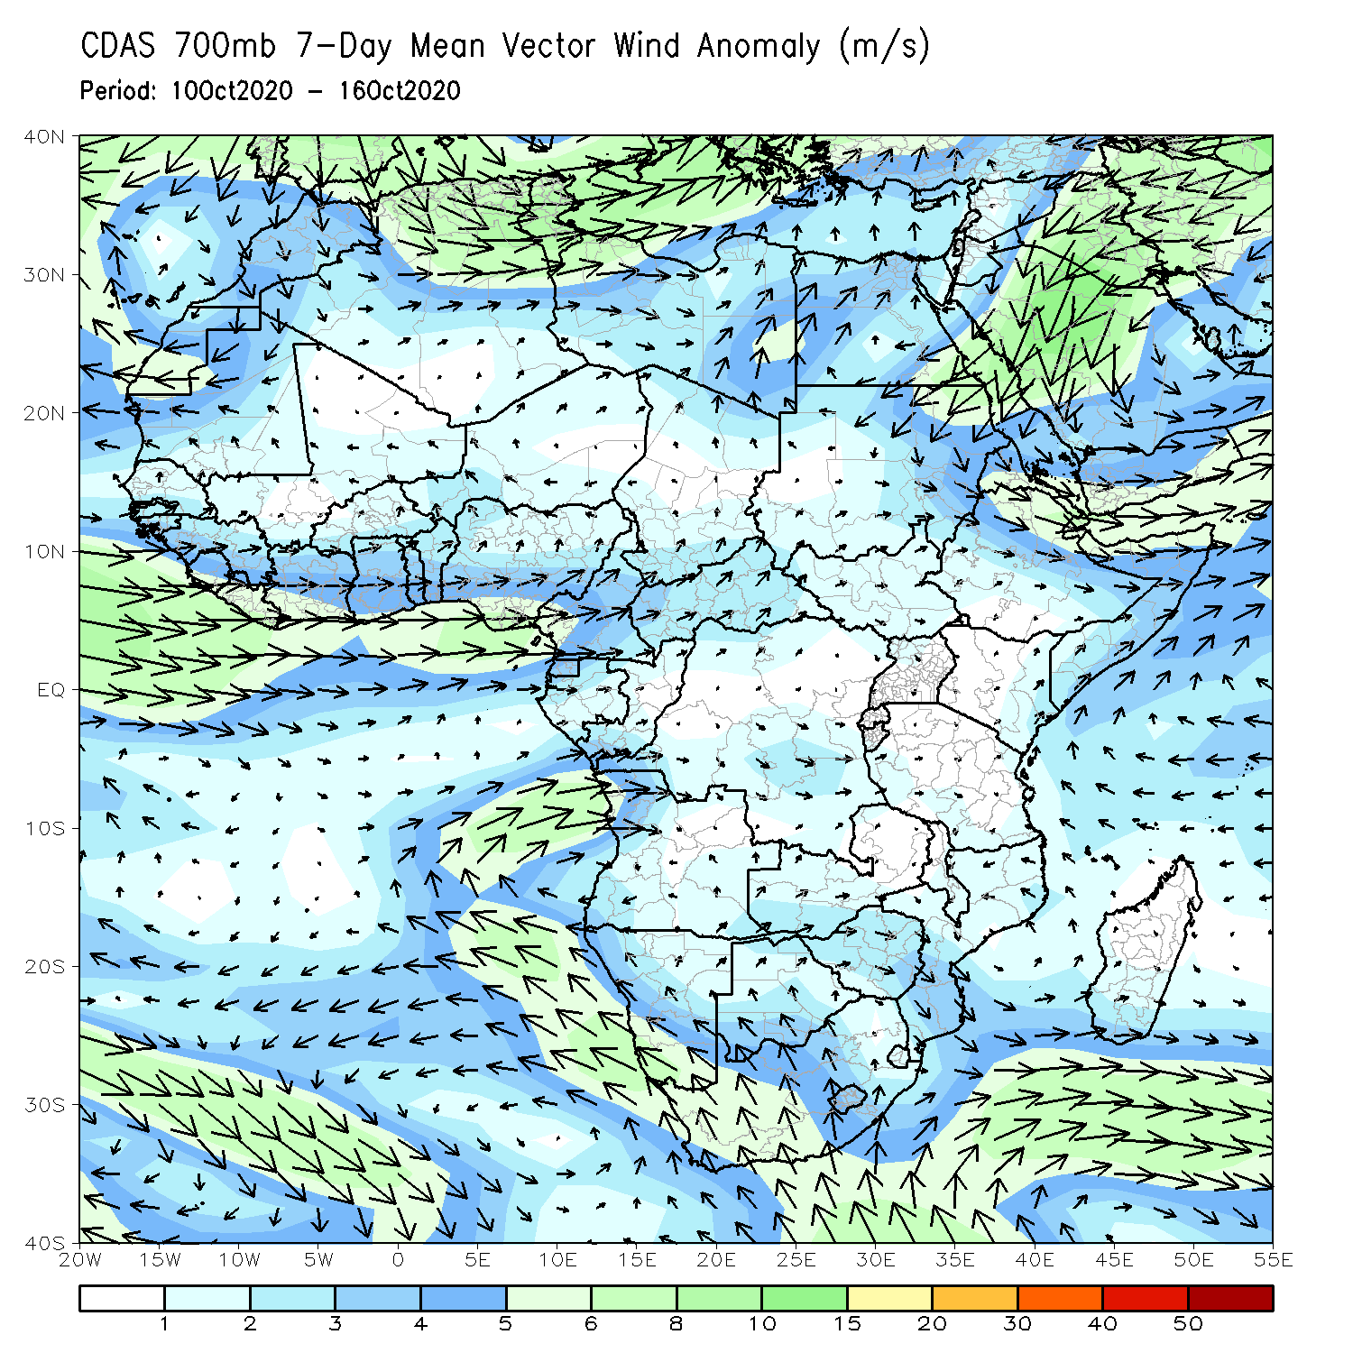
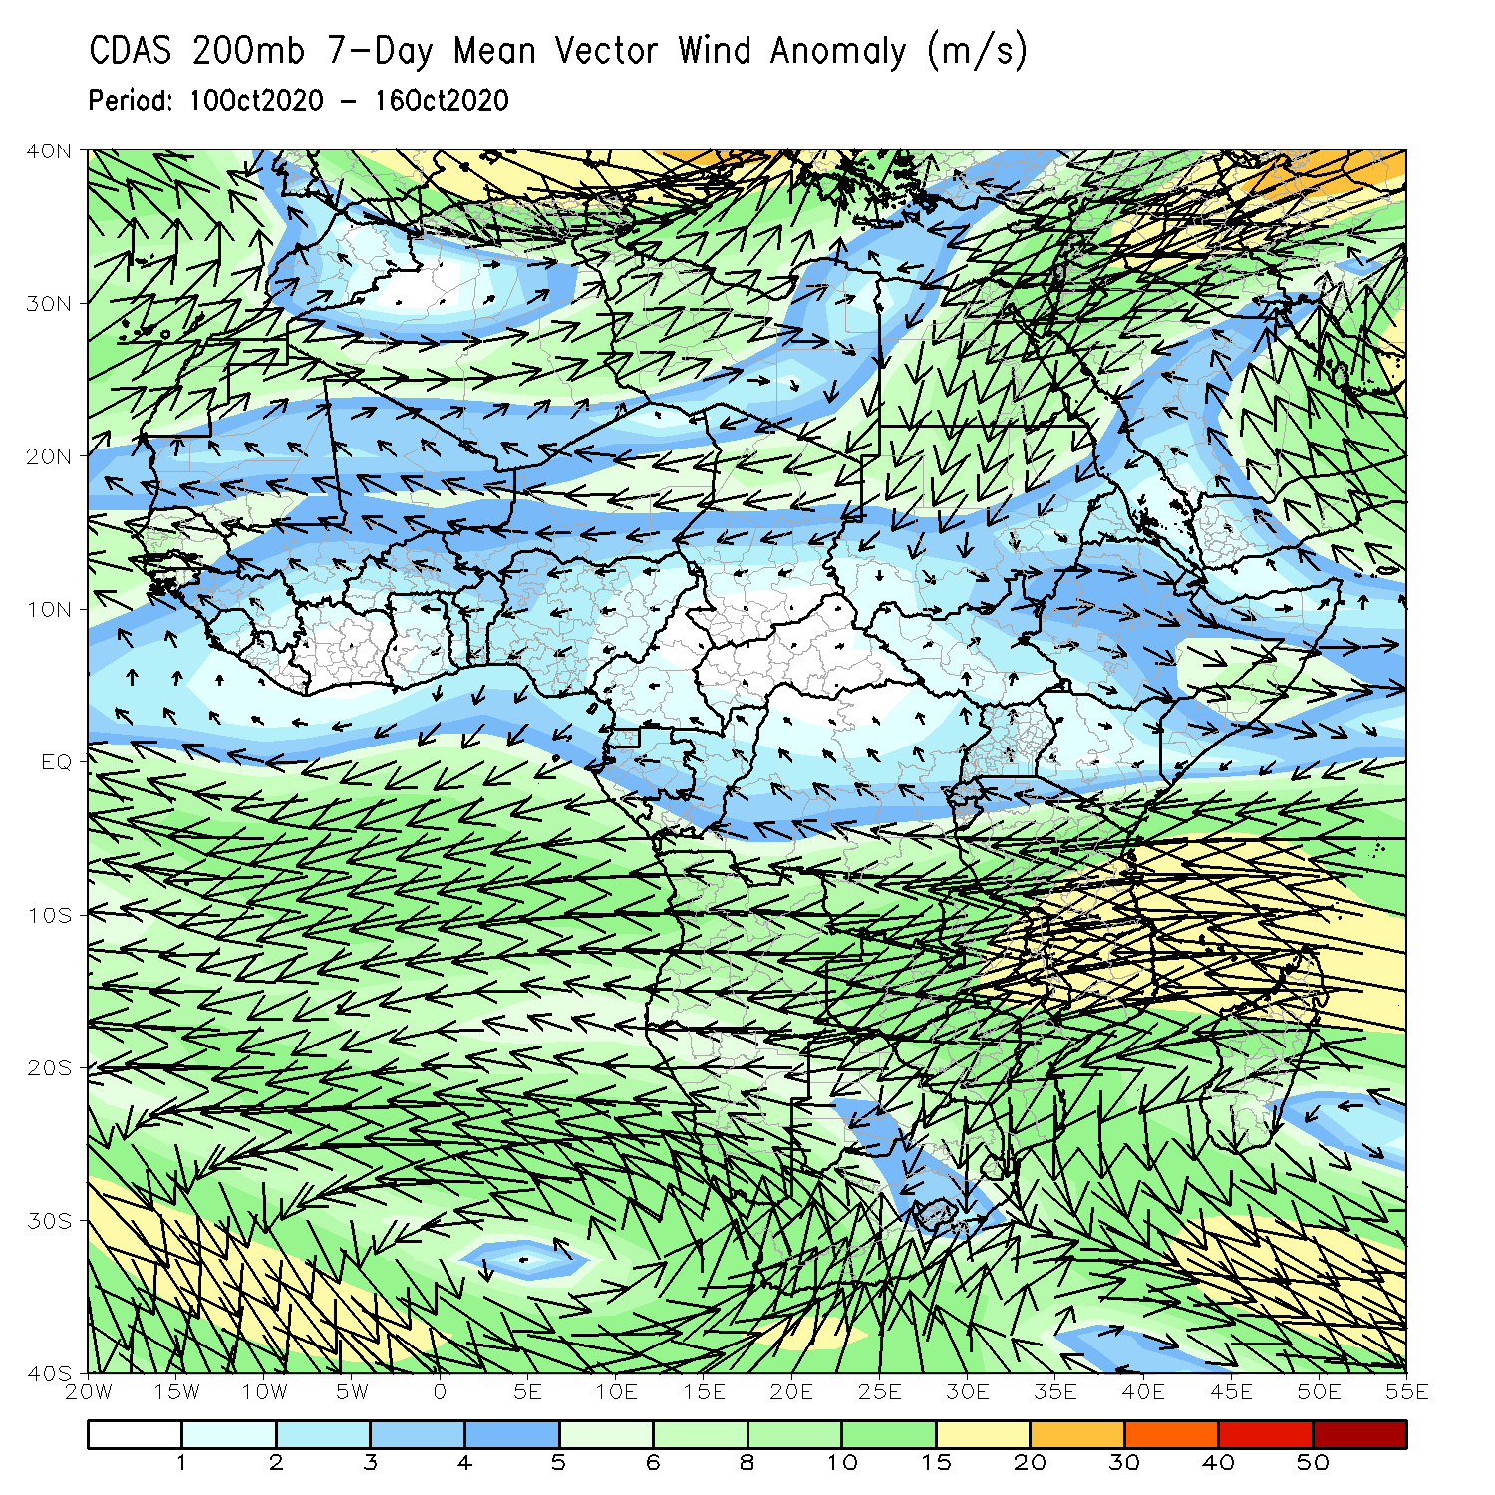
Atmospheric Circulation: Last 7 Days
The low level wind anomaly (left panel) featured a prominent westerly flow pattern along the Gulf of Guinea coast and an anomalous cyclonic flow over the Arabian Peninsula. The upper level (right panel) revealed a strengthening of the Mascarene and the St Helena High Pressure systems across southern Africa, both consistent with La Nina conditions and the moisture surpluses observed in southern Africa.

Slide 8
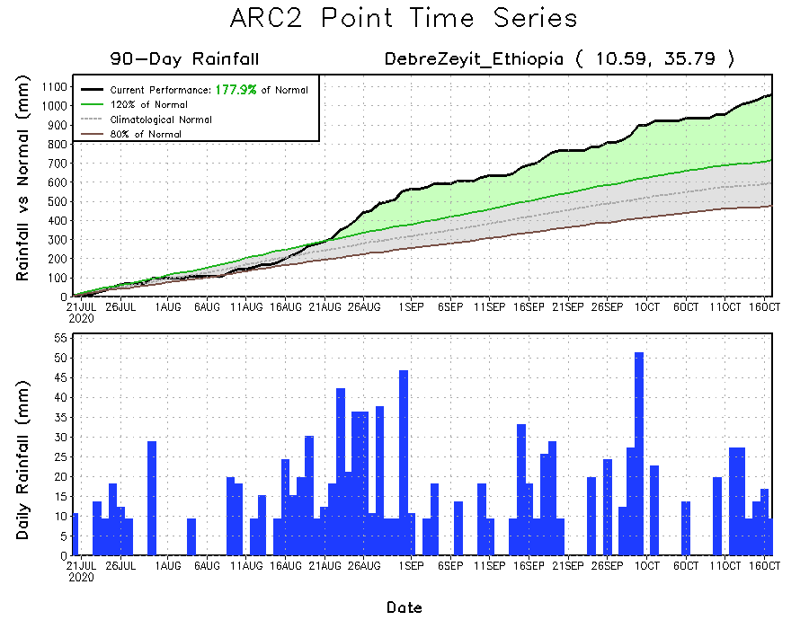
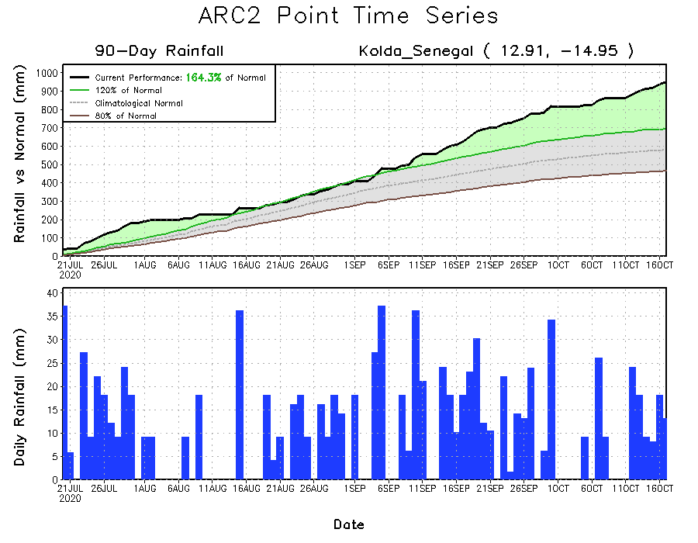
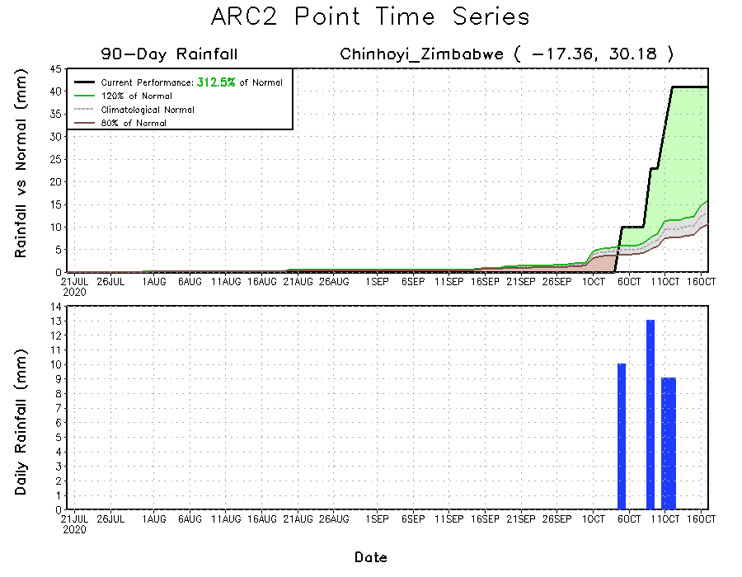
Rainfall Evolution
Daily evolution of rainfall over the last 90 days at selected locations shows that steady rains continued to fall over Senegal (bottom left). After a short break, rainfall returned to western Ethiopia during the past week (top right). Moderate to heavy rains in northern Zimbabwe, indicated a good start to the rainfall season in southern Africa.

Slide 9
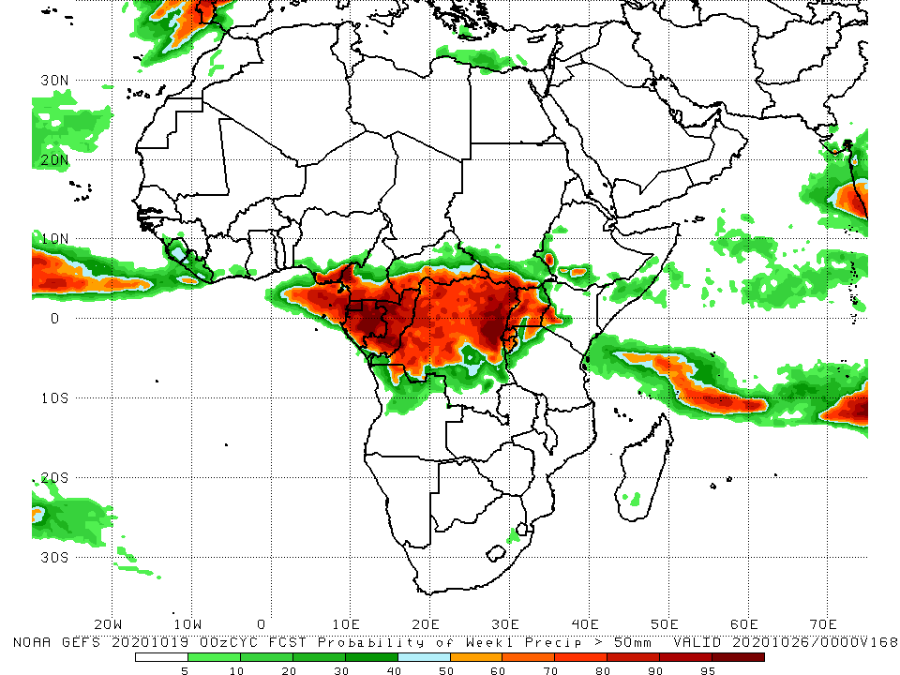
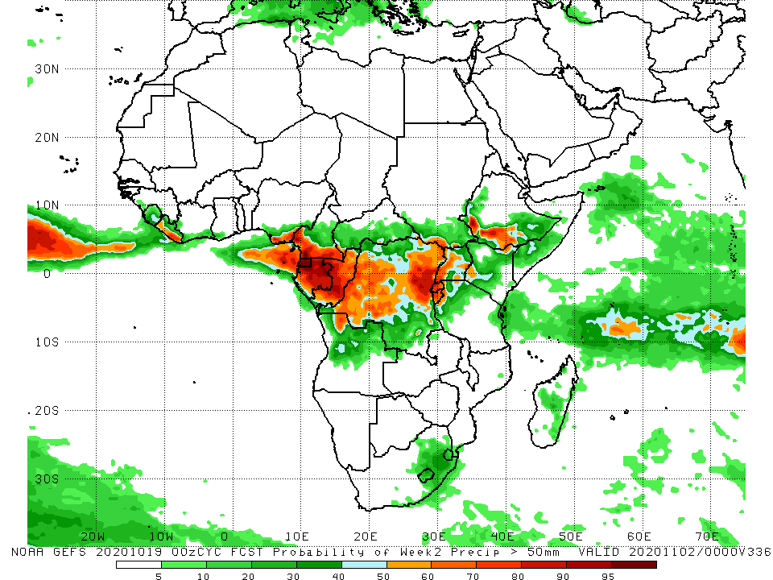
NCEP GEFS Model Forecasts Non-Bias Corrected Probability of precipitation exceedance
Week-1 Valid 20 – 26 October, 2020
Week-2: Valid 27 October – 02 November, 2020
There is an increased chance for rainfall to exceed 50 mm over portions of the northern areas of Central Africa for both week-1 (left panel) and week-2 (right panel).
Notes:
9

Slide 10
Summary
During the past 30 to 90 days, in West Africa, above-average rainfall was observed across much of the Sahel. In contrast, rainfall was below-average over the southern areas of the Gulf of Guinea region. In Central Africa, rainfall was below average along the coast and above average in interior Central Africa. In East Africa, rainfall was above average in much of the Greater Horn of Africa, except for eastern Kenya and southern Somalia. Rainfall was above average in southern Africa.
During the past 7 days, the West Africa monsoon continued its withdrawal. However, the western end of the Sahel and the Gulf of Guinea region registered moderate the heavy rains. In Central Africa, light rains sustained moisture deficits along the coast, while moderate rains resulted in moisture surpluses in the interior. In East Africa, heavy rains returned to western Ethiopia, while drier than normal conditions prevailed over eastern Kenya and southern Somalia. In Southern Africa, moderate to heavy rains resulted in moisture surpluses in many areas in the region.
There is an increased chance for rainfall to exceed 50 mm over portions of the northern areas of Central Africa for both week-1 and week-2.

