Slide 1
The African Monsoon Recent Evolution and Current Status Include Week-1 and Week-2 Outlooks
Update prepared by
Climate Prediction Center / NCEP
02 November 2020
For more information, visit:
http://www.cpc.ncep.noaa.gov/products/Global_Monsoons/African_Monsoons/precip_monitoring.shtml

Slide 2
Outline
Highlights
Recent Evolution and Current Conditions
NCEP GEFS Forecasts
Summary

Slide 3
Highlights: Last 7 Days
Below average rains sustained moisture deficits in southern Somalia. Dry conditions alleviated flooding in the Western Ethiopian Highlands. Heavy rains soaked eastern South Africa.
The week-1 outlooks indicate a moderate to high chance for rainfall to exceed 50 mm over Central Africa and pockets in equatorial East Africa. For week-2, the chance for rainfall to exceed 50 mm is limited to Gabon, southern Congo, and eastern DRC.

Slide 4
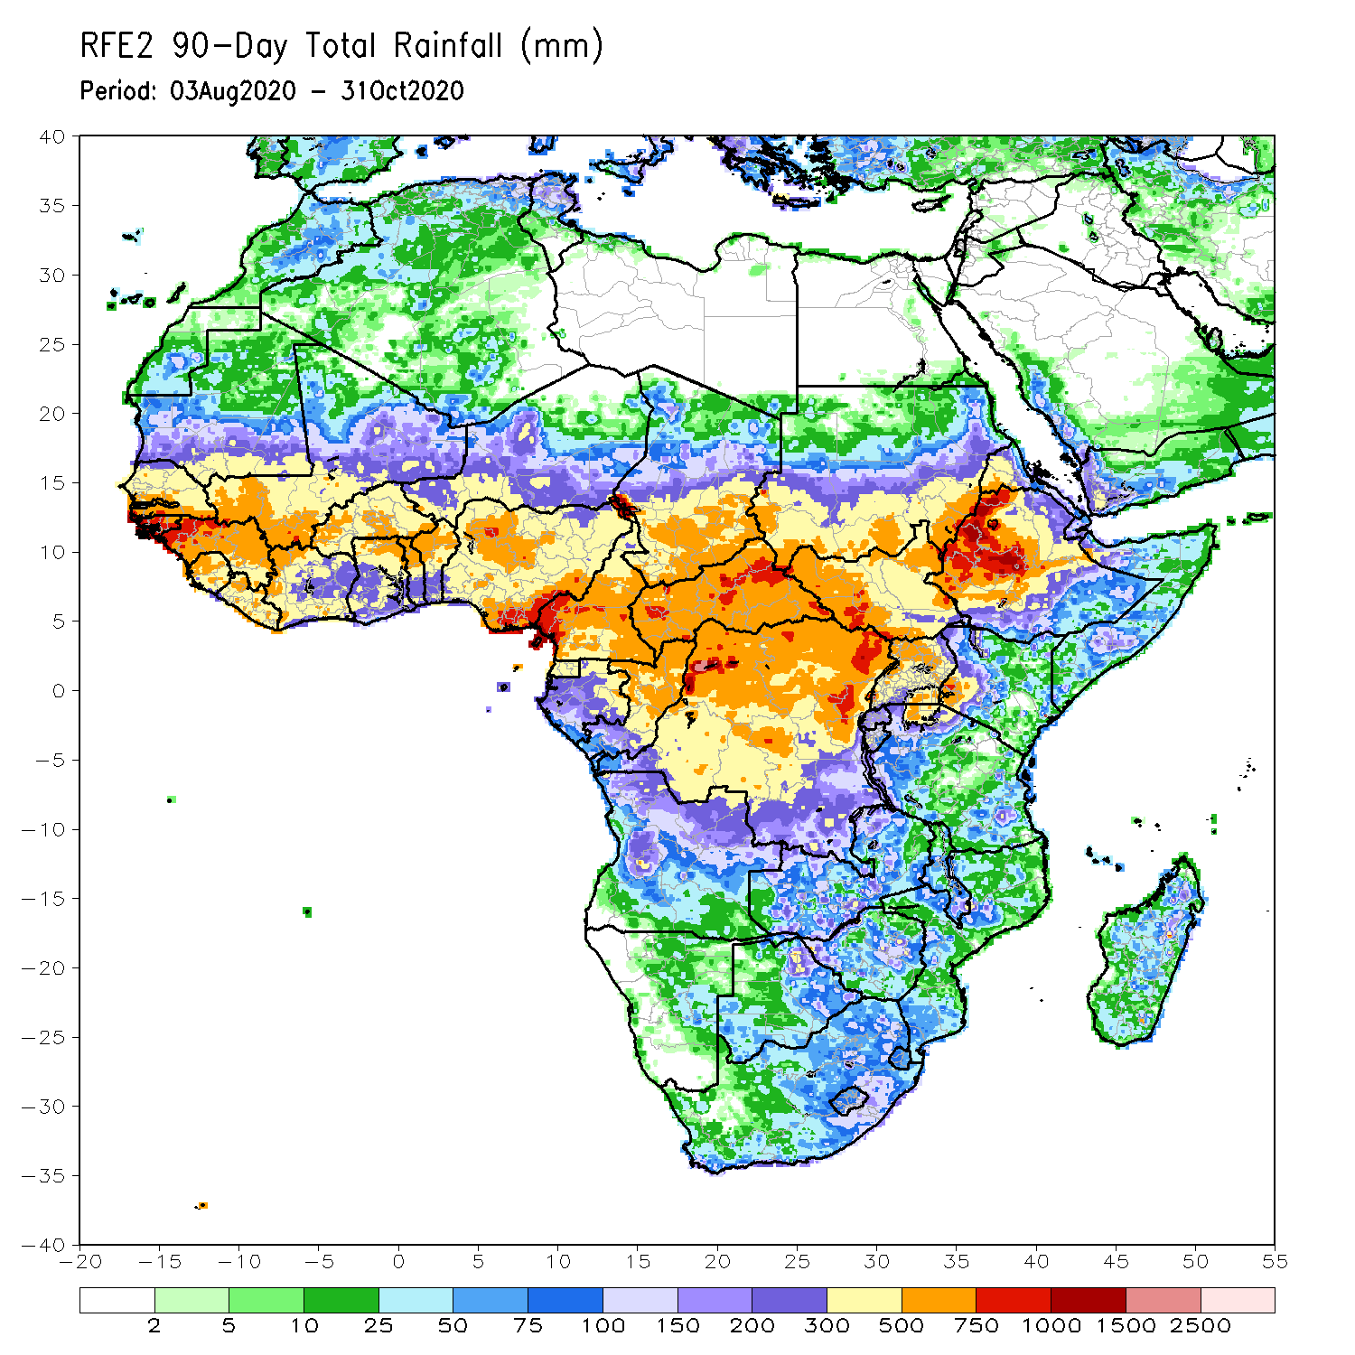
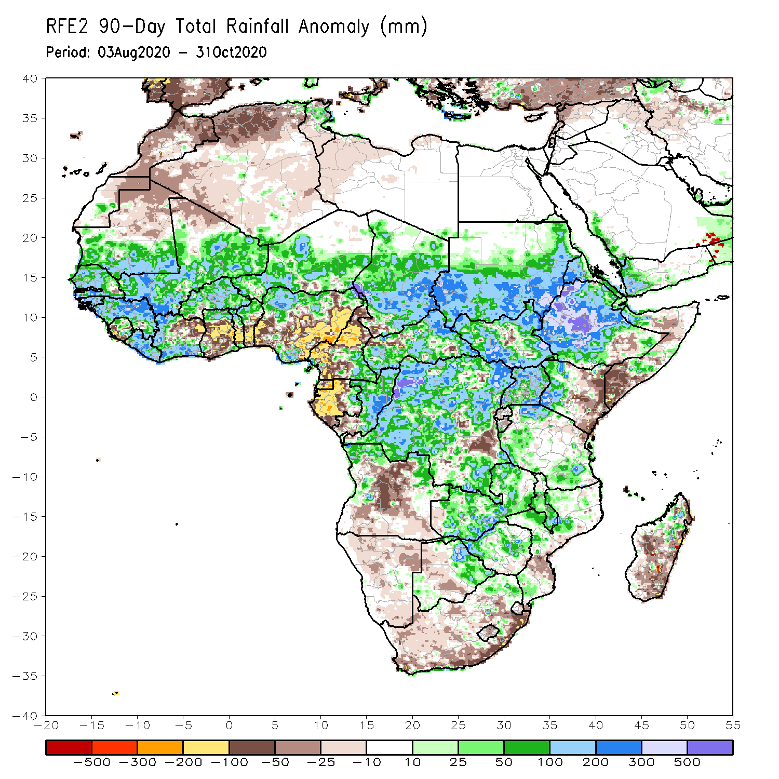
Rainfall Patterns: Last 90 Days
Over the past 90 days, in West Africa, above-average rainfall was observed across much of the Sahel from Senegal eastward to Chad. Rainfall was also above-average from Guinea to much of Cote D’Ivoire. In contrast, rainfall was below-average over the southern areas of the Gulf of Guinea region from northeastern Cote d’Ivoire eastward to Nigeria. The moisture deficits extended to western Central Africa in the area encompassing Cameroon, Gabon and southeastern Congo. Rainfall was much above-average in the remainder of Central Africa from southern Chad to the northern two third of DRC. Rainfall was locally below average in southeastern DRC. In East Africa, the heaviest amounts 500 to 1500 mm (200 – 500 mm above the mean) occurred over the Ethiopian Highlands and locally over southern Sudan. Well above-average rainfall (over 300 mm above the mean) was also observed over south Sudan and Uganda. Rainfall was below-average over eastern Kenya and southern Somalia. In southern Africa, moisture surpluses prevailed over Zambia, Zimbabwe, and the northern tip of Madagascar. Rainfall was below-average from northcentral Angola to eastern South Africa and the southern two third of Madagascar.
Notes:
4

Slide 5
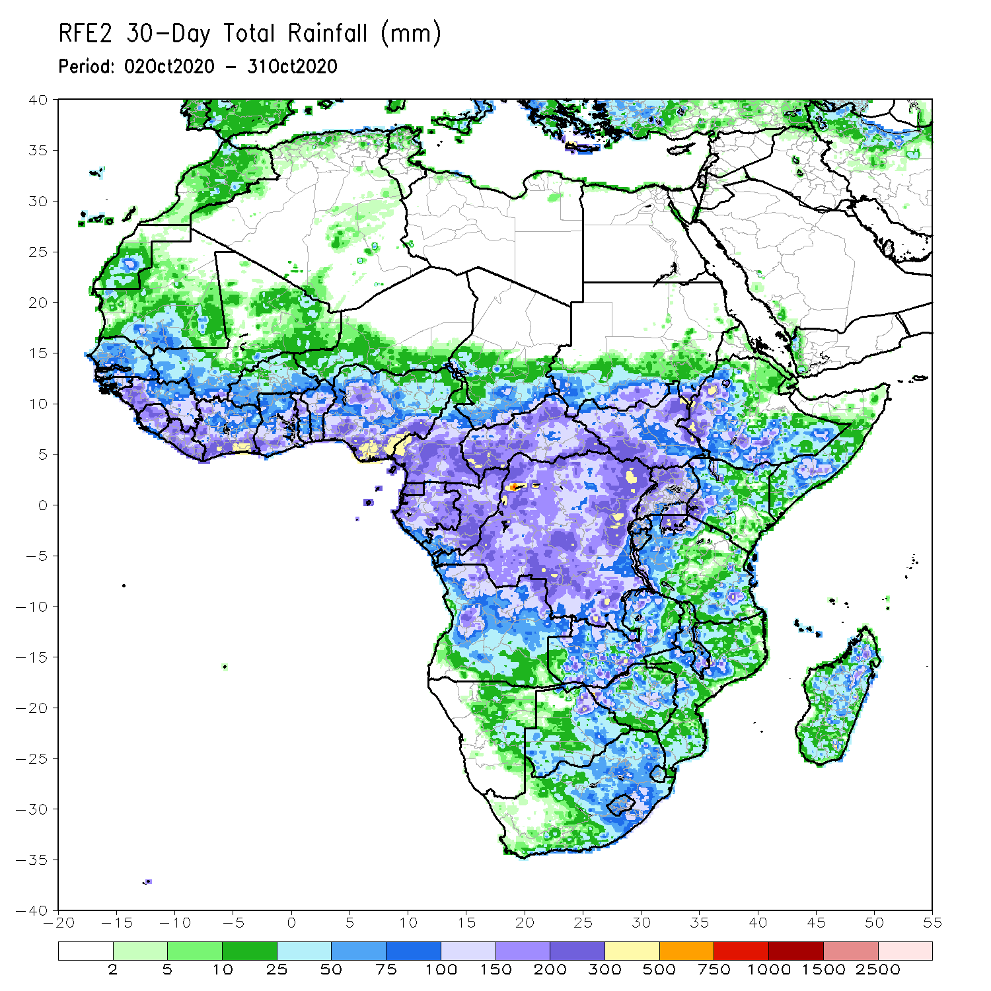
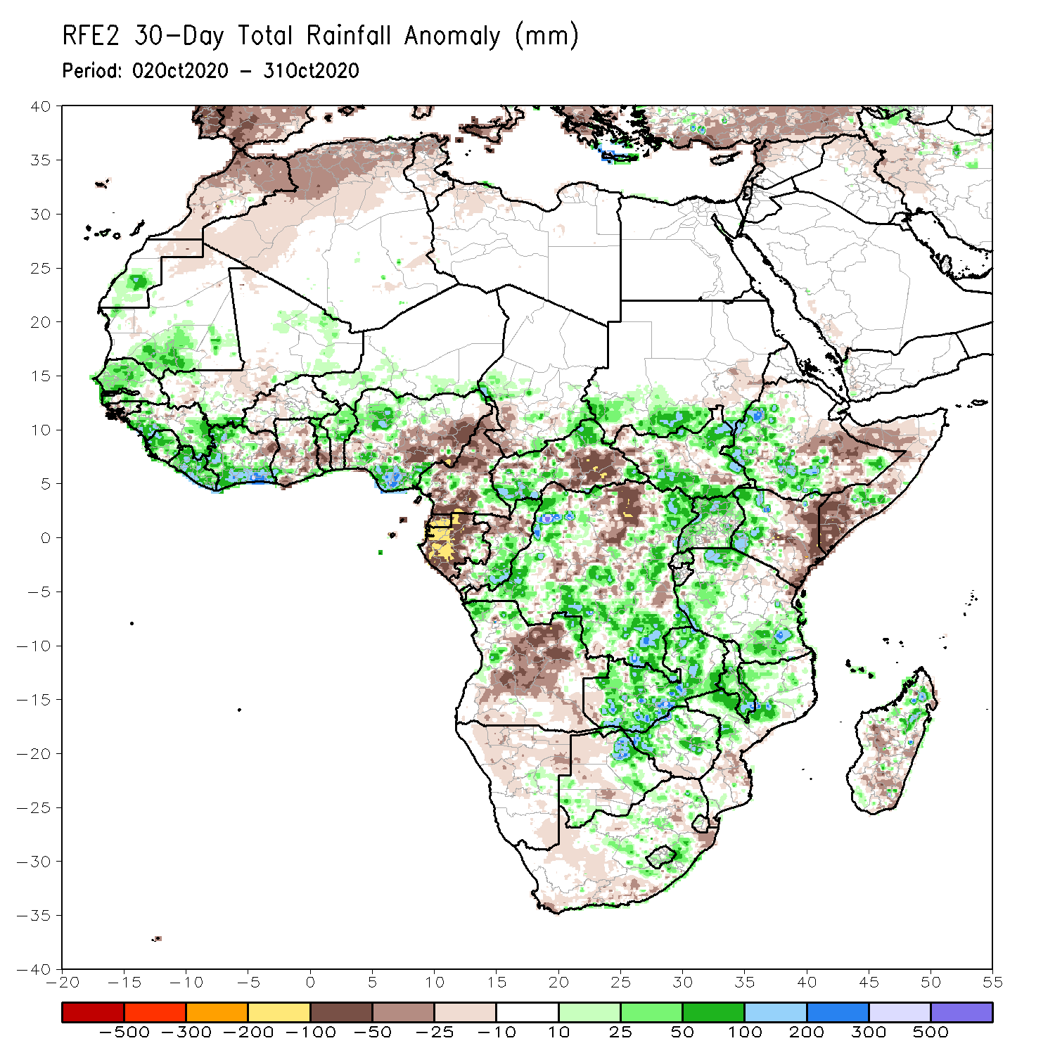
Rainfall Patterns: Last 30 Days
During the past 30 days, rainfall totals diminished over West Africa as the West African Monsoon has been retreating over the past several weeks. However, rainfall was above-average over portions of the Sahel and across much of the Gulf of Guinea region. The exceptions were pockets along coastal Benin and eastern Nigeria. In Central Africa, rainfall was below average along the coastal areas and over south eastern CAR and pockets in northern DRC. Rainfall was above average over southeastern Congo, western and eastern DRC. In East Africa, moisture surpluses prevailed over the Ethiopian Highlands and over southern Sudan along the border with South Sudan. Above average rainfall was also observed over parts of South Sudan, northern Uganda, and western Kenya. In contrast, rainfall was below average over eastern Kenya and southern Somalia. In Southern Africa, rainfall was above average over Zambia, local areas in Zimbabwe, and southern Malawi. Rainfall was below average over the southern two-third of Madagascar.
Notes:
5

Slide 6
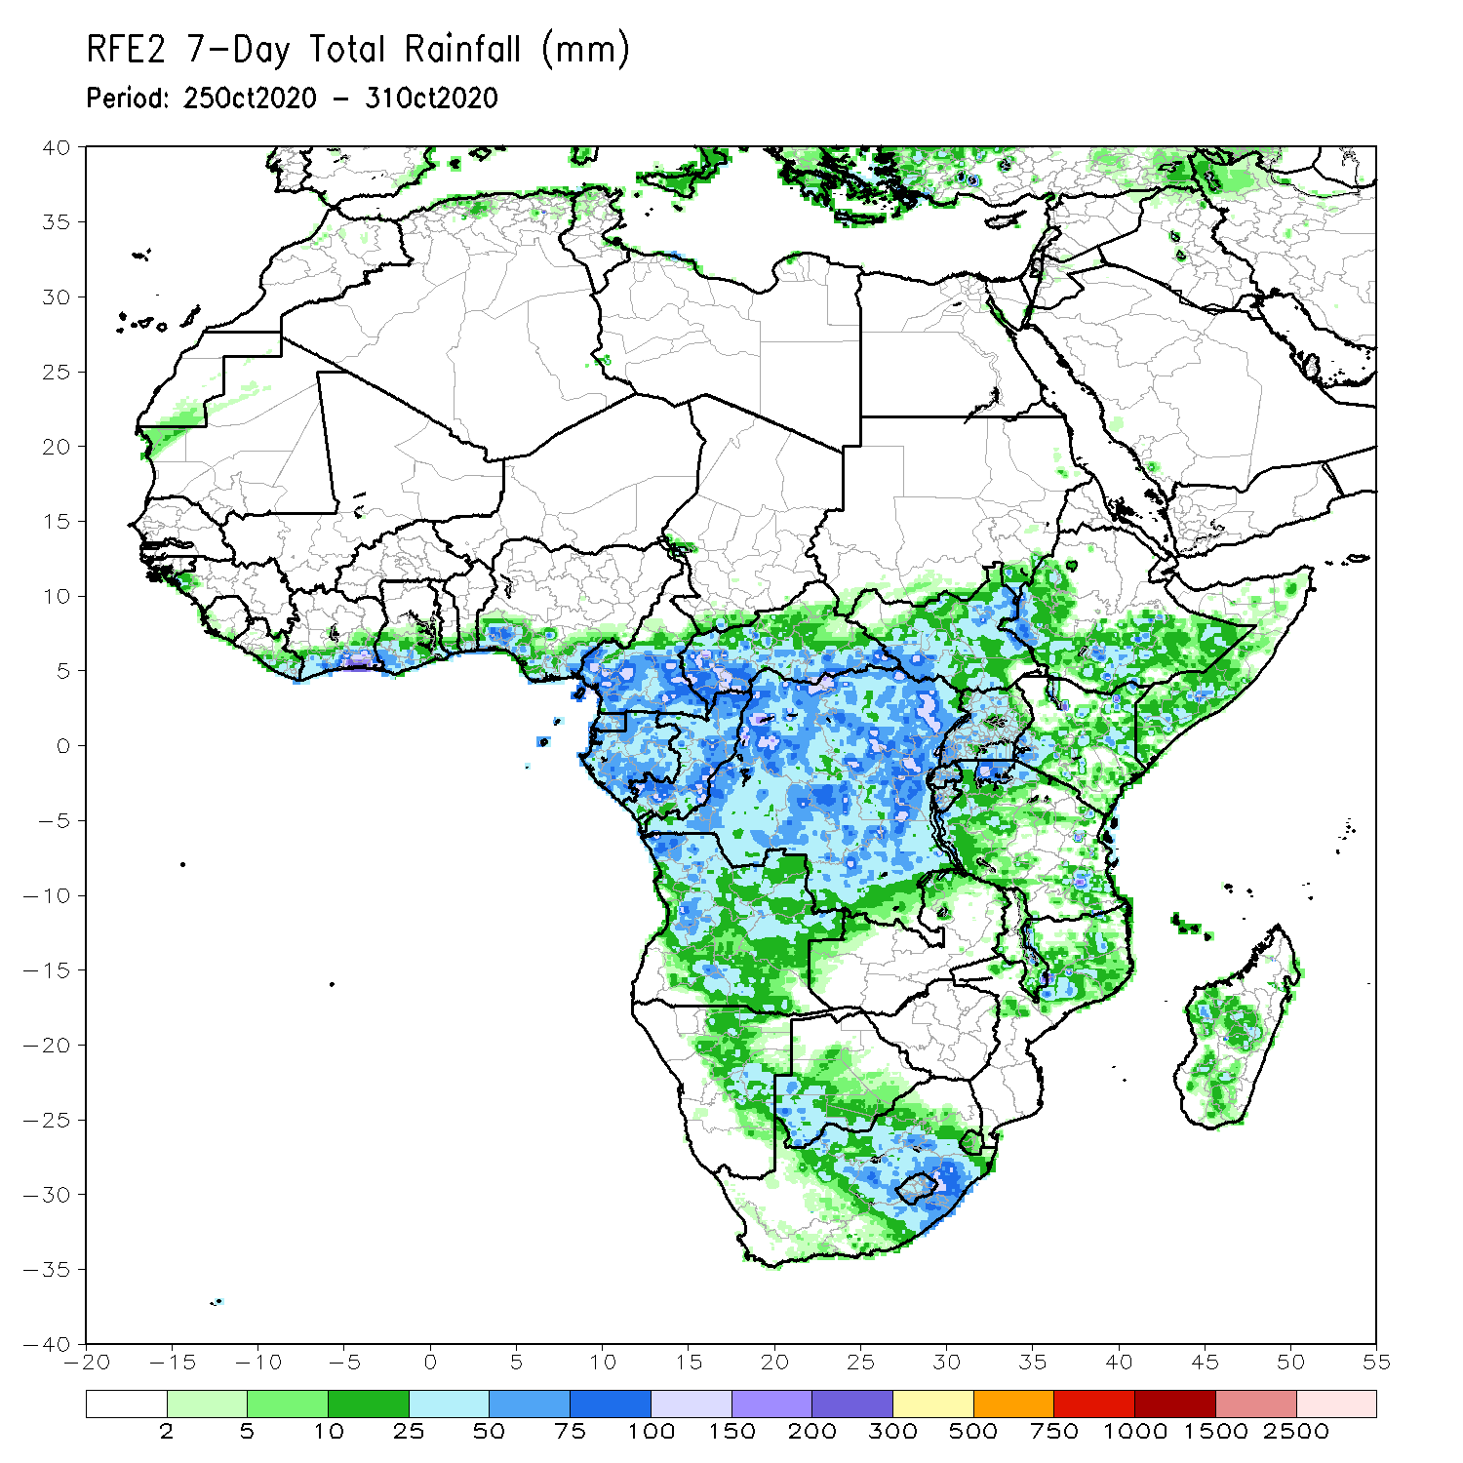
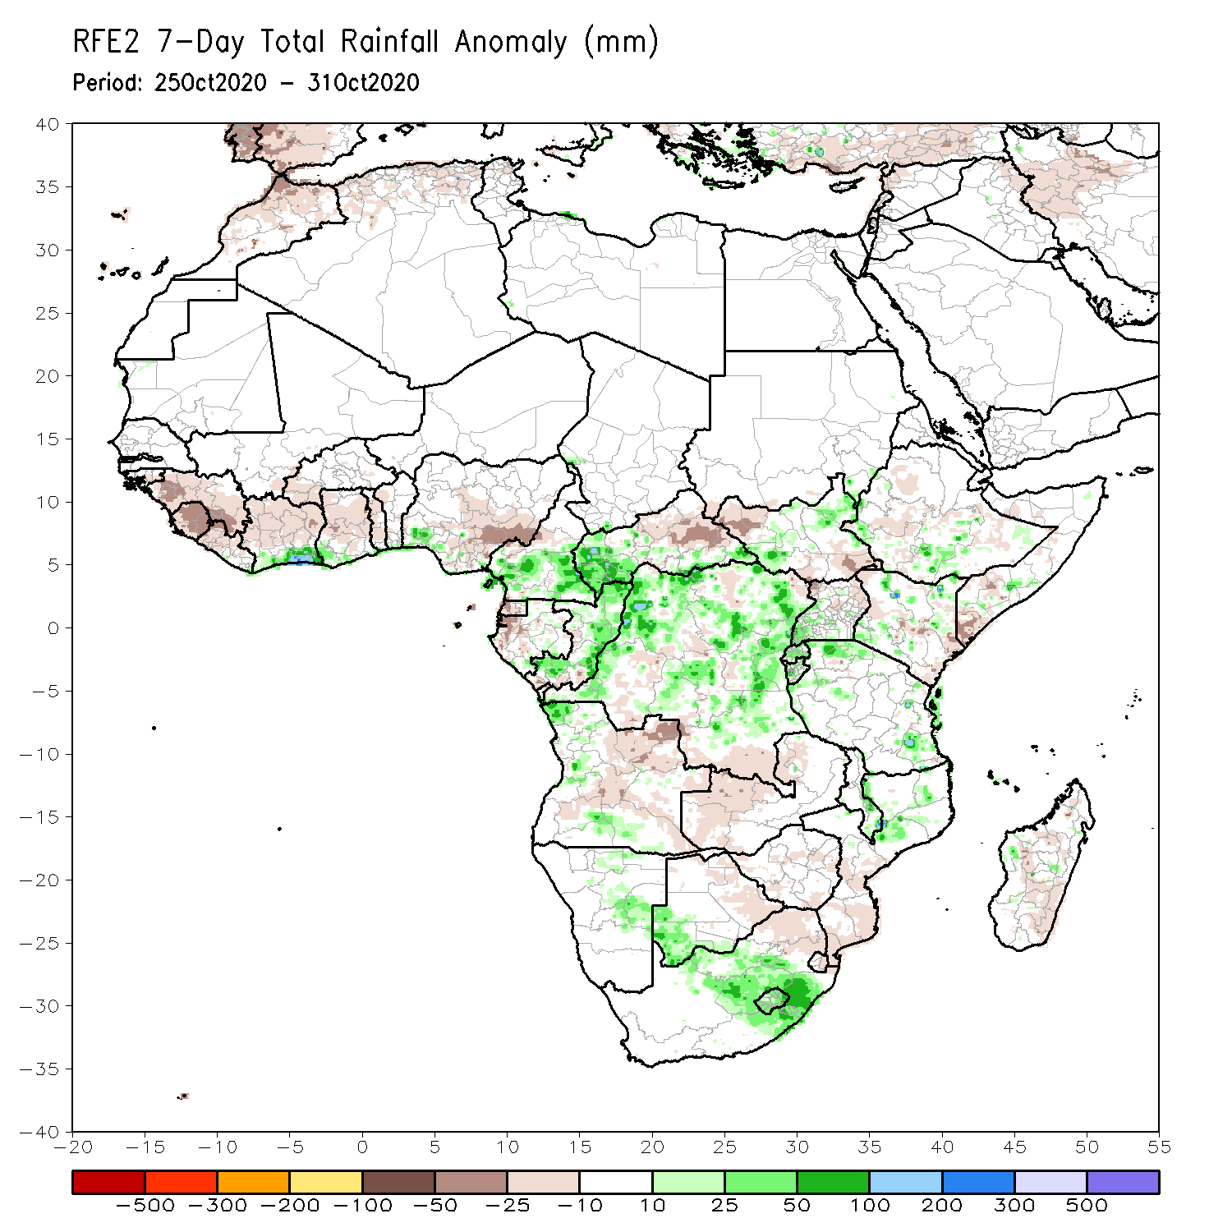
Rainfall Patterns: Last 7 Days
During the past 7 days, in West Africa, seasonable dry weather prevailed over the Sahel as the West African monsoon became inactive. Rainfall was below average across much of the Gulf of Guinea Region, except for pockets along coastal Cote d’Ivoire, where totals ranged between 25 and 75 mm (10-50 mm above the mean). In Central Africa, excessive rainfall locally approaching 300 mm pounded parts of northern DRC with moisture surpluses exceeding 100 mm. Rainfall was slightly below average over parts of DRC and Gabon. Average rains with totals ranging between 10 and 75 mm were observed across much of the Greater Horn of Africa. In Southern Africa, dry conditions prevailed across the east-central part encompassing Zambia, Zimbabwe and southern Mozambique. Moderate to heavy rains (75 – 100 mm (25 – 50 mm above the mean) soaked eastern South Africa.

Slide 7
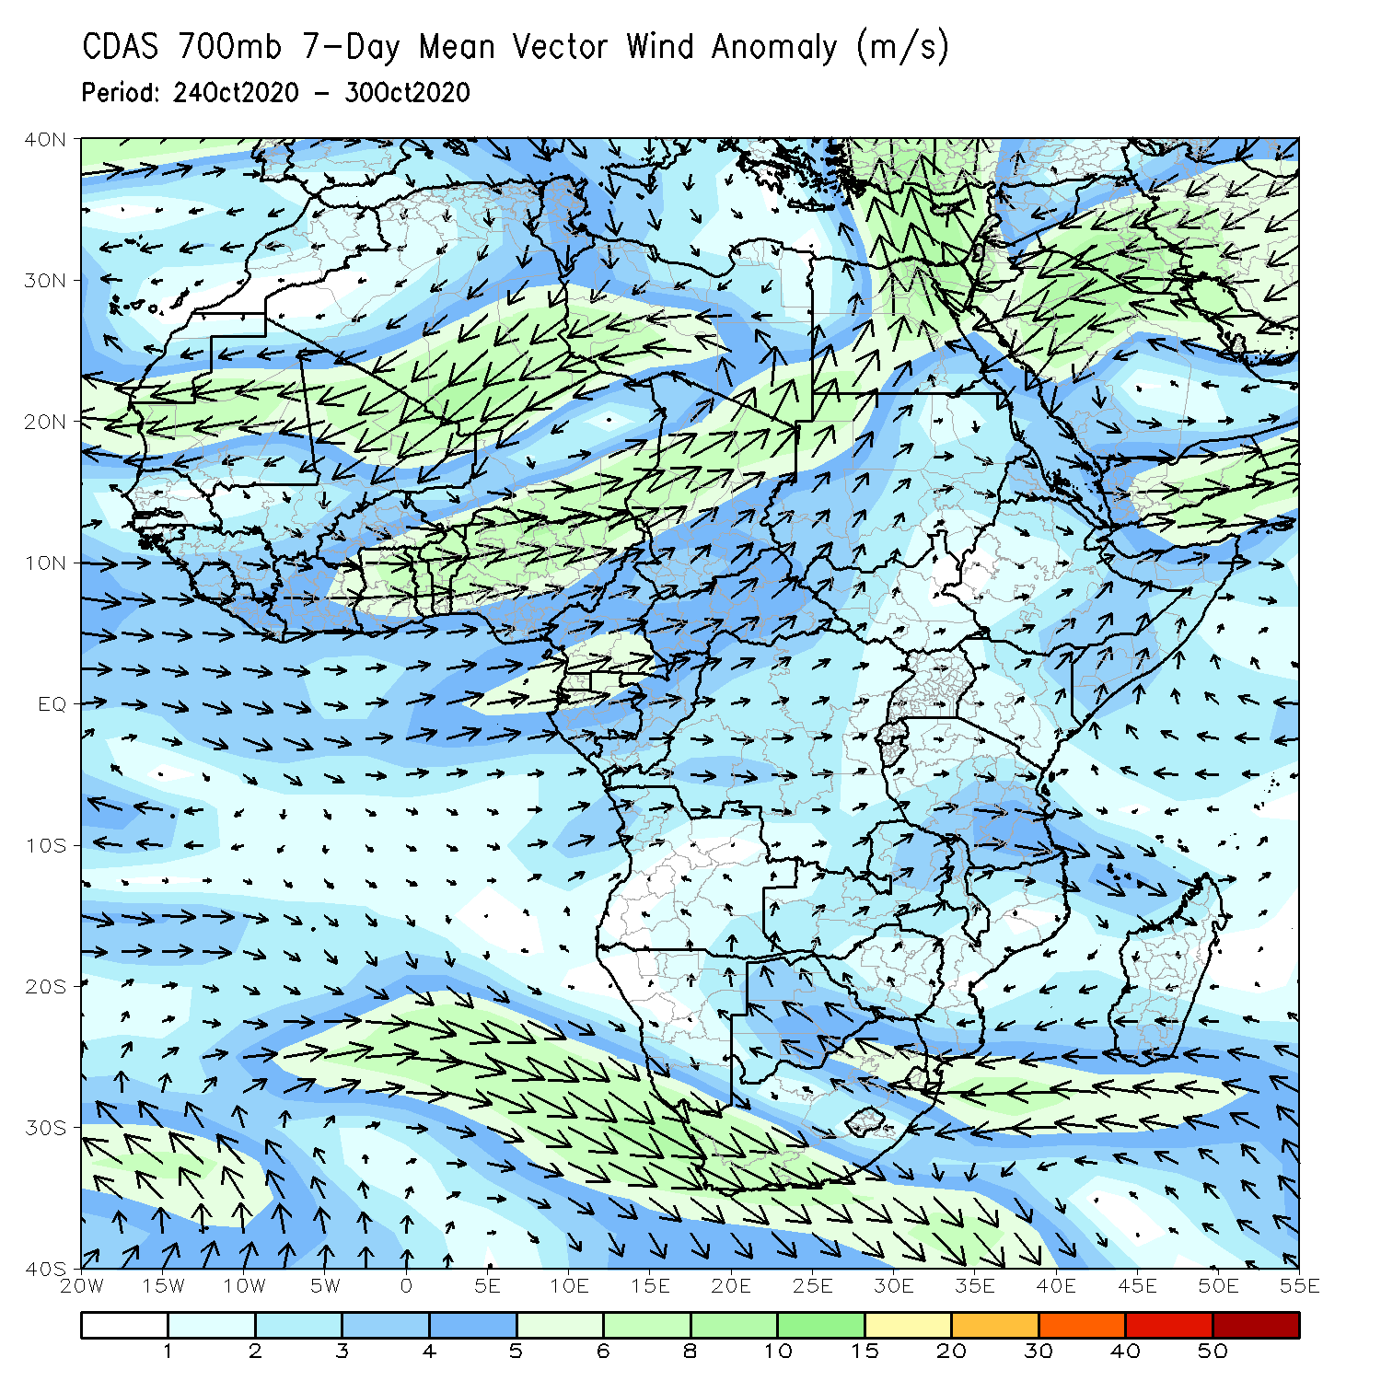
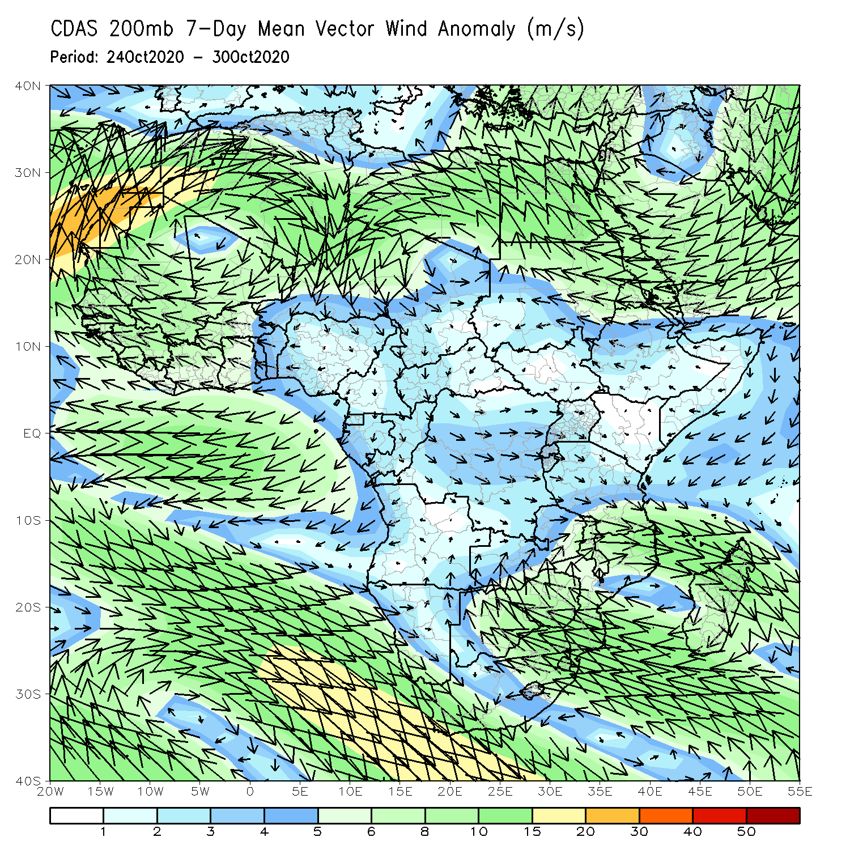
Atmospheric Circulation: Last 7 Days
An anomalous mid-level cyclonic circulation (left panel) dominated sub-Saharan Africa north of the equator. At upper-level, a triplet Anticyclonic-Cyclonic-Anticyclonic pattern prevailed across northern Africa and the Arabian Peninsula, while both the St Helena High and the Mascarene high pressure systems across southern Africa weakened.

Slide 8
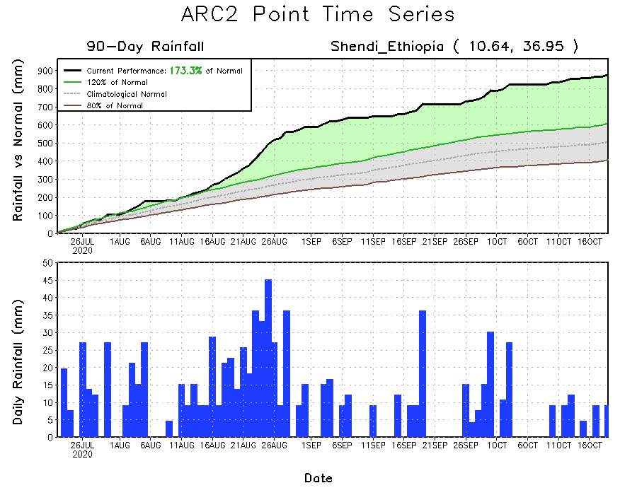
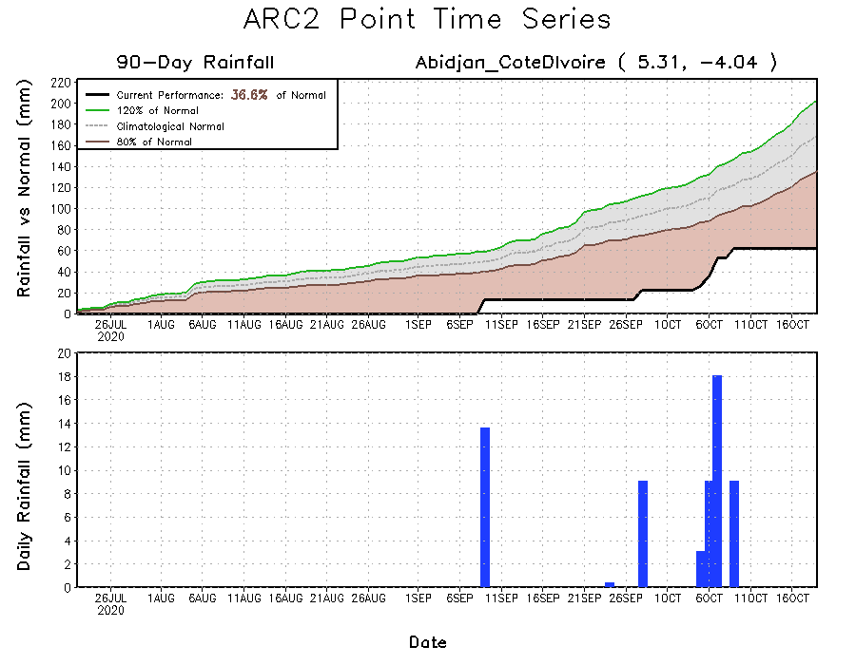
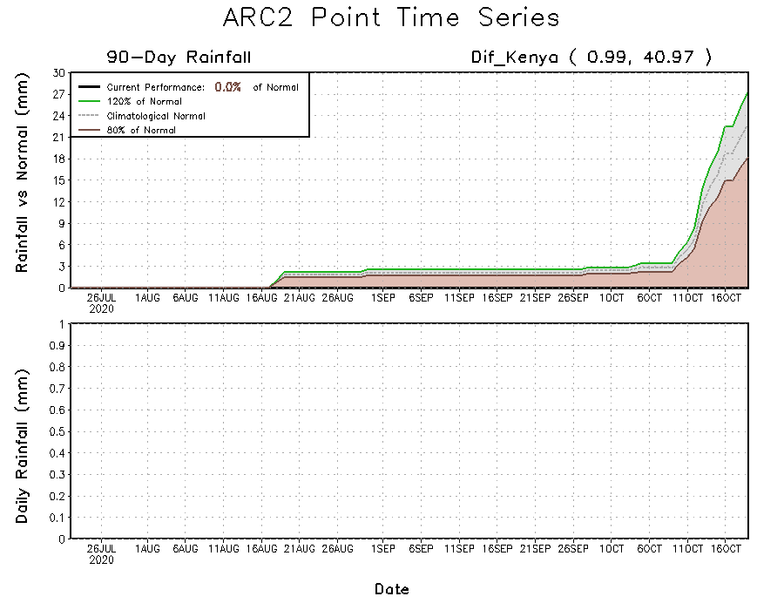
Rainfall Evolution
Daily evolution of rainfall over the last 90 days at selected locations shows that dry conditions sustained moisture deficits over central Cote d’Ivoire (bottom left). Moisture surpluses increased over southern Sudan as light raisn continued to fall (top right), while southern Somalia is off to a slow start to the short rainfall season (bottom right).

Slide 9
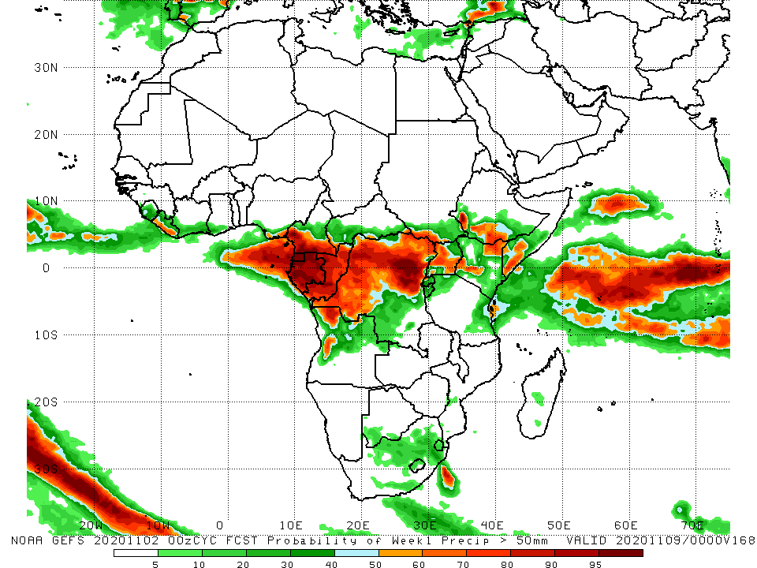
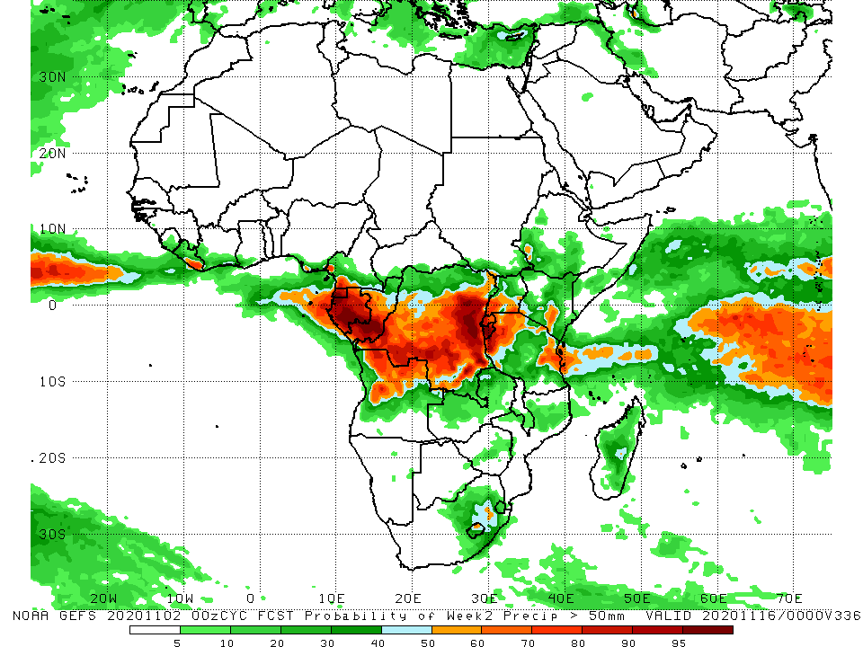
NCEP GEFS Model Forecasts Non-Bias Corrected Probability of precipitation exceedance
Week-1 Valid 03 – 09 November, 2020
Week-2: Valid 10 – 16 November, 2020
For week-1 (left panel), the NCEP GEFS indicates a moderate to high chance (over 70%) for rainfall to exceed 50 mm over Central Africa and pockets in equatorial East Africa. For week-2 (right panel), the chance for rainfall to exceed 50 mm is confined to Gabon, southern Congo, and eastern DRC.
Notes:
9

Slide 10
Summary
During the past 30 to 90 days, in West Africa, above-average rainfall was observed across much of the Sahel. In contrast, rainfall was below-average over the southern areas of the Gulf of Guinea region. In Central Africa, rainfall was below average along the coast and above average in interior Central Africa. In East Africa, rainfall was above average in much of the Greater Horn of Africa, except for eastern Kenya and southern Somalia. Rainfall was above average in parts of southern Africa.
Over the past 7 days seasonable dry weather prevailed over the Sahel as the West African monsoon became inactive. Rainfall was below average across much of the Gulf of Guinea Region. In Central Africa, excessive rainfall pounded parts of northern DRC with moisture surpluses exceeding 100 mm. Rainfall was slightly below average over parts of DRC and Gabon. Average rains were observed across much of the Greater Horn of Africa. However, light rains sustained moisture deficits in southern Somalia. In Southern Africa, dry conditions prevailed across the east-central part encompassing Zambia, Zimbabwe and southern Mozambique. Moderate to heavy rains soaked eastern South Africa. .
The GEFS indicates a moderate to high chance for rainfall to exceed 50 mm over parts of Central Africa and pockets in equatorial East Africa.

