Slide 1
The African Monsoon Recent Evolution and Current Status Include Week-1 and Week-2 Outlooks
Update prepared by
Climate Prediction Center / NCEP
23 November 2020
For more information, visit:
http://www.cpc.ncep.noaa.gov/products/Global_Monsoons/African_Monsoons/precip_monitoring.shtml

Slide 2
Outline
Highlights
Recent Evolution and Current Conditions
NCEP GEFS Forecasts
Summary

Slide 3
Highlights: Last 7 Days
Moderate to heavy rainfall sustained moisture surpluses across eastern Angola, Zambia and much of Botswana. Above-average rainfall was also observed over much of Tanzania, while suppressed rainfall prevailed over much of southeastern Africa.
The week-1 and week-2 outlooks indicate a moderate to high chance for rainfall to exceed 50 mm across Gabon, Congo, southern and eastern DRC, Zambia, and the Lake Victoria region including Tanzania.

Slide 4
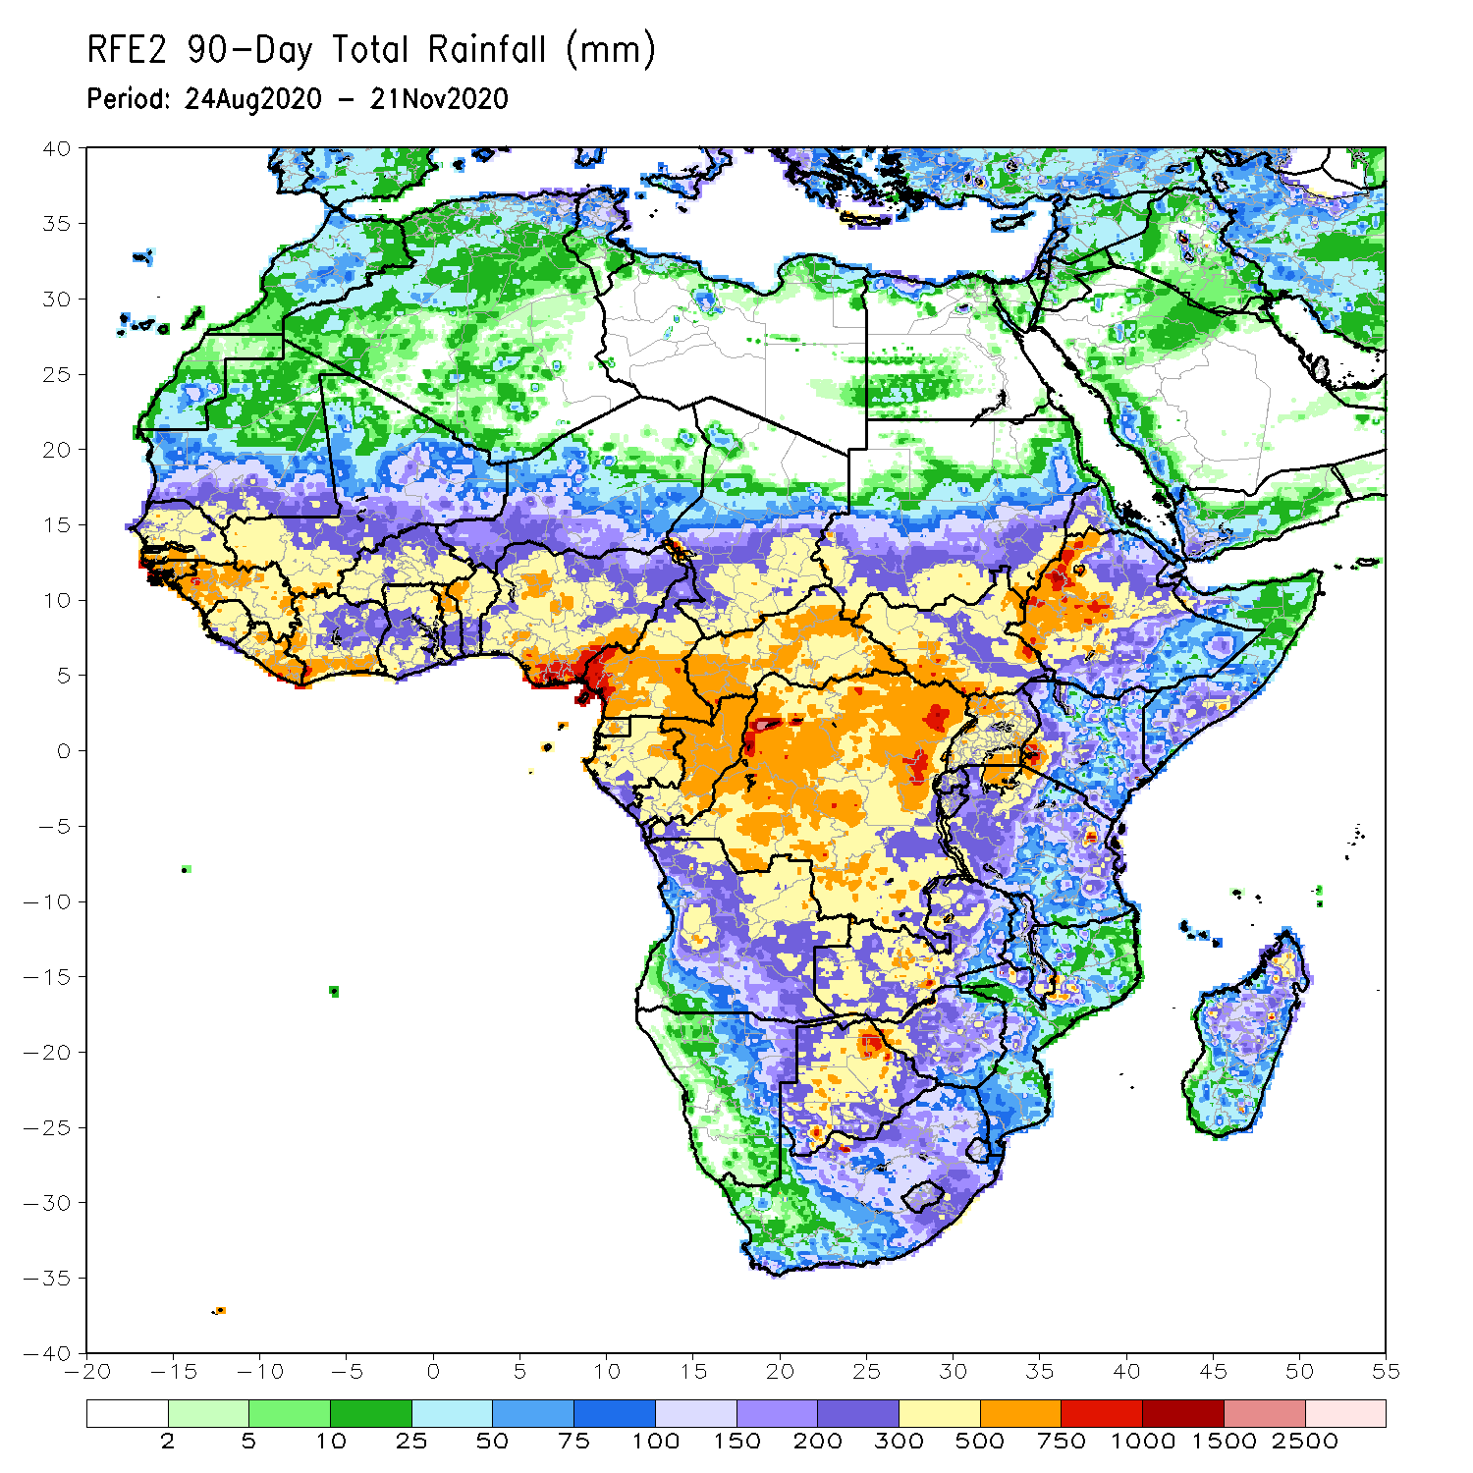
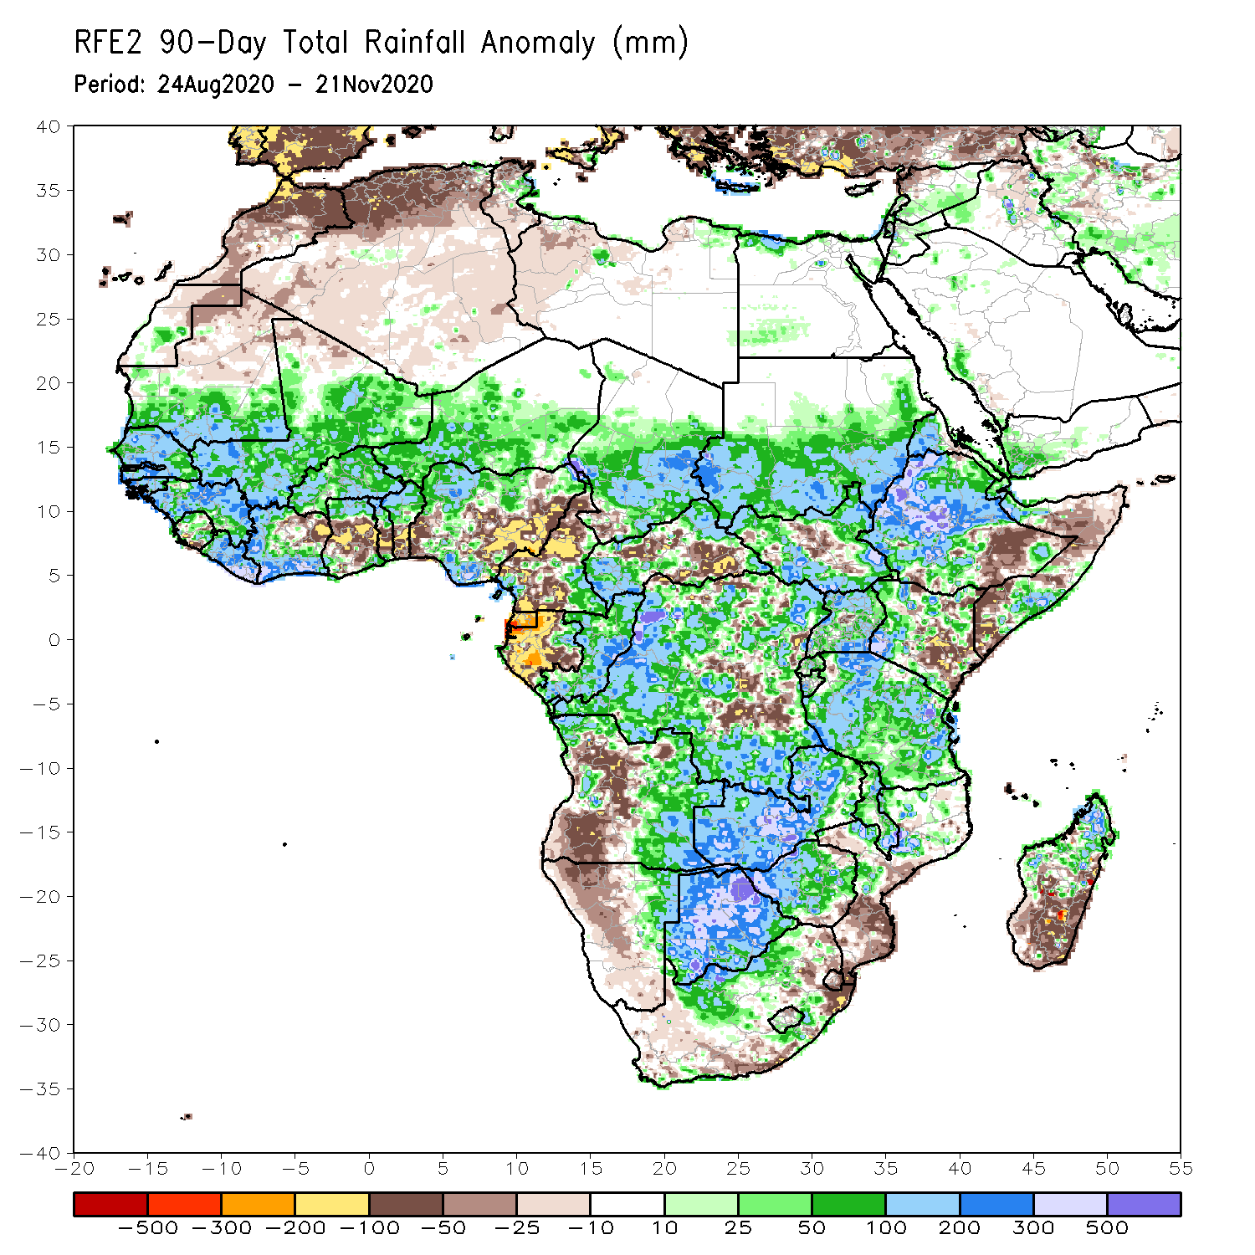
Rainfall Patterns: Last 90 Days
Over the past 90 days, in West Africa, above-average rainfall was observed across much of the Sahel from Senegal eastward to Chad. Rainfall was also above-average from Guinea to much of Cote D’Ivoire. In contrast, rainfall was below-average over the southern areas of the Gulf of Guinea region from northeastern Cote d’Ivoire eastward to Nigeria. The moisture deficits extended to the western areas of Cameroon and Gabon. Rainfall was also below average over pockets in CAR southeastern DRC. Rainfall was much above-average in the remainder of Central Africa from southern Chad to much of DRC. In East Africa, the heaviest amounts 500 to 1500 mm (200 – 500 mm above the mean) occurred over the Ethiopian Highlands. Well above-average rainfall (over 300 mm above the mean) was also observed over South Sudan and Uganda. Rainfall was below-average over southeastern Ethiopia, southeastern Kenya and southern Somalia. In southern Africa, moisture surpluses prevailed over Zambia, Zimbabwe, Botswana, and the northern areas of Madagascar. Rainfall was below-average over central and southern Angola into Namibia and South Africa. The southern areas of Mozambique and Madagascar also registered below average rainfall.
Notes:
4

Slide 5
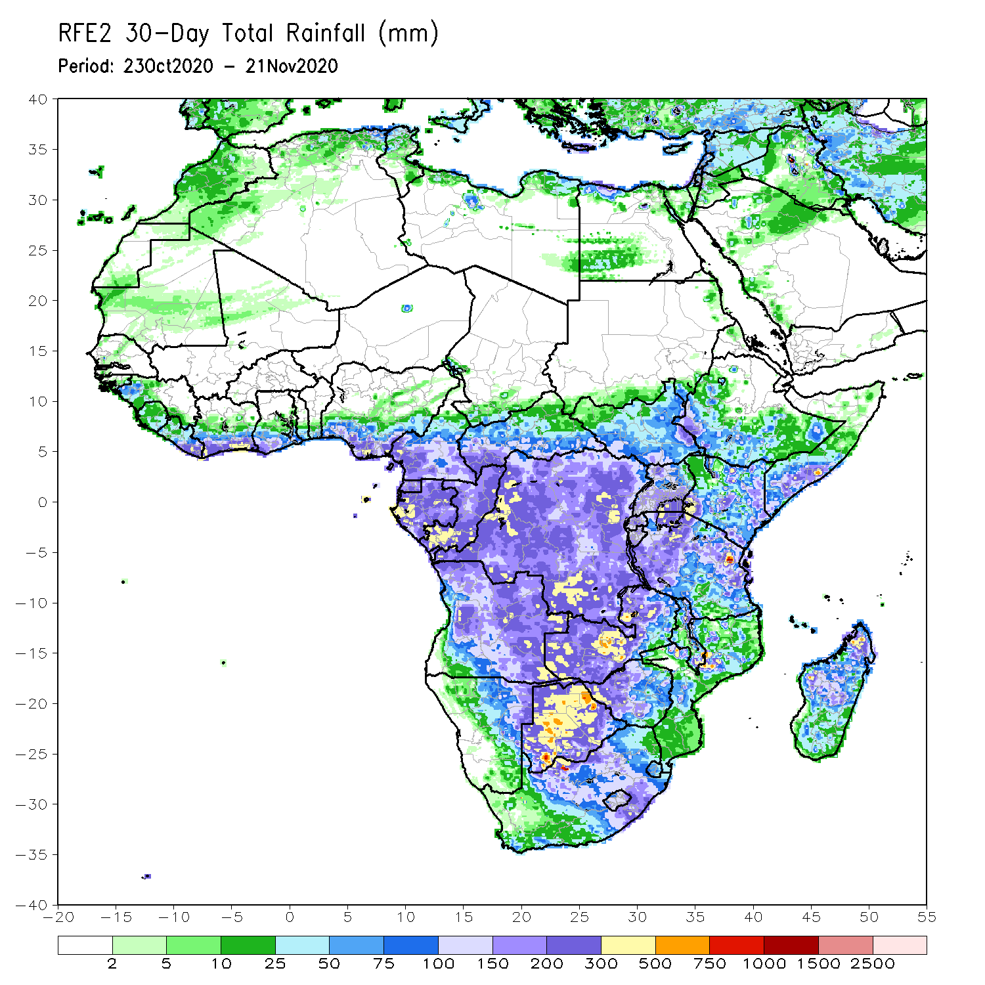
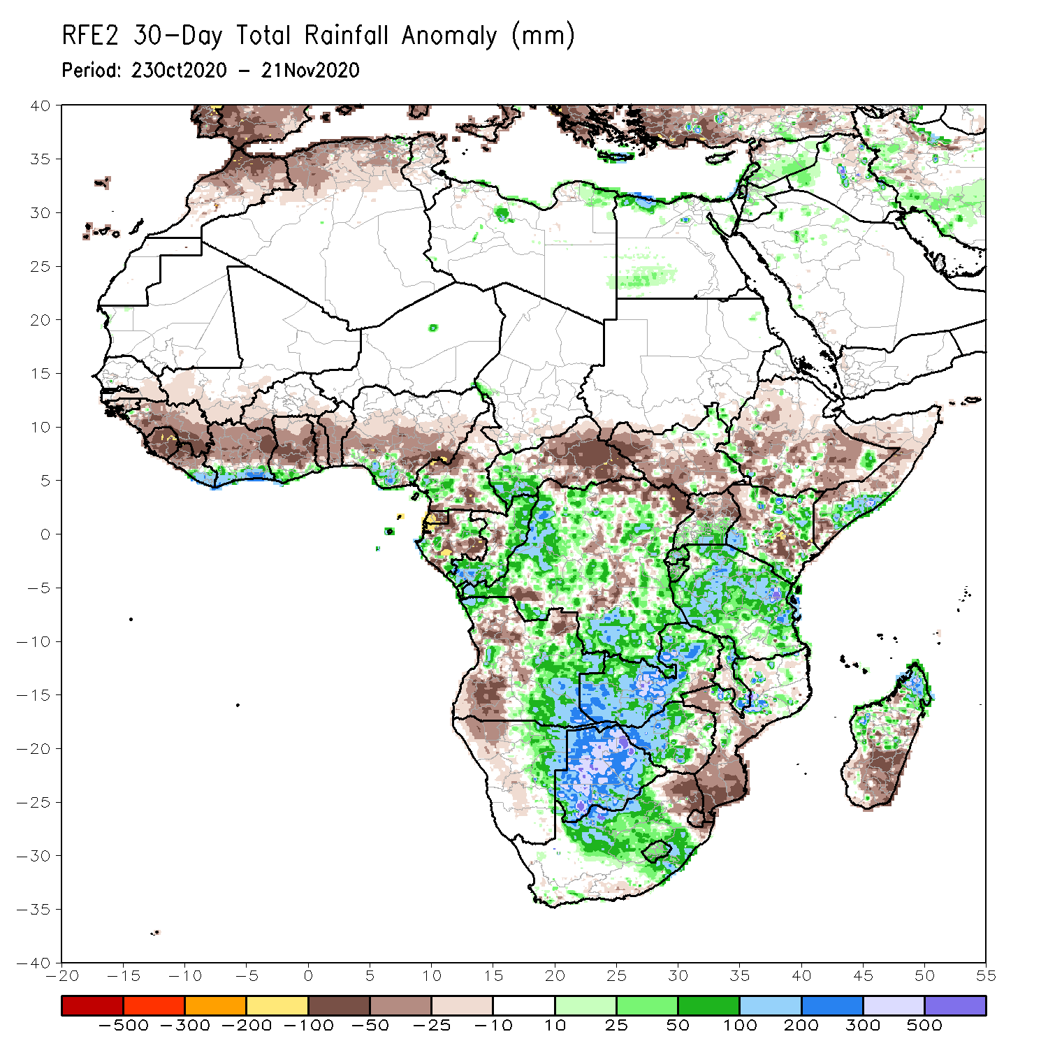
Rainfall Patterns: Last 30 Days
During the past 30 days, rainfall totals diminished over West Africa as the West African Monsoon retreated over the past several weeks. Rainfall was below-average over much of the northern areas of the Gulf of Guinea region, while the coastal areas received above average rains. In Central Africa, rainfall was below average over parts of Cameroon and Gabon, and much of CAR. Rainfall was also below average over pockets in DRC. Rainfall was above average over much of Congo and DRC. In East Africa, moisture surpluses prevailed over local areas in Ethiopia, southern Uganda, and northern Kenya. Rainfall was also above average over much of Tanzania. Below average rainfall was observed over many places in Ethiopia, northern and southern Somalia. In Southern Africa, rainfall was much above average over Zambia, Botswana and Zimbabwe. Moisture surpluses were also registered over the central areas of South Africa, including portions of the Maize Triangle, and the northern areas of Madagascar. Rainfall was below average over the southern areas of Mozambique and Madagascar.
Notes:
5

Slide 6
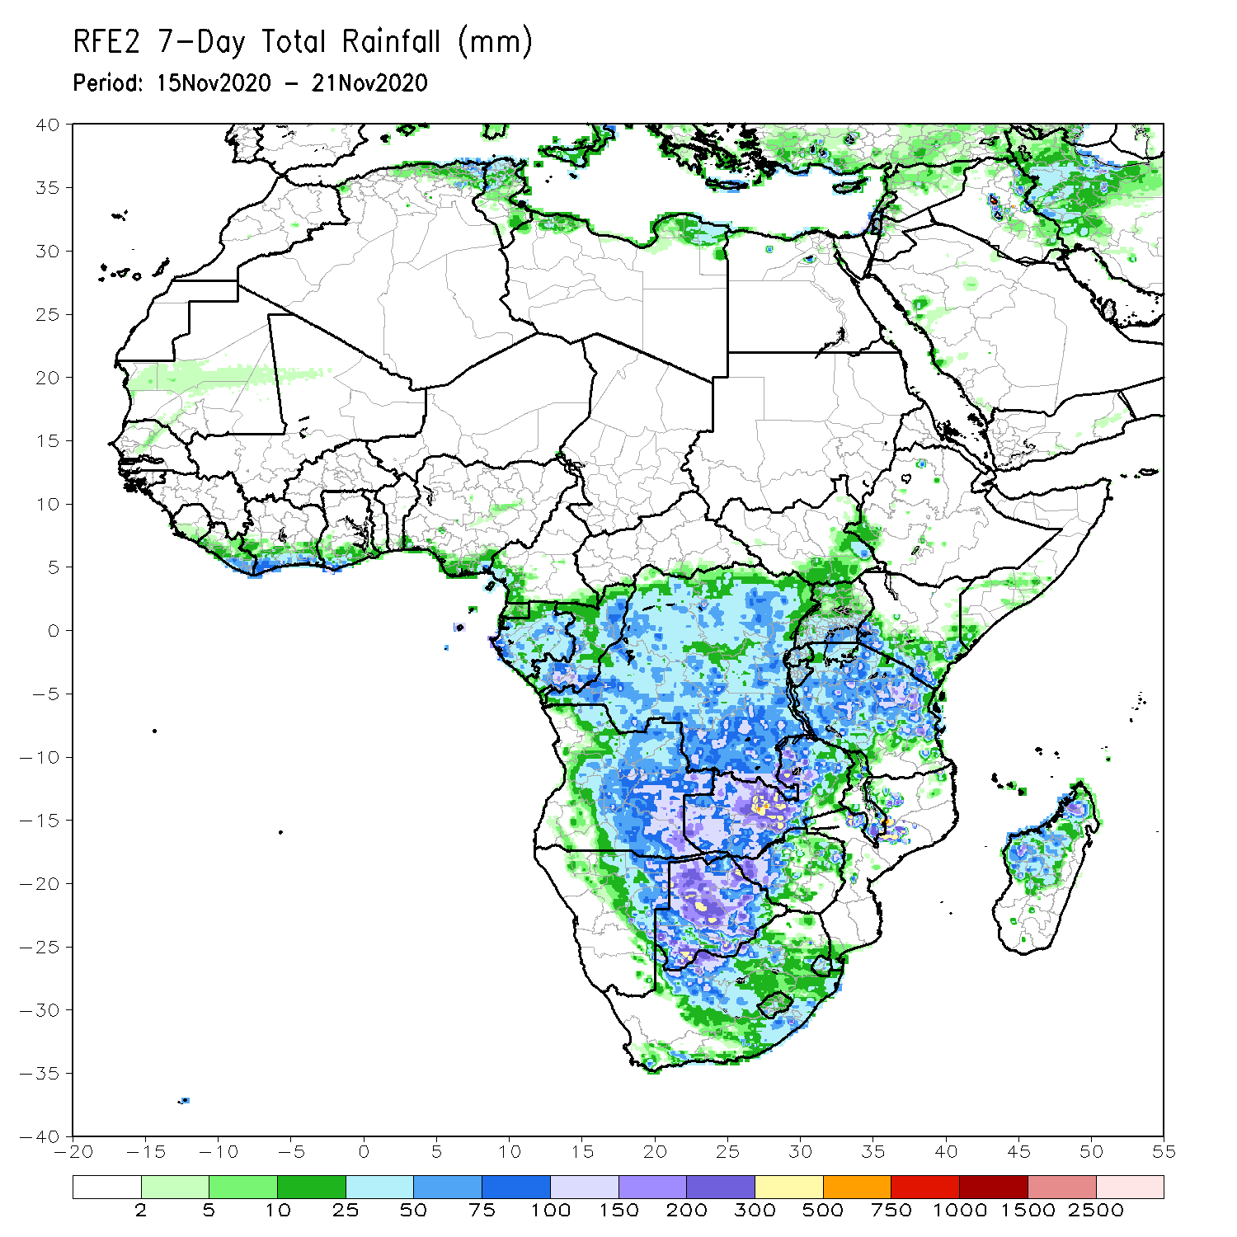
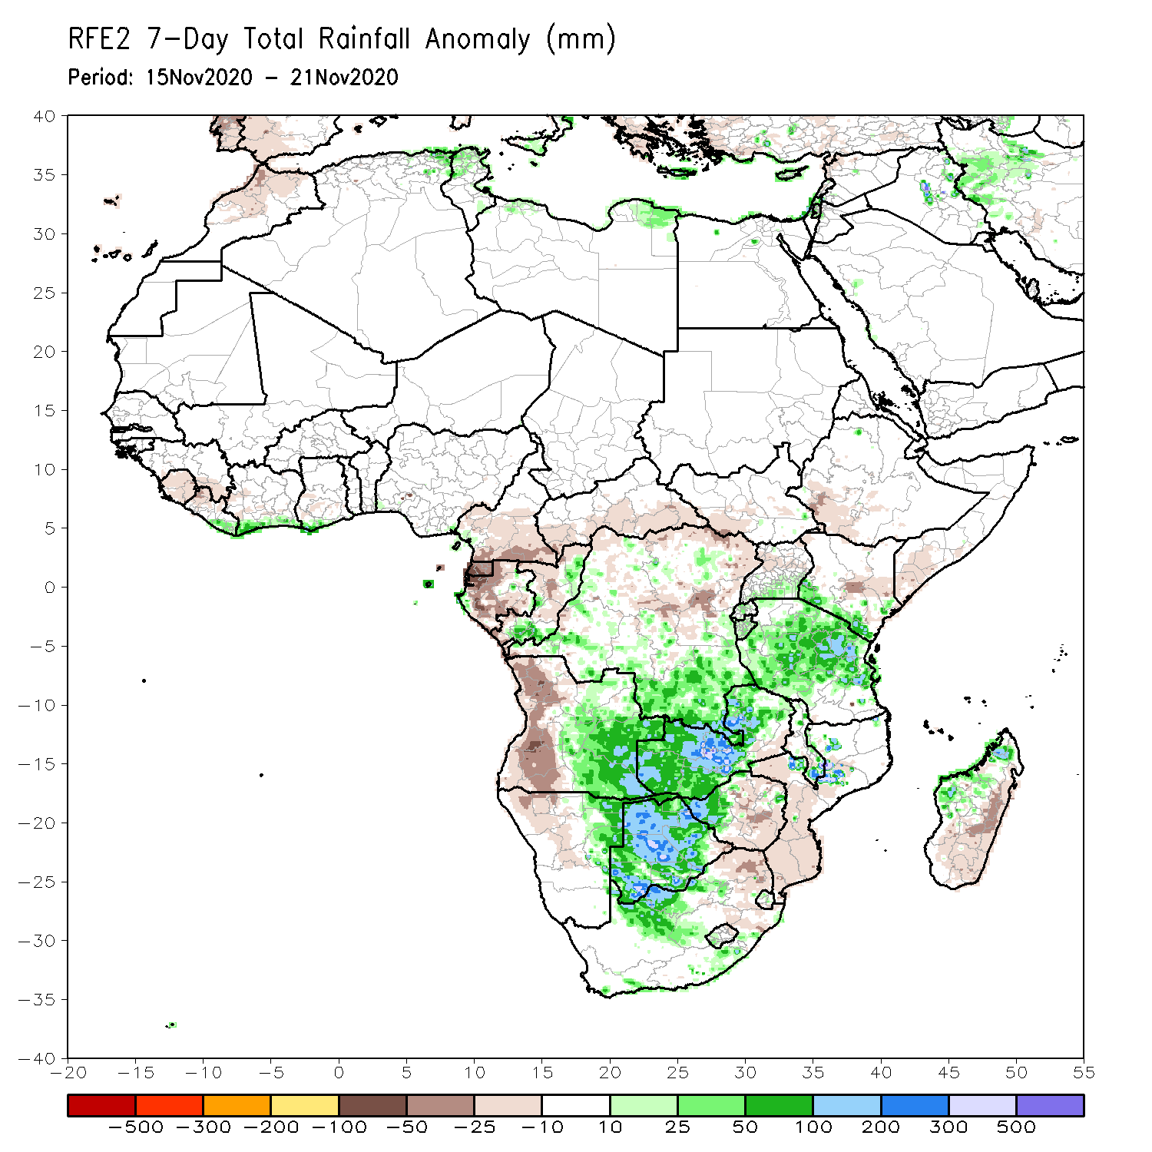
Rainfall Patterns: Last 7 Days
During the past 7 days, in East Africa, moderate to locally heavy rains (50-150 mm; 25-100 mm above the mean) fell over the central and northern areas of Tanzania and southern Kenya. Rainfall totals remained below-average over pocket areas in Kenya and southern Somalia. In Southern Africa, another week of heavy rains (75-300 mm; 50-200 mm above the mean) sustained moisture surpluses in western Zambia and Botswana. Sizable rainfall amounts fell over eastern Angola, while below average rains (25-50 mm) fell over western Angola, much of northwestern Namibia, eastern South Africa, eastern Zimbabwe and Mozambique. Northwestern Madagascar saw light to moderate rainfall with amounts ranging between 50 and 100 mm; 25-50 mm above the mean), while eastern and southern Madagascar had below-average rainfall. In Central Africa, rainfall was above average over portions of northern and southern DRC, southern Congo, while below-average rainfall was registered over Gabon, Equatorial Guinea, Congo. Light rains sustained moisture deficits in parts of Cameroon and CAR. Moderate rains fell along coastal Cote d’Ivoire, while seasonable dry weather prevailed across the Sahel.

Slide 7
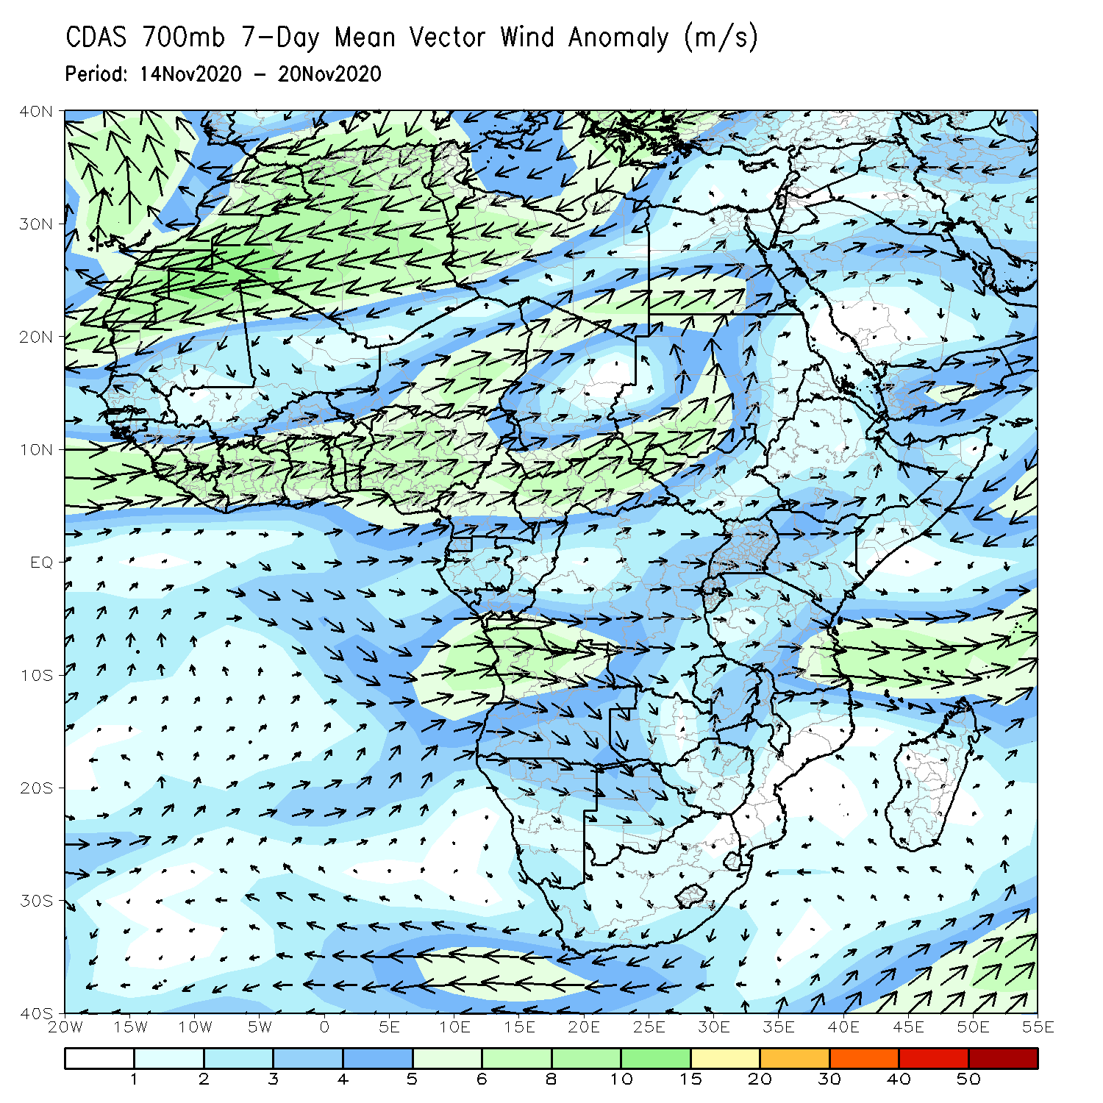
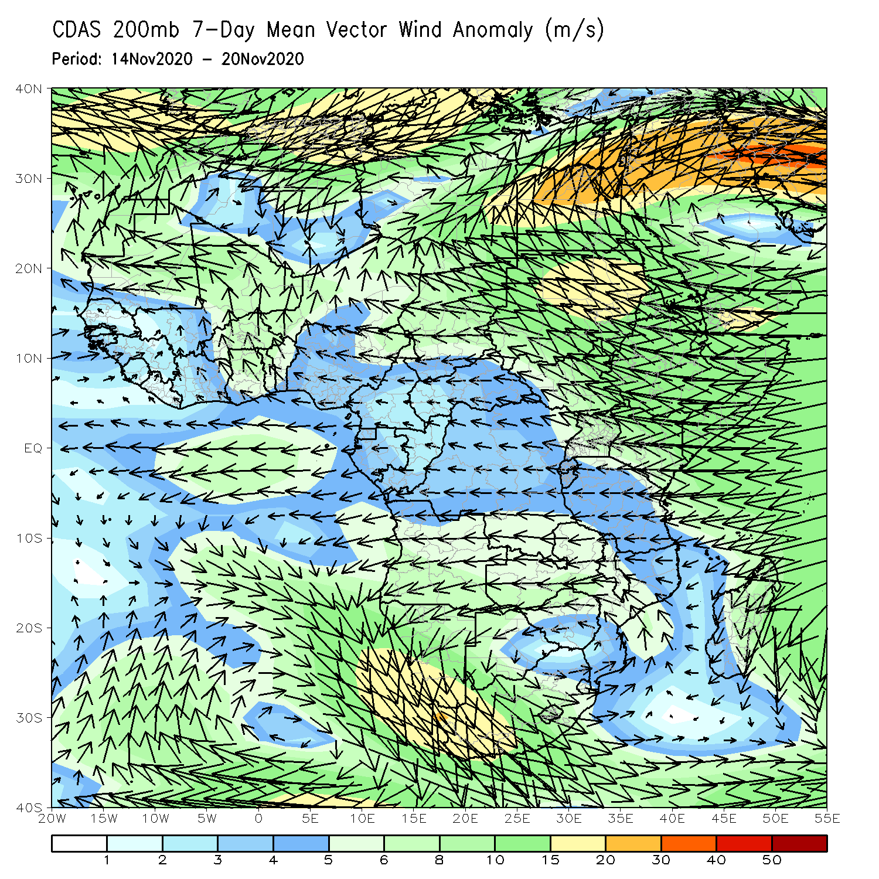
Atmospheric Circulation: Last 7 Days
An anomalous lower-level westerly flow (left panel) was observed along the Gulf of Guinea coast into Central Africa. At upper level (right panel), an anomalous anticyclonic flow prevailed across southern Africa.

Slide 8
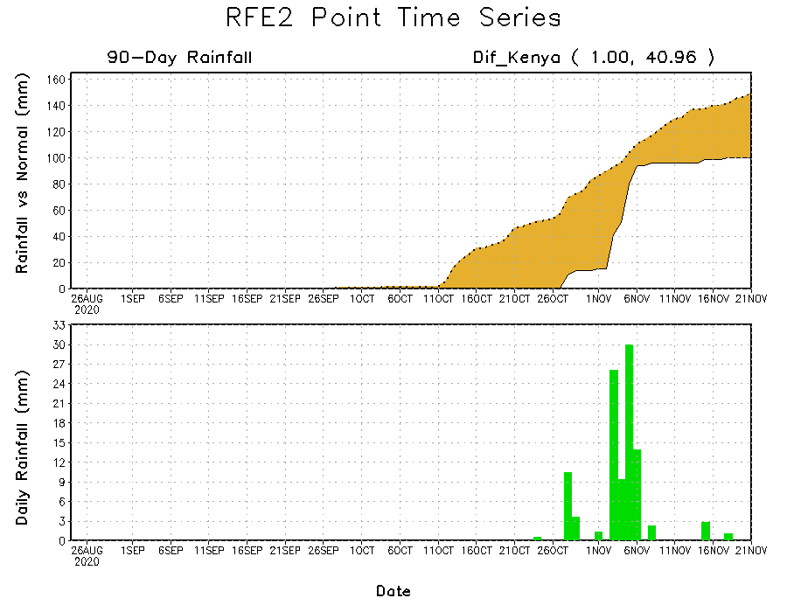
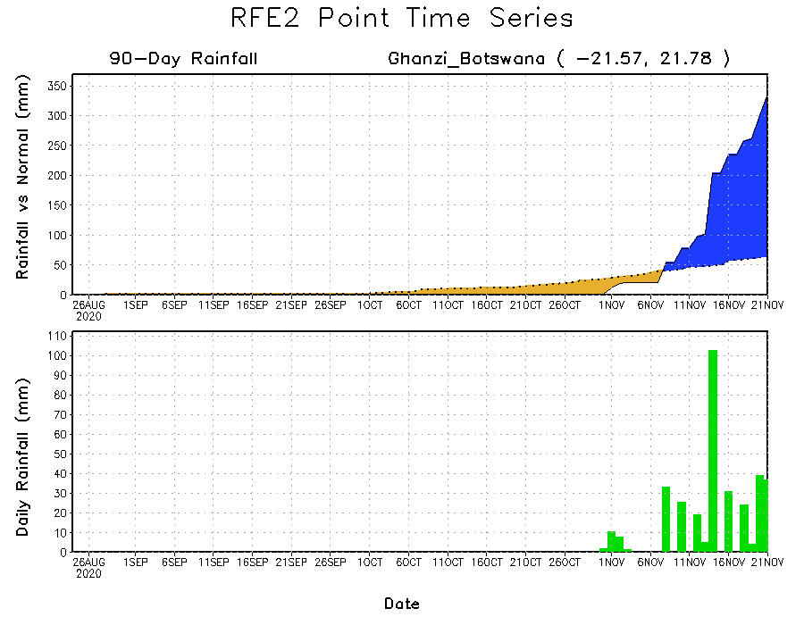
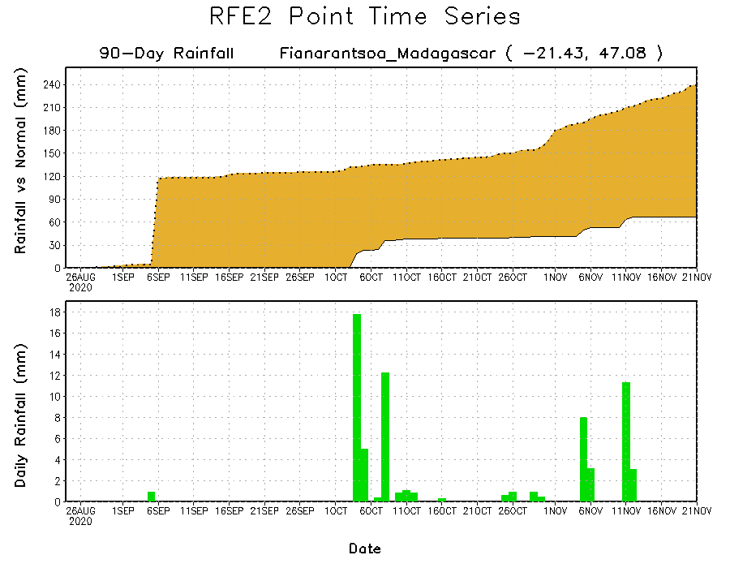
Rainfall Evolution
Daily evolution of rainfall over the last 90 days at selected locations shows that moderate to locally heavy rainfall sustained moisture surpluses over many parts of Botswana (bottom left). Moisture deficits continued to prevail over eastern Kenya (top right) and southern Madagascar (bottom right).

Slide 9
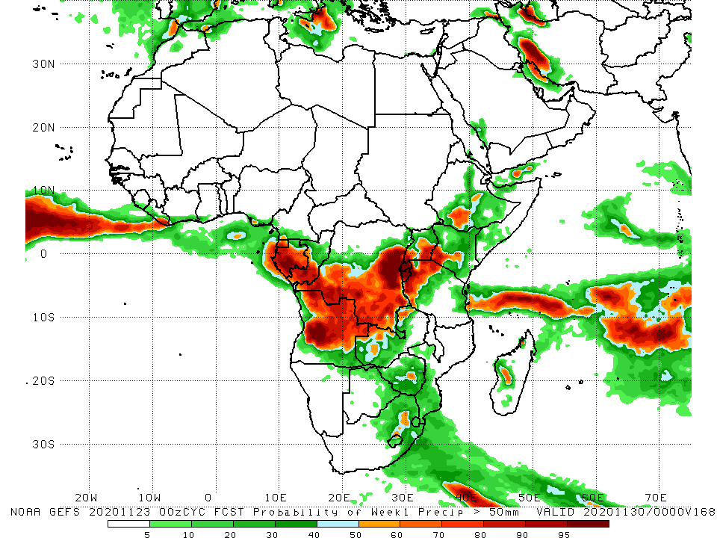
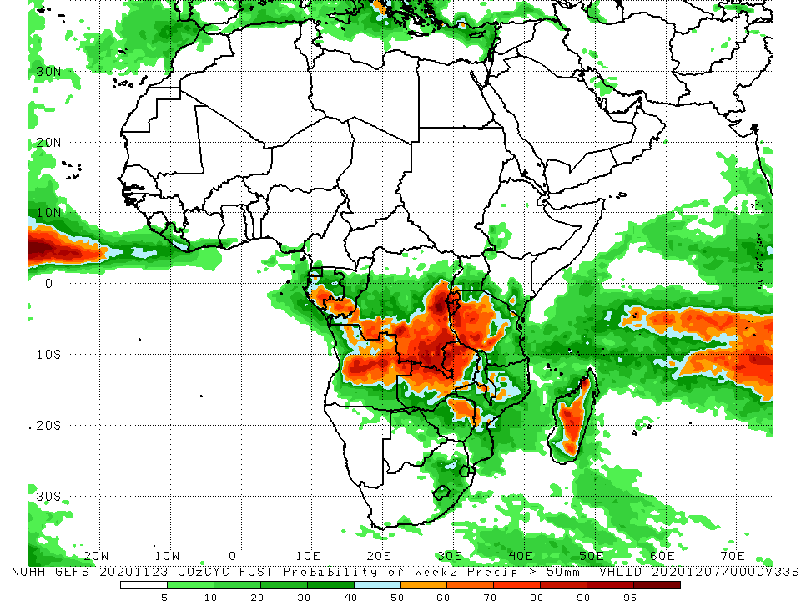
NCEP GEFS Model Forecasts Non-Bias Corrected Probability of precipitation exceedance
Week-1 Valid 24 – 30 November, 2020
Week-2: Valid 1 – 7 December, 2020
For week-1 (left panel and week-2 (right panel)), the NCEP GEFS indicates a moderate to high chance (over 70%) for rainfall to exceed 50 mm over Central Africa and pockets in East Africa.
Notes:
9

Slide 10
Summary
During the past 30 to 90 days, in West Africa, rainfall was above average over much of the Sahel, but as the West African monsoon retreated, seasonable dry weather prevailed over the Sahel during the past several weeks, while rainfall was below average over the northern areas of the Gulf of Guinea region. However, rainfall was above average along the coast. In Central Africa, rainfall was above average across much of the region, except for the western areas, which continued to register below average rainfall over the past several weeks. In East Africa, rainfall was above average over portions of equatorial East Africa, including Tanzania, while below-average rainfall was observed over northern and southern Somalia, and southeastern Kenya. Rainfall was much above average over the northern areas of southern Africa, but below average over the southern areas of Mozambique and Madagascar.
Moderate to heavy rainfall sustained moisture surpluses across eastern Angola, Zambia and much of Botswana. Above-average rainfall was also observed over much of Tanzania, while suppressed rainfall prevailed over much of southeastern Africa.
The week-1 and week-2 outlooks indicate a moderate to high chance for rainfall to exceed 50 mm across Gabon, Congo, southern and eastern DRC, Zambia, and the Lake Victoria region including Tanzania.

