Slide 1
The African Monsoon Recent Evolution and Current Status Include Week-1 and Week-2 Outlooks
Update prepared by
Climate Prediction Center / NCEP
14 December 2020
For more information, visit:
http://www.cpc.ncep.noaa.gov/products/Global_Monsoons/African_Monsoons/precip_monitoring.shtml

Slide 2
Outline
Highlights
Recent Evolution and Current Conditions
NCEP GEFS Forecasts
Summary

Slide 3
Highlights: Last 7 Days
During the past 7 days, heavy rains sustained moisture surpluses in Zambia, portions of Botswana, and northern Zimbabwe. Dry conditions resulted substantial moisture deficits over eastern Tanzania.
For week-1, the NCEP GEFS indicates a moderate to high chance (over 70%) for rainfall to exceed 50 mm over southern Gabon, southeastern DRC and much of Zambia and Zimbabwe. For week-2, the chance for rainfall to exceed 50 mm is confined to Zambia and northern Zimbabwe.

Slide 4
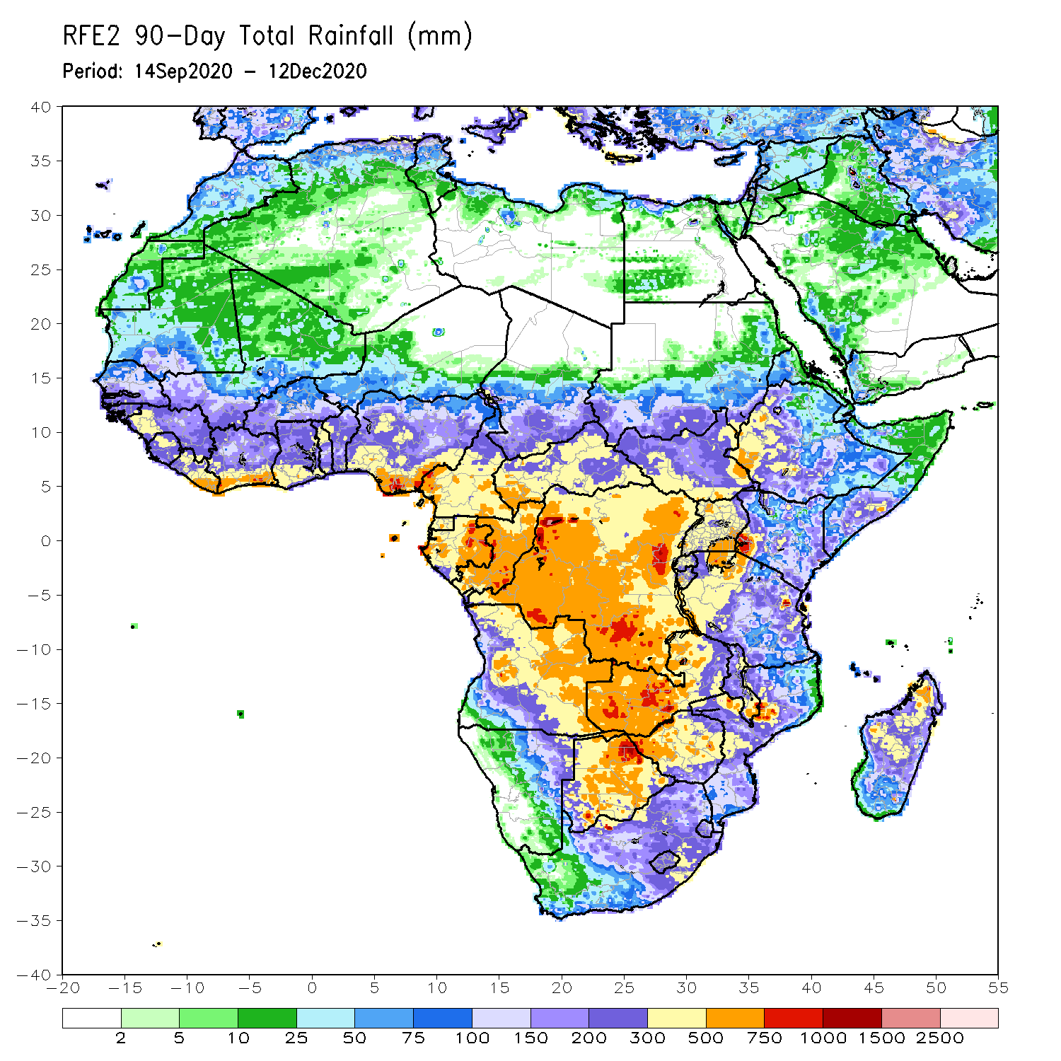
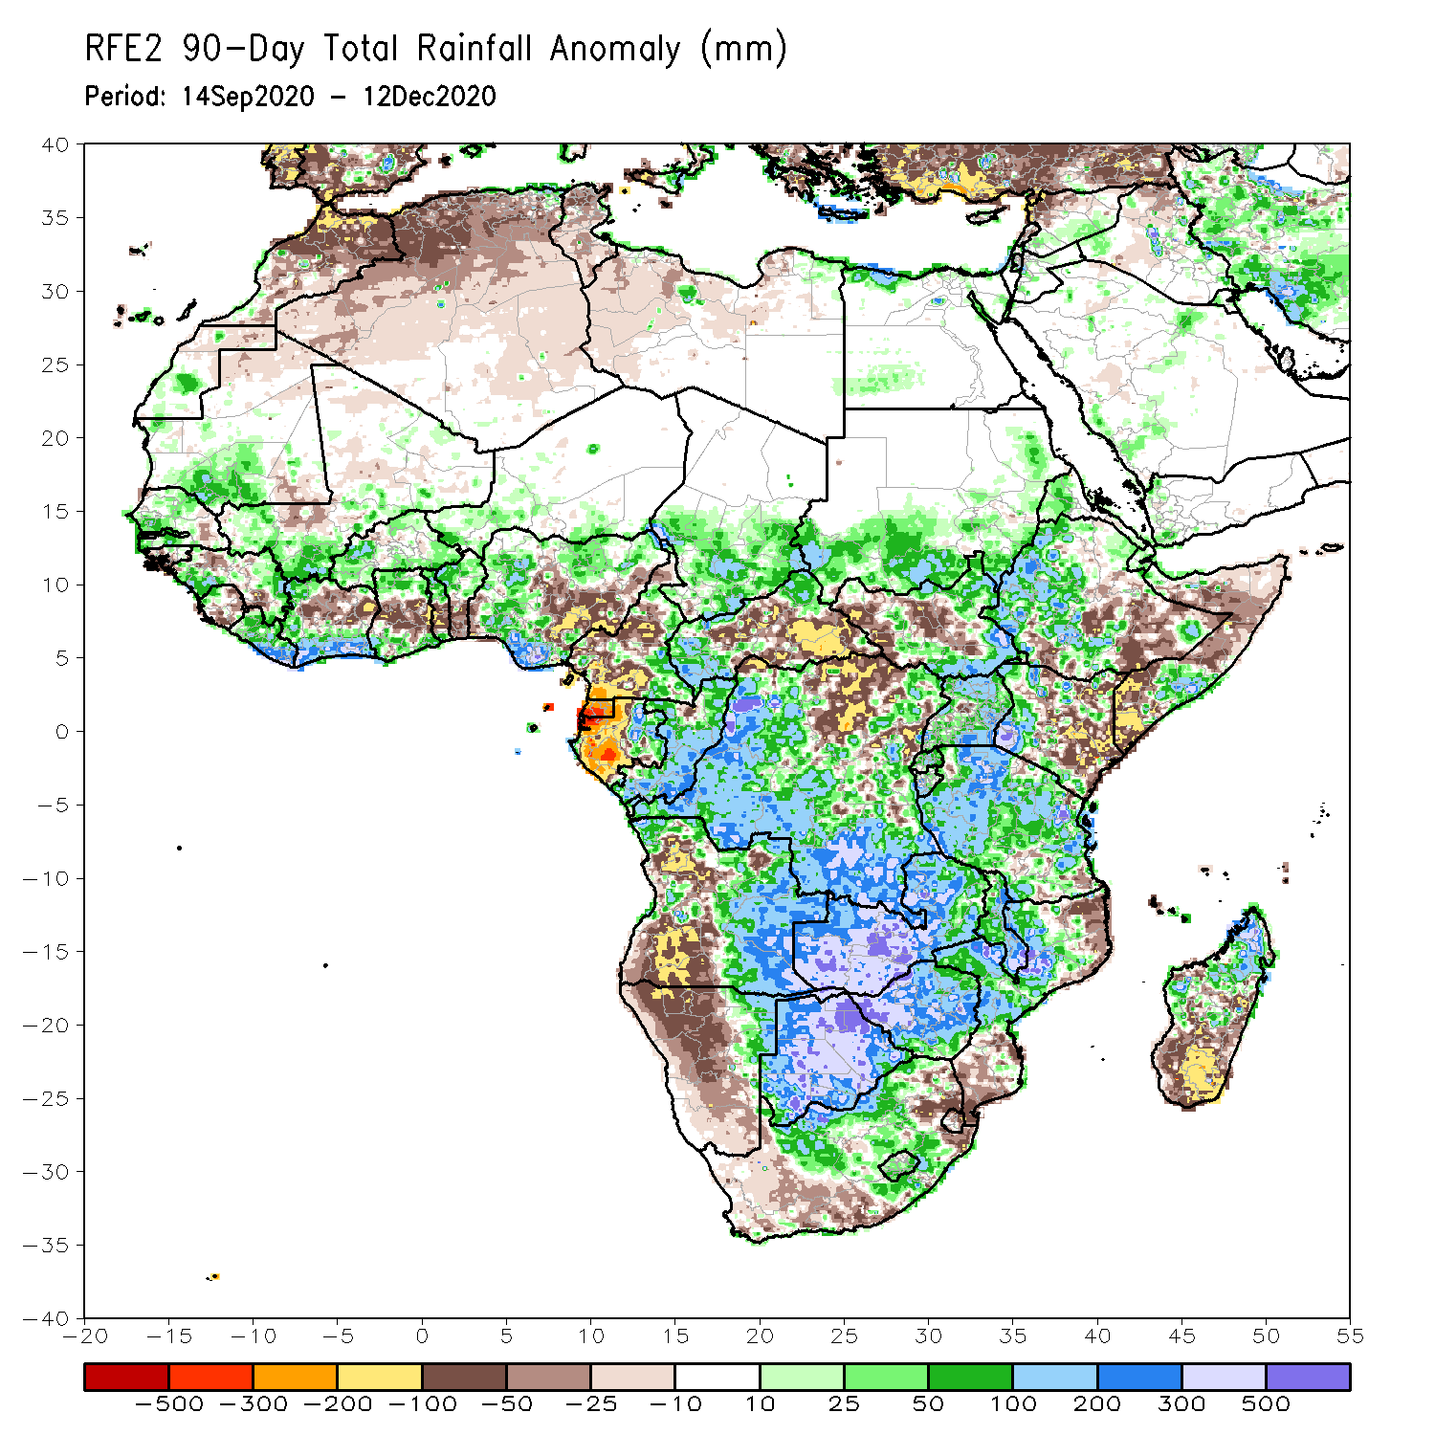
Rainfall Patterns: Last 90 Days
Over the past 90 days, in East Africa, rainfall was significantly below average over eastern Kenya, southern and northern Somalia, and portions of eastern Ethiopia. Rainfall was also below average over parts of South Sudan. Rainfall was above average over southern Sudan, western Ethiopia, and Uganda. The uptick in rainfall extended to much of northern and western Tanzania. In southern Africa, persistent rains resulted in sustained moisture surpluses over Zambia, Botswana, and Zimbabwe. Rainfall was also above average over central Mozambique and northern Madagascar. Persistent light rains resulted in moisture deficits in western Angola and northern Namibia. Rainfall was also below average along the border between South Africa and Mozambique and over southern Madagascar. In Central Africa, rainfall above average over much of DRC and Congo. Rainfall was below average over northern DRC, and CAR. Below average rains were also observed over the western areas of Gabon and Cameroon. In West Africa, rainfall was below average in the central areas of the Gulf of Guinea region, and above average along the coast. Rainfall was generally above average over the Sahel.
Notes:
4

Slide 5
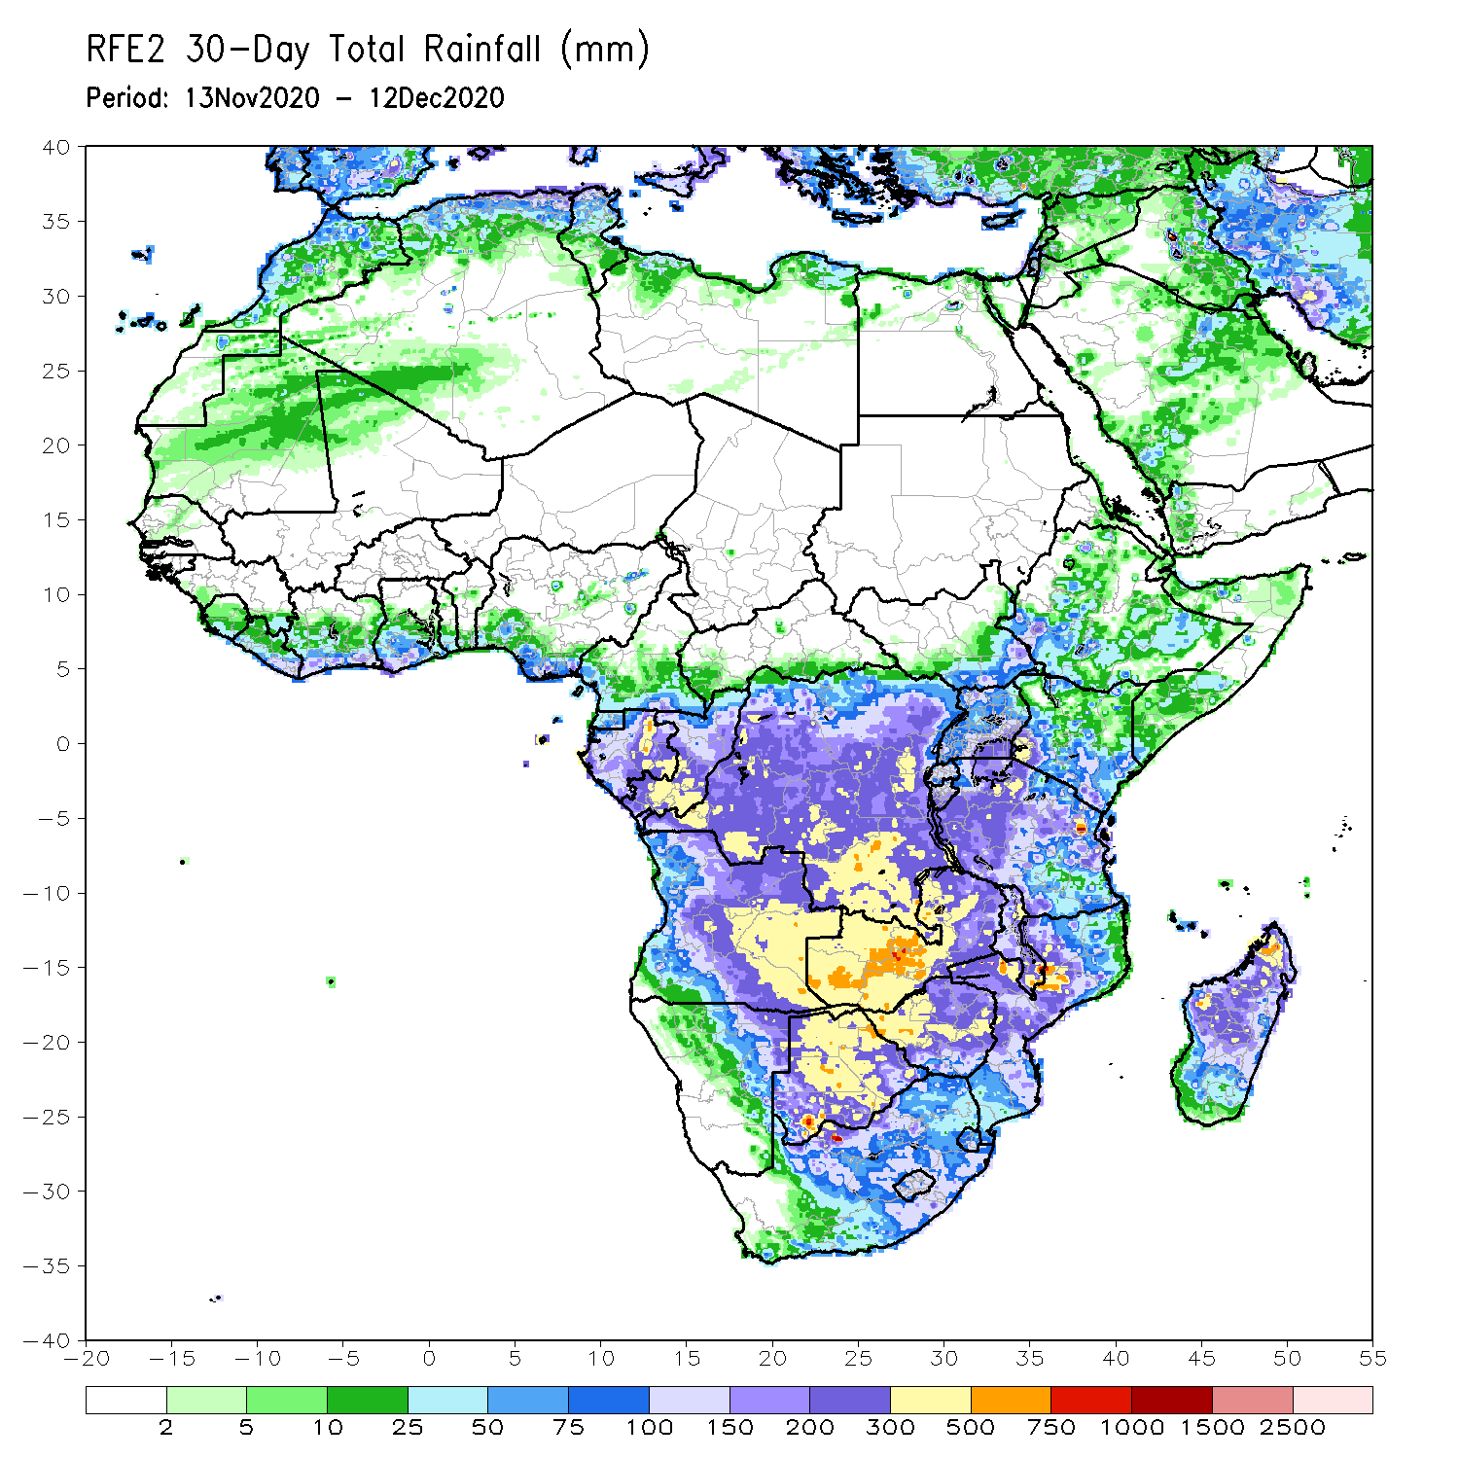
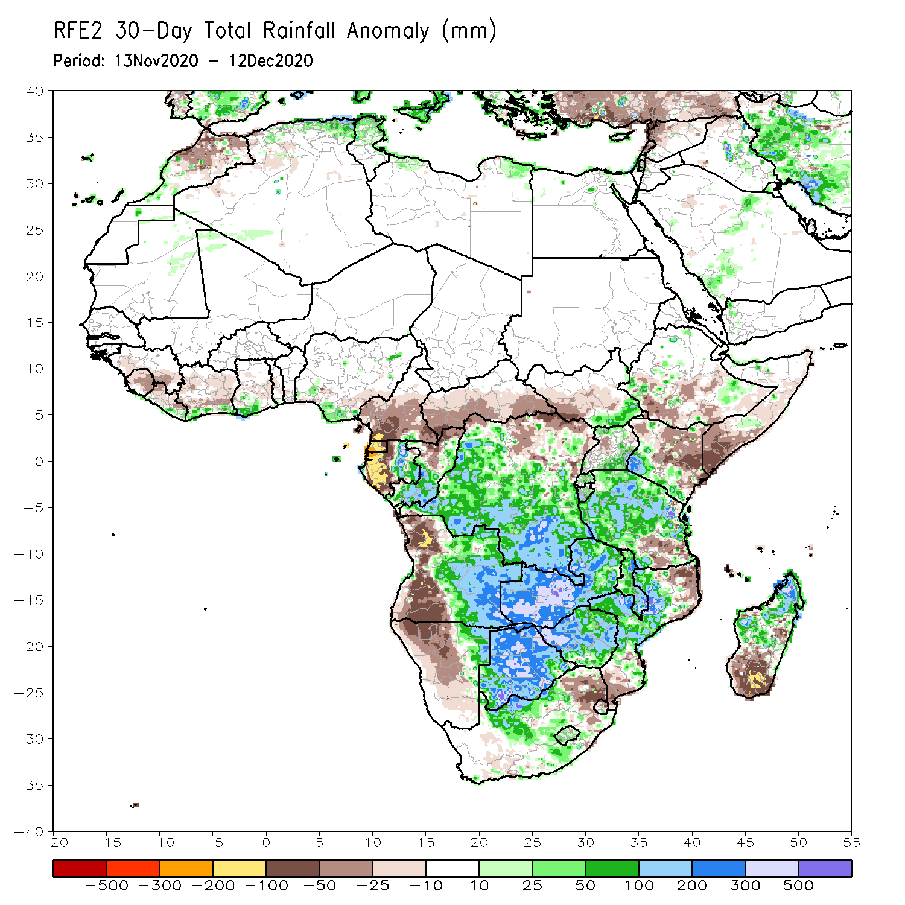
Rainfall Patterns: Last 30 Days
During the past 30 days, in East Africa, several weeks of light rains resulted in moisture deficits over southern Somalia, eastern Kenya, and pockets in southern Ethiopia. Rainfall was above average locally over southwestern Kenya and much of Tanzania, except for the southeastern areas. In southern Africa, persistent moderate to heavy rains resulted in moisture surpluses over Zambia, Botswana, and Zimbabwe. Rainfall was also above average over central Mozambique and northern Madagascar. Persistent light rains resulted in moisture deficits in western Angola and northern Namibia. Rainfall was also below average over northeastern South Africa, the northern and southern tips of Mozambique and southern Madagascar. In central Africa, rainfall was above average over central and southern DRC, southern Congo, and eastern Gabon. Rainfall was below average over western Gabon, and the southern areas of Cameroon and CAR. In West Africa, rainfall was slightly above average in pockets along the Guinean coast.
Notes:
5

Slide 6
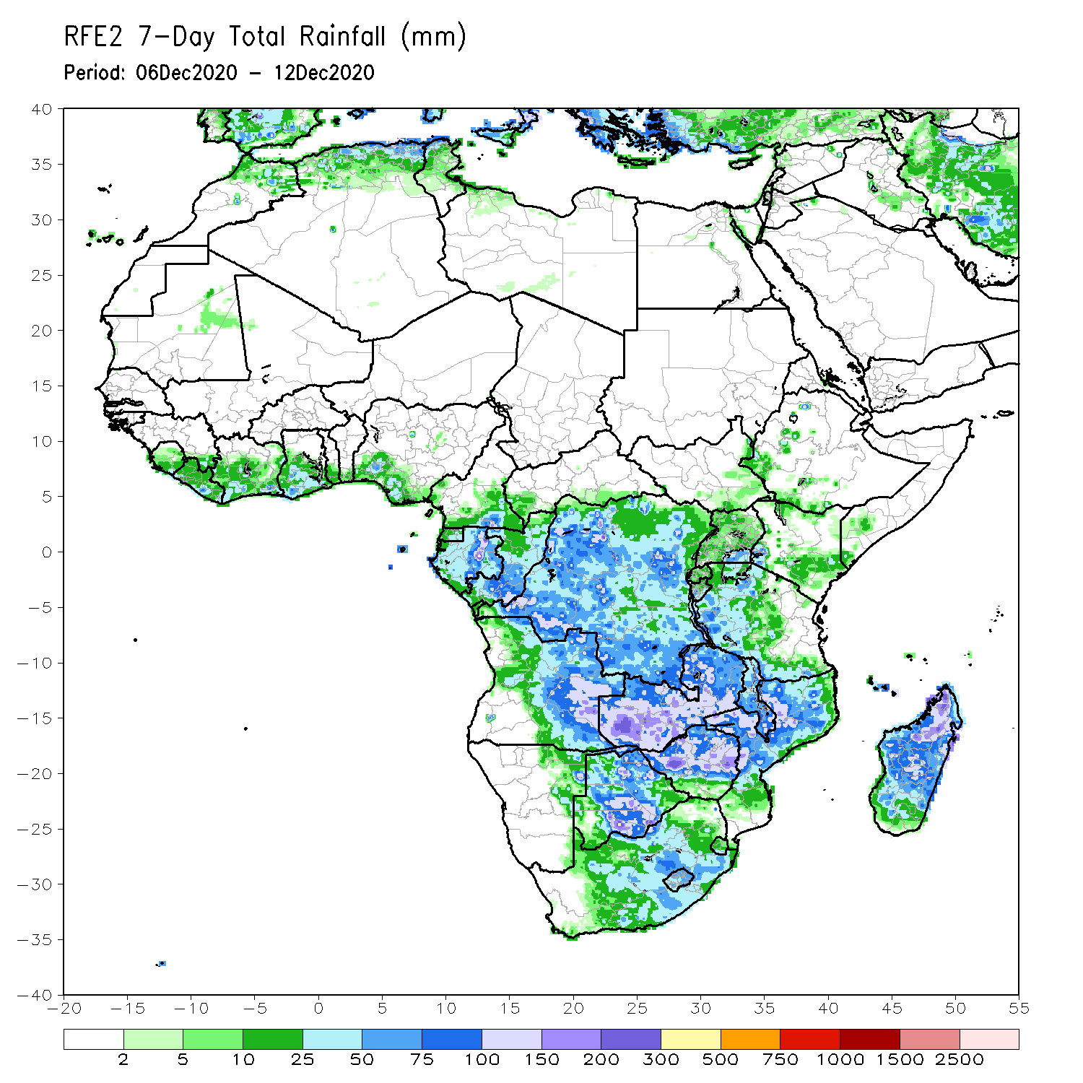
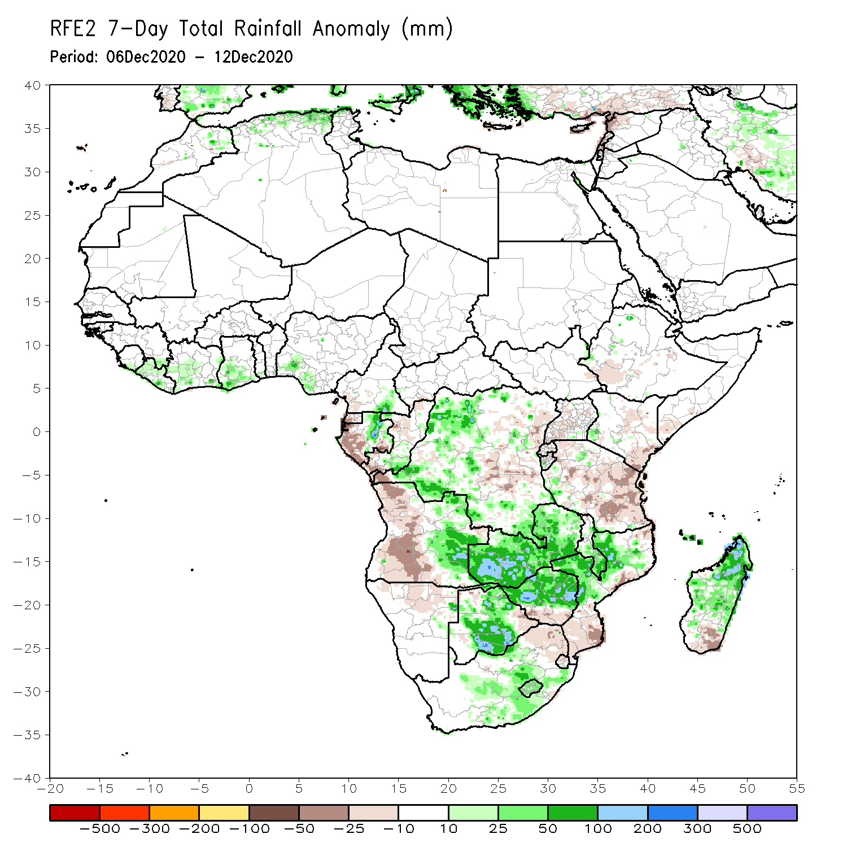
Rainfall Patterns: Last 7 Days
During the past 7 days, in East Africa, dry conditions prevailed over much of the Greater Horn of Africa including Ethiopia, Somalia, and northern Kenya. Light rains resulted in slight moisture deficits in southern Kenya, Uganda, and western Tanzania. Dry conditions prevailed over eastern Tanzania, where moisture deficits were most severe. In Southern Africa, heavy rains sustained moisture surpluses in Zambia, portions of Botswana, and northern Zimbabwe. Rainfall was also above average over the northern two third of Madagascar. In contrast, rainfall was slightly below average over the western half of Angola, northeastern South Africa and southern Mozambique. In Central Africa, light rains sustained moisture deficits in Gabon. Rainfall was locally heavy and above average over pockets in western DRC. In West Africa moderate rains fell along coastal Gulf of Guinea resulting a slight uptick in precipitation in local areas.

Slide 7
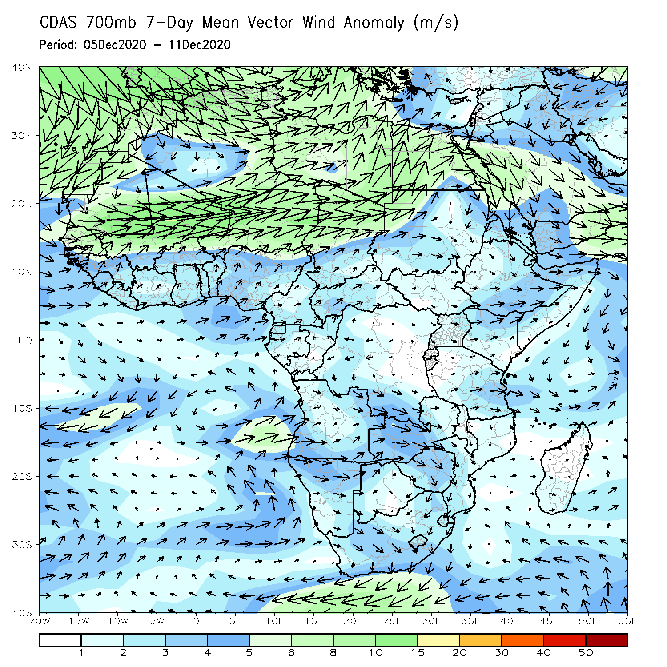
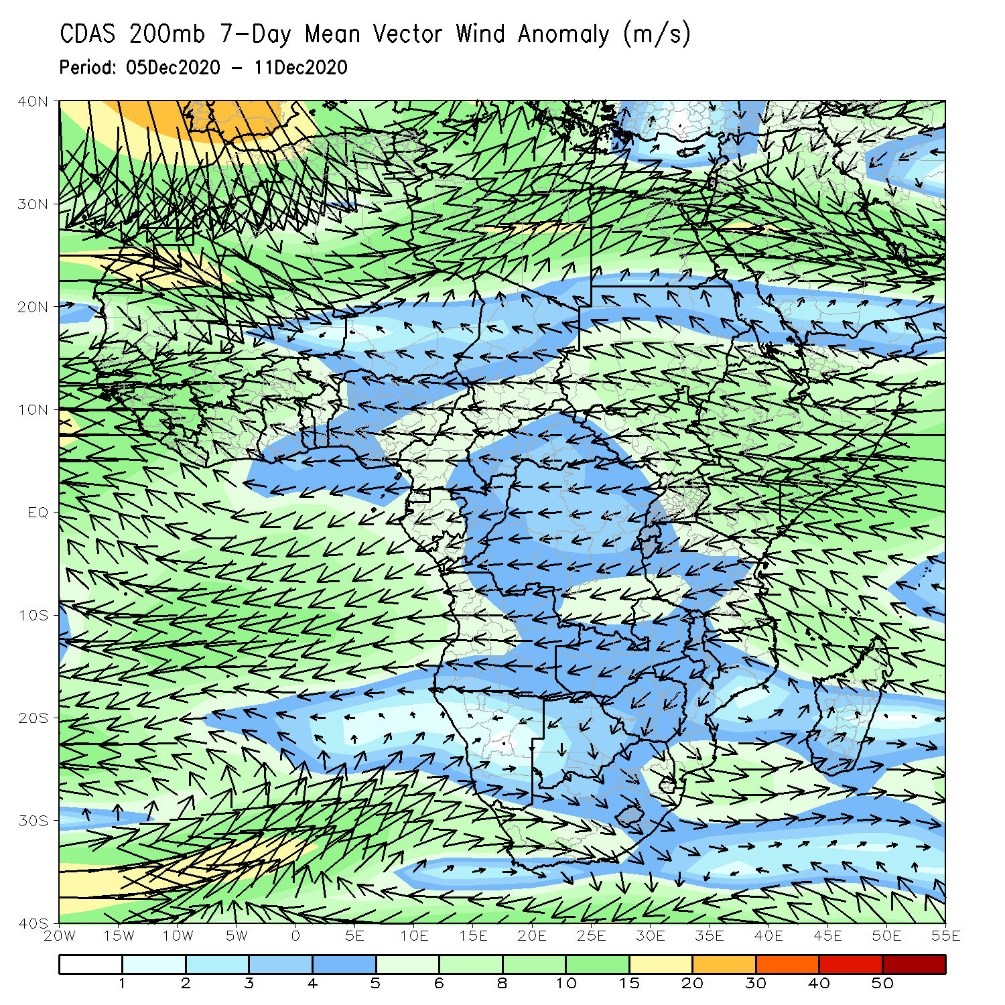
Atmospheric Circulation: Last 7 Days
At low level (left panel), an anomalous anticyclonic circulation prevailed off the coast of Angola, while westerly wind anomalies persisted over Zambia. At upper level (right panel) an anomalous anticyclonic circulation prevailed over southeastern Africa.

Slide 8
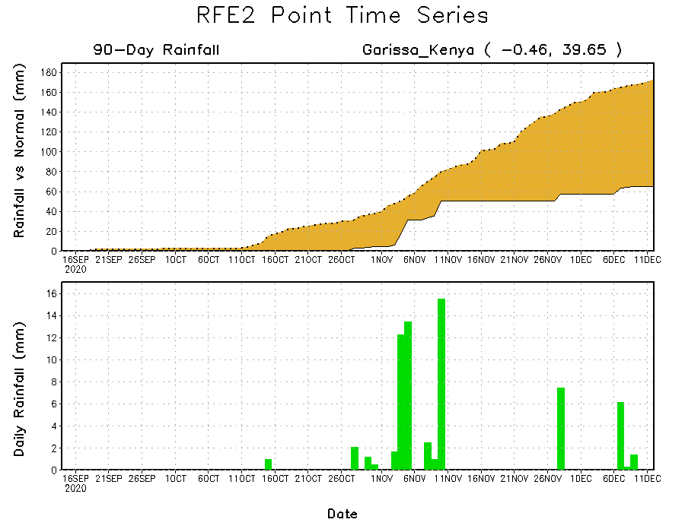
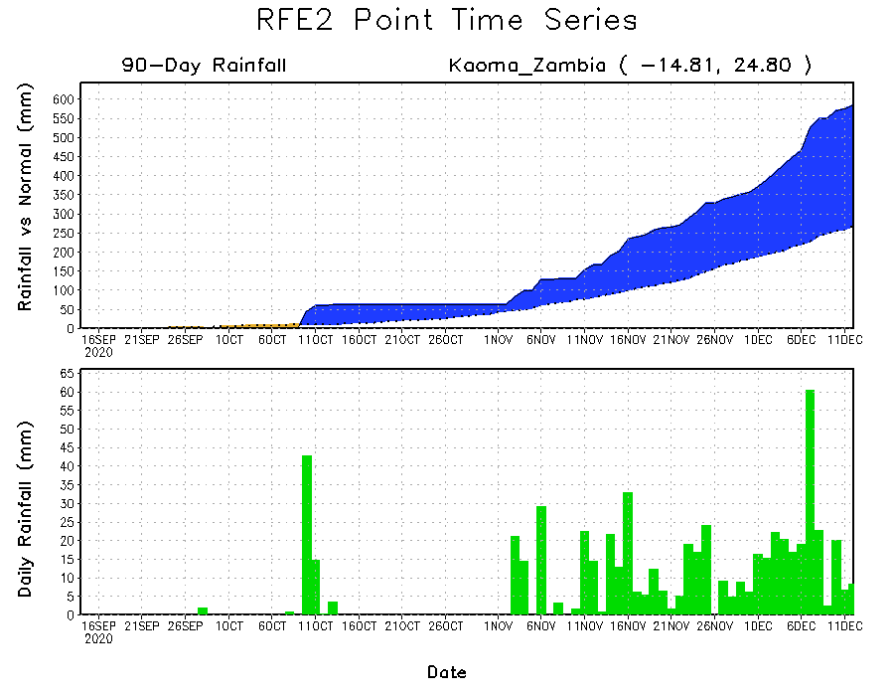
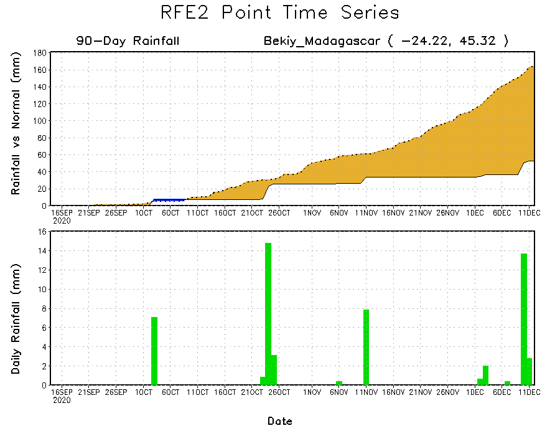
Rainfall Evolution
Daily evolution of rainfall over the last 90 days at selected locations shows that moderate to locally heavy rainfall sustained moisture surpluses over western Zambia (bottom left). Dry conditions settled in over eastern Kenya (top right) and southern Madagascar (bottom right).

Slide 9
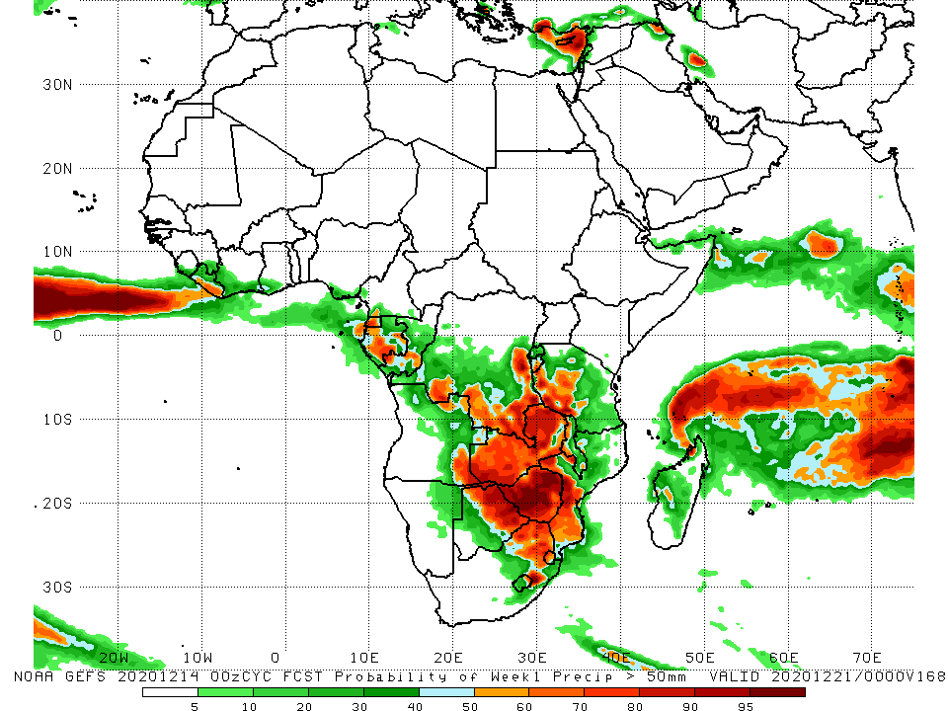
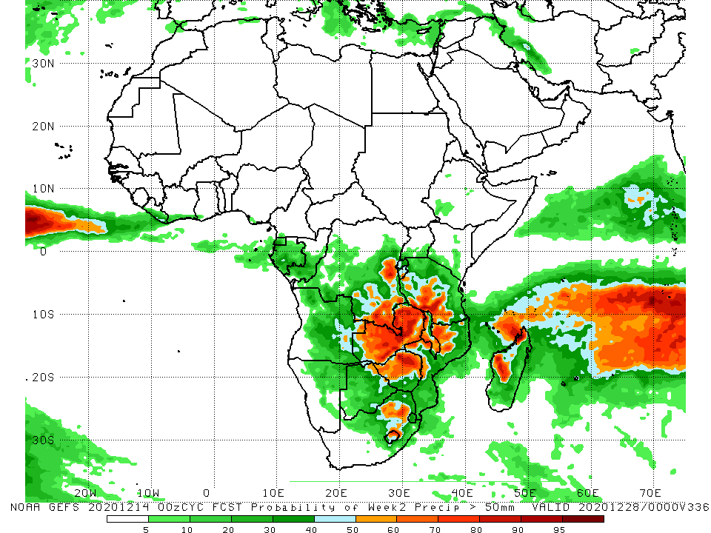
NCEP GEFS Model Forecasts Non-Bias Corrected Probability of precipitation exceedance
Week-1, Valid: 15 – 21 December, 2020
Week-2, Valid: 22 – 28 December, 2020
For week-1 (left panel), the NCEP GEFS indicates a moderate to high chance (over 70%) for rainfall to exceed 50 mm over southern Gabon, southeastern DRC and much of Zambia and Zimbabwe. For week-2 (right panel), the chance for rainfall to exceed 50 mm is confined to Zambia and northern Zimbabwe.
Notes:
9

Slide 10
Summary
During the past 30 to 90 days, in East Africa, moisture deficits prevailed over southern Somalia, eastern Kenya, and pockets in southern Ethiopia. Rainfall was above average locally over southwestern Kenya and much of Tanzania. In southern Africa, rainfall was above average over the northern areas of the region, including northern Madagascar. Rainfall was below average over western Angola and northern Namibia. In central Africa, rainfall was above average over central and southern DRC, southern Congo, and eastern Gabon. Rainfall was below average over western Gabon, and the southern areas of Cameroon and CAR. In West Africa, rainfall was slightly above average in pockets along the Guinean coast.
During the past 7 days, in East Africa, dry conditions prevailed over much of the Greater Horn of Africa including Ethiopia, Somalia, and northern Kenya. In Southern Africa, heavy rains sustained moisture surpluses over the northern areas, including the northern two third of Madagascar. In contrast, rainfall was slightly below average over the western areas. In Central Africa, light rains sustained moisture deficits in Gabon, while moisture surpluses prevailed over western DRC.
The week-1 and week-2 outlooks indicate a moderate to high chance for rainfall to exceed 50 mm over southern Gabon, southeastern DRC and much of Zambia and Zimbabwe. For week-2, the chance for rainfall to exceed 50 mm is confined to Zambia and northern Zimbabwe.

