Slide 1
The African Monsoon Recent Evolution and Current Status Include Week-1 and Week-2 Outlooks
Update prepared by
01 February 2021
For more information, visit:
http://www.cpc.ncep.noaa.gov/products/Global_Monsoons/African_Monsoons/precip_monitoring.shtml

Slide 2
Outline
Highlights
Recent Evolution and Current Conditions
NCEP GEFS Forecasts
Summary

Slide 3
Highlights: Last 7 Days
During the past 7 days, in Southern Africa, moderate to locally heavy rainfall sustained moisture surpluses across northern Namibia, Botswana, Zimbabwe and South Africa. Rainfall was also above-average over local areas in Angola, Mozambique and Madagascar. Below-average rainfall was observed over parts of central Angola, pocket areas in southern Tanzania, and portions of Mozambique and Madagascar. In Central Africa, moderate to locally heavy rains sustained moisture surpluses over much of Gabon, Congo and DRC.
The week-1 and week-2 outlooks indicate a moderate to high chance for rainfall to exceed 50 mm over southern Gabon, southern Congo, eastern Angola, southern DRC, northeastern Namibia, Botswana, Zimbabwe, southern Tanzania, Zambia, Malawi, northeastern South Africa, and parts of Mozambique and Madagascar.

Slide 4
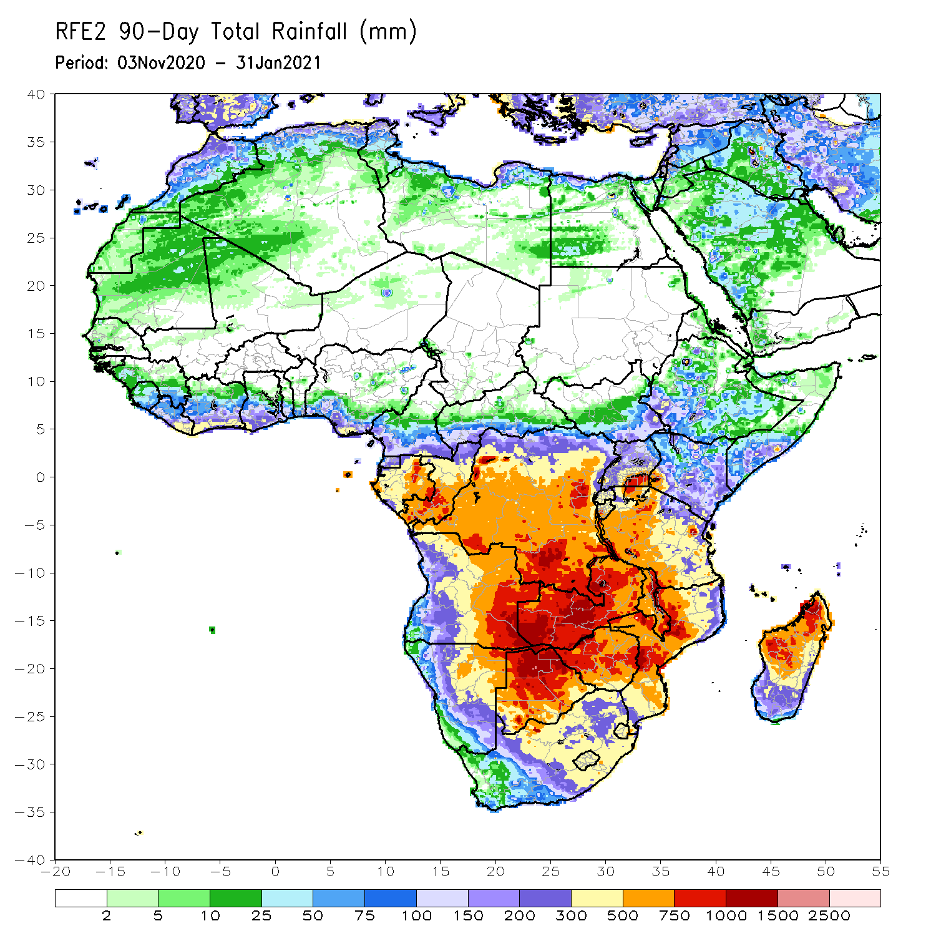
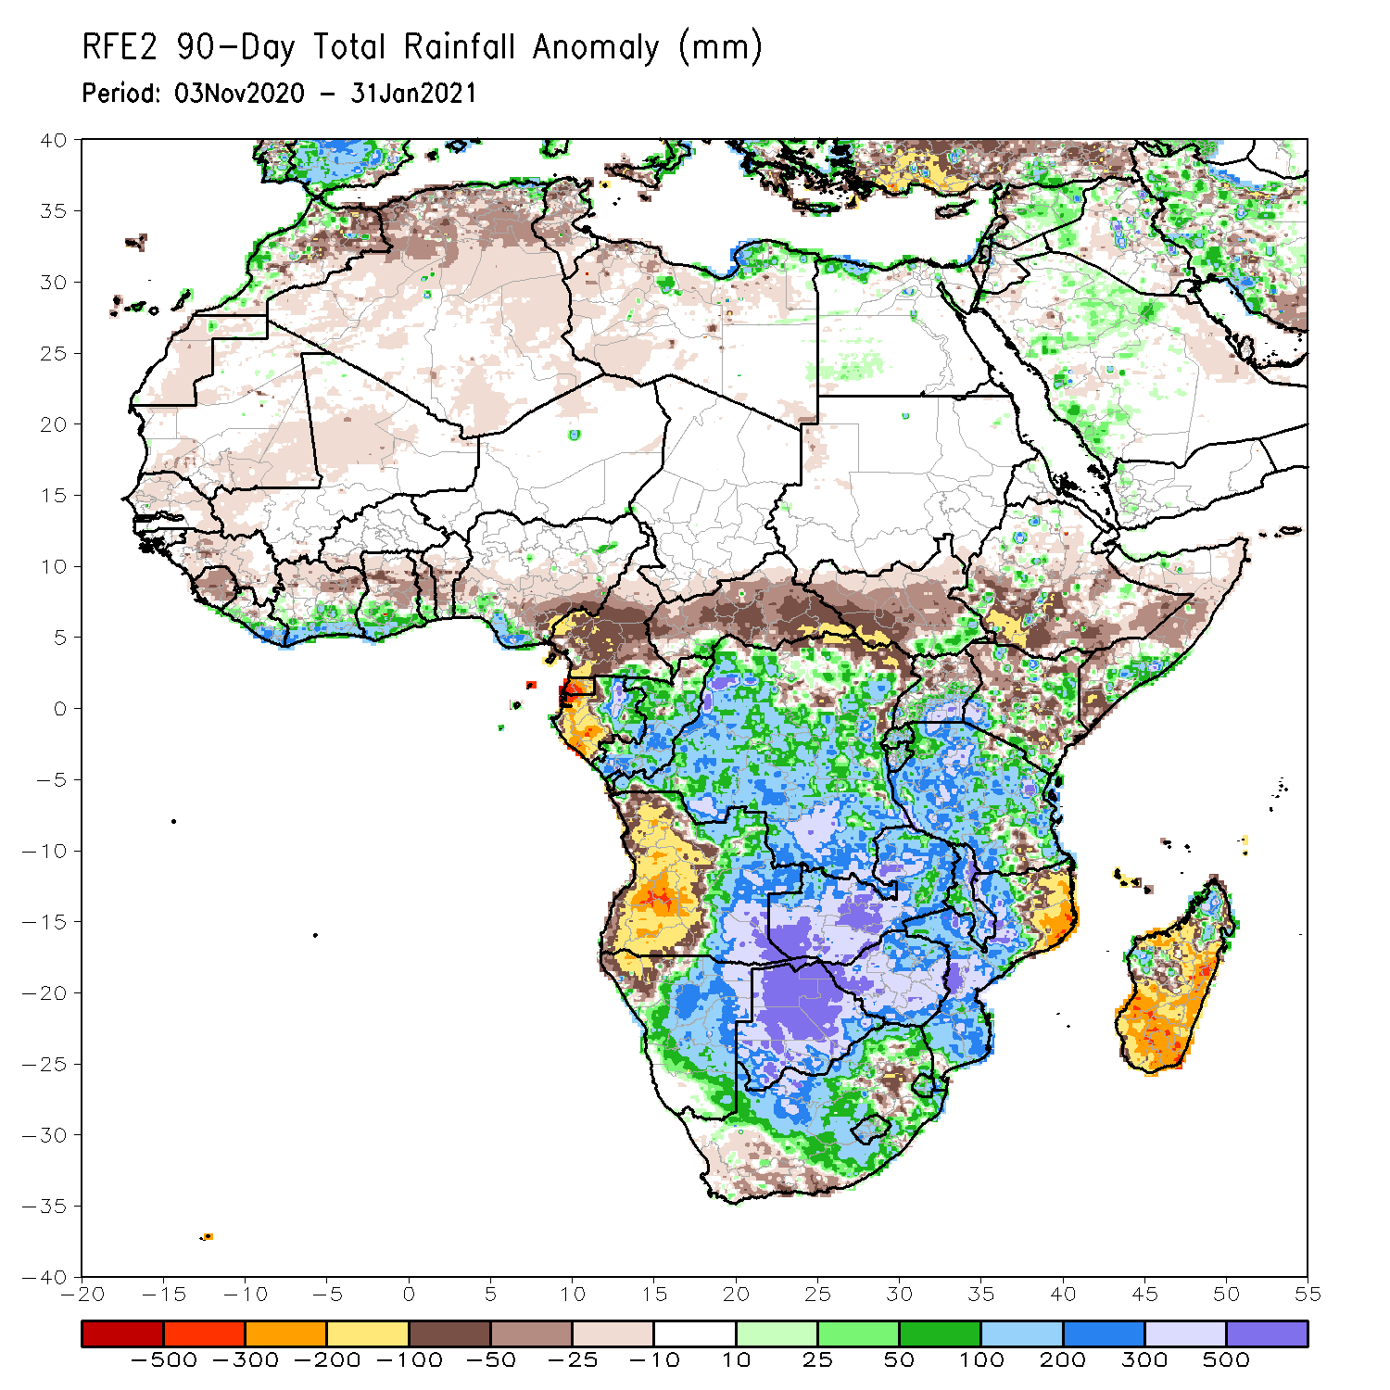
Rainfall Patterns: Last 90 Days
Over the past 90 days, in southern Africa, persistent rains resulted in sustained moisture surpluses over eastern Angola, Zambia, Botswana, and Zimbabwe. Rainfall was also above average over many parts of Mozambique and pocket areas in northern Madagascar. Persistent light rains resulted in moisture deficits in western Angola and northwestern Namibia. Rainfall was also below average along the border between South Africa and Mozambique and over central and southern Madagascar. In East Africa, rainfall was below average over parts of southern Ethiopia and Kenya, and local areas in Somalia. Rainfall was also below average over many parts of South Sudan. Rainfall was above average over southeastern South Sudan, pocket areas in Kenya and Somalia, and Uganda and much of Tanzania. In Central Africa, rainfall was above average over many parts of DRC and Congo. Rainfall was below average over local areas in northern DRC and much of CAR. Below average rains were also observed over the western areas of Gabon and much of Cameroon. In West Africa, rainfall was below average in the central areas of the Gulf of Guinea region, and above average along the coast.
Notes:
4

Slide 5
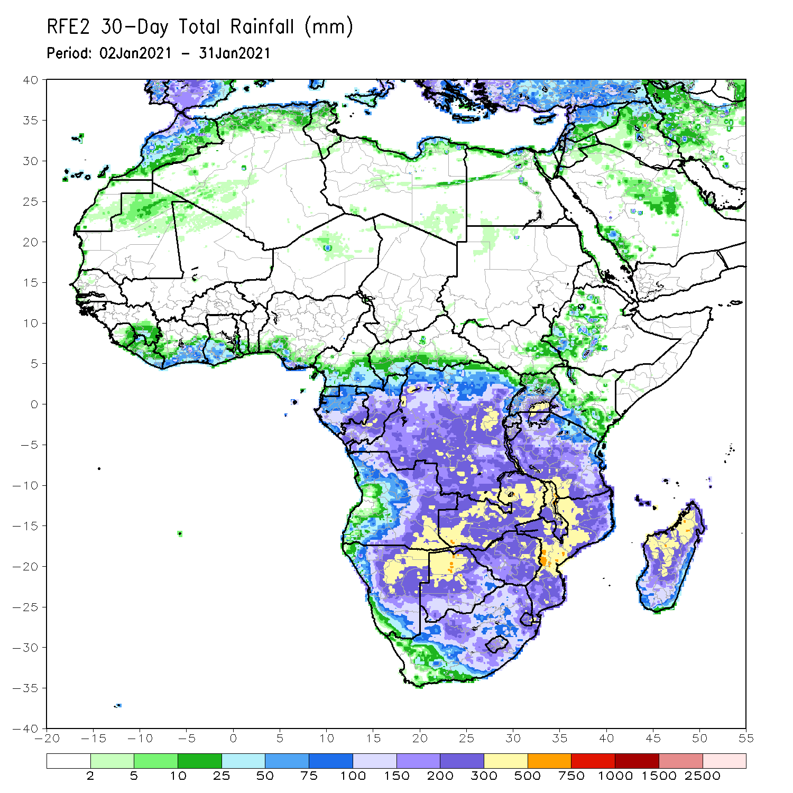
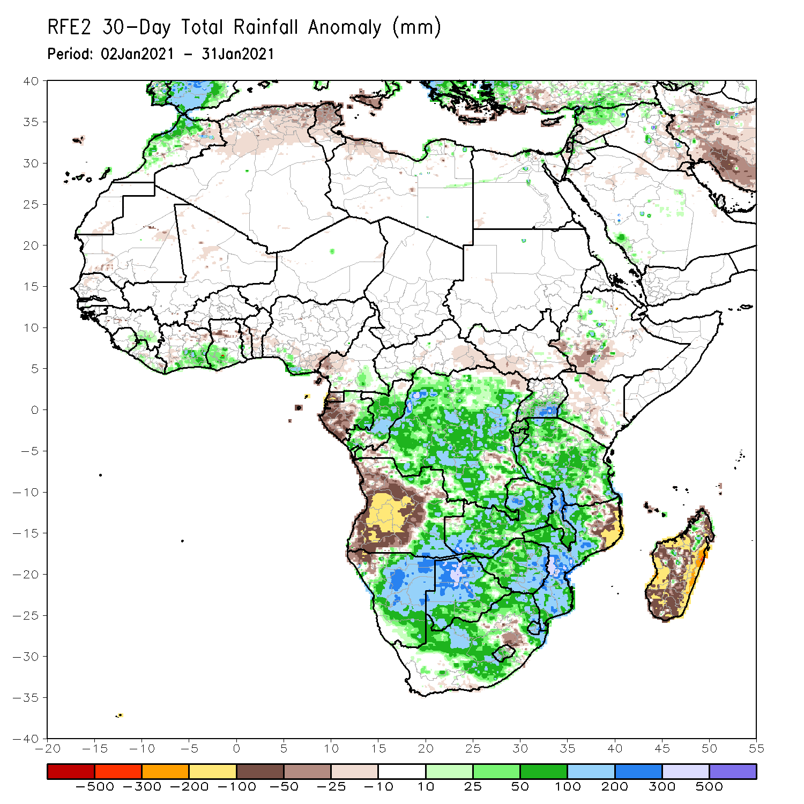
Rainfall Patterns: Last 30 Days
During the past 30 days, in southern Africa, persistent moderate to heavy rains resulted in moisture surpluses over eastern Angola, Namibia, Zambia, Botswana, and Zimbabwe. Rainfall was also above average over central and southern Mozambique. Persistent light rains resulted in moisture deficits in western and central Angola, and northwestern Namibia. Rainfall was also below average over pocket areas in northeastern South Africa, northeastern Mozambique, and over much of Madagascar.in East Africa, rainfall was above average many parts of Tanzania. In central Africa, rainfall was above average over much of DRC and Congo. Rainfall was below average over western and central Gabon. In West Africa, rainfall was slightly above average in pockets along the Guinean coast.
Notes:
5

Slide 6
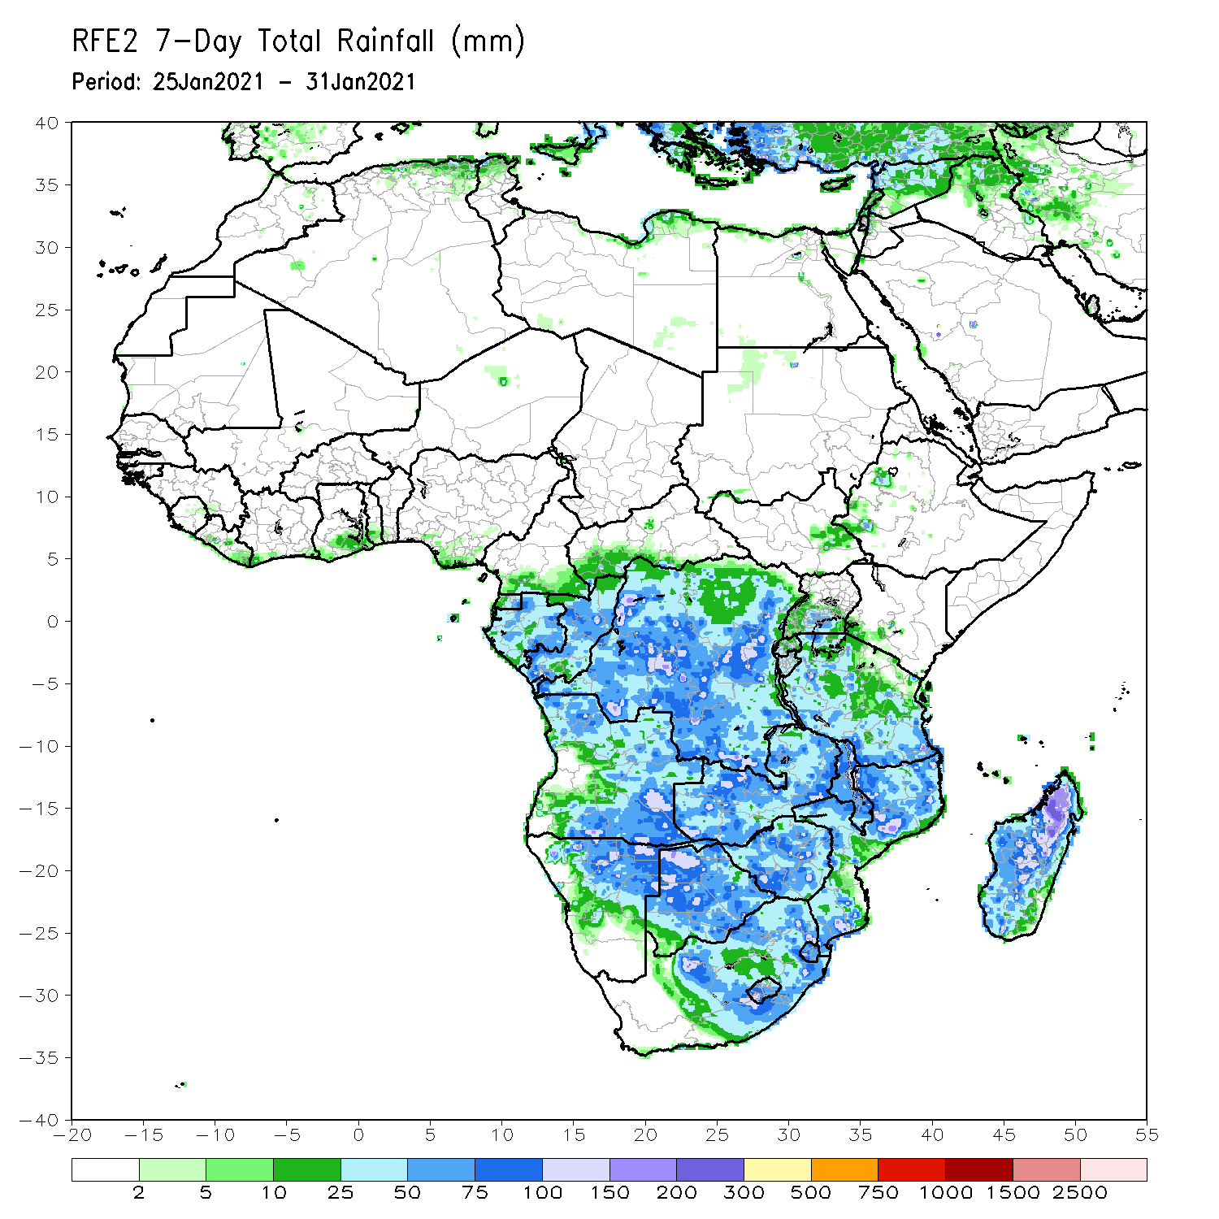
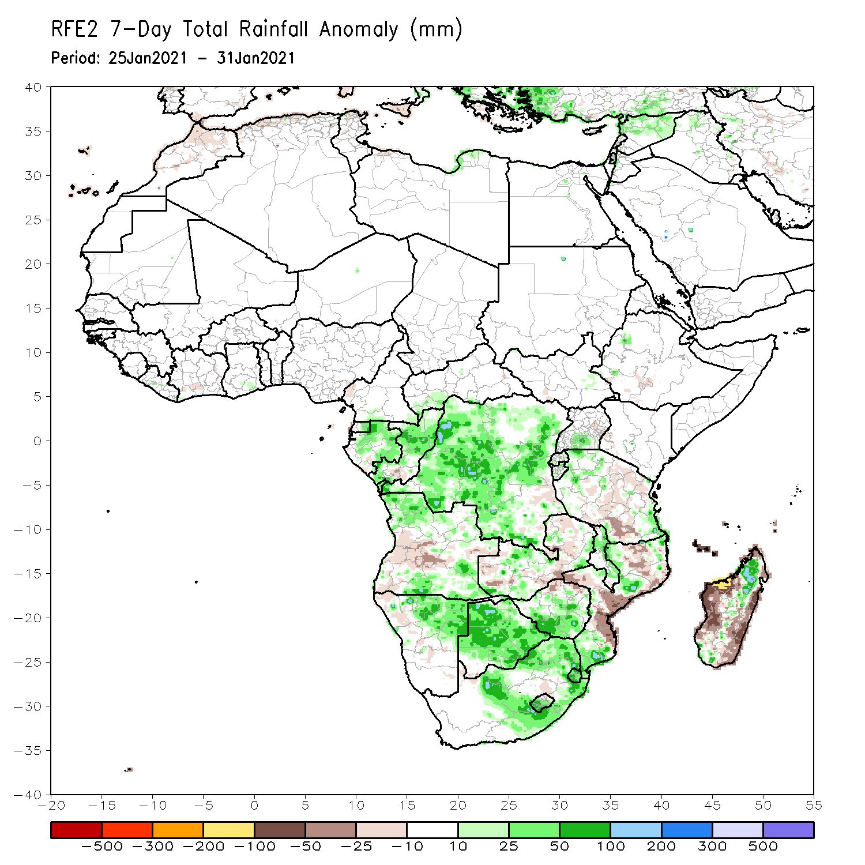
Rainfall Patterns: Last 7 Days
During the past 7 days, in Southern Africa, moderate to locally heavy rainfall sustained moisture surpluses across northern Namibia, Botswana, Zimbabwe and South Africa. Rainfall was also above-average over local areas in Angola, Mozambique and Madagascar. Below-average rainfall was observed over parts of central Angola, pocket areas in southern Tanzania, and portions of Mozambique and Madagascar. In Central Africa, moderate to locally heavy rains sustained moisture surpluses over much of Gabon, Congo and DRC.

Slide 7
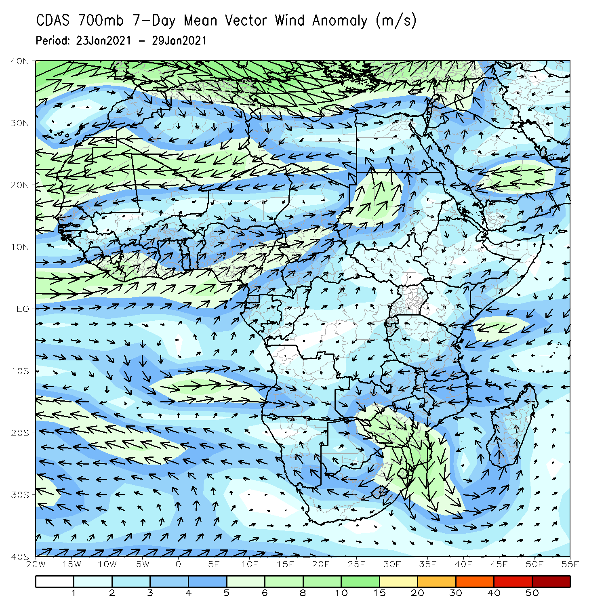
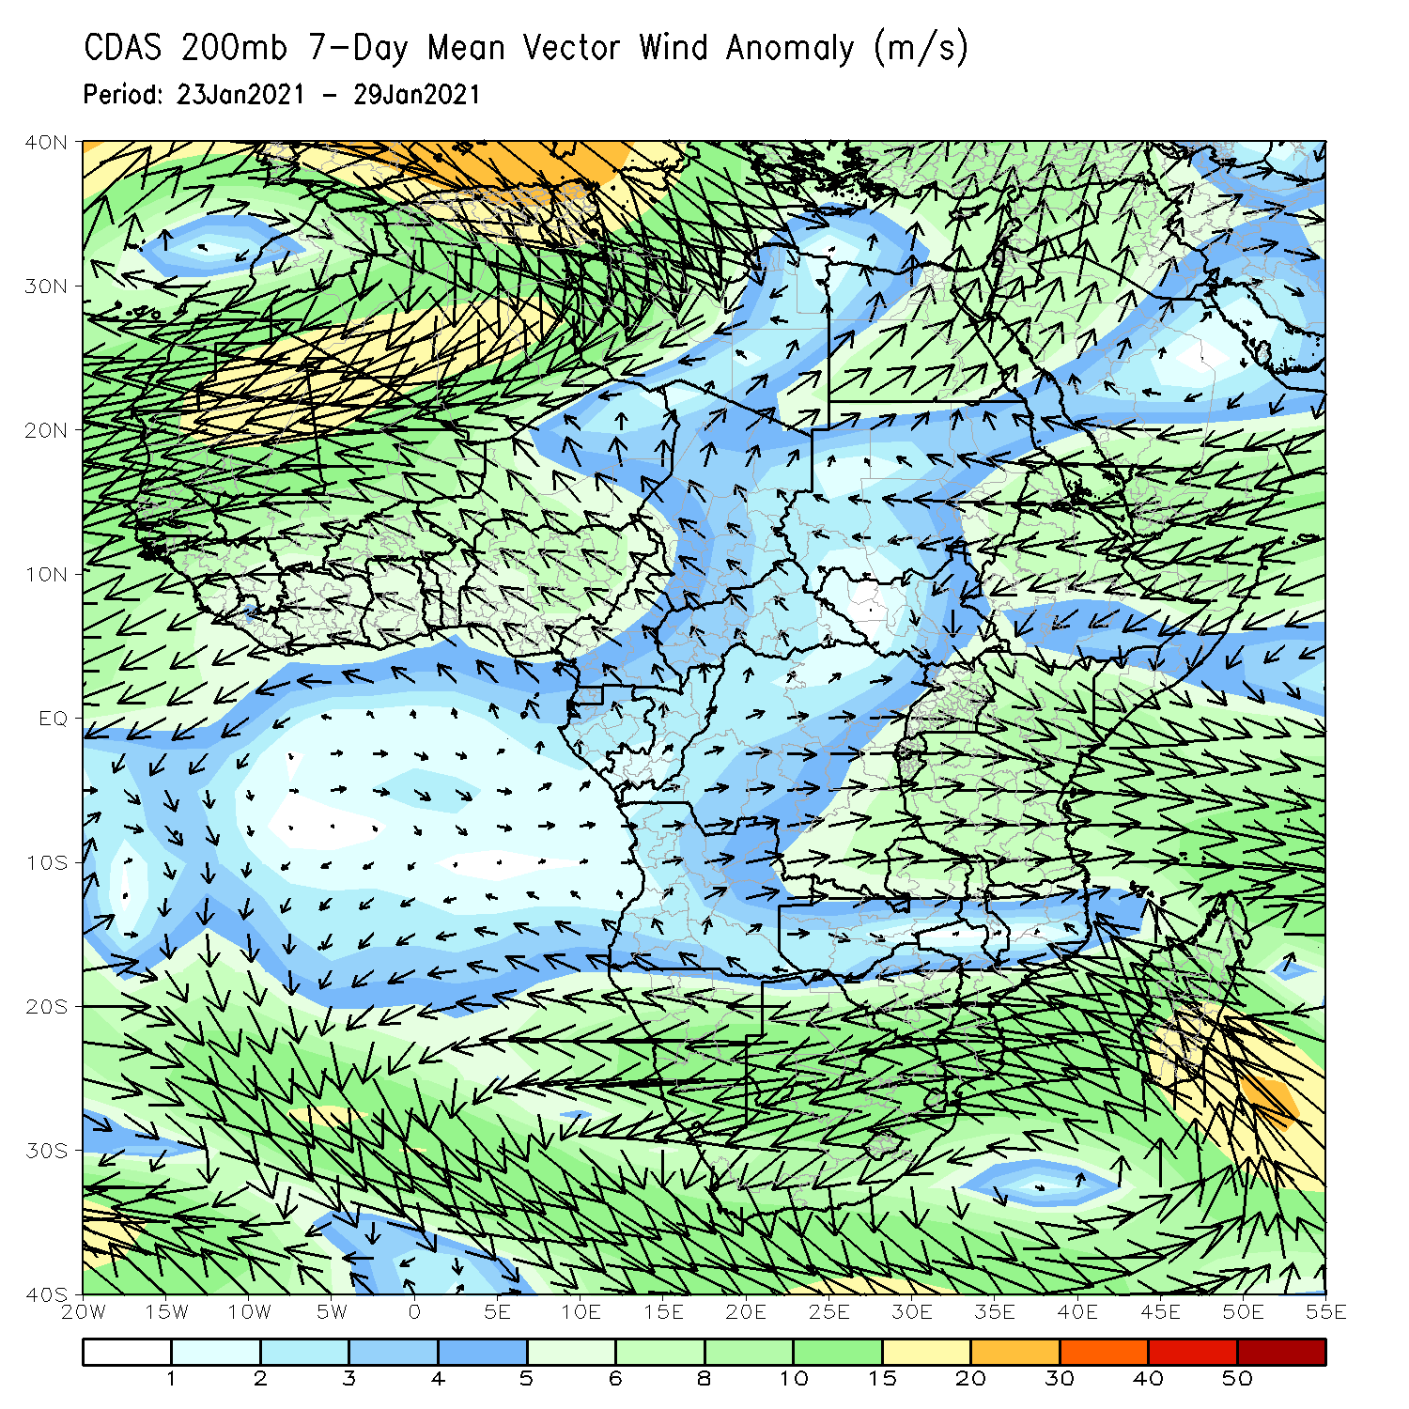
Atmospheric Circulation: Last 7 Days
At lower-level (left panel), anomalous cyclonic circulation over Southern Africa may have contributed to the observed above-average rainfall in the region.

Slide 8
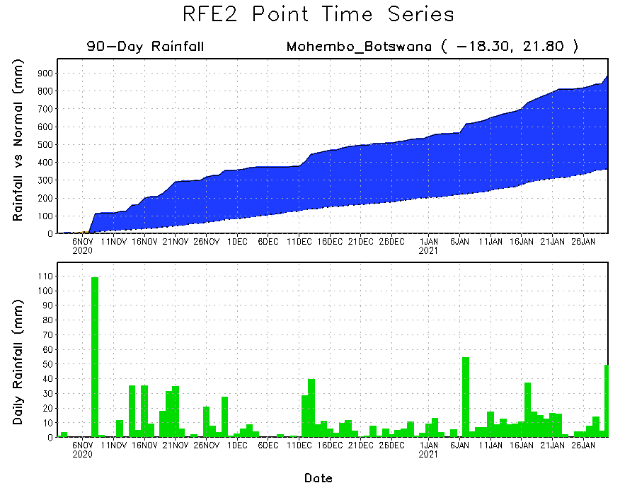
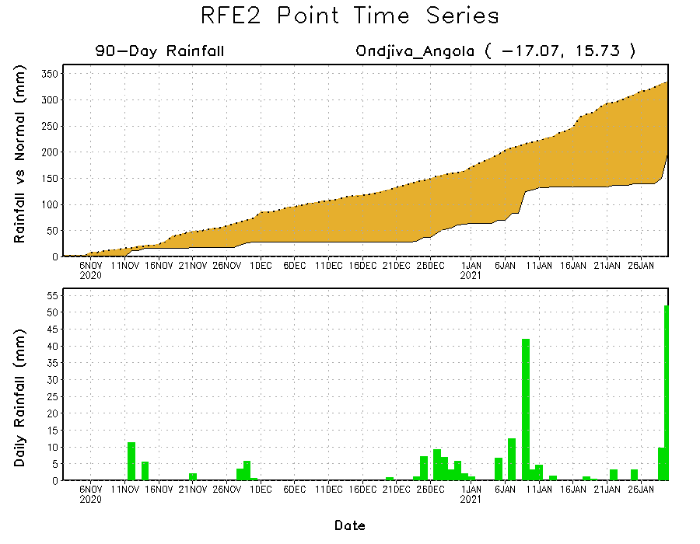
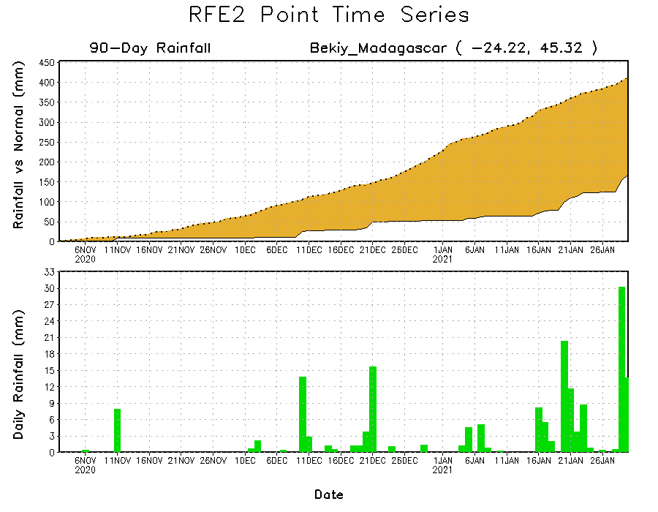
Rainfall Evolution
Daily evolution of rainfall over the last 90 days at selected locations shows heavy rainfall sustained moisture surpluses over parts of Botswana (top right). Seasonal total rainfall remained below-average over southern Angola (bottom left) and southern Madagascar (bottom right) despite a recent rainfall increase in the region .

Slide 9
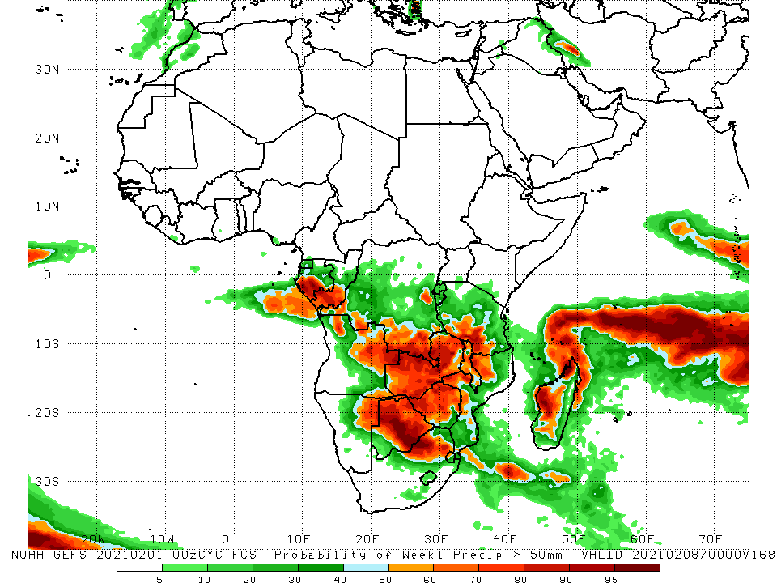
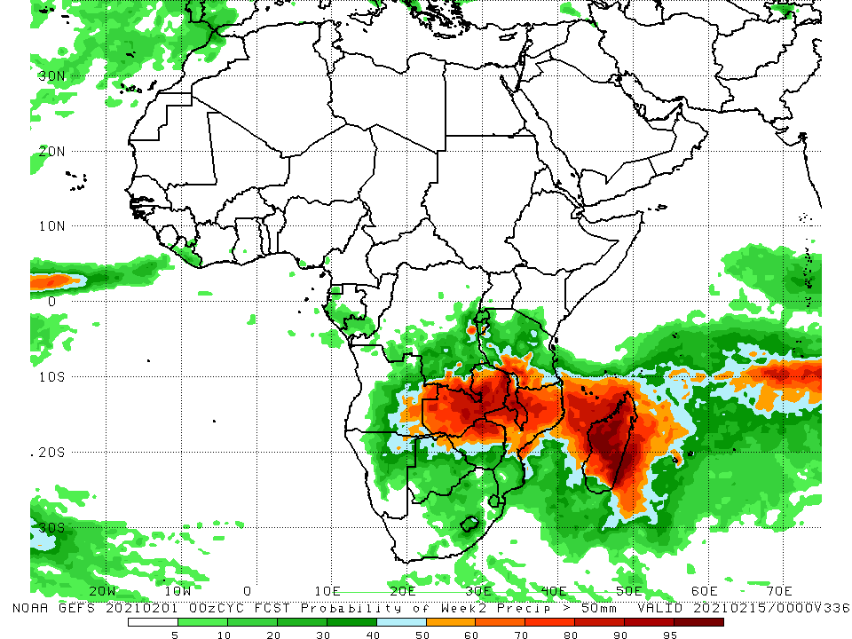
NCEP GEFS Model Forecasts Non-Bias Corrected Probability of precipitation exceedance
Week-1, Valid: 2 - 8 February, 2021
Week-2, Valid: 9 - 16 February, 2021
For week-1 (left panel), the NCEP GEFS indicates a moderate to high chance (over 70%) for rainfall to exceed 50 mm over southern Gabon, southern Congo, eastern Angola, southern DRC, northeastern Namibia, Botswana, Zimbabwe, southern Tanzania, Zambia, Malawi, northeastern South Africa, and parts of Mozambique and Madagascar. For week-2 (right panel), the chance for rainfall to exceed 50 mm is mostly confined to the northern portions of Southern Africa, including Madagascar.
Notes:
9

Slide 10
Summary
During the past 30 to 90 days, in southern Africa, rainfall was above average over the northern areas of the region. Rainfall was below average over western Angola and northern Namibia. In East Africa, moisture deficits prevailed over portions of southern Ethiopia, and pocket areas of Somalia and Kenya. Rainfall was above average much of Tanzania and Uganda. In central Africa, rainfall was above average over much of DRC, southern Congo, and eastern Gabon. Rainfall was below average over western Gabon, Equatorial Africa and CAR. In West Africa, rainfall was slightly above average in pockets along the Guinean coast.
During the past 7 days, in Southern Africa, moderate to locally heavy rainfall sustained moisture surpluses across northern Namibia, Botswana, Zimbabwe and South Africa. Rainfall was also above-average over local areas in Angola, Mozambique and Madagascar. Below-average rainfall was observed over parts of central Angola, pocket areas in southern Tanzania, and portions of Mozambique and Madagascar. In Central Africa, moderate to locally heavy rains sustained moisture surpluses over much of Gabon, Congo and DRC.
The week-1 and week-2 outlooks indicate a moderate to high chance for rainfall to exceed 50 mm over southern Gabon, southern Congo, eastern Angola, southern DRC, northeastern Namibia, Botswana, Zimbabwe, southern Tanzania, Zambia, Malawi, northeastern South Africa, and parts of Mozambique and Madagascar.

