Slide 1
The African Monsoon Recent Evolution and Current Status Include Week-1 and Week-2 Outlooks
Update prepared by
08 March 2021
For more information, visit:
http://www.cpc.ncep.noaa.gov/products/Global_Monsoons/African_Monsoons/precip_monitoring.shtml

Slide 2
Outline
Highlights
Recent Evolution and Current Conditions
NCEP GEFS Forecasts
Summary

Slide 3
Highlights: Last 7 Days
During the past 7 days, in Southern Africa, moderate to locally heavy rainfall resulted in moisture surpluses over eastern Zambia, southern Tanzania, Malawi, northern Mozambique, and much of Madagascar. Below-average rainfall was observed over southern Angola, northern Namibia and western Zambia. Rainfall was also below-average over parts of Botswana, Zimbabwe, central and southern Mozambique and parts of South Africa. In Central Africa, light rains sustained moisture deficits over Equatorial Guinea and pockets of northern DRC.
For week-1 and week-2, there is a moderate to high chance (over 70%) for rainfall to exceed 50 mm over southern Cameroon, Equatorial Guinea, Gabon, Congo, parts of DRC, Angola, northern and eastern Zambia, Malawi, southern Tanzania and northern Mozambique.

Slide 4
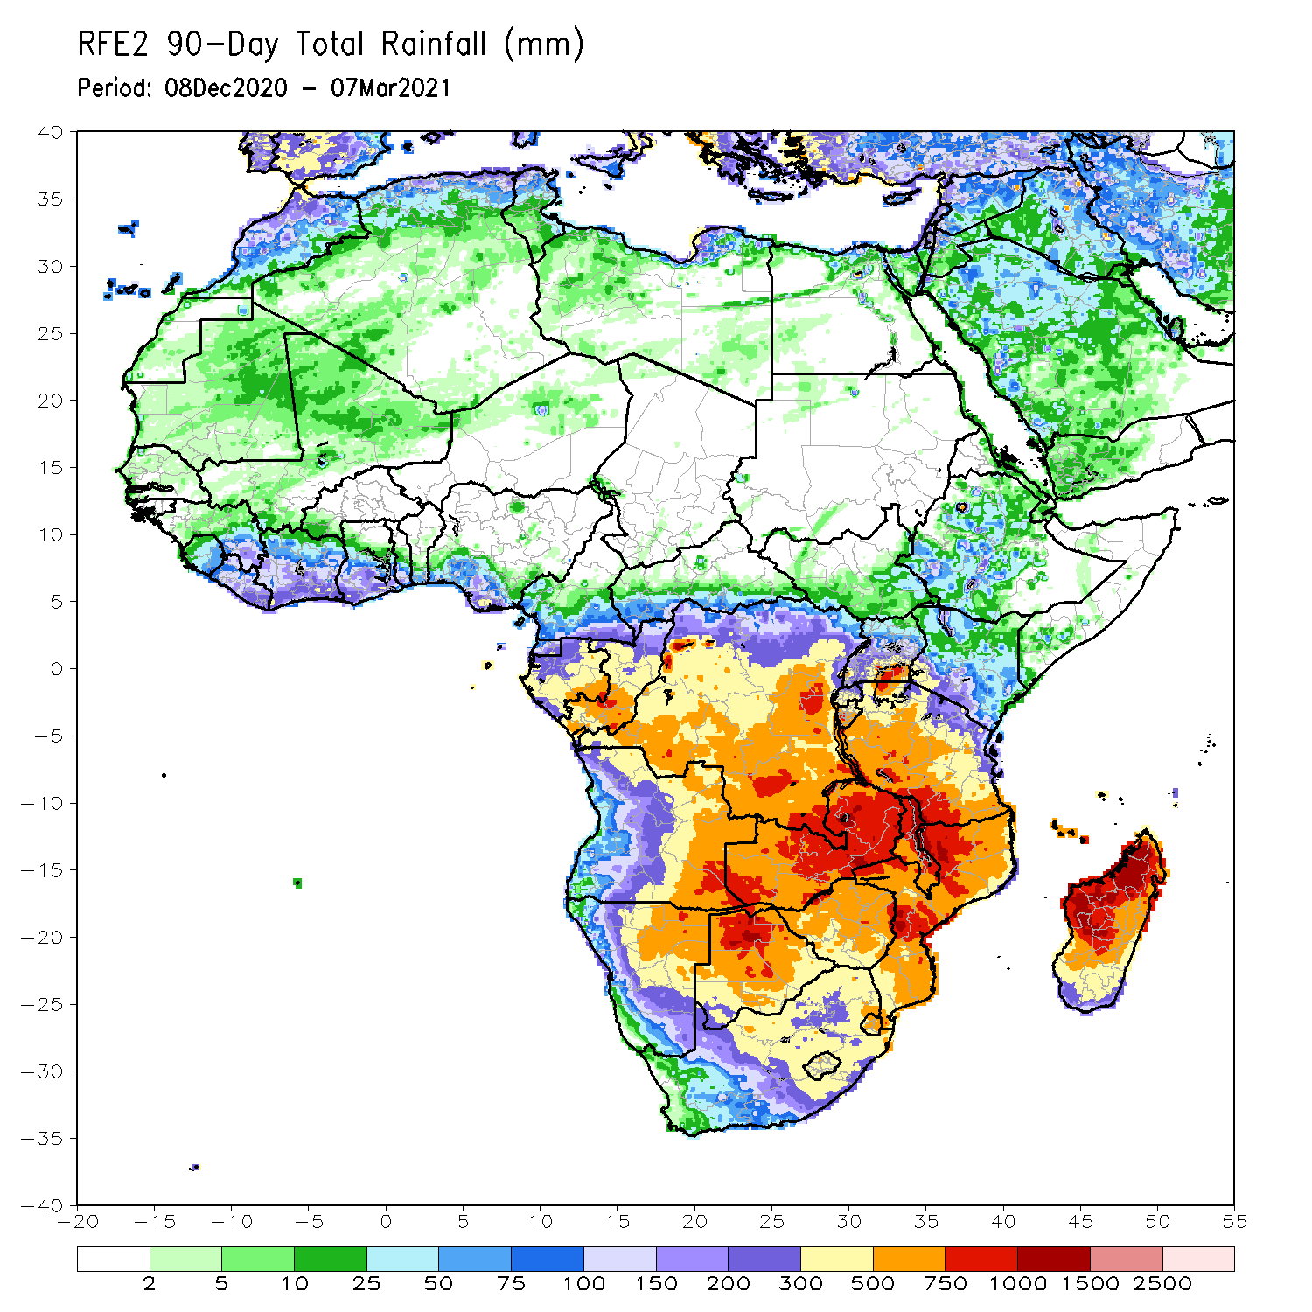
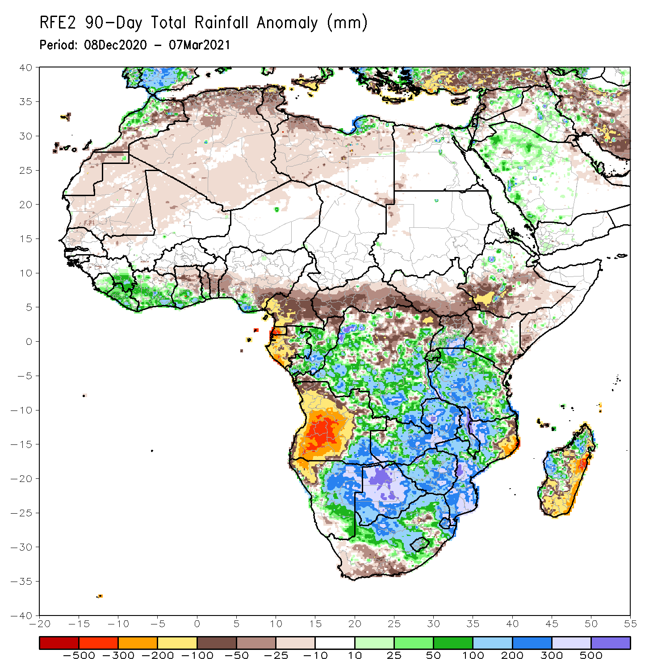
Rainfall Patterns: Last 90 Days
Over the past 90 days, in southern Africa, moderate to locally heavy rains resulted in sustained moisture surpluses over eastern Angola, Zambia, Botswana, Zimbabwe and southern Mozambique. Rainfall was also above average over many parts of Namibia and South Africa, Malawi, and parts of western and northern Madagascar. Persistent light rains resulted in moisture deficits in western and central Angola, and northwestern Namibia. Rainfall was also below average pockets of northeastern Mozambique, and over parts of eastern and southern Madagascar. In East Africa, rainfall was below average over parts of southern Ethiopia, Kenya, southern Somalia. Rainfall was also below average over much of South Sudan and northern Uganda. Rainfall was above average over parts of southern Kenya, southern Uganda, Rwanda, Burundi and much of Tanzania. In Central Africa, rainfall was above average over many parts of DRC and Congo. Rainfall was below average over local areas in northern DRC and much of CAR. Below average rains were also observed over the western areas of Gabon and much of Cameroon. In West Africa, rainfall was above average along the Gulf of Guinea coast.
Notes:
4

Slide 5
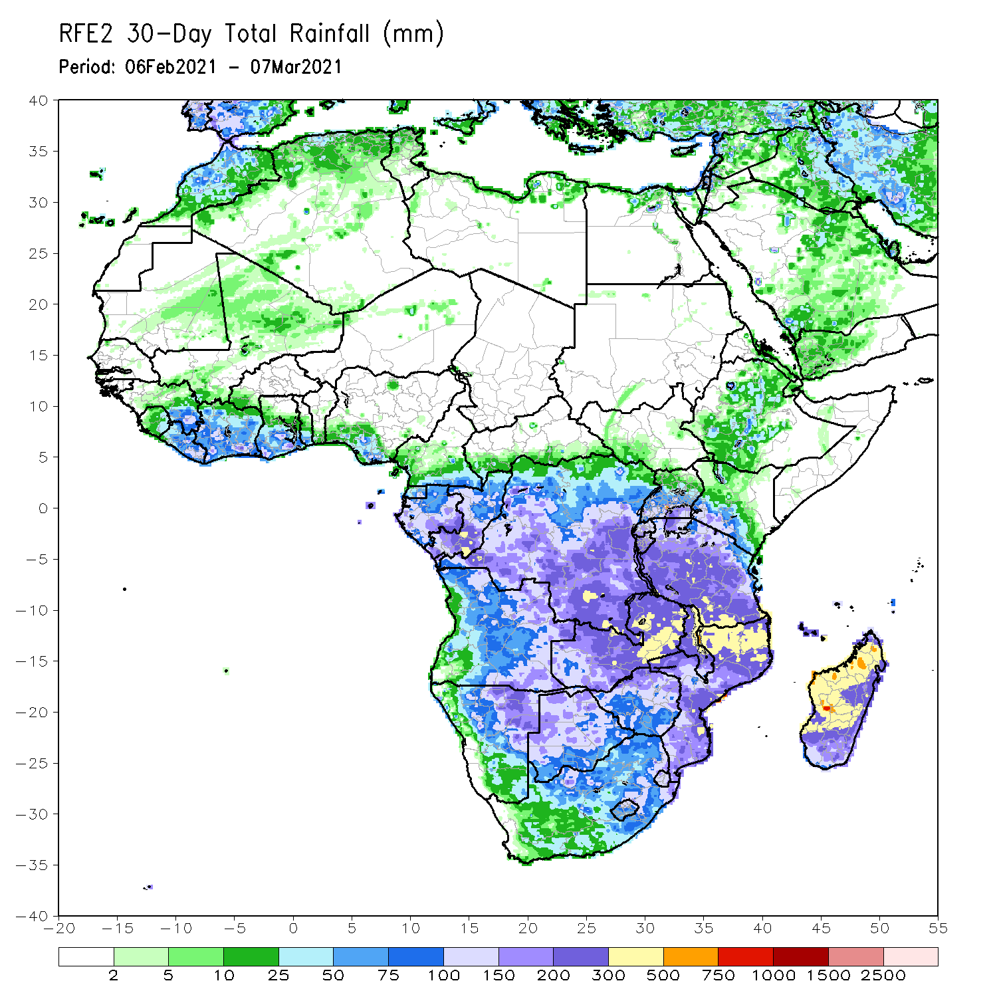
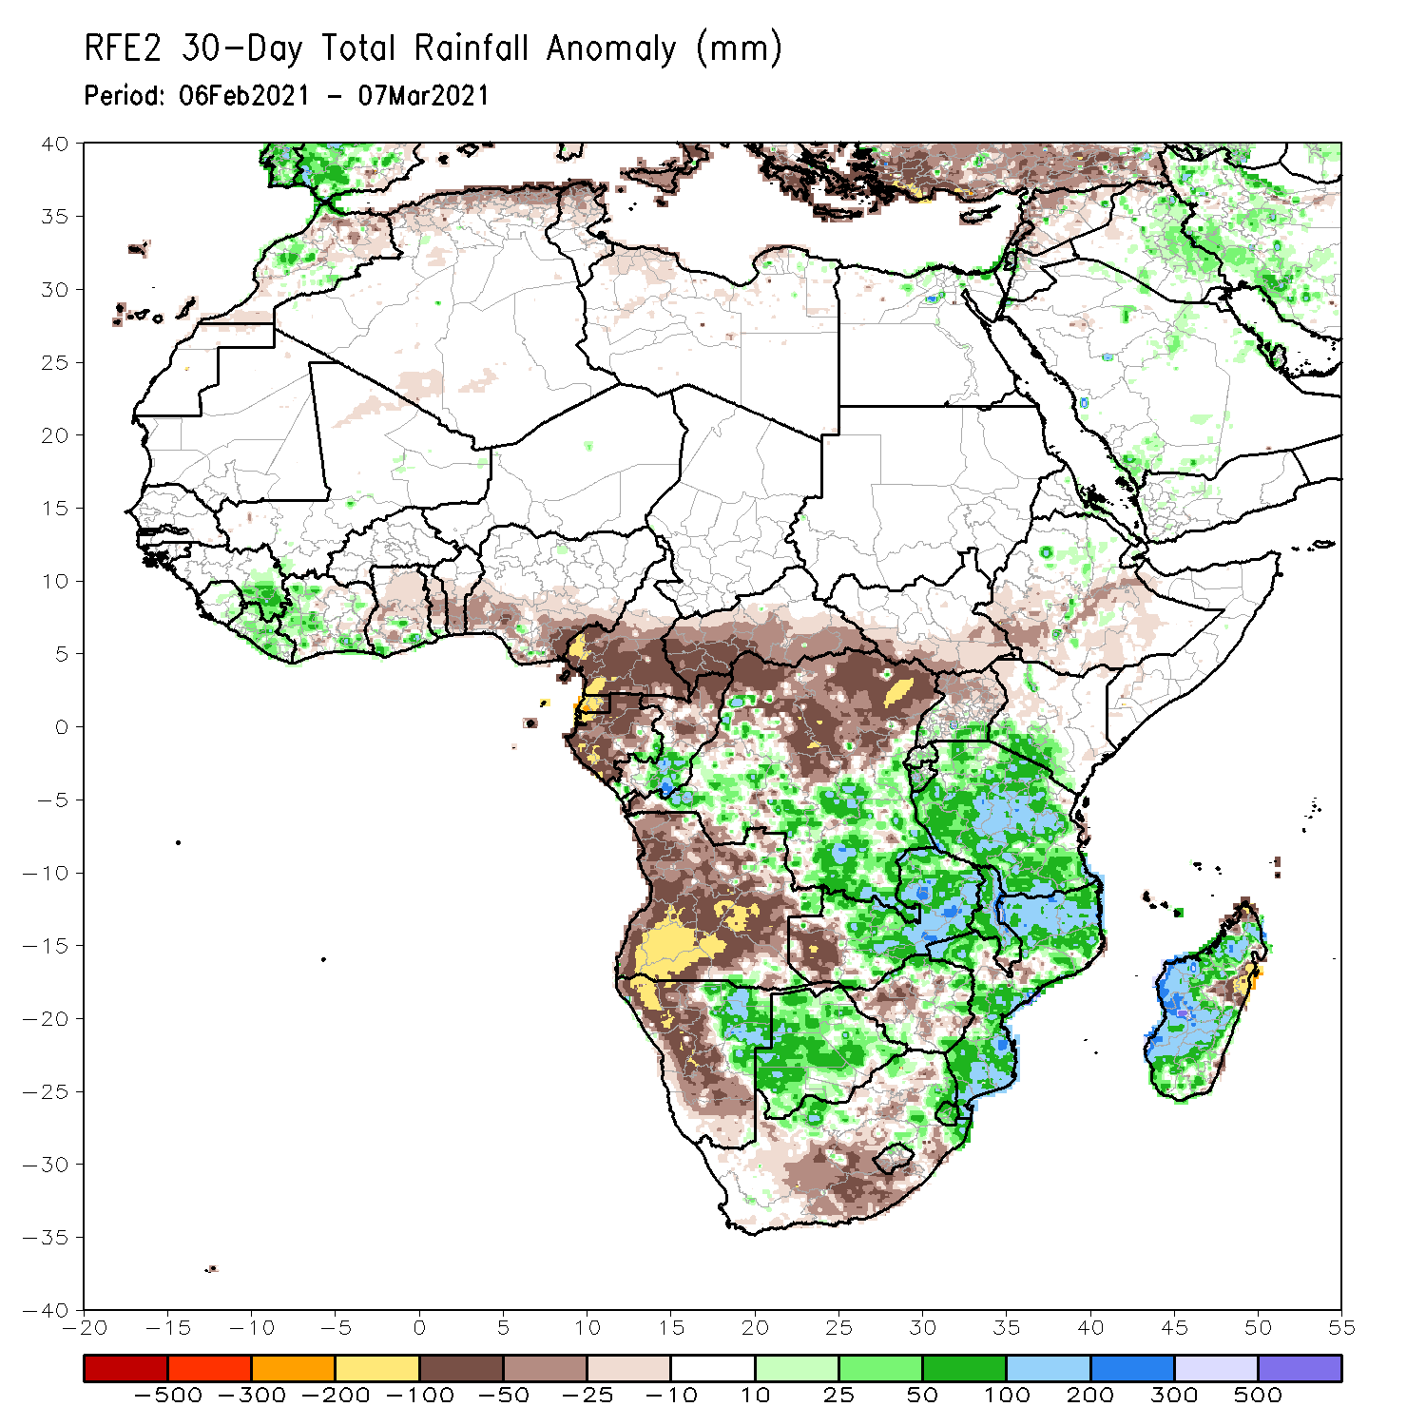
Rainfall Patterns: Last 30 Days
During the past 30 days, in southern Africa, moderate to heavy rains resulted in moisture surpluses over eastern Namibia, many parts of Zambia, Malawi and Botswana. Rainfall was also above average over pockets of northern South Africa, and much of Mozambique. Persistent light rains resulted in moisture deficits over much of Angola, western Namibia and the southern portions of South Africa. In Central Africa, rainfall was below average over much of Gabon, Equatorial Guinea, Cameroon, Central Africa Republic and northern DRC. In East Africa, below rainfall was observed over local areas in Ethiopia. Rainfall was above-average over parts of southern Kenya and much of Tanzania. In West Africa, above-average rainfall was observed over local areas along the Gulf of Guinea coast.
Notes:
5

Slide 6
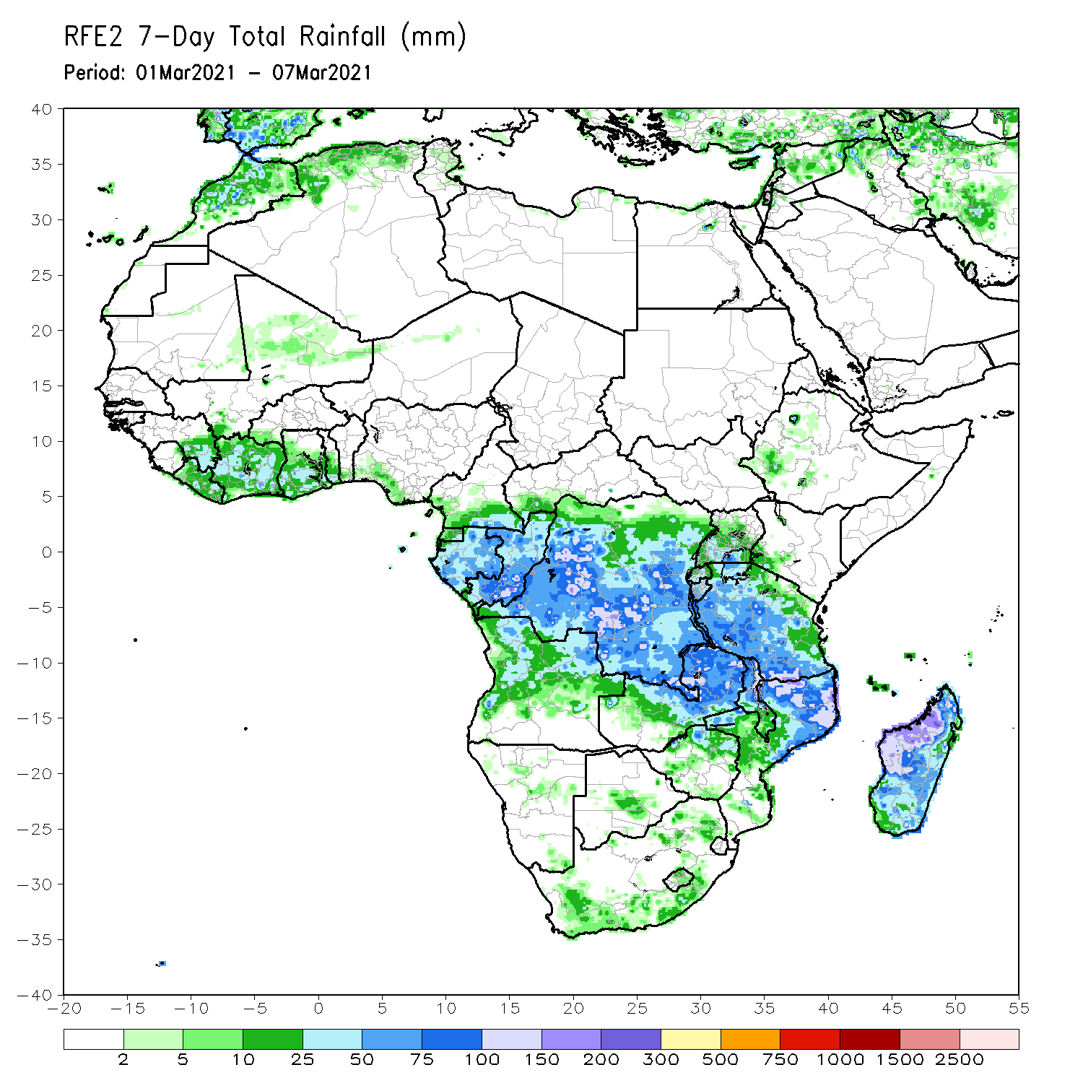
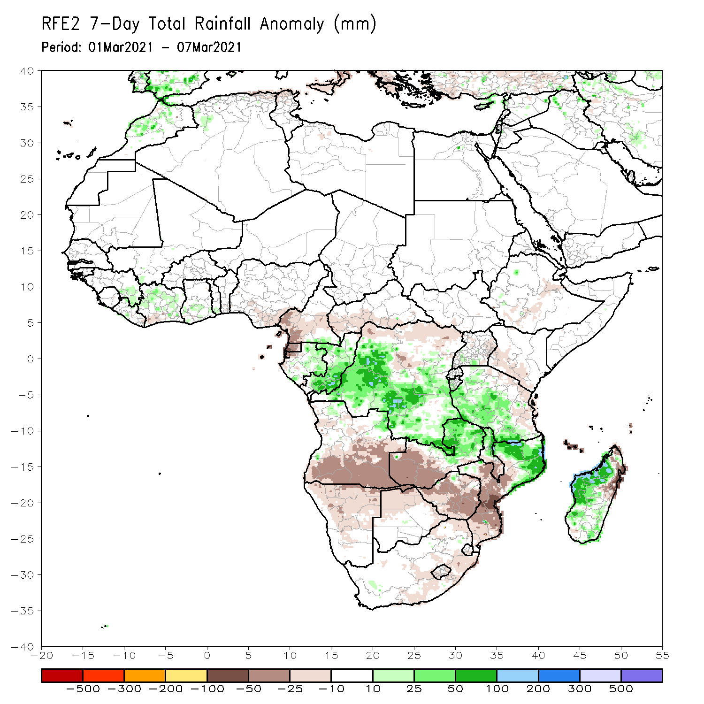
Rainfall Patterns: Last 7 Days
During the past 7 days, in Southern Africa, moderate to locally heavy rainfall resulted in moisture surpluses over eastern Zambia, southern Tanzania, Malawi, northern Mozambique, and much of Madagascar. Below-average rainfall was observed over southern Angola, northern Namibia and western Zambia. Rainfall was also below-average over parts of Botswana, Zimbabwe, central and southern Mozambique and parts of South Africa. In Central Africa, light rains sustained moisture deficits over Equatorial Guinea and pockets of northern DRC.

Slide 7
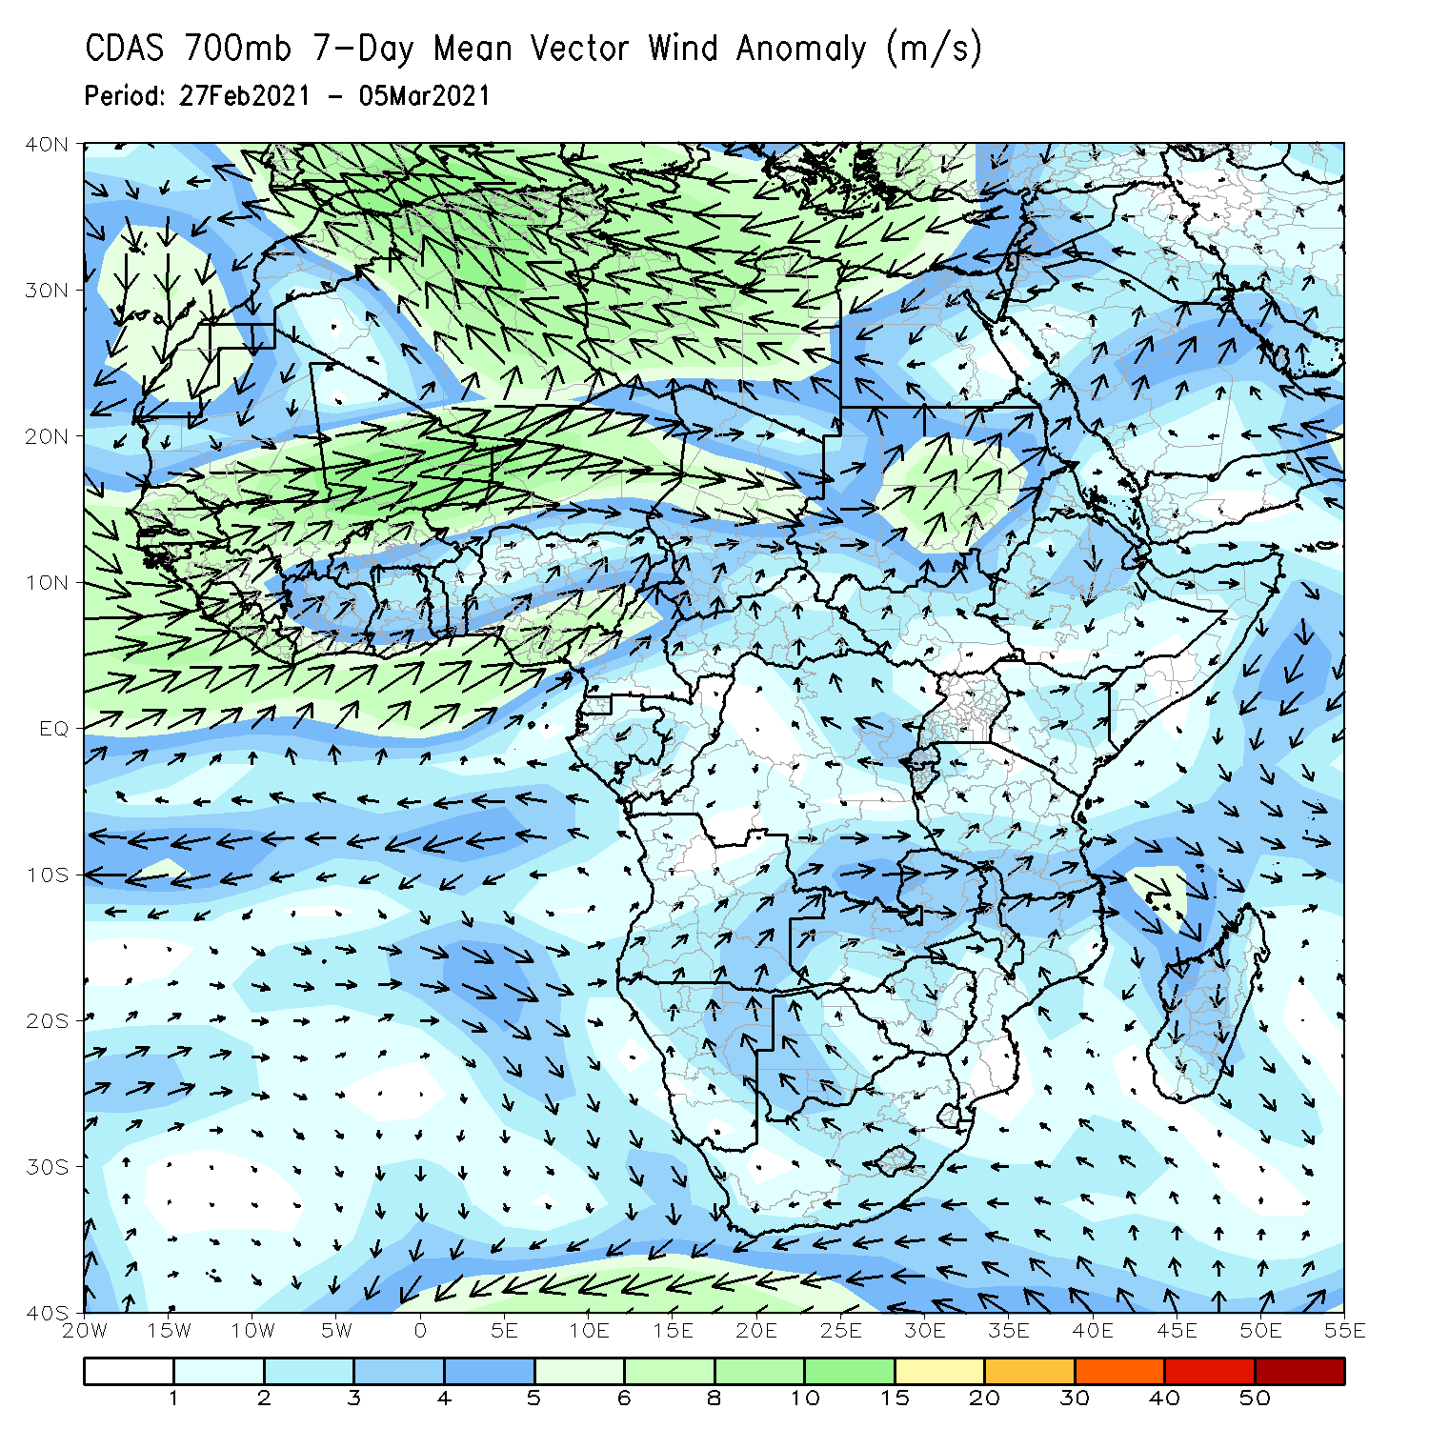
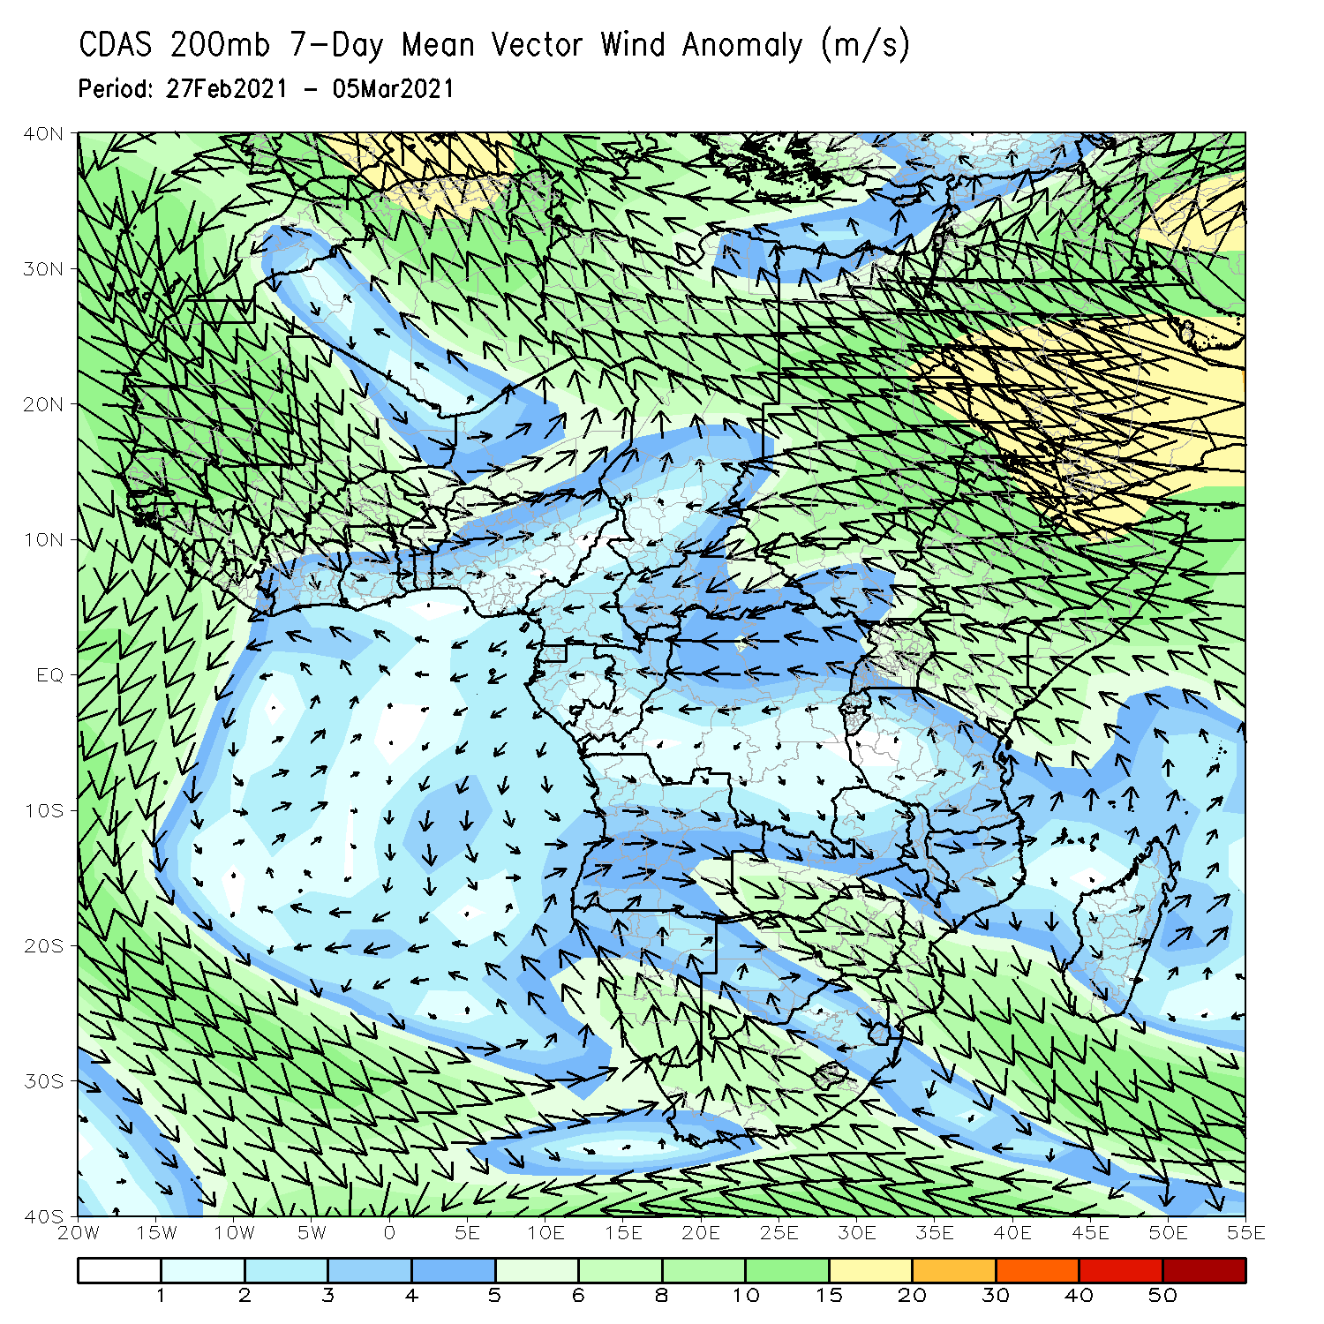
Atmospheric Circulation: Last 7 Days
At lower-level (left panel), anomalous cyclonic circulation was evident across the central and eastern portions of Southern Africa.

Slide 8
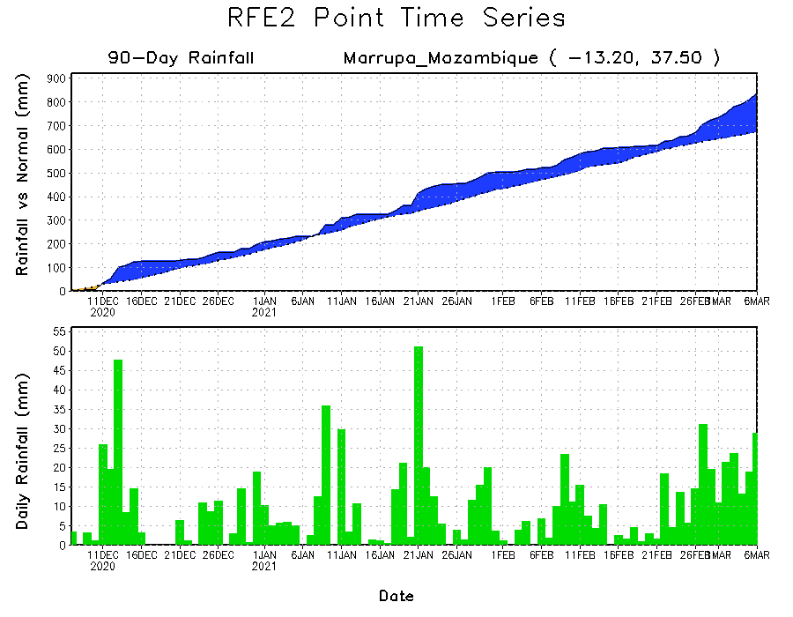
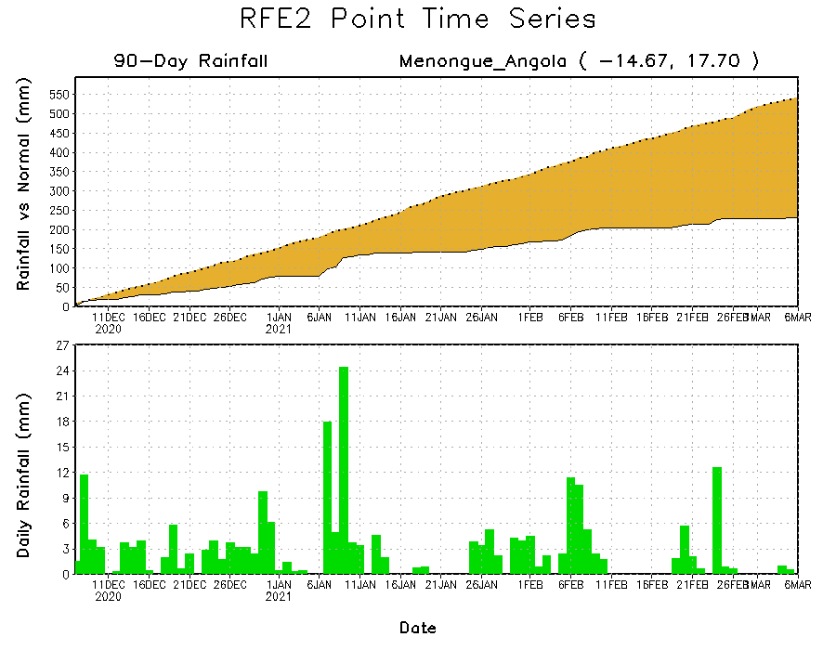
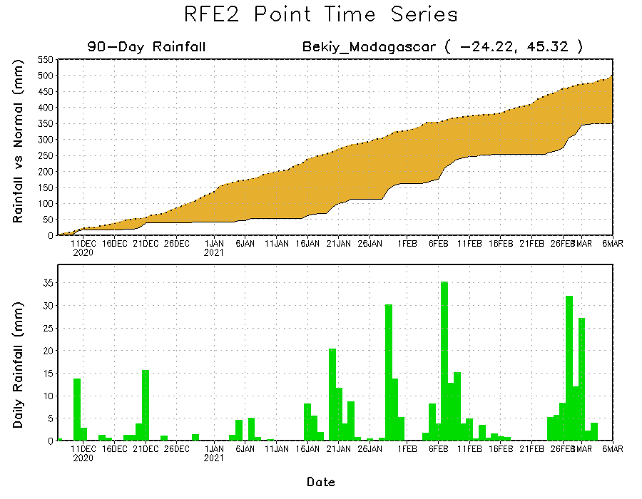
Rainfall Evolution
Daily evolution of rainfall over the last 90 days at selected locations shows moderate to heavy rainfall sustained moisture surpluses over parts of northern Mozambique (top right). Seasonal total rainfall remained below-average over portions of Angola (bottom left) and southern Madagascar (bottom right).

Slide 9
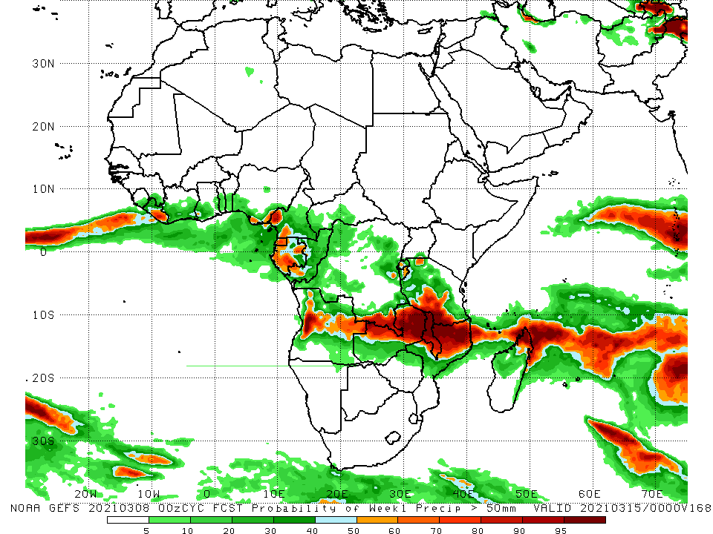
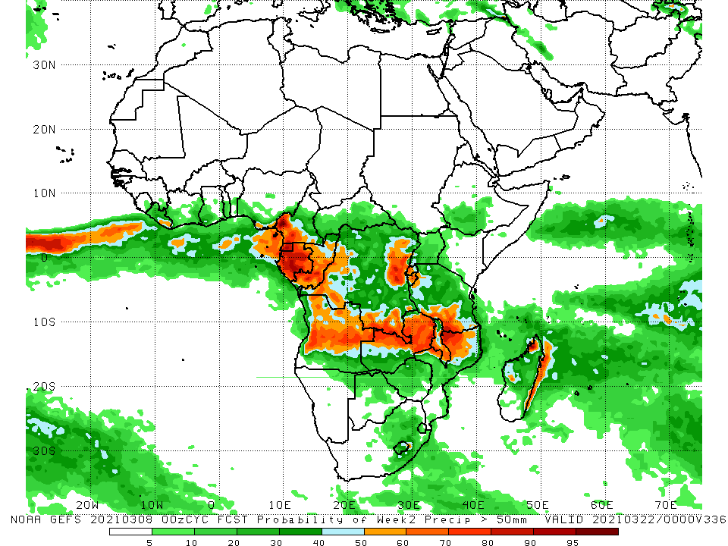
NCEP GEFS Model Forecasts Non-Bias Corrected Probability of precipitation exceedance
Week-1, Valid: 9 - 15 March, 2021
Week-2, Valid: 16 - 22 March, 2021
For week-1 (left panel) and week-2 (right panel), the NCEP GEFS indicates a moderate to high chance (over 70%) for rainfall to exceed 50 mm over southern Cameroon, Equatorial Guinea, Gabon, Congo, parts of DRC, Angola, northern and eastern Zambia, Malawi, southern Tanzania and northern Mozambique.
Notes:
9

Slide 10
Summary
During the past 30 to 90 days, in southern Africa, moderate to heavy rains resulted in sustained moisture surpluses over eastern Namibia, Botswana, Malawi, and Zimbabwe. Rainfall was below average over western and central Angola, and western Namibia. In East Africa, moisture deficits prevailed over portions of southern Ethiopia, and local areas in Somalia and Kenya. Rainfall was above average much of Tanzania and Uganda. In central Africa, rainfall was above average over portions of DRC and southern Congo. Rainfall was below average over western Gabon, Equatorial Guinea and CAR. In West Africa, rainfall was slightly above average in pockets along the Guinean coast.
During the past 7 days, in Southern Africa, moderate to locally heavy rainfall resulted in moisture surpluses over eastern Zambia, southern Tanzania, Malawi, northern Mozambique, and much of Madagascar. Below-average rainfall was observed over southern Angola, northern Namibia and western Zambia. Rainfall was also below-average over parts of Botswana, Zimbabwe, central and southern Mozambique and parts of South Africa. In Central Africa, light rains sustained moisture deficits over Equatorial Guinea and pockets of northern DRC.
For week-1 and week-2, there is a moderate to high chance (over 70%) for rainfall to exceed 50 mm over southern Cameroon, Equatorial Guinea, Gabon, Congo, parts of DRC, Angola, northern and eastern Zambia, Malawi, southern Tanzania and northern Mozambique.

