Slide 1
The African Monsoon Recent Evolution and Current Status Include Week-1 and Week-2 Outlooks
Update prepared by
29 March 2021
For more information, visit:
http://www.cpc.ncep.noaa.gov/products/Global_Monsoons/African_Monsoons/precip_monitoring.shtml

Slide 2
Outline
Highlights
Recent Evolution and Current Conditions
NCEP GEFS Forecasts
Summary

Slide 3
Highlights: Last 7 Days
During the past 7 days, in East Africa, rainfall was slightly below-average over parts of Ethiopia, Kenya and Uganda, and over the western and central portions of Tanzania. Rainfall was above-average over parts of southern and eastern Tanzania. In Southern Africa, rainfall was slightly above-average over parts of Angola, eastern Namibia, western Botswana and South Africa. Below-average rainfall was observed over parts of northern Angola, Zambia and Zimbabwe. In Central Africa rainfall was above-average over Equatorial Guinea, Gabon, CAR and DRC. In West Africa, above-average rainfall was observed over portions of the Gulf of Guinea countries.
For week-1 and week-2, there is a moderate to high chance (over 70%) for rainfall to exceed 50 mm over Equatorial Guinea, western Gabon, eastern DRC, Rwanda, Burundi, Tanzania, and portions of Angola.

Slide 4
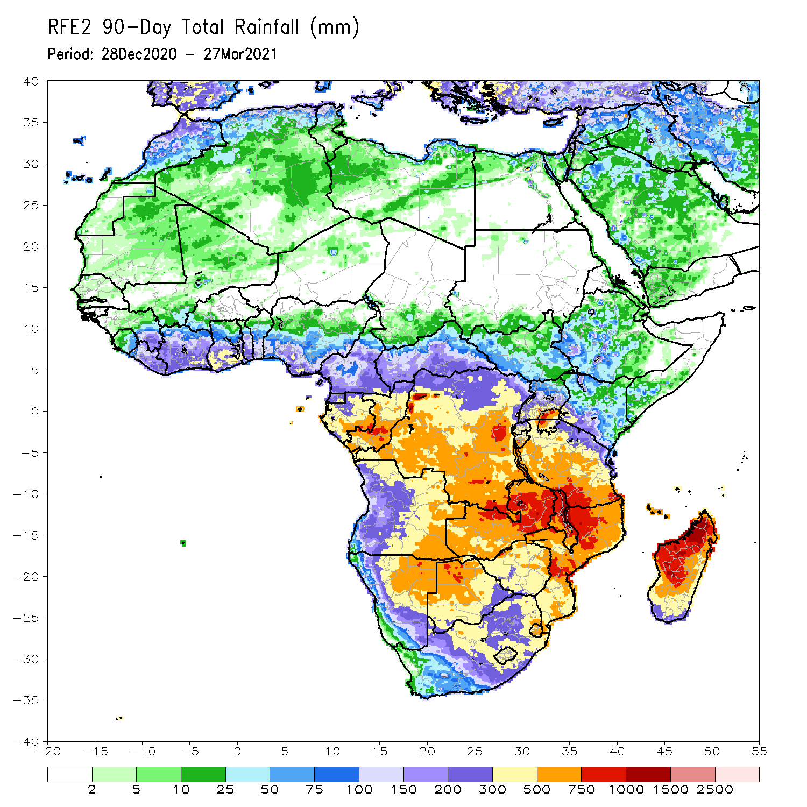
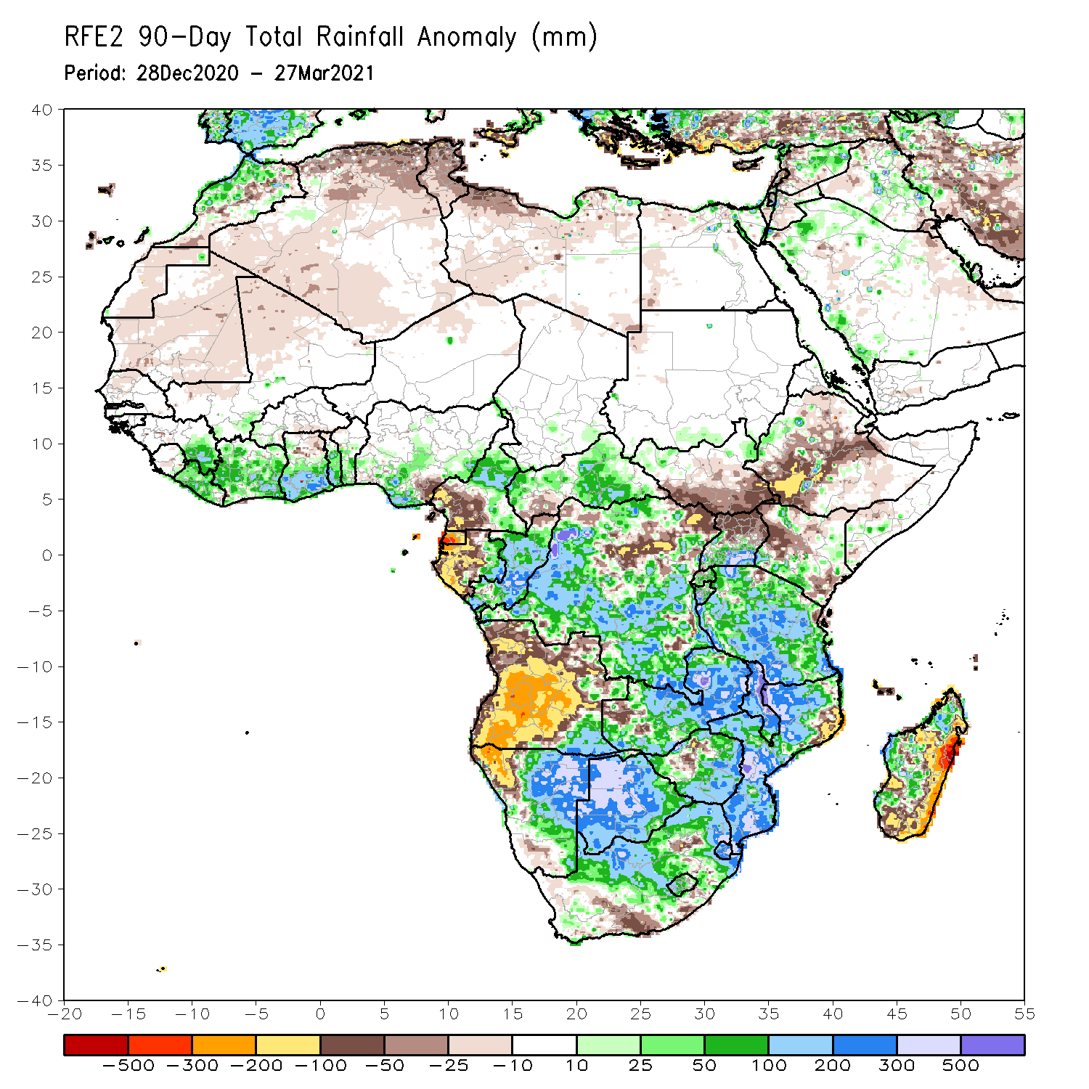
Rainfall Patterns: Last 90 Days
Over the past 90 days, in East Africa, rainfall was below-average over parts of Ethiopia and Kenya. Rainfall was also below-average over much of South Sudan and northern Uganda. Rainfall was above-average over above-average over southern Uganda, Rwanda, Burundi and much of Tanzania. Rainfall was also above-average over pockets of Ethiopia, southern Somalia and Kenya. In southern Africa, moderate to locally heavy rains resulted in sustained moisture surpluses over central and eastern Namibia and much of Botswana. Rainfall was also above-average over southeastern Angola, Zambia, Malawi, Zimbabwe, much of Mozambique and South Africa, and parts of western and northern Madagascar. Persistent light rains resulted in moisture deficits over many parts of Angola, and parts of northwestern Namibia. Rainfall was also below-average over pockets of northeastern Mozambique, and eastern and southern Madagascar. In Central Africa, rainfall was above-average over many parts of DRC, Congo and CAR. Rainfall was below-average over local areas in northern DRC and CAR. Below-average rains were also observed over the western areas of Gabon, Equatorial Guinea and southern Cameroon. In West Africa, rainfall was above-average over many places in the Gulf of Guinea countries.
Notes:
4

Slide 5
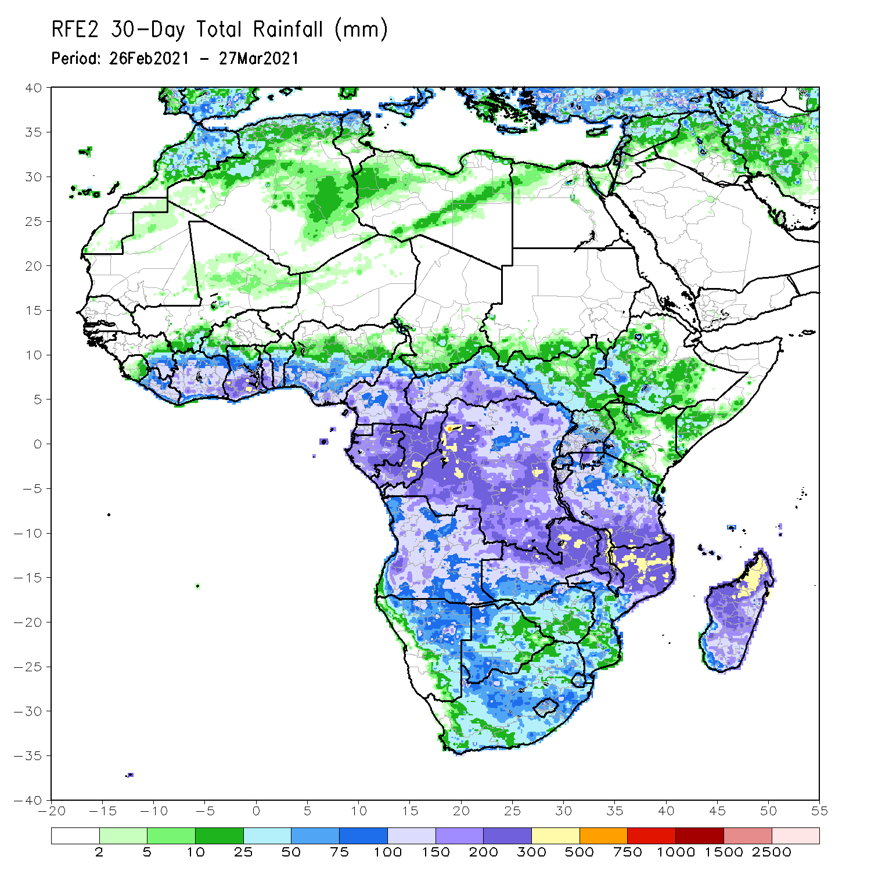
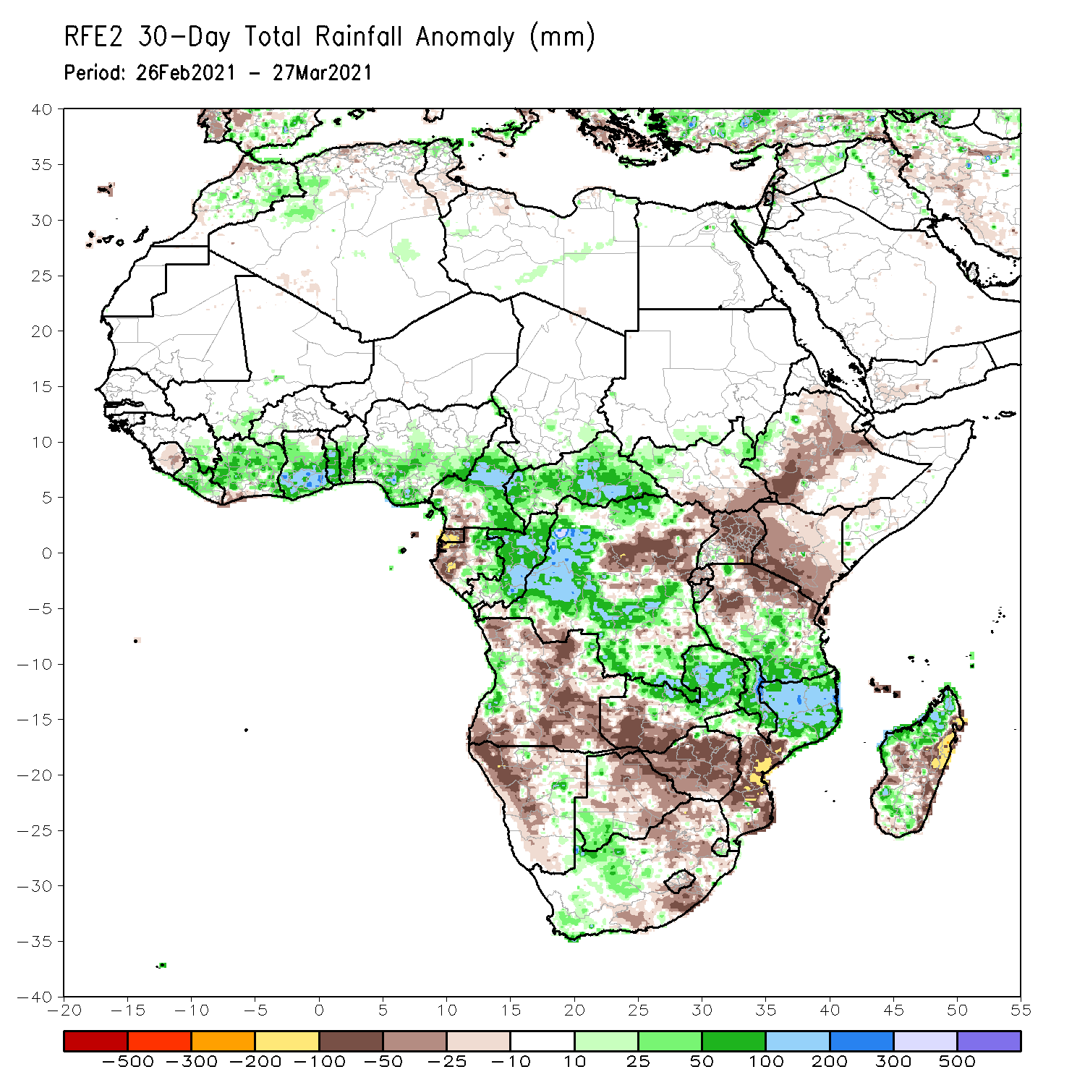
Rainfall Patterns: Last 30 Days
During the past 30 days, in East Africa, below-average rainfall was observed over parts of Ethiopia, southern South Sudan, Uganda, Rwanda, Burundi, Kenya, and northern Tanzania. In contrast, rainfall was above-average over central and southern Tanzania. In southern Africa, moderate to heavy rains resulted in moisture surpluses over eastern Zambia, Malawi, northern Mozambique, and portions of Madagascar. Rainfall was also above-average over local areas in Angola, Namibia, Botswana and Southern Africa. In contrast, persistent light rains sustained moisture deficits over much of Angola, much of Namibia, western Zambia, Botswana, Zimbabwe, portions of South Africa, southern Mozambique, and over pockets of Madagascar. In Central Africa, rainfall was below-average over western Gabon and northeastern DRC. In West Africa, Rainfall was above-average over many places in the Gulf of Guinea countries.
Notes:
5

Slide 6
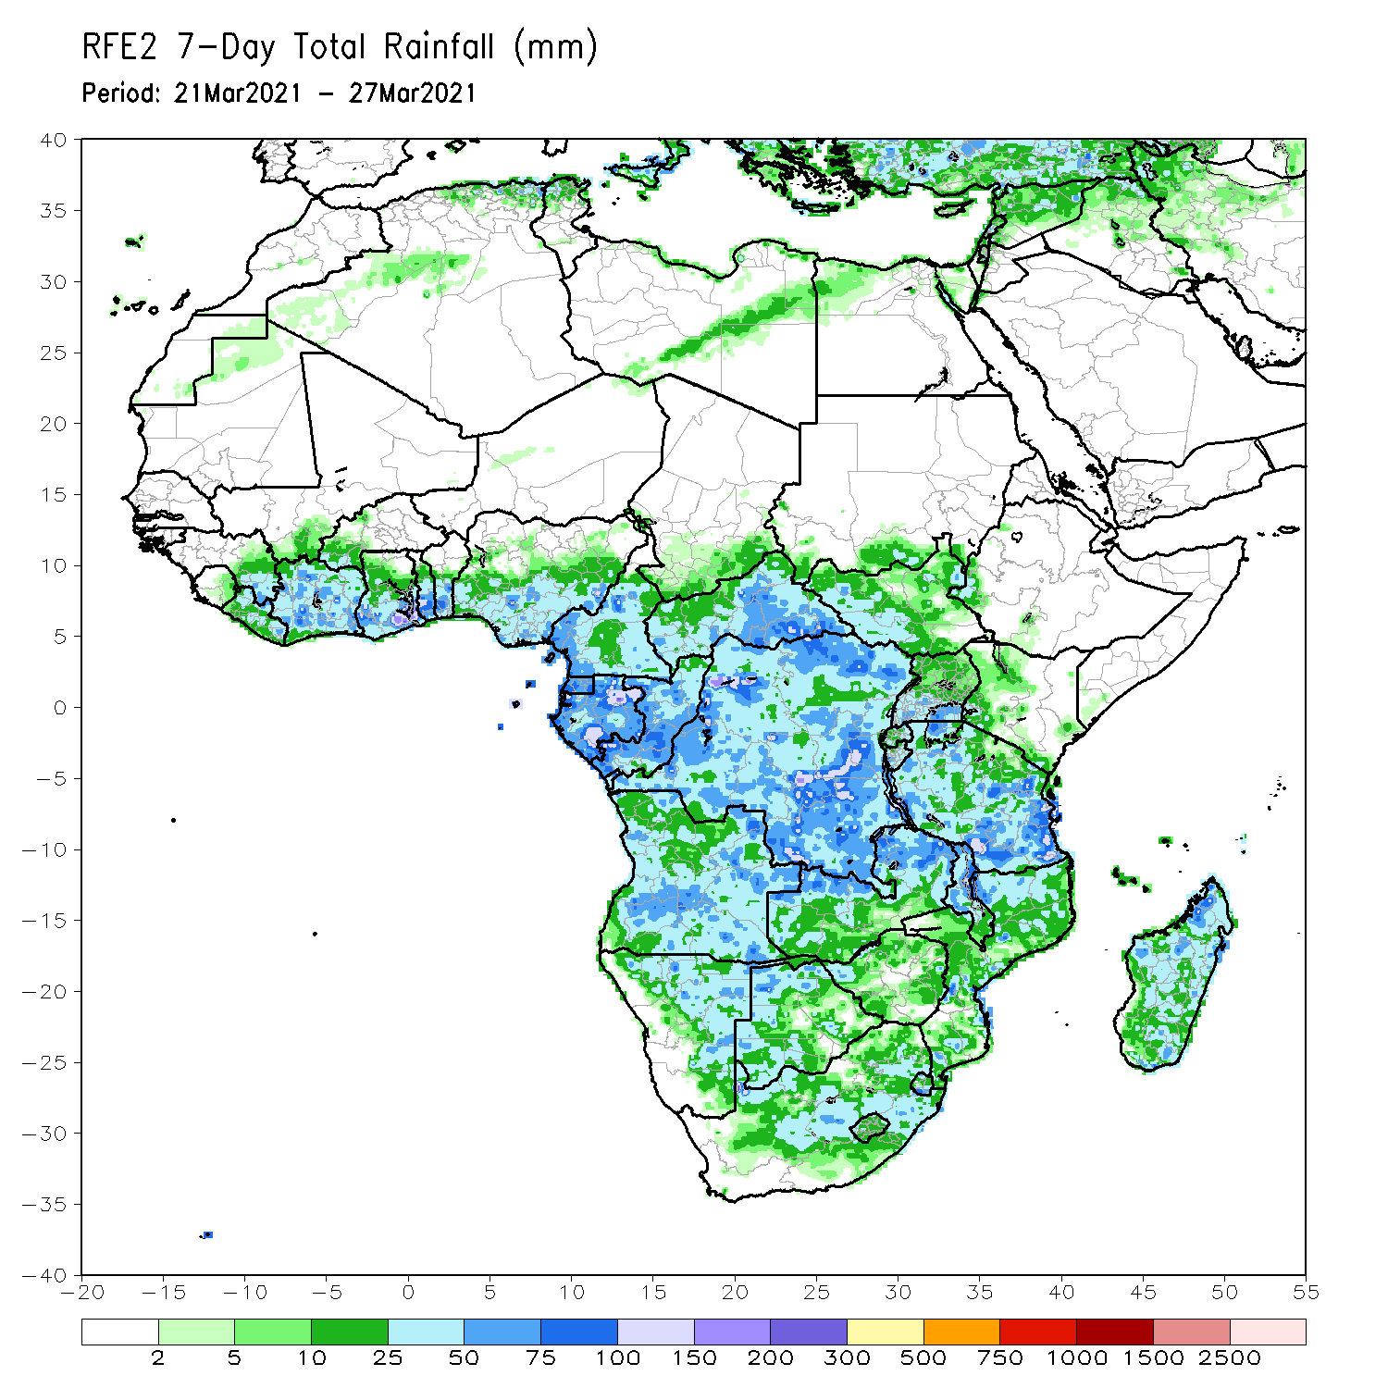
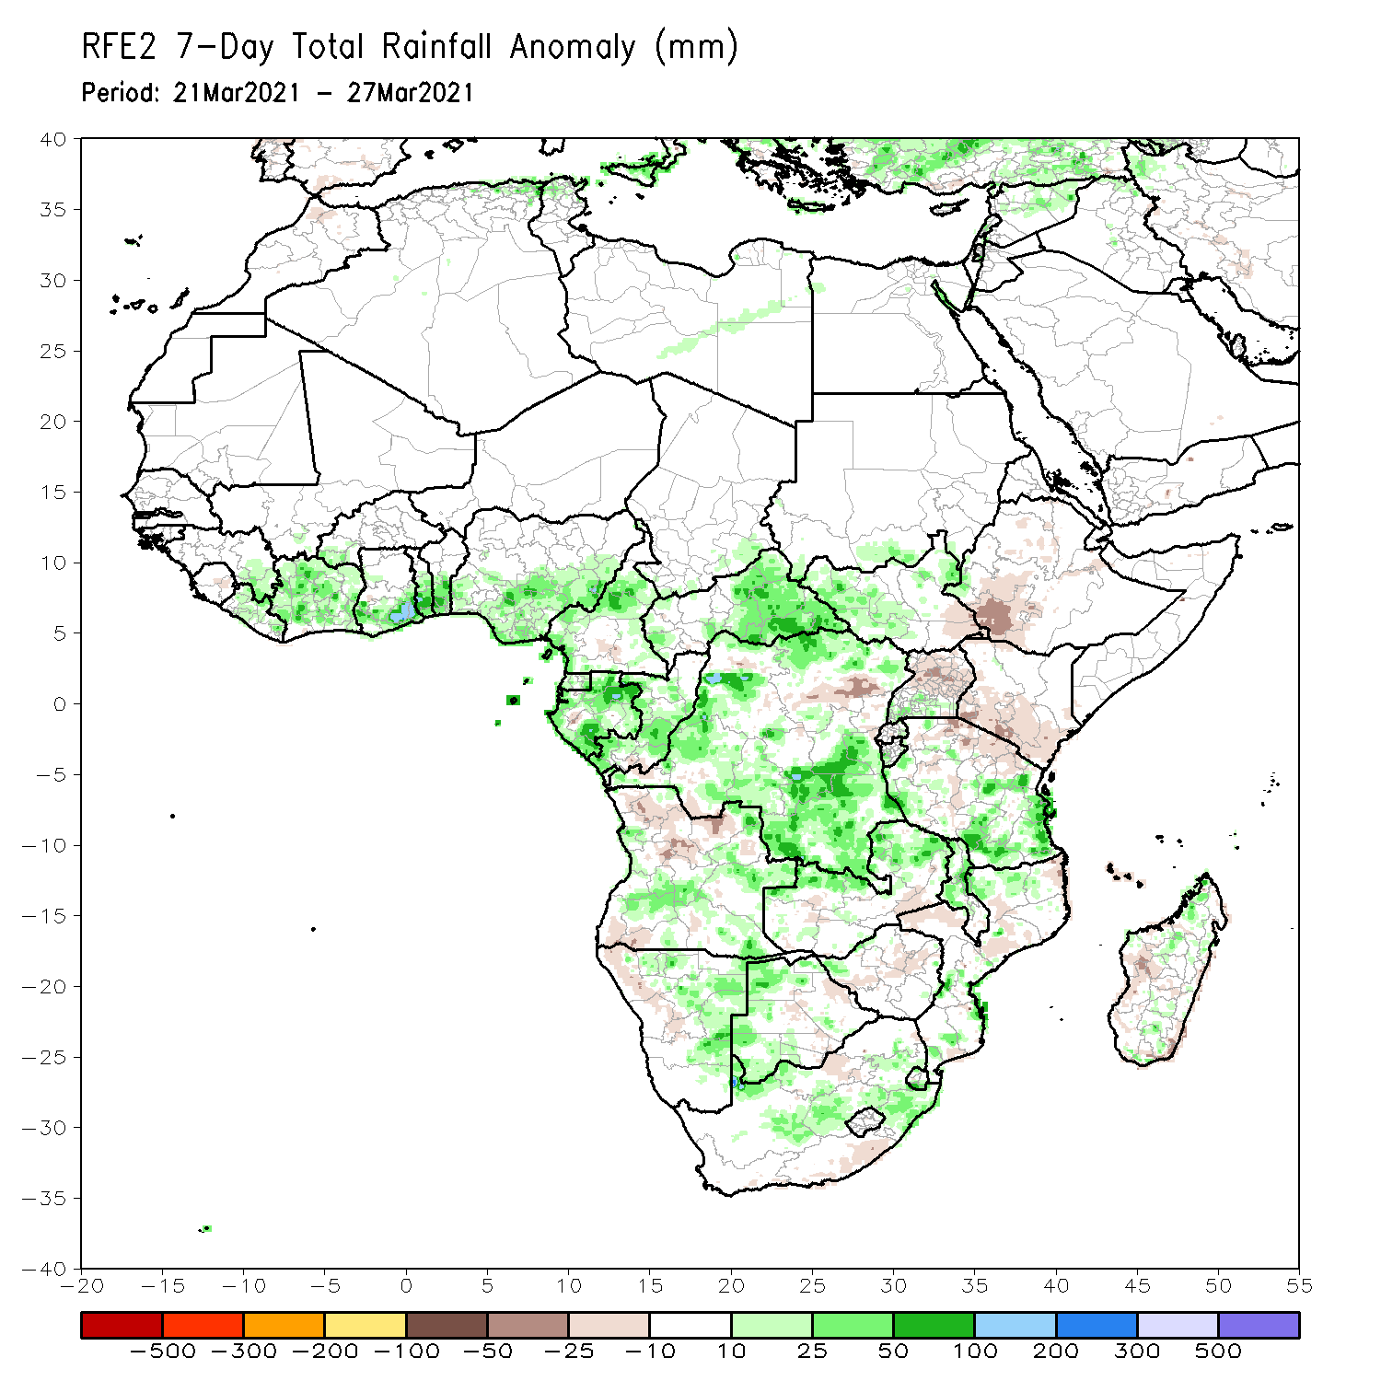
Rainfall Patterns: Last 7 Days
During the past 7 days, in East Africa, rainfall was slightly below-average over parts of Ethiopia, Kenya and Uganda, and the western and central portions of Tanzania. Rainfall was above-average over parts of southern and eastern Tanzania. In Southern Africa, rainfall was slightly above-average over parts of Angola, eastern Namibia, western Botswana and South Africa. Below-average rainfall was observed over parts of northern Angola, Zambia and Zimbabwe. In Central Africa rainfall was above-average over Equatorial Guinea, Gabon, CAR and DRC. In West Africa, above-average rainfall was observed over portions of the Gulf of Guinea countries.

Slide 7
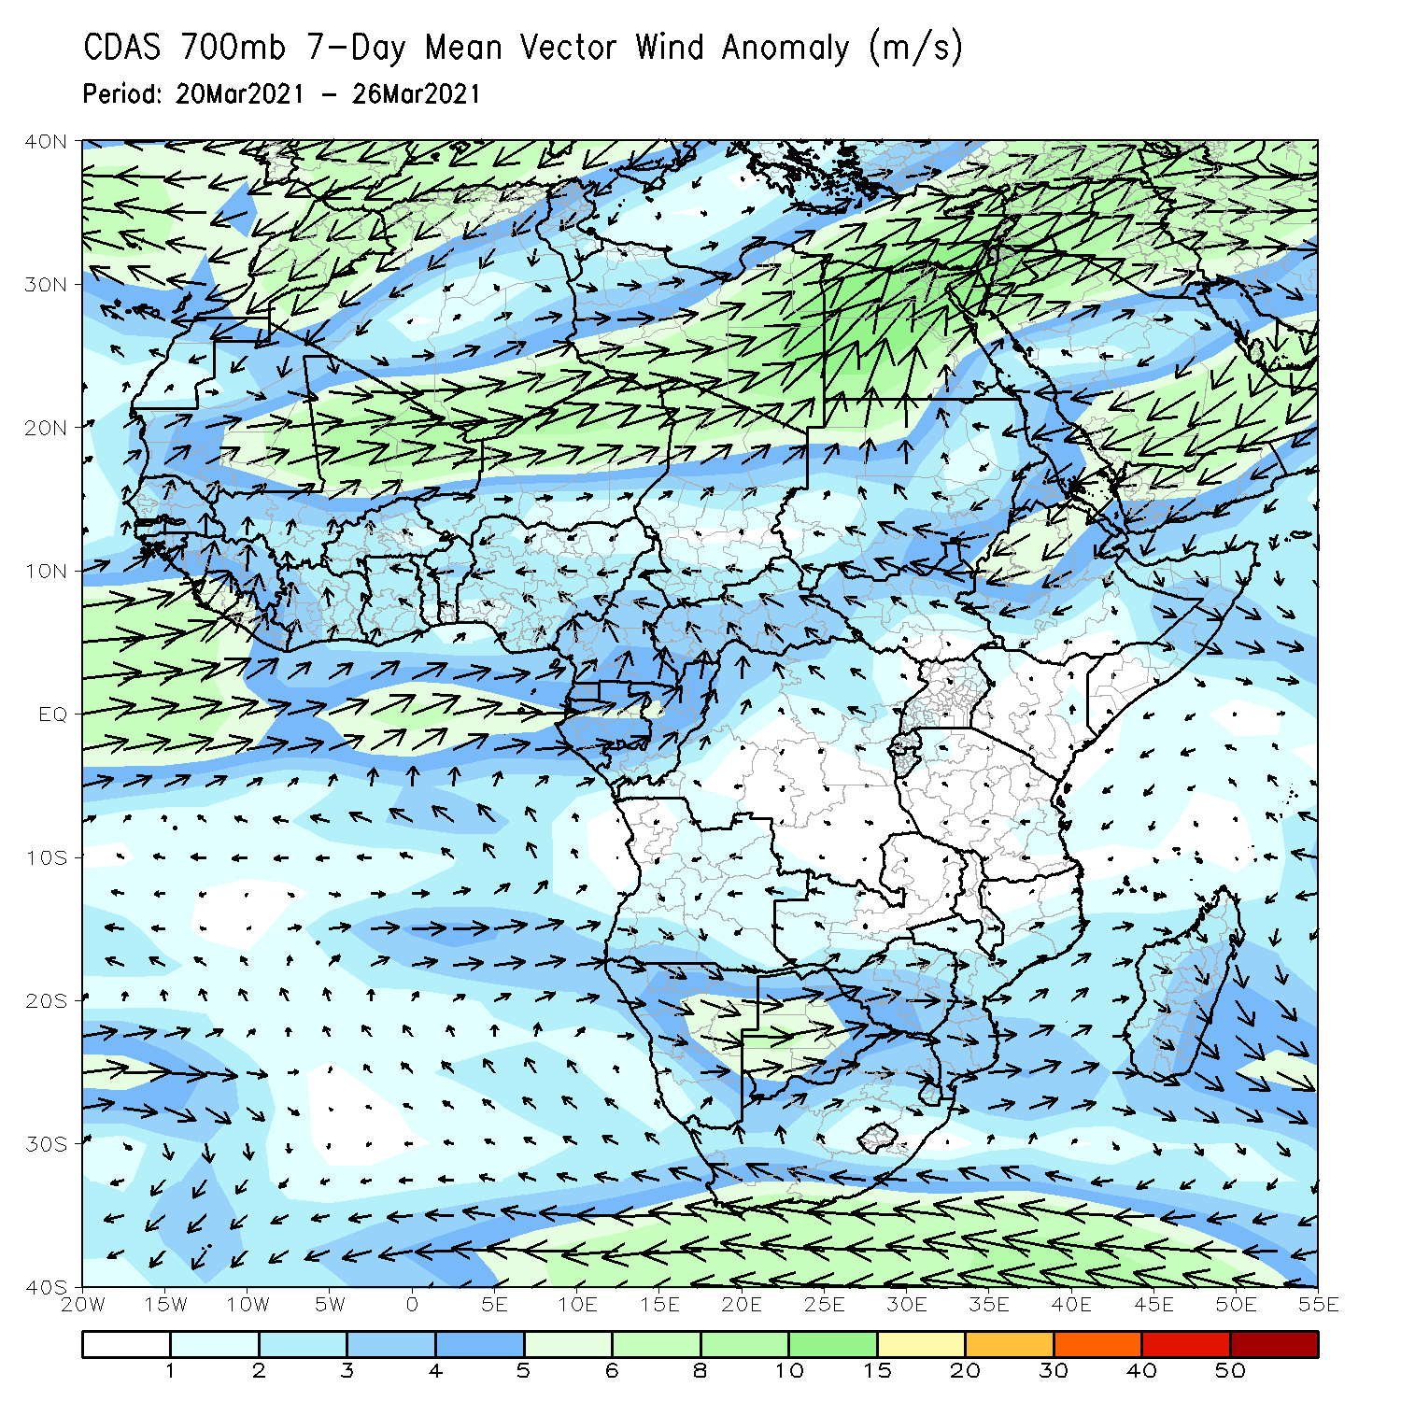
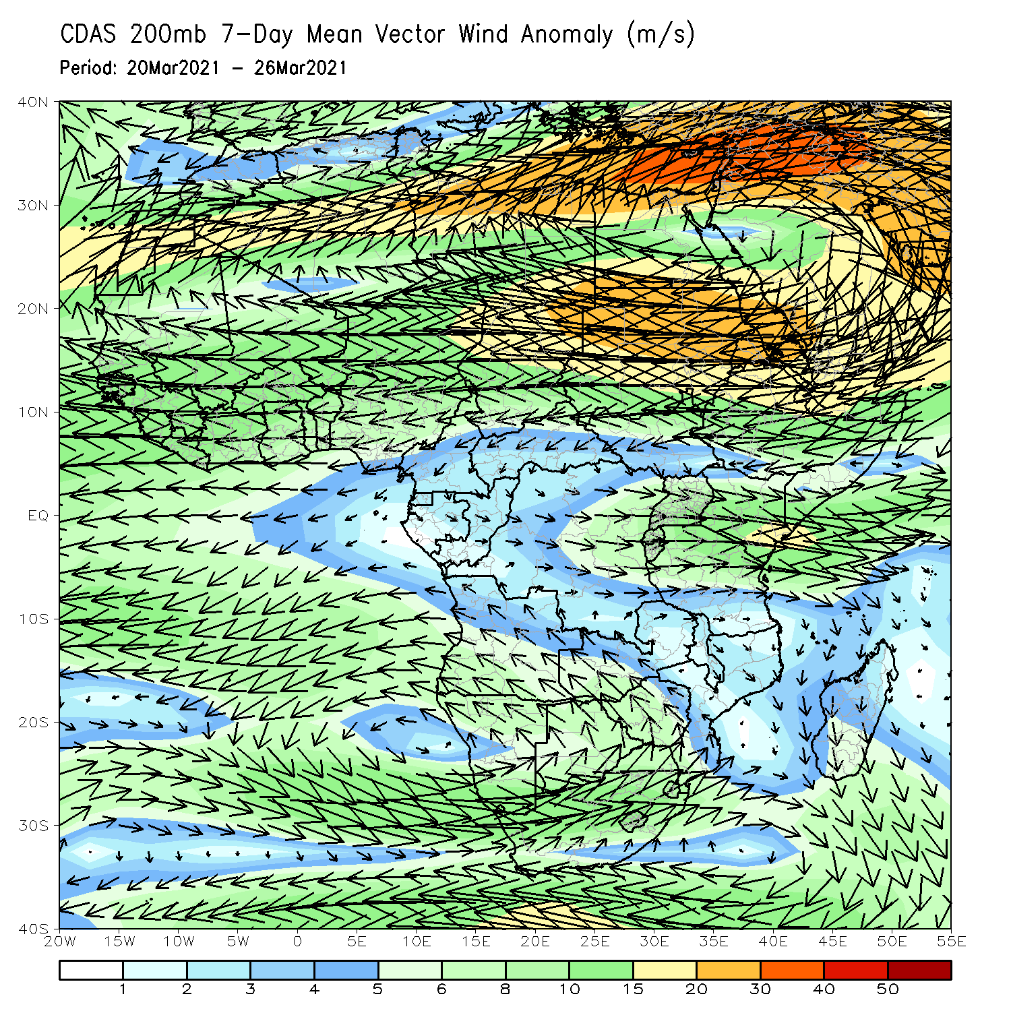
Atmospheric Circulation: Last 7 Days
At lower-level (left panel), anomalous onshore flow with its associated cyclonic turning across the Gulf of Guinea area may have contributed to the observed above-average rainfall in the region.

Slide 8
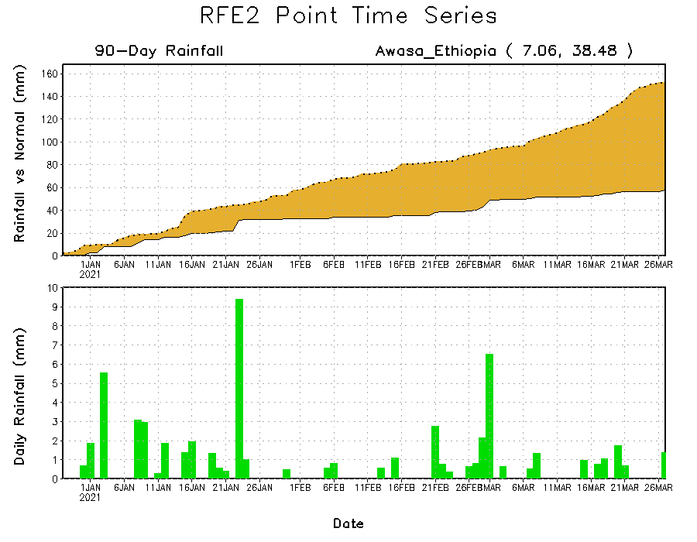
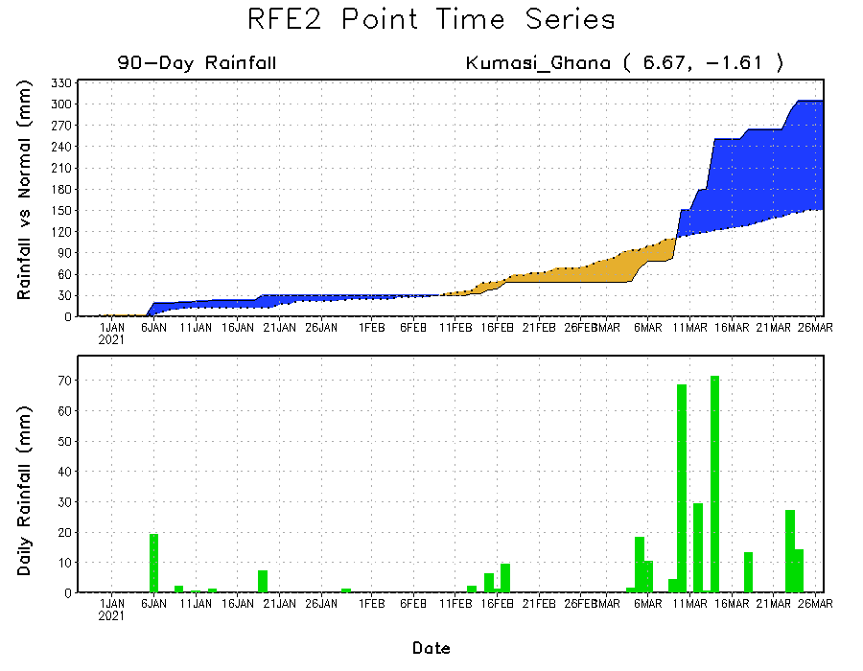
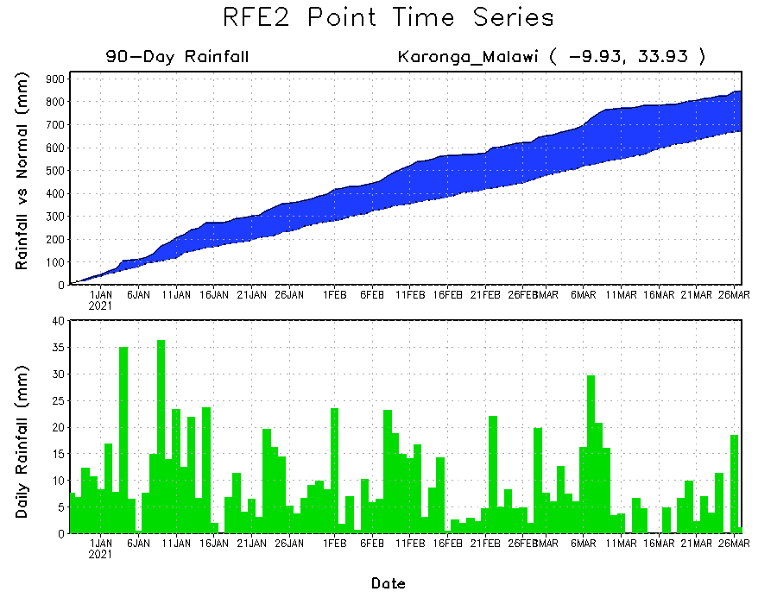
Rainfall Evolution
Daily evolution of rainfall over the last 90 days at selected locations shows moderate to heavy rainfall sustained moisture surpluses over parts of Ghana (bottom left) and Malawi (bottom right). Seasonal total rainfall remained below-average over portions of Ethiopia (top right).

Slide 9
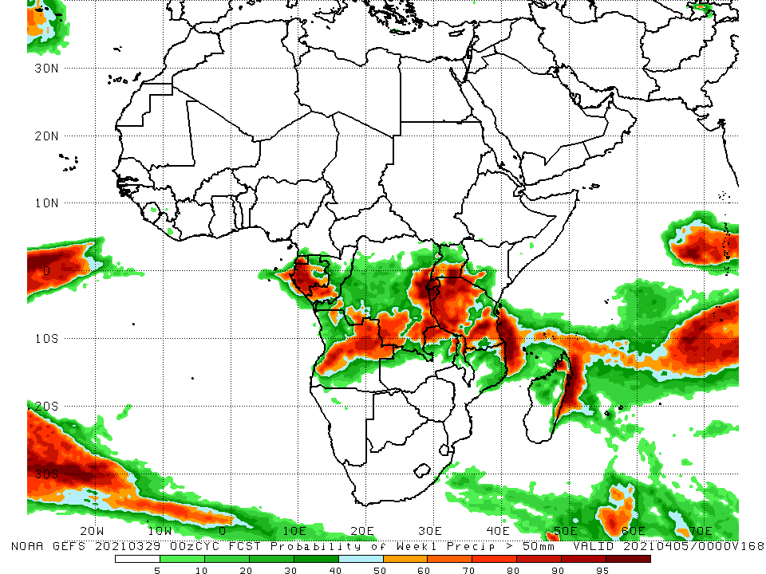
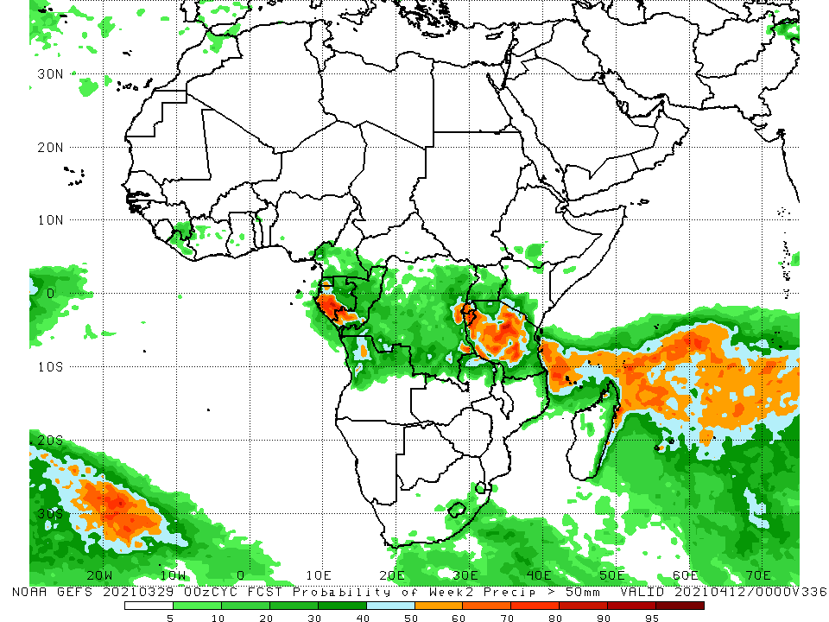
NCEP GEFS Model Forecasts Non-Bias Corrected Probability of precipitation exceedance
Week-1, Valid: 30 March - 5 April, 2021
Week-2, Valid: 6 - 12 April, 2021
For week-1 (left panel), the NCEP GEFS indicates a moderate to high chance (over 70%) for rainfall to exceed 50 mm over Equatorial Guinea, western Gabon, eastern DRC, Rwanda, Burundi, Tanzania, and portions of Angola. For week-2 (right panel), the chance for rainfall to exceed 50 mm is mostly confined to much of western Gabon, Rwanda, Burundi and Tanzania.
Notes:
9

Slide 10
Summary
During the past 30 to 90 days, in East Africa, moisture deficits prevailed over parts of South Sudan and Ethiopia, Uganda, Rwanda, Burundi, and northern Tanzania. Rainfall was above-average central and southern Tanzania. In southern Africa, moderate to heavy rains resulted in moisture surpluses over eastern Zambia, Malawi, northern Mozambique, portions of Madagascar, and local areas in Angola, Namibia, Botswana and Southern Africa. In contrast, persistent light rains sustained moisture deficits over much of Angola, much of Namibia, western Zambia, Botswana, Zimbabwe, portions of South Africa, southern Mozambique, and over pockets of Madagascar. In Central Africa, rainfall was below-average over western Gabon and northeastern DRC. In West Africa, Rainfall was above-average over many places in the Gulf of Guinea countries.
During the past 7 days, in East Africa, rainfall was slightly below-average over parts of Ethiopia, Kenya and Uganda, and the western and central portions of Tanzania. Rainfall was above-average over parts of southern and eastern Tanzania. In Southern Africa, rainfall was slightly above-average over parts of Angola, eastern Namibia, western Botswana and South Africa. Below-average rainfall was observed over parts of northern Angola, Zambia and Zimbabwe. In Central Africa rainfall was above-average over Equatorial Guinea, Gabon, CAR and DRC. In West Africa, above-average rainfall was observed over portions of the Gulf of Guinea countries.
For week-1 and week-2, there is a moderate to high chance (over 70%) for rainfall to exceed 50 mm over Equatorial Guinea, western Gabon, eastern DRC, Rwanda, Burundi, Tanzania, and portions of Angola.

