Slide 1
The African Monsoon Recent Evolution and Current Status Include Week-1 and Week-2 Outlooks
Update prepared by
5 April 2021
For more information, visit:
http://www.cpc.ncep.noaa.gov/products/Global_Monsoons/African_Monsoons/precip_monitoring.shtml

Slide 2
Outline
Highlights
Recent Evolution and Current Conditions
NCEP GEFS Forecasts
Summary

Slide 3
Highlights: Last 7 Days
During the past 7 days, in East Africa, rainfall was slightly below-average over parts of Ethiopia and Kenya. Rainfall was above-average over southern Uganda, and northern and eastern Tanzania. In Southern Africa, rainfall was slightly above-average over parts of Angola, northwestern Namibia, and parts of western Botswana. Rainfall was slightly below-average over Zambia, much of Botswana, Zimbabwe, Mozambique, South Africa and Madagascar. In Central Africa rainfall was above-average over eastern Gabon, Congo and parts of DRC. Below-average rainfall was observed over western Gabon, and parts of central and northern DRC. In West Africa, below-average rainfall was observed over portions of the Gulf of Guinea countries.
For week-1 and week-2, there is a moderate to high chance (over 70%) for rainfall to exceed 50 mm over Equatorial Guinea, Gabon, parts of eastern and southern DRC, Rwanda, Burundi, and much of Tanzania.

Slide 4
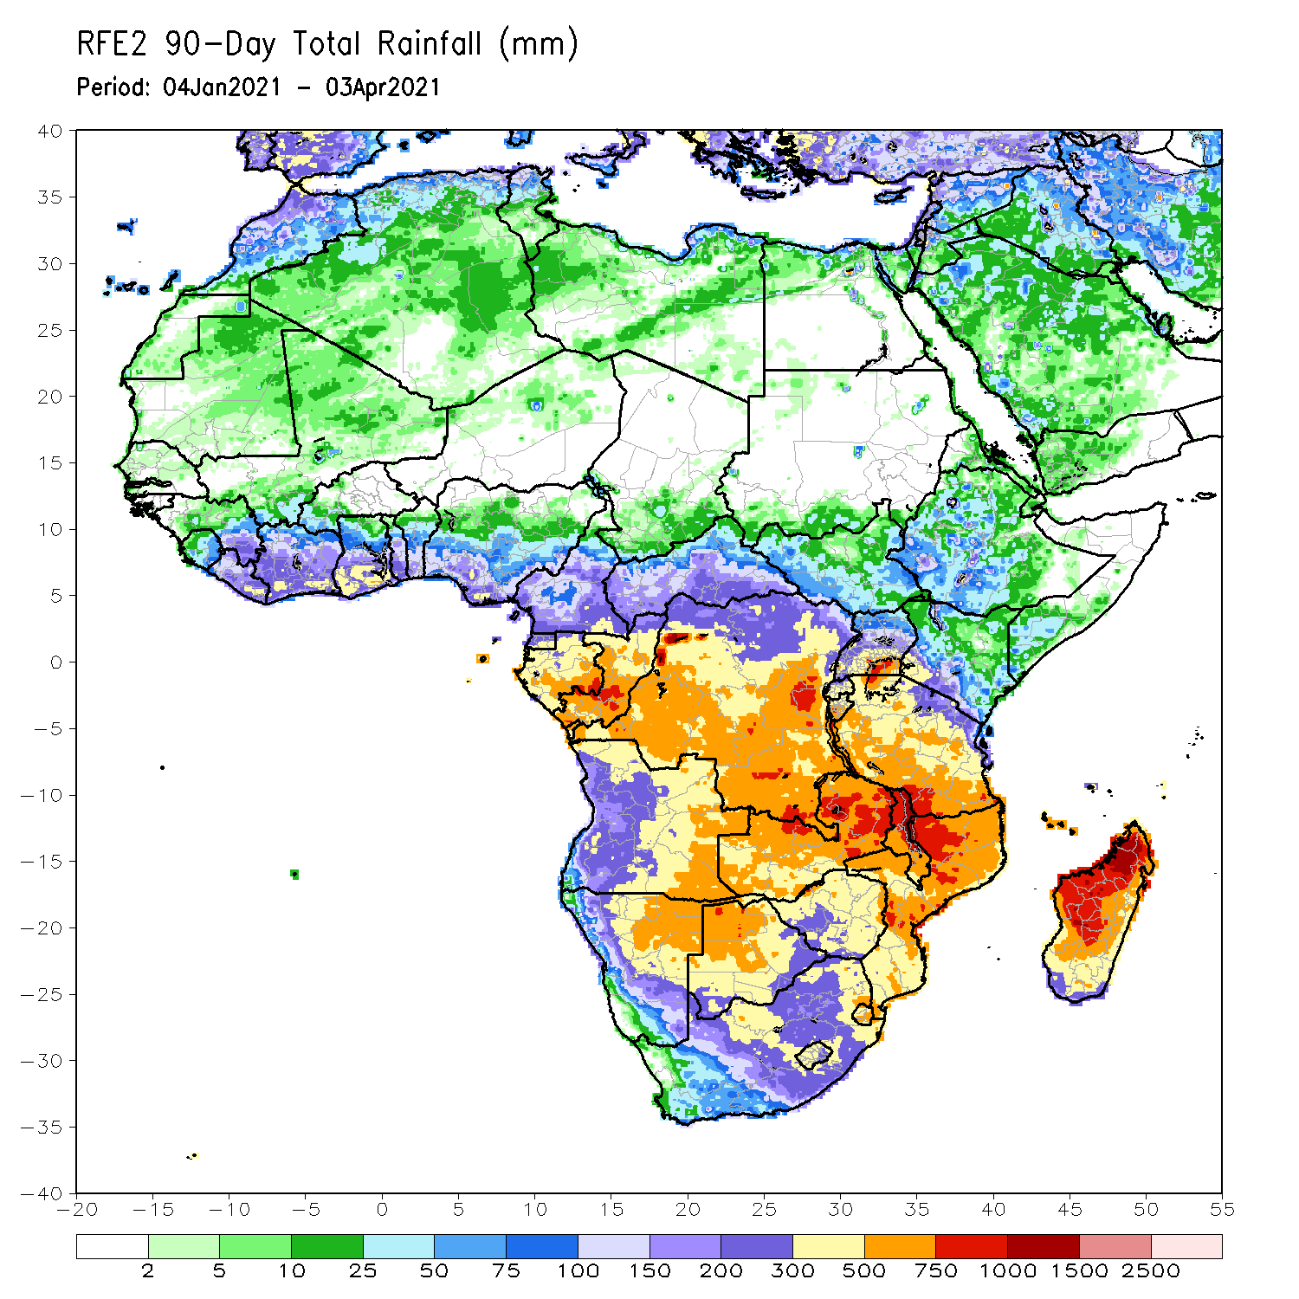
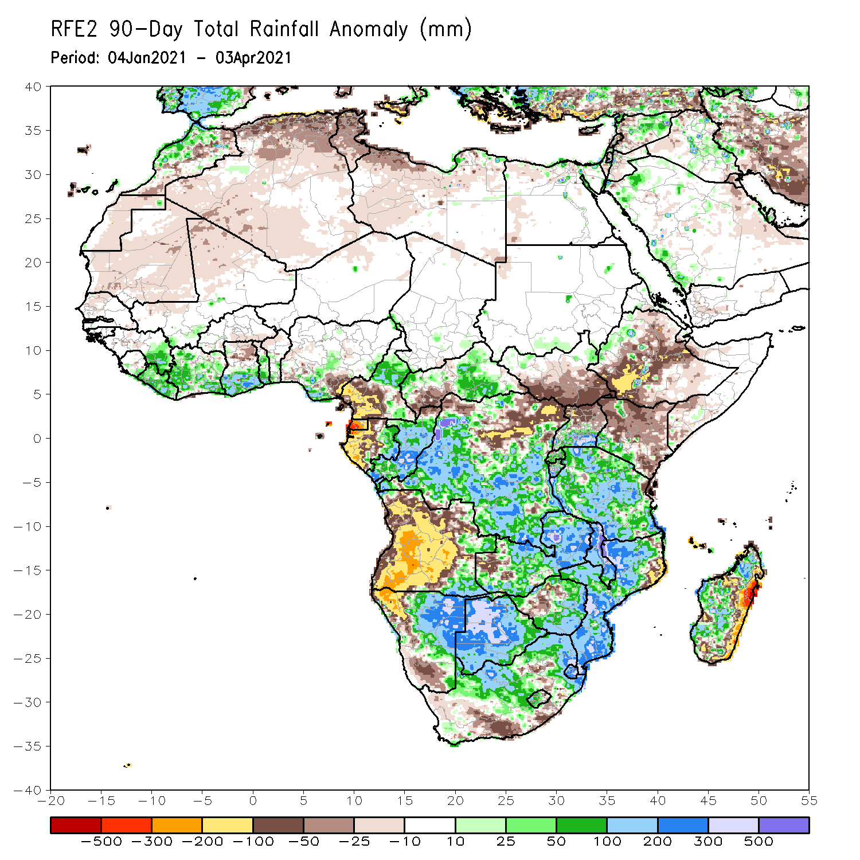
Rainfall Patterns: Last 90 Days
Over the past 90 days, in East Africa, rainfall was below-average over many parts of Ethiopia and Kenya. Rainfall was also below-average over much of South Sudan and northern Uganda. Rainfall was above-average over southern Uganda, Rwanda, Burundi and much of Tanzania, and pockets of western Ethiopia. In southern Africa, moderate to locally heavy rains resulted in sustained moisture surpluses over central and eastern Namibia and much of Botswana. Rainfall was also above-average over southeastern Angola, Zambia, Malawi, Zimbabwe, much of Mozambique and South Africa, and Madagascar. Persistent light rains resulted in moisture deficits over many parts of Angola, and parts of western Namibia. Rainfall was also below-average over pockets of Zimbabwe and northeastern Mozambique, South Africa, and eastern Madagascar. In Central Africa, rainfall was above-average over many parts of DRC, Congo and CAR. Rainfall was below-average over northeastern DRC and western CAR. Below-average rains were also observed over the western areas of Gabon, Equatorial Guinea and southern Cameroon. In West Africa, rainfall was above-average over portions of the Gulf of Guinea countries.
Notes:
4

Slide 5
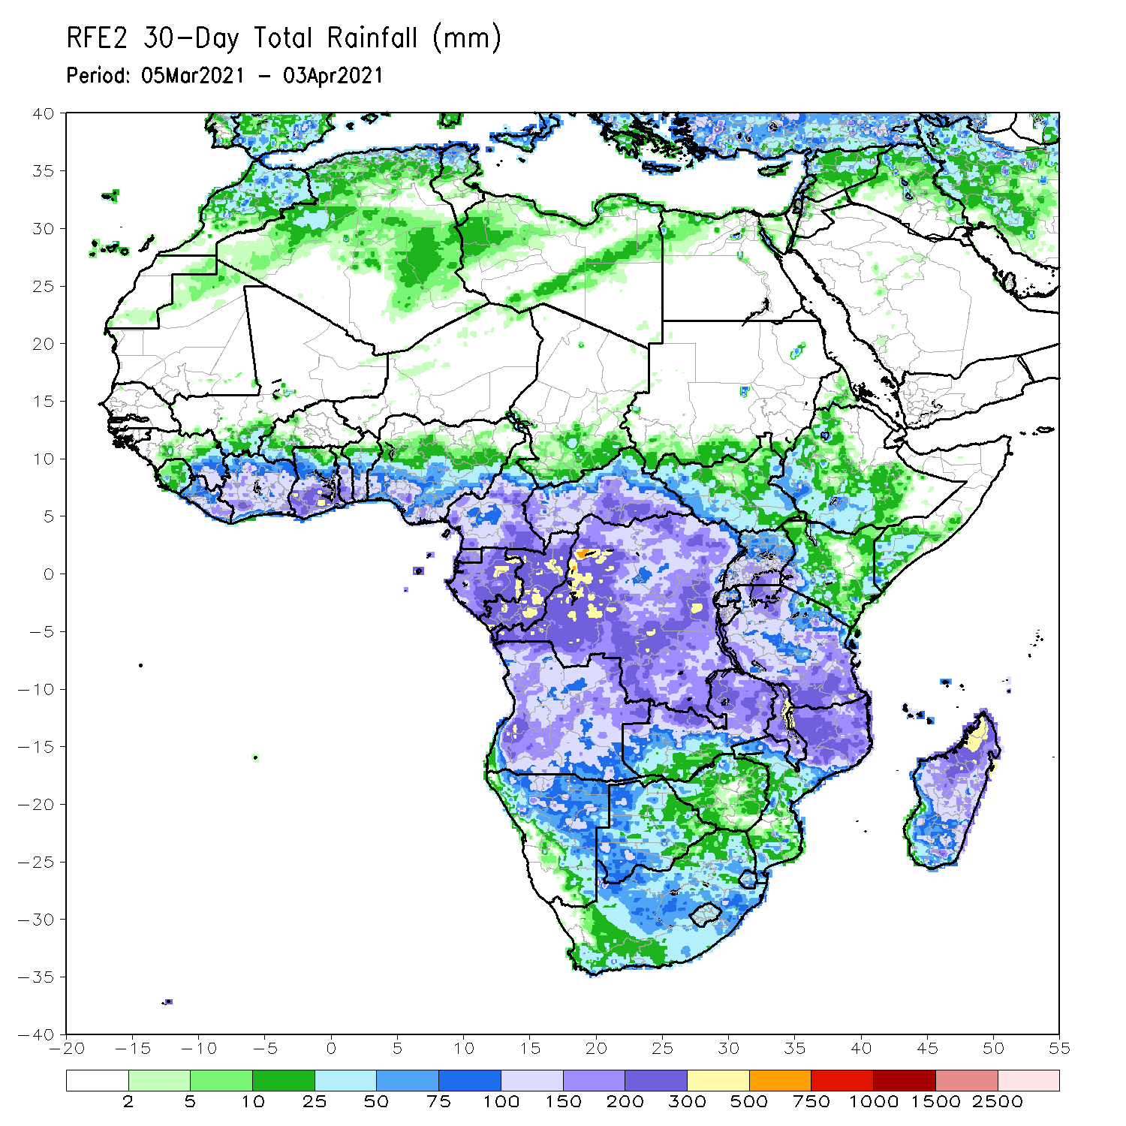
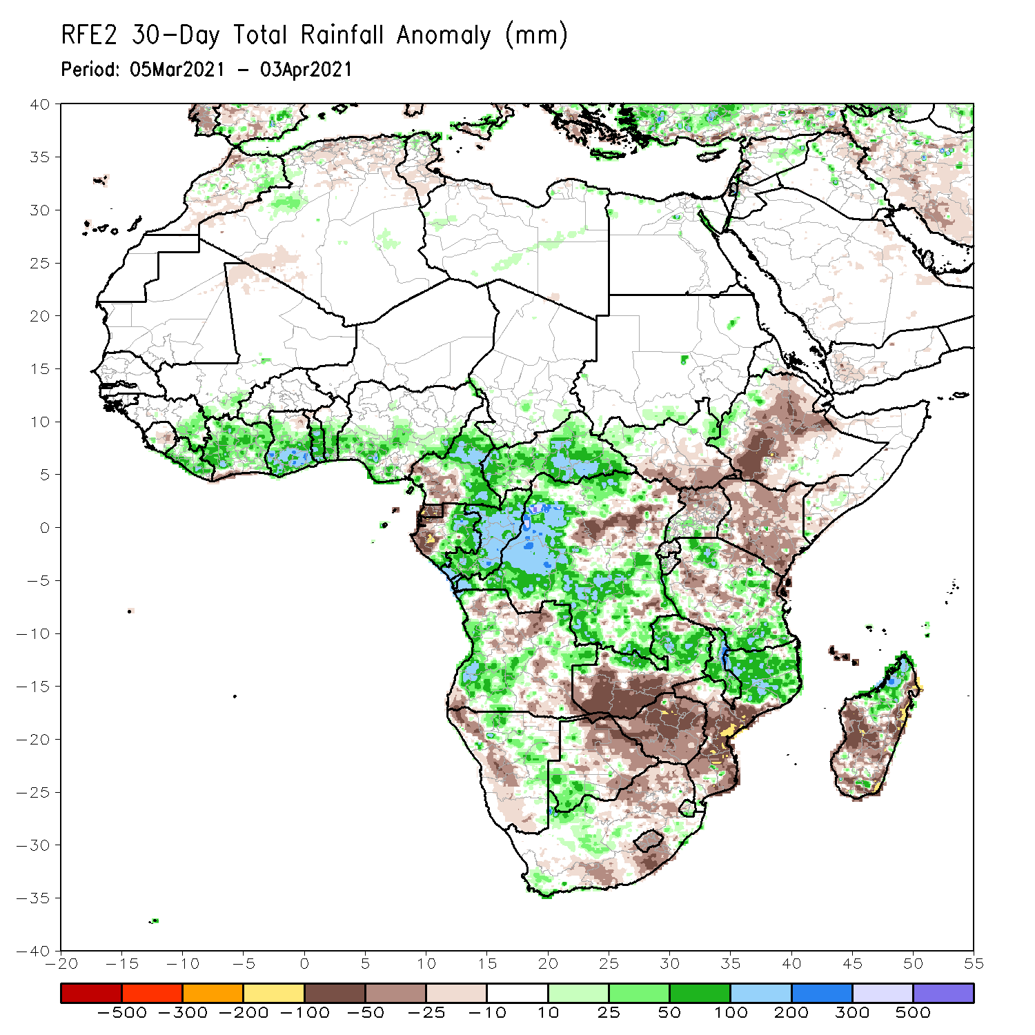
Rainfall Patterns: Last 30 Days
During the past 30 days, in East Africa, below-average rainfall was observed over parts of Ethiopia, southern South Sudan, Uganda, Rwanda, Burundi, Kenya, and parts of Tanzania. In contrast, rainfall was above-average over central and southern Tanzania. In southern Africa, moderate to heavy rains resulted in moisture surpluses over eastern Zambia, Malawi, northern Mozambique, and portions of northern Madagascar. Rainfall was also above-average over local areas in Angola, Namibia, Botswana and Southern Africa. In contrast, persistent light rains sustained moisture deficits over pockets of Angola, western Namibia, western Zambia, Botswana, Zimbabwe, portions of South Africa, southern Mozambique, and southern Madagascar. In Central Africa, rainfall was below-average over western Gabon and northeastern DRC. Rainfall was above-average over eastern Gabon, Congo, many parts of DRC, and CAR. In West Africa, rainfall was above-average over many places in the Gulf of Guinea countries.
Notes:
5

Slide 6
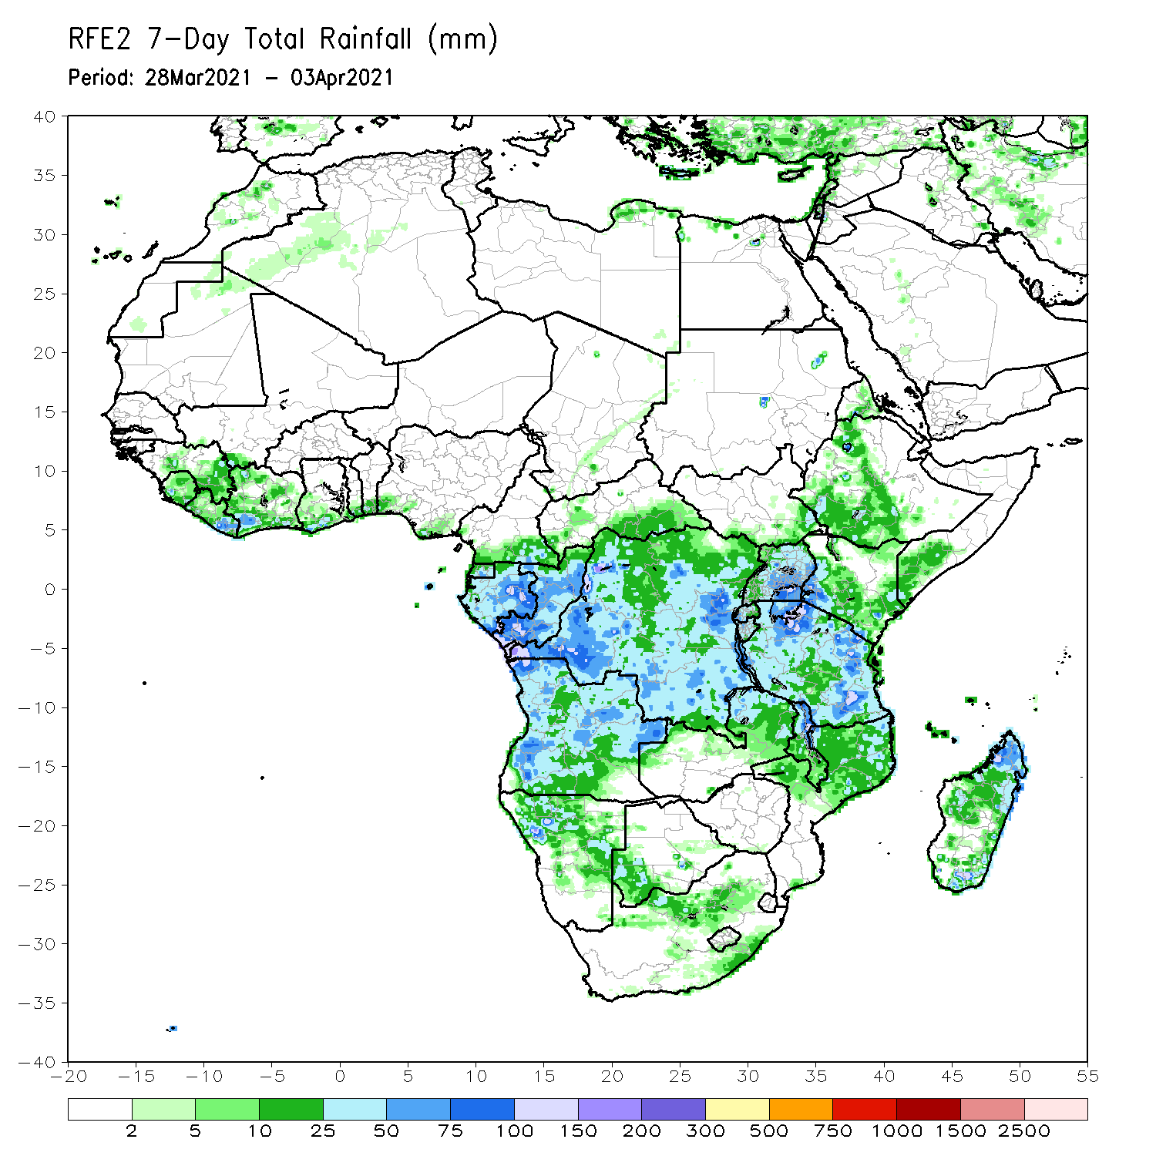
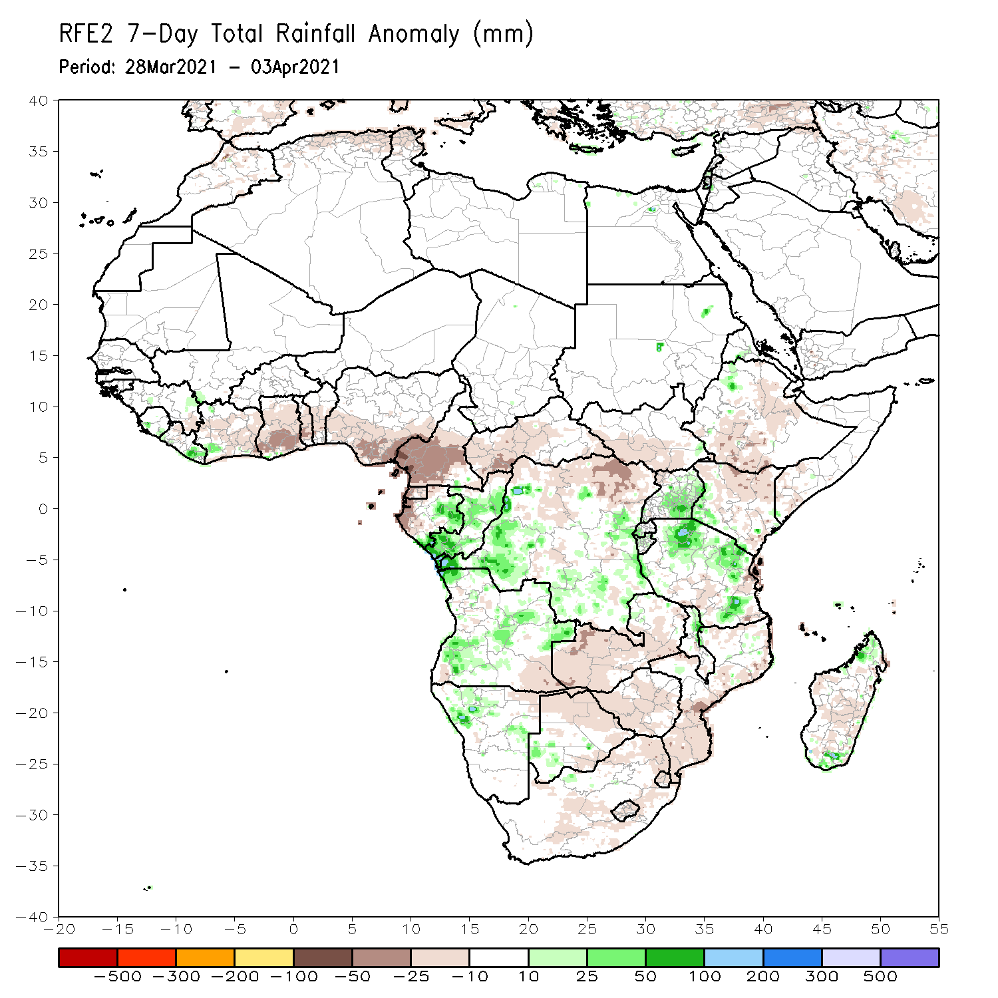
Rainfall Patterns: Last 7 Days
During the past 7 days, in East Africa, rainfall was slightly below-average over parts of Ethiopia and Kenya. Rainfall was above-average over southern Uganda, and northern and eastern Tanzania. In Southern Africa, rainfall was slightly above-average over parts of Angola, northwestern Namibia, and parts of western Botswana. Rainfall was slightly below-average over Zambia, much of Botswana, Zimbabwe, Mozambique, South Africa and Madagascar. In Central Africa rainfall was above-average over eastern Gabon, Congo and parts of DRC. Below-average rainfall was observed over western Gabon, and parts of central and northern DRC. In West Africa, below-average rainfall was observed over portions of the Gulf of Guinea countries.

Slide 7
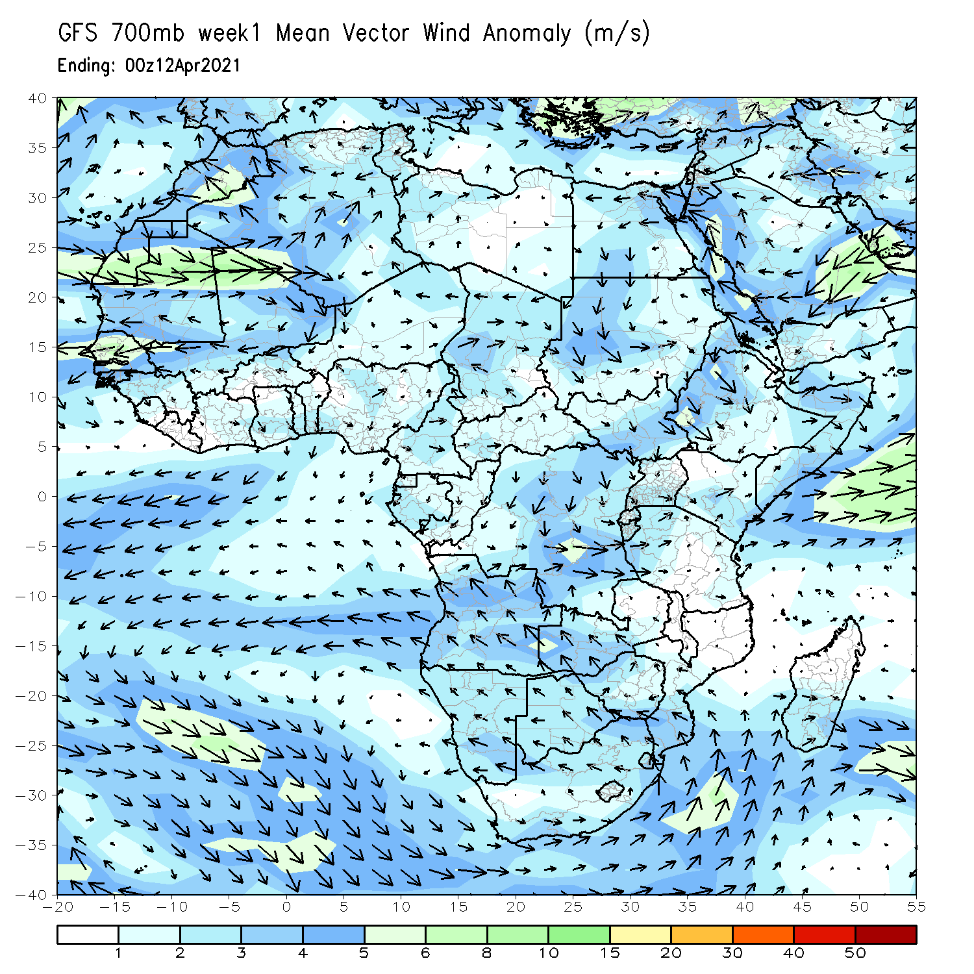
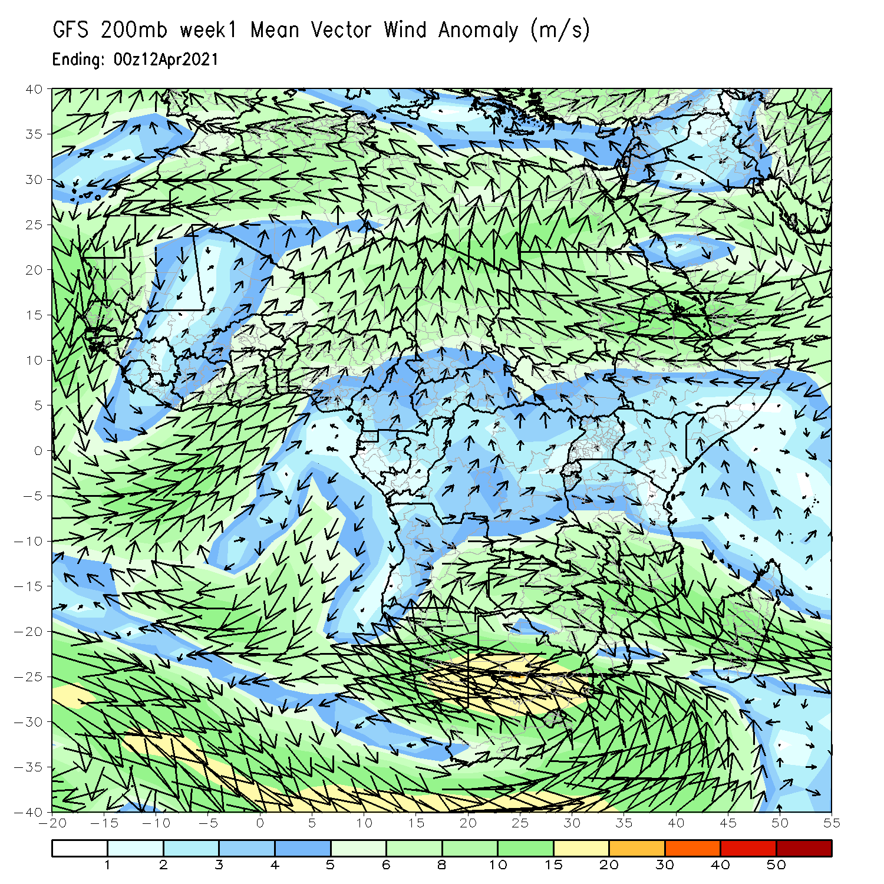
Atmospheric Circulation: Last 7 Days
At lower-level (left panel), anomalous offshore flow in the Gulf of Guinea and East Africa may have contributed to the observed suppressed rainfall in the regions.

Slide 8
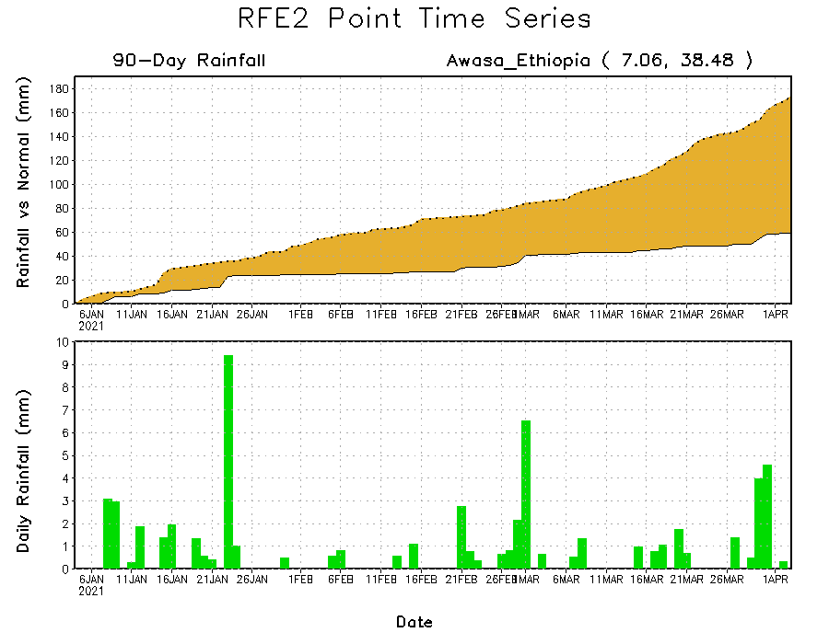
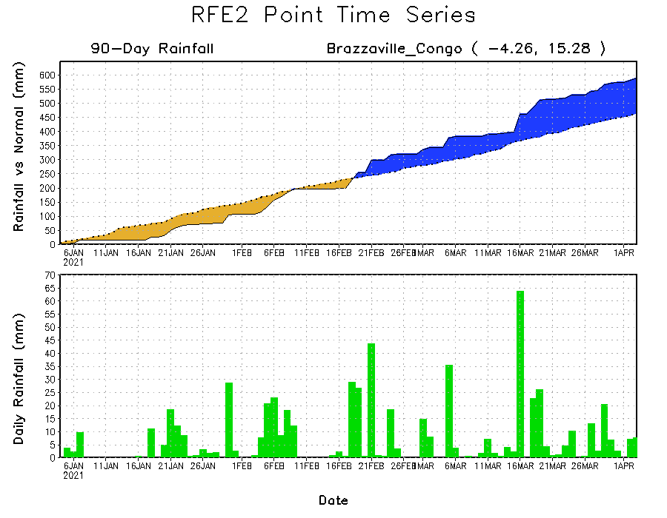
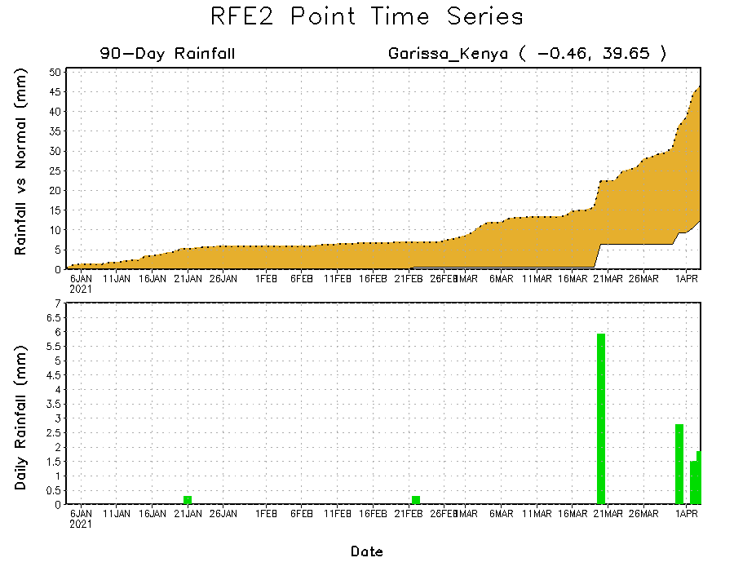
Rainfall Evolution
Daily evolution of rainfall over the last 90 days at selected locations shows moderate to heavy rainfall sustained moisture surpluses over parts of Congo (bottom left). Seasonal total rainfall remained below-average over portions of Ethiopia (top right) and Kenya (bottom right).

Slide 9
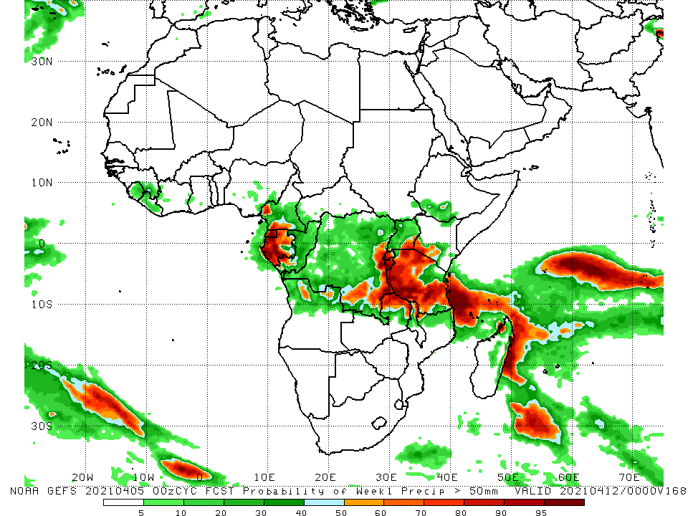
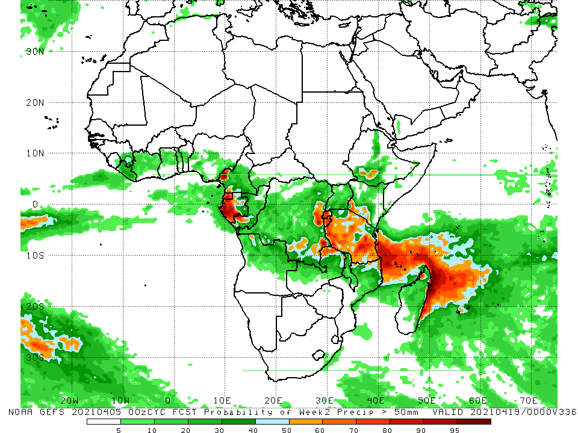
NCEP GEFS Model Forecasts Non-Bias Corrected Probability of precipitation exceedance
Week-1, Valid: 6 - 12 April, 2021
Week-2, Valid: 13 - 19 April, 2021
For week-1 (left panel) and week-2 (right panel), the NCEP GEFS indicates a moderate to high chance (over 70%) for rainfall to exceed 50 mm over Equatorial Guinea, Gabon, parts of eastern and southern DRC, Rwanda, Burundi, and much of Tanzania.
Notes:
9

Slide 10
Summary
During the past 30 to 90 days, in East Africa, below-average rainfall was observed over parts of Ethiopia, southern South Sudan, Uganda, Rwanda, Burundi, Kenya, and parts of Tanzania. In contrast, rainfall was above-average over central and southern Tanzania. In southern Africa, moderate to heavy rains resulted in moisture surpluses over eastern Zambia, Malawi, northern Mozambique, and portions of northern Madagascar. Rainfall was also above-average over local areas in Angola, Namibia, Botswana and Southern Africa. In contrast, persistent light rains sustained moisture deficits over pockets of Angola, western Namibia, western Zambia, Botswana, Zimbabwe, portions of South Africa, southern Mozambique, and southern Madagascar. In Central Africa, rainfall was below-average over western Gabon and northeastern DRC. Rainfall was above-average over eastern Gabon, Congo, many parts of DRC, and CAR. In West Africa, rainfall was above-average over many places in the Gulf of Guinea countries.
During the past 7 days, in East Africa, rainfall was slightly below-average over parts of Ethiopia and Kenya. Rainfall was above-average over southern Uganda, and northern and eastern Tanzania. In Southern Africa, rainfall was slightly above-average over parts of Angola, northwestern Namibia, and parts of western Botswana. Rainfall was slightly below-average over Zambia, much of Botswana, Zimbabwe, Mozambique, South Africa and Madagascar. In Central Africa rainfall was above-average over eastern Gabon, Congo and parts of DRC. Below-average rainfall was observed over western Gabon, and parts of central and northern DRC. In West Africa, below-average rainfall was observed over portions of the Gulf of Guinea countries.
For week-1 and week-2, there is a moderate to high chance (over 70%) for rainfall to exceed 50 mm over Equatorial Guinea, Gabon, parts of eastern and southern DRC, Rwanda, Burundi, and much of Tanzania.

