Slide 1
The African Monsoon Recent Evolution and Current Status Include Week-1 and Week-2 Outlooks
Update prepared by
12 April 2021
For more information, visit:
http://www.cpc.ncep.noaa.gov/products/Global_Monsoons/African_Monsoons/precip_monitoring.shtml

Slide 2
Outline
Highlights
Recent Evolution and Current Conditions
NCEP GEFS Forecasts
Summary

Slide 3
Highlights: Last 7 Days
During the past 7 days, in East Africa, rainfall was slightly below-average over parts of Ethiopia and northern Kenya. Rainfall was above-average over Uganda, western and southern Kenya, and northern Tanzania. In Central Africa rainfall was below-average over much of Gabon, Congo, CAR, and parts of northern DRC. In West Africa, above-average rainfall was observed over pockets of the Gulf of Guinea countries.
For week-1 and week-2, there is a moderate to high chance (over 70%) for rainfall to exceed 50 mm over parts of southern Cameroon, Equatorial Guinea, Gabon, northern Angola, parts of southern and eastern DRC, Rwanda, Burundi, southern Uganda, much of Tanzania and parts of southern Ethiopia.

Slide 4
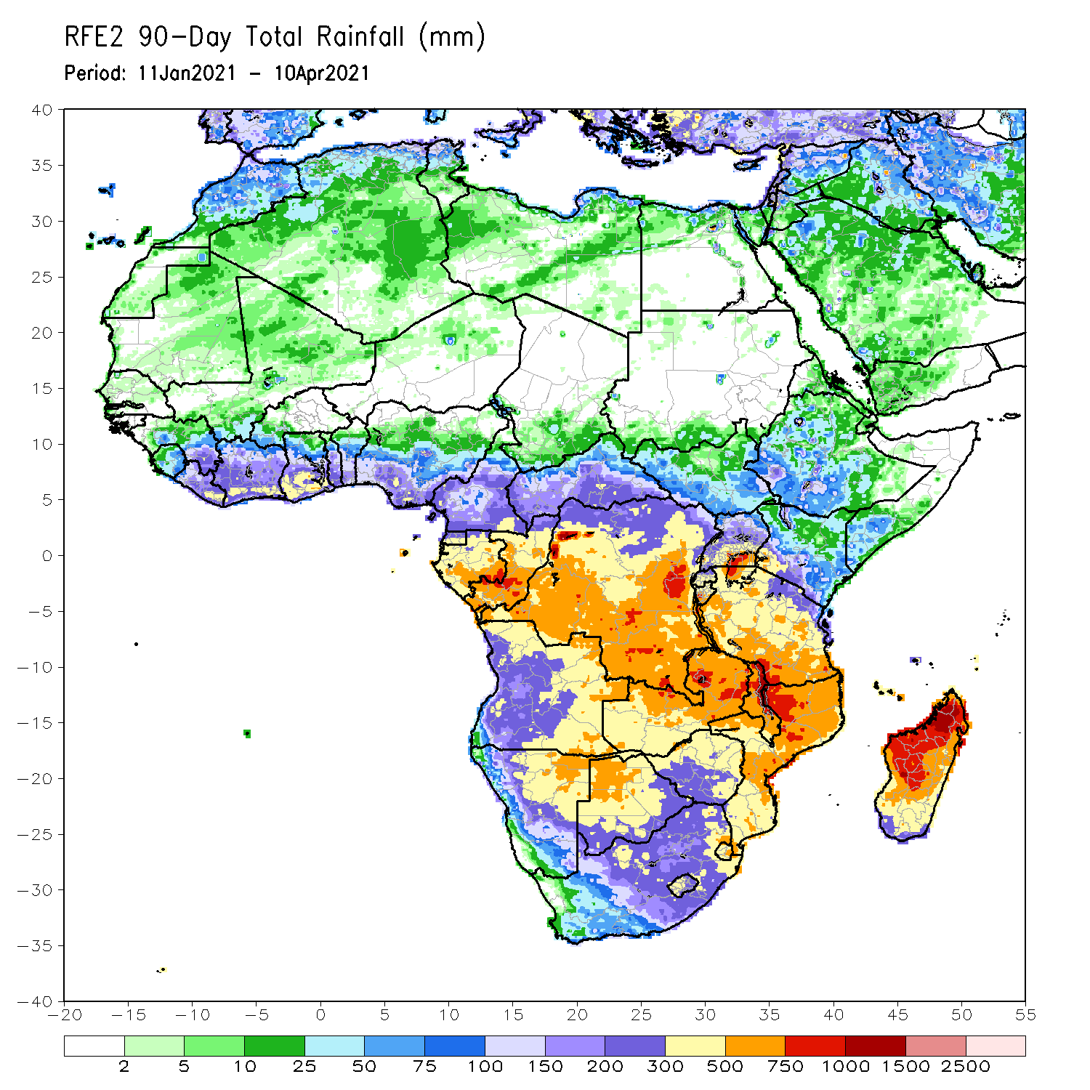
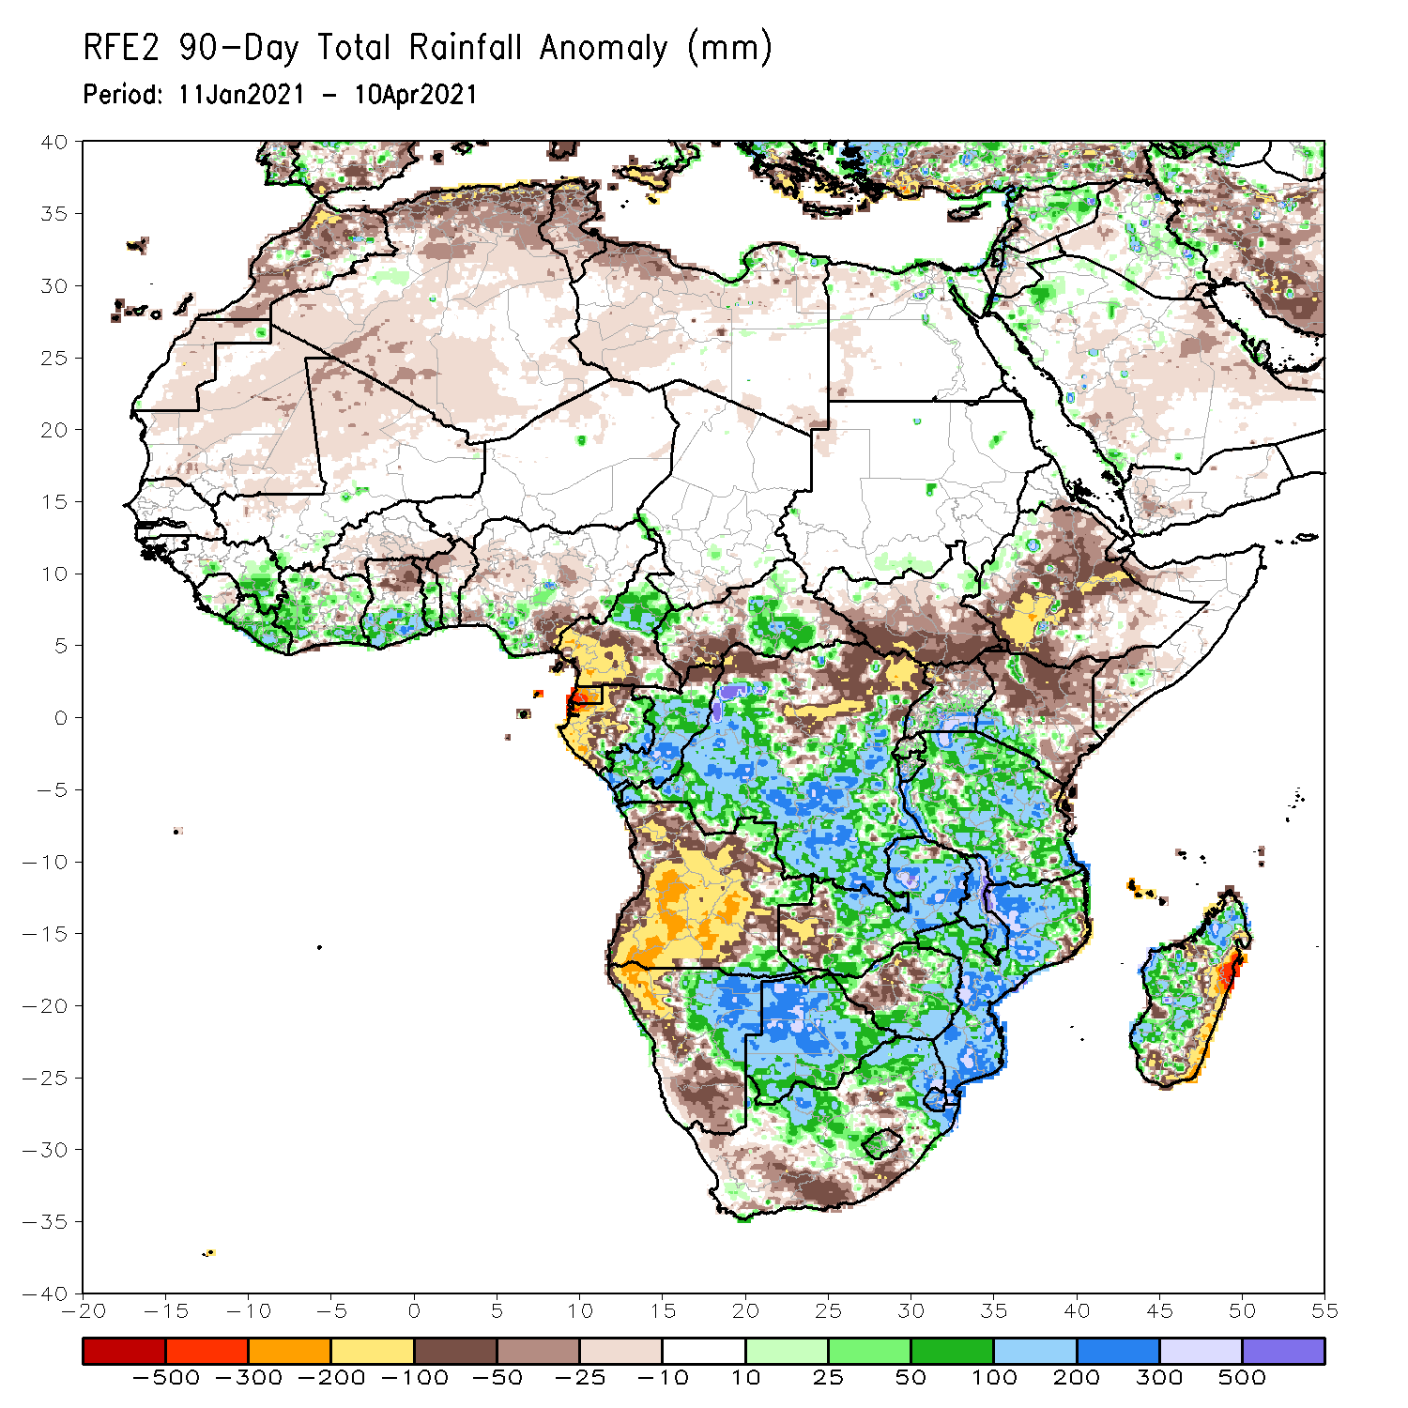
Rainfall Patterns: Last 90 Days
Over the past 90 days, in East Africa, rainfall was below-average over many parts of Ethiopia and Kenya. Rainfall was also below-average over much of South Sudan and northern Uganda. Rainfall was above-average over southern Uganda, Rwanda, Burundi and much of Tanzania, and pockets of western Ethiopia and southwestern Kenya. In southern Africa, moderate to locally heavy rains resulted in sustained moisture surpluses over central and eastern Namibia and much of Botswana. Rainfall was also above-average over southeastern Angola, central and eastern Zambia, Malawi, Zimbabwe, much of Mozambique and South Africa, and Madagascar. Persistent light rains resulted in moisture deficits over many parts of Angola, and parts of western Namibia. Rainfall was also below-average over western Zambia, pockets of Zimbabwe and eastern Madagascar, South Africa, and eastern Madagascar. In Central Africa, rainfall was above-average over many parts of DRC, Congo and eastern CAR. Rainfall was below-average over northeastern DRC and western CAR. Below-average rains were also observed over the western areas of Gabon, Equatorial Guinea and southern Cameroon. In West Africa, rainfall was above-average over portions of the Gulf of Guinea countries.
Notes:
4

Slide 5
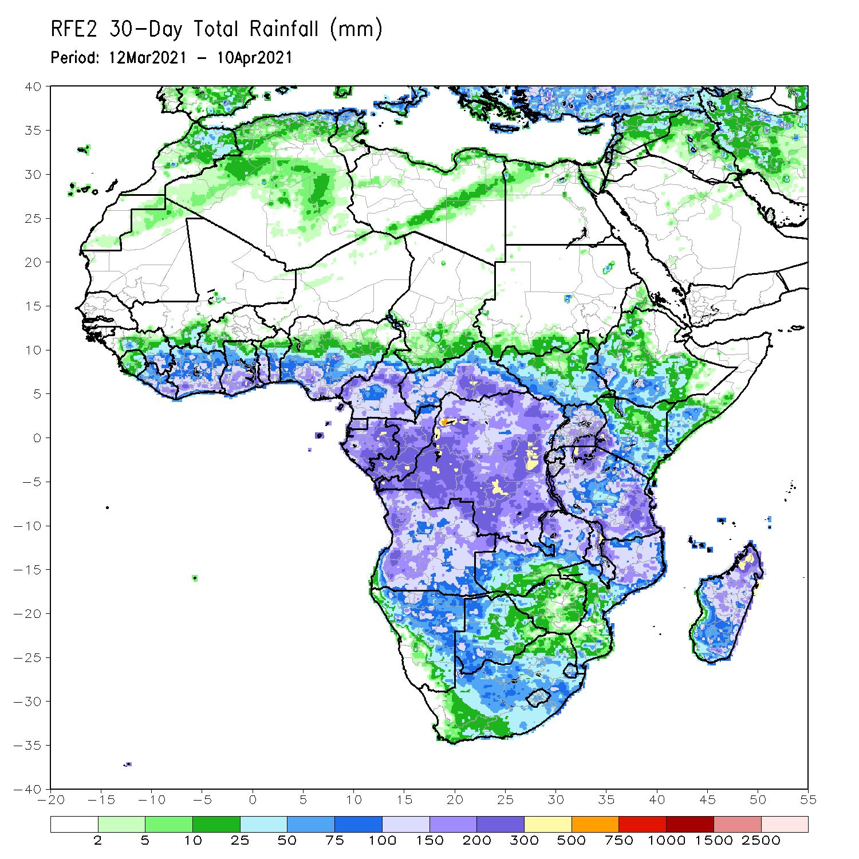
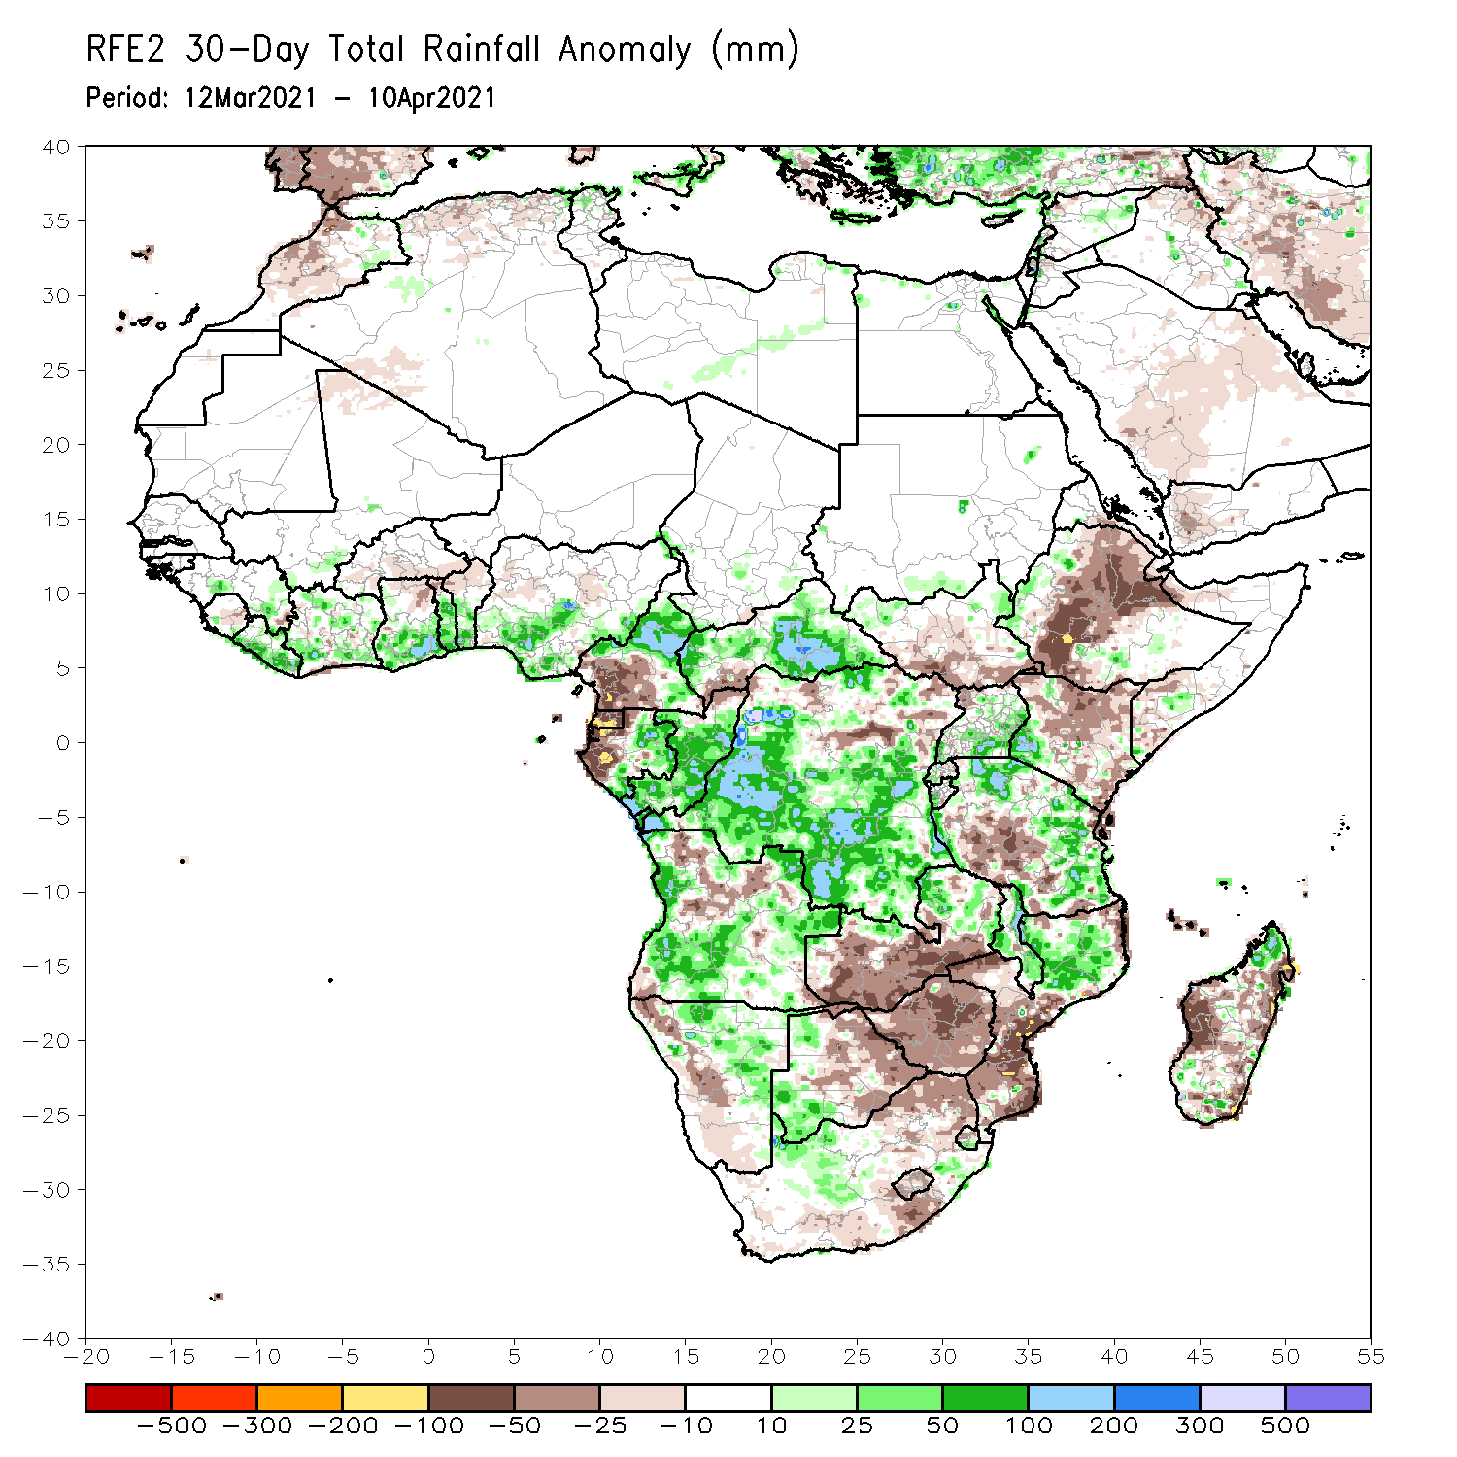
Rainfall Patterns: Last 30 Days
During the past 30 days, in East Africa, below-average rainfall was observed over many parts of Ethiopia, southern South Sudan, much of Kenya, and parts of Tanzania. In contrast, rainfall was above-average over Uganda, central and southern Tanzania, and pockets of Kenya and Ethiopia. In southern Africa, moderate to heavy rains resulted in moisture surpluses over portions of Angola, Namibia, southwestern Botswana, and pockets of Southern Africa. Rainfall was also above-average over eastern Zambia, Malawi, northern Mozambique, and pockets of northern Madagascar. In contrast, persistent light rains sustained moisture deficits over pockets of Angola, western Namibia, southern Zambia, eastern Botswana, Zimbabwe, portions of South Africa, southern Mozambique, and parts of Madagascar. In Central Africa, rainfall was below-average over western Gabon and northeastern DRC. Rainfall was above-average over eastern Gabon, Congo, many parts of DRC, and CAR. In West Africa, rainfall was above-average over portions of the Gulf of Guinea countries.
Notes:
5

Slide 6
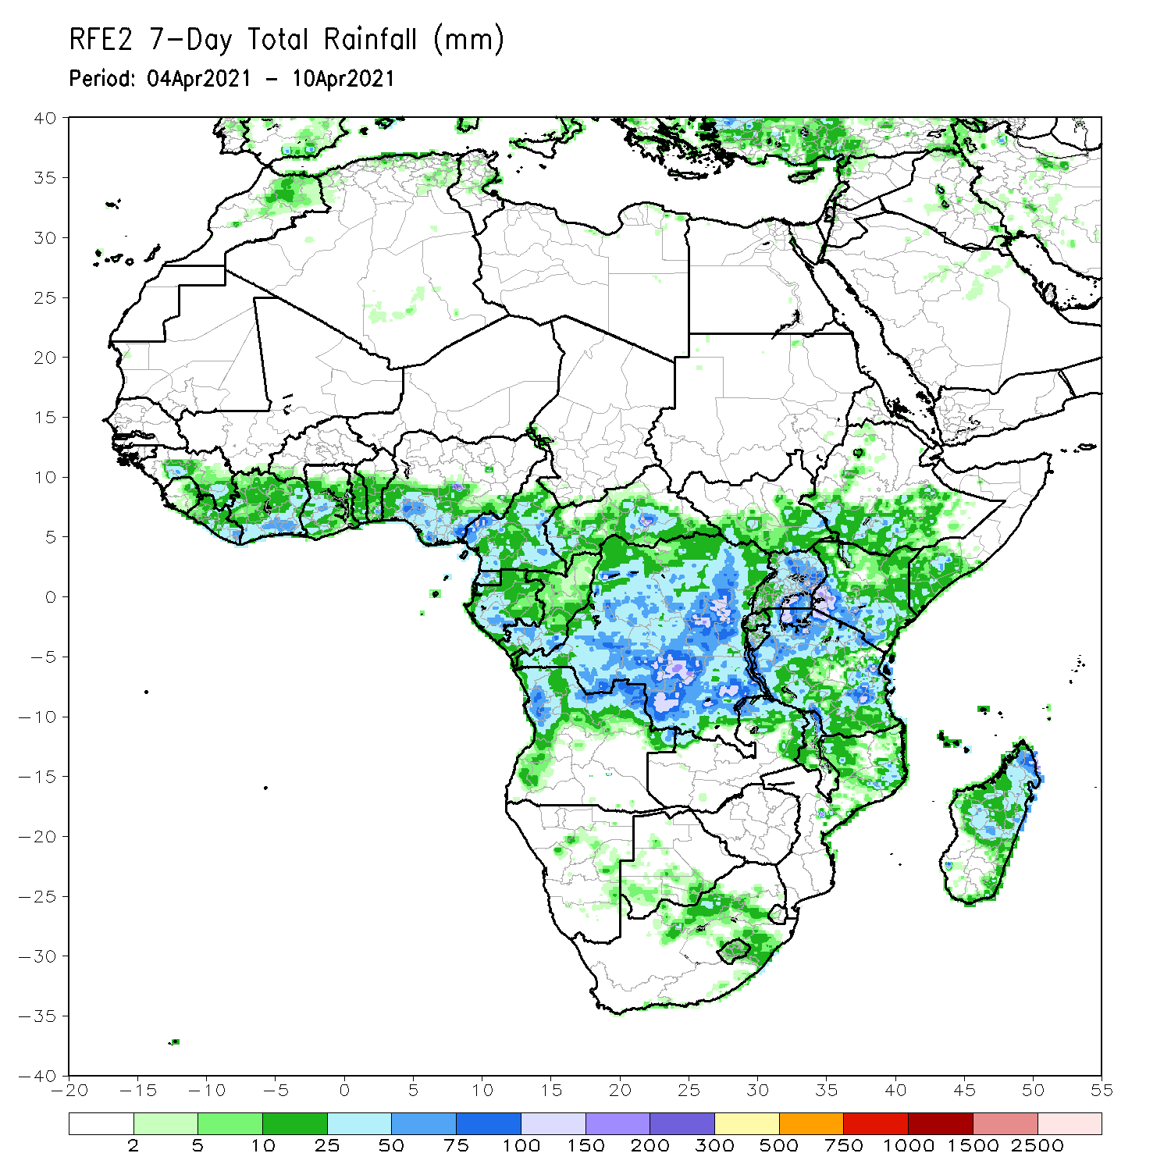
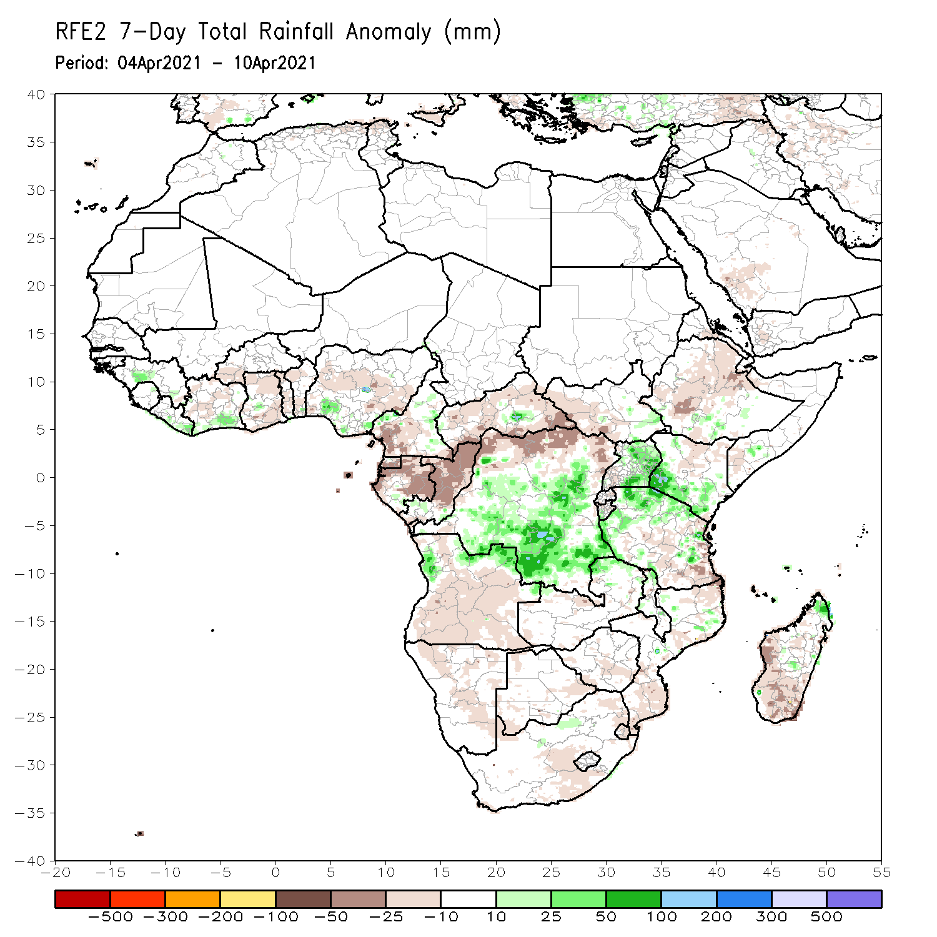
Rainfall Patterns: Last 7 Days
During the past 7 days, in East Africa, rainfall was slightly below-average over parts of Ethiopia and northern Kenya. Rainfall was above-average over Uganda, western and southern Kenya, and northern Tanzania. In Central Africa rainfall was below-average over much of Gabon, Congo, CAR, and parts of northern DRC. In West Africa, above-average rainfall was observed over pockets of the Gulf of Guinea countries.

Slide 7
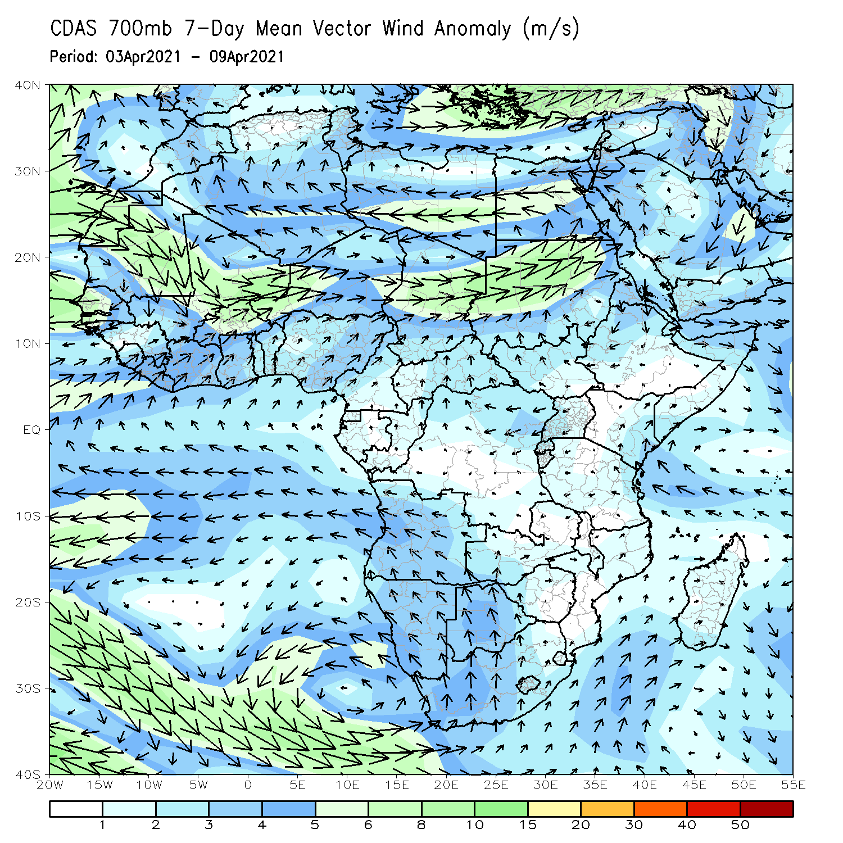
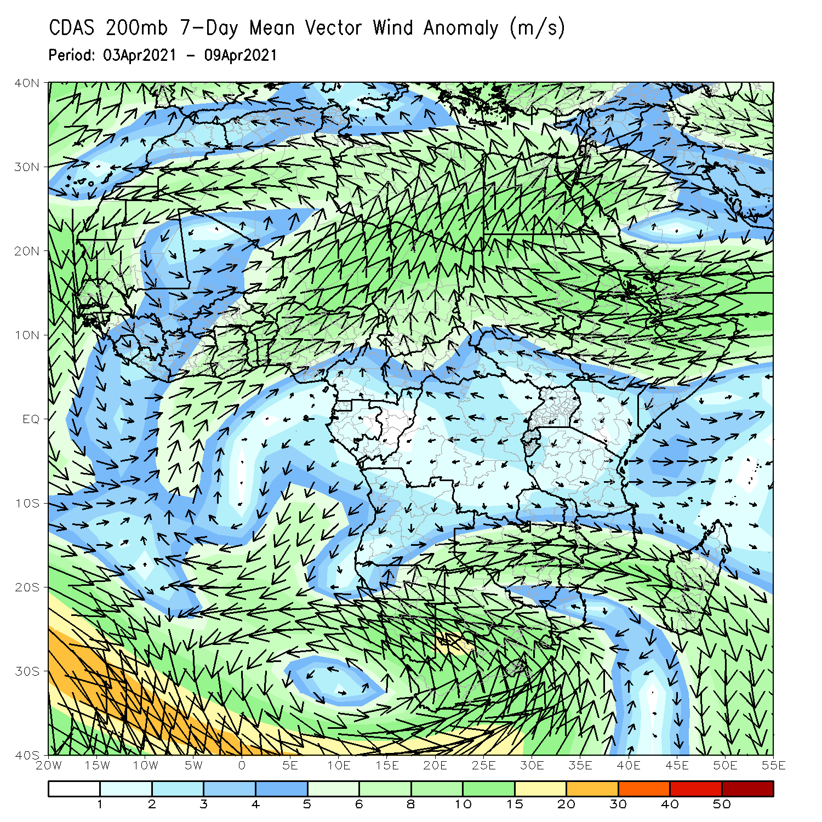
Atmospheric Circulation: Last 7 Days
At lower-level (left panel), anomalous onshore was observed in the Gulf of Guinea and coastal East Africa regions.

Slide 8
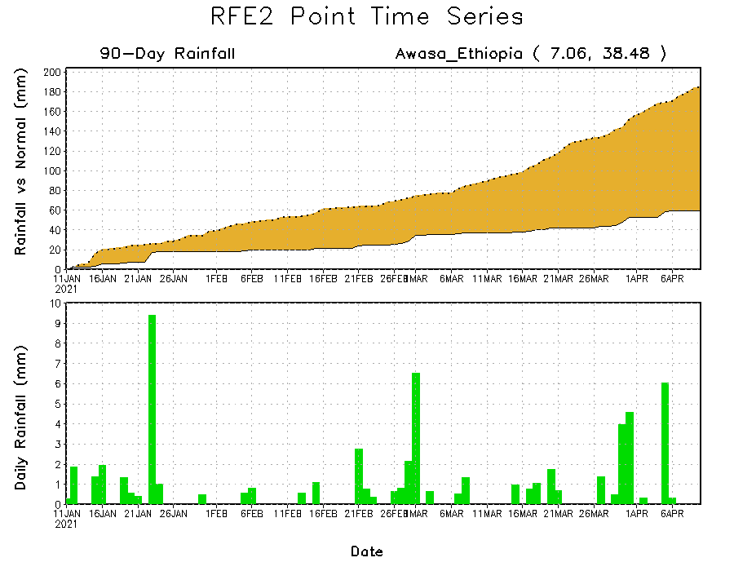
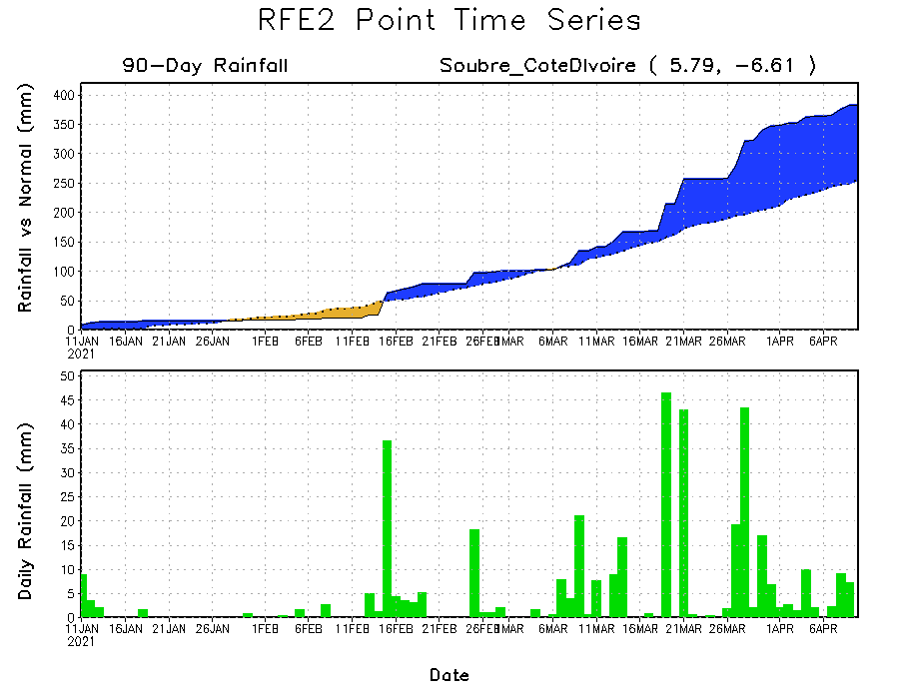
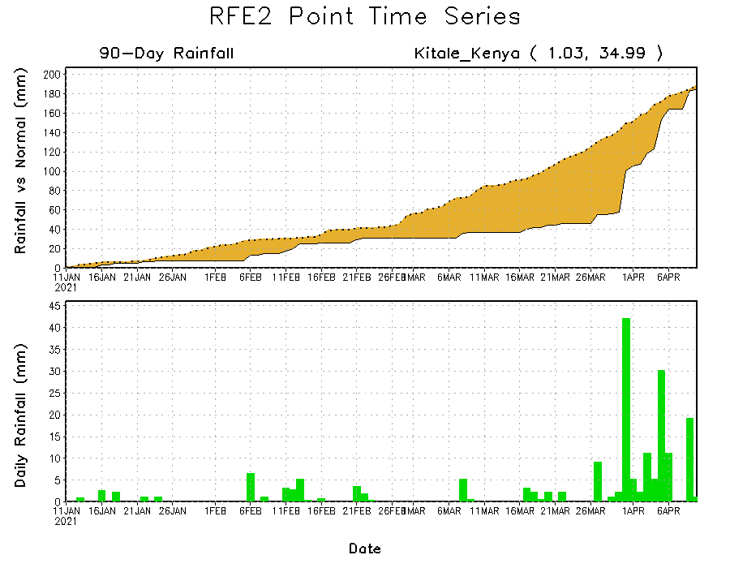
Rainfall Evolution
Daily evolution of rainfall over the last 90 days at selected locations shows moderate to heavy rainfall sustained moisture surpluses over parts of Cote d’Ivoire (bottom left). Moderate to locally heavy rainfall helped to reduce rainfall deficits over parts of western Kenya (bottom right). Seasonal total rainfall remained below-average over portions of Ethiopia (top right).

Slide 9
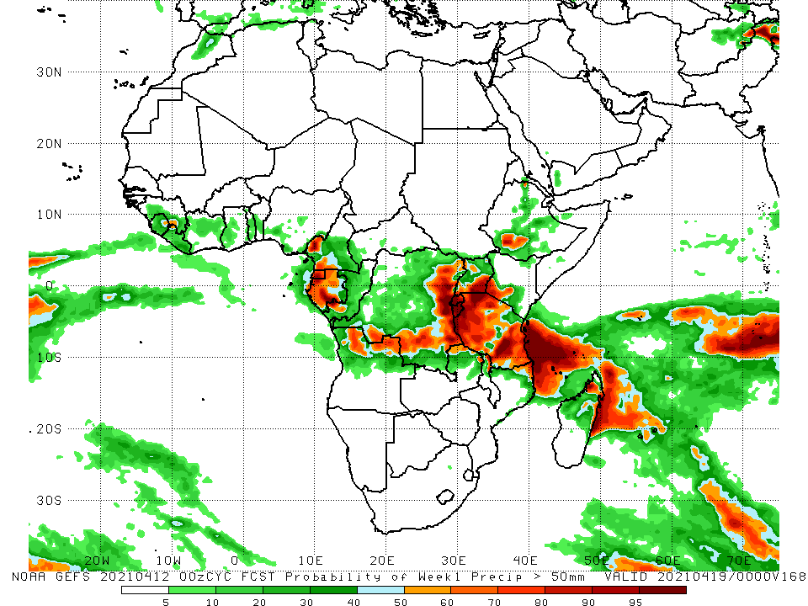
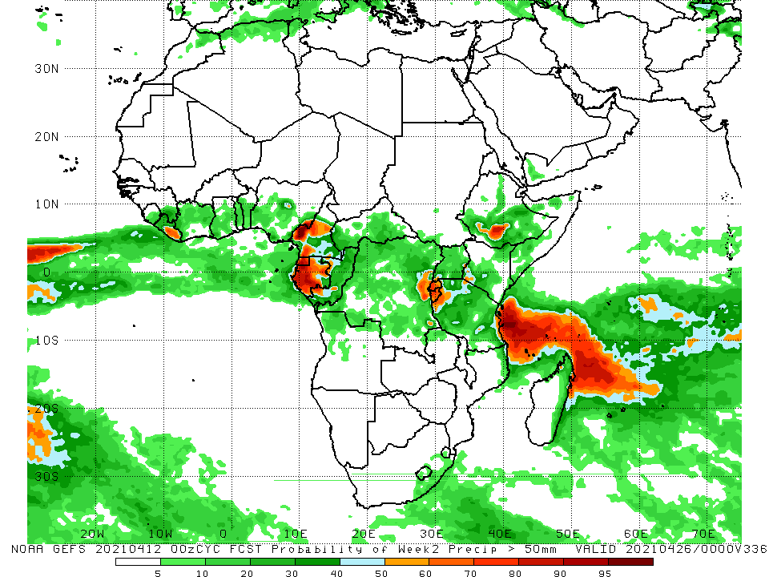
NCEP GEFS Model Forecasts Non-Bias Corrected Probability of precipitation exceedance
Week-1, Valid: 13 - 19 April, 2021
Week-2, Valid: 20 - 26 April, 2021
For week-1 (left panel), the NCEP GEFS indicates a moderate to high chance (over 70%) for rainfall to exceed 50 mm over parts of southern Cameroon, Equatorial Guinea, Gabon, northern Angola, parts of southern and eastern DRC, Rwanda, Burundi, southern Uganda, much of Tanzania and parts of southern Ethiopia. For week-2 (right panel), the chance for rainfall to exceed 50 mm is mostly confined to parts of Cameroon, Gabon, Rwanda, Burundi, and pockets of southern Ethiopia and eastern DRC.
Notes:
9

Slide 10
Summary
During the past 30 to 90 days, in East Africa, below-average rainfall was observed over many parts of Ethiopia, southern South Sudan, much of Kenya, and parts of Tanzania. In contrast, rainfall was above-average over Uganda, central and southern Tanzania, and pockets of Kenya and Ethiopia. In southern Africa, moderate to heavy rains resulted in moisture surpluses over portions of Angola, Namibia, southwestern Botswana, and pockets of Southern Africa. Rainfall was also above-average over eastern Zambia, Malawi, northern Mozambique, and pockets of northern Madagascar. In contrast, persistent light rains sustained moisture deficits over pockets of Angola, western Namibia, southern Zambia, eastern Botswana, Zimbabwe, portions of South Africa, southern Mozambique, and parts of Madagascar. In Central Africa, rainfall was below-average over western Gabon and northeastern DRC. Rainfall was above-average over eastern Gabon, Congo, many parts of DRC, and CAR. In West Africa, rainfall was above-average over portions of the Gulf of Guinea countries.
During the past 7 days, in East Africa, rainfall was slightly below-average over parts of Ethiopia and northern Kenya. Rainfall was above-average over Uganda, western and southern Kenya, and northern Tanzania. In Central Africa rainfall was below-average over much of Gabon, Congo, CAR, and parts of northern DRC. In West Africa, above-average rainfall was observed over pockets of the Gulf of Guinea countries.
For week-1 and week-2, there is a moderate to high chance (over 70%) for rainfall to exceed 50 mm over parts of southern Cameroon, Equatorial Guinea, Gabon, northern Angola, parts of southern and eastern DRC, Rwanda, Burundi, southern Uganda, much of Tanzania and parts of southern Ethiopia.

