Slide 1
The African Monsoon Recent Evolution and Current Status Include Week-1 and Week-2 Outlooks
Update prepared by
26 April 2021
For more information, visit:
http://www.cpc.ncep.noaa.gov/products/Global_Monsoons/African_Monsoons/precip_monitoring.shtml

Slide 2
Outline
Highlights
Recent Evolution and Current Conditions
NCEP GEFS Forecasts
Summary

Slide 3
Highlights: Last 7 Days
During the past 7 days, in East Africa, rainfall was above-average over parts of western and southern Ethiopia, northern South Sudan, and pockets of Kenya and northern Tanzania. Below-average rainfall was observed over pockets of southern and eastern Ethiopia, southern South Sudan, Uganda, northwestern Kenya and parts of central and eastern Tanzania. In Central Africa, rainfall was above-average over much of Equatorial Guinea, Gabon, Congo, CAR, and parts of western DRC. Below-average rainfall was observed over parts of northeastern DRC. In West Africa, above-average rainfall was observed over parts of Liberia, Cote d’Ivoire, southern Ghana, southern Togo, southern Benin, and southwestern Nigeria. Below-average rainfall was observed over pockets of Cote d’Ivoire and Ghana, central and eastern Nigeria and Cameroon.
For week-1 and week-2, there is a moderate to high chance (over 70%) for rainfall to exceed 50 mm over southern Cameroon, Equatorial Guinea, Gabon, southern Congo, northern Angola, parts of southern and eastern DRC, Rwanda, Burundi, Uganda, portions of Tanzania, and many parts of Ethiopia and northern Somalia.

Slide 4
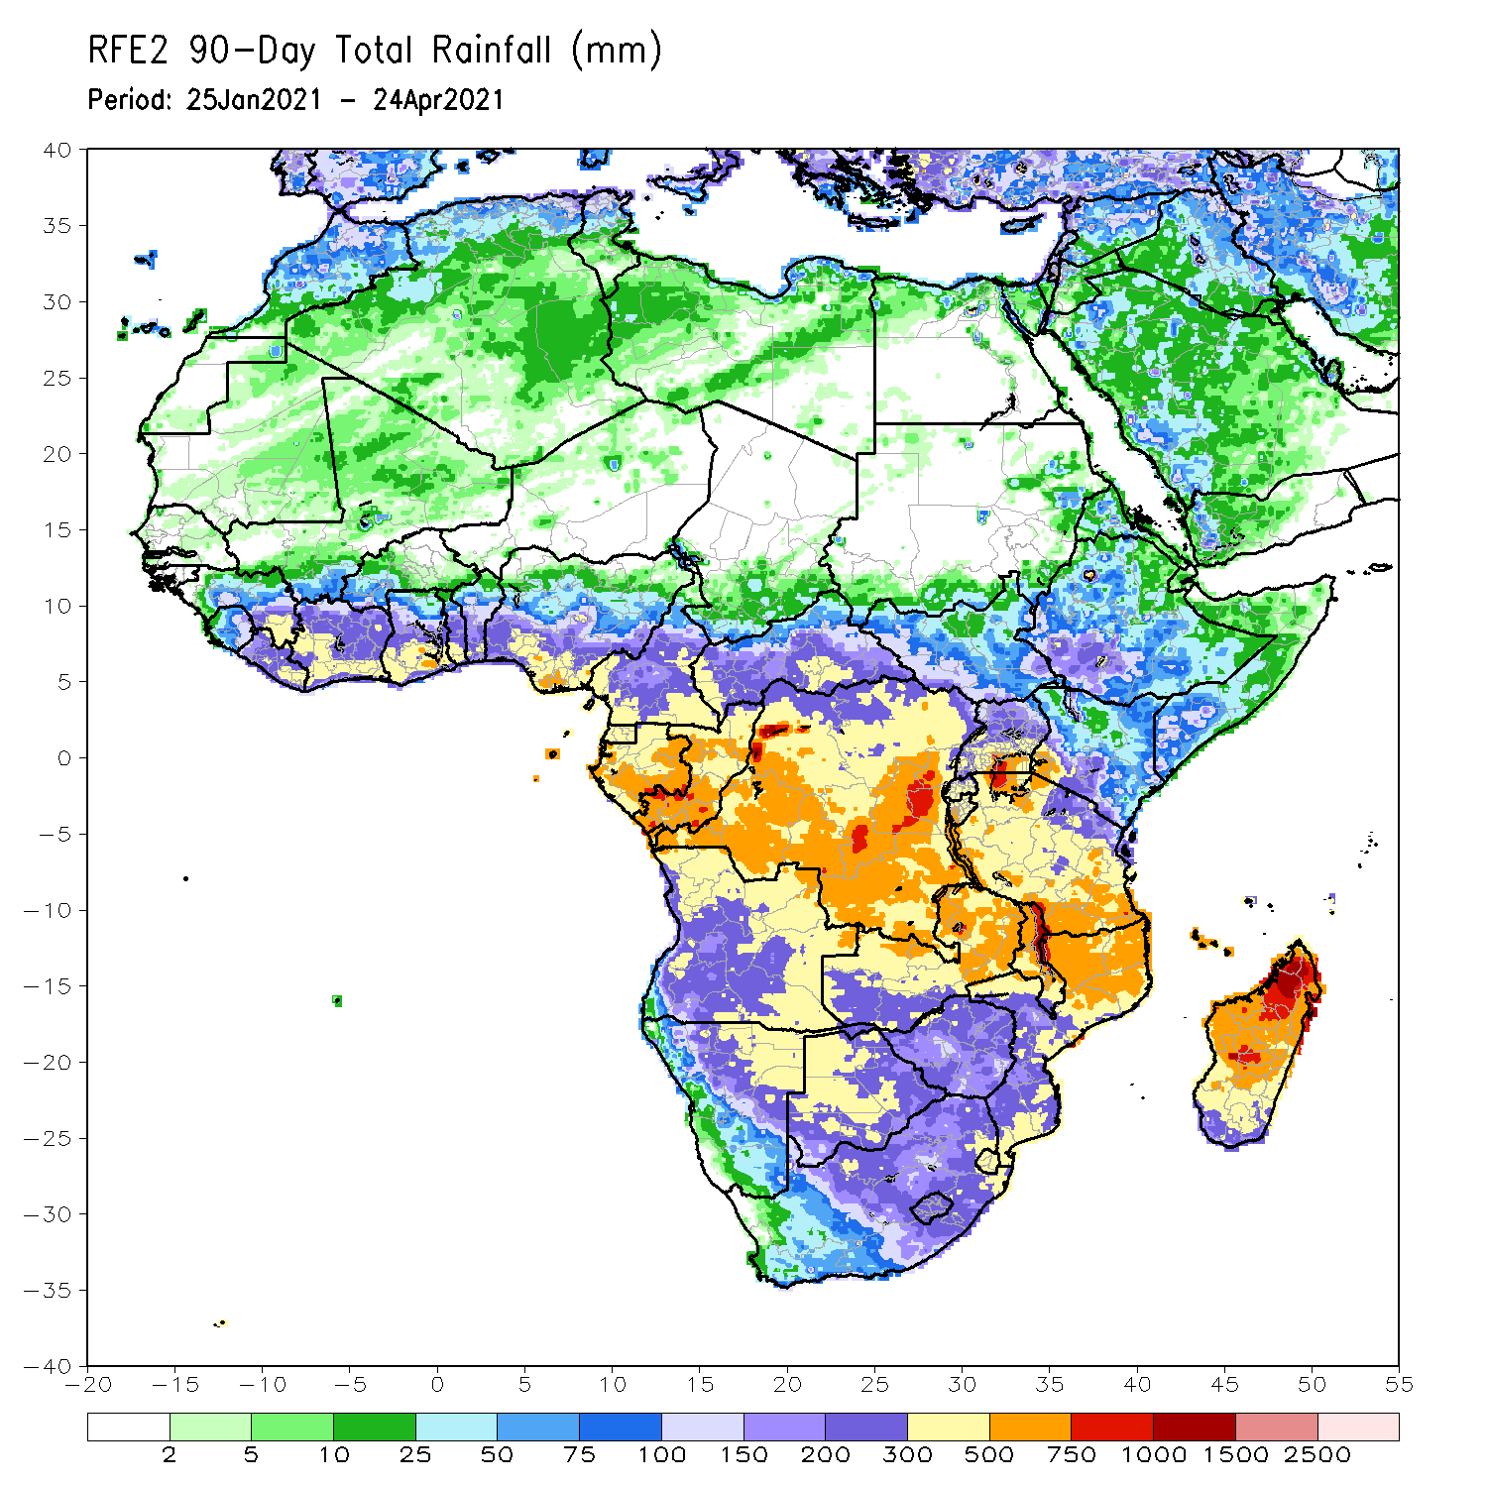
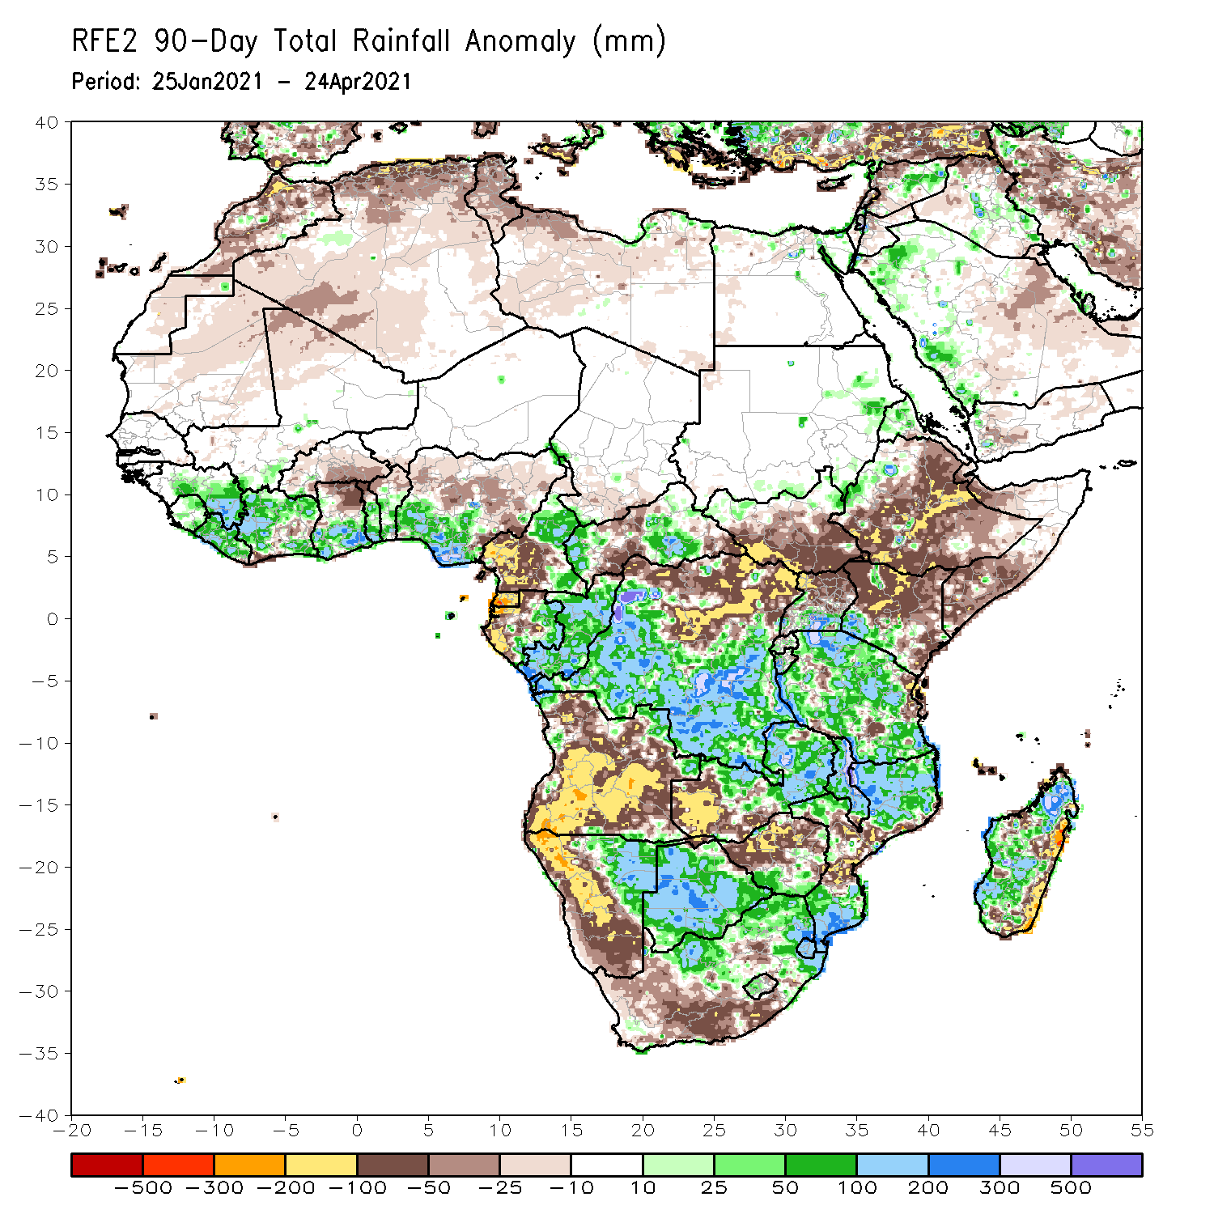
Rainfall Patterns: Last 90 Days
Over the past 90 days, in East Africa, rainfall was below-average over many parts of Ethiopia and Kenya, and southern Somalia. Rainfall was also below-average over much of South Sudan and northern Uganda. Above-average rainfall was observed over southern Uganda, Rwanda, Burundi and much of Tanzania, and pockets of western Ethiopia and southwestern Kenya. In southern Africa, above-average rainfall was observed over northeastern and eastern Namibia, and much of Botswana. Rainfall was also above-average over central and eastern Zambia, Malawi, southern Zimbabwe, northern and southern Mozambique, northern South Africa, and many parts of Madagascar. Persistent light rains resulted in moisture deficits over much of Angola, and western and southern Namibia. Rainfall was also below-average over western Zambia, western and northern Zimbabwe, parts of eastern Madagascar, and western and southern South Africa. In Central Africa, rainfall was above-average over many parts of DRC, eastern Gabon, Congo, and eastern CAR. Rainfall was below-average over parts of northern and northeastern DRC, and western CAR. Below-average rains were also observed over the western areas of Gabon, Equatorial Guinea, the far northern Congo, and southern Cameroon. In West Africa, rainfall was above-average over portions of the Gulf of Guinea countries. Below-average rainfall was observed over northern Ghana, parts of Burkina Faso, and central and northern Nigeria.
Notes:
4

Slide 5
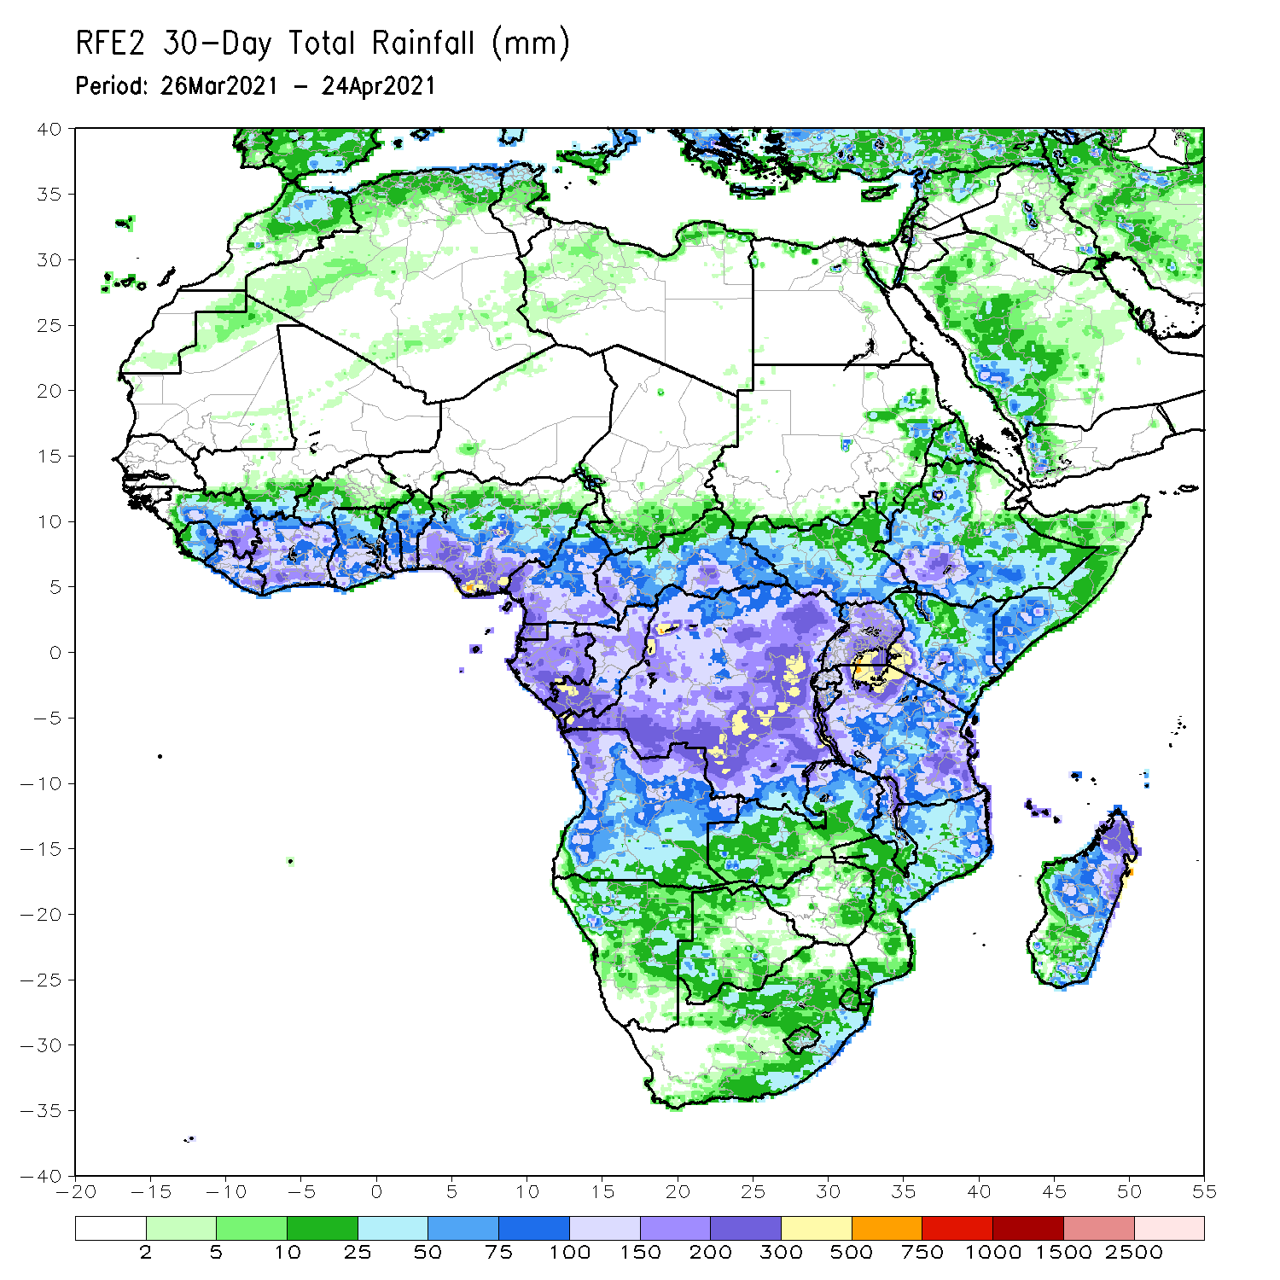
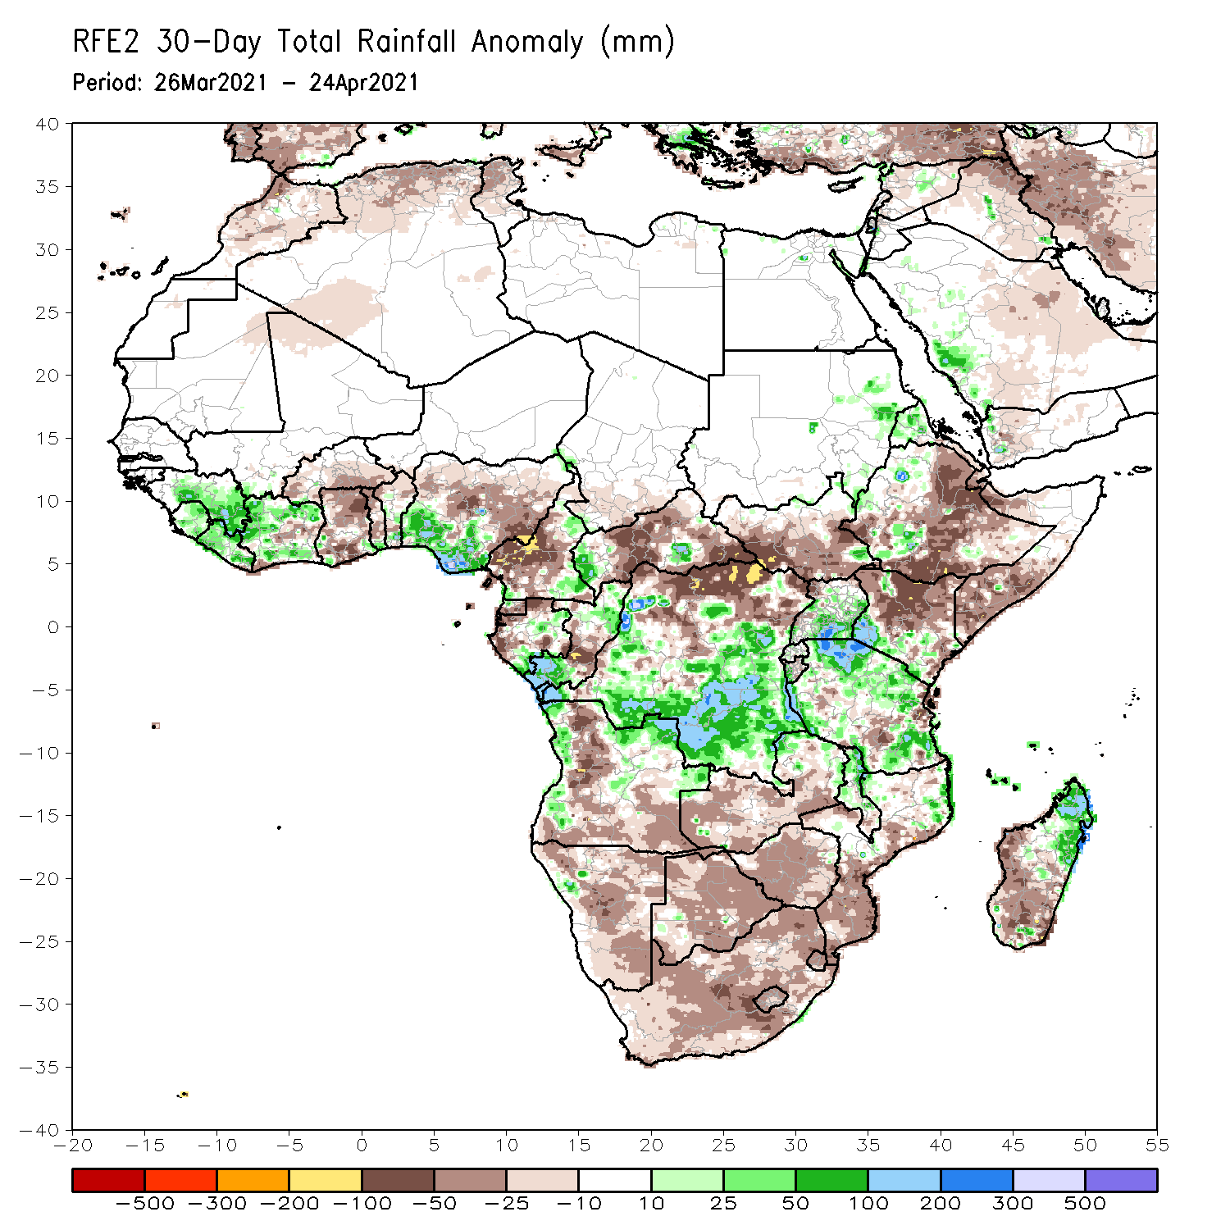
Rainfall Patterns: Last 30 Days
During the past 30 days, in East Africa, below-average rainfall was observed over eastern and southern Ethiopia, South Sudan, many parts of Kenya, and southern Somalia. In contrast, rainfall was above-average over much of Uganda and Tanzania, and pockets of Kenya and Ethiopia. In Central Africa, rainfall was below-average over portions of Gabon and CAR, central Congo, northern DRC. Rainfall was above-average over pockets of Gabon, northern and southern Congo, central and southern DRC, and pockets of CAR. In West Africa, rainfall was above-average over portions of the Gulf of Guinea countries. Below-average rainfall was observed over parts of Cote d’Ivoire, much of Ghana, Togo, Benin, and central and northern Nigeria. In southern Africa, rainfall was below-average over much of Southern Africa. Below-average rainfall was observed over northern Malawi and northeastern Madagascar.
Notes:
5

Slide 6
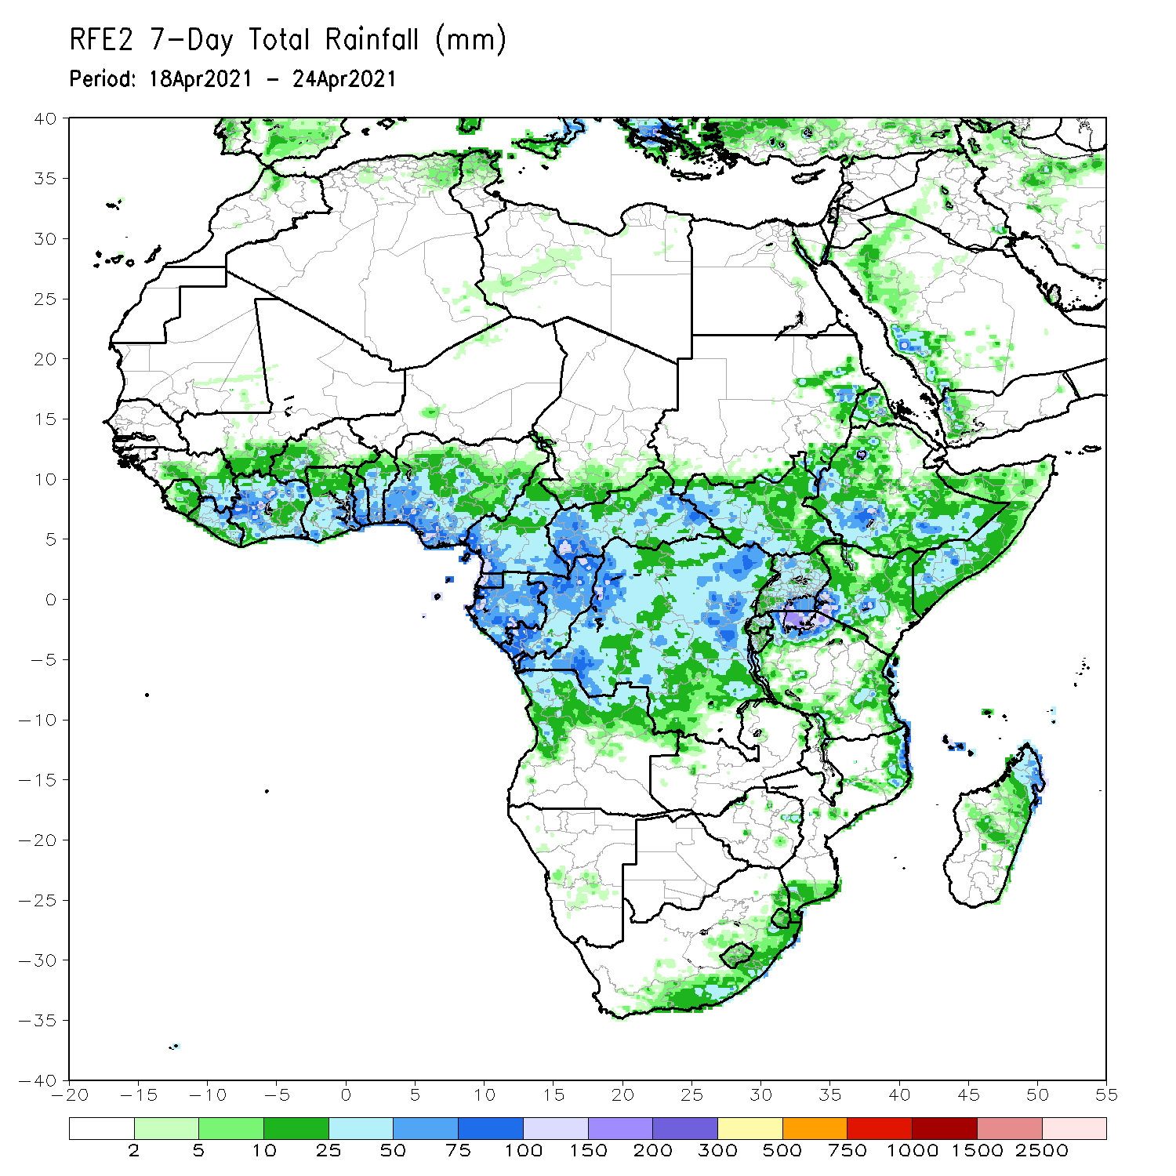
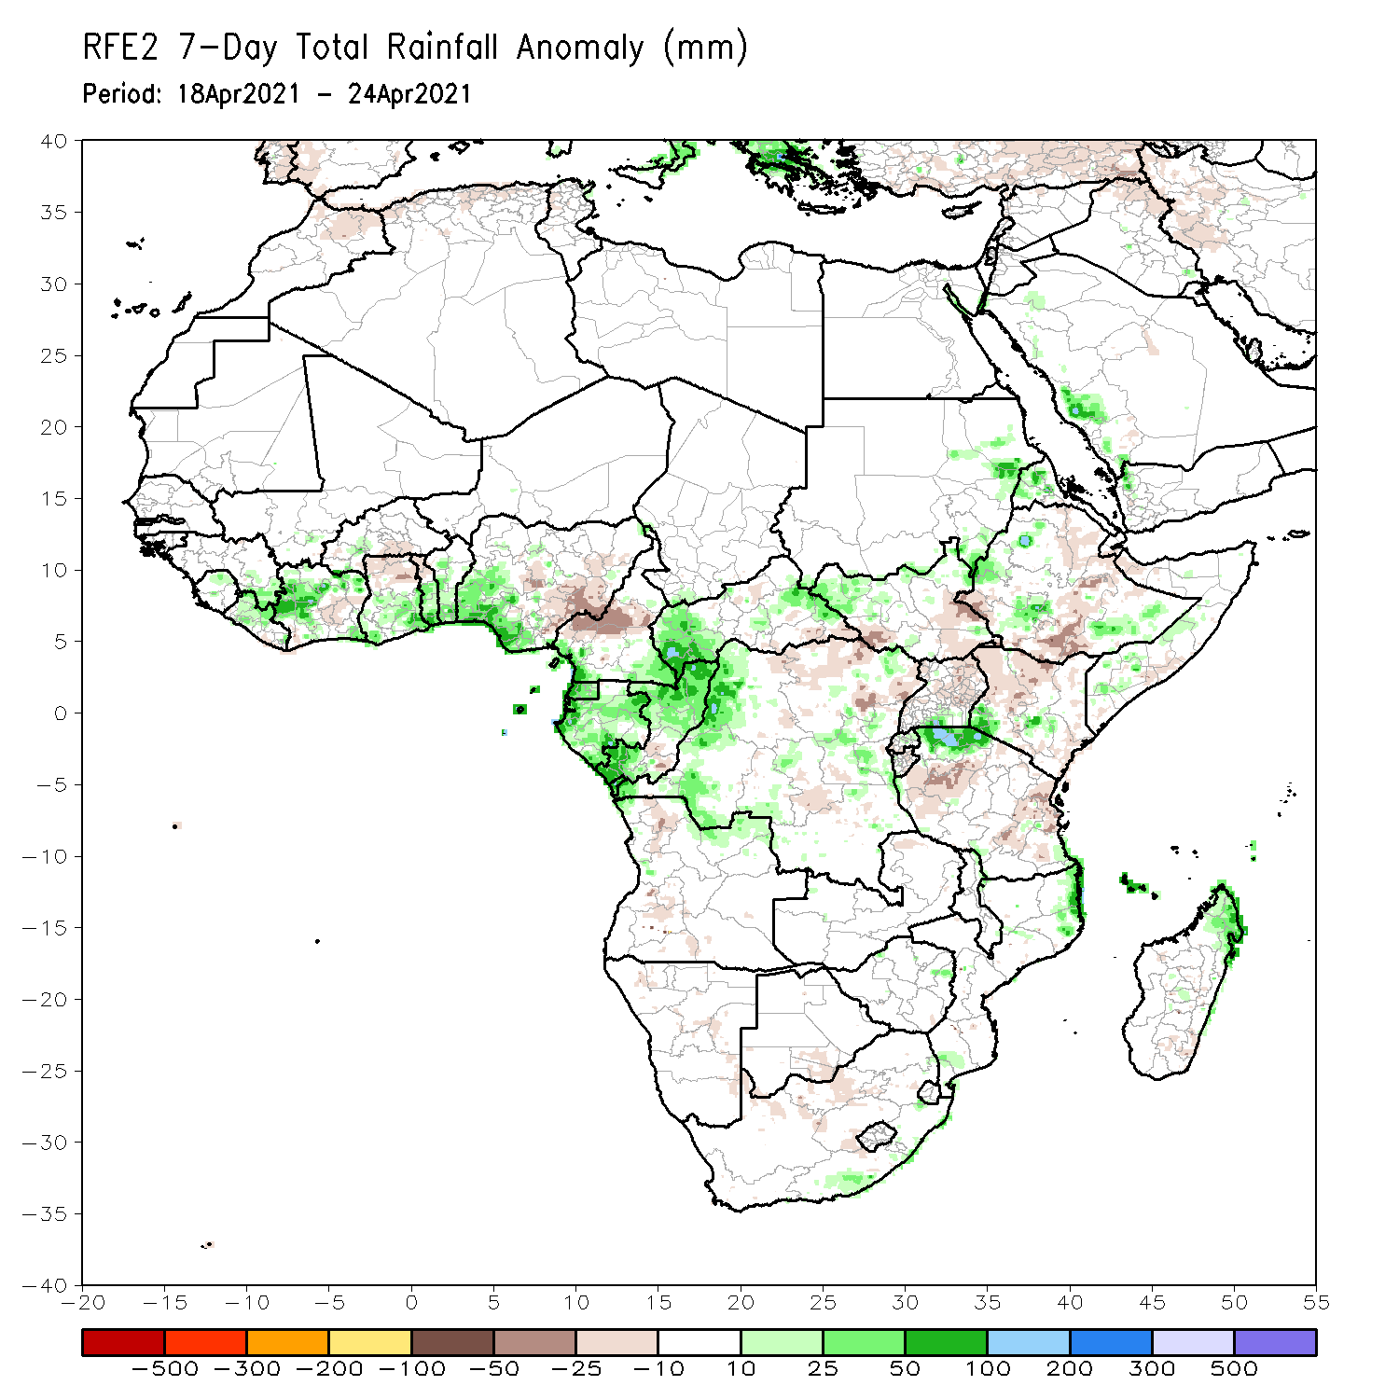
Rainfall Patterns: Last 7 Days
During the past 7 days, in East Africa, rainfall was above-average over parts of western and southern Ethiopia, northern South Sudan, and pockets of Kenya and northern Tanzania. Below-average rainfall was observed over pockets of southern and eastern Ethiopia, southern South Sudan, Uganda, northwestern Kenya and parts of central and eastern Tanzania. In Central Africa, rainfall was above-average over much of Equatorial Guinea, Gabon, Congo, CAR, and parts of western DRC. Below-average rainfall was observed over parts of northeastern DRC. In West Africa, above-average rainfall was observed over parts of Liberia, Cote d’Ivoire, southern Ghana, southern Togo, southern Benin, and southwestern Nigeria. Below-average rainfall was observed over pockets of Cote d’Ivoire and Ghana, central and eastern Nigeria and Cameroon.

Slide 7
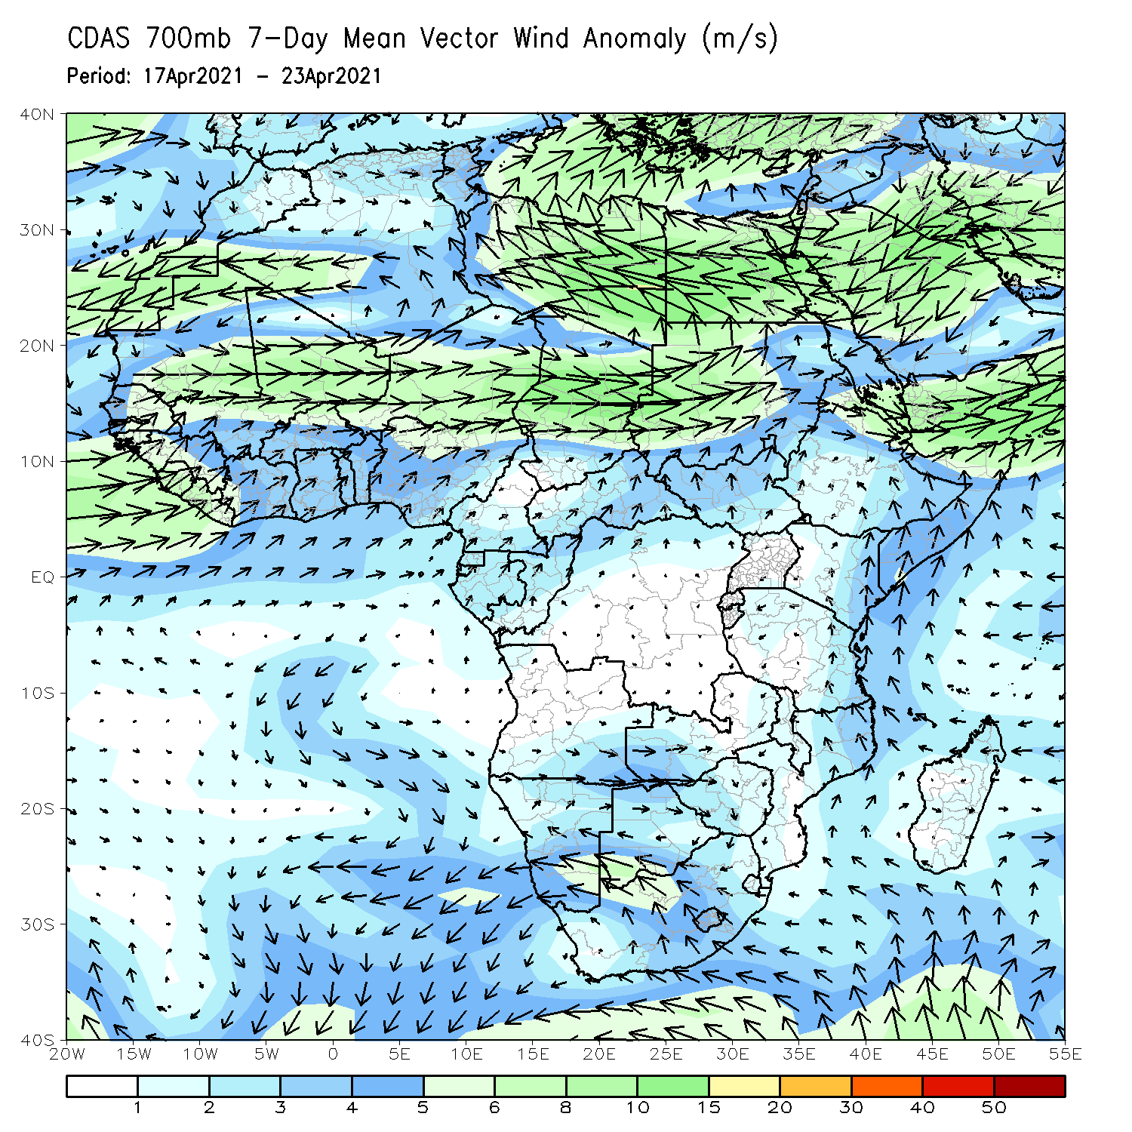
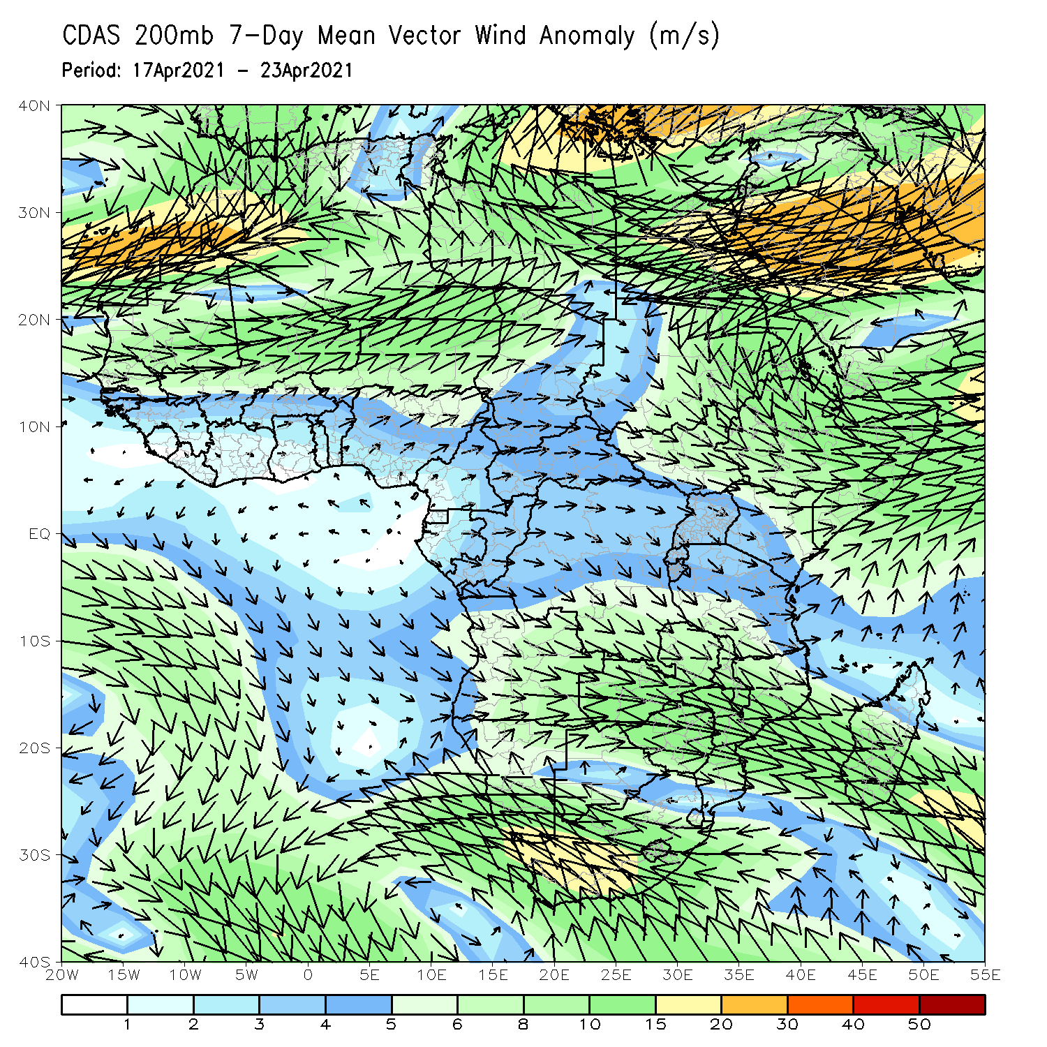
Atmospheric Circulation: Last 7 Days
At lower-level (left panel), anomalous onshore was observed in the Gulf of Guinea and coastal East Africa regions.

Slide 8
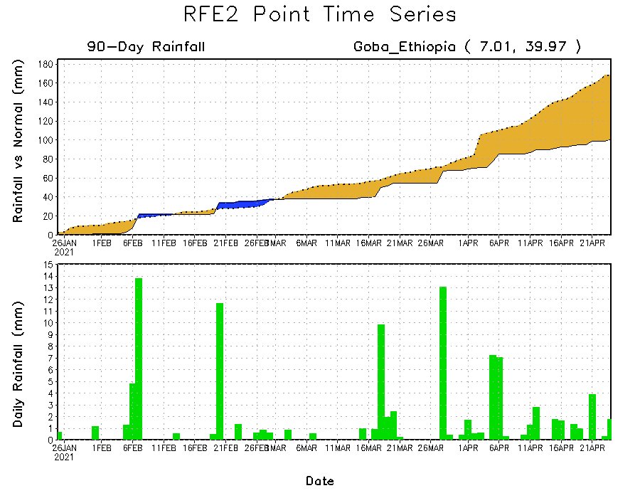
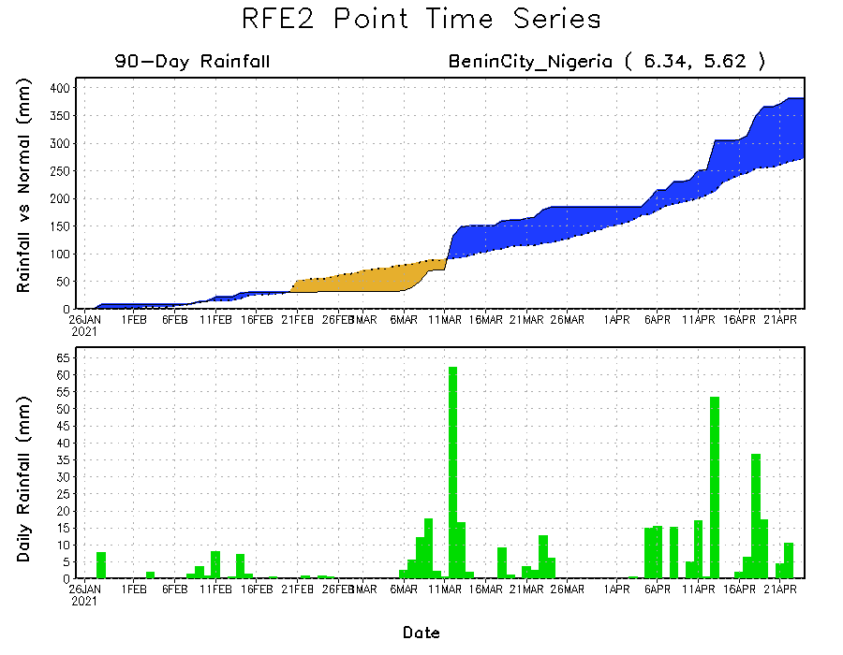
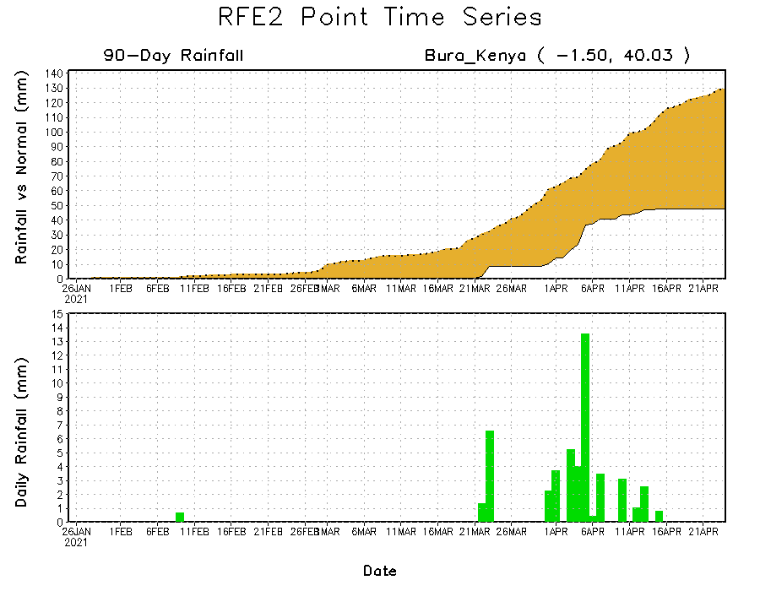
Rainfall Evolution
Daily evolution of rainfall over the last 90 days at selected locations shows moderate to heavy rainfall sustained moisture surpluses over parts of southern Nigeria (bottom left). Seasonal total rainfall remained below-average over portions of Ethiopia (top right) and Kenya (bottom right).

Slide 9
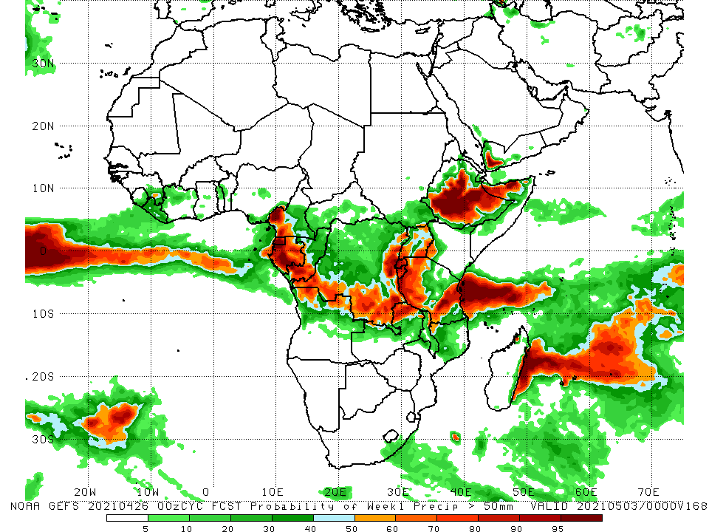
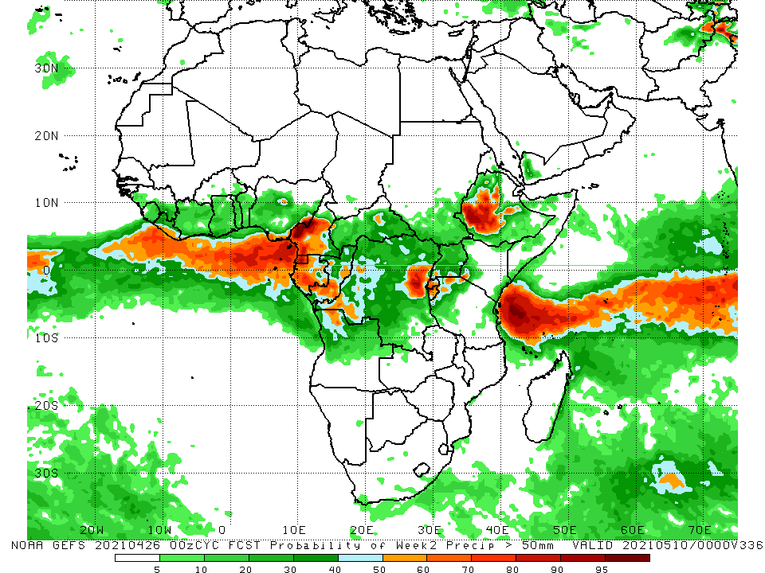
NCEP GEFS Model Forecasts Non-Bias Corrected Probability of precipitation exceedance
Week-1, Valid: 27 April - 03 May, 2021
Week-2, Valid: 04 - 10 May, 2021
For week-1 (left panel), the NCEP GEFS indicates a moderate to high chance (over 70%) for rainfall to exceed 50 mm over southern Cameroon, Equatorial Guinea, Gabon, southern Congo, northern Angola, parts of southern and eastern DRC, Rwanda, Burundi, Uganda, portions of Tanzania, and many parts of Ethiopia and northern Somalia. For week-2 (right panel), the chance for rainfall to exceed 50 mm is mostly confined to parts of Cameroon, Gabon, Congo, the far western and eastern DRC, Rwanda, Burundi, Ethiopia, and northwestern Tanzania.
Notes:
9

Slide 10
Summary
During the past 30 to 90 days, in East Africa, below-average rainfall was observed over eastern and southern Ethiopia, South Sudan, many parts of Kenya, and southern Somalia. In contrast, rainfall was above-average over much of Uganda and Tanzania, and pockets of Kenya and Ethiopia. In Central Africa, rainfall was below-average over portions of Gabon and CAR, central Congo, northern DRC. Rainfall was above-average over pockets of Gabon, northern and southern Congo, central and southern DRC, and pockets of CAR. In West Africa, rainfall was above-average over portions of the Gulf of Guinea countries. Below-average rainfall was observed over parts of Cote d’Ivoire, much of Ghana, Togo, Benin, and central and northern Nigeria. In southern Africa, rainfall was below-average over much of Southern Africa. Below-average rainfall was observed over northern Malawi and northeastern Madagascar.
During the past 7 days, in East Africa, rainfall was above-average over parts of western and southern Ethiopia, northern South Sudan, and pockets of Kenya and northern Tanzania. Below-average rainfall was observed over pockets of southern and eastern Ethiopia, southern South Sudan, Uganda, northwestern Kenya and parts of central and eastern Tanzania. In Central Africa, rainfall was above-average over much of Equatorial Guinea, Gabon, Congo, CAR, and parts of western DRC. Below-average rainfall was observed over parts of northeastern DRC. In West Africa, above-average rainfall was observed over parts of Liberia, Cote d’Ivoire, southern Ghana, southern Togo, southern Benin, and southwestern Nigeria. Below-average rainfall was observed over pockets of Cote d’Ivoire and Ghana, central and eastern Nigeria and Cameroon.
For week-1 and week-2, there is a moderate to high chance (over 70%) for rainfall to exceed 50 mm over southern Cameroon, Equatorial Guinea, Gabon, southern Congo, northern Angola, parts of southern and eastern DRC, Rwanda, Burundi, Uganda, portions of Tanzania, and many parts of Ethiopia and northern Somalia.

