Slide 1
The African Monsoon Recent Evolution and Current Status Include Week-1 and Week-2 Outlooks
Update prepared by
03 May 2021
For more information, visit:
http://www.cpc.ncep.noaa.gov/products/Global_Monsoons/African_Monsoons/precip_monitoring.shtml

Slide 2
Outline
Highlights
Recent Evolution and Current Conditions
NCEP GEFS Forecasts
Summary

Slide 3
Highlights: Last 7 Days
During the past 7 days, in East Africa, rainfall was above-average over many parts of Ethiopia, northern Somalia, northern South Sudan, and parts of Tanzania. Below-average rainfall was observed over southern South Sudan, much of Kenya, and southern Somalia. In Central Africa, rainfall was above-average over many parts of DRC. Below-average rainfall was observed over much of Equatorial Guinea, Gabon, Congo, CAR and parts of northern DRC. In West Africa, below-average rainfall was observed over many places in the Gulf of Guinea countries.
For week-1 and week-2, there is a moderate to high chance (over 70%) for rainfall to exceed 50 mm over Cameroon, Equatorial Guinea, Gabon, western and northern Angola, DRC, Rwanda, Burundi, western Kenya, western Tanzania, many parts of Ethiopia, and portions of Somalia.

Slide 4
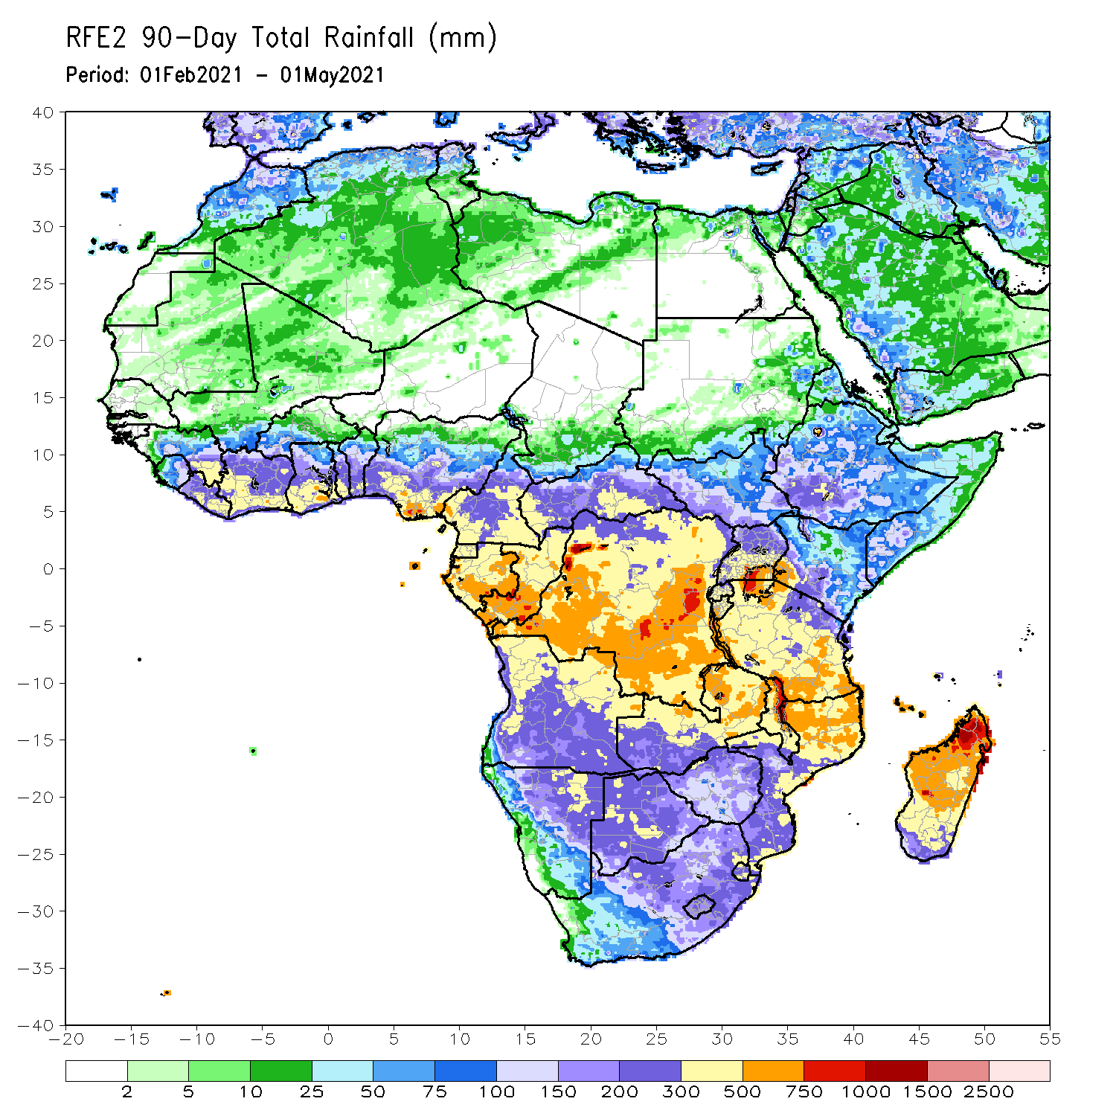
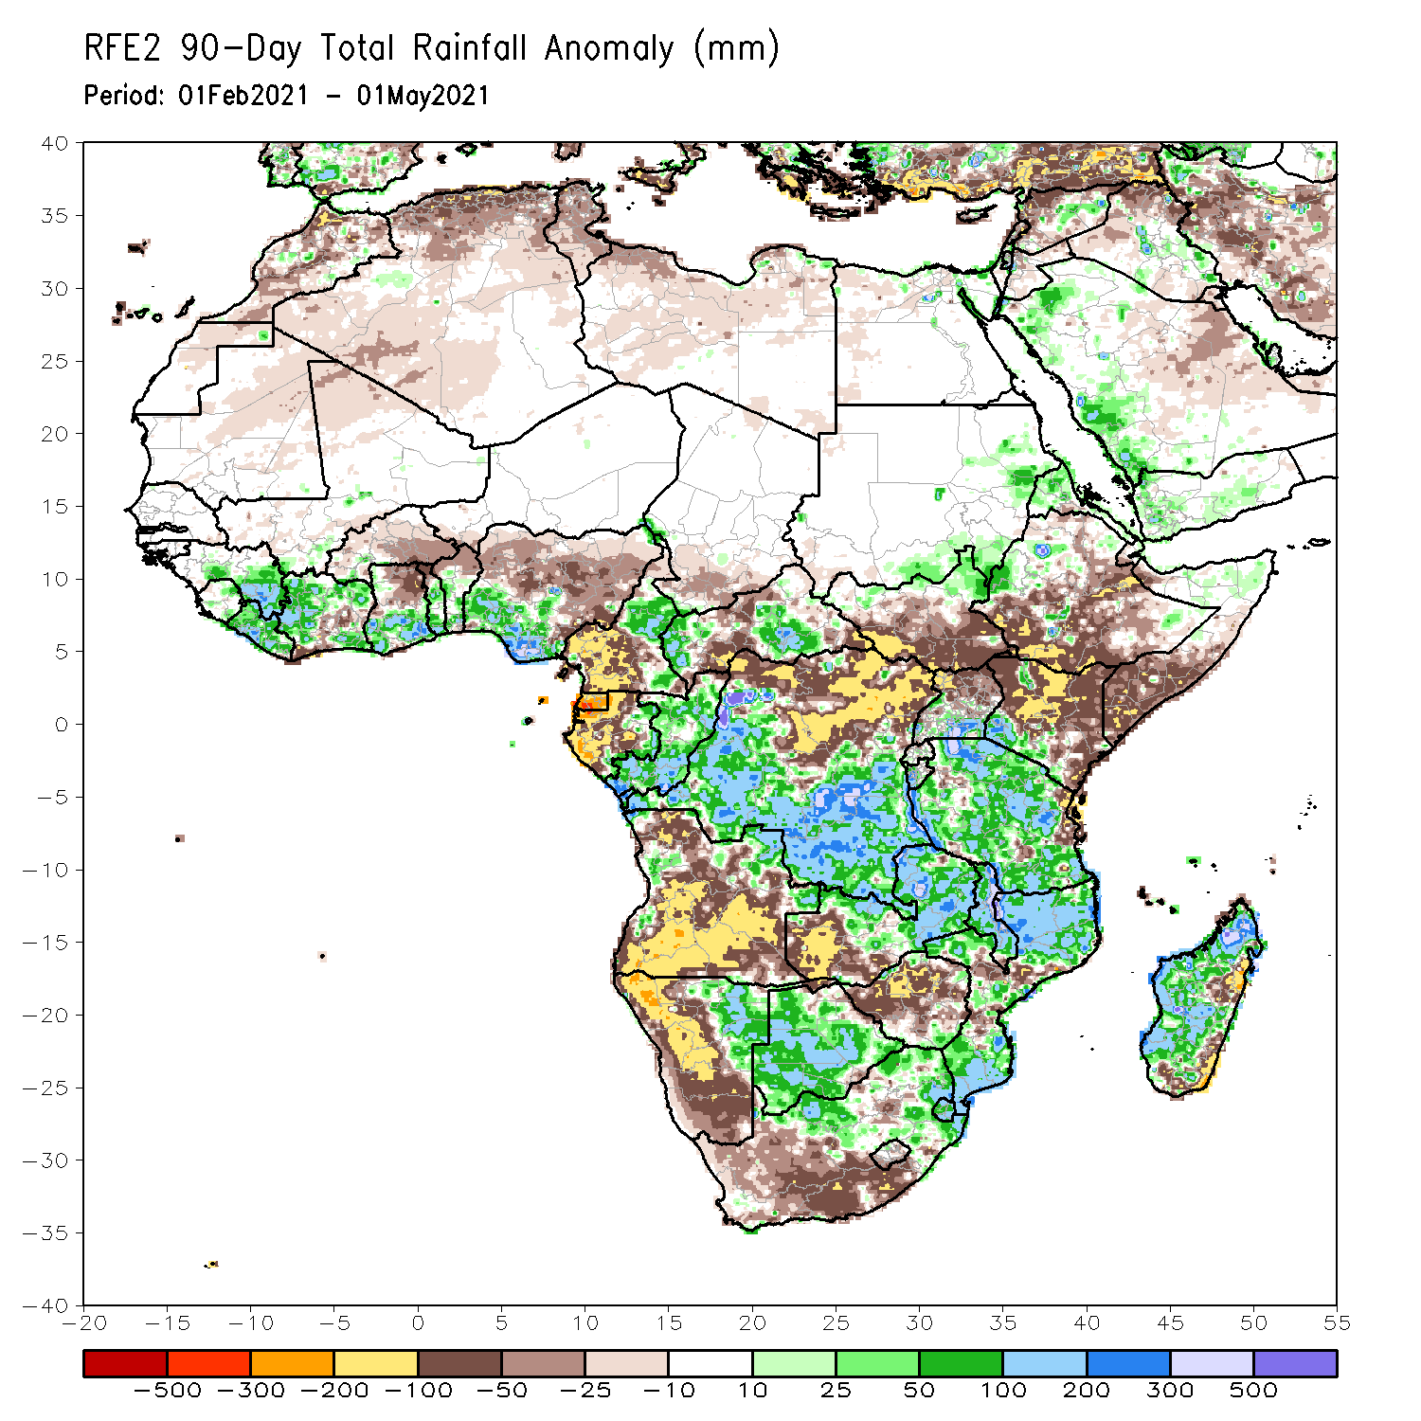
Rainfall Patterns: Last 90 Days
Over the past 90 days, in East Africa, rainfall was below-average over many parts of Ethiopia and Kenya, and southern Somalia. Rainfall was also below-average over much of South Sudan and northern Uganda. Above-average rainfall was observed over southern Uganda, Rwanda, Burundi and much of Tanzania, and pockets of western Ethiopia and southwestern Kenya. In southern Africa, above-average rainfall was observed over northeastern and eastern Namibia, and much of Botswana. Rainfall was also above-average over central and eastern Zambia, Malawi, many parts of Mozambique, northern South Africa, and much of Madagascar. Persistent light rains resulted in moisture deficits over much of Angola, and western and southern Namibia. Rainfall was also below-average over western Zambia, much of Zimbabwe, pockets of eastern Madagascar, and western and southern South Africa. In Central Africa, rainfall was above-average over central and southern DRC, eastern Gabon, Congo, and parts of CAR. Rainfall was below-average over parts northern DRC, and central CAR. Below-average rains were also observed over the western areas of Gabon, Equatorial Guinea, the far northern Congo, and southern Cameroon. In West Africa, rainfall was above-average over many places in the Gulf of Guinea countries. Below-average rainfall was observed over pockets of Cote d’Ivoire, northern Ghana, parts of Burkina Faso, and central and northern Nigeria.
Notes:
4

Slide 5
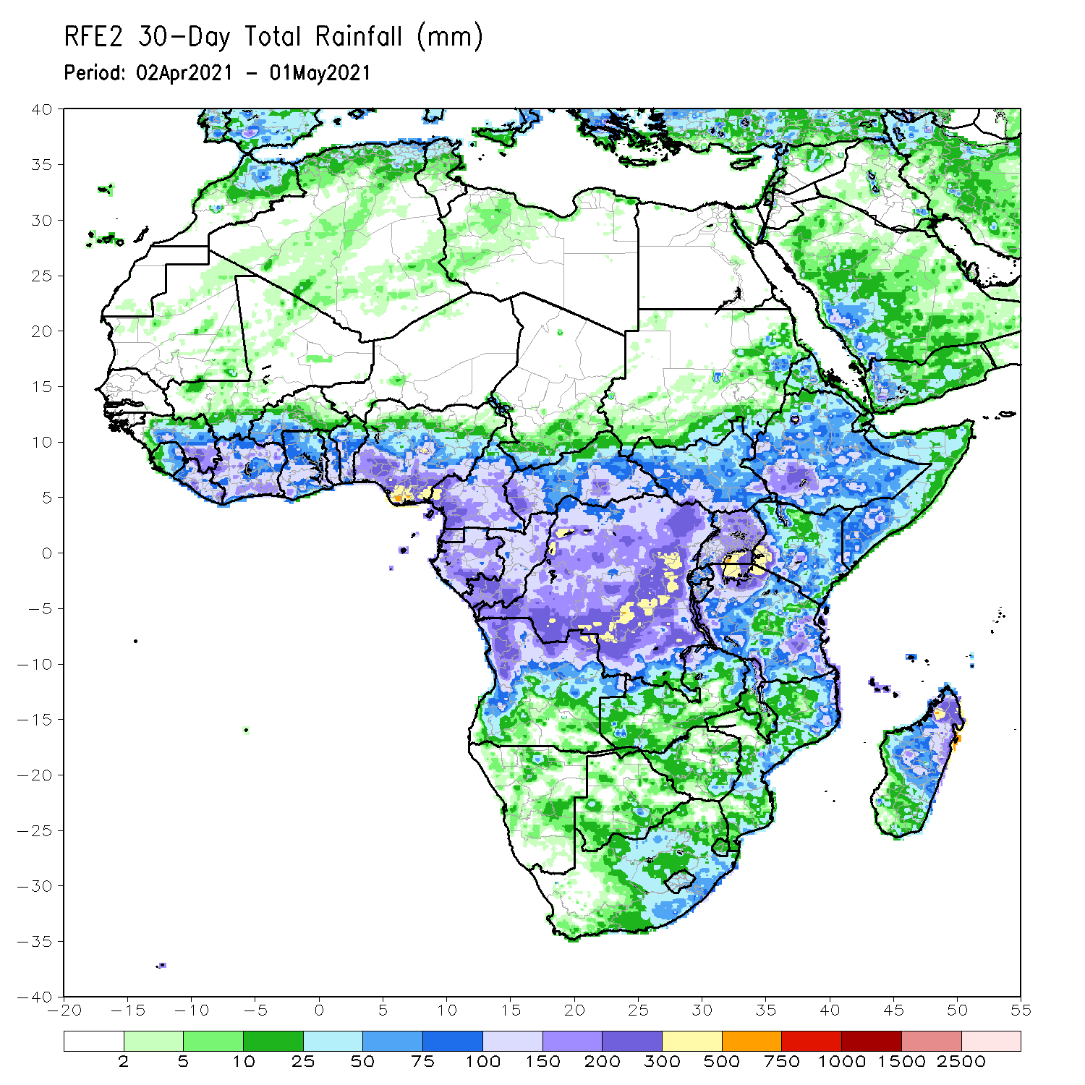
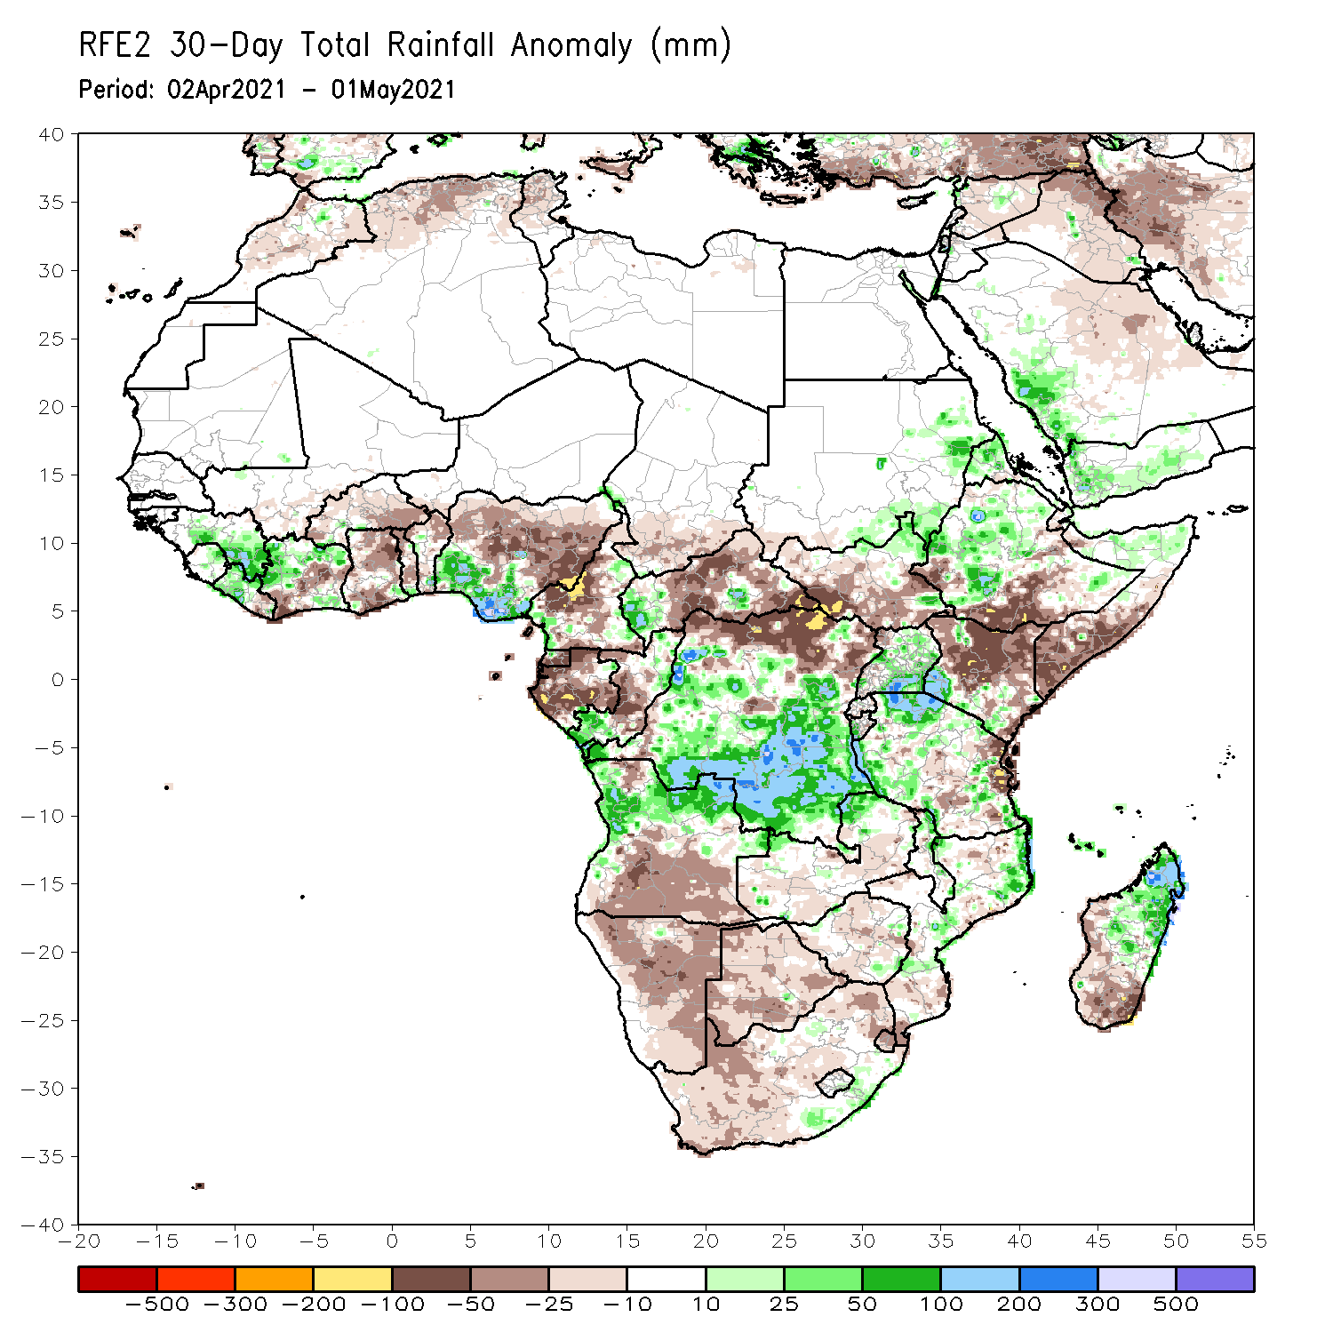
Rainfall Patterns: Last 30 Days
During the past 30 days, in East Africa, below-average rainfall was observed over southwestern and southern Ethiopia, parts of South Sudan, many parts of Kenya, and southern Somalia. In contrast, rainfall was above-average over much of Uganda and Tanzania, and portions of Ethiopia and southwestern Kenya. In Central Africa, rainfall was below-average over much of Gabon central Congo, northern DRC and portions of CAR. Rainfall was above-average over pockets of CAR, southern Congo, and central and southern DRC. In West Africa, rainfall was above-average over portions of the Gulf of Guinea countries. Below-average rainfall was observed over parts of Cote d’Ivoire, much of Ghana, Burkina Faso, Togo, Benin, and central and northern Nigeria. In southern Africa, rainfall was below-average over much of Southern Africa. Below-average rainfall was observed over northern Malawi and northeastern Madagascar.
Notes:
5

Slide 6
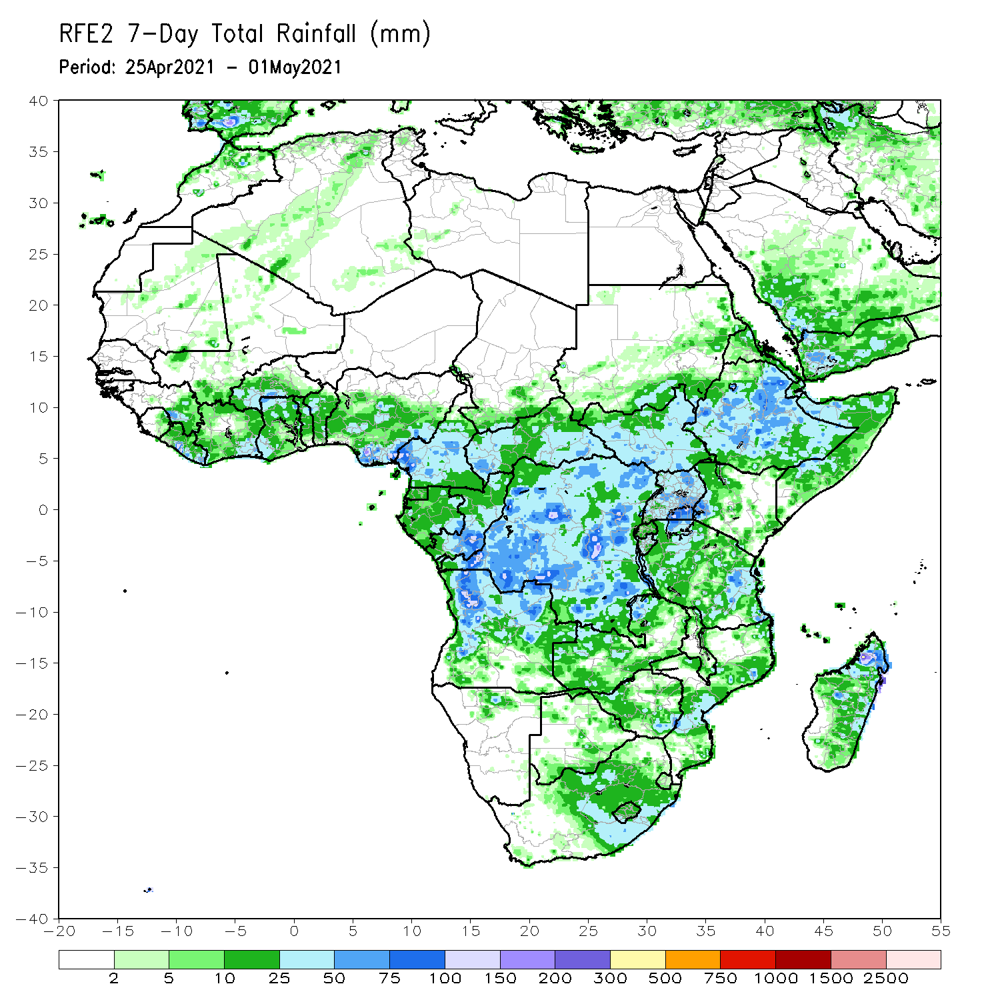
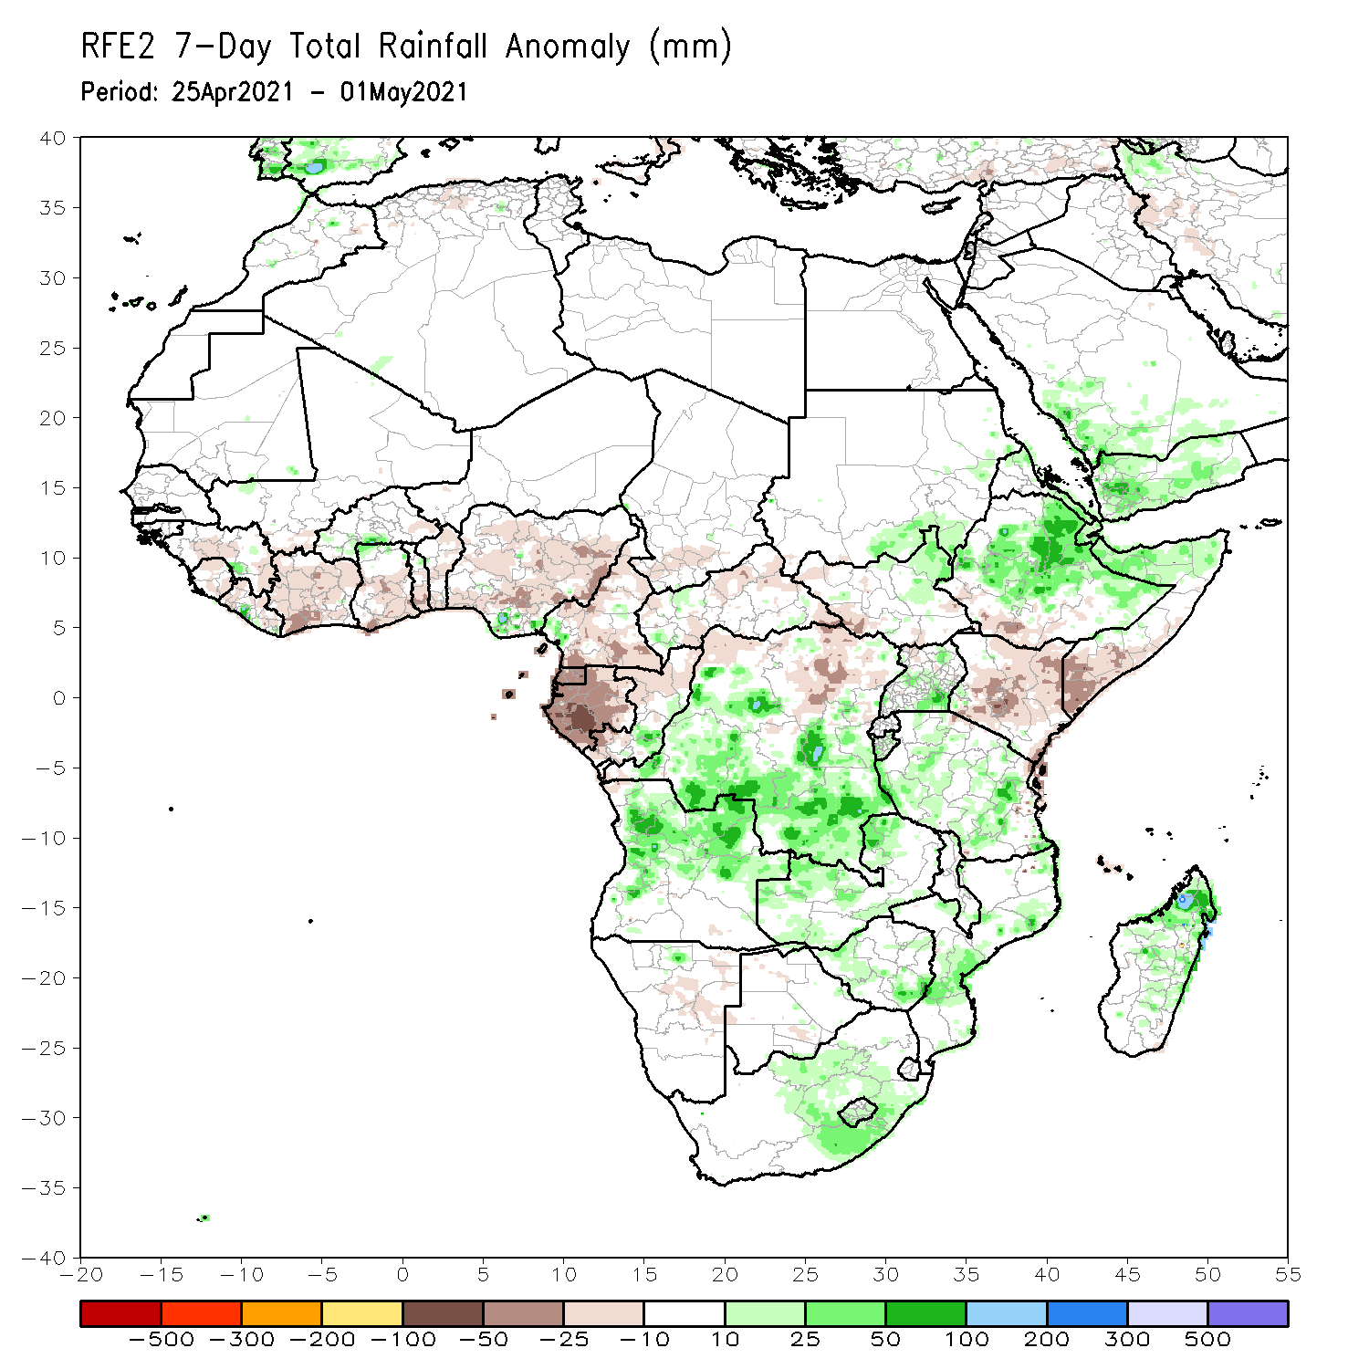
Rainfall Patterns: Last 7 Days
During the past 7 days, in East Africa, rainfall was above-average over many parts of Ethiopia, northern Somalia, northern South Sudan, and parts of Tanzania. Below-average rainfall was observed over southern South Sudan, much of Kenya, and southern Somalia. In Central Africa, rainfall was above-average over many parts of DRC. Below-average rainfall was observed over much of Equatorial Guinea, Gabon, Congo, CAR and parts of northern DRC. In West Africa, below-average rainfall was observed over many places in the Gulf of Guinea countries.

Slide 7
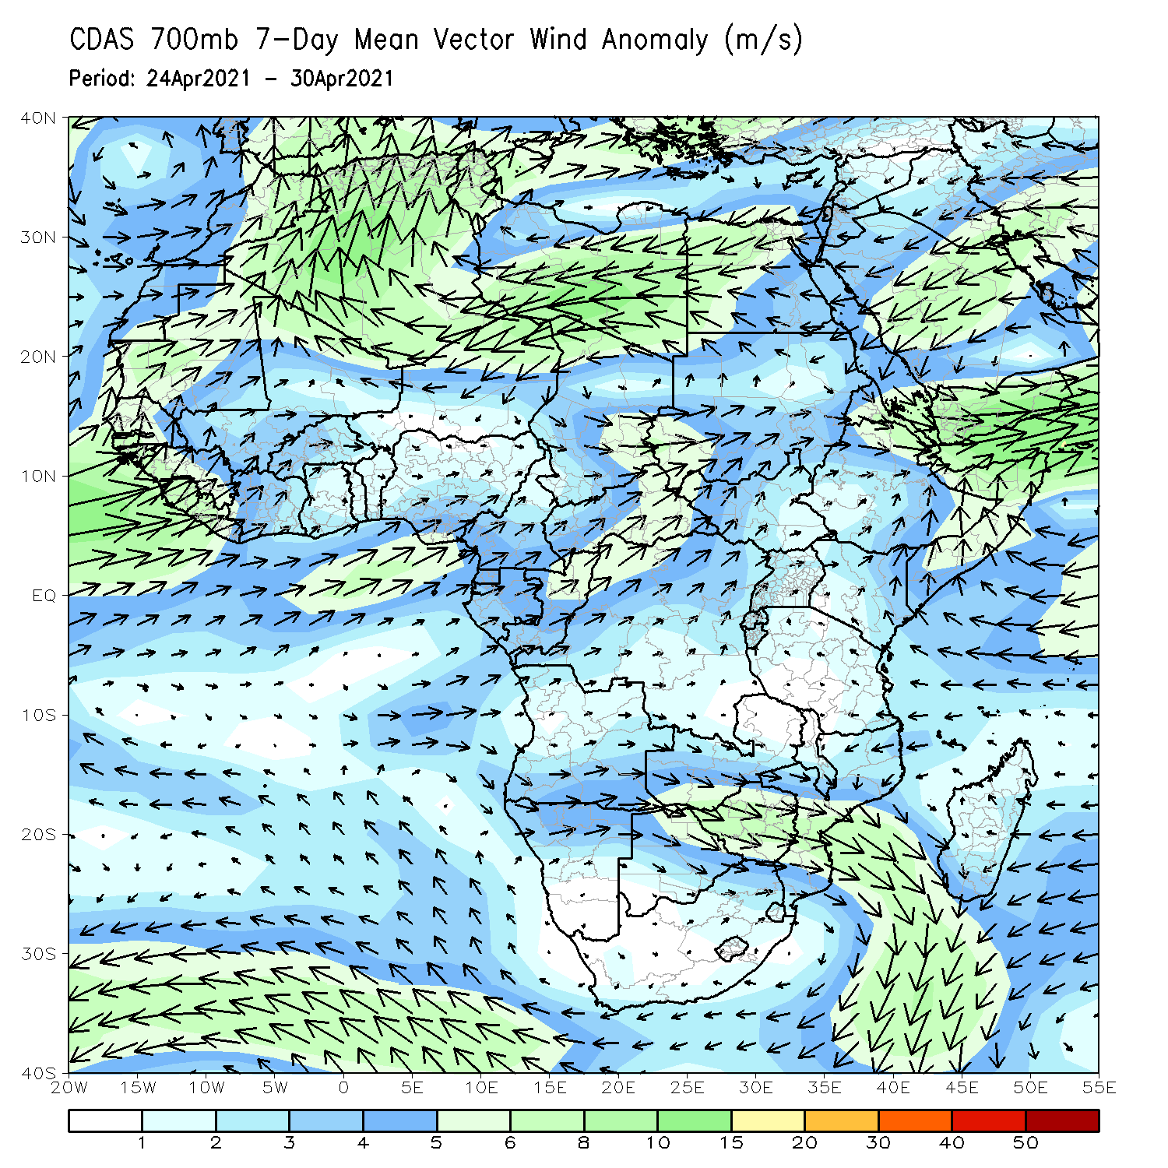
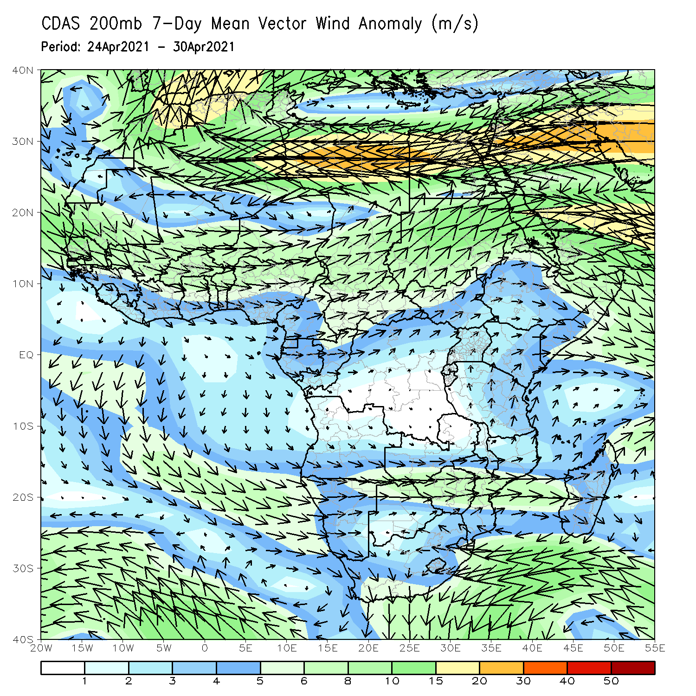
Atmospheric Circulation: Last 7 Days
At lower-level (left panel), anomalous onshore was observed in the Gulf of Guinea and coastal East Africa regions.

Slide 8
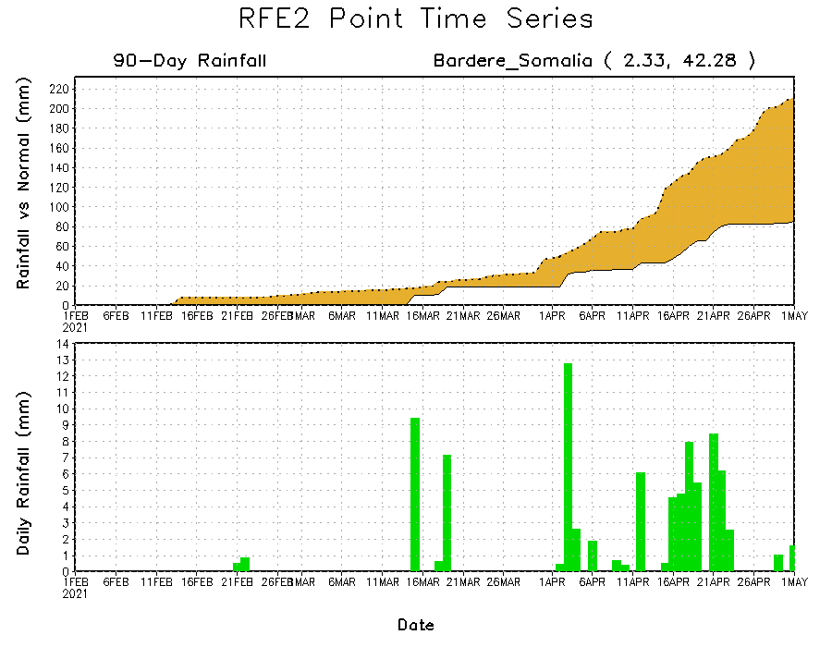
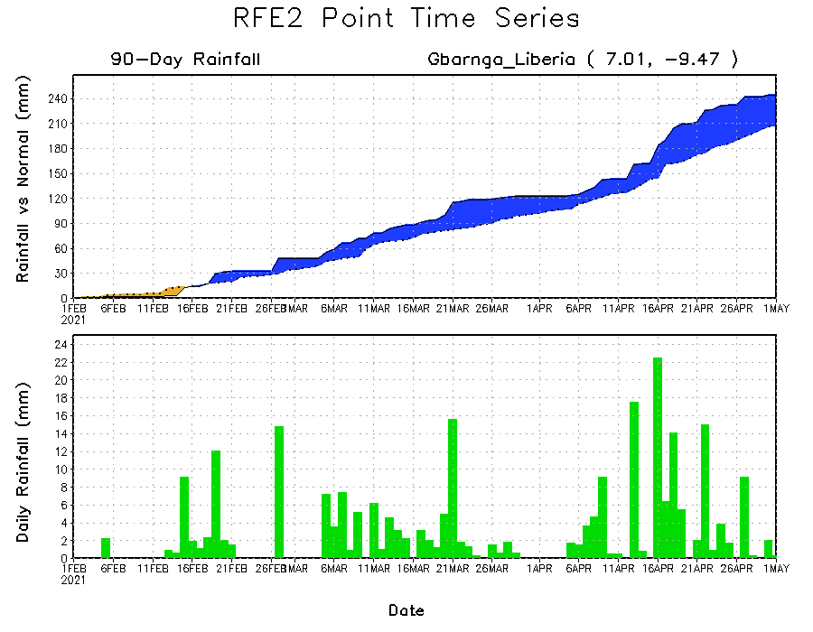
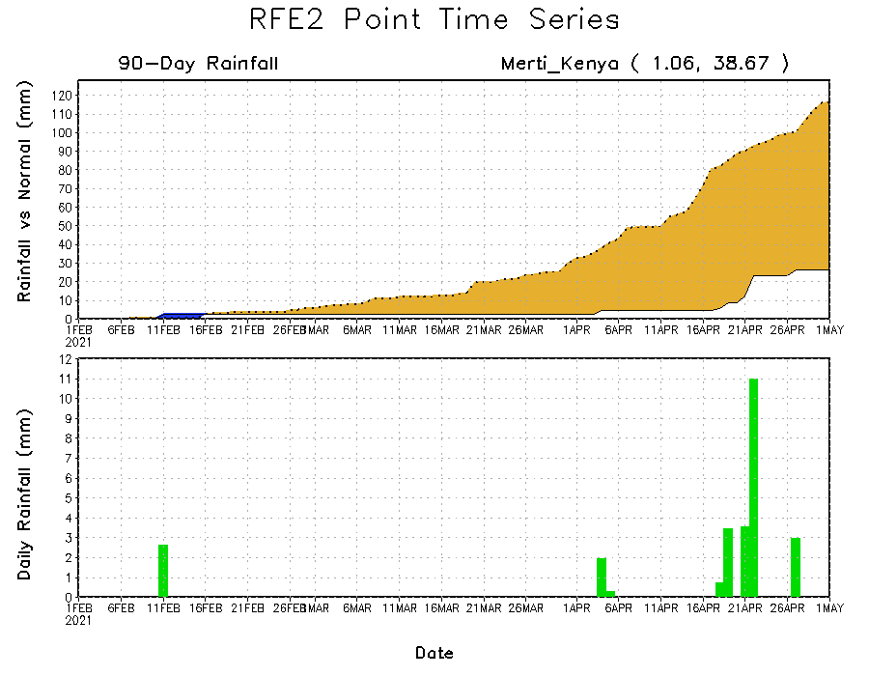
Rainfall Evolution
Daily evolution of rainfall over the last 90 days at selected locations shows moderate to heavy rainfall sustained moisture surpluses over parts of southern Liberia (bottom left). Seasonal total rainfall remained below-average over portions of Kenya (top right) and southern Somalia (bottom right).

Slide 9
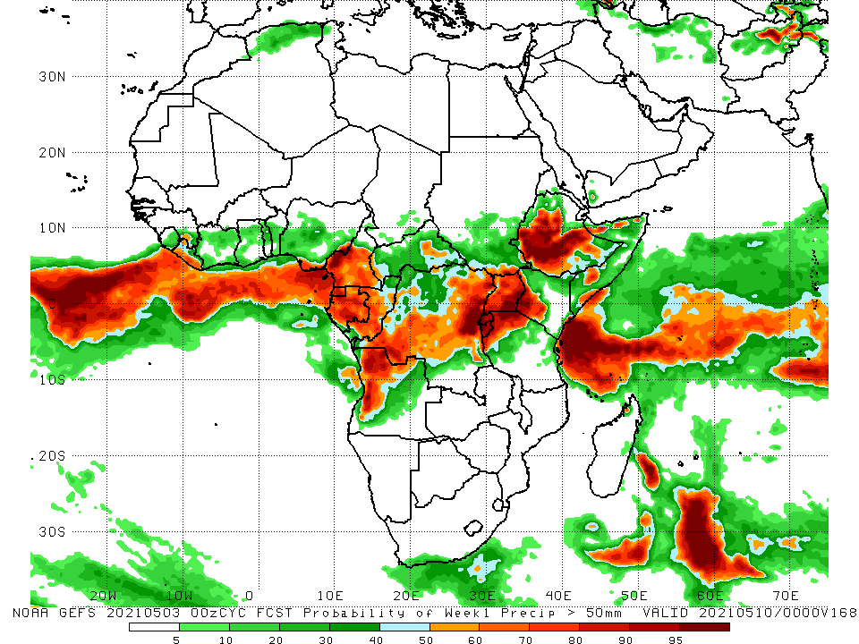
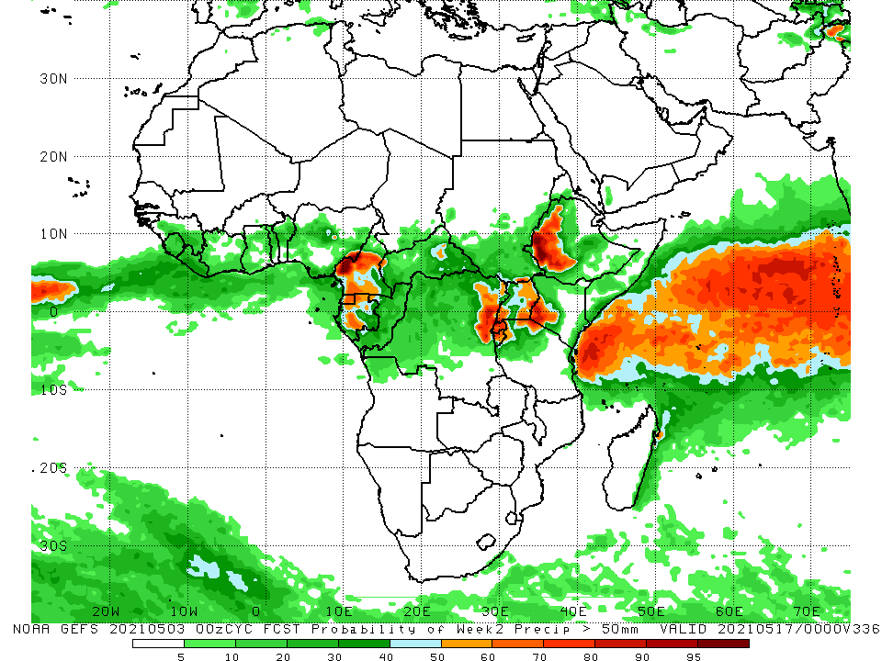
NCEP GEFS Model Forecasts Non-Bias Corrected Probability of precipitation exceedance
Week-1, Valid: 04 - 10 May, 2021
Week-2, Valid: 11 - 17 May, 2021
For week-1 (left panel), the NCEP GEFS indicates a moderate to high chance (over 70%) for rainfall to exceed 50 mm over Cameroon, Equatorial Guinea, Gabon, western and northern Angola, DRC, Rwanda, Burundi, western Kenya, western Tanzania, many parts of Ethiopia, and portions of Somalia. For week-2 (right panel), the chance for rainfall to exceed 50 mm is mostly confined to parts of Cameroon, Equatorial Guinea, Gabon, northeastern DRC, Rwanda, Burundi, Uganda, western Kenya and western Ethiopia.
Notes:
9

Slide 10
Summary
During the past 30 to 90 days, in East Africa, below-average rainfall was observed over southwestern and southern Ethiopia, parts of South Sudan, many parts of Kenya, and southern Somalia. In contrast, rainfall was above-average over much of Uganda and Tanzania, and portions of Ethiopia and southwestern Kenya. In Central Africa, rainfall was below-average over much of Gabon central Congo, northern DRC and portions of CAR. Rainfall was above-average over pockets of CAR, southern Congo, and central and southern DRC. In West Africa, rainfall was above-average over portions of the Gulf of Guinea countries. Below-average rainfall was observed over parts of Cote d’Ivoire, much of Ghana, Burkina Faso, Togo, Benin, and central and northern Nigeria. In southern Africa, rainfall was below-average over much of Southern Africa. Below-average rainfall was observed over northern Malawi and northeastern Madagascar.
During the past 7 days, in East Africa, rainfall was above-average over many parts of Ethiopia, northern Somalia, northern South Sudan, and parts of Tanzania. Below-average rainfall was observed over southern South Sudan, much of Kenya, and southern Somalia. In Central Africa, rainfall was above-average over many parts of DRC. Below-average rainfall was observed over much of Equatorial Guinea, Gabon, Congo, CAR and parts of northern DRC. In West Africa, below-average rainfall was observed over many places in the Gulf of Guinea countries.
For week-1 and week-2, there is a moderate to high chance (over 70%) for rainfall to exceed 50 mm over Cameroon, Equatorial Guinea, Gabon, western and northern Angola, DRC, Rwanda, Burundi, western Kenya, western Tanzania, many parts of Ethiopia, and portions of Somalia.

