Slide 1
The African Monsoon Recent Evolution and Current Status Include Week-1 and Week-2 Outlooks
Update prepared by
24 May 2021
For more information, visit:
http://www.cpc.ncep.noaa.gov/products/Global_Monsoons/African_Monsoons/precip_monitoring.shtml

Slide 2
Outline
Highlights
Recent Evolution and Current Conditions
NCEP GEFS Forecasts
Summary

Slide 3
Highlights: Last 7 Days
During the past 7 days, in East Africa, rainfall was below average over much of the Greater Horn of Africa. In Central Africa, rainfall was above-average over much of Equatorial Guinea, southern Cameroon, CAR, Gabon, Congo and northern DRC. Above-average rainfall was observed over the far western Gulf of Guinea region. Suppressed precipitation was observed across the central and eastern portions of the Gulf of Guinea region.
Week-1 outlooks call for an increased chance for below-average rainfall over the central and eastern portions of the Gulf of Guinea region and the neighboring areas of the Sahel. There is also an increased chance for below-average rainfall over eastern CAR, northern DRC, South Sudan and western Ethiopia. There is an increased chance for above average rainfall over the far western Gulf of Guinea region, and much of Equatorial Guinea, Gabon and parts of Congo.
Week-2 outlooks call for an increased chance for above-average rainfall Guinea, Sierra Leone, western Liberia, southern and eastern Nigeria, Cameroon, Equatorial Guinea, and Gabon. In contrast, there is an increased chance for below-average rainfall over northeastern Cote d'Ivoire, Burkina Faso, portions of Ghana, northern Togo and northern Benin, and eastern CAR, northern DRC, South Sudan, and parts of southwestern Ethiopia and northern Uganda.

Slide 4
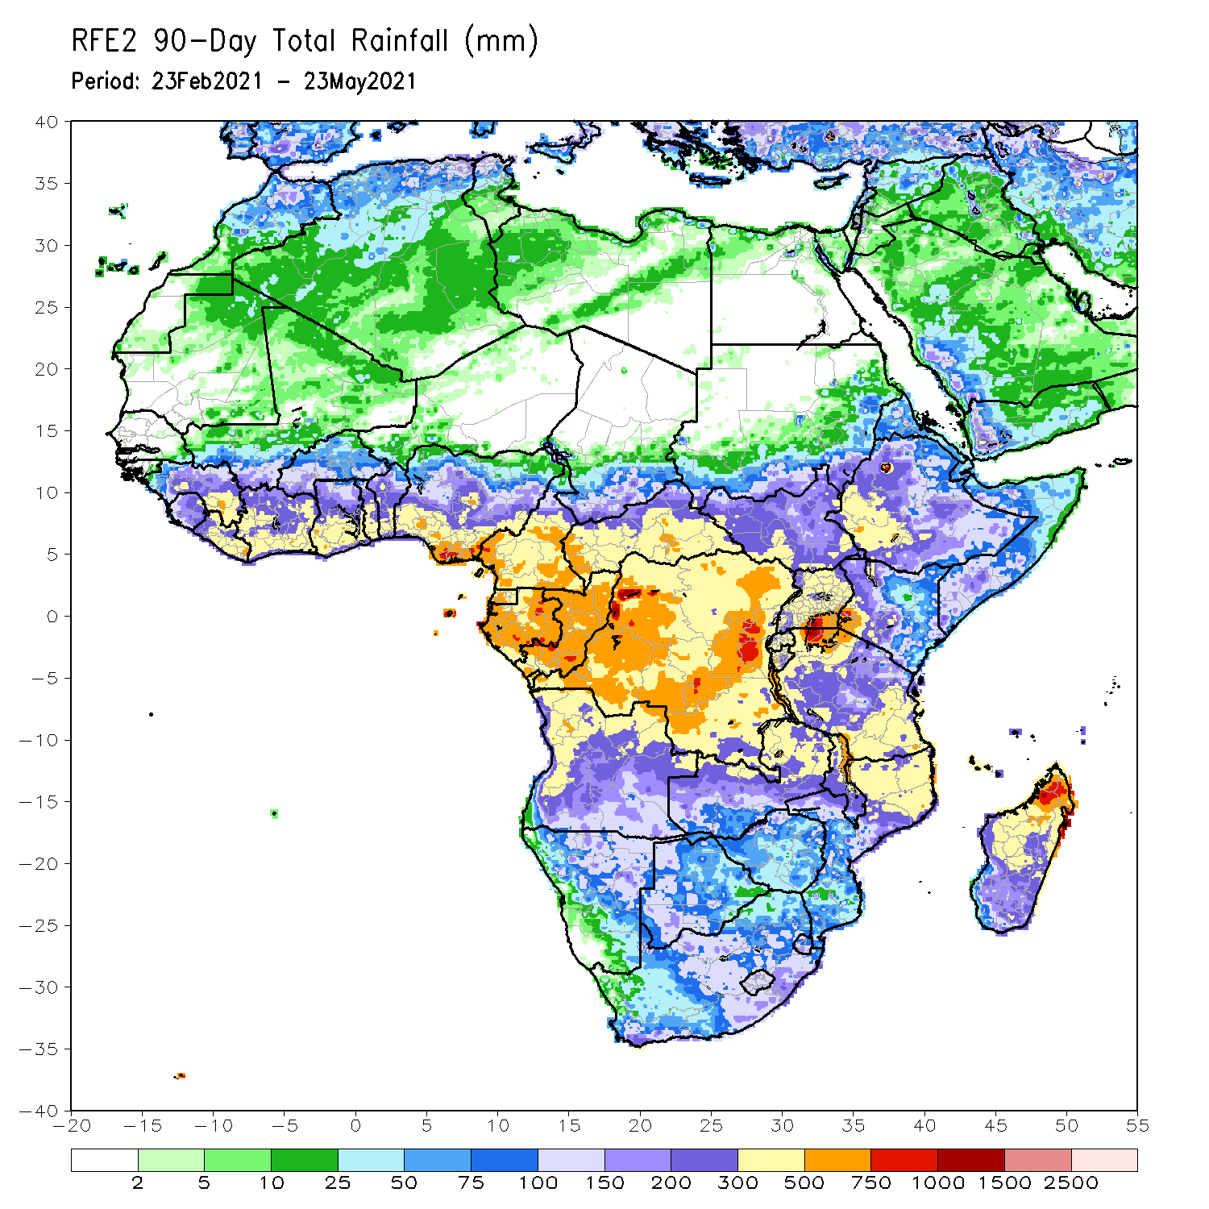
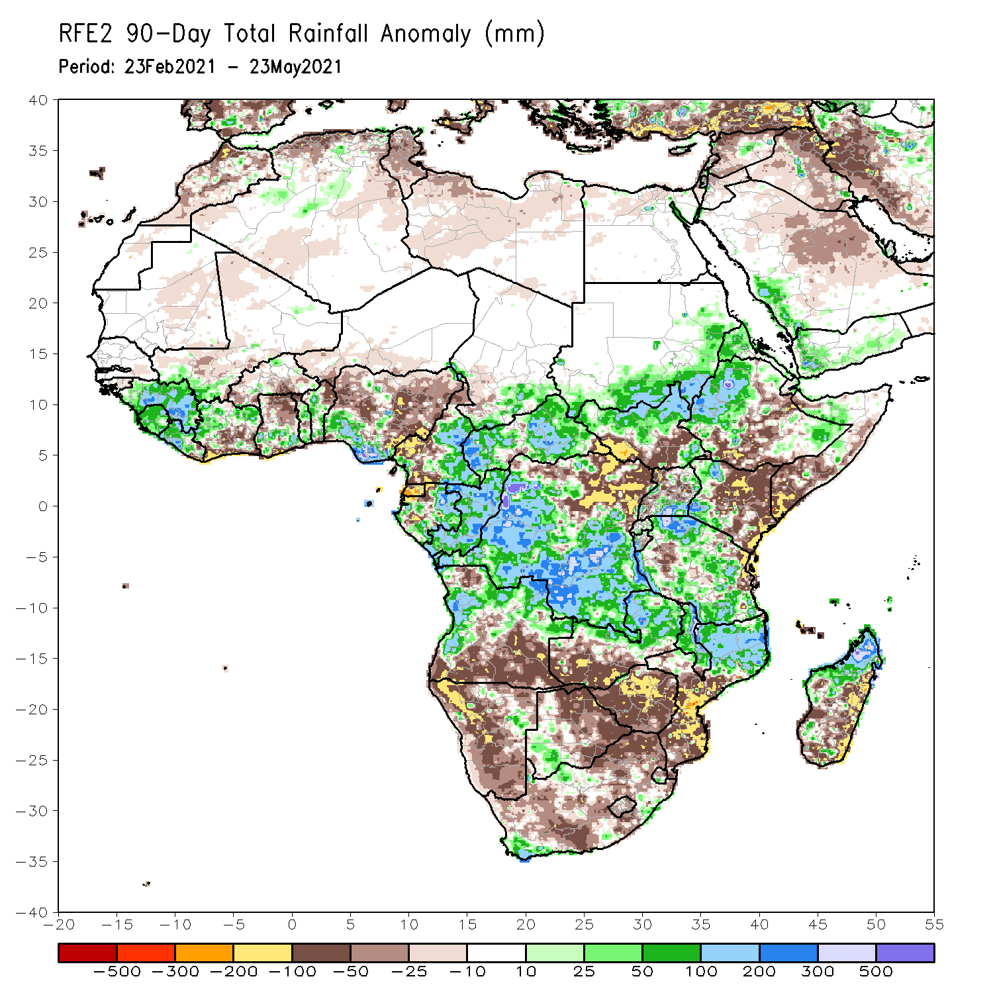
Rainfall Patterns: Last 90 Days
Over the past 90 days, in East Africa, above-average rainfall was observed over western and parts of southeastern Ethiopia, northern South Sudan, southern and eastern Sudan, Eritrea, southern Uganda, much of Tanzania, and pockets of northern Somalia. Rainfall was below-average over parts of central and southern Ethiopia, southern Somalia, and eastern Kenya. Rainfall was also below-average over southern South Sudan and northern Uganda. In southern Africa, above-average rainfall was observed over western and northern Angola, and pockets of Namibia and Botswana. Rainfall was also above-average over central and eastern Zambia, Malawi, northern Mozambique, local areas in South Africa, and northern Madagascar. Persistent light rains resulted in moisture deficits over central and southern Angola, and much of Namibia. Rainfall was also below-average over western Zambia, much of Zimbabwe, eastern Madagascar, and many parts of South Africa. In Central Africa, rainfall was above-average over central and southern DRC, much of Gabon, Congo, and much of CAR. Rainfall was below-average over parts northern DRC. Below-average rains were also observed over Equatorial Guinea and western Cameroon. In West Africa, rainfall was above-average over many places in the Gulf of Guinea countries. Below-average rainfall was observed over pockets of Cote d’Ivoire, northern Ghana, parts of Burkina Faso, and central and northern Nigeria.
Notes:
4

Slide 5
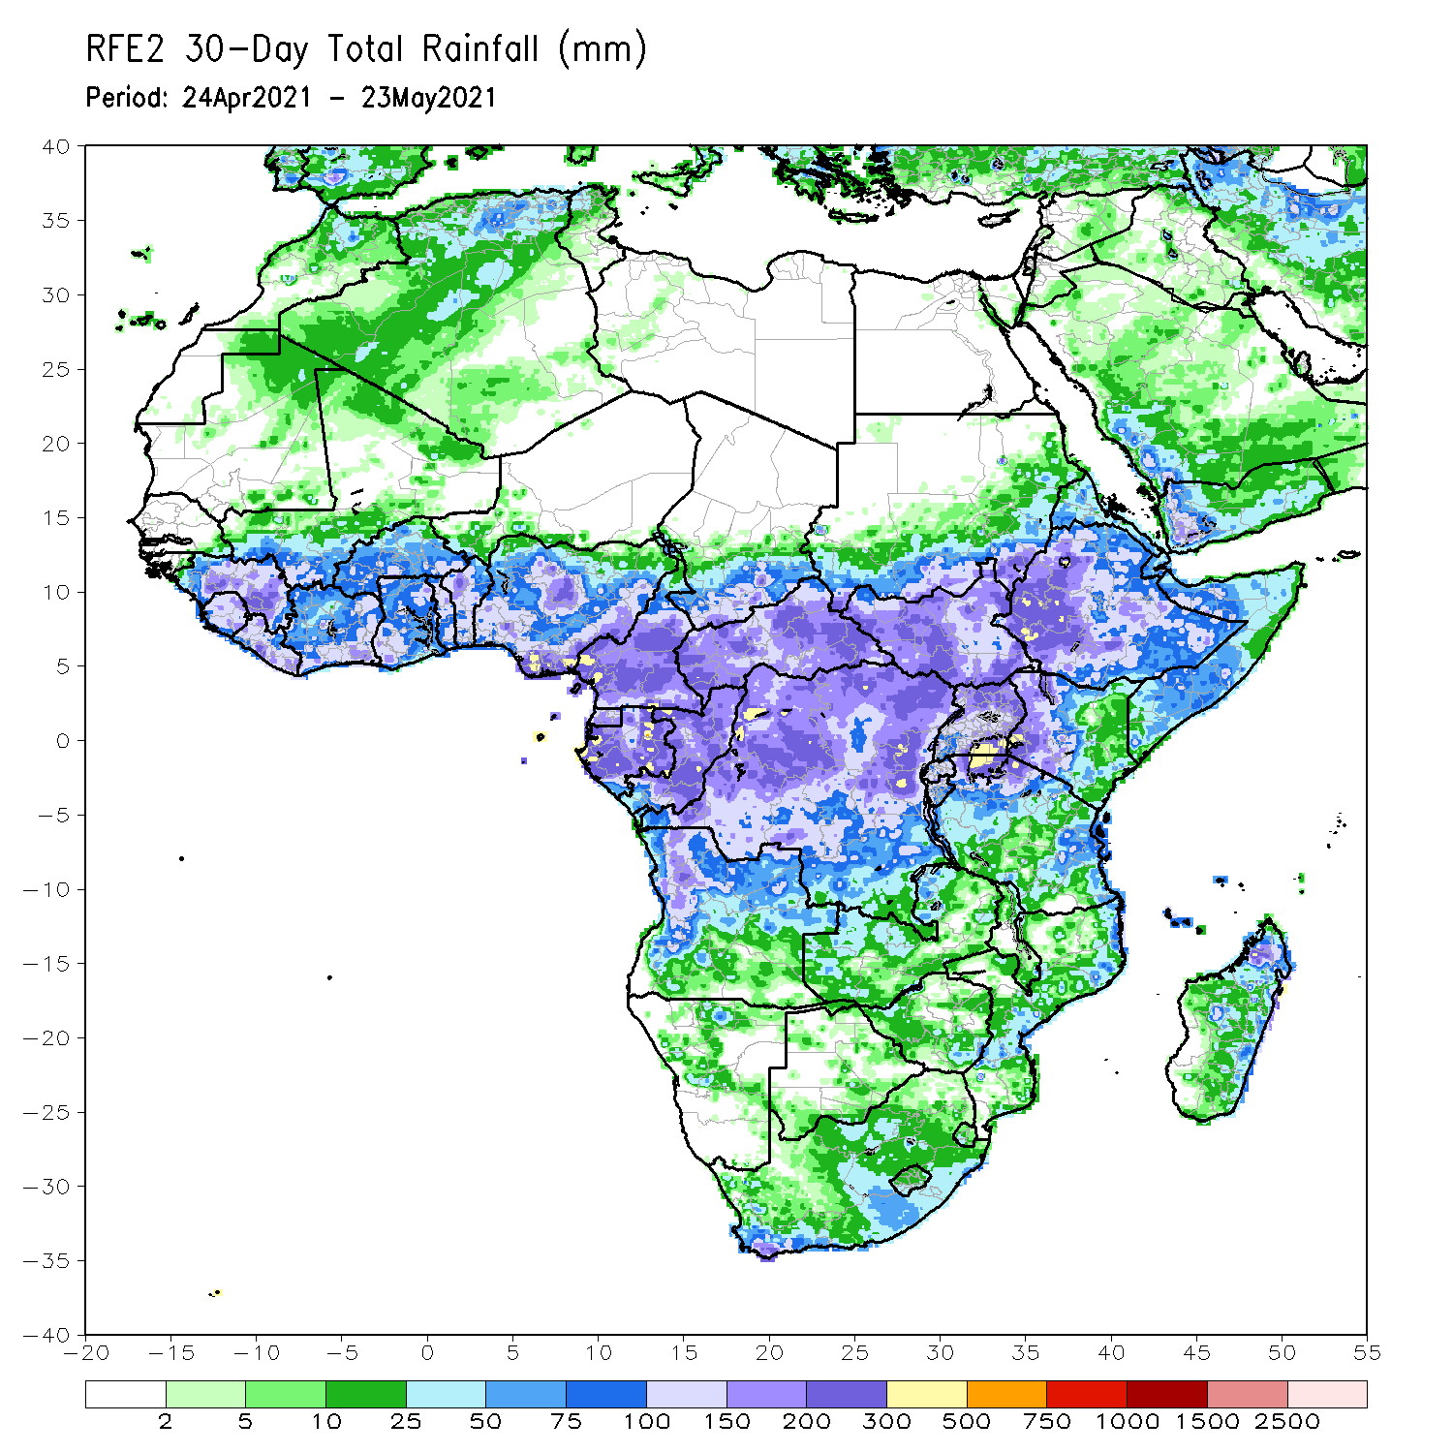
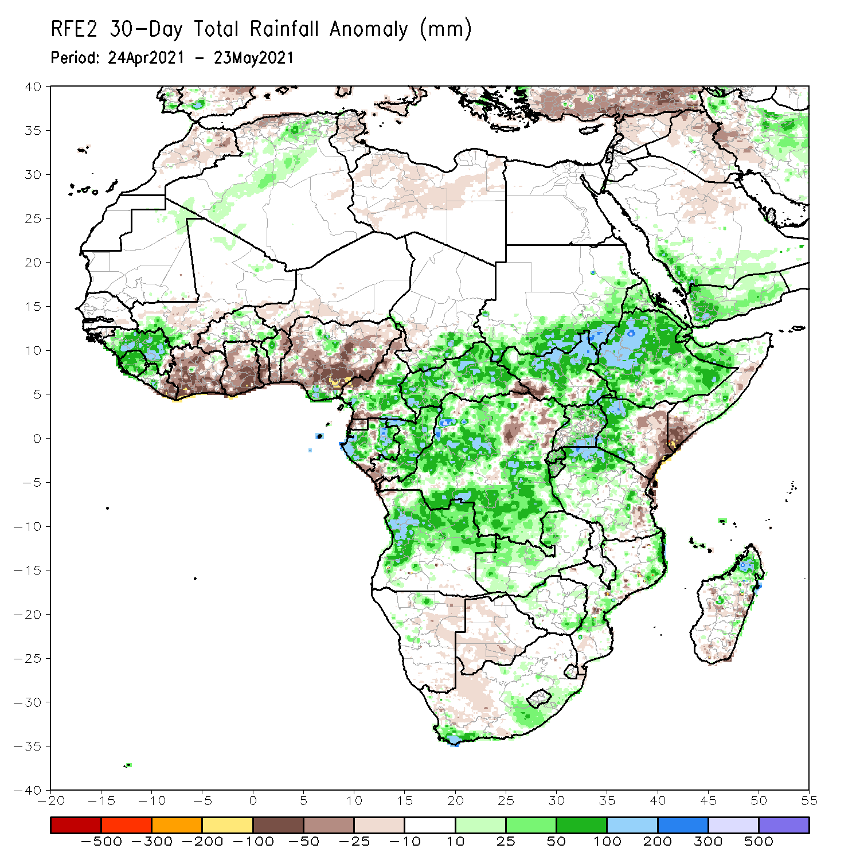
Rainfall Patterns: Last 30 Days
During the past 30 days, in East Africa, above-average rainfall was observed over much of Ethiopia, parts of southern and eastern Sudan, much of South Sudan, and parts of Uganda and western Kenya. Rainfall was below-average over eastern Kenya and pockets of southern South Sudan, and southern Somalia. In Central Africa, rainfall was below-average over the far southern Congo, and northeastern DRC. Rainfall was above-average over much of CAR, much of Congo, and DRC. In West Africa, rainfall was above-average over portions of the far western Gulf of Guinea countries. Below-average rainfall was observed across the central and eastern portions of the Gulf of Guinea region.
Notes:
5

Slide 6
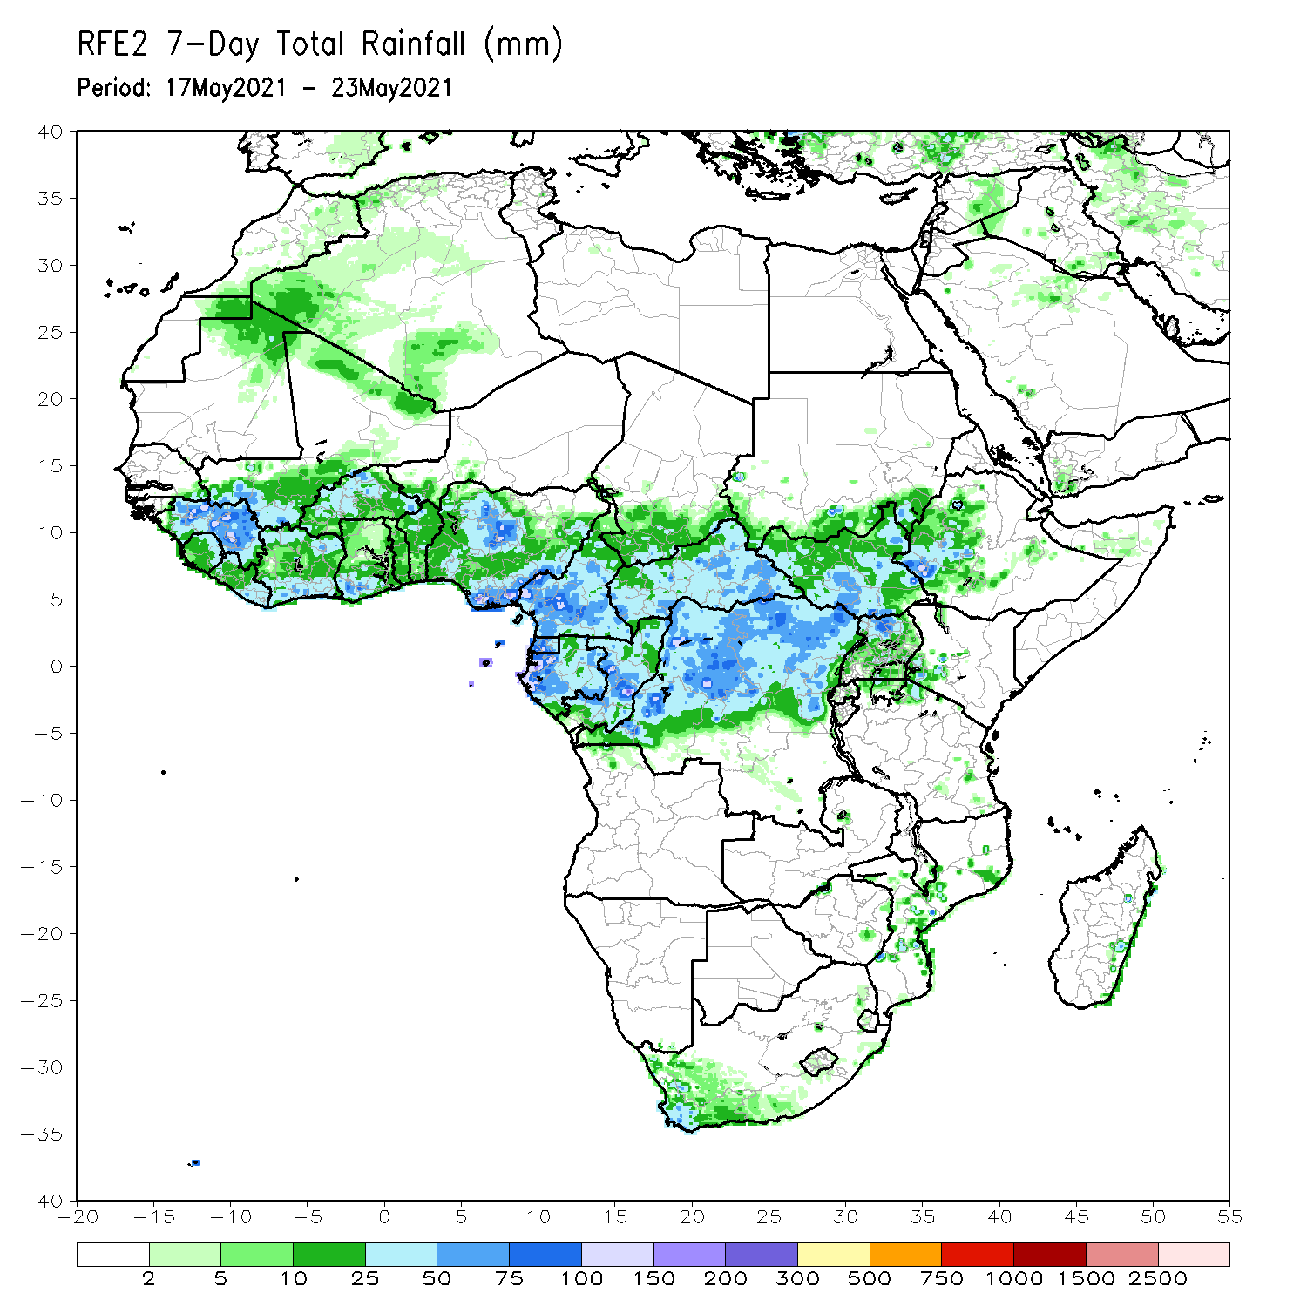
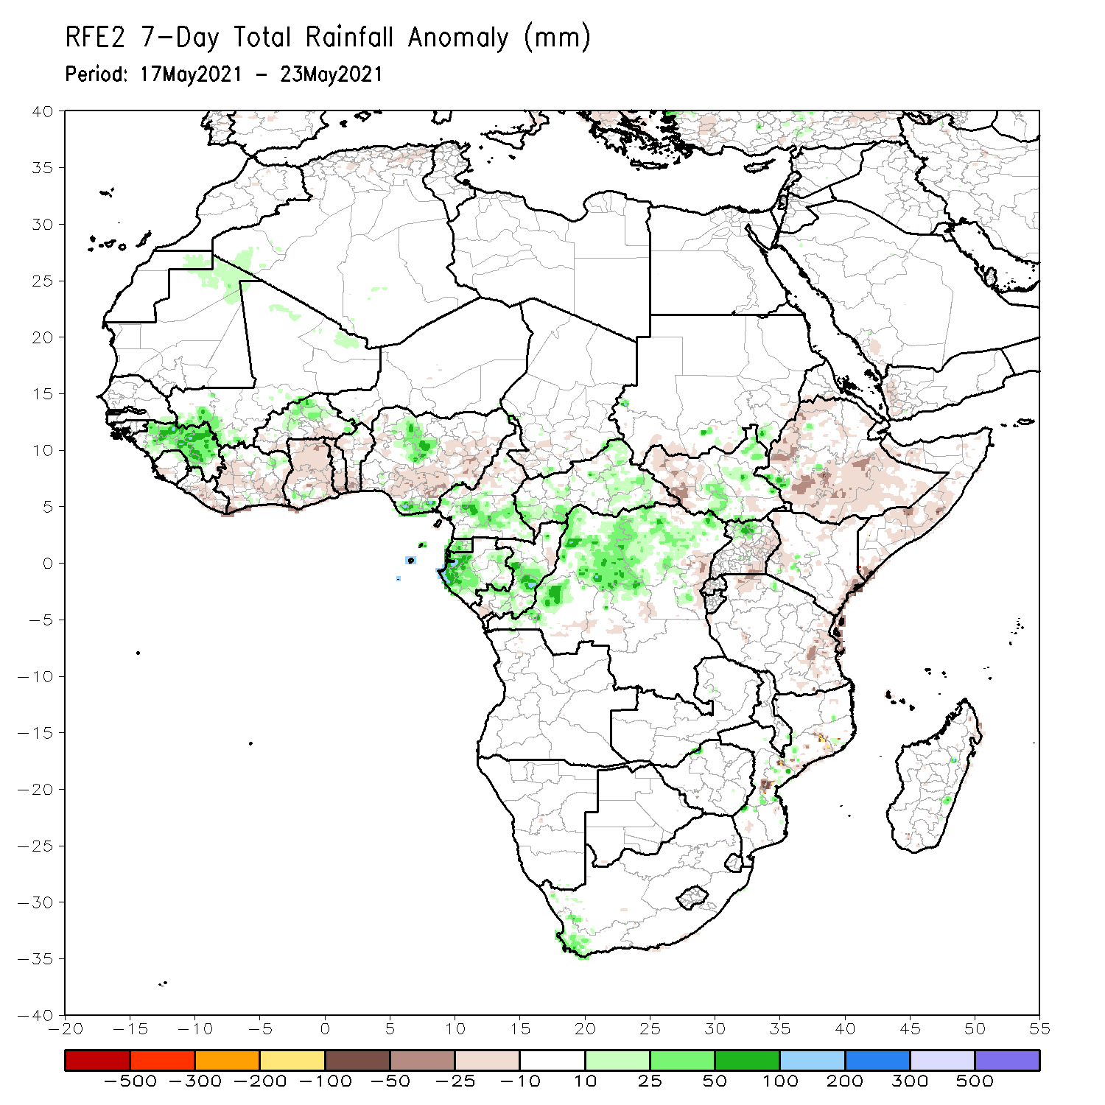
Rainfall Patterns: Last 7 Days
During the past 7 days, in East Africa, rainfall was slightly below average over much of the Greater Horn of Africa. In Central Africa, rainfall was above-average over much of Equatorial Guinea, southern Cameroon, CAR, Gabon, Congo and northern DRC. Above-average rainfall was observed over the far western Gulf of Guinea region. Suppressed precipitation was observed across the central and eastern portions of Gulf of Guinea region.

Slide 7
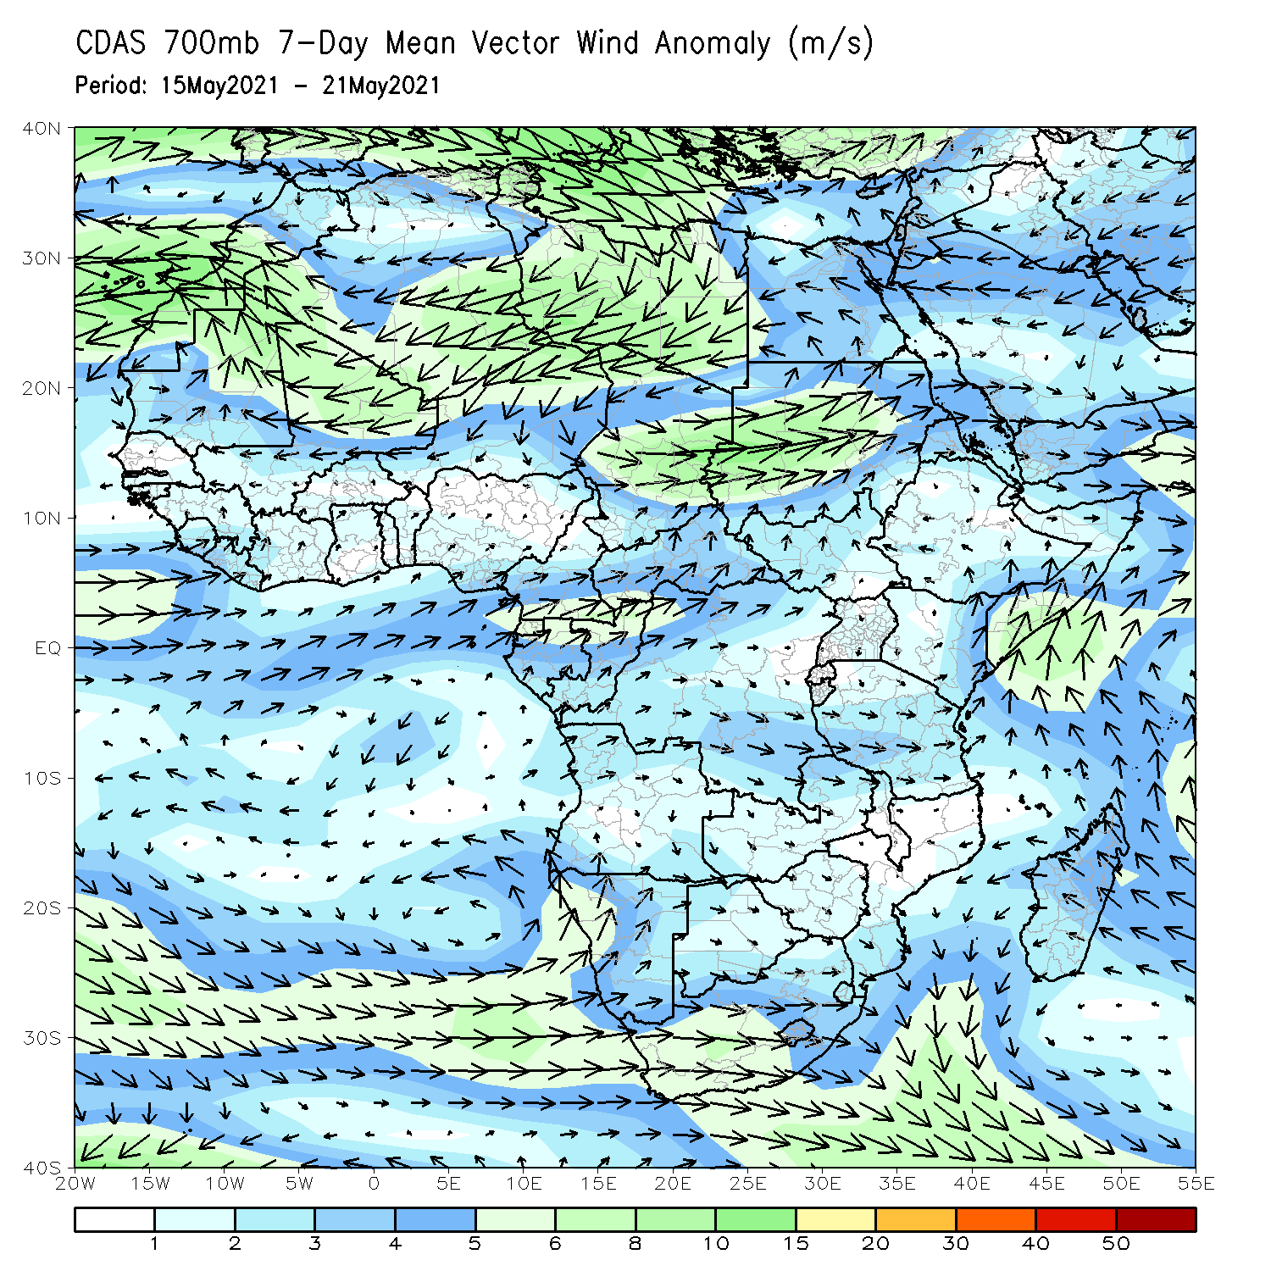
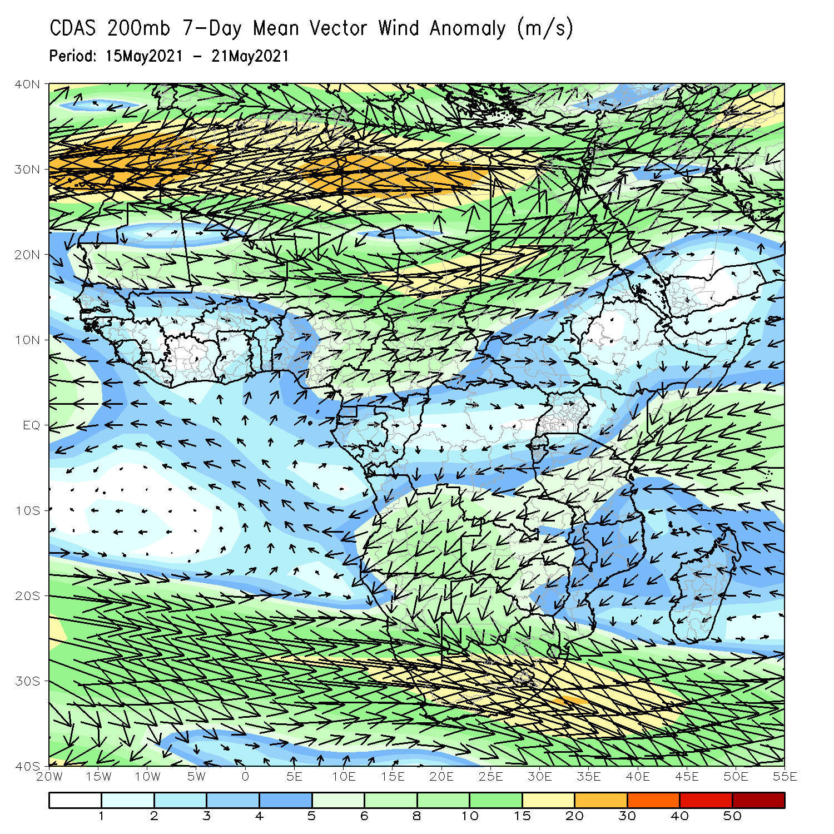
Atmospheric Circulation: Last 7 Days
At lower-level (left panel), anomalous southwesterly flow was observed in the Gulf of Guinea region.

Slide 8
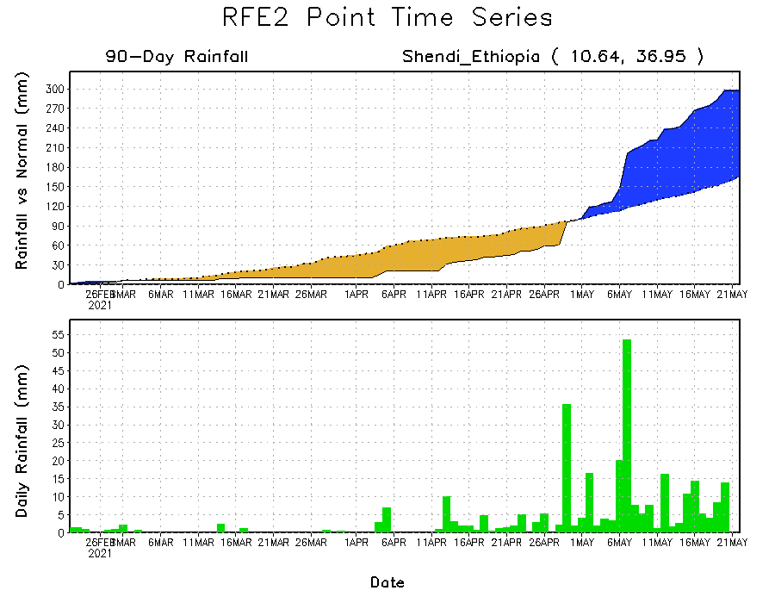
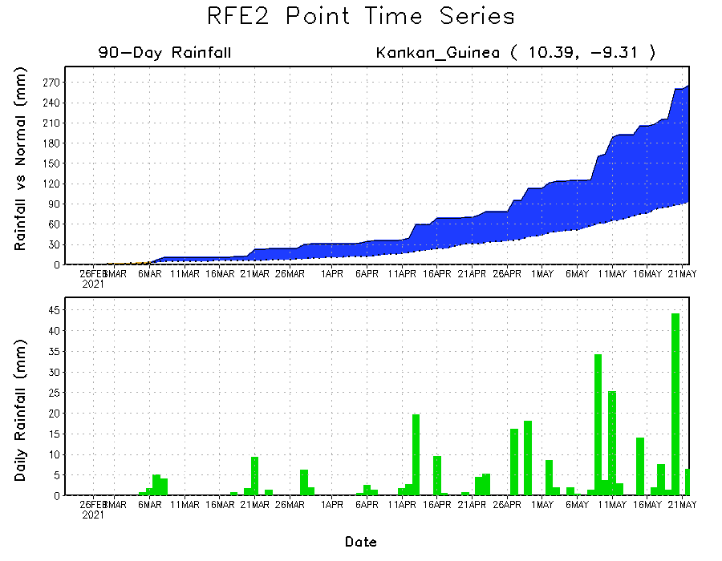
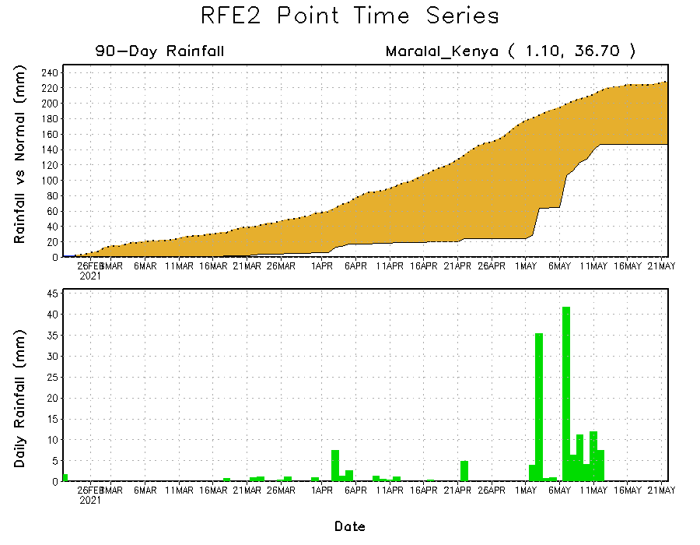
Rainfall Evolution
Daily evolution of rainfall over the last 90 days at selected locations shows moderate to heavy rainfall sustained moisture surpluses over parts of Guinea (bottom left). Moderate to locally heavy rainfall sustained moisture surpluses over parts of western Ethiopia (top right). In contrast, seasonal total rainfall remained below-average over portions of Kenya (bottom right).

Slide 9
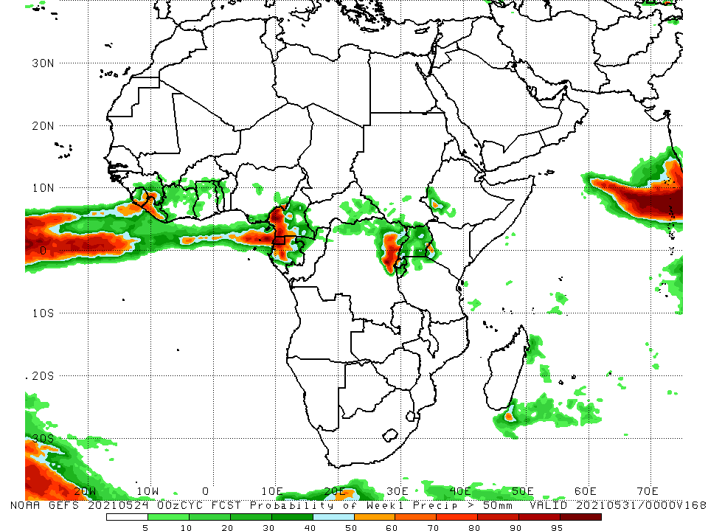
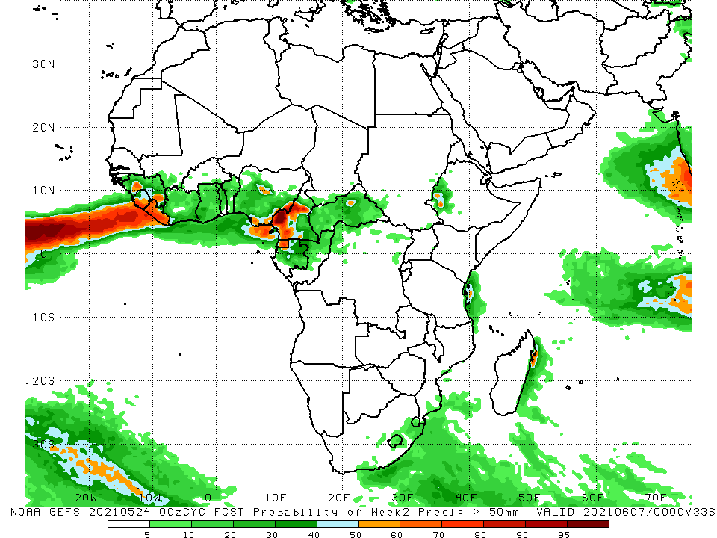
NCEP GEFS Model Forecasts Non-Bias Corrected Probability of precipitation exceedance
Week-1, Valid: 25 - 31 May, 2021
Week-2, Valid: 01 – 07 June, 2021
For week-1 (left panel), week-2 (right panel), the NCEP GEFS indicates a moderate to high chance (over 70%) for rainfall to exceed 50 mm over Sierra Leone, Liberia, parts of Cameroon, Equatorial Guinea, Gabon, and parts of northeastern DRC.
Notes:
9

Slide 10
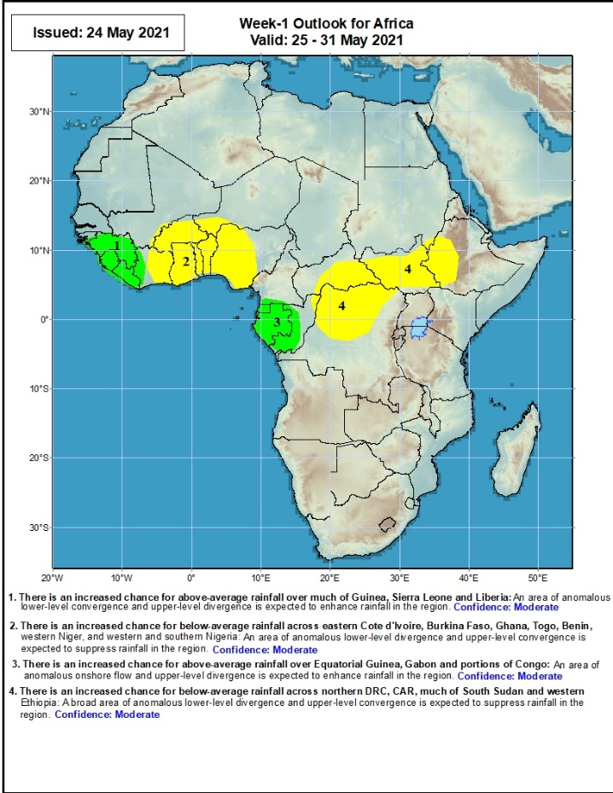
Week-1 Precipitation Outlooks
25 – 31 May, 2021
There is an increased chance for above-average rainfall over much of Guinea, Sierra Leone and Liberia: An area of anomalous lower-level convergence and upper-level divergence is expected to enhance rainfall in the region. Confidence: Moderate
There is an increased chance for below-average rainfall across eastern Cote d'Ivoire, Burkina Faso, Ghana, Togo, Benin, and western and southern Nigeria: An area of anomalous lower-level divergence and upper-level convergence is expected to suppress rainfall in the region. Confidence: Moderate
There is an increased chance for above-average rainfall over Equatorial Guinea, Gabon and portions of Congo: An area of anomalous lower-level convergence and upper-level divergence is expected to enhance rainfall in the region. Confidence: Moderate
There is an increased chance for below-average rainfall across northern DRC, CAR, much of South Sudan and western Ethiopia: A broad area of anomalous lower-level divergence and upper-level convergence is expected to suppress rainfall in the region. Confidence: Moderate
Notes:
10

Slide 11
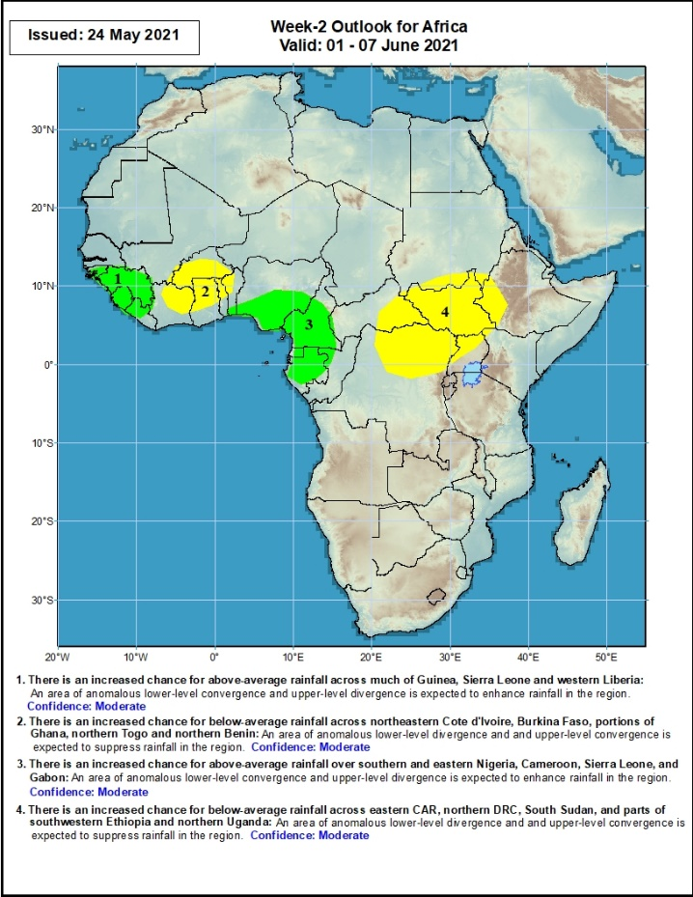
Week-2 Precipitation Outlooks
01 – 07 June, 2021
There is an increased chance for above-average rainfall across much of Guinea, Sierra Leone and western Liberia: An area of anomalous lower-level convergence and upper-level divergence is expected to enhance rainfall in the region. Confidence: Moderate
There is an increased chance for below-average rainfall across northeastern Cote d'Ivoire, Burkina Faso, portions of Ghana, northern Togo and northern Benin: An area of anomalous lower-level divergence and upper-level convergence is expected to suppress rainfall in the region. Confidence: Moderate
There is an increased chance for above-average rainfall over southern and eastern Nigeria, Cameroon, Sierra Leone, and Gabon: An area of anomalous lower-level divergence and upper-level convergence is expected to suppress rainfall in the region. Confidence: Moderate
There is an increased chance for below-average rainfall across eastern CAR, northern DRC, South Sudan, and parts of southwestern Ethiopia and northern Uganda: An area of anomalous lower-level divergence and upper-level convergence is expected to suppress rainfall in the region. Confidence: Moderate
Notes:
11

Slide 12
Summary
During the past 30 to 90 days, in East Africa, above-average rainfall was observed over much of Ethiopia, parts of southern and eastern Sudan, much of South Sudan, and parts of Uganda and western Kenya. Rainfall was below-average over eastern Kenya and pockets of southern South Sudan, and southern Somalia. In Central Africa, rainfall was below-average over the far southern Congo, and northeastern DRC. Rainfall was above-average over much of CAR, much of Congo, and DRC. In West Africa, rainfall was above-average over portions of the far western Gulf of Guinea countries. Below-average rainfall was observed across the central and eastern portions of the Gulf of Guinea region.
During the past 7 days, in East Africa, rainfall was slightly below average over much of the Greater Horn of Africa. In Central Africa, rainfall was above-average over much of Equatorial Guinea, southern Cameroon, CAR, Gabon, Congo and northern DRC. Above-average rainfall was observed over the far western Gulf of Guinea region. Suppressed precipitation was observed across the central and eastern portions of the Gulf of Guinea region.
Week-1 outlooks call for an increased chance for below-average rainfall over the central and eastern portions of the Gulf of Guinea region and the neighboring areas of the Sahel. There is also an increased chance for below-average rainfall over eastern CAR, northern DRC, South Sudan and western Ethiopia. There is an increased chance for above average rainfall over the far western Gulf of Guinea region, and much of Equatorial Guinea, Gabon and parts of Congo. Week-2 outlooks call for an increased chance for above-average rainfall Guinea, Sierra Leone, western Liberia, southern and eastern Nigeria, Cameroon, Equatorial Guinea, and Gabon. In contrast, there is an increased chance for below-average rainfall over northeastern Cote d'Ivoire, Burkina Faso, portions of Ghana, northern Togo and northern Benin, and eastern CAR, northern DRC, South Sudan, and parts of southwestern Ethiopia and northern Uganda.

