Slide 1
The African Monsoon Recent Evolution and Current Status Include Week-1 and Week-2 Outlooks
Update prepared by
01 June 2021
For more information, visit:
http://www.cpc.ncep.noaa.gov/products/Global_Monsoons/African_Monsoons/precip_monitoring.shtml

Slide 2
Outline
Highlights
Recent Evolution and Current Conditions
NCEP GEFS Forecasts
Summary

Slide 3
Highlights: Last 7 Days
During the past 7 days, in East Africa, rainfall was below-average over many places in the Greater Horn of Africa. In Central Africa, rainfall was below-average over eastern CAR, Congo and DRC. Above-average rainfall was observed over parts of Cameroon, Equatorial Guinea and western Gabon. In West Africa, above-average rainfall was observed over pockets of the Gulf of Guinea region. Suppressed precipitation was observed over many parts in Liberia and Nigeria.
Week-1 outlooks call for an increased chance for above-average rainfall over the far western and eastern Gulf of Guinea region. There is an increased chance for below-average rainfall across northeastern DRC, Uganda, Rwanda, Burundi, northern Tanzania, western Kenya, eastern South Sudan and Ethiopia.
Week-2 outlooks call for an increased chance for above-average rainfall over Guinea-Bissau, Guinea, Sierra Leone, Liberia, southern Nigeria, Cameroon, Equatorial Guinea, and Gabon. In contrast, there is an increased chance for below-average rainfall over parts of southern CAR, northern DRC, South Sudan, and southwestern Ethiopia and northern Uganda.

Slide 4
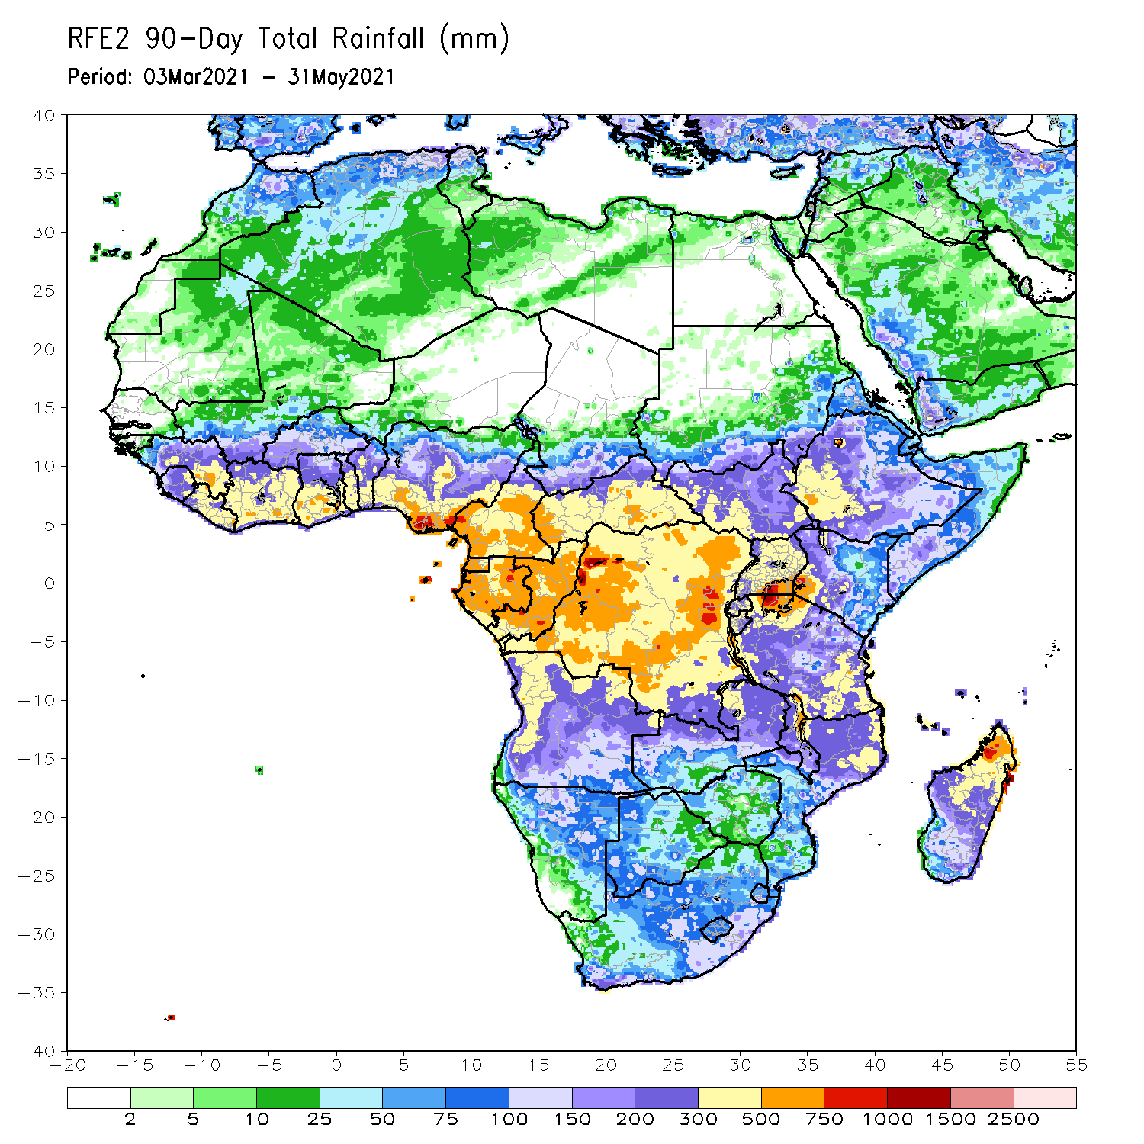
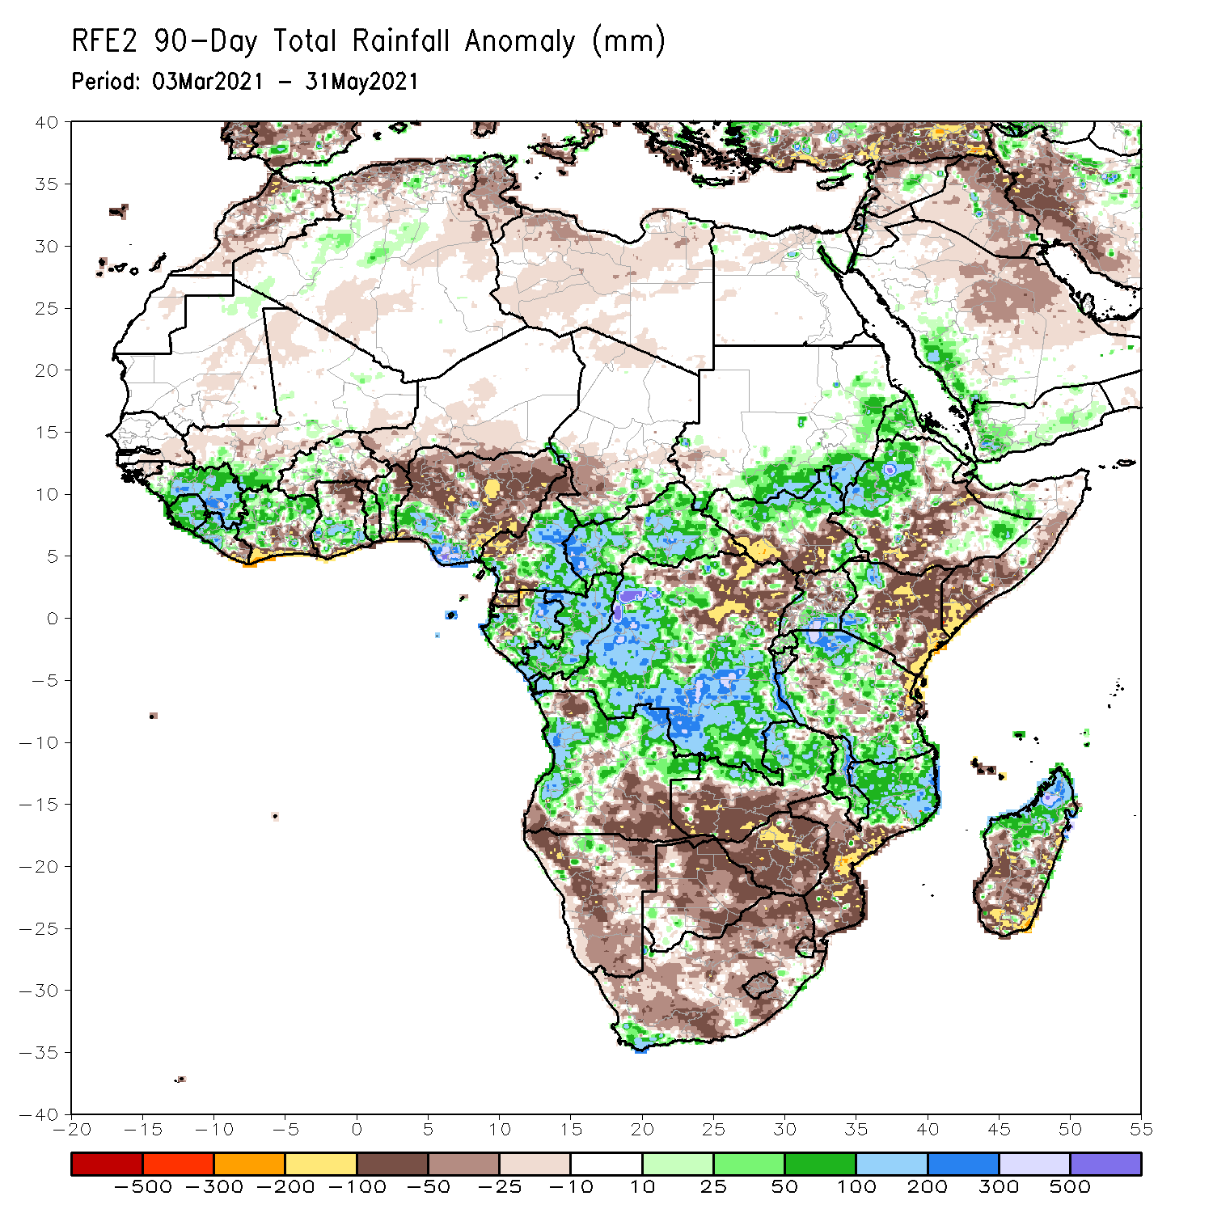
Rainfall Patterns: Last 90 Days
Over the past 90 days, in East Africa, above-average rainfall was observed over western and parts of southeastern Ethiopia, northern South Sudan, southern and eastern Sudan, Eritrea, southern Uganda, western Kenya, much of Tanzania, and pockets of northern Somalia. Rainfall was below-average over parts of central and southern Ethiopia, southern Somalia, and eastern Kenya. Rainfall was also below-average over southern South Sudan and northern Uganda. In southern Africa, above-average rainfall was observed over the northern portions of Southern Africa, while below-average rainfall was observed over central and southern portions of Southern Africa. In Central Africa, rainfall was above-average over central and southern DRC, much of Gabon, Congo, and much of CAR. Rainfall was below-average over parts northern DRC. Below-average rains were also observed over Equatorial Guinea and western Cameroon. In West Africa, rainfall was above-average over many places in the Gulf of Guinea countries. Below-average rainfall was observed over pockets of Cote d’Ivoire, northern Ghana, and central and northern Nigeria.
Notes:
4

Slide 5
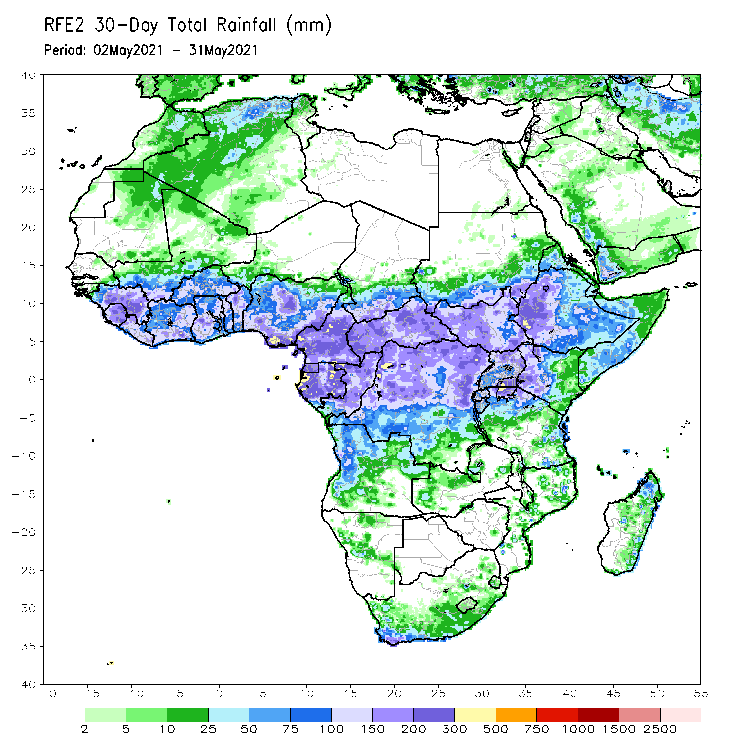
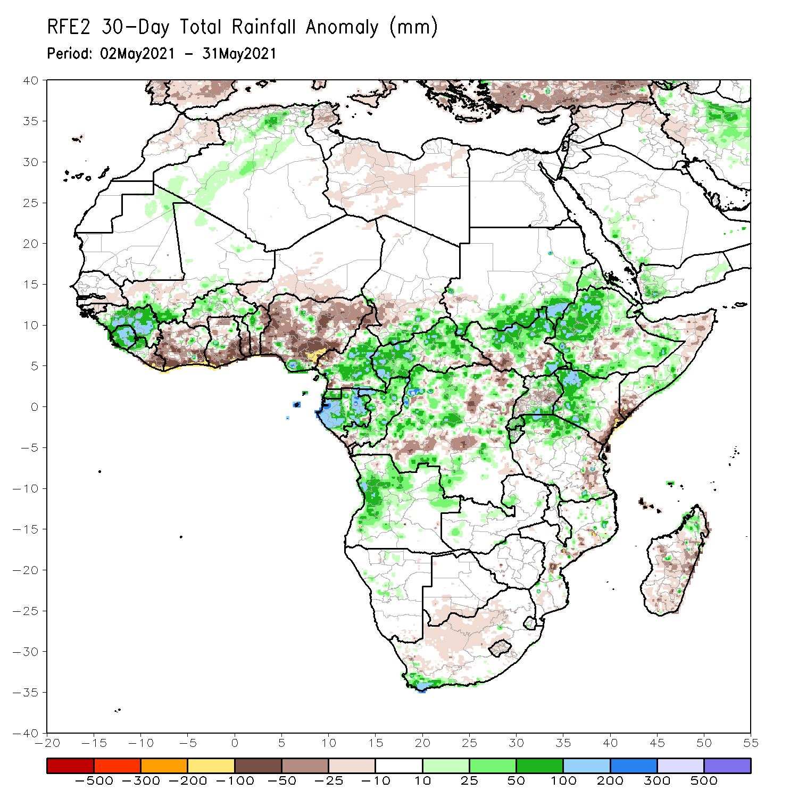
Rainfall Patterns: Last 30 Days
During the past 30 days, in East Africa, above-average rainfall was observed over much of Ethiopia, parts of southern and eastern Sudan, much of South Sudan, and parts of Uganda and western Kenya. Rainfall was below-average over the far eastern Kenya and pockets of southern South Sudan, and southern Somalia. In Central Africa, rainfall was below-average over the far southern Congo, and pockets of DRC. Rainfall was above-average over much of CAR, Congo, and many parts of DRC. In West Africa, rainfall was above-average over portions of the far western Gulf of Guinea countries. Below-average rainfall was observed across the central and eastern portions of the Gulf of Guinea region.
Notes:
5

Slide 6
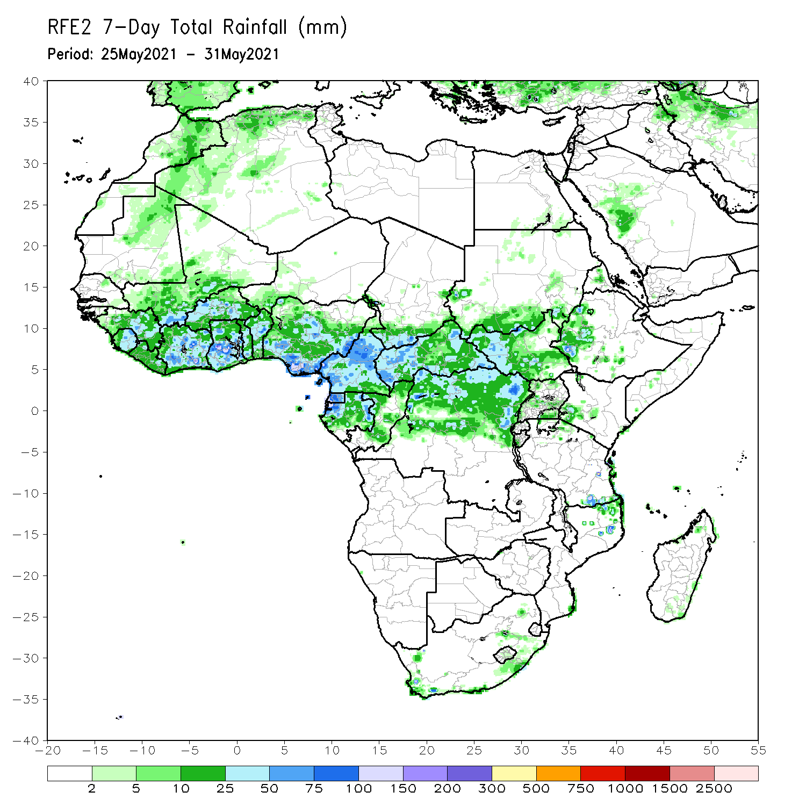
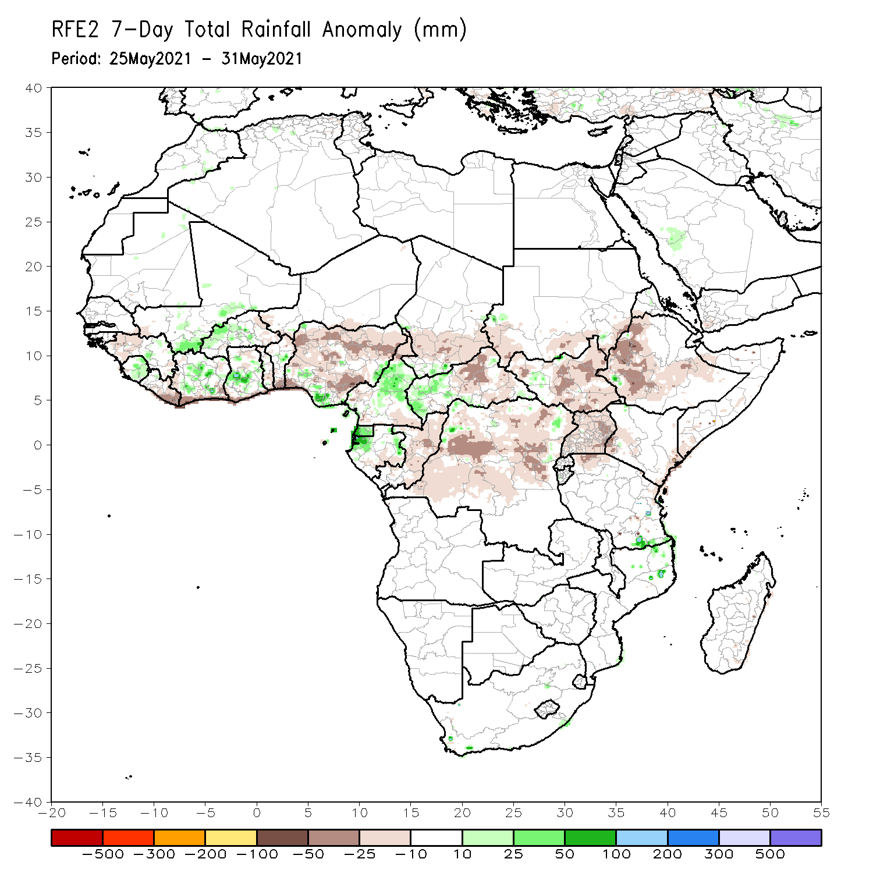
Rainfall Patterns: Last 7 Days
During the past 7 days, in East Africa, rainfall was below average over many places in the Greater Horn of Africa. In Central Africa, rainfall was below-average over eastern CAR, Congo and DRC. Above-average rainfall was observed over parts of Cameroon, Equatorial Guinea and western Gabon. In West Africa, above-average rainfall was observed over pockets of the Gulf of Guinea region. Suppressed precipitation was observed over many parts of Liberia and Nigeria.

Slide 7
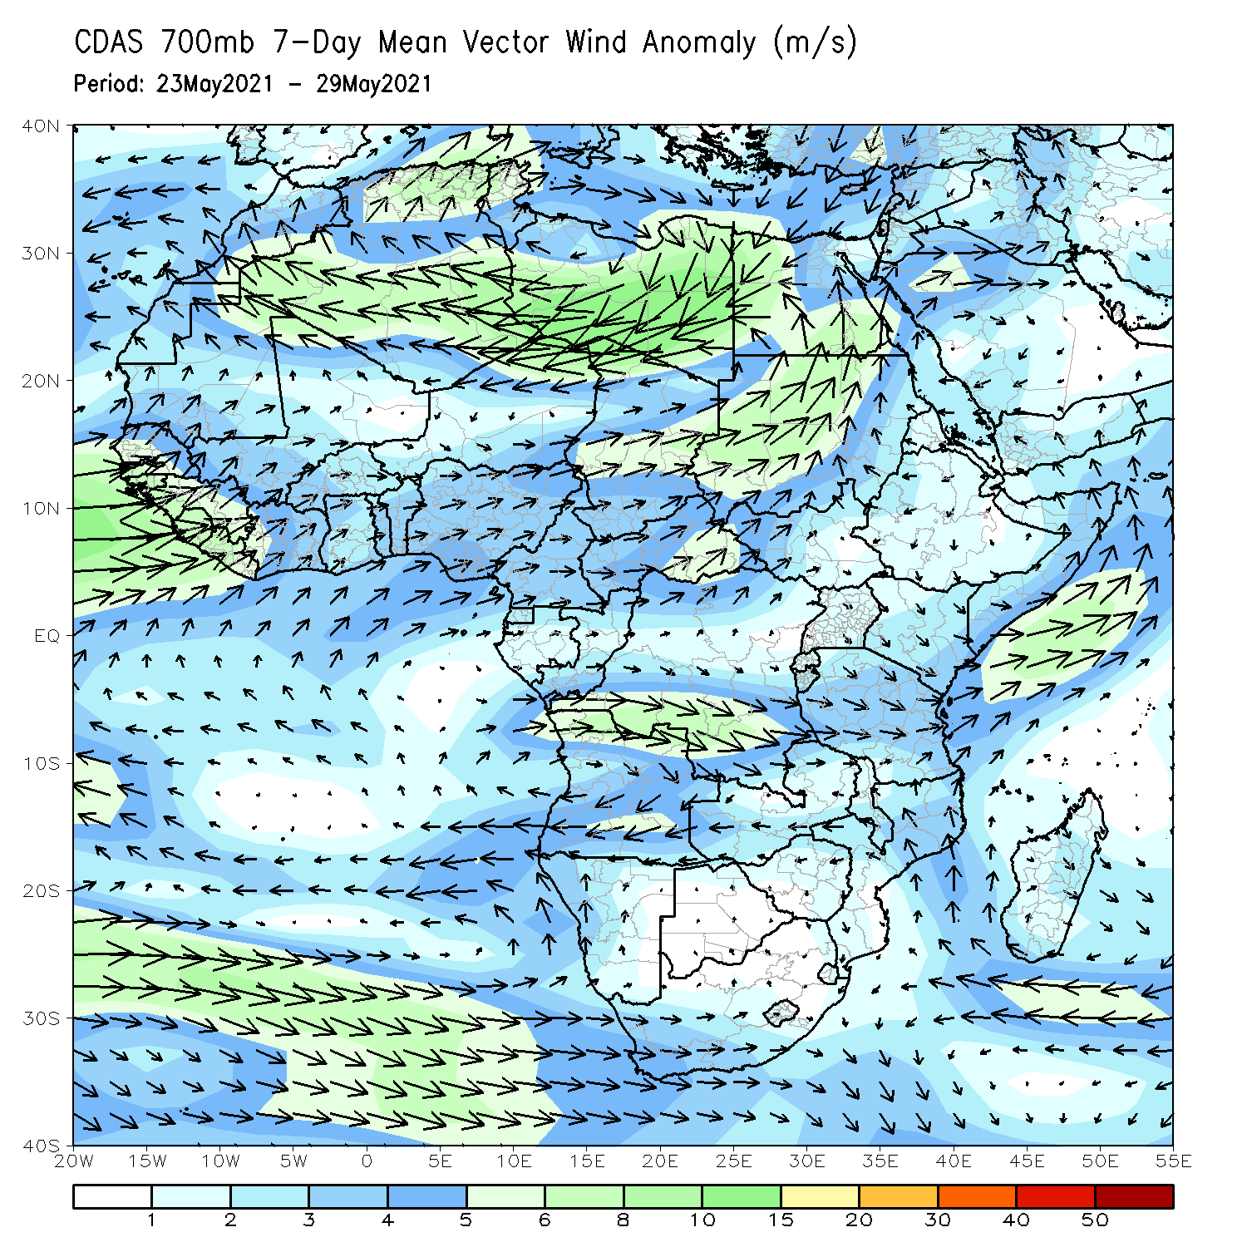
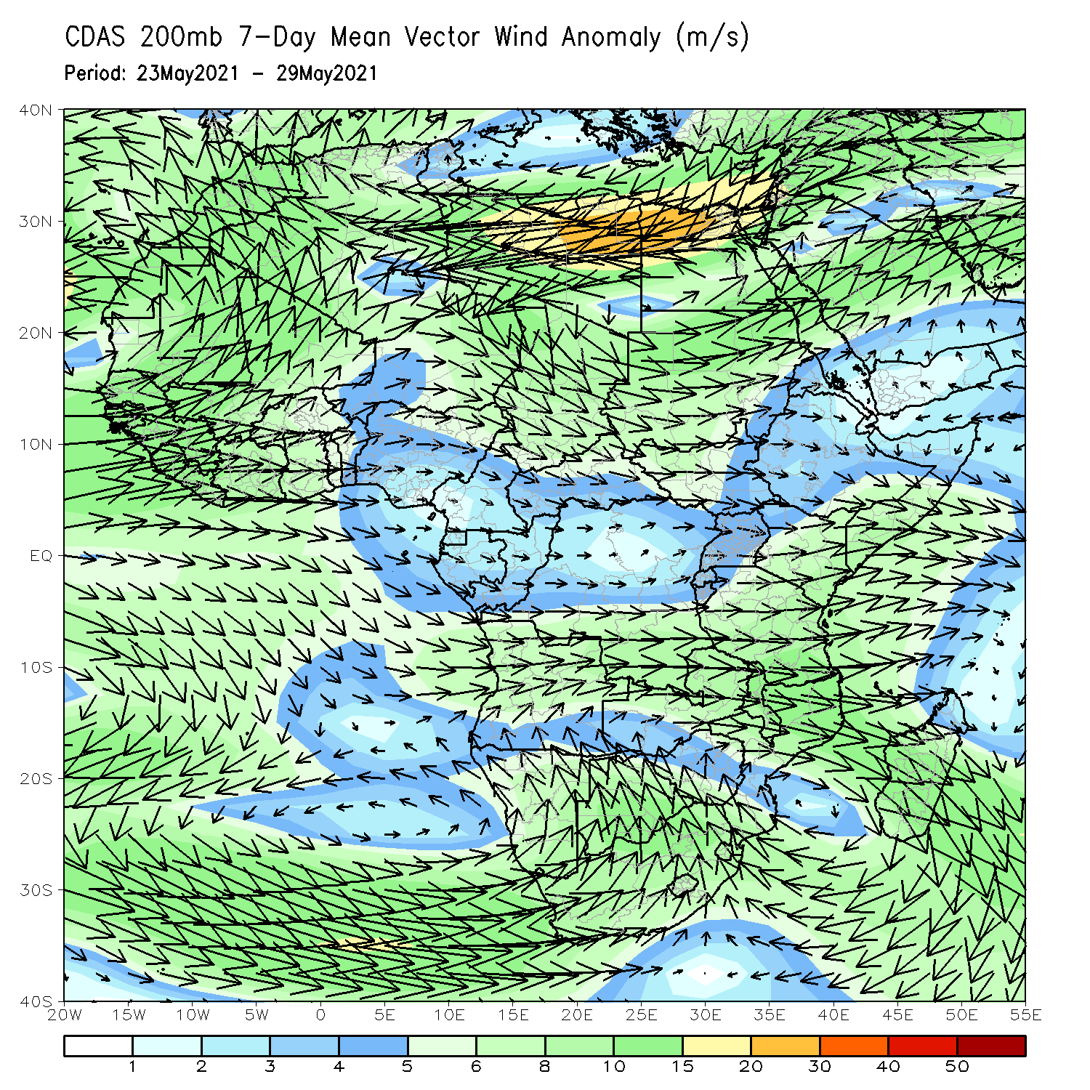
Atmospheric Circulation: Last 7 Days
At lower-level (left panel), anomalous westerly flow was observed in the Gulf of Guinea region, while anomalous offshore flow prevailed across equatorial East Africa.

Slide 8
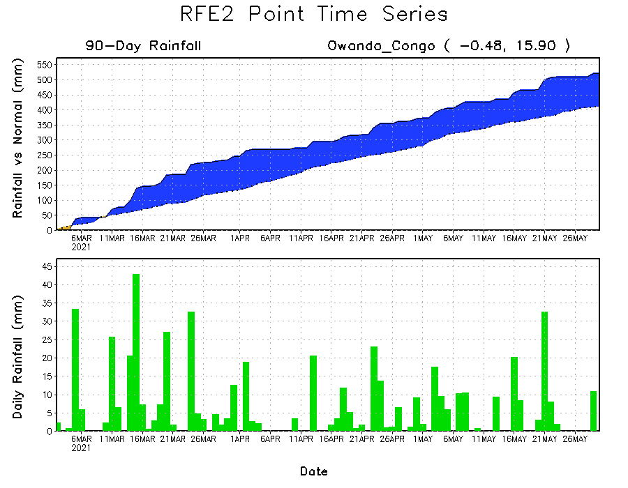
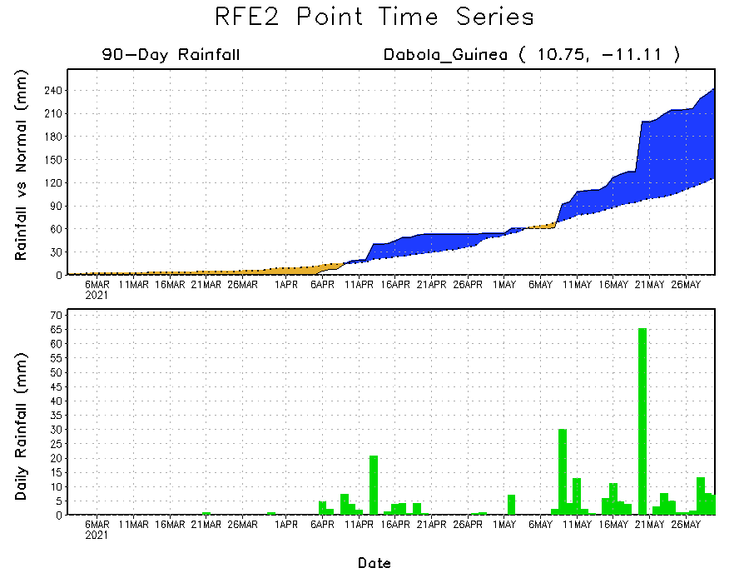
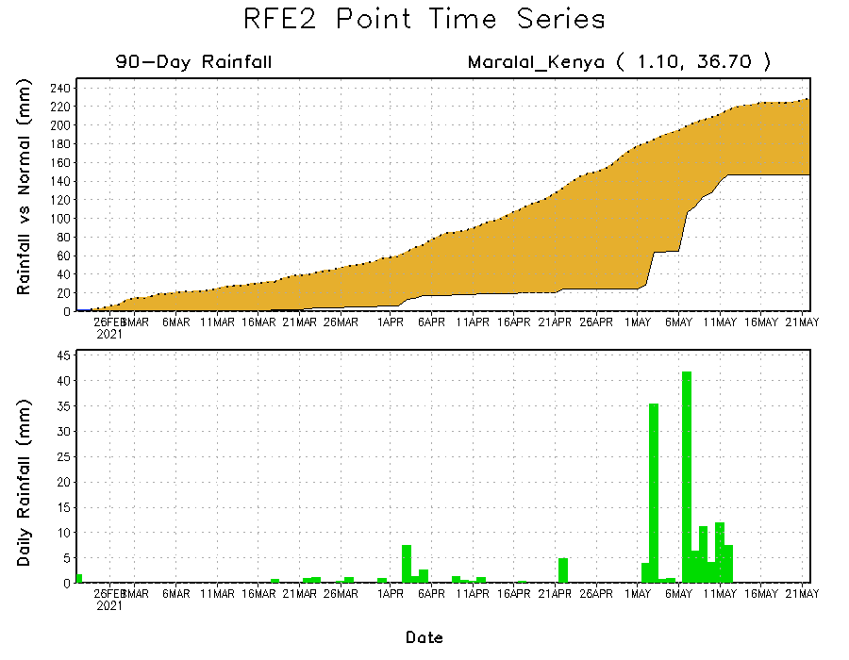
Rainfall Evolution
Daily evolution of rainfall over the last 90 days at selected locations shows moderate to heavy rainfall sustained moisture surpluses over parts of Guinea (bottom left) and Congo (top right). In contrast, seasonal total rainfall remained below-average over portions of southern Ethiopia (bottom right).

Slide 9
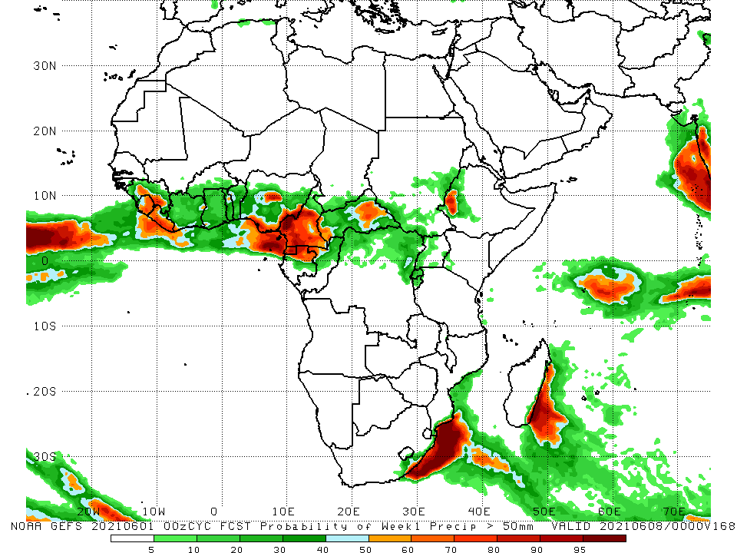
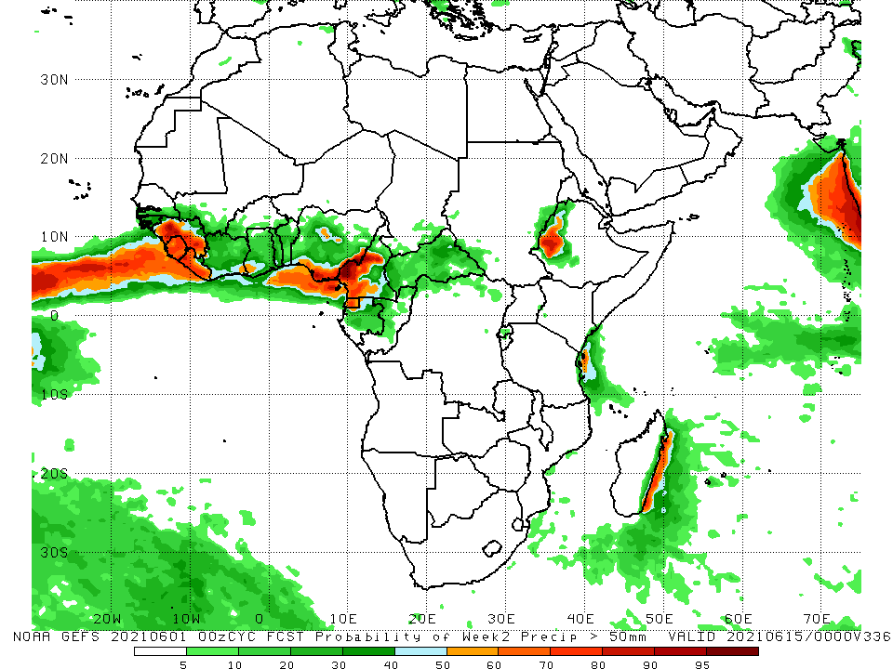
NCEP GEFS Model Forecasts Non-Bias Corrected Probability of precipitation exceedance
Week-1, Valid: 02 – 08 June, 2021
Week-2, Valid: 09 – 15 June, 2021
For week-1 (left panel), and week-2 (right panel), the NCEP GEFS indicates a moderate to high chance (over 70%) for rainfall to exceed 50 mm over Sierra Leone, Liberia, southeastern Nigeria, Cameroon, Equatorial Guinea, northern Gabon, and parts of southwestern Ethiopia.
Notes:
9

Slide 10
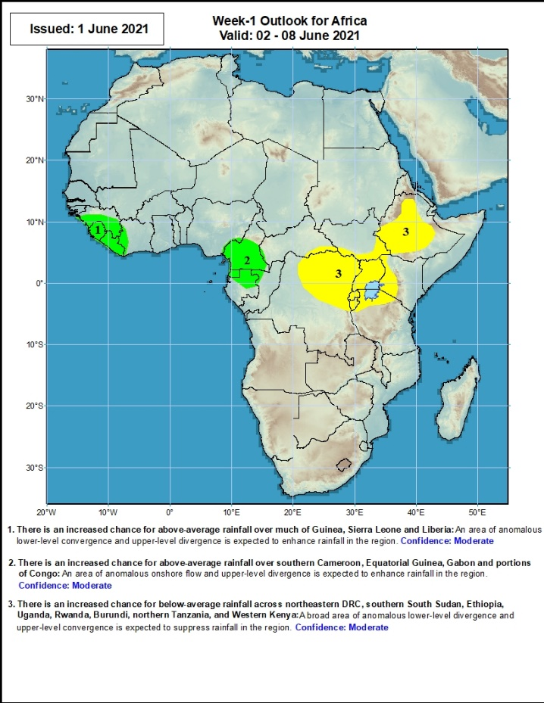
Week-1 Precipitation Outlooks
02 – 08 June, 2021
There is an increased chance for above-average rainfall over parts of Guinea, Sierra Leone and Liberia: An area of anomalous lower-level convergence and upper-level divergence is expected to enhance rainfall in the region. Confidence: Moderate
There is an increased chance for above-average rainfall over southern Cameroon, Equatorial Guinea, and northern Gabon: An area of anomalous lower-level convergence and upper-level divergence is expected to enhance rainfall in the region. Confidence: Moderate
There is an increased chance for below-average rainfall across northeastern DRC, Uganda, Rwanda, Burundi, northern Tanzania, western Kenya, eastern South Sudan and Ethiopia: A broad area of anomalous lower-level divergence and upper-level convergence is expected to suppress rainfall in the region. Confidence: Moderate
Notes:
10

Slide 11
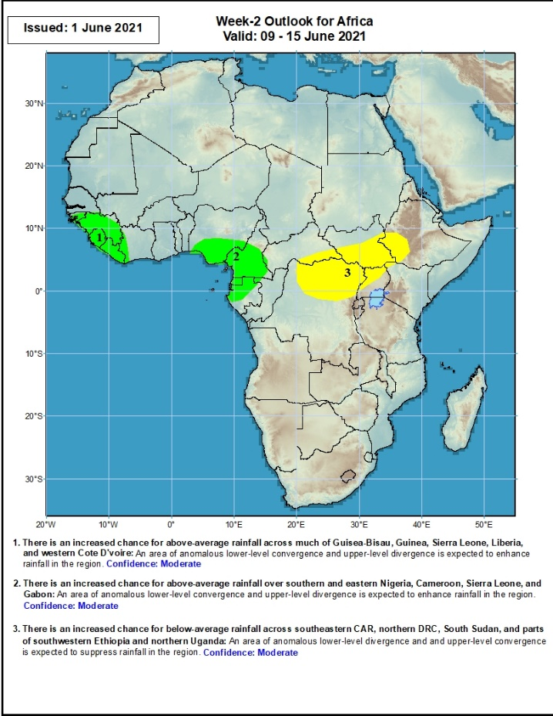
Week-2 Precipitation Outlooks
09 – 15 June, 2021
There is an increased chance for above-average rainfall across much of Guinea-Bissau, Guinea, Sierra Leone and Liberia: An area of anomalous lower-level convergence and upper-level divergence is expected to enhance rainfall in the region. Confidence: Moderate
There is an increased chance for above-average rainfall over southern and eastern Nigeria, Cameroon, Equatorial Guinea,, and Gabon: An area of anomalous lower-level convergence and upper-level divergence is expected to enhance rainfall in the region. Confidence: Moderate
There is an increased chance for below-average rainfall across eastern northern DRC, parts of southern CAR, northern Uganda, southern South Sudan, and southwestern Ethiopia and northern Uganda: An area of anomalous lower-level divergence and upper-level convergence is expected to suppress rainfall in the region. Confidence: Moderate
Notes:
11

Slide 12
Summary
During the past 30 to 90 days, in East Africa, above-average rainfall was observed over much of Ethiopia, parts of southern and eastern Sudan, much of South Sudan, and parts of Uganda and western Kenya. Rainfall was below-average over the far eastern Kenya and pockets of southern South Sudan, and southern Somalia. In Central Africa, rainfall was below-average over the far southern Congo, and pockets of DRC. Rainfall was above-average over much of CAR, Congo, and many parts of DRC. In West Africa, rainfall was above-average over portions of the far western Gulf of Guinea countries. Below-average rainfall was observed across the central and eastern portions of the Gulf of Guinea region.
During the past 7 days, in East Africa, rainfall was below average over many places in the Greater Horn of Africa. In Central Africa, rainfall was below-average over eastern CAR, Congo and DRC. Above-average rainfall was observed over parts of Cameroon, Equatorial Guinea and western Gabon. In West Africa, above-average rainfall was observed over pockets of the Gulf of Guinea region. Suppressed precipitation was observed over many parts of Liberia and Nigeria.
Week-1 outlooks call for an increased chance for above-average rainfall over the far western and eastern Gulf of Guinea region. There is an increased chance for below-average rainfall across northeastern DRC, Uganda, Rwanda, Burundi, northern Tanzania, western Kenya, eastern South Sudan and Ethiopia. Week-2 outlooks call for an increased chance for above-average rainfall over Guinea-Bissau, Guinea, Sierra Leone, Liberia, southern Nigeria, Cameroon, Equatorial Guinea, and Gabon. In contrast, there is an increased chance for below-average rainfall over parts of southern CAR, northern DRC, South Sudan, and southwestern Ethiopia and northern Uganda.

