Slide 1
The African Monsoon Recent Evolution and Current Status Include Week-1 and Week-2 Outlooks
Update prepared by
14 June 2021
For more information, visit:
http://www.cpc.ncep.noaa.gov/products/Global_Monsoons/African_Monsoons/precip_monitoring.shtml

Slide 2
Outline
Highlights
Recent Evolution and Current Conditions
NCEP GEFS Forecasts
Summary

Slide 3
Highlights: Last 7 Days
During the past 7 days, in East Africa, rainfall was below average over southern South Sudan, southwestern Ethiopia, and parts of Uganda. Above-average rainfall was observed over pockets of southern Sudan and western Ethiopia. In Central Africa, rainfall was below-average over northeastern DRC. Above-average rainfall was observed over Equatorial Guinea, Gabon, Congo, northwestern DRC and parts of CAR. In West Africa, above-average rainfall was observed over pockets of Guinea, much of Cote D’Ivoire, and pockets of Ghana, Burkina Faso, Togo and Nigeria. Below-average rainfall was observed along the Gulf of Guinea coast.
Week-1 and week-2 outlooks call for an increased chance for above-average rainfall over portions of the Guinea region, and western Ethiopia. In contrast the outlooks call for an increased chance for below-average rainfall over parts of northern DRC.

Slide 4
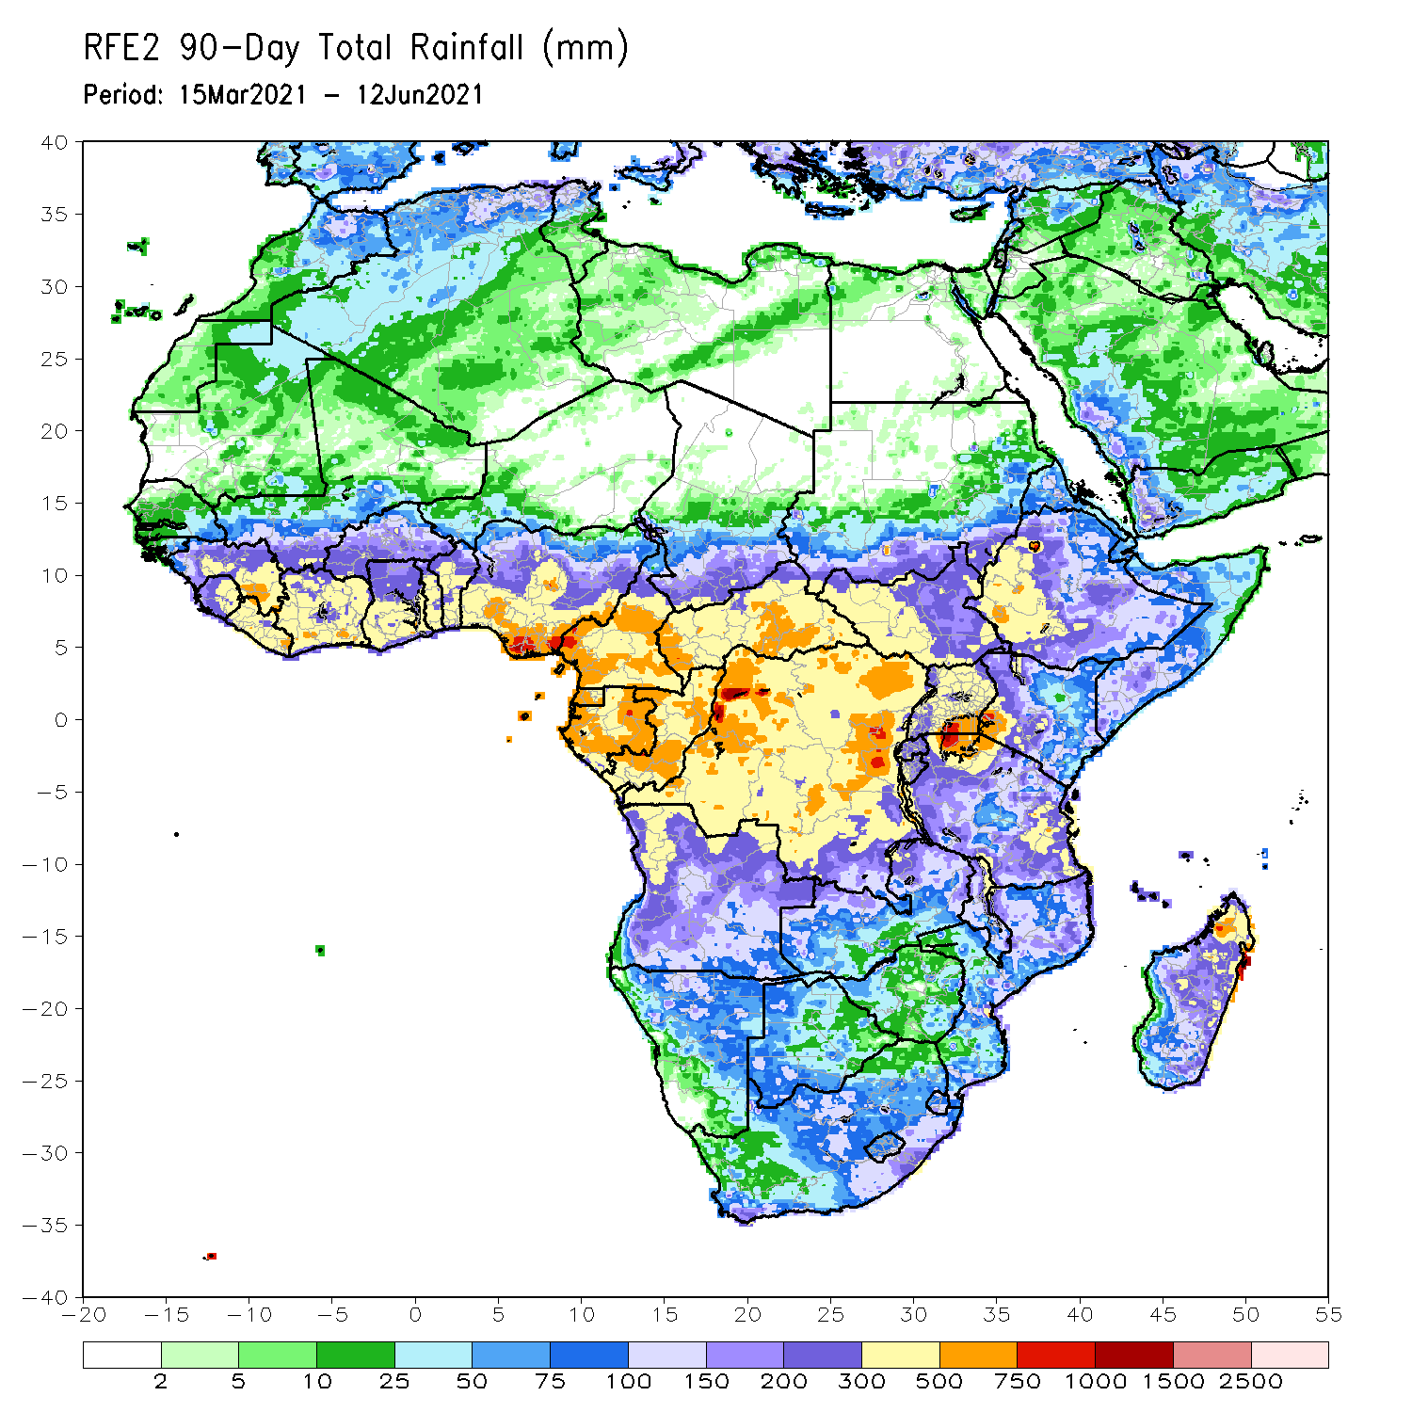
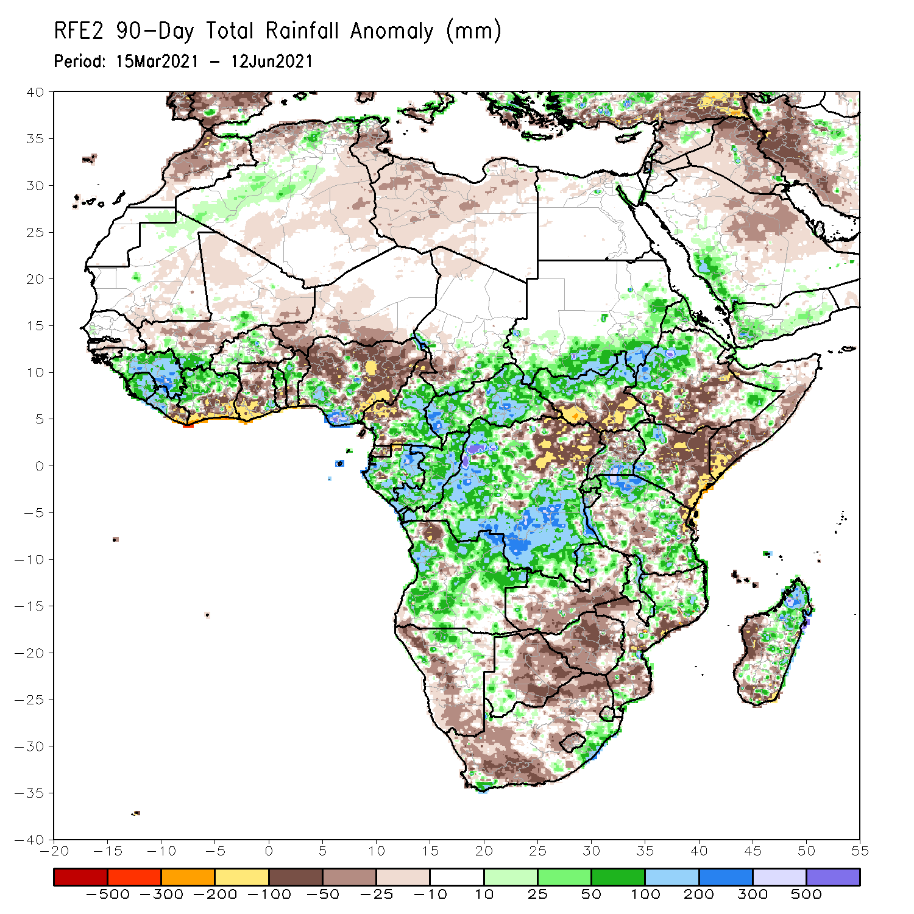
Rainfall Patterns: Last 90 Days
Over the past 90 days, in East Africa, above-average rainfall was observed over western Ethiopia, northern South Sudan, southern and eastern Sudan, Eritrea, southern Uganda, pockets of southeastern Ethiopia, western Kenya, and northern and eastern Tanzania. Rainfall was below-average over parts of central and southern Ethiopia, southern Somalia, and eastern Kenya. Rainfall was also below-average over southern South Sudan, northern Uganda and western Tanzania. In southern Africa, above-average rainfall was observed over the northern portions of Southern Africa, while below-average rainfall was observed over central and southern portions of Southern Africa. In Central Africa, rainfall was above-average over central and southern DRC, much of Gabon, Congo, and much of CAR. Rainfall was below-average over northeastern DRC. Below-average rains were also observed over Equatorial Guinea and western Cameroon. In West Africa, rainfall was above-average over many places in the Gulf of Guinea countries. Below-average rainfall was observed over coastal Cote d’Ivoire, Ghana, and central and northern Nigeria.
Notes:
4

Slide 5
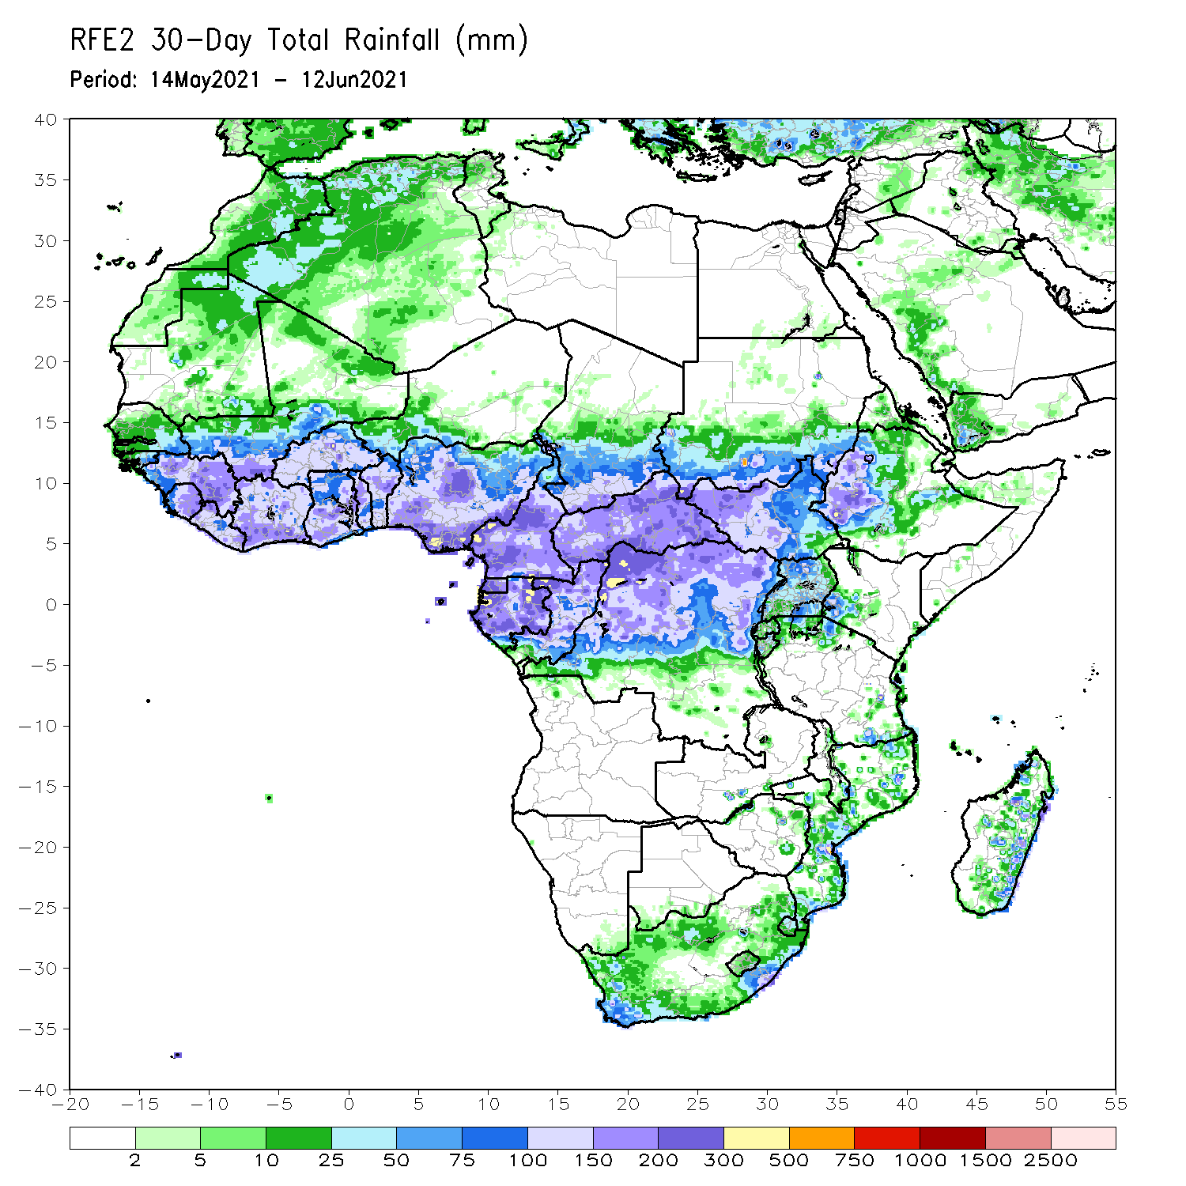
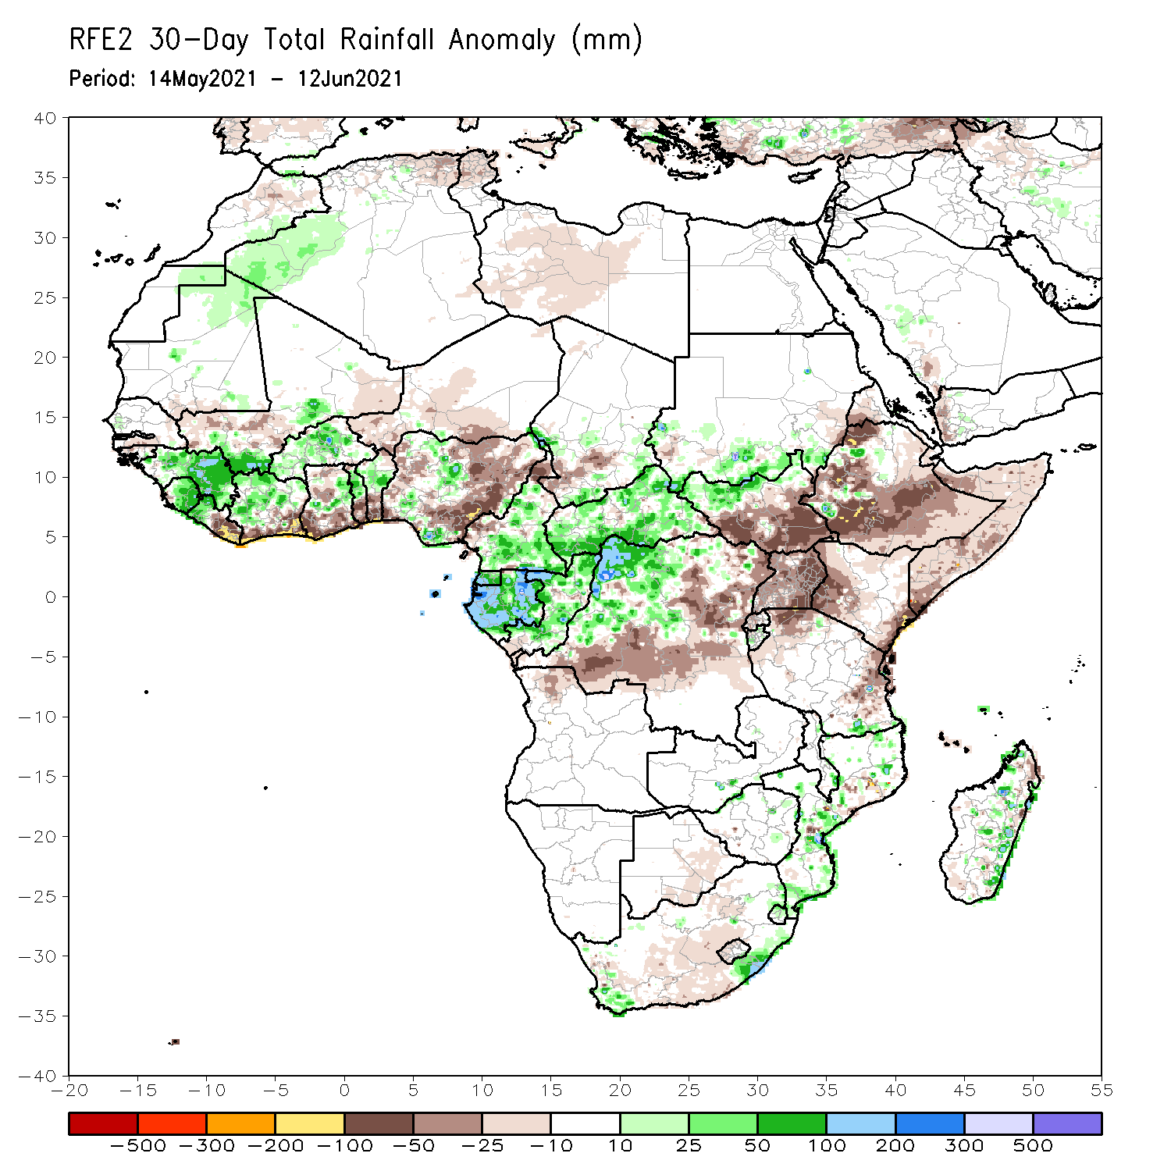
Rainfall Patterns: Last 30 Days
During the past 30 days, in East Africa, above-average rainfall was observed over pockets of southern Sudan and northern South Sudan. Rainfall was below-average over southern South Sudan, much of Ethiopia, Uganda, Kenya and Somalia. In Central Africa, rainfall was below-average over parts of central and northeastern DRC. Rainfall was above-average over Equatorial Guinea, Gabon, Congo, much of CAR, and northwestern DRC. In West Africa, rainfall was above-average over Guinea, Sierra Leone, Cote d’Ivoire, Burkina Faso, pockets of Ghana, Togo, Benin and Nigeria. Below-average rainfall was observed over eastern Liberia, coastal Cote d’Ivoire, Ghana, Togo and Benin, and portions of Nigeria.
Notes:
5

Slide 6
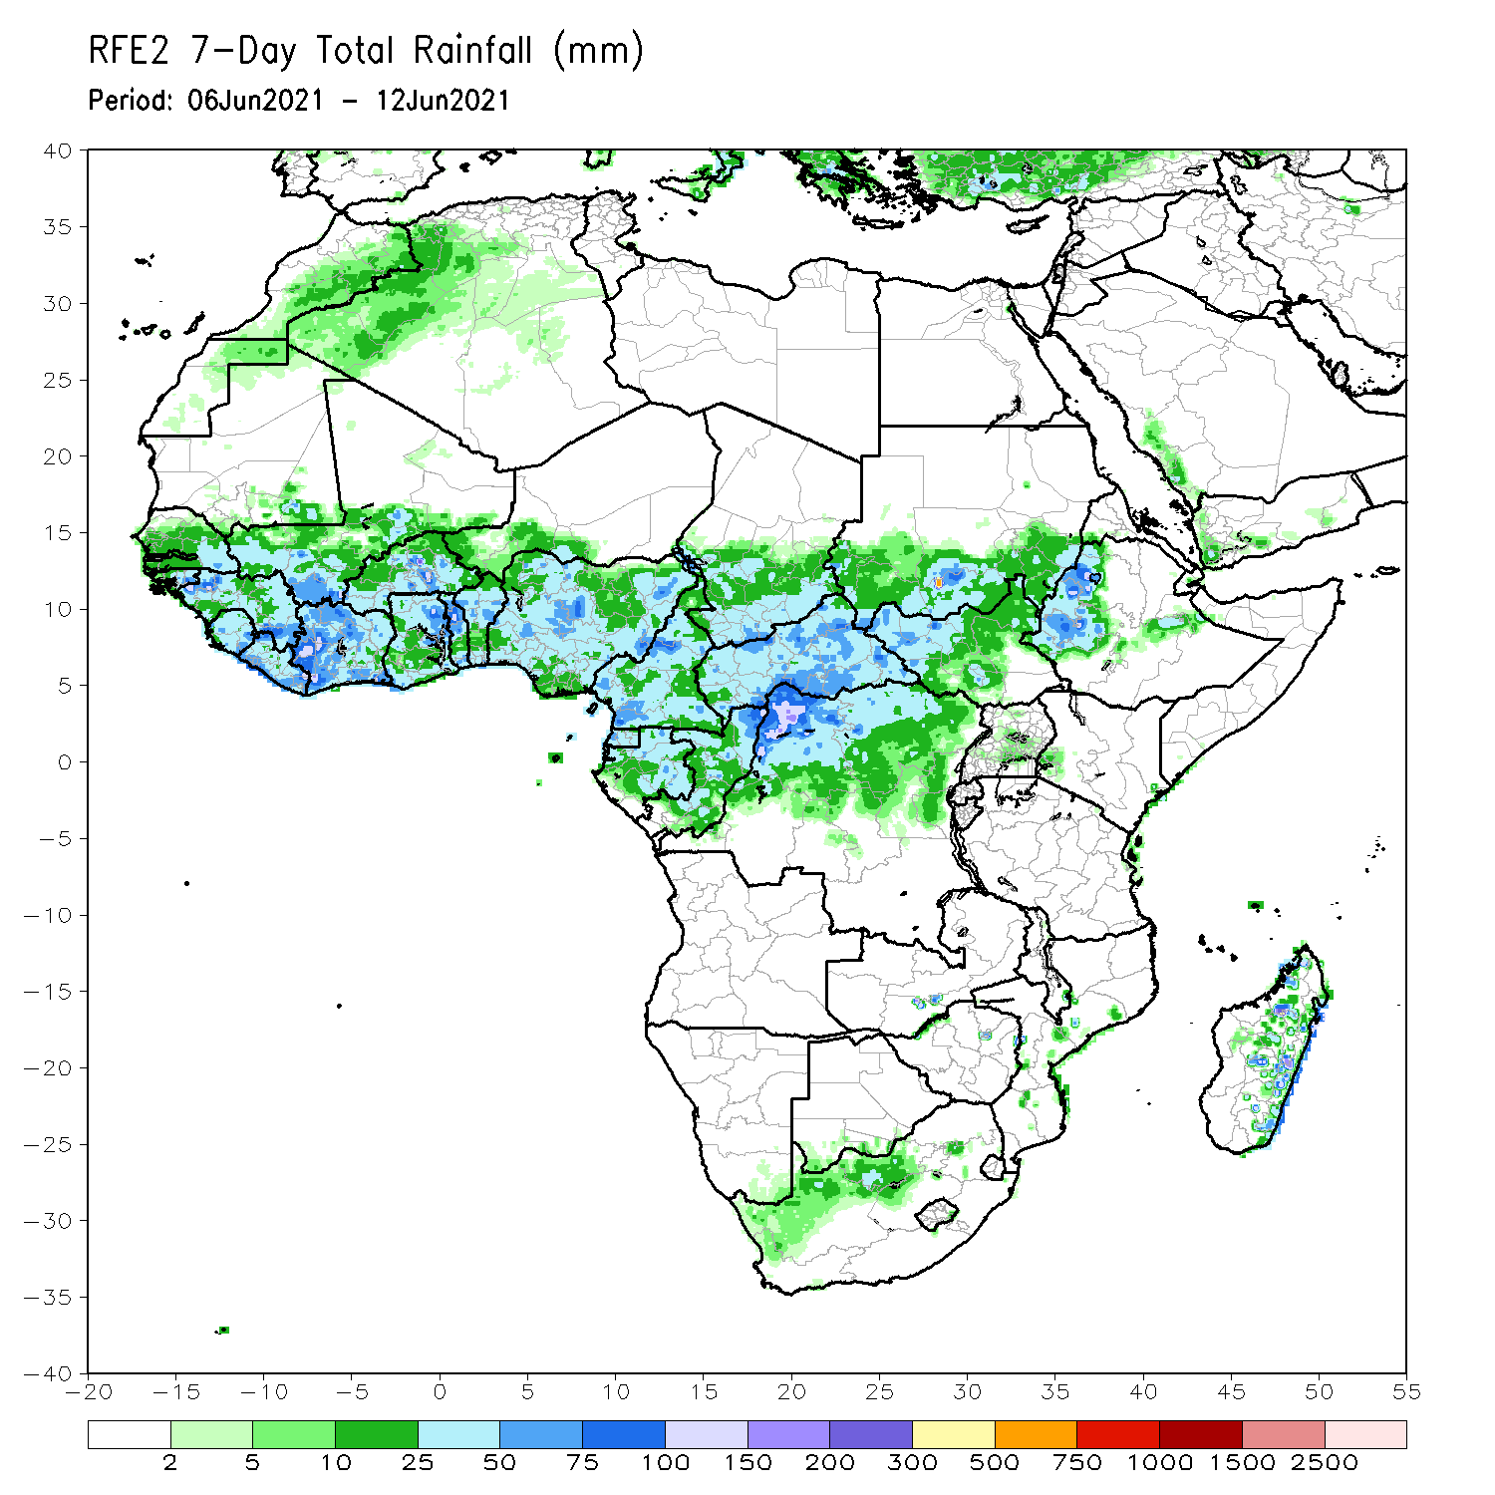
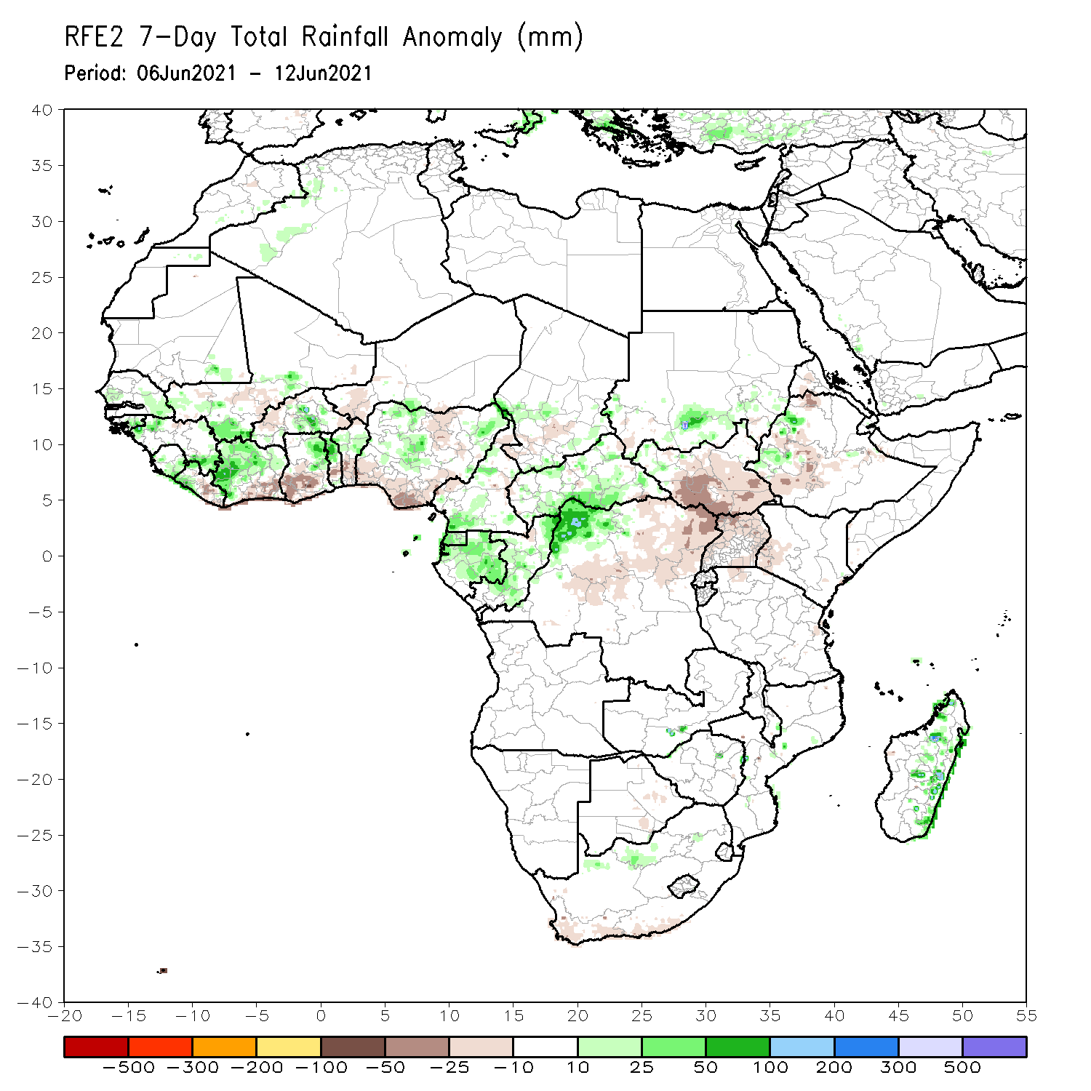
Rainfall Patterns: Last 7 Days
During the past 7 days, in East Africa, rainfall was below average over southern South Sudan, southwestern Ethiopia, and parts of Uganda. Above-average rainfall was observed over pockets of southern Sudan and western Ethiopia. In Central Africa, rainfall was below-average over northeastern DRC. Above-average rainfall was observed over Equatorial Guinea, Gabon, Congo, northwestern DRC and parts of CAR. In West Africa, above-average rainfall was observed over pockets of Guinea, much of Cote D’Ivoire, and pockets of Ghana, Burkina Faso, Togo and Nigeria. Below-average rainfall was observed along the Gulf of Guinea coast.

Slide 7
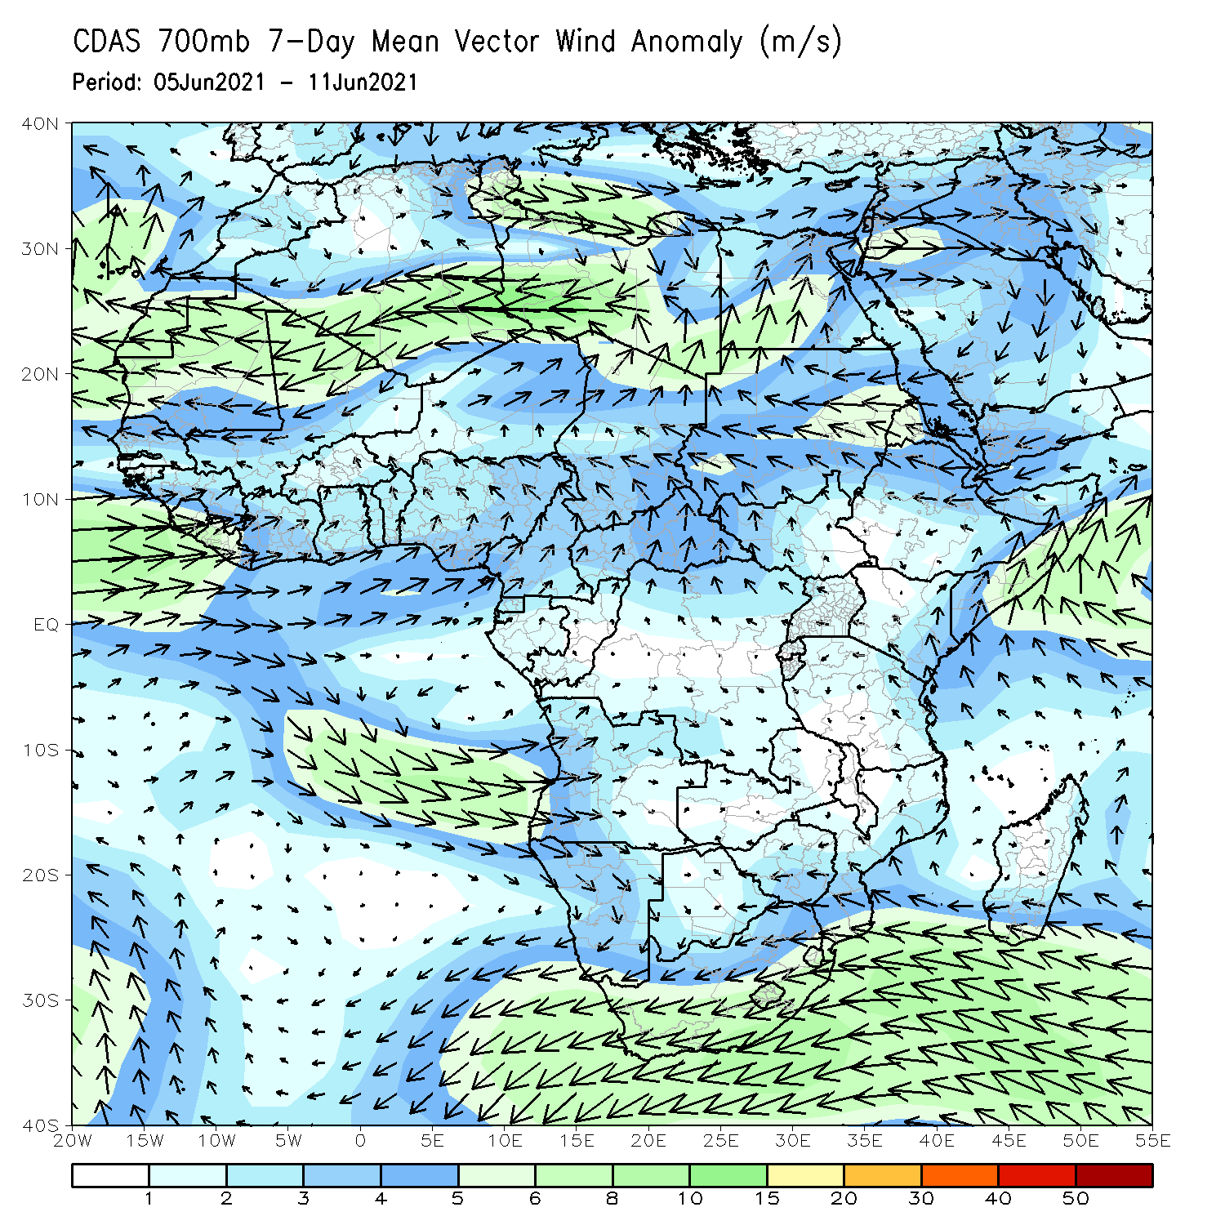
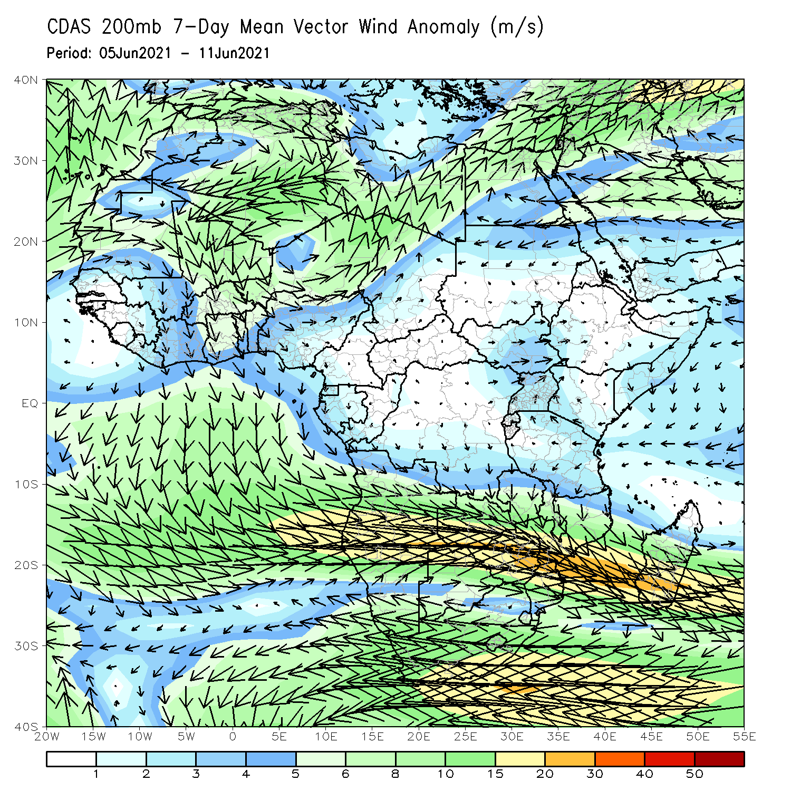
Atmospheric Circulation: Last 7 Days
At 700-hPa level (left panel), anomalous cyclonic turning was observed over much of the Gulf of Guinea region.

Slide 8
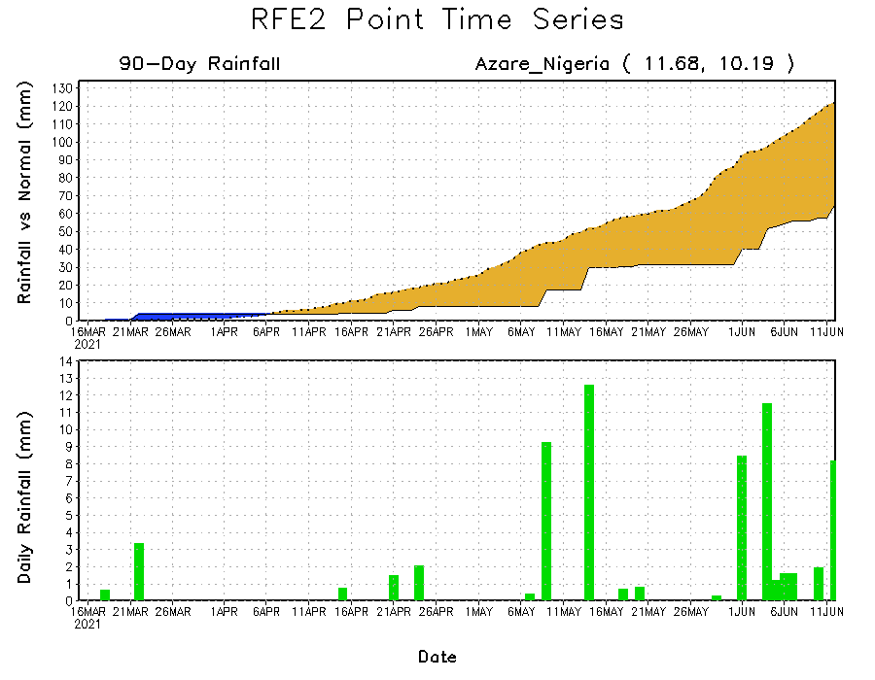
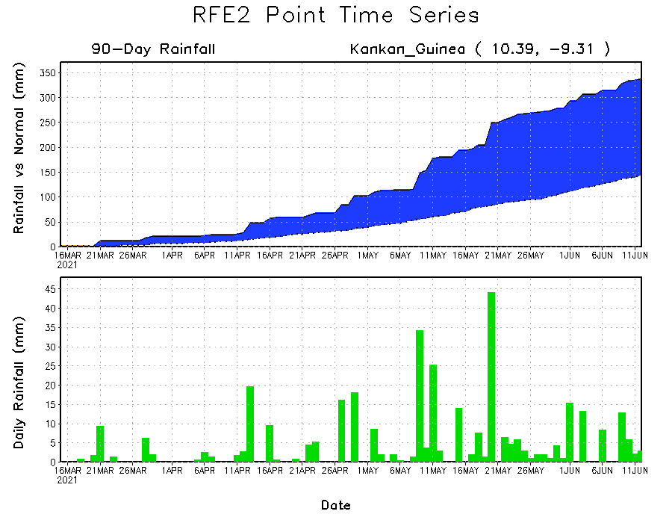
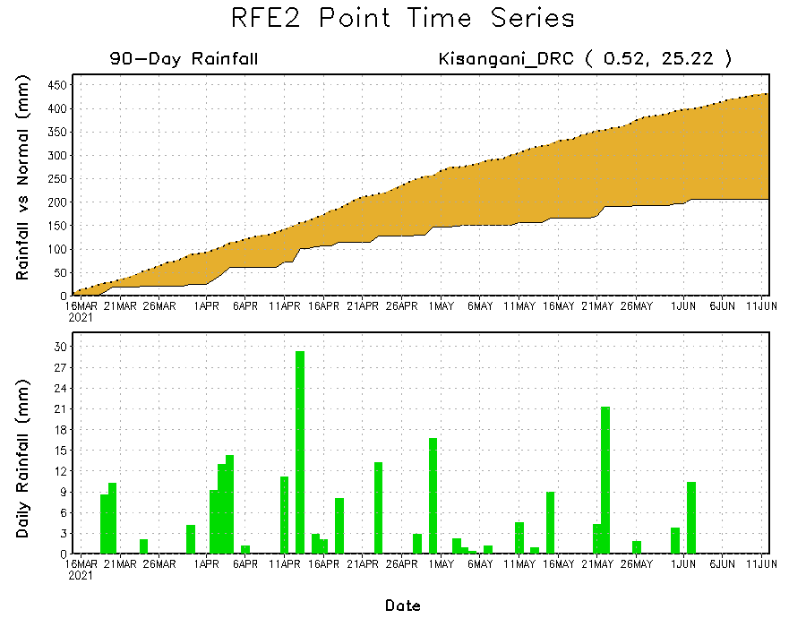
Rainfall Evolution
Daily evolution of rainfall over the last 90 days at selected locations shows moderate to heavy rainfall sustained moisture surpluses over parts of Guinea (bottom left). In contrast, seasonal total rainfall remained below-average over portions of northern Nigeria (top right) and northeastern DRC (bottom right).

Slide 9
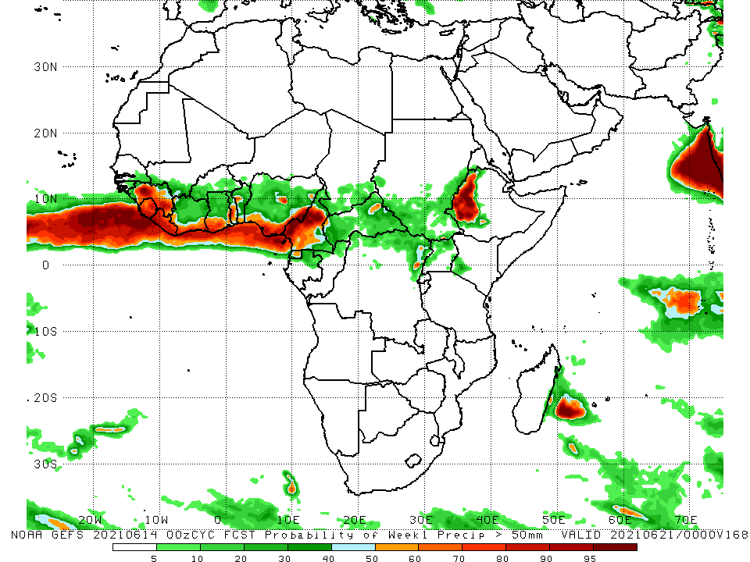
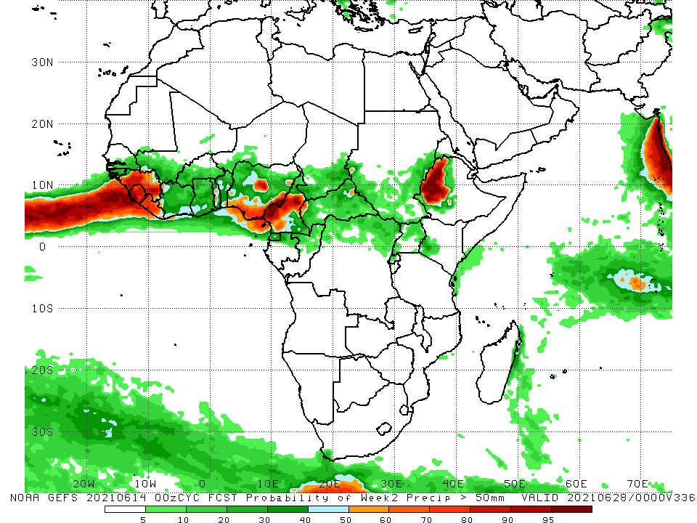
NCEP GEFS Model Forecasts Non-Bias Corrected Probability of precipitation exceedance
Week-1, Valid: 15 – 21 June, 2021
Week-2, Valid: 22 – 28 June, 2021
For week-1 (left panel) and week-2 (right panel), the NCEP GEFS indicates a moderate to high chance (over 70%) for rainfall to exceed 50 mm along the Gulf of Guinea coast, and western Ethiopia.
Notes:
9

Slide 10
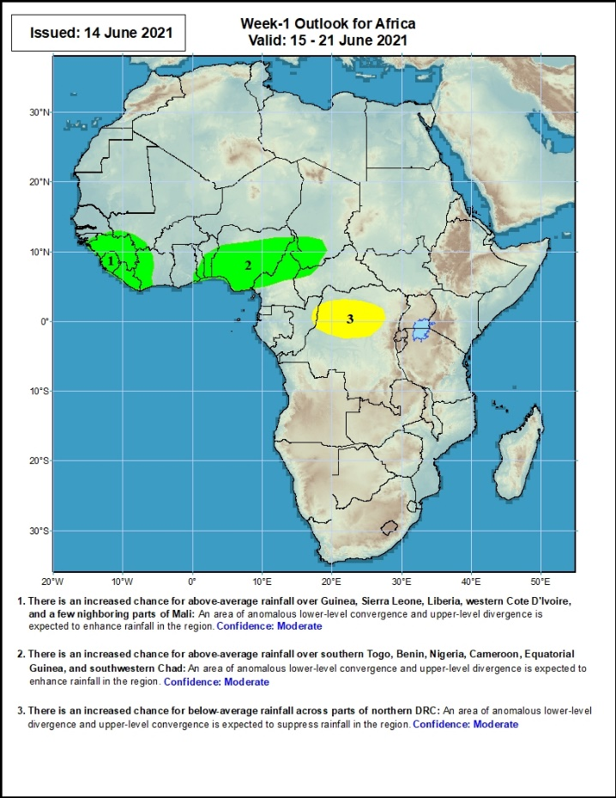
Week-1 Precipitation Outlooks
15 – 21 June, 2021
There is an increased chance for above-average rainfall over much of Guinea, Sierra Leone, Liberia, and western Cote d’Ivoire: An area of anomalous lower-level convergence and upper-level divergence is expected to enhance rainfall in the region. Confidence: Moderate
There is an increased chance for above-average rainfall over southern Togo, southern Benin, northern Nigeria, northern Cameroon and southern Chad: An area of anomalous lower-level convergence and upper-level divergence is expected to enhance rainfall in the region. Confidence: Moderate
There is an increased chance for below-average rainfall over northern DRC: An area of anomalous lower-level divergence and upper-level convergence is expected to suppress rainfall in the region. Confidence: Moderate
Notes:
10

Slide 11
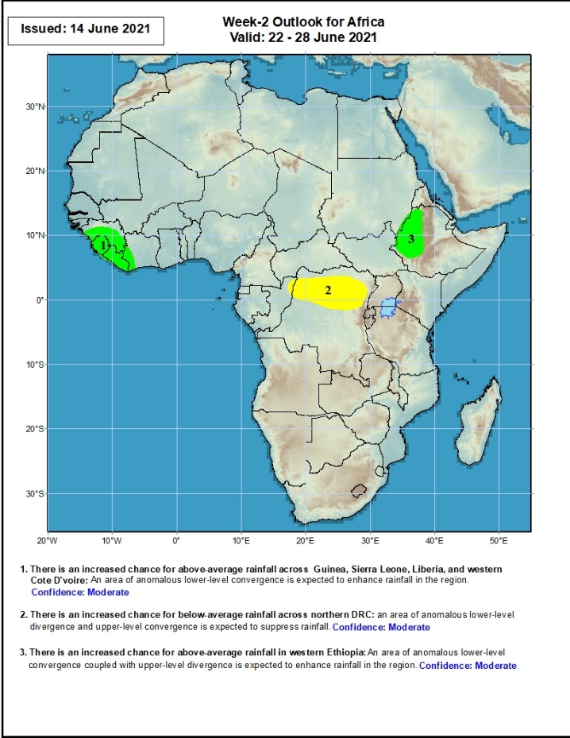
Week-2 Precipitation Outlooks
22 – 28 June, 2021
There is an increased chance for above-average rainfall over much of Guinea, Sierra Leone, Liberia, and western Cote d’Ivoire: An area of anomalous lower-level convergence and upper-level divergence is expected to enhance rainfall in the region. Confidence: Moderate
There is an increased chance for below-average rainfall across northern DRC: An area of anomalous lower-level divergence and upper-level convergence is expected to suppress rainfall in the region. Confidence: Moderate
There is an increased chance for above-average rainfall over western Ethiopia: An area of anomalous lower-level convergence and upper-level divergence is expected to enhance rainfall in the region. Confidence: Moderate
Notes:
11

Slide 12
Summary
During the past 30 to 90 days, in East Africa, above-average rainfall was observed over pockets of southern Sudan and northern South Sudan. Rainfall was below-average over southern South Sudan, much of Ethiopia, Uganda, Kenya and Somalia. In Central Africa, rainfall was below-average over parts of central and northeastern DRC. Rainfall was above-average over Equatorial Guinea, Gabon, Congo, much of CAR, and northwestern DRC. In West Africa, rainfall was above-average over Guinea, Sierra Leone, Cote d’Ivoire, Burkina Faso, pockets of Ghana, Togo, Benin and Nigeria. Below-average rainfall was observed over eastern Liberia, coastal Cote d’Ivoire, Ghana, Togo and Benin, and portions of Nigeria.
During the past 7 days, in East Africa, rainfall was below average over southern South Sudan, southwestern Ethiopia, and parts of Uganda. Above-average rainfall was observed over pockets of southern Sudan and western Ethiopia. In Central Africa, rainfall was below-average over northeastern DRC. Above-average rainfall was observed over Equatorial Guinea, Gabon, Congo, northwestern DRC and parts of CAR. In West Africa, above-average rainfall was observed over pockets of Guinea, much of Cote D’Ivoire, and pockets of Ghana, Burkina Faso, Togo and Nigeria. Below-average rainfall was observed along the Gulf of Guinea coast.
Week-1 and week-2 outlooks call for an increased chance for above-average rainfall over portions of the Guinea region, and western Ethiopia. In contrast the outlooks call for an increased chance for below-average rainfall over parts of northern DRC.

