Slide 1
The African Monsoon Recent Evolution and Current Status Include Week-1 and Week-2 Outlooks
Update prepared by
21 June 2021
For more information, visit:
http://www.cpc.ncep.noaa.gov/products/Global_Monsoons/African_Monsoons/precip_monitoring.shtml

Slide 2
Outline
Highlights
Recent Evolution and Current Conditions
NCEP GEFS Forecasts
Summary

Slide 3
Highlights: Last 7 Days
During the past 7 days, in East Africa, rainfall was above-average over southern Sudan, northern South Sudan, and parts of western Ethiopia and Uganda. Below-average rainfall was observed over pockets of central southern Sudan. In Central Africa, rainfall was below-average over parts of central and northern DRC, and pockets of CAR. Above-average rainfall was observed over parts of eastern DRC. In West Africa, above-average rainfall was observed over pockets of Guinea, Sierra Leone, central Guinea, southern Mali, Burkina Faso, northern Benin, and parts of Nigeria. Below-average rainfall was observed over Liberia, southern Cote d’Ivoire, Ghana, Togo and southern Benin.
Week-1 outlooks call for an increased chance for above-average rainfall over Guinea-Bissau, Guinea, Sierra Leone, Liberia, southern Cote d’Ivoire, southern Nigeria and Cameroon. In contrast, there is an increased chance for below-average rainfall over southern Burkina Faso and northern Ghana.
Week-2 outlooks call for an increased chance for below-average rainfall over southern Senegal, southern Mali, Burkina Faso, western Niger, and northern DRC. In contrast, there is an increased chance for above-average rainfall over Sierra Leone, Liberia, western Cote d’Ivoire, and western Ethiopia.

Slide 4
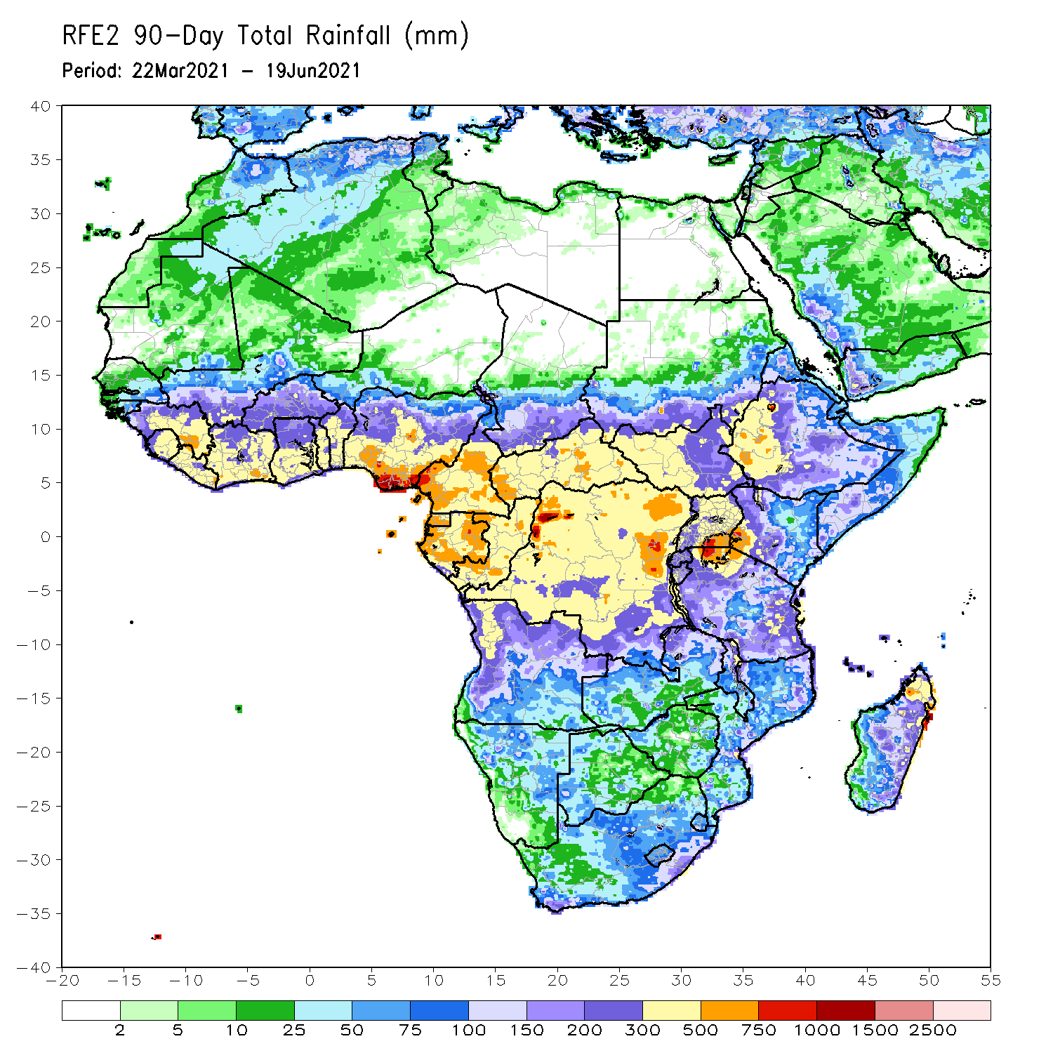
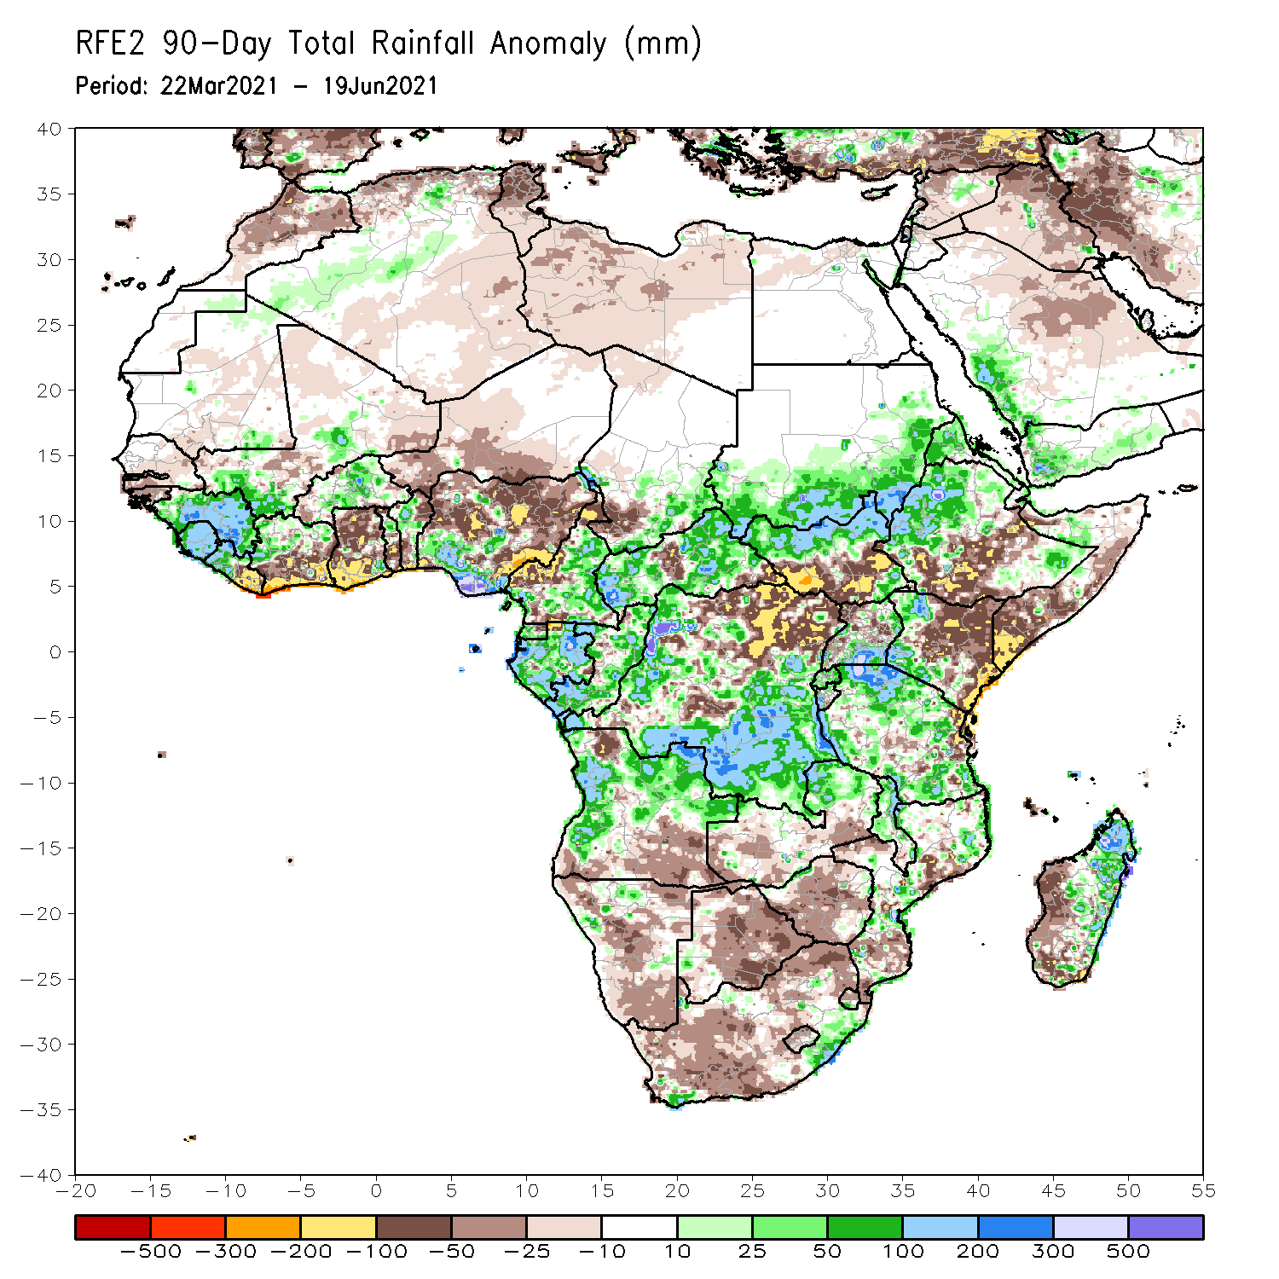
Rainfall Patterns: Last 90 Days
Over the past 90 days, in East Africa, above-average rainfall was observed over western Ethiopia, northern South Sudan, southern and eastern Sudan, Eritrea, southern Uganda, pockets of southeastern Ethiopia, western Kenya, and much of Tanzania. Rainfall was below-average over parts of southern Ethiopia, central and southern Somalia, and eastern Kenya. Rainfall was also below-average over southern South Sudan, northern Uganda and pockets of Tanzania. In southern Africa, above-average rainfall was observed over the northern portions of Southern Africa, while below-average rainfall was observed over central and southern portions of Southern Africa. In Central Africa, rainfall was above-average over central and southern DRC, Equatorial Guinea, Gabon, Congo, and much of CAR. Rainfall was below-average over northeastern DRC, central CAR, and western Cameroon. In West Africa, rainfall was above-average over much of Guinea, Sierra Leone, northern Cote d’Ivoire, Burkina Faso, northern Benin, and southern Nigeria. Below-average rainfall was observed over eastern Liberia, southern Cote d’Ivoire, Ghana, southern Togo, southern Benin, Niger, and northern Nigeria.
Notes:
4

Slide 5
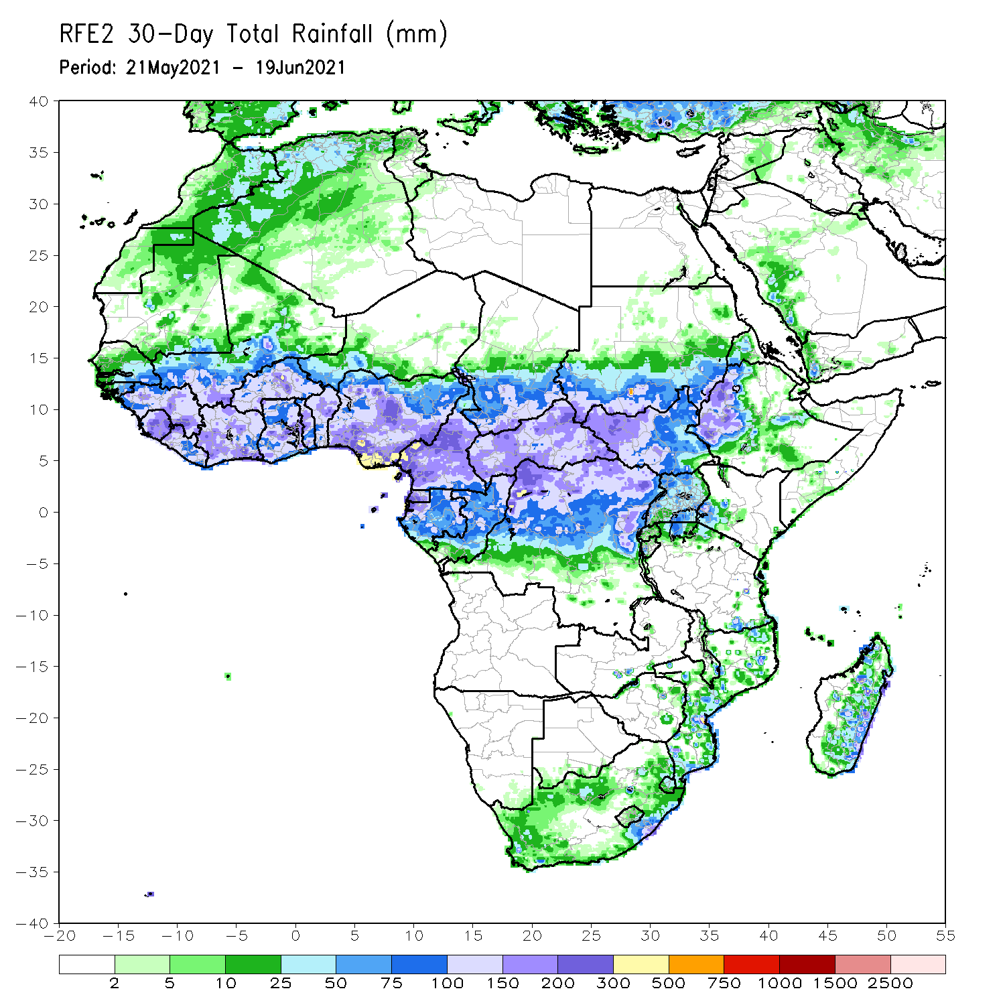
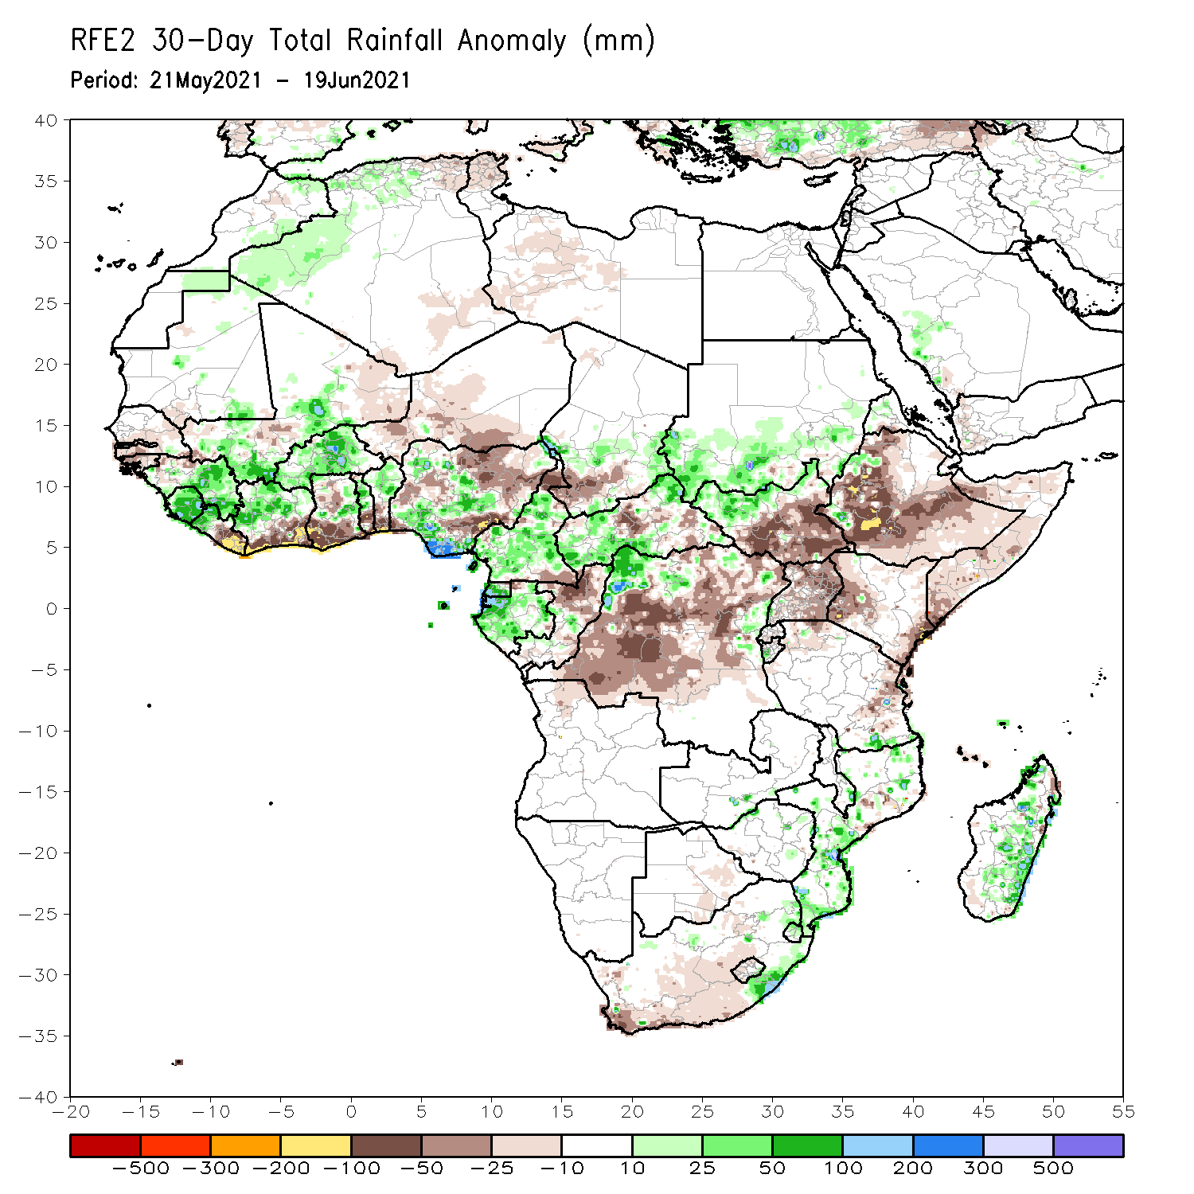
Rainfall Patterns: Last 30 Days
During the past 30 days, in East Africa, above-average rainfall was observed over parts of southern Sudan and northern South Sudan Republic. Rainfall was below-average over southern South Sudan, many parts of Ethiopia, Uganda, Kenya and Somalia. In Central Africa, rainfall was below-average over parts of central and northeastern DRC. Rainfall was above-average over Equatorial Guinea, Gabon, Congo, much of CAR, and northwestern DRC. In West Africa, rainfall was above-average over eastern Guinea, Sierra Leone, northern Cote d’Ivoire, Burkina Faso, pockets of Ghana, northern Togo, northern Benin, and parts of Nigeria. Below-average rainfall was observed over parts of Senegal, eastern Liberia, coastal Cote d’Ivoire, southern Ghana, southern Togo, southern Benin, and portions of Niger and Nigeria.
Notes:
5

Slide 6
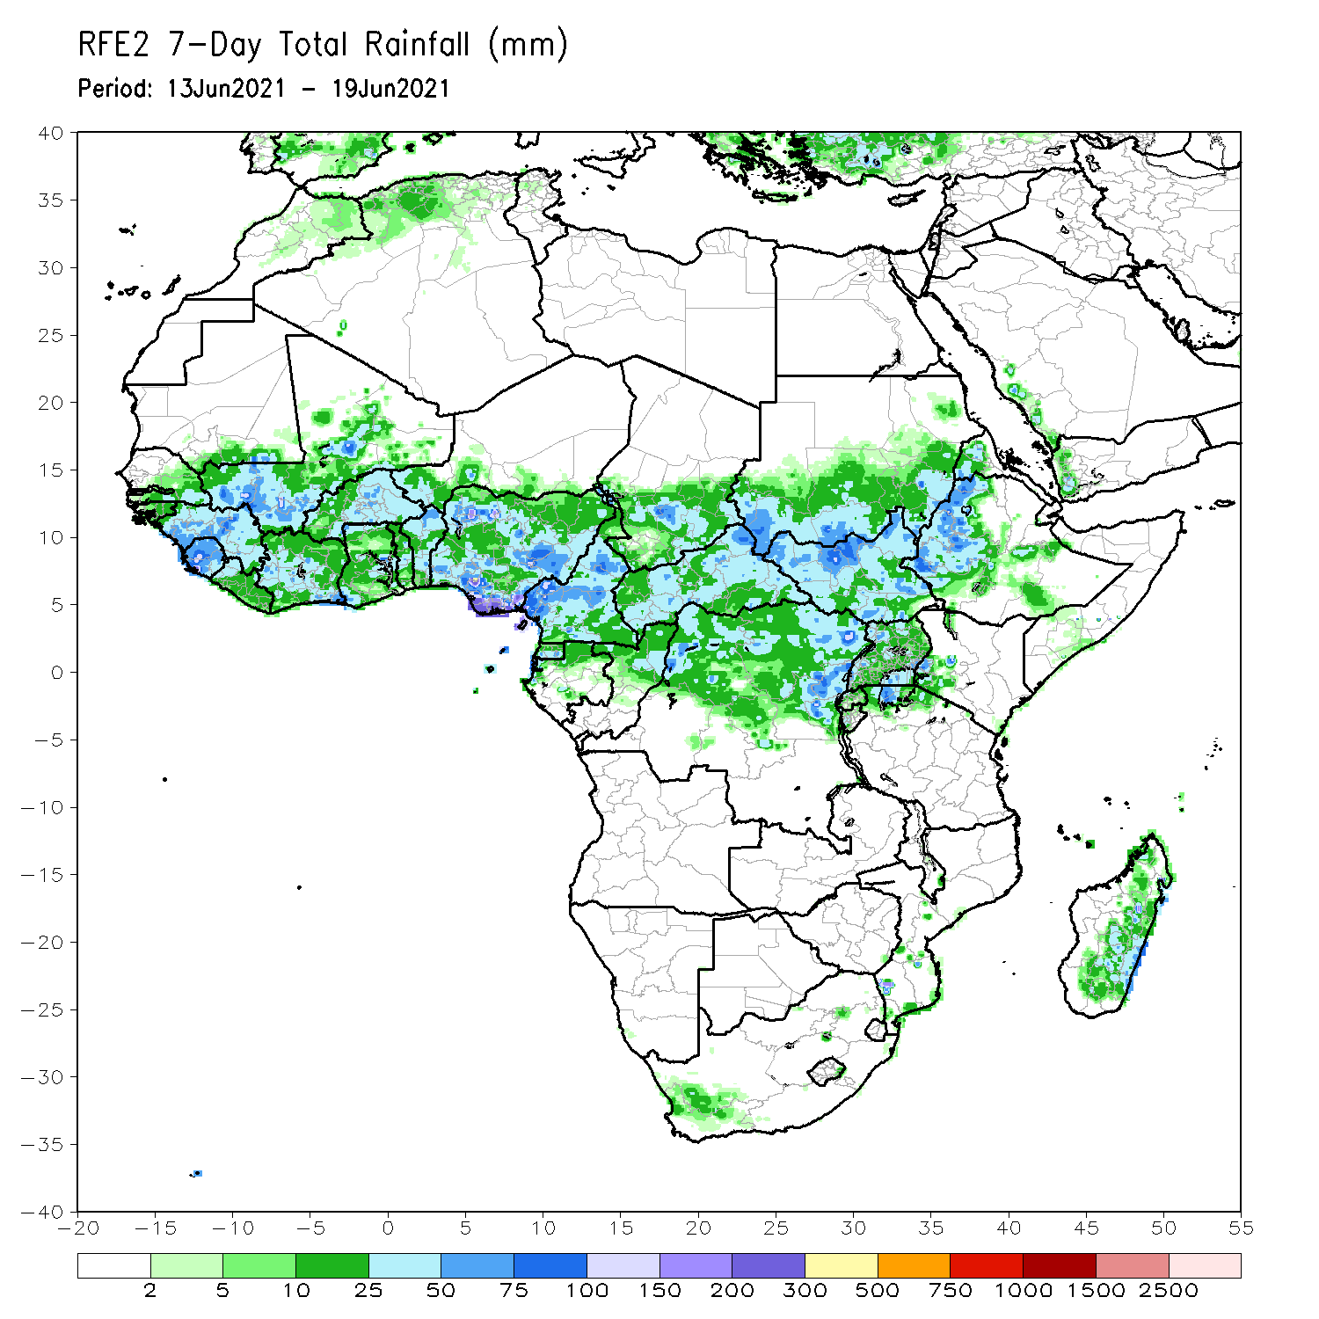
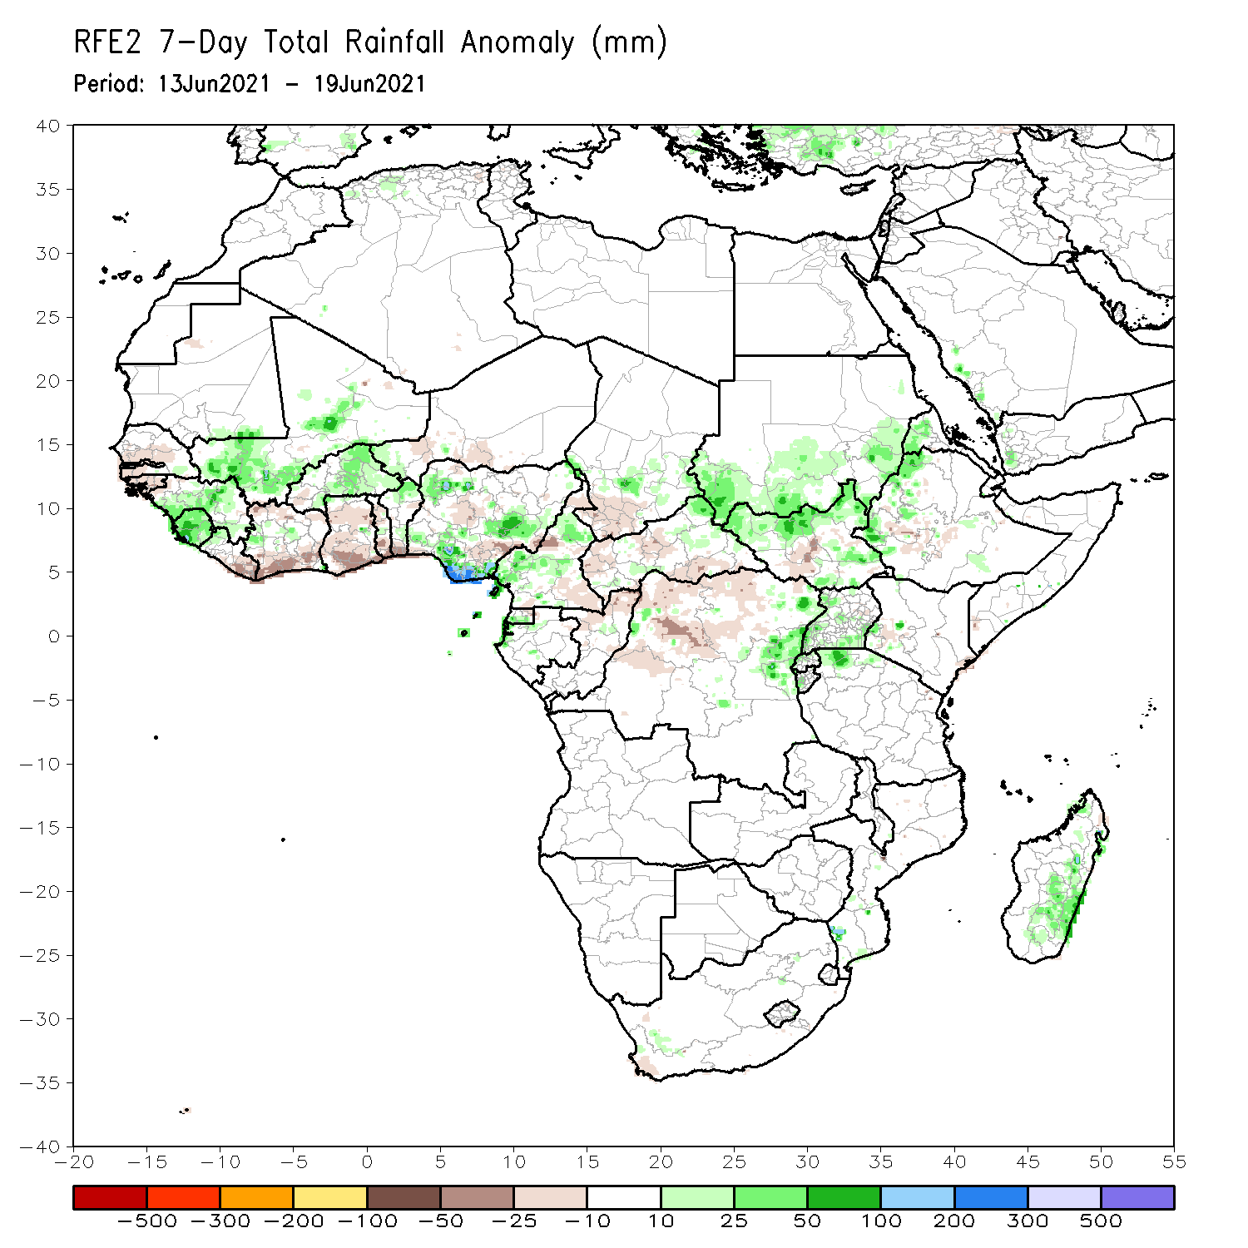
Rainfall Patterns: Last 7 Days
During the past 7 days, in East Africa, rainfall was above-average over southern Sudan, northern South Sudan, parts of western Ethiopia and Uganda. Below-average rainfall was observed over pockets of central southern Sudan. In Central Africa, rainfall was below-average over parts of central and northern DRC, and pockets of CAR. Above-average rainfall was observed over parts of eastern DRC. In West Africa, above-average rainfall was observed over pockets of Guinea, Sierra Leone, central Guinea, southern Mali, Burkina Faso, northern Benin, and parts of Nigeria. Below-average rainfall was observed over Liberia, southern Cote d’Ivoire, Ghana, Togo and southern Benin.

Slide 7
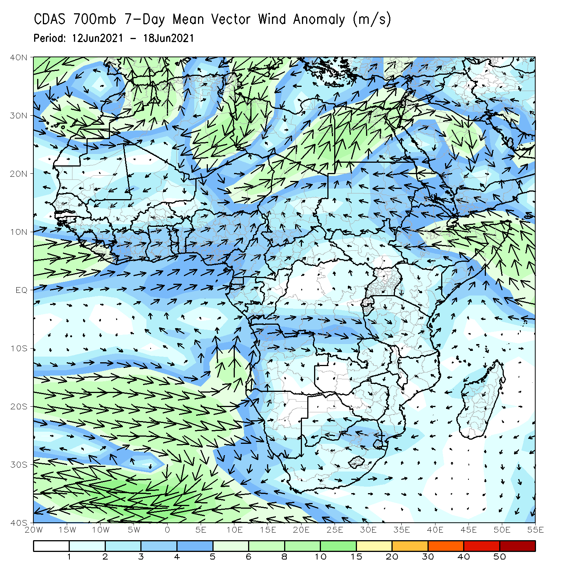
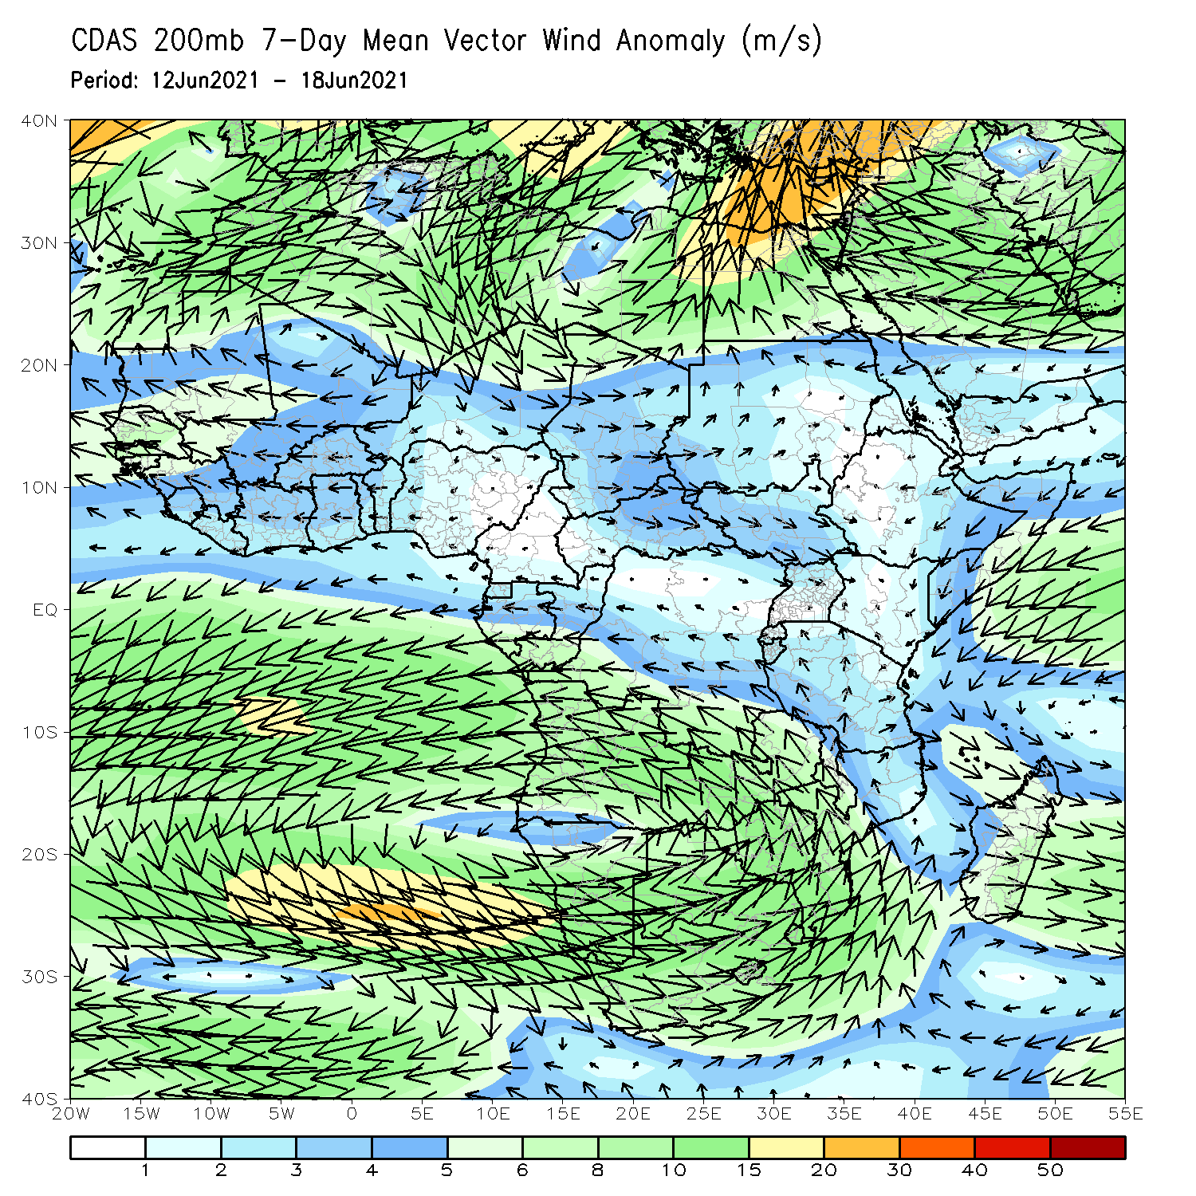
Atmospheric Circulation: Last 7 Days
At 700-hPa level (left panel), anomalous westerly to southwesterly flow was observed across the Gulf of Guinea region.

Slide 8
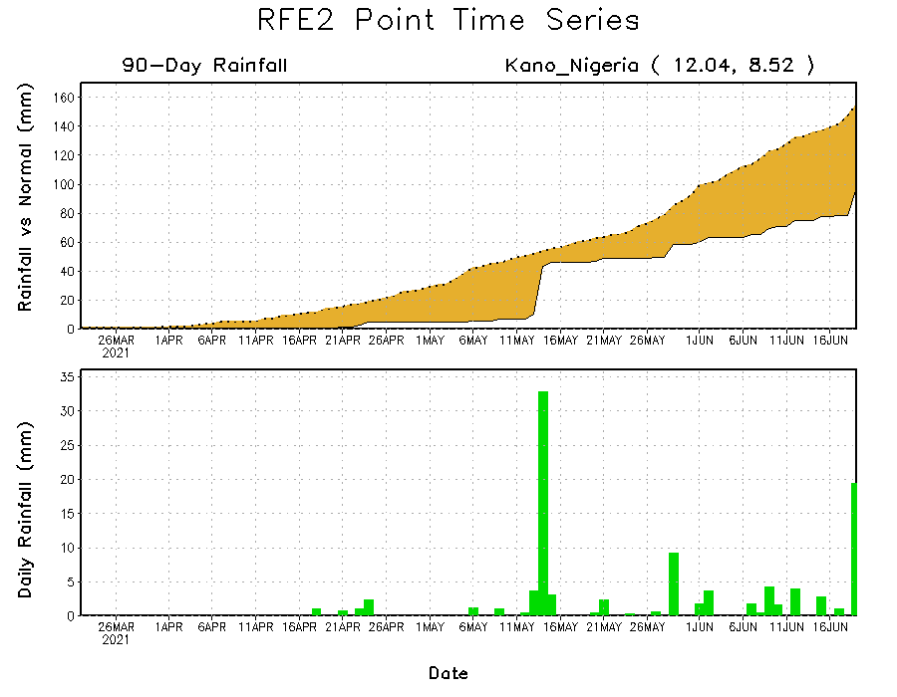
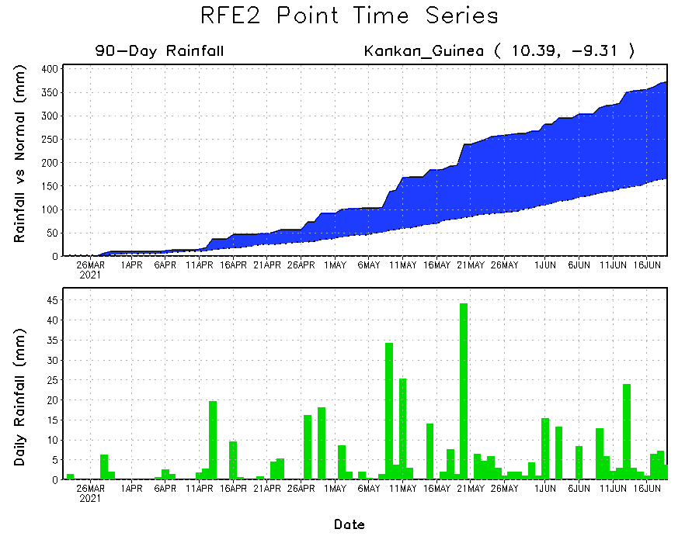
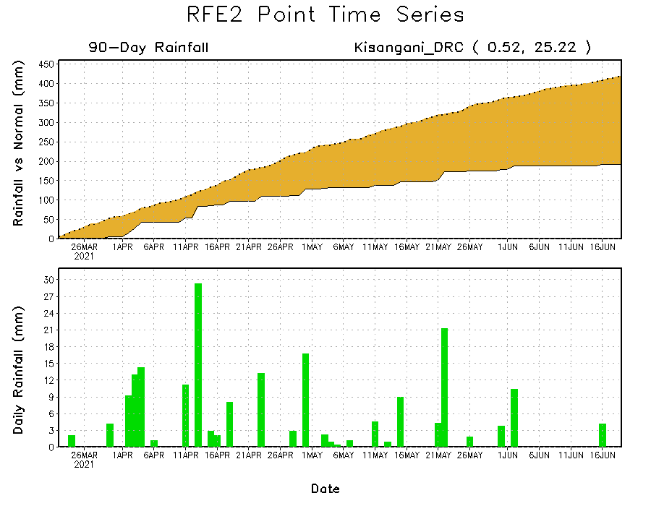
Rainfall Evolution
Daily evolution of rainfall over the last 90 days at selected locations shows moderate to heavy rainfall sustained moisture surpluses over parts of Guinea (bottom left). In contrast, seasonal total rainfall remained below-average over portions of northern Nigeria (top right) and northeastern DRC (bottom right).

Slide 9
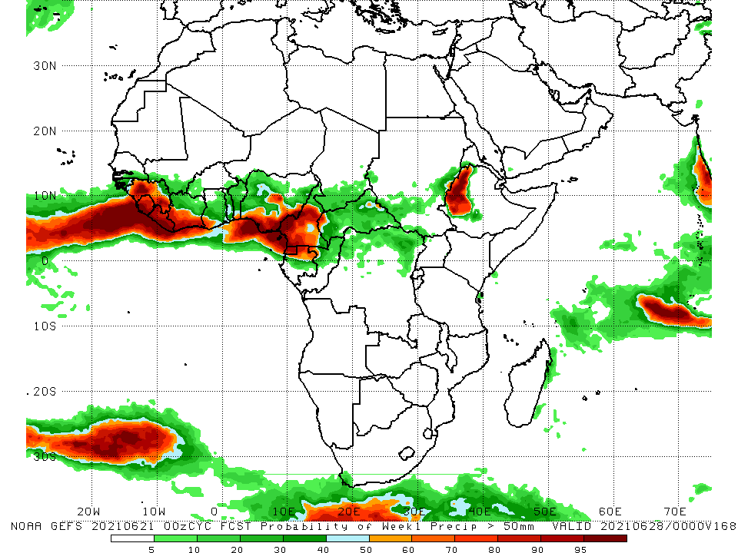
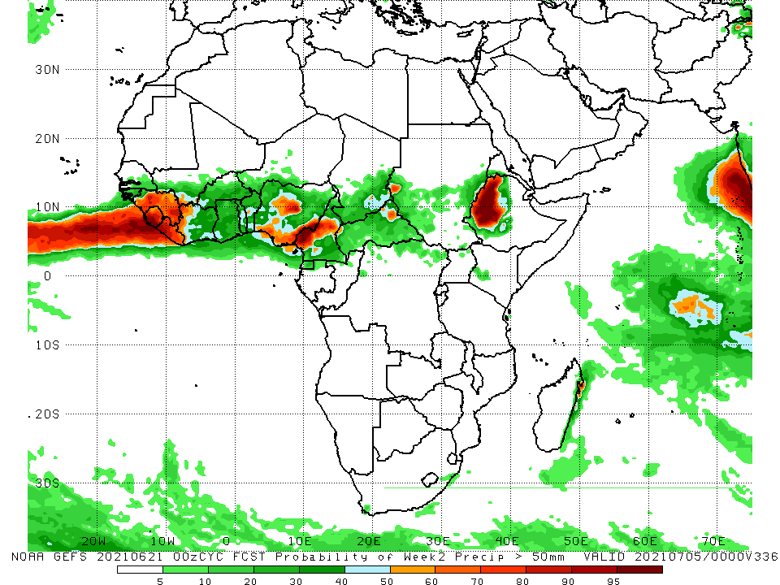
NCEP GEFS Model Forecasts Non-Bias Corrected Probability of precipitation exceedance
Week-1, Valid: 22 – 28 June, 2021
Week-2, Valid: 29 June – 05 July, 2021
For week-1 (left panel) and week-2 (right panel), the NCEP GEFS indicates a moderate to high chance (over 70%) for rainfall to exceed 50 mm along the Gulf of Guinea coast, and western Ethiopia.
Notes:
9

Slide 10
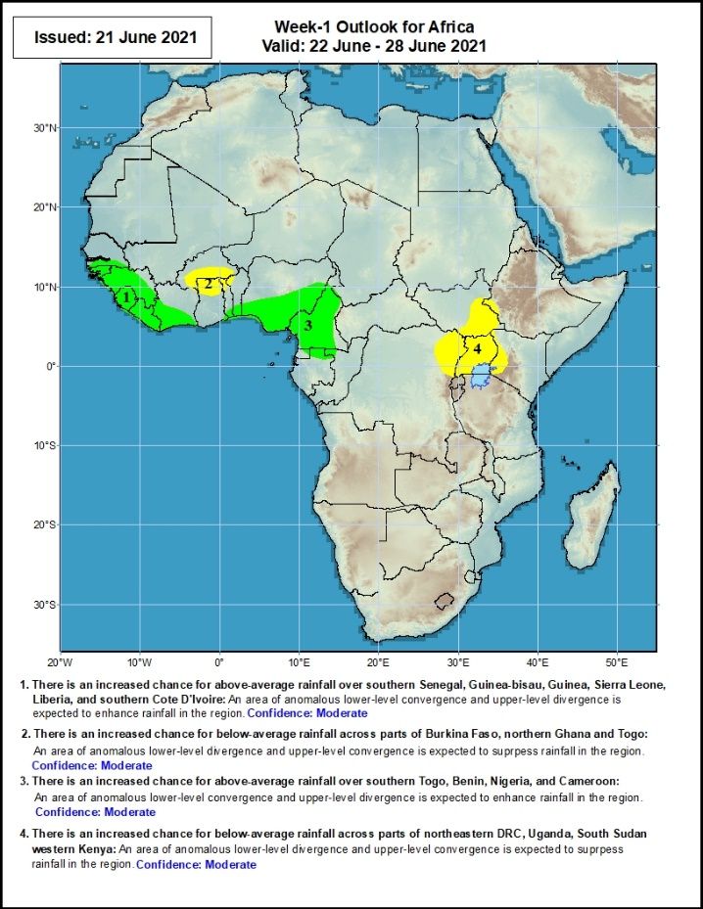
Week-1 Precipitation Outlooks
22 – 28 June, 2021
There is an increased chance for above-average rainfall over Guinea-Bissau, Guinea, Sierra Leone, Liberia and southern Cote d’Ivoire: An area of anomalous lower-level convergence and upper-level divergence is expected to enhance rainfall in the region. Confidence: Moderate
There is an increased chance for below-average rainfall over southern Burkina Faso, and northern Ghana: An area of anomalous lower-level divergence and upper-level convergence is expected to suppress rainfall in the region. Confidence: Moderate
There is an increased chance for above-average rainfall over southern Nigeria and Cameroon: An area of anomalous lower-level convergence and upper-level divergence is expected to enhance rainfall in the region. Confidence: Moderate
There is an increased chance for below-average rainfall over parts of eastern DRC, eastern South Sudan, Uganda and western Kenya: An area of anomalous lower-level divergence and upper-level convergence is expected to suppress rainfall in the region. Confidence: Moderate
Notes:
10

Slide 11
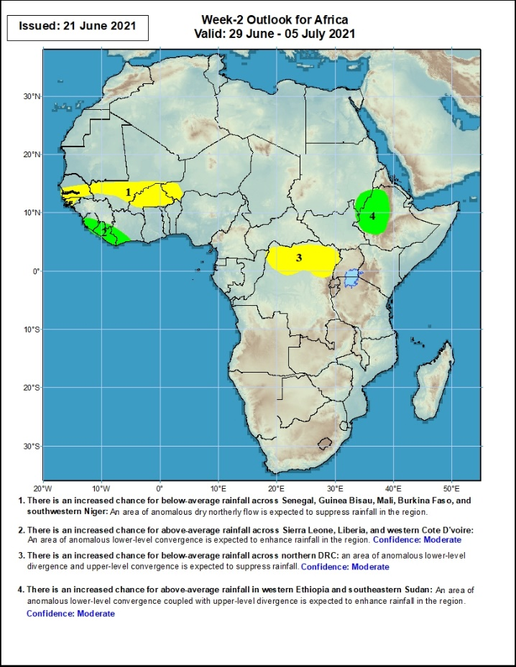
Week-2 Precipitation Outlooks
29 June – 05 July, 2021
There is an increased chance for below-average rainfall across southern Senegal, southern Mali, Burkina Faso and western Niger: An area of anomalous lower-level divergence and upper-level convergence is expected to suppress rainfall in the region. Confidence: Moderate
There is an increased chance for above-average rainfall over much of Sierra Leone, Liberia, and western Cote d’Ivoire: An area of anomalous lower-level convergence and upper-level divergence is expected to enhance rainfall in the region. Confidence: Moderate
There is an increased chance for below-average rainfall across northern DRC: An area of anomalous lower-level divergence and upper-level convergence is expected to suppress rainfall in the region. Confidence: Moderate
There is an increased chance for above-average rainfall over western Ethiopia: An area of anomalous lower-level convergence and upper-level divergence is expected to enhance rainfall in the region. Confidence: Moderate
Notes:
11

Slide 12
Summary
During the past 30 to 90 days, in East Africa, above-average rainfall was observed over parts of southern Sudan and northern South Sudan Republic. Rainfall was below-average over southern South Sudan, many parts of Ethiopia, Uganda, Kenya and Somalia. In Central Africa, rainfall was below-average over parts of central and northeastern DRC. Rainfall was above-average over Equatorial Guinea, Gabon, Congo, much of CAR, and northwestern DRC. In West Africa, rainfall was above-average over eastern Guinea, Sierra Leone, northern Cote d’Ivoire, Burkina Faso, pockets of Ghana, northern Togo, northern Benin, and parts of Nigeria. Below-average rainfall was observed over parts of Senegal, eastern Liberia, coastal Cote d’Ivoire, southern Ghana, southern Togo, southern Benin, and portions of Niger and Nigeria.
During the past 7 days, in East Africa, rainfall was above-average over southern Sudan, northern South Sudan, parts of western Ethiopia and Uganda. Below-average rainfall was observed over pockets of central southern Sudan. In Central Africa, rainfall was below-average over parts of central and northern DRC, and pockets of CAR. Above-average rainfall was observed over parts of eastern DRC. In West Africa, above-average rainfall was observed over pockets of Guinea, Sierra Leone, central Guinea, southern Mali, Burkina Faso, northern Benin, and parts of Nigeria. Below-average rainfall was observed over Liberia, southern Cote d’Ivoire, Ghana, Togo and southern Benin.
Week-1 outlooks call for an increased chance for above-average rainfall over Guinea-Bissau, Guinea, Sierra Leone, Liberia, southern Cote d’Ivoire, southern Nigeria and Cameroon. In contrast, there is an increased chance for below-average rainfall over southern Burkina Faso and northern Ghana.
Week-2 outlooks call for an increased chance for below-average rainfall over southern Senegal, southern Mali, Burkina Faso, western Niger, and northern DRC. In contrast, there is an increased chance for above-average rainfall over Sierra Leone, Liberia, western Cote d’Ivoire, and western Ethiopia.

