Slide 1
The African Monsoon Recent Evolution and Current Status Include Week-1 and Week-2 Outlooks
Update prepared by
12 July 2021
For more information, visit:
http://www.cpc.ncep.noaa.gov/products/Global_Monsoons/African_Monsoons/precip_monitoring.shtml

Slide 2
Outline
Highlights
Recent Evolution and Current Conditions
NCEP GEFS Forecasts
Summary

Slide 3
Highlights: Last 7 Days
During the past 7 days, in East Africa, rainfall was above-average over parts of eastern and southern Sudan, South Sudan, and Ethiopia. In Central Africa, rainfall was above-average over pockets of northern DRC, CAR and southern Chad. Below-average rainfall was observed over parts of Cameroon and western CAR. In West Africa, above-average rainfall was observed over Guinea, Sierra Leone, northern Mali, and Niger. Below-average rainfall was observed over pockets of Senegal, western Mali, Cote d’Ivoire and Nigeria.
Week-1 outlooks call for an increased chance for above-average rainfall over Guinea-Bissau, Guinea, Sierra Leone, Liberia, western Cote d'Ivoire, northern South Sudan, parts of southern and eastern Sudan, and portions of Eritrea and Ethiopia. In contrast, the outlooks call for an increased chance for below-average rainfall over northern Senegal, southern Mauritania, central Mali, Burkina Faso, northern Ghana, northern Togo, northern Benin and western Niger, parts of northern DRC and southern CAR.
Week-2 outlooks call for an increased chance for above-average rainfall over southern Senegal, Gambia, Guinea-Bissau, Guinea, Sierra Leone, southern Mali, Burkina Faso, parts of northern Ghana, western Niger, northern Benin and northwestern Nigeria, parts of eastern Sudan eastern South Sudan, and western Ethiopia. In contrast, the outlooks call for below-average rainfall over eastern Liberia, southern Cote d'Ivoire, southern Ghana, southern Togo, southern Benin, northern DRC, and parts of southern CAR southern South Sudan.

Slide 4
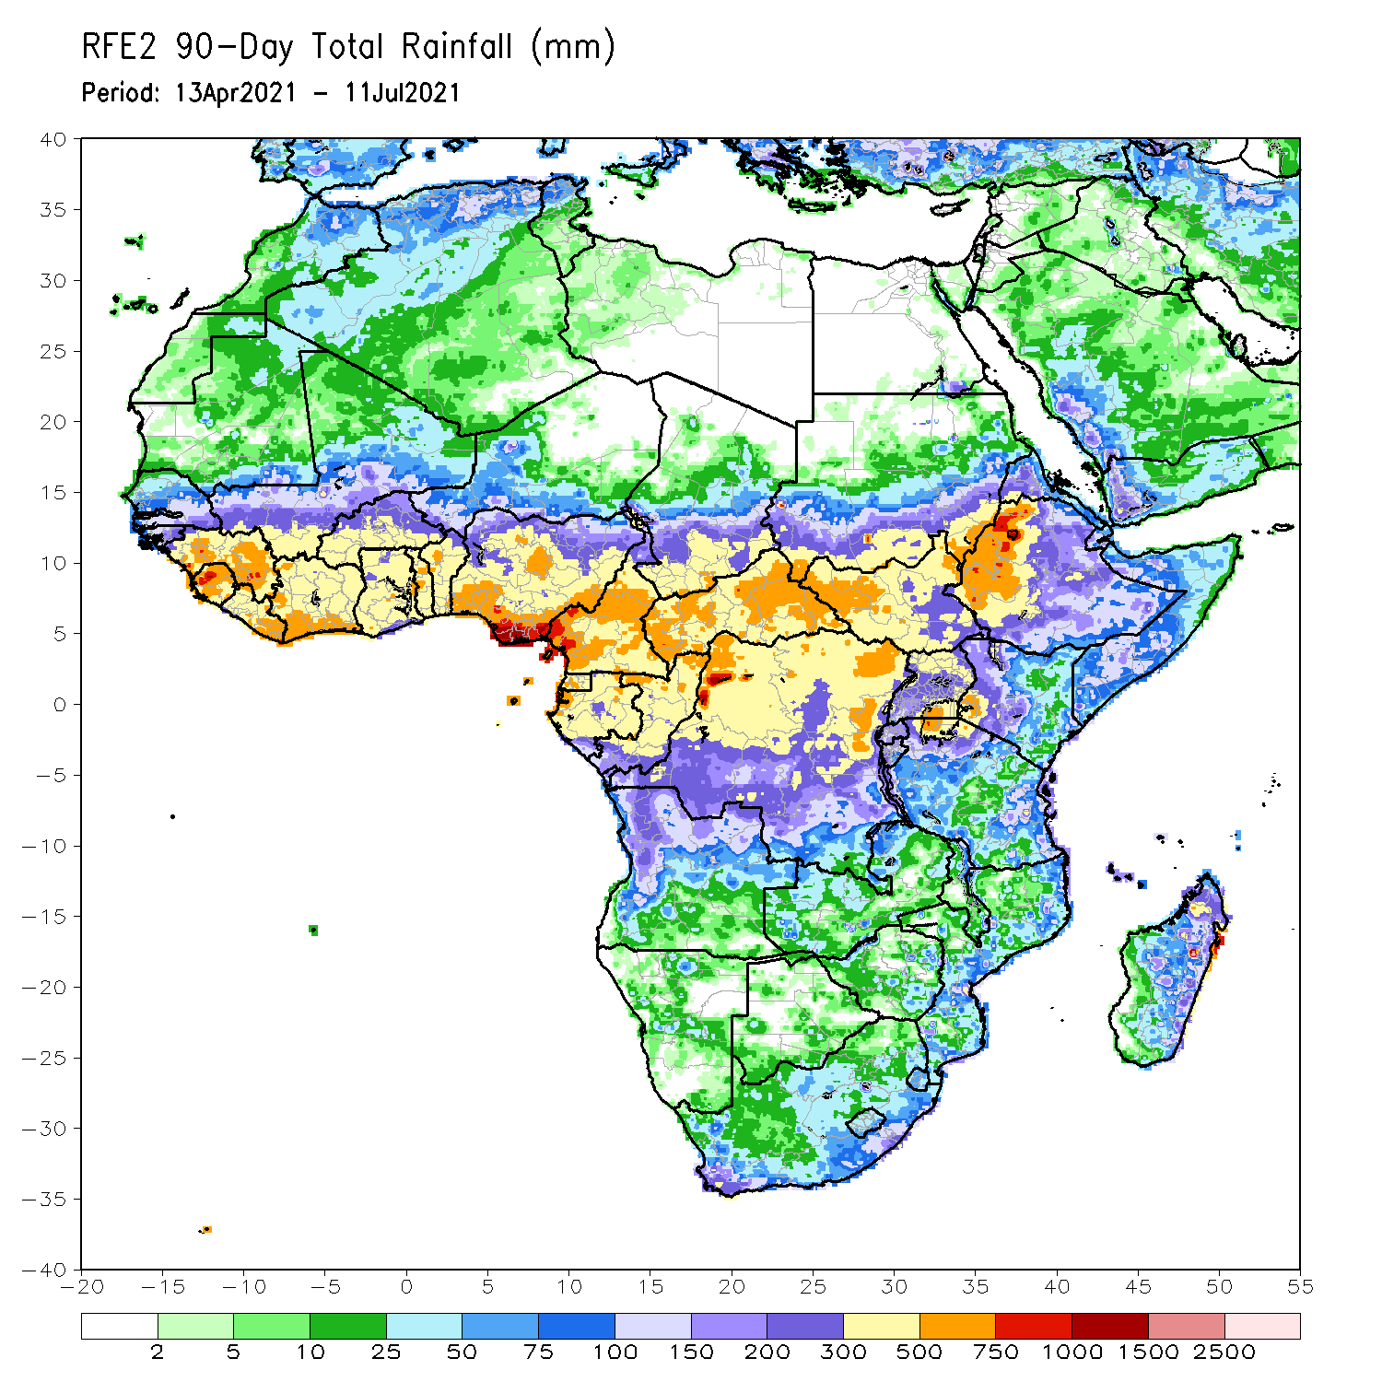
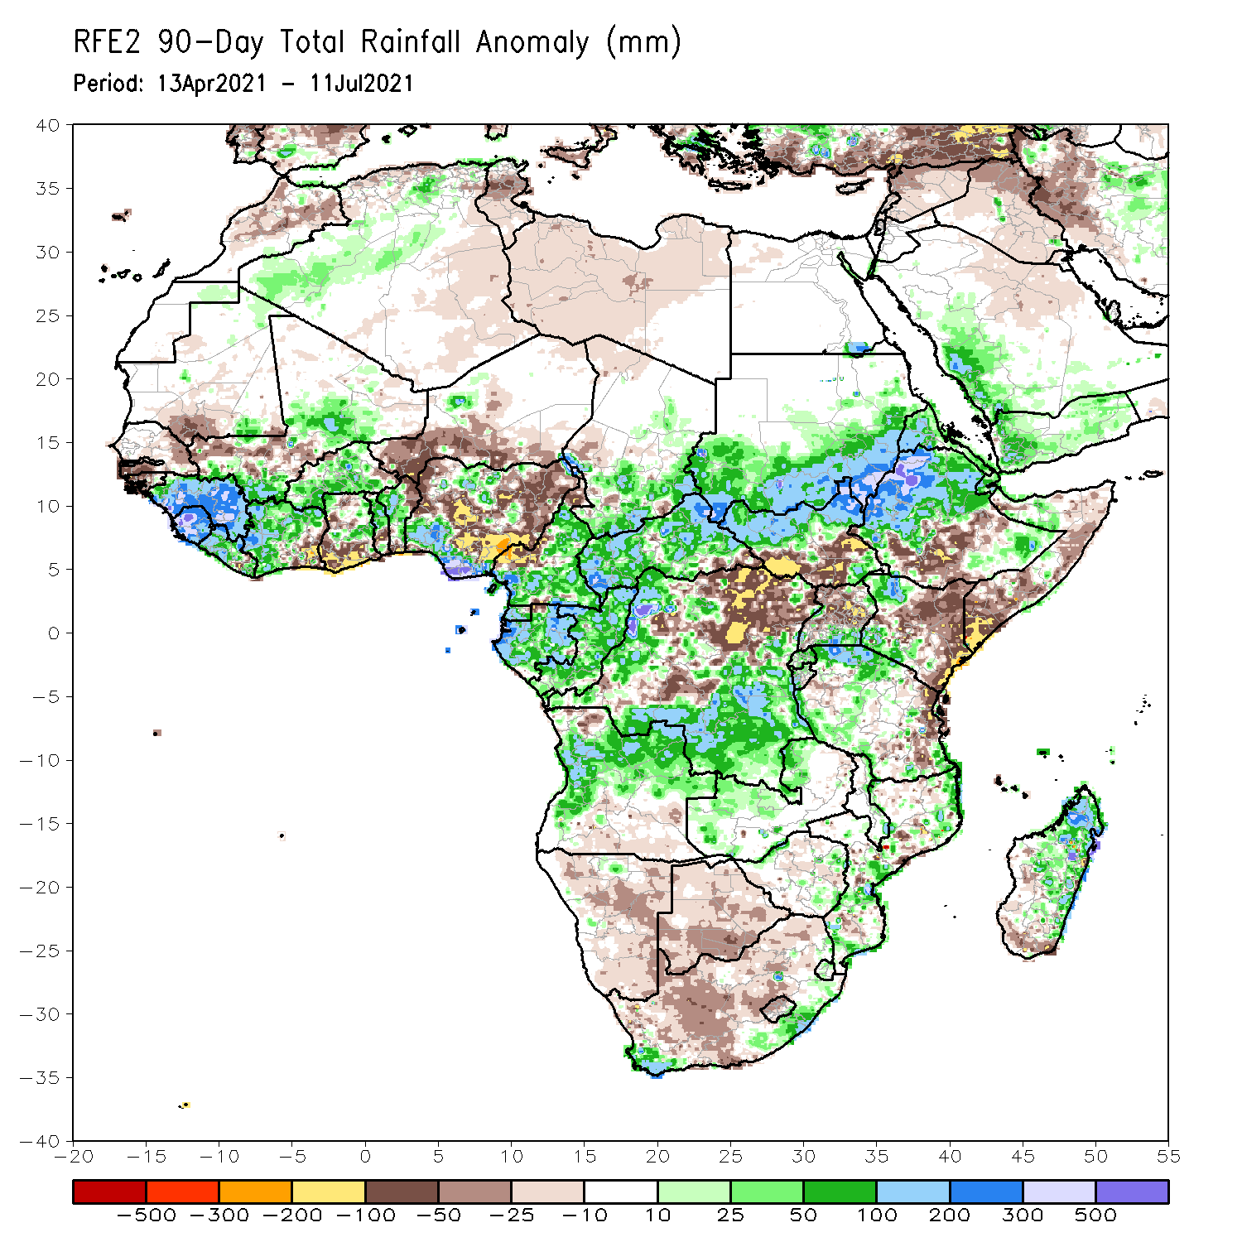
Rainfall Patterns: Last 90 Days
Over the past 90 days, in East Africa, above-average rainfall was observed over western Ethiopia, northern South Sudan, southern and eastern Sudan, Eritrea, parts of southern Uganda, pockets of southeastern Ethiopia, western Kenya, and northern Tanzania. Rainfall was below-average over parts of southern Ethiopia, central and southern Somalia, and central and eastern Kenya. Rainfall was also below-average over southern South Sudan, northern Uganda and parts of eastern Tanzania. In southern Africa, above-average rainfall was observed over the far northern Southern Africa, while below-average rainfall was observed over the central and southern portions of Southern Africa. In Central Africa, rainfall was above-average over western and southern DRC, Equatorial Guinea, Gabon, Congo, and much of CAR. Rainfall was below-average over northeastern and central DRC, pockets of central CAR, and western Cameroon. In West Africa, rainfall was above-average over much of Guinea, Sierra Leone, Cote d’Ivoire, Burkina Faso, northern Benin, and southern Nigeria. Below-average rainfall was observed over parts of Senegal, coastal Cote d’Ivoire, parts of Ghana, western Niger, and central and northern Nigeria.
Notes:
4

Slide 5
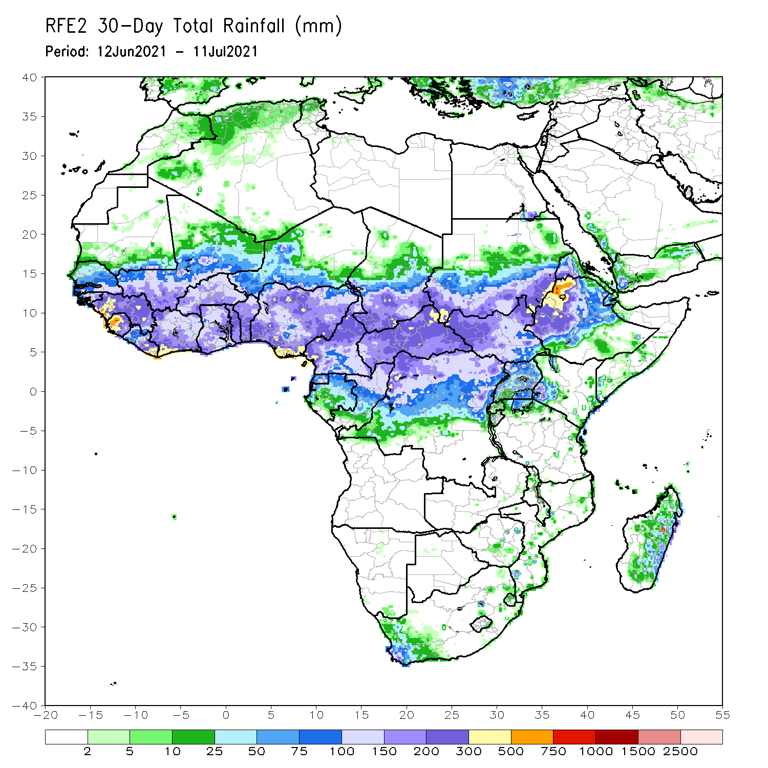
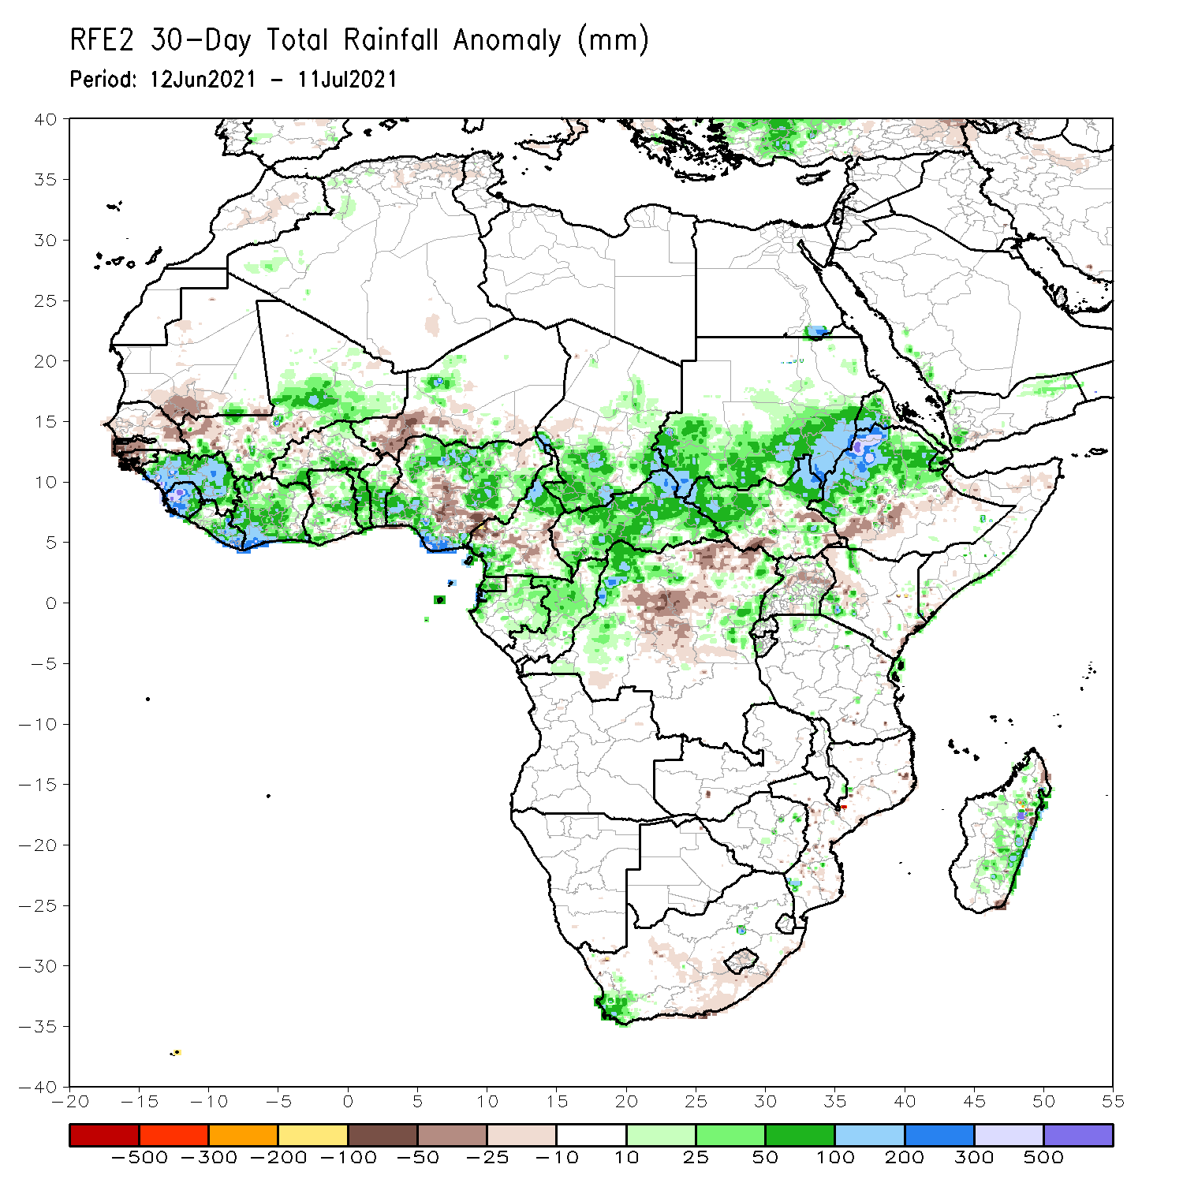
Rainfall Patterns: Last 30 Days
During the past 30 days, in East Africa, above-average rainfall was observed over the southern and eastern parts of Sudan and northern South Sudan Republic, and many parts of Ethiopia. Rainfall was below-average over pockets of South Sudan, parts of southern Ethiopia, and pockets of Uganda. In Central Africa, rainfall was below-average over parts of central and northeastern DRC. Rainfall was above-average over Equatorial Guinea, Gabon, Congo, much of CAR, and pockets of DRC. In West Africa, rainfall was above-average over much of the Gulf of Guinea region and the neighboring areas of the Sahel. Below-average rainfall was observed over parts of Senegal, western Mali, Guinea-Bissau, Niger, and pockets of Nigeria.
Notes:
5

Slide 6
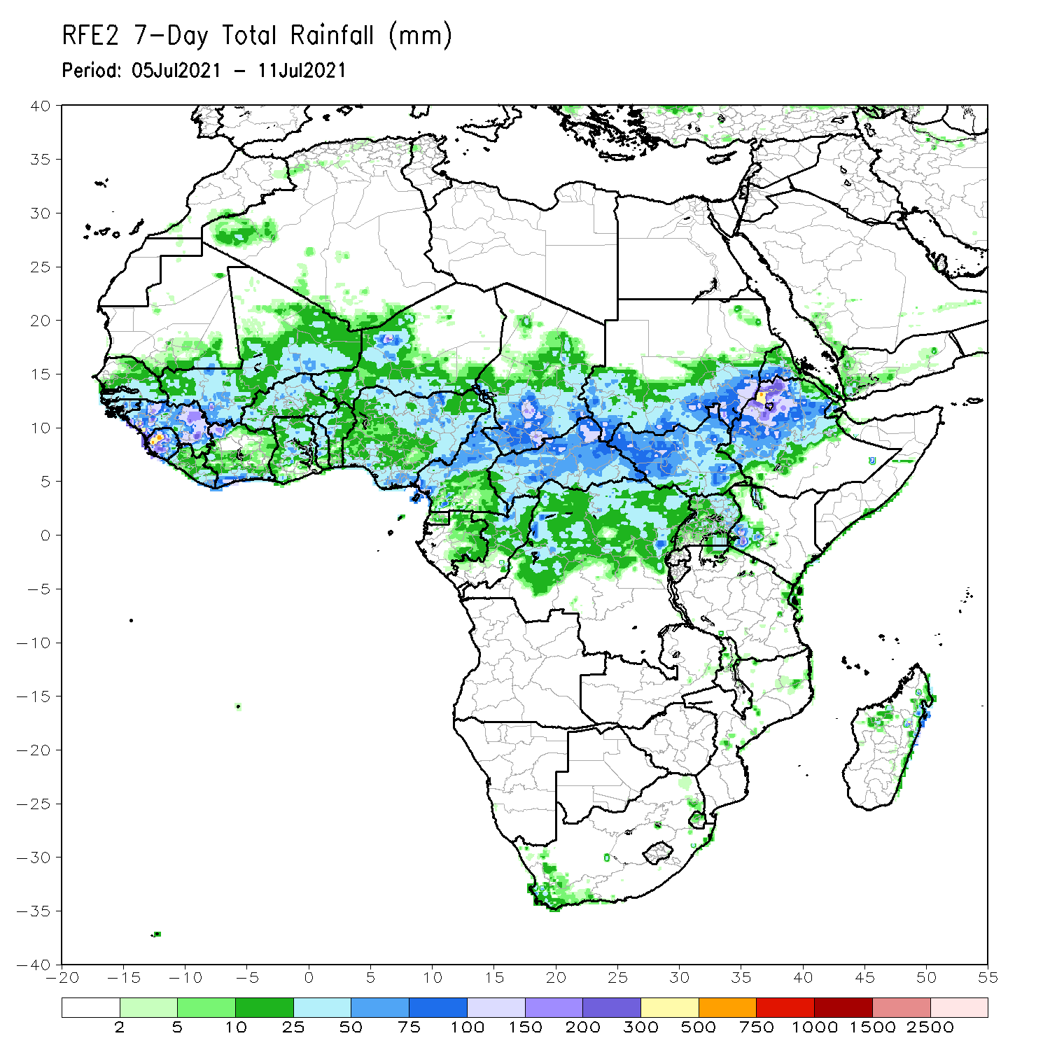
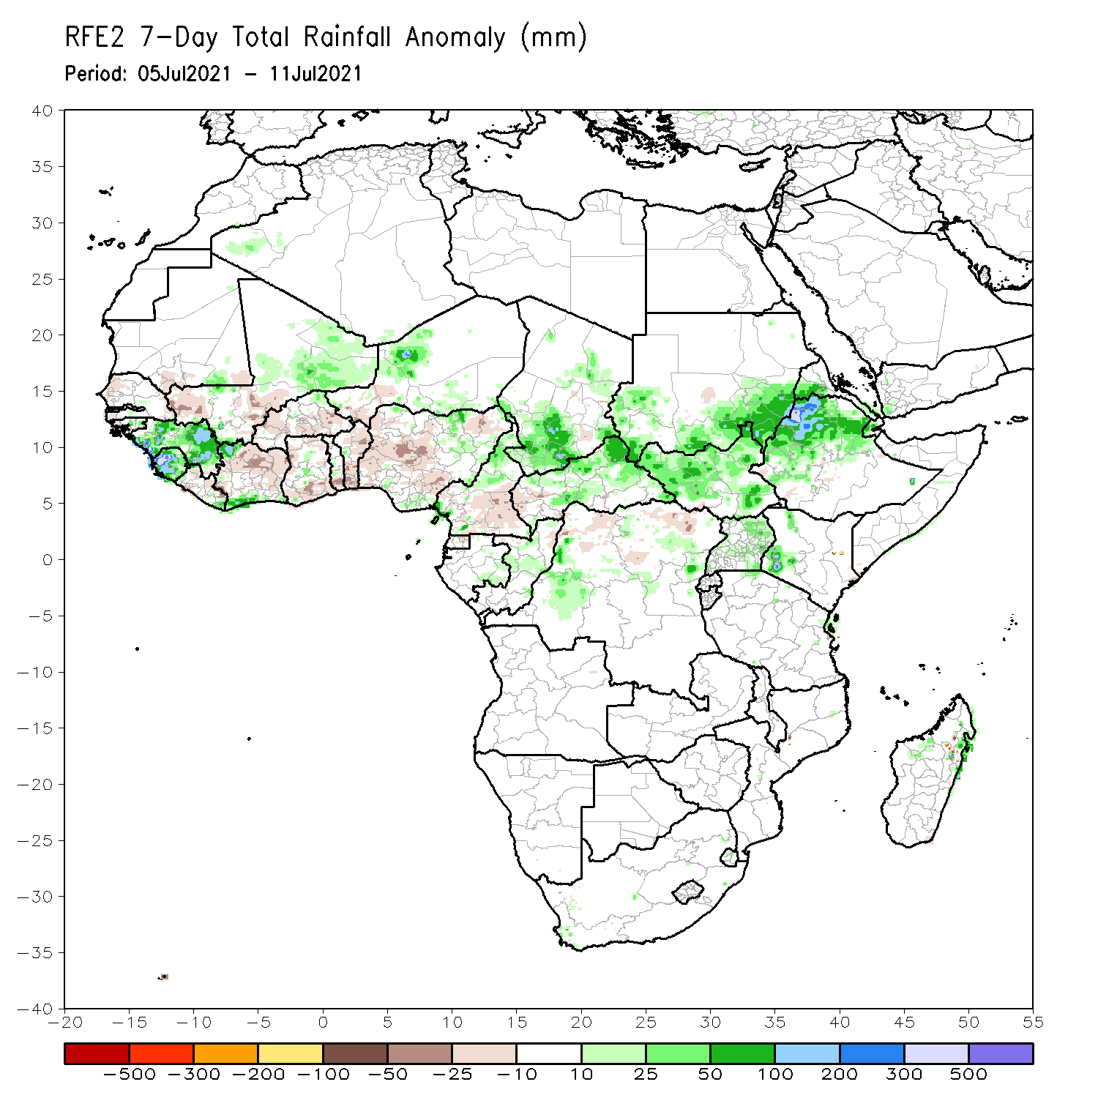
Rainfall Patterns: Last 7 Days
During the past 7 days, in East Africa, rainfall was above-average over parts of eastern and southern Sudan, South Sudan, and Ethiopia. In Central Africa, rainfall was above-average over pockets of northern DRC, CAR and southern Chad. Below-average rainfall was observed over parts of Cameroon and western CAR. In West Africa, above-average rainfall was observed over Guinea, Sierra Leone, northern Mali, and Niger. Below-average rainfall was observed over pockets of Senegal, western Mali, Cote d’Ivoire and Nigeria.

Slide 7
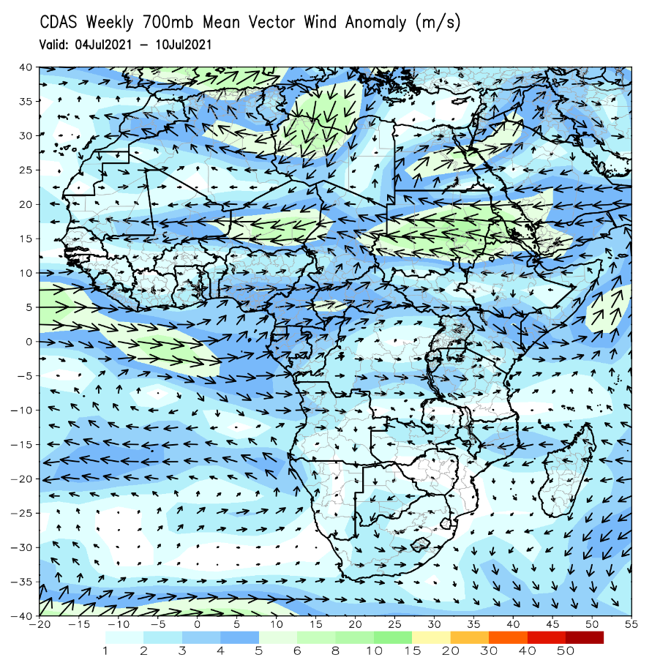
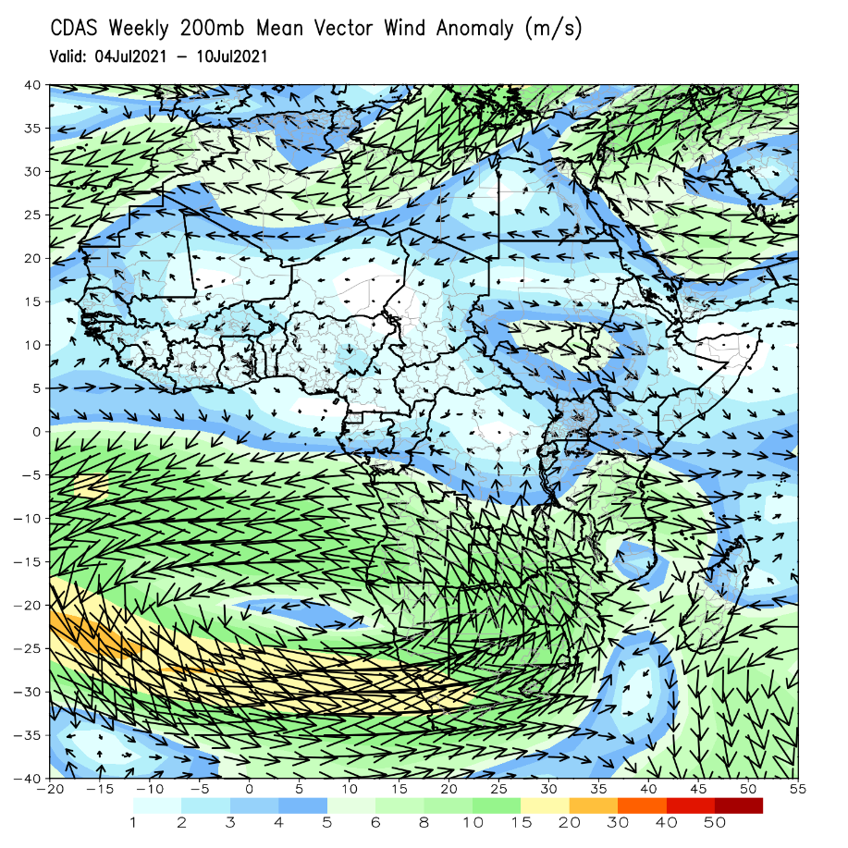
Atmospheric Circulation: Last 7 Days
At 700-hPa level (left panel), anomalous easterly flow was observed across the Sudano-Sahelian region.

Slide 8
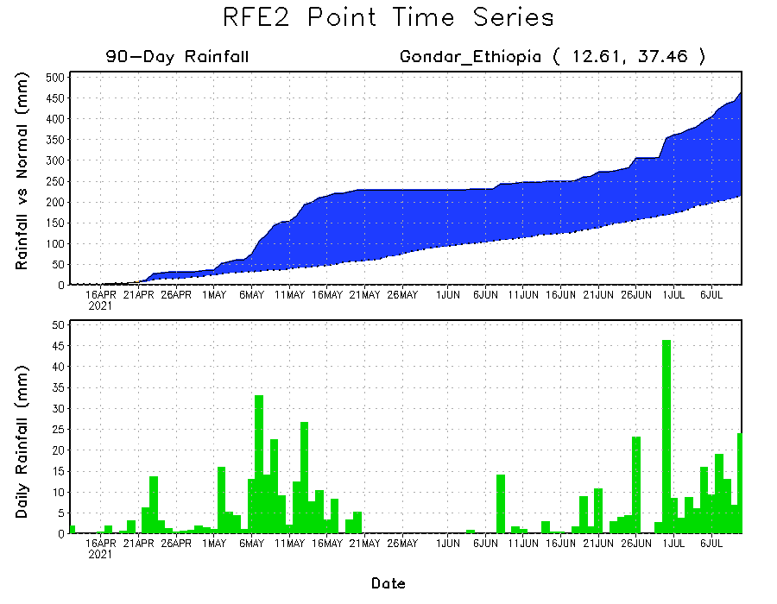
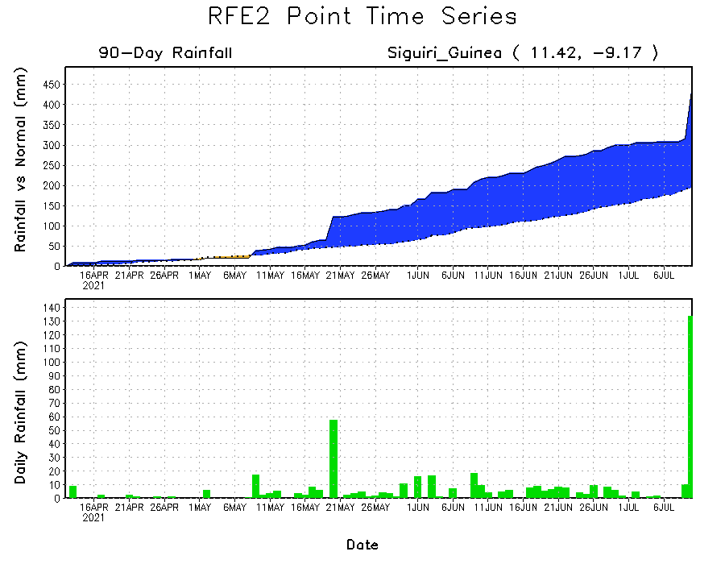
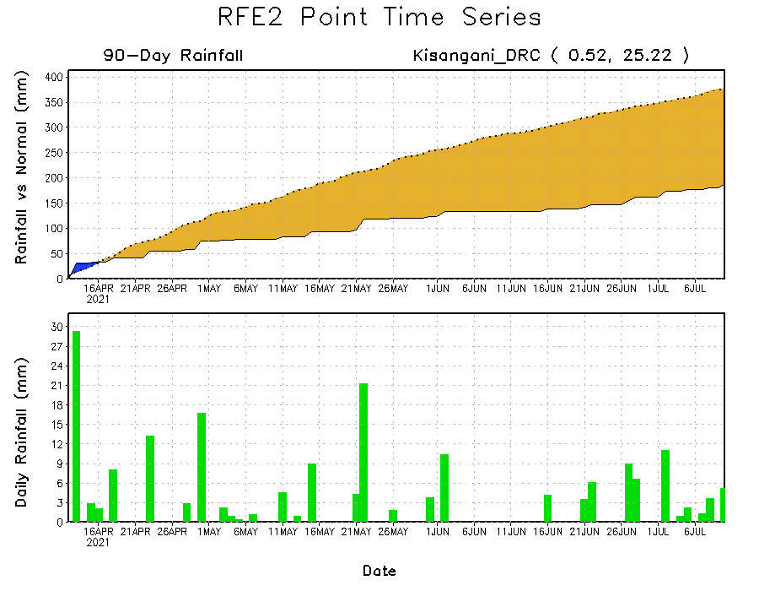
Rainfall Evolution
Daily evolution of rainfall over the last 90 days at selected locations shows moderate to heavy rainfall sustained moisture surpluses over parts of Guinea (bottom left) and western Ethiopia (top right). In contrast, seasonal total rainfall remained below-average over northeastern DRC (bottom right).

Slide 9
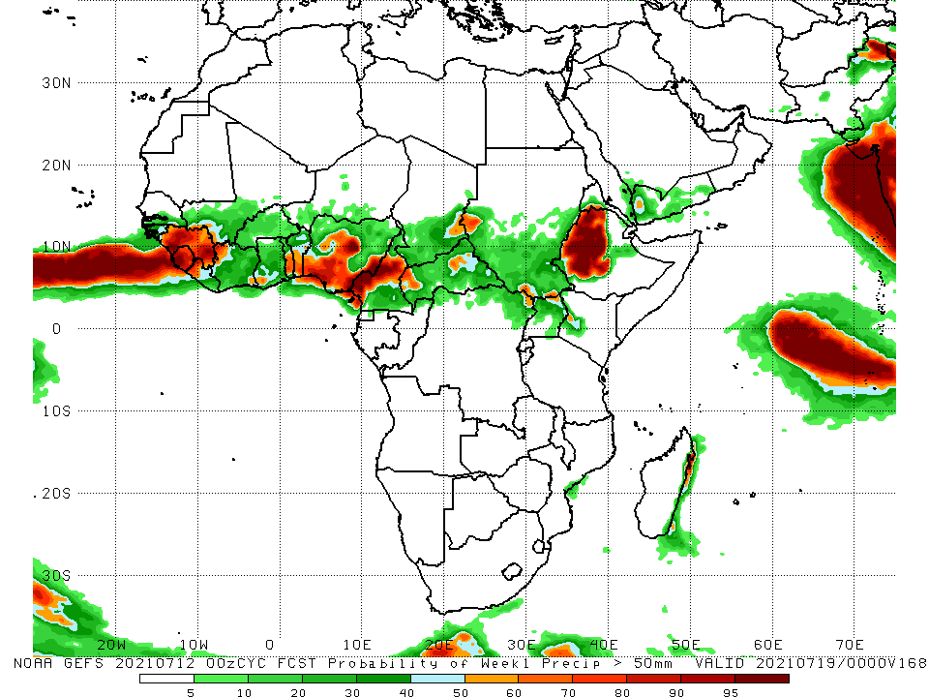
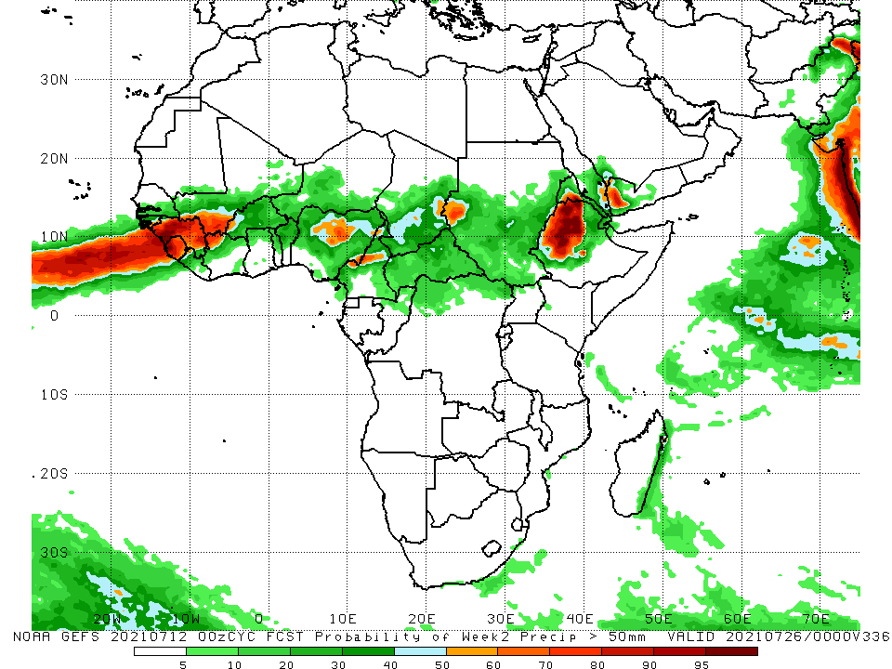
NCEP GEFS Model Forecasts Non-Bias Corrected Probability of precipitation exceedance
Week-1, Valid: 13 – 19 July, 2021
Week-2, Valid: 20 – 26 July, 2021
For week-1 (left panel) and week-2 (right panel), the NCEP GEFS indicates a moderate to high chance (over 70%) for rainfall to exceed 50 mm over much of Guinea, Sierra Leone, Liberia, parts of Nigeria, Cameroon, southern Chad, and western Ethiopia.
Notes:
9

Slide 10
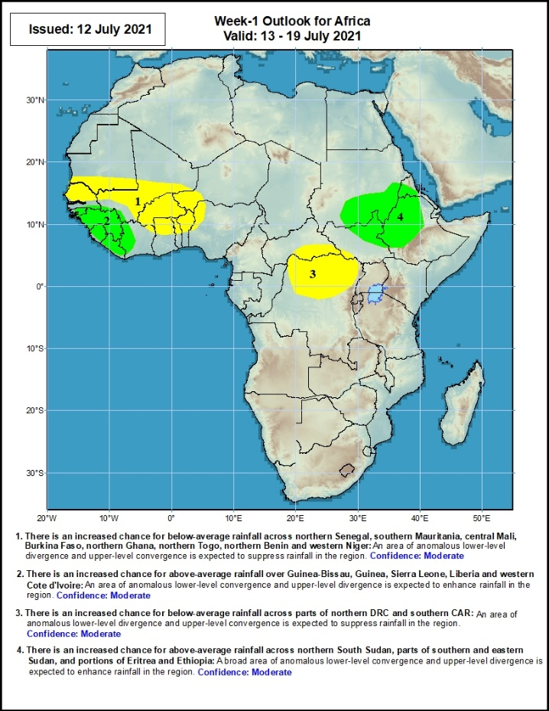
Week-1 Precipitation Outlooks
13 – 19 July, 2021
There is an increased chance for below-average rainfall across northern Senegal, southern Mauritania, central Mali, Burkina Faso, northern Ghana, northern Togo, northern Benin and western Niger: An area of anomalous lower-level divergence and upper-level convergence is expected to suppress rainfall in the region. Confidence: Moderate
There is an increased chance for above-average rainfall over Guinea-Bissau, Guinea, Sierra Leone, Liberia and western Cote d'Ivoire: An area of anomalous lower-level convergence and upper-level divergence is expected to enhance rainfall in the region. Confidence: Moderate
There is an increased chance for below-average rainfall across parts of northern DRC and southern CAR: An area of anomalous lower-level divergence and upper-level convergence is expected to suppress rainfall in the region Confidence: Moderate
There is an increased chance for above-average rainfall across northern South Sudan, parts of southern and eastern Sudan, and portions of Eritrea and Ethiopia: A broad area of anomalous lower-level convergence and upper-level divergence is expected to enhance rainfall in the region. Confidence: Moderate
Notes:
10

Slide 11
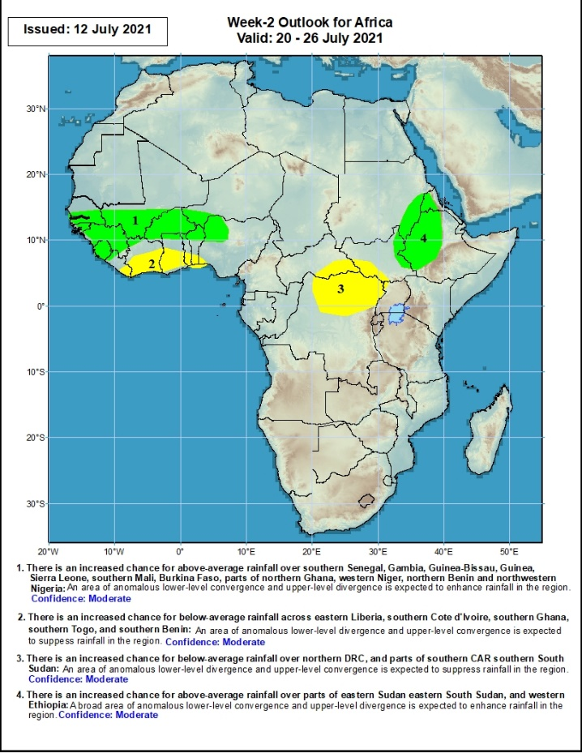
Week-2 Precipitation Outlooks
20 – 26 July, 2021
There is an increased chance for above-average rainfall over southern Senegal, Gambia, Guinea-Bissau, Guinea, Sierra Leone, southern Mali, Burkina Faso, parts of northern Ghana, western Niger, northern Benin and northwestern Nigeria: An area of anomalous lower-level convergence and upper-level divergence is expected to enhance rainfall in the region. Confidence: Moderate
There is an increased chance for below-average rainfall across eastern Liberia, southern Cote d'Ivoire, southern Ghana, southern Togo, and southern Benin: An area of anomalous lower-level divergence and upper-level convergence is expected to suppress rainfall in the region. Confidence: Moderate
There is an increased chance for below-average rainfall over northern DRC, and parts of southern CAR southern South Sudan: An area of anomalous lower-level divergence and upper-level convergence is expected to suppress rainfall in the region. Confidence: Moderate
There is an increased chance for above-average rainfall over parts of eastern Sudan eastern South Sudan, and western Ethiopia: A broad area of anomalous lower-level convergence and upper-level divergence is expected to enhance rainfall in the region. Confidence: Moderate
Notes:
11

Slide 12
Summary
During the past 30 to 90 days, in East Africa, above-average rainfall was observed over the southern and eastern parts of Sudan and northern South Sudan Republic, and many parts of Ethiopia. Rainfall was below-average over pockets of South Sudan, parts of southern Ethiopia, and pockets of Uganda. In Central Africa, rainfall was below-average over parts of central and northeastern DRC. Rainfall was above-average over Equatorial Guinea, Gabon, Congo, much of CAR, and pockets of DRC. In West Africa, rainfall was above-average over much of the Gulf of Guinea region and the neighboring areas of the Sahel. Below-average rainfall was observed over parts of Senegal, western Mali, Guinea-Bissau, Niger, and pockets of Nigeria.
During the past 7 days, in East Africa, rainfall was above-average over parts of eastern and southern Sudan, South Sudan, and Ethiopia. In Central Africa, rainfall was above-average over pockets of northern DRC, CAR and southern Chad. Below-average rainfall was observed over parts of Cameroon and western CAR. In West Africa, above-average rainfall was observed over Guinea, Sierra Leone, northern Mali, and Niger. Below-average rainfall was observed over pockets of Senegal, western Mali, Cote d’Ivoire and Nigeria.
Week-1 outlooks call for an increased chance for above-average rainfall over Guinea-Bissau, Guinea, Sierra Leone, Liberia, western Cote d'Ivoire, northern South Sudan, parts of southern and eastern Sudan, and portions of Eritrea and Ethiopia. In contrast, the outlooks call for an increased chance for below-average rainfall over northern Senegal, southern Mauritania, central Mali, Burkina Faso, northern Ghana, northern Togo, northern Benin and western Niger, parts of northern DRC and southern CAR.
Week-2 outlooks call for an increased chance for above-average rainfall over southern Senegal, Gambia, Guinea-Bissau, Guinea, Sierra Leone, southern Mali, Burkina Faso, parts of northern Ghana, western Niger, northern Benin and northwestern Nigeria, parts of eastern Sudan eastern South Sudan, and western Ethiopia. In contrast, the outlooks call for below-average rainfall over eastern Liberia, southern Cote d'Ivoire, southern Ghana, southern Togo, southern Benin, northern DRC, and parts of southern CAR southern South Sudan.

