Slide 1
The African Monsoon Recent Evolution and Current Status Include Week-1 and Week-2 Outlooks
Update prepared by
19 July 2021
For more information, visit:
http://www.cpc.ncep.noaa.gov/products/Global_Monsoons/African_Monsoons/precip_monitoring.shtml

Slide 2
Outline
Highlights
Recent Evolution and Current Conditions
NCEP GEFS Forecasts
Summary

Slide 3
Highlights: Last 7 Days
During the past 7 days, in East Africa, rainfall was above-average over pockets of Sudan and South Sudan, and many parts of Ethiopia. In Central Africa, rainfall was above-average over pockets of northern DRC and central Chad. Below-average rainfall was observed over many parts of CAR, southern Chad and pockets of northern DRC. In West Africa, above-average rainfall was observed over Guinea, Sierra Leone, pockets of Mali, parts of Cote d’Ivoire and Ghana, Togo, southern Niger and northeastern Nigeria. Below-average rainfall was observed over parts of Burkina Faso and Nigeria.
Week-1 outlooks call for an increased chance for above-average rainfall over Guinea, Sierra Leone, western Liberia, eastern Chad, portions of Sudan, South Sudan and western Ethiopia. In contrast, the outlooks call for an increased chance for below-average rainfall over Senegal, southern Mauritania, central Mali, western Burkina Faso, along the Gulf of Guinea coast, southeastern Cameroon, southern CAR, eastern Gabon, northern Congo and northern DRC.
Week-2 outlooks call for an increased chance for above-average rainfall over Guinea, Sierra Leone, western Libra, southern Mali, western Burkina Faso, northeastern Nigeria, northern Cameroon, southern Chad, western Sudan, and western Ethiopia. In contrast the outlooks call for an increased chance for below-average rainfall over eastern Cote d'Ivoire, southern Ghana, Togo, Benin, southern Nigeria, northern Congo, northern DRC and parts of southern CAR.

Slide 4
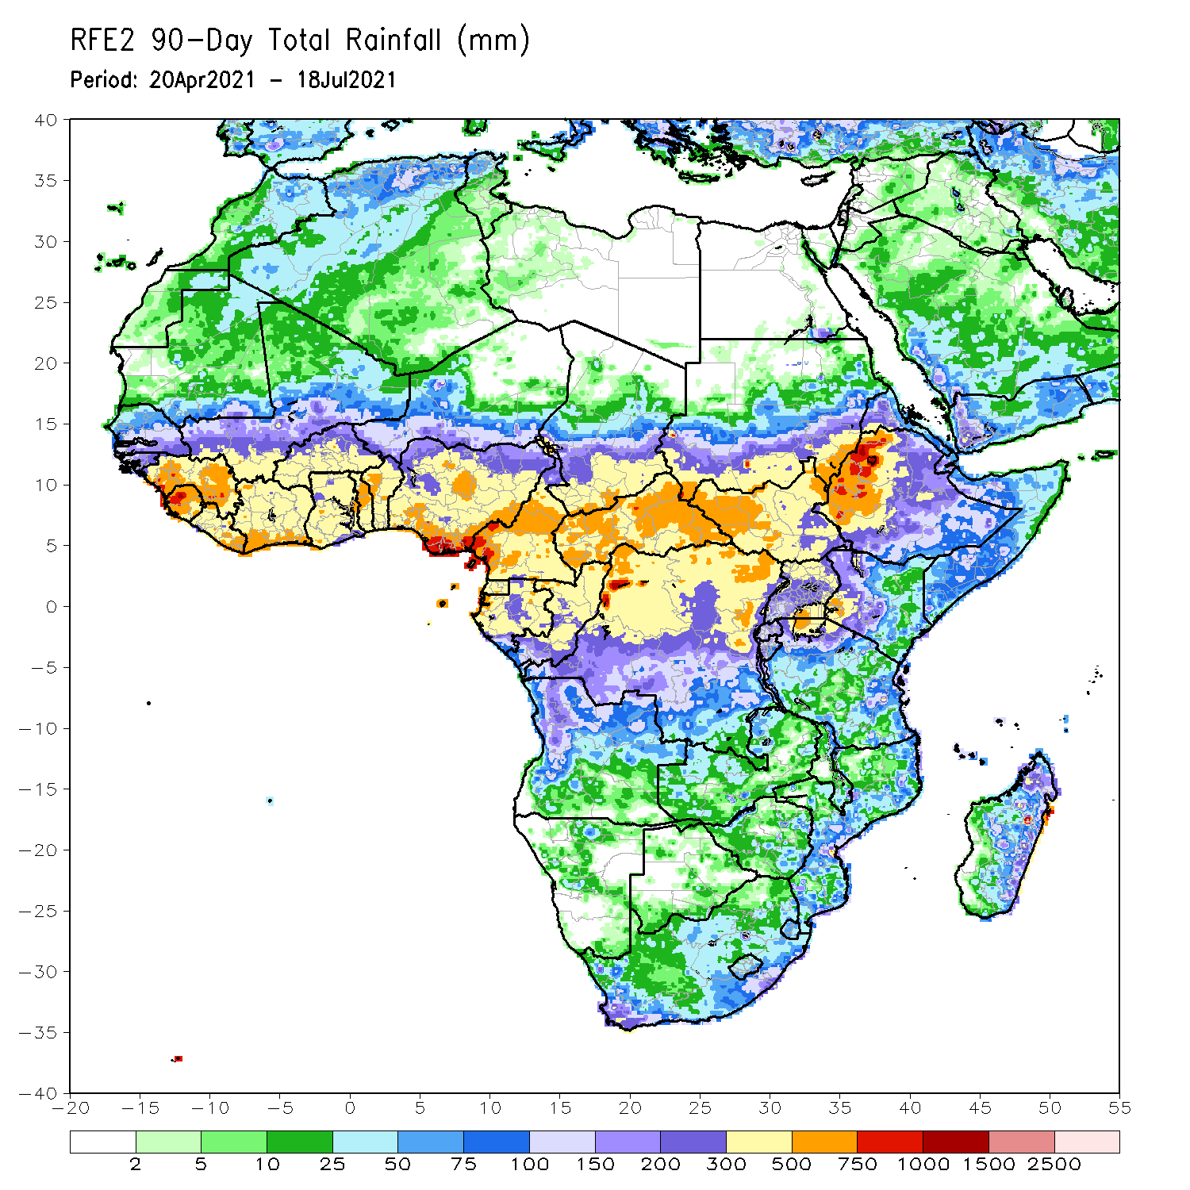
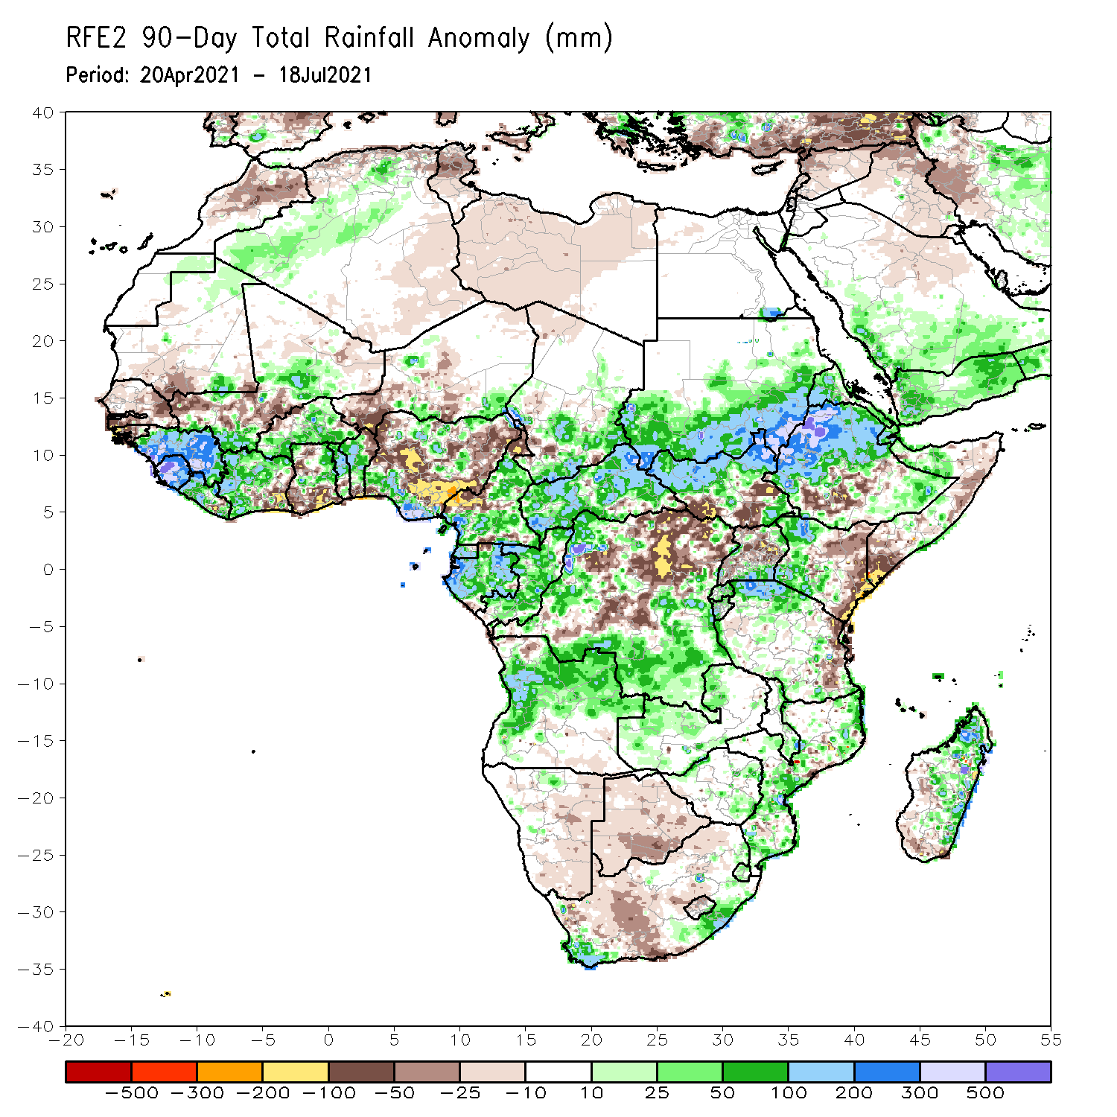
Rainfall Patterns: Last 90 Days
Over the past 90 days, in East Africa, above-average rainfall was observed over western Ethiopia, northern South Sudan, southern and eastern Sudan, Eritrea, parts of southern Uganda, pockets of southeastern Ethiopia, western Kenya, and northern Tanzania. Rainfall was below-average over parts of southern Ethiopia, central and southern Somalia, and central and eastern Kenya. Rainfall was also below-average over southern South Sudan, northern Uganda and parts of eastern Tanzania. In southern Africa, above-average rainfall was observed over the far northern Southern Africa, while below-average rainfall was observed over the central and southern portions of Southern Africa. In Central Africa, rainfall was above-average over western and southern DRC, Equatorial Guinea, Gabon, Congo, and much of CAR. Rainfall was below-average over northeastern and central DRC, pockets of southern CAR, and western Cameroon. In West Africa, rainfall was above-average over much of Guinea, Sierra Leone, Cote d’Ivoire, Burkina Faso, northern Benin, and southern Nigeria. Below-average rainfall was observed over parts of Senegal, coastal Cote d’Ivoire, parts of Ghana, western Niger, and central and northern Nigeria.
Notes:
4

Slide 5
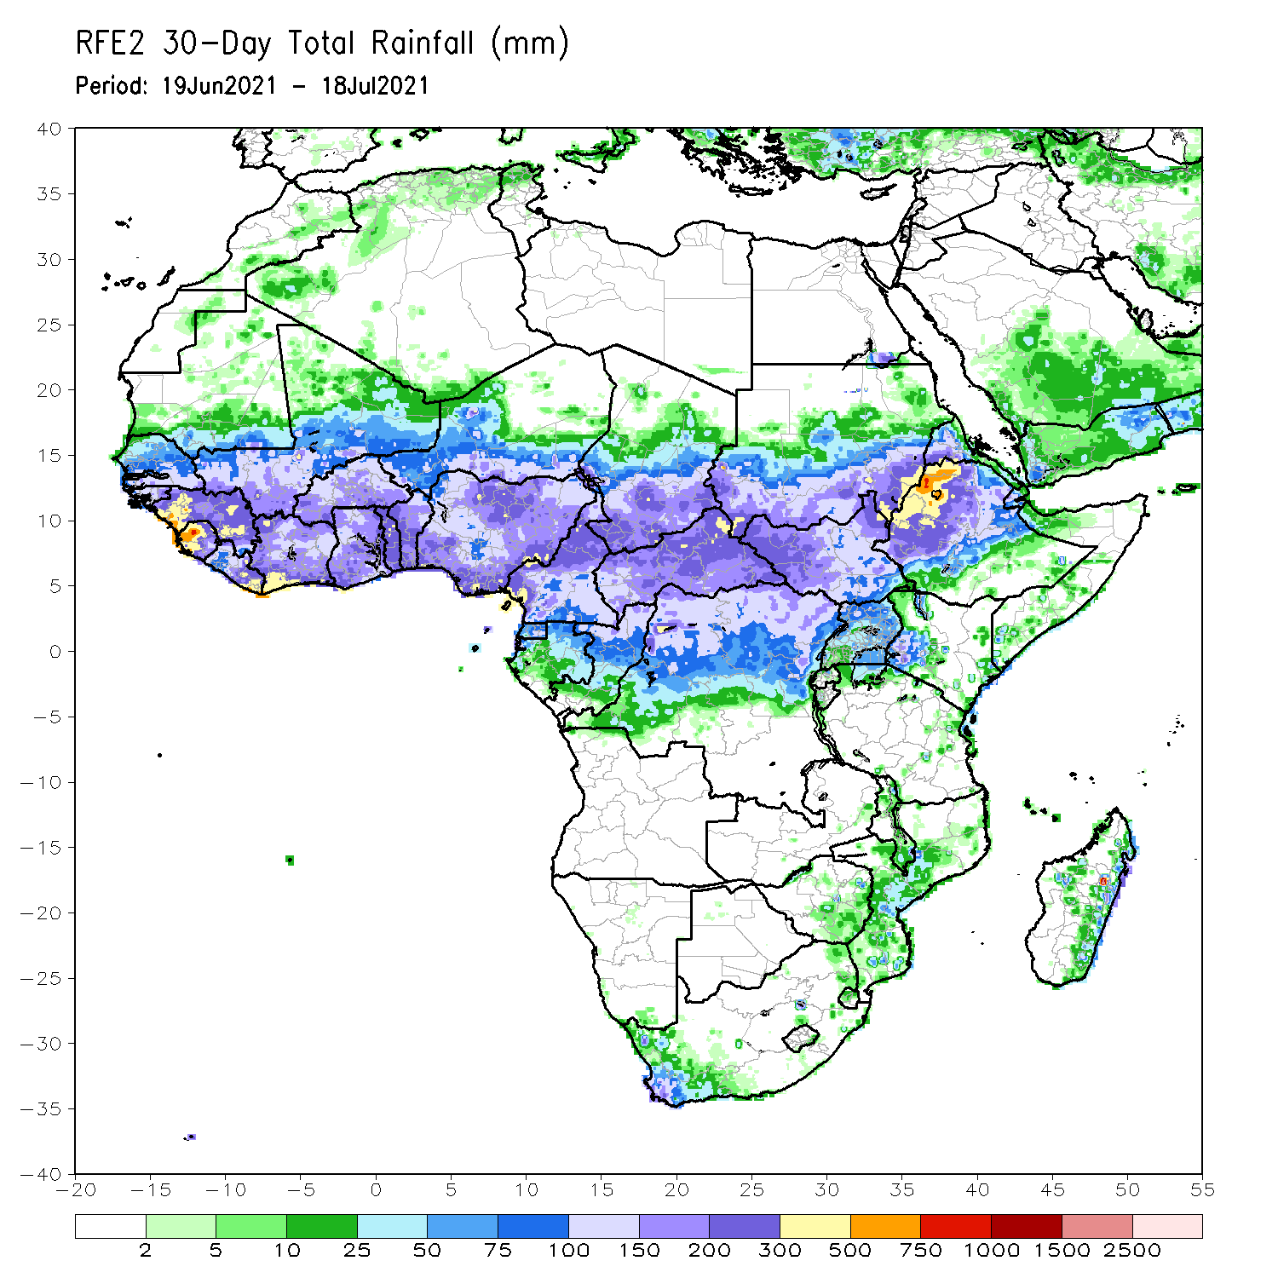
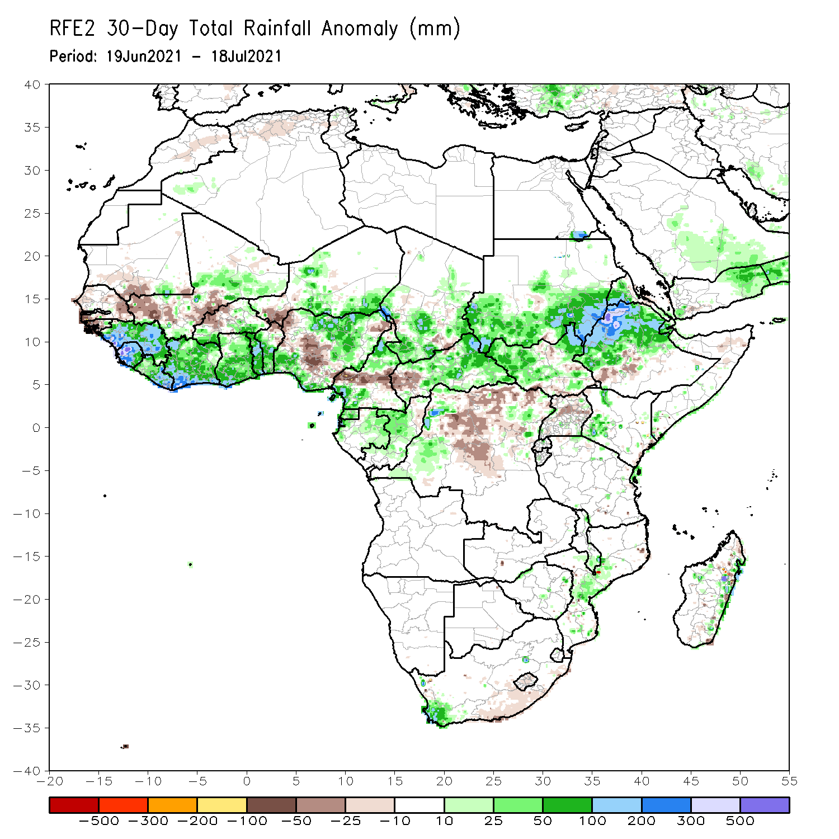
Rainfall Patterns: Last 30 Days
During the past 30 days, in East Africa, above-average rainfall was observed over the southern and eastern parts of Sudan and northern South Sudan Republic, and many parts of Ethiopia. Rainfall was below-average over pockets of South Sudan and southern Ethiopia, and parts of Uganda. In Central Africa, rainfall was below-average over parts of central and northern DRC. Rainfall was above-average over Equatorial Guinea, Gabon, Congo, much of CAR, and pockets of DRC. In West Africa, rainfall was above-average over much of the Gulf of Guinea region and the neighboring areas of the Sahel. Below-average rainfall was observed over parts of Senegal, western Mali, Guinea-Bissau, Niger, and pockets of Nigeria.
Notes:
5

Slide 6
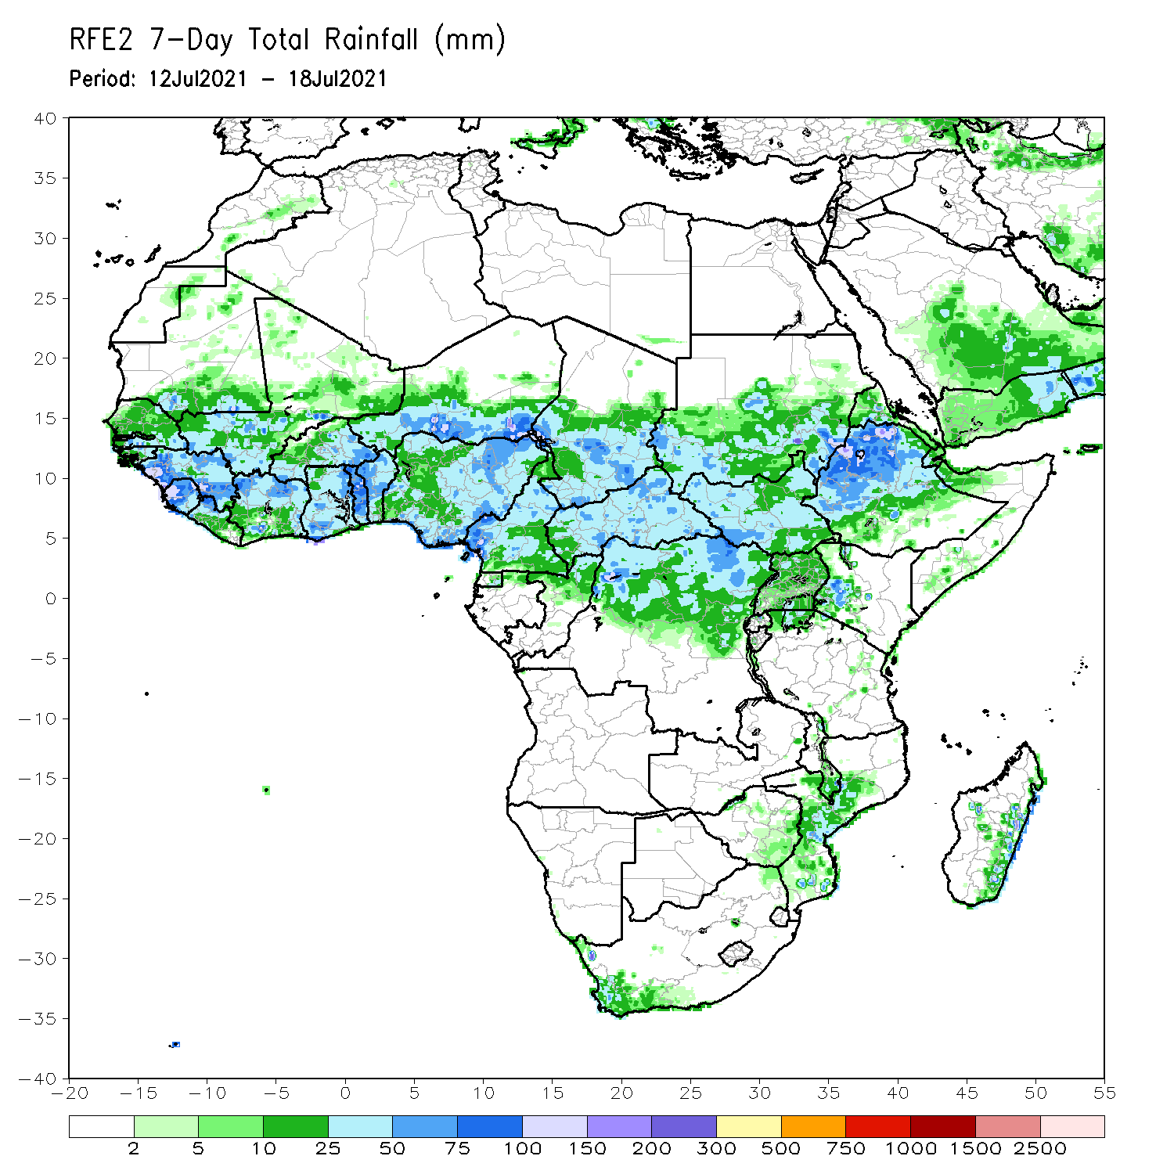
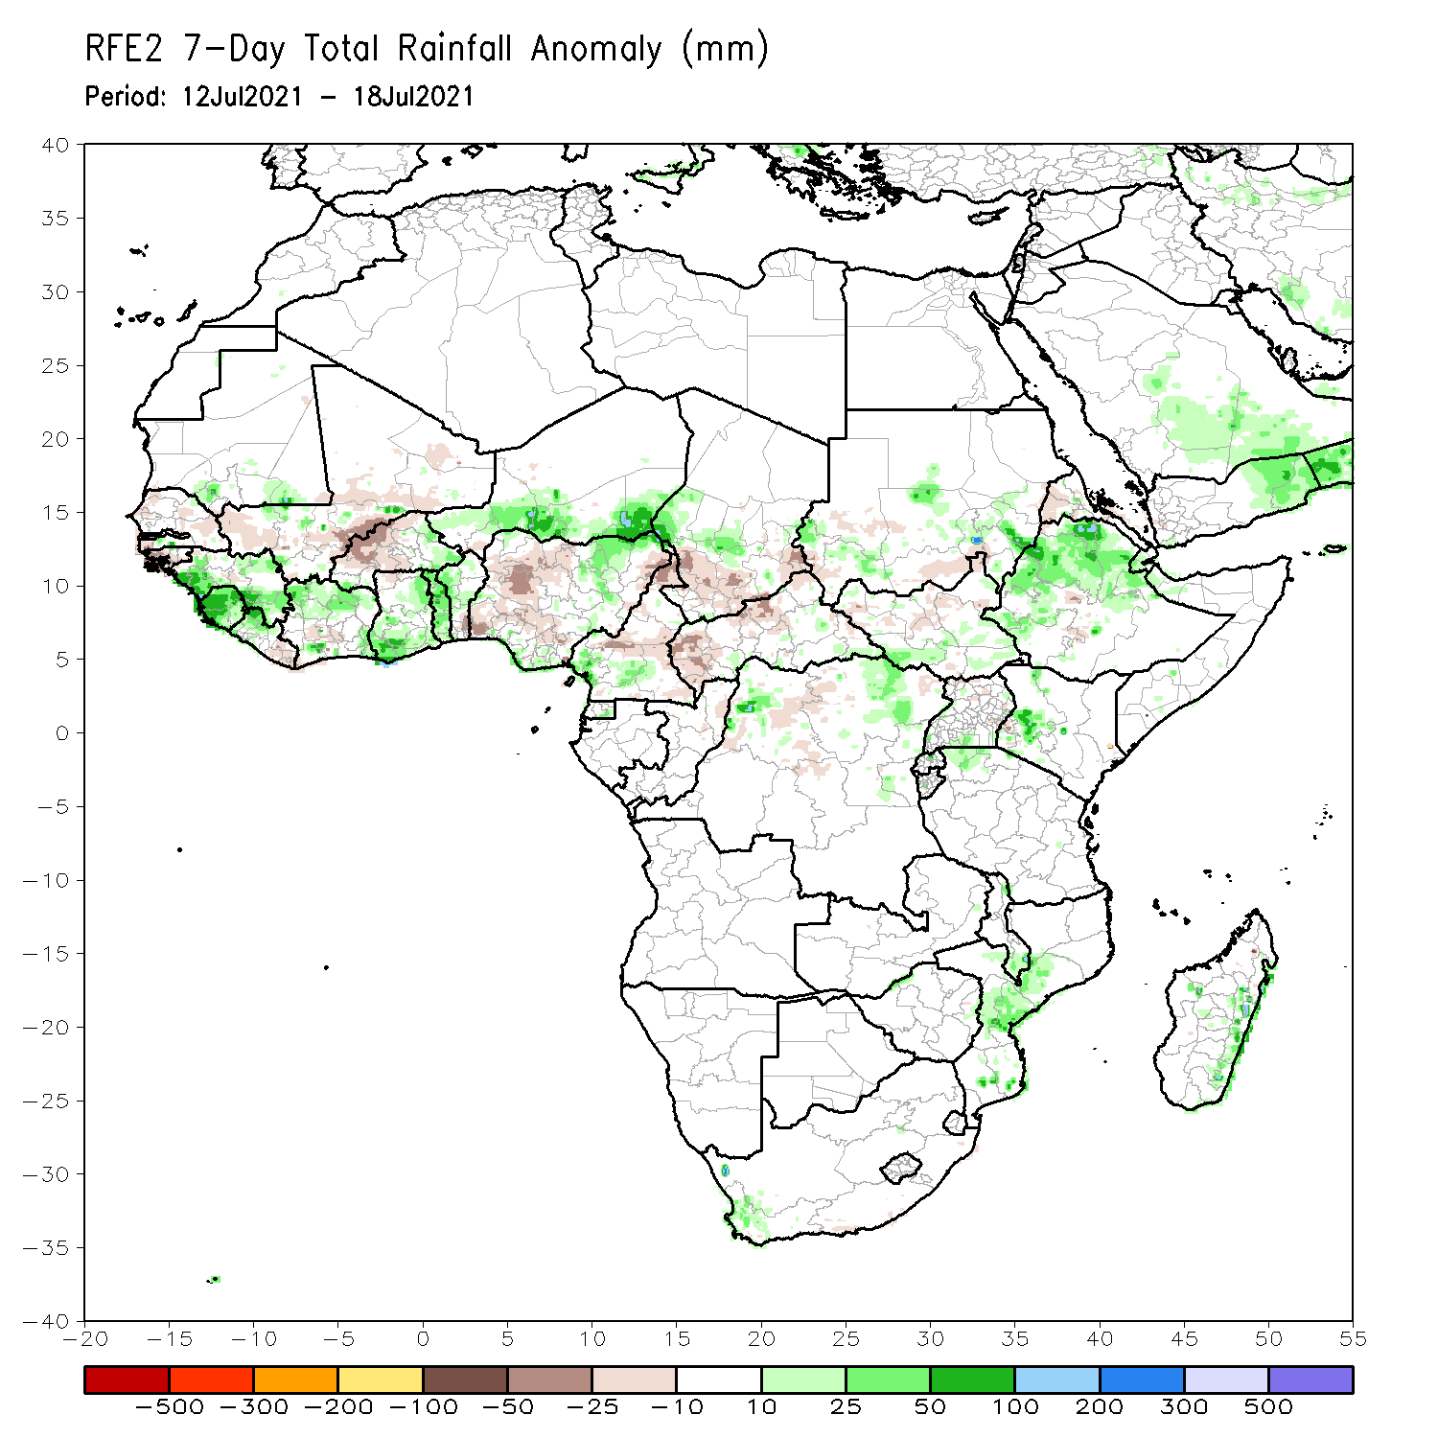
Rainfall Patterns: Last 7 Days
During the past 7 days, in East Africa, rainfall was above-average over pockets of Sudan and South Sudan, and many parts of Ethiopia. In Central Africa, rainfall was above-average over pockets of northern DRC and central Chad. Below-average rainfall was observed over many parts of CAR, southern Chad and pockets of northern DRC. In West Africa, above-average rainfall was observed over Guinea, Sierra Leone, pockets of Mali, parts of Cote d’Ivoire and Ghana, Togo, southern Niger and northeastern Nigeria. Below-average rainfall was observed over parts of Burkina Faso and Nigeria.

Slide 7
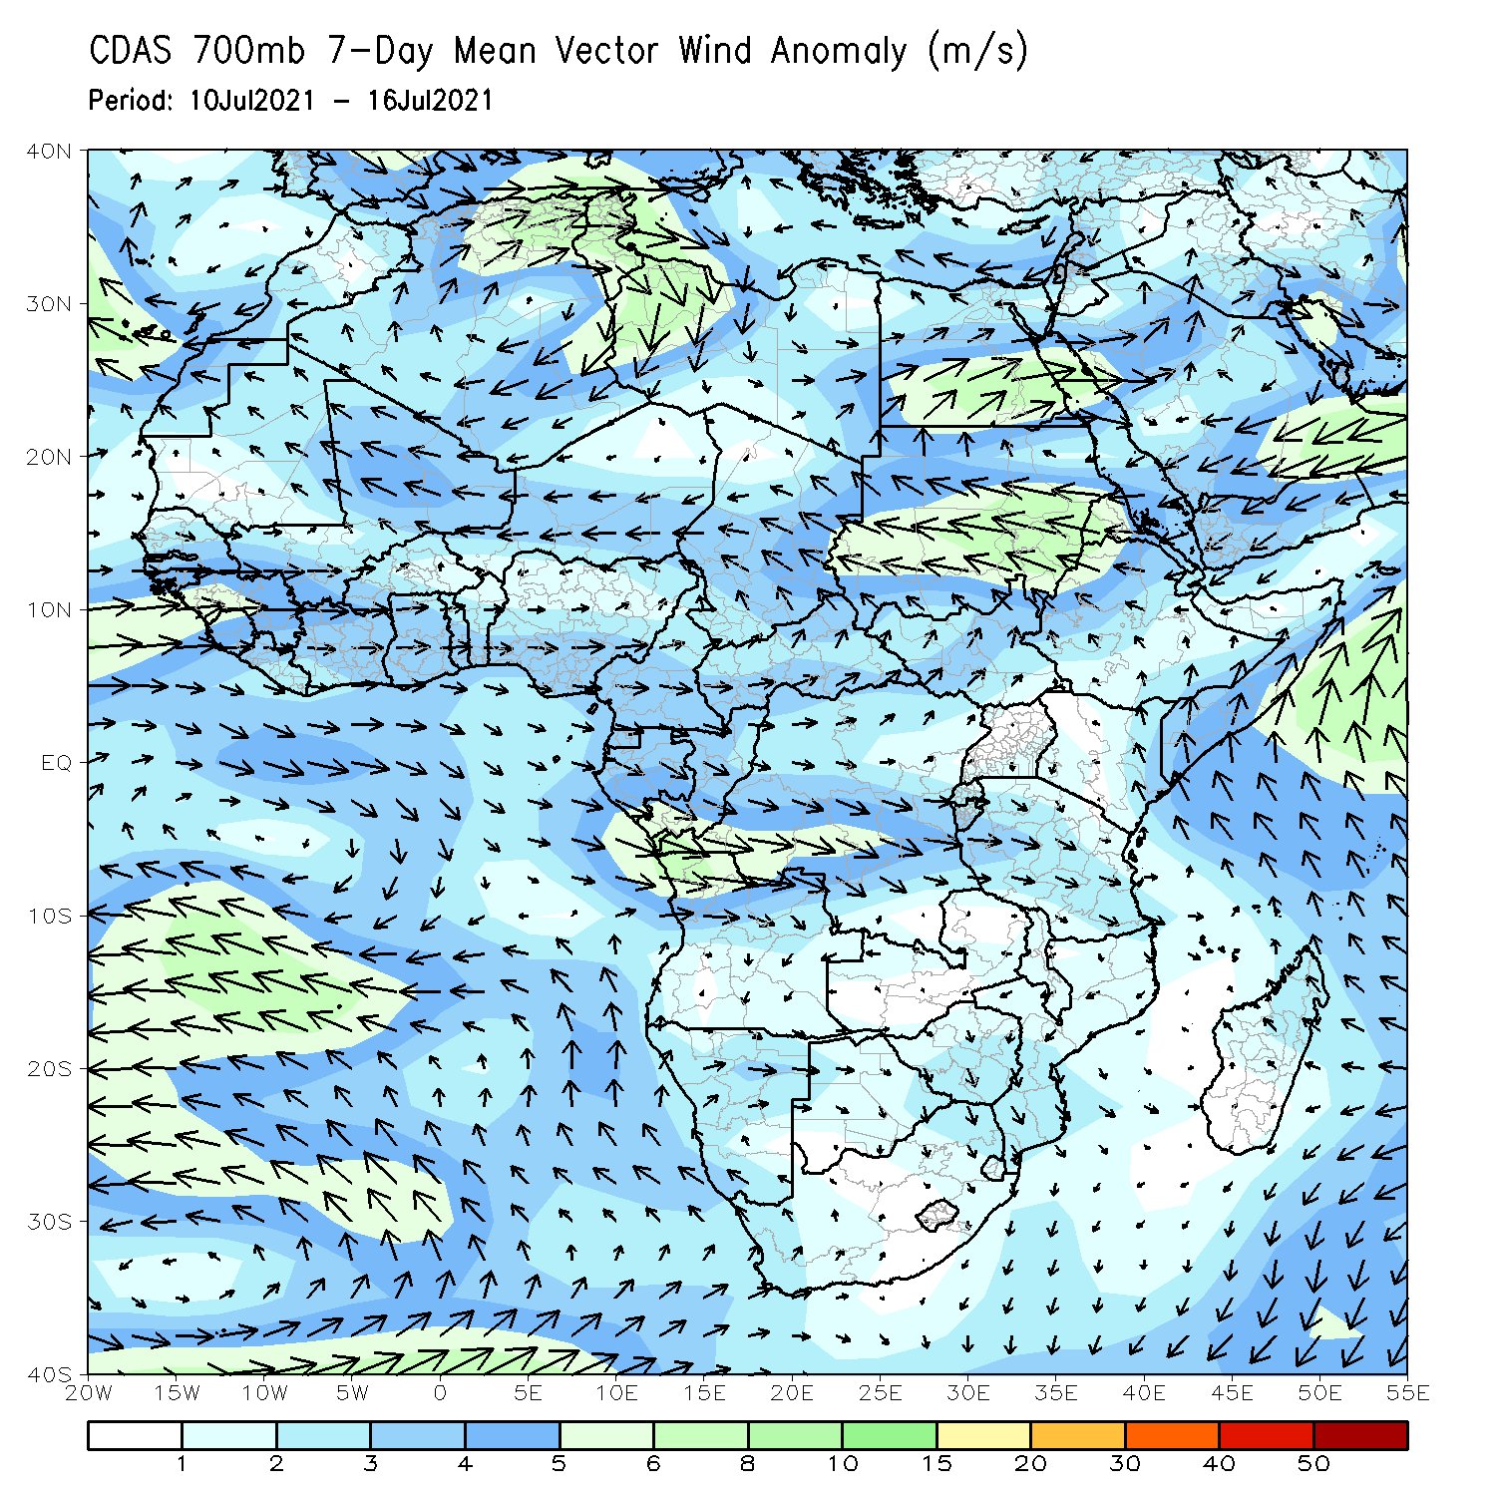
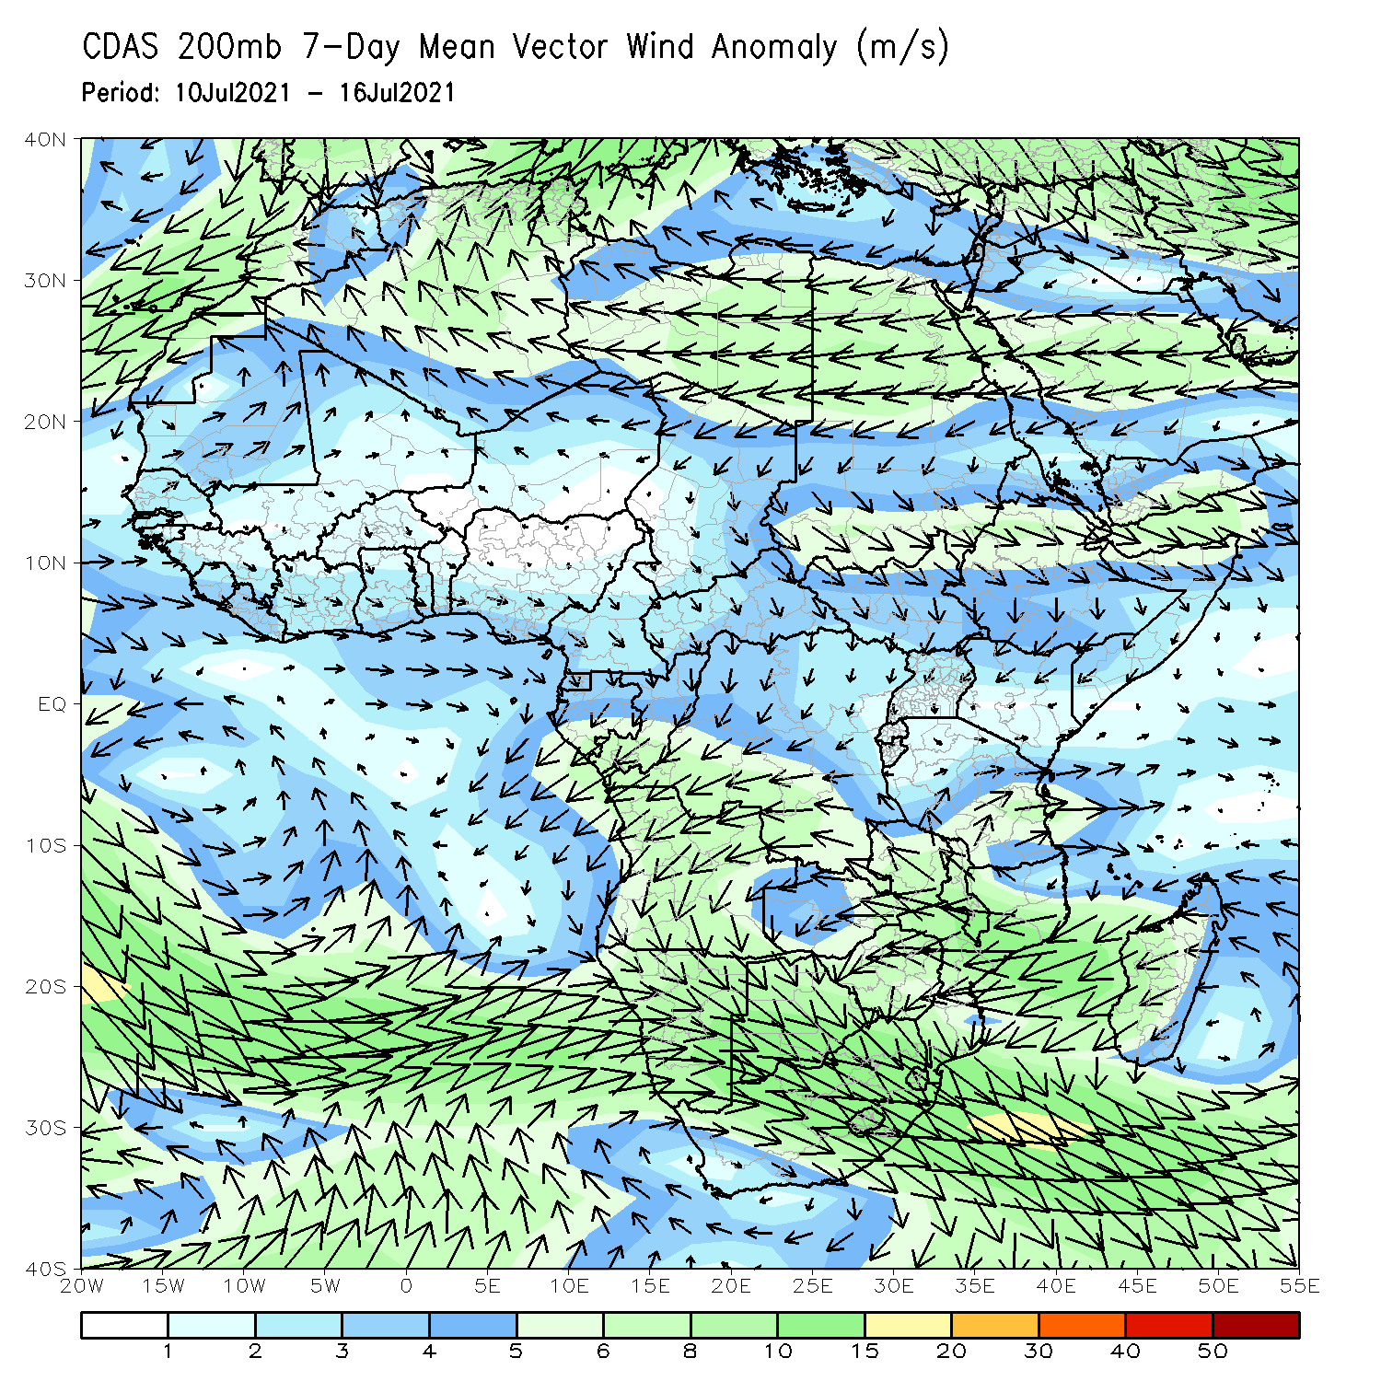
Atmospheric Circulation: Last 7 Days
At 700-hPa level (left panel), stronger than normal easterly flow was observed across the Sudano-Sahelian region.

Slide 8
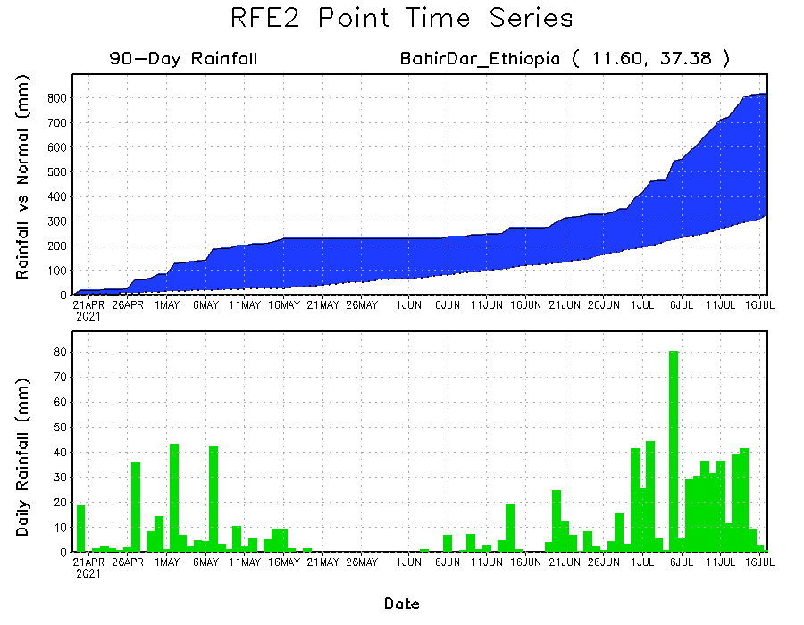
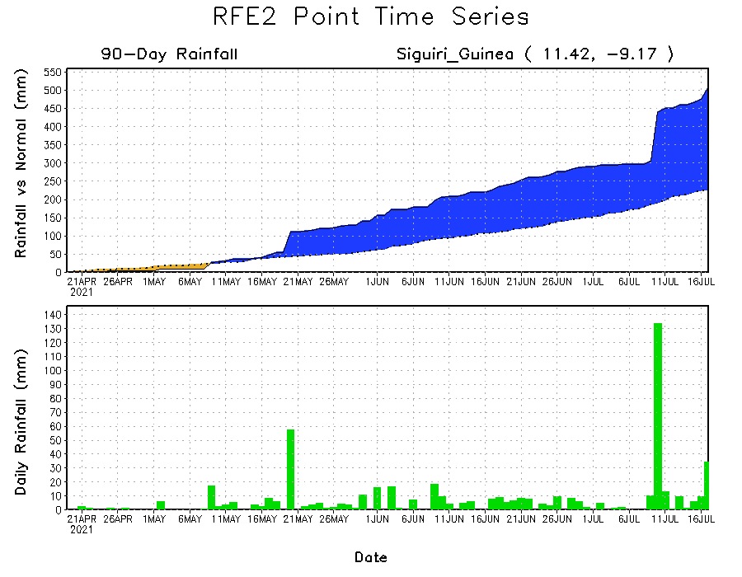
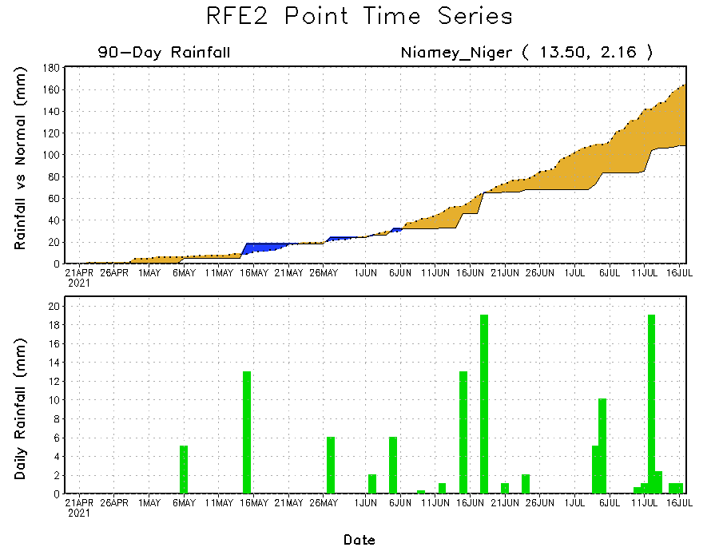
Rainfall Evolution
Daily evolution of rainfall over the last 90 days at selected locations shows moderate to heavy rainfall sustained moisture surpluses over parts of Guinea (bottom left) and western Ethiopia (top right). In contrast, early season dryness was evident over parts of Niger (bottom right).

Slide 9
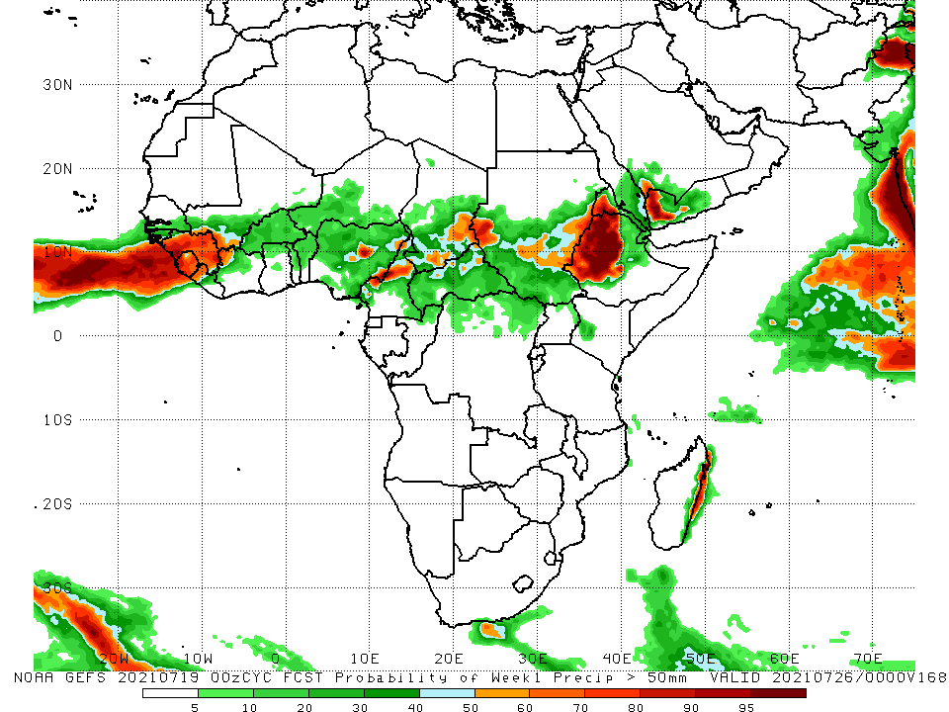
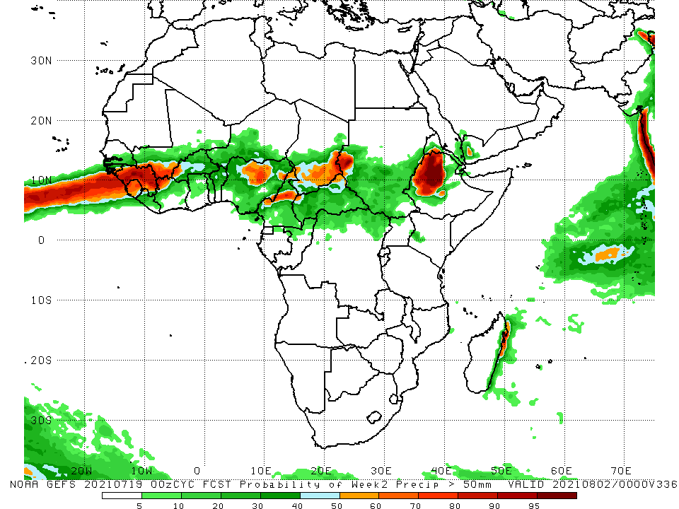
NCEP GEFS Model Forecasts Non-Bias Corrected Probability of precipitation exceedance
Week-1, Valid: 20 – 26 July, 2021
Week-2, Valid: 27 July – 02 August, 2021
For week-1 (left panel) and week-2 (right panel), the NCEP GEFS indicates a moderate to high chance (over 70%) for rainfall to exceed 50 mm over much of Guinea, Sierra Leone, western Liberia, parts of Nigeria, Cameroon, parts of Chad, and western Ethiopia.
Notes:
9

Slide 10
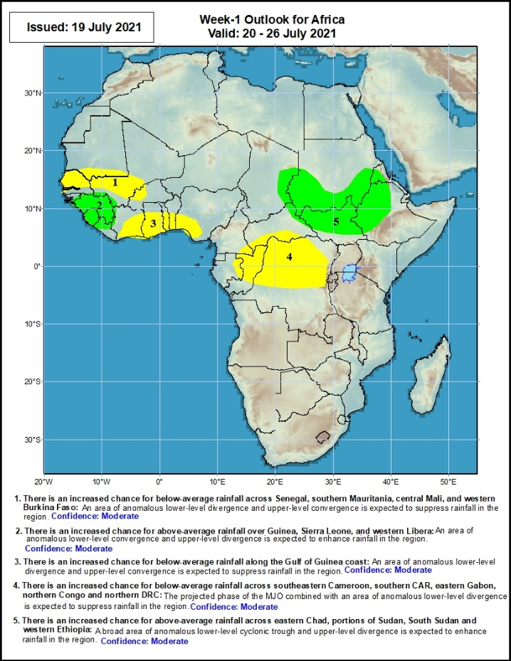
Week-1 Precipitation Outlooks
20 – 26 July, 2021
There is an increased chance for below-average rainfall across Senegal, southern Mauritania, central Mali, and western Burkina Faso: An area of anomalous lower-level divergence and upper-level convergence is expected to suppress rainfall in the region. Confidence: Moderate
There is an increased chance for above-average rainfall over Guinea, Sierra Leone, and western Liberia: An area of anomalous lower-level convergence and upper-level divergence is expected to enhance rainfall in the region. Confidence: Moderate
There is an increased chance for below-average rainfall along the Gulf of Guinea coast: An area of anomalous lower-level divergence and upper-level convergence is expected to suppress rainfall in the region. Confidence: Moderate
There is an increased chance for below-average rainfall across southeastern Cameroon, southern CAR, eastern Gabon, northern Congo and northern DRC: The projected phase of the MJO combined with an area of anomalous lower-level divergence is expected to suppress rainfall in the region. Confidence: Moderate
There is an increased chance for above-average rainfall across eastern Chad, portions of Sudan, South Sudan and western Ethiopia: A broad area of anomalous lower-level cyclonic trough and upper-level divergence is expected to enhance rainfall in the region. Confidence: Moderate
Notes:
10

Slide 11
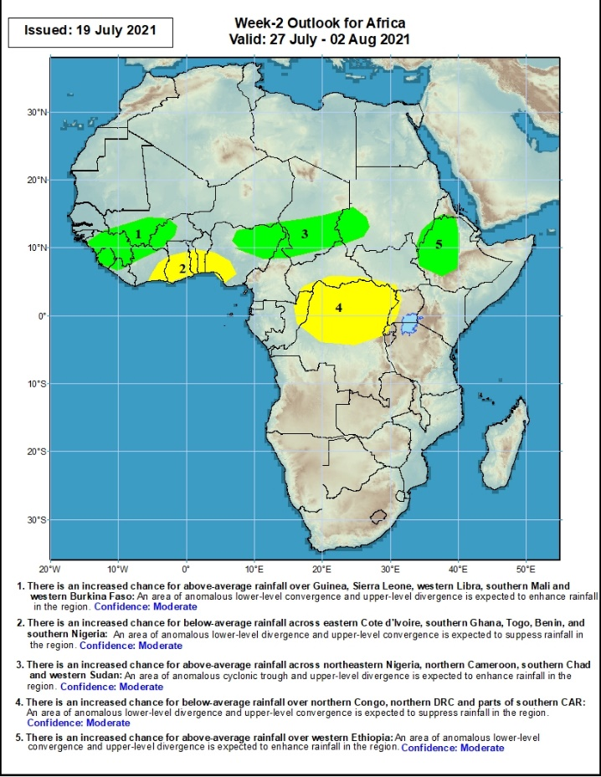
Week-2 Precipitation Outlooks
27 July – 2 August, 2021
There is an increased chance for above-average rainfall over Guinea, Sierra Leone, western Libra, southern Mali and western Burkina Faso: An area of anomalous lower-level convergence and upper-level divergence is expected to enhance rainfall in the region. Confidence: Moderate
There is an increased chance for below-average rainfall across eastern Cote d'Ivoire, southern Ghana, Togo, Benin, and southern Nigeria: An area of anomalous lower-level divergence and upper-level convergence is expected to suppress rainfall in the region. Confidence: Moderate
There is an increased chance for above-average rainfall across northeastern Nigeria, northern Cameroon, southern Chad and western Sudan: An area of anomalous lower-level cyclonic trough and upper-level divergence is expected to enhance rainfall in the region. Confidence: Moderate
There is an increased chance for below-average rainfall over northern Congo, northern DRC and parts of southern CAR: An area of anomalous lower-level divergence and upper-level convergence is expected to suppress rainfall in the region. Confidence: Moderate
There is an increased chance for above-average rainfall over western Ethiopia: An area of anomalous lower-level convergence and upper-level divergence is expected to enhance rainfall in the region. Confidence: Moderate
Notes:
11

Slide 12
Summary
During the past 30 to 90 days, in East Africa, above-average rainfall was observed over the southern and eastern parts of Sudan and northern South Sudan Republic, and many parts of Ethiopia. Rainfall was below-average over pockets of South Sudan and southern Ethiopia, and parts of Uganda. In Central Africa, rainfall was below-average over parts of central and northern DRC. Rainfall was above-average over Equatorial Guinea, Gabon, Congo, much of CAR, and pockets of DRC. In West Africa, rainfall was above-average over much of the Gulf of Guinea region and the neighboring areas of the Sahel. Below-average rainfall was observed over parts of Senegal, western Mali, Guinea-Bissau, Niger, and pockets of Nigeria.
During the past 7 days, in East Africa, rainfall was above-average over pockets of Sudan and South Sudan, and many parts of Ethiopia. In Central Africa, rainfall was above-average over pockets of northern DRC and central Chad. Below-average rainfall was observed over many parts of CAR, southern Chad and pockets of northern DRC. In West Africa, above-average rainfall was observed over Guinea, Sierra Leone, pockets of Mali, parts of Cote d’Ivoire and Ghana, Togo, southern Niger and northeastern Nigeria. Below-average rainfall was observed over parts of Burkina Faso and Nigeria.
Week-1 outlooks call for an increased chance for above-average rainfall over Guinea, Sierra Leone, western Liberia, eastern Chad, portions of Sudan, South Sudan and western Ethiopia. In contrast, the outlooks call for an increased chance for below-average rainfall over Senegal, southern Mauritania, central Mali, western Burkina Faso, along the Gulf of Guinea coast, southeastern Cameroon, southern CAR, eastern Gabon, northern Congo and northern DRC.
Week-2 outlooks call for an increased chance for above-average rainfall over Guinea, Sierra Leone, western Libra, southern Mali, western Burkina Faso, northeastern Nigeria, northern Cameroon, southern Chad, western Sudan, and western Ethiopia. In contrast the outlooks call for an increased chance for below-average rainfall over eastern Cote d'Ivoire, southern Ghana, Togo, Benin, southern Nigeria, northern Congo, northern DRC and parts of southern CAR.

