Slide 1
The African Monsoon Recent Evolution and Current Status Include Week-1 and Week-2 Outlooks
Update prepared by
26 July 2021
For more information, visit:
http://www.cpc.ncep.noaa.gov/products/Global_Monsoons/African_Monsoons/precip_monitoring.shtml

Slide 2
Outline
Highlights
Recent Evolution and Current Conditions
NCEP GEFS Forecasts
Summary

Slide 3
Highlights: Last 7 Days
During the past 7 days, in East Africa, rainfall was above-average over southern and eastern Sudan, northern Ethiopia, Eritrea and pockets of South Sudan. Below-average rainfall was observed over pockets of South Sudan, southwestern Ethiopia and Uganda. In Central Africa, rainfall was above-average over pockets of northern DRC, CAR and central Chad. Below-average rainfall was observed over Cameroon, parts of CAR, portions of southern Chad and pockets of northern DRC. In West Africa, above-average rainfall was observed over Guinea and Sierra Leone, Below-average rainfall was observed over much of the Gulf of Guinea region, and over parts of Senegal, central Mali and Burkina Faso.
Week-1 outlooks call for an increased chance for above-average rainfall over southern Senegal, Guinea-Bissau, Guinea, Sierra Leone, western Liberia, southern Mali, Burkina Faso southern Niger, central and northern Nigeria, northern Cameroon, southwestern Chad and western CAR. In contrast, the outlooks call for an increased chance for below-average rainfall over portions of Cote d'Ivoire, Ghana, Togo, southern Benin, southwestern Nigeria, northern Congo, southern CAR, southern South Sudan, northern DRC and Uganda.
Week-2 outlooks call for an increased chance for above-average rainfall over Guinea-Bissau, Guinea, Sierra Leone, western Liberia, northeastern Nigeria and northern Cameroon. In contrast the outlooks call for an increased chance for below-average rainfall over northern Senegal, southern Mauritania, central Mali, Burkina Faso, parts of northern Cote d'Ivoire, northern Ghana, northern Togo, northern Benin and western Niger, northern Congo, northern DRC and parts of southern CAR.

Slide 4
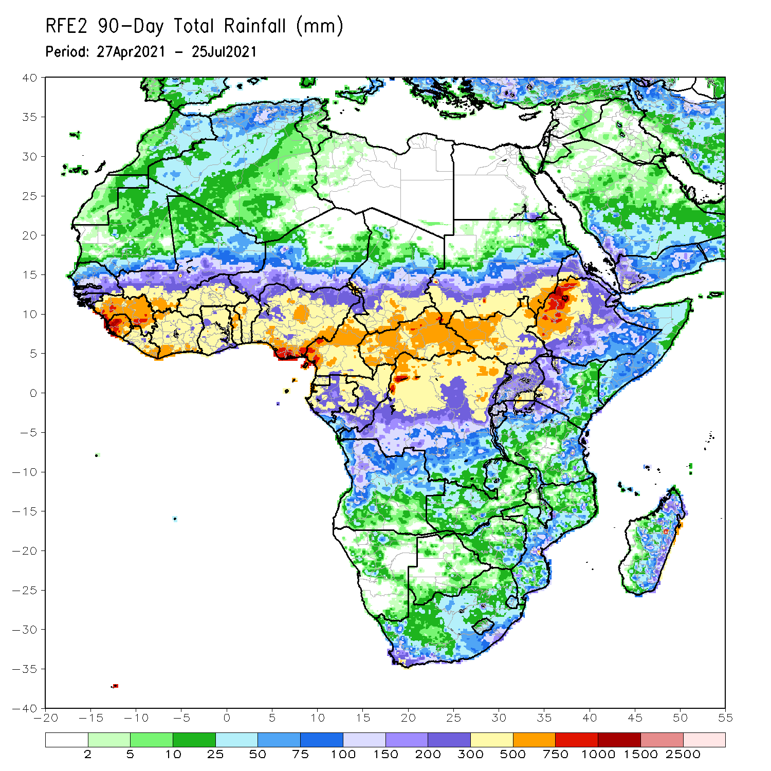
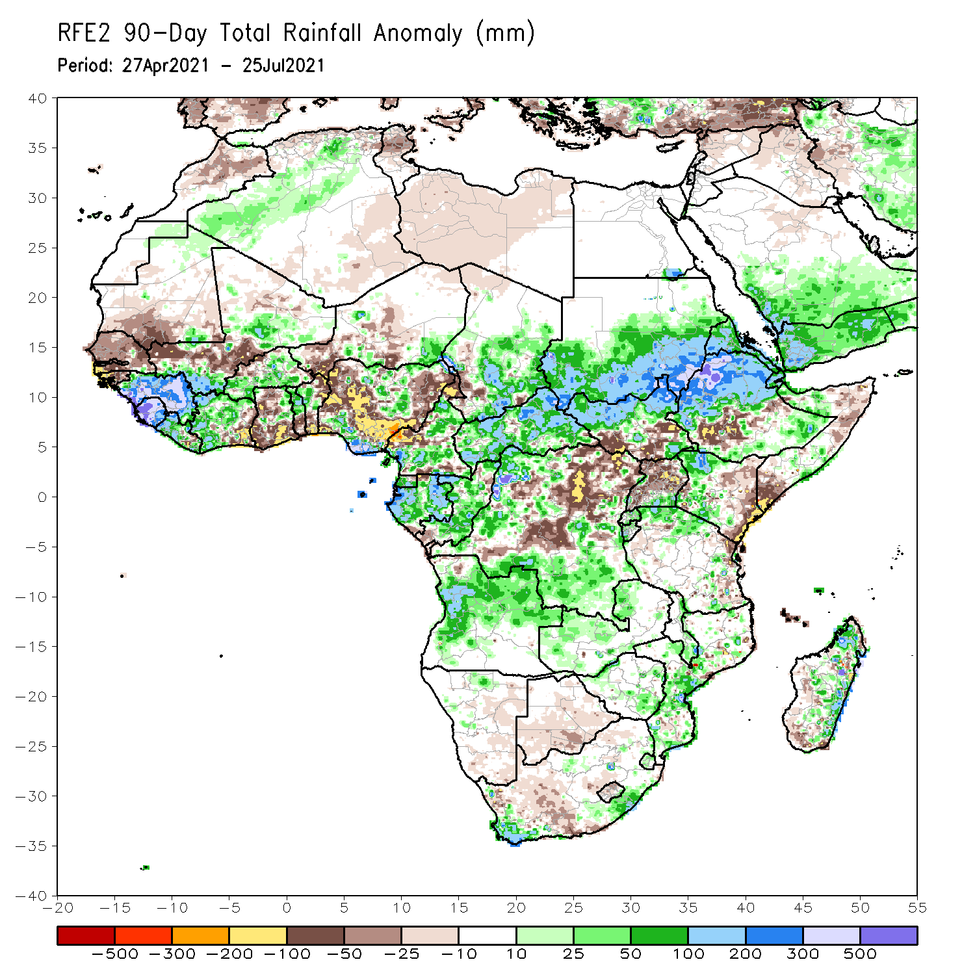
Rainfall Patterns: Last 90 Days
Over the past 90 days, in East Africa, above-average rainfall was observed over western and northern Ethiopia, Eritrea, northern South Sudan, southern and eastern Sudan, pockets of southeastern Ethiopia, western Kenya, and northern Tanzania. Rainfall was below-average over parts of southern Ethiopia, pockets of central and southern Somalia, and central and eastern Kenya. Rainfall was also below-average over southern South Sudan, northern Uganda and parts of eastern Tanzania. In southern Africa, above-average rainfall was observed over the far northern Southern Africa, while below-average rainfall was observed over pocket areas in the central and southern portions of Southern Africa. In Central Africa, rainfall was above-average over western and southern DRC, Equatorial Guinea, Gabon, Congo, and much of CAR. Rainfall was below-average over northeastern and central DRC. In West Africa, rainfall was above-average over much of Guinea, Sierra Leone, Liberia, Cote d’Ivoire, Burkina Faso, northern Benin, and southern Nigeria. Below-average rainfall was observed over Senegal, southern Mauritania, central Mali, parts of eastern Cote d’Ivoire, parts of Ghana, western Niger, and central and northern Nigeria.
Notes:
4

Slide 5
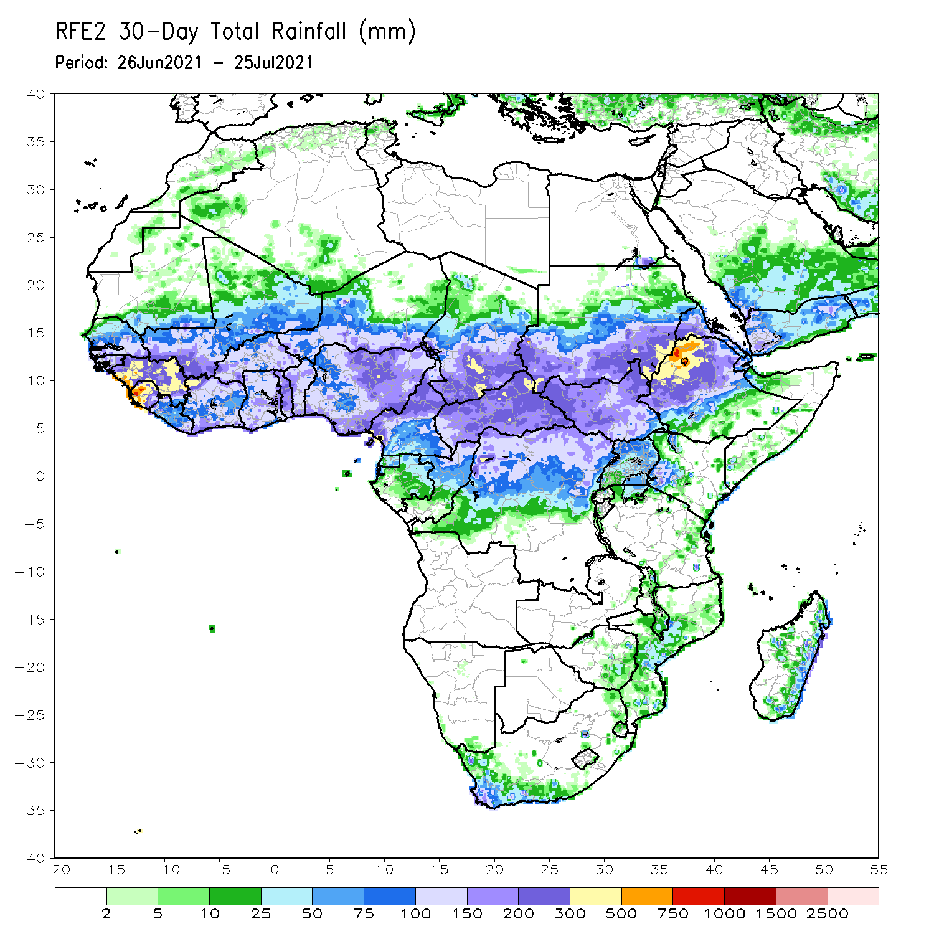
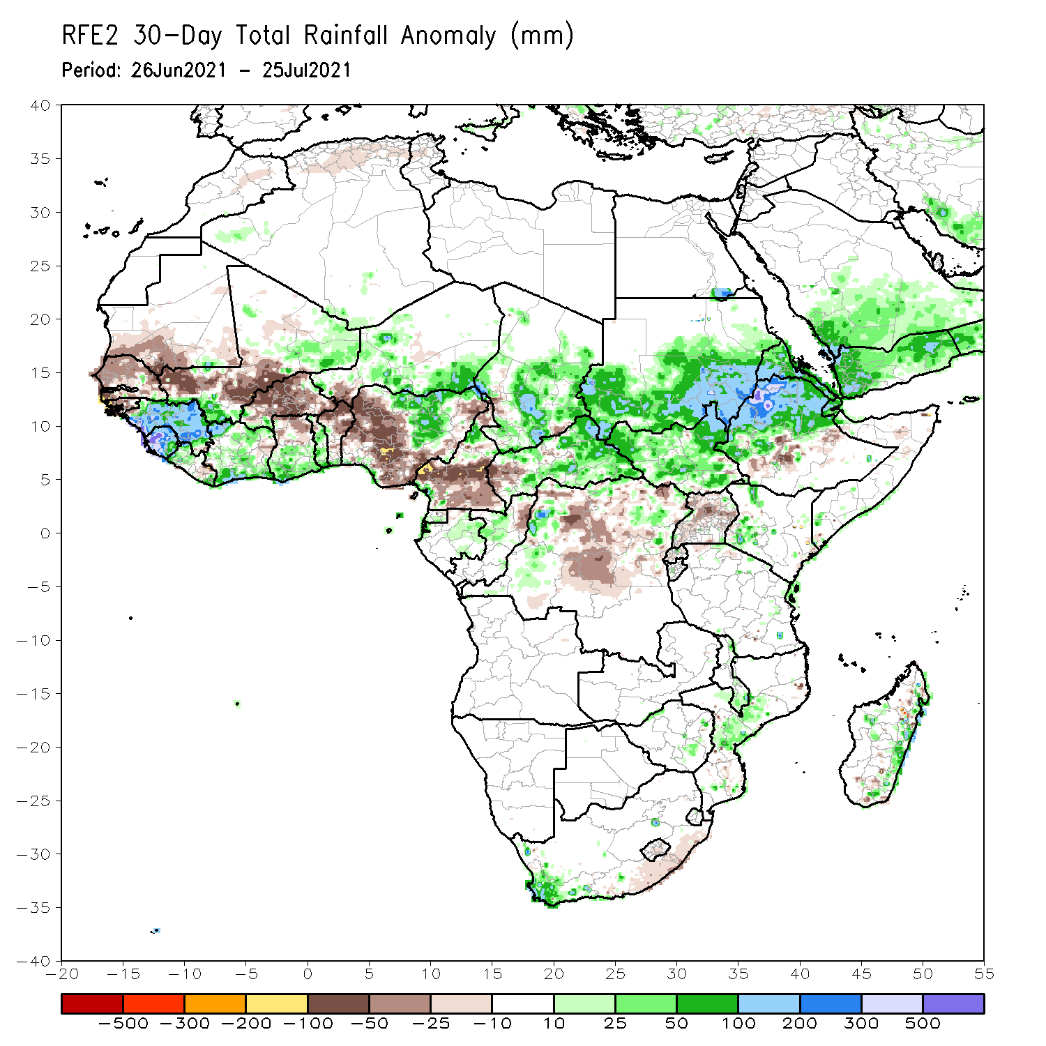
Rainfall Patterns: Last 30 Days
During the past 30 days, in East Africa, above-average rainfall was observed over the southern and eastern parts of Sudan and northern South Sudan Republic, and many parts of Ethiopia. Rainfall was below-average over pockets of southern Ethiopia, and parts of Uganda. In Central Africa, rainfall was below-average over parts of central and northern DRC, and southern Cameroon. Rainfall was above-average over Equatorial Guinea, Gabon, Congo, much of CAR, and pockets of DRC. In West Africa, rainfall was above-average over much of the Gulf of Guinea region. Below-average rainfall was observed over parts of Senegal, southern Mali, Guinea-Bissau, Burkina Faso, Niger, and portions of Nigeria.
Notes:
5

Slide 6
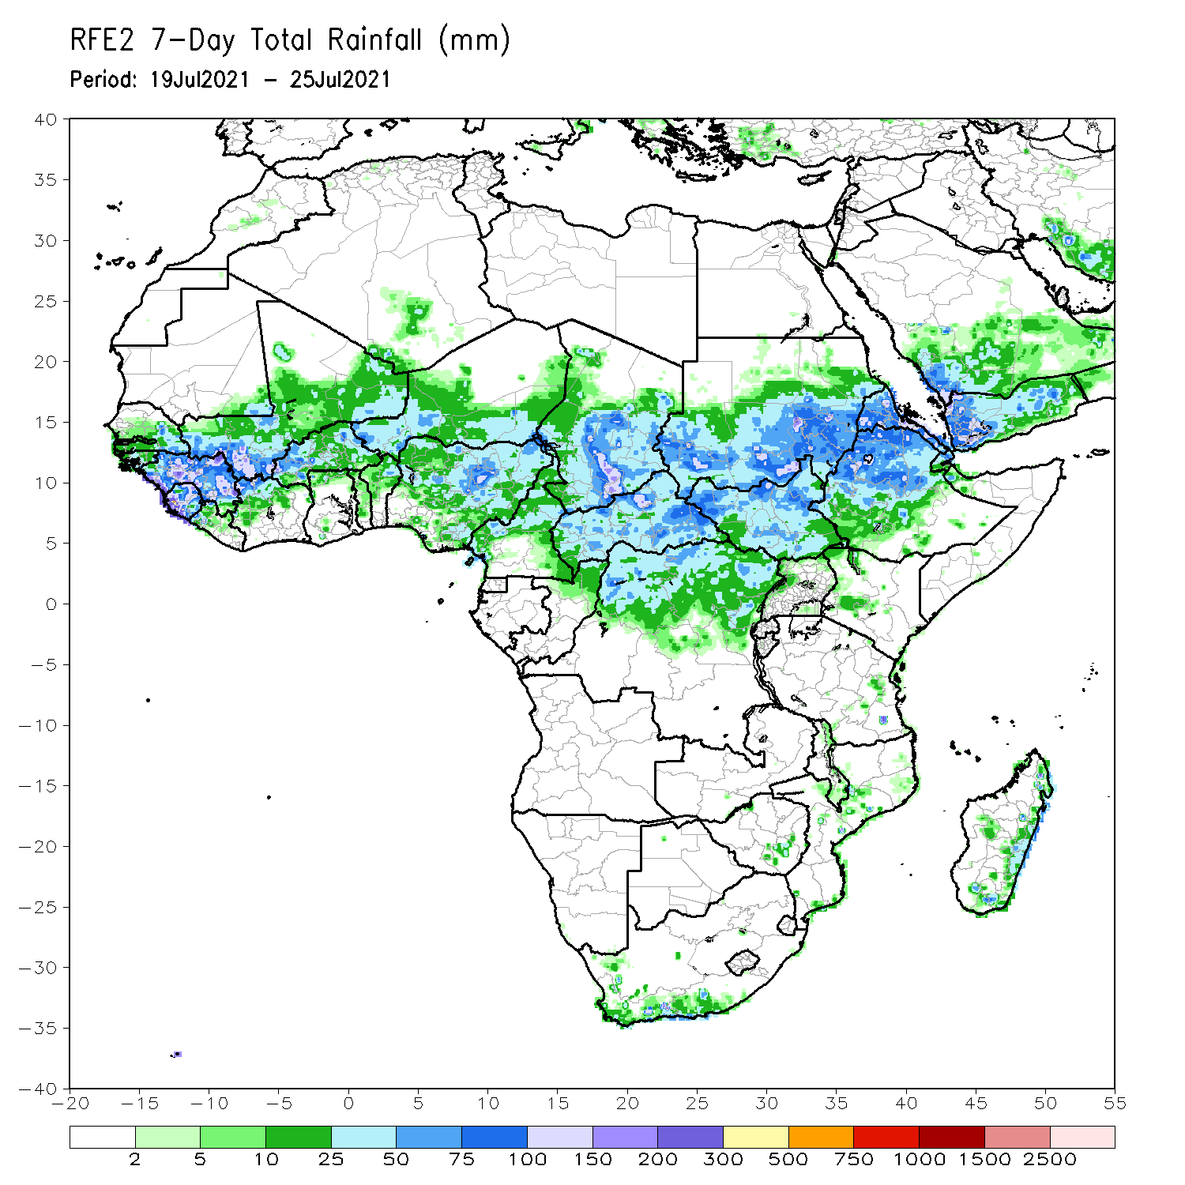
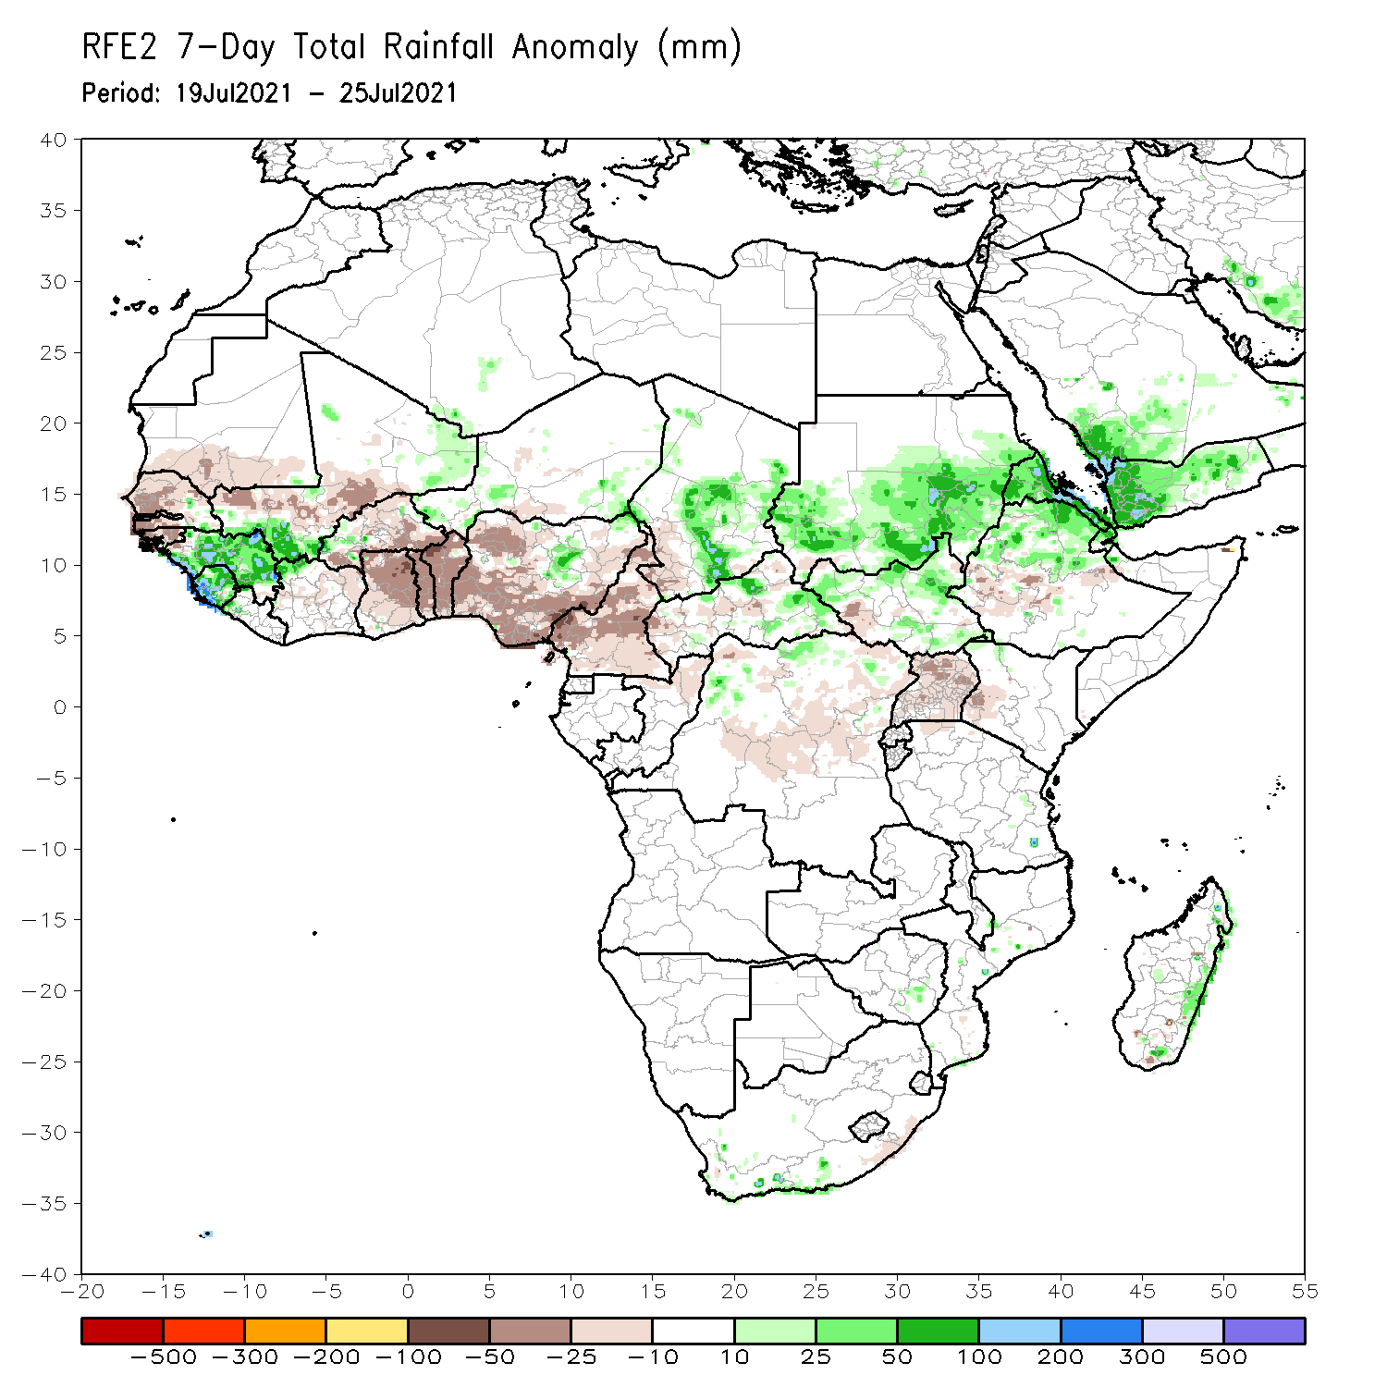
Rainfall Patterns: Last 7 Days
During the past 7 days, in East Africa, rainfall was above-average over southern and eastern Sudan, northern Ethiopia, Eritrea and pockets of South Sudan. Below-average rainfall was observed over pockets of South Sudan, southwestern Ethiopia and Uganda. In Central Africa, rainfall was above-average over pockets of northern DRC, CAR and central Chad. Below-average rainfall was observed over Cameroon, parts of CAR, portions of southern Chad and pockets of northern DRC. In West Africa, above-average rainfall was observed over Guinea and Sierra Leone, Below-average rainfall was observed over much of the Gulf of Guinea region, and over parts of Senegal, central Mali and Burkina Faso.

Slide 7
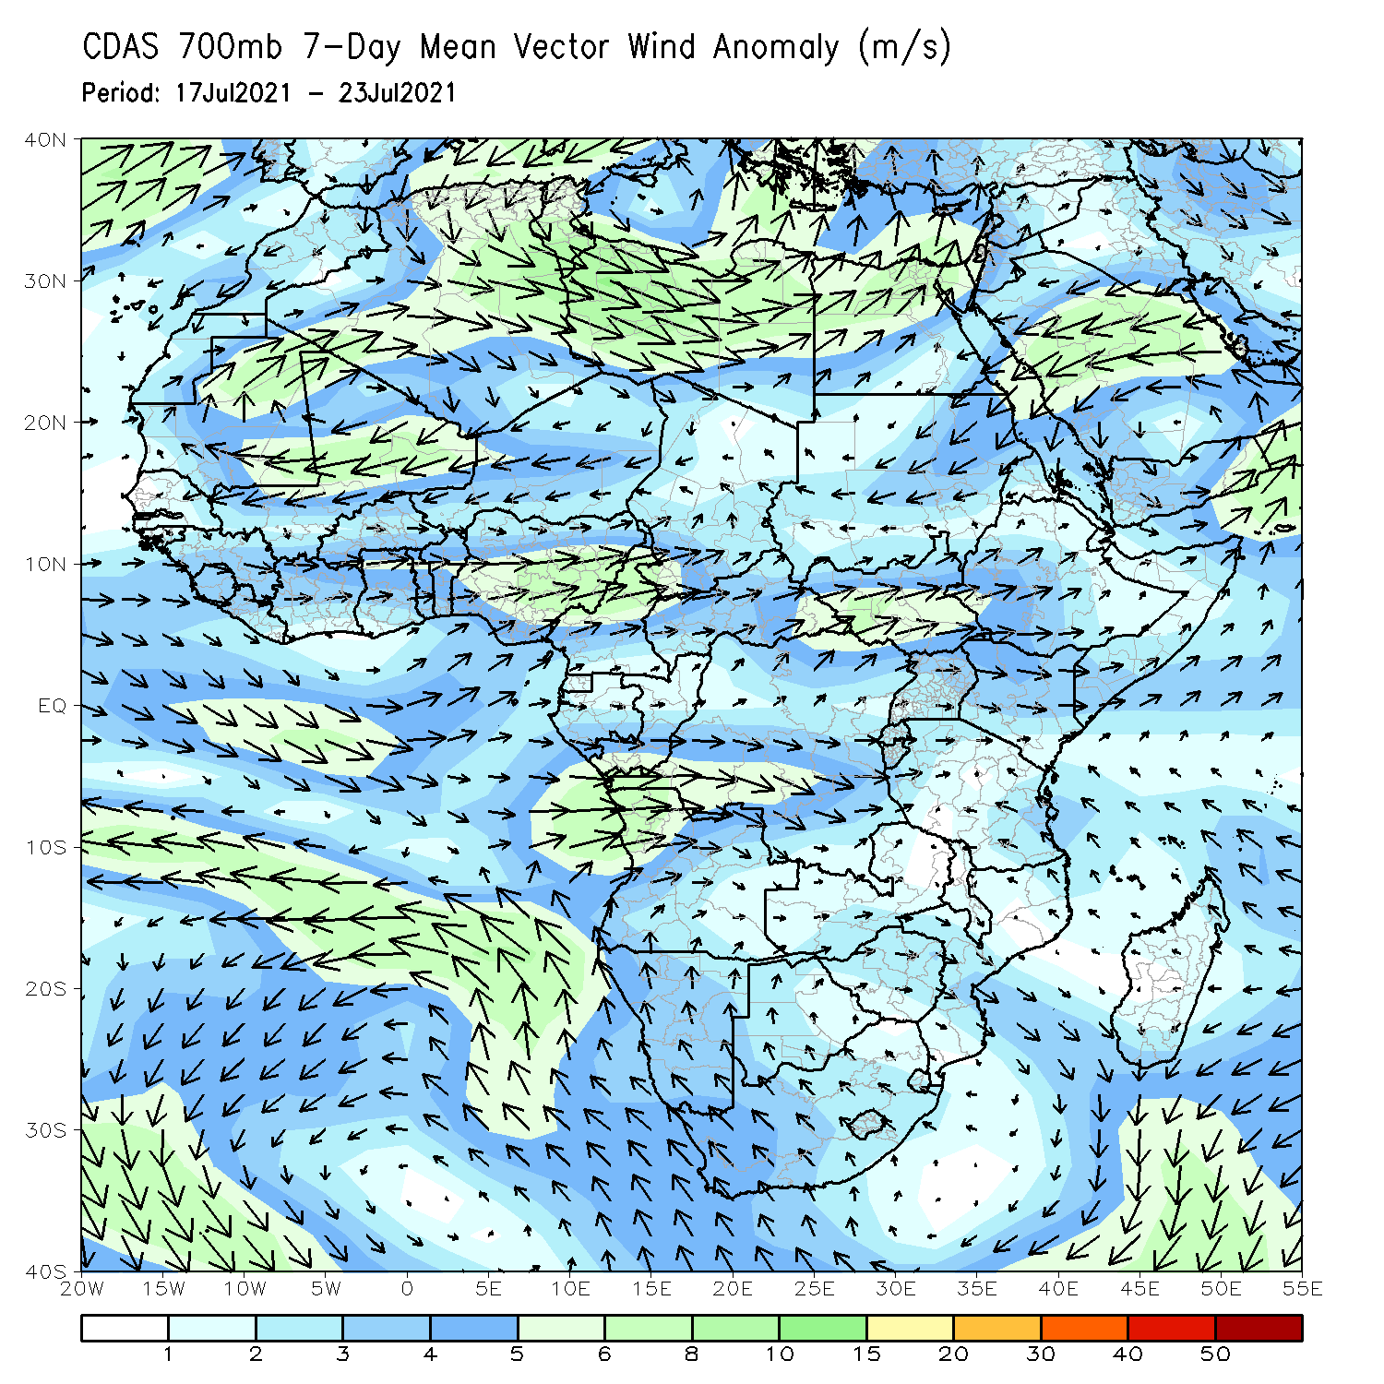
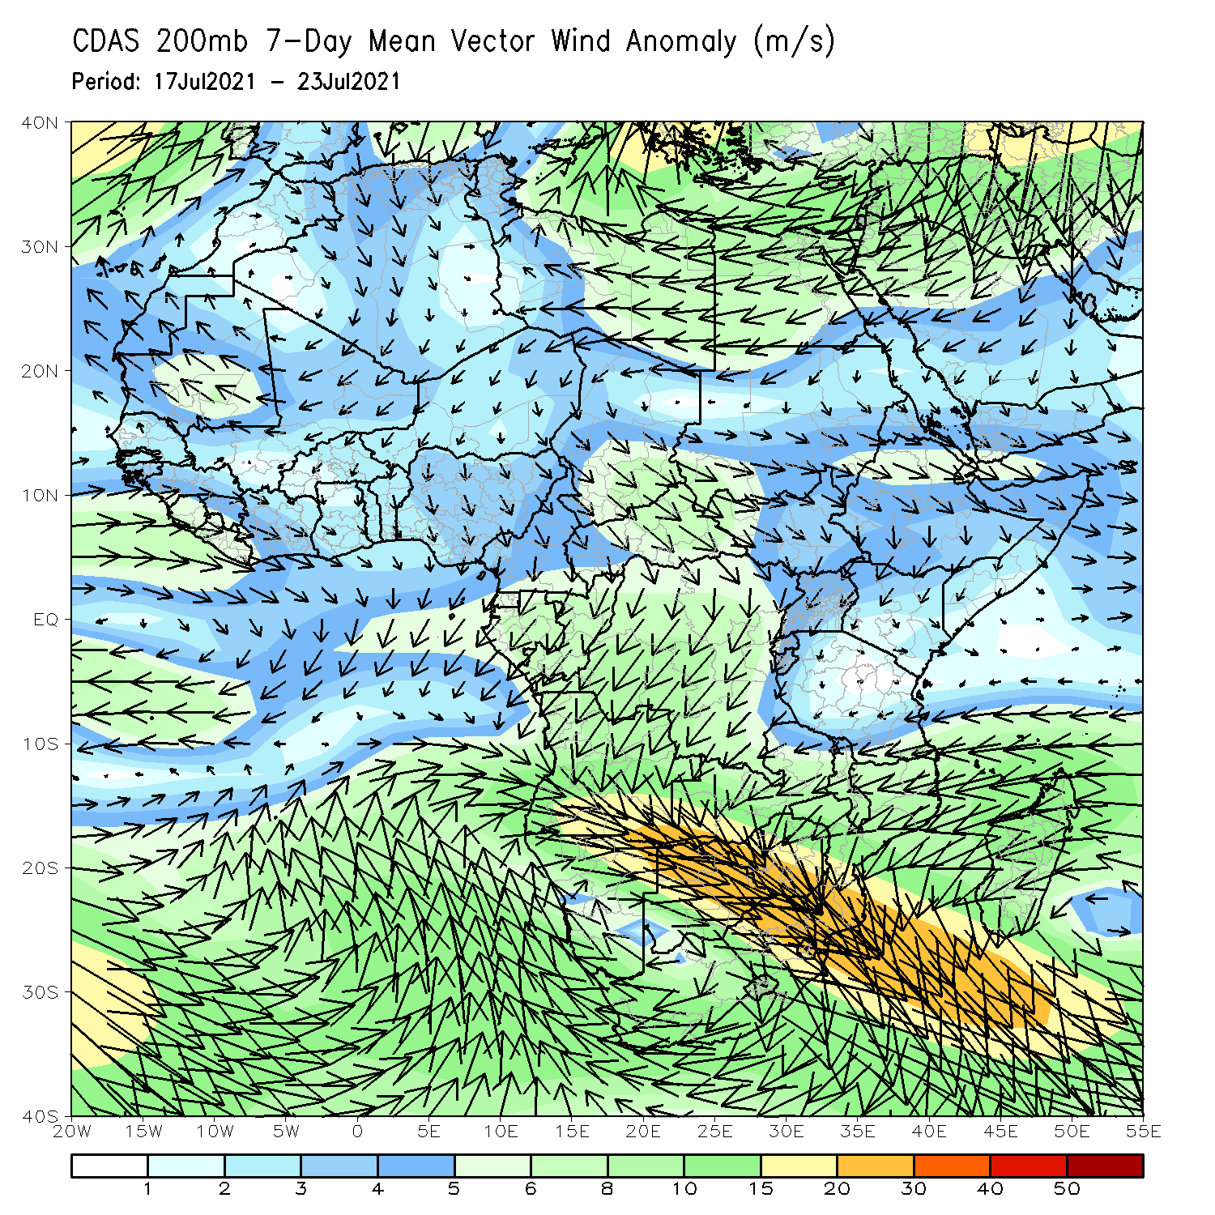
Atmospheric Circulation: Last 7 Days
At 700-hPa level (left panel), anomalous cyclonic flow was observed in the Sahel region.

Slide 8
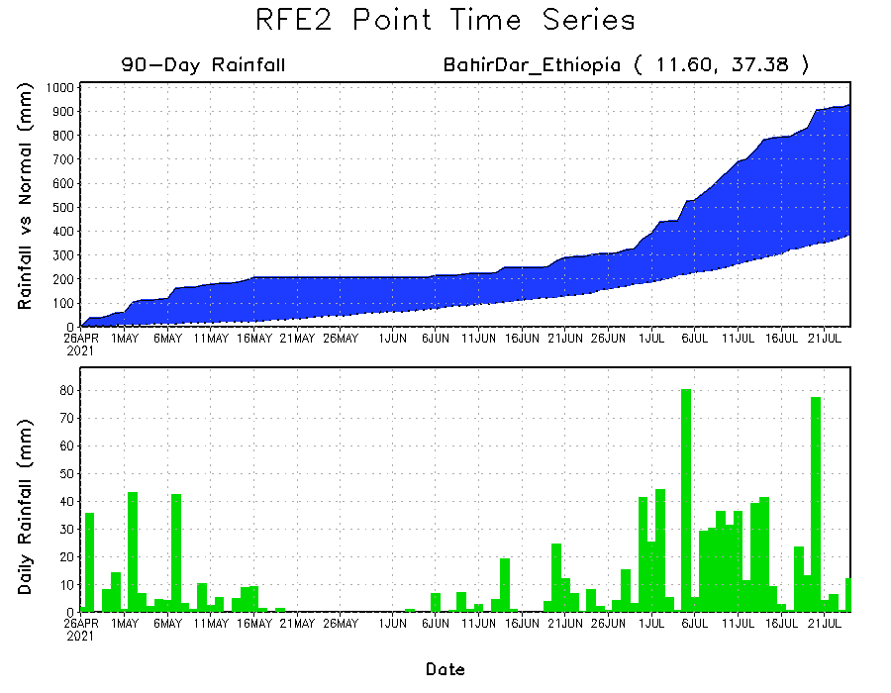
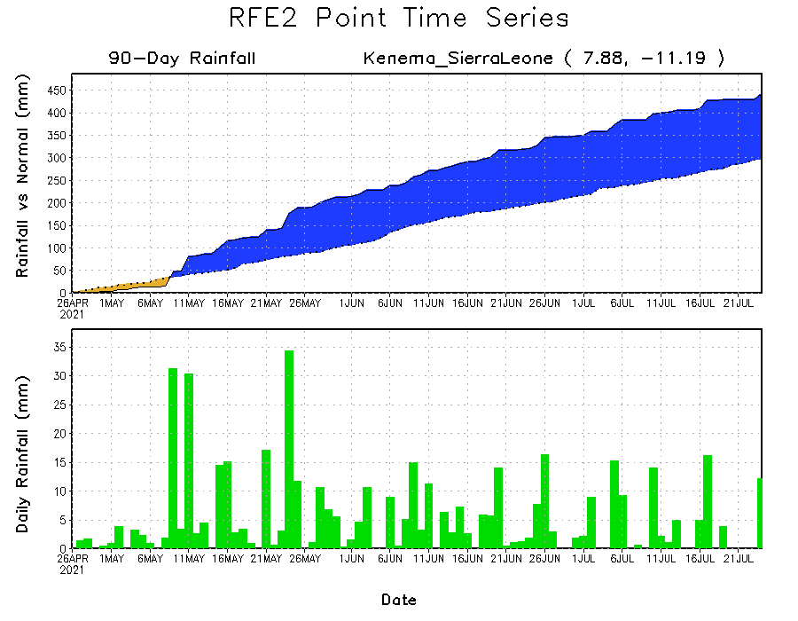
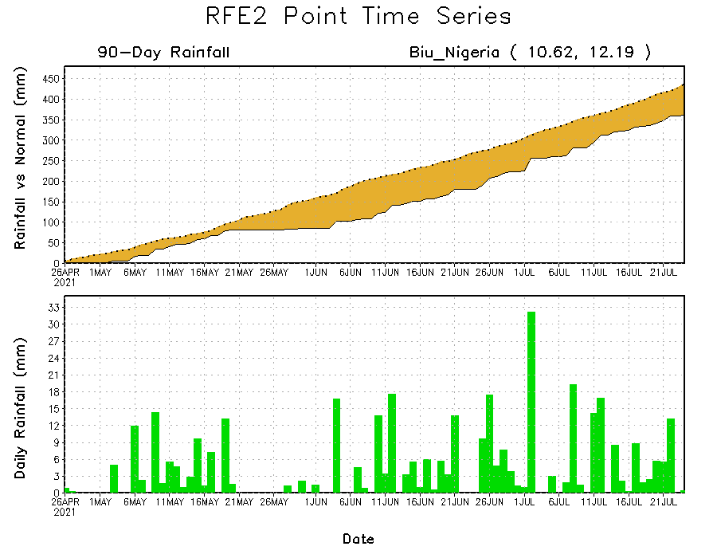
Rainfall Evolution
Daily evolution of rainfall over the last 90 days at selected locations shows moderate to heavy rainfall sustained moisture surpluses over parts of Sierra Leone (bottom left) and western Ethiopia (top right). In contrast, seasonal total rainfall remained below-average over northeastern Nigeria (bottom right).

Slide 9
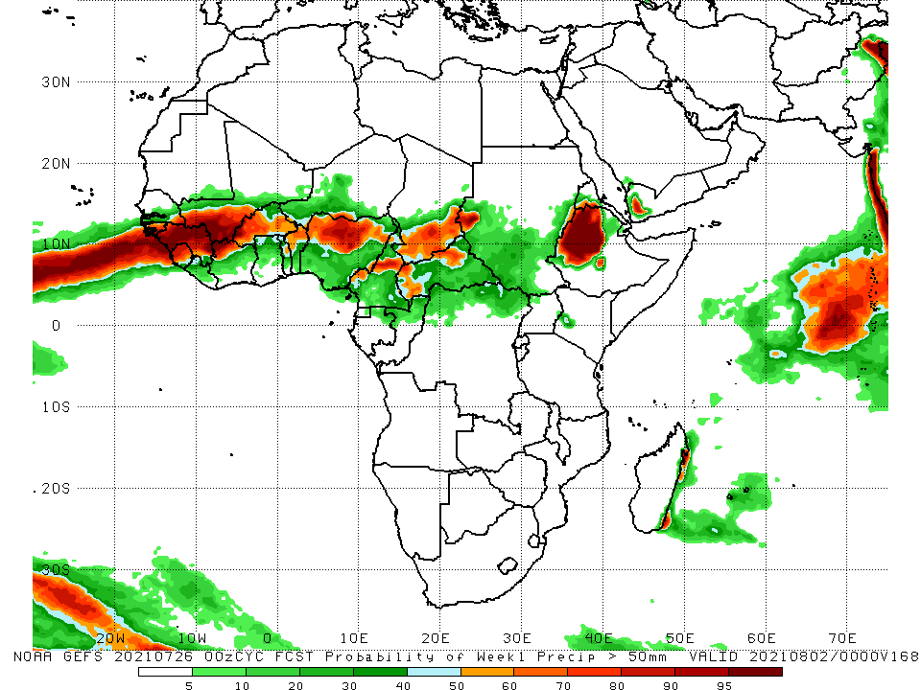
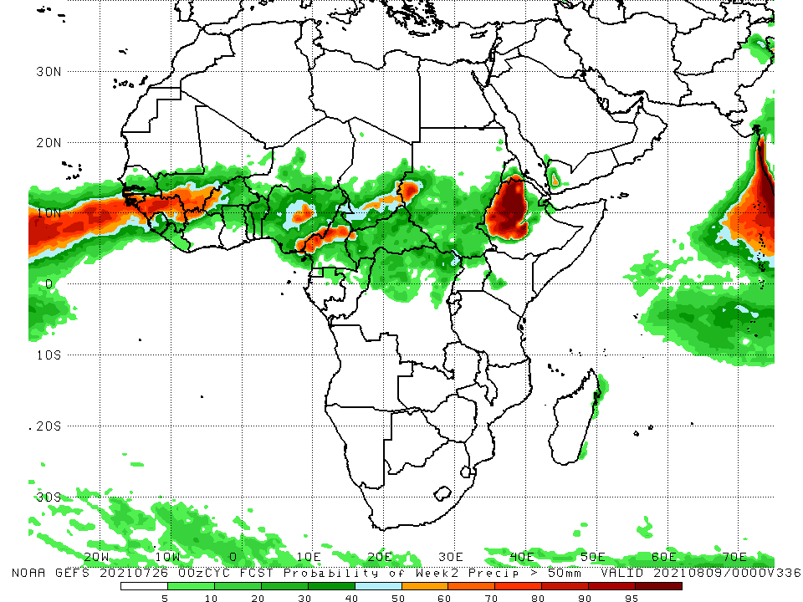
NCEP GEFS Model Forecasts Non-Bias Corrected Probability of precipitation exceedance
Week-1, Valid: 27 July – 02 August, 2021
Week-2, Valid: 03 – 09 August, 2021
For week-1 (left panel) and week-2 (right panel), the NCEP GEFS indicates a moderate to high chance (over 70%) for rainfall to exceed 50 mm over Guinea, Sierra Leone, southern Mali, western Burkina Faso, northern Benin, northern Nigeria, northern Cameroon, southern Chad, and western Ethiopia.
Notes:
9

Slide 10
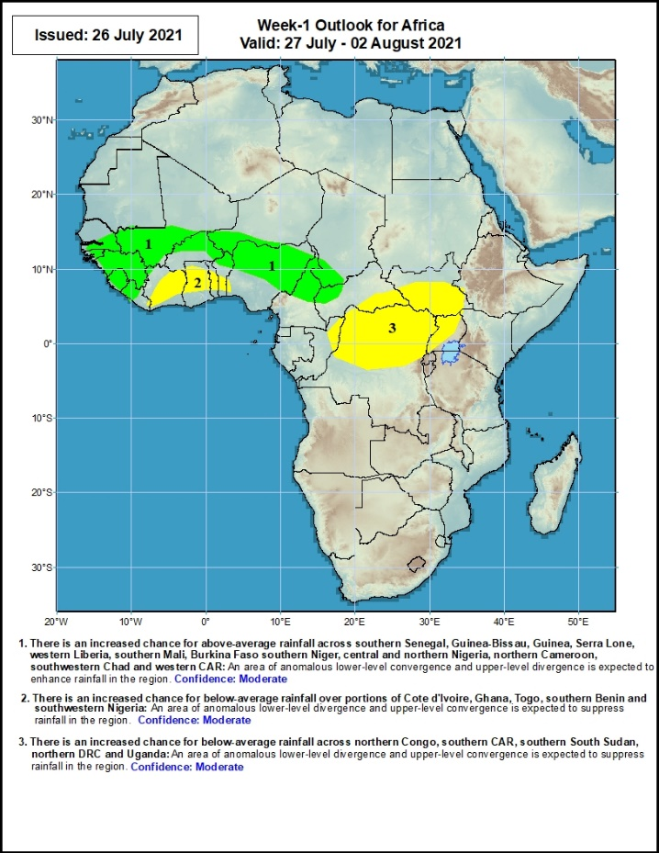
Week-1 Precipitation Outlooks
27 July – 2 August, 2021
There is an increased chance for above-average rainfall across southern Senegal, Guinea-Bissau, Guinea, Serra Lone, western Liberia, southern Mali, Burkina Faso, southern Niger, central and northern Nigeria, northern Cameroon, southwestern Chad and western CAR: An area of anomalous lower-level convergence and upper-level divergence is expected to enhance rainfall in the region. Confidence: Moderate
There is an increased chance for below-average rainfall over portions of Cote d'Ivoire, Ghana, Togo, southern Benin and southwestern Nigeria: An area of anomalous lower-level divergence and upper-level convergence is expected to suppress rainfall in the region. Confidence: Moderate
There is an increased chance for below-average rainfall across northern Congo, southern CAR, southern South Sudan, northern DRC and Uganda: An area of anomalous lower-level divergence and upper-level convergence is expected to suppress rainfall in the region. Confidence: Moderate
Notes:
10

Slide 11
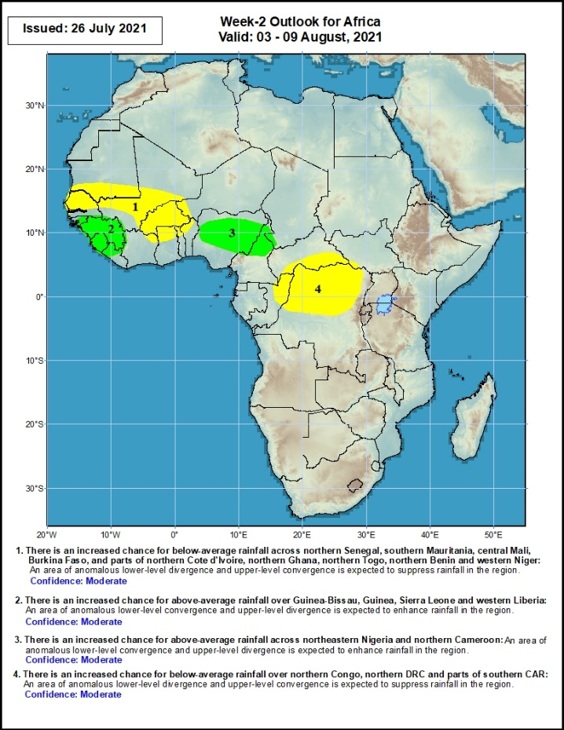
Week-2 Precipitation Outlooks
03 – 09 August, 2021
There is an increased chance for below-average rainfall across northern Senegal, southern Mauritania, central Mali, Burkina Faso, and parts of northern Cote d'Ivoire, northern Ghana, northern Togo, northern Benin and western Niger: An area of anomalous lower-level divergence and upper-level convergence is expected to suppress rainfall in the region. Confidence: Moderate
There is an increased chance for above-average rainfall over Guinea-Bissau, Guinea, Sierra Leone and western Liberia: An area of anomalous lower-level convergence and upper-level divergence is expected to enhance rainfall in the region. Confidence: Moderate
There is an increased chance for above-average rainfall across northeastern Nigeria and northern Cameroon: An area of anomalous lower-level convergence and upper-level divergence is expected to enhance rainfall in the region. Confidence: Moderate
There is an increased chance for below-average rainfall over northern Congo, northern DRC and parts of southern CAR: An area of anomalous lower-level divergence and upper-level convergence is expected to suppress rainfall in the region. Confidence: Moderate
Notes:
11

Slide 12
Summary
During the past 30 to 90 days, in East Africa, above-average rainfall was observed over the southern and eastern parts of Sudan and northern South Sudan Republic, and many parts of Ethiopia. Rainfall was below-average over pockets of southern Ethiopia, and parts of Uganda. In Central Africa, rainfall was below-average over parts of central and northern DRC, and southern Cameroon. Rainfall was above-average over Equatorial Guinea, Gabon, Congo, much of CAR, and pockets of DRC. In West Africa, rainfall was above-average over much of the Gulf of Guinea region. Below-average rainfall was observed over parts of Senegal, southern Mali, Guinea-Bissau, Burkina Faso, Niger, and portions of Nigeria.
During the past 7 days, in East Africa, rainfall was above-average over southern and eastern Sudan, northern Ethiopia, Eritrea and pockets of South Sudan. Below-average rainfall was observed over pockets of South Sudan, southwestern Ethiopia and Uganda. In Central Africa, rainfall was above-average over pockets of northern DRC, CAR and central Chad. Below-average rainfall was observed over Cameroon, parts of CAR, portions of southern Chad and pockets of northern DRC. In West Africa, above-average rainfall was observed over Guinea and Sierra Leone, Below-average rainfall was observed over much of the Gulf of Guinea region, and over parts of Senegal, central Mali and Burkina Faso.
Week-1 outlooks call for an increased chance for above-average rainfall over southern Senegal, Guinea-Bissau, Guinea, Sierra Leone, western Liberia, southern Mali, Burkina Faso southern Niger, central and northern Nigeria, northern Cameroon, southwestern Chad and western CAR. In contrast, the outlooks call for an increased chance for below-average rainfall over portions of Cote d'Ivoire, Ghana, Togo, southern Benin, southwestern Nigeria, northern Congo, southern CAR, southern South Sudan, northern DRC and Uganda..
Week-2 outlooks call for an increased chance for above-average rainfall over Guinea-Bissau, Guinea, Sierra Leone, western Liberia, northeastern Nigeria and northern Cameroon. In contrast the outlooks call for an increased chance for below-average rainfall over northern Senegal, southern Mauritania, central Mali, Burkina Faso, parts of northern Cote d'Ivoire, northern Ghana, northern Togo, northern Benin and western Niger, northern Congo, northern DRC and parts of southern CAR.

