Slide 1
The African Monsoon Recent Evolution and Current Status Include Week-1 and Week-2 Outlooks
Update prepared by
23 August 2021
For more information, visit:
http://www.cpc.ncep.noaa.gov/products/Global_Monsoons/African_Monsoons/precip_monitoring.shtml

Slide 2
Outline
Highlights
Recent Evolution and Current Conditions
NCEP GEFS Forecasts
Summary

Slide 3
Highlights: Last 7 Days
During the past 7 days, southeastern Senegal, southern Mauritania, southwestern Mali, Guinea, Sierra Leone, northern Liberia, and northwestern Nigeria received rainfall totals of over 150 mm (moisture surpluses of over 100 mm). In addition, weekly rainfall amounts reached 300-500 mm across pocket areas in southern Mauritania, Guinea, Sierra Leone, and Liberia (moisture surpluses of over 200 mm).
The week-1 outlooks depict an increased chance for above-average rainfall across much of the Gulf of Guinea region, including southern Senegal. Conversely, there is an increased chance for below-average rainfall across parts of southern Mauritania, central Mali, Burkina Faso, western Niger, northwestern Nigeria, eastern DRC, southern South Sudan, Uganda, Rwanda, Burundi and parts of northwestern Tanzania.
The week-2 outlooks call for an increased chance for above-average rainfall across much of Guinea, Sierra Leone, Liberia, Côte d'Ivoire, eastern Nigeria, Cameroon and western CAR. In contrast, there is an increased chance for below-average rainfall across parts of southern Mauritania, central Mali, Burkina Faso, western Niger, northern Benin, northwestern Nigeria, and the Lake Victoria region and the neighboring areas.

Slide 4
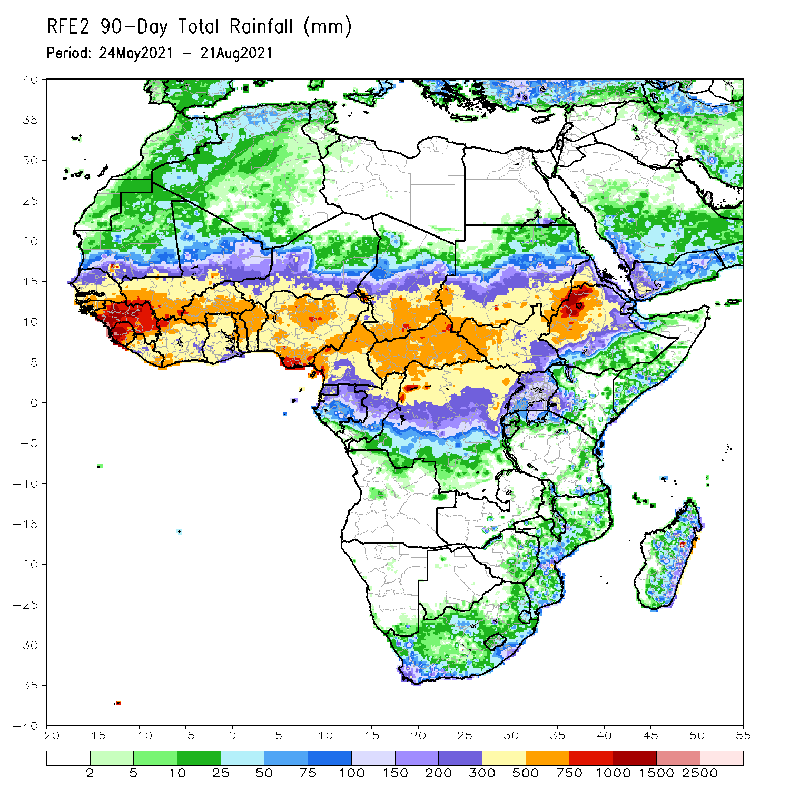
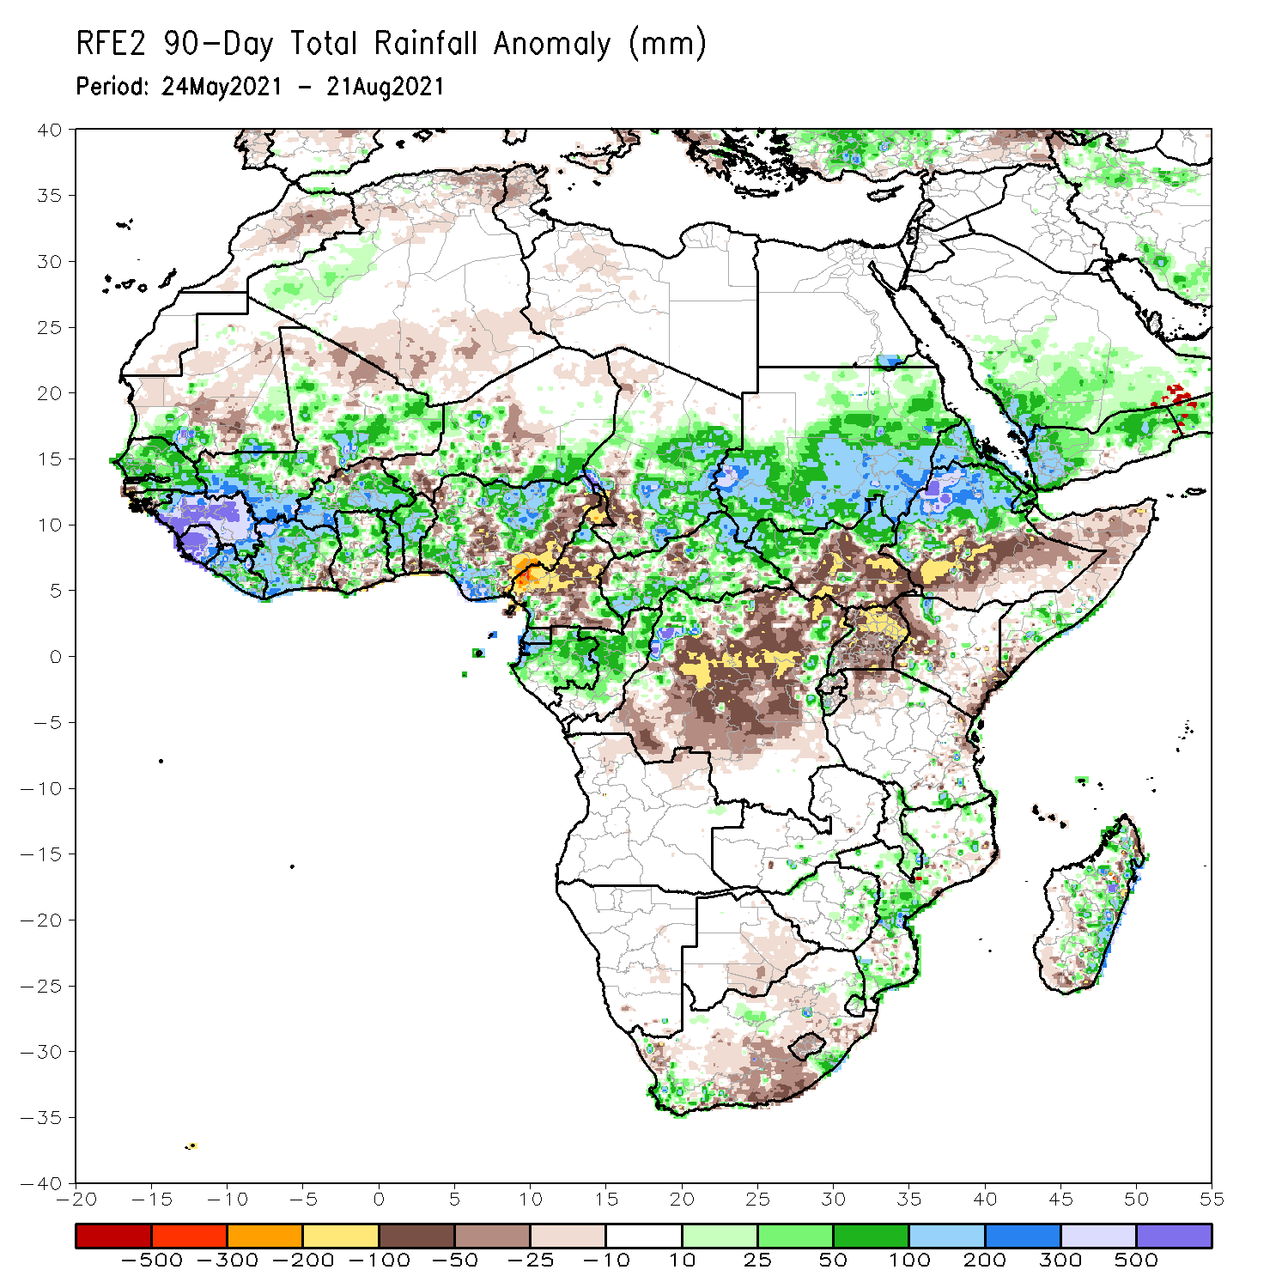
Rainfall Patterns: Last 90 Days
Over the past 90 days, in East Africa, rainfall was well above-average over Sudan, northern South Sudan, Eritrea, and northern Ethiopia. Below-average rainfall was observed central and southern South Sudan, southern Ethiopia, Somalia, Uganda, Kenya, and northwestern and eastern Tanzania.
In southern Africa, above-average rainfall was observed over local areas in South Africa and Zimbabwe, and many parts in Mozambique and eastern Madagascar. Light moisture deficits were observed over Botswana, much of South Africa and Lesotho, and portions of Madagascar.
In Central Africa, positive precipitation anomalies were found over central and southern Chad, much of CAR, Equatorial Guinea, Gabon, Congo, and local areas in northwestern and eastern DRC. Negative precipitation anomalies occurred in southwestern Chad, much of Cameroon, portions of CAR, and much of DRC.
In West Africa, moisture surpluses were observed over much of Senegal, Guinea-Bissau, Guinea, Sierra Leone, Liberia, Côte d’Ivoire, many parts of Mali, central and southern Burkina Faso, Ghana, Togo, Benin, parts of Niger, and northern and southern Nigeria. Southwestern Senegal, northern Mali, northern Burkina Faso, southern Benin, portions of Niger and Nigeria experienced moisture deficits.
Notes:
4

Slide 5
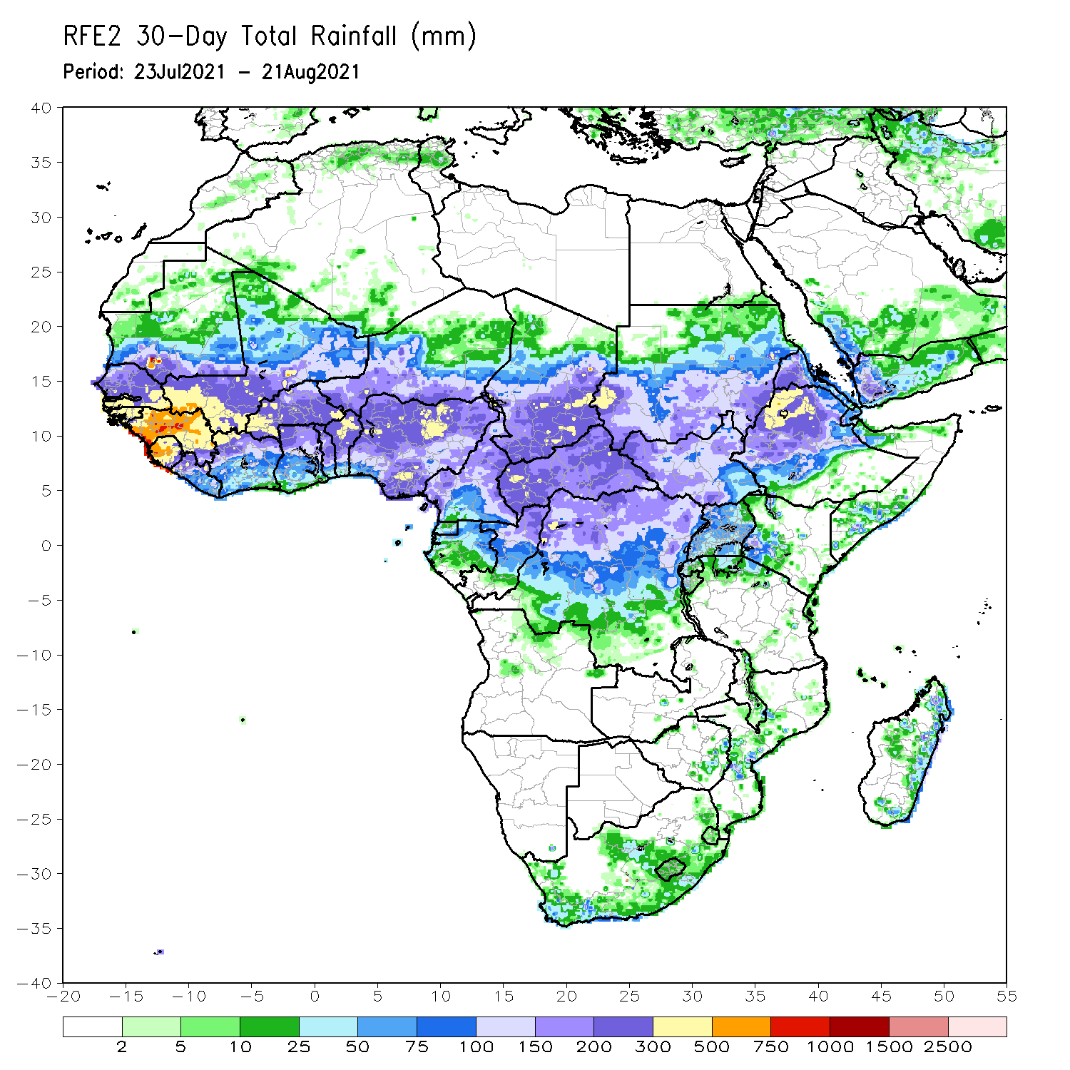
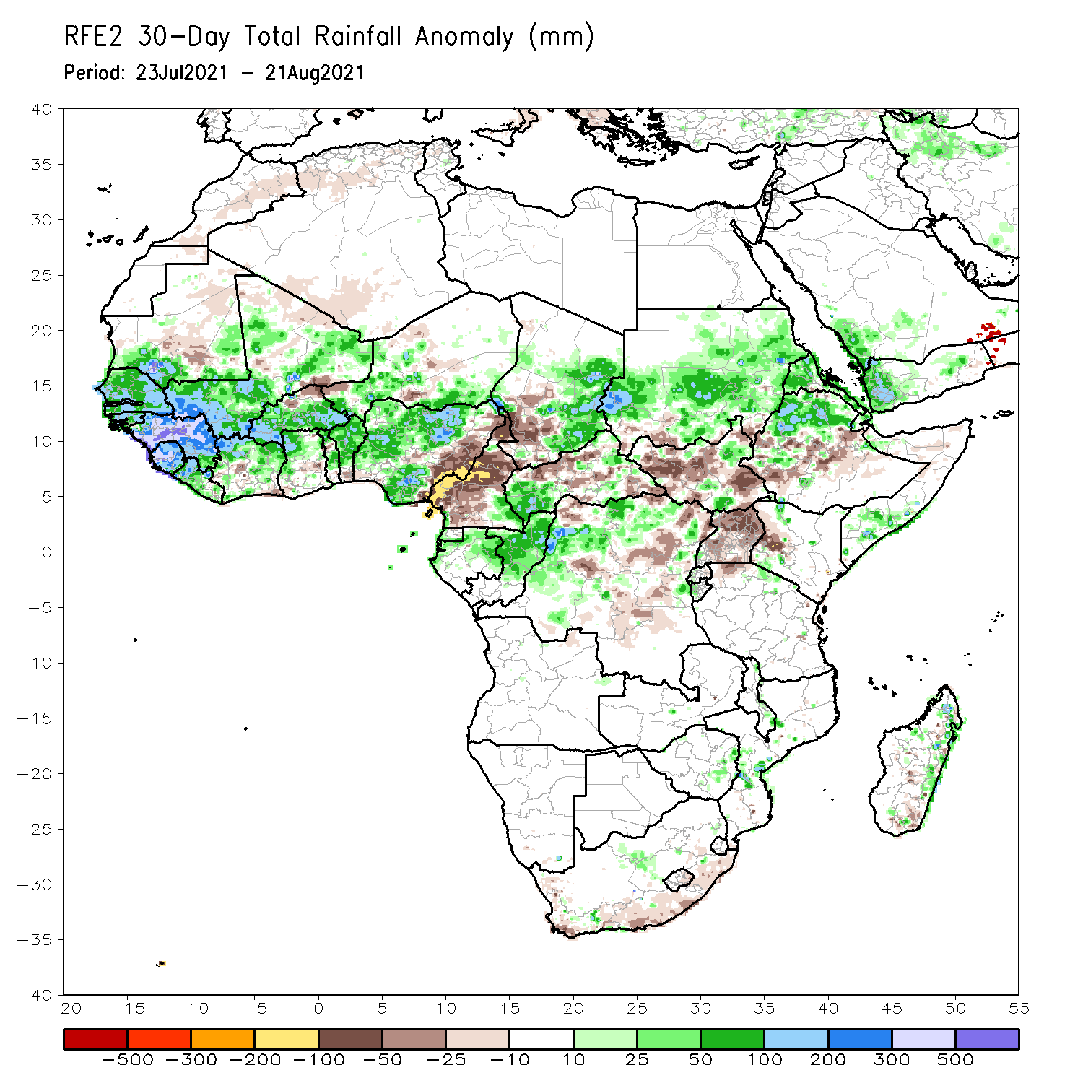
Rainfall Patterns: Last 30 Days
During the past 30 days, in East Africa, above-average rainfall was observed over Sudan, Eritrea, northern Ethiopia, and local areas in southern Somalia. Rainfall was below-average over central Ethiopia, much of South Sudan, western Kenya, and Uganda.
In southern Africa, scattered light moisture surpluses were found in Mozambique, eastern Zimbabwe, and eastern Madagascar. Light moisture deficits were observed over the southern part of South Africa and Madagascar.
In Central Africa, eastern Chad, southwestern CAR, Gabon, Congo, and northern DRC experienced positive rainfall anomalies. Conversely, southwestern Chad, much of Cameroon, and portions of CAR and DRC experienced negative rainfall anomalies.
In West Africa, rainfall was above-average over Senegal, Guinea-Bissau, Guinea, Sierra Leone, Liberia, northern Côte d’Ivoire, Mali, central and southern Burkina Faso, northern Ghana, Togo, Benin, Niger and northern and southern Nigeria. Moisture deficits were observed over northern Burkina Faso and eastern Nigeria.
Notes:
5

Slide 6
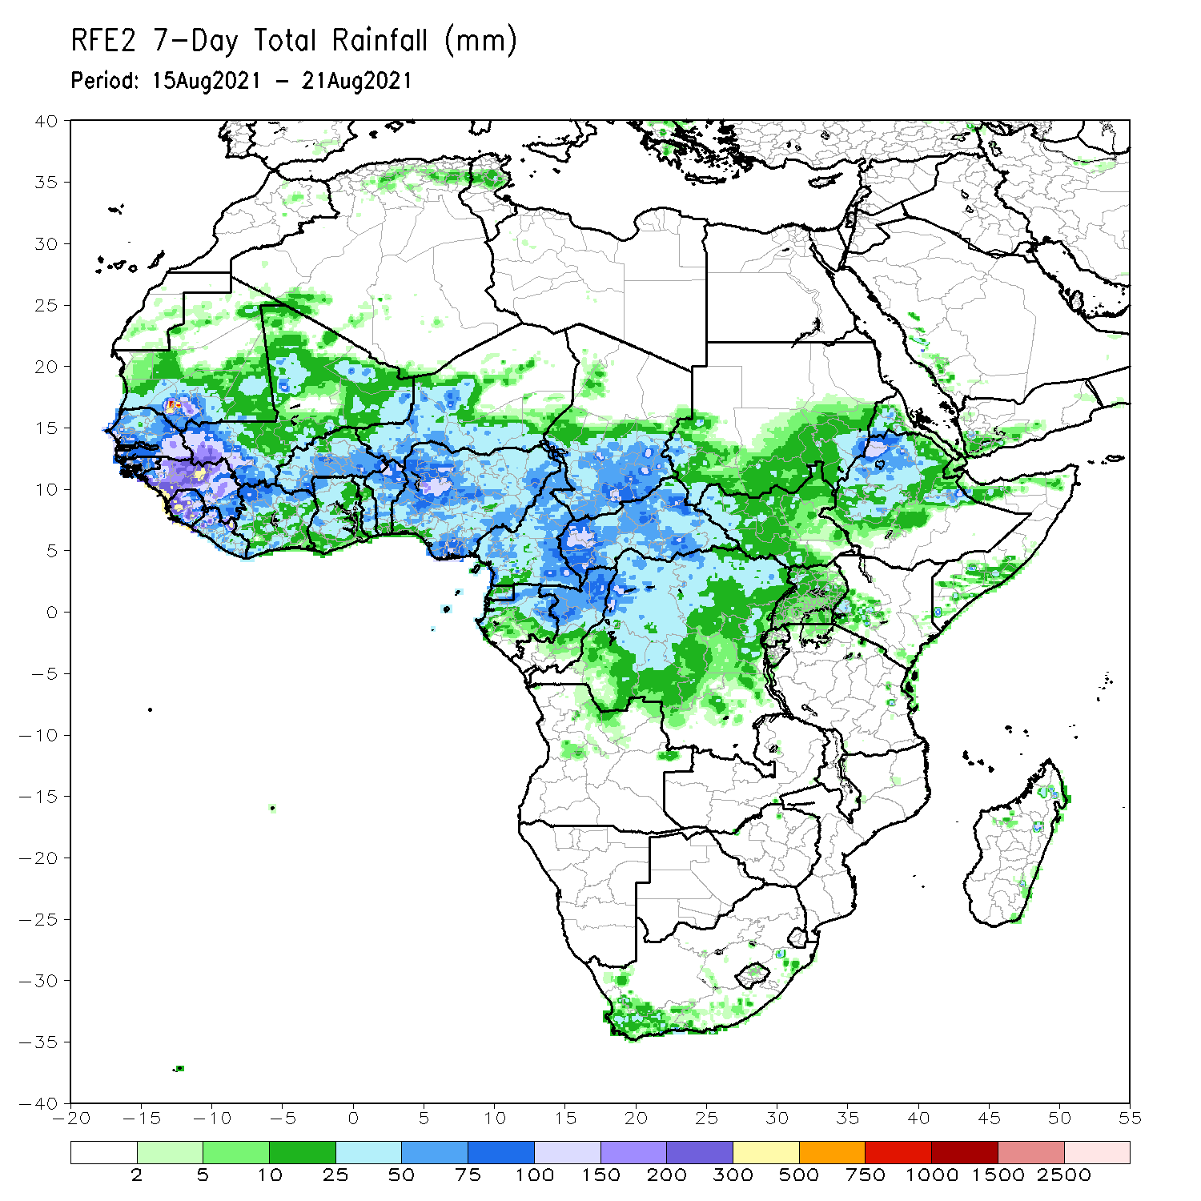
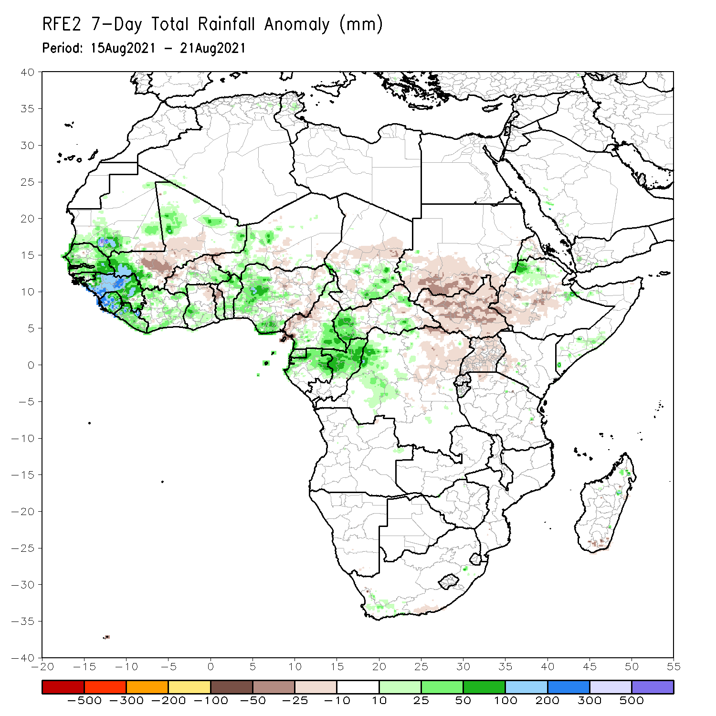
Rainfall Patterns: Last 7 Days
During the past 7 days, much of the East African region observed near-normal to below-normal rainfall, except local areas in southern and eastern Ethiopia and Somalia.
In Central Africa, rainfall was above-average over southern Chad, northern and southern Cameroon, western and eastern CAR, Equatorial Guinea, Gabon, Congo and western DRC. Central and southwestern Chad, western Cameroon, portions of CAR, and eastern DRC experienced below-average rainfall.
In West Africa, southern Mauritania, Senegal, Guinea-Bissau, Guinea, Sierra Leone, Liberia, northern and southwestern Mali, Côte d’Ivoire, western Niger, Benin, and western Nigeria observed above-average rainfall. Central Mali, northern Burkina Faso, northern Togo, and eastern Nigeria experienced below-average rainfall conditions.

Slide 7
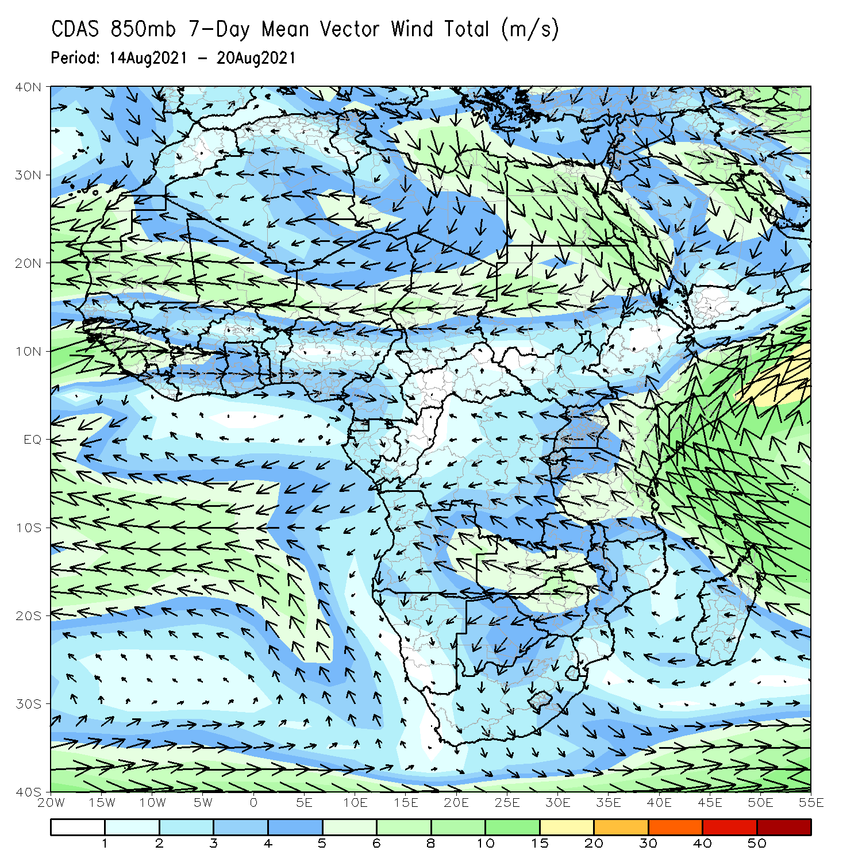
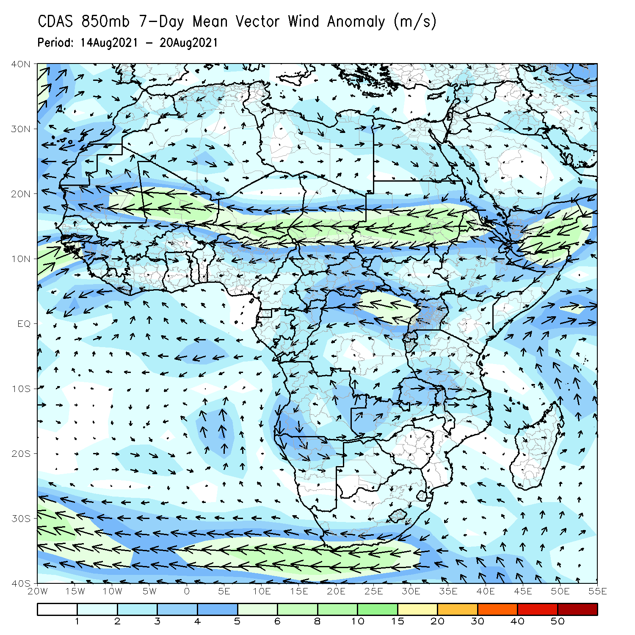
Atmospheric Circulation: Last 7 Days
The 850-hPa atmospheric circulation pattern features a moisture-laden westerly flow over Senegal, Guinea, Sierra Leone, and Côte d’Ivoire (right panel). This flow may have contributed to enhanced rainfall in those areas.
An anomalous cyclonic circulation was present over Central Africa (right panel).

Slide 8
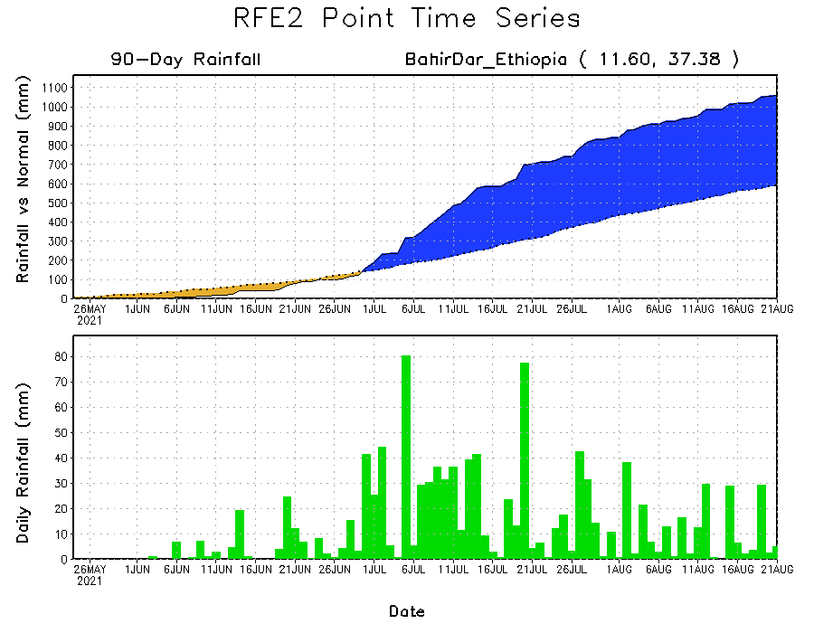
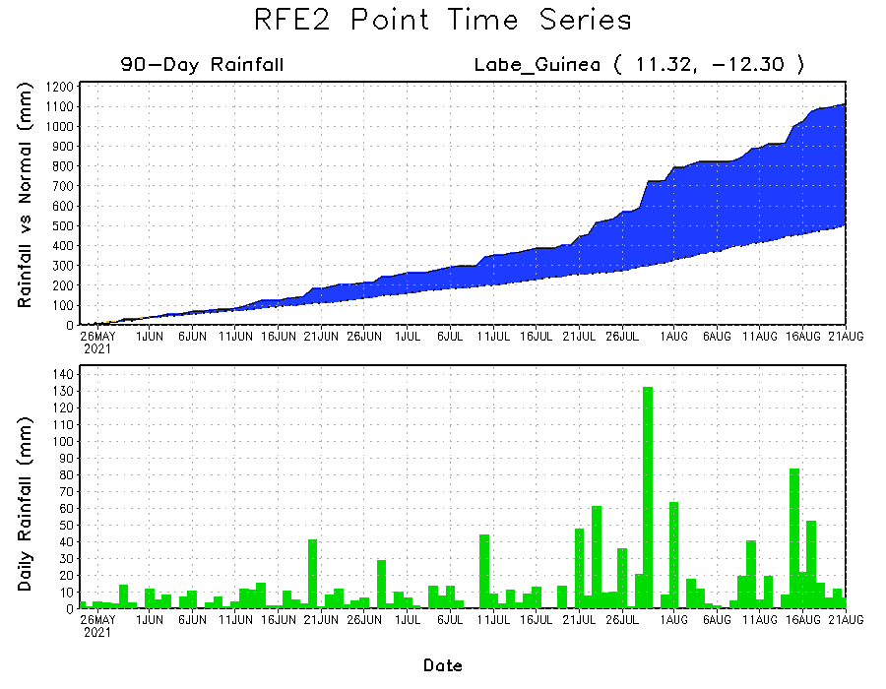
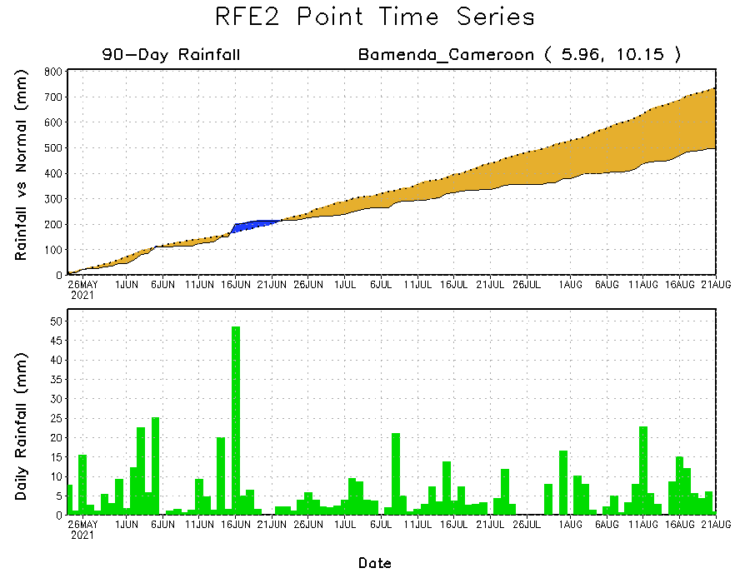
Rainfall Evolution
Daily evolution of rainfall over the last 90 days at selected locations shows moderate to heavy rainfall sustained moisture surpluses over parts of Guinea (bottom left) and western Ethiopia (top right). In contrast, seasonal total rainfall remained below-average over western Cameroon (bottom right).

Slide 9
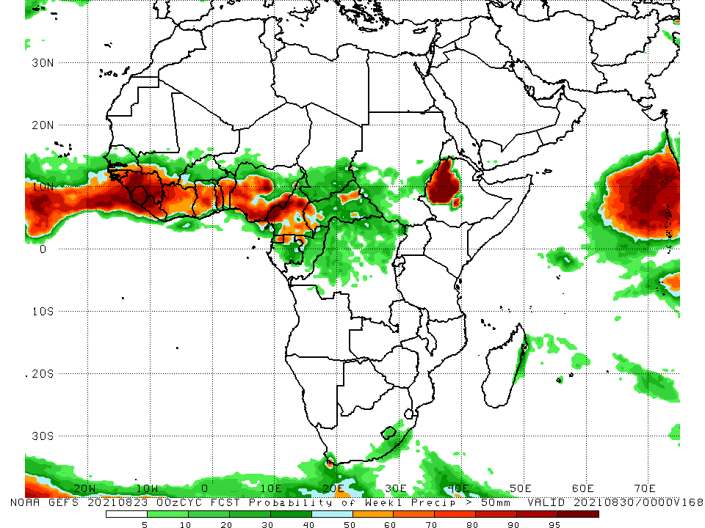
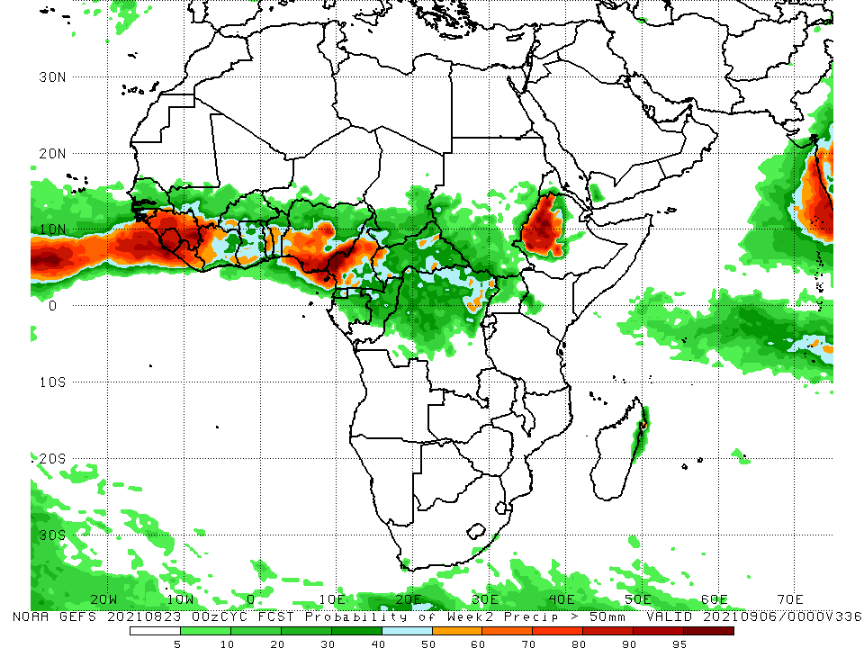
NCEP GEFS Model Forecasts Non-Bias Corrected Probability of precipitation exceedance
Week-1, Valid: 24 – 30 August, 2021
Week-2, Valid: 31 August – 6 September, 2021
For week-1 (left panel) and week-2 (right panel), the NCEP GEFS forecasts indicate a moderate to high chance (over 70%) for rainfall to exceed 50 mm over southern Senegal, Guinea-Bissau, Guinea, Sierra Leone, Liberia, Côte d’Ivoire, southwestern Mali, southwestern Burkina Faso, portions Ghana, Togo, and Benin, southern Nigeria, Cameroon, local areas in CAR and DRC, and western Ethiopia.
In addition, week-1 forecast depicts an increased chance for weekly rainfall to exceed 50 mm in Equatorial Guinea, northern Gabon, and northern Togo.
Notes:
9

Slide 10
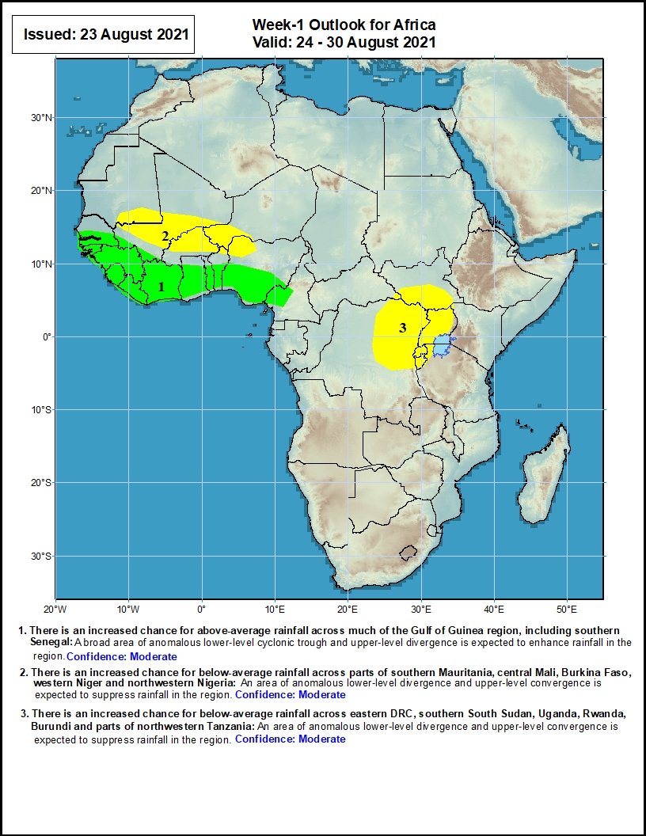
Week-1 Precipitation Outlooks
24 – 30 August, 2021
There is an increased chance for above-average rainfall across much of the Gulf of Guinea region, including southern Senegal: A broad area of anomalous lower-level cyclonic trough and upper-level divergence is expected to enhance rainfall in the region.
There is an increased chance for below-average rainfall across parts of southern Mauritania, central Mali, Burkina Faso, western Niger and northwestern Nigeria: An area of anomalous lower-level divergence and upper-level convergence is expected to suppress rainfall in the region.
There is an increased chance for below-average rainfall across eastern DRC, southern South Sudan, Uganda, Rwanda, Burundi and parts of northwestern Tanzania: An area of anomalous lower-level divergence and upper-level convergence is expected to suppress rainfall in the region.
Notes:
10

Slide 11
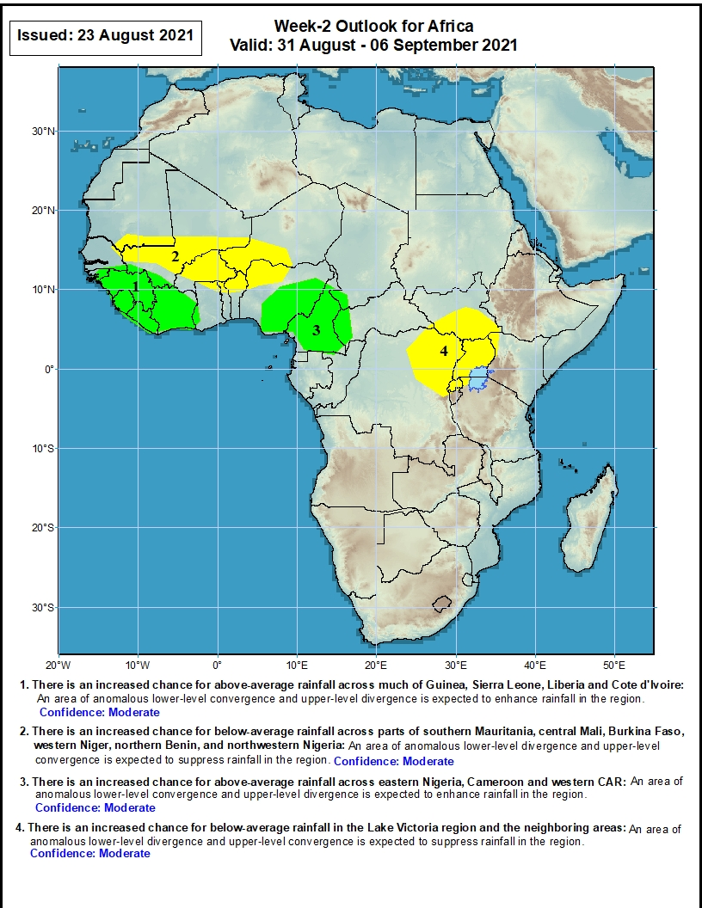
Week-2 Precipitation Outlooks
31 August – 6 September, 2021
There is an increased chance for above-average rainfall across much of Guinea, Sierra Leone, Liberia and Côte d'Ivoire: An area of anomalous lower-level convergence and upper-level divergence is expected to enhance rainfall in the region.
There is an increased chance for below-average rainfall across parts of southern Mauritania, central Mali, Burkina Faso, western Niger, northern Benin, and northwestern Nigeria: An area of anomalous lower-level divergence and upper-level convergence is expected to suppress rainfall in the region.
There is an increased chance for above-average rainfall across eastern Nigeria, Cameroon and western CAR: An area of anomalous lower-level convergence and upper-level divergence is expected to enhance rainfall in the region.
There is an increased chance for below-average rainfall in the Lake Victoria region and the neighboring areas: An area of anomalous lower-level divergence and upper-level convergence is expected to suppress rainfall in the region.
Notes:
11

Slide 12
Summary
During the past 30 to 90 days, in East Africa, above-average rainfall was observed over Sudan, parts of South Sudan Republic, Eritrea, and northern Ethiopia. Rainfall was below-average over southern Ethiopia, Uganda, and western Kenya. In Central Africa, moisture surpluses were found in eastern Chad, portions of CAR, Gabon, Congo, and part of northern DRC. Moisture deficits occurred in Cameroon, southwestern Chad, parts of CAR, and central DRC. In West Africa, rainfall was above-average over Senegal, Guinea-Bissau, Guinea, Sierra Leone, Liberia, Mali, Burkina Faso, Côte d’Ivoire, Togo, Benin, parts of Niger, and portions of Nigeria. Below-average rainfall was observed over northern Burkina Faso, and eastern Nigeria.
During the past 7 days, much of the East African region observed near-normal to below-normal rainfall conditions, except local areas in northern and eastern Ethiopia and Somalia. In Central Africa, rainfall was well above-average over southeastern Chad, southern Cameroon, Equatorial Guinea, Gabon, Congo, western CAR and northwestern DRC. In West Africa, rainfall was well above average in southern Mauritania, Guinea, Sierra Leone, Liberia, northwestern Mali, and western Nigeria. Moisture deficits occurred in central Mali, northern Burkina Faso, northern Togo, and eastern Nigeria.
The week-1 outlooks depict an increased chance for above-average rainfall across much of the Gulf of Guinea region, including southern Senegal. Conversely, there is an increased chance for below-average rainfall across parts of southern Mauritania, central Mali, Burkina Faso, western Niger, northwestern Nigeria, eastern DRC, southern South Sudan, Uganda, Rwanda, Burundi and parts of northwestern Tanzania.
The week-2 outlooks call for an increased chance for above-average rainfall across much of Guinea, Sierra Leone, Liberia, Côte d'Ivoire, eastern Nigeria, Cameroon and western CAR. In contrast, there is an increased chance for below-average rainfall across parts of southern Mauritania, central Mali, Burkina Faso, western Niger, northern Benin, northwestern Nigeria, and the Lake Victoria region and the neighboring areas.

