Slide 1
The African Monsoon Recent Evolution and Current Status Include Week-1 and Week-2 Outlooks
Update prepared by
13 September 2021
For more information, visit:
http://www.cpc.ncep.noaa.gov/products/Global_Monsoons/African_Monsoons/precip_monitoring.shtml

Slide 2
Outline
Highlights
Recent Evolution and Current Conditions
NCEP GEFS Forecasts
Summary

Slide 3
Highlights: Last 7 Days
During the past 7 days, local areas over southwestern Burkina Faso, southwestern Nigeria, central Chad, the northeastern border of Nigeria and Chad, western Sudan, southern CAR, portions of DRC, eastern South Sudan, and northern Ethiopia received moderate to heavy rainfall, with precipitation totals of over 100 mm (positive precipitation anomalies of over 50 mm).
The week-1 outlooks depict an increased chance for above-average rainfall across southern Senegal, Guinea-Bissau, Guinea, Sierra Leone, Liberia, Equatorial Guinea, Gabon, central Congo, and southwestern Ethiopia. Conversely, there is an increased chance for below-average rainfall across southwestern Ethiopia.
The week-2 outlooks call for an increased chance for above-average rainfall across eastern South Sudan, southwestern Ethiopia, northeastern DRC, northern Uganda and northwestern Kenya. In contrast, there is an increased chance for below-average rainfall across eastern Guinea, southwestern Mali, southern Burkina Faso, northern Cote d'Ivoire, northern Ghana, Togo and Benin.

Slide 4
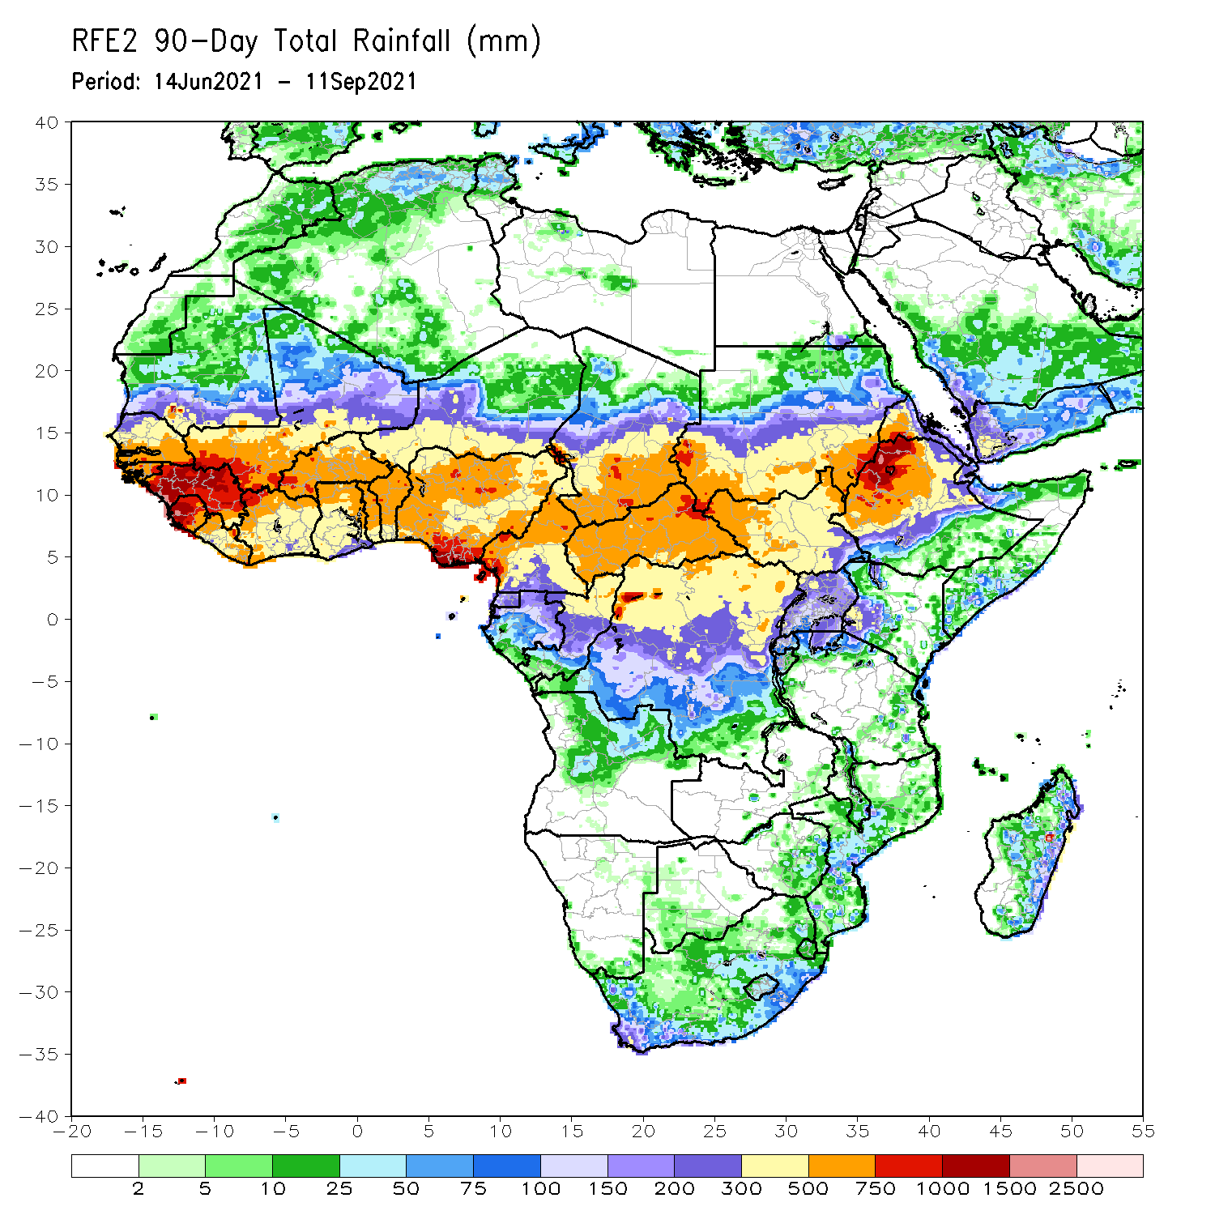
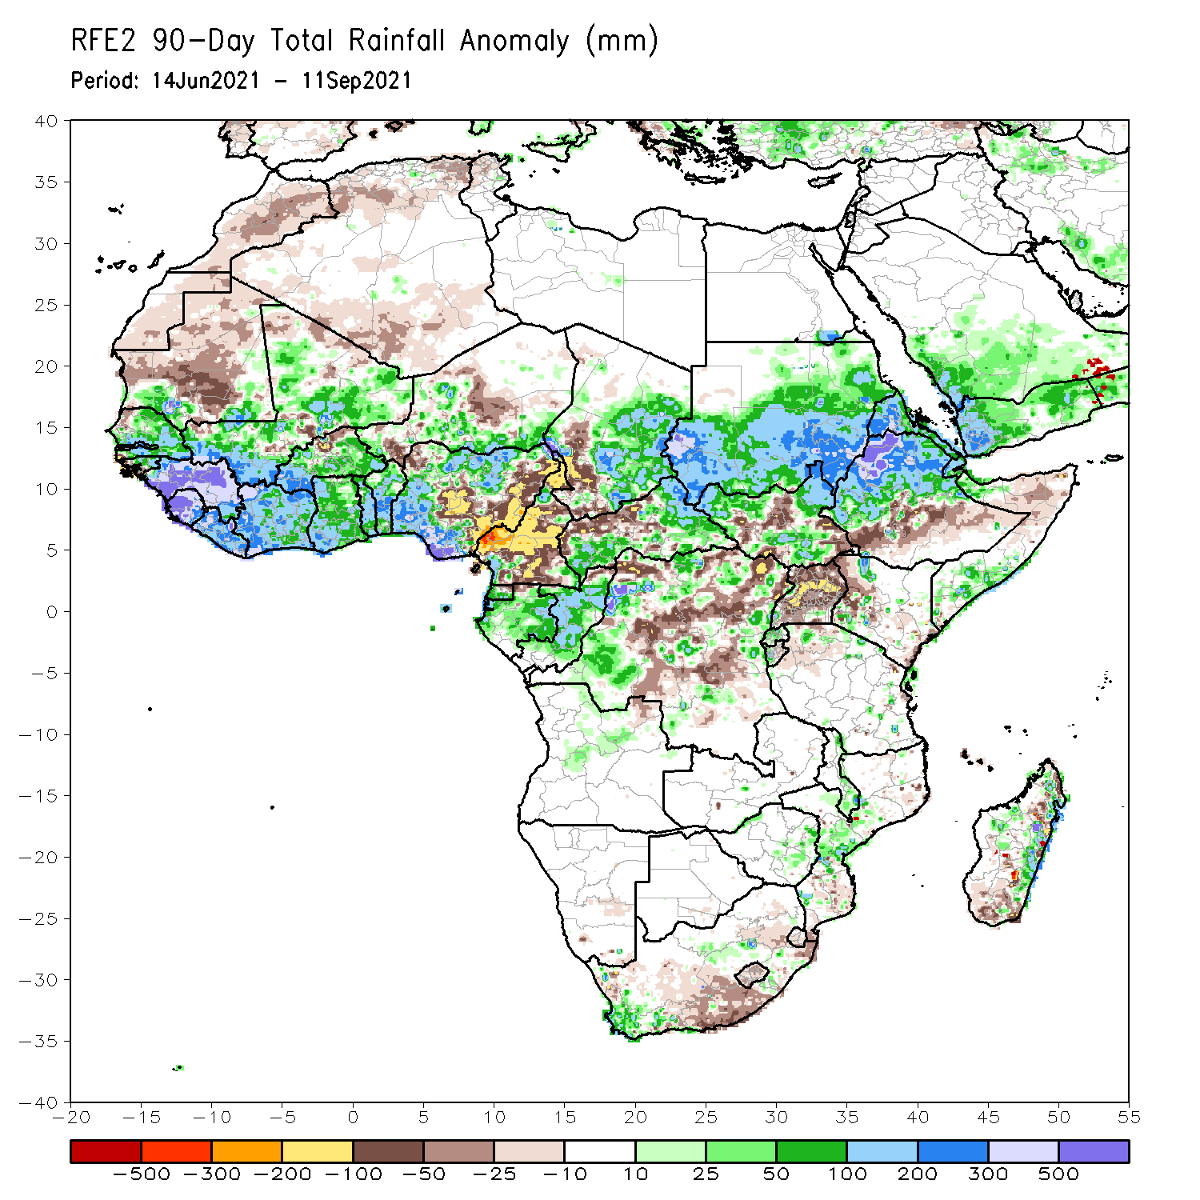
Rainfall Patterns: Last 90 Days
Over the past 90 days, in East Africa, above-average rainfall was observed over Sudan, northern and southern South Sudan, Eritrea, northern Ethiopia, and local areas in northern and southern Somalia. Rainfall was below-average over portions of South Sudan, southern Ethiopia, western Kenya, and Uganda.
In southern Africa, local areas in the southern part of South Africa, Zimbabwe, central Mozambique and eastern Madagascar experienced moisture surpluses. Light moisture deficits were present across much of South Africa and Lesotho, and portions of Madagascar.
In Central Africa, positive precipitation anomalies were found over eastern Chad, eastern and southwestern CAR, Equatorial Guinea, Gabon, Congo, and local areas in DRC. Negative precipitation anomalies occurred in southwestern Chad, much of Cameroon, northwestern CAR, and many parts of DRC.
In West Africa, southwestern Mauritania, much of Senegal, eastern Guinea-Bissau, Guinea, Sierra Leone, Liberia, Côte d’Ivoire, much of Mali and Burkina Faso, Ghana, Togo, Benin, and northern and southern Nigeria observed moisture surpluses. Northern Burkina Faso, southwestern and central Niger, and eastern Nigeria experienced moisture deficits.
Notes:
4

Slide 5
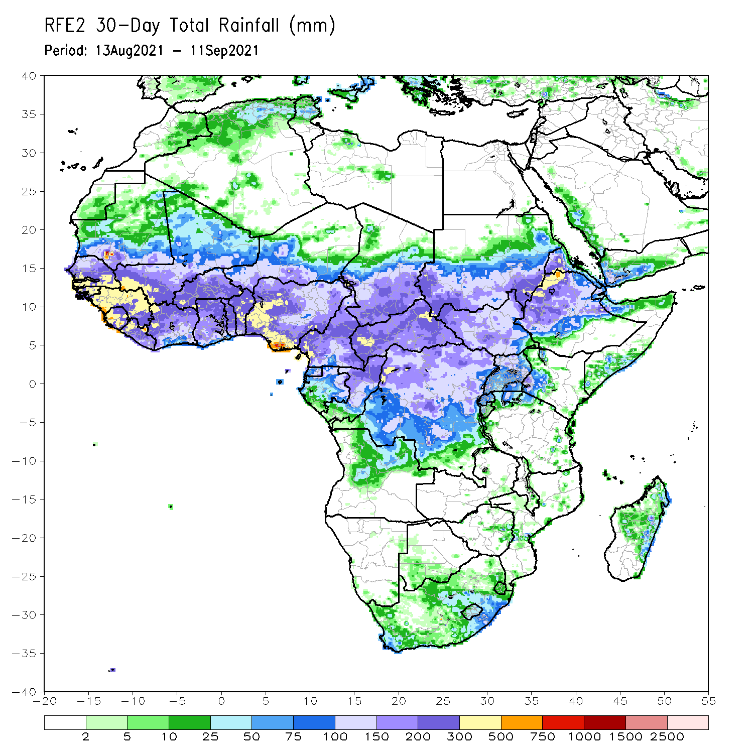
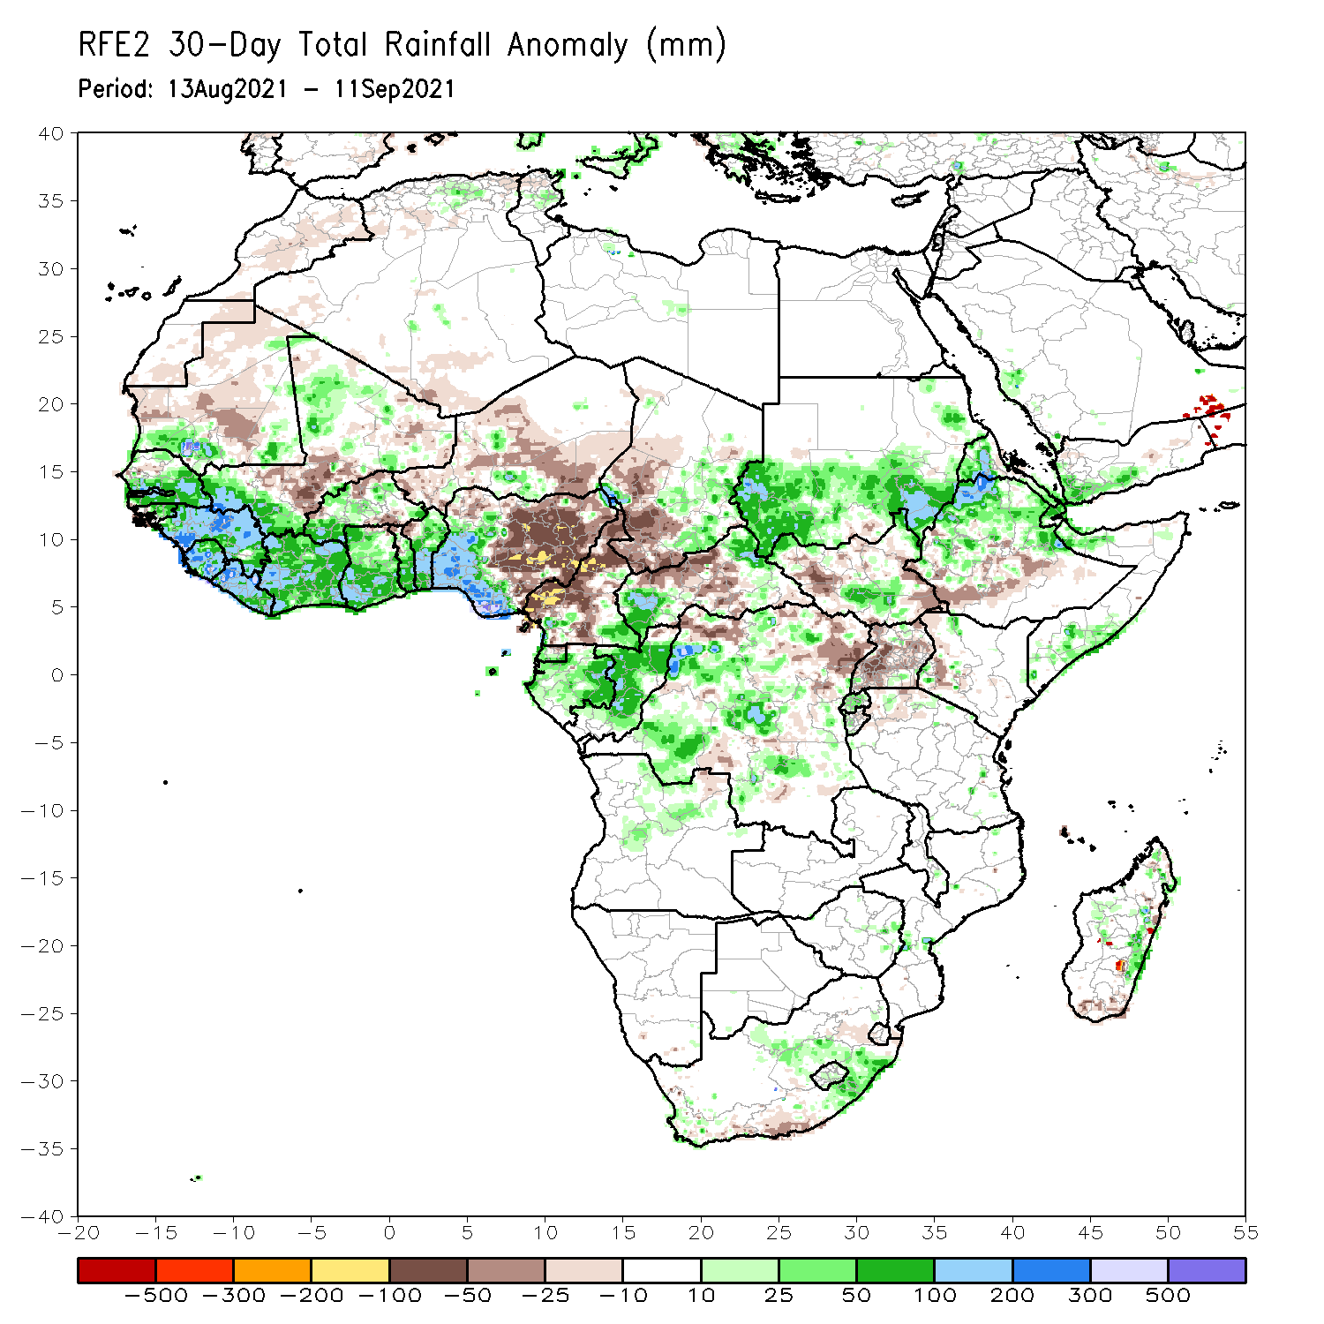
Rainfall Patterns: Last 30 Days
During the past 30 days, in East Africa, above-average rainfall was observed over Sudan, portions of South Sudan, Eritrea, northern Ethiopia, and local areas in northern and southern Somalia. Rainfall was below-average over western and eastern South Sudan, southern Ethiopia, Uganda, and western Kenya.
In Central Africa, eastern Chad, southwestern and northeastern CAR, southeastern Cameroon, Gabon, Congo, and many parts of DRC experienced positive rainfall anomalies. Conversely, western Chad, much of Cameroon, and portions of CAR and northern DRC experienced negative rainfall anomalies.
In West Africa, moisture surpluses were present across southern Mauritania, much Senegal, Guinea-Bissau, Guinea, Sierra Leone, Liberia, southwestern Mali, southwestern Burkina Faso, Côte d’Ivoire, Ghana, southern Togo, Benin, and southwestern Nigeria. Eastern Nigeria, central Mali, northern Togo, northwestern Benin, and much of Niger observed moisture deficits.
Notes:
5

Slide 6
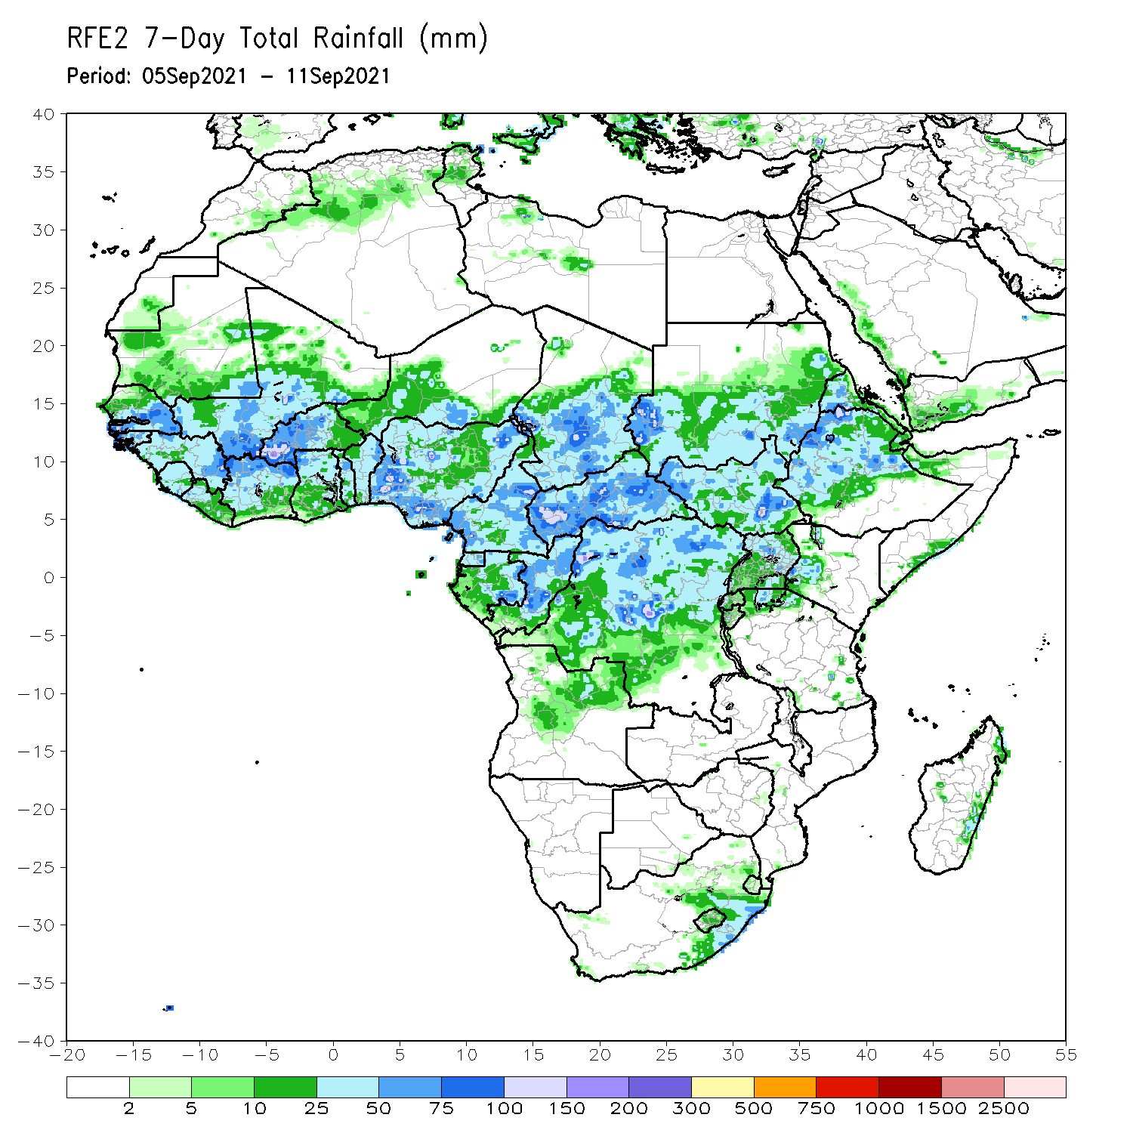
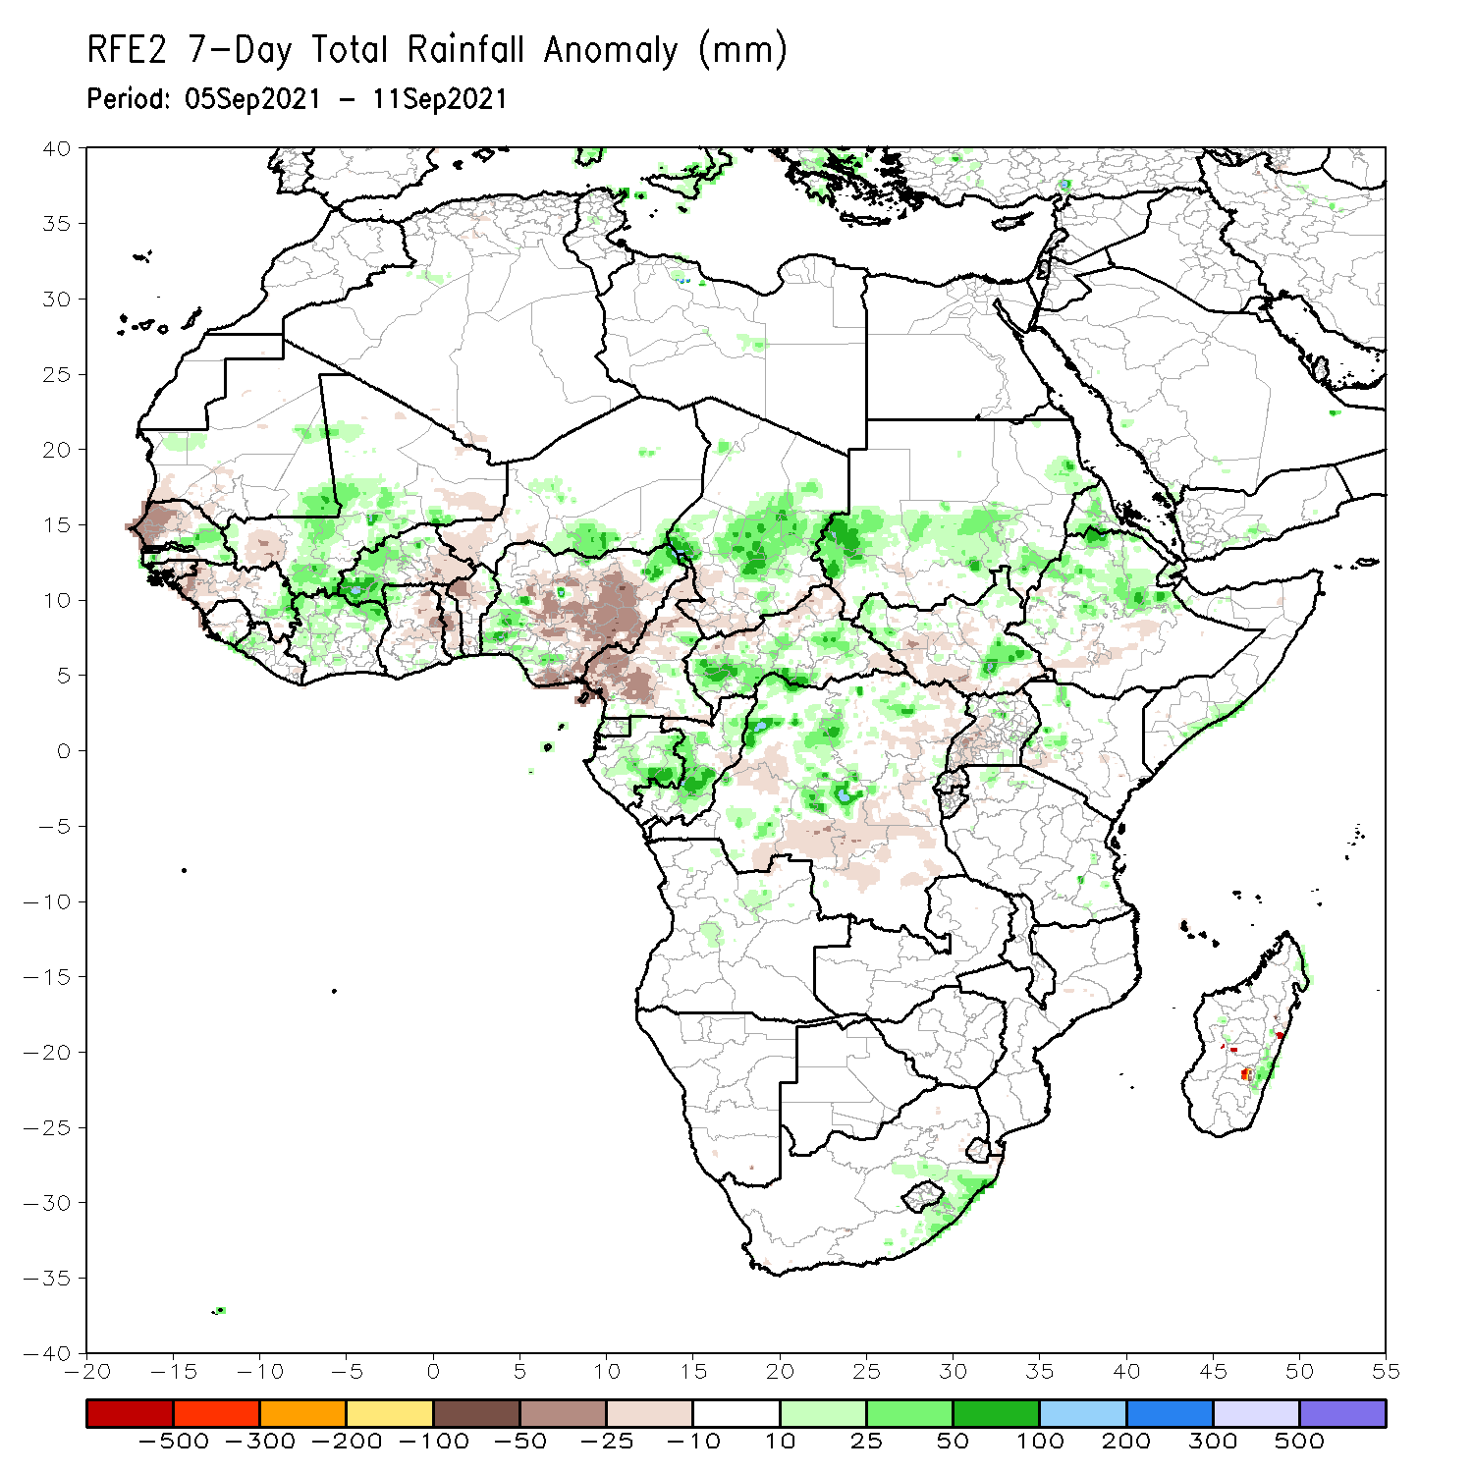
Rainfall Patterns: Last 7 Days
During the past 7 days, precipitation was above-average across Sudan, Eritrea, northern Ethiopia, southeastern South Sudan, and pocket areas in western Kenya and northern and southern Somalia. Precipitation was slightly below-average over western South Sudan and Uganda.
In Central Africa, moisture surpluses were present over the central part of Chad, southern CAR, Gabon, Congo, and central and northern DRC. Conversely, southwestern Chad, Cameroon, northern CAR, and portions of DRC experienced light moisture deficits.
In West Africa, southern Senegal, much of Mali, southeastern Guinea, much of Mali, northern Côte d’Ivoire, western Burkina Faso, southeastern Niger, and western and northeastern Nigeria observed above-average rainfall. Northern Senegal, western Guinea, eastern Burkina Faso, southwestern Niger, eastern Ghana, Togo, Benin, and much of Nigeria experienced below-average rainfall conditions.

Slide 7
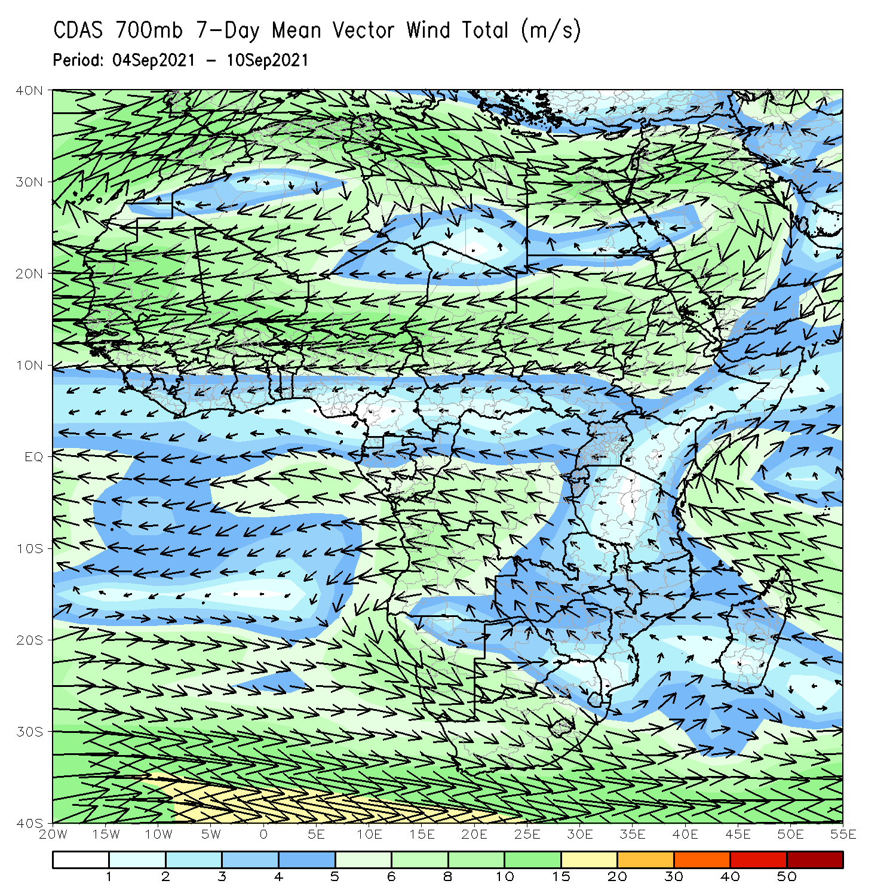
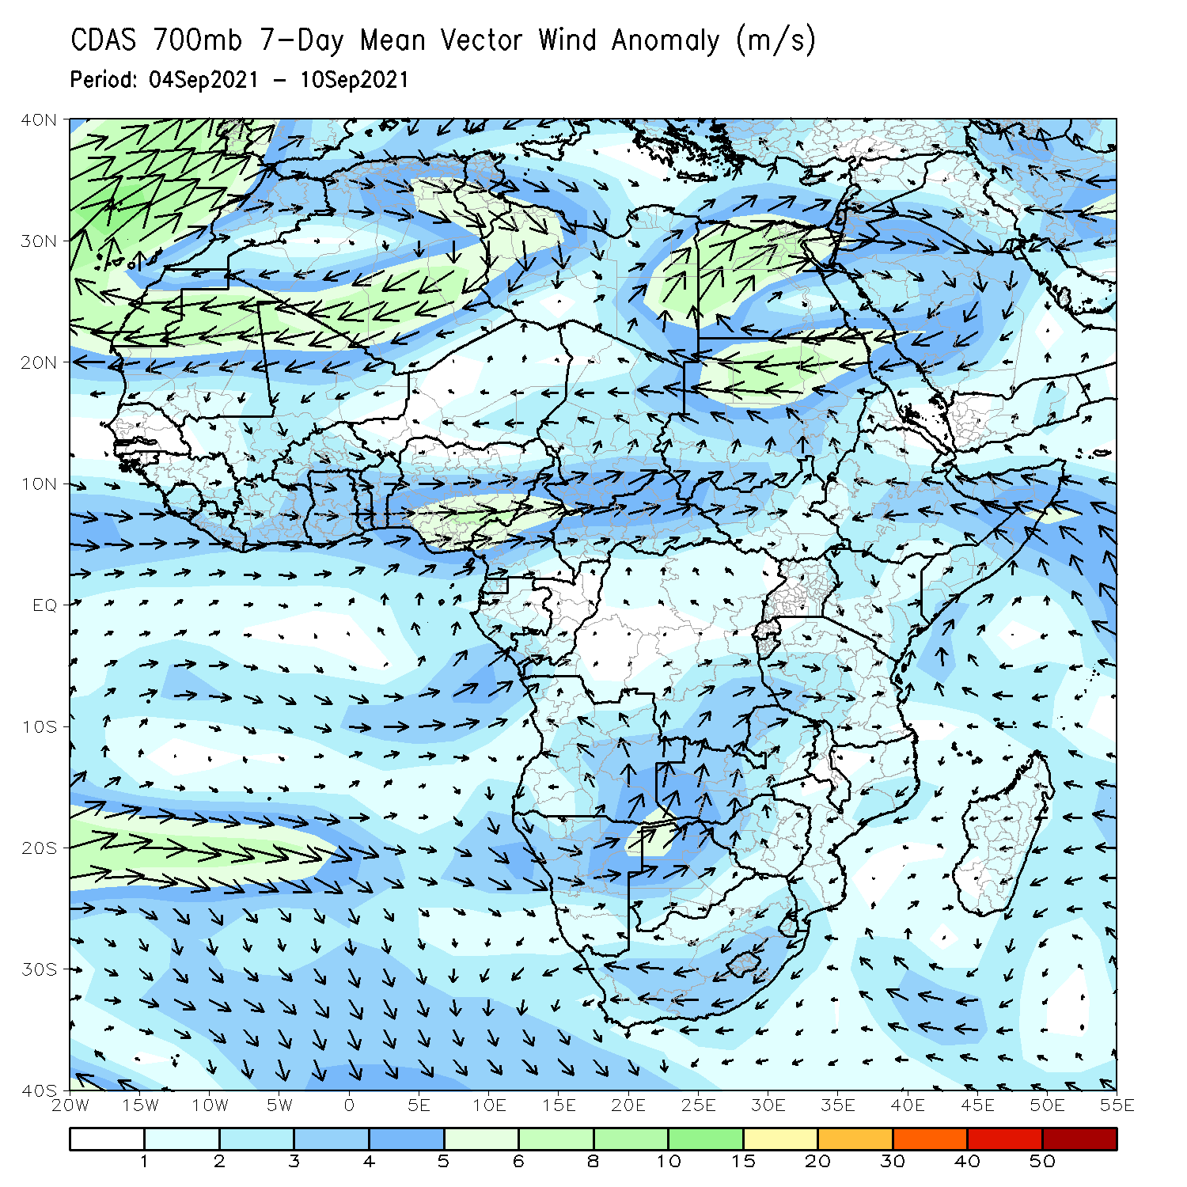
Atmospheric Circulation: Last 7 Days
v
The 700-hPa atmospheric circulation pattern features a cyclonic circulation over the Sahel region. The cyclonic flows over Mali, Burkina Faso as well as Sudan and Chad may have contributed to enhanced rainfall in those areas (right panel).
The anomalous moisture-laden westerly wind over the South Atlantic Ocean likely contributed to enhanced rainfall over Gabon and Congo.
The cyclonic circulation located off the eastern coast of the Horn of Africa may have led to enhanced rainfall across coastal areas of Somalia.

Slide 8
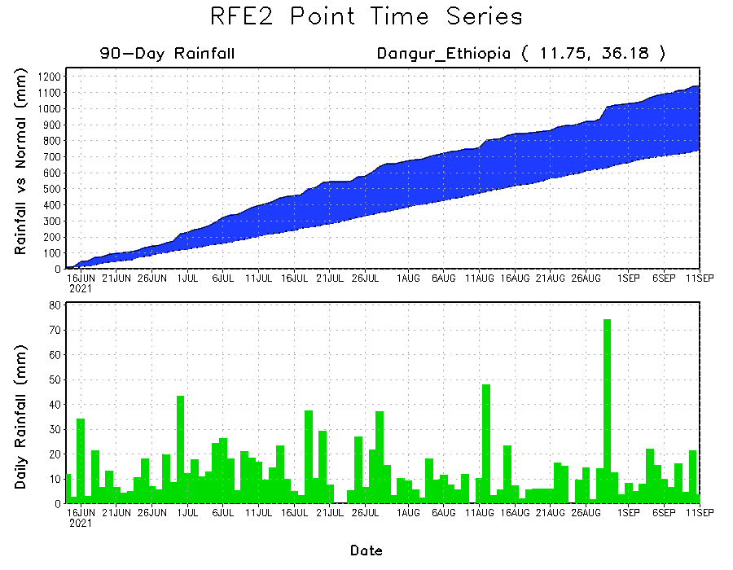
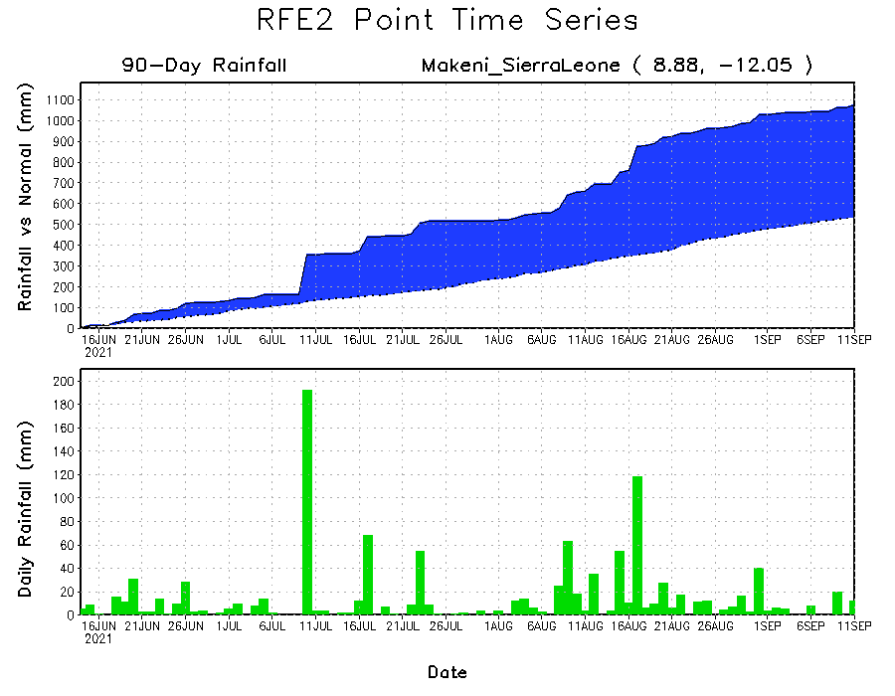
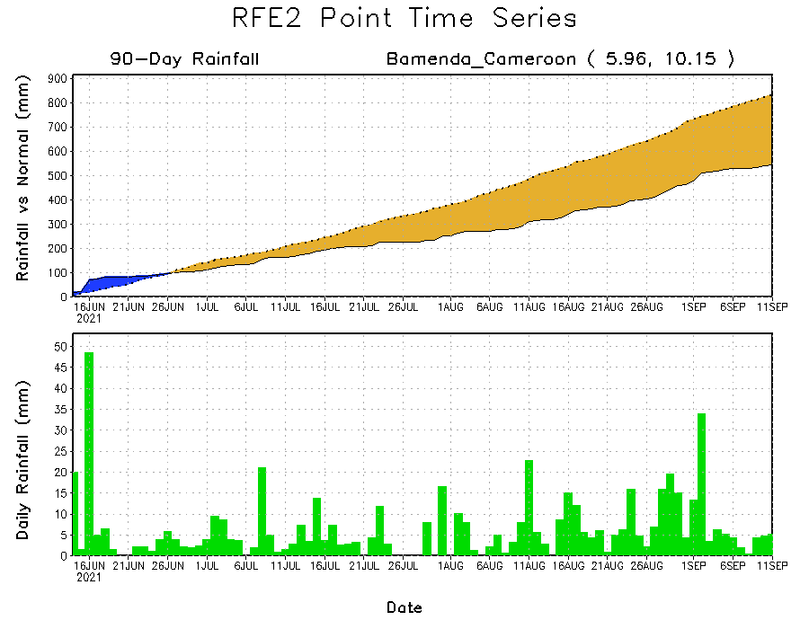
Rainfall Evolution
Daily evolution of rainfall over the last 90 days at selected locations shows moderate to heavy rainfall sustained moisture surpluses over Sierra Leone (bottom left) and northwestern Ethiopia (top right). In contrast, seasonal total rainfall remained below-average over southwestern Cameroon despite recent rainfall (bottom right).

Slide 9
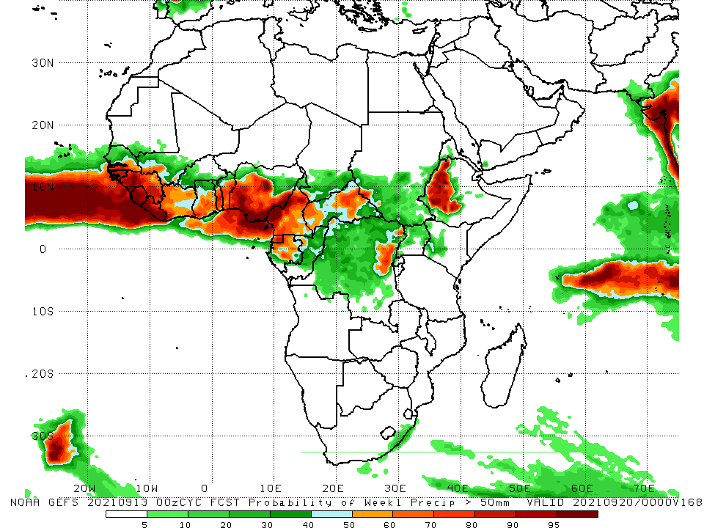
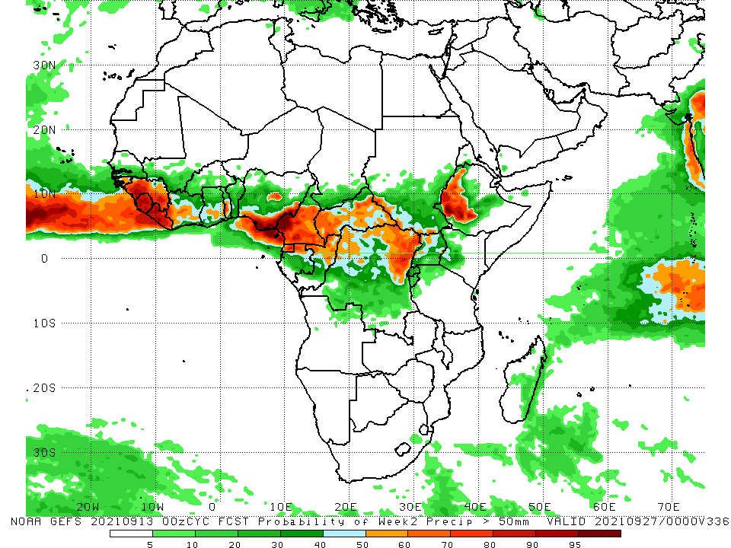
NCEP GEFS Model Forecasts Non-Bias Corrected Probability of precipitation exceedance
Week-1, Valid: 14 – 20 September 2021
Week-2, Valid: 21 – 27 September 2021
For week-1 and week-2 (left panel), the NCEP GEFS forecasts indicate a moderate to high chance (over 70%) for rainfall to exceed 50 mm over southern Senegal, Guinea-Bissau, Guinea, Sierra Leone, Liberia, many parts of the Gulf of Guinea countries, Equatorial Guinea, Gabon, northern Congo, CAR, portions of DRC, and western Ethiopia.
In addition, week-2 forecast depicts an increased chance for weekly rainfall to exceed 50 mm across Uganda and western South Sudan.
Notes:
9

Slide 10
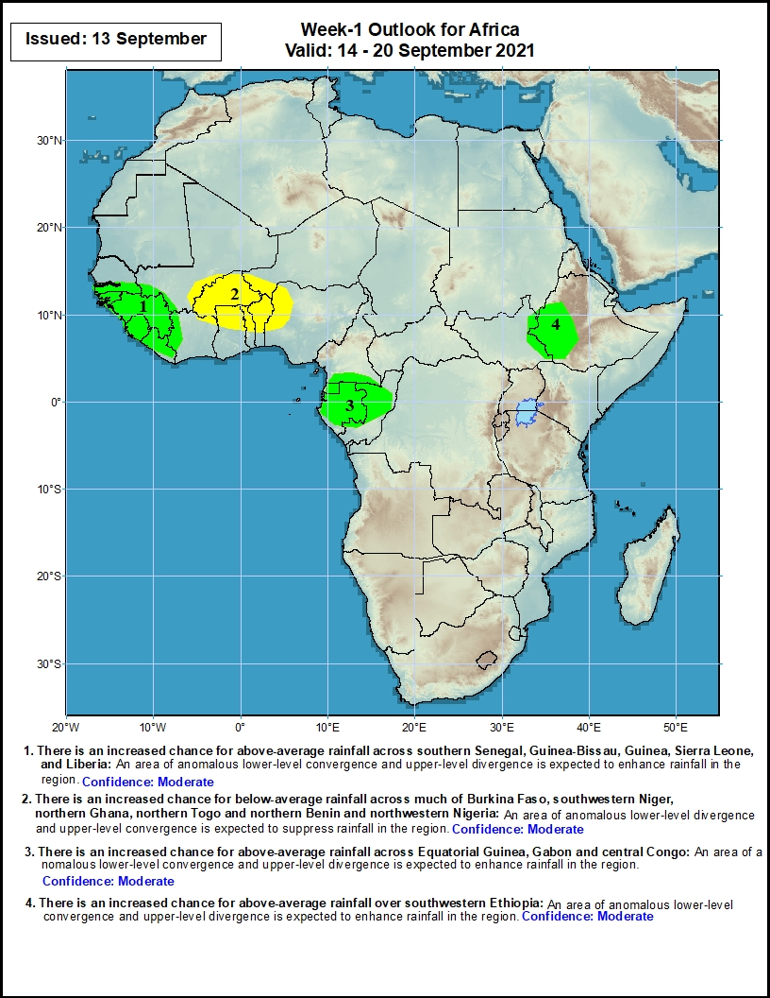
Week-1 Precipitation Outlooks
14 – 20 September 2021
There is an increased chance for above-average rainfall across southern Senegal, Guinea-Bissau, Guinea, Sierra Leone, and Liberia: An area of anomalous lower-level convergence and upper-level divergence is expected to enhance rainfall in the region. Confidence: Moderate
There is an increased chance for below-average rainfall across much of Burkina Faso, southwestern Niger, northern Ghana, northern Togo and northern Benin and northwestern Nigeria: An area of anomalous lower-level divergence and upper-level convergence is expected to suppress rainfall in the region. Confidence: Moderate
There is an increased chance for above-average rainfall across Equatorial Guinea, Gabon and central Congo: An area of anomalous lower-level convergence and upper-level divergence is expected to enhance rainfall in the region. Confidence: Moderate
There is an increased chance for above-average rainfall over southwestern Ethiopia: An area of anomalous lower-level convergence and upper-level divergence is expected to enhance rainfall in the region. Confidence: Moderate
Notes:
10

Slide 11
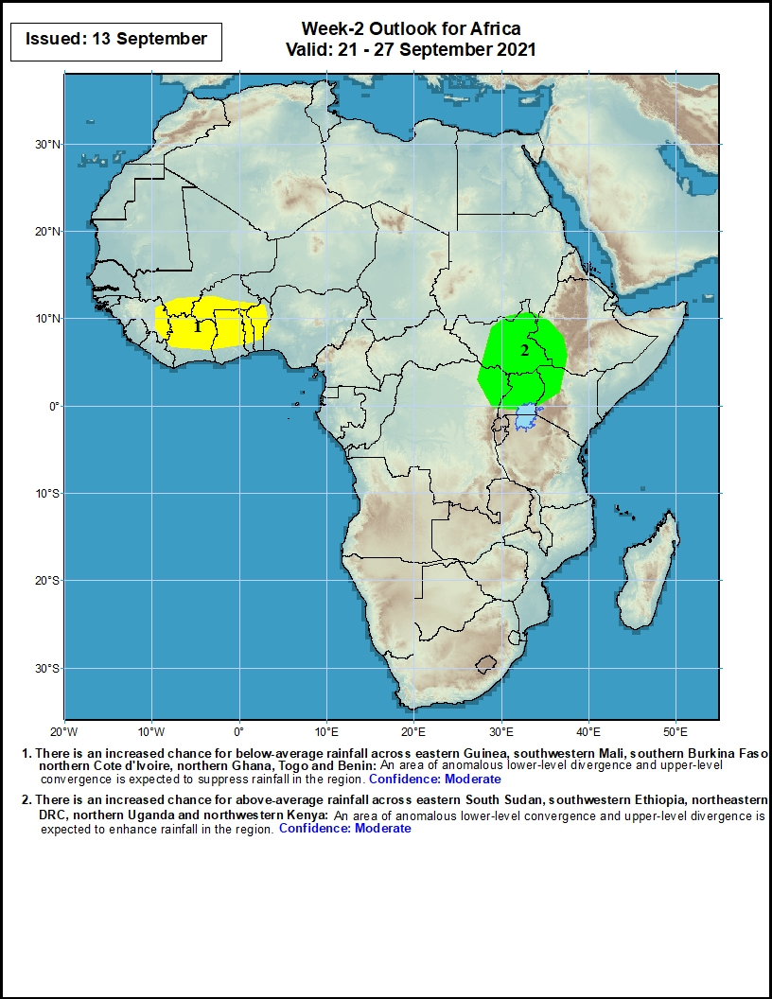
Week-2 Precipitation Outlooks
21 – 27 September 2021
There is an increased chance for below-average rainfall across eastern Guinea, southwestern Mali, southern Burkina Faso, northern Cote d'Ivoire, northern Ghana, Togo and Benin: An area of anomalous lower-level divergence and upper-level convergence is expected to suppress rainfall in the region. Confidence: Moderate
There is an increased chance for above-average rainfall across eastern South Sudan, southwestern Ethiopia, northeastern DRC, northern Uganda and northwestern Kenya: An area of anomalous lower-level convergence and upper-level divergence is expected to enhance rainfall in the region. Confidence: Moderate
Notes:
11

Slide 12
Summary
During the past 30 to 90 days, in East Africa, above-average rainfall was observed over Sudan, portions of South Sudan, Eritrea, northern Ethiopia, and local areas over northern and southern Somalia. Rainfall was below-average over parts of South Sudan, southern Ethiopia, Uganda, and western Kenya. In Central Africa, moisture surpluses were found in eastern Chad, northeastern and southwestern CAR, Gabon, Congo, and parts DRC. Moisture deficits occurred in Cameroon, western Chad, northwestern CAR, and portions of DRC. In West Africa, southern Mauritania, much of Senegal, Guinea-Bissau, Guinea, Sierra Leone, Liberia, southwestern Mali, southern Burkina Faso, and much of the Gulf of Guinea countries observed above-average rainfall. Eastern Nigeria and northern Burkina Faso continued to experience drier than normal conditions.
During the past 7 days, the East African region observed above-normal rainfall conditions. In Central Africa, rainfall was above-average over Chad, much of CAR, Gabon, Congo, and central and northern DRC. Cameroon, southern Chad, northern CAR, and portions of DRC observed light moisture deficits. Moisture surpluses were present over southern Senegal, much of Mali, western Burkina Faso, eastern Guinea, northern Côte d’Ivoire, southeastern Niger and southwestern and northeastern Nigeria. Light moisture deficits occurred across northern Senegal, western Guinea, eastern Burkina Faso, southwestern Niger, eastern Ghana, Togo, Benin, and much of Nigeria.
The week-1 outlooks depict an increased chance for above-average rainfall across southern Senegal, Guinea-Bissau, Guinea, Sierra Leone, Liberia, Equatorial Guinea, Gabon, central Congo, and southwestern Ethiopia. Conversely, there is an increased chance for below-average rainfall across southwestern Ethiopia.
The week-2 outlooks call for an increased chance for above-average rainfall across eastern South Sudan, southwestern Ethiopia, northeastern DRC, northern Uganda and northwestern Kenya. In contrast, there is an increased chance for below-average rainfall across eastern Guinea, southwestern Mali, southern Burkina Faso, northern Cote d'Ivoire, northern Ghana, Togo and Benin.

