Slide 1
The African Monsoon Recent Evolution and Current Status Include Week-1 and Week-2 Outlooks
Update prepared by
27 September 2021
For more information, visit:
http://www.cpc.ncep.noaa.gov/products/Global_Monsoons/African_Monsoons/precip_monitoring.shtml

Slide 2
Outline
Highlights
Recent Evolution and Current Conditions
NCEP GEFS Forecasts
Summary

Slide 3
Highlights: Last 7 Days
During the past 7 days, moderate to heavy rainfall totals of 150-200 mm fell across coastal areas of Nigeria and northern CAR (positive precipitation anomalies of over 100 mm). Precipitation was also well-above average over the southern portion of the Gulf of Guinea countries, parts of Sudan and South Sudan, and western Ethiopia (moisture surpluses of over 50 mm).
The week-1 outlooks depict an increased chance for above-average rainfall across Sierra Leone, southern Guinea, Liberia, southern Côte d'Ivoire, eastern South Sudan and southwestern Ethiopia. Conversely, there is an increased chance for below-average rainfall across northeastern Cote d'Ivoire, northern Ghana, northern Togo, northern Benin, southern CAR, and northern DRC.
The week-2 outlooks call for an increased chance for above-average rainfall across Sierra Leone, eastern Guinea, Liberia, parts of western Côte d'Ivoire, eastern South Sudan, and western Ethiopia. In contrast, there is an increased chance for below-average rainfall across eastern Cote d'Ivoire, Ghana, Togo, Benin, southern CAR and northern DRC.

Slide 4
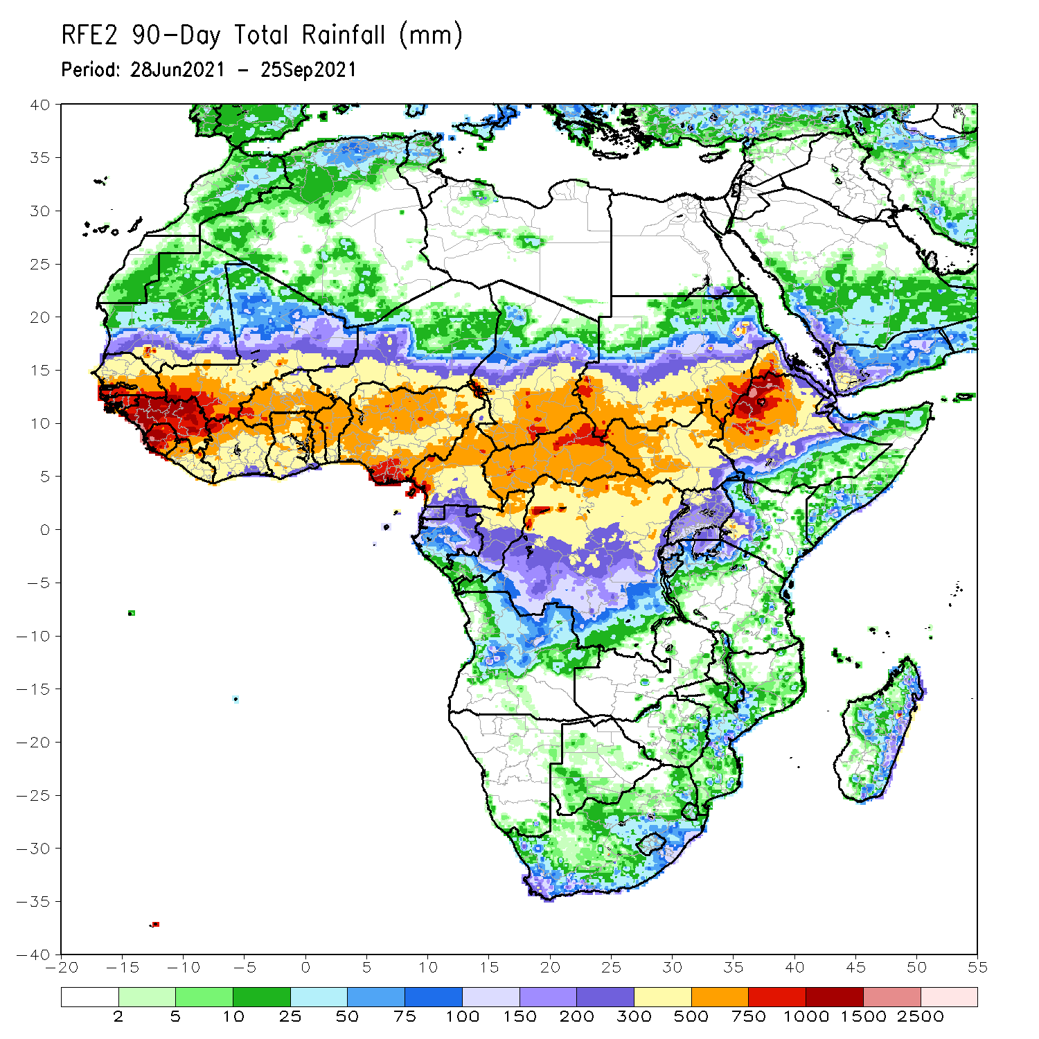
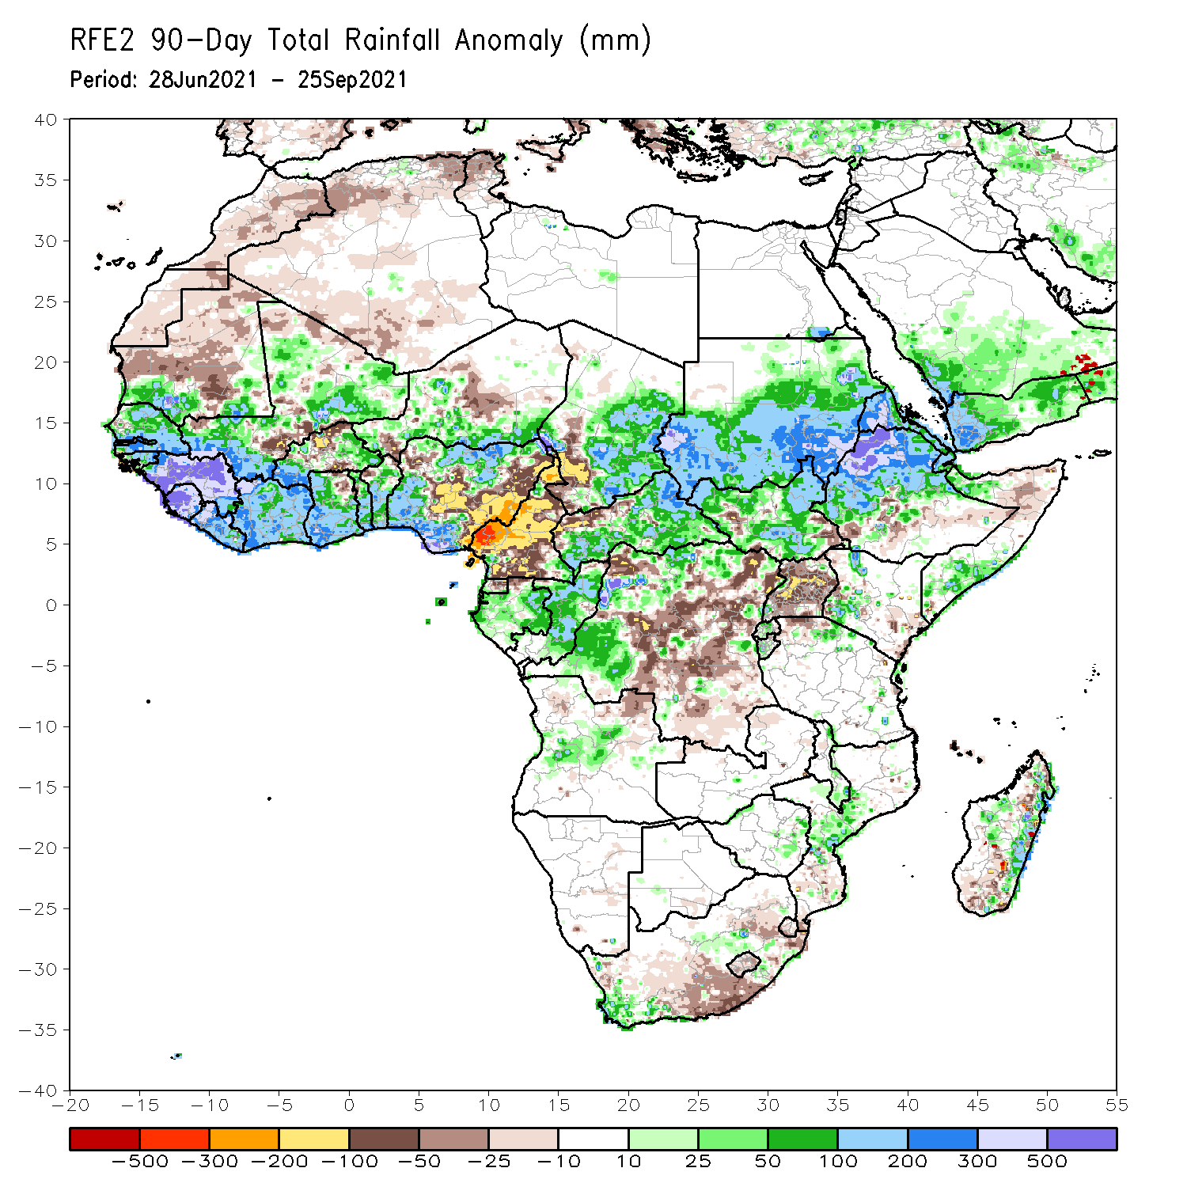
Rainfall Patterns: Last 90 Days
Over the past 90 days, in West Africa, rainfall totals exceeded 750 mm across southern Senegal, Guinea-Bissau, northern Liberia, southwestern Mali, and northeastern Nigeria. The highest rainfall totals reached 1000-1500 mm and occurred in Guinea, Sierra Leone, and southern Nigeria (moisture surpluses of over 500 mm). Conversely, Northern Burkina Faso and central and eastern Nigeria experienced moisture deficits of over 100 mm.
In Central Africa, positive precipitation anomalies of 100-200 mm were found over the western border of Chad and Cameroon, eastern Chad, portions of CAR, eastern Gabon, Congo, and local areas in northwestern DRC. Large negative precipitation anomalies of over 100 mm were observed in Cameroon, southwestern Chad, and local areas in northwestern CAR. In particular, western Cameroon experienced moisture deficits of 300-500 mm.
In East Africa, northwestern Ethiopia received heavy rainfall amounts of over 1000 mm (more than 500 mm above the mean). Precipitation was in excess of 200 mm in western and eastern Sudan, western Eritrea, and northwestern Ethiopia. Uganda continued to experience sustained negative precipitation anomalies of over 50 mm.
In southern Africa, coastal areas of South Africa, central part of Mozambique, and the eastern coast of Madagascar registered rainfall amounts of over 150 mm (moisture surpluses of over 50 mm). Light moisture deficits of 10-50 mm were present across much of South Africa and Lesotho, and portions of Madagascar.
Notes:
4

Slide 5
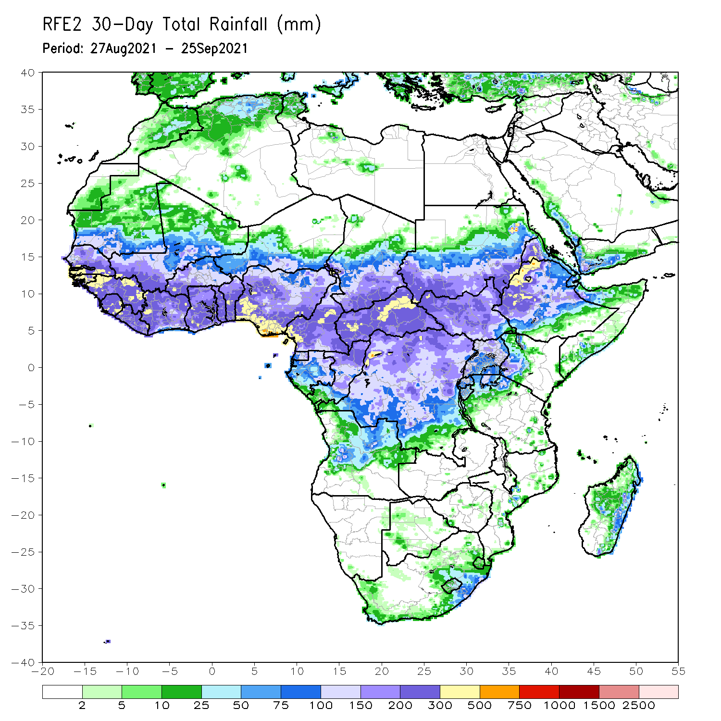
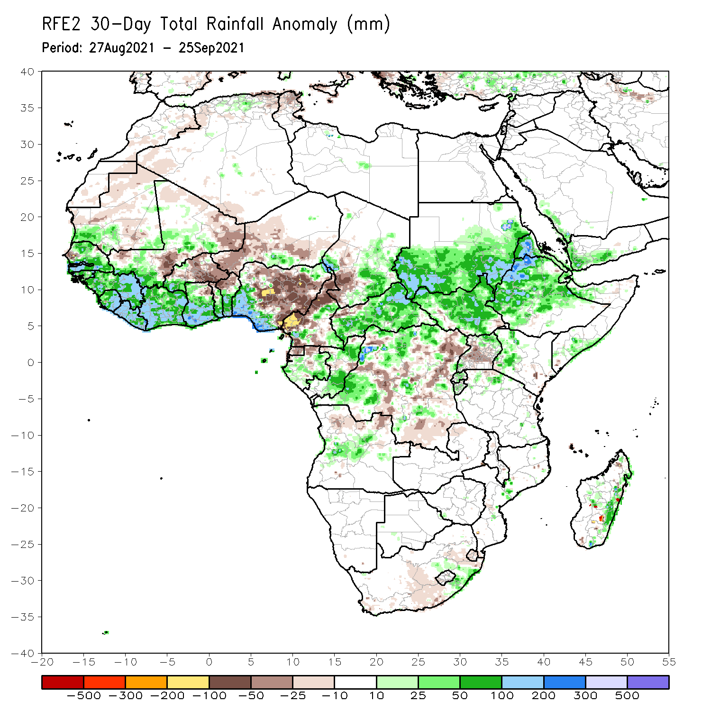
Rainfall Patterns: Last 30 Days
During the past 30 days, in West Africa, above-average rainfall was observed across much of Senegal, Guinea-Bissau, Guinea, Sierra Leone, southwestern Mali, southwestern Burkina Faso, and from Liberia to western Nigeria. Much of Niger, eastern Burkina Faso, northern Togo, northern Benin experienced below-average rainfall. Northern and eastern Nigeria observed negative precipitation anomalies of over 50 mm, while southwestern Nigeria observed positive precipitation anomalies of over 100 mm (rainfall amounts of over 300 mm).
In Central Africa, precipitation was above-average across eastern Chad, CAR, portions of Cameroon, eastern Gabon, Congo, and many parts of DRC (more than 50 mm above the mean). Western Chad, much of Cameroon, northwestern CAR, Equatorial Guinea, northern Gabon, and portions of DRC received below-average rainfall (more than 25 mm below the mean). In particular, western Cameroon observed negative precipitation anomalies of 100-200 mm.
In East Africa, the rainfall amounts reached 300-500 mm in western Eritrea and northwestern Ethiopia (more than 200 mm above the mean). Precipitation was above-average across much of the East African region, except over central Uganda (light moisture deficits of 25-50 mm).
Notes:
5

Slide 6
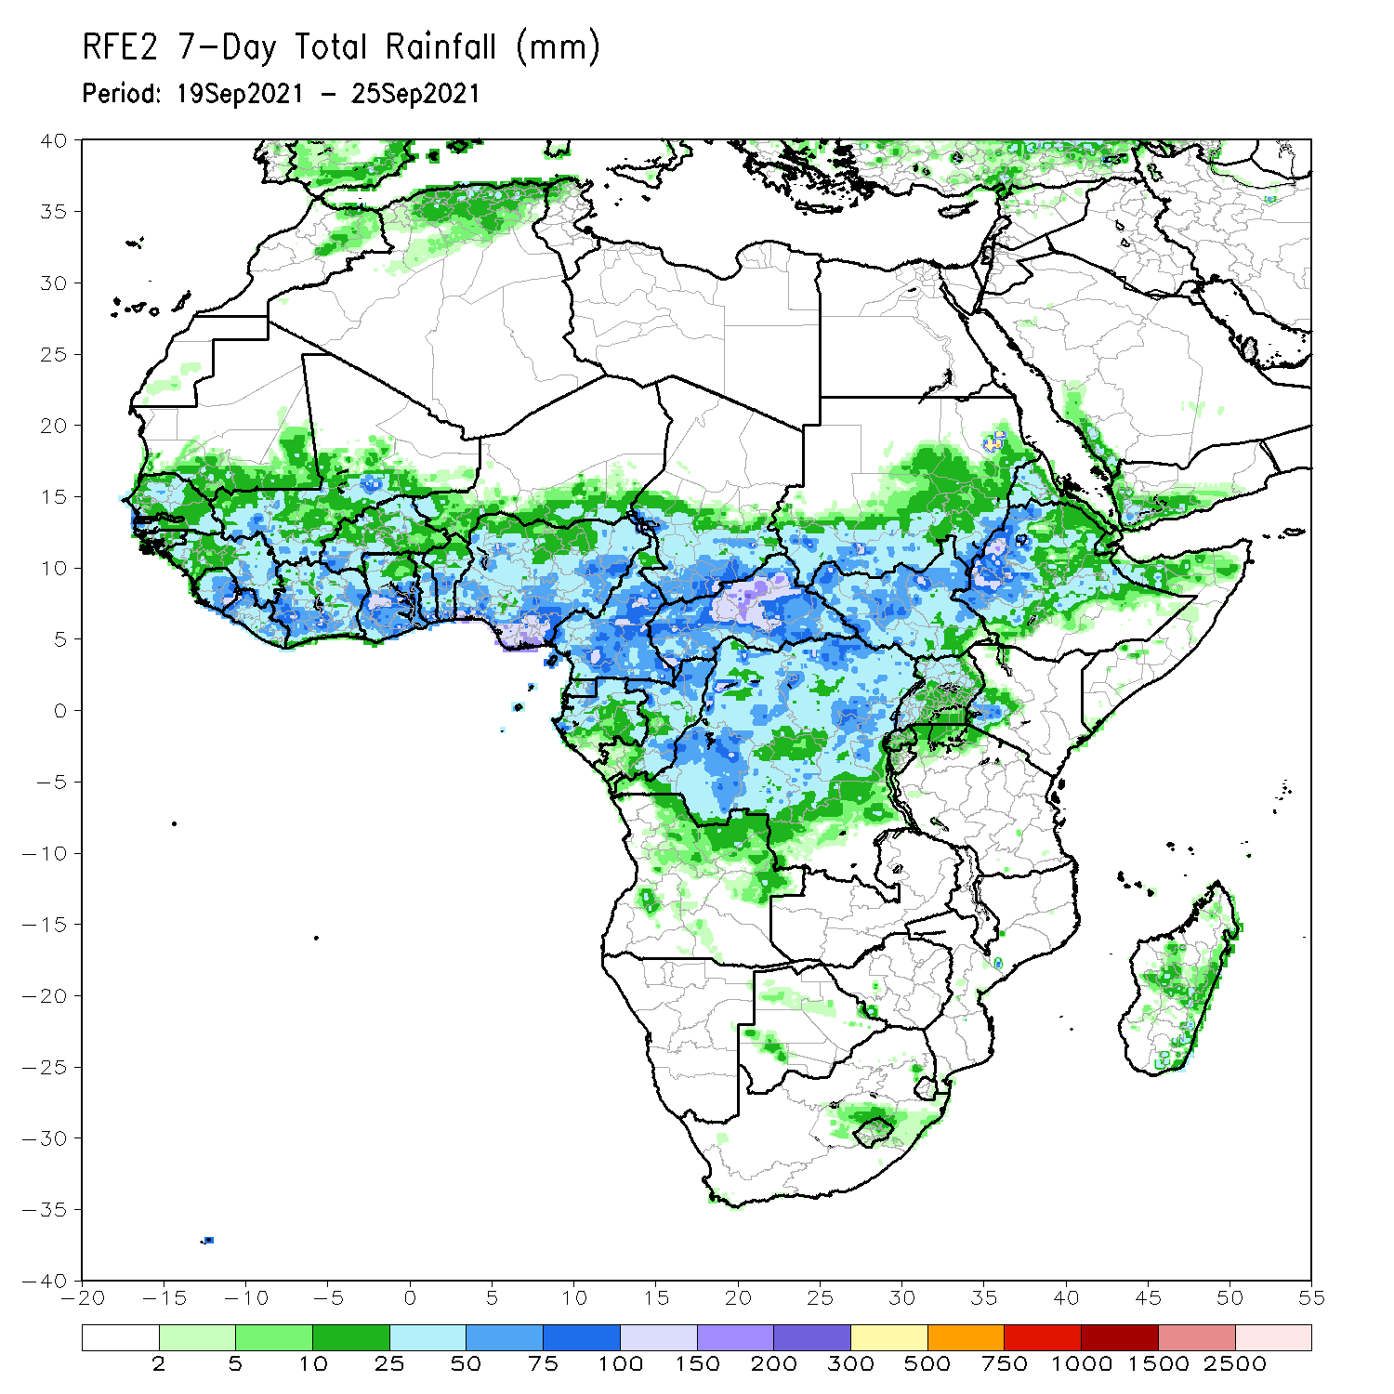
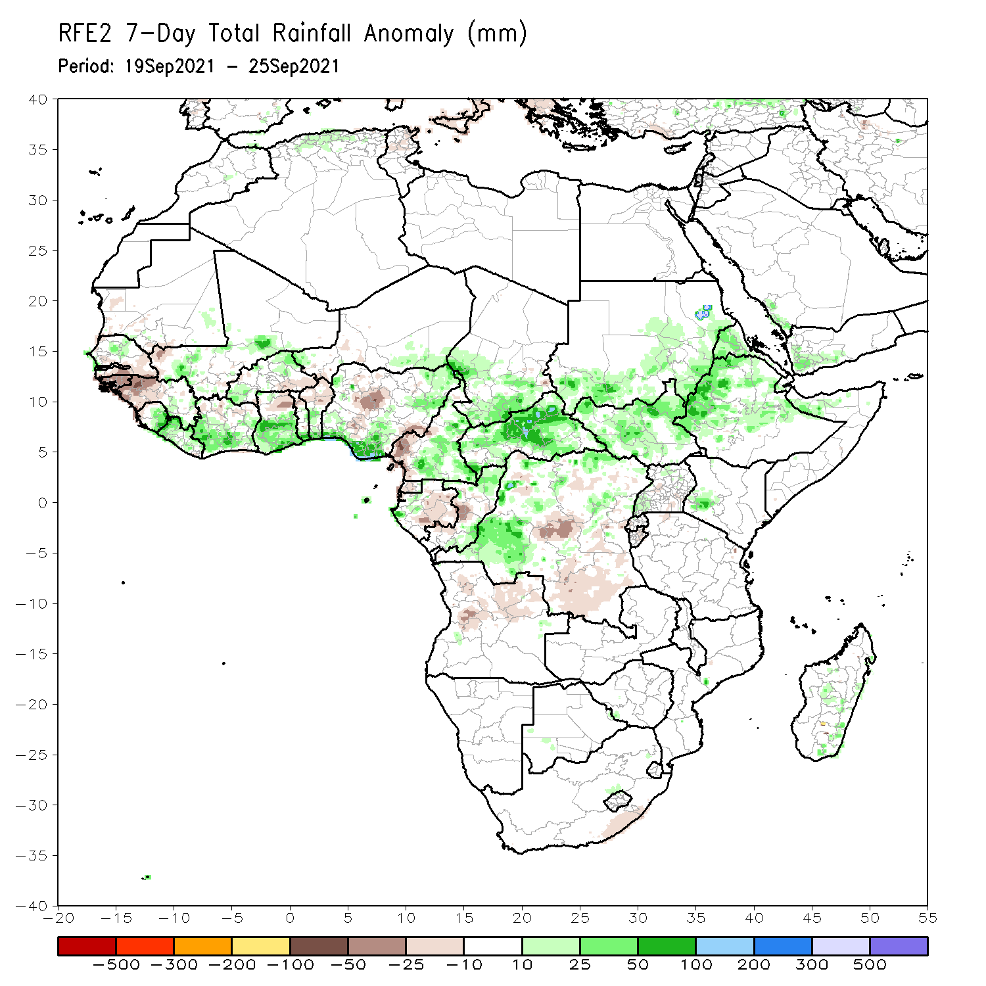
Rainfall Patterns: Last 7 Days
During the past 7 days, in West Africa, precipitation was above-average over northern Senegal, Mali, southern Niger, Sierra Leone northern and southwestern Burkina Faso, Liberia, the southern part of the Gulf of Guinea countries, and northwestern and northeastern Nigeria (more than 25 mm above the mean). Coastal areas of Nigeria received rainfall totals of over 150 mm (more than 100 mm above the mean). Southern Senegal, Guinea-Bissau, western Guinea, northern Ghana, and central Nigeria experienced below-average rainfall (more than 25 mm below the mean).
In Central Africa, northern CAR registered rainfall amounts of over 100 mm (more than 50 mm above the mean). Southern Chad, eastern Cameroon, northern and southern Congo, and many parts of DRC observed above-average rainfall. Precipitation was below-average over southwestern Cameroon, Equatorial Guinea, eastern Gabon, central Congo, and many parts of DRC.
East Africa received above-average rainfall, with moisture surpluses of over 25 mm.

Slide 7
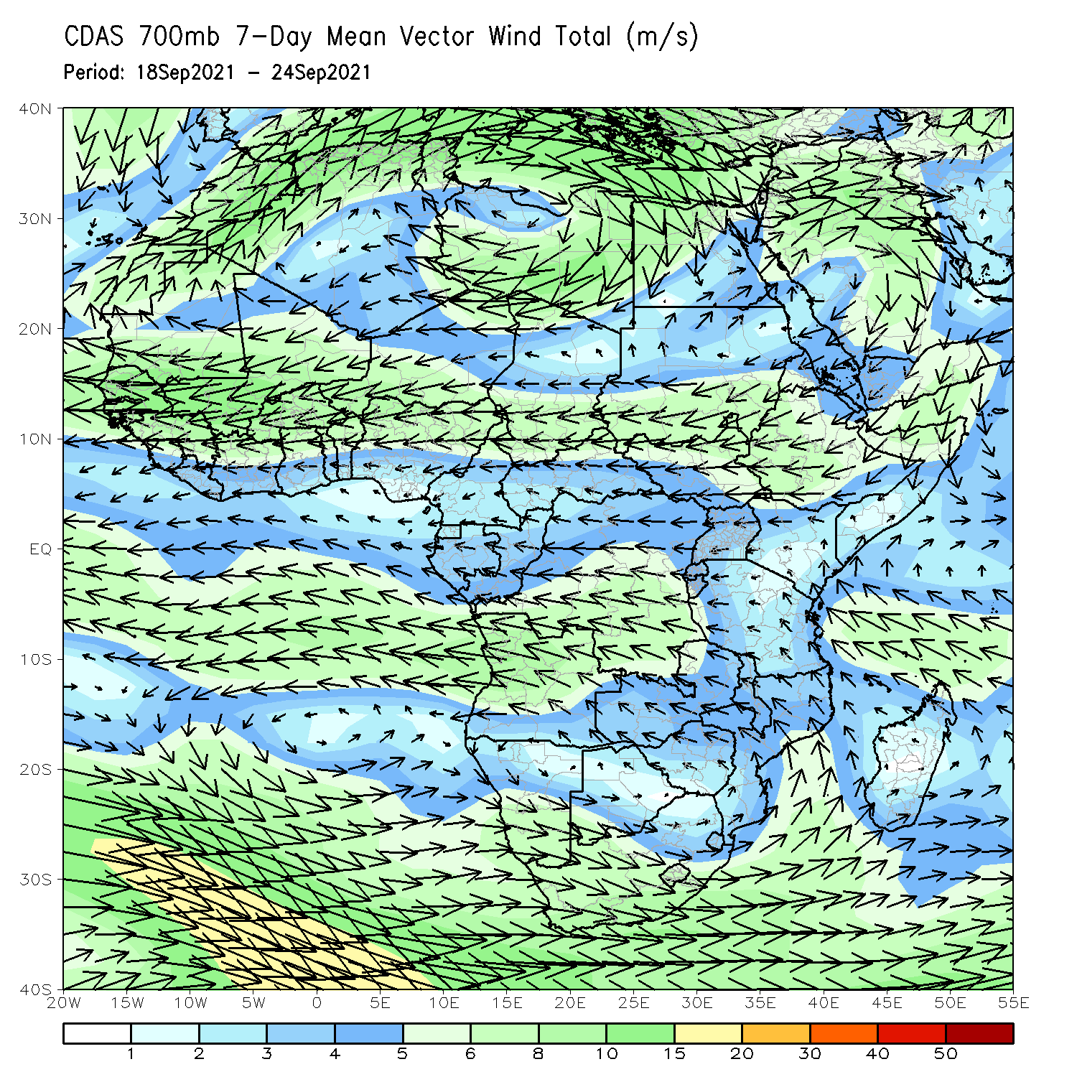
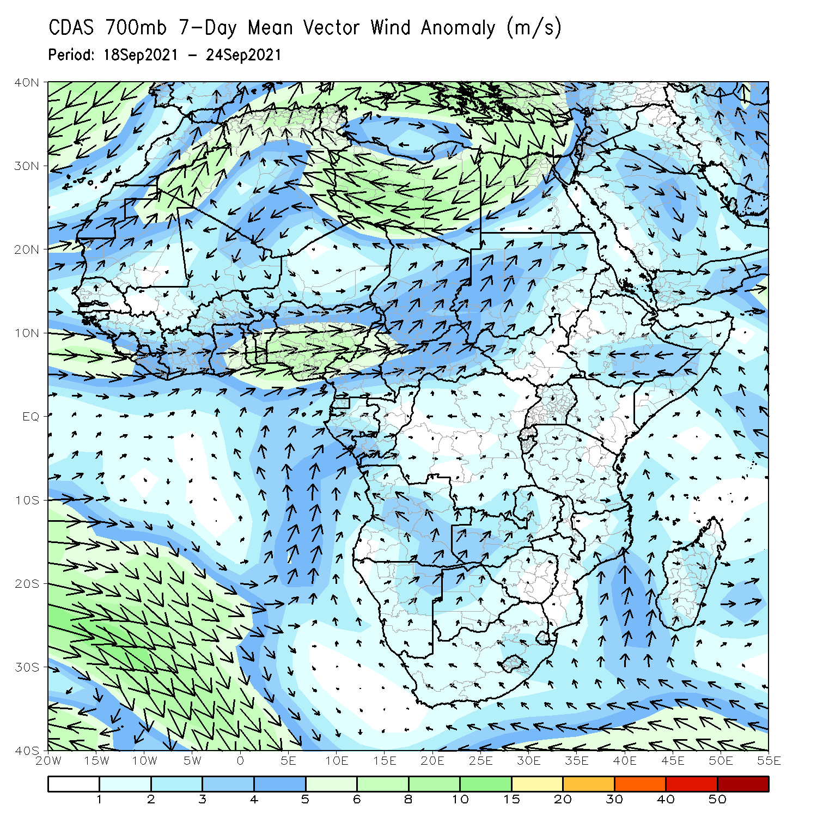
Atmospheric Circulation: Last 7 Days
The 700-hPa atmospheric circulation pattern features an anomalous westerly flow over the Gulf of Guinea region and a southwesterly flow over Chad, CAR, Sudan, and South Sudan.

Slide 8
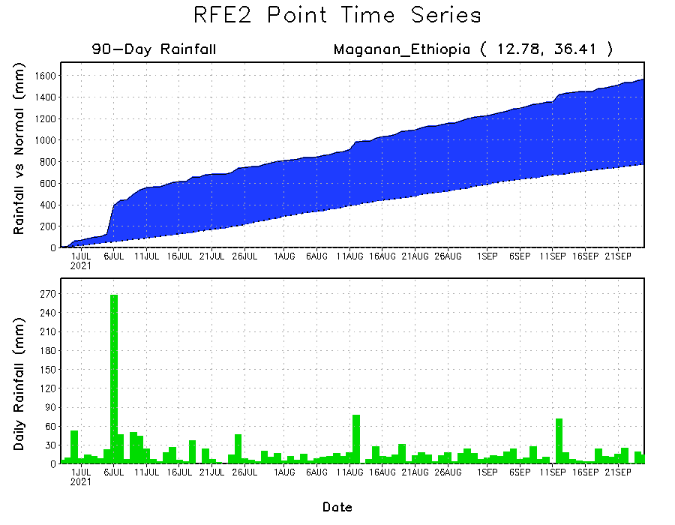
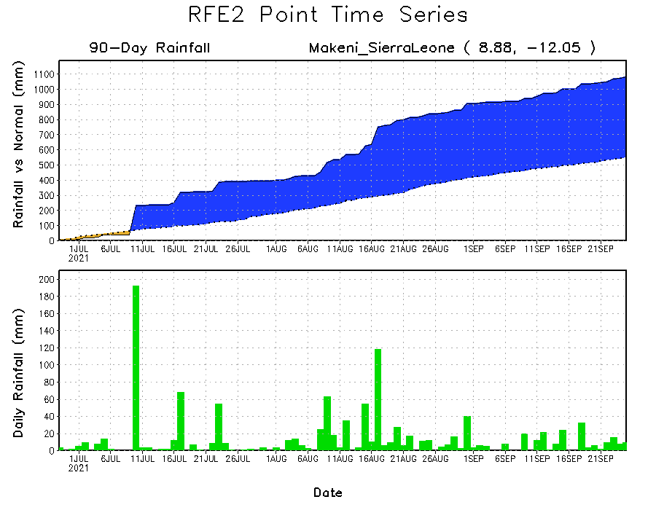
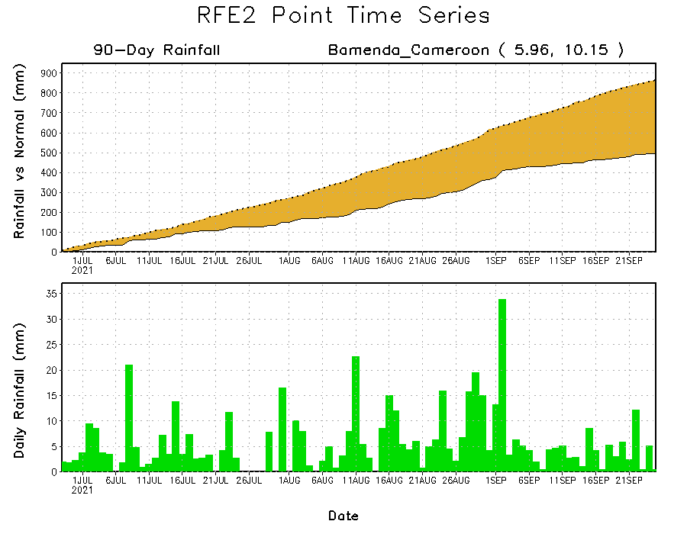
Rainfall Evolution
Daily evolution of rainfall over the last 90 days at selected locations shows moderate to heavy rainfall sustained moisture surpluses over Sierra Leone (bottom left) and northwestern Ethiopia (top right). In contrast, seasonal total rainfall remained below-average over southwestern Cameroon despite recent rainfall (bottom right).

Slide 9
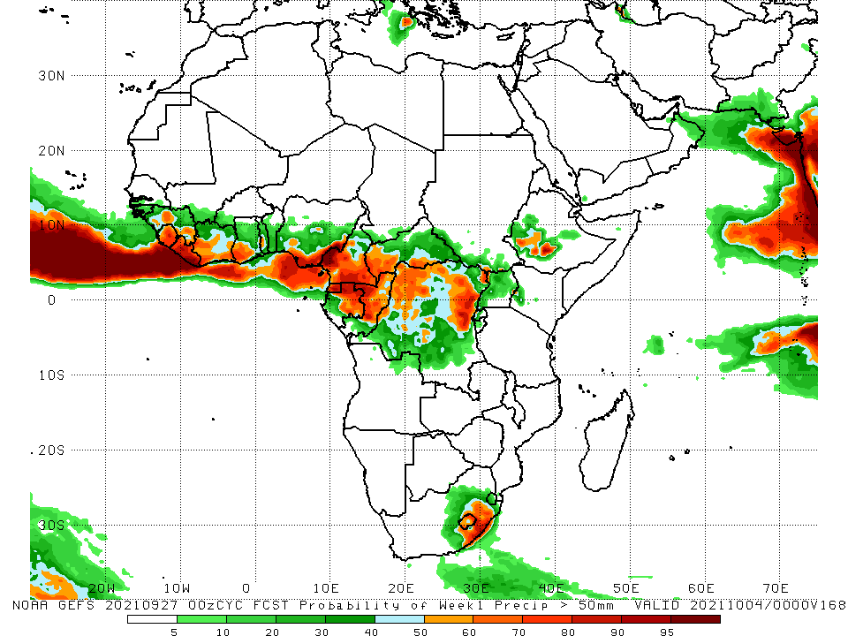
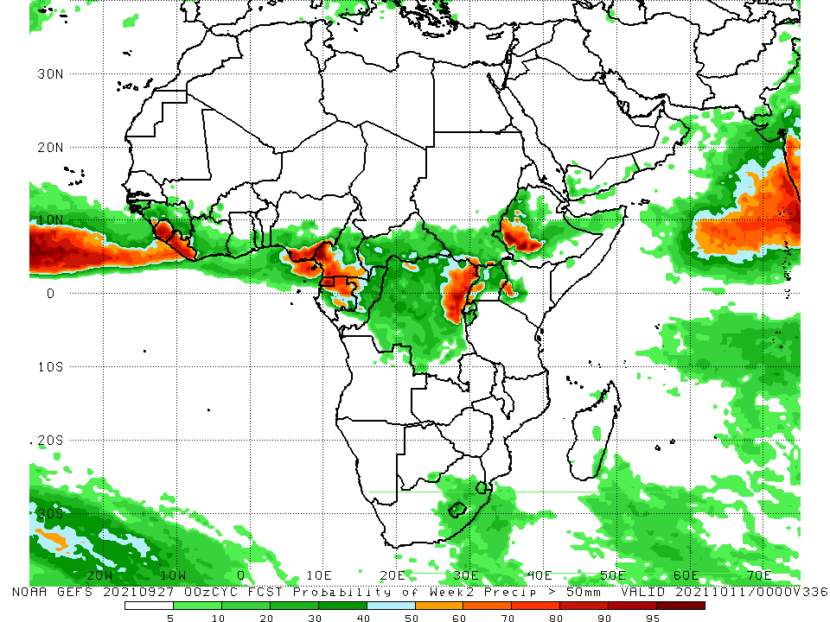
NCEP GEFS Model Forecasts Non-Bias Corrected Probability of precipitation exceedance
Week-1, Valid: 28 September – 4 October 2021
Week-2, Valid: 5 – 11 October 2021
For week-1 (left panel), the NCEP GEFS forecasts indicate a moderate to high chance (over 70%) for rainfall to exceed 50 mm over Guinea, Sierra Leone, Liberia, Côte d’Ivoire, southern Ghana, southern Togo, southern Nigeria, Cameroon, Equatorial Guinea, eastern Gabon, Congo, western and southern CAR, DRC, eastern South Africa, Lesotho, and western Ethiopia.
Week-2 forecast (right) depicts an increased chance for weekly rainfall to exceed 50 mm across western Guinea, Sierra Leone, Liberia, southern Nigeria, southern Cameroon, Equatorial Guinea, northern Gabon, western Congo, eastern DRC, and western Ethiopia.
Notes:
9

Slide 10
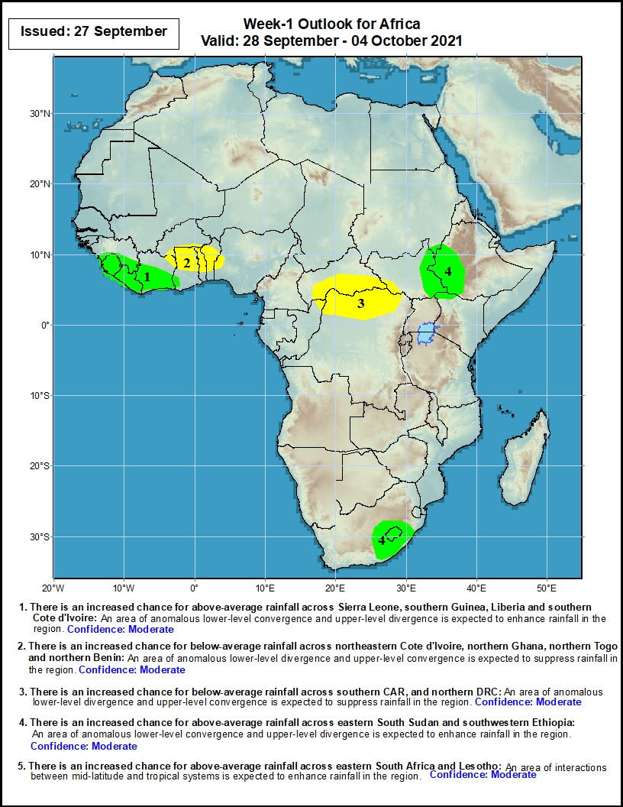
Week-1 Precipitation Outlooks
28 September – 4 October 2021
There is an increased chance for above-average rainfall across Sierra Leone, southern Guinea, Liberia and southern Cote d'Ivoire: An area of anomalous lower-level convergence and upper-level divergence is expected to enhance rainfall in the region. Confidence: Moderate
There is an increased chance for below-average rainfall across northeastern Cote d'Ivoire, northern Ghana, northern Togo and northern Benin: An area of anomalous lower-level divergence and upper-level convergence is expected to suppress rainfall in the region. Confidence: Moderate
There is an increased chance for below-average rainfall across southern CAR, and northern DRC: An area of anomalous lower-level divergence and upper-level convergence is expected to suppress rainfall in the region. Confidence: Moderate
There is an increased chance for above-average rainfall across eastern South Sudan and southwestern Ethiopia: An area of anomalous lower-level convergence and upper-level divergence is expected to enhance rainfall in the region. Confidence: Moderate
Notes:
10

Slide 11
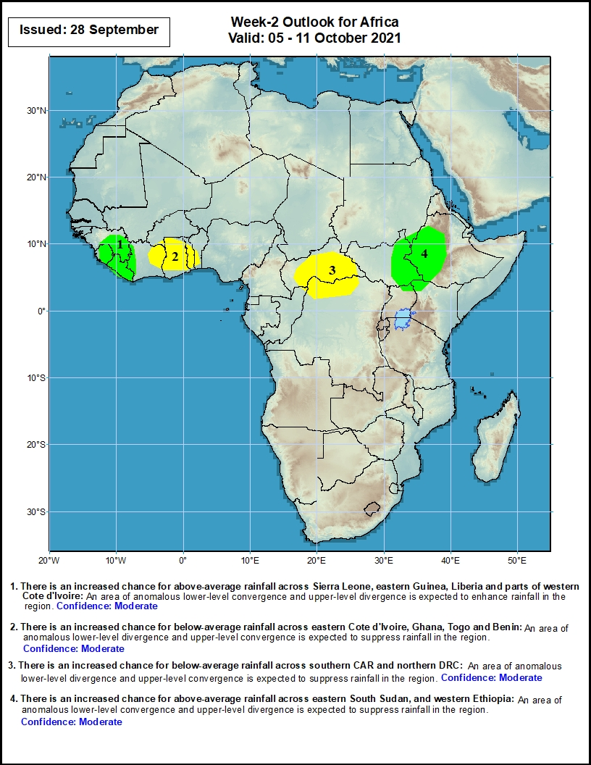
Week-2 Precipitation Outlooks
5 – 11 October 2021
There is an increased chance for above-average rainfall across Sierra Leone, eastern Guinea, Liberia and parts of western Cote d'Ivoire: An area of anomalous lower-level convergence and upper-level divergence is expected to enhance rainfall in the region. Confidence: Moderate
There is an increased chance for below-average rainfall across eastern Cote d'Ivoire, Ghana, Togo and Benin: An area of anomalous lower-level divergence and upper-level convergence is expected to suppress rainfall in the region. Confidence: Moderate
There is an increased chance for below-average rainfall across southern CAR and northern DRC: An area of anomalous lower-level divergence and upper-level convergence is expected to suppress rainfall in the region. Confidence: Moderate
There is an increased chance for above-average rainfall across eastern South Sudan, and western Ethiopia: An area of anomalous lower-level convergence and upper-level divergence is expected to enhance rainfall in the region. Confidence: Moderate
Notes:
11

Slide 12
Summary
During the past 30 to 90 days, in West Africa, southern Mauritania, much of Senegal, Guinea-Bissau, Guinea, Sierra Leone, Liberia, southwestern Mali, southwestern Burkina Faso, and much of the Gulf of Guinea countries observed above-average rainfall. Central and eastern Nigeria continued to experience drier than normal conditions. In Central Africa, moisture surpluses were found in eastern Chad, CAR, Congo, and parts DRC. Moisture deficits occurred in Cameroon, Equatorial Guinea, western Chad, northwestern CAR, and portions of DRC. In East Africa, above-average rainfall prevailed in Sudan, South Sudan, Eritrea, and Ethiopia. Moisture deficits sustained in Uganda.
During the past 7 days, the southern part of the Gulf of Guinea countries observed above-average rainfall. Southern Senegal, Guinea-Bissau, and western Guinea received below-average rainfall. Local areas in northern CAR experienced well above-average rainfall. Above-average rainfall prevailed in the Horn of Africa.
The week-1 outlooks depict an increased chance for above-average rainfall across Sierra Leone, southern Guinea, Liberia, southern Côte d'Ivoire, eastern South Sudan and southwestern Ethiopia. Conversely, there is an increased chance for below-average rainfall across northeastern Cote d'Ivoire, northern Ghana, northern Togo, northern Benin, southern CAR, and northern DRC.
The week-2 outlooks call for an increased chance for above-average rainfall across Sierra Leone, eastern Guinea, Liberia, parts of western Côte d'Ivoire, eastern South Sudan, and western Ethiopia. In contrast, there is an increased chance for below-average rainfall across eastern Cote d'Ivoire, Ghana, Togo, Benin, southern CAR and northern DRC.

