Slide 1
The African Monsoon Recent Evolution and Current Status Include Week-1 and Week-2 Outlooks
Update prepared by
4 October 2021
For more information, visit:
http://www.cpc.ncep.noaa.gov/products/Global_Monsoons/African_Monsoons/precip_monitoring.shtml

Slide 2
Outline
Highlights
Recent Evolution and Current Conditions
NCEP GEFS Forecasts
Summary

Slide 3
Highlights: Last 7 Days
During the past 7 days, in West Africa, local areas in western Guinea, Sierra Leone, southeastern Côte d’Ivoire, southern Ghana, southern Burkina Faso, and northwestern and central Nigeria registered rainfall totals of over 100 mm (more than 50 mm above the mean). In Central Africa, precipitation was above-average across southeastern Cameroon, Congo, and DRC. In particular, pocket areas in western DRC received precipitation totals of over 150 mm (more than 100 mm above the mean). The eastern part of South Africa observed positive precipitation totals of over 25 mm.
The week-1 outlooks depict an increased chance for above-average rainfall across Sierra Leone, Liberia, western Ethiopia and parts of eastern South Sudan. Conversely, there is an increased chance for below-average rainfall across Eastern Cote d’Ivoire, southern Ghana, Togo, southern Benin, southwestern Nigeria, CAR, northern DRC, Eastern South Africa, Lesotho and Eswatini.
The week-2 outlooks call for an increased chance for above-average rainfall across Sierra Leone, Liberia, southwestern Ethiopia and parts of eastern South Sudan. In contrast, there is an increased chance for below-average rainfall across eastern Cote d’Ivoire, southern Ghana, southern Togo, southern Benin, southwestern Nigeria, eastern Cameroon, northern Congo, CAR, northern DRC and western South Sudan.

Slide 4
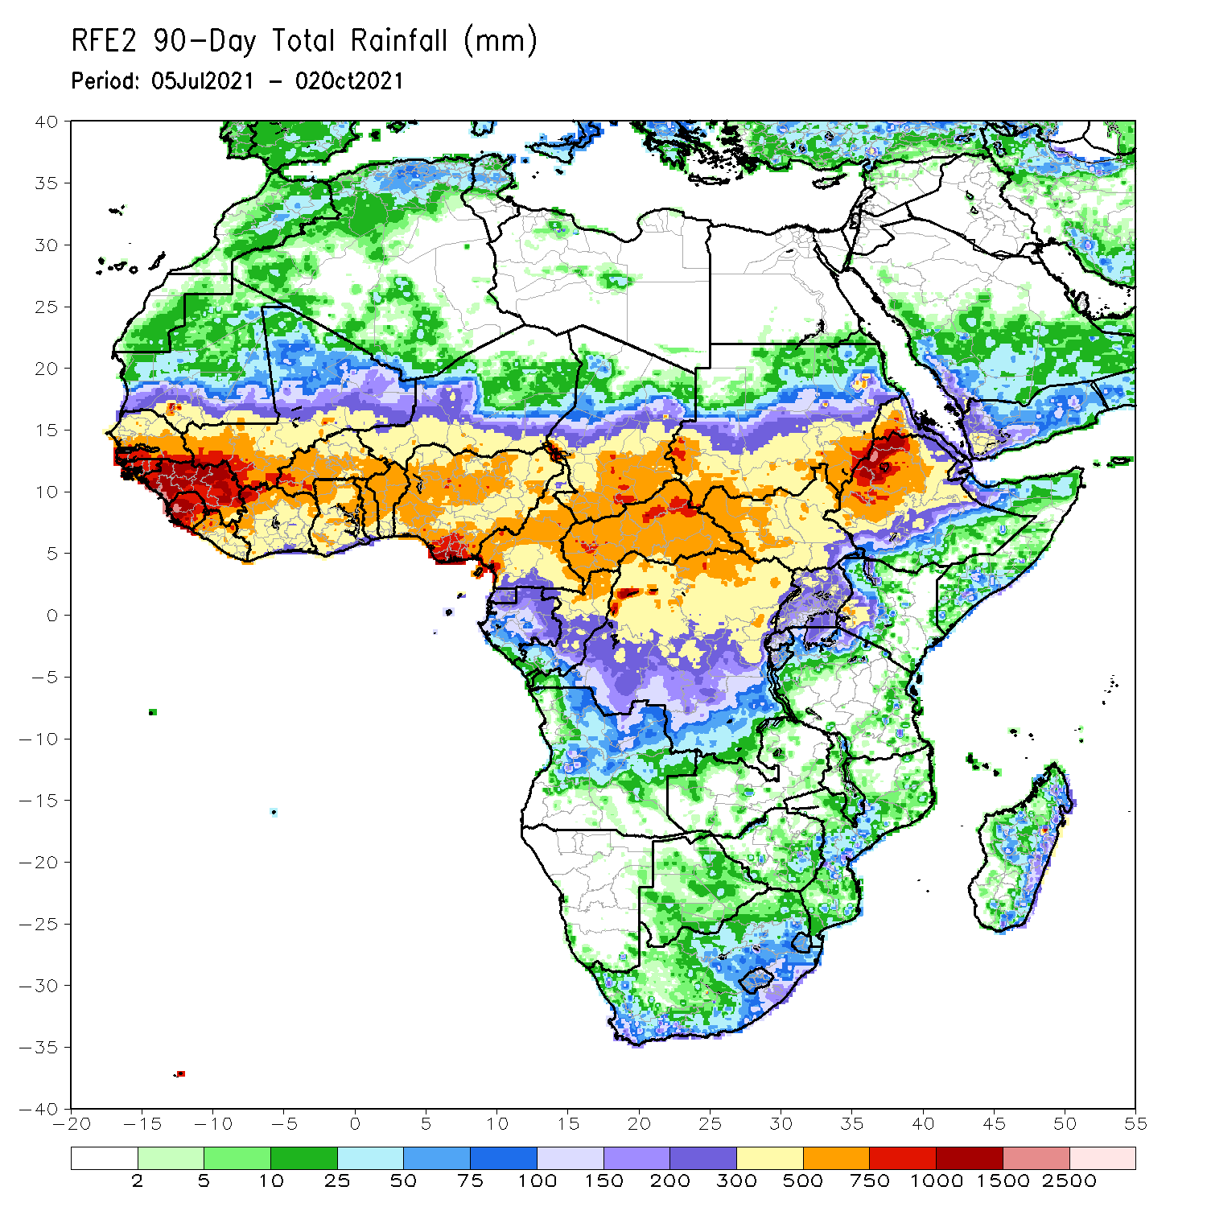
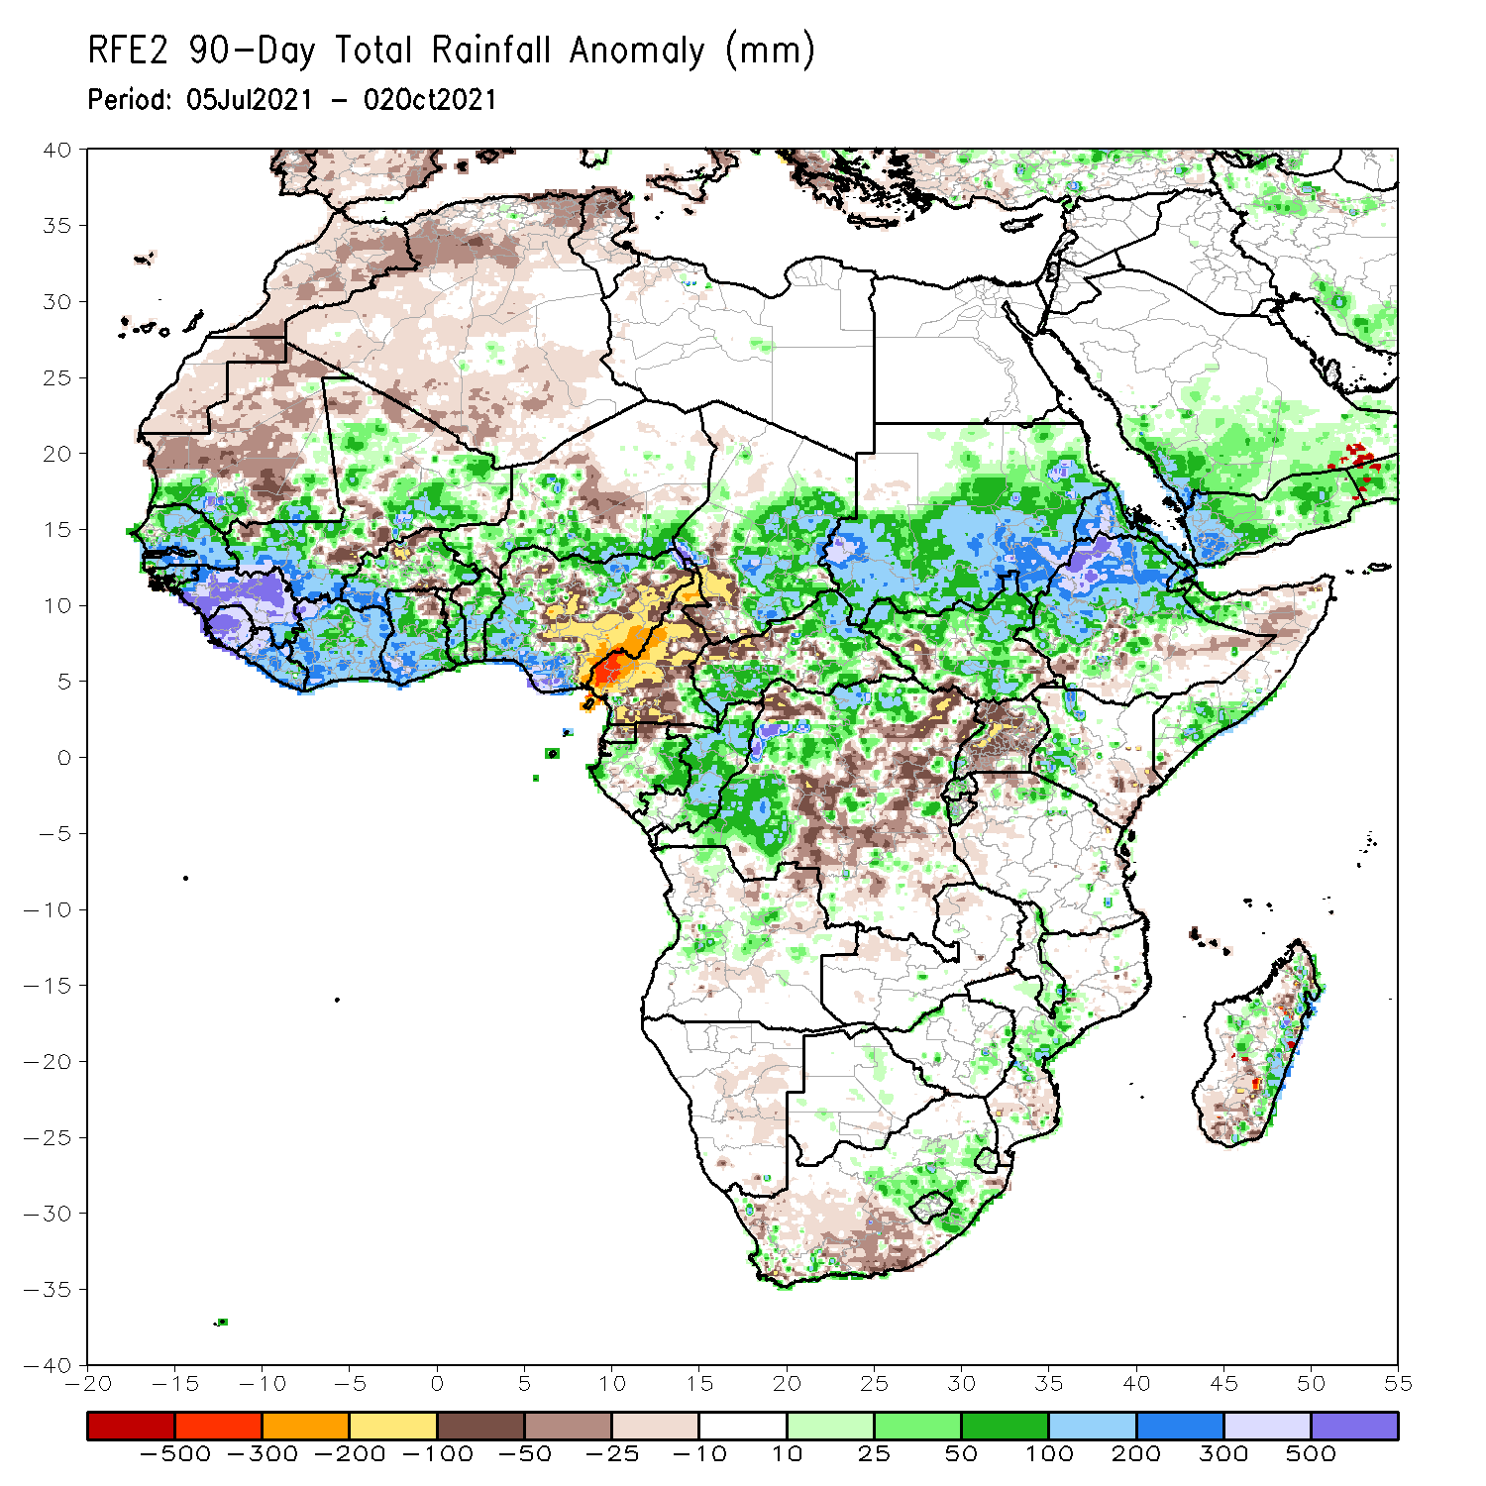
Rainfall Patterns: Last 90 Days
Over the past 90 days, in West Africa, rainfall totals exceeded 1000 mm across Guinea, Sierra Leone, and coastline of Nigeria (moisture surpluses of over 500 mm). Precipitation was in excess of 200 mm across southern Senegal, southwestern Mali, Liberia, southwestern Burkina Faso, portions of Côte d’Ivoire, southwestern Ghana, and southern Nigeria. Conversely, local areas in northern Burkina Faso and central and eastern Nigeria experienced moisture deficits of over 100 mm.
In Central Africa, positive precipitation anomalies of 100-200 mm were found over the western border of Chad and Cameroon, eastern Chad, portions of CAR, Congo, and local areas in western DRC. Large negative precipitation anomalies of over 100 mm were observed in Cameroon, southwestern Chad, and local areas in northwestern CAR. In particular, southwestern Cameroon experienced moisture deficits of 300-500 mm.
In East Africa, northwestern Ethiopia received heavy rainfall amounts of over 1000 mm (more than 500 mm above the mean). Precipitation was in excess of 200 mm in western and eastern Sudan, western Eritrea, and northern Ethiopia. Uganda continued to experience sustained negative precipitation anomalies of over 50 mm.
In southern Africa, central part of Mozambique and the eastern coast of Madagascar registered rainfall amounts of over 200 mm (moisture surpluses of over 100 mm). Light moisture deficits of 10-50 mm were present across much of western South Africa, and portions of Madagascar.
Notes:
4

Slide 5
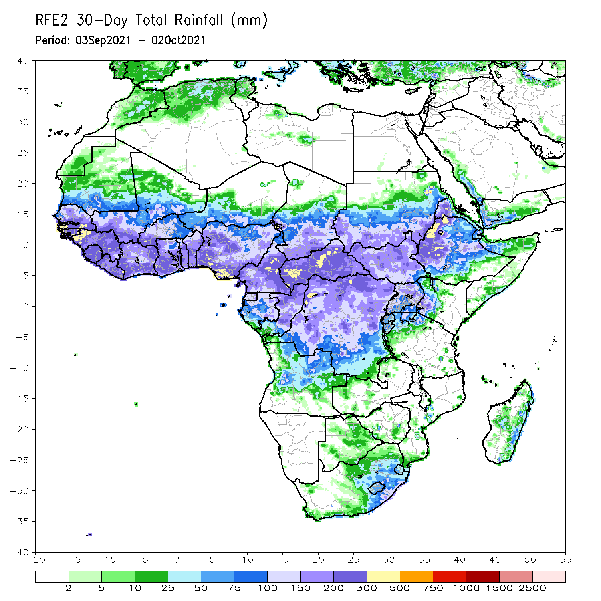
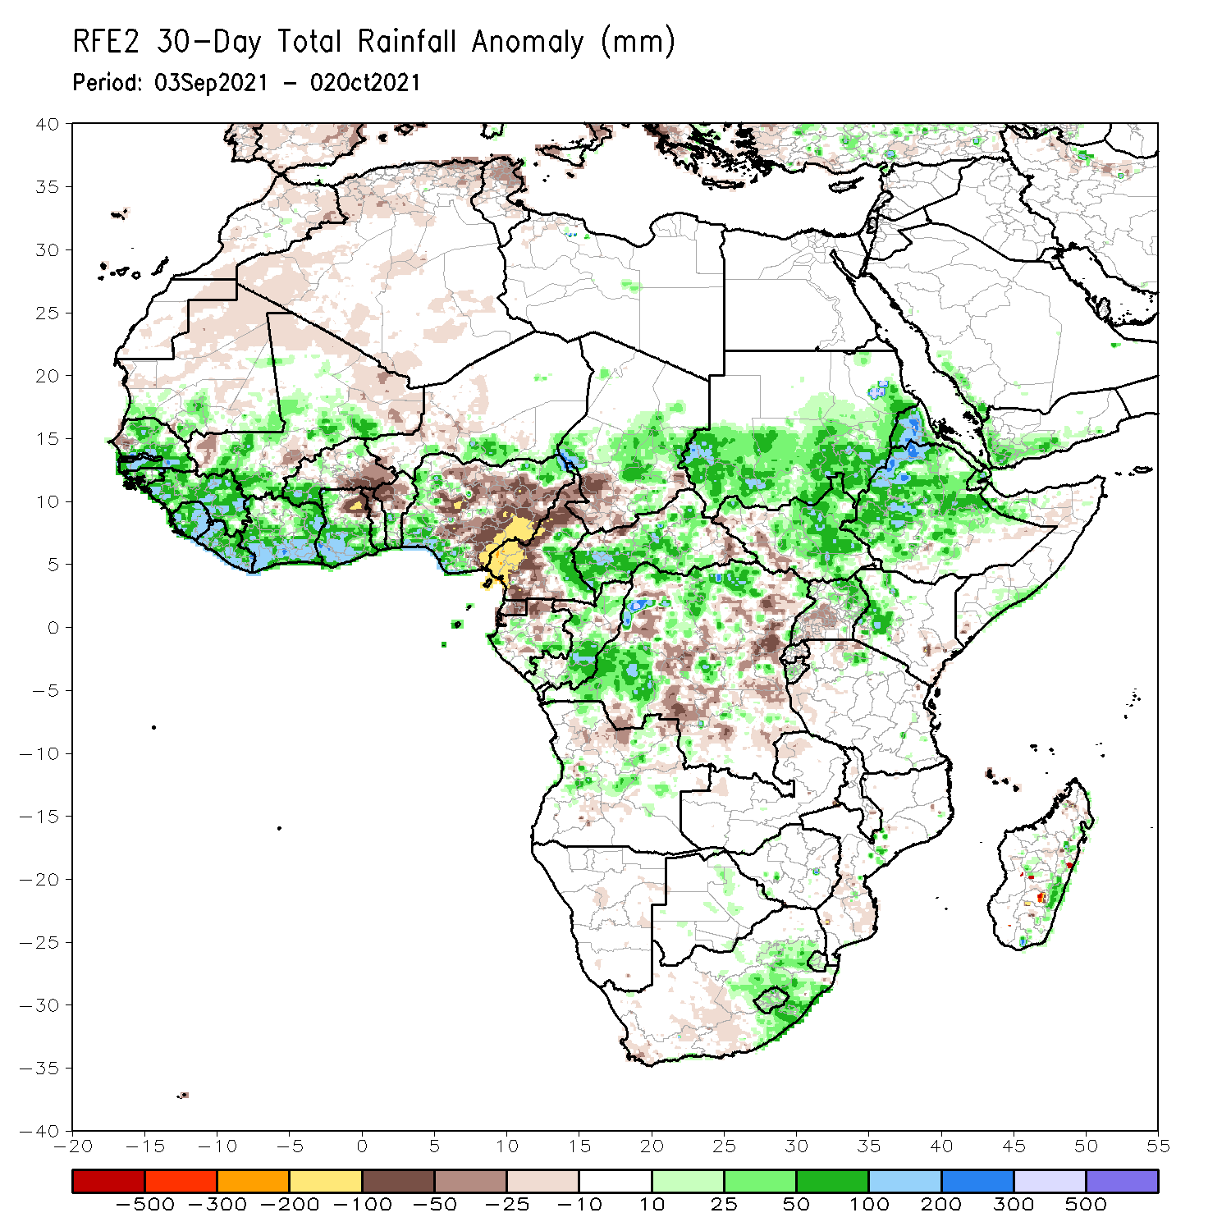
Rainfall Patterns: Last 30 Days
During the past 30 days, in West Africa, above-average rainfall was observed across much of Senegal, Guinea-Bissau, Guinea, Sierra Leone, portions of Mali, southwestern Burkina Faso, Côte d’Ivoire, much of Ghana, southern Togo, southern Benin, and western and southeastern Nigeria (more than 50 mm above the mean). Southeastern Burkina Faso, northeastern Ghana, northern Togo, northern Benin, and much of Nigeria, experienced below-average rainfall (more than 50 mm below the mean). Northeastern Ghana, and eastern Nigeria observed negative precipitation anomalies of over 100 mm.
In Central Africa, precipitation was above-average across Chad, CAR, eastern Cameroon, Congo, and many parts of DRC (more than 50 mm above the mean). Southwestern Chad, much of Cameroon, Equatorial Guinea, northern Gabon, and portions of DRC received below-average rainfall (more than 25 mm below the mean). In particular, western Cameroon observed negative precipitation anomalies of 100-200 mm.
In East Africa, the rainfall amounts reached 300-500 mm in western Eritrea and northwestern Ethiopia (more than 200 mm above the mean). Precipitation was above-average across much of the East African region, except over central Uganda and western South Sudan (light moisture deficits of 10-25 mm).
In Southern Africa, the eastern part of South Africa and eastern coastline of Madagascar observed above-average rainfall (more than 25 mm above the mean).
Notes:
5

Slide 6
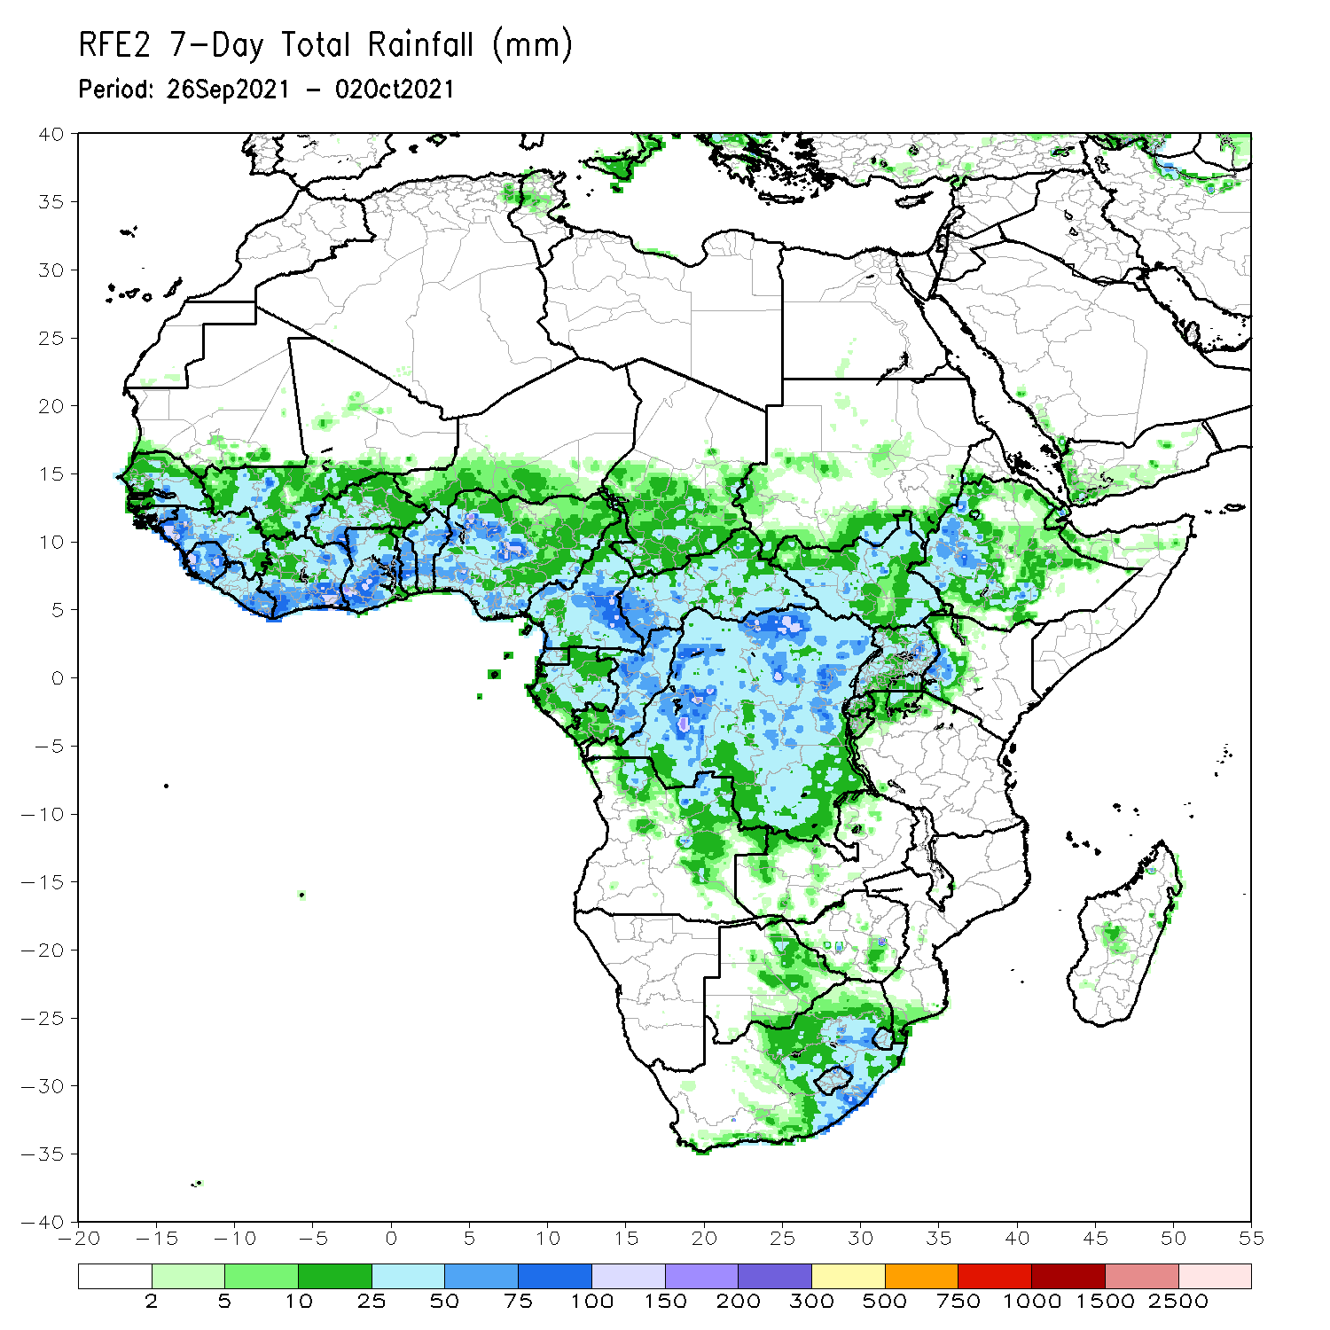
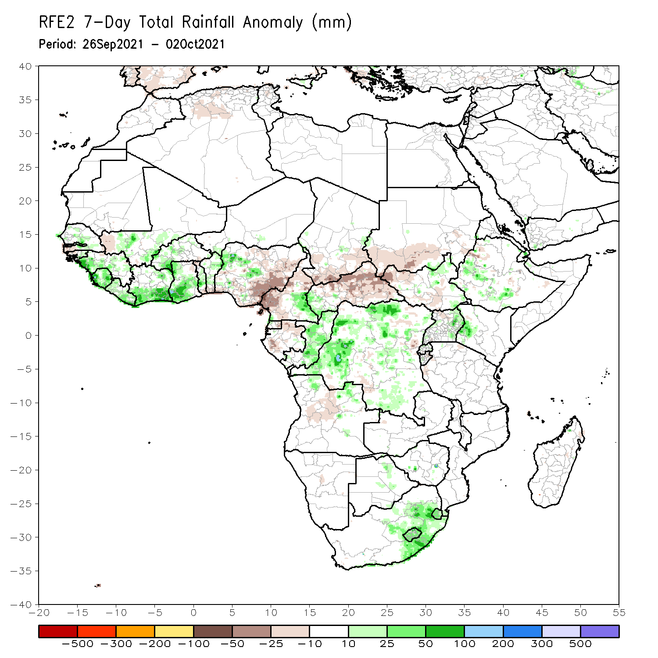
Rainfall Patterns: Last 7 Days
During the past 7 days, in West Africa, precipitation was above-average across much of Senegal, Guinea, Sierra Leone, Liberia, southern Mali, Burkina Faso, northwestern Nigeria, and from Côte d’Ivoire to Benin. Eastern Nigeria observed negative precipitation anomalies of 25-50 mm.
In Central Africa, southeastern Cameroon, Congo, and DRC experienced above-average rainfall. Conversely, southern Chad, northern and western Cameroon, Gabon, and much of CAR experienced below-average rainfall.
East Africa, light moisture surpluses of 10-50 mm were observed across northeastern South Sudan, western Ethiopia, eastern Uganda, and western Kenya. Moisture deficits of 10-25 mm were found across southern Sudan and portions of South Sudan.
The eastern part of South Africa registered rainfall totals of over 25 mm (more than 25 mm above the mean).

Slide 7
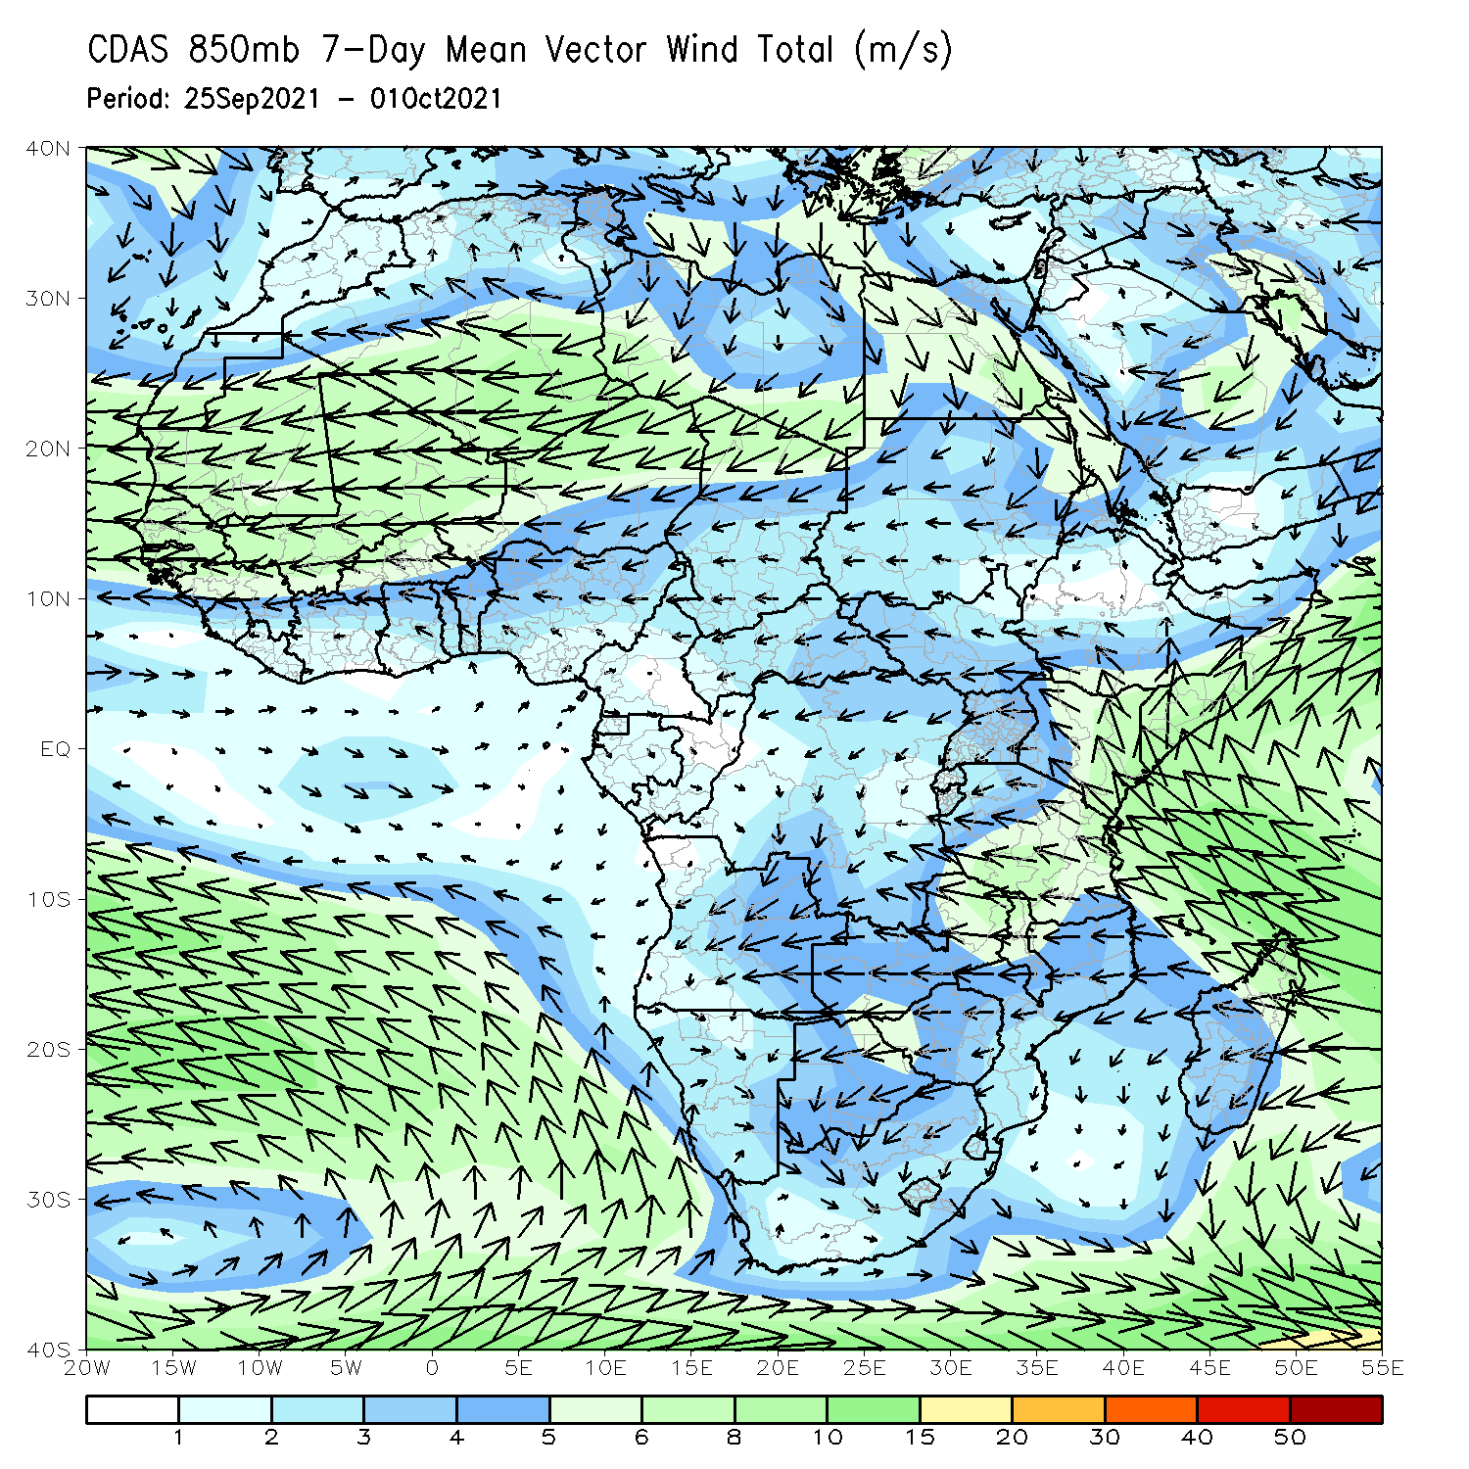
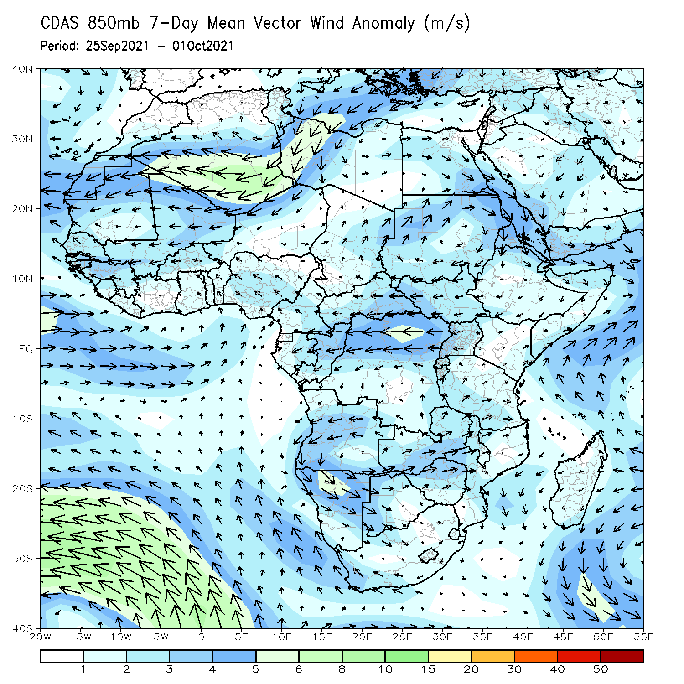
Atmospheric Circulation: Last 7 Days
The 850-hPa atmospheric circulation pattern features an anomalous cyclonic circulation over the Gulf of Guinea region and DRC. This may have contributed to enhanced rainfall in those areas.

Slide 8
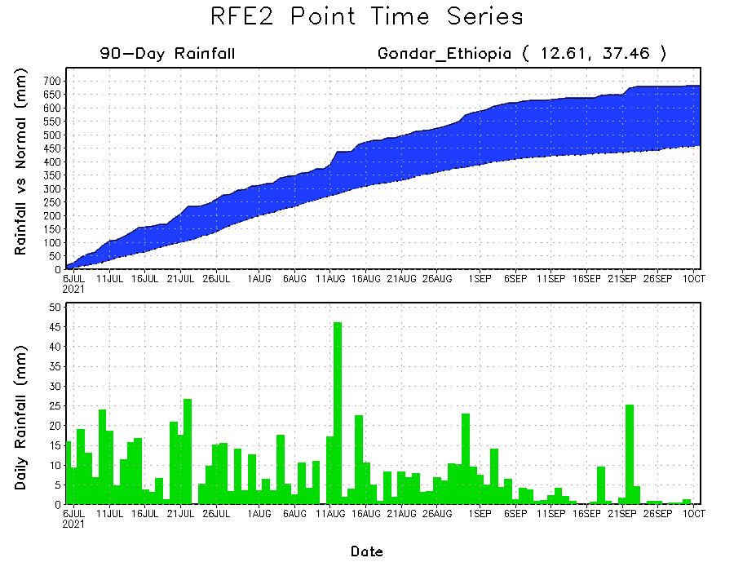
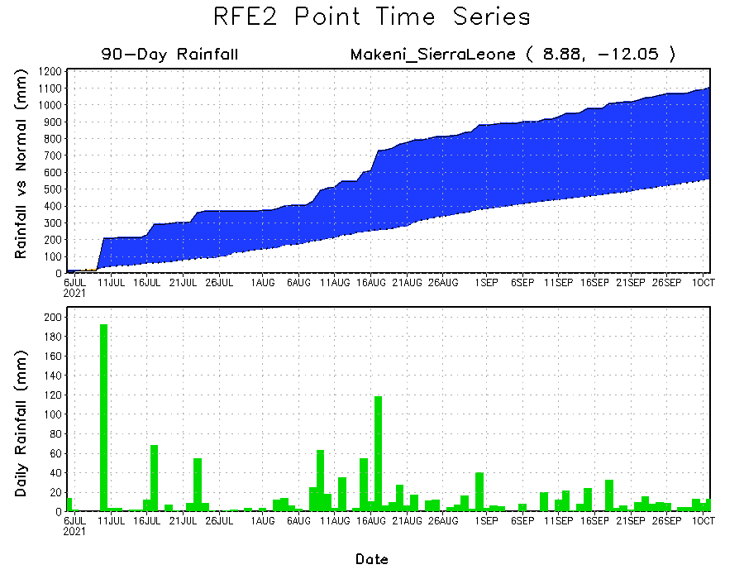
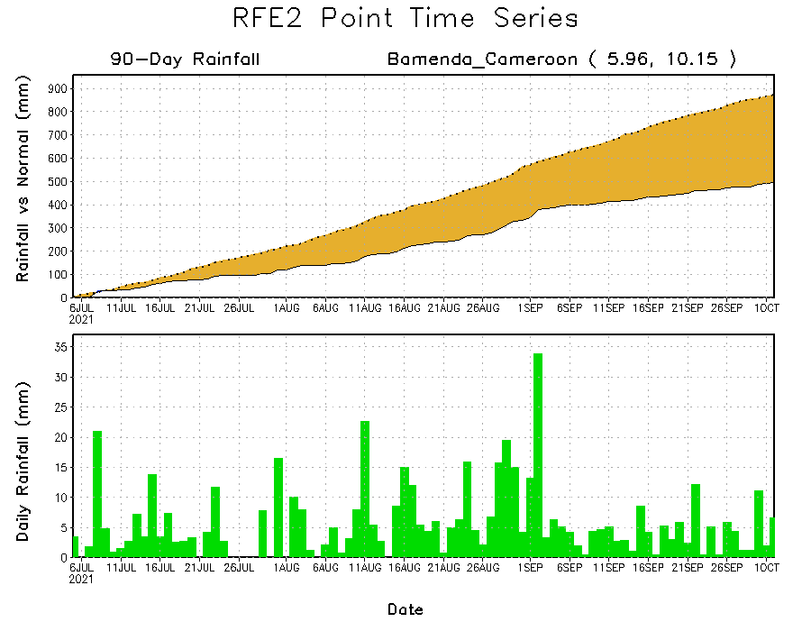
Rainfall Evolution
Daily evolution of rainfall over the last 90 days at selected locations shows moderate to heavy rainfall sustained moisture surpluses over Sierra Leone (bottom left) and northwestern Ethiopia (top right). In contrast, seasonal total rainfall remained below-average over southwestern Cameroon despite recent rainfall (bottom right).

Slide 9
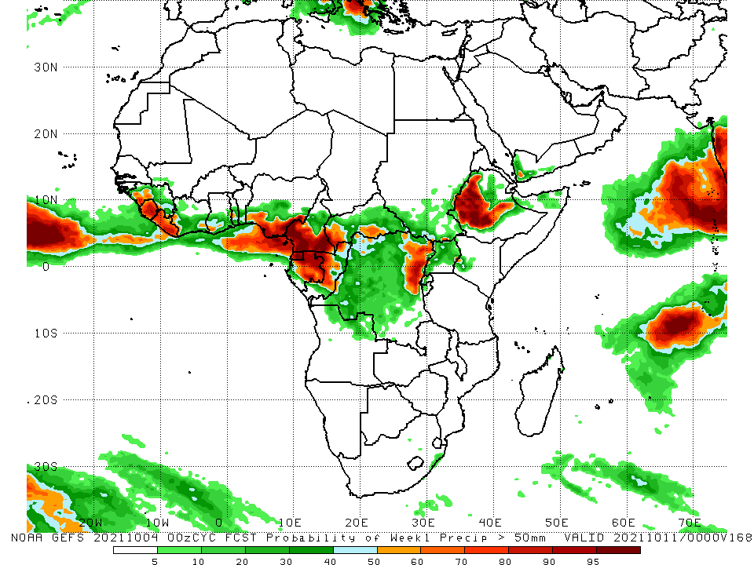
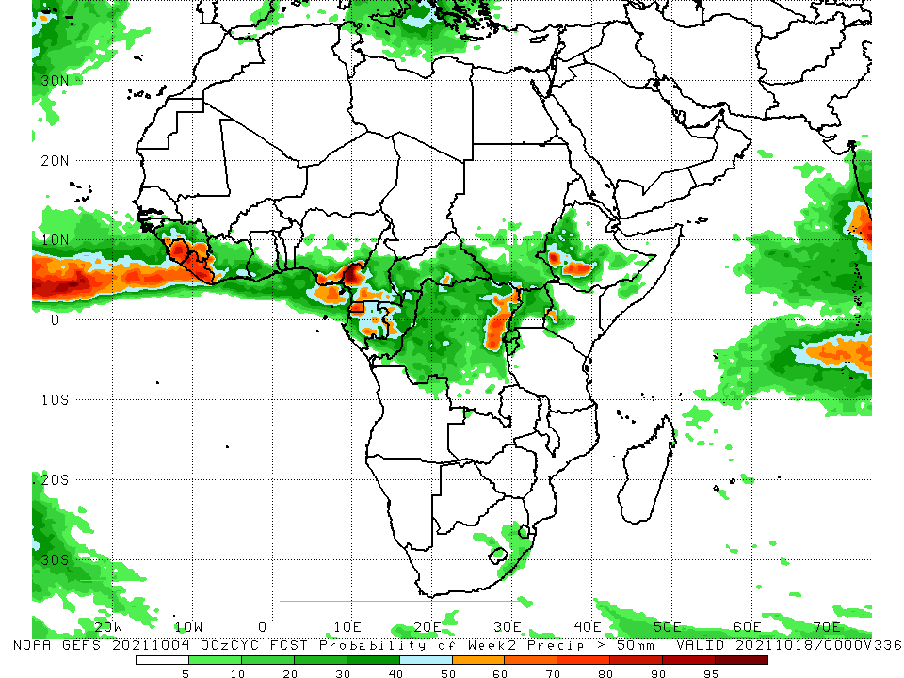
NCEP GEFS Model Forecasts Non-Bias Corrected Probability of precipitation exceedance
Week-1, Valid: 5 – 11 October 2021
Week-2, Valid: 12 – 18 October 2021
For week-1 (left panel) and week-2 (right), the NCEP GEFS forecasts indicate a moderate to high chance (over 70%) for rainfall to exceed 50 mm over Guinea, Sierra Leone, Liberia, portions of Côte d’Ivoire, southern Nigeria, southern Cameroon, Equatorial Guinea, Gabon, Congo, portions of CAR and DRC and western Ethiopia.
In addition, week-1 forecast depicts an increased chance for weekly rainfall to exceed 50 mm across local areas in southern Ghana and southern Togo.
Notes:
9

Slide 10
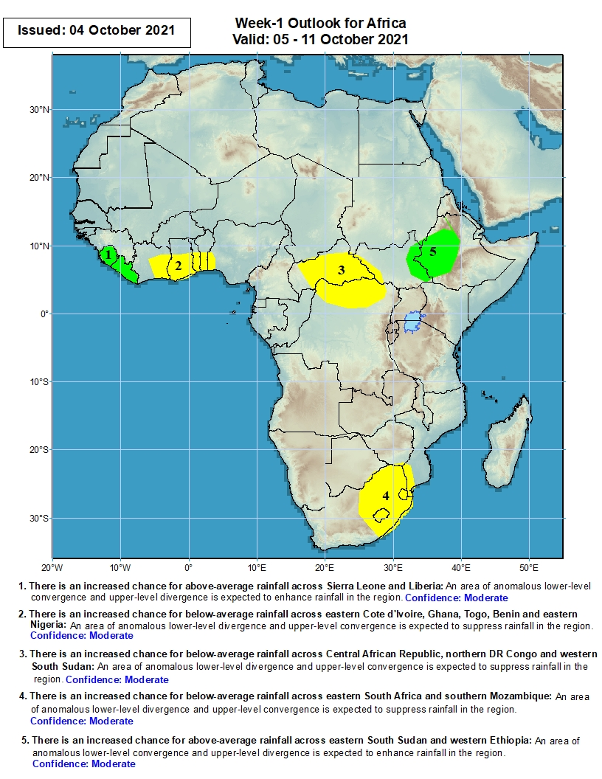
Week-1 Precipitation Outlooks
5 – 11 October 2021
There is an increased chance for above-average rainfall across Sierra Leone and Liberia: An area anomalous lower-level convergence and upper-level divergence is expected to enhance rainfall in the region. Confidence: Moderate
There is an increased chance for below-average rainfall across Eastern Cote d’Ivoire, southern Ghana, Togo, southern Benin and southwestern Nigeria: An area anomalous lower-level divergence and upper-level convergence is expected to suppress rainfall in the region. Confidence: Moderate
There is an increased chance for below-average rainfall across CAR and northern DRC: An area anomalous lower-level divergence and upper-level convergence is expected to suppress rainfall in the region. Confidence: Moderate
There is an increased chance for below-average rainfall across Eastern South Africa, Lesotho and Eswatini: An area anomalous lower-level divergence and upper-level convergence is expected to suppress rainfall in the region. Confidence: Moderate
There is an increased chance for above-average rainfall across western Ethiopia and parts of eastern South Sudan: An area anomalous lower-level convergence and upper-level divergence is expected to enhance rainfall in the region. Confidence: Moderate
Notes:
10

Slide 11
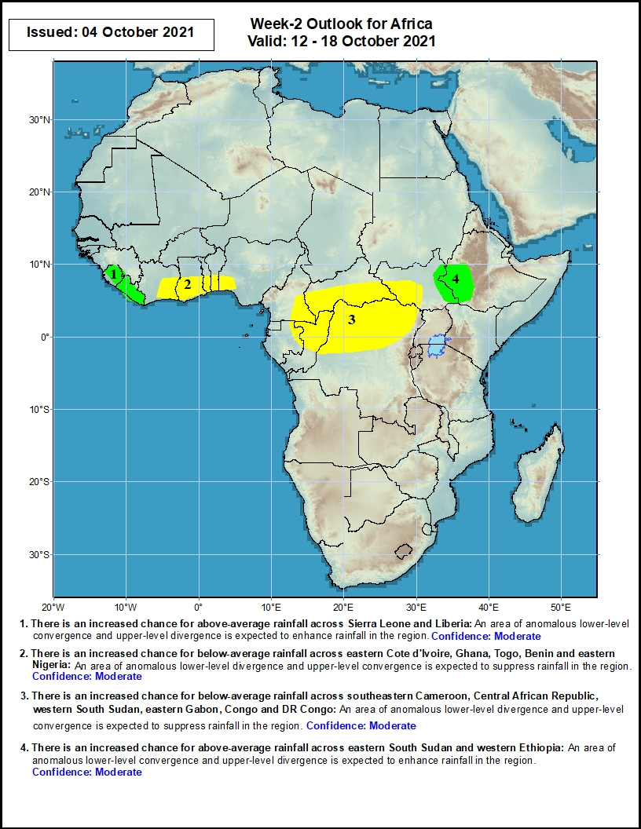
Week-2 Precipitation Outlooks
12 – 18 October 2021
There is an increased chance for above-average rainfall across Sierra Leone and Liberia: An area anomalous lower-level convergence and upper-level divergence is expected to enhance rainfall in the region. Confidence: Moderate
There is an increased chance for below-average rainfall across eastern Cote d’Ivoire, southern Ghana, southern Togo, southern Benin and southwestern Nigeria: An area anomalous lower-level divergence and upper-level convergence is expected to suppress rainfall in the region. Confidence: Moderate
There is an increased chance for below-average rainfall across eastern Cameroon, northern Congo, CAR, northern DRC and western South Sudan: The projected phase of the MJO combined with, an area anomalous lower-level divergence and upper-level convergence is expected to suppress rainfall in the region. Confidence: Moderate
There is an increased chance for above-average rainfall across southwestern Ethiopia and parts of eastern South Sudan: An area anomalous lower-level convergence and upper-level divergence is expected to enhance rainfall in the region. Confidence: Moderate
Notes:
11

Slide 12
Summary
During the past 30 to 90 days, in West Africa, southern Mauritania, much of Senegal, portions of Mali, southwestern Burkina Faso, southern Niger, Guinea-Bissau, Guinea, Sierra Leone, Liberia, Côte d’Ivoire, much of Ghana, southern Togo, southern Benin, and southern Nigeria observed above-average rainfall. Central and eastern Nigeria continued to experience large negative precipitation anomalies. In Central Africa, moisture surpluses were found in eastern Chad, CAR, Congo, and parts DRC. Moisture deficits occurred in Cameroon, Equatorial Guinea, northern Gabon, southwestern Chad, and portions of DRC. In East Africa, above-average rainfall prevailed in Sudan, South Sudan, Eritrea, and Ethiopia. The eastern part of South Africa and the eastern coastline of Madagascar experienced above-average rainfall.
During the past 7 days, in West Africa, precipitation was above-average across Senegal, Mali, Burkina, and from Guinea to western Nigeria. Many parts of Nigeria experienced below-average rainfall. In Central Africa, western DRC experienced moisture surpluses of over 100 mm, while northern CAR and western Cameroon observed moisture deficits of 25-50 mm. In East Africa, local areas in eastern South Sudan, Uganda, western Kenya, and western Ethiopia received above-average rainfall. Southern Sudan and much of South Sudan experienced light negative precipitation anomalies. Moderate rainfall fell across eastern South Africa.
The week-1 outlooks depict an increased chance for above-average rainfall across Sierra Leone, Liberia, western Ethiopia and parts of eastern South Sudan. Conversely, there is an increased chance for below-average rainfall across Eastern Cote d’Ivoire, southern Ghana, Togo, southern Benin, southwestern Nigeria, CAR, northern DRC, Eastern South Africa, Lesotho and Eswatini.
The week-2 outlooks call for an increased chance for above-average rainfall across Sierra Leone, Liberia, southwestern Ethiopia and parts of eastern South Sudan. In contrast, there is an increased chance for below-average rainfall across eastern Cote d’Ivoire, southern Ghana, southern Togo, southern Benin, southwestern Nigeria, eastern Cameroon, northern Congo, CAR, northern DRC and western South Sudan.

